Slide 1
SoLID Baffle and
Background Update
Zhiwen Zhao
UVa
2013/05/23

Slide 2
PVDIS challenge
High luminosity (1.27e³⁹/cm2/s for 50uA on 40cm LD2 target) causes high rate and high energy dose on detectors
Baffle shields low energy EM photons directly from target while low energy electrons are bent away by field
Most interesting physics at high Q2 and high x needs DIS electrons with highest energy which bend least and fly like photons, so comprise is needed
Positive pions contribute in background at trigger level and are better to be suppressed

Slide 3
Design Condition
  SoLID latest CLEOv8 field map
  30 sectors with each sector covering 12 deg
  each plate is 9cm thick lead
  Z (40, 68, 96, 124, 152, 180) cm
    no overlap with current setup
  Rin (4.00, 12.86, 23.61, 34.36, 45.10, 55.85)cm
  Rout (39.60, 59.94, 80.28, 100.63, 120.97, 141.31)cm
    Optimized for polar angle 21-36 deg acceptance of full 40cm long target with center at 10cm, except the first baffle inner radius needs to be at 4cm instead of 2cm to avoid more EM background

Slide 4
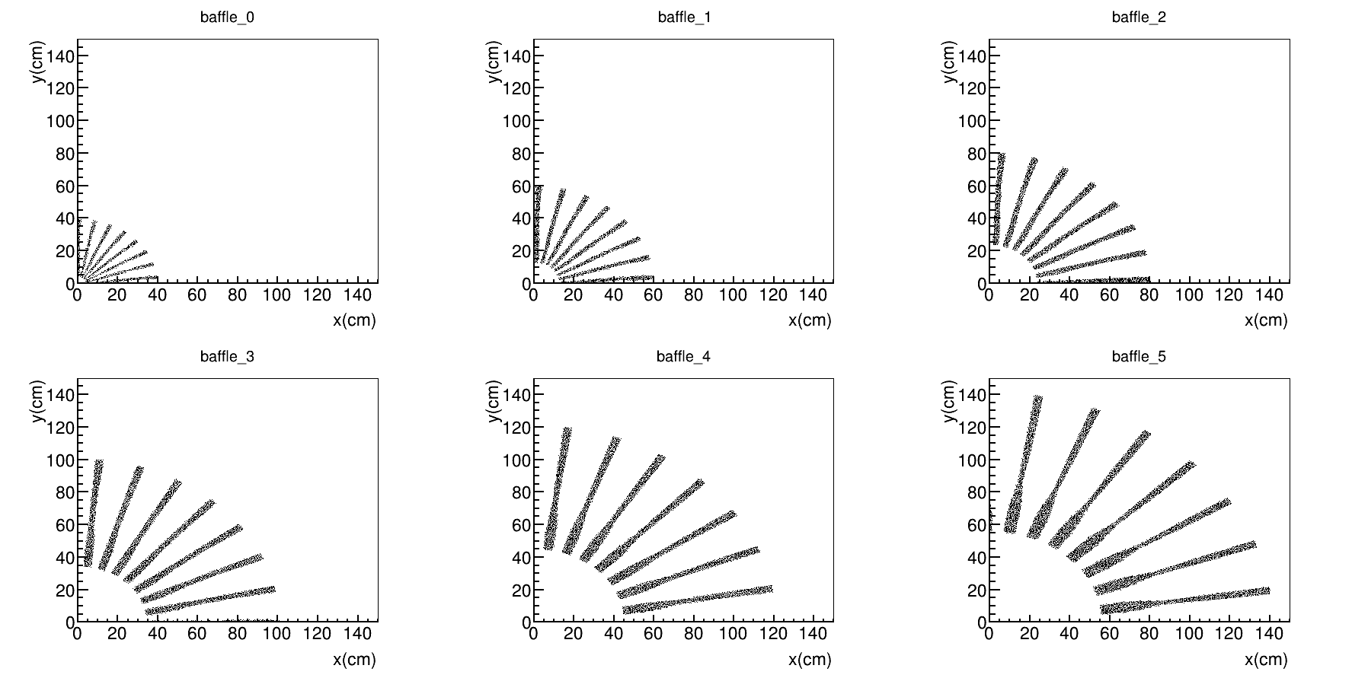
Current Baffle
(Smaller Z baffle cut inner)
Continue with Seamus’s approach, but take all design conditions into account
  refer to
    https://hallaweb.jlab.org/wiki/index.php/Baffle_Design
    https://hallaweb.jlab.org/wiki/index.php/Solid_design_FOM

Slide 5
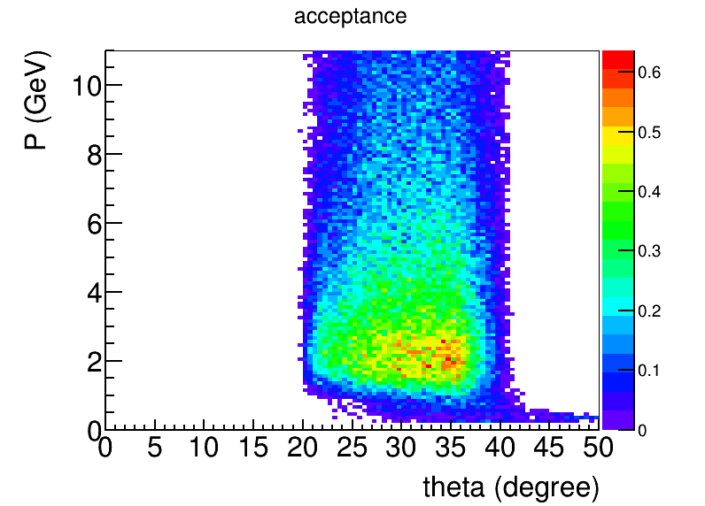
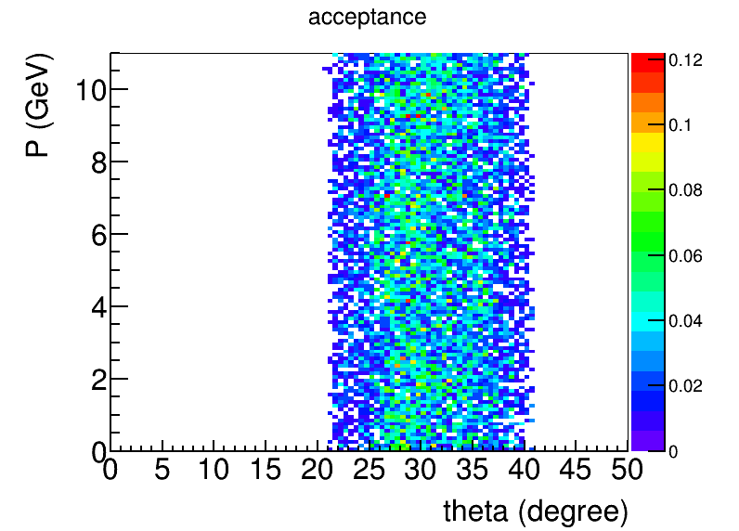
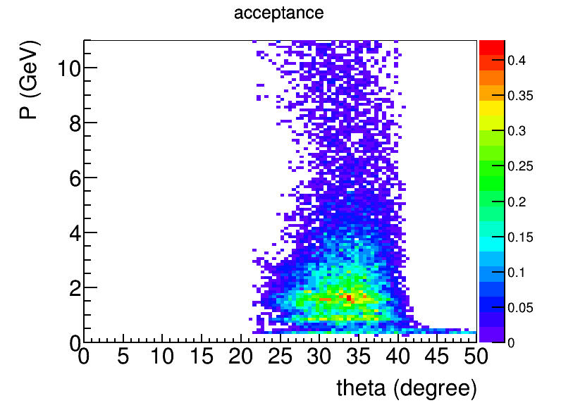
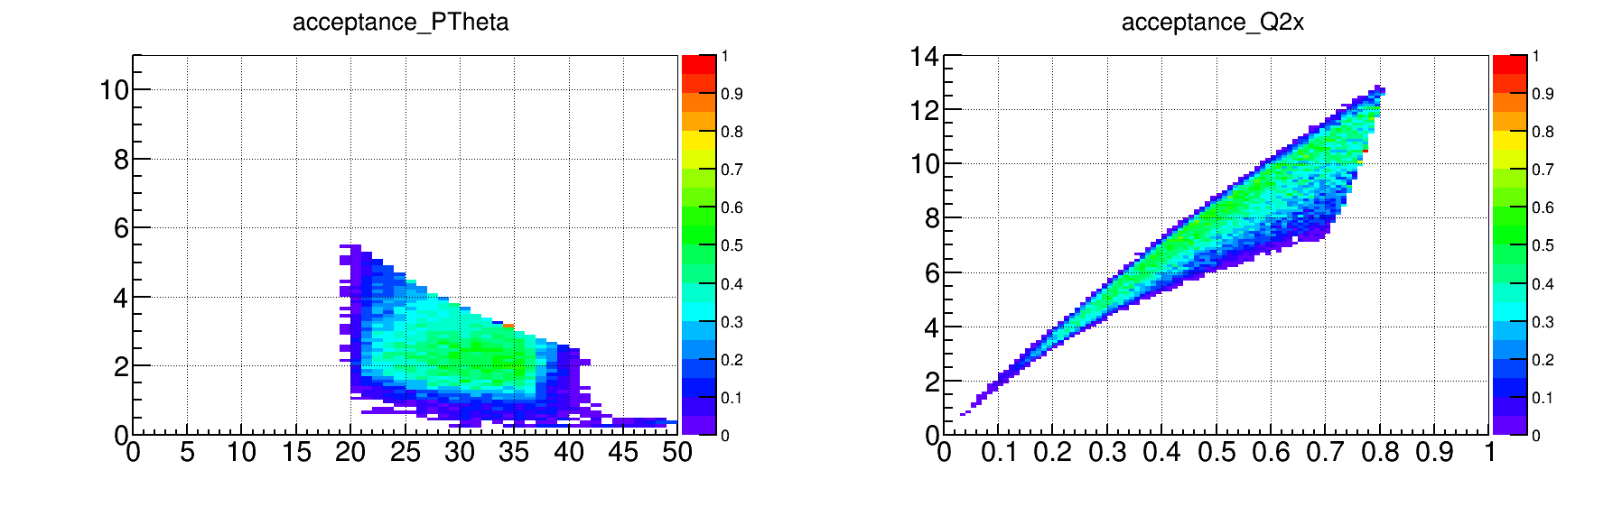
General acceptance
negative
neutral
positive
20%
5%
30%
20%
eDIS acceptance
40%
50%

Slide 6
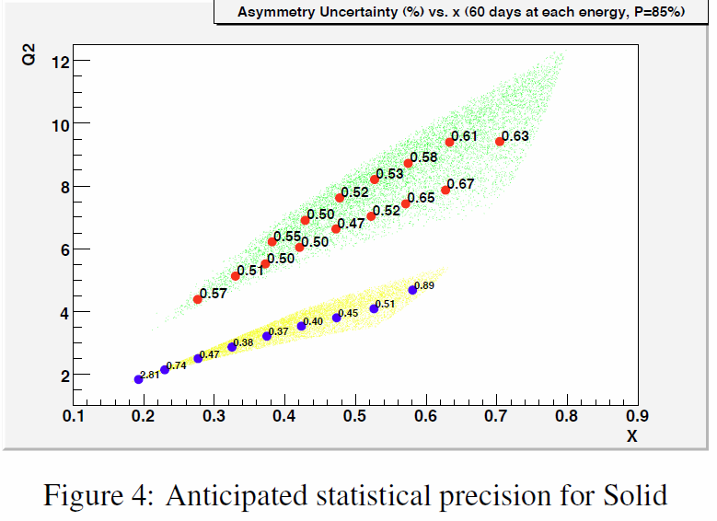
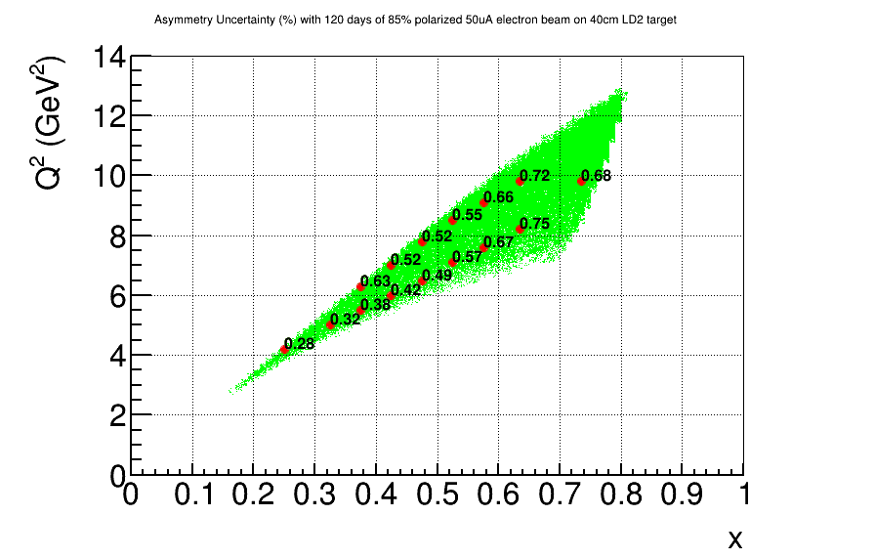
Apv Error
50uA 85% polarized 11GeV beam on 40cm LD2 for 120 days
Trigger at 2GeV
BaBar field and baffle, from proposal
CLEO field and baffle, from proposal

Slide 7
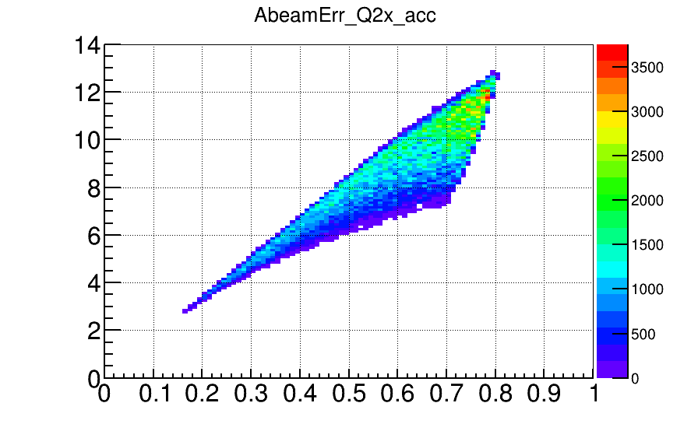
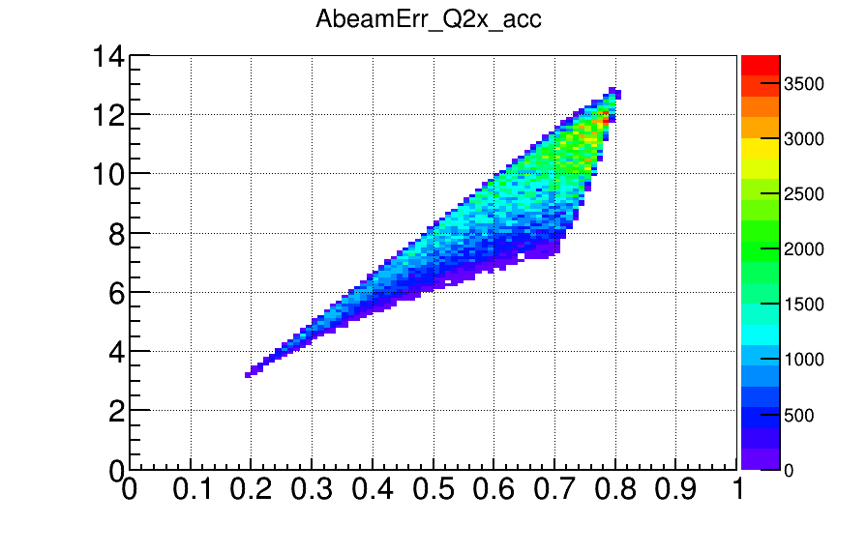
Trigger effect
ApvErr trigger (GeV)
0.17,0.24,0.36,0.38,0.42,0.39,0.48,0.44,0.56,0.51,0.66,0.64,0.75,0.70,0.67 0.0
0.20,0.26,0.36,0.40,0.42,0.40,0.48,0.44,0.56,0.51,0.66,0.64,0.75,0.70,0.67 1.5
0.27,0.31,0.37,0.62,0.45,0.51,0.48,0.51,0.56,0.54,0.66,0.65,0.75,0.70,0.67 2.0
0.38,0.37,0.39,0.96,0.42,0.74,0.48,0.65,0.56,0.65,0.66,0.75,0.75,0.74,0.67 2.3
0.53,0.43,0.43,1.46,0.44,1.03,0.48,0.86,0.56,0.80,0.66,0.89,0.75,0.83,0.69 2.5
2.13,0.84,0.63,0.00,0.56,9.22,0.56,2.83,0.60,2.14,0.68,1.97,0.75,1.40,0.81 3.0
ApvErr at large Q2 and large x starts to increase if trigger > 2GeV
trigger 2.0
trigger 2.3

Slide 8
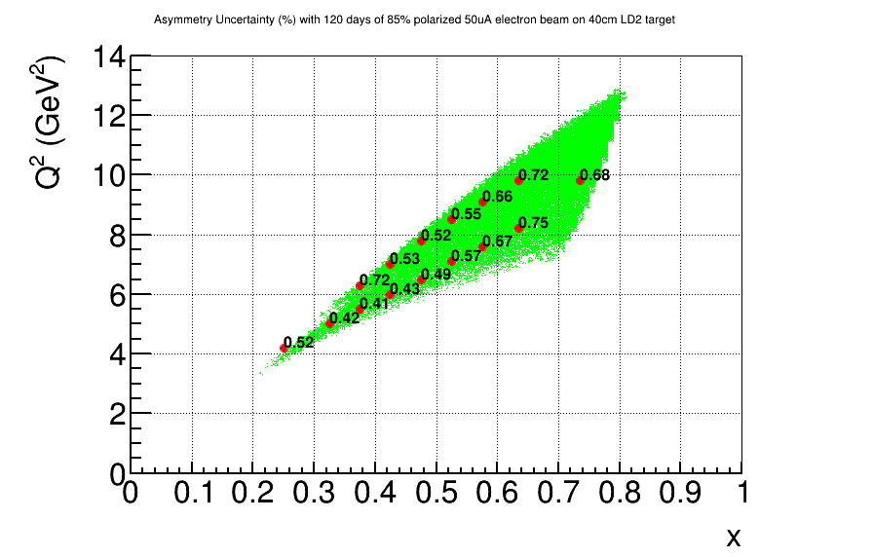
Trigger effect
ApvErr trigger (GeV)
0.28,0.32,0.38,0.63,0.42,0.52,0.49,0.52,0.57,0.55,0.67,0.66,0.75,0.72,0.68 p<2.0, r(110cm – 270cm)
1.90,0.58,0.44,0.72,0.43,0.53,0.49,0.52,0.57,0.55,0.67,0.66,0.75,0.72,0.68 p<3.0, r(110cm – 140cm)
p<2.5 ,r(140cm – 170cm)
p<2.0, r (170cm – 270cm)
0.52,0.42,0.41,0.72,0.43,0.53,0.49,0.52,0.57,0.55,0.67,0.66,0.75,0.72,0.68 p<2.5, r(110cm – 170cm)
p<2.0, r(170cm – 270cm)
This could an option for trigger
p<2.5, r(110cm – 170cm)
p<2.0, r(170cm – 270cm)
p<2.0, r(110cm – 270cm)

Slide 9
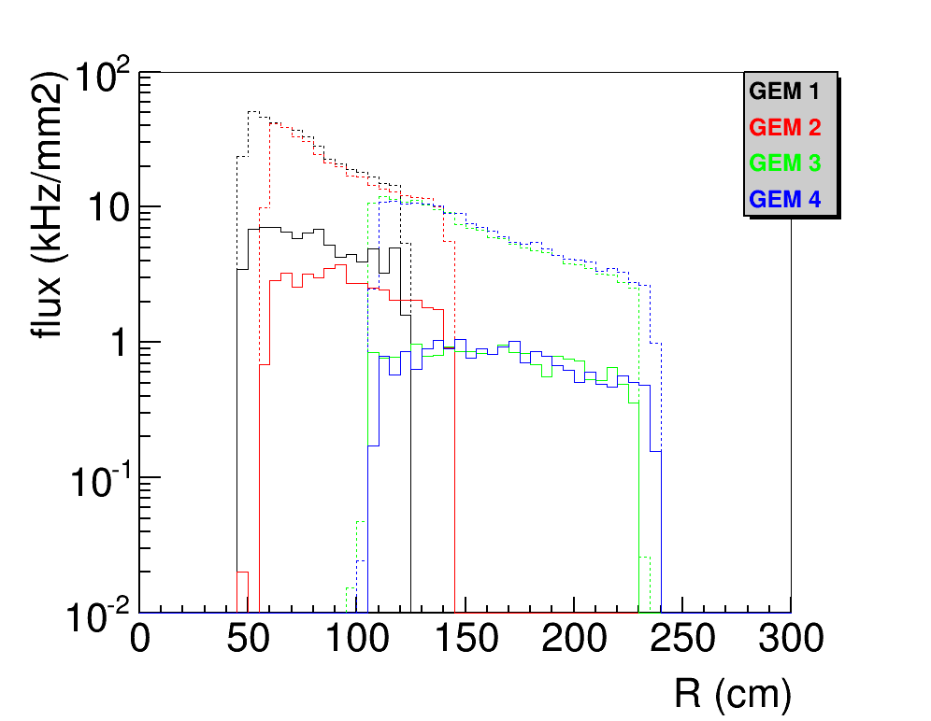
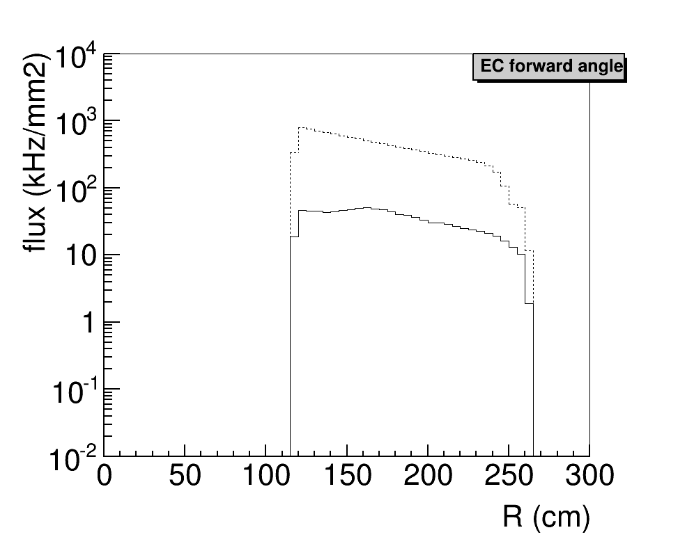
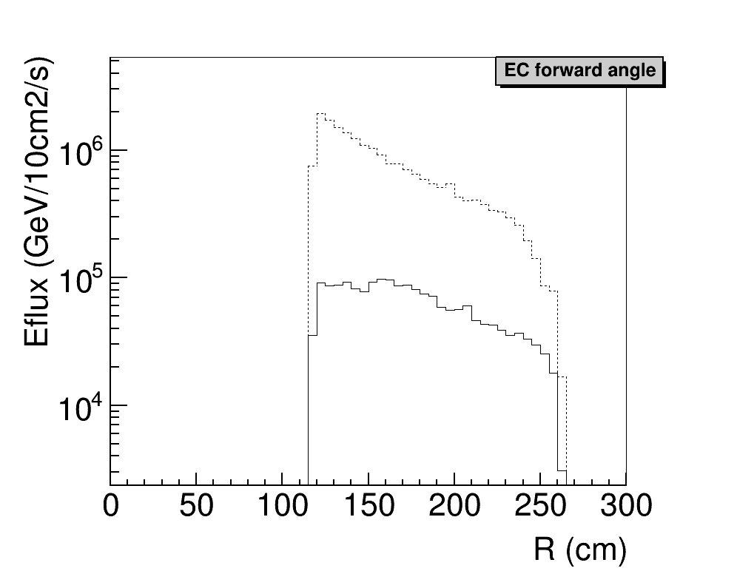
Background, baffle effect

Slide 10
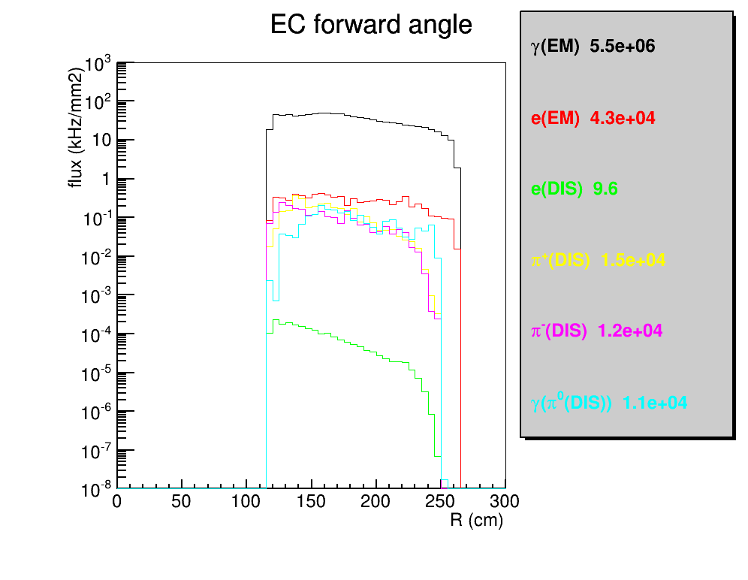
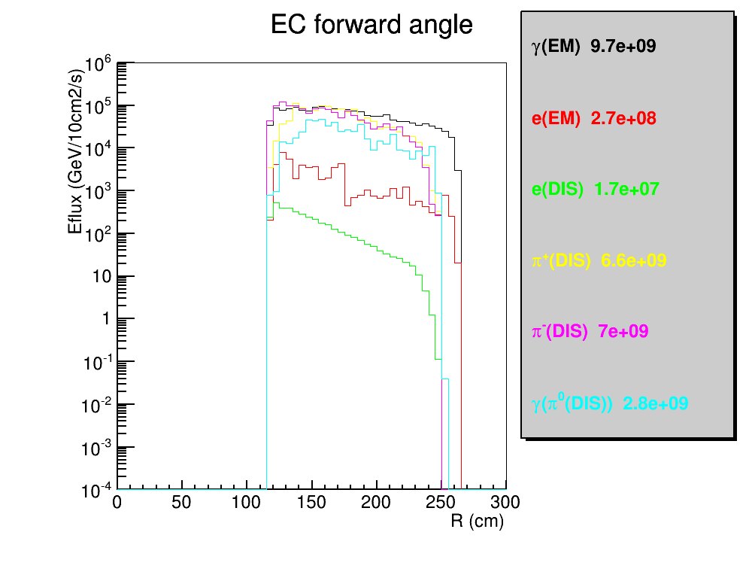
Hit on EC in R(physics+background)

Slide 11
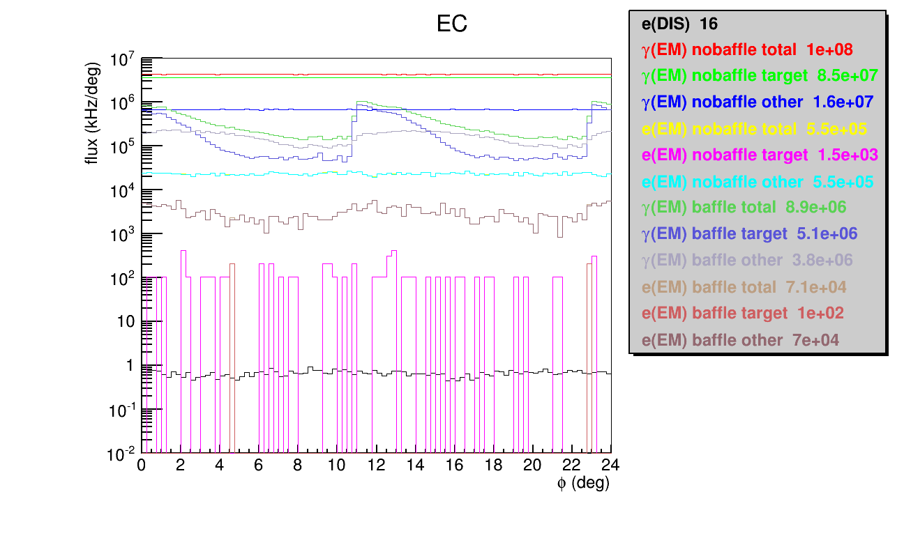
Hit on EC in Phi(physics+background)

Slide 12
GEM geometry

Slide 13
PVDIS GEM
id | Z (cm) | PVDIS target center |  | PVDIS target full
 |  | R range (cm) | Area (m2) | R range (cm) | Area (m2)
1 | 157.5 | 56-107 | 2.6116 | 48-122 | 3.9521
2 | 185.5 | 67-128 | 3.7369 | 59-143 | 5.3307
3 | 306 | 113-215 | 10.5105 | 105-230 | 13.1554
4 | 315 | 117-222 | 11.1824 | 109-237 | 13.9135
total |  |  | 28.0414 |  | 36.3517
CLEO coil center at 0.
PVDIS 40cm long target with center at 10cm
PVDIS angle 21-36 degree
Considering the CLEO baffle, plane 1 and 2 are directly behind baffle and only need partial coverage (70-80%?), plane 3 and 4 are between Cherenkov and EC and need full coverage
To cover full target, GEM needs to increase by 30%

Slide 14
SIDIS/JPsi GEM
id | Z (cm) | SIDIS target center |  | SIDIS target full |  | JPsi target center
 |  | R range (cm) | Area (m2) | R range (cm) | Area (m2) | R range needed (cm) | Area needed (m2) | Area addition to “SIDIS target center” (m2) | Area addition to “SIDIS target full” (m2)
1 | -175 | 46-78 | 1.2466 | 41-87 | 1.8498 | 36-67 | 1.0031 | 0.2576 | 0.1210
2 | -150 | 26-91 | 2.3892 | 23-98 | 2.8510 | 21-80 | 1.8720 | 0.0738 | 0.0276
3 | -119 | 30-103 | 3.0502 | 27-112 | 3.7118 | 25-97 | 2.7595 | 0.0864 | 0.0327
4 | -68 | 37-126 | 4.5575 | 34-135 | 5.3624 | 32-123 | 4.4312 | 0.1084 | 0.0415
5 | 5 | 46-95 | 2.1705 | 44-100 | 2.5334 | 42-90 | 1.9905 | 0.1106 | 0.0540
6 | 92 | 58-118 | 3.3175 | 55-123 | 3.8026 | 55-115 | 3.2044 | 0.1065 | 0.0000
total |  |  | 16.7315 |  | 20.1110 |  | 15.2607 | 0.7433 (4.5%) | 0.2768 (1.4%)
CLEO coil center at 0.
Plane (1,2,3,4) cover large angle and plane (2,3,4,5,6) cover forward angle
SIDIS 40cm long target with center at -350cm, SIDIS angle 7.5-14.85-24 degree
JPsi 15cm long target with center at -300cm tentatively, JPsi angle 8- 16.28-28 degree
Jpsi coverage is only optimized by target center as it’s length is smaller
GEM size determined by “Jpsi target center” inner and “SIDIS target full” outer
PVDIS has more than enough GEM for SIDIS/JPsi to cover full target

Slide 15
backup

Slide 16
Design Detail
  Common
  use SoLID CLEOv8 field map
  30 sectors with each sector covering 12 deg
  Still each plate is 9cm thick of lead
  SCALE MIN=1.4, MAX=1.4, LASTBAF=0. in makebaf5.C
Larger Z baffle only
  Z (40, 70, 100, 130, 160, 190) cm
    overlap with Cherenkov and leaves no room for GEM
  Rin (3.90, 15.30, 26.60, 37.90, 49.20, 61.01)cm
  Rout (41.31, 62.32, 83.32, 104.33, 125.34, 142.00)cm
    Not optimized for polar angle 21-36 deg acceptance of full 40cm long target with center at 10cm
Smaller Z baffle only
  Z (40, 68, 96, 124, 152, 180) cm
    no overlap with current setup
  Rin (2.11, 12.86, 23.61, 34.36, 45.10, 55.85)cm
  Rout (39.60, 59.94, 80.28, 100.63, 120.97, 141.31)cm
    Optimized for polar angle 21-36 deg acceptance of full 40cm long target with center at 10cm

Slide 17
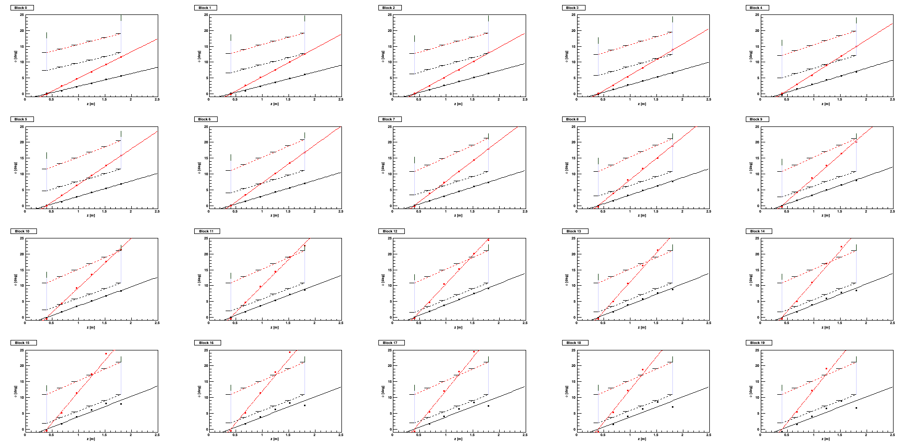
Design approach from larger Z baffle to smaller Z baffle
Continue with Seamus’s approach
  In simulation, throw negative particles from target position with field, record tracks at different position
  Then do linear fitting to figure out what kind of blocking should be at the assumed baffle plates position.
  Output the opening (not block)
  refer to
    https://hallaweb.jlab.org/wiki/index.php/Baffle_Design
    https://hallaweb.jlab.org/wiki/index.php/Solid_design_FOM
Fix a bug of detector plane position in the input file
Change Z, Rin, Rout to the desired values

Slide 18
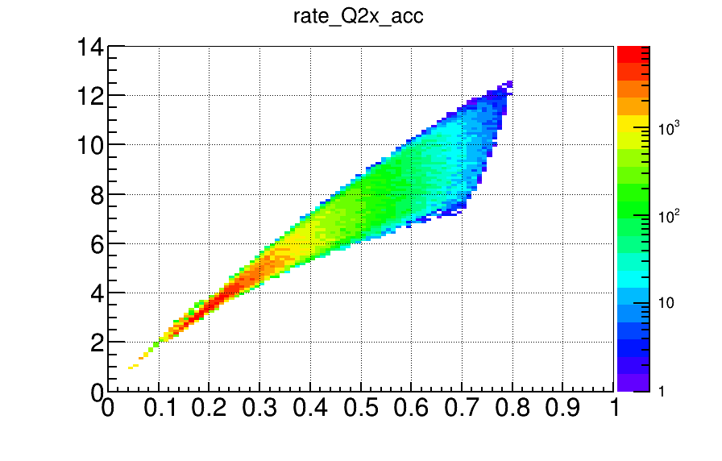
eDIS rate

