Slide 1
Hall A DAQ meeting
April 6th 2015
Alexandre Camsonne

Slide 2
Agenda
budget Compton ( Bob / Alex / Dave )
new BCM receiver / BCM calibration ( Luke ? )
BigBite DAQ status ( Alexandre )
silo file transfer errors ( Bob / Ole ? )
SoLID review outcome DAQ recommendations ( JP / Alexandre )
upcoming experiment preparation (GMp/DVCS, Ar ee'p, APEX ) ( Alexandre )
SBS Fastbus status and plan (Dasuni ?)
SBS trigger distribution scheme ( Alexandre )
SBS cerenkov trigger and readout using VETROC ( Alexandre - same as what was presented at SBS meeting )

Slide 3
Budget Compton
for integrating mode DAQ
1 ..... Gate Generator, 2 VME scalers, .... 19
Spare V1495, spare V538A
for counting mode DAQ;
assume we use existing FADC
2 ..... VXS Crate, cpu, TI ................ 22
3 ..... Prototype VETROC .................. 5
(~ 1 year later need 5 production
boards for a total of 40K$)
To buy after the single plane recently installed
is demonstrated to work
4 ..... Thick silicon for E-det .......... 38
3 planes for 26K$
7 for 35K$
10 for 38K$ (preferred)

Slide 4
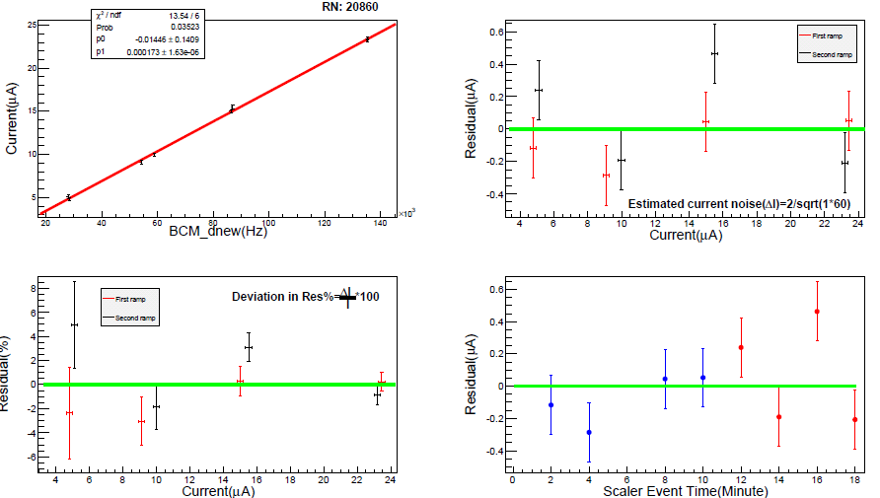
BCM new receiver down

Slide 5
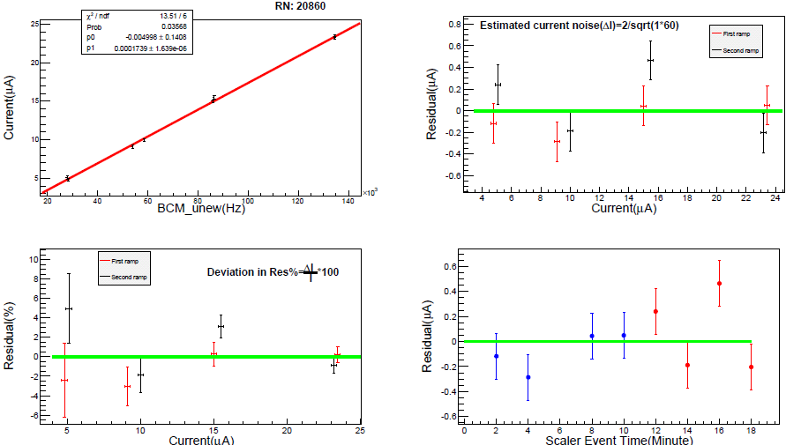
BCM new receiver up

Slide 6
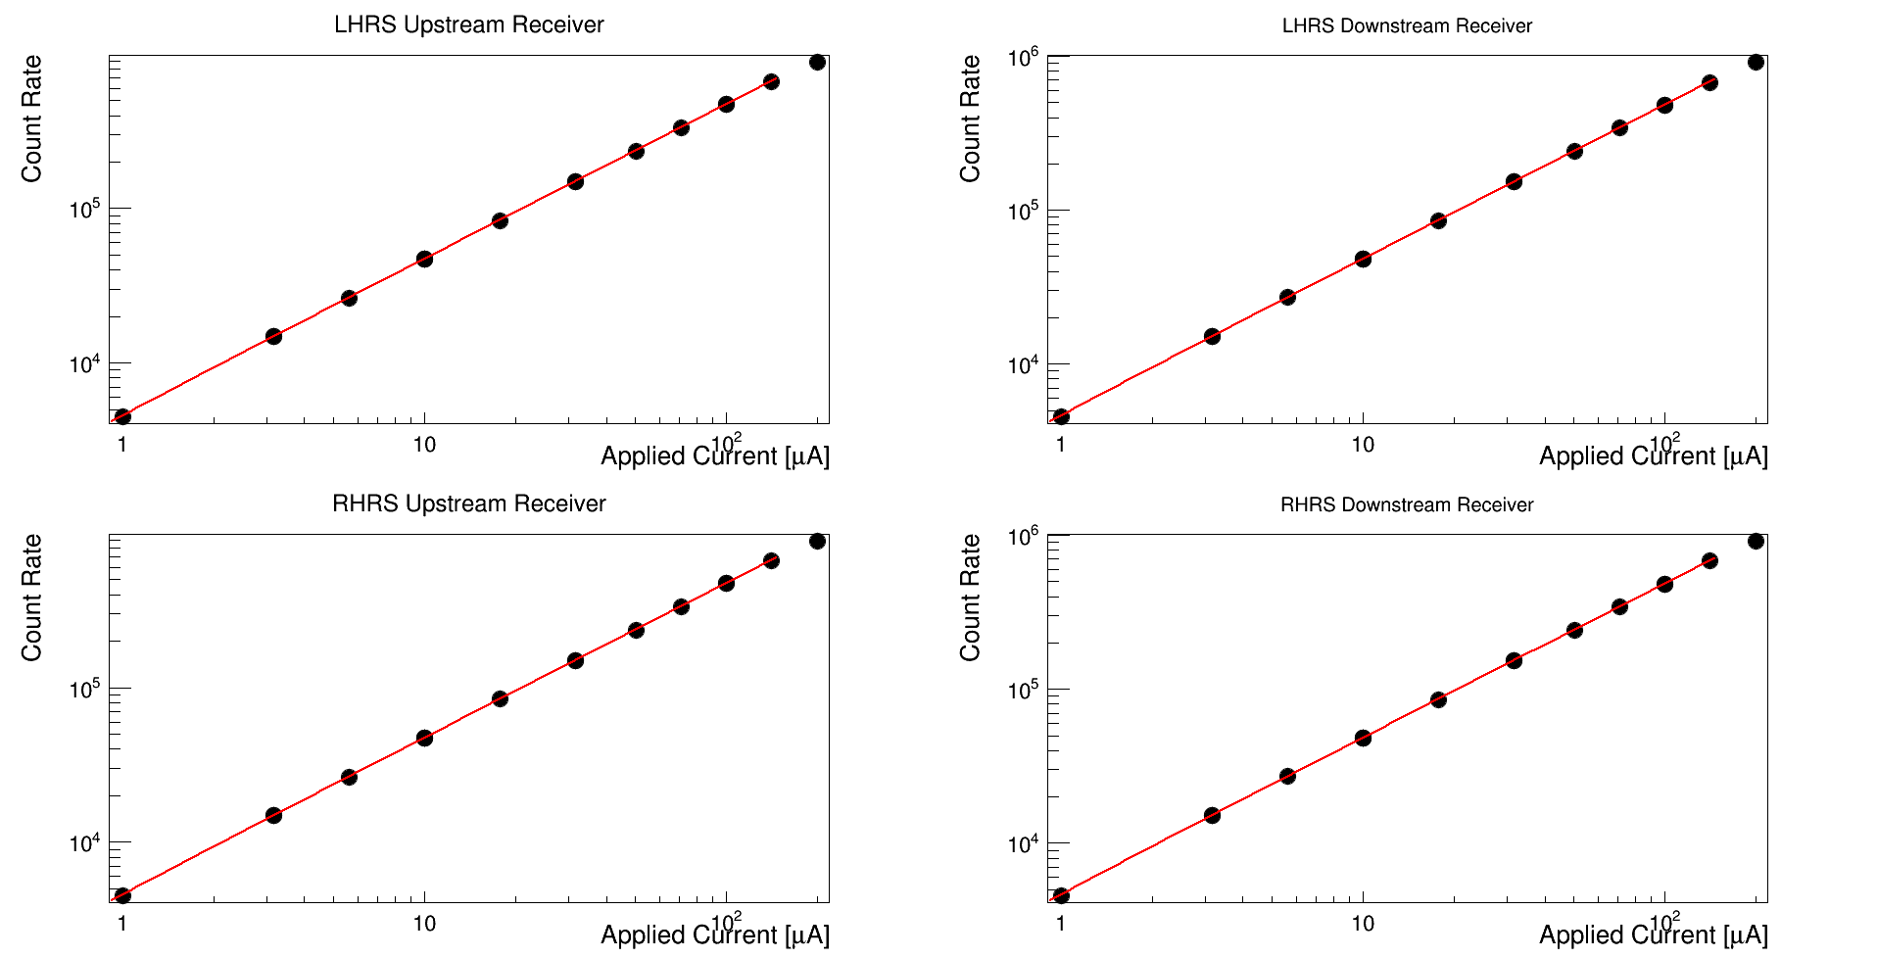
BCM new receiver RF source
https://logbooks.jlab.org/entry/3322081

Slide 7
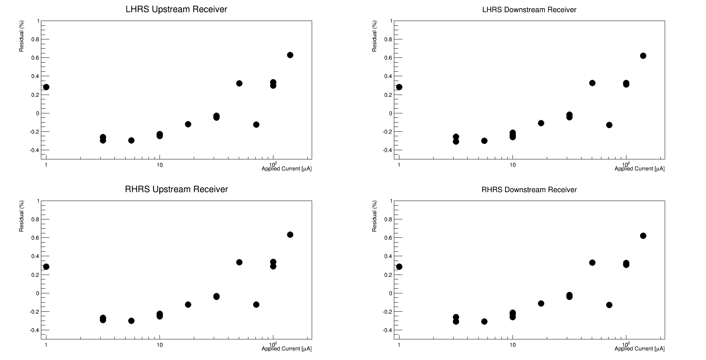
BCM new receiver RF source
https://logbooks.jlab.org/entry/3322081

Slide 8
Standard 1MHz BCM
Offset from 1 MHz box about -15 mV
Added linear fan
x3 saturates at about 15 uA
x10 saturates above 5 uA
Need to check overlap of different gains
Need low current data for calibration linearity check
3 options
Keep this way if x10,x3 and x1 cover whole range
Revert back no fan ( should be ok 15 mV = 0.2 uA )
Get Musson to open the 1 MHz box and adjust offset

Slide 9
BigBite DAQ status
3 CPUs
1 crate trigger with new TI with 1877S
1 crate triggering from back with 1877S
1 crate bad 5V PS fixed
Few bad slots will replace bin when tests done
Need program V1495
New computer would be handy

Slide 10
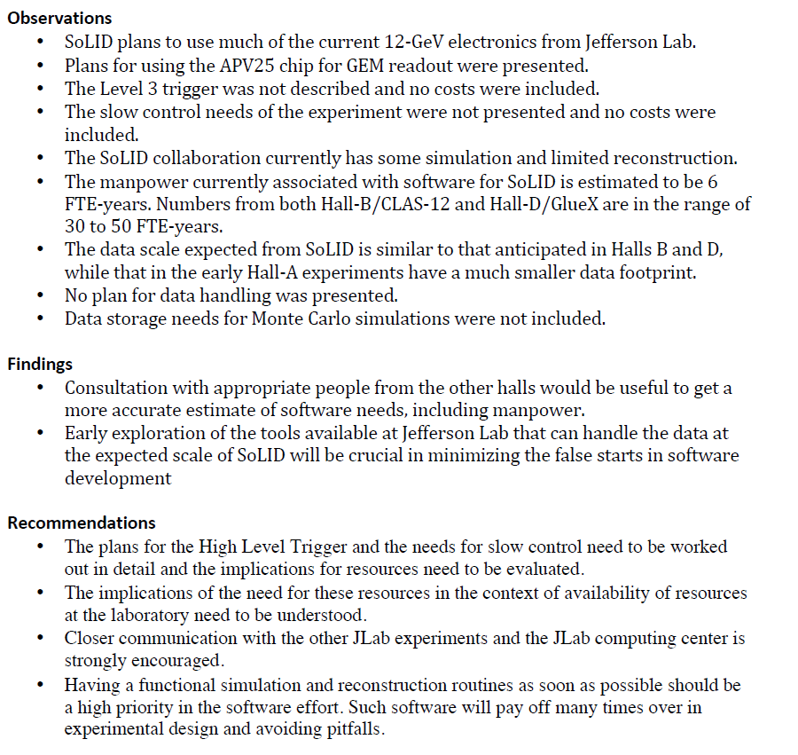
SoLID review DAQ

Slide 11
SoLID review DAQ

Slide 12
SILO transfer errors
A few files did not get transferred regularly
Second script to check and resubmit : works fine
Ole might have found the issue

Slide 13
Upcoming experiment
Low energy runnning
Coincidence trigger for Ar (ee’p) ?
1 DAQ for both HRS
Need Aerogel ?
Need efficiency trigger for proton

Slide 14
APEX plan
Mostly same as Gmp
Coincidence trigger
FADC for SciFi detector : install VME64X crate in Right HRS ( 11 FADC for HCAL , need 8 )
Need implement TDC sparsification
Include FPP ?
Optional : deploy new TI in parallel to standard TI to have event blocking option

Slide 15
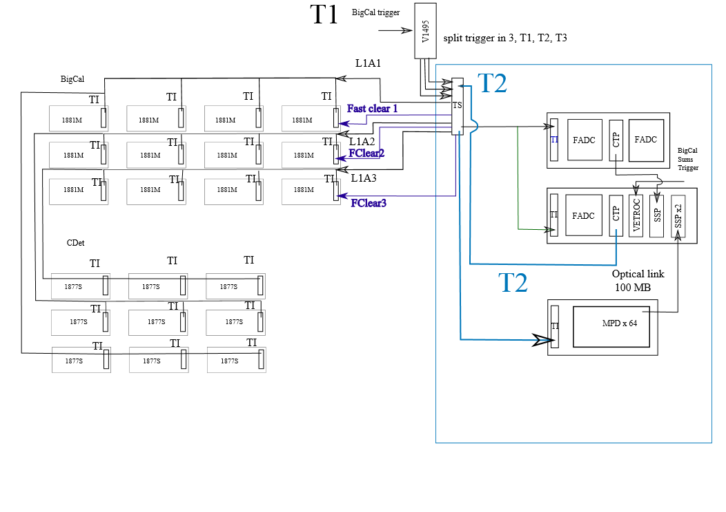
SBS Trigger scheme
Presented to SBS review

Slide 16
SBS Trigger scheme
New TI scheme

Slide 17
SBS Trigger scheme
Use on TS for pipeline DAQ and Fastbus
Use trigger partitioning ( trigger part of DAQ depending on the trigger ) feature of new TS
Need new TI
Advantage :
TS takes care of flipping ( could try to get rid of V1495 and do in TS )
One data stream

Slide 18
SBS Cerenkov Trigger

Slide 19
SBS meeting VETROC application for Cerenkov triggering
Alexandre Camsonne
March 18th 2015

Slide 20
VETROC board
Developped for Compton and SoLID MRPC
64 input + 8 input and 8 output
Extension with mezannine to 128 channels (compatible with V1495 mezzanines )
Optical link
VXS link for triggering purpose
Will try to develop high resolution TDC ( possibly 25 ps resolution )
Estimate price around 2.5 K$ for 64 channels and about 4 K$ for 128 channels

Slide 21
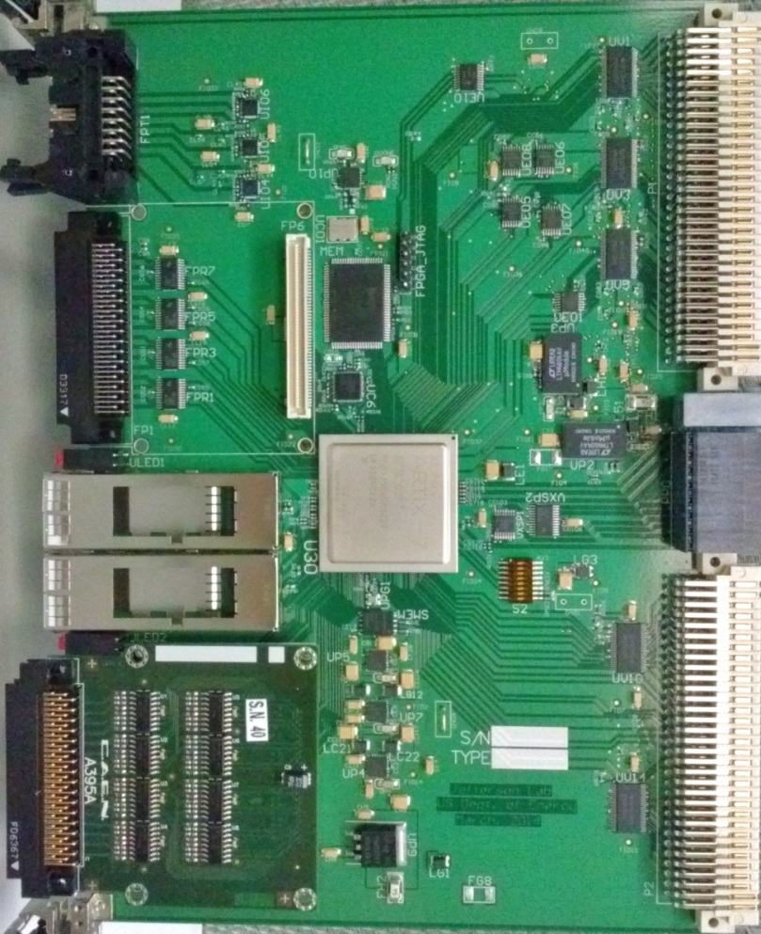
vXS fPGA-based Time to Digital Converter (vfTDC)
18Mbit RAM
Generic
8 differential In
8 ECL out
preliminary
VME64x:
Register,
Data Readout
32 differential in
32 LVTTL in
Trigger Interface
Trg/Clk/Reset/Busy
VXS P0:
Trg/Clk/Reset/Busy
4x fiber Tx/Rx
28 LVTTL on row A
4 + 4 LVTTL on row D
28 LVTTL on row C
32 differential in
32 LVTTL in (with mezz. for differential IN)
FPGA, XC7A200T-2FF1156C

Slide 22
Pipelined electronics
250 MHz sampling
4x 3 GBps Optical fiber link
Can process hits every 4 ns or 8 ns
Readout VME320 : 200 MB/s ( 5 times faster than Fastbus )

Slide 23
(1) Simple FPGA logic
Fast, potentially no crate
OR of all AND of a 3 channels
Cerenkov trigger
In about 200 ns max
Or of all VETROC output

Slide 24
(2) Pipeline logic VME64X
Optical links
4x3 GBps
SSP
Optical links
4x3 GBps
128
X
8
=
1024
Trigger latency :
250 ns ( serialisation / deserialisation )
15 ns data
50 ns Processing
Trigger in about 350 ns for 1024 channels

Slide 25
(3) Pipeline logic VXS
VXS lanes 5 GBps
CTP
VXS lanes 5 GBps
Up to 16 VETROC per VXS crates : 2048 channels
Trigger latency :
250 ns ( serialisation / deserialisation )
15 ns data ( 128 bits per board )
50 ns Processing
Trigger in about 350 ns

Slide 26
(4) Hybrid pipeline logic VXS
16 x SSP and 1 GTP in VXS crate
VETROC
VME64X
crates
Channels = 2048 * crates
Latency
Serialization VXS VETROC-SSP 250 ns
Serialization SSP 250 ns
Serialization VXS SSP-GTP 250 ns
Data transfer = 2048 / 8 GBps = 256 ns per crate
Processing 500 ns
Trigger latency about 2 us for 2 crates
Up to 16*8=128 VETROC = 16384 channels

Slide 27
(5) Full fledge pipeline logic VXS
16 x SSP and 1 GTP
VETROC
VXS
Crates
16 VETROC
Per crate
=
2048
Channels = 2048 * crates
Latency
Serialization VXS VETROC-CTP 250 ns
Serialization CTP – SSP 250 ns
Serialization SSP-GTP 250 ns
Data transfer = 2048 / 8 GBps = 256 ns per crate
Processing 500 ns
Trigger latency about 2.3 us for 2 crates
Up to 128 x 2048 channels
=
262,144

Slide 28
Readout
High resolution TDC available at readout stage ( could be made available at trigger level but need redesign ) : preliminary resolution 20 ps on 128 channels
VME320 : 140 MB/s sustained
Can fully take advantage of event blocking

Slide 29
GRINCH
550 PMT
Option (2)
5 x VETROC = 5x4K$ =20 K$
1 VME64X crate = 8 K$
1 SSP = 5 K$
1 TI = 4 K$
1 CPU = 4 K$
Total about 41 K$

Slide 30
RICH
2400 channels
Option (4)
1 VME64X crates = 8 K$ = 8 K$
1 VXS crate = 15 K$
2 CPU = 2 x 4 K$ =16 K$
1 GTP = 6 K$
2 TI = 2 x 3 K$ = 6 K$
3 SSP = 3 x 5 K$ = 15 K$
1 TD = 4 K$
19 VETROC = 19 x 4 K$ = 76 K$
Total = 146 K$

Slide 31
RICH
2400 channels
Option (5)
3 VXS crate = 3x 15 K$ = 45 K$
2 CTP = 2 x 5 K$ = 10 K$
3 CPU = 2 x 4 K$ =12 K$
1 GTP = 6 K$
3 TI = 2 x 3 K$ = 6 K$
1 SSP = 5 K$
19 VETROC = 19 x 4 K$ = 76 K$
Total = 160 K$

Slide 32
RICH triggers
Have all PMTs every 4 ns
Clustering
Ring ?
If redesign of firmware logic to have high resolution at L1
Could have time over threshold and have amplitude at L1
Cut on single PMT amplitude
Threshold on digital sum all PMTs
Threshold on digital sum on ring or clusters

Slide 33
Conclusion
VETROC can form prompt trigger and do readout
Pipeline logic can be used for more complicated triggers ( more latency around 300 ns ) might be still fast enough for L1A within a crate, can be used for L2 with HCAL
Cost ranges from
High resolution readout developed 25 ps resolution
Might be able to have high resolution at trigger level with investment

