Slide 1
G2p Safety Readiness Review January 17, 2012 Radiation Damage
George Kharashvili, Radiation Control

Slide 2
Dose & Displacement Damage
Radiation Damage to Materials/Electronics
!!! A Rough Overview Only !!!
commercial COTS hardened electronics
accelerators
Semiconductors
Polymers
Ceramics
Metals and alloys
10.0 1E2 1E3 1E4 1E5 1E6 1E7 1E8 1E9 1E10 1E11 Gy
1E12 1E13 1E14 1E15 1E16 1E17 1E18 1E19 1E20 1E21 1E22 n/cm²
- no damage
- mild to severe damage
- destruction
!!! Assumption !!! (depends on particle energy spectra) 1 neutron (1MeV) /cm² ~ 3.3E-11 Gy
© Lockheed Martin

Slide 3
Radiation damage levels in terms of 1-MeV neutron equivalent fluence in Si were calculated assuming following running conditions:
Energy | Current | Duration
2.254 GeV | 100 nA | 11.1 days
3.35 GeV | 100 nA | 6.6 days

Slide 4
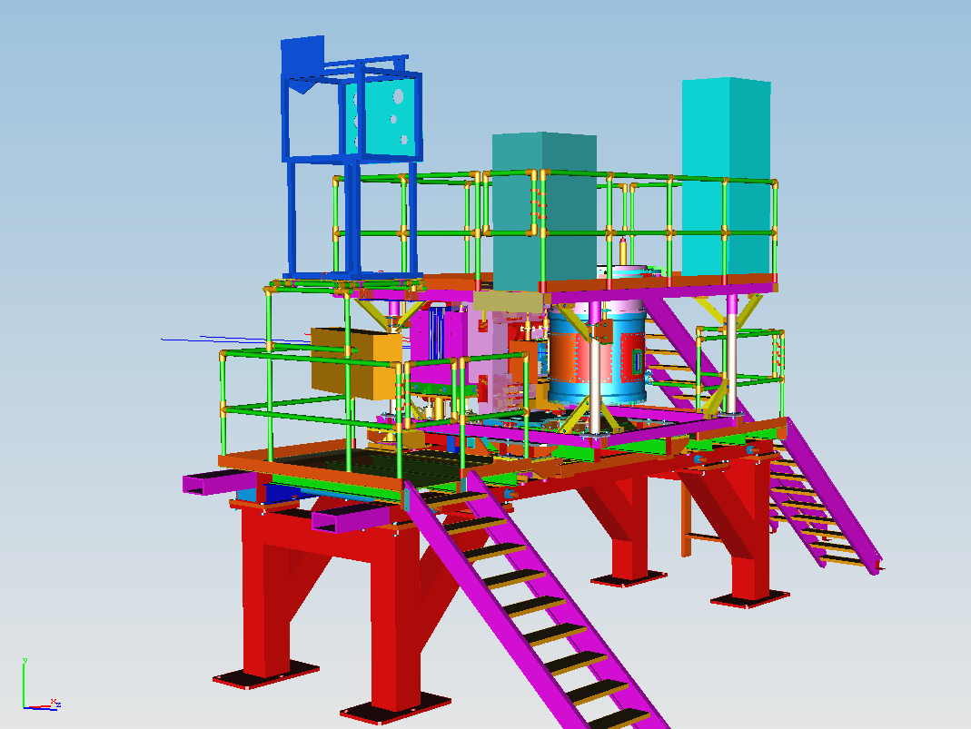

Slide 5
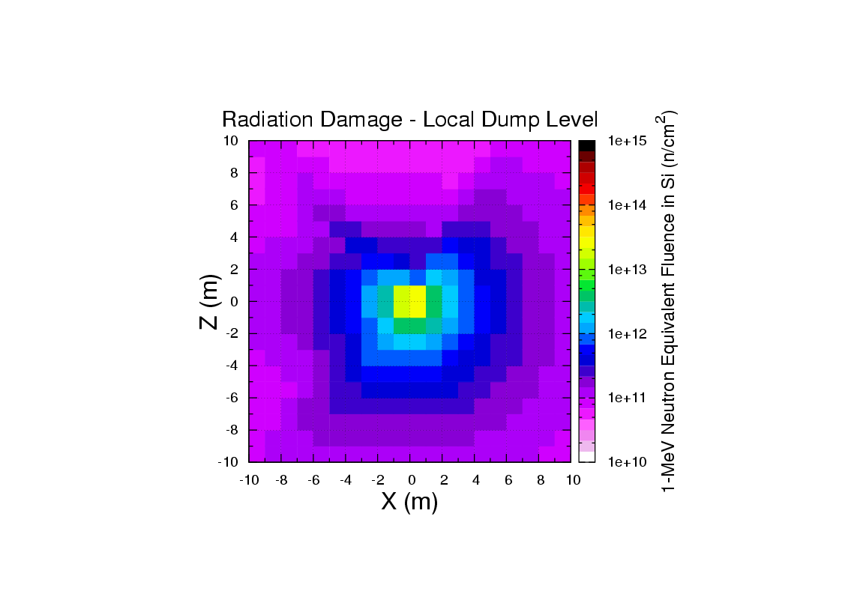
X=0, Z=0 corresponds to the face of the local dump

Slide 6
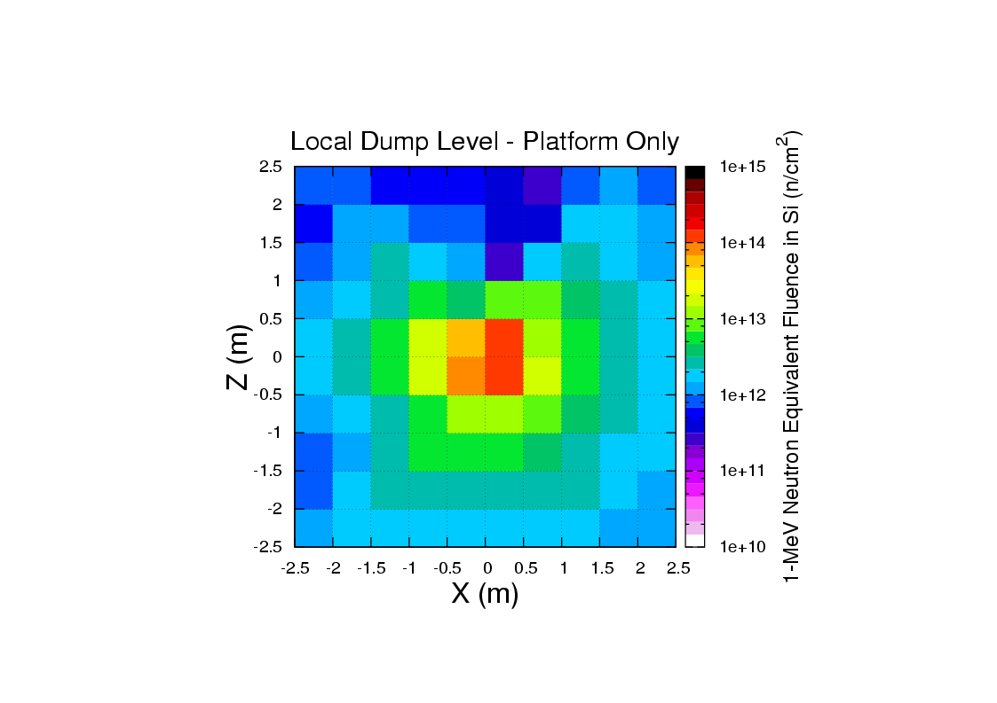

Slide 7
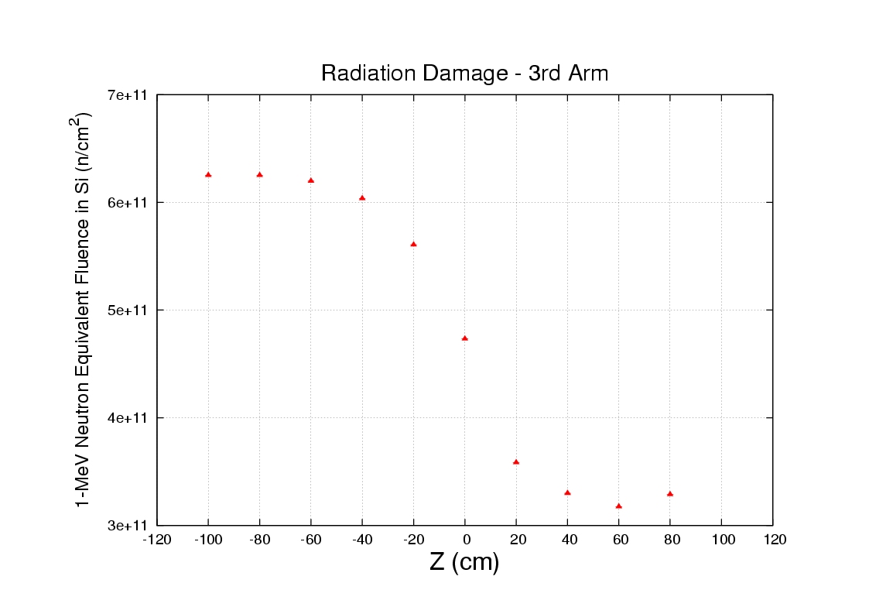
Radiation damage levels along the beam axis, 2m away from the dump.
Detectors 3rd arm is located in the ~4 x 10¹¹ n/cm² area.

Slide 9
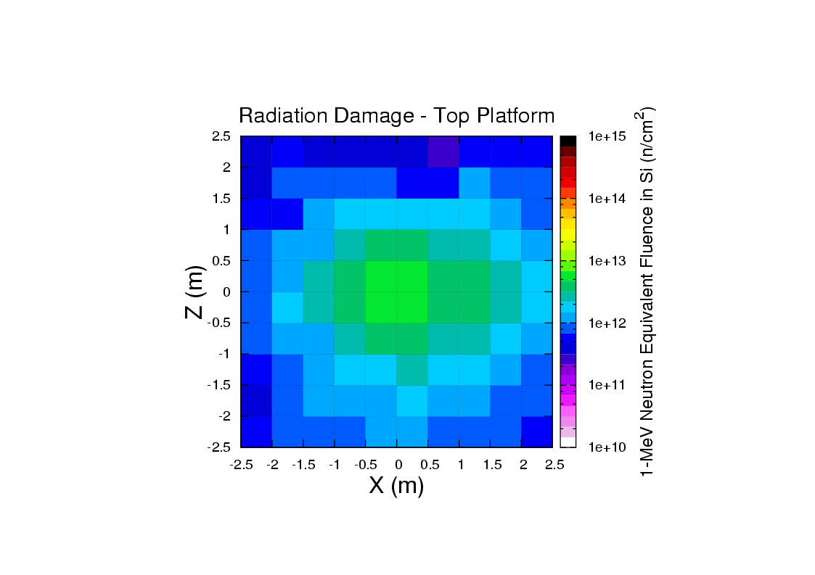

Slide 11
