Slide 1
G2P Installation Readiness

Slide 2
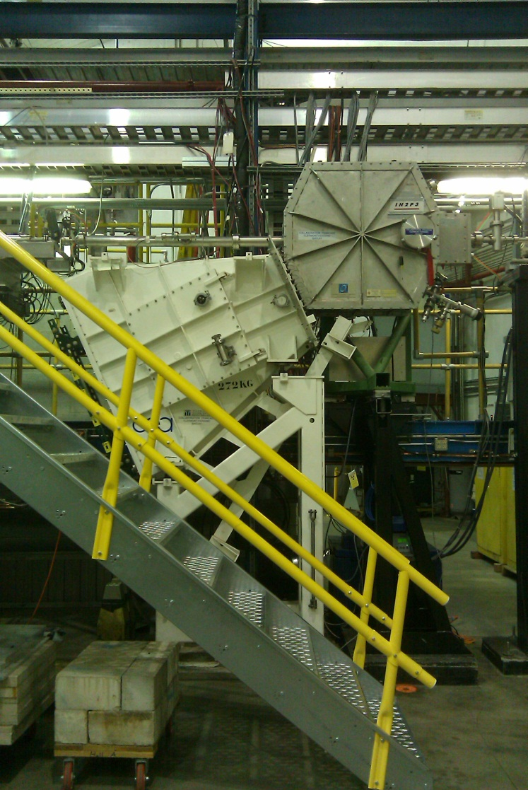
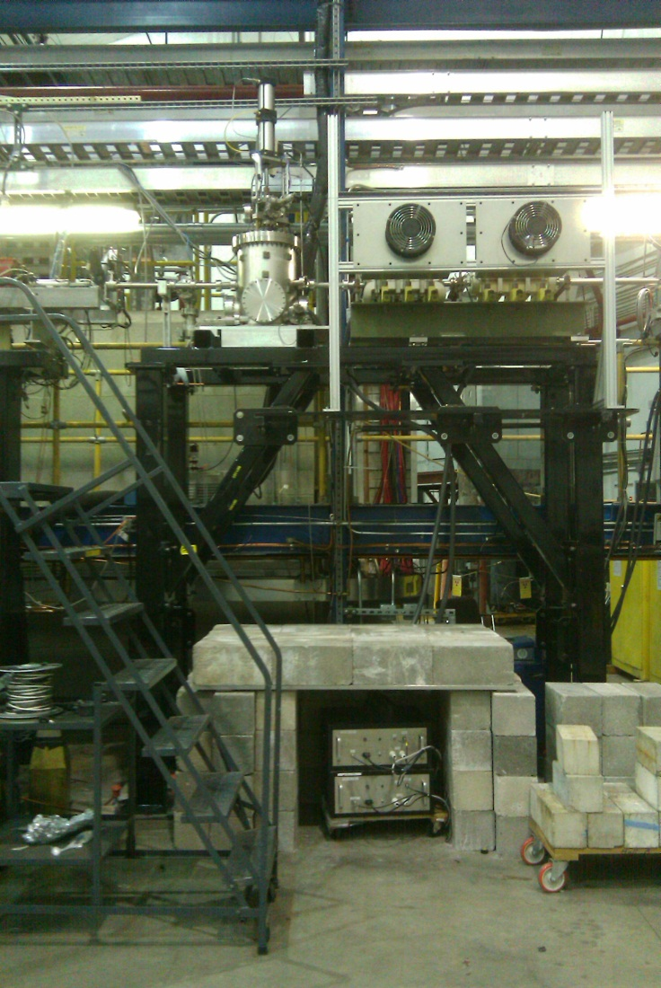
Fast raster & Calorimeter

Slide 3
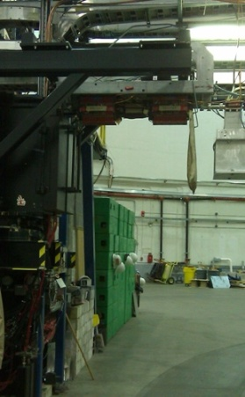
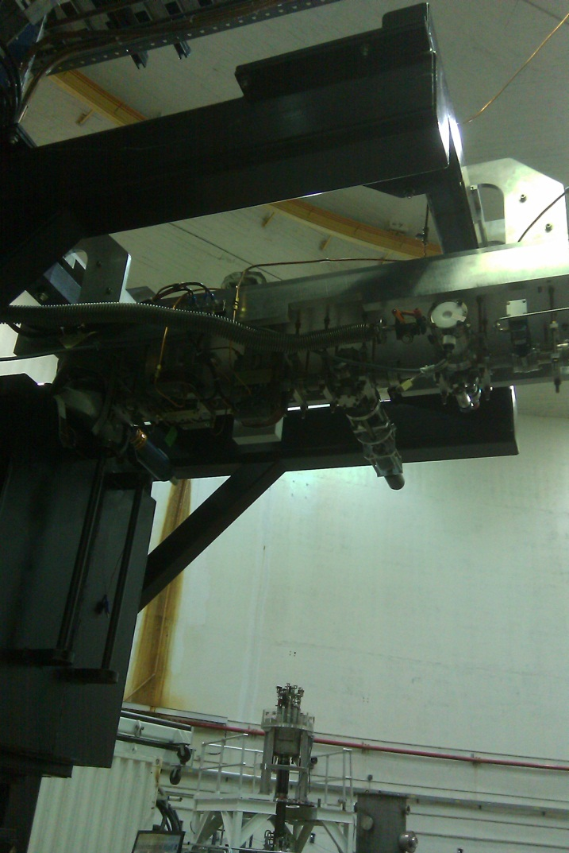
Upside down girder

Slide 4
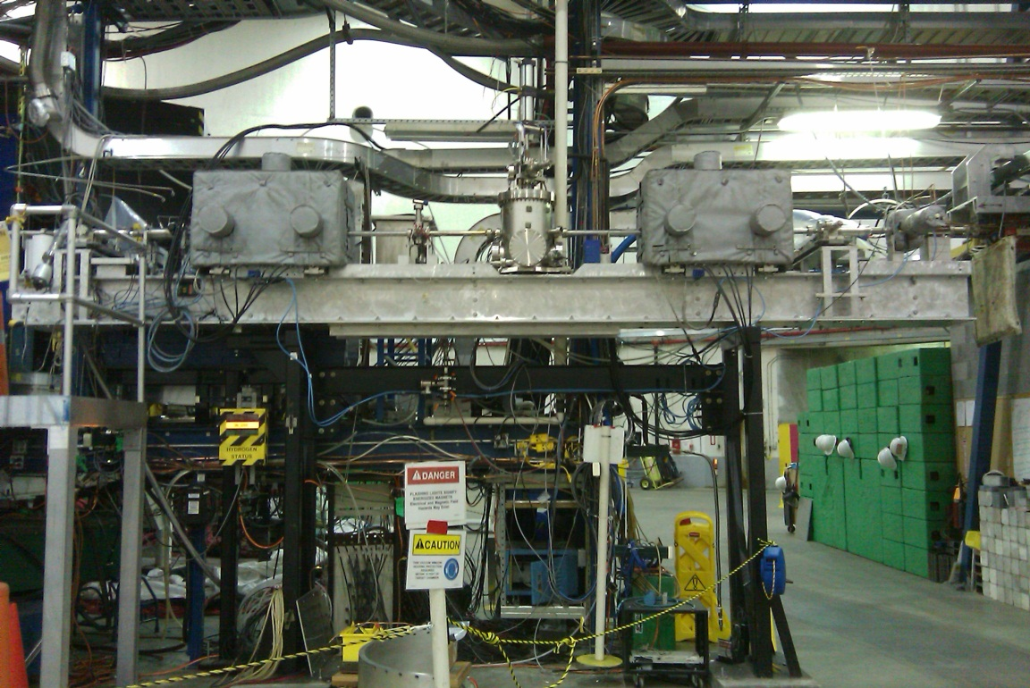
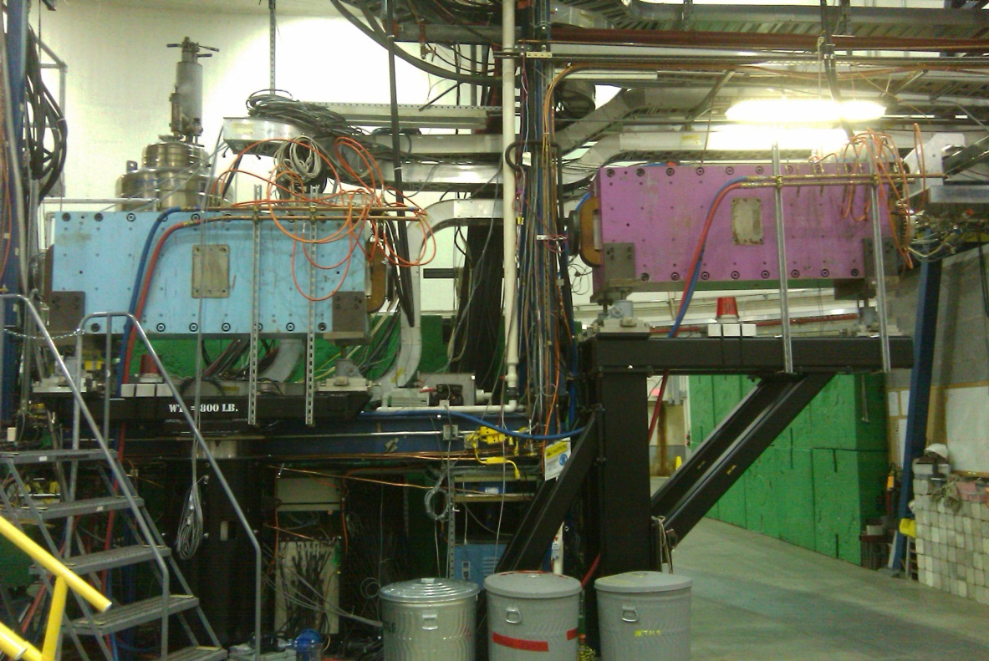
FZ magnets

Slide 5
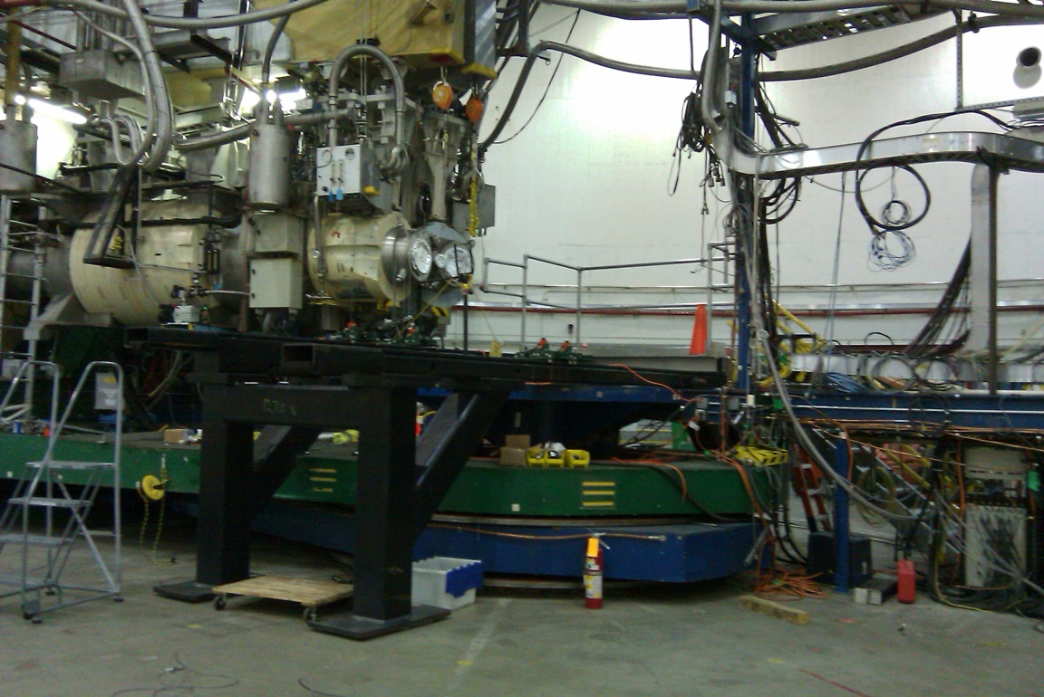
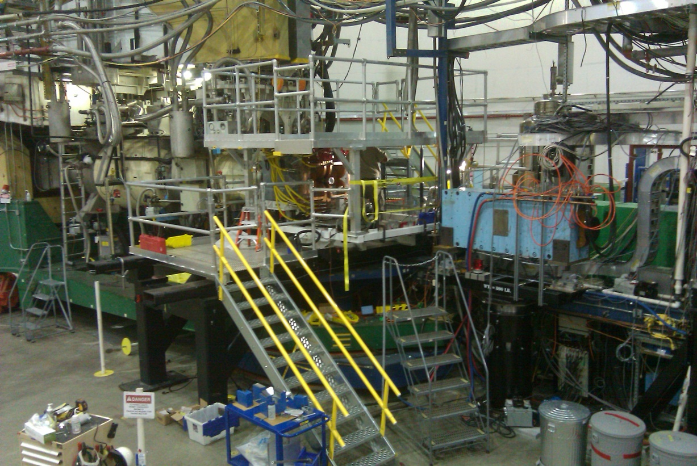
Target platform

Slide 6
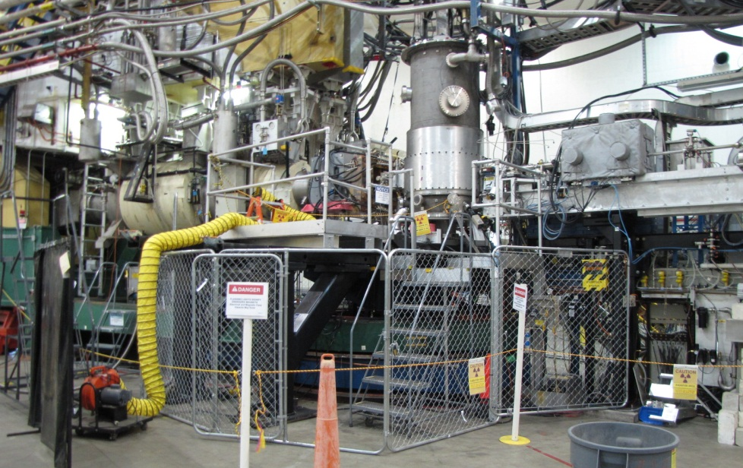
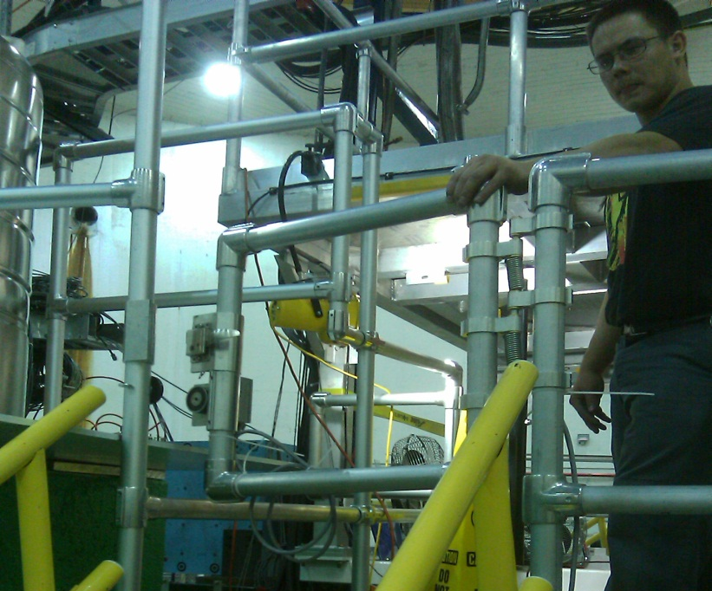
Target Platform security
Prex Radcon security fence
Gates
Interlocked magnetic locks
Warning beacons
E stop button
Bolted on window covers

Slide 7
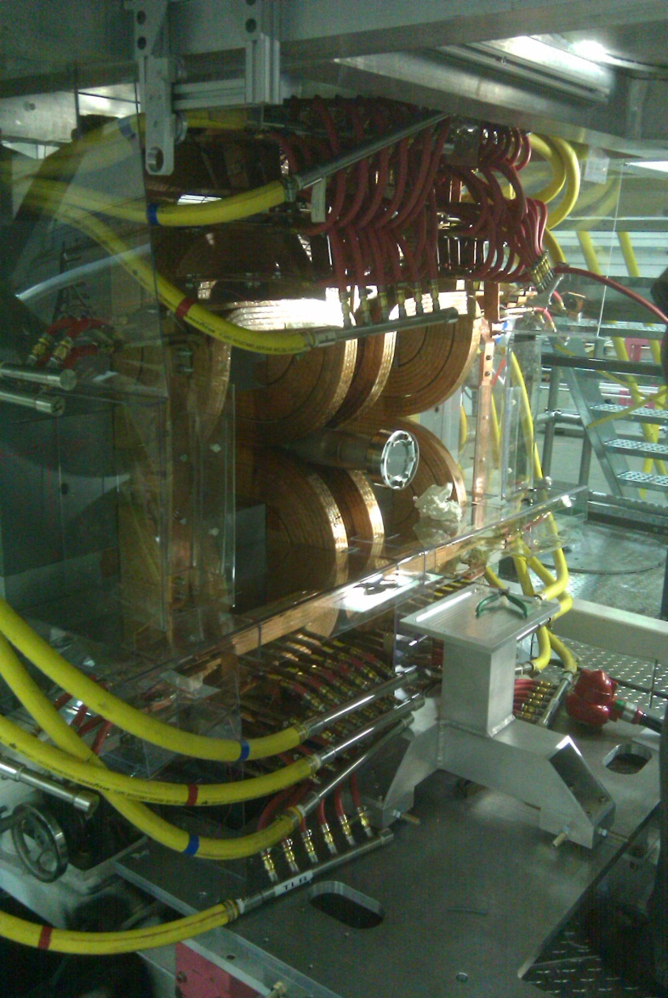
Septum Magnet
In place
Pre aligned
Power shielding installed
Water lines tested
Working on OSPs for power up

Slide 8
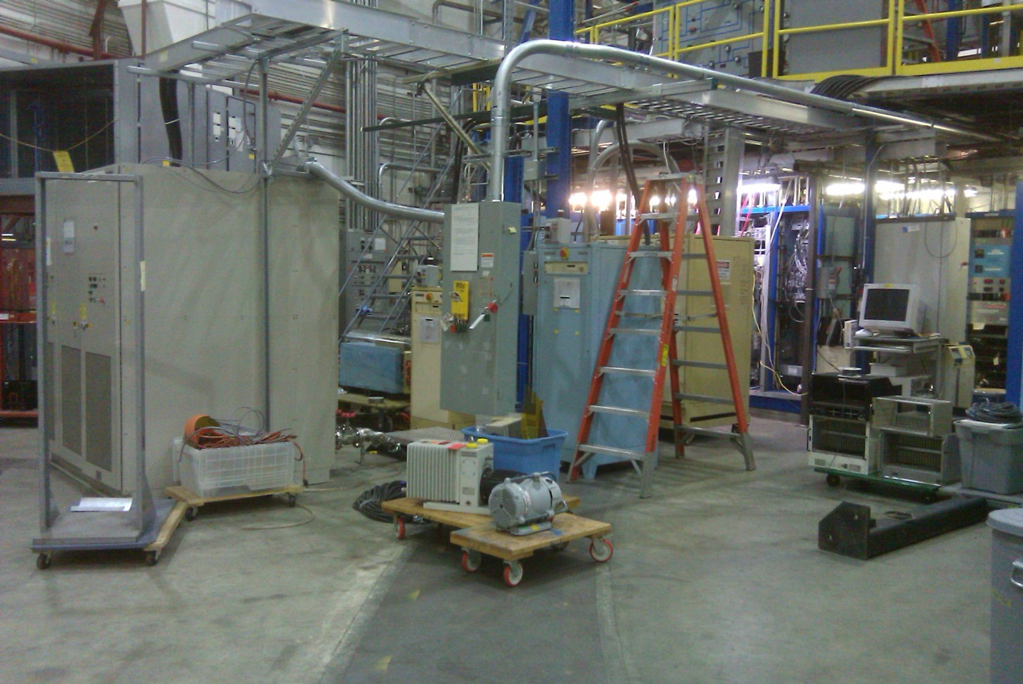
Power supplies
Have begun operational checkout of
Big Box
HKS
FZ 1
FZ 2

Slide 9
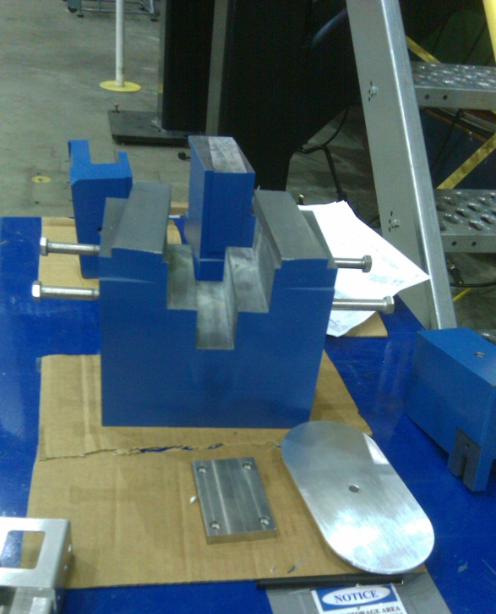
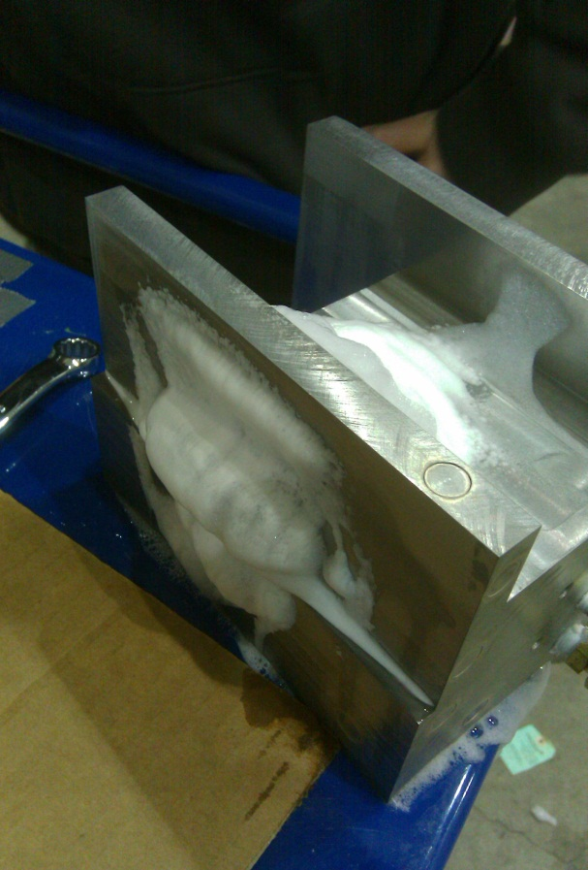
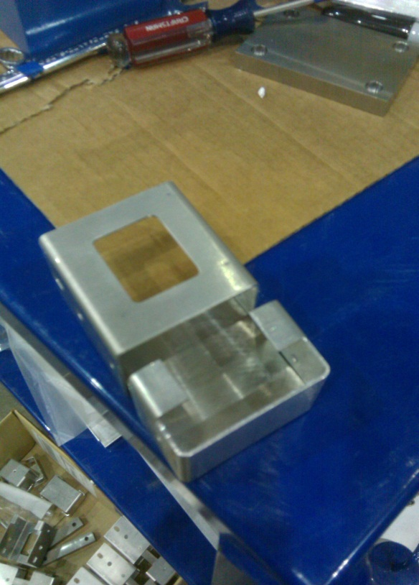
Beam Dump
Lead parts here
Inserts are here
Tungsten here with issues to resolve

Slide 10
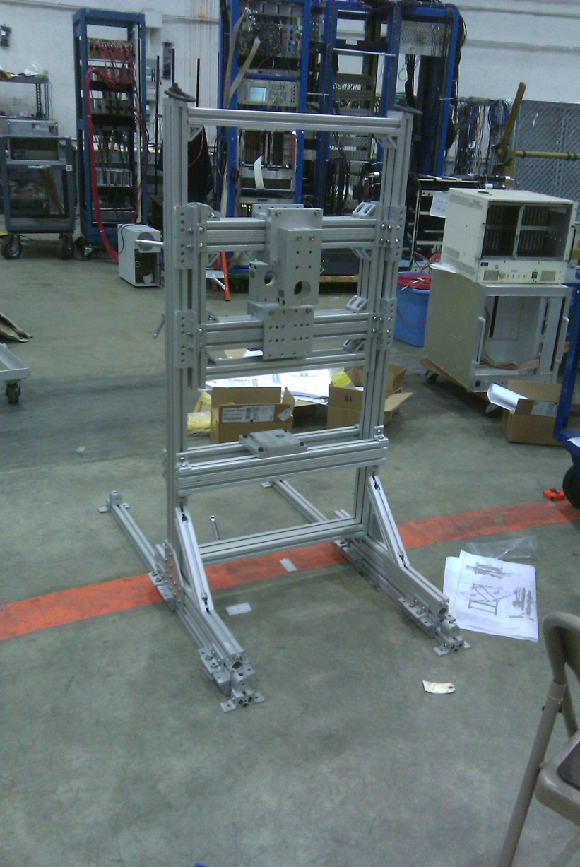
Third arm
Being assembled

Slide 11
Experiment OSPs
Slow Raster operation and testing Being written
FZ magnets operation and testing Complete
FZ 2 magnet positioning and alignment Being written
Target operation and testing In review
HKS power supply operation and testing In review
Big Box power supply operation and testing In review
Septum magnet operation and testing In review
Septum magnet mapping Being written
Lower balcony access for third arm access In review
Beam dump insert removal and replacement In review

Slide 12
Concerns
Survivability of target magnet
Radiation levels at local beam dump

Slide 13
Questions?

