Slide 1
Baffle update
Zhiwen Zhao
2013/08/13

Slide 2
Acceptance study

Slide 3
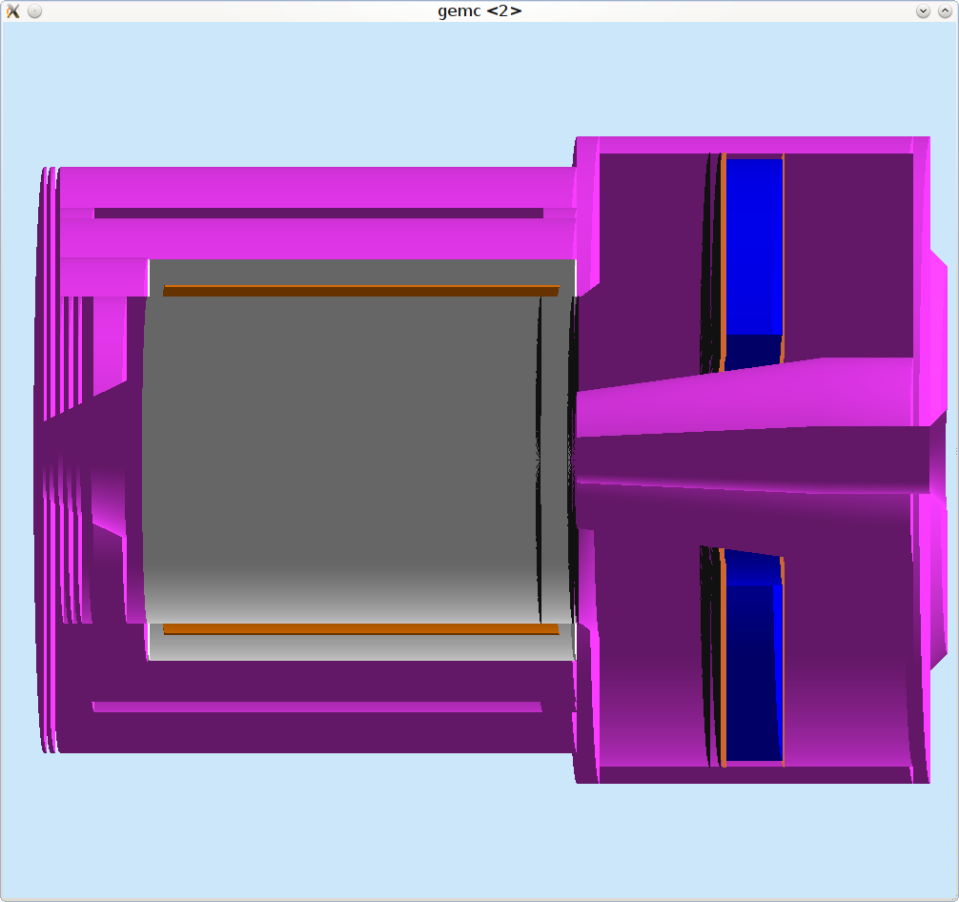
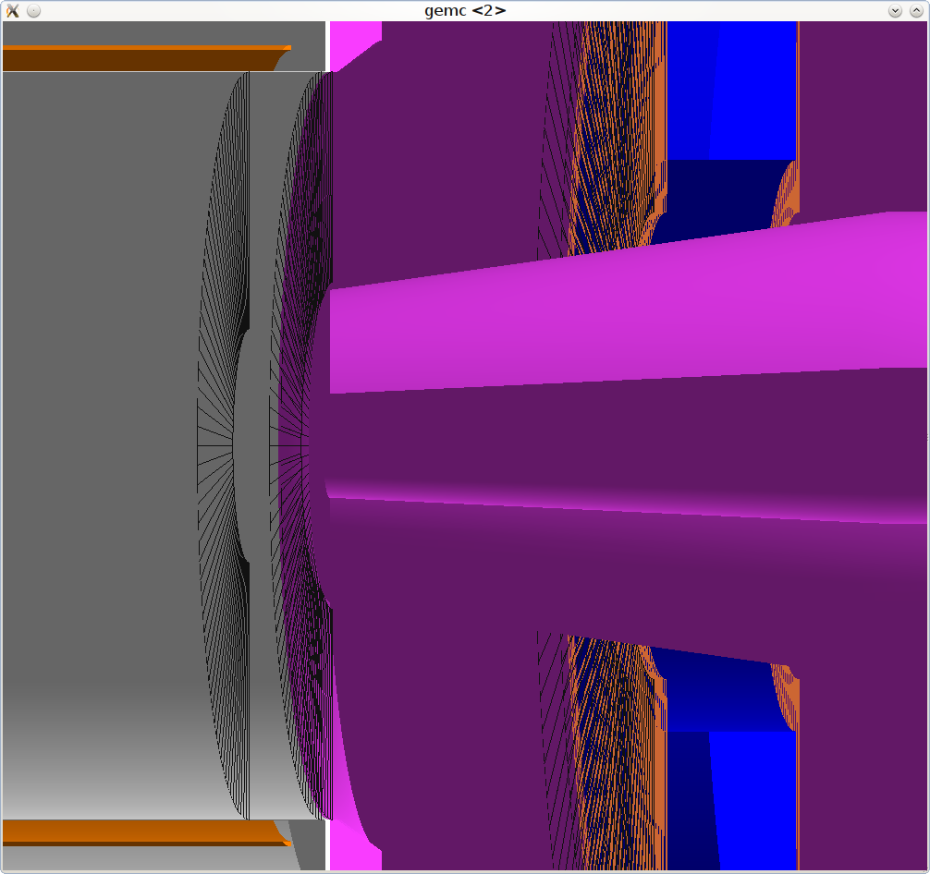
condition
PVDIS setup, no baffle
Vacuum plane in front of EC and GEM, everything else are kryptonite or vacuum
Virtual plane in front of EC R(90,270)cm to record hits, limited by endcap size
EC module R(110,265)cm, 110cm due to target downstream end at 21 degree, 265cm due to endcap size
EC effect R(110,250)cm, 250cm choose to ensure EC best performance
Throw in geantino/chargedgeantino from various vertex and evenly in P and theta
Look at accepted particles on virtual plane in front of EC with cut on R(110,250)cm to determine acceptance

Slide 4
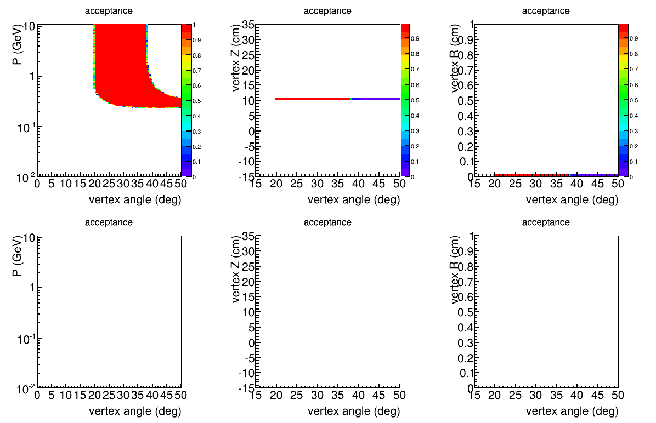
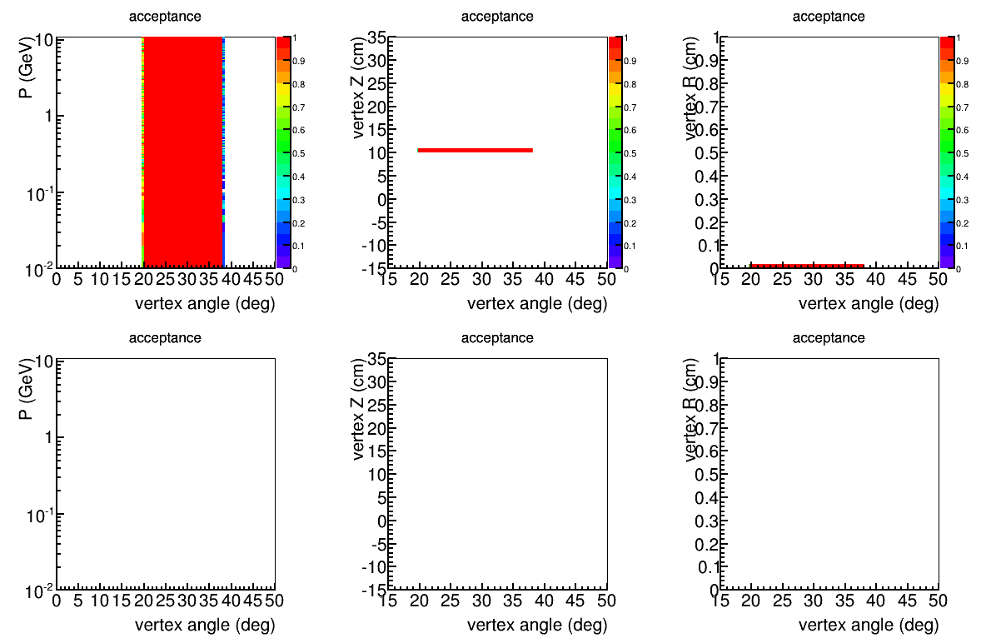
negative
point source
Z=10cm
r=0mm
neutral
positive

Slide 5
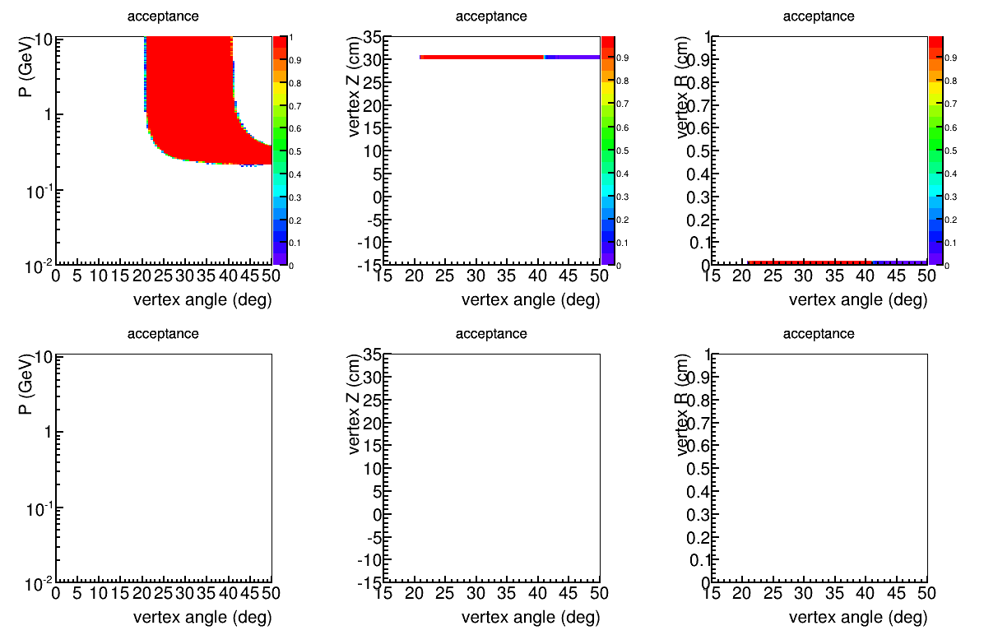
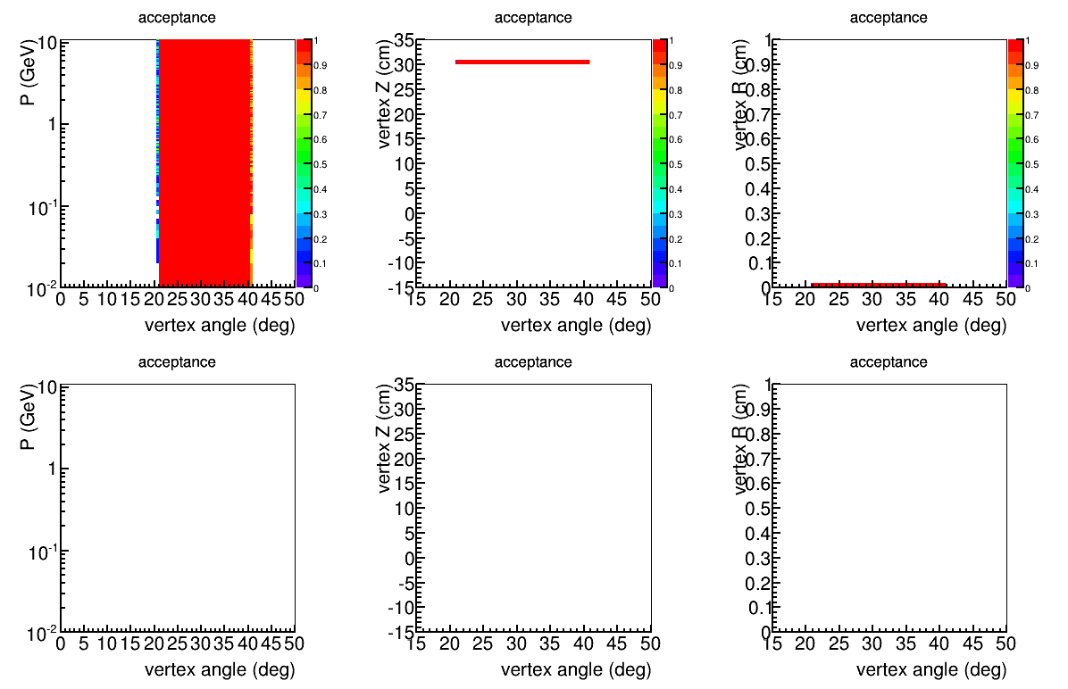
negative
point source
Z=30cm
r=0mm
neutral
Accept larger
polar angle
positive

Slide 6
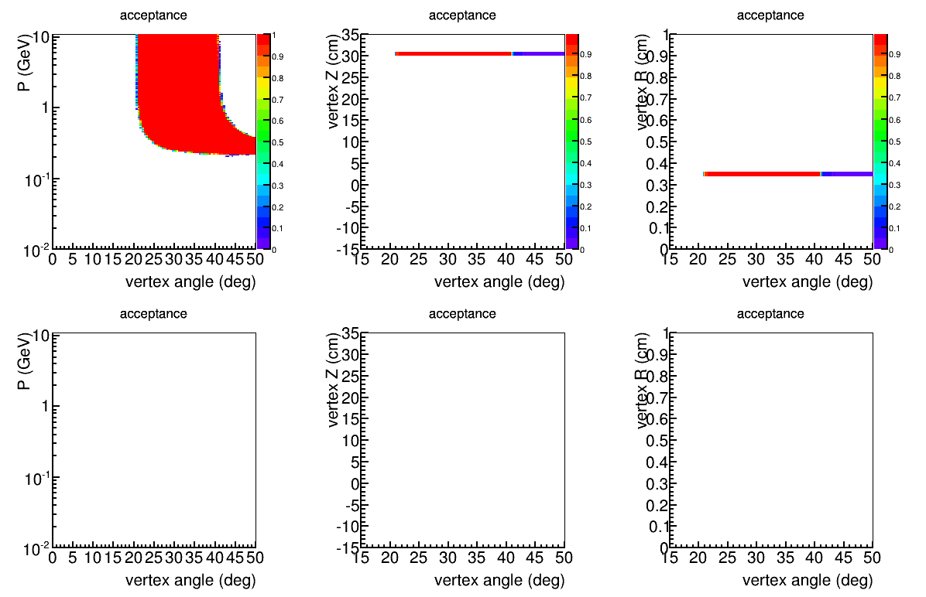
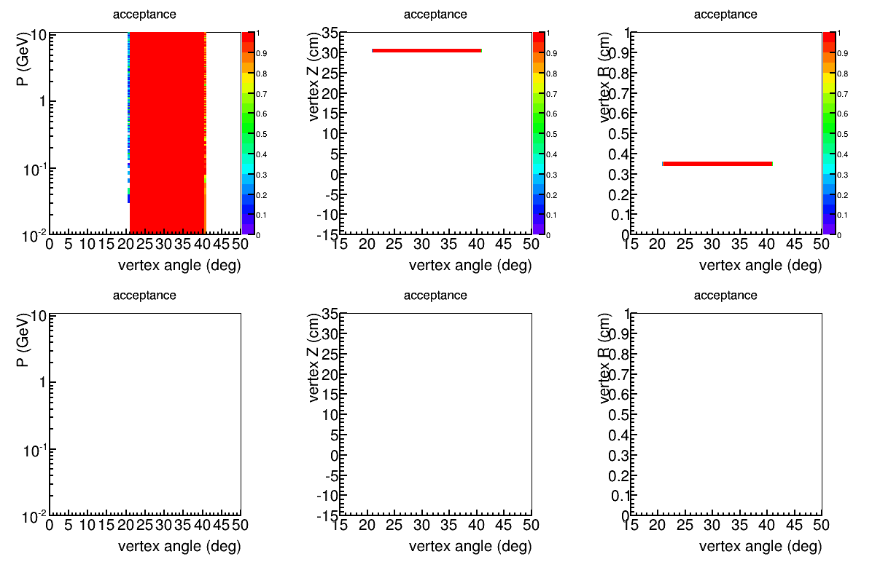
negative
point source
Z=30cm
r=3.536mm
neutral
Accept larger
polar angle
positive

Slide 7
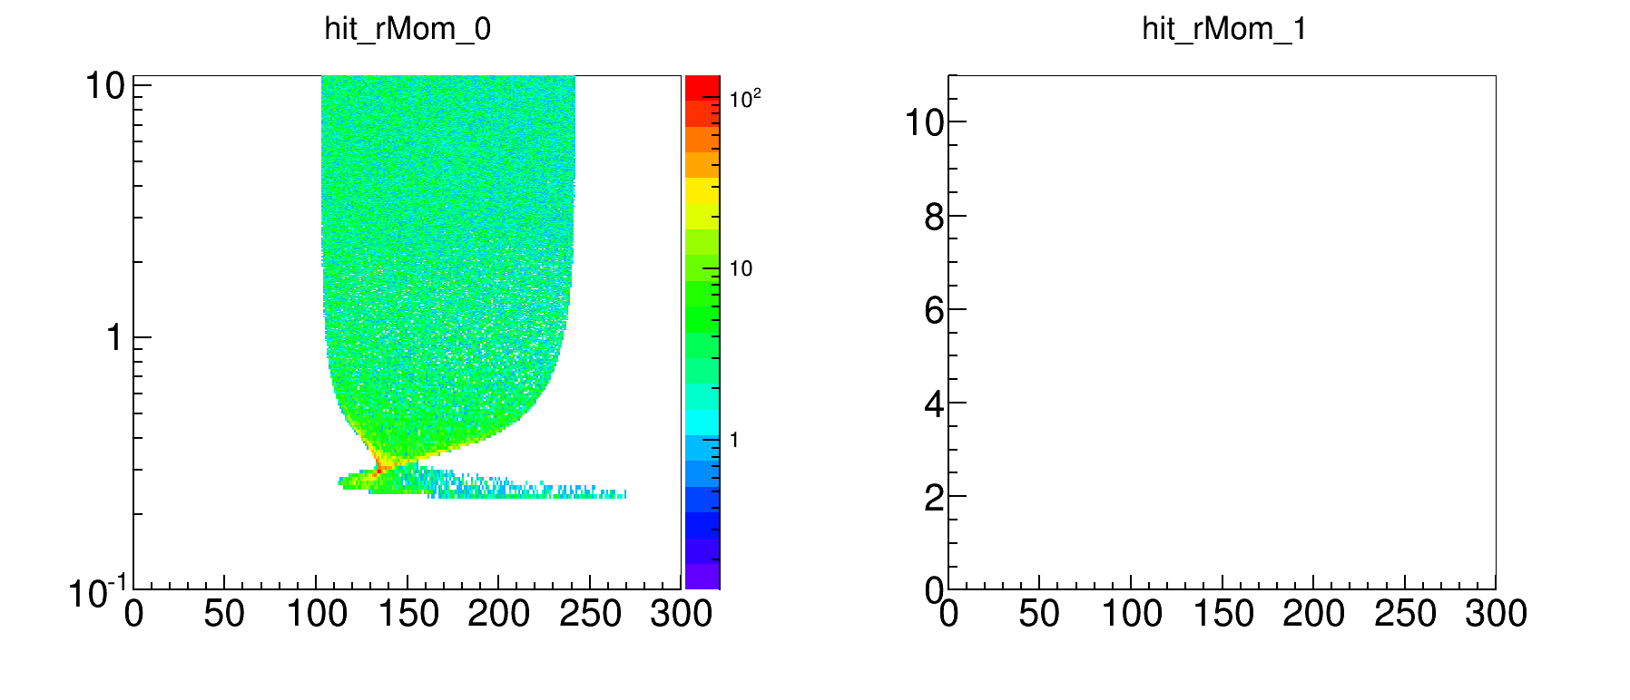
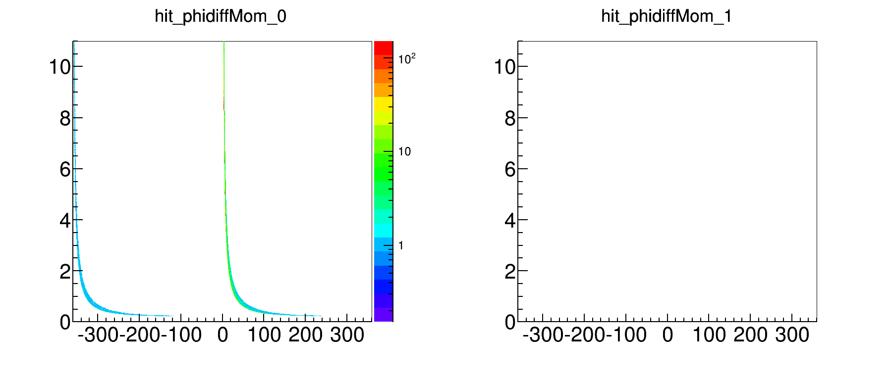
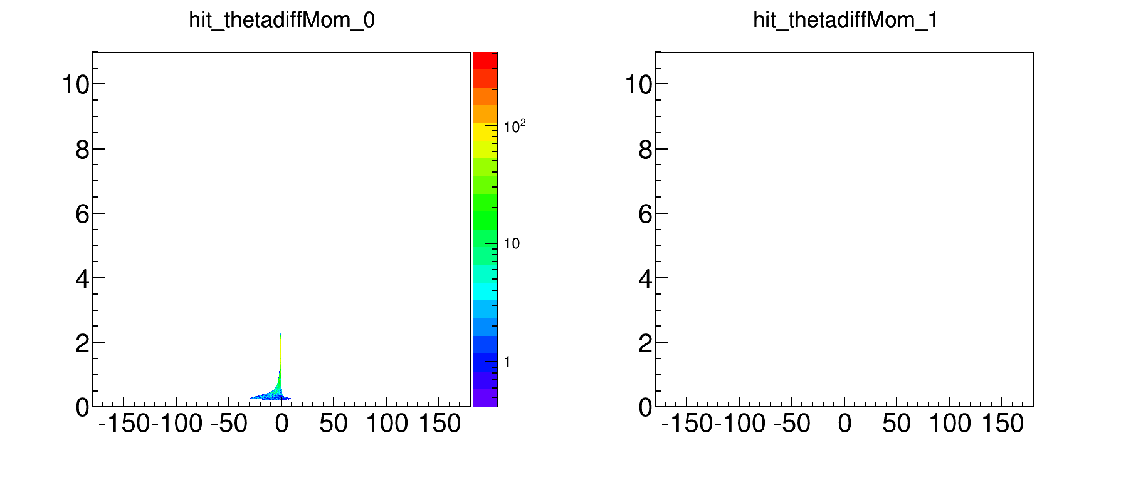
How particle rotates in SoLID field
Point source
Z=10cm
r=0mm
negative
Mom
R
Phi_diff
Theta_diff
Sweep away < 0.2MeV, Squeeze ~ 0.3GeV

Slide 8
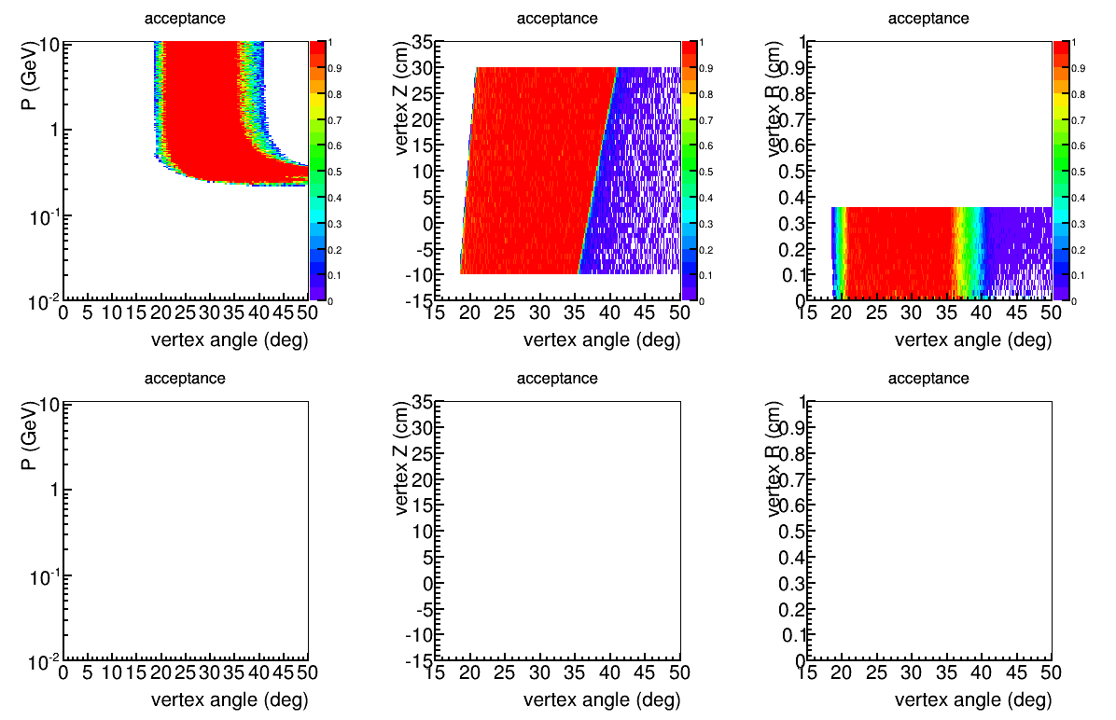
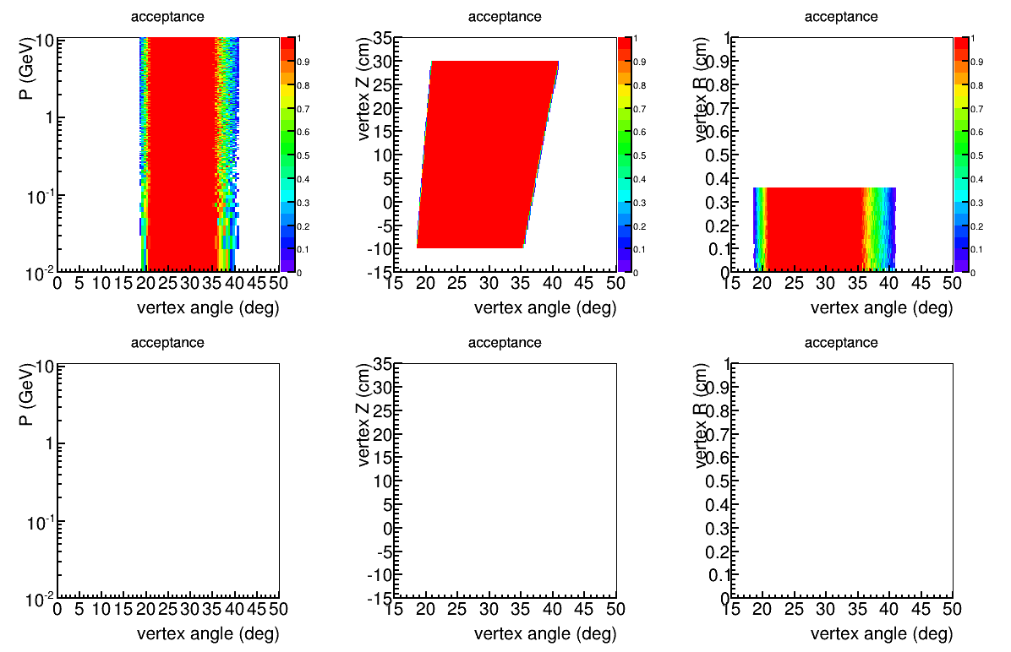
negative
source
Z(-10,30)cm
R(0,3.536)mm
neutral
Strong bending < 0.5GeV
Sweep away < 0.2GeV
positive

Slide 9
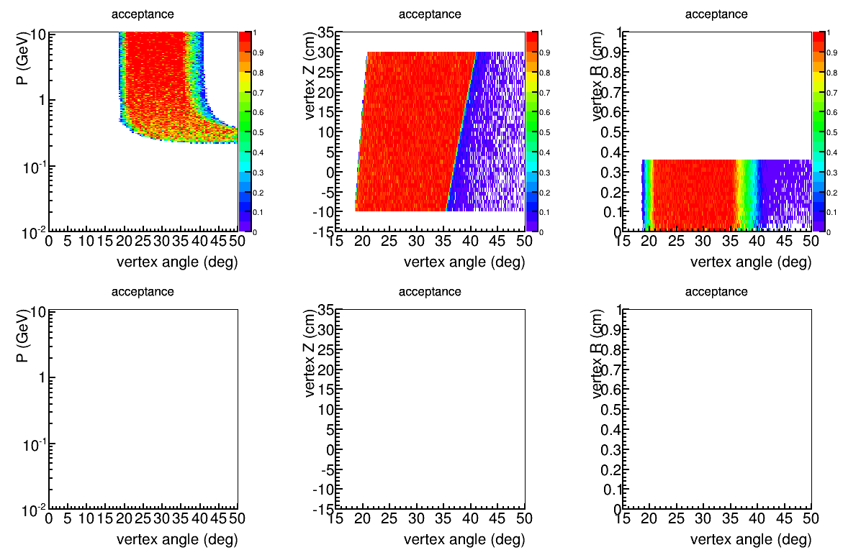
e-
source
Z(-10,30)cm
R(0,3.536)mm
pim
~3% pion decay before reach EC
pip

Slide 10
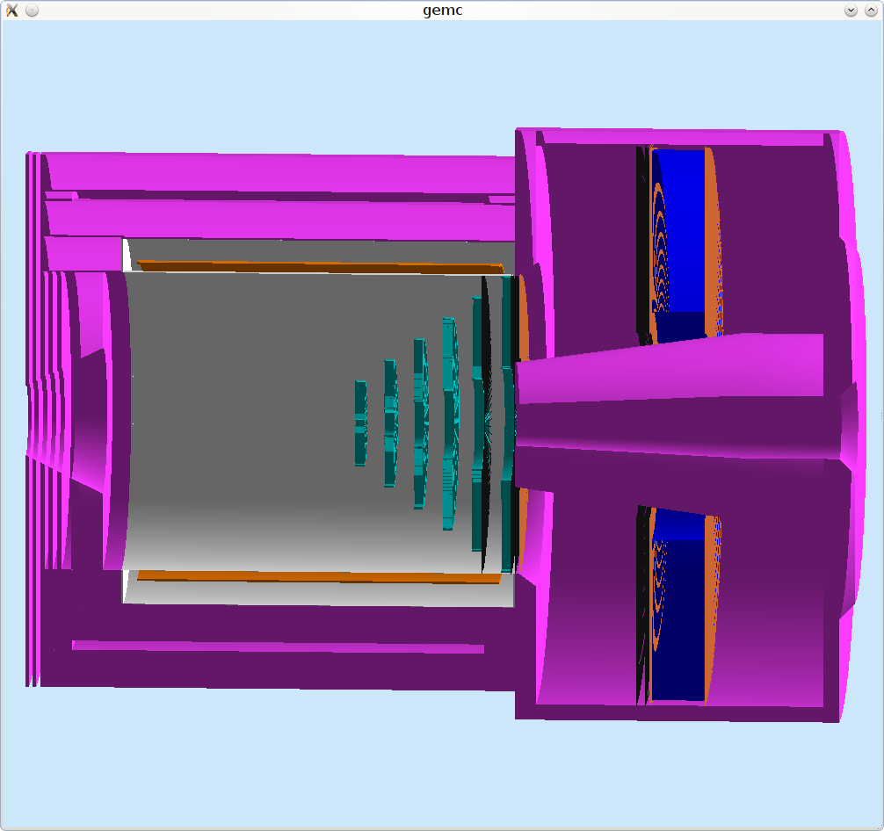
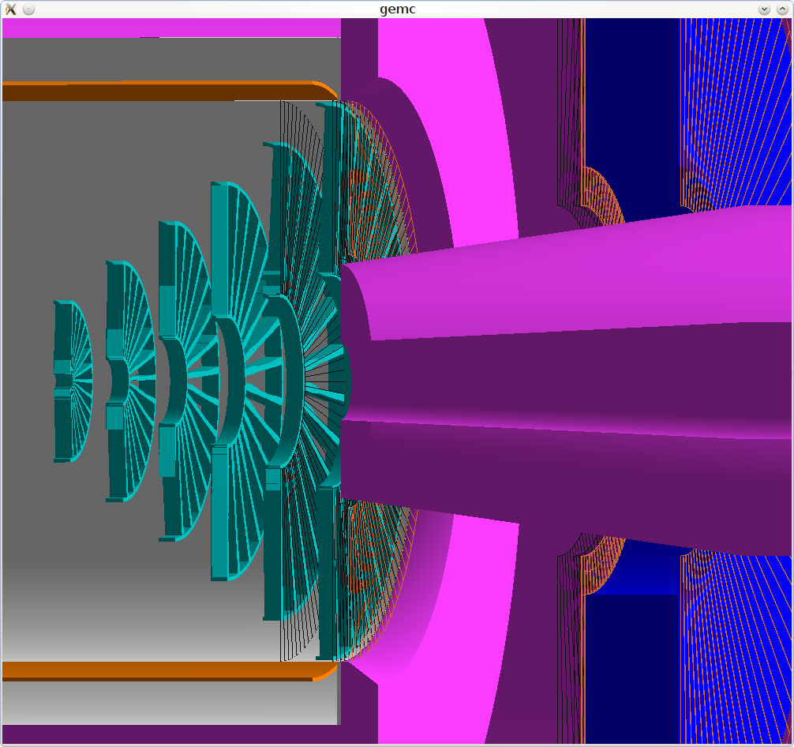
condition
PVDIS setup, with baffle
All similar to no baffle case, just add kryptonite baffle
Use cutinner 4cm

Slide 11
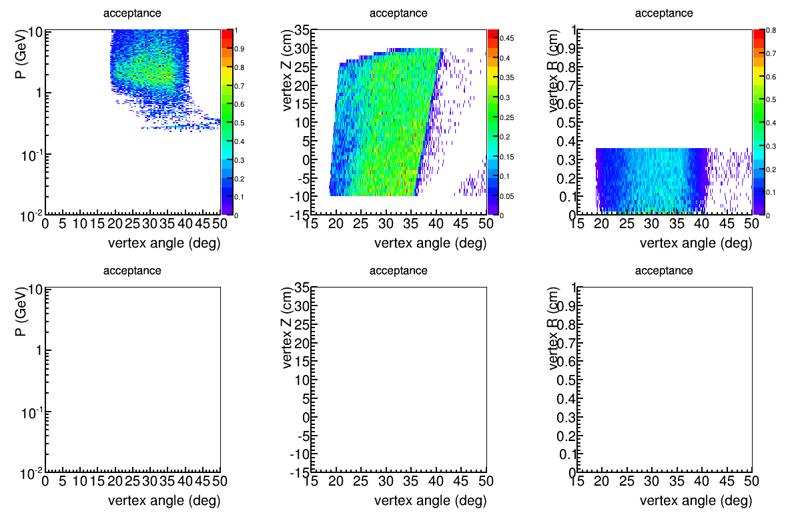
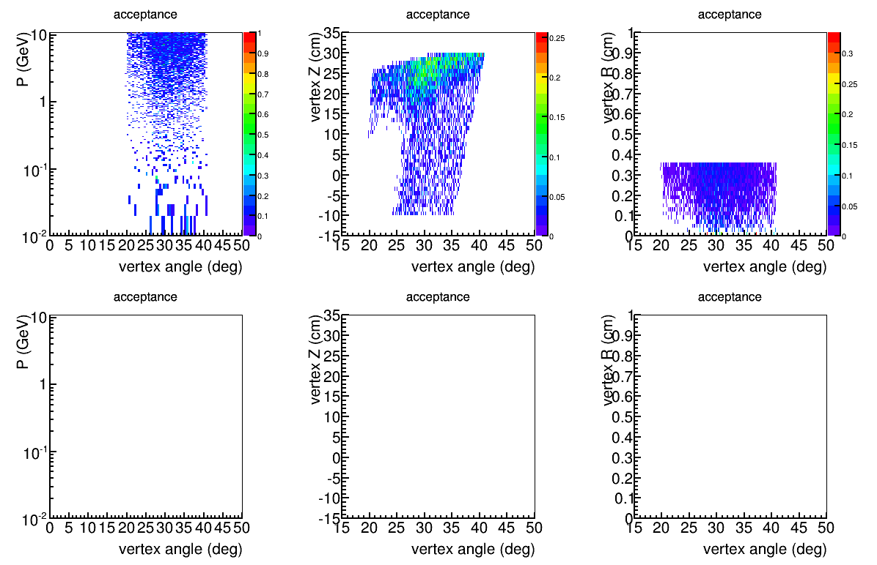
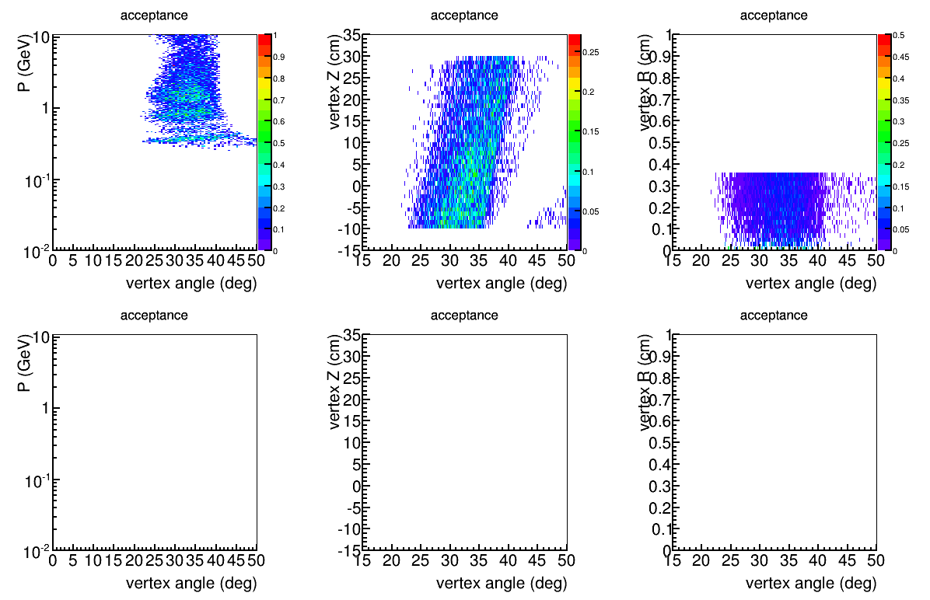
negative
source
Z(-10,30)cm
R(0,3.536)mm
neutral
Strong bending < 0.5GeV
Sweep away < 0.2GeV
positive

Slide 12
Process | Proposal PAC34 |  | Current
 | open | baffled | Open | Baffle (smallerZ 4cm) |  | Baffle (largerZ)
e DIS total | 2500 kHz | 110 kHz | 7800 kHz | 1140 kHz |  | 830 kHz
eDIS W>2GeV,x>0.20 | 1500 kHz | 110 | 2000 kHz | 650 kHz |  | 618 kHz
eDIS W>2GeV,x>0.55 | 35 kHz | 12 | 94 kHz | 24 kHz |  | 28 kHz
eDIS W>2GeV,x>0.65 | 8 kHz | 3 | 22 kHz | 5.7 kHz |  | 6.7 kHz
pim all |  |  | 26700 MHz | 1000 MHz |  | 560 MHz
pim p>0.3GeV | 2300 MHz | 140 MHz | 14000 MHz | 740 MHz |  | 160 MHz
pim p>1.0GeV | 460 MHz | 70 MHz | 1600 MHz | 270 MHz |  | 150 MHz
pim p>2.0GeV | 26 MHz | 8 MHz | 53 MHz | 17 MHz |  | 18 MHz
pip all |  |  | 26900 MHz | 1400 MHz |  | 1200 MHz
pip p>0.3GeV |  |  | 14000 MHz | 610 MHz |  | 280 MHz
pip p>1.0GeV |  |  | 1600 MHz | 71 MHz |  | 5.3 MHz
pip p>2.0GeV |  |  | 51 MHz | 0.25 MHz |  | 0.039 MHz
e DIS W>2GeV,x<0.20 EC triggered | 680 kHz | 102 kHz | 1430kHz | 446 kHz | 448kHz | 485kHz
Pim EC triggered | 540 kHz | 120 kHz | 604000 kHz | 47900 kHz | 4250 kHz | 23900 kHz
Pip EC triggered |  |  | 616000 kHz | 16900 kHz | 226 kHz | 1960 kHz
Pim EC triggered, Pileup | 10 kHz | <2 kHz

Slide 13
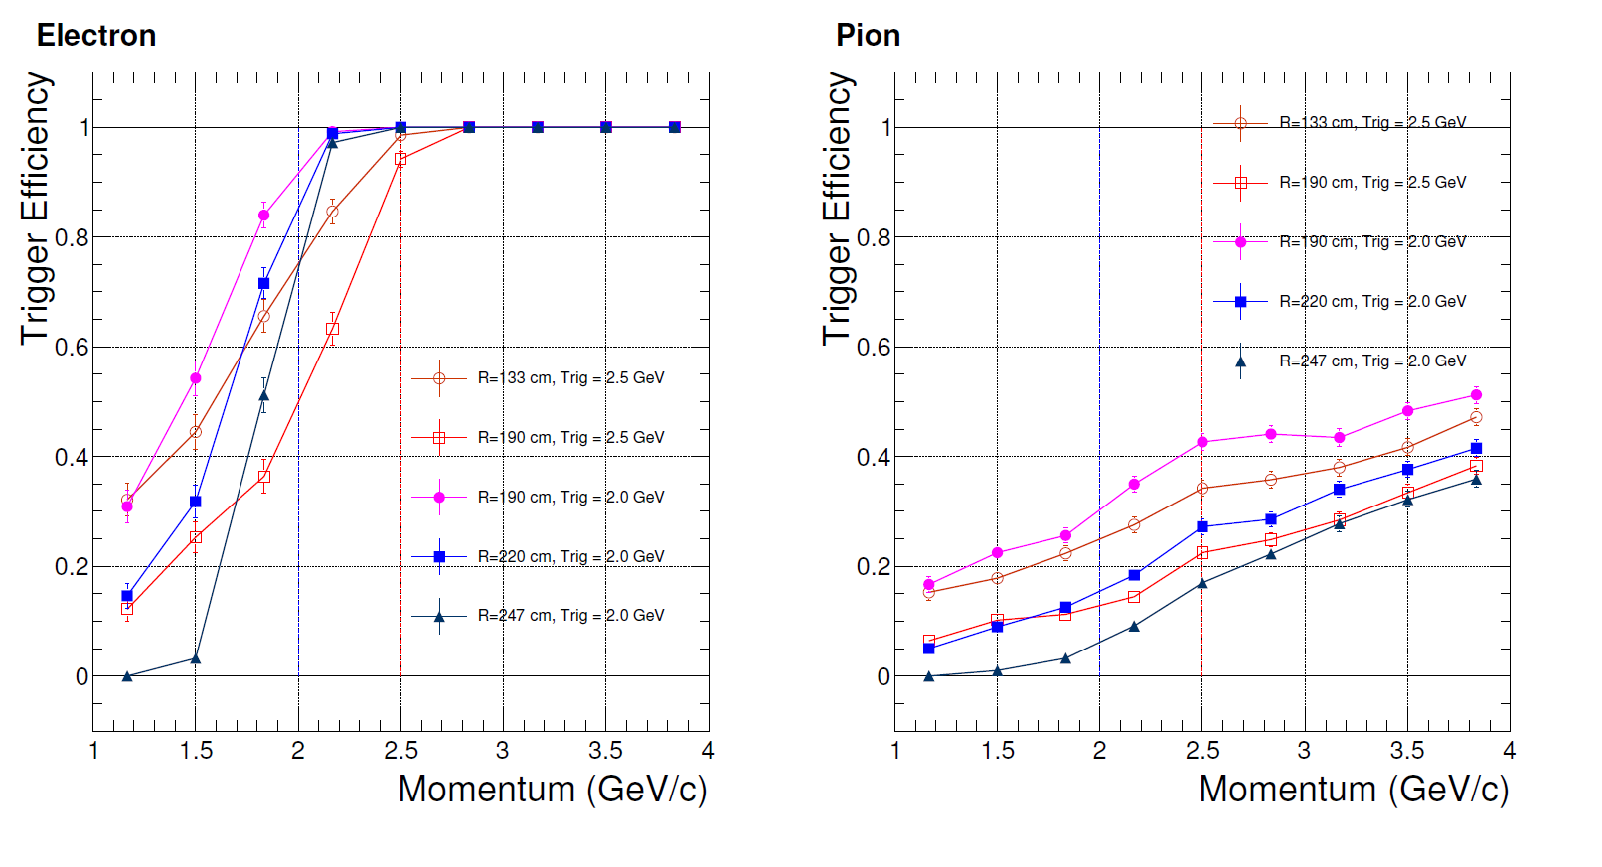
PVDIS EC Trigger Effect

Slide 14
trigger

Slide 15
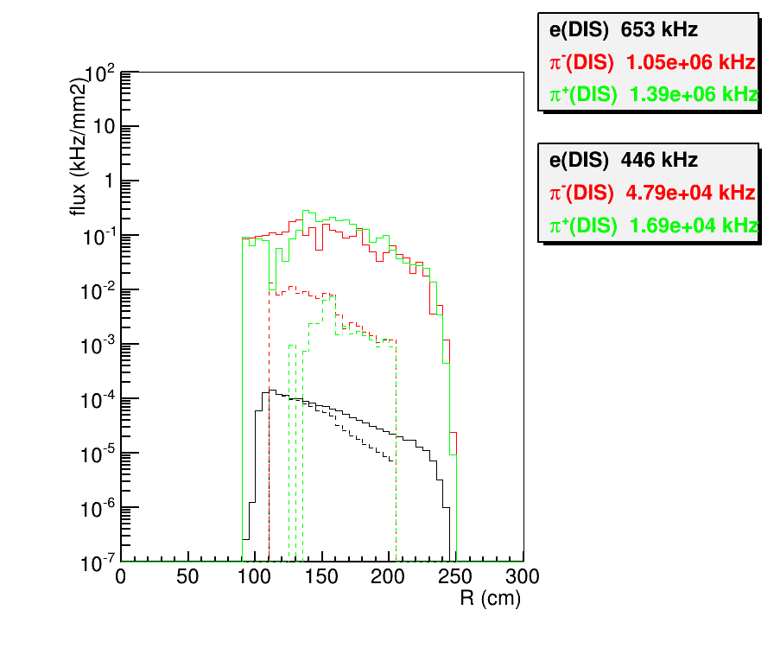

Slide 16
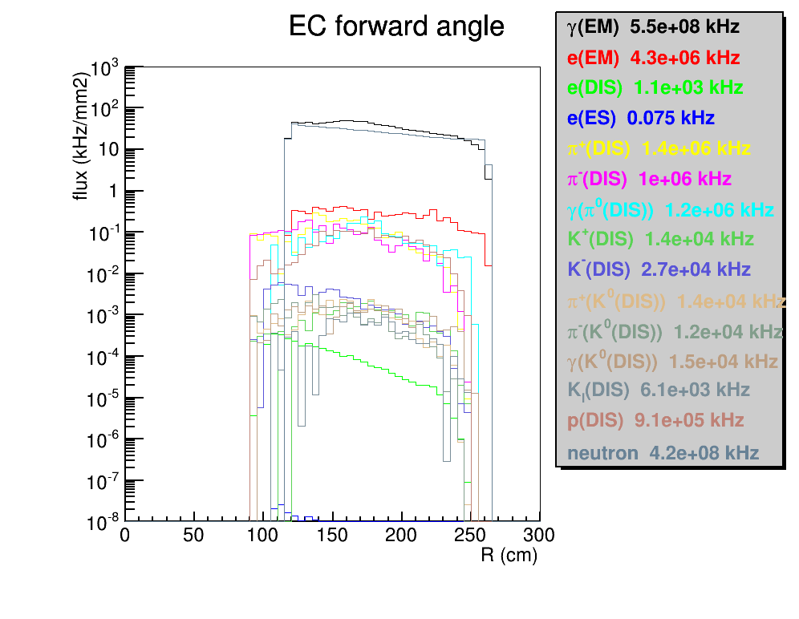

Slide 17
Generator “eicRate”
eDIS rate based on formula from PDG on proton or neutron
eES rate based on formula on proton or neutron
hadron rate based on Wiser fit
pip,pim,Kp,Km,p and p-bar on proton from Wiser fit directly
pi0 rate = (pip+pim)/2 , Ks,Kl rate = (Kp+Km)/2
pip/pim rate on proton = pim/pip rate on neutron, Kp/Km rate on proton = Km/Kp rate on neutron
p rate on proton = p rate on neutron
radlen used in Wiser fit, The crosssection output from Wiser is linearly proportional to radlen. Different code uses different estimation of radlen, here is what “eicRate” uses
Intrad = 2.0*log(e_lab/0.000511)/(137.0*3.14159)
= 0.0464 (for 11 GeV beam)
radlen = 0.5*rad*100.*(4.0/3.0) + intrad*100.0
= 8.22 (for 40cm LD2 target with rad=40/745.4=0.0537)

Slide 18
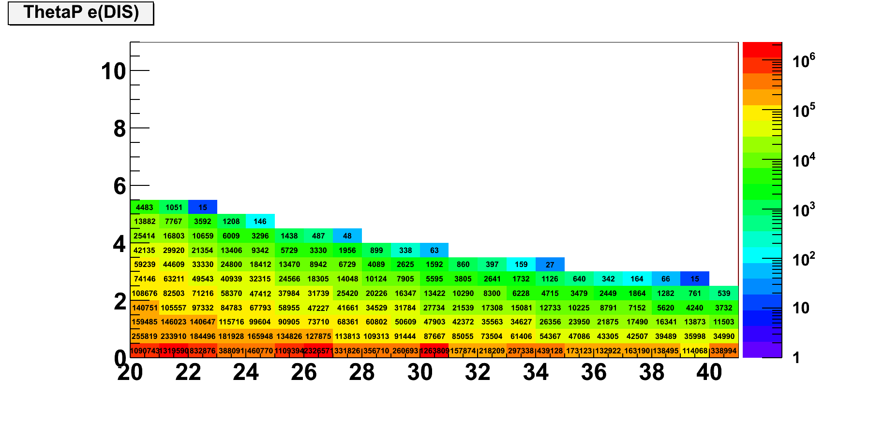
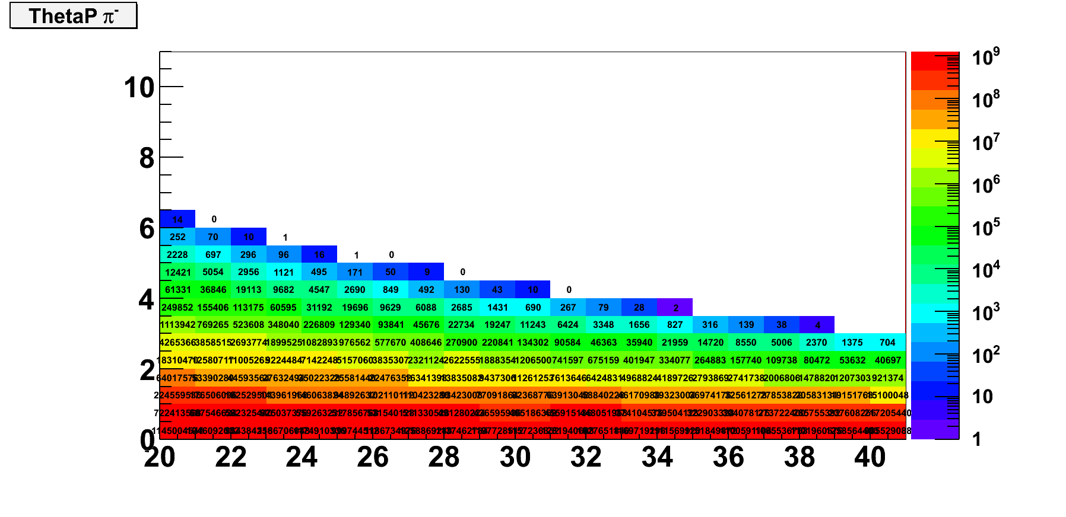

Slide 19
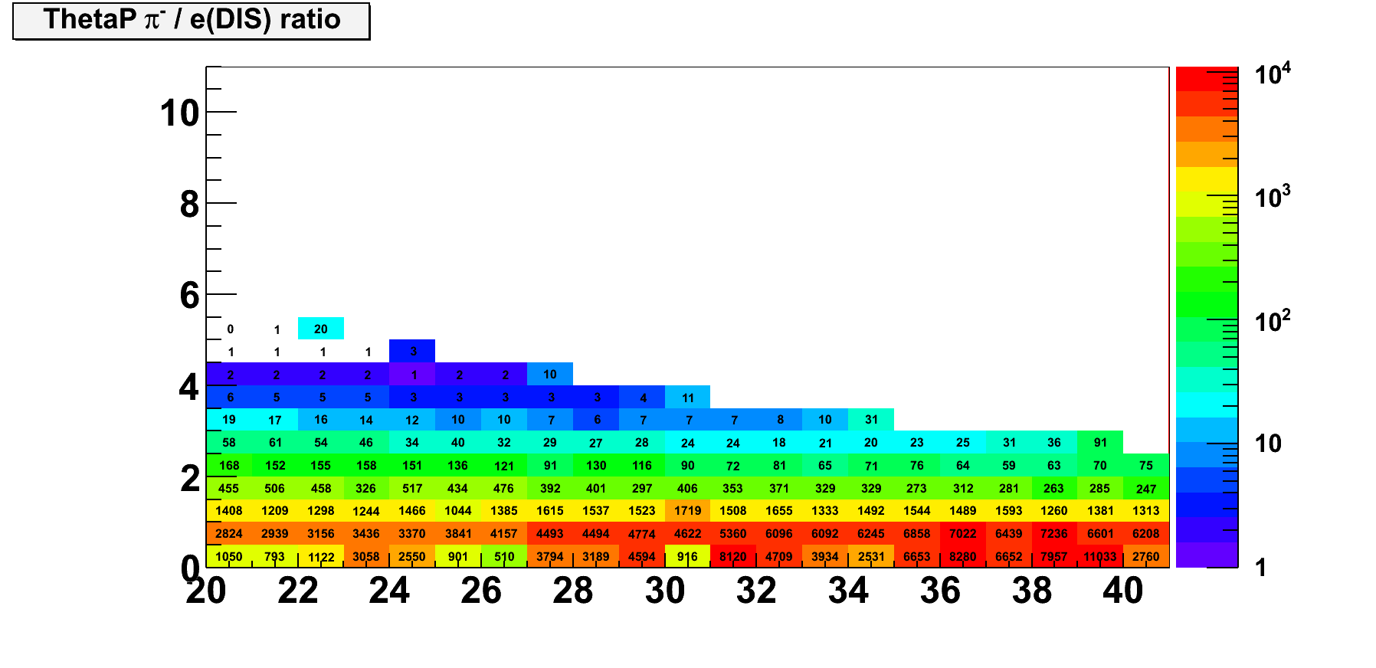
Pim/e ratio
1e2 P>2GeV, 5e2 P>1.5GeV,
1e3 P>1GeV, 5e3 P <1GeV

Slide 20
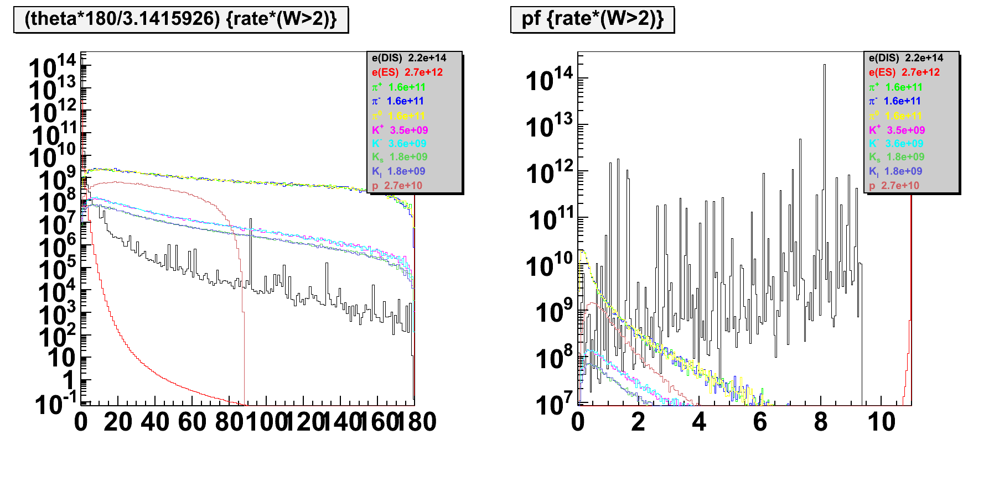
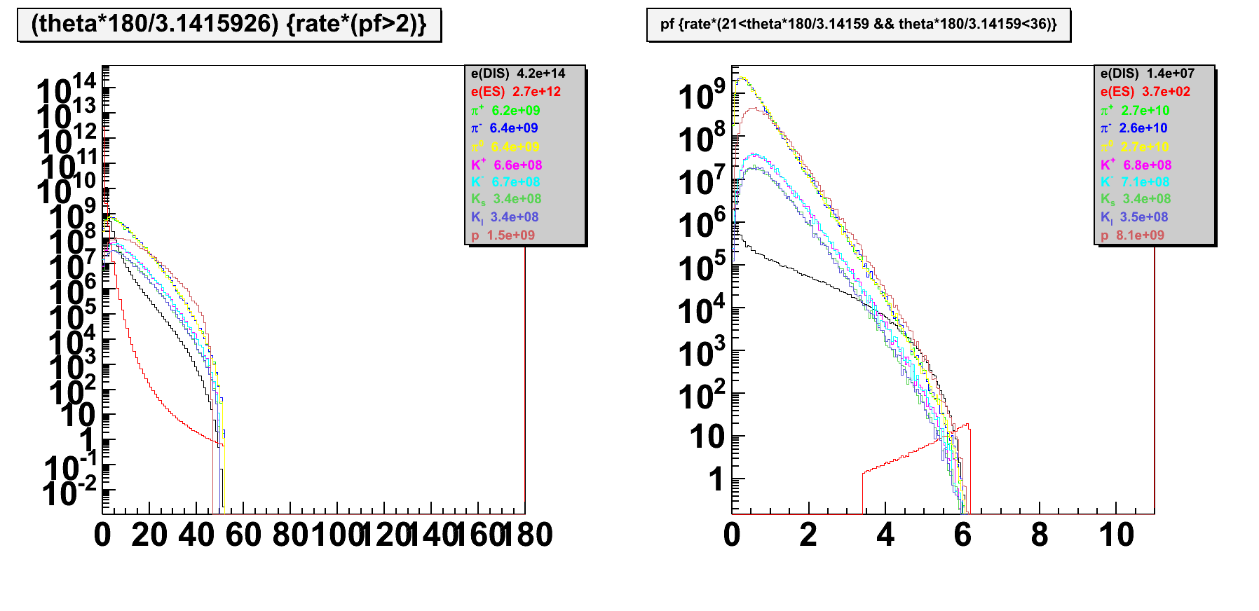
No cut
No cut
Cut P>2GeV
Cut 21<theta<36

