Slide 1
MRPC Simulation at BESIII
Fenfen An
anff@ihep.ac.cn
Institute of High Energy Physics, Beijing
2017.01.18

Slide 2
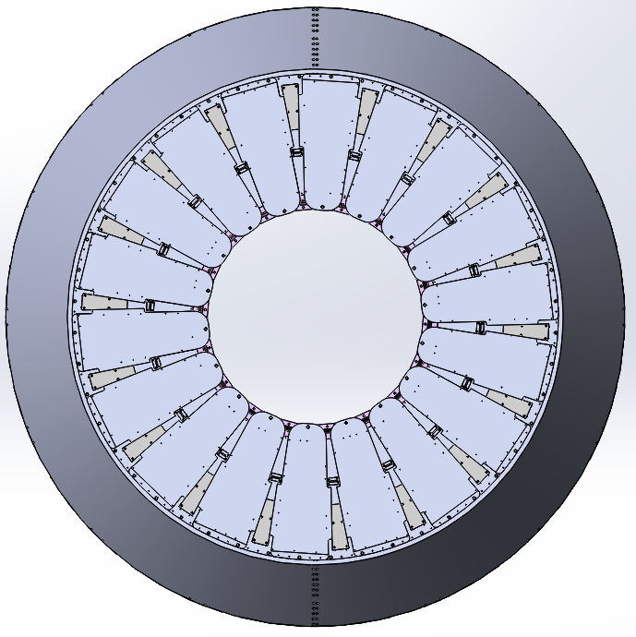
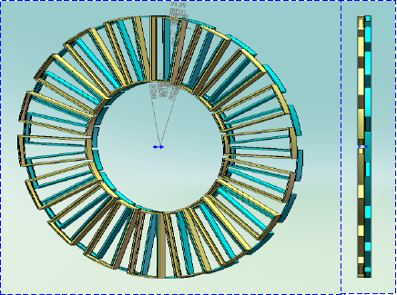
MRPC Detector at BESIII
1728mm
764mm
Module Arrangement in one endcap

Slide 3
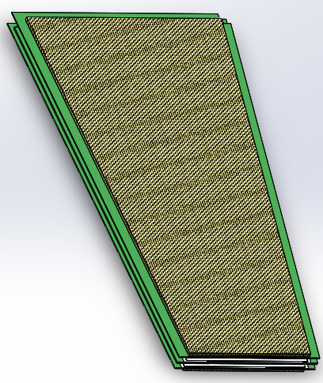
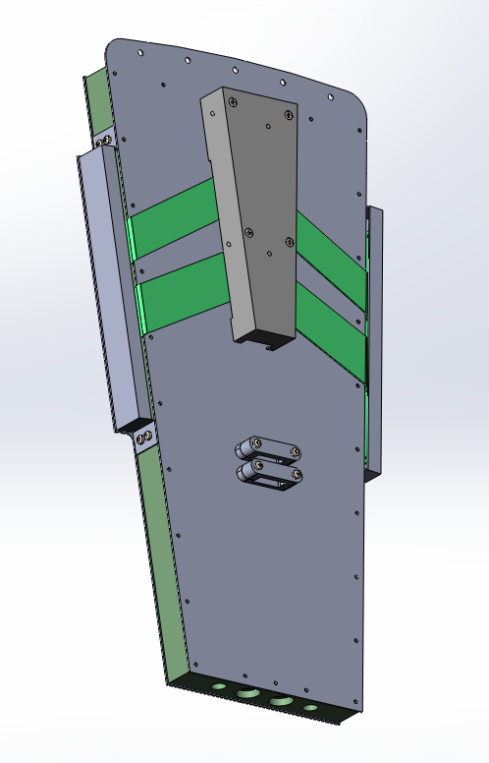
One MRPC Module
Bare Chamber
Frame of the gas container
Upper and lower Covers
Front-end Electronic Boxes

Slide 4
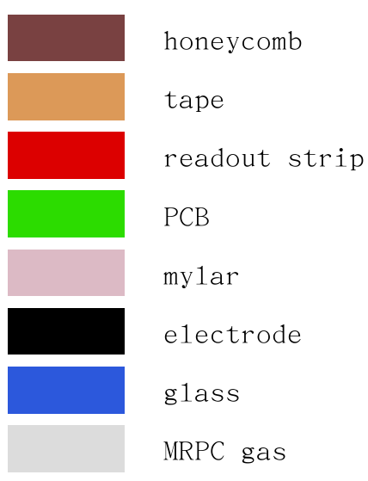
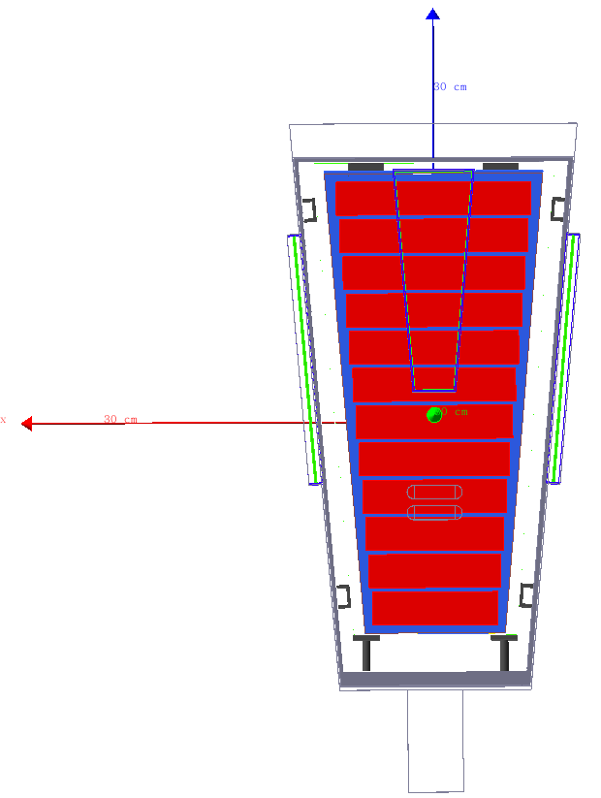
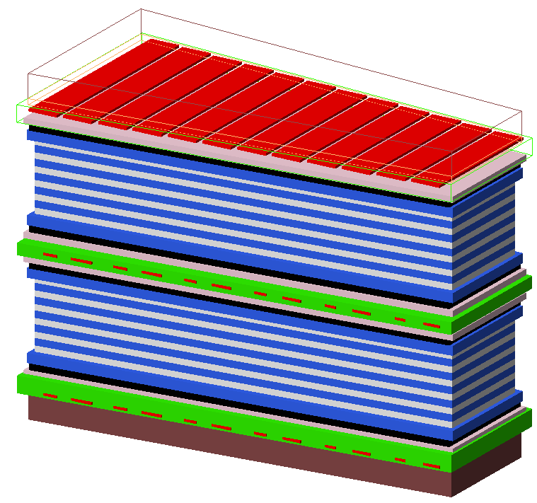
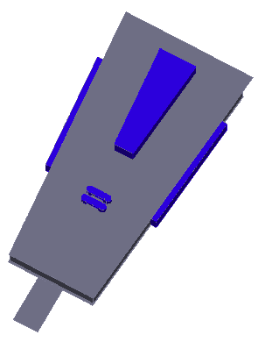
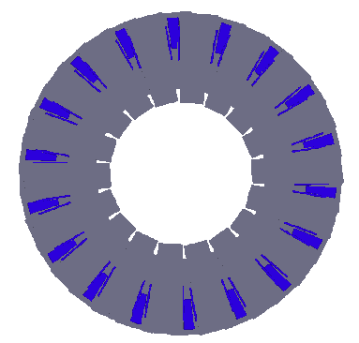
Geant4 Simulation
Placed in Aluminum box of a 25 mm thickness.
Small parts are simulated
Bare chamber built of layers of materials
Detail simulation of the geometry and material may not help for precise simulation of MRPC detection efficiency since it’s light (~2.5kg for one module), but may influence the energy measurement by the calorimeter behind it.
The key point is to set sensitive gas area in the right position.

Slide 5
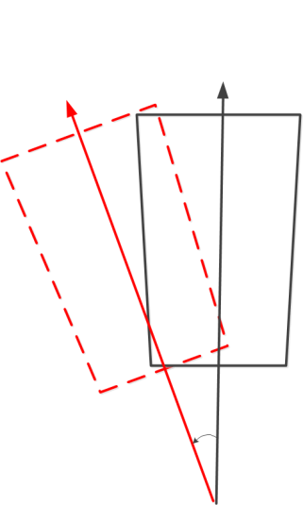
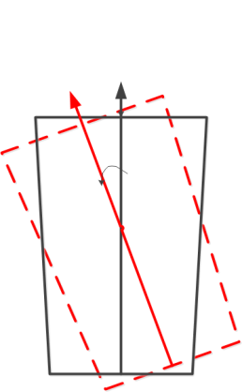
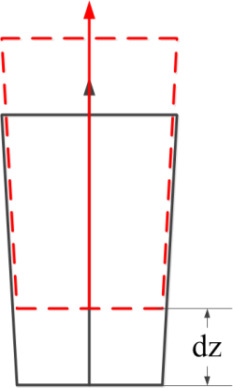
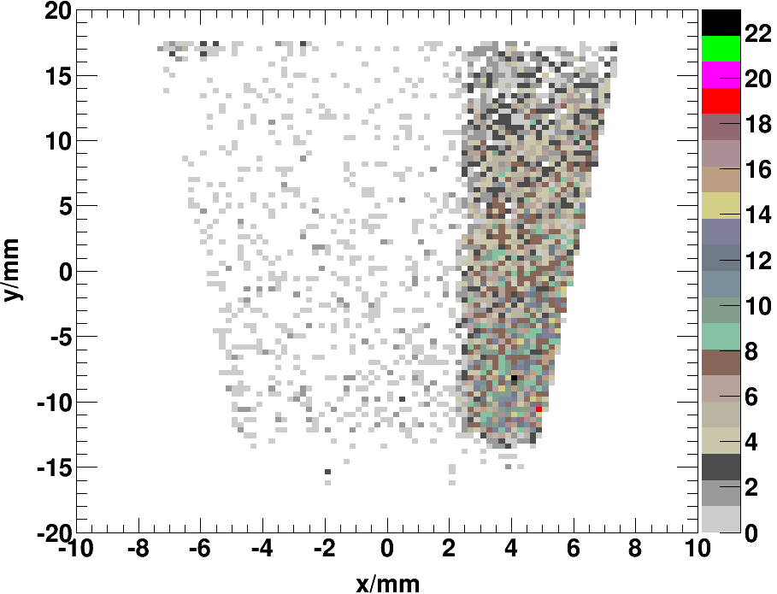
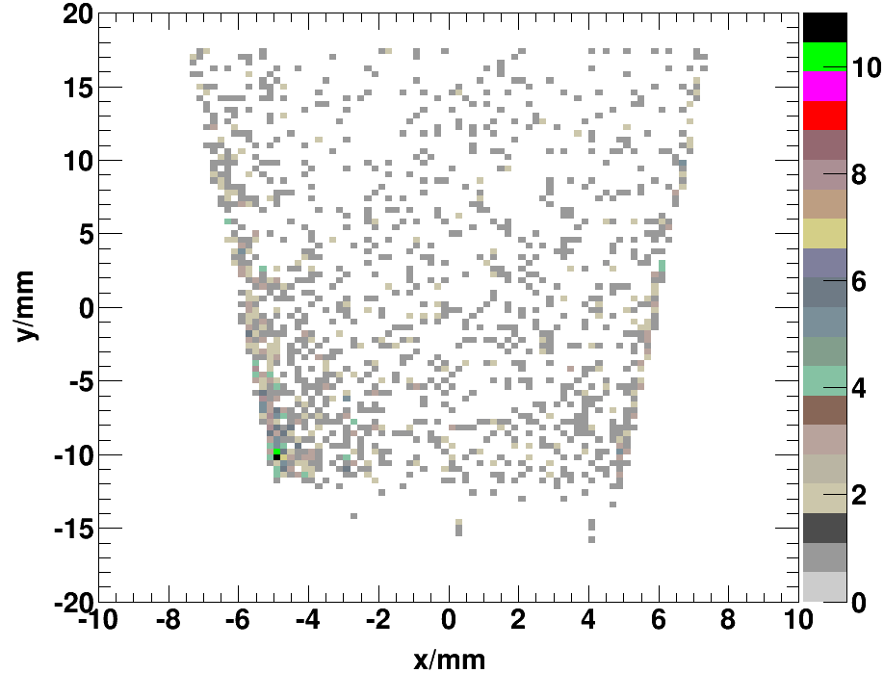
Alignment
Identical arrangement with real detector to provide correct extrapolated position
$→$ Alignment of each module
$${dθ}_{2}$$
$${dθ}_{1}$$
Missing hits of extrapolated tracks (collision data taken by prototype modules)
$$dZ=6mm$$
$$dθ_{1}=3^{o}$$
$$dθ_{2}=2^{o}$$
Before Alignment
After Alignment

Slide 6
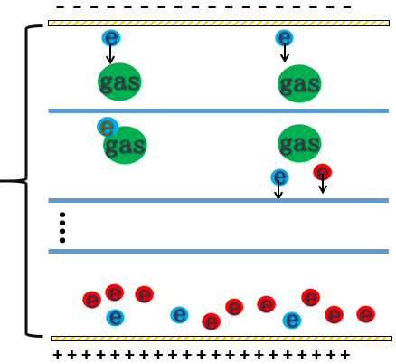
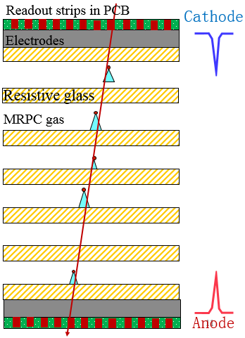
MRPC Working Principle
Digitization to real detector response
$→$ convert deposit energy provided by Geant4 to output signals from electronics
200 steps
MRPC working principle:
Primary ionization in the gas
Electrons get multiplied and move under electric field
Avalanches simultaneously induce current on the readout strips

Slide 7
Primary Ionization
- - - - - - - - - - -
Primary E-Ion pairs $N_{ion}$
0.22mm
$$N_{ion}=\frac{E_{dep}}{E_{ion}}$$
Deposit energy, provided by GEANT4
+ + + + + + + + + + + +
Energy required for one E-Ion
Questions to consider:
1. How many interactions are required in one gas gap? (Geant4 step length=0.03mm, 7 interact.)
2. How much energy is required for one ionization? ($E_{ion}$)
3. Fluctuation of $N_{ion}$ (Gaussion distribution, $σ=\sqrt{N_{ion}∗f}$, $f$=0.2)
The only key question above is Q2: To make it generate ionizations!
Step Length and Fano Factor $f$ will not actually influence the final total number of primary electrons

Slide 8
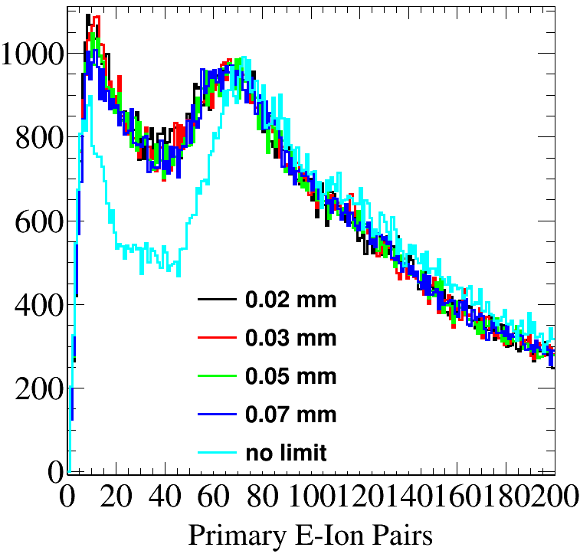
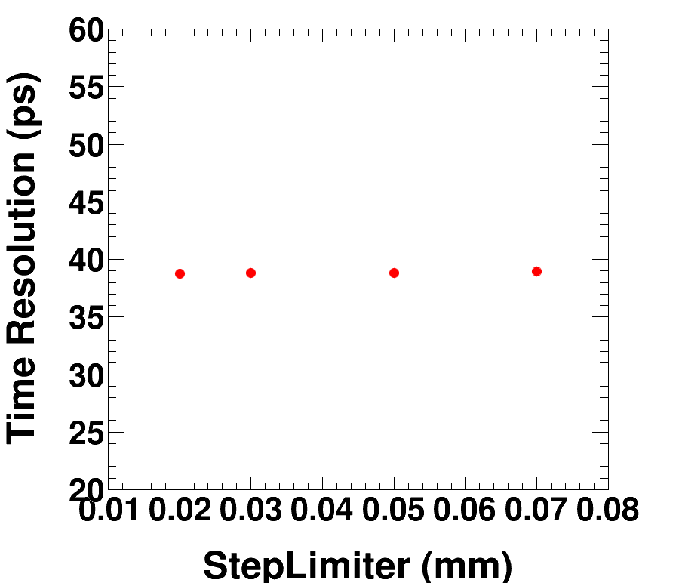
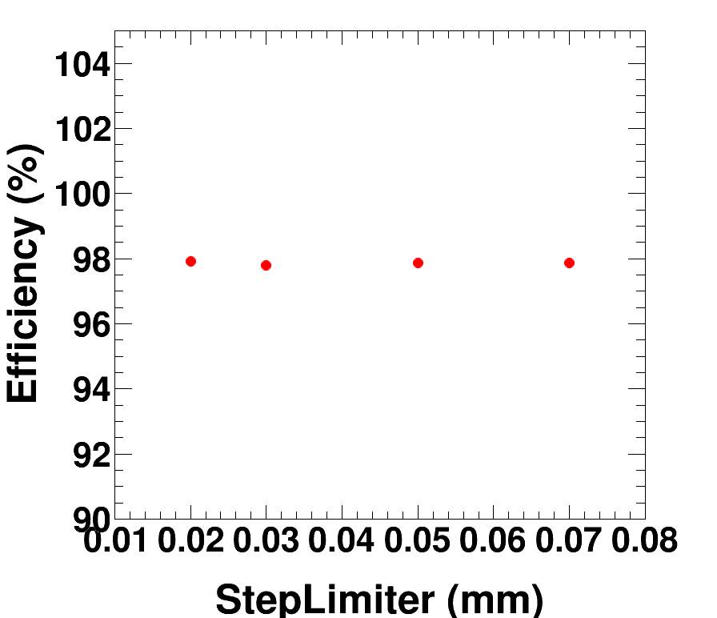
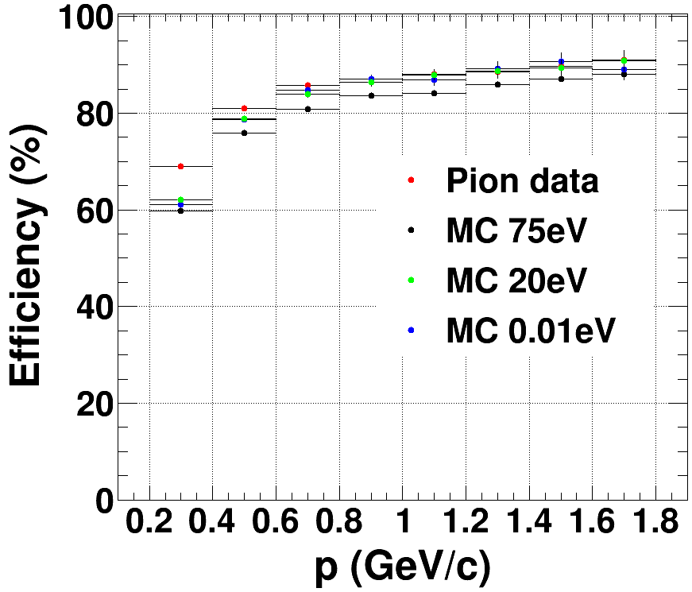
Primary Ionization
Step Limiter changes don’t influence the total number of primary electrons, and thus not time resolution and efficiency
$E_{ion}$ should have been determined based on references. In BESIII case, we tune it lower than theoretical value, to make it more sensitive to small signals.
$E_{ion}=20$ eV at BESIII

Slide 9
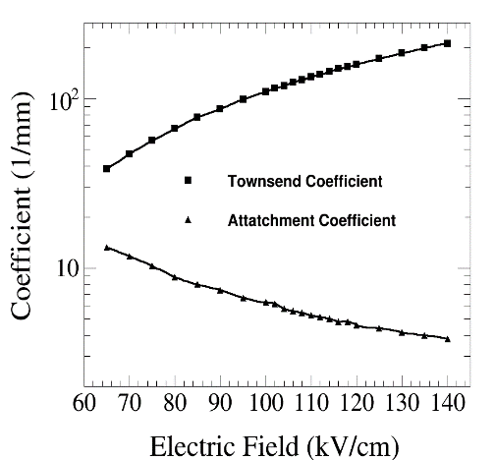
Electron Multiplication
Avalanche process is simulated based on the 1D-model introduced in Ref. [Nucl. Instrum. Meth. A 500 (1-3) (2003) 144]
1. Divide the gas gap into 200 steps, with primary electrons at the positions given by G4.
2. Under electric field E, when one electron moves to the next step, we calculate its probability to get ionized (Townsend coefficient $α$) or get attached (Attachment coefficient $η$).
It stops multiplication if it’s saturated ($N_{ava}$>$1.5×{10}^{7}$)
3. Repeat step 2 until it reaches the edge.
200 steps
Calculated using MAGBOLTZ

Slide 10
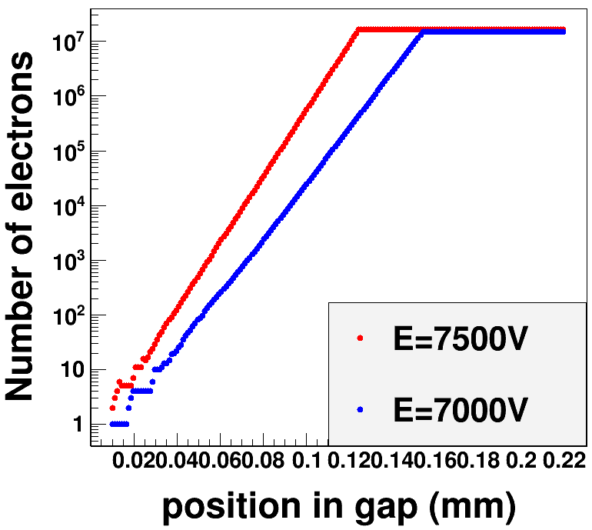
Electron Multiplication
Avalanche evolution along one gas gap, which grows exponentially until the size exceeds 1.5${×10}^{7}$, i.e. 2.4 pC, close to the avalanche-streamer limit [Nucl. Instrum. Meth. A 305 (1991) 91]
Transverse diffusion is ignored, space charge effect is simplified, because they won’t affect the leading time that determines the detection efficiency
During BESIII physics runs, electric field E has been tuned so that MRPC had reached the detection efficiency plateau, so MC tuning of the 1-d model becomes not so critical for data and MC consistency

Slide 11
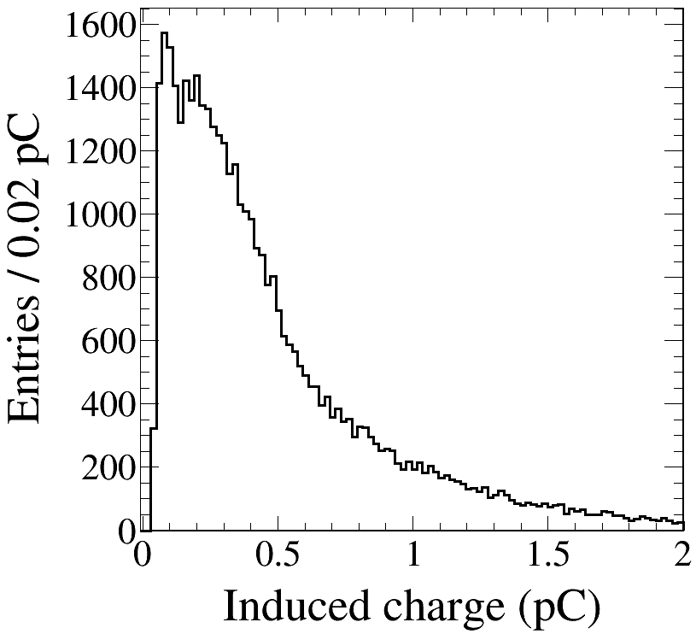
Charge Induction
Signal current induced on the readout pads is calculated using Ramo’s theorem
[S. Ramo, Proceedings of IRE 27 (1939)]
$$i\left(t\right)=E_{weight}v_{drift}Q_{e}N(t)$$
A threshold cut $Q_{thres}$ is applied on the induced signal
The shape is simpler than in real data (no multi-peaks due to reflection), but OK. No influence on detection after T-Q correction
$$Q_{thres}$$

Slide 12
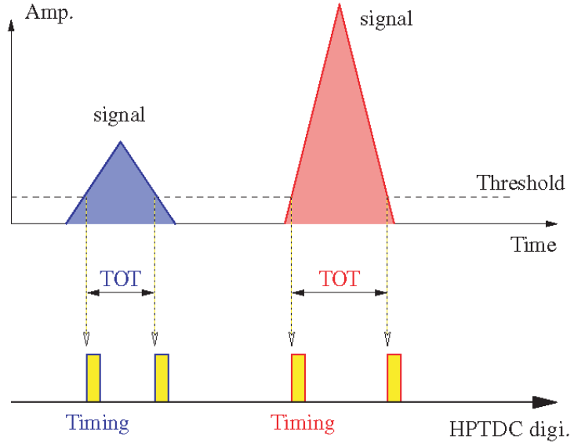
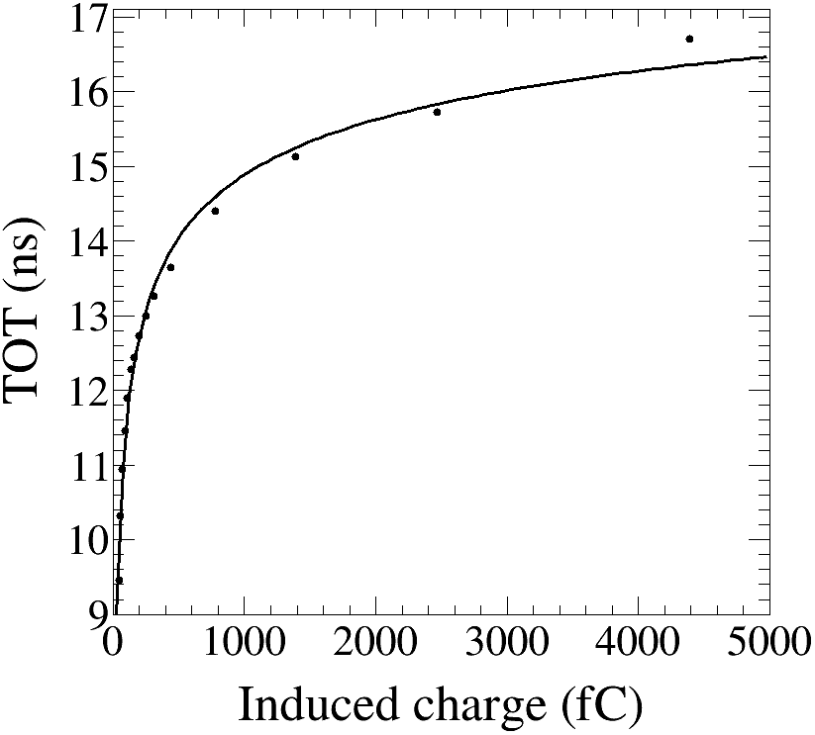
Time Conversion
Definition of TDC and TOT in MC:
TDC consists of $t_{thres}$ (the time when charge crosses $Q_{thres})$ and $t_{prop}$ (propagation time along the strips assuming a velocity of 0.5c)
TOT: ${t_{trailing}−t}_{leading}$, convert to Q based on experimental relationship (right plot)

Slide 13
MC Tuning Parameters
Tuning parameters
$E_{ion}$: energy to produce one E-ion pair
Fano factor: fluctuation of the E-Ion pair production
StepLimiter: Limit the step where incident particles
interact with the sensitive detector area
Electric field E: determine the avalanche evolution
Saturation effect
$Q_{thres}$: threshold charge defines TDC
$σ_{const}$: fluctuation of TDC and TOT
TDC Jitter function
Charge-to-TOT conversion function
Dead channels
Decided values
20 eV
0.2
0.03 mm
7000 V
$$1.5×{10}^{7}$$
45 fC
38 ps (TDC), 27 ps (ADC)
Taken from exp.
Taken from exp.

Slide 14
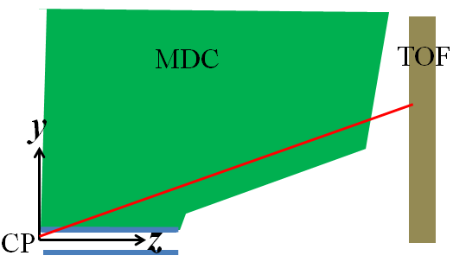
Calibration & Reconstruction in MC
Time difference: $Δt=t_{meas}−t_{exp}$
Measured time of flight
$t_{meas}=TDC−t_{est}−t_{cor}\left(Q,z\right)$
Expected time of flight: $t_{exp}=L/β$
The correction formula in MC:
For single end time:
For combined time:
$$t_{cor}^{single} =p_{0}+\frac{p_{1}}{\sqrt{Q}}+p_{2}.z$$
$$t_{cor}^{combine} =p_{0}+\frac{p_{1}}{\sqrt{Q}}$$

Slide 15
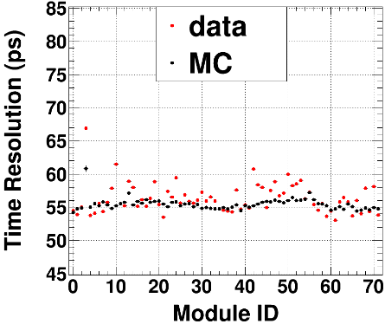
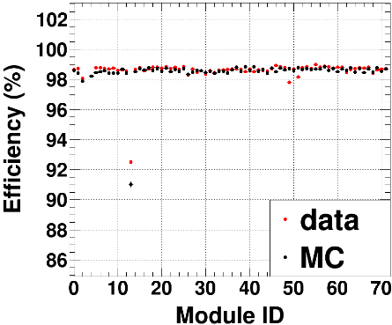
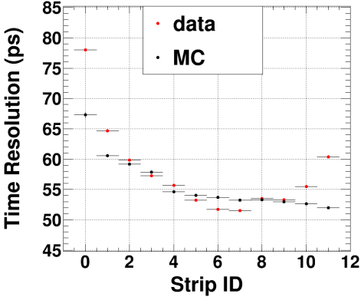
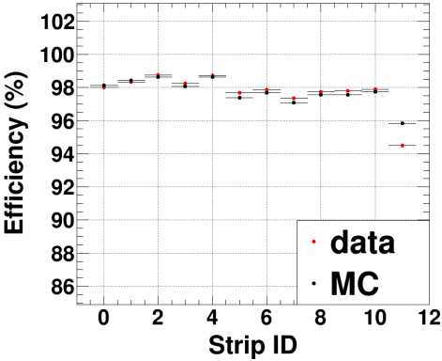
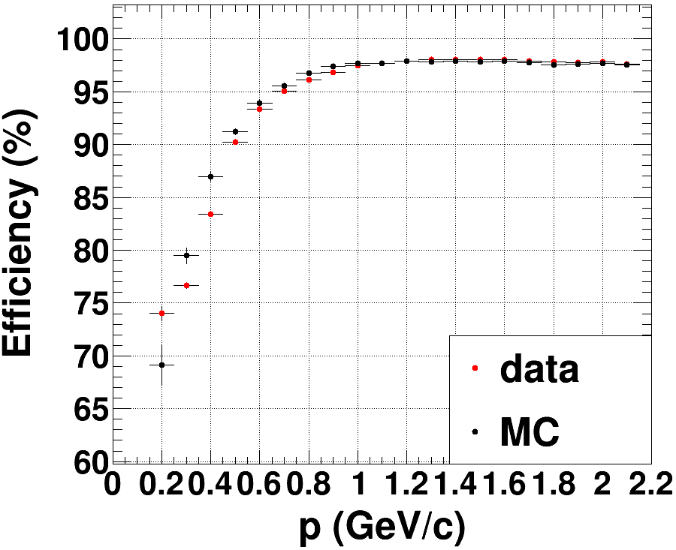
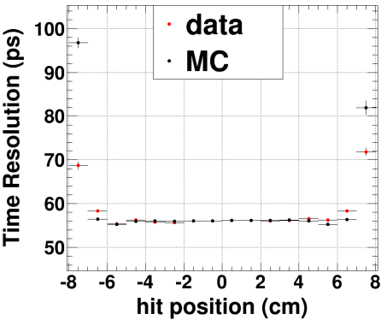
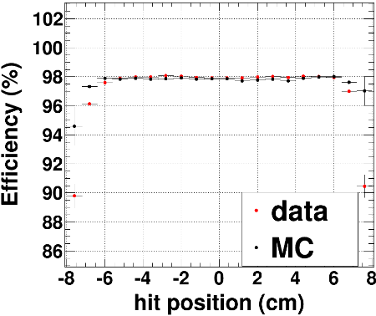
Data & MC Comparison (Electron)
Electrons are a good benchmark for MC tuning, and for checking reconstruction & calibration algorithm
$$ε_{dec}=\frac{N_{\left|Δt\right|<1ns}}{N_{MDC ext}}$$
In radiative Bhabha events, consistent within1% for $p>$0.5 GeV/c
Good consistency achieved in Bhabha events

Slide 16
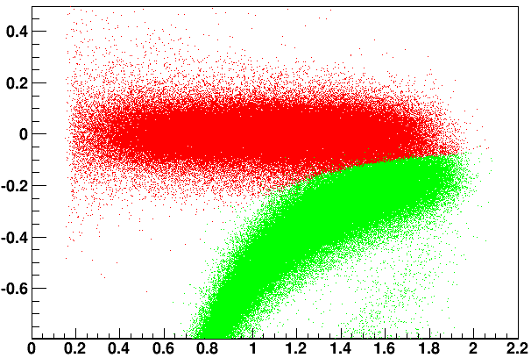
Data & MC Comparison (Hadron)
The main task of MRPC is $K/π$ separation
$$Δt(ns)\sim p(GeV/c)$$
$$ε_{pid(K/π)}=\frac{N_{Prob\left(K/π\right)>Prob(π/K) }}{N_{MDC trk}}$$
$π$
$$K$$
For MC, the ultimate goal is to achieve 1% consistency of PID efficiency with data
Control samples: $e^{+}e^{−}→$KK$ππ,$KK$πππ^{0},ππππ, πππππ^{0},ππππππ, KKππππ,$KKKK
We purify the control samples so that background is less than 1%.

Slide 17
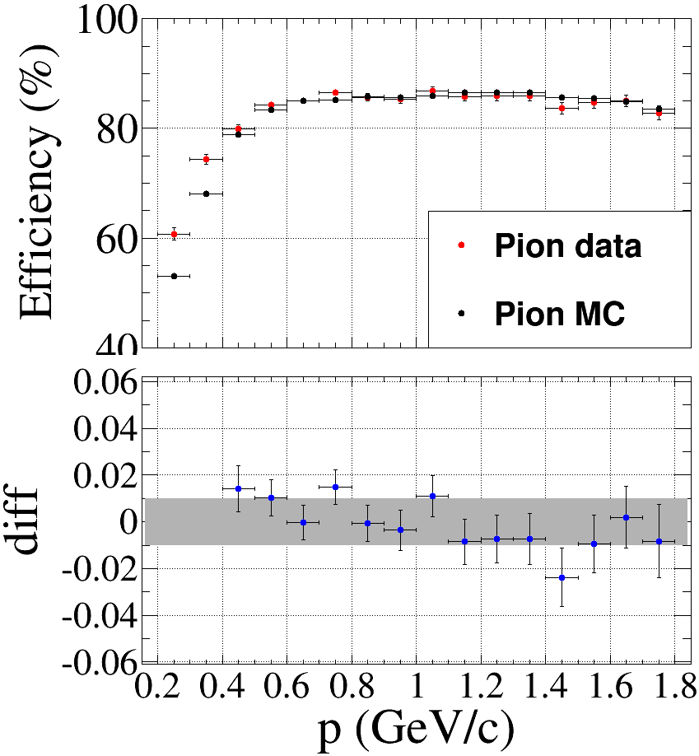
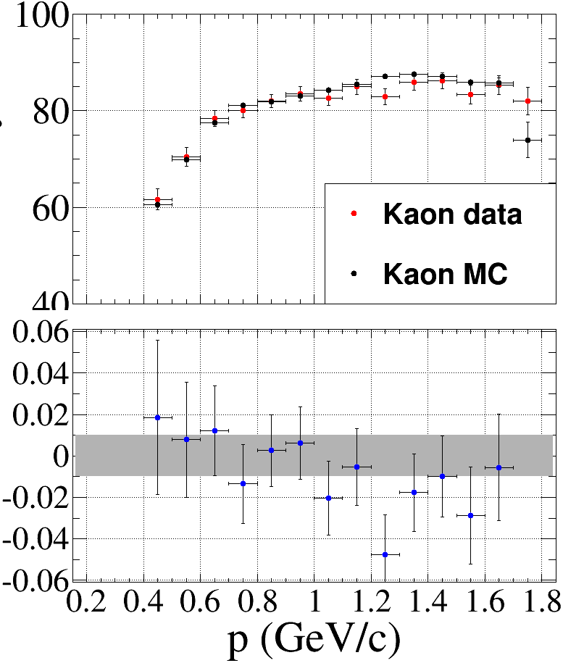
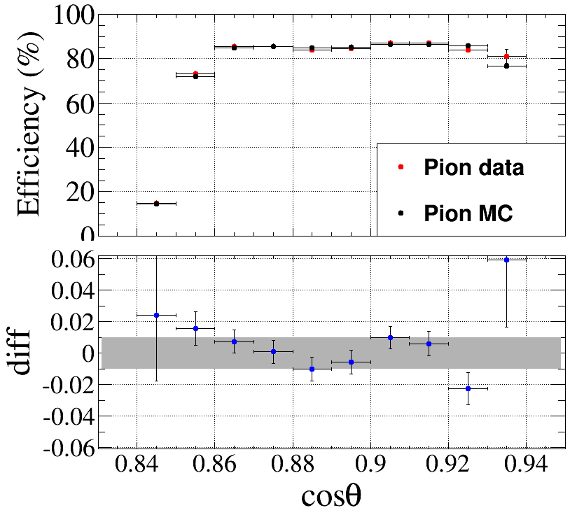
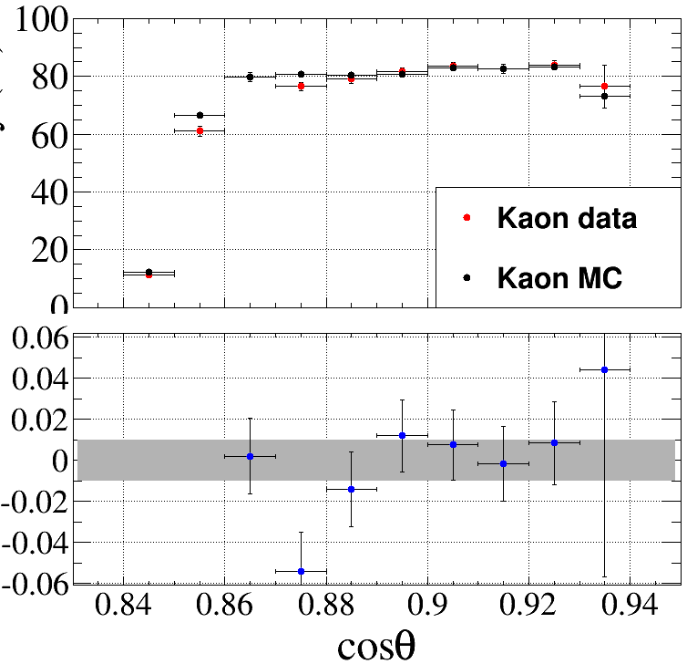
Data & MC Comparison (Hadron)
Generally PID consistency is expected within $p\sim cosθ$ 2-demensional space
$θ$ demotes the polar angle relative to the beam
Generally 1% consistent

Slide 18
Conclusion
At BESIII, the MRPC detector has very high efficiency (99% in beam test) and good resolution (~60 ps), which reduces the requirements of simulation of the signal shape (the avalanche model, saturation effect, ignorance of the reflection in strips …)
In simulation, tuning the parameters to the highest sensitivity would make good consistency of PID efficiency between data and MC
Thank You

Slide 19
Backup

Slide 20
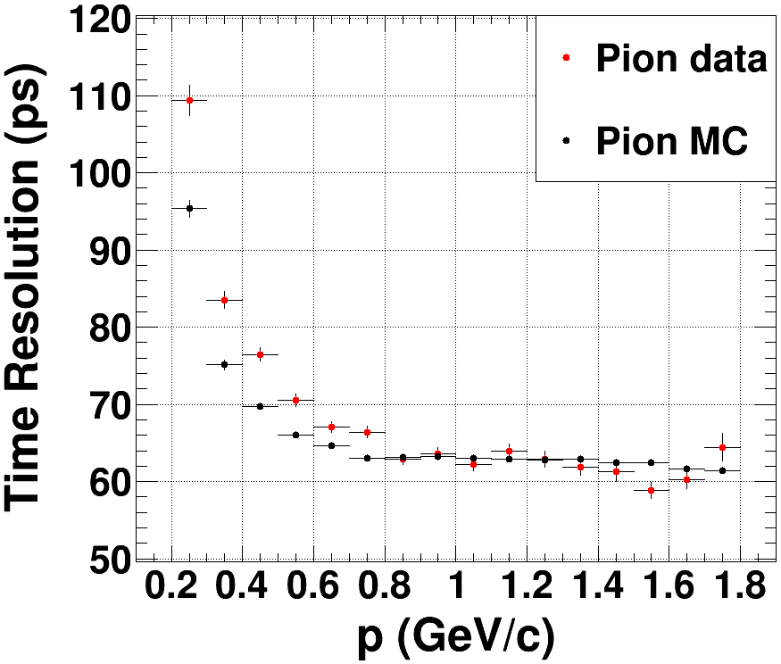
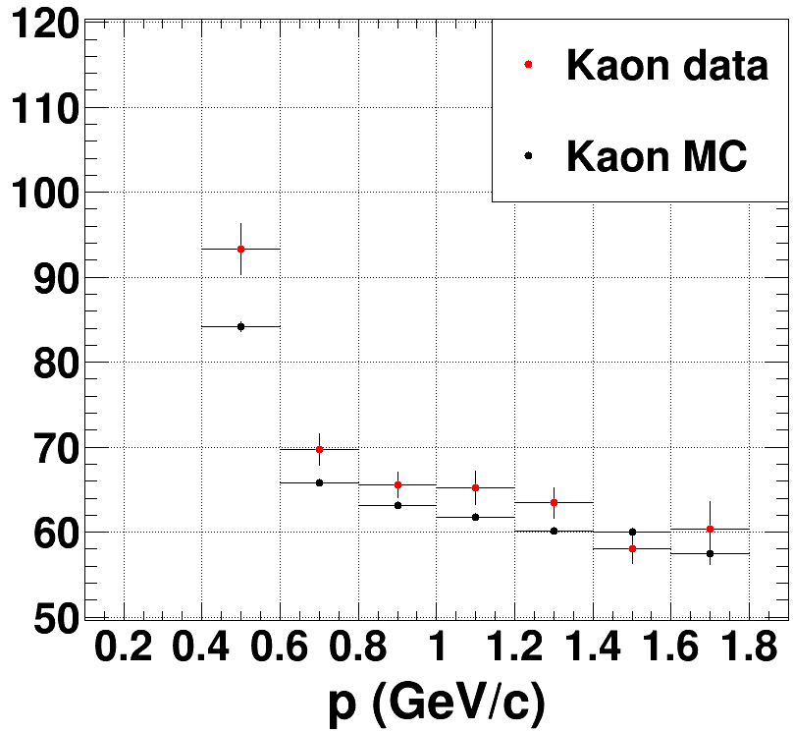
Data & MC Comparison (Hadron)
MC resolution is smeared to be consistent with data
Resolution consistency is not so crucial due to the excellent resolution and the separation ability (next page)

Slide 21
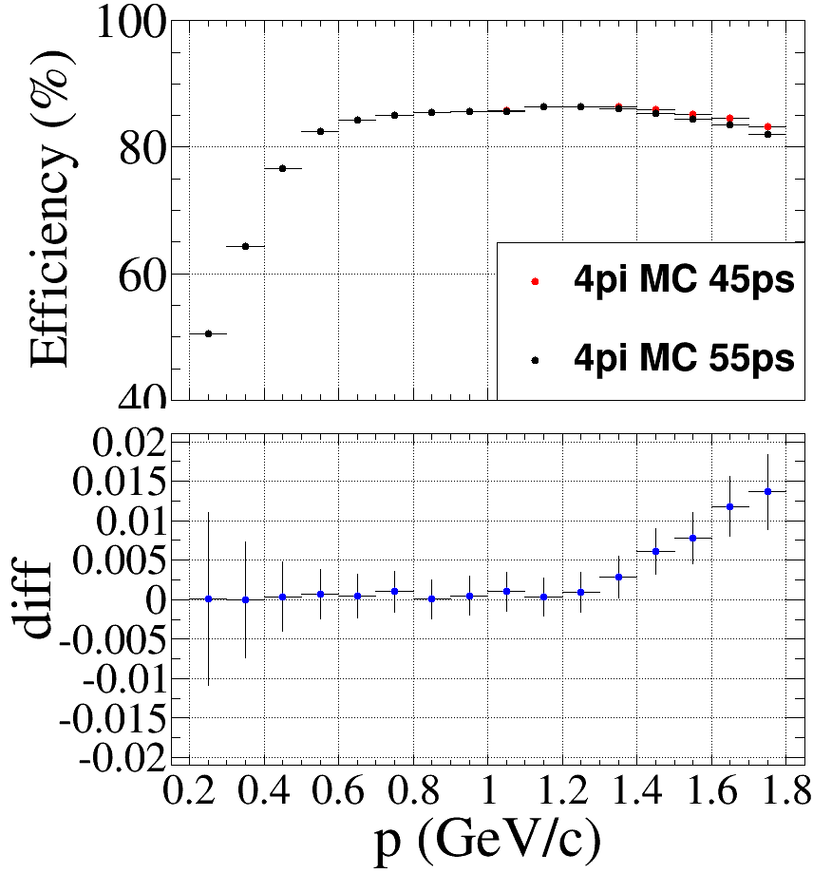
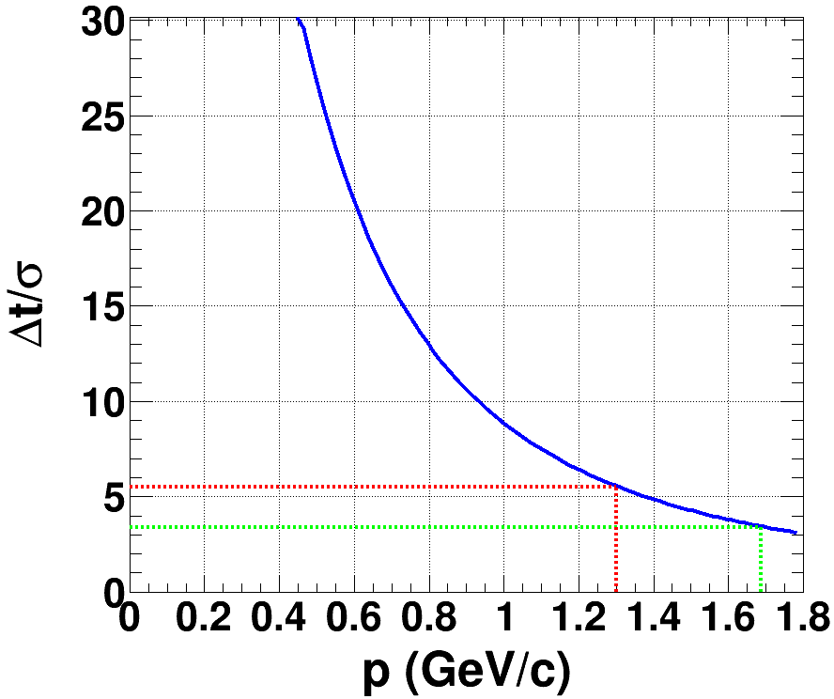
MRPC Misidentification
$$2σ$$
3$σ$
2$σ$ separation ($ε_{misPID}=0.3\%$) corresponds to 1.3 GeV/c momentum
3$σ$ separation ($ε_{misPID}=4.5\%$) corresponds to 1.68 GeV/c momentum
10ps more smearing of resolution would not actually influence up to 1.3 GeV/c

