Slide 1
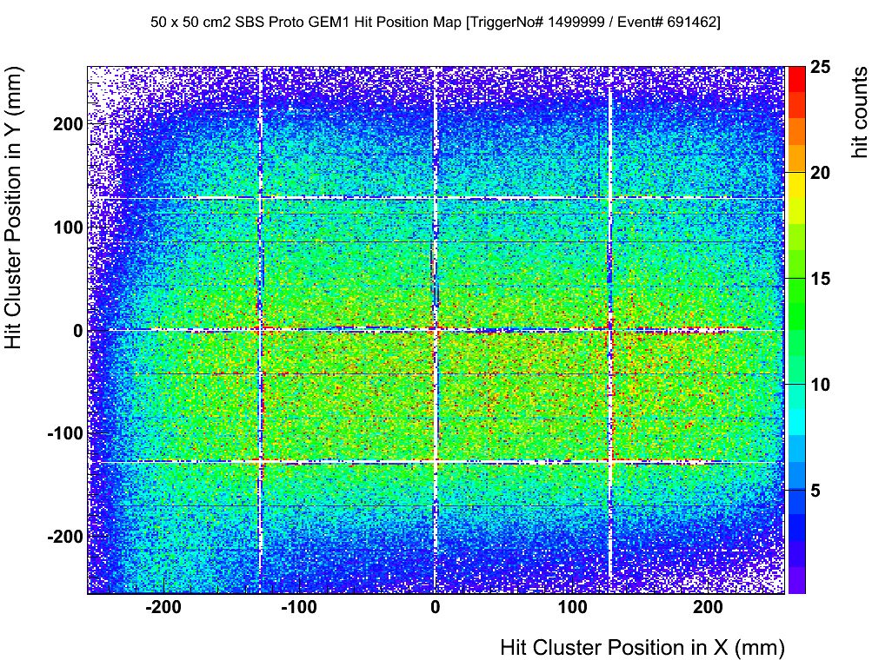
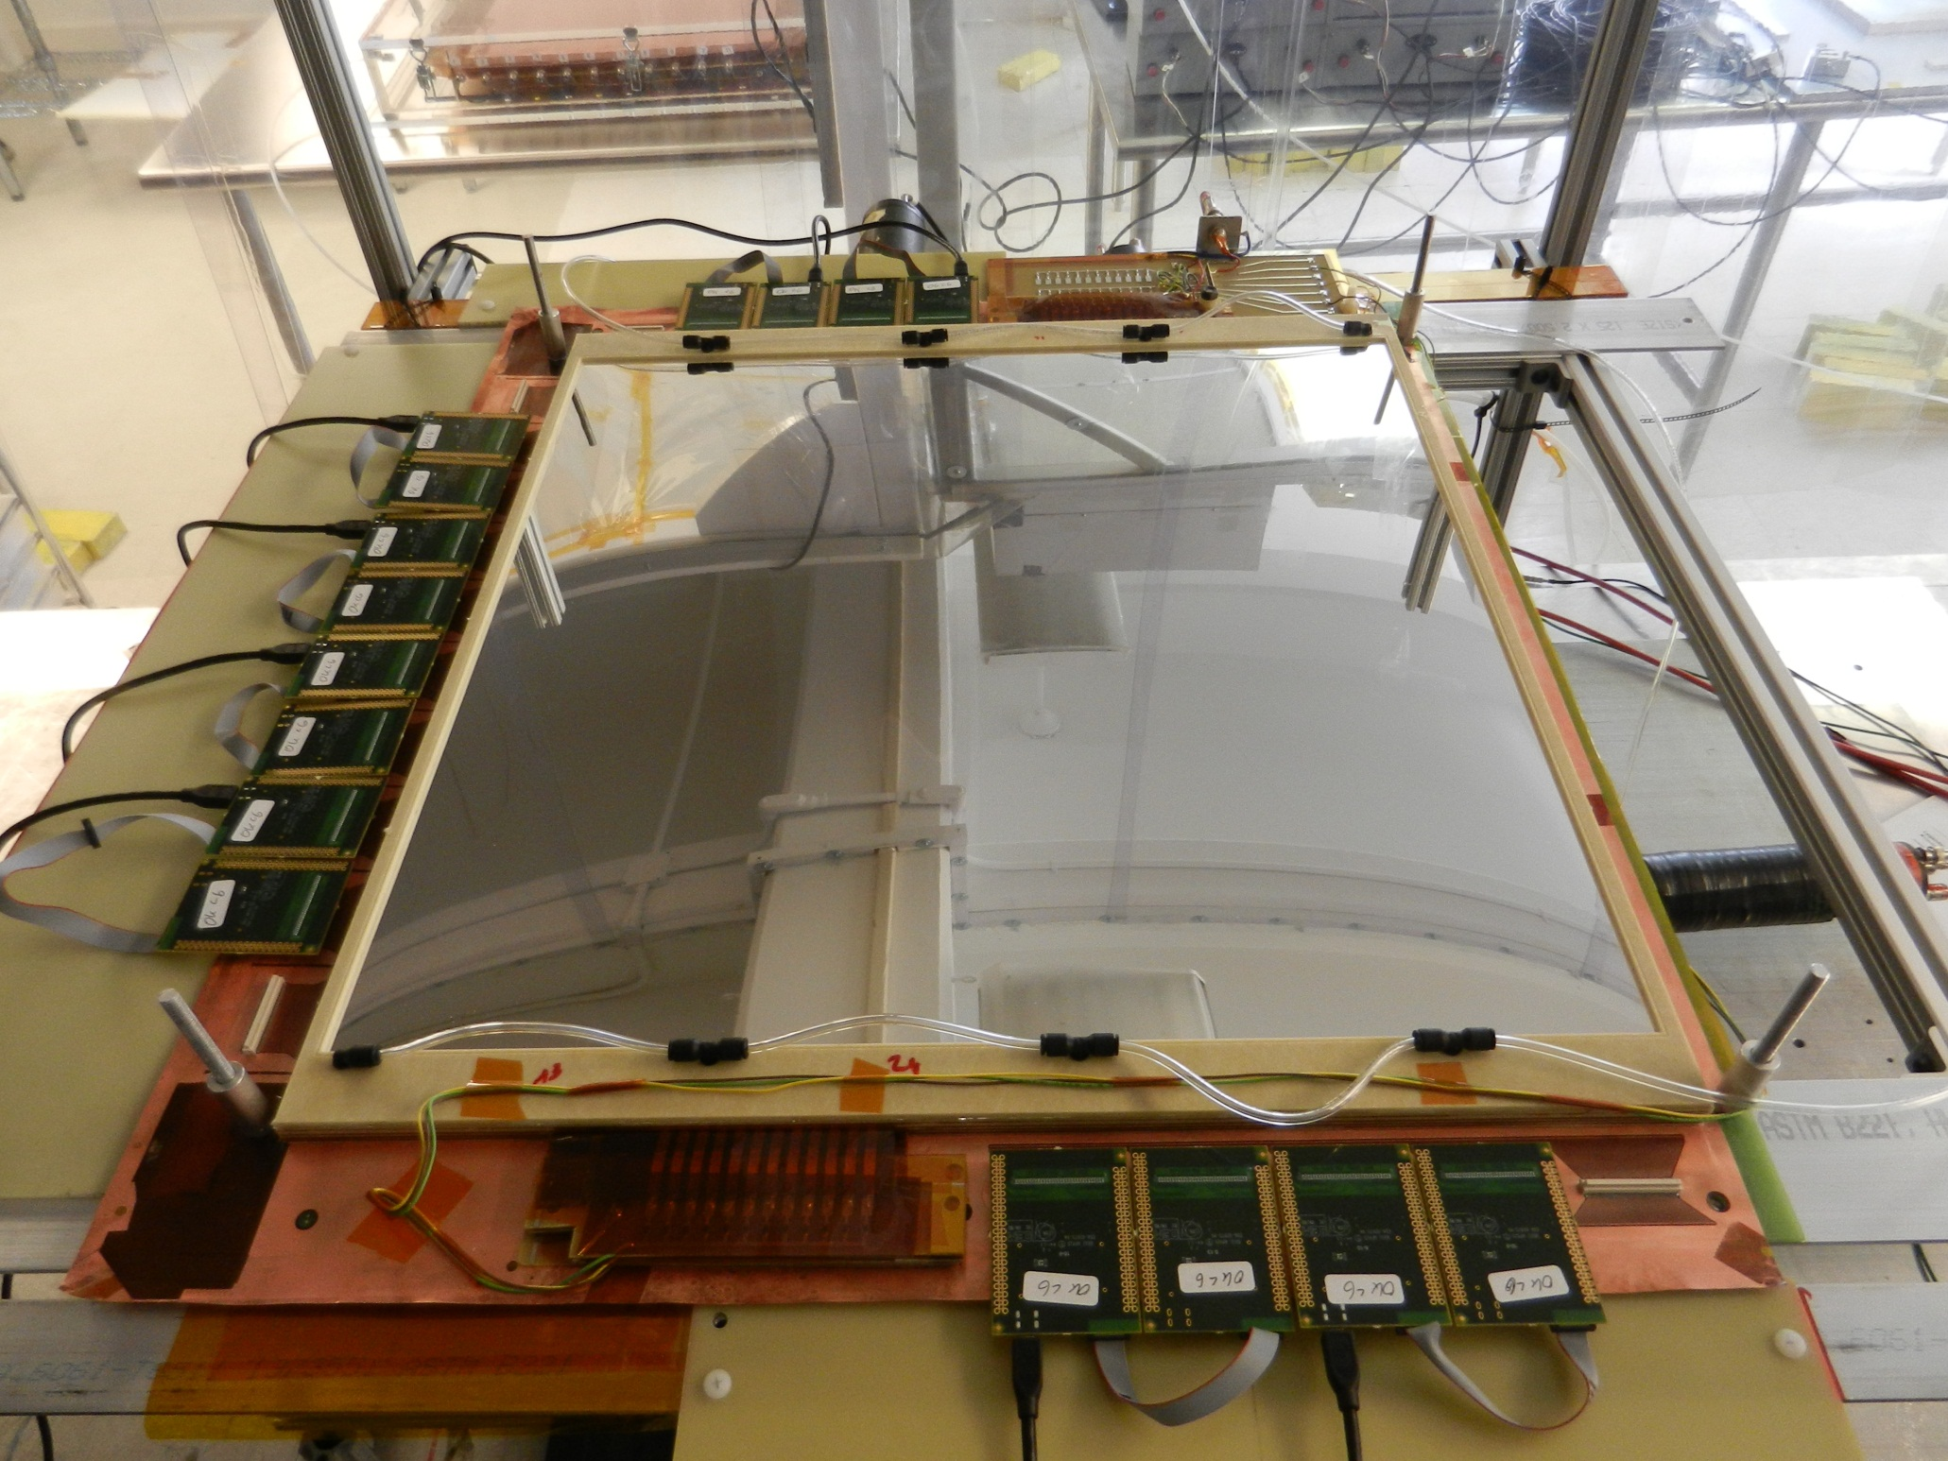
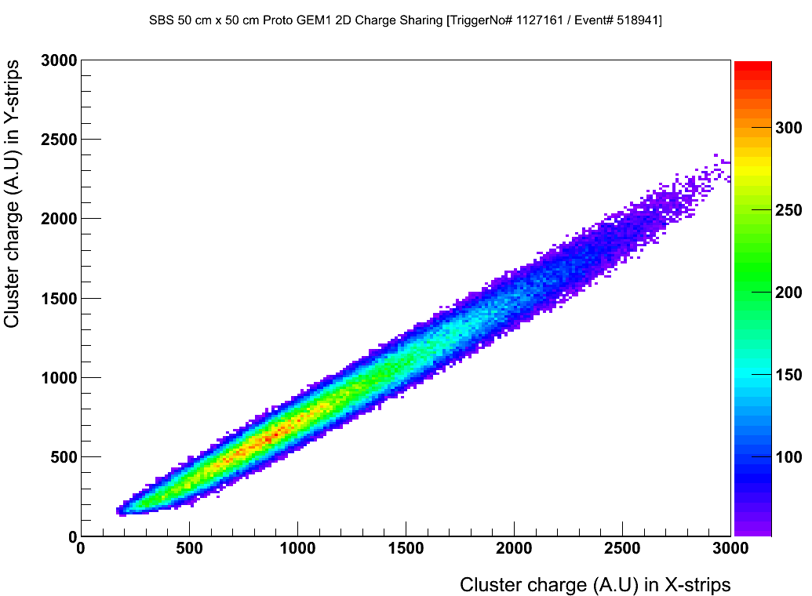
SBS GEM module full-size prototype
Fully equipped with readout electronics (APV25)
Hit distribution
X and Y hit amplitude correlation
97% detection efficiency
Prototype meets SBS design requirements
Starting production of 40 modules in September

Slide 2
SBS GEM pre R&D at UVa
Duration : August 2011 - August 2013
Funding received: Total: $ 270 k (3 contracts - $ 45 k, $ 98 k and $ 127 k.)
Other funding for UVa GEM R&D: UVa internal funds - $ 60 k, EIC detector R&D - $ 150 k and all team members except Dr. Nelyubin paid by Liyanage DOE grant)
UVa GEM team: Liyanage (PI), Nelyubin and Gnanvo (Research scientists), Saenboonruang , Gu, Bai, and Sacher (students)
SBS GEM prototypes produced:
2011-2012- two SBS prototype modules
prototype # 1: operational, with 4 out of 20 sectors disabled.
prototype # 2: operational, with 1 out of 20 sectors disabled.
conclusion: basic design works, but needs many design improvements to facilitate fabrication and operation.
2012 – An improved new design prepared addressing the noted issues.
2012-2013 – two SBS prototype modules
fabrication considerably improved with the new design.
All sectors operational with all characterization results meeting SBS design criteria.
SBS GEM module design and fabrication methods established.
2013 – Two GEM modules currently under fabrication based on the established design and procedure: several minor improvements will be tested using these two final pre R&D modules.
Two APV25 based readout systems capable of reading 10,000 channels was setup and characterized.
Conclusion: the SBS GEM module design and fabrication procedure established with Full size prototypes meeting design goals

Slide 3
SBS production plan
It is divided to WBS 2 and WBS3. However: the actual schedule is mostly driven by foil availability, man power consideration etc.
Per PMP we need to get GEM components for both WBS 2 and 3 in next two years.
So, I would like to go by the number of modules.
Fabricate 40 modules + 8 spares in three years: ( as PMP plan for all polarimeter trackers. )
Need to order components (GEM foils, readout planes and frames) for 48 chambers now.
GEM foils and readout planes are the most urgent
Setup a manpower + other expenses contract by this Fall.
CERN has agreed to deliver the foils over one year.
UVa will assemble ~ 16 modules per year for the next 3 years.
Plan to have 48 modules assembled, instrumented and tested by the end of 2016. At least 40 modules should meet the spec.

Slide 4
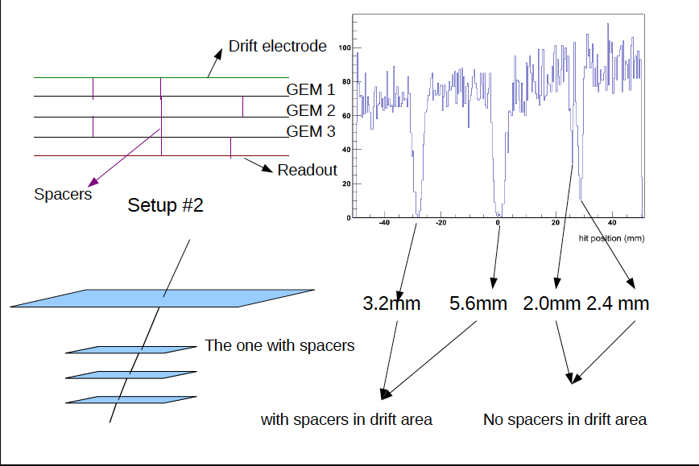
Study of Spacers in GEM module

Slide 5
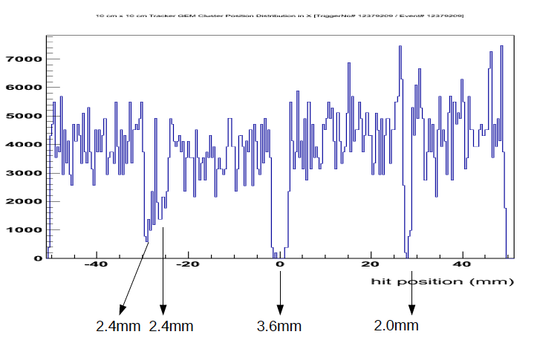
Study of Spacers in GEM module
Conclusions:
Each GEM/readout spacer (2 mm tall), seems to contribute ~ 2.4 mm.
Drift spacer (3 mm tall) contributes ~ 3.5 mm.
Add Roughly quadratically.
Little or no dependence on track angle.
Might depend on the particle rate: check at Fermilab

Slide 6
Proposed Large Area GEM chamber
Rui de Oliveira’s group at CERN has offered to collaborate with us to build a 50 cm x 200 cm GEM chamber.
Jefferson lab-UVa collaboration has the expertise, infra-structure and capability to build such a GEM chamber
Would be a breakthrough in large area tracking technology.
Size ideally matched for Jlab large detectors: Huge boost to future experiments.
Cover large areas with no dead zones.
Link to industrial applications beyond nuclear physics: National security, Radiation detection, Medical Physics …..

Slide 7
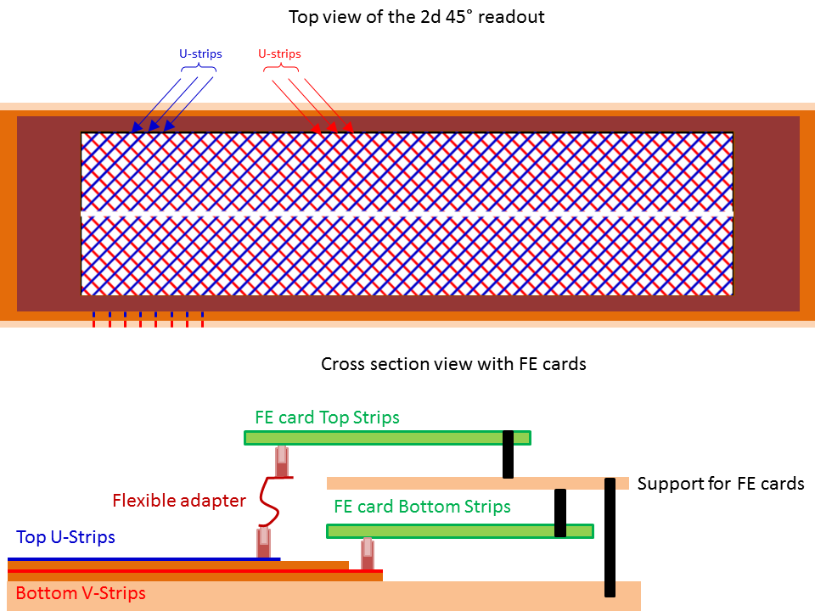
Proposed Large Area GEM chamber
200 cm x 50 cm active area.
Base frame with wide sides
U-V readout from both sides
400 micron strip pitch.
longest strip is ~ 35 cm
Readout cards in two layers.
Readout: 18 k of APV-25 based SRS electronic channels

Slide 8
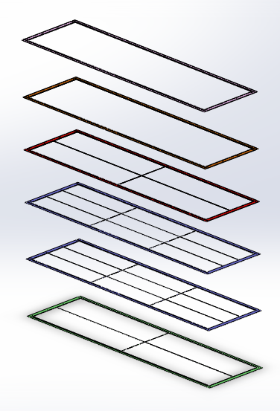
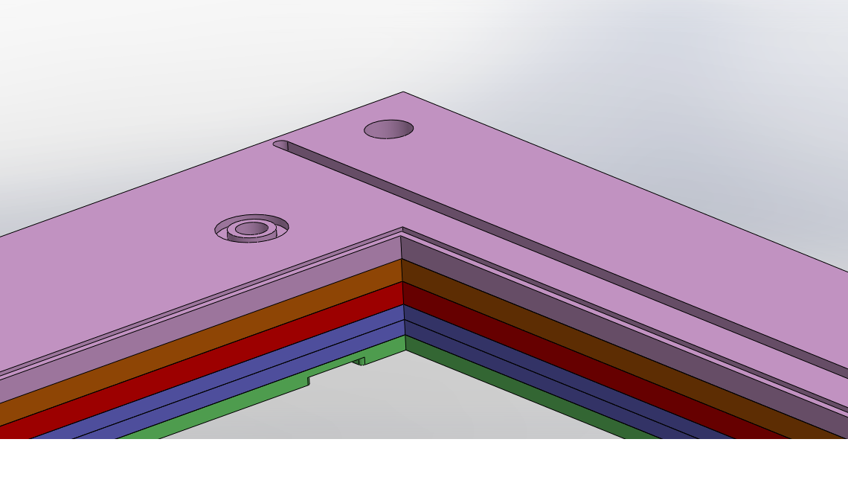
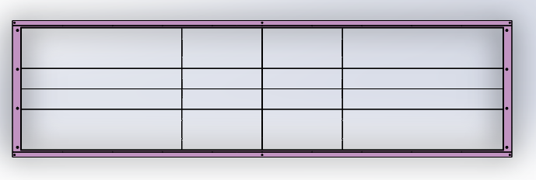
Frame design underway
Design/mechanical studies underway within Solidworks to evaluate:
Evaluate stress on frames
Foil deformations
Gas flow.
Frame assembly techniques

Slide 9
Proposed Plan
Year 1 :
GEM chamber and assembly fixtures design – 3 months { $ 25,500}
GEM components and assembly fixture fabrication – 6 months .
GEM foils readout plane at CERN { $ 28,000}
GEM frames at RESARM in Belgium { $ 20,000}
Assembly fixtures at UVa. { $ 10,000}
Chamber assembly and initial testing – 3 months { $ 25,500}
Year 2:
Instrument chamber with electronics.
Test and characterize the chamber.
Personnel
Bogdan Wojtsekhowski - Jefferson Lab.
Nilanga Liyanage, Kondo Gnanvo, Vladimir Nelyubin, Chao Gu, Xinzhan Bai, and Danning Di and Seth Sacher - UVa

