Slide 1
Report about HERA-B modules
Carlos Ayerbe-Gayoso (College of William and Mary)
SBS Collaboration Meeting – February 6th 2013

Slide 2
REMINDER
HERA-B ECal modules are of Shashlik kind.
Middle and outer ECal modules have the same cross-section, 11.5x11.5 cm² . The length is of 34 cm (20X₀)
Middle sections are divided in 4 sections, outer consists in only one section

Slide 3
We got 10 Ecal HERA-B Modules borrowed from ITEP (Moscow – Russia)
They consist in 5 middle and 5 outer modules
They had been transported from DESY (Hamburg-Germany) last November and arrived to Jlab in December
In order to test them, the modules are placed in TEDF’s High Bay, at Hall A space.

Slide 4
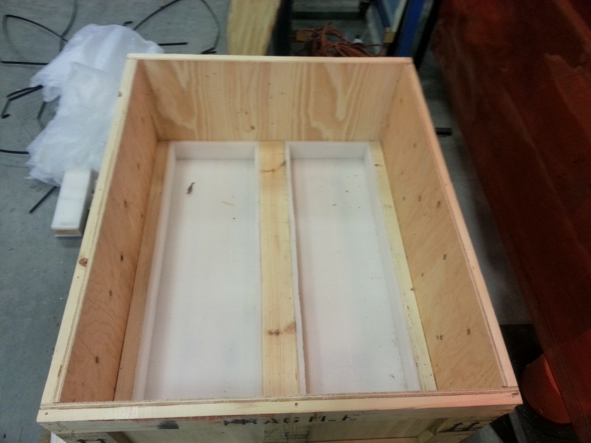
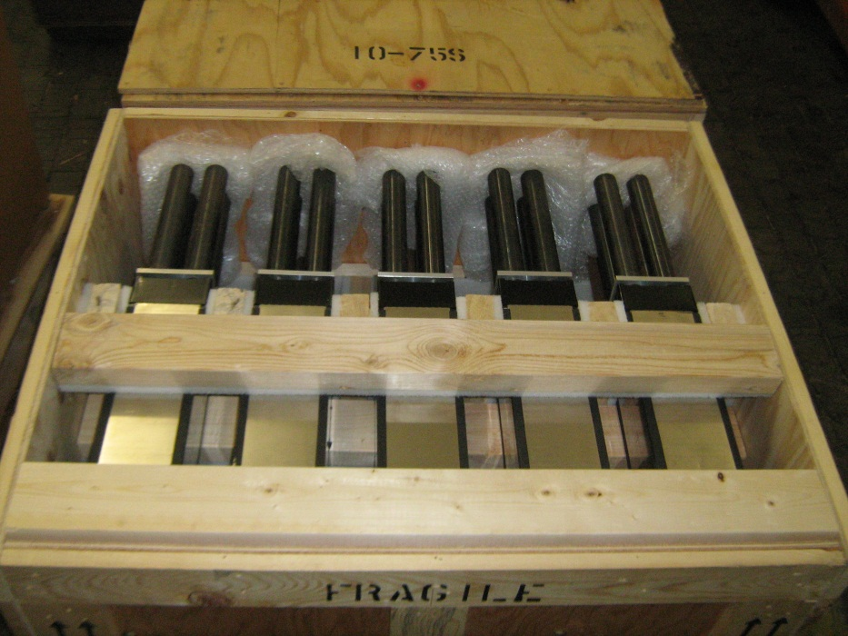
The modules were packed in a wooden box provided by DESY Shipping and handling dept.
(wooden box should comply USA customs admittance)
Outer modules
Middle modules
Notes:
Although the box looks correct for transport, is was not optimized for the modules.
There is a set of wooden beams fixed to the box.
They were used to place the modules.
This was assuming that the modules were a rigid structure.
These beams had introduced some stress in the modules giving them some deformations and breaking the black paper which covers the modules.

Slide 5
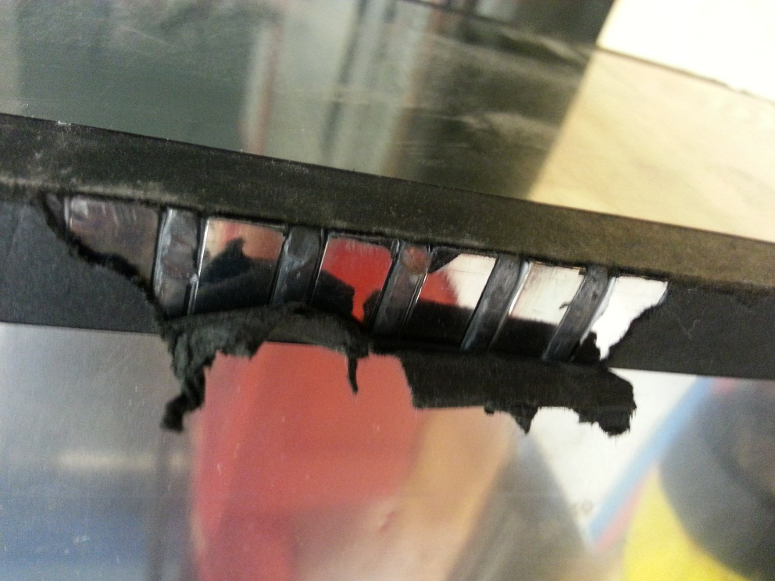
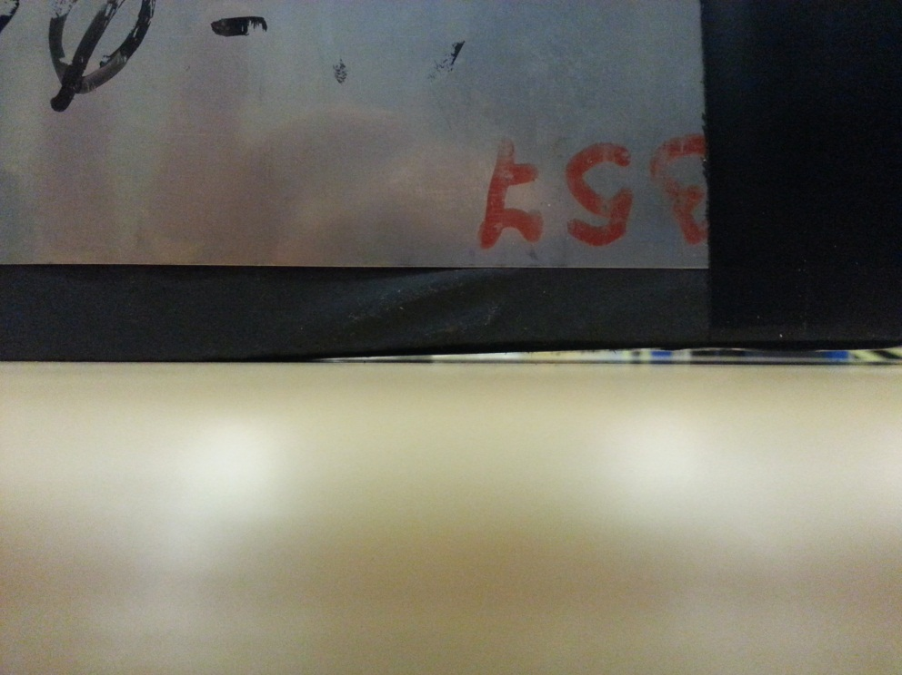
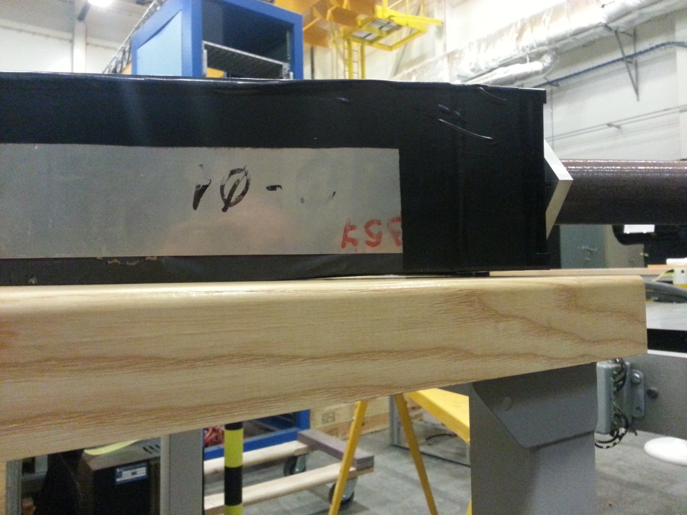
Light tight paper broken, showing the structure of lead+sintillators
Deformation of the module structure
Notes:
In any case, none of the modules have broken
Integrity of fibers had been tested qualitative with the use of a laser
Deformations were corrected applying pressure with the help of other modules

Slide 6
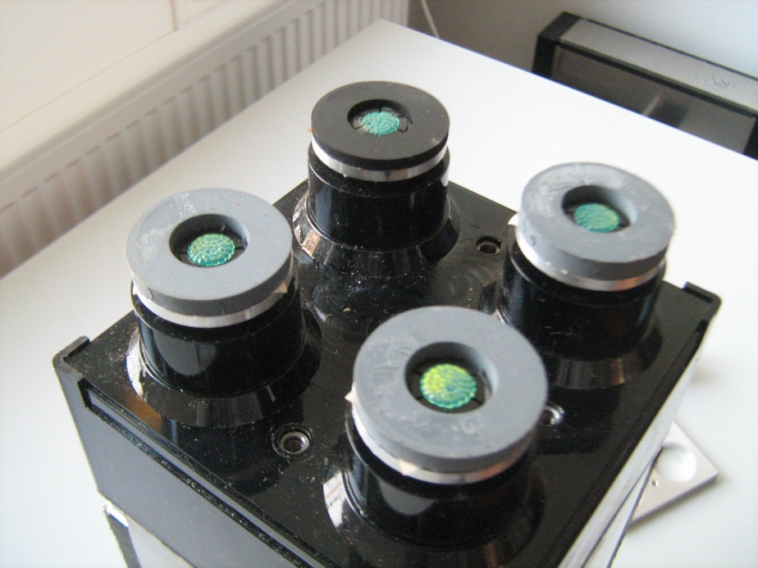
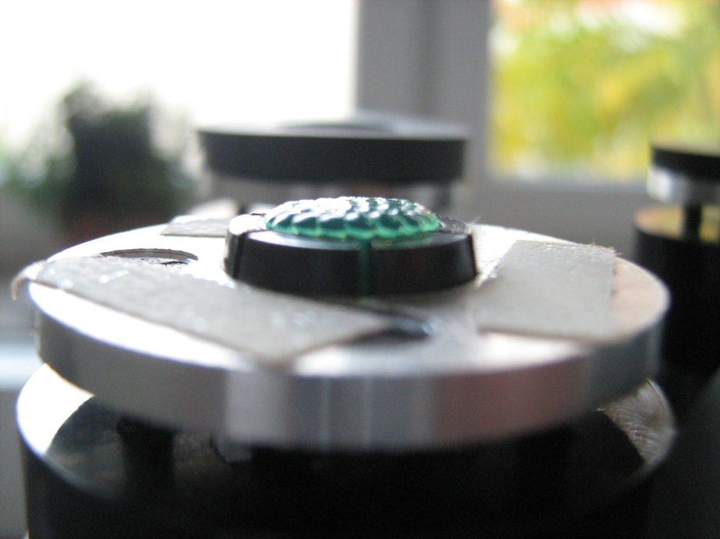
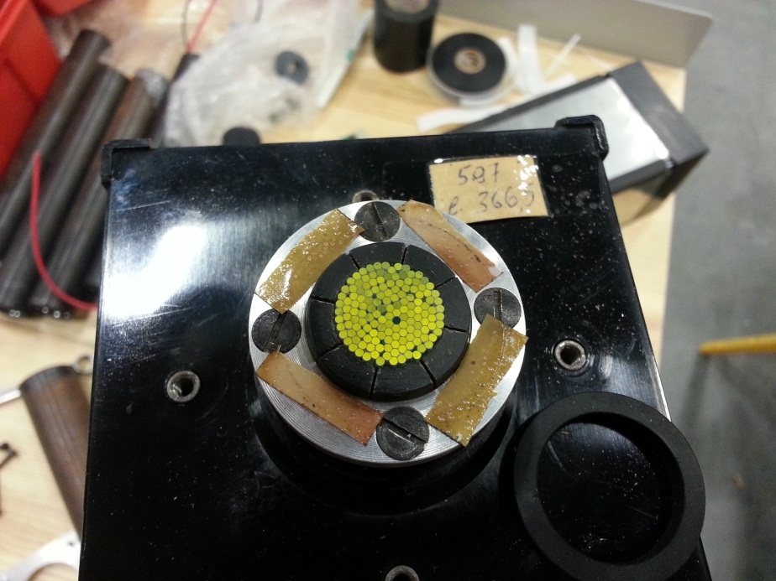
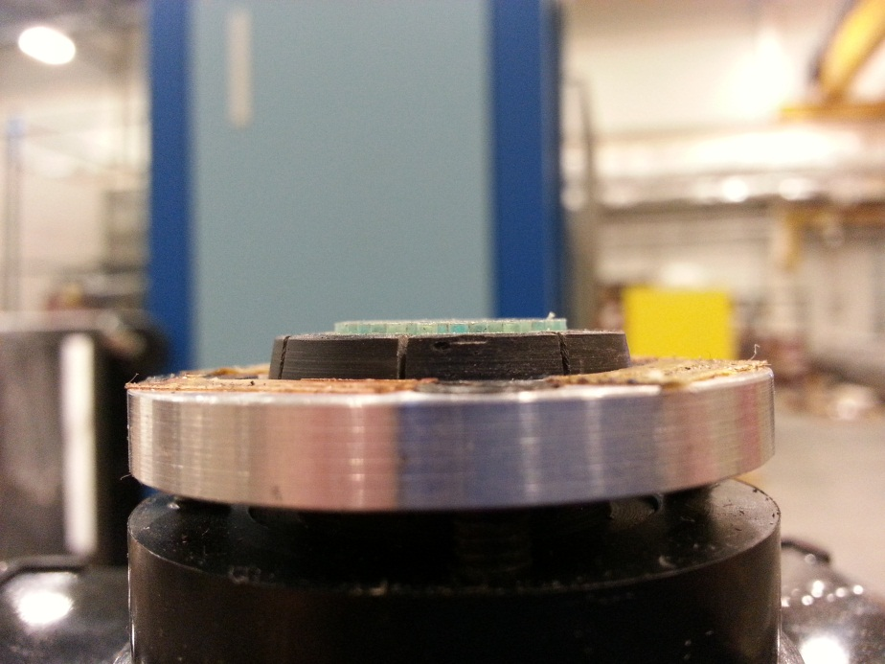
Middle Module
Detail of the WLS fibers (to the PMT)
Outer Modules

Slide 7
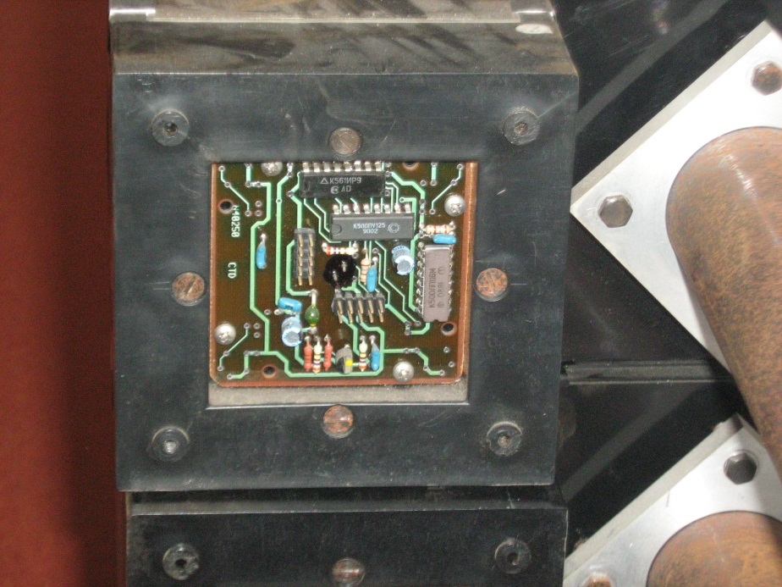
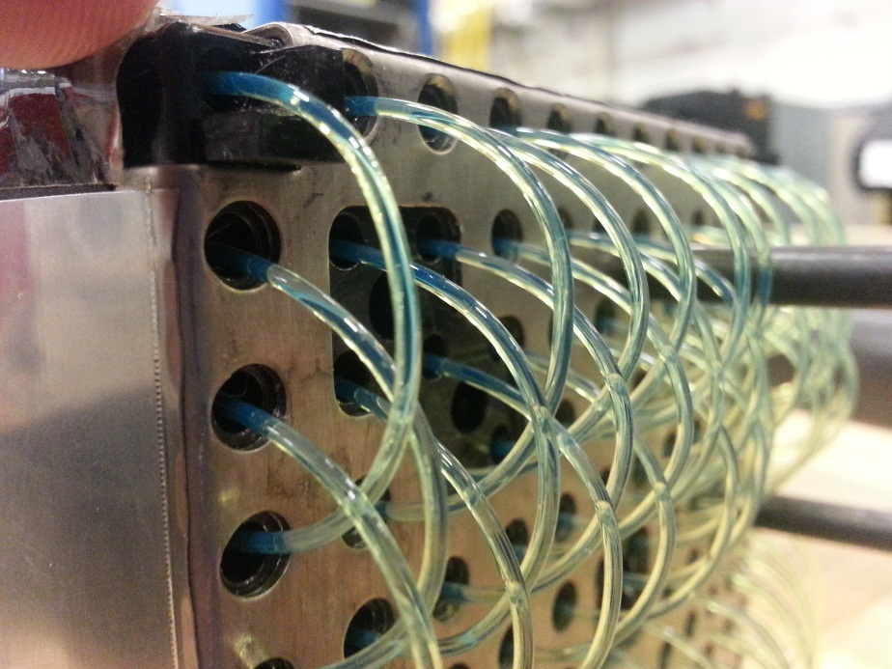
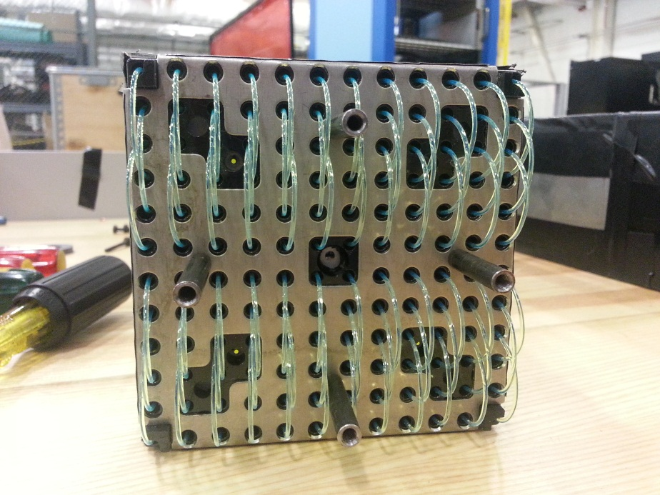
LED controller
Detail of the WLS fibers at the end cap
Circles show the dummy fibers for the LED (the yellow indicates middle and red outer)

Slide 8
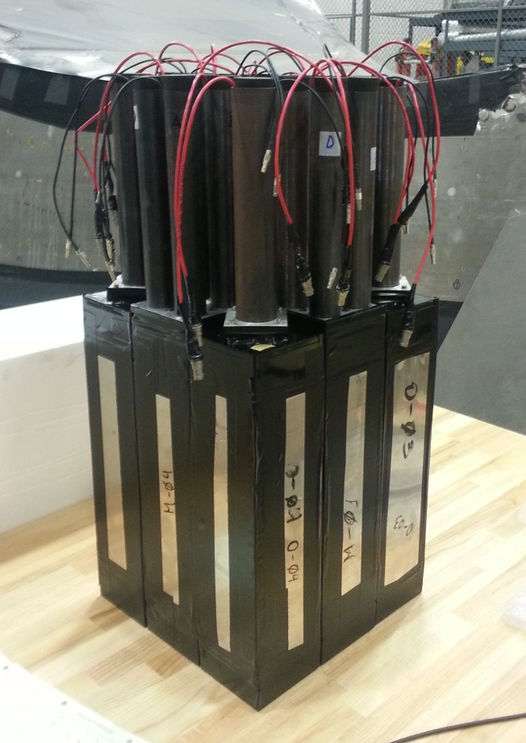
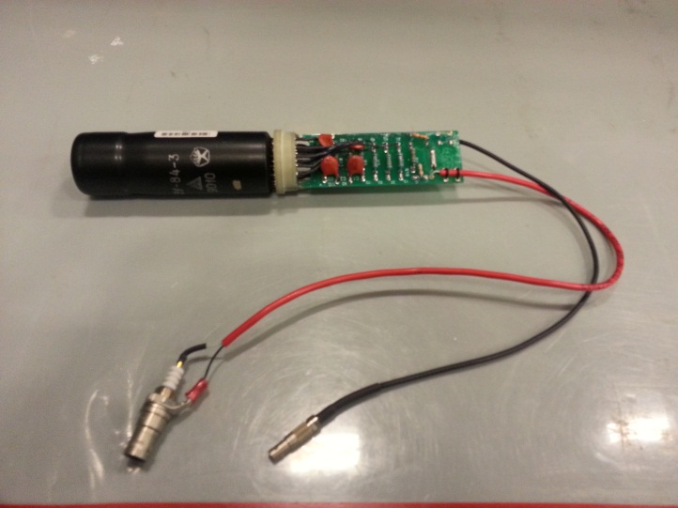
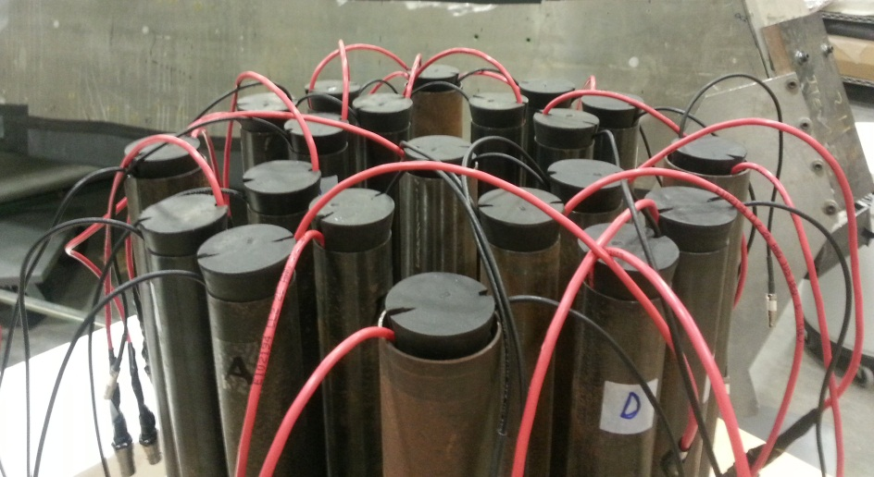
The read-out is made through the PMT FEU-84
All modules were protected for light leaks, measuring the current drain before and after
This PMT fits perfectly into the allocation tube.
The base is covered with a plastic foil to isolate it from the pipe.
The pipe is ended with a rubber stopper with two slits for the cables.

Slide 9
Set-up for cosmic test (in preparation)
The test is being conducted in collaboration with Mark Jones, Alexander Camsonne and Tony Losada (CNU) at TEDF High Bay.
The plan is construct a telescope with a series of scintillator paddles to trigger cosmics which cross only a given module.
We are having more interest in the response of the outer modules but not exclusively.
A wiki web page has been open:
https://hallaweb.jlab.org/wiki/index.php/Sampling_Calorimeter
We expect to start getting data in the following days.

Slide 10
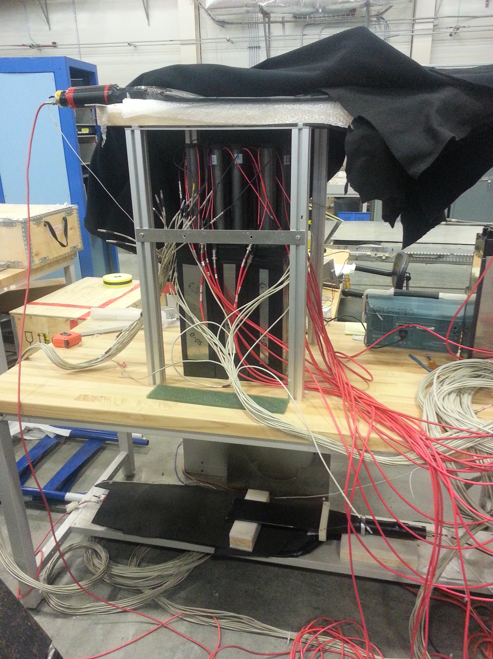
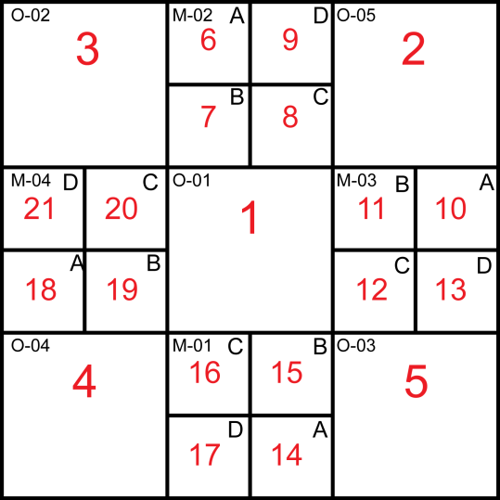
One scintillator 12’’x6’’ paddle on top
Arrangement of the modules
One scintillator 12’’x6’’ paddle with a small paddle of the width of the module on bottom

Slide 11
OUTLOOK
There are discussions with Alexander Vasiliev from IHEP (Protvino-Moscow-Russia) about the feasibility to build new Shskshlik modules. IHEP is planning to build two new calorimeters (SPASCHARM and PANDA). Their design is of cells of 5.5x5.5 cm² and 380 layers of lead (0.275mm) and scintillator (1.5mm) with an energy resolution of 3-4%.
Last weeks we had contact Zhiwen Zhao from SoLID collaboration since they are planning a forward calorimeter with Shashlyk technique. He agreed to collaborate with us testing and share MC studies.
Also, we are studying the feasibility of a beam test in SLAC in collaboration with Tom Hemmick (StonyBrook). They are interested in test some GEM chambers. Still in discussion and waiting answers.

