Slide 1
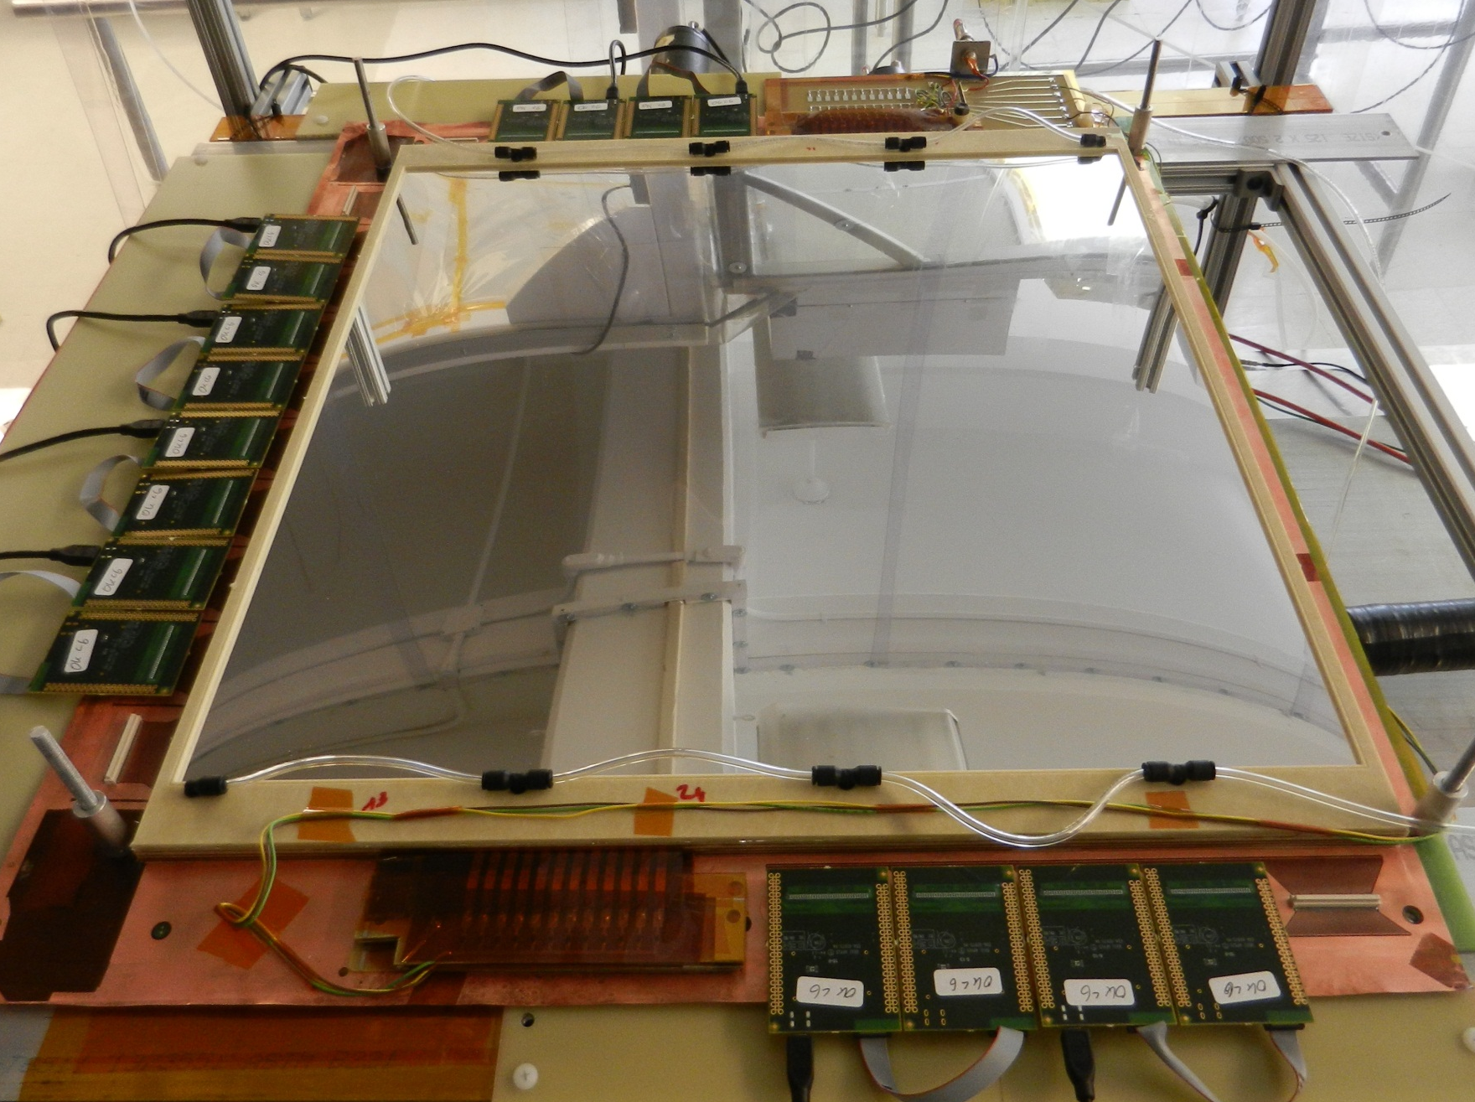
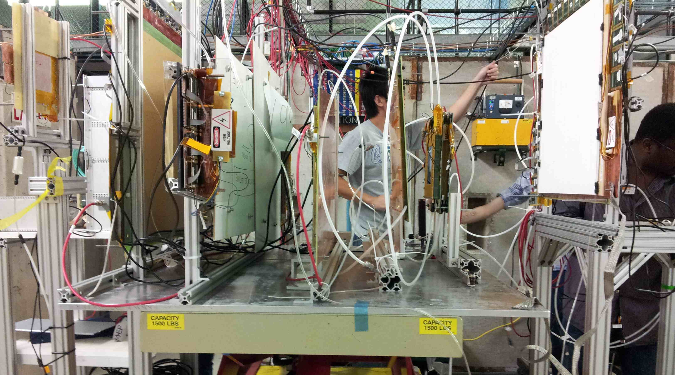
SBS Large GEM Trackers
Back trackers: Eight 60 cm x 200 cm GEM layers + 2 spare layers Built at Uva
Four 60 cm x 50 cm modules make a layer.
New UVa module design for backtracker
UVa GEM Lab setup for production.
Full size prototypes built and working meeting design goals.
Pre R&D program highly successful
Ready for final production
Contract for first 29 modules in place ($ 541 k)
Orders for GEM foils placed.
Start production by 02/2014; produce ~ 2 modules per month after that.
Now testing and comparing two APV25 based readout systems:
CERN SRS system – 10 k chan. at UVa
INFN MPD system – 3 k chan. at UVa.
Final readout configuration for backtracker to be determined by 11/13.
Fermilab Beam test of two full size prototypes fully equipped with electronics going on now.
A full size SBS prototype GEM module
Fermilab beamtest setup

