Slide 1
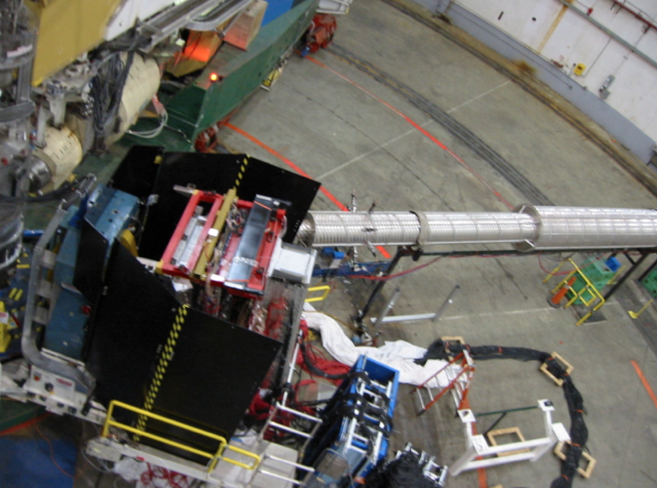
BigBite Spectrometer Status
BigBite was used for several experiments during JLab 6 GeV including:
Neutron Form Factor: S. Riordan et al., Phys.Rev.Lett.105 (2010) 262302.
Short Range Correlations: R. Subedi et al., Science 320 (2008)1476.
Transversity: X. Qian et al., Phys.Rev.Lett.107 (2011) 072003.
BigBite has an equally exciting series of physics planned for JLab 12 GeV including: u/d ratios, A1n, and form factor measurements.
Current Equipment includes:
Tesla Meter Dipole (~100msr)
Wire Chambers
Gas Cherenkov (low rate)
Timing Scintillators
Lead Glass Calorimeter
New Equipment includes:
GEM Chambers
Grinch Cherenkov (high rate)
Redesigned detector frame
Photo shows the BigBite spectrometer in Hall A configured for electron detection.

