Slide 1
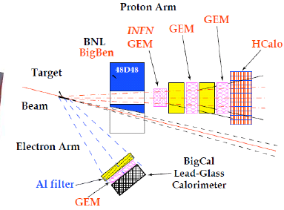
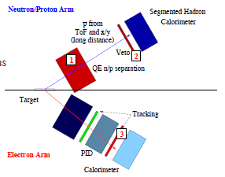
SuperBig Bite DAQ
Use of standard Fastbus with pipeline Flash ADC for Hadron Calorimeter and APV25 GEM tracker readout
Fastbus
1800 calorimeter channels
16 crates
6 Power Supply
New CODA 3 electronics improve deadtime by 30%
19 controller, 28 bin, 12 PS,176 TDC,6200 ADC channels tested
Trigger
Analog sum ECal
Coincidence ECAL HCAL
10 KHz coincidence rate
Analog trigger for electromagnetic calorimeter and Big Bite
Digita trigger for HCAL
GEM trackers
6 Front trackers INFN
8 Rear chamber
APV25 readout
Custom VME readout INFN
Readout ported to Linux VME controller
Start implementation in JLAB DAQ environment
FADC for HCAL
242 channels
16 FADC
Digital summing for triggering
2 VXS crate, 4 FADC received for R&D

