Slide 1
Update on SBS Back Tracker GEM @ UVa
K. Gnanvo, N. Liyanage, V Nelyubin, K. Saenboonruang, Seth Saher
Cross Talk issues with APV25 Electronics
Uniformity tests results with ⁹⁰Sr source

Slide 2
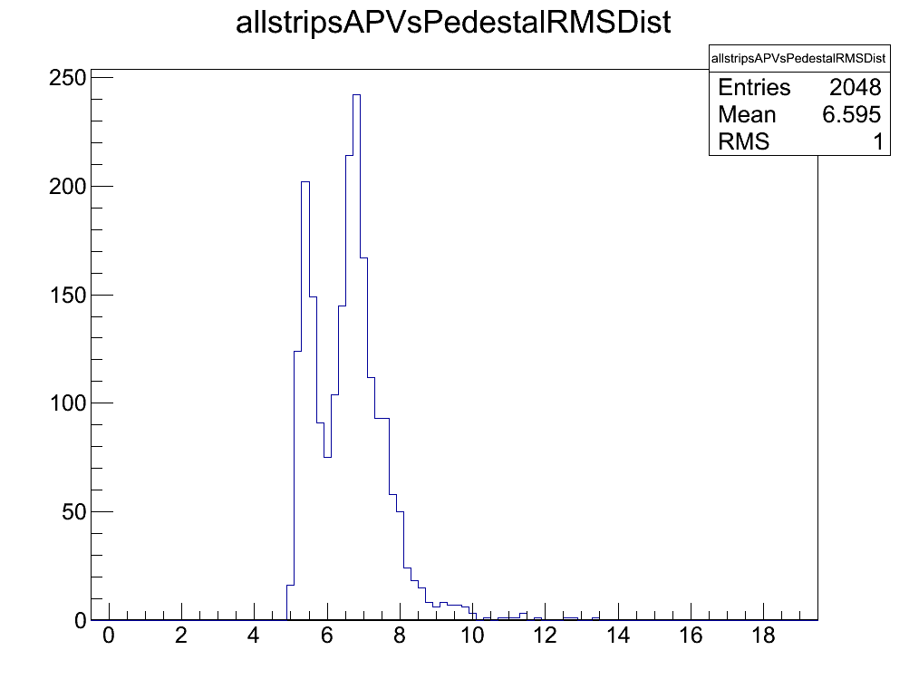
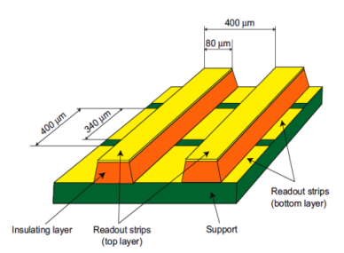
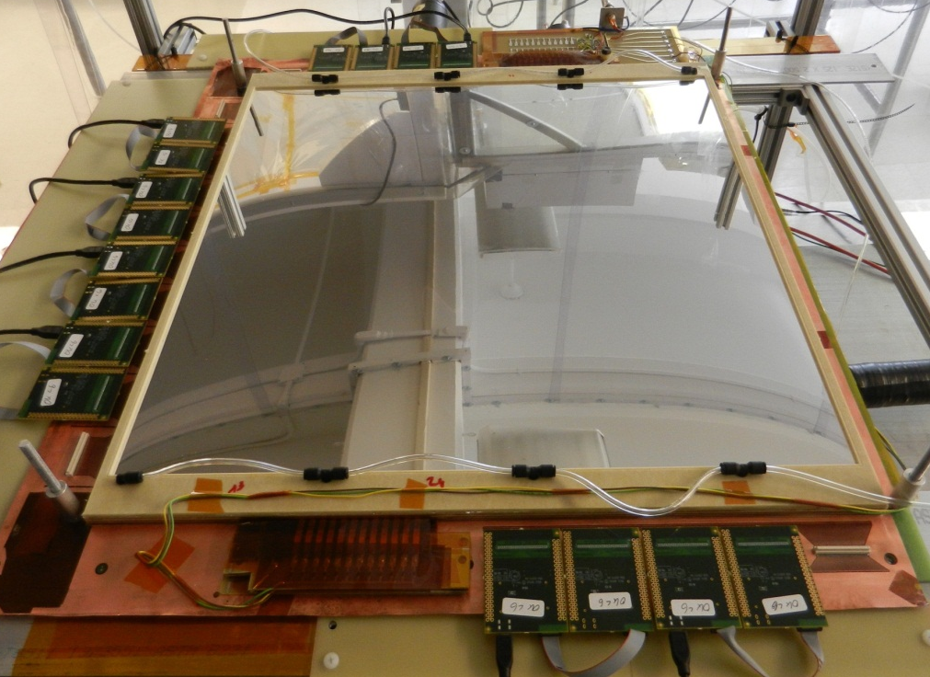
SBS Back Tracker Proto1 with APV25-SRS FE cards
Pedestal RMS noise distribution over 16 APV
ADC Ch counts
For 50 × 50 cm2 COMPASS-like readout, typical rms after common mode correction of the baseline is on average of 6-7 adc counts for apv25-SRS
@ 230 e-/adc ➔ ~ 1200 to 1500 ENC
a cut at 5 sigma for zero suppression ➔ ~ 6000 e-

Slide 3
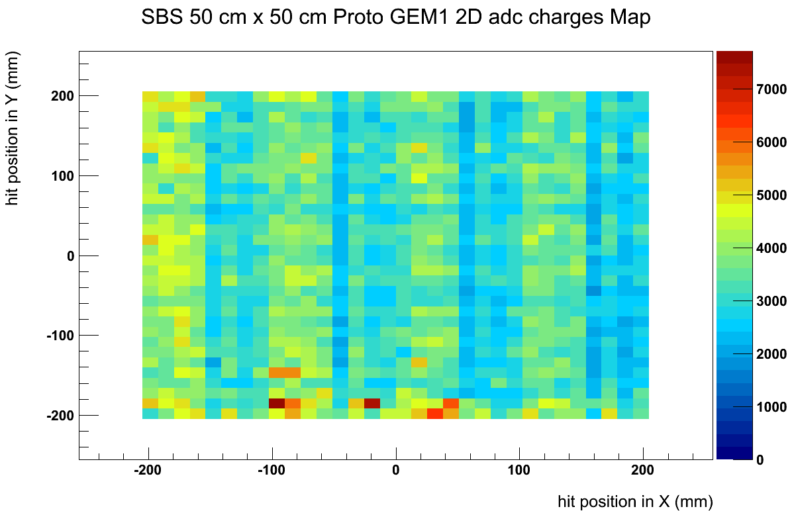
Gain (non) uniformity of the chamber
Gas flow uniform in Y direction ➔ gas inlet and outlet
We suspects a non uniformity of the gain due to the gas flow in the X direction
The gas flow in X is facilitated by groove in the spacer but not sure if it is
X
Y
window
Drift cathode
GEM foil 1
GEM foil 2
GEM foil 3
Mean cluster adc counts 2D map
ADC counts
Y
X

Slide 4
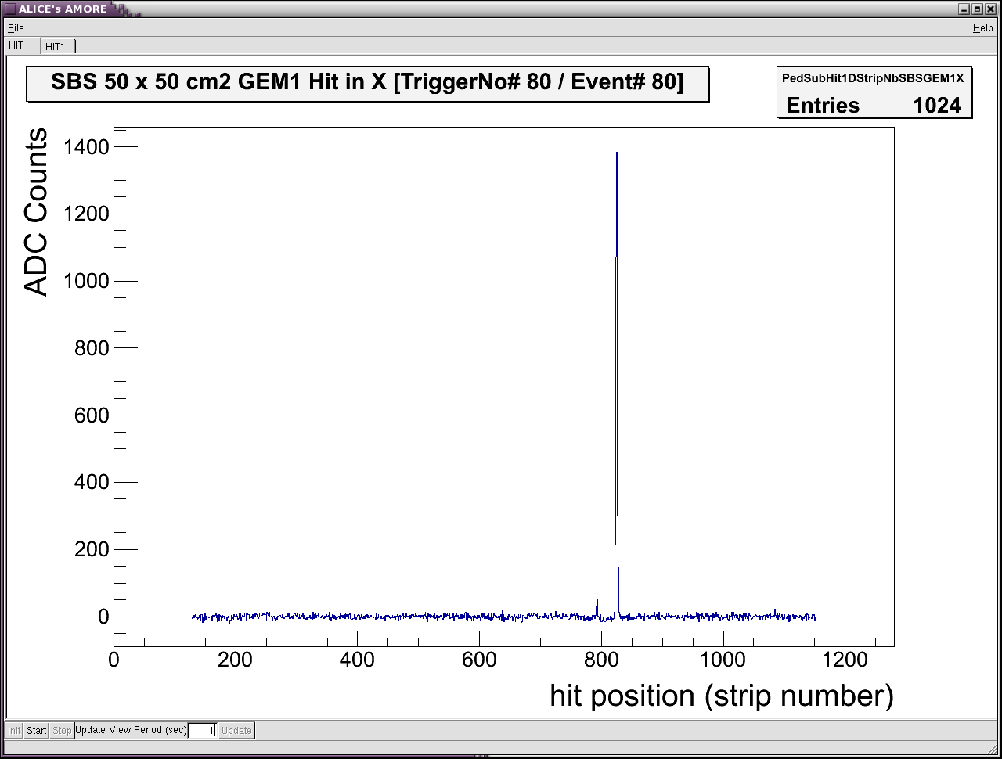
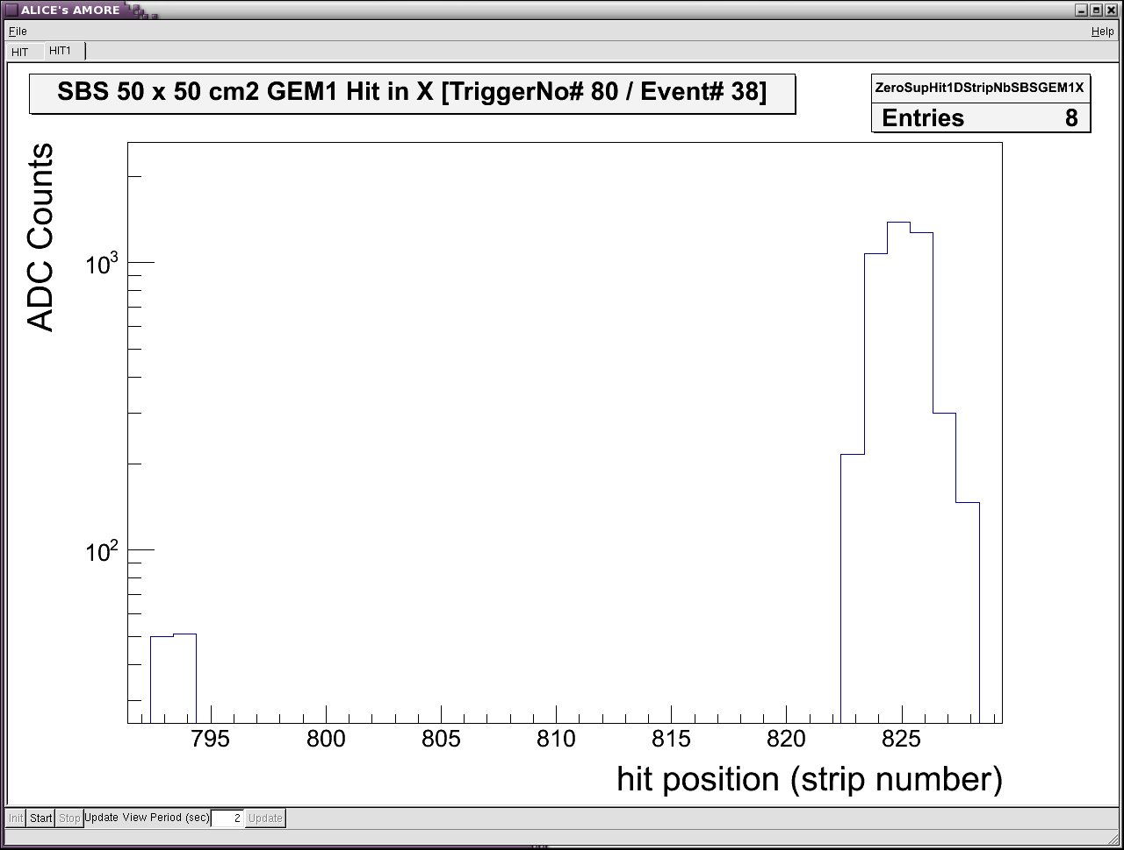
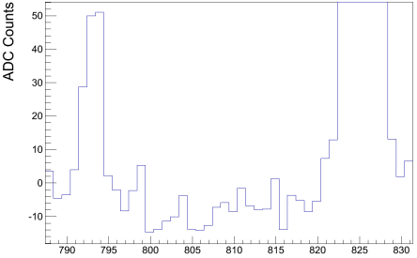
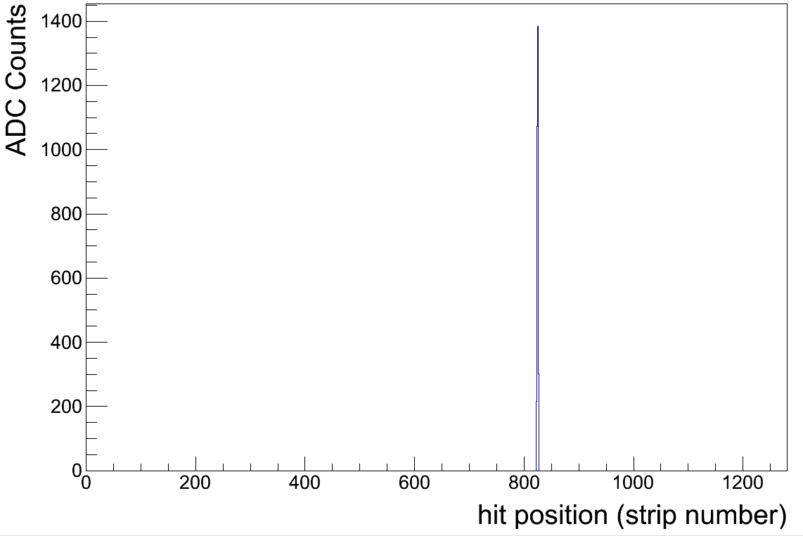
Cross Talk in APV25 Electronics
5σ cut
Current version of the analysis (AMORE) code:
Only single cluster event used for 2D hit maps, X-Y charges correlation etc … and minimal cluster size = 2hits
For high amplitude hits, cross talk cluster survives a 5σ zero suppression cut ➔ Event seen with 2 clusters and rejected
Cross talk is suppressed at 7σ here in this example
7σ cut

Slide 5
Cross talk effect previously reported at RD51 Coll. meetings 2011
K. Gnanvo, GEM R&D Muon Tomography, Florida Tech
RD51 Coll. Meeting April 2011
M. Byzsewsky, Micromegas for ATLAS Muon chamber Upgrade
RD51 mini week January 201111

Slide 6
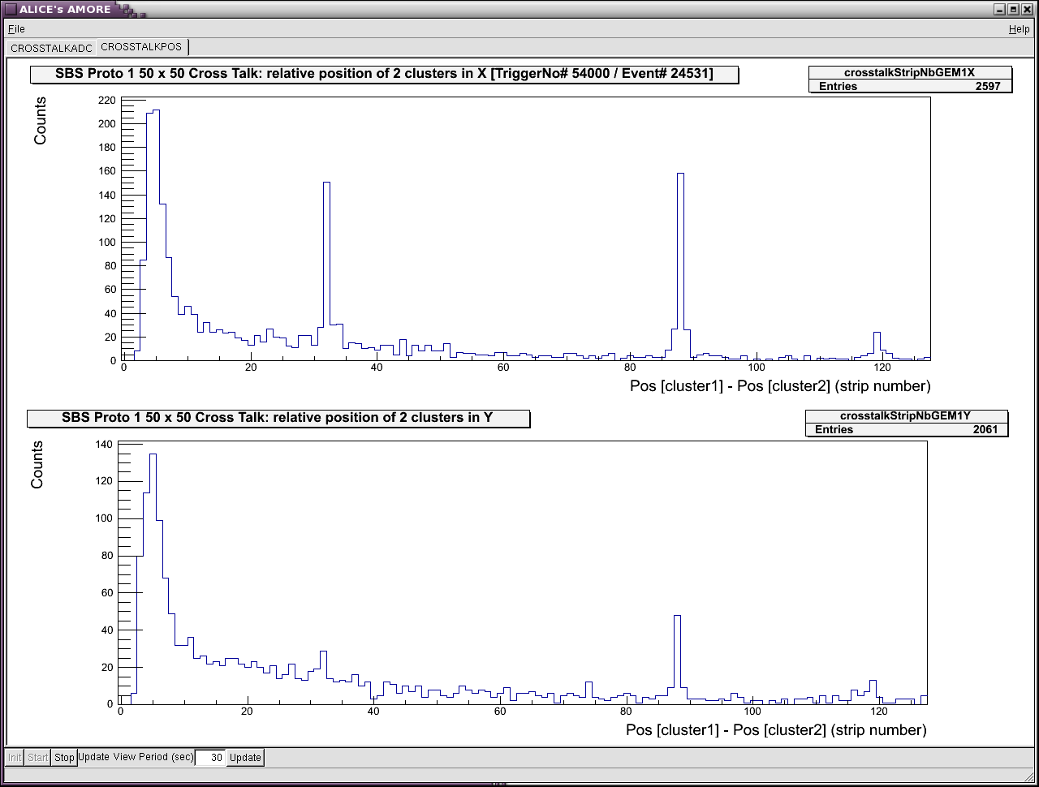
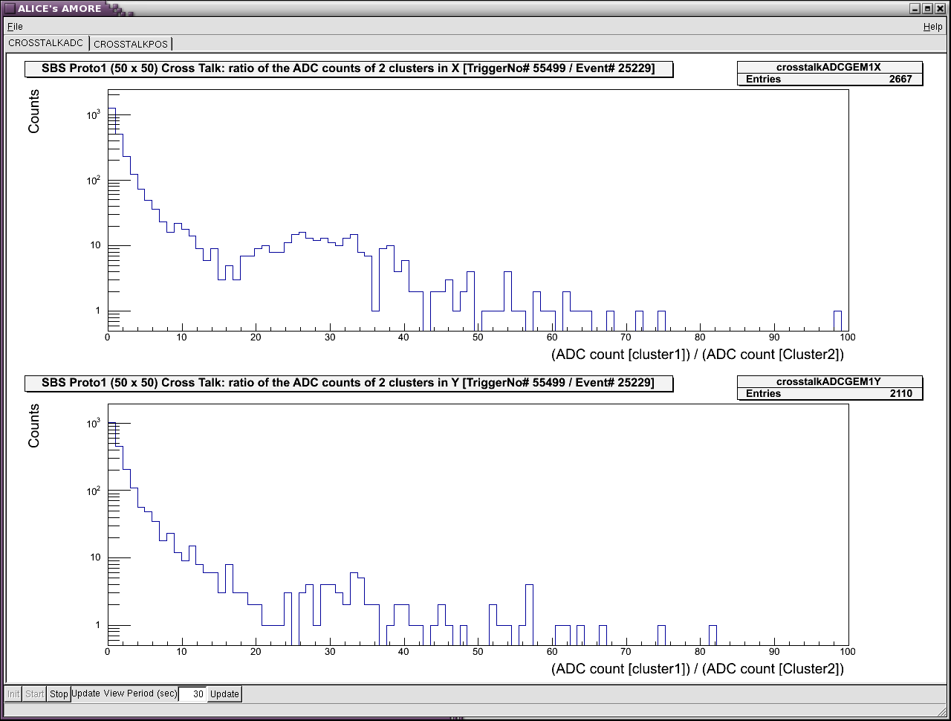
Distribution of the relative position (X_{cluster1} – X_{cluster2}) of two clusters in 2-clusters events
Distribution of ADC counts ratio (ADC_{cluster1} / ADC _{cluster2} ) of two clusters in 2-clusters events
Along X-axis
Along X-axis
Pics at 32, 88 and 120 ➔
cross talk effect
Large ratio > 20 correlated to the cross talk pics
Along Y-axis
Along Y-axis
Real 2-cluster events

Slide 7
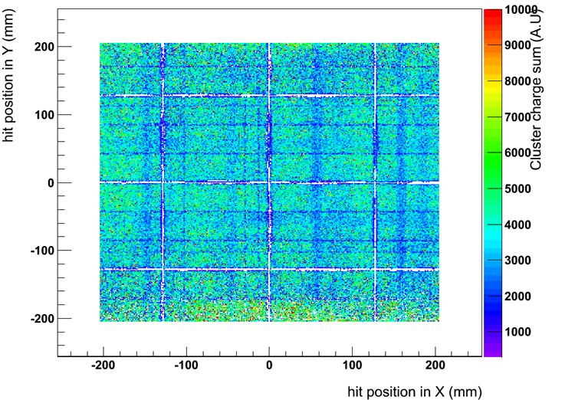
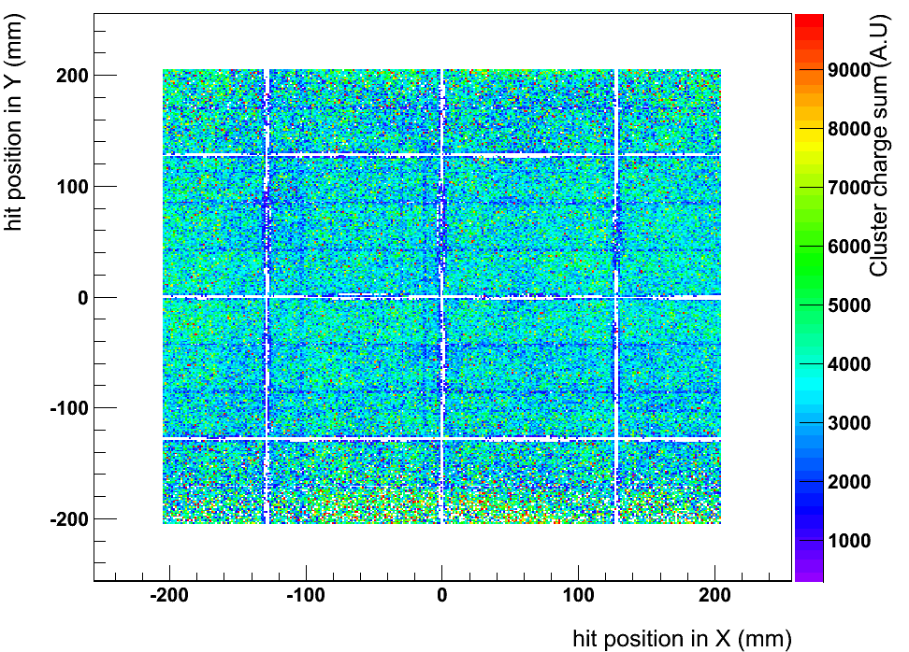
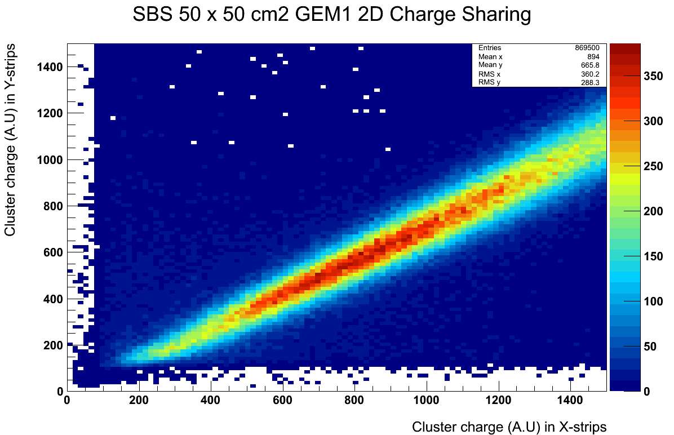
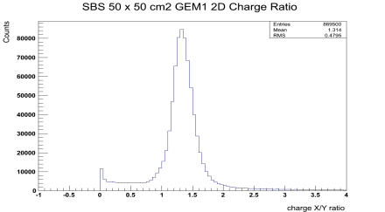
2D Map of “mean” ADC: Gain uniformity
@ 5σ pedestal cut
@ 10σ pedestal cut
“mean” ADC
=
Ʃ_{N} ADC / N_{Hits}
Cross talk effect more pronounced for X than for Y ➔ non equal charge sharing ➔ Cross talk cluster suppressed at 5σ cut
Along X-axis
ADC(X) / ADC (Y)
= 1.34
Along Y-axis

Slide 8
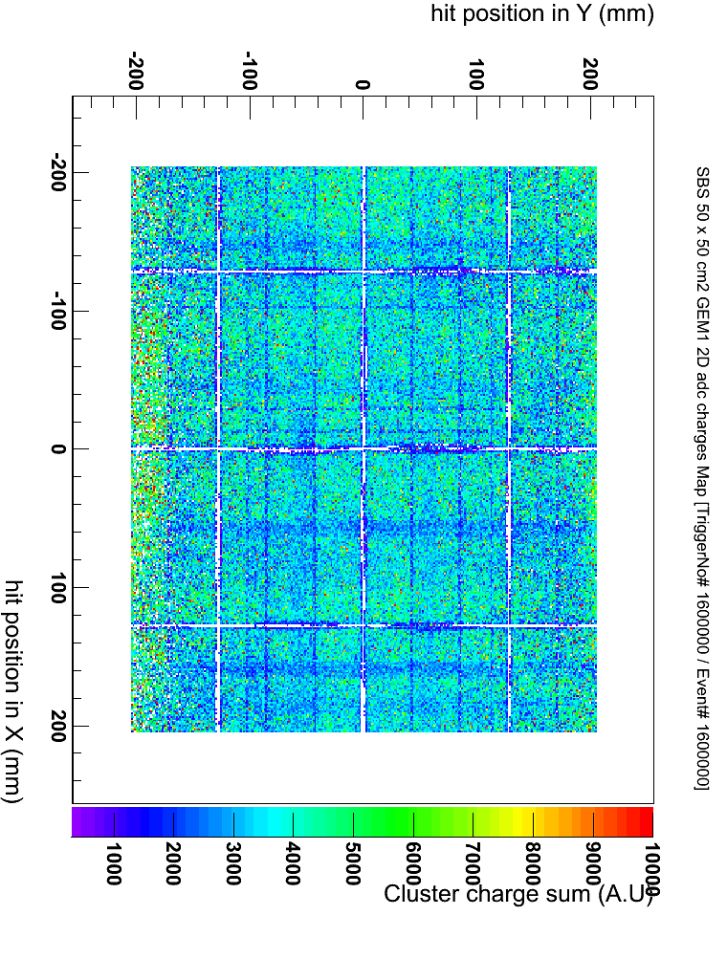
Cross talk only for APV25-slaves ➔ Effect of SAMTEC flat cable?
M
S
M
S
SAMTEC flat cable

Slide 9
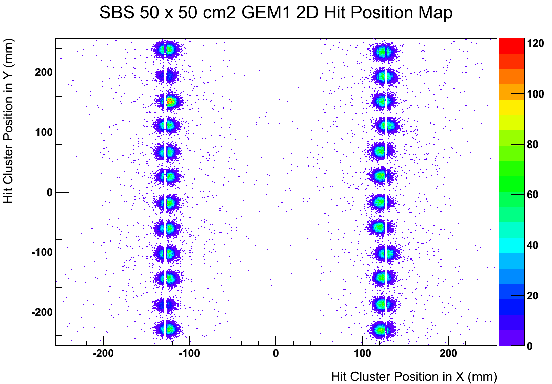
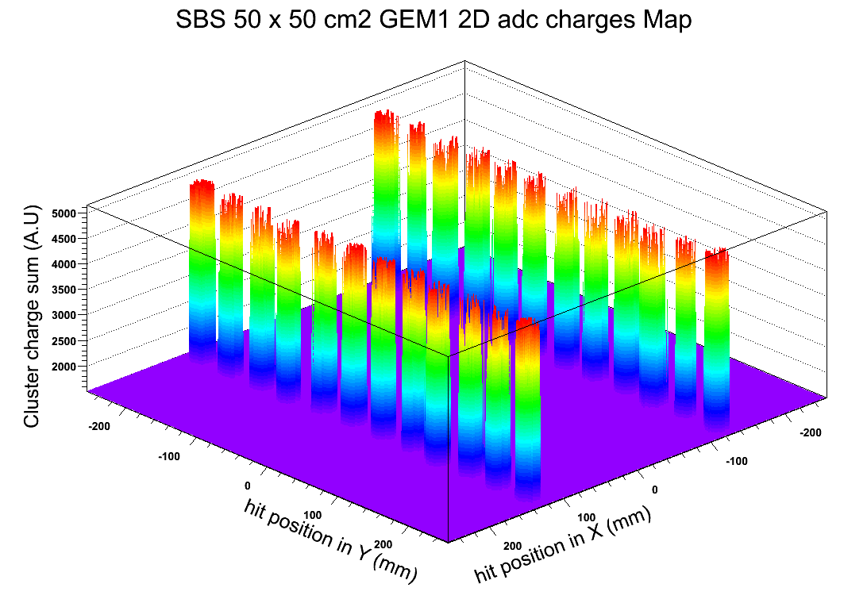
Test with ⁹⁰Sr source
Efficiency measurement with ⁹⁰Sr
About 92% at 4400 V
⁹⁰Sr Source just on top of the spacer along Y axis ➔ few % drop in the efficiency of the chamber expected
Results consistent with the > 95% efficiency expected for the Triple-GEM
Hit map (N_{Hits} / bin)
“mean” ADC
=
Ʃ_{N} ADC / N_{Hits}
“mean” ADC (gain uniformity)

