Slide 1


Don Jones
for the MOLLER collaboration
SBS weekly meeting
Dec 12, 2022

Slide 2
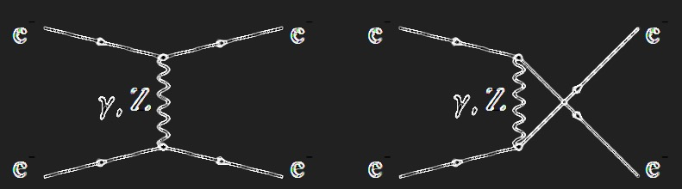
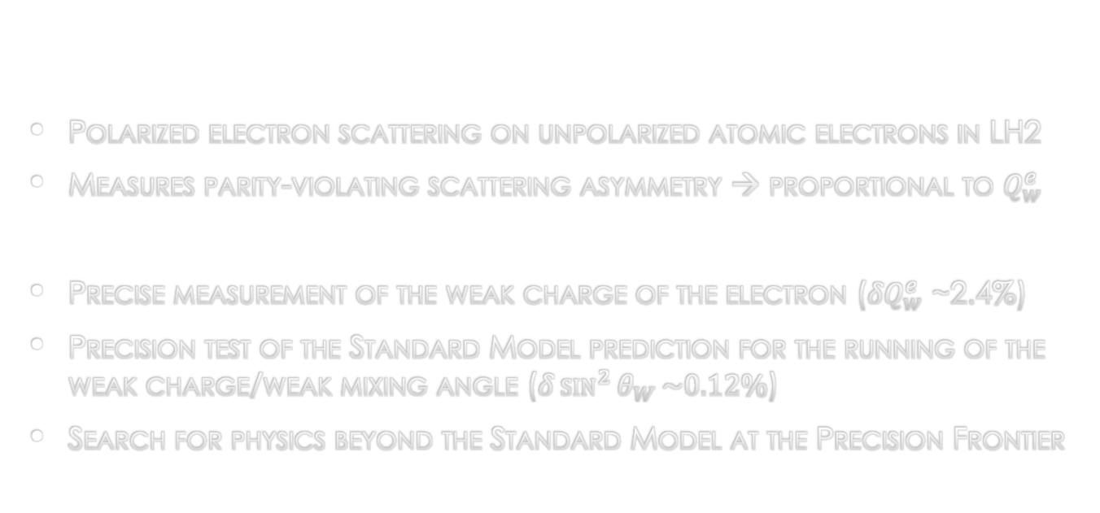
Moller experiment overview
Polarized electron scattering on unpolarized atomic electrons in LH2
Measures parity-violating scattering asymmetry → proportional to $Q_{w}^{e}$
Precise measurement of the weak charge of the electron $\text{(}{δQ}_{w}^{e}$ ~2.4%)
Precision test of the Standard Model prediction for the running of the weak charge/weak mixing angle ($δ\sin^{2}{θ_{W}}\sim 0.12\%$)
Search for physics beyond the Standard Model at the Precision Frontier

Slide 3
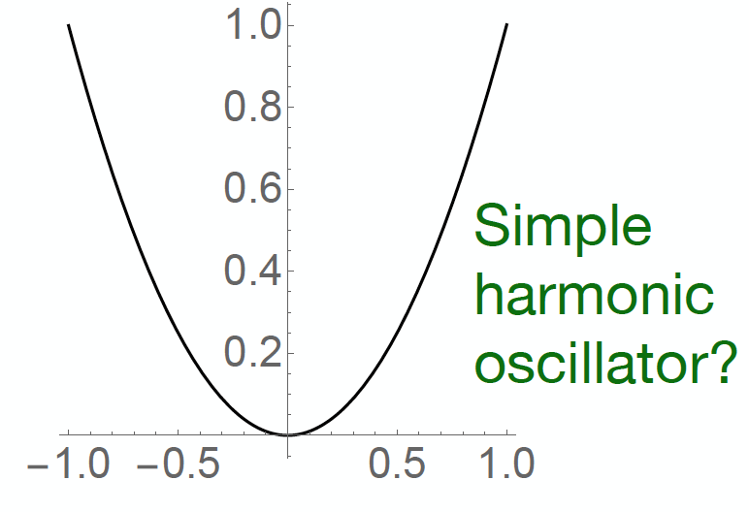
High Energy Physics @ Low Energy = Precision

Slide 4
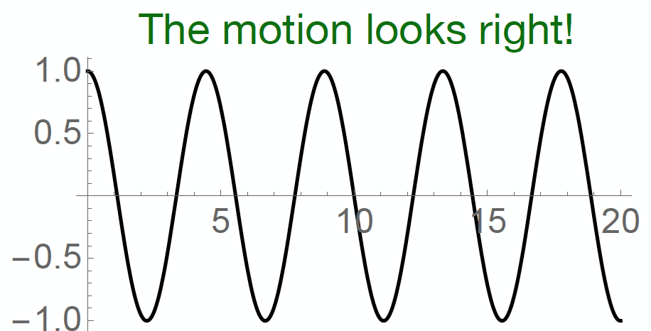
High Energy Physics @ Low Energy = Precision

Slide 5
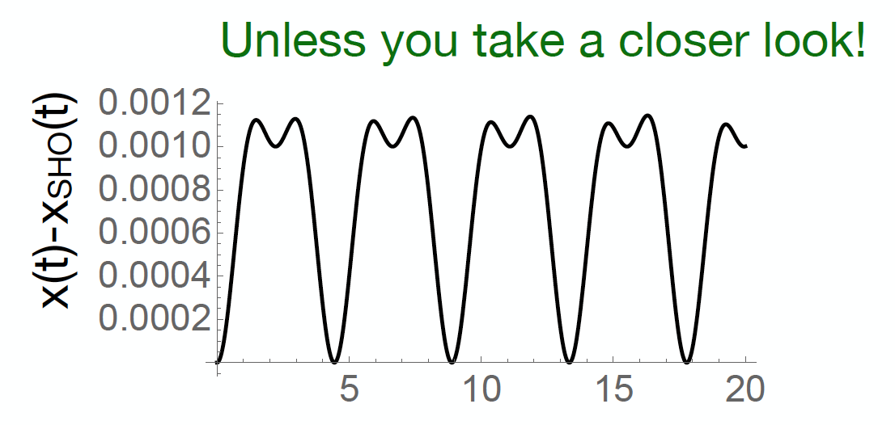
High Energy Physics @ Low Energy = Precision

Slide 6
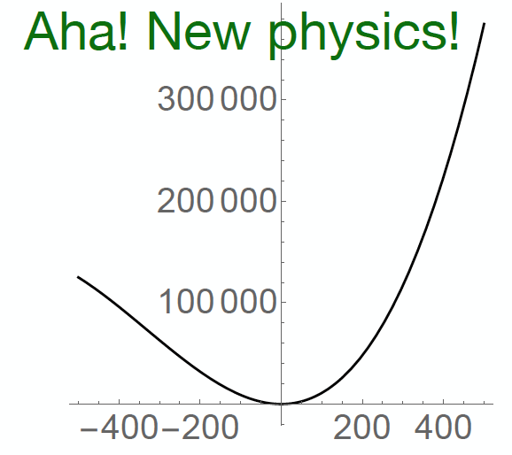
High Energy Physics @ Low Energy = Precision

Slide 7
How are Parity Experiments Different?
Some folks groan when they hear Parity experiments are on the schedule. They are quite different in their demands and the way they extract their physics.
They are typically measuring tiny asymmetries (ppm level) so they obsess over beam quality to the annoyance of MCC and other Halls
  (EG. differences in average beam position between left and right helicity states needs to be at the nm scale)
  Incessantly measure beam characteristics and detector sensitivities to them
  Continuously monitor distribution widths: Eg. a small increase in asymmetry width from target boiling and noisy instrumentation could easily lead to an effective loss of 50% in statistics.
Usually pushing precision boundaries and require creativity to eliminate unknown errors not previously encountered.
Statistical requirements are such that event counting is impossible and you have to resort to measuring integrated PMT current instead.
  Pedestals are a big deal
  Go to great lengths to prevent any crosstalk or ground loops that might be correlated with Helicity
Carefully account for even tiny backgrounds
  Precision of MOLLER requires we replace many beamline components. Even “non-magnetic” stainless (316L) is too magnetic for use in some places due to its magnetic polarization in ambient fields ~1G with the potential to introduce parity conserving asymmetries at ppb levels

Slide 8
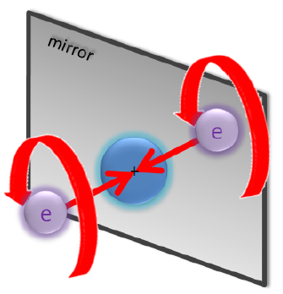
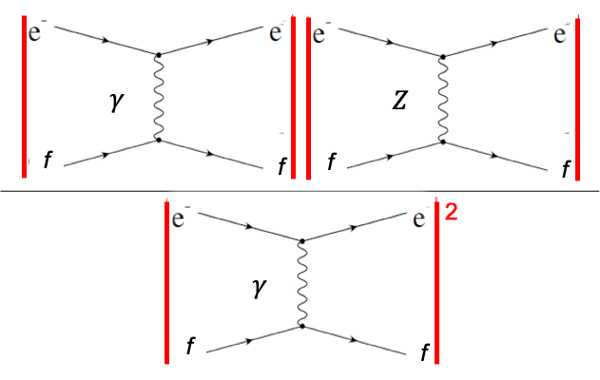
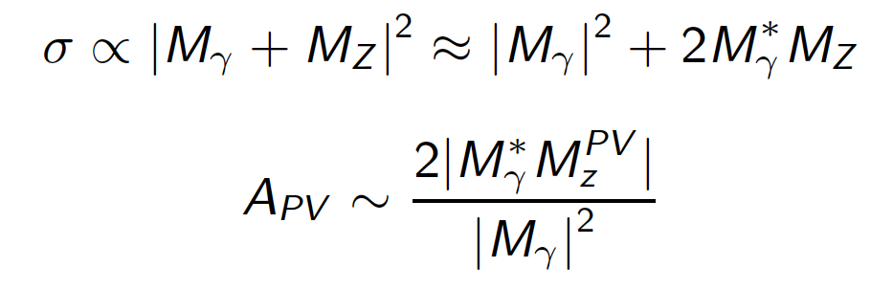

Parity violating electron scattering (PVES)
Electron beam scattering from fixed target
Reverse electron beam helicity = mirror exp
PV asymmetry in scattering rates arises from interference between EM and neutral current amplitudes
$$∝Q_{W}$$

Slide 9
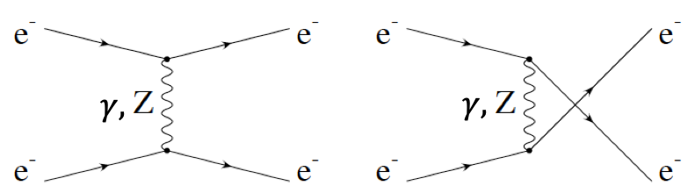
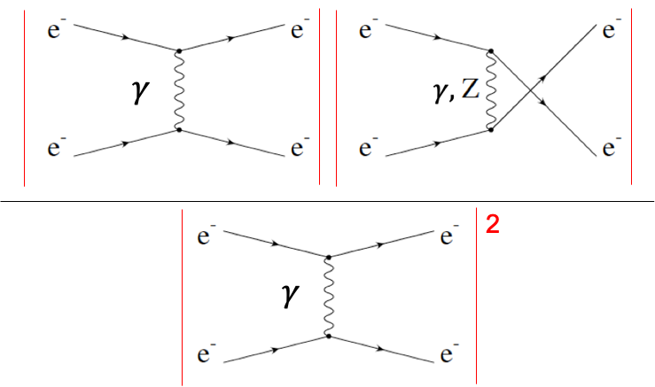


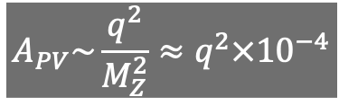







Parity violating electron scattering (PVES)
Electron beam scattering from fixed target
Reverse electron beam helicity = mirror exp
PV asymmetry in scattering rates arises from interference between EM and neutral current amplitudes
$$\frac{1}{q^{2}}$$
$$\frac{1}{M_{Z}^{2}}$$
$$γ$$
$$γ$$
$$Z$$
$$γ$$
f
f
f
f
f
f
f
f
$$∝Q_{W}$$
$$\frac{1}{q^{4}}$$
$$γ$$
$$γ$$
GeV/c
f
f
f
f
$$A_{PV}\sim \frac{q^{2}}{M_{Z}^{2}}≈q^{2}×{10}^{−4}$$

Slide 10
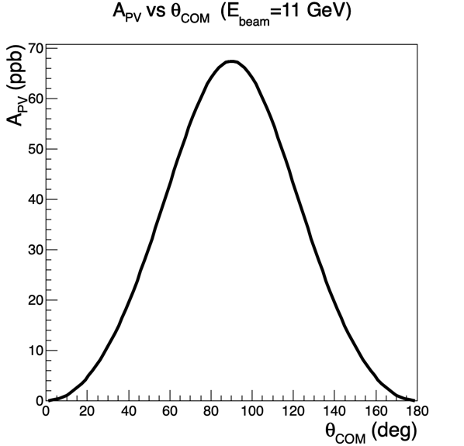
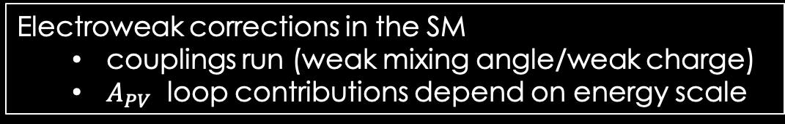
Parity-violating Moller scattering
Tree
level
Electroweak corrections in the SM
  couplings run (weak mixing angle/weak charge)
  $A_{PV}$ loop contributions depend on energy scale

Slide 11
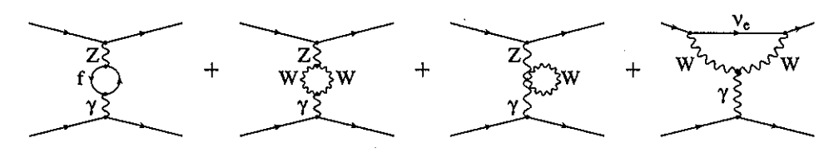
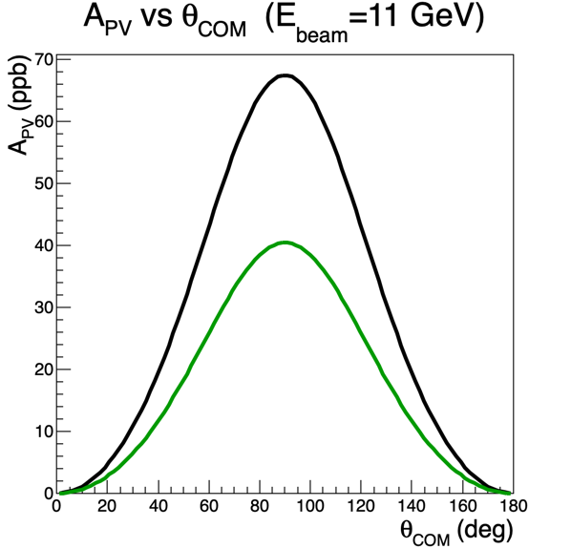
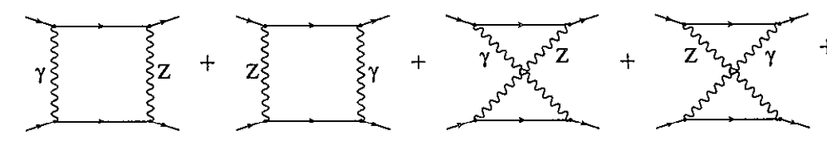
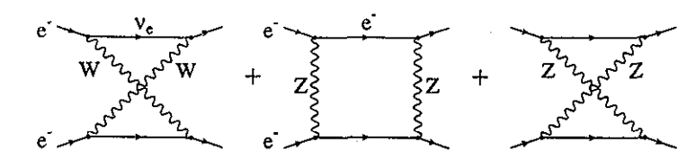
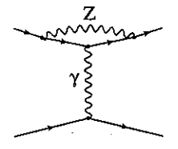

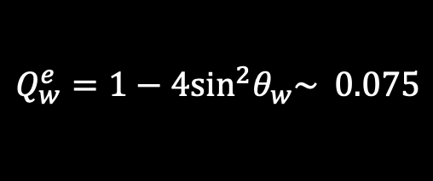

Parity-violating Moller scattering
tree level 1 loop EW corrections
$$Q_{w}^{e}=1−4{\text{sin}}^{2}θ_{w}\sim 0.075$$
$$0.0435$$
tree level 1 loop EW corrections
$A_{PV}$($θ_{CM}=90°$) = 67 ppb 40 ppb
Tree
level
Corrected
2 Loop corrections calculations underway!

Slide 12
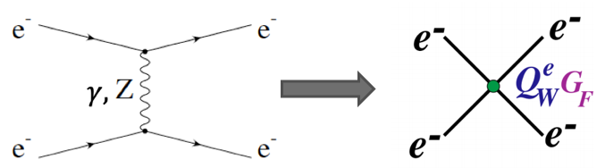
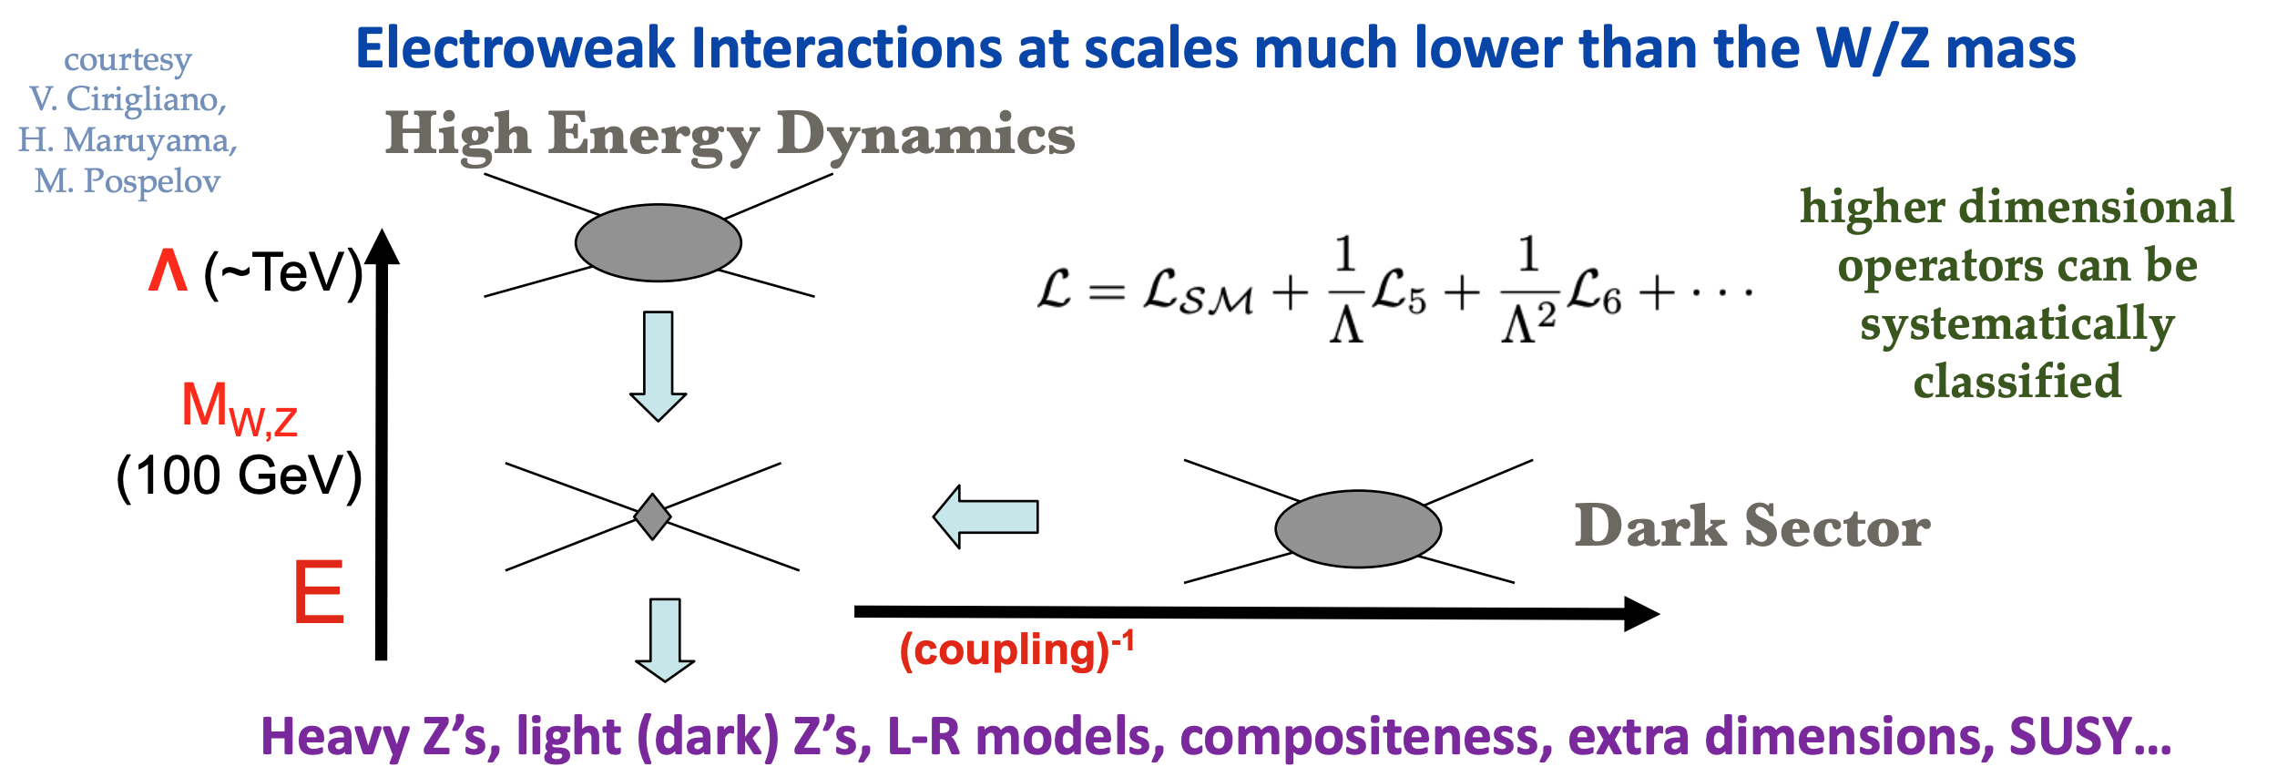

Sensitivity to New Physics
Precise measurement of PV asymmetry probes certain models of new physics at TeV scales
  Interactions modeled as contact interactions with new physics entering in loops at mass scale $Λ$ and coupling $g$
  $\frac{{δA}_{PV}}{A_{PV}}=2.4\%⟶ g\sim 1⟶Λ\sim 7 TeV$
  $Λ\sim 100 MeV⟶g\sim {10}^{−3}α_{QED}$

Slide 13
11 GeV beam
1.25 m LH2 target
Full azimuth acceptance 5-21mrad
65 µA max current
Moller rate ~2 GHz/ µA
344 PAC days (688 calendar days) spread over 3 running periods

Slide 14
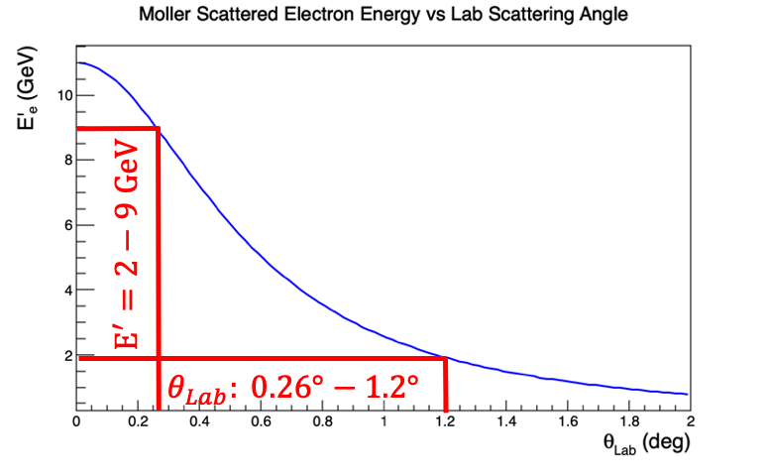
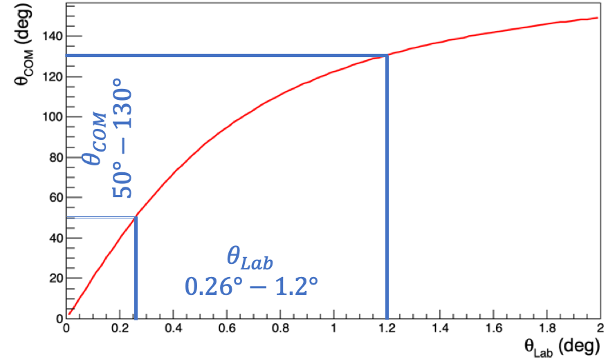
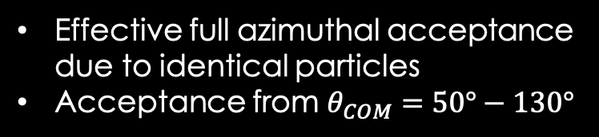
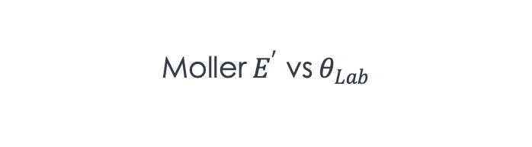

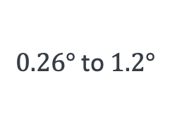
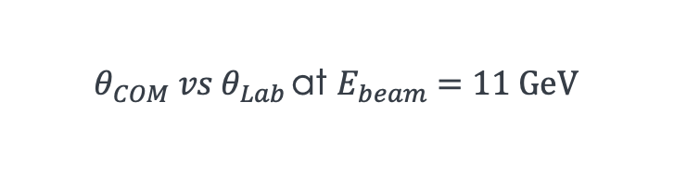
Acceptance
Effective full azimuthal acceptance due to identical particles
Acceptance from $θ_{COM}=50°−130°$
Det
$$E=11\text{GeV}$$
$$0.26° \text{to} 1.2°$$
LH2
$θ_{COM} vs θ_{Lab }$at $E_{beam}=11 \text{GeV}$
$$\text{Moller} E^{′} \text{vs} θ_{Lab}$$
Max FOM @ 5.5 GeV

Slide 15
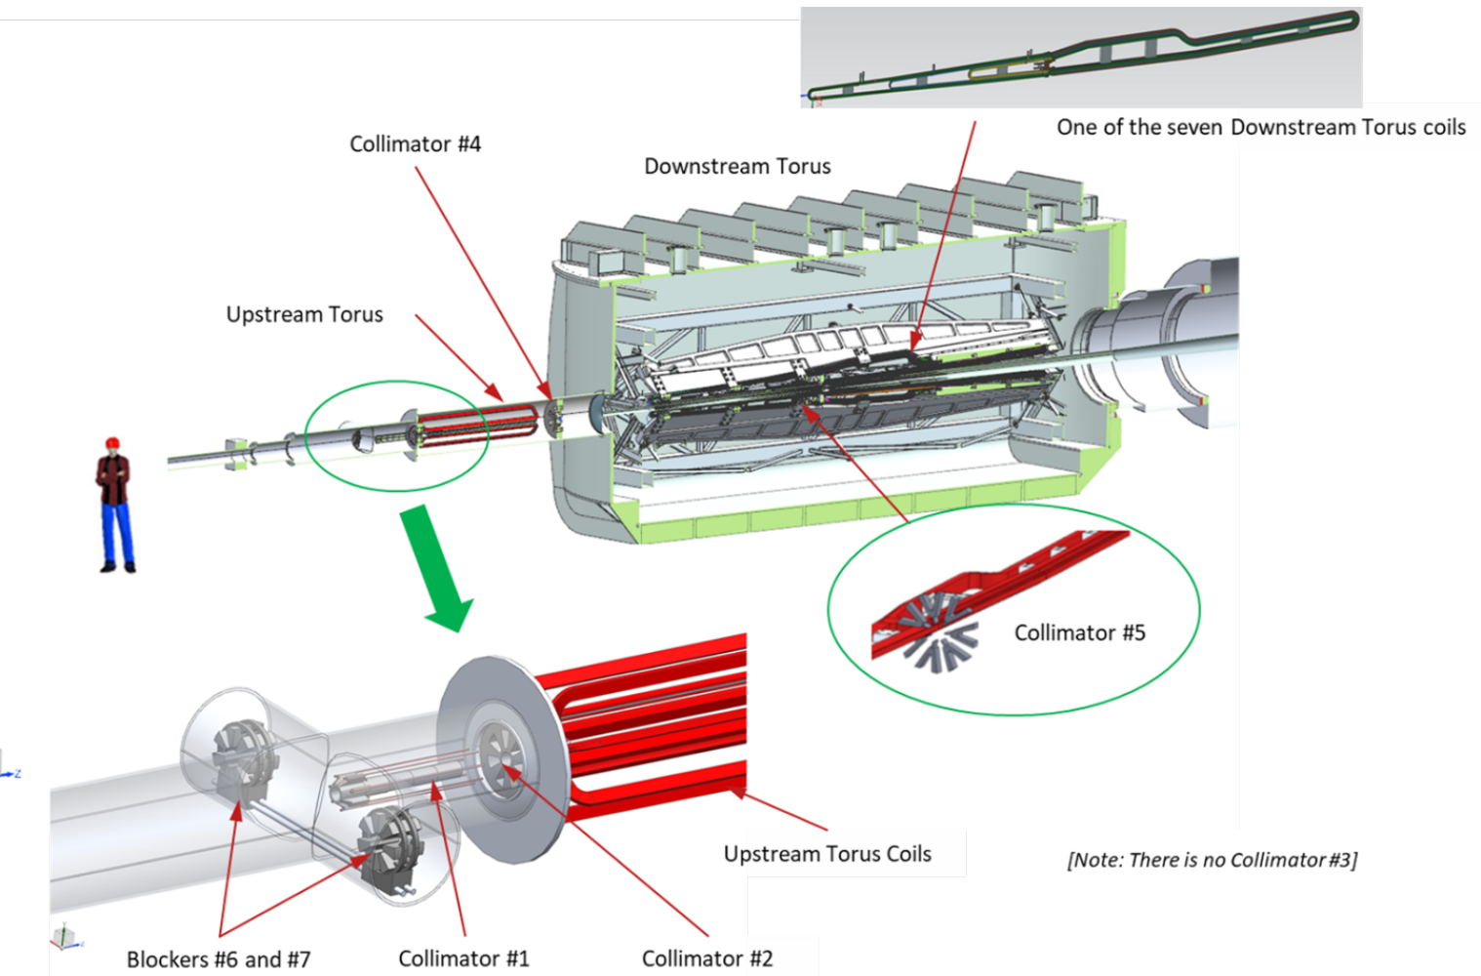
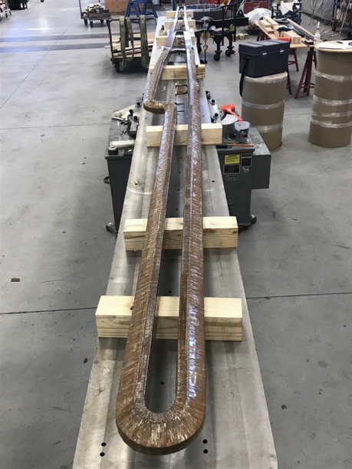
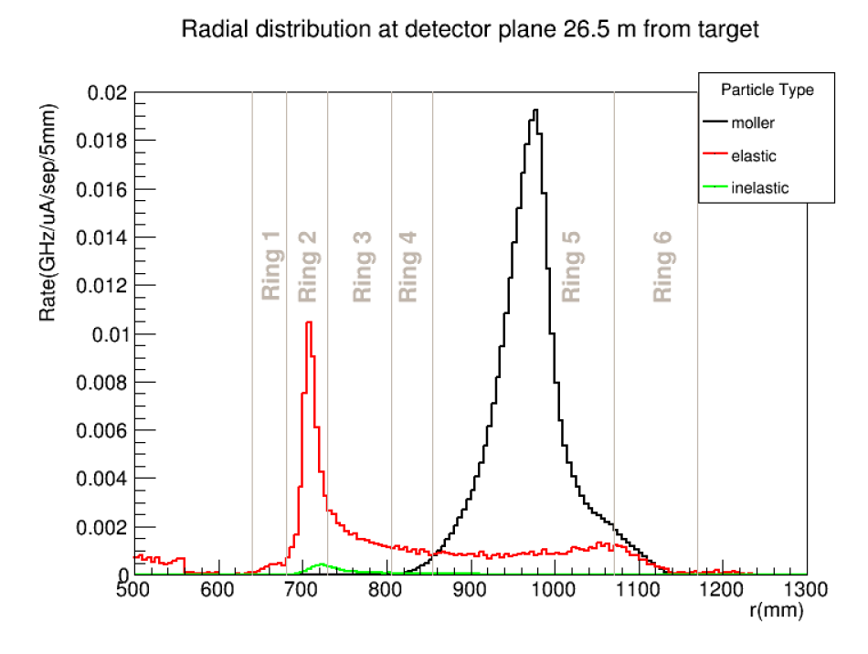
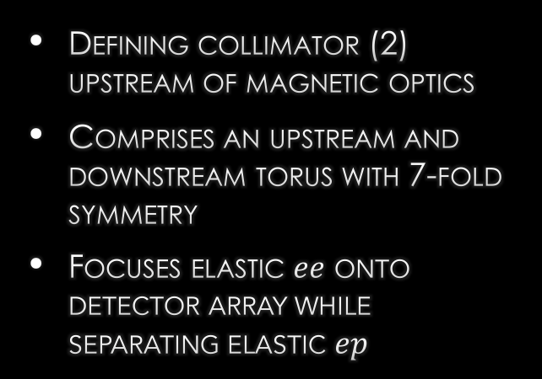
SPECTROMETER
Defining collimator (2) upstream of magnetic optics
Comprises an upstream and downstream torus with 7-fold symmetry
Focuses elastic $ee$ onto detector array while separating elastic $ep$
Early coil prototype

Slide 16
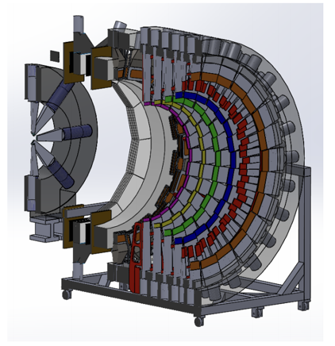
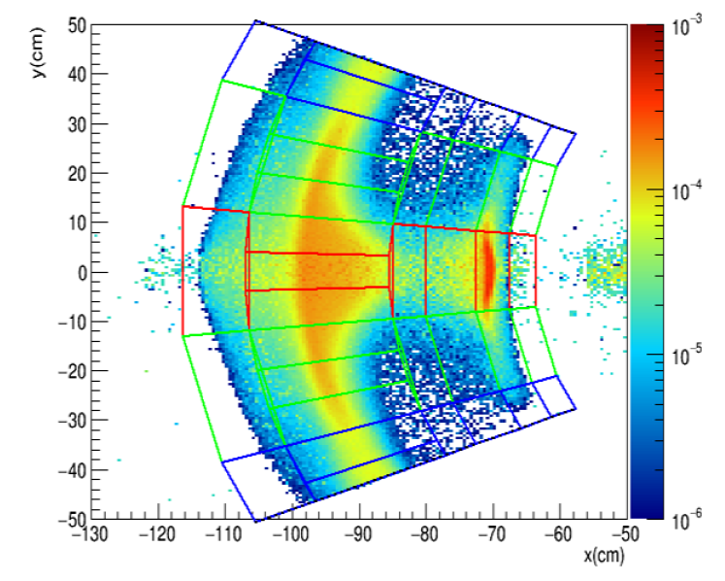
DETECTORS
Six main detector rings over full azimuth measuring different parts of signal
Integrating in current mode
  122 GHz for moller ring
Simulated single octant rate with approximate detector locations

Slide 17
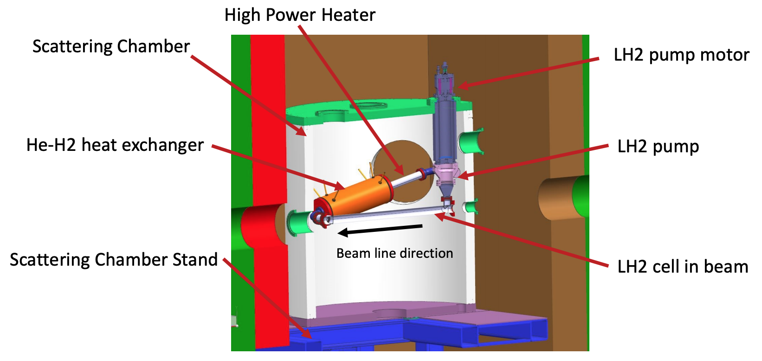
Liquid Hydrogen Target
1.25 m long target
Designed with extensive CFD
Qweak target precursor
  47 ppm → 30 ppm
  Flow 17 l/s → 25 l/s
  Cooling 3 kW → 4 kW

Slide 18
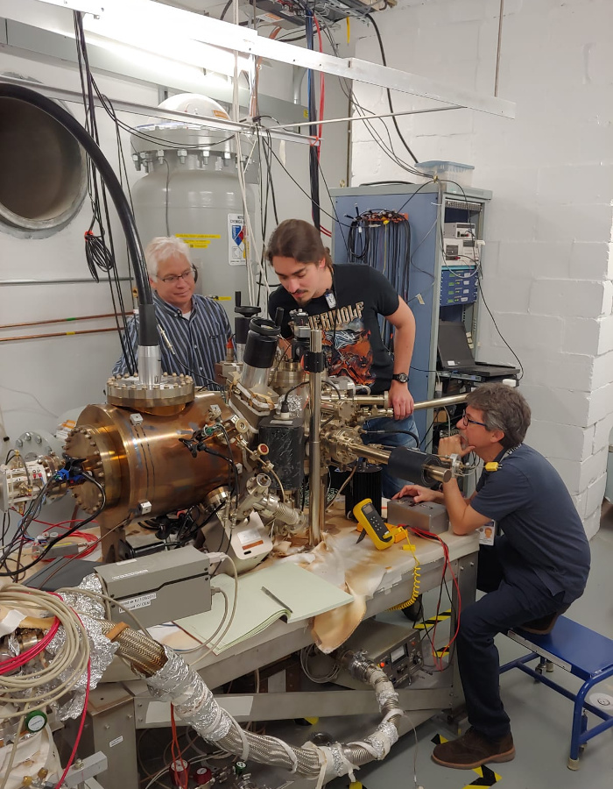
Parity Quality Electron Beam
High polarization (~85%)→ routinely accomplished with GaAs photocathode

Slide 19
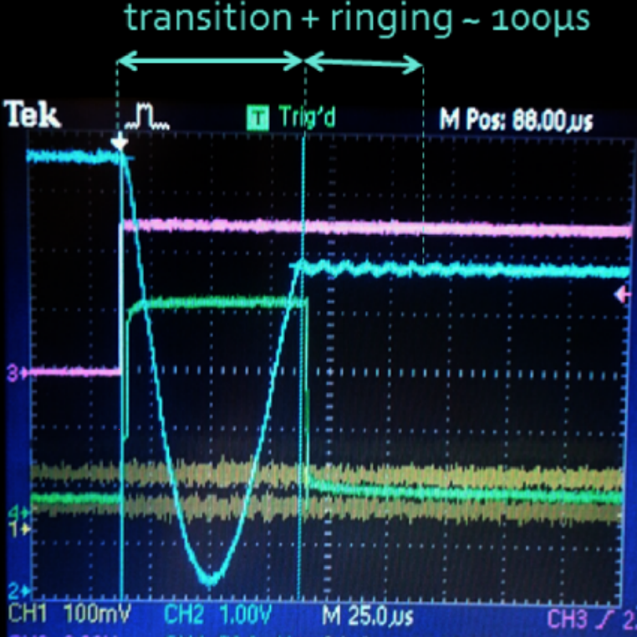
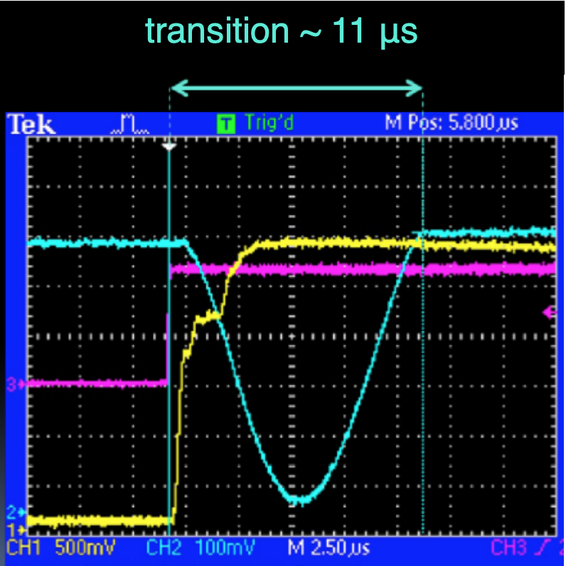
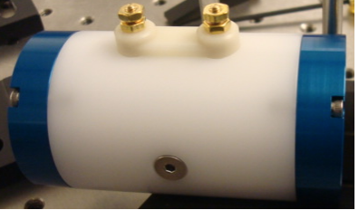
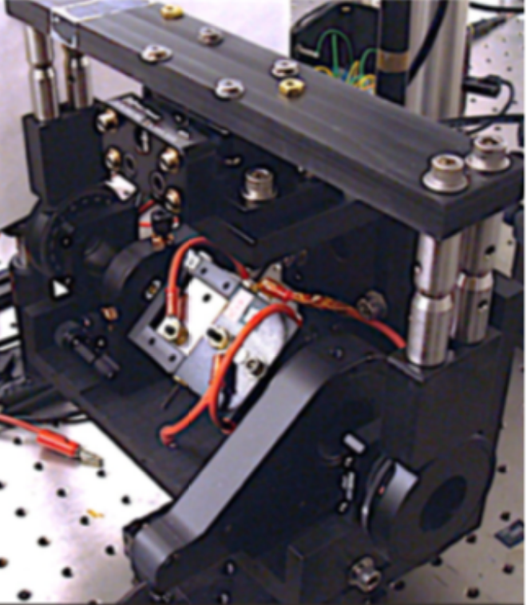
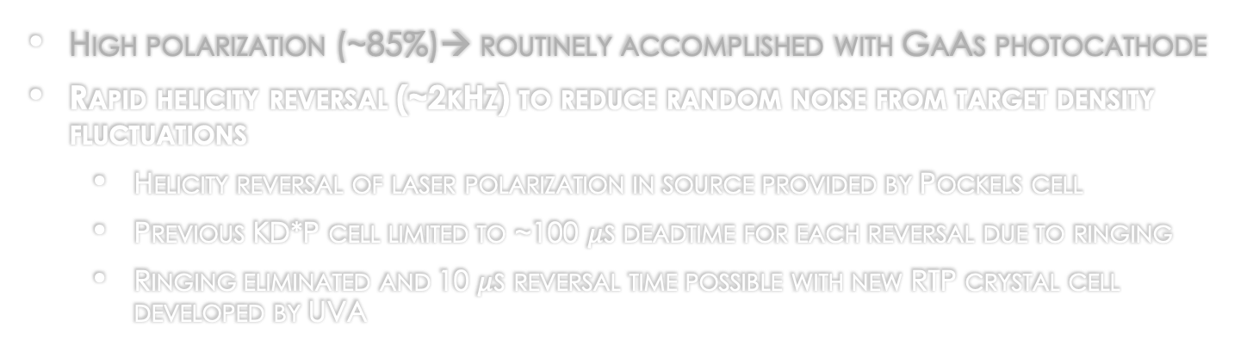
Parity Quality Electron Beam
High polarization (~85%)→ routinely accomplished with GaAs photocathode
Rapid helicity reversal (~2kHz) to reduce random noise from target density fluctuations
  Helicity reversal of laser polarization in source provided by Pockels cell
  Previous KD*P cell limited to ~100 $μ$s deadtime for each reversal due to ringing
  Ringing eliminated and 10 $μ$s reversal time possible with new RTP crystal cell developed by UVA
KD*P
RTP

Slide 20
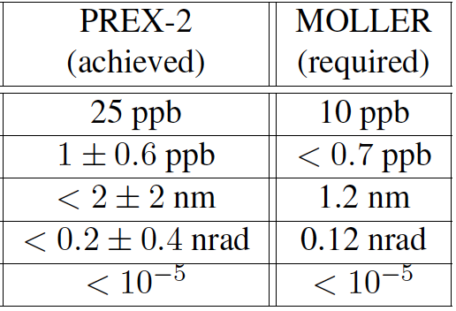
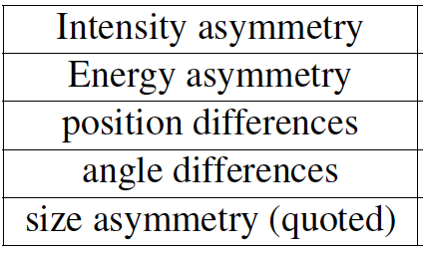
Parity Quality Electron Beam
High polarization (~85%)→ routinely accomplished with GaAs photocathode
Rapid helicity reversal (~2kHz) to minimize random noise (eg. Target density fluctuations and slow drifts
Helicity correlated (HC) Differences suppressed
Achieving Moller Requirements
Injector upgrade including new Wien filter and 200 keV gun with no RF prebuncher
  Reduced space charge effects (beam halo)
  Better matching = adiabatic damping
  No x/y coupling
RTP cell provides ability to feed back on position and intensity differences

Slide 21
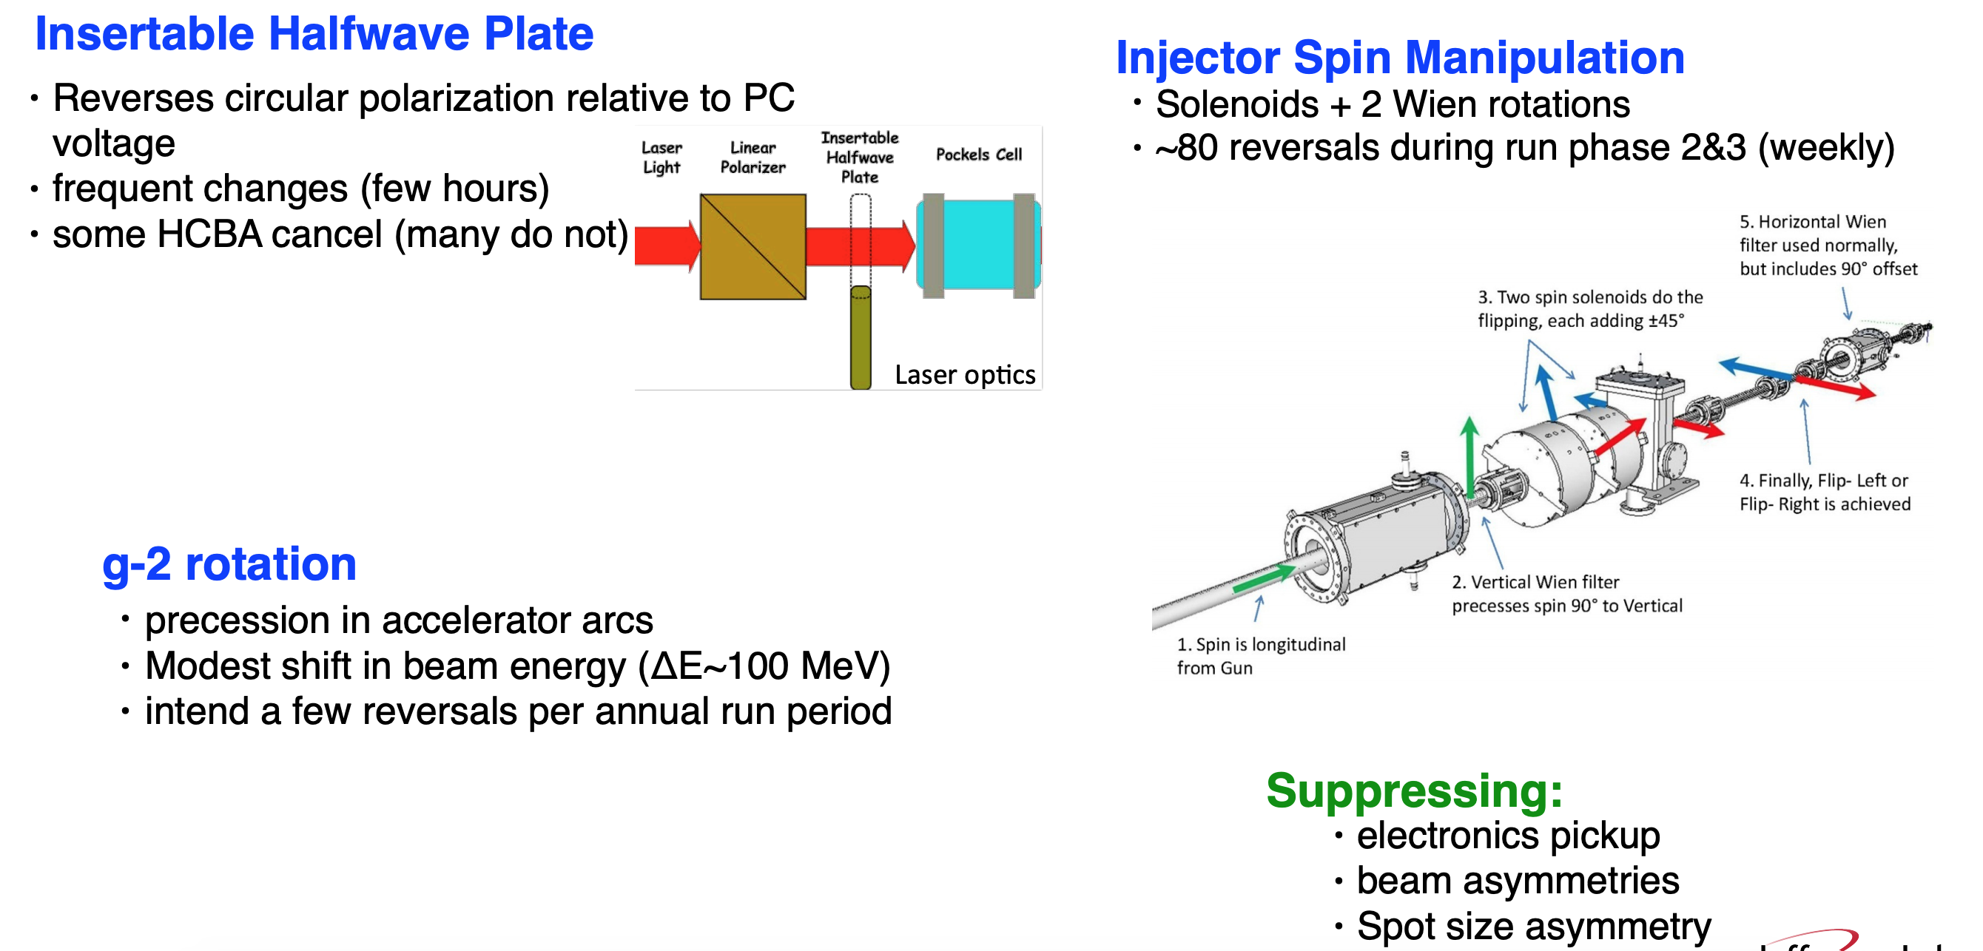
Parity Quality Electron Beam
High polarization (~85%)→ routinely accomplished with GaAs photocathode
Rapid helicity reversal (~2kHz) to minimize random noise (eg. Target density fluctuations and slow drifts
Helicity correlated (HC) Differences suppressed
Cancelation of remaining HC false asymmetries = Slow reversals
Courtesy K. Paschke

Slide 22
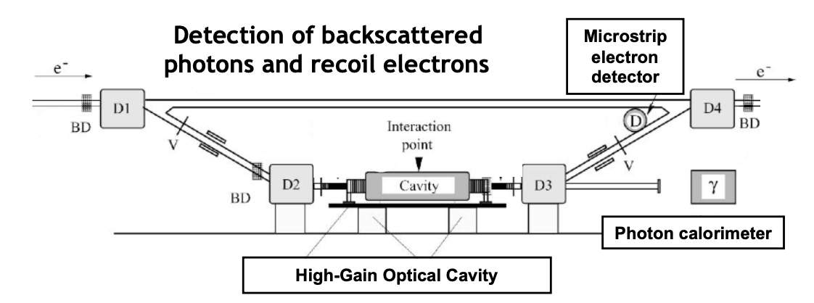
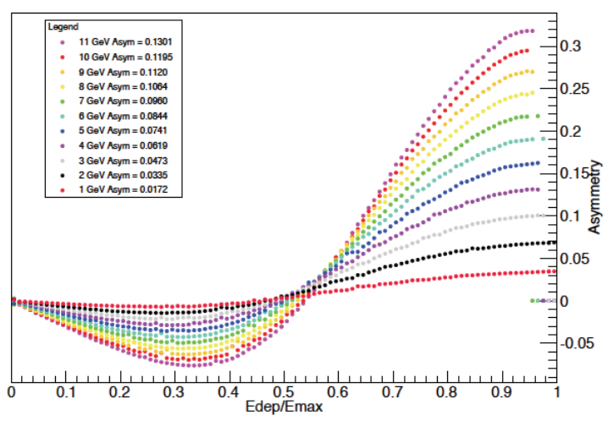
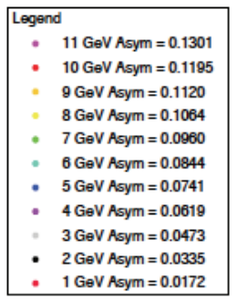

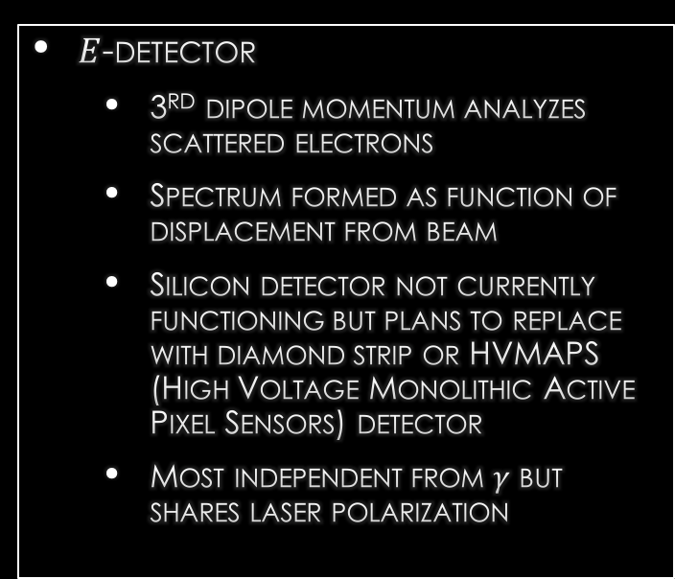

POLARIMETRY: Compton ~0.4%
Scattering ~3kW circularly polarized green laser from electron beam and detecting both back-scattered $γ$and e-
$γ$-detector
  No-threshold integration 200 MhZ
  Operating during PREXII-CREX
$E$-detector
  3rd dipole momentum analyzes scattered electrons
  Spectrum formed as function of displacement from beam
  Silicon detector not currently functioning but plans to replace with diamond strip or HVMAPS (High Voltage Monolithic Active Pixel Sensors) detector
  Most independent from $γ$ but shares laser polarization

Slide 23


POLARIMETRY: Moller ~0.4%
Elastic ee scattering from a Fe foil polarized || beam
Parity conserving Moller asym
$$A=\frac{σ_{↑↑}−σ_{↓↑}}{σ_{↑↑}+σ_{↓↑}}$$
$$A_{meas}=\sum_{i,j=x,y,z}{P_{i}^{t}A_{ij}P_{j}^{b}}$$
Measured asymmetry for us
  $$A_{long}=P_{z}^{t}A_{zz}P_{z}^{b}$$
Key systematics being studied: Levchuk effect, target polarization, sensitivity to optics
Lots of lessons learned during PREXII/CREX
may add GEM tracker to reduce systematics from optics uncertainty

Slide 24
MOLLER Project Team has been very active
Thanks to the leads who have helped shepherd MOLLER through Several reviews
  Project Manager: J. Fast
  Deputy Project Manager: J. Butler
  Project Engineer: R. Wines
  Safety Lead: E. Folts
STATUS
Achieved CD1 in Dec 2020
Going through reviews now expecting CD2-3 in early 2023
Expect to begin installation in Fall of 2024 with first physics beam in 2025

Slide 25
Thank You
The MOLLER collaboration consists of ~160 authors, 37 institutions from 6 countries

Slide 26



Figure of Merit
${\text{A}}_{\text{pv}}$ varies over acceptance from 40 to 27 ppb → $\left\langle {\text{A}}_{\text{pv}}\right\rangle$~32 ppb
Cross section minimum at $θ_{COM}=90°$
FOM = $\left\langle A_{PV}^{2}R_{ee}\right\rangle$ maximum at $θ_{COM}=90°$ and varies slowly away from 90 deg

Slide 27



Sensitivity to New Physics
New physics can be parametrized by contact interactions in an effective Lagrangian
Varying sensitivity to different couplings
  MOLLER part of larger program to probe phase space of different models of new physics
  With $\frac{g}{4π}=1$ as in high energy physics gives MOLLER sensitivity to $Λ_{LL}^{ee}=27$ TeV
https://arxiv.org/abs/1302.6263

Slide 28


Running of Weak mixing angle
Running of $\sin^{2}{θ_{W}}$ precisely given by Standard Model and anchored absolutely by Measurements at the Z-pole resonance
3 sigma difference between LEP 1 and SLC measurements with nearly equal precision
  Average agrees well with Higgs boson mass of 126 GeV
  Choosing one or the other has ruins agreement with different implications for high energy dynamics
MOLLER proposal to measure ${δsin}^{2}{θ_{W}} =$ 0.00028 has same level of precision and interpretability
Best projected sensitivity to $\sin^{2}{θ_{W}}$at low $Q^{2}$or at collider over next decade.

