Slide 1
ECal Installation
Don Jones
SBS Weekly meeting
Mar 29, 2023

Slide 2
Rough schedule
April-May Hall open for GEp and other work
May 29-July 21 Crane repair. Other work can also be done in the hall just needs to be coordinated
July 21 - Aug 10th Get the hall ready for beam. We will try and start beam as soon as reasonable.
Gives some buffer to finish the crane work.
Aug10th - Oct 2nd Run GEn and A_LL experiment
Oct 2nd - Jan 30th deinstall polarized target and install cryotarget etc for GEn-Rp
Jan 30th - Feb 26th Run GEN-RP and K_LL
Feb 27th - Aug 23th Install GEP
Aug-Dec run GEp

Slide 3
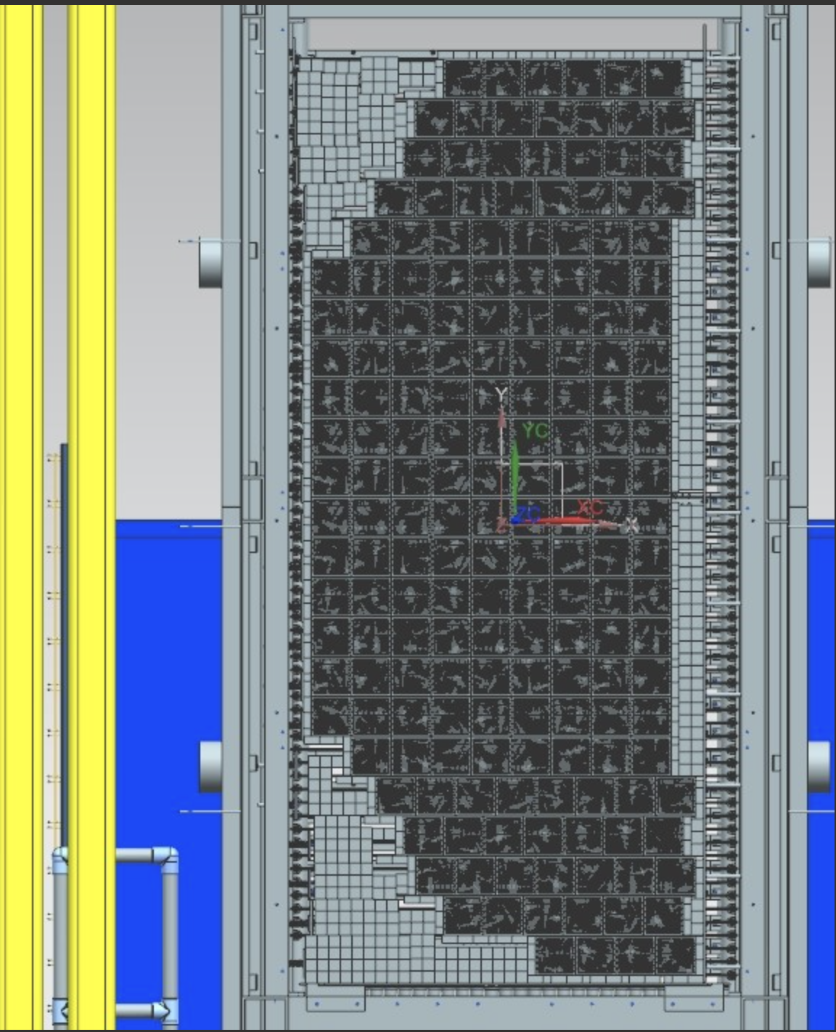
ECal overview
184 supermodules
  Each with 9 crystals and 9 PMTs
  5”x 5”
  23 tall (9.6’) and 9.5 (4.0’) wide in active area
Frame sits on elevated (3’ tall) platform.
  Frame further elevates active area so that bottom row is 5’ off the hall floor and the detector is centered on beam line 10’ off the floor
Inactive crystals used for stacking support
Will be located at three different angles and distances from target so entire platform on Hilman rollers

Slide 4
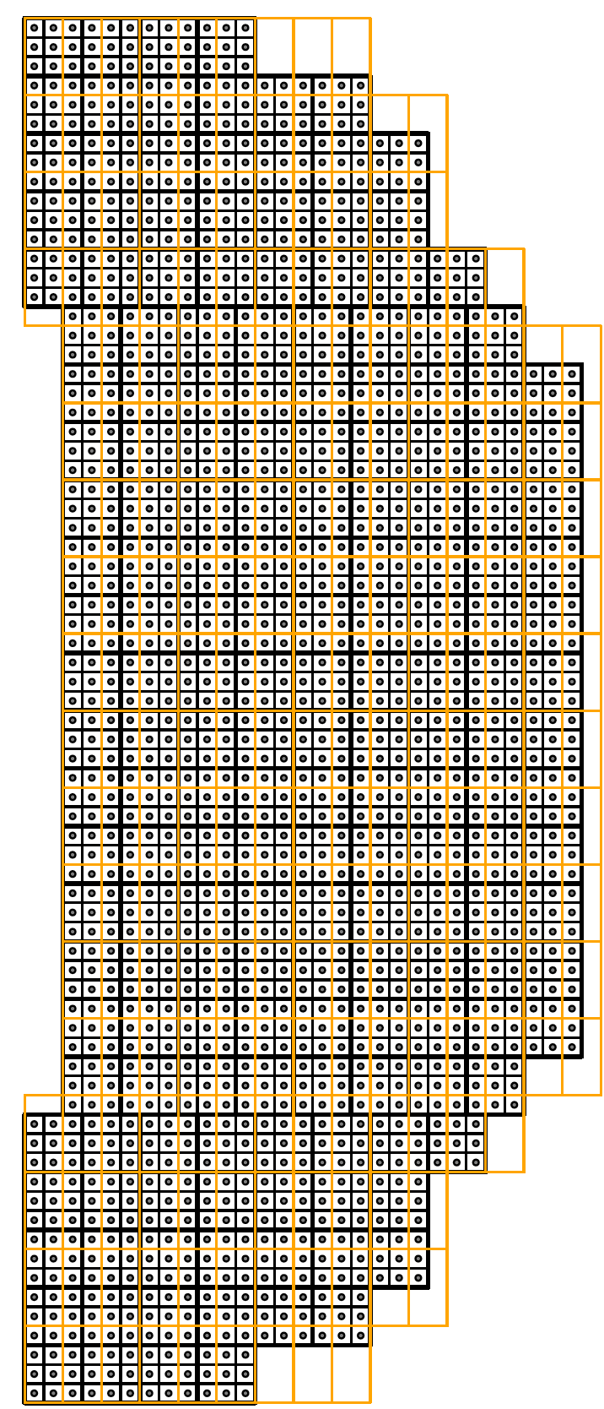

Slide 5
General considerations
Due to space constraints onsite, installation will primarily happen in the Hall
Will have to work around crane repair activity this summer and break for running GEn/ALL (Aug-Sept 2023) and GEn-RP/KLL (Feb 2024)
Electronics, cables, patch panels and rack space currently used by BigBite, GRINCH and Hodoscope will be repurposed for ECal
  Much of the activity will be compressed into the Spring and Summer of 2024
  Limited in the amount of early electronics we can hook-up/pre-install
ECal is just one arm of a complex experimental installation.
  Need to coordinate activities between different parties to ensure we aren’t hindering each other’s progress.
  To the best extent possible, map out daily activities in advance and distribute to other teams with possible overlapping or colliding goals

Slide 6
Components for installation and assembly
ECal supermodule stack
  Install frame on platform
  Install lifting assembly for moving supermodules into place
  Stack crystals+ supermodules
  Assemble heating system
  Install insulation and light-tight enclosure assembly
  Install PMTs + bases carefully documenting the position of each individually calibrated PMT in the matrix
  Install light guide cooling system
  Install frame + patch panels for PMT signal+HV cables
  Map and label HV and signal cables
  Install HV boxes outside enclosure
  Route HV lines to boxes
  Route signal cables to Front End racks
  Test heating system meets requirements in full set up

Slide 7
Components for installation and assembly
Front end electronics
  Install racks on platform and power them up
  Install NIM crates + cooling fans + patch panels
  Create channel map for each PMT to summing module channel
  Attach cables to proper summing modules
  Create map and label PMT to patch panel channels
  Build ribbon cables and attach from to patch panels
  At the earliest possible, check each of the 1656 individual PMT and HV channel by reading them out on an oscilloscope at the patch panel. Repair/replace (cables, PMTs, bases as needed)

Slide 8
Components for installation and assembly
HV system installation
  Make remaining 24 pin HV cables and break out boxes
  Route 75m cables from racks near detector to SHV panel boxes in DAQ bunker
  Install SHV supplies + modules in racks in DAQ bunker
  Create map for SHV panels to supply channels
  Run SHV cables from patch panels to modules
  Test each channel and replace modules as needed
Test entire HV + readout chain using cosmics
Gain match using cosmics (do we need cosmic paddles for a trigger?) and input from simulation using procedure similar to the one used in calibrating BigBite

Slide 9
Components for installation and assembly
Signal cables from Front End to DAQ bunker
  1656 long cables
  Have a combination of 110m, 100m and 75m cables
  Making 800 more 75m cables
  Label and test
  BNC to BNC going from FE patch panel to DAQ patch panel
DAQ electronics
  Going with FADC-based system
  Install 7 VME crates (up to 256 channels per crate) for 104 FADCs + 1 VME crate for trigger supervisor
  Install 1 VXS crate + 1 NIM crate for scalers
  Install patch panels (combination of BNC to LEMO for LEMO-LEMO cables and BNC to BNC for BNC to LEMO cables)
  Check signals at patch panels
  Create map from patch panel to FADC channel
  Install cables from patch panels to FADCs documenting relative cable path length from PMT to DAQ for each channel and grouping similar lengths into the same module

Slide 10
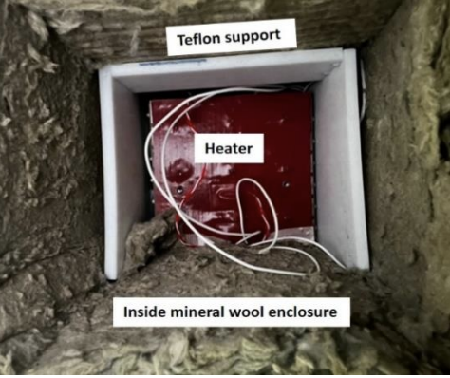
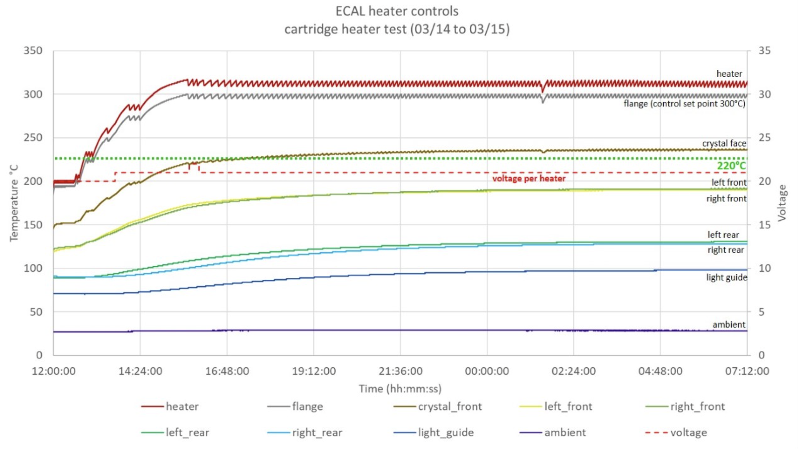
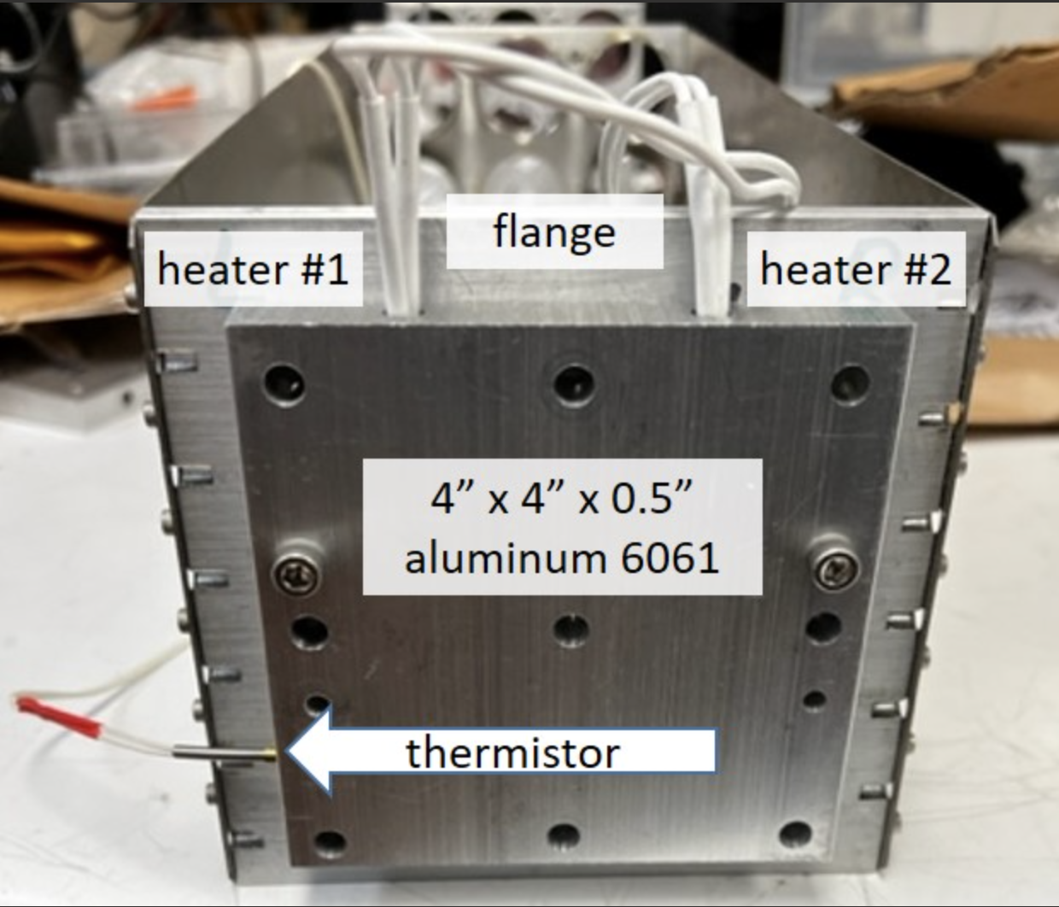
Ongoing efforts: heating tests
Jack Segal strongly recommends using 48 VDC heaters to stay below safety thresholds→requires increase in current by factor of 6
DSG has completed two iterations of the heating test with a single supermodule
  Silicone heaters stuck to front surface (max rated temp 250 degC). Monitored heater temp only and reached >220 degC with 92 Watts
  Cartridge heaters (24 VDC) in aluminum plate. Required 315 degC on heater to reach 220 degC on crystal face.

Slide 11
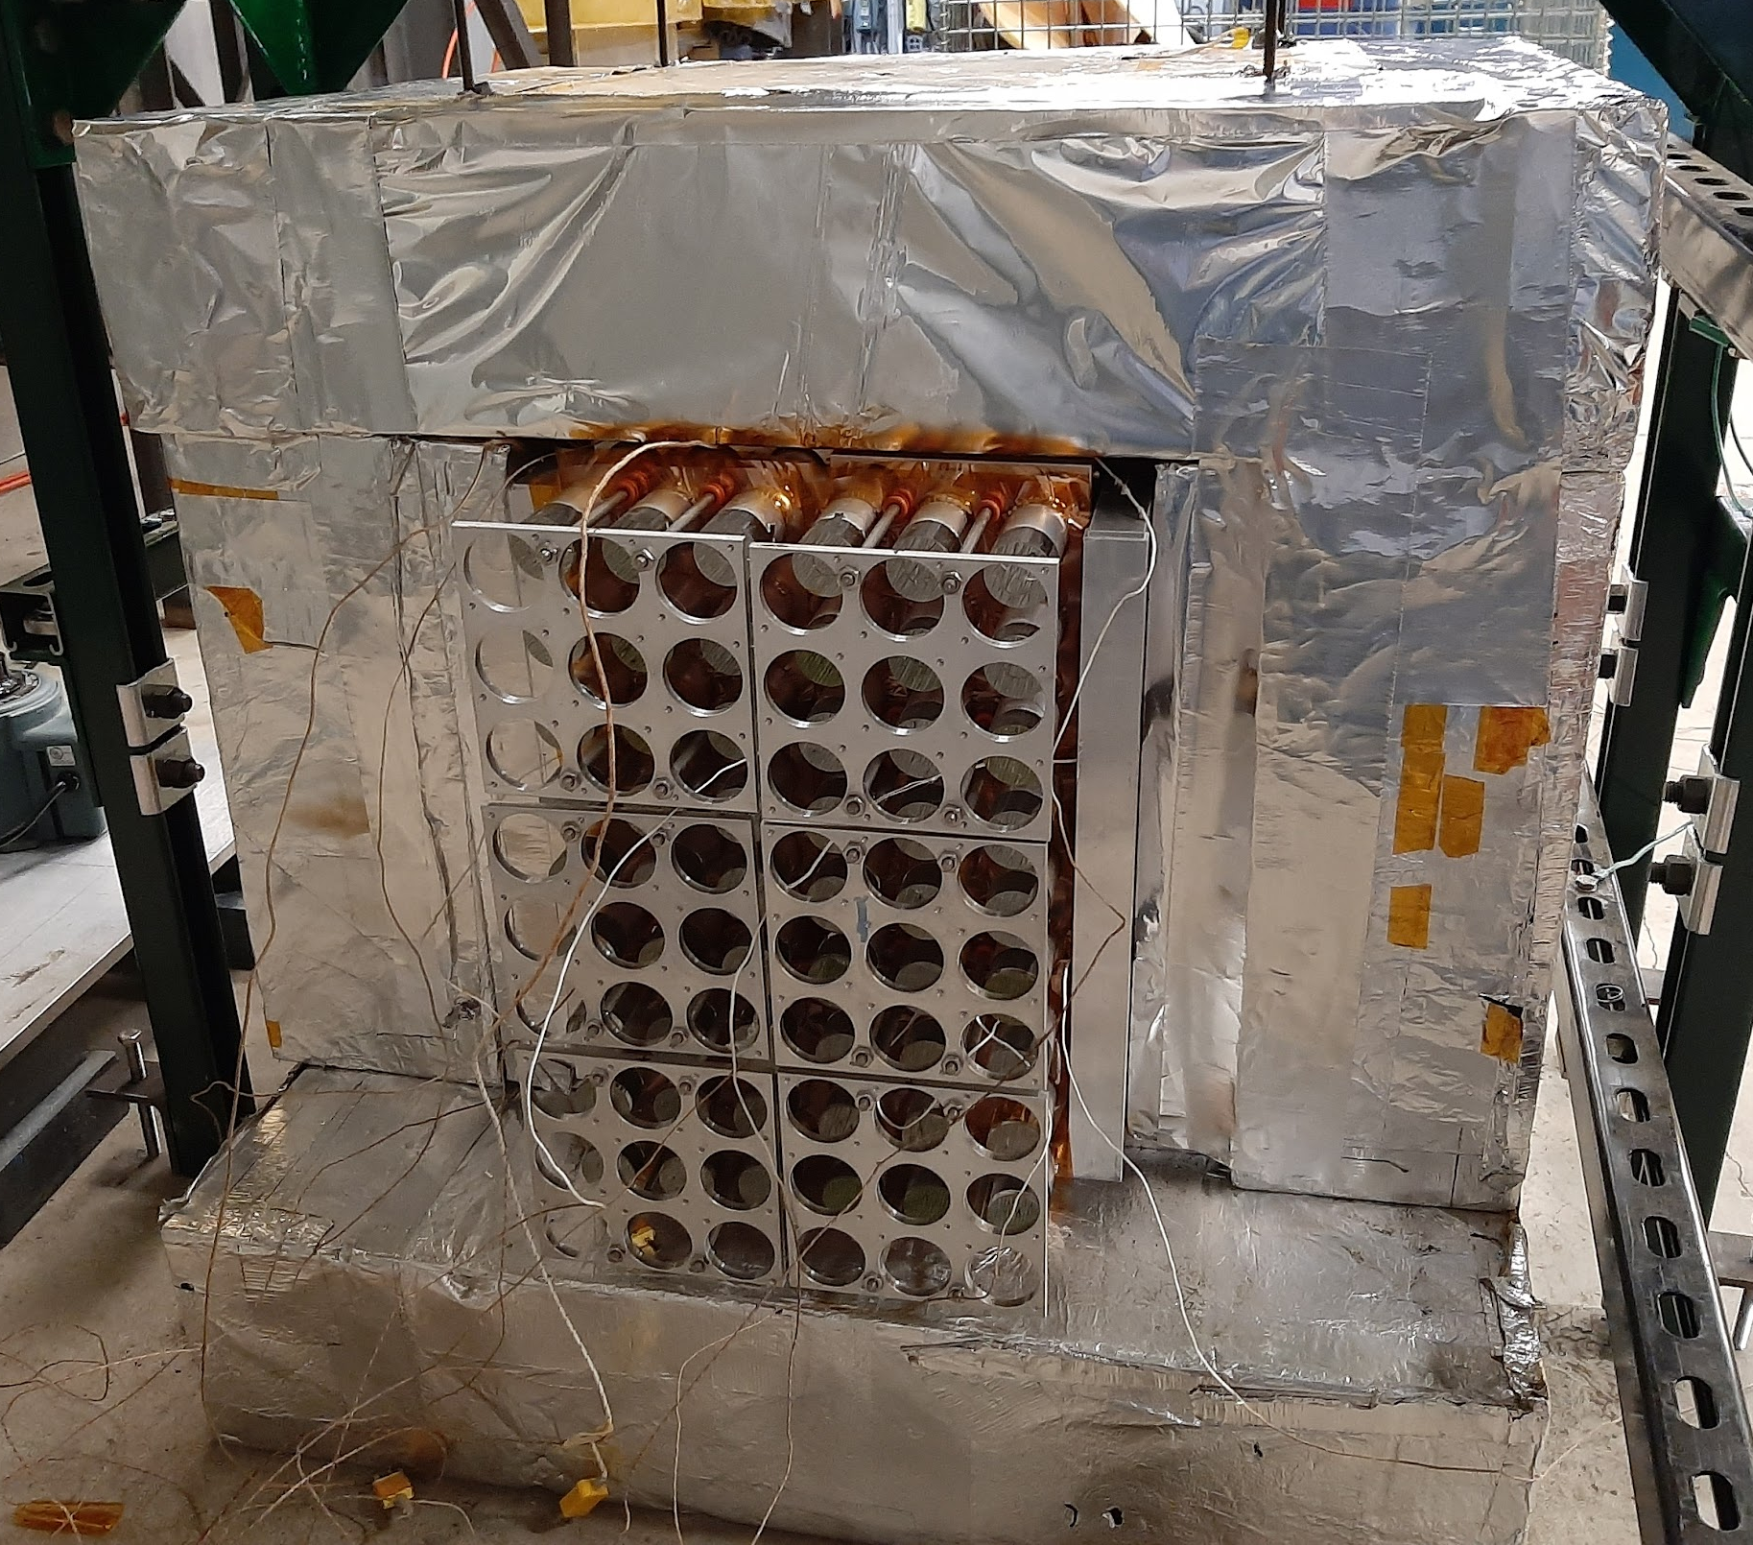
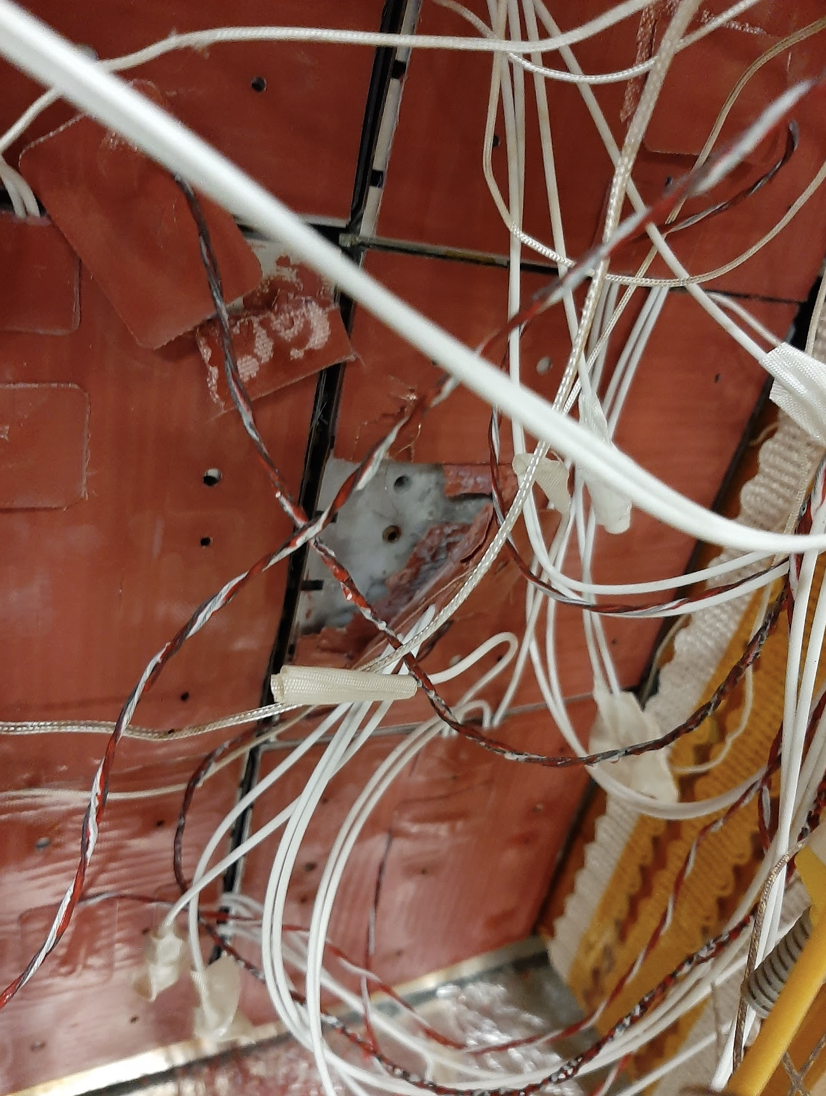
Ongoing efforts: heating tests
I completed a test using the same silicone heaters on a 6 supermodules prototype but only monitoring crystal temperatures
  Reached ~220 degC on front face with 125W
  Don’t know how hot heaters got, but deterioration evident post-test so likely exceeded rated temperature
  Determined these heaters will not be sufficient

Slide 12
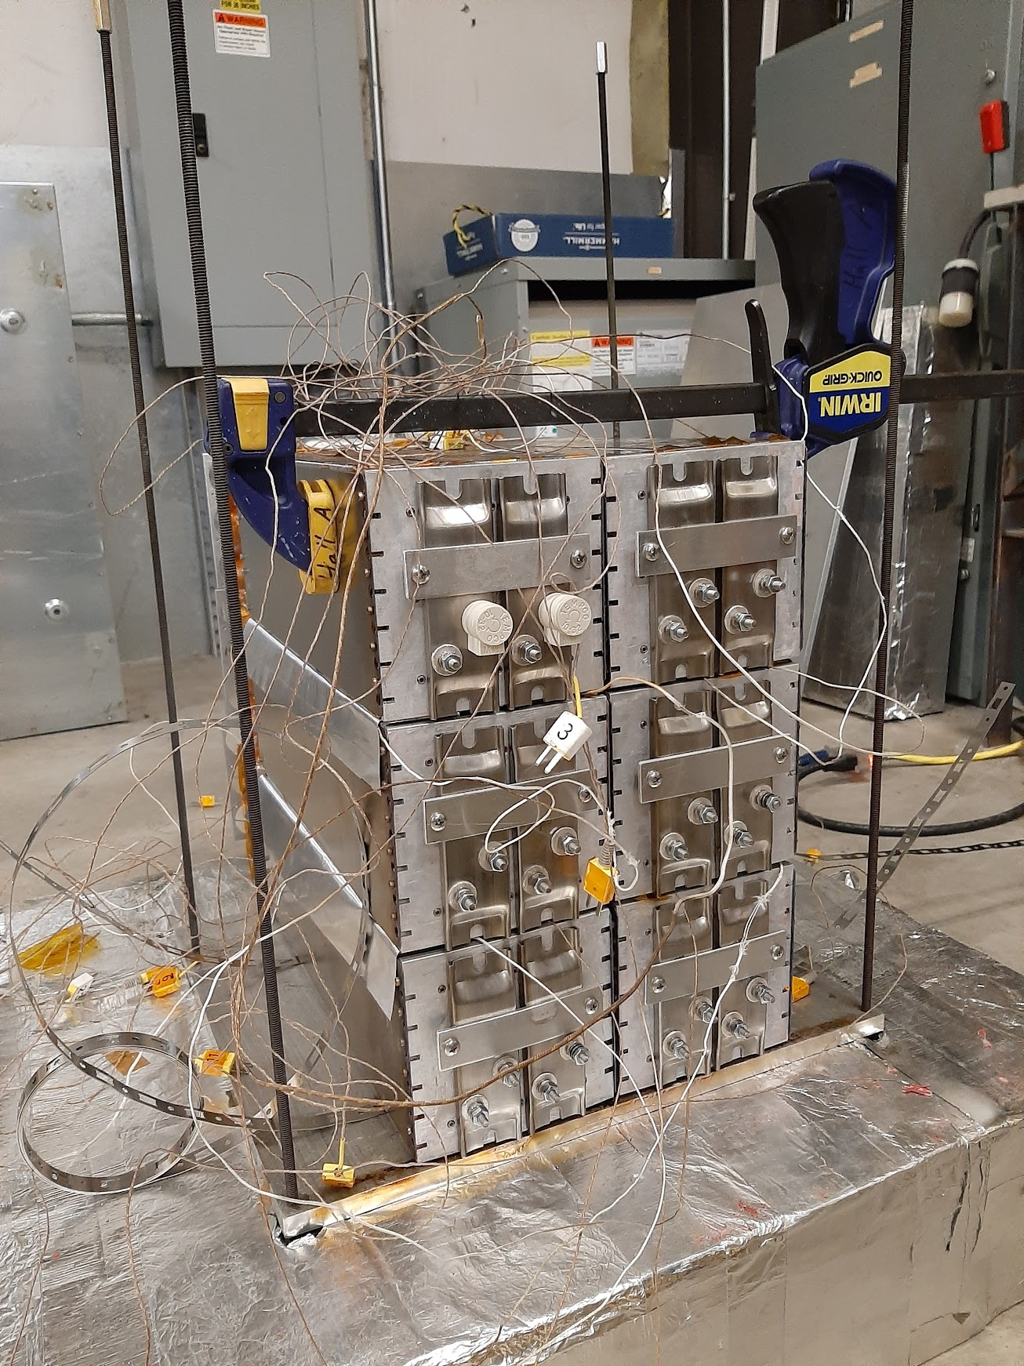
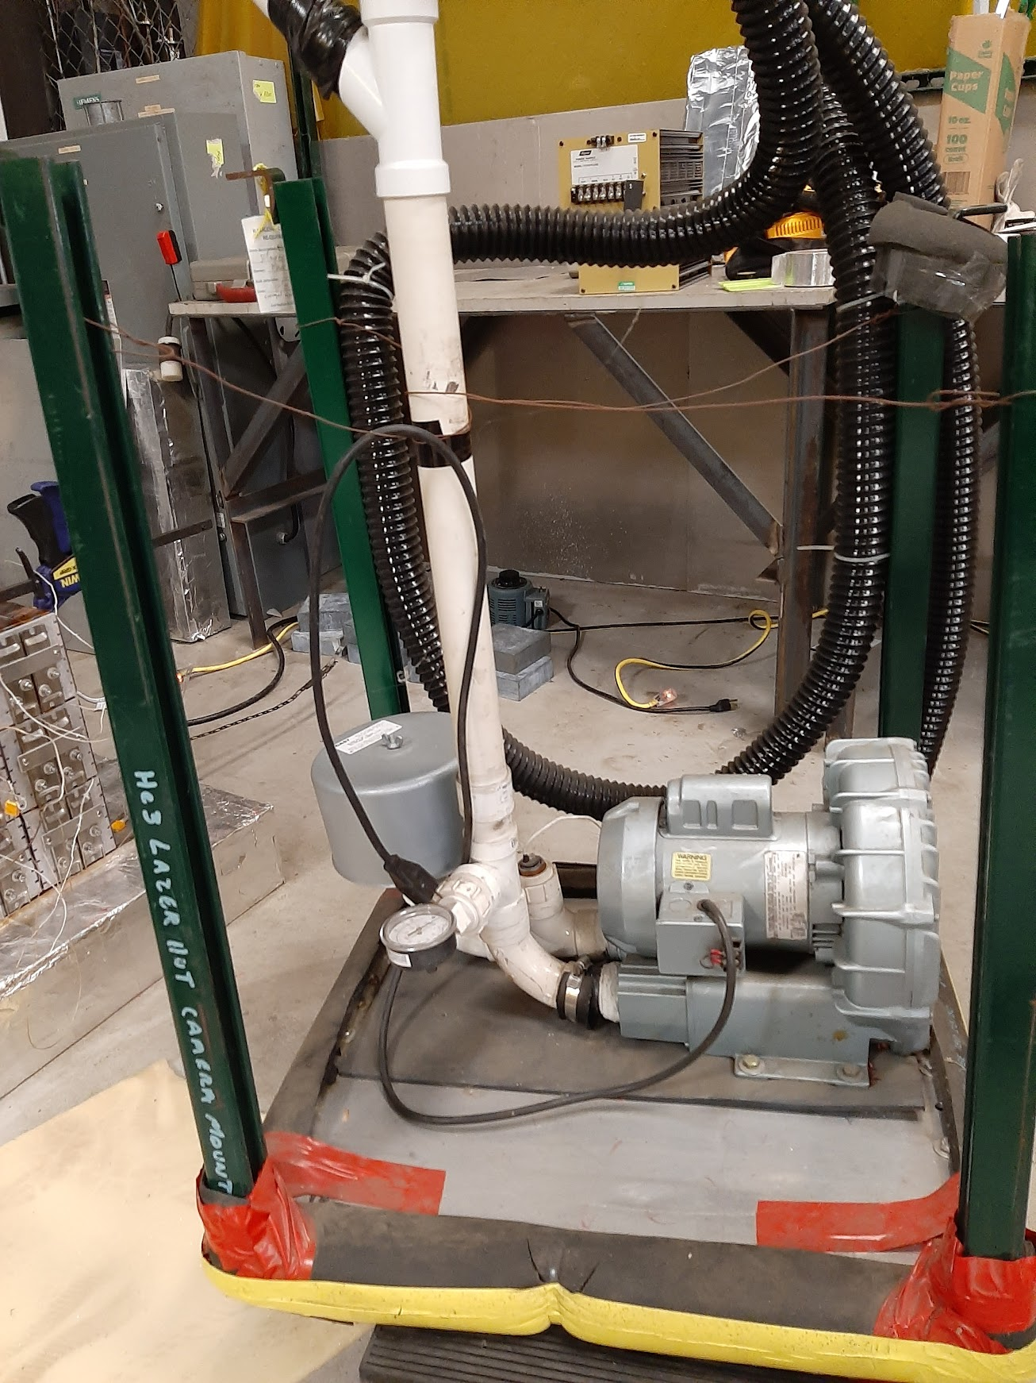
Ongoing efforts: heating tests
Final 6 supermodule prototype test using 120 VAC plate heaters currently being built
  Will monitor crystal and heater temperatures
  Include light guide cooling
  Side heaters will also be employed
Once we have demonstrated (in early to mid April) we can reach the desired temperatures, heaters (either plate as shown here or cartridge as used by DSG) will be custom ordered at 48 VDC and the power we need.
Want all components designed and ordered by June if possible

Slide 13
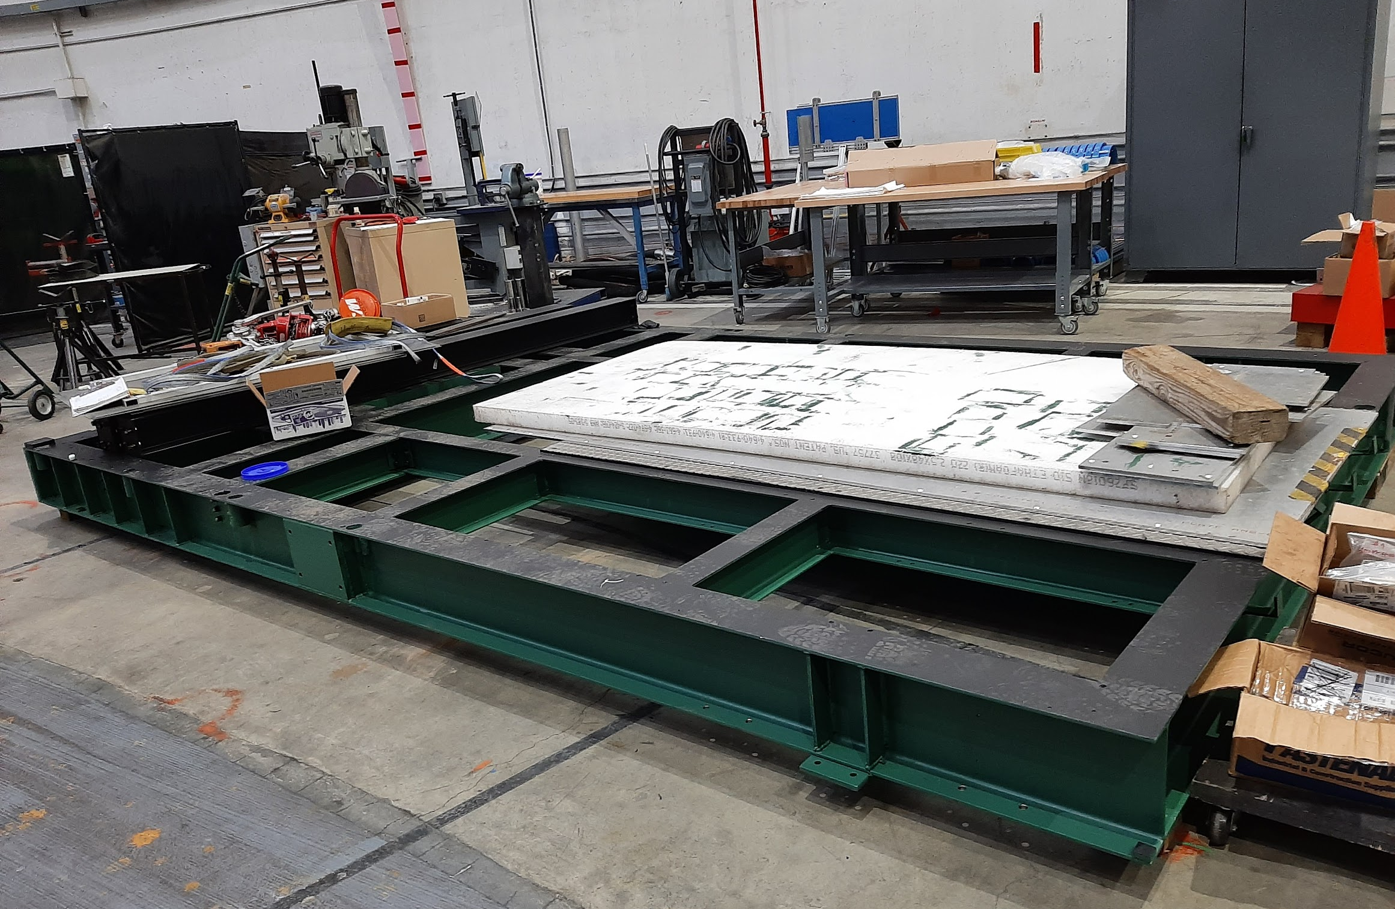
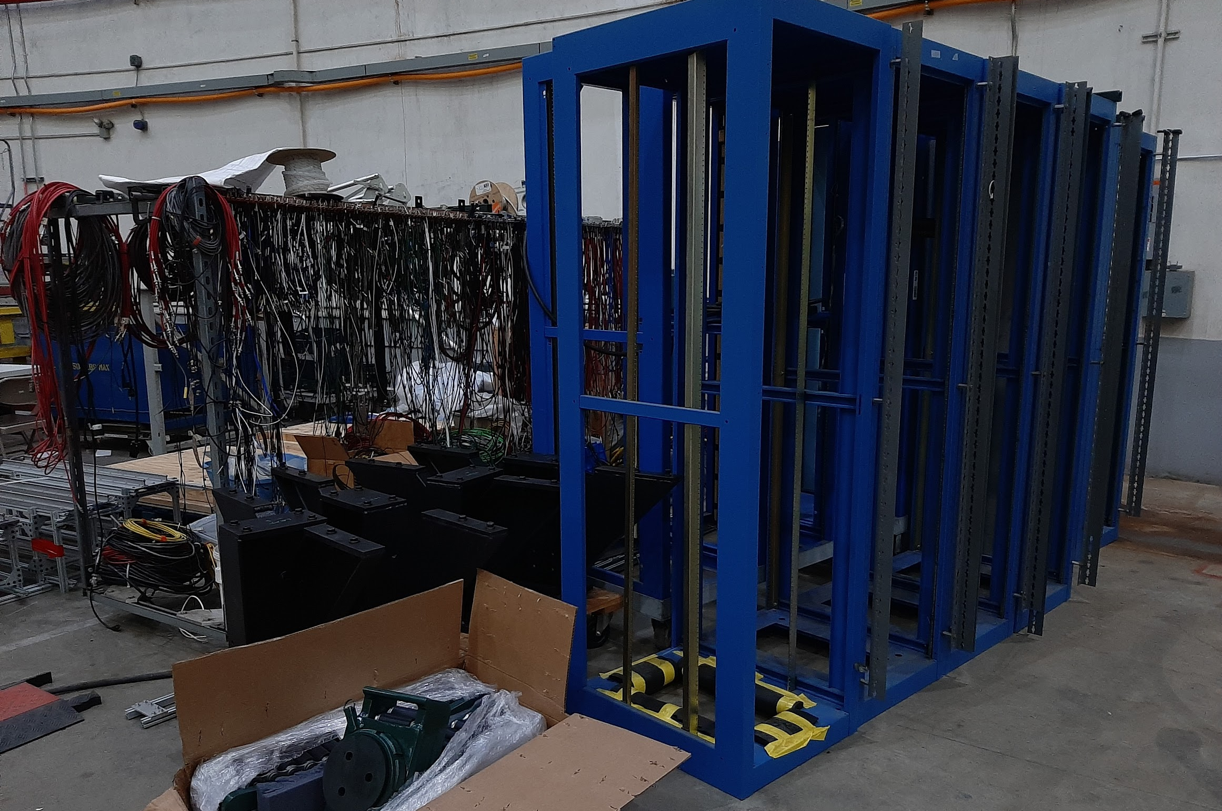

Ongoing efforts: ECal platform
Platform, frame and components moved to hall
Will be assembled soon on beam left
Installation of supermodules will start once assembly
is complete

Slide 14
Ongoing efforts: cables, HV boxes, etc.
Need 22 more 48 channel HV boxes. Mindy is engaged in building these.
Several more 24 pin cables being built. Waiting for part to arrive (late April).
~1000 75m cables being cut and will have to be BNC terminated
Light guide cooling system design being completed and will be ordered soon
PMTs gain individually measured and base construction nearing completion at JMU
All major components ordered. Efforts to locate and ensure anything neglected is located or ordered soon and on time.
Laying out all electronics components and their locations and mapping all signal and HV paths

Slide 15
Big picture installation timeline
Now April-July 2023
Conclude heating tests and order all heaters and connectors required.
Ensure all remaining elements of ECal + enclosure are designed and ordered
Move 5 HV racks and install in DAQ bunker, power up and install all crates, modules and patch panels. Install cables from module to patch panels.
Get training for scissor lift and elevated working with harness
Install supermodules, thermocouples and heaters
Locate place and install heater power supplies and wire them up
Develop controls for heater
Install PMTs+bases and rear patch panel assembly
Complete insulation + enclosure installation

Slide 16
Big picture installation timeline
Oct 2023 – Jan 2024
Install HV cables from patch panel on rear of ECal HV boxes just outside enclosure
Install signal cables from patch panel on rear of ECal to Front End summing/amplifying modules
Install Front End electronics
Complete enclosure installation including rear panels and test for light tightness
Do high-temperature tests of oven. May have to work weekend/evening during initial heat up since there are usually strong odors during the first few hours that could annoy others working in the area.
Completely connect HV chain from supplies to PMTs
Test each channel using cosmics and oscilloscope at Front End patch panels

Slide 17
Big picture installation timeline
Mar – July 2024
Un-install and decable BigBite+GRINCH+Hodo
Get all FADCs (new ones + NPS + BigBite)
Install DAQ: 7 VME crates+FADCs, 1 trigger supervisor crate, scaler crate
Run 1656 long cables from Front End to DAQ bunker
Install patch panels for signal cables
Install short BNC to LEMO or LEMO to LEMO cables from patch panels to FADCs
Test, test, test

Slide 18
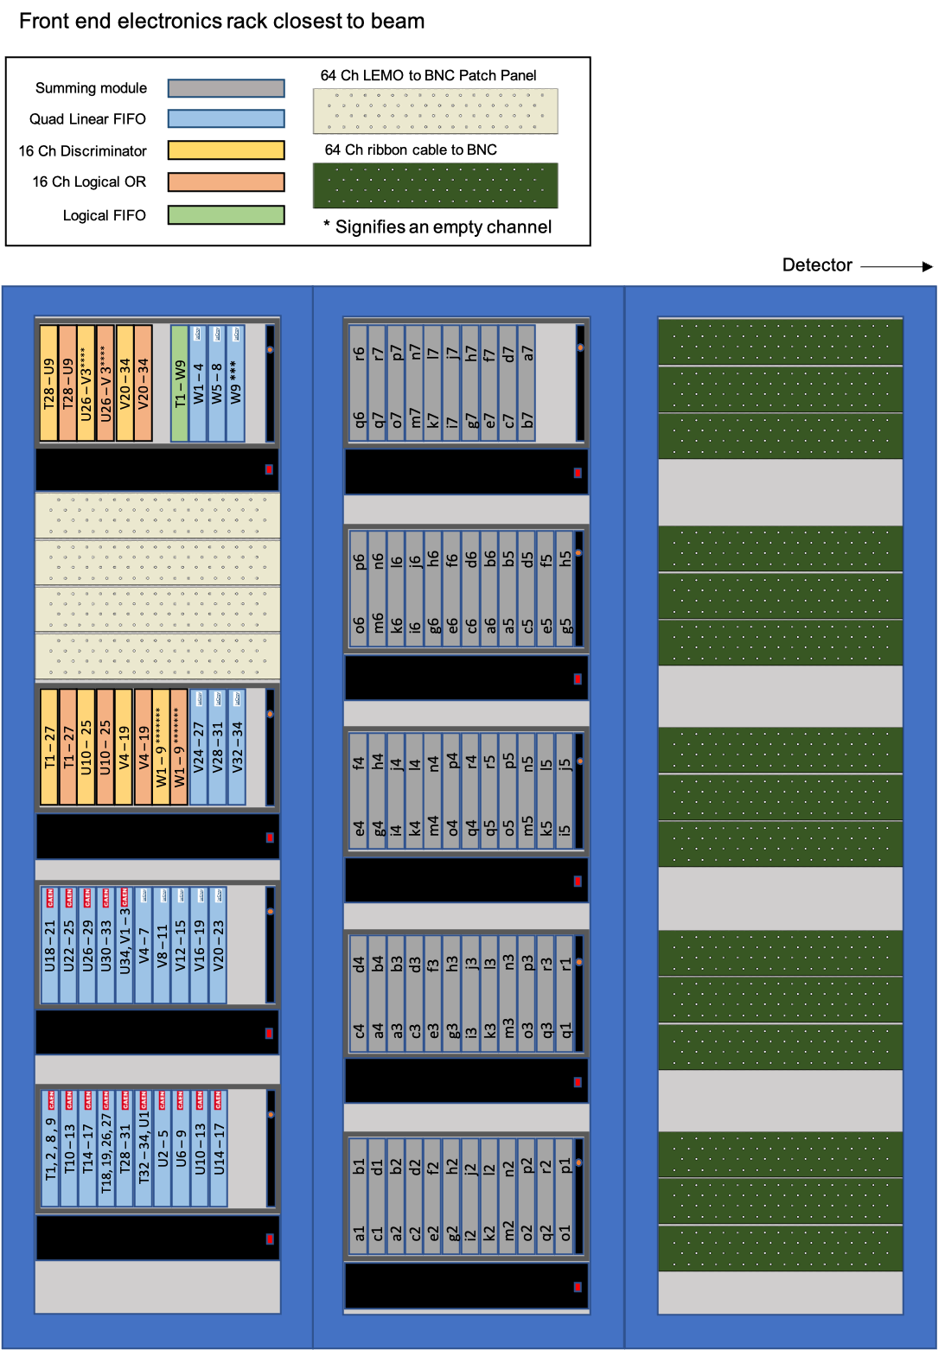
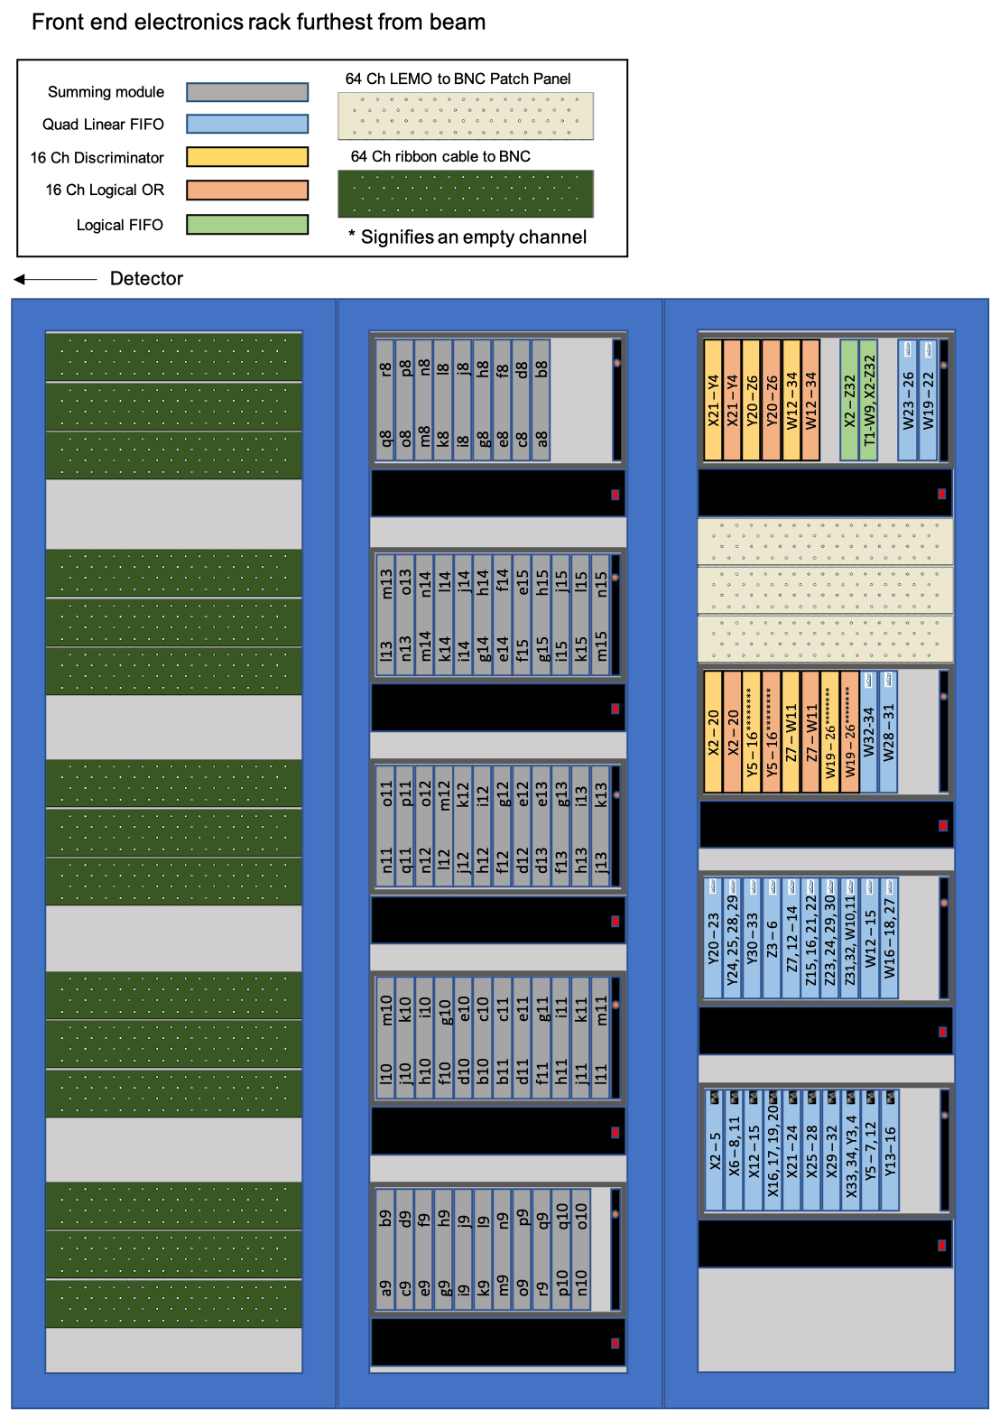
What the Front End used to look like

Slide 19
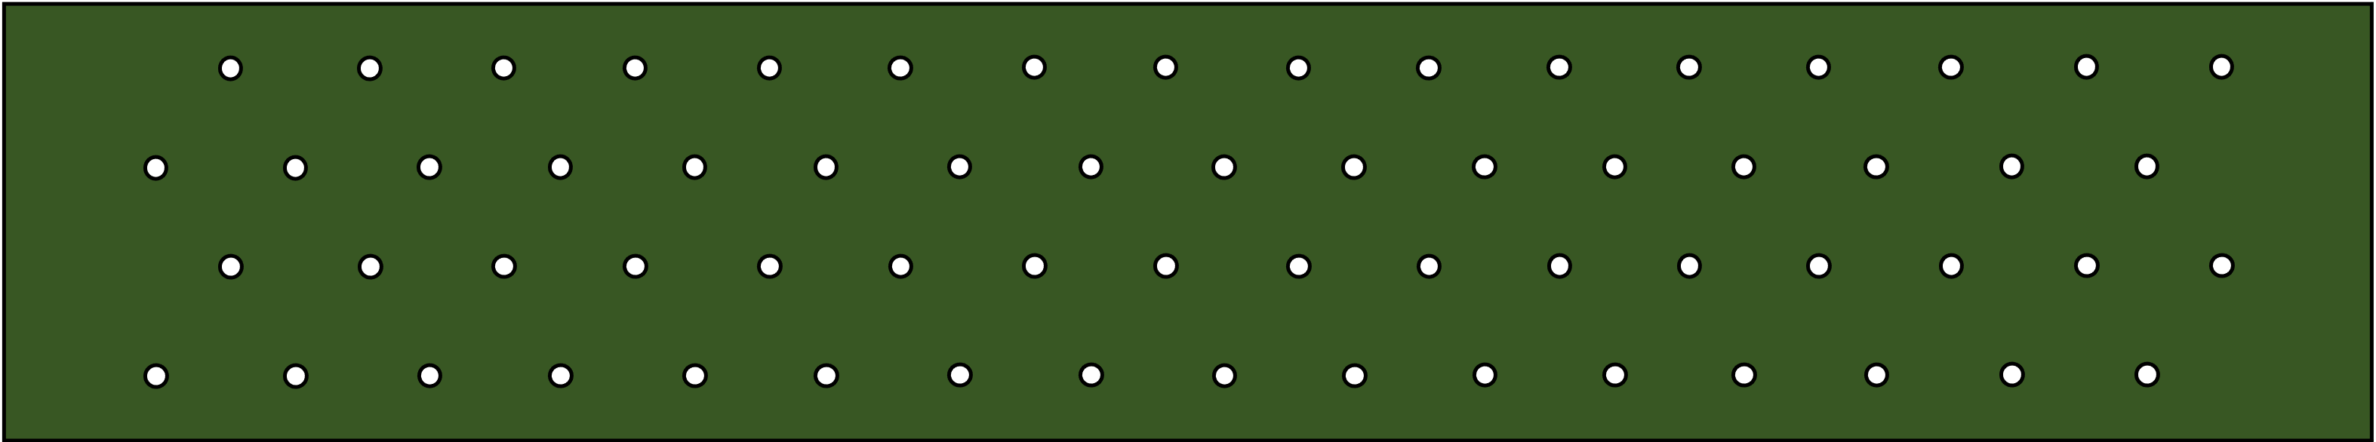
Summing module
64 Ch ribbon cable to BNC
Front End simplified due to FADC readout → trigger now in FPGA
Front end electronics rack closest to beam
Front end electronics rack furthest from beam
16 channel summing-amplifying NIM modules
64 channel flat cable-to-BNC patch panels

Slide 20
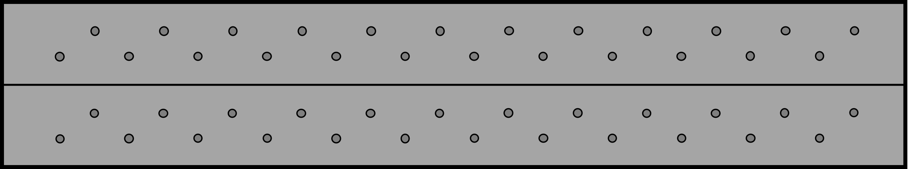
SHV PP
120 Channels
SHV PP
192 Channels
SHV PP
192 Channels
SHV PP
192 Channels
HV
HV
HV
HV
HV
1656 High Voltage Channels over 5 Racks
SHV PP
192 Channels
SHV PP
192 Channels
SHV PP
192 Channels
SHV PP
192 Channels
HV
HV
HV
HV
HV

Slide 21
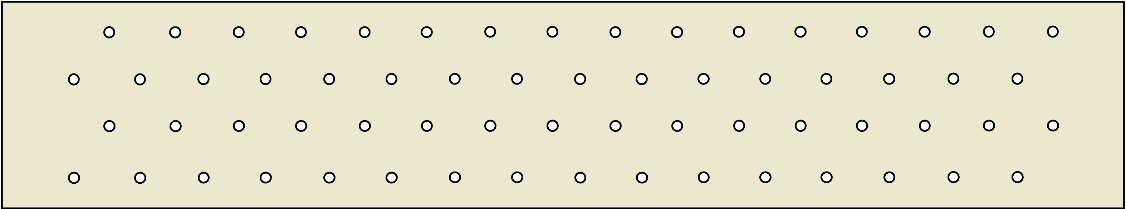

Cable tray
BNC to LEMO PP
8ns LEMO-LEMO
cables to FADC
256 channels
BNC to LEMO PP
8ns LEMO-LEMO
cables to FADC
256 channels
U14 – 17
U14 – 17
U14 – 17
U14 – 17
NIM crate
VME
VXS
Trigger electronics crate
Scaler crate
VME
VME
BNC to BNC PP
3m BNC-LEMO
cables to FADC
256 channels
FADC crate
FADC crate
Cable tray
1656 Channels VME FADCs
BNC to LEMO PP
8ns LEMO-LEMO
cables to FADC
256 channels
BNC to ? PP
?m ?-LEMO
cables to FADC
256 channels
VME
BNC to ? PP
?m ?-LEMO
cables to FADC
128 channels
FADC crate
BNC to BNC PP
3m BNC-LEMO
cables to FADC
256 channels
VME
VME
VME
VME
FADC crate
FADC crate
FADC crate
FADC crate

Slide 22
Cable trays
Current layout
Reconfiguration steps
Move storage shelves and install 5 racks for HV in their place. Install HV crates and modules in racks (Summer 2023)
Move HCal racks slightly to give more room.
De-install BigBite and Hodoscope electronics, HV and cabling (April 2024)
Consolidate GEM electronics in two racks (April 2024)
Move central racks and power supply outward to allow 3 racks for CDET
Install Patch Panels, VME crates for FADCs and Trigger supervisor and install scaler crate.
Run cables and connect everything up.
Add ceiling panels?
CDet
BB
GRINCH
HCAL
CDet
Storage shelves
FADCs, Scaler, TS crates
GEMS
HCAL
BigBite, Hodoscope
GEMS
GEMS
DAQ Bunker in Hall
GEMS
CDet
Rack
power supply
Power supply
Ceiling panel edge
28’ 2”
Power supplies
Cable tray

Slide 23
Conclusion
Lots to get done
Need lots of help (students, postdocs, researchers)
Great opportunity to get experience with installing a large-scale modern experiment
Overall picture/plan in place, but details like precise schedule and personnel still need to be worked out.

