Slide 1
G_{Ep}/G_{Mp} to a Q² of ~15 GeV²
Meeting of the Gep(V) Collaboration
Jlab, September 5, 2008
Charles F. Perdrisat

Slide 2
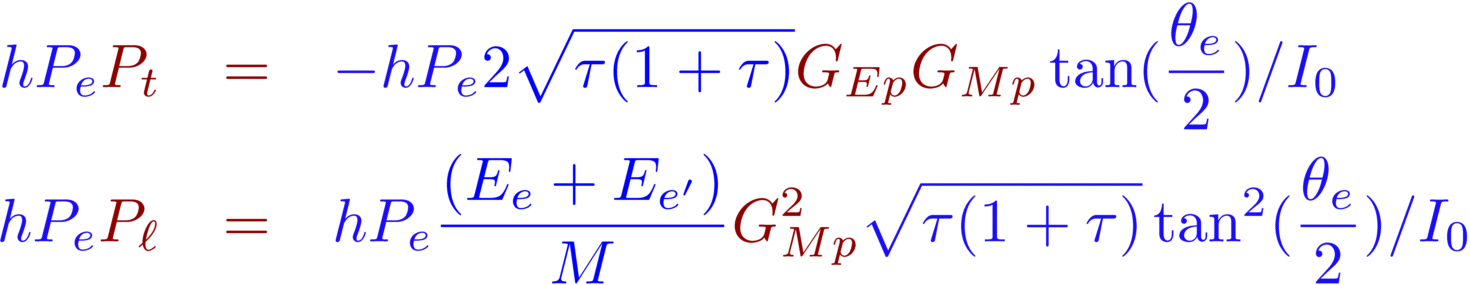
Recoil Polarization
Polarization transfer in or spin-target asymmetry
result in either polarization of the recoil proton, or in parallel-
transverse asymmetry, respectively.
For recoil polarization, the two polarization components are:
The beauty of the method is that the Form Factor ratio is independent of the electron polarization and of the polarimeter analyzing power:

Slide 3
all Rosenbluth separation data
Divided by the dipole form factor G_{D}=(1-Q²/0.71)⁻²

Slide 4
Recoil Polarization Results

Slide 5
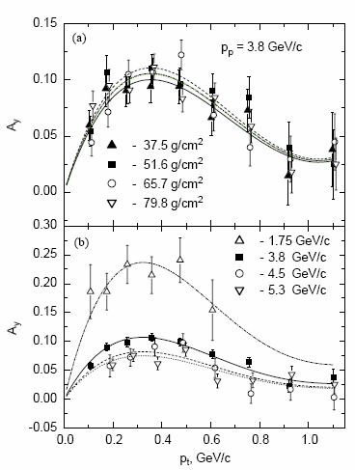
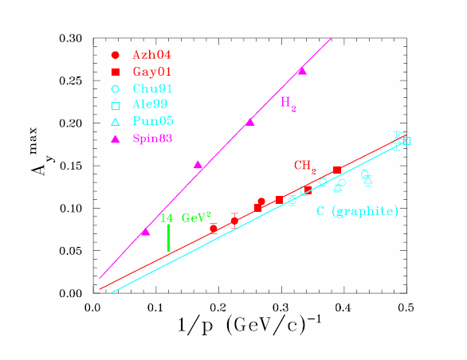
Carbon/CH2/H2 Analyzing Power Data
Q² =5.6 GeV²
Q² =8.4 GeV²

Slide 6
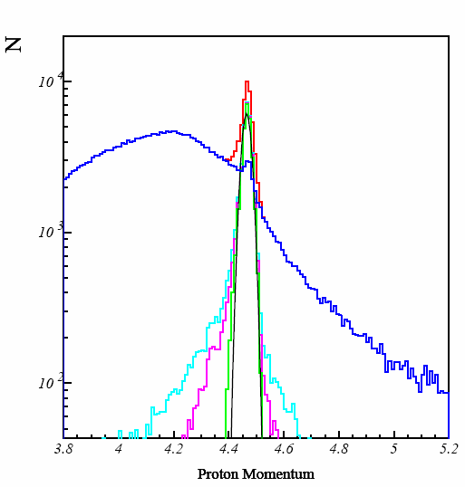
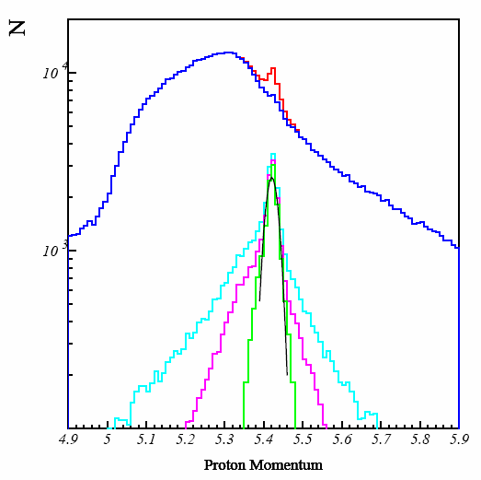
Proton Momentum Spectrum
Q²=6.8 GeV²
Q²=8.5 GeV²
Red : all events, Cyan: with δ-θ cut, Magenta: requiring co-planarity,
Green: localization in BigCal and polar angle correlation with fit in Black
Blue: the background

Slide 7
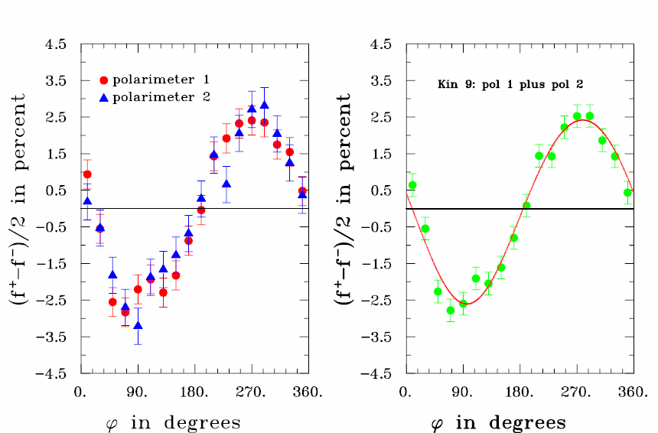
Sample of Physical Asymmetry at Q²
of 8.5 GeV²

Slide 8
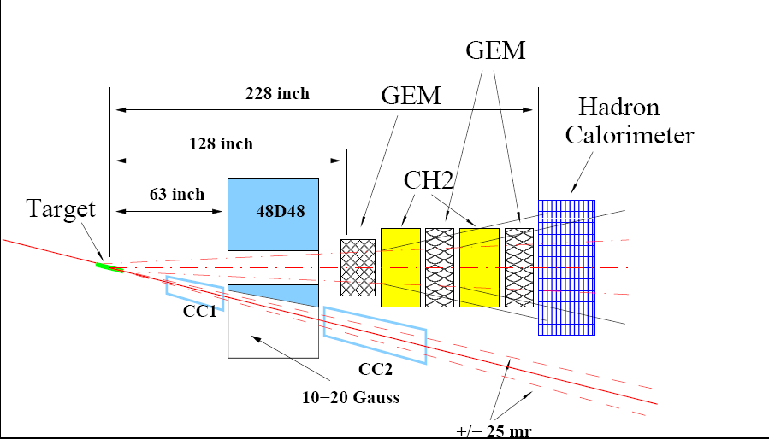
Setting up CUE environ

Slide 9
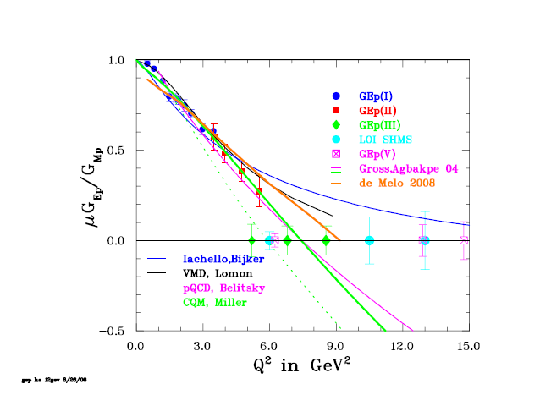
GEp(V) with 12 GeV in Hall A

Slide 10
The End

