Slide 1
Hall A Update
Thia Keppel
6/4/13

Slide 2
Near term accelerator schedule – same as last meeting
Accelerator Run II: Beam in hall 3/2014, or maybe as early as 1/2014 (?)
> 1.1 GeV/pass, 3 pass spin-up to Hall A
up to 5.5 pass to D by ~5/14
Shut down 5/3/14
Accelerator Run III: 8/30/14 – 12/1/14
CD4A milestones
12 GeV 5.5 pass capable installed
11 GeV 5 pass to A, B, C installed
> 2 nA 2.2 GeV single pass transported
Plan
E > 2 GeV/pass, 10 GeV to Hall D
2 Hall operation
Accelerator Run IV: 2/13/15 – 6/1/15
E > 2 GeV/pass, 2 hall operation
CD4B Halls B,C,D operational, > 6, 6, 10 GeV
Schedule rebaseline likely – won’t effect Hall A or accelerator
Physics Run I: 8/30/15 – 12/23/15
E > 2 GeV/pass
Physics Run II: 2/6/16 – 6/25/16
Physics Run III: 9/12/16 – 12/22/16
Spring, fall, spring, fall runs continue….
Rebaselining might carry some changes, but unlikely to effect SBS

Slide 3
Hall A Projected Experiment Schedule as of 8/2012 - available on Hall A wiki
Run Period
February - May | August – December | February - June | August - December | February - June | September - December
GMp / DVCS – I (APEX) | GMp / DVCS - I
 |  | ³H/³He (A₁^{n}) | PREX (APEX)
 |  |  |  | A₁^{n} (SBS) (DVCS-II) (APEX) | SBS (A₁^{n}) (DVCS-II) (APEX)
2014
2015
2016
SBS
Experiments in parentheses represent potential schedule changes.
MOLLER, SOLID…?....

Slide 4
General Hall near term thoughts for SBS
Hall A should see first beam in less than ~1 year ☺
Upgrade and infrastructure work underway
Beamline – energy, current, position, polarimetry,…
HRS’s – detector upgrades and general refurbishing
Many things to do and help appreciated!
Experiments using ~standard equipment scheduled initially
Allows for parallel efforts preparing for new equipment (³He target, PREX, SBS,….MOLLER,….)

Slide 5
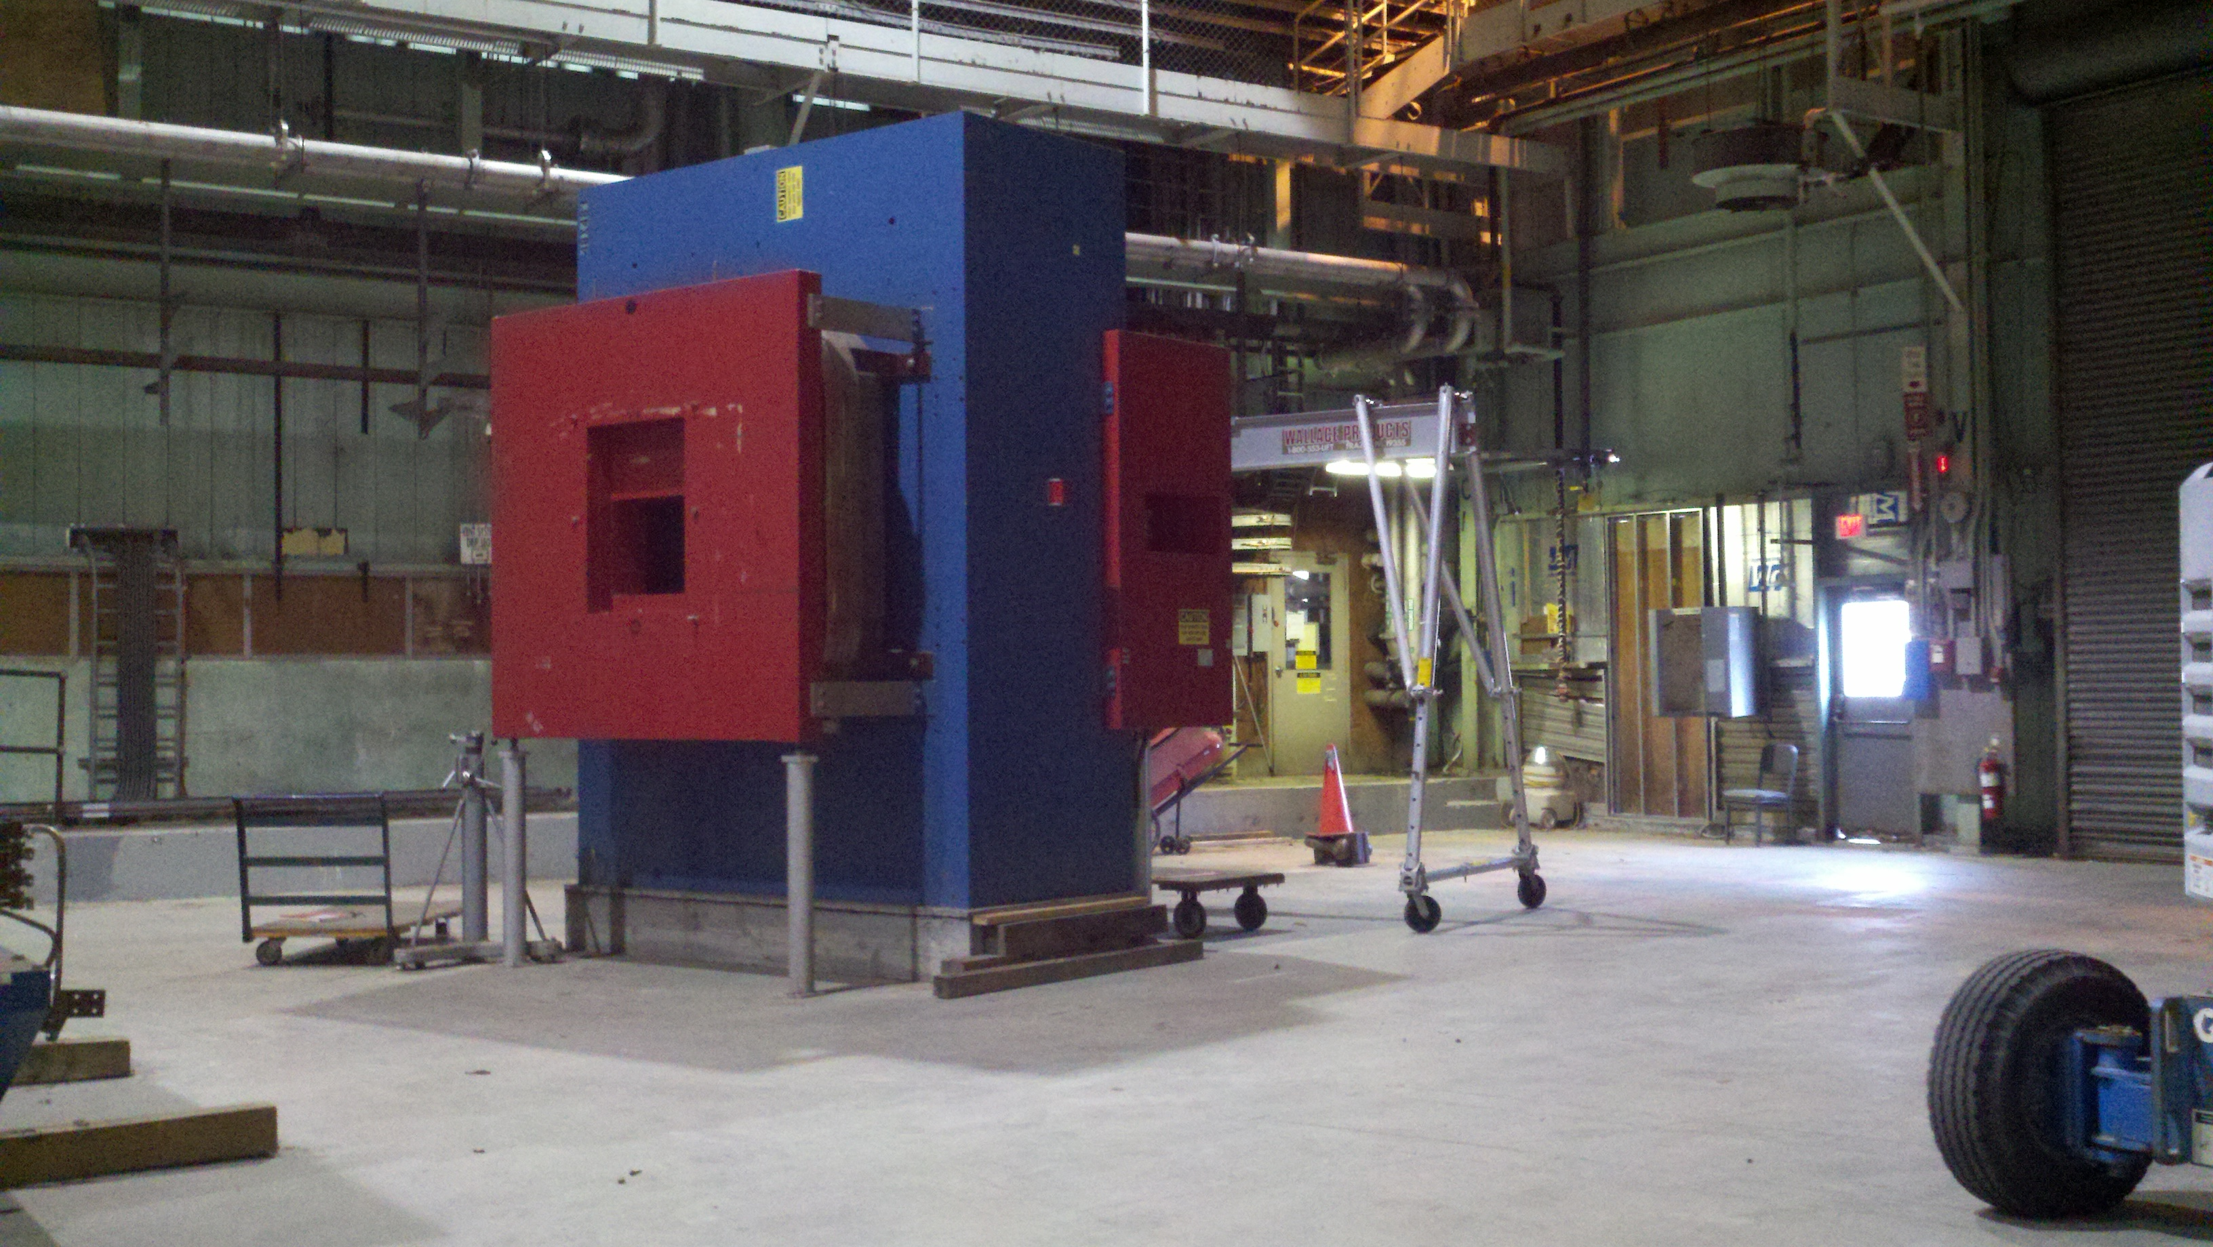
SBS Current Activities
10/1/12 SBS “Program” started with DOE
Subset of the proposed physics program (magnet and GEMs)
Hall A currently supporting “pre-R&D” and SBS-related work
³He target development (Gordon Cates)
GEM tracker prototyping at UVA (Nilanga Liyanage)
Hadron calorimeter (Gregg Franklin) Fermilab scintillator purchase approved

Slide 6
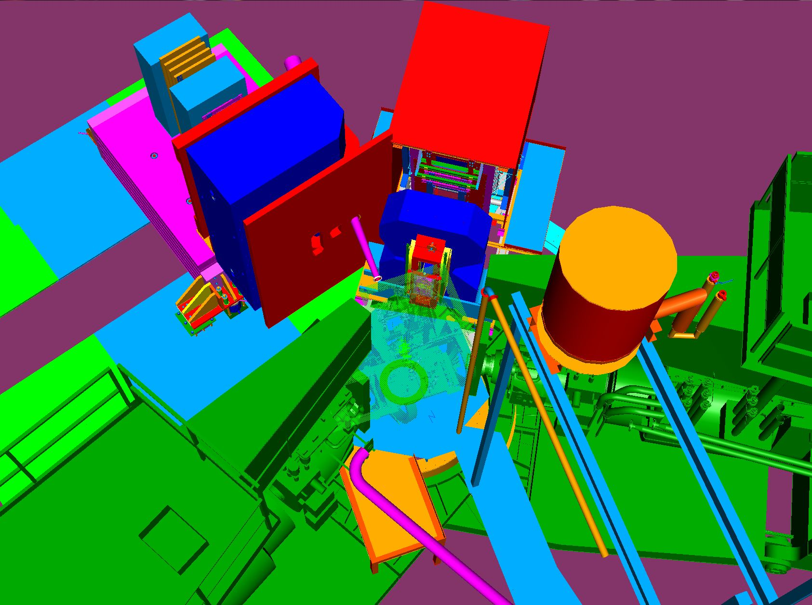
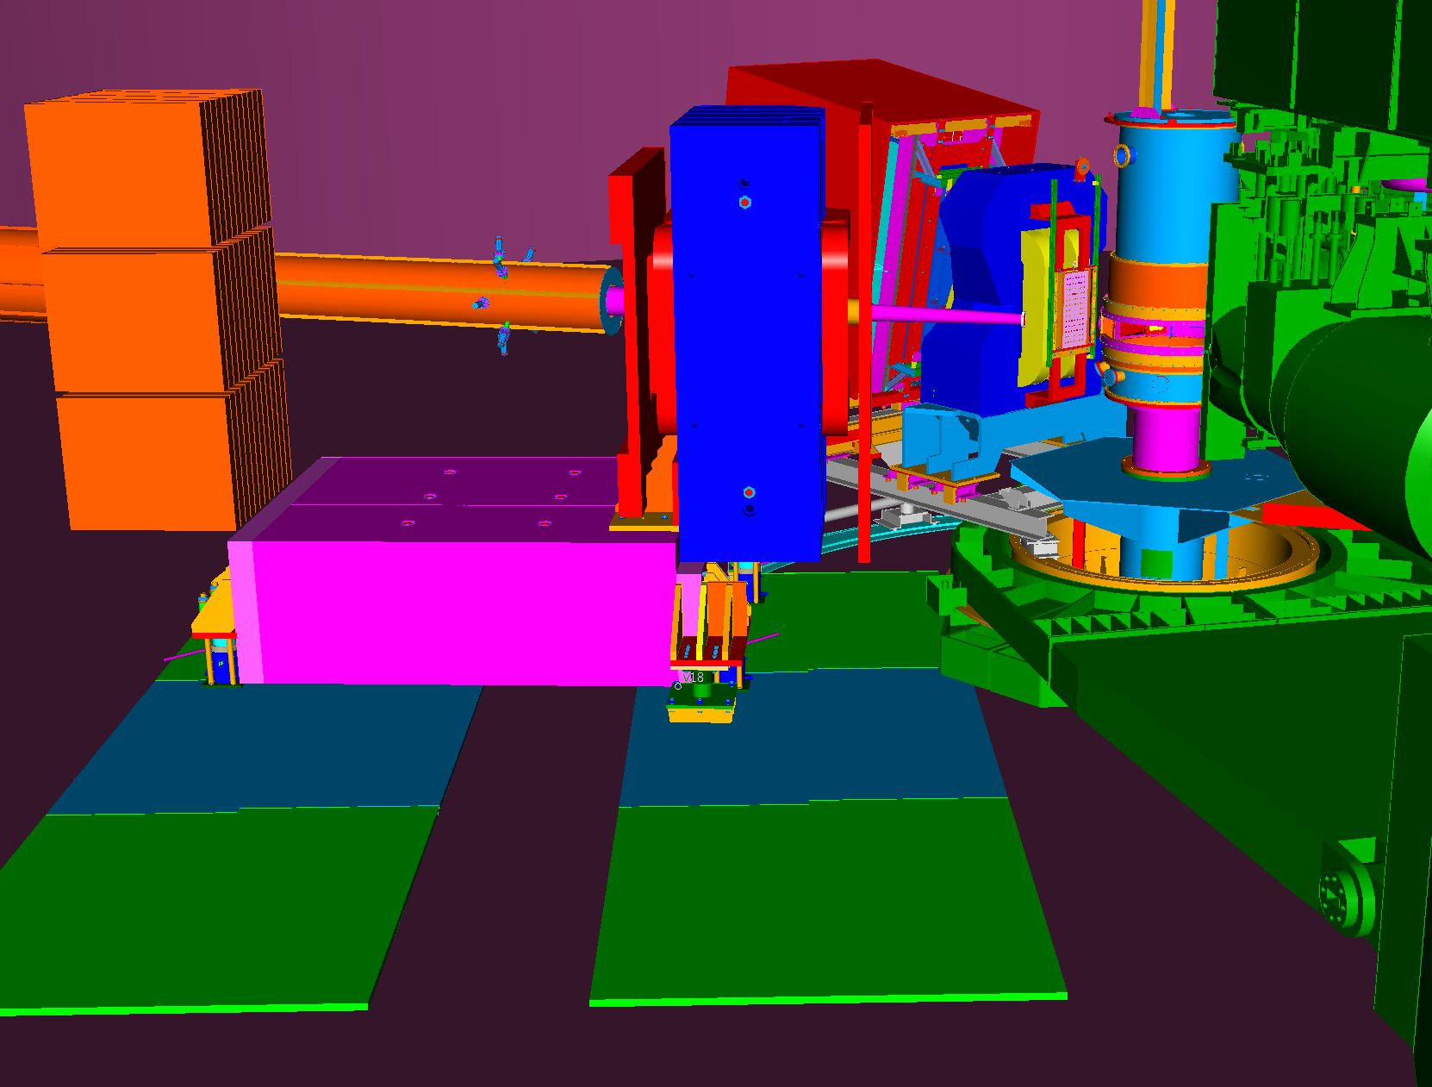
SBS Design and Engineering (See Robin’s talk!)
G_{E}^{n}
Yoke modification drawings ~30% complete
Design work ongoing for magnet counter weight support, will incorporate movement of support to relocate magnet
Design details of rollers, jack mounts, magnet bracket, floor plates ongoing, ~65% complete
Detailed drawings of new coils ~25%
Power supply specification completed, in procurement
Layout and design of shielded beampipe and vacuum snout ~20%
Defining field clamps and design of clamp supports ~15%
Detector support design ~20%
Mid-June delivery expected for magnet from BNL
G_{M}^{n}

Slide 7
Other Thoughts
New PAC procedures for no-additional-beamtime-needed requests
Does the SBS collaboration anticipate experiments like this?
If so, suggest working on a process for review

Slide 8
Looks on track for first SBS run in 2016 or 2017!

