Slide 1
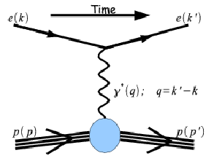
Detector Development for the SBS High Q² Proton Form Factor Experiment at JLab:
AN ENHANCED COORDINATE DETECTOR
Adam J. Sarty
Saint Mary’s University
This was opening slide
for an “update presentation” given at the recent APS GHP Workshop
On behalf of Jefferson Lab’s
HALL A “SBS” COLLABORATION
Notes:
Cover Page alternative

Slide 2
Plan for the rest of this talk:
Review of a couple of “set up” slides (selected from what was used for the GHP Workshop talk designed for an outside audience)
Lead into current status of the Coordinate Detector design and prototyping.
Leave you with the results of the “fun” we had testing/evaluating ~10,000 phototube pixels (602 16-channel MA-PMTs … transferred from FermiLab CDF decommissioning to JLab ☺ )

Slide 3
Layout of Experiment: (taken from latest CDR for the SBS)

Slide 4
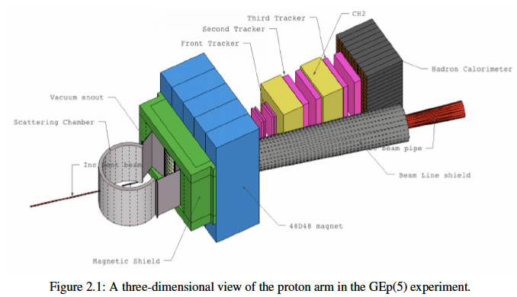
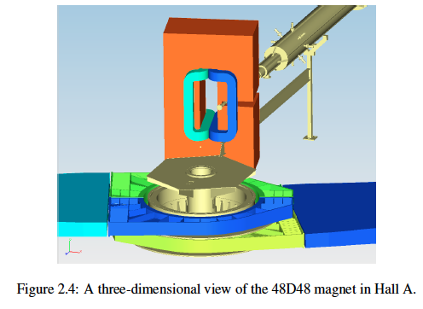
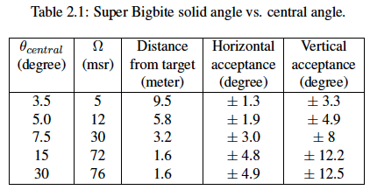
Layout of Experiment: (taken from latest CDR for the SBS)
Luminosities up to 8 × 10³⁸ e/s × nucleon/cm²
Full acceptance for 40cm long target
v.good angular resolution
good momentum resolution

Slide 5
The Background Issue (taken from latest CDR for the SBS: simulations by L. Pentchev)
Front Tracker
has direct view of target – flux of primary photons can be about 120 kHz/cm² with energy above 1 MeV, at middle of GEM

Slide 6
The Background Issue (taken 2010 review: simulations by L. Pentchev)

Slide 7
The Background Issue (taken latest CDR: simulations by L. Pentchev)
use many GEM planes (x/y, u/v) with separation; group strips when position resolution isn’t as stringent
Concluded: tracking detector rates well below (~100 x) what has been experimentally observed for rate capability of GEM-based chambers. Tracking efficiency can remain high (~99%) even in high backgrounds.

Slide 8
The Background Issue (taken latest CDR: simulations by L. Pentchev)
use many GEM planes (x/y, u/v) with separtion; group strips when position resolution isn’t as stringent
Concluded: tracking detector rates well below (~100 x) what has been experimentally observed for rate capability of GEM-based chambers. Tracking efficiency can remain high (~99%) even in high backgrounds.
I missed talking about one thing inherent in these conclusions – the trigger.

Slide 9
The Background Issue (taken latest CDR: simulations by L. Pentchev)
use many GEM planes (x/y, u/v) with separtion; group strips when position resolution isn’t as stringent
Concluded: tracking detector rates well below (~100 x) what has been experimentally observed for rate capability of GEM-based chambers. Tracking efficiency can remain high (~99%) even in high backgrounds.
I missed talking about one thing inherent in these conclusions – the trigger.
And this is the Coordinate Detector I am supposed to tell you about!

Slide 10
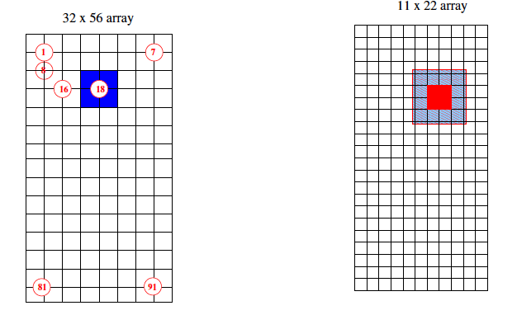
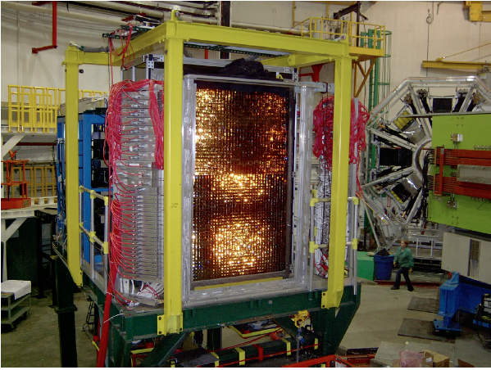
Smart Trigger to Reduce Background: Use ep Angular Correlations
Since ep elastic events are co-planar: use 2nd level triggering to match electron and proton calorimeter block hits. (and: using high energy thresholds on both calorimeters: 3-4 GeV for proton, ~2.5 GeV for electron, keeps rates tolerable)

Slide 11
Smart Trigger to Reduce Background: Use ep Angular Correlations
Since ep elastic events are co-planar: use 2nd level triggering to match electron and proton calorimeter block hits. (and: using high energy thresholds on both calorimeters: 3-4 GeV for proton, ~2.5 GeV for electron, keeps rates tolerable)
How to Make Better? – latest CDR includes COORDINATE DETECTOR …

Slide 12
Smart Trigger to Reduce Background: Use ep Angular Correlations AND ADD COORDINATE DETECTOR
Continued simulations revealed that a 20cm Al block should be placed in front of Ecal (to reduce damage from low-E background)
BUT, also concluded that if electron angle could be resolved vertically to ~0.5 mr, would result in ~5 MeV/c uncertainty in ep-momentum balance … much smaller than typical ~150 MeV/c out-of-plane momentum for inelastic events ➔ powerful additional background suppresion!
SO: CDet in front of electron calorimeter
2 planes of GEMs
Horizontal strips only
These were already in the previous table ☺

Slide 13
Smart Trigger to Reduce Background: Use ep Angular Correlations AND ADD COORDINATE DETECTOR
Continued simulations revealed that a 20cm Al block should be placed in front of Ecal (to reduce damage from low-E background)
BUT, also concluded that if electron angle could be resolved vertically to ~0.5 mr, would result in ~5 MeV/c uncertainty in ep-momentum balance … much smaller than typical ~150 MeV/c out-of-plane momentum for inelastic events ➔ powerful additional background suppresion!
SO: CDet in front of electron calorimeter
2 planes of GEMs
Horizontal strips only
These were already in the previous table ☺
BUT WE CAN DO EVEN BETTER! …

Slide 14
Smart Trigger to Reduce Background: Use ep Angular Correlations AND ENHANCE the COORDINATE DETECTOR
Add a 3rd plane (in front of the 2-GEM-plane CDet currently in the plan)
MC studies to optimize sizes of scintillator bars needed: 2 x 52 cm horizontal bars (vertically stacked) 5mm “tall”, 30 mm “thick” readout of each bar by 2mm diameter WLS fiber inserted in middle, through length, of each bar and: need only 15cm block of CH2 in front (instead of 20cm AL)
Improved position resolution (1.8mm ➔1.3mm)
Improved Time Res for coincidence (10ns ➔1.0ns)

Slide 15
Smart Trigger to Reduce Background: Use ep Angular Correlations AND ENHANCE the COORDINATE DETECTOR
In planning stages now (not yet been approved through our new project management organization)
Design Considerations:
Split horizontal length into two separate bars to keep rate-per-bar tolerable (~120 kHz/bar)
Position this extra scint plane as close in front of GEM CDet planes as possible, and as close to 15cm-thick CH2 absorber as possible
Have minimal material in active area
Have minimal “dead zones”, so mechanical fit of structure should fit without need for metal framework (for example)
Arrange scintillators such that “flat face” of bars always are tipped to directly face the target
WLS fibers will be connected to 16-channel MA-PMTs

Slide 16
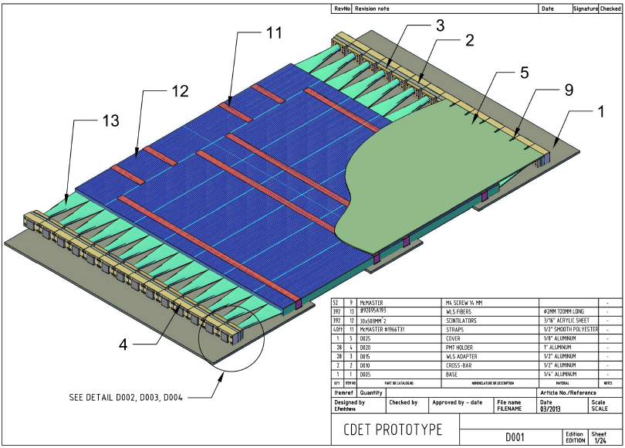
Will be 8 of these: 2 x (4 stacked)

Slide 17
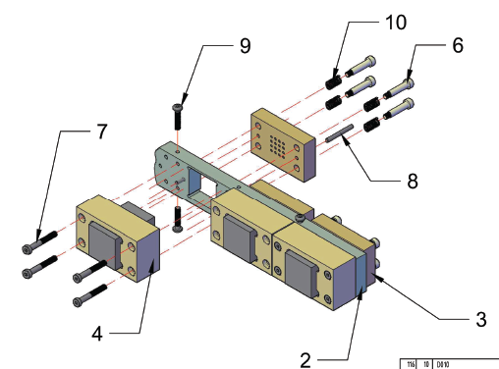
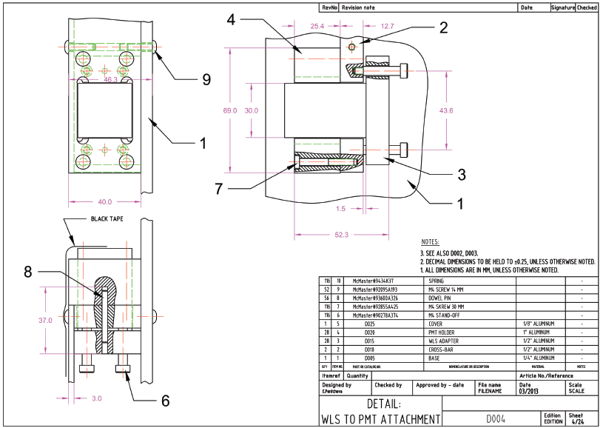
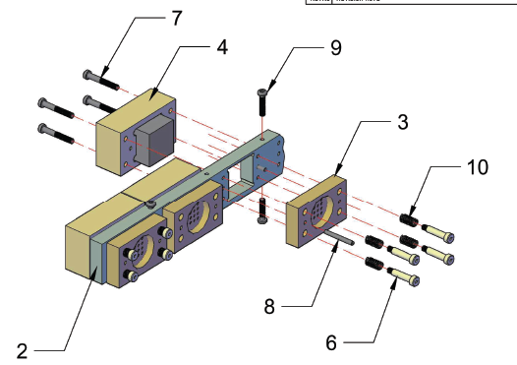
Mechanisms for securely connecting each bar’s WLS light-guide fiber to the MA-PMTs

Slide 18
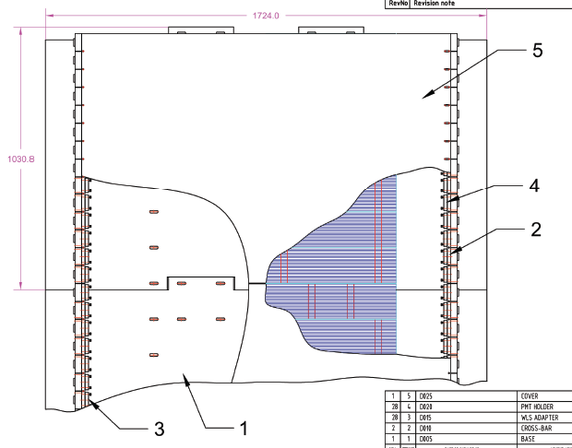
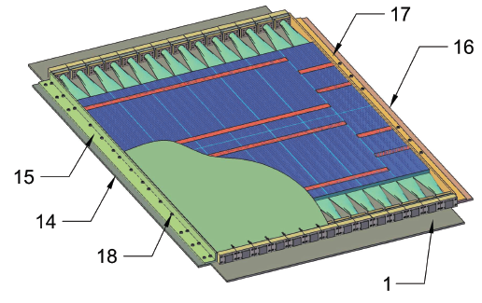
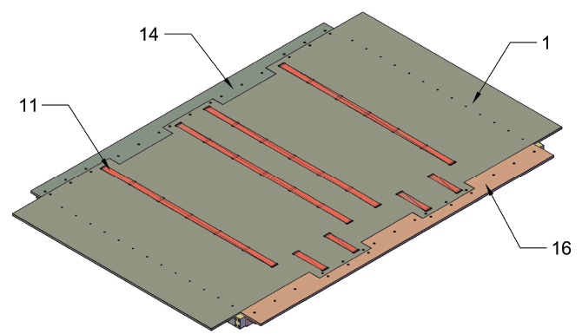
¼” Al plate on top
Showing puzzle-piece mechanism to fit vertical-stacking
scintillators “strapped” into bundles to keep positioning
Plan painting of scint. bars for light-tightness (don’t rely on total internal reflection)

Slide 19
Smart Trigger to Reduce Background: Use ep Angular Correlations AND ENHANCE the COORDINATE DETECTOR
One of the things which precipitated our investigation into Enhancing the Coordinate Detector with a scintillating-bar plane was: acquisition of 602 16-channel MA-PMTs from FermiLab (from decommissioning of CDF experiment)
Huge cost saver!
Note: this represents just under 10,000 channels … the additional 3rd CDet plane I just discussed requires ~1700 channels (lots left…)
Now the Fun Stuff: testing those 10,000 pixels to see if they still work! ….

Slide 20
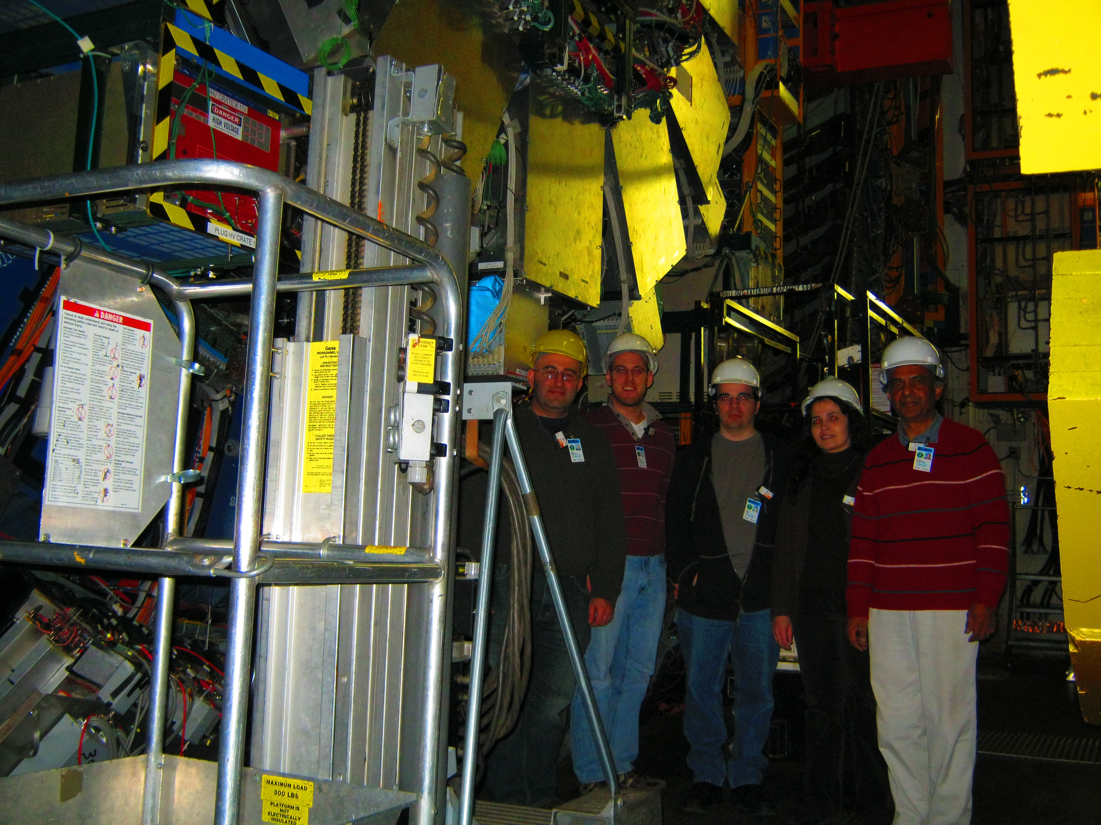
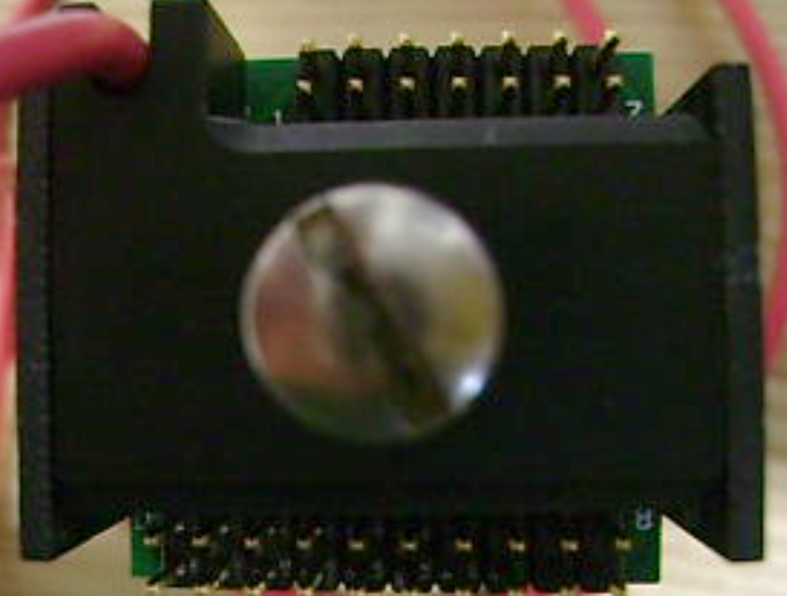
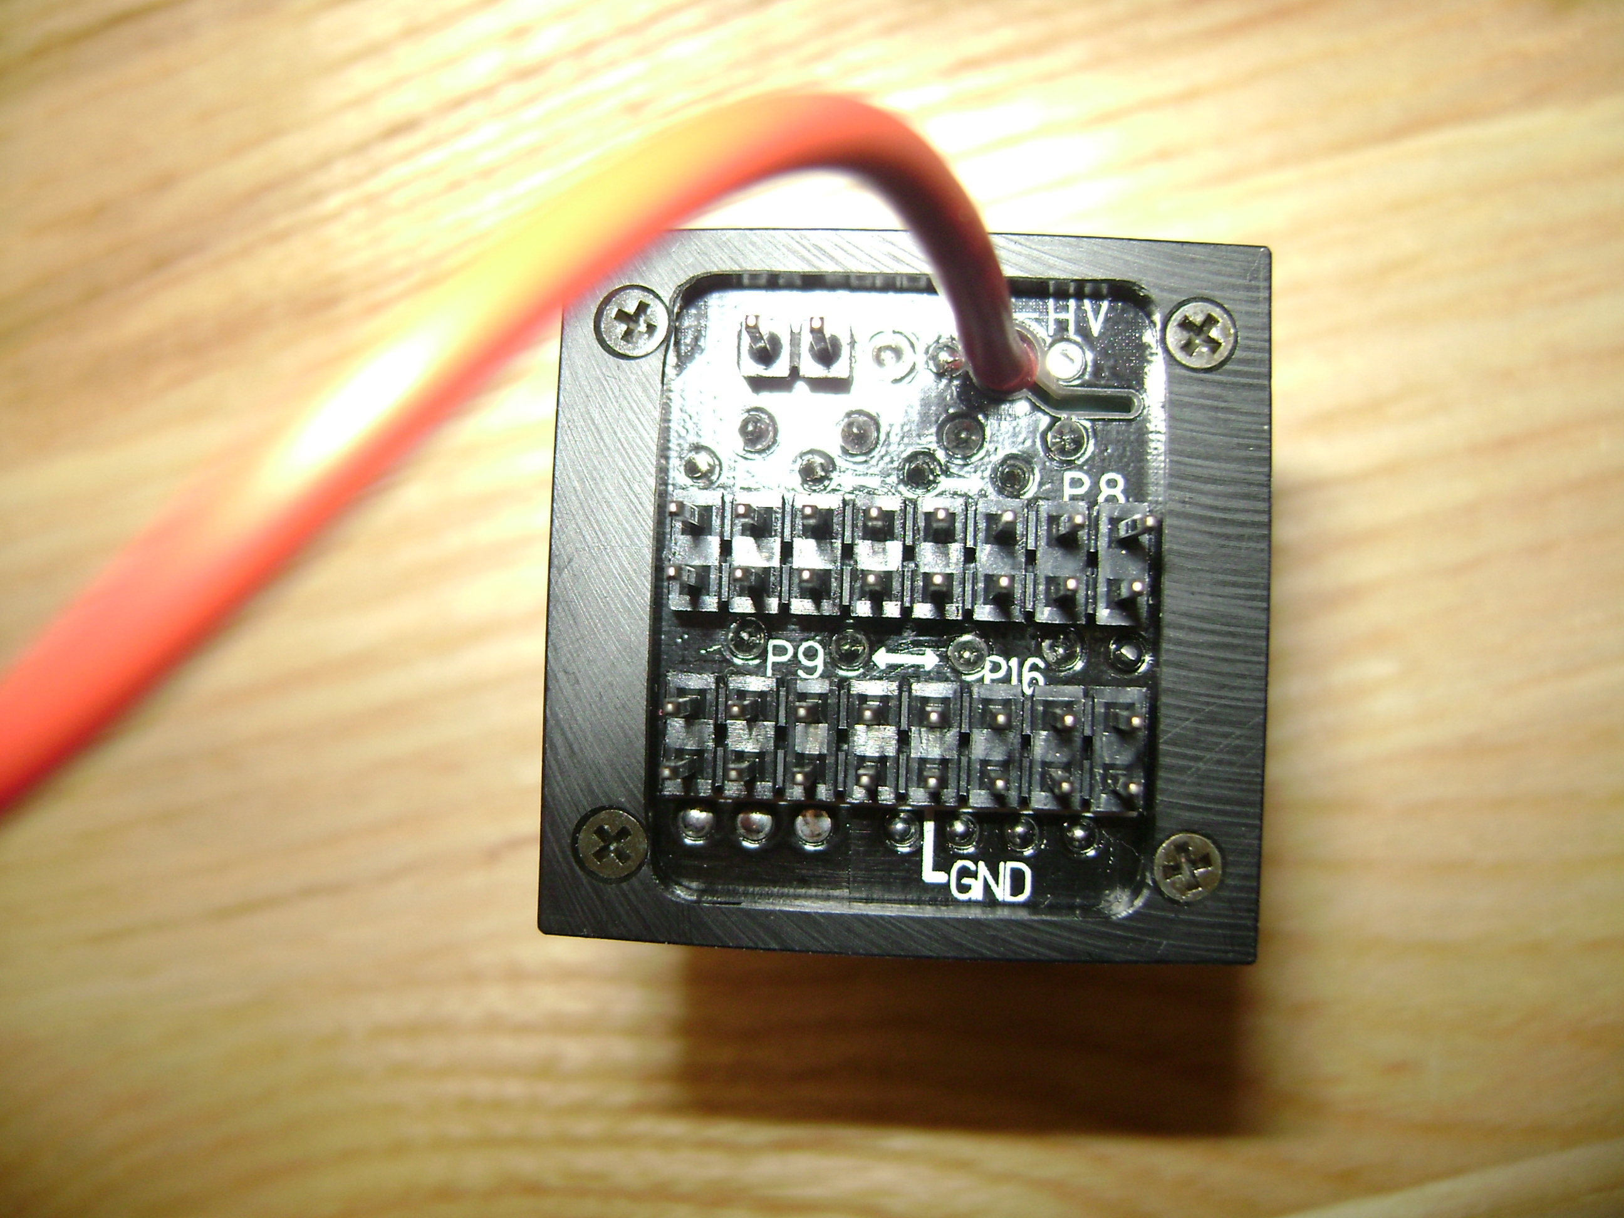
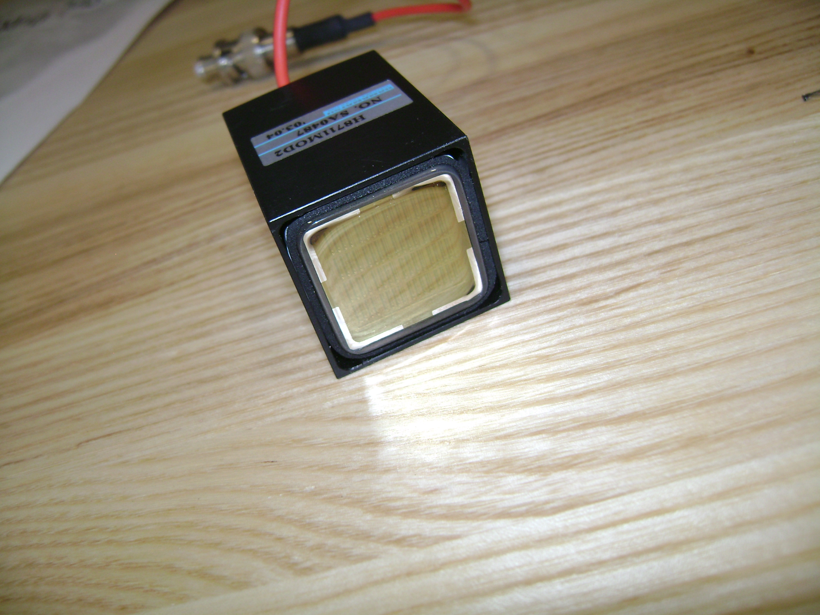
Testing the MA-PMTs acquired from FermiLab (for evaluating use in Enhanced Coordinate Detector)
Dec 2011: Mahbub, Vahe, Lamiaa (Rutgers pdf @ FNAL) and 2 SMU grad students (David and Jason) spent several days at FNAL retrieving PMTs
R5900-00-M16
(416 of these)
“Type 2”
H8711
(186 of these)
“Type 1”

Slide 21
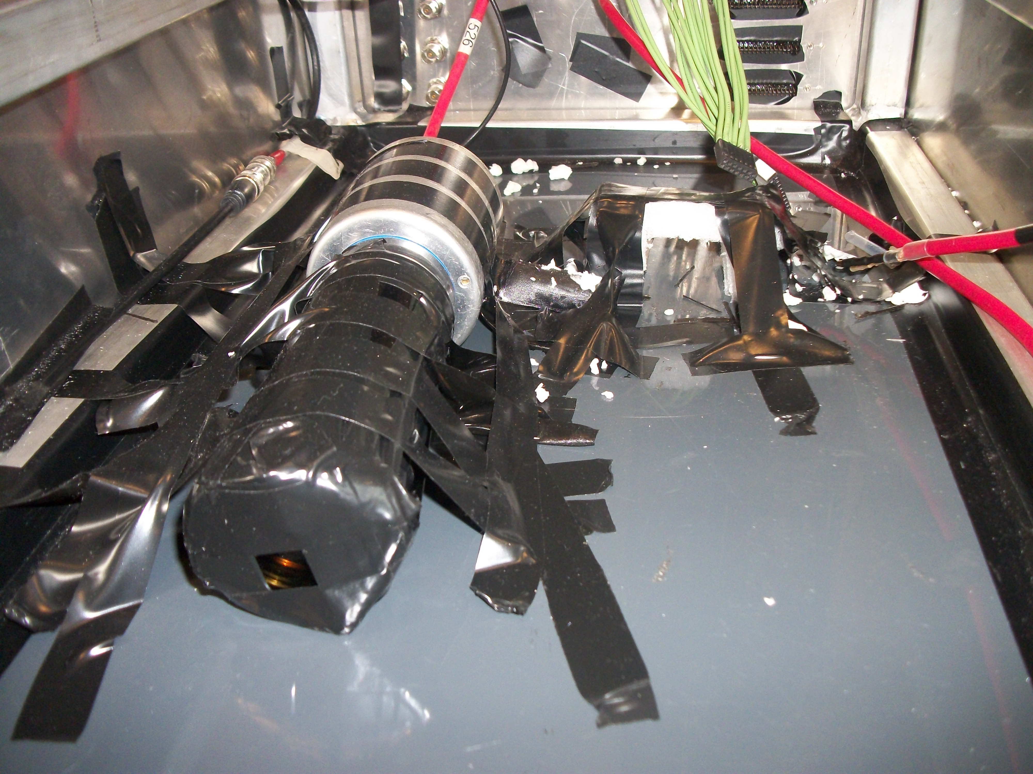
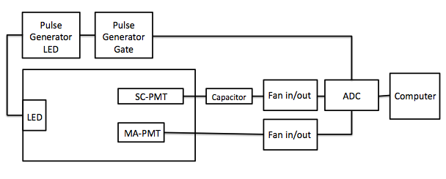
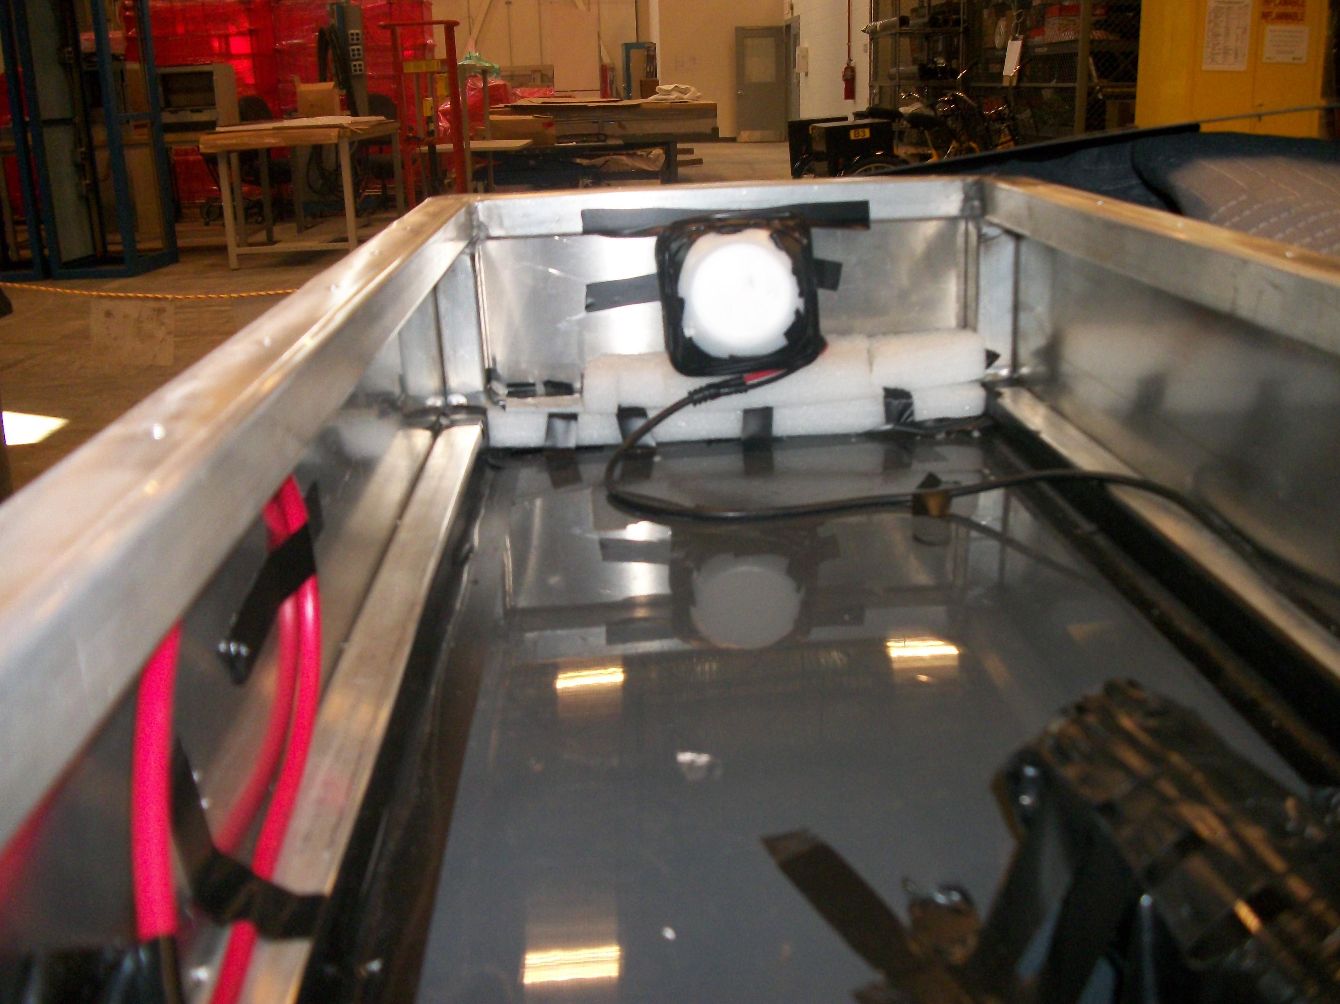
Testing the MA-PMTs acquired from FermiLab (for evaluating use in Enhanced Coordinate Detector)
Summer 2012: testing @ JLab: use pulsed LED to measure relative response (all relative to a calibrator single-channel 2” PMT to which all responses were normalized)

Slide 22
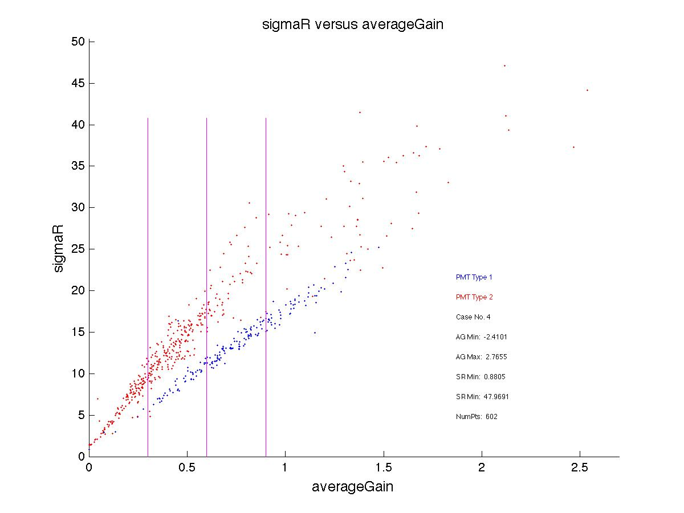
Testing the MA-PMTs acquired from FermiLab (for evaluating use in Enhanced Coordinate Detector)
x-axis = <A>
pedestal-subtracted response, divided by the pedestal-subtracted standard-PMT-response (our control), averaged over all 16 pixels for a maPMTS
y-axis = <width>
average signal-width (in ADC channels) of all 16 pixel responses for each maPMT
Best maPMT response: high <A> low <width>
Finalized for BSc Honours thesis (J. Campbell)

Slide 23
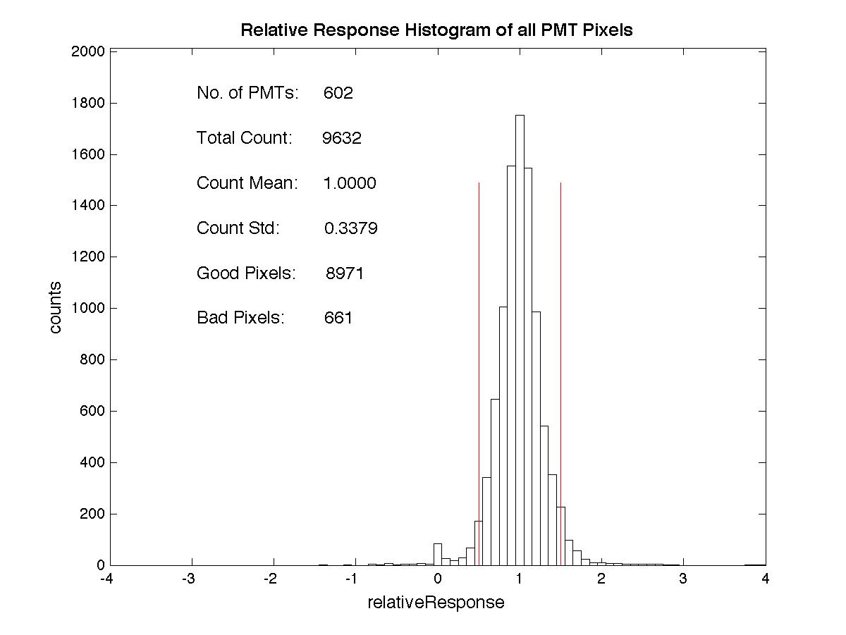
Testing the MA-PMTs acquired from FermiLab (for evaluating use in Enhanced Coordinate Detector)
Check for “uniformity of response” within the 16 pixels of each MA-PMT

Slide 24
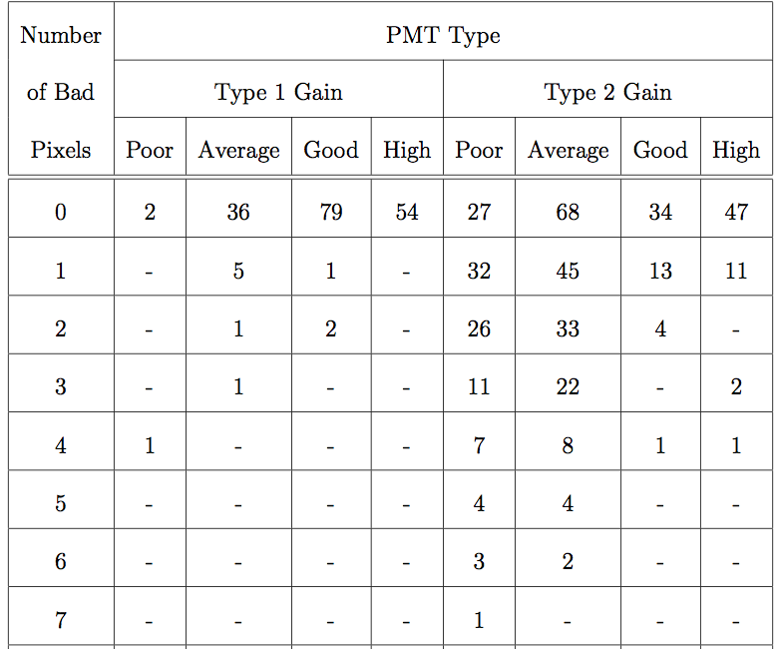
Testing the MA-PMTs acquired from FermiLab (for evaluating use in Enhanced Coordinate Detector)
P: 32
A: 50
G: 14
H: 11
--------------
T: 107
P: 29
A: 104
G: 113
H: 101
----------
T: 347

Slide 25
The Real Deal – current status:
What we had planned (as of last SBS Collab meeting, Oct. 2012):
I had applied for ~$150k (CAN) to build prototype (to test mechanical design) and to buy/build the extra (3rd) plane of scintillators, as just discussed.
Once this was underway, use what we’d learned to formulate best argument to formally ask SBS Collab to make a project change: replace first two GEM planes of CDet with scintillator planes (argument: more cost-effective, plus improved performance)

Slide 26
The Real Deal – current status:
What we had planned (as of last SBS Collab meeting, Oct. 2012):
I had applied for ~$150k (CAN) to build prototype (to test mechanical design) and to buy/build the extra (3rd) plane of scintillators, as just discussed.
Once this was underway, use what we’d learned to formulate best argument to formally ask SBS Collab to make a project change: replace first two GEM planes of CDet with scintillator planes (argument: more cost-effective, plus improved performance)
What happened?
Unsuccessful at obtaining Canadian equipment money (only 2 equipment grants awarded last year at this level, compared to ~10 in previous…)
BUT: moving forward with building PROTOTYPE at William & Mary machine shop …

Slide 27
The Real Deal – current status:
The plan for a prototype to be constructed:
2 planes
Each plane having 4 “sections” (to test the jigsaw-puzzle stacking, and the side-by-side formation)
Each section a scaled-down version of actual: 14 stacked scintillator bars per section (since design allows for each MA-PMT to receive 14 WLS fibers from 14 scintillators).
Prototype won’t use scintillators, just plastic (test of mechanical design only).
Include “end caps” needed to house all PMTs etc so this design can be tested.
Cost estimate:
@ William & Mary machine shop (via Todd Averett): ~$16k (internal rate … cost to JLab may be about twice this amount)

Slide 28
The Real Deal – current status:
Who is doing (managing) this project??
Unclear (to me, anyway …)
Plan was for Mahbub and I to split responsibilities:
my SMU students and I doing mechanical assembly and building/testing of scintillator sections at SMU, then shipping to Jlab
Mahbub to provide funds for design/development of prototype, then oversee overall construction of CDet
Electronics testing (using J. Annand’s NINO boards) … ?
Now that I am without CAN $ to support my planned efforts, what next?
Apply again? Enhanced chances if CDet were more critical to SBS program (as opposed to adding just a 3rd plane enhancement) … have had to “re-assign” project for new grad student (Jessica Campbell).
Someone else / another institution?

