Slide 1
FASTBUS DAQ
Sergey Abrahamyan
Yerevan Physics Institute
Norfolk State University
SBS collaboration

Slide 2
Overview
FASTBUS requirements
Dead time improvements
Hardware preparation and testing
Summary

Slide 3
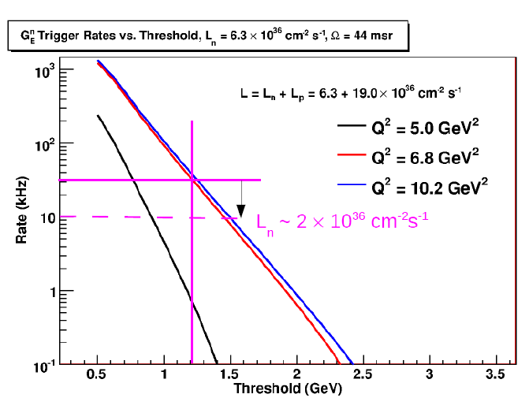
experiment
Extrapolation from GeN
Threshold = 1.2 GeV
L(A1N) = 2 × 10³⁶ cm⁻² s⁻¹
Trigger rate = 10 kHz

Slide 4
experiment
Detector | Detector Channels | DAQ channels | Gate [ns] | hits
Gas Cherenkov | 550 | 550 time 550 amplitude | 50 | 30 30
Scintillators | 180 | 180 time 180 amplitude | 50 | 5 5
Calorimeter | 243 | 243 amplitude | 100 | 45
Calorimeter Sums | 26 | 26 amplitude 26 time | 100 | 2 2
999 amplitude channels - 16 ADC modules or 11 TDC+MQT modules
756 time channels - 8 TDC modules
120 hits/event = 480 bytes/event at 10kHz trigger rate → 5Mb/s
With TDC full scale window on a level of 1-1.5 µs data rate will be ~50Mb/s

Slide 5
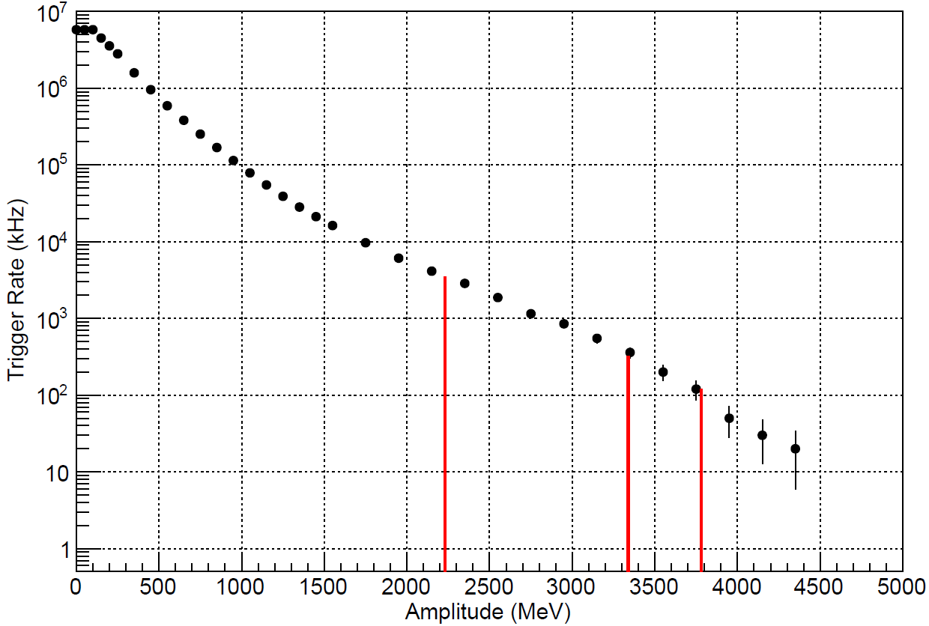
experiment
MC simulation
11 GeV 80 µA beam
40 cm LH₂
ECal at 30° at 3.0m
32×56 = 1792 blocks
4.0×4.0×40.0 cm
E_{thr}/E_{max} (%) | Rate (kHz)
50 | 3500
75 | 320
85 | 120

Slide 6
experiment
L1 trigger rate 320 kHz at 75% threshold
120 kHz at 85% threshold
Block threshold (MeV) | Number of fired blocks | Data rate (Mb/s) E_{thr}/E_{max} = 0.75 | Data rate (Mb/s) E_{thr}/E_{max} = 0.85
0 | 75 | 2×75×4×0.32 = 192 | 2×75×4×0.12 = 72
1 | 53 | 136 | 50
3 | 35 | 90 | 34
5 | 28 | 72 | 26
1792 amplitude channels - 28 ADC modules or 19 TDC+MQT modules
1792 time channels - 19 TDC modules

Slide 7
Methods to reduce dead time
Sparsification
Event blocking
SFI Sequencing
Parallel DAQ systems

Slide 8
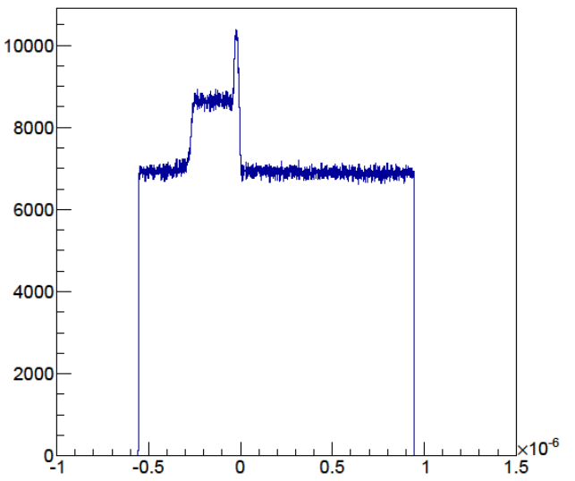
Sparsification
Typical TDC spectrum without sparsification. Only 300ns window out of 1.5µs full scale window has useful data
full- scale window
0-32 µs (8ns step)
Start from background
Common Stop
Start from signal
Sparsification
0-8µs
(0.5ns step)
Gate
Enabling of sparsification allows significantly reduce event size. All TDC modules have been tested to work in sparsification mode.

Slide 9
Event Blocking
Triggers
Overhead
Readout
Overhead
Readout
Overhead
Readout
Overhead
Readout
20µs 50µs 20µs 50µs 20µs 50µs 20µs 50µs
Readout time is 50 µs + 2 µs per 16 channel.
64 channels – 58 µs
128 channels – 66 µs
For one channel readout.
4 events no EB – 280 µs
4 events with EB – 220 µs
Triggers
Overhead
Readout
Readout
Readout
Readout
20µs 50µs 50µs 50µs 50µs

Slide 10
Event Blocking test results
20 kHz rate
New TI version 3
Linux CPU
Event Blocking | Number of channels | Number of modules | Life time (%)
1 | 1 | 1 | 71
4 | 1 | 1 | 90
1 | 64 | 3 | 65
4 | 64 | 3 | 80

Slide 11
SFI sequencing
Preload FASTBUS commands to SFI to reduce number of ROC-FASTBUS transactions.
SFI Sequencing tested for 1 and 3 modules readout did not find out any improvement in dead-time.

Slide 12
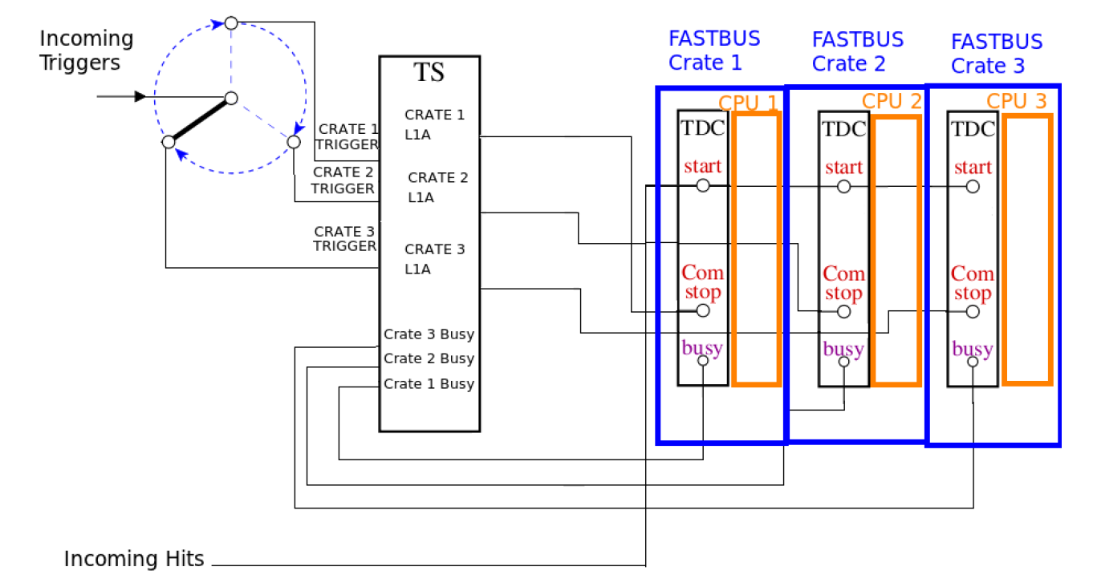
Parallel DAQ

Slide 13
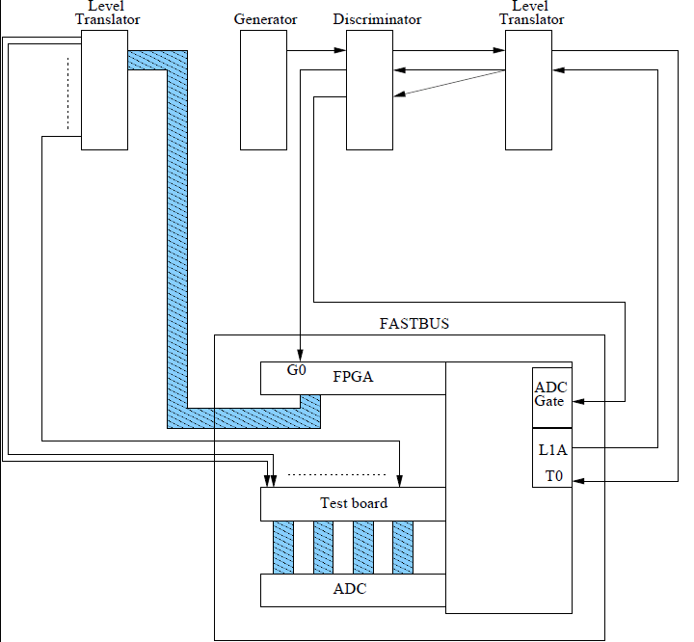
ADC test setup

Slide 14
ADC test procedure
FPGA reprogrammed to generate programmable width ECL signals
Signal width ~ amplitude
12000 events generated the width changes every 1000 event
Each ADC channel should have 12 peaks with fixed amplitude 1000 events in each
Pedestal events also generated to look the width of the pedestal

Slide 15
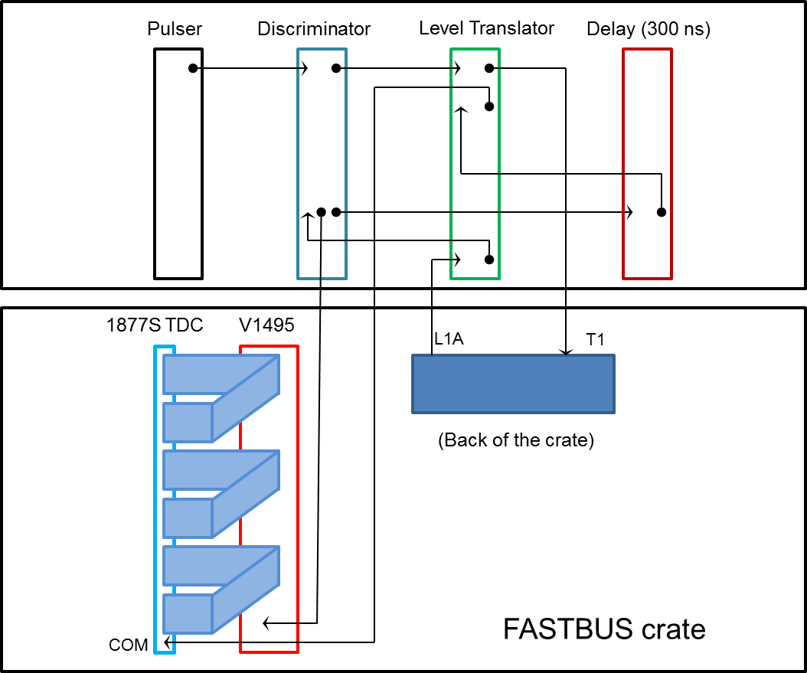
TDC test setup

Slide 16
TDC test procedure
Sparsification CRL #1
Full scale time window = 400 ns
Sparsification threshold = 0 ns
325 ns
Common stop
400 ns
0 ns
Sparsification CRL #2
Full scale time window = 400 ns
Sparsification threshold = 300 ns
325 ns
Common stop
Sparse. Thresh.
400 ns
300 ns
0 ns
325 ns
Sparsification CRL #3
Full scale time window = 496 ns
Sparsification threshold = 424 ns
Common stop
Sparse. Thresh.

Slide 17
Test results
200 TDC-s tested
175 good TDC-s
20 has problems in single channel
5 has other issues
120 ADC-s tested
97 good ADC-s
22 has problems in single channel
1 does not accept gate
All tested modules are marked and the DB created describing the location and test results

Slide 18
Summary
Hardware
  TDC and ADC modules tested and ready to use
  6 power supplies available
  18 FASTBUS bins available
  18 SFI modules available, 14 tested
  Looks we have enough Geographical Address Control (GAC) and Arbitration Timing Control (ATC) cards, but they need to be tested.
Software
  Sparsification mode tested with Intel CPU
  SFI sequencing tested have not seen an improvement in dead time
  Event blocking tested for 3 module 64 channels configuration, life time increased from 68% to 80% for 20 kHz generator rate.
  Parallel DAQ test is in progress

