Slide 1
Update on SBS Polarimeter GEMs and SRS Electronics
Kondo Gnanvo
SBS Collaboration Meeting, July7-8, 2014
Nilanga Liyanage, Chau Dao, Danning Di, Xinxhan Bai, Vladimir Nelyubin, Huong Nguyen

Slide 2
Outline
Status of the production SBS Polarimeter GEM modules
Latest issues under investigation.
Report on the performances of the chambers at FNAL and JLab test beam
Update on APV25-SRS Electronics for SBS

Slide 3
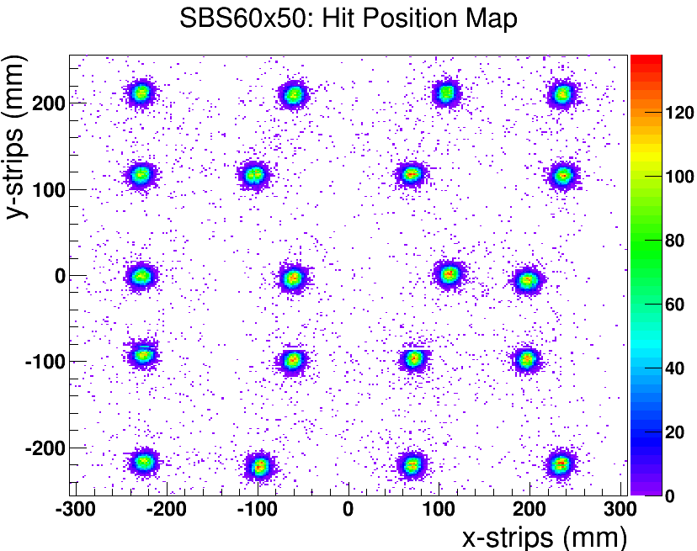
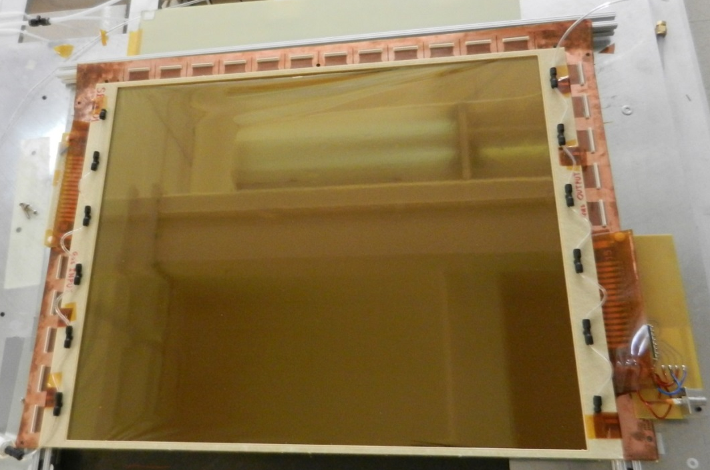
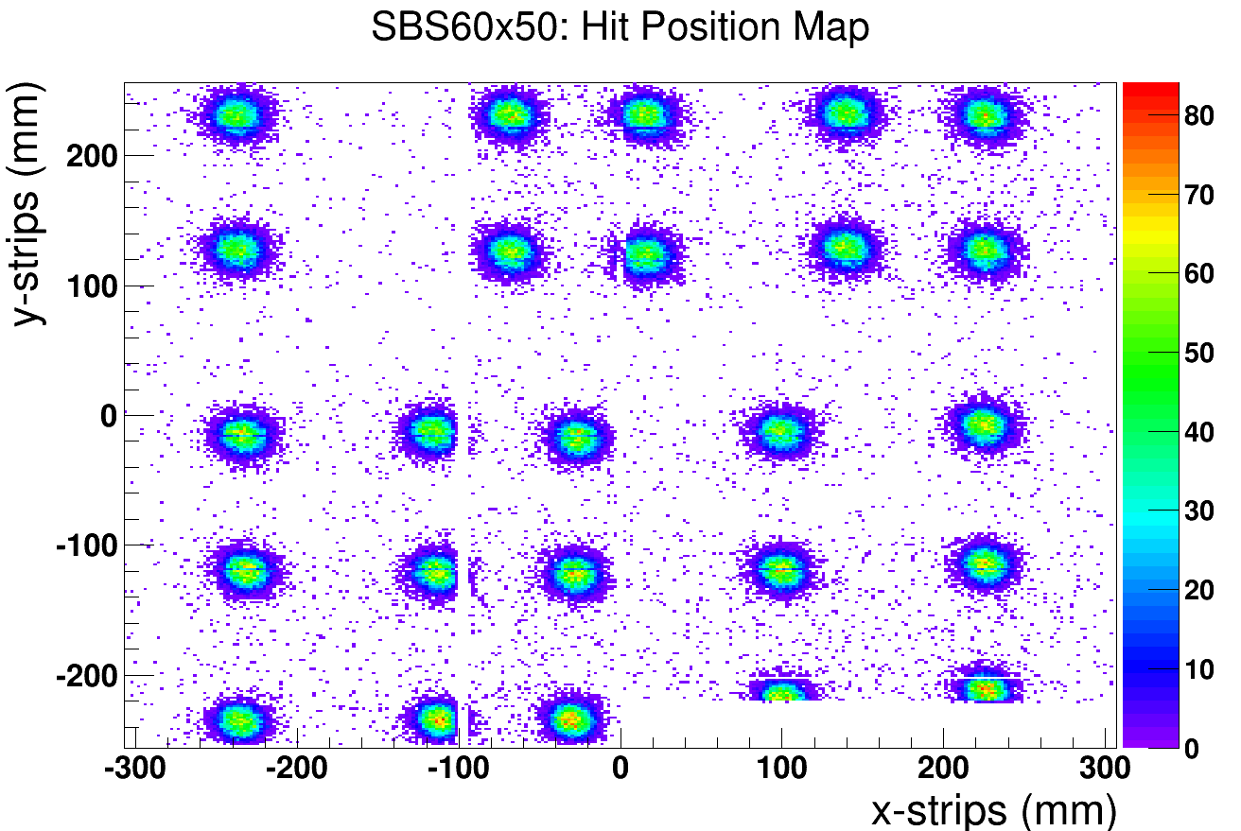
Production Status of SBS Back Tracker GEM modules
sbs_module1: Sr90 position scan
First two modules sbs_module1 and sbs_module_2 was built
One HV sector on sbs_module2 is shorted
Two modules under test on the Sr90 and cosmic test bench in UVa detector lab, good response uniformity scan
3rd module not yet assembled
sbs_module2: Sr90 position scan

Slide 4
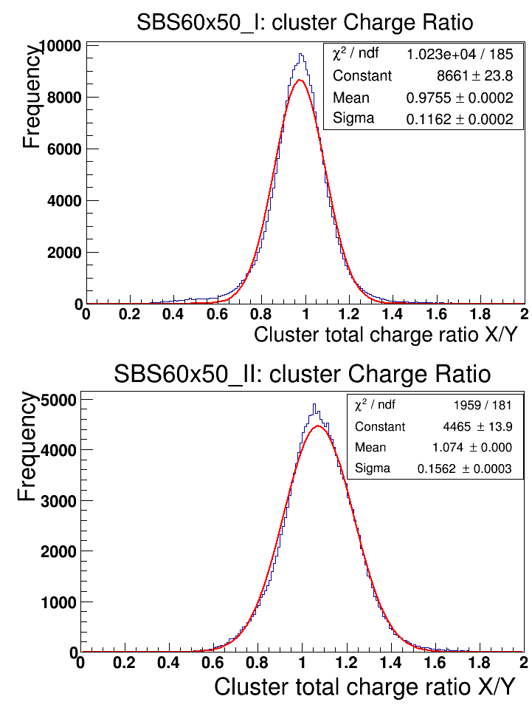
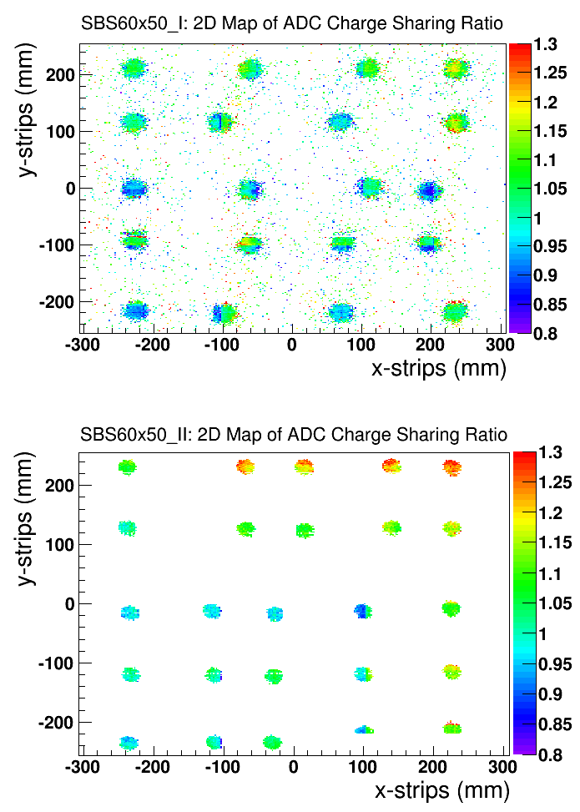
Cluster ADC charge sharing X-strips vs. Y- strips
sbs_module 1: Charge sharing ratio
Spatial distr. of the charge ratio
Charge sharing ratio: Ratio (x-strips/y-strips) of cluster total charges (ADC unit)
Cluster total charge: Sum of the signal peak ADCs from all the strips of the cluster
Equal sharing: distribution mean around 1 for the two modules.
Spatial distribution is also uniform across the chamber
Overall performance of sbs_module1 slightly better
sbs_module 2: Charge sharing ratio
Spatial distr. of the charge ratio

Slide 5
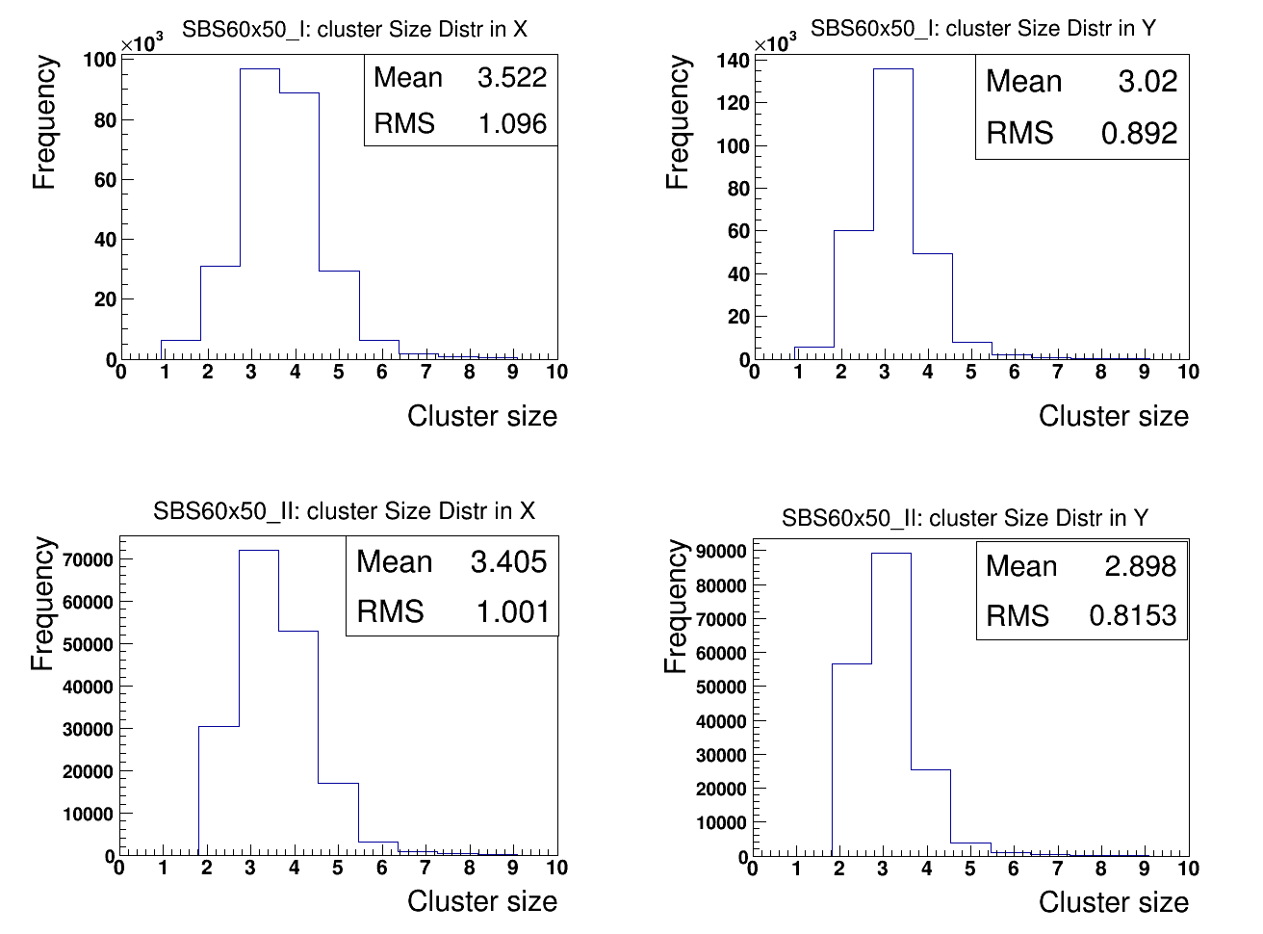
Cluster size @ 4100 V

Slide 6
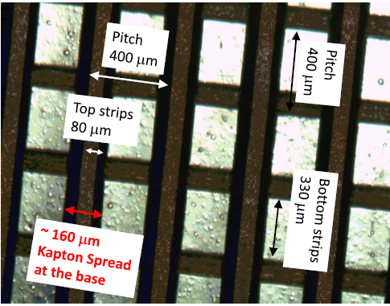
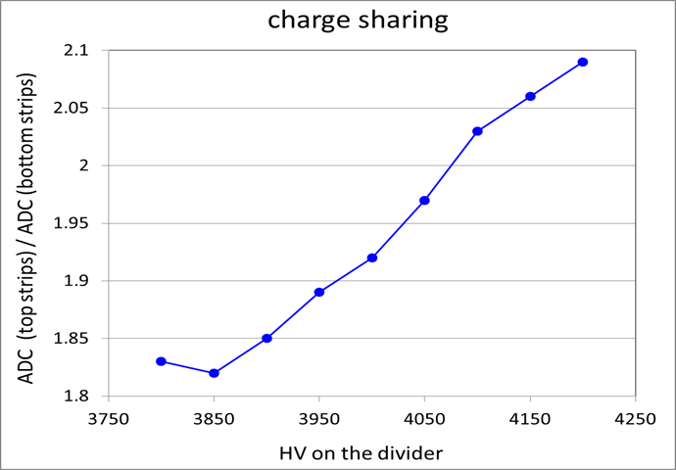
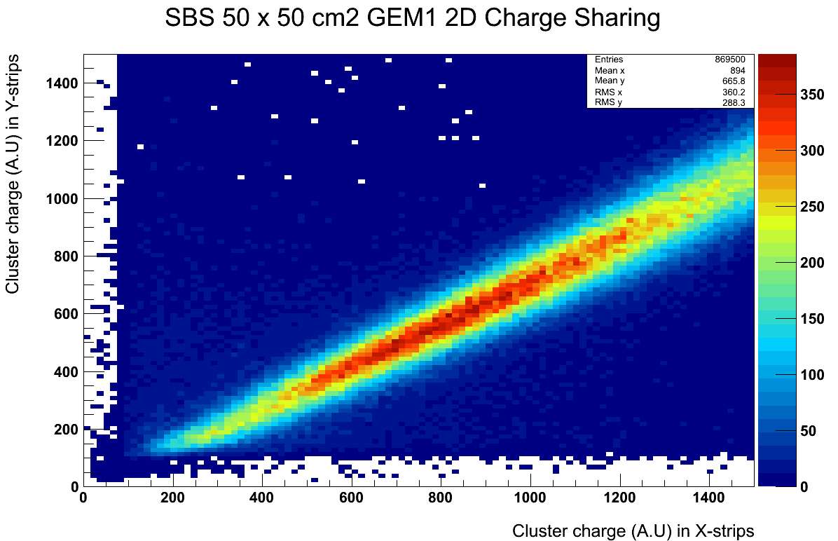
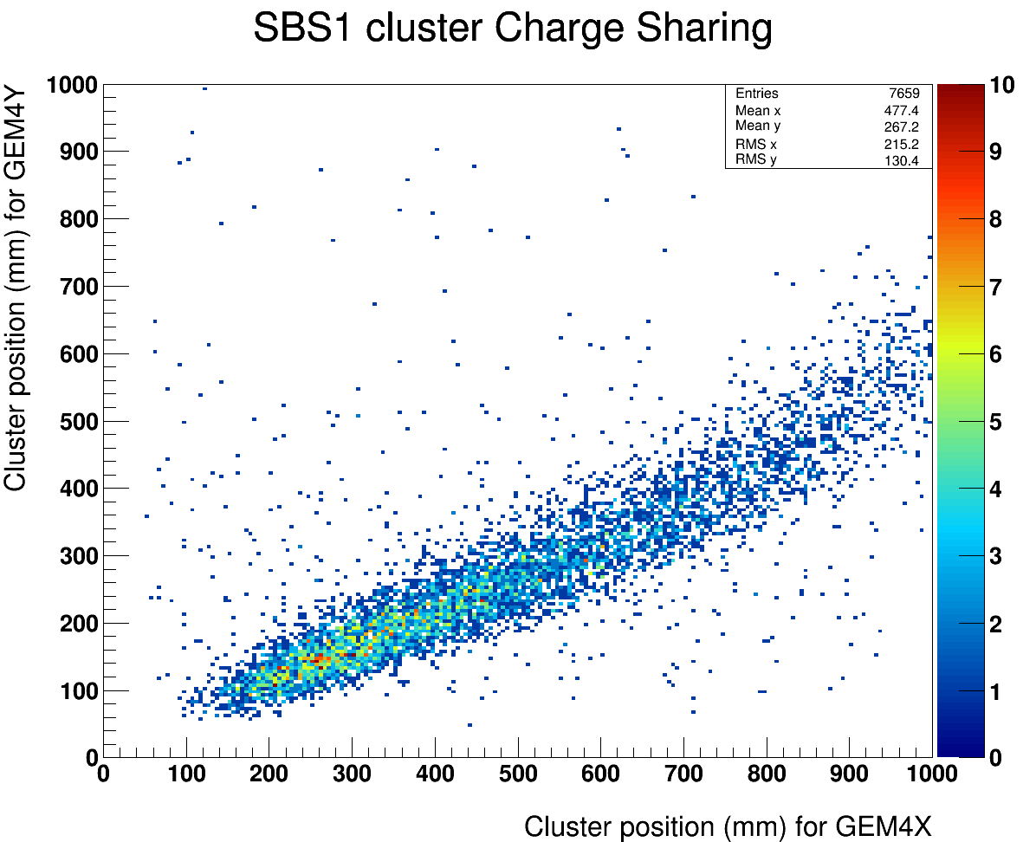
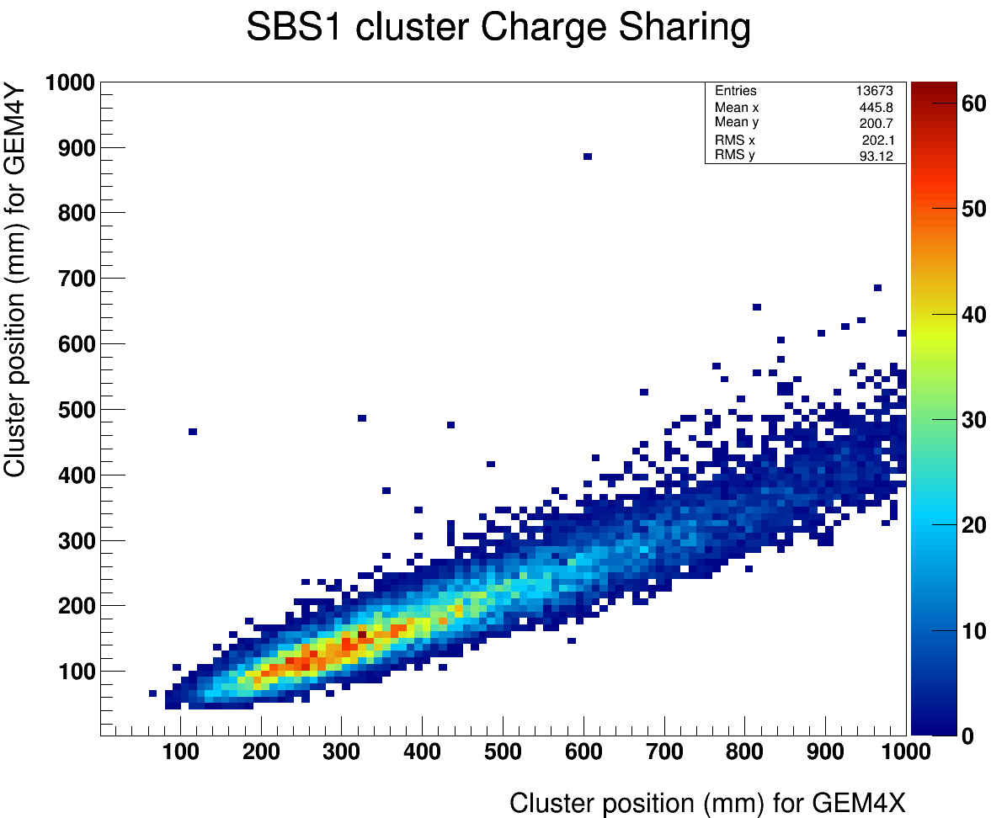
Previous SBS Back Trackers GEM Prototypes:
poor quality of the readout board and wrong dimensions for the strip
The problem:
Strong non-equal charge sharing between top and bottom strips (X/Y)
Ratio of the charge sharing dependent on the rate of particle in the chamber
Problem discovered with he FNAL test beam data in October 2013)
The cause
Parameters for the strips width different from COMPASS design
Too large spread of the base of the Kapton separating top and bottom strip
Masking part of the bottom strips, charging up around bottom strips in high rate environment
Charge sharing ratio vs. HV
Uva Lab: Cosmic data
Charge sharing ratio (X/Y) = 1.34
FNAL: 25 GeV Hadrons
Charge sharing ratio (X/Y) = 1.81
FNAL: 120 GeV Protons
Charge sharing ratio (X/Y) = 2.25

Slide 7
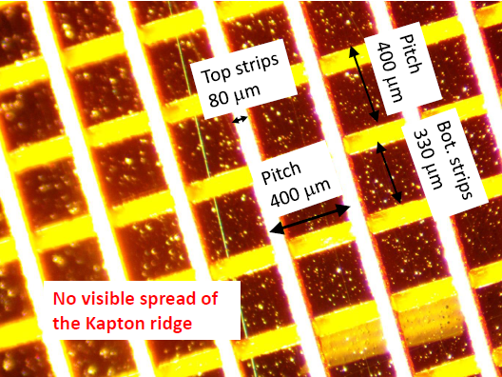
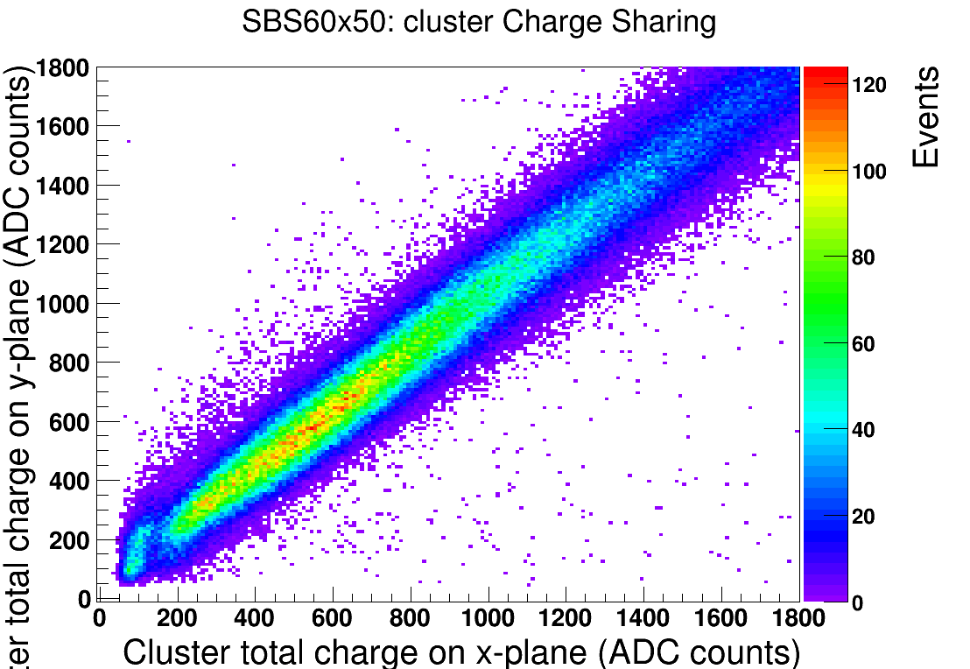
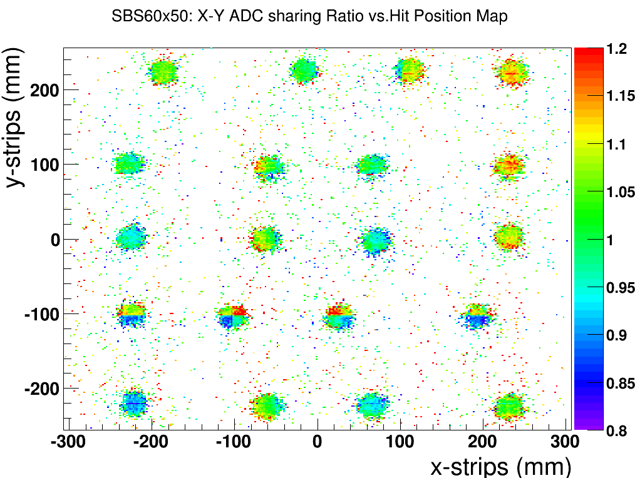
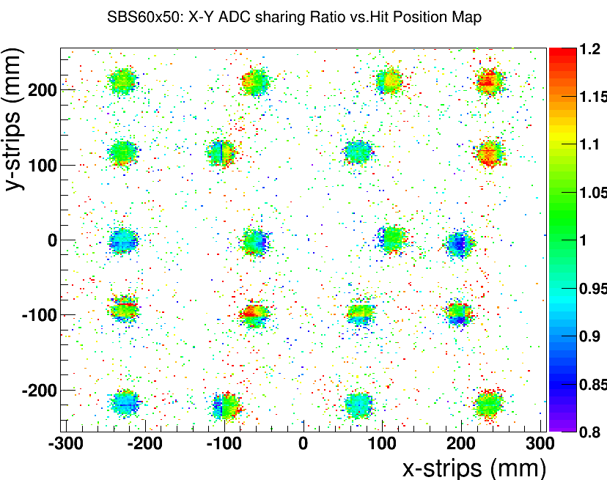
First two SBS Back Trackers modules:
Correct strip dimensions and improved quality of production
Solution: Improvement of quality of readout board at CERN
Optical quality inspection of the board in the lab at UVa
First 3 readout board show very good quality
Data show equal charge for both modules.
Mean of ratio distribution mean ~ 1 and sigma ~ 0.12
Good spatial uniformity of the charge sharing
No significant change at different gas flow rate
Need high rate test to fully qualify the improvement
Bot. Strips
350 μm
Flow = 10 units ~ 2 V/h, SBS 60 x 50 V = 3.6 L
X vs. Y ADC charge correlation
Gas flow = 5 units
Gas flow = 15 units

Slide 8
Plans for the next batch of SBS Back Tracker Modules
The first two modules have been built and they now are been tested with cosmic and radioactive sources.
One sector on sbs_module2 had a short after during the final test after assembly
The charge sharing issue previously for the SBS GEM prototypes and due to the poor quality of the readout board production has been addressed
Test of the chambers at very high rate with x-ray source to validate the fix is planned.
The X-ray source has been delivered and the setup with the shielding box in the detector lab is ongoing
We got notification from CERN that the next batch of foils will be shipped on July 18th.
RESARM report a 3 weeks delay in the production of the frames due to technical problems and summer break. The frames are expected to be e shipped by July 28th
We plan to start the assembly the next 3 chambers soon after that we receive the foils from CERN

Slide 9
Outline
Status of the production SBS Polarimeter GEM modules
Latest issues under investigation.
Report on the performances of the chambers at FNAL and JLab test beam
Update on APV25-SRS Electronics for SBS

Slide 10
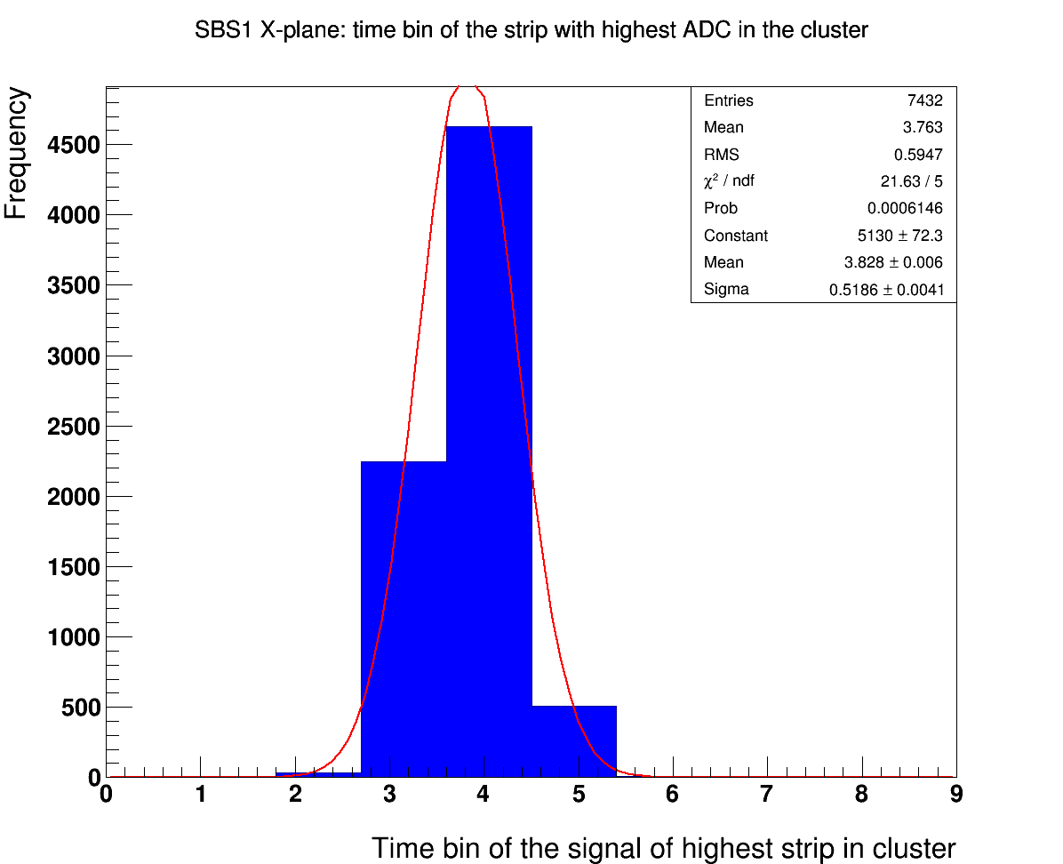
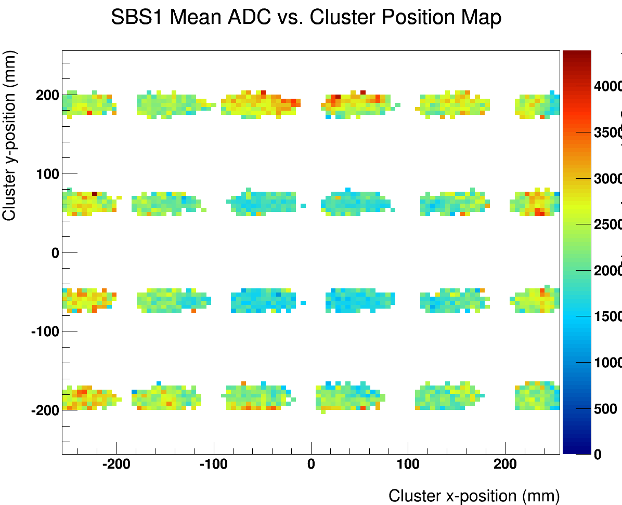
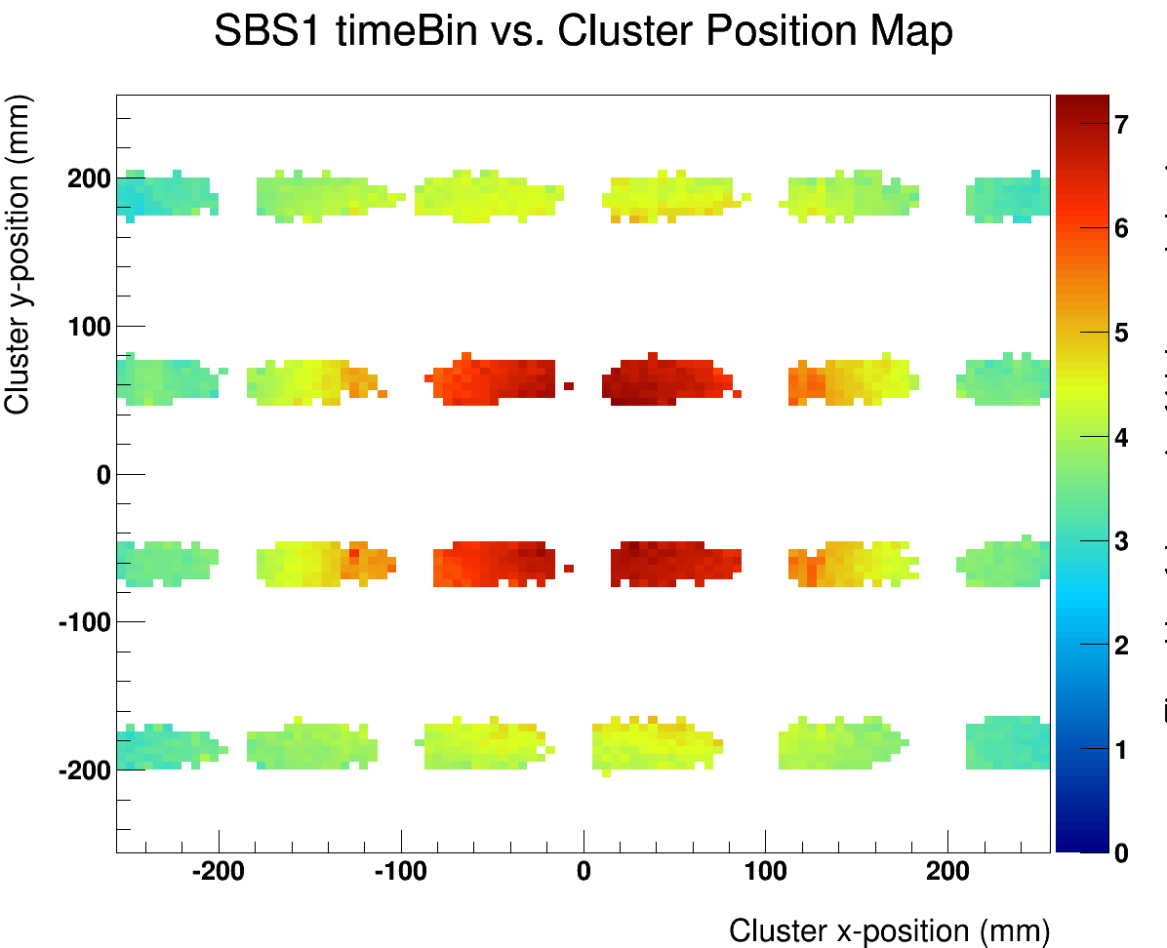
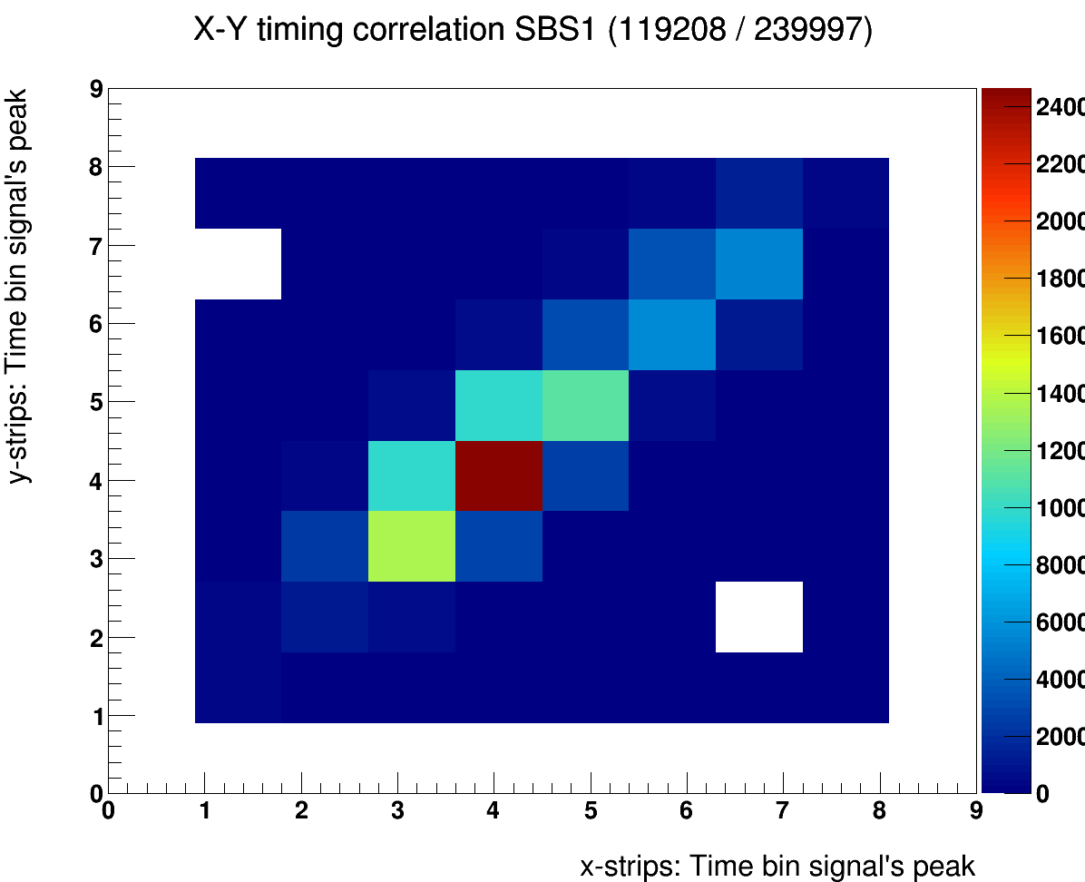
Problem no1: Displacement of APV25 signal peak position in time
Spatial non uniformity of the timing of signal peak wr.t. trigger latency
up to 3 time samples 25 ns difference from the edge to the center
This was seen with both original gas flow design (horizontally from one side of the chamber to the other side) and the current back tracker GEM design (vertically from drift region to induction region)
Gas flow was high @ the FNAL test beam (but we did not measure it)
Perfect correlation of position of the peak between X and Y signals
Timing inversely correlated to the gain uniformity for high gas flow
Distr. of the bin of the signal peak
Average ADC
2D map of the bin of signal peak
X-Y correlation of the peak position
Time bin

Slide 11
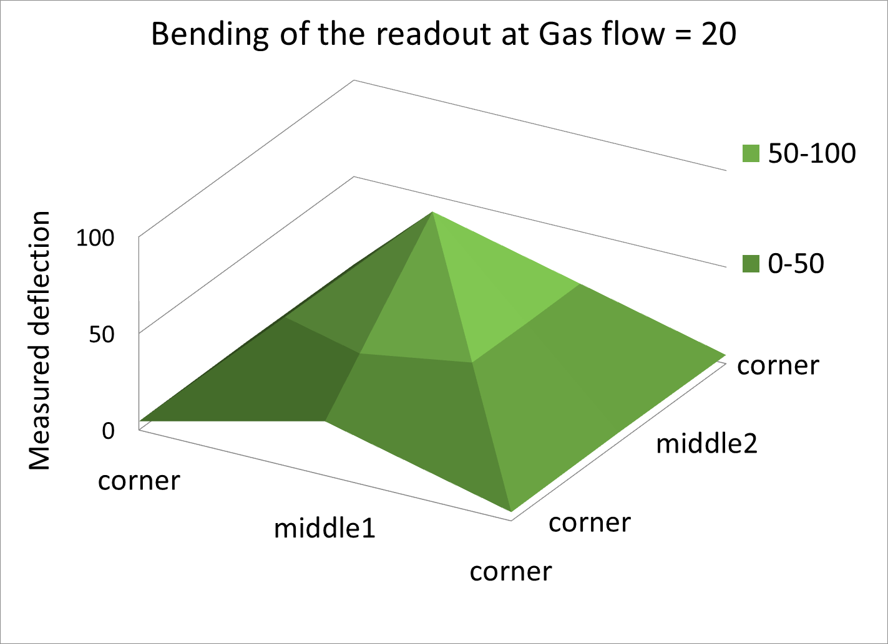
Study of the bending of readout honeycomb support vs. gas flow rate
(Data taken by Chau Dao)
Setup of a test (see cartoon below) to measure the bending of the readout board (honeycomb support) with the flow rate inside the chamber
Measurement were taken at 4 location on the bottom side of the honeycomb support
The measured deflection of 100 units is equivalent to 2.54 mm
A gas flow = 10 units represent 2 volumes (V) change / hour in the GEM chamber (V = 3.6 L)
middle2
center
corner
middle1

Slide 12
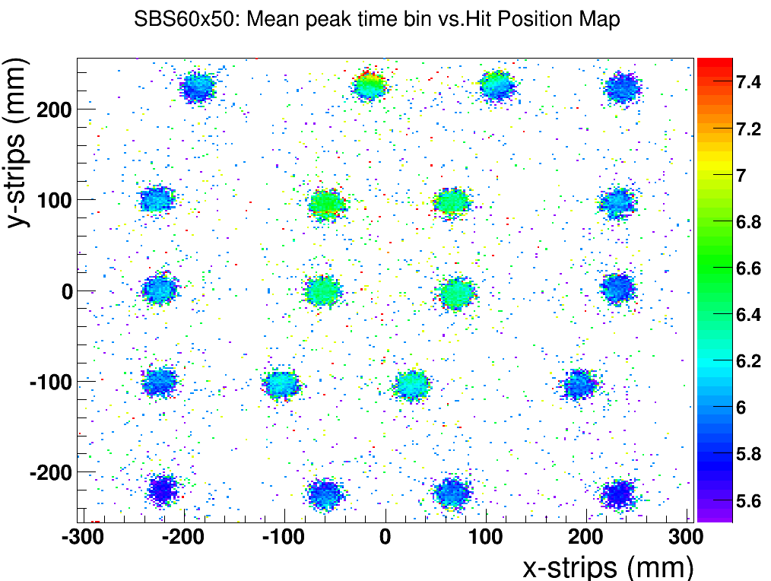
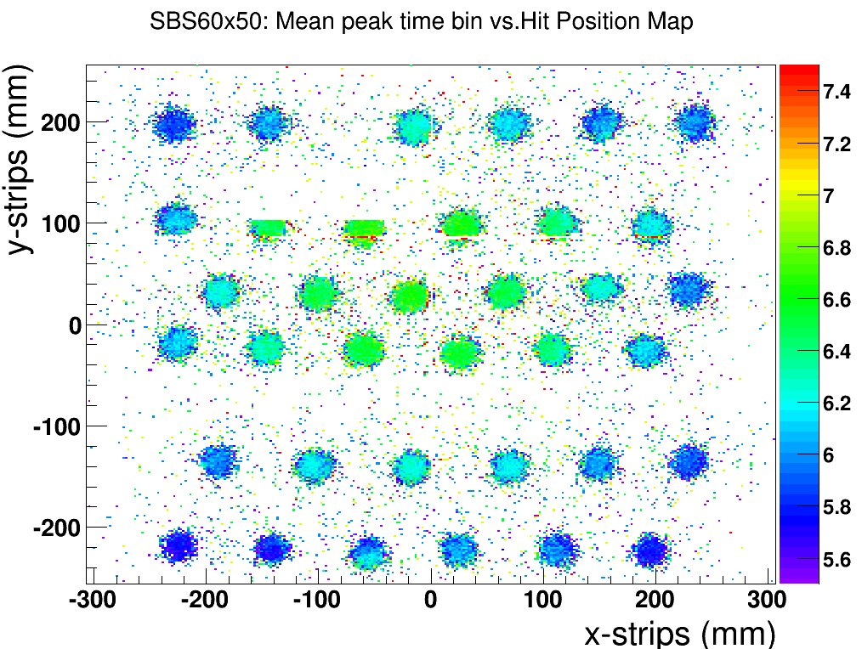
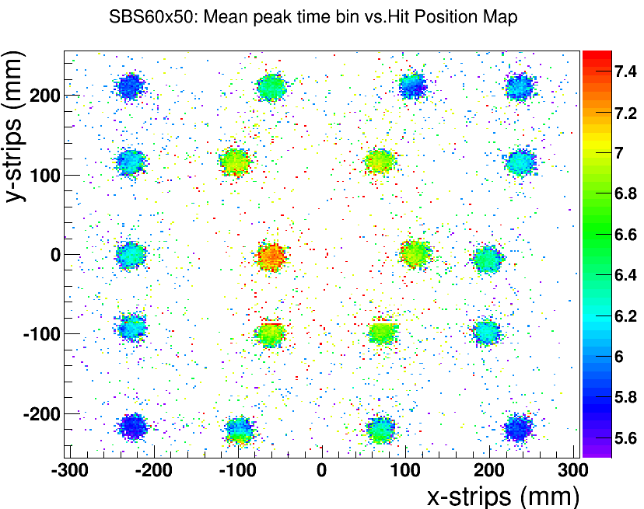
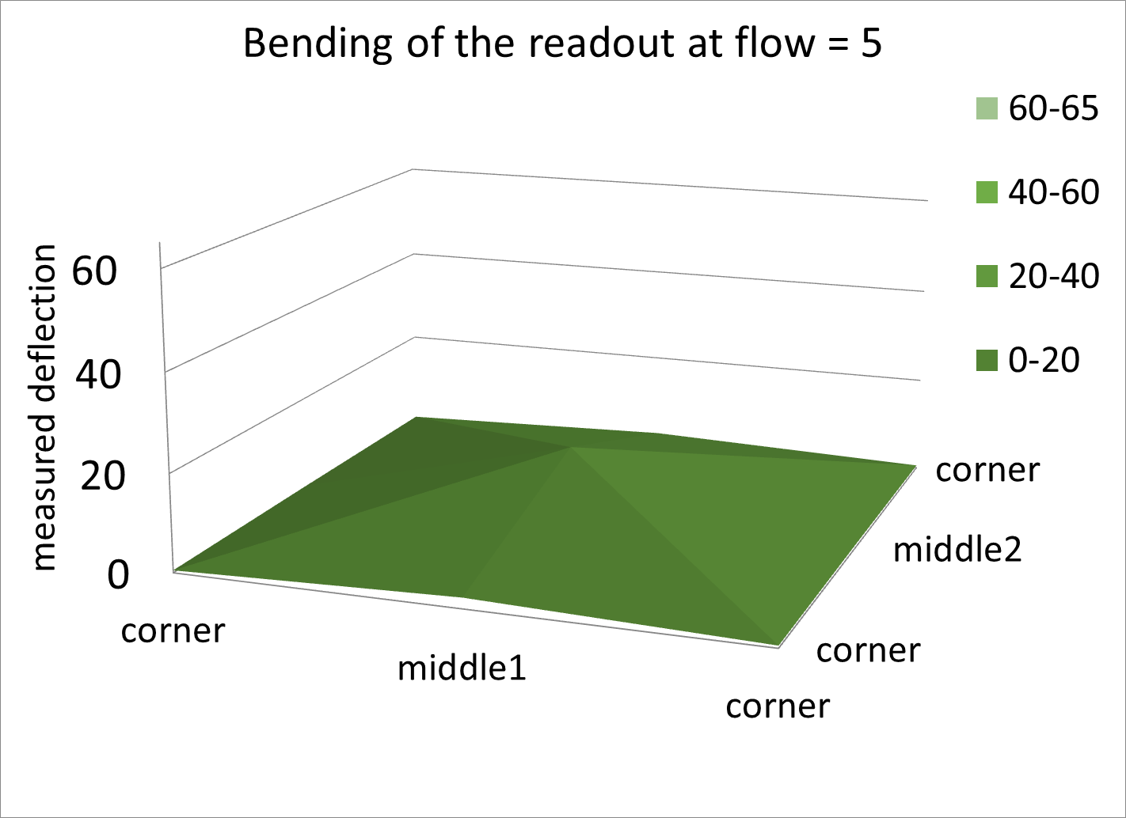
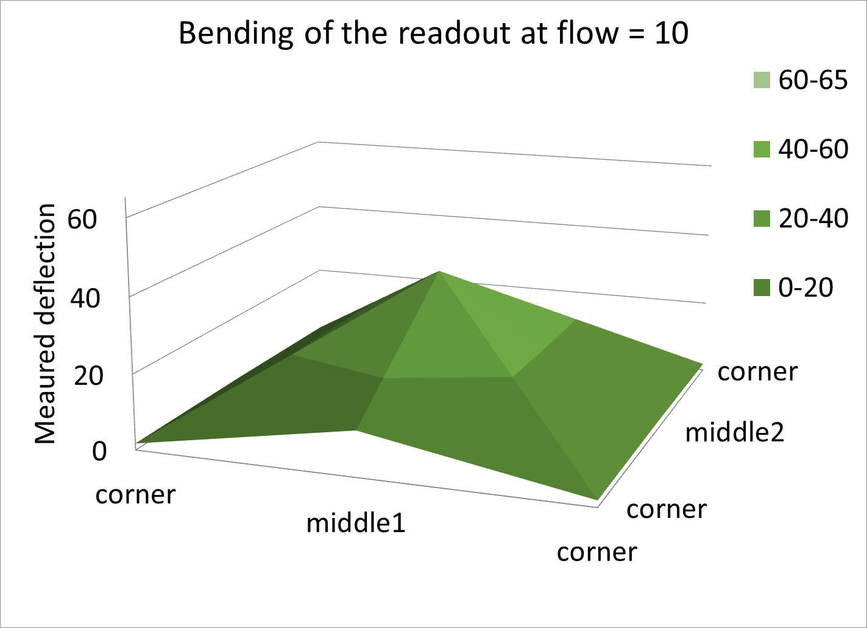
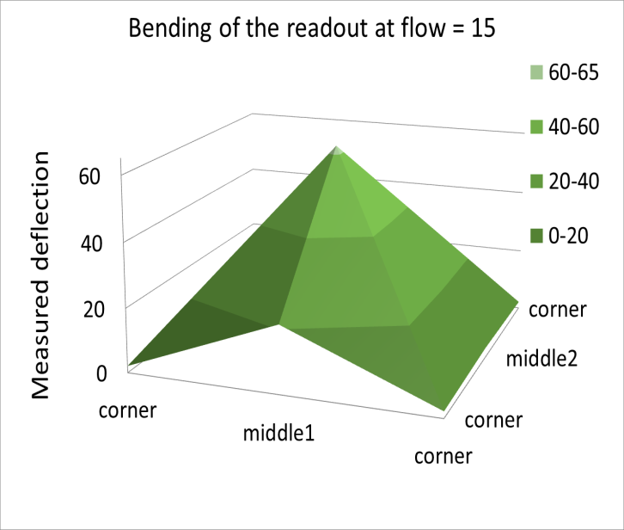
APV25 signal peak position vs. bending of readout board
Scan the newly built 60x50 GEM module with Sr90 source at different flow rates.
A gas flow = 10 units represent 2 volumes change per hour. The volume of the SBS BT GEM chamber is 3.6 L)
Clear dependence of the signal peak spatial non uniformity with gas flow
Clear correlation between the signal peak position and the deformation of the readout board
Gas flow = 5 units
Gas flow = 10 units
Gas flow = 15 units
A gas flow = 10 units represent 2 volumes (V) change / hour in the GEM chamber (V = 3.6 L)

Slide 13
Idea for correction of the bending of the readout
Clear correlation between the bending and the displacement of the signal peak position
Idea to test is to add a 25 μm Kapton foil gas window at bottom of the chamber and flow the gas inside to compensate the overpressure inside the chamber.
Easy idea to implement and we could test the signal peak position against gas flow with it to validate it
Gas input

Slide 14
Problem no2: Gas window foil accidentally attached to drift cathode
Problem
We observed during the test beam at JLab that the gas windows of both chambers gets pulled down and attached to the drift cathode window below it during chamber operation.
We believe that this is due to electrostatic attraction between the gas window and the drift Cathode.
The signal time is strongly affected and spread over as much as 100 ns when this happens.
Manage to release the gas window from the cathode by gently pressing to the bottom of the chamber.
Solution
We are investigating a simple fix for this problem: adding some spacer in this region of the chamber
We hope that the spacers is enough to prevent the collapse of the gas window foil to the drift
window foil
floating
Electrostatic force
Drift Cathode at -4kV
Ground

Slide 15
Outline
Status of the production SBS Polarimeter GEM modules
Latest issues under investigation.
Report on the performances of the chambers at FNAL and JLab test beam
Update on APV25-SRS Electronics for SBS

Slide 16
Test Beam @ FNAL (october 2013)
Successful test beam campaign with SBS 50 ×50 cm² prototype alongside the EIC-SoLID GEM prototype
Data analysis for spatial resolution, gain efficiency, gain uniformity, timing of the APV25 signal …
FNAL test beam data reveals big issues (timing of the APV25 vs. gas flow, Quality of readout board vs charge sharing …)
Medium size APV25 electronic tested at moderate trigger rate 400 Hz
Large GEM Test Beam Setup @ (FNAL) UVa an FIT
SBS GEM1
EIC-SoLID GEM
SBS GEM2

Slide 17
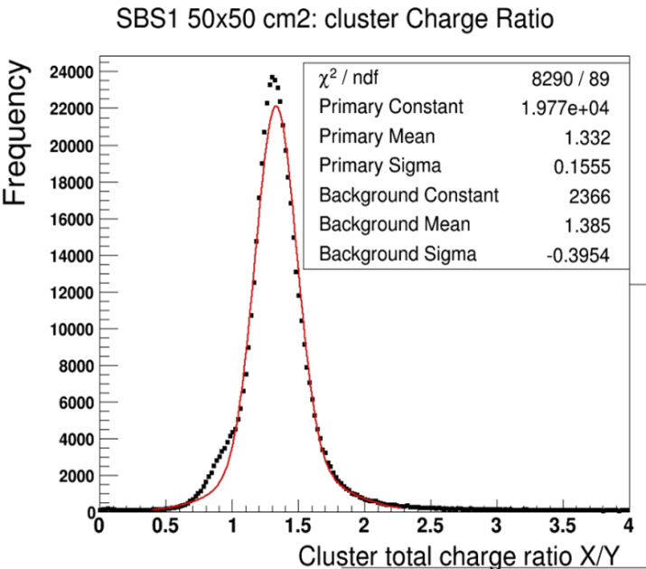
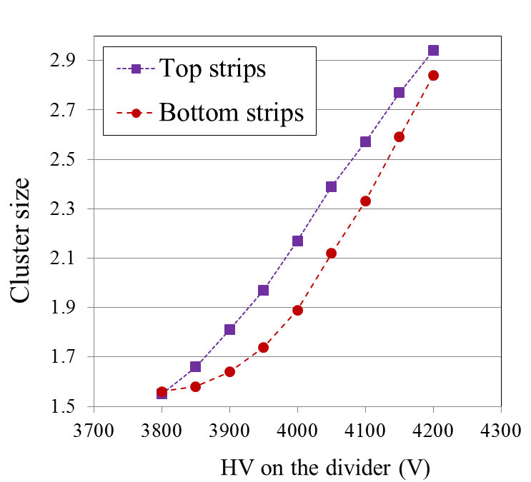
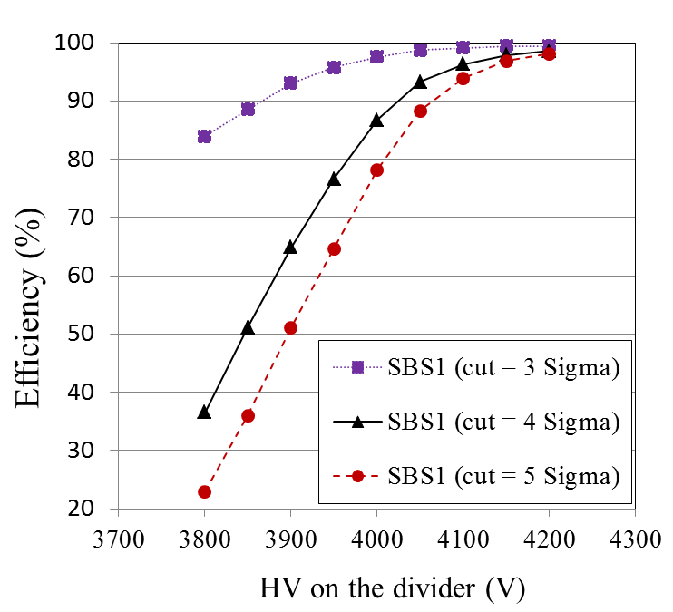
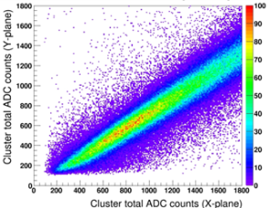
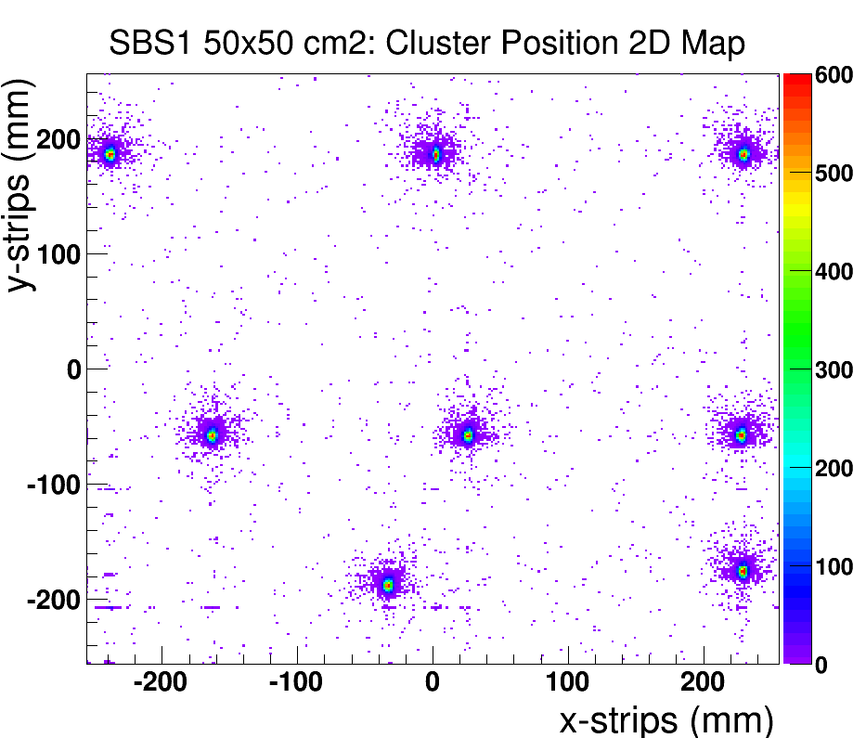
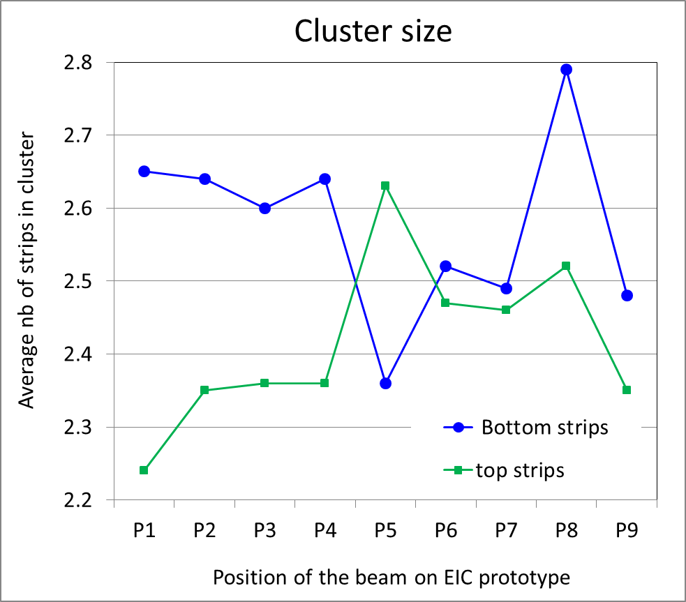
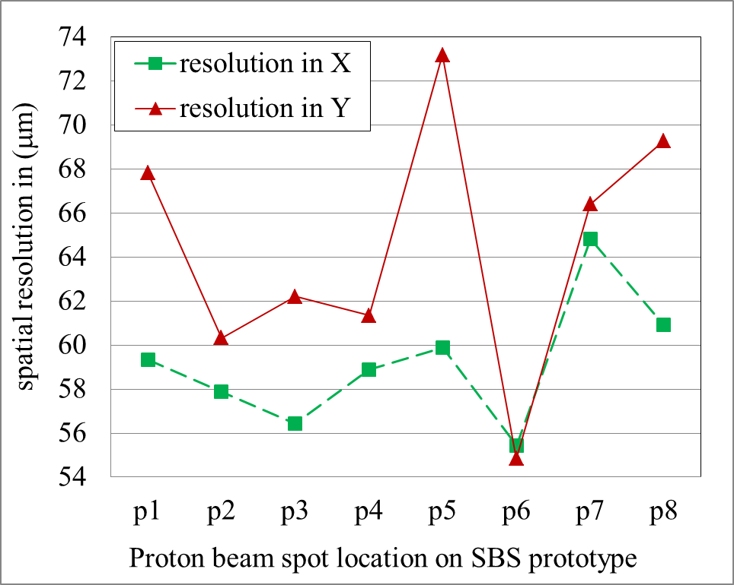
Test Beam @ FNAL (October 2013): results from data analysis
Charge sharing
Cluster size vs. HV
Gain efficiency curve vs. HV
Position scan with proton beam
Cluster size @ scanned positions
Spatial resolution @ scanned positions
P4
P5
P6
P3
P1
P2
P8
P7

Slide 18
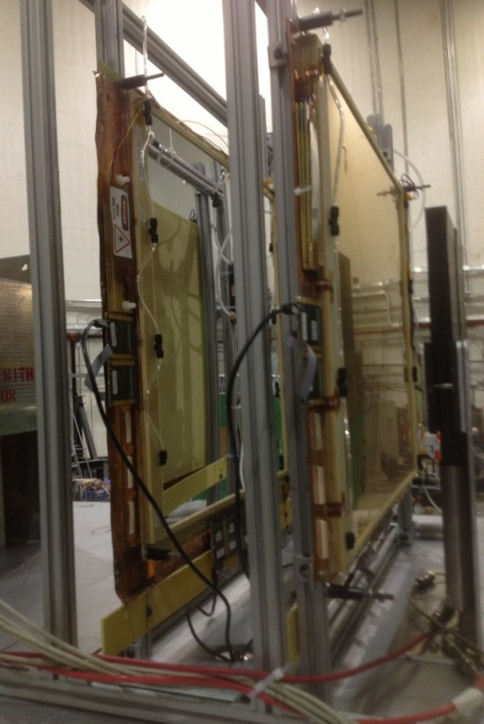
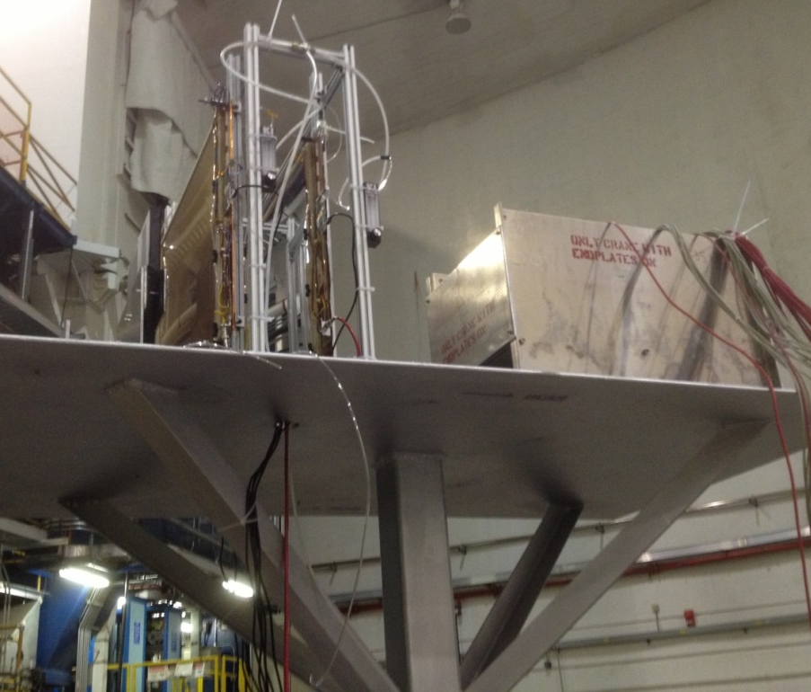
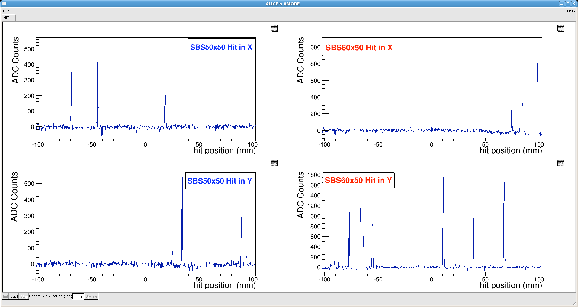
Test Beam in Hall A @ JLab (April 2014)
Two SBS GEM Module: 20 cm ×20 cm read out
Trigger: Coincidence between PMT-Scintillators upstream and Lead Glass downstream
2 PMT Scintillators (16 × 16 cm² ) side by side, and 4 × 3 cm² Lead glass blocks (10 × 10 cm² )
Readout System: APV25-SRS + DATE DAQ
PMT + Scint.
(MSU,Mitra Shabestari)
4 × 3 Pb Glass Blocks
(Yerevan HallC, Mark Jones)
SBS Proto2_50×50
SBS Proto3_60×50
Multiple hits event in the two chambers
Analysis of the timing information is ongoing
Specially extract signal from background base on the timing of the apv signal
JLab test beam reveals the problem of gas window foil very rarely collapsing on the drift cathode probably due to electrostatic

Slide 19
Outline
Status of the production SBS Polarimeter GEM modules
Latest issues under investigation.
Report on the performances of the chambers at FNAL and JLab test beam
Update on APV25-SRS Electronics for SBS

Slide 20
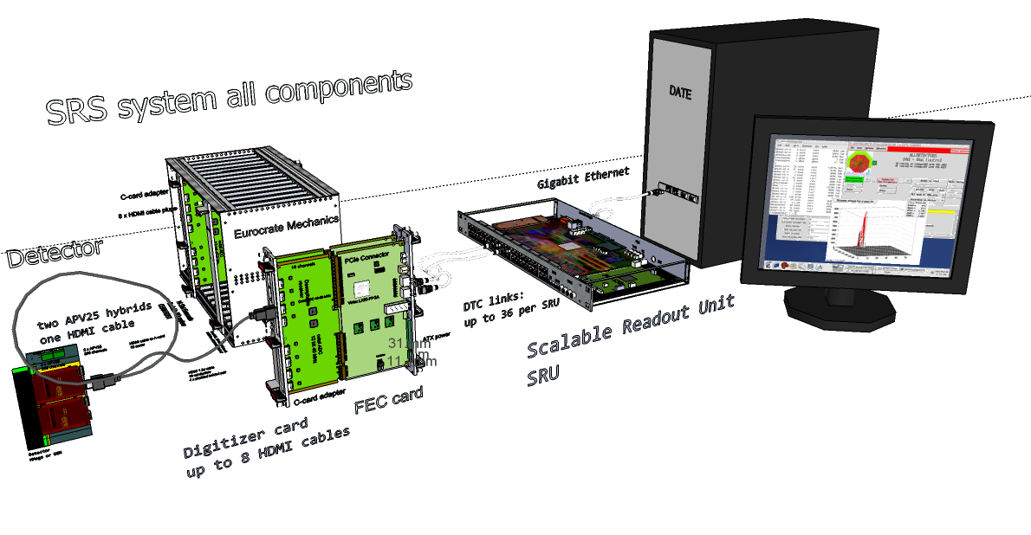
Experience with APV25-SRS @ UVa
SRS with the SRU
Small size (2k channels) in use in the detector lab at UVa lab the last 3 years
Successful run with medium size (8k channels) SRS during test beam at FNAL and JLab
But current system not designed for real experiment-environment like the SBS GEMs
Shortcomings of the current APV25-SRS
APV25 hybrids are not rad hard compliant
HDMI cables length is a limitation for a system that need to be at some distance from the detector area
Limitation on acquisition rate: 5 khz expected for SBS GEp5 experiment
Safety concerned and crate certification issues raised for operation in environment like JLab

Slide 21
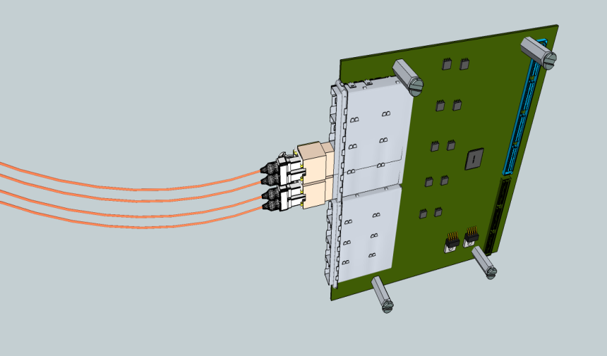
ATCA-SRS architecture
DETECTOR
DETECTOR- FRAME
Cavern
Counting room
Online
High radiation up 1MRad
Magnetic fields up 2T
Moderate radiation 20kRad
Magnetic fields < 1 T
noisy & harsh
environment
Low radiation
Low magnetic field < 5 Gauss
Multi-
Gbit
fibres
SRS –ATCA*
HDMI Micro
Copper link 5m
OC
box
APV25
Bi-dir optical fibres
<200m,
1..10 Gbit SFP
850 nm MM fibre
APV25
FPGA
APV25
Data, Trigger
Clock, Control
APV25
APV hybrids”= frontend
ASICs with SEU-hard
Companion chip*
DTCC protocol:
Data,Trigger,
Clock, Control
4-ch Buck controller
APV25
APV25
Optical SRS-adapter mezzanine**
for ATCA: 8 x SFP+
Low –dissipation , clean
ASIC power 5mW/ch
Unregulated power
4.5 … 15 V /10A
*EicSys GmbH
**short term: ATCA /RTM
with 16 x SFP already available
*initially FPGA

Slide 22
Upgrades needed for SBS Back Tracker GEMs
Optical to Copper Box with ADC option
Link from OC directly to the RTM
Skip digital mezzanine adapter board
APV-hybrid with radiation tolerant capability
Remove the voltage regulator
hybrids powered from OC boxes through HDMI
New development must be compatible with the ATCA version
High density readout and high rate capability
certified ATCA crate, safety concerns need to be addressed

Slide 23
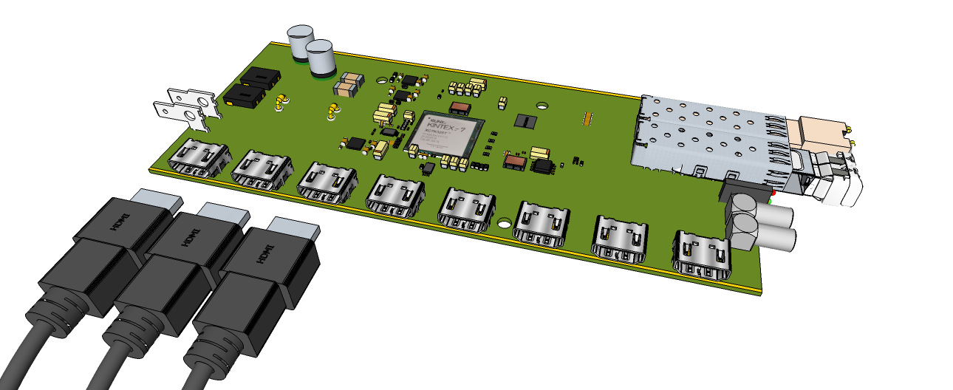
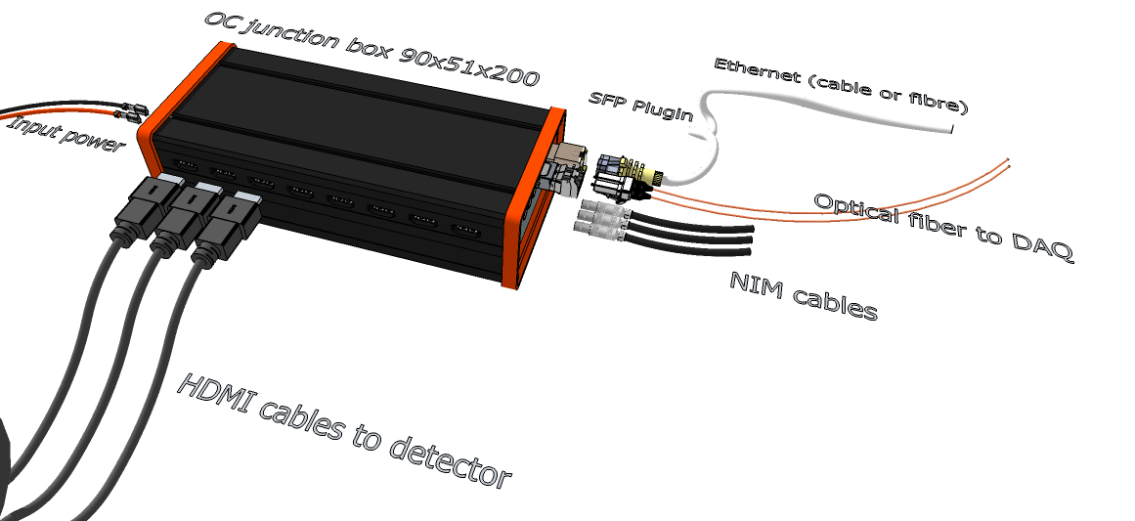
Optical to Copper for Analog readout (OCA)
Solution for Counting room distance (>30m) to detectors
Maintain hybrid power/readout via short copper HDMI
Data, Trigger, Clock, Control (DTCC) via fiber or cable
SEU’s mitigated by off-detector copper-to-fiber conversion
Integrate new VMM128 hybrid digital readout (OCD)
Backward compatibility with APV25 (OCA)
Hybrid powering included via HDMI cables
Accessibility to hybrid power, connectors and links
Single point failure range reduced to 1 single HDMI cable
Ground-loop scope reduced to detector –OC distance
OCA developed by EicSys in parallel under CERN/RD51 supervision

Slide 24
Radiation tolerant APV25-SRS hybrids v5
New revision APV25-SRS v5 with external powering scheme provided by the OC box via HDMI
Removal of the voltage regulators from the hybrids
Concept successfully tested and implemented for the VMM-SRS hybrid (supported by ATLAS NSW)
Limited support needed for the development of the new revision APV25-SRS v5

Slide 25
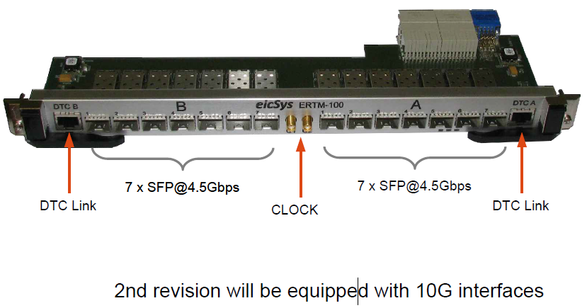
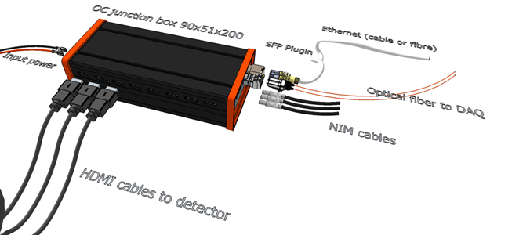
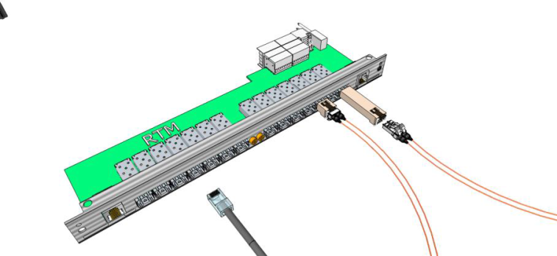
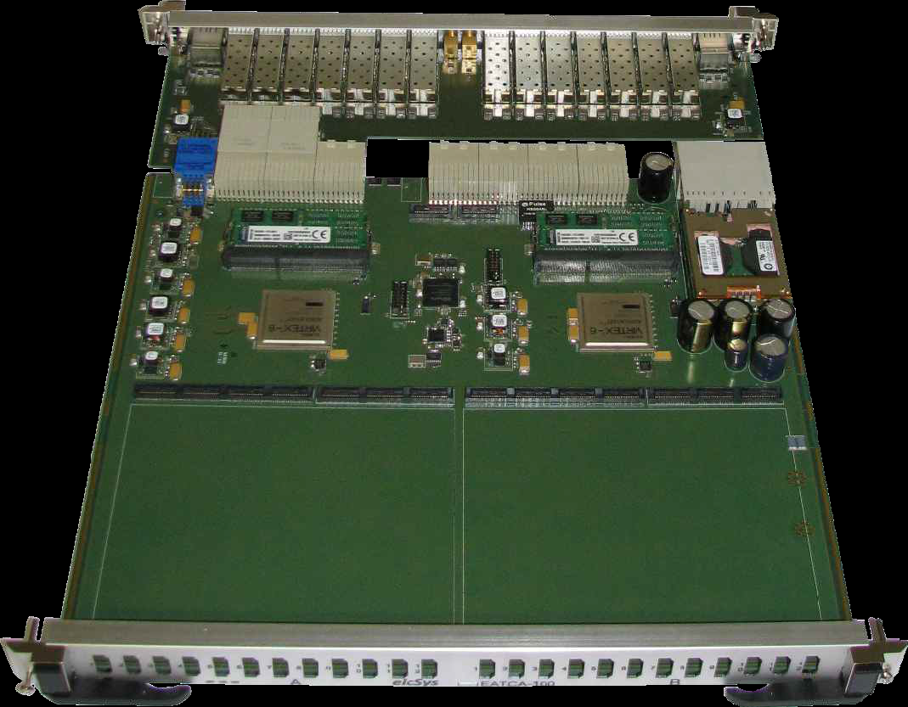
From the OCA data links to ATCA blade via RTM
OCA
RTM
ATCA blade
Current solution with the digital data from the OC directly to the RTM, bypass the optical adapter mezzanine card and from RTM to the ATCA blade
Processed data with common mode correction and zero suppression at the ATCA blade are sent to SRU via RTM DTC links
This scheme need to be tested and evaluated

Slide 26
Summary
First 2 SBS Polarimeter GEM modules are built and are been tested with cosmic and radioactive sources.
Construction of next 3 chambers to start end July. Expected production rhythm of 3 chambers / month is contingent to delivery of the GEMs and readout board from CERN
Fixes for minor issues discovered from the analysis of FNAL and JLab test beam data are under investigation and could be easily implemented in the next modules at minimal additional cost
Upgrades are needed to adapt the APV25-SRS readout system to the requirements of the SBS experiment.
The R&D and prototyping for the upgrades are done by CERN RD51 in collaboration with EicSys for the implementation in ATCA framework. Minimal support is expected from SBS

Slide 27
Back up

Slide 28
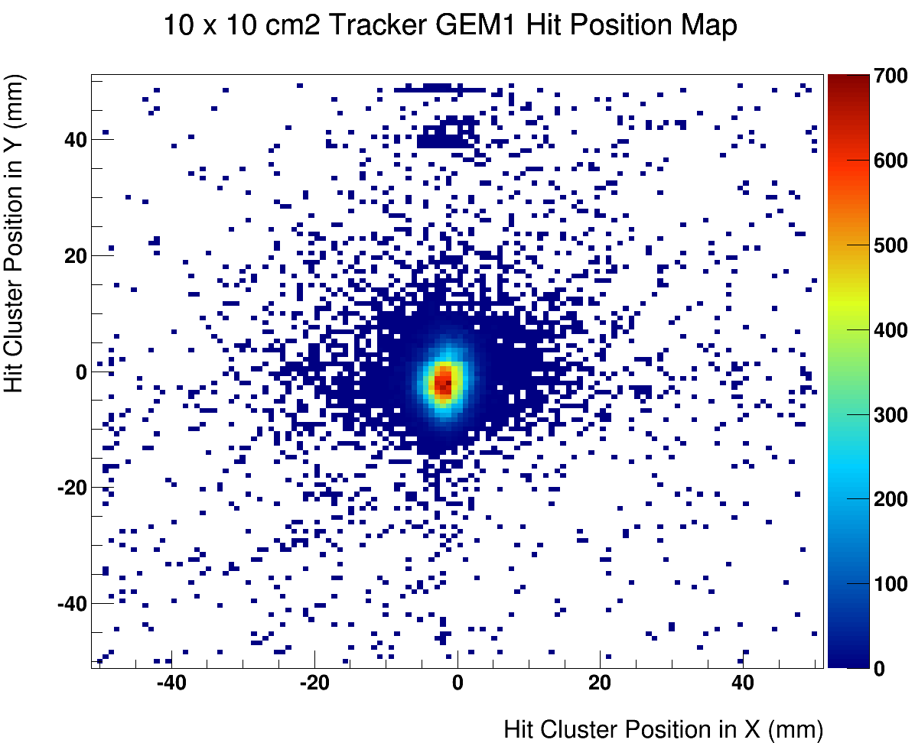
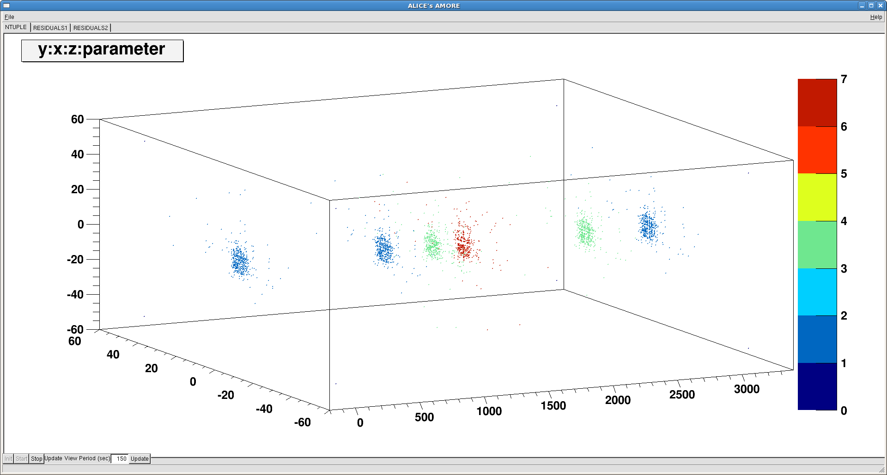
UVa GEMs @ FNAL Test Beam (Oct. 2013): 120 GeV Proton Beam
Beam profile on TRK_1
EIC-SoLID
TRK_4: SBS2
TRK_0
TRK_1
SBS1
TRK_2
Space points of the GEMs chambers from 50K events.
DAQ rate ~ 400 Hz, 3 APV25 time samples

Slide 29
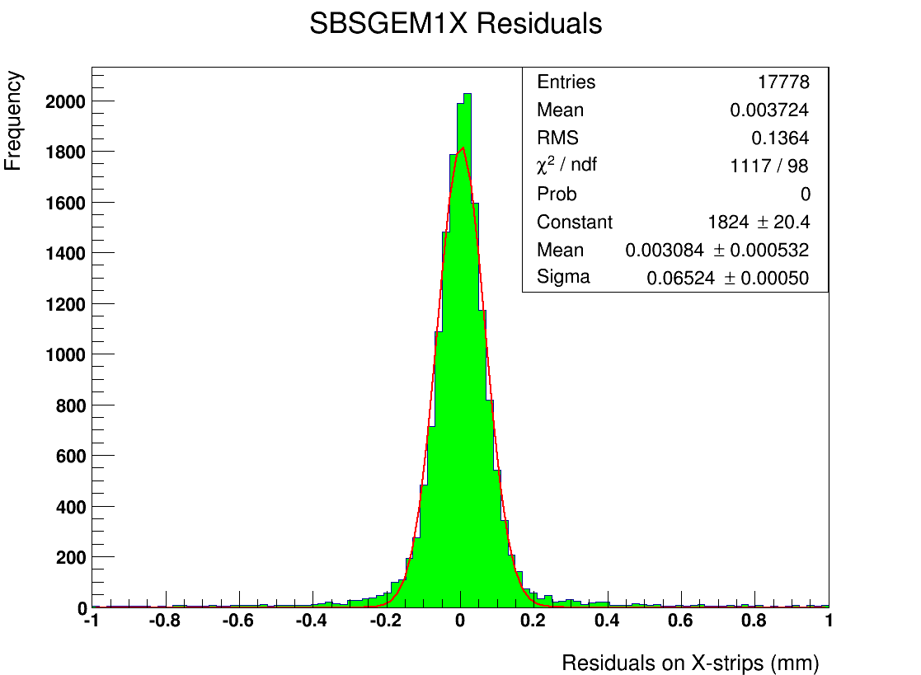
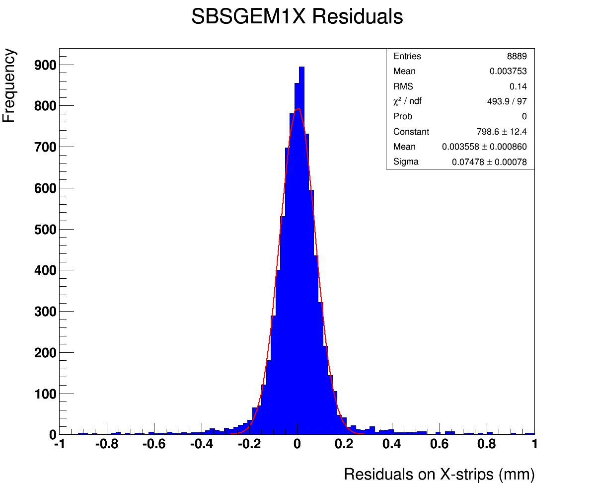
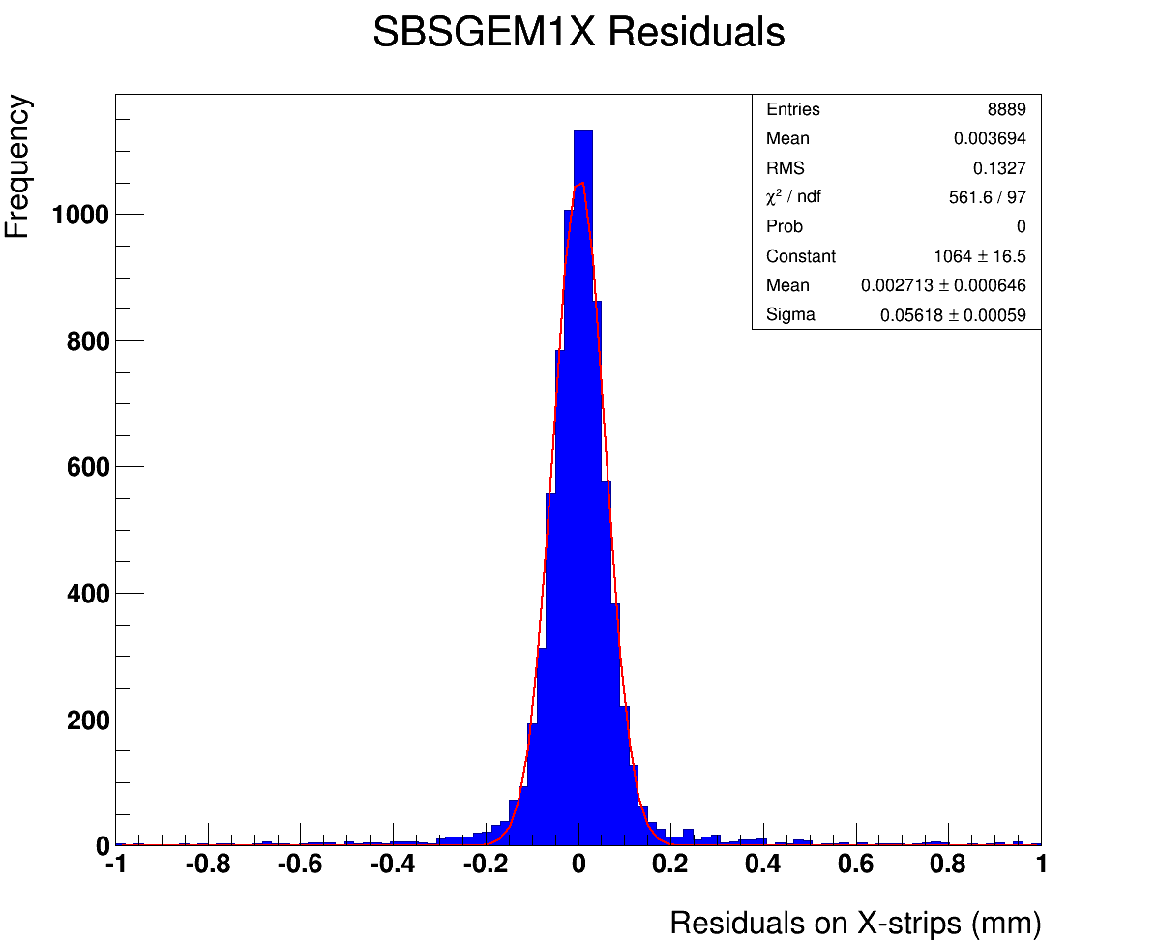
SBS1_50×50: Resolution studies from track fit residuals
Tracking: Linear fit using the single hit from 3 trackers
Exclusive residual: SBS1 data excluded from the fit
Inclusive residual: SBS1 data used for the fit
Resolution: Geometric mean of the width (σ_{resolution}) of exclusive and inclusive residuals distribution:
σ_{resolution} = sqrt (σ_{exclusive} × σ_{inclusive})
Resolution
σ = 65 μm
Exclusive
σ_{x} = 75 μm
Inclusive
σ_{x} = 56 μm

Slide 30
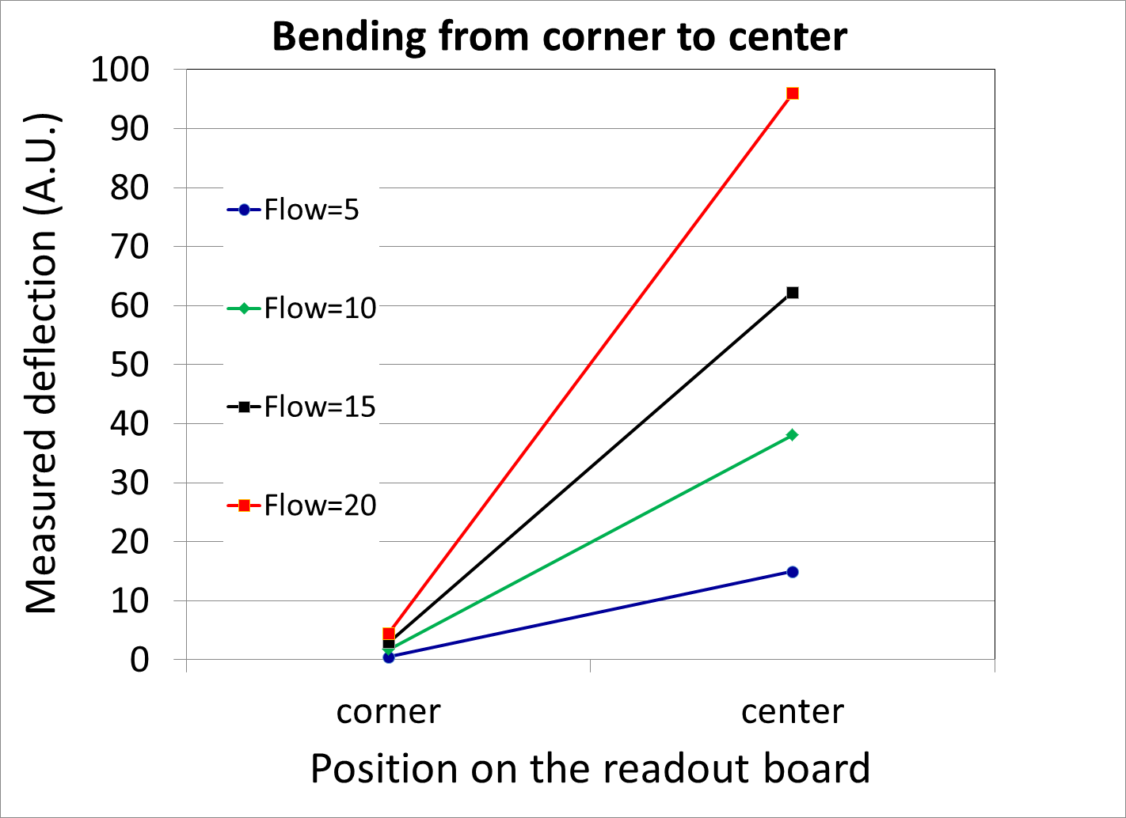
Measurement of the bending of readout board with the gas flow rate
middle2
center
corner
middle1

