Slide 1

Update on the Gas Ring Imaging Cherenkov (GRINCH) Detector for A₁^{n} using BigBite
SBS Meeting
July 8th, 2014
Todd Averett
Department of Physics
The College of William and Mary
Williamsburg, VA USA
Physics Department at William and Mary
In collaboration with:
S. Barcus, H. Yao, William and Mary
B. Wojtsekhowski, S. Esp, Jefferson Lab
Ahmidouch, S. Danagoulian, NC A&T
I. Niculescu, G. Niculescu, JMU
J. Annand, Glasgow
Wiki: http://wm-jlab.physics.wm.edu/mediawiki/index.php/Bigbite_Gas_Cherenkov
Email: hyao@wm.edu, tdaver@wm.edu

Slide 2
Motivation: High Rate Running
Expect 4-5x increase in total luminosity over previous BigBite running.
Assume 4-5x background rate.
30 degree scattering angle
Segmented PMT array (29mm tubes), 9(8) x 60 tubes
Search for timing clusters in 5-10 ns window.
Magnetic shielding between rows.
Locate PMT array on large angle side away from beam line.
C₄F₈O heavy gas at 1 atm

Slide 3
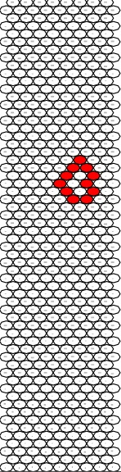
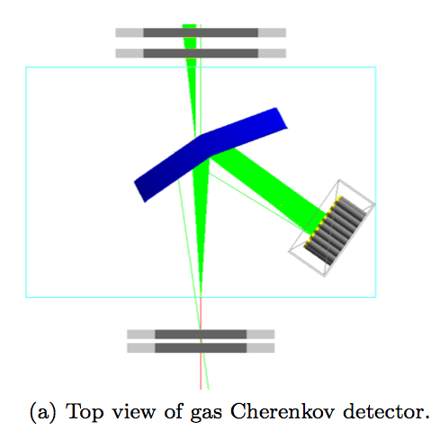
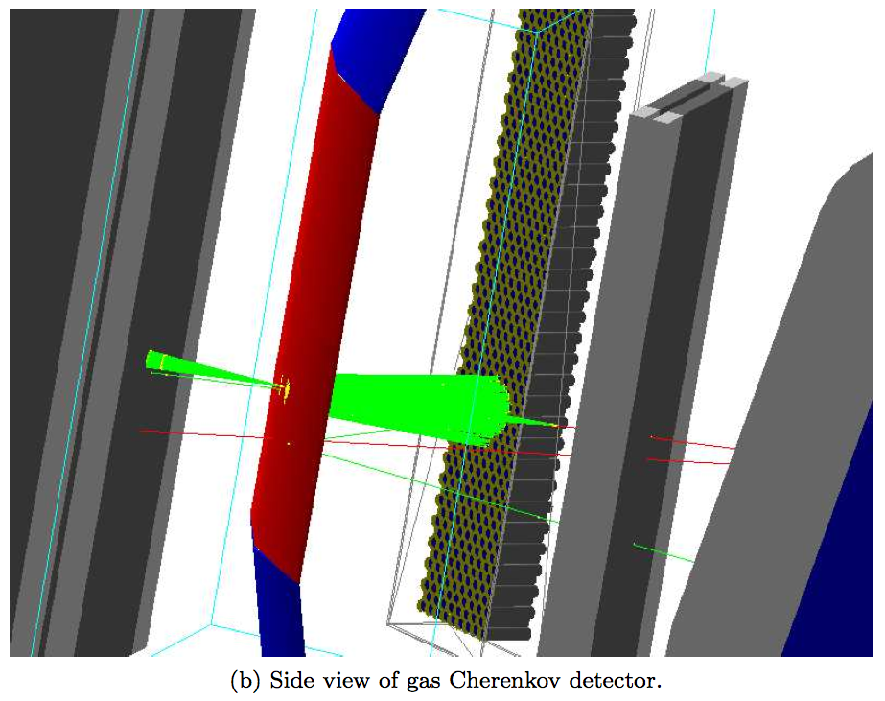
Simulation
GEANT4 simulation includes cross-sections for electrons and pions in event generator. Background not included.
Clusters with avg 10 PMT’s/event (.geq. 1 ph.e.) and 1.7 p.e.’s/tube

Slide 4
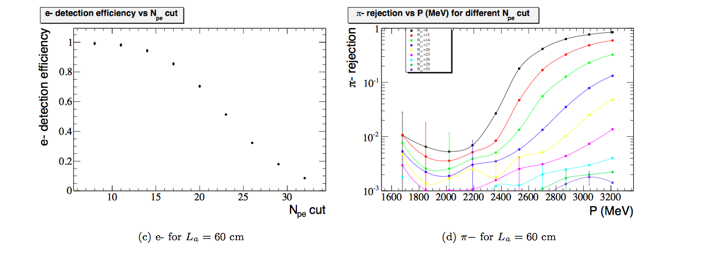
Electron and π efficiencies
Require η_{π} < 0.1

Slide 5
Mirror
PMT
Array
Mirror
Frame
Incoming
Particles

Slide 6
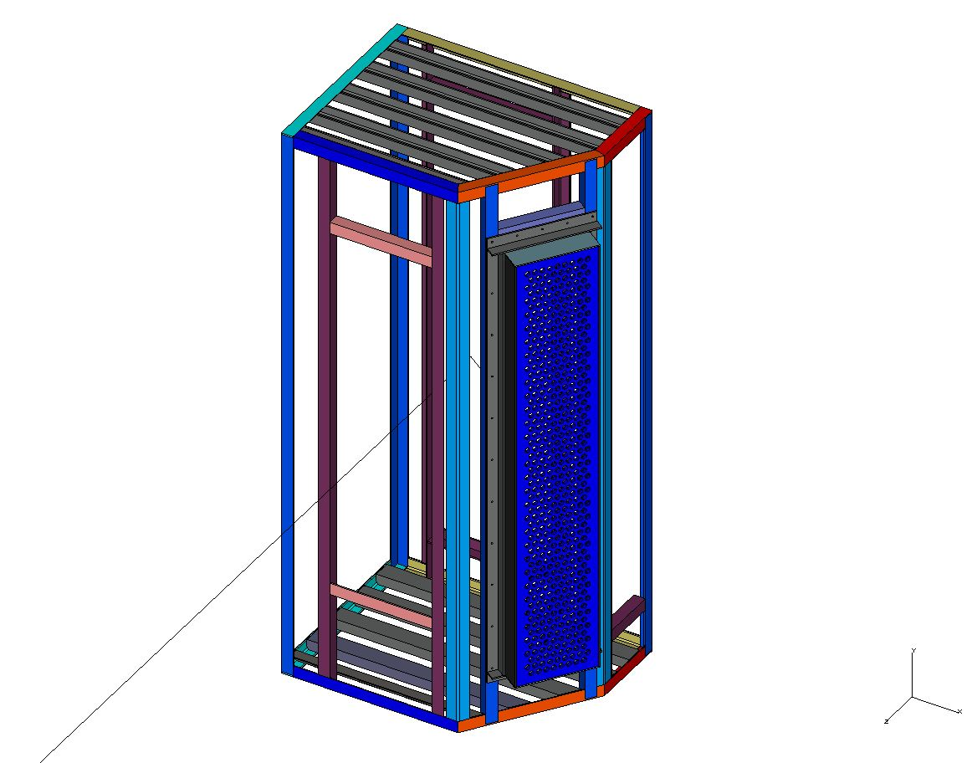
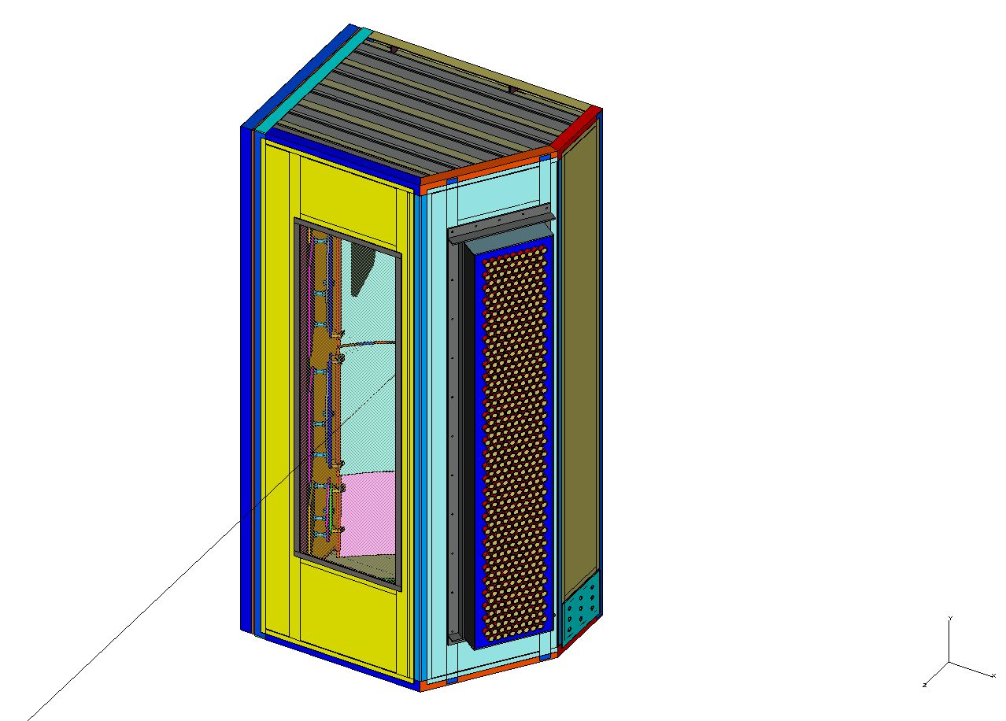
Design
Vessel Weldment
Front View
Complete Assembly
Front View

Slide 7
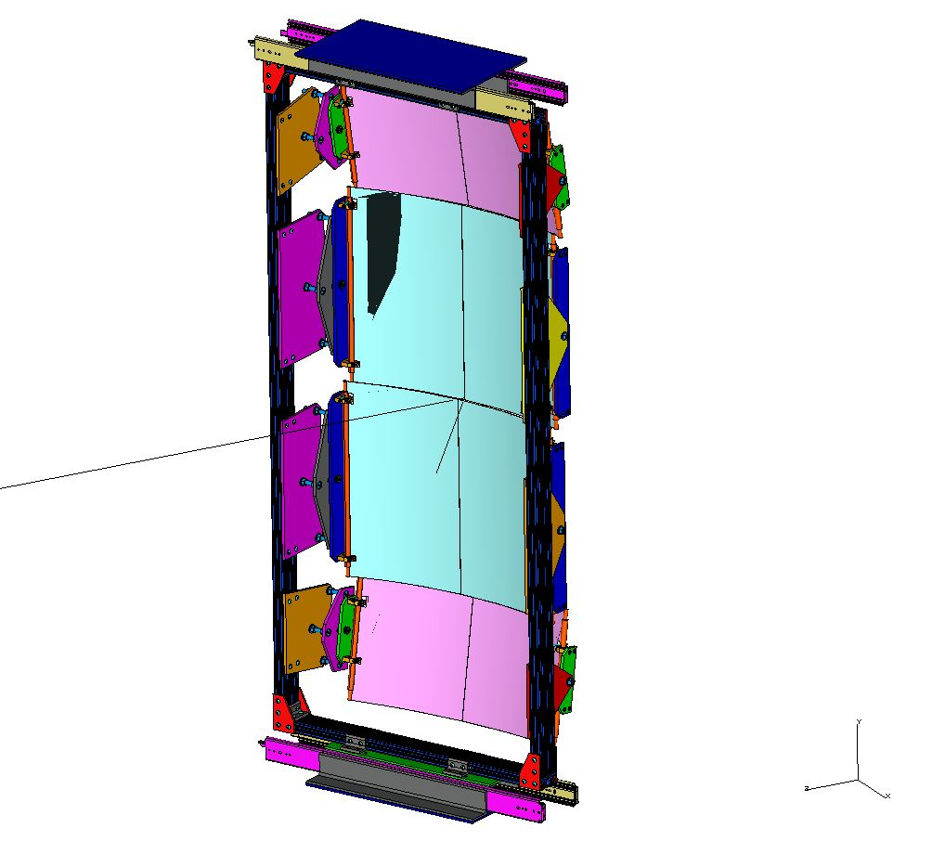
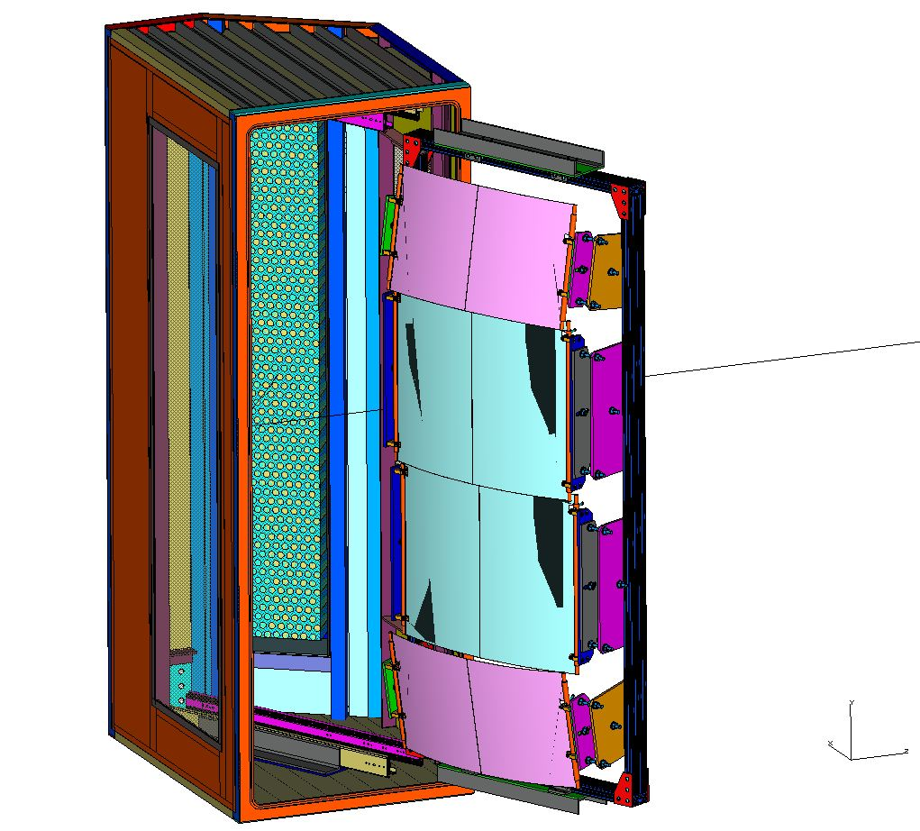
Mirrors and Frame
Front View—Completed and being tested
Mirrors Out of Vessel
Rear View

Slide 8
Status Update
Mirror design completed last year. Mirror assembly fabricated by W&M machine shop. Currently testing alignment with full geometry. (T. Averett, S. Barcus, H. Yao)
PMT array design completed last year. Out for bids (NC A&T responsibility)
Partial vessel design made in early 2013. Still waiting for design time to complete.
NINO front-end cards design complete; funds for production in place (J. Annand)
Full characterization of PMTs in production mode (JMU).

Slide 9
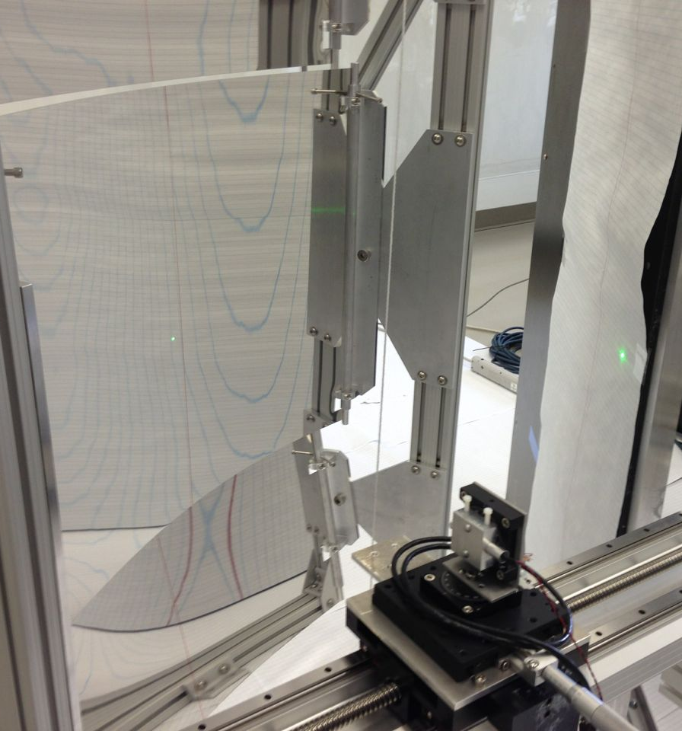
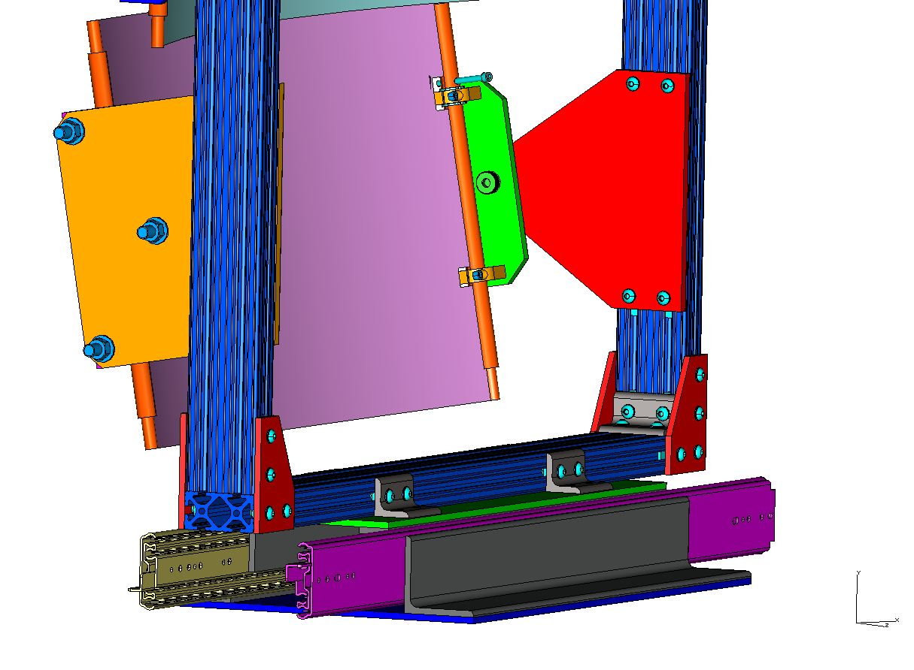
Mirror Frame and Alignment
Mirror
Alignment
Fixture
Rail System

Slide 10
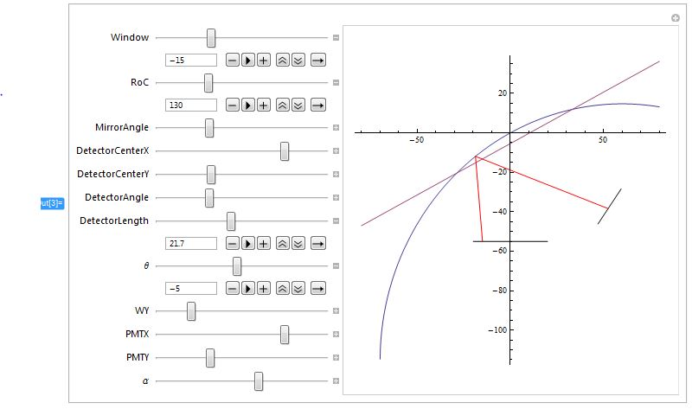
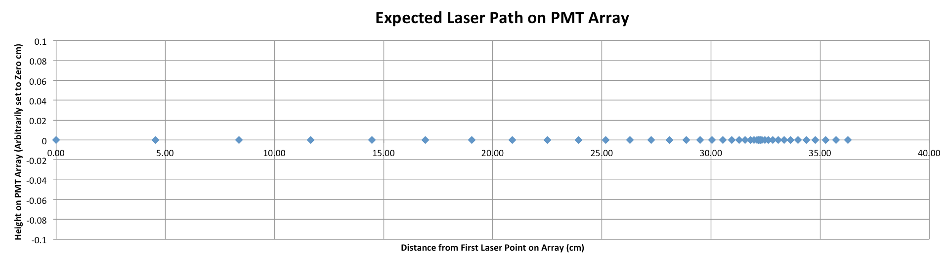
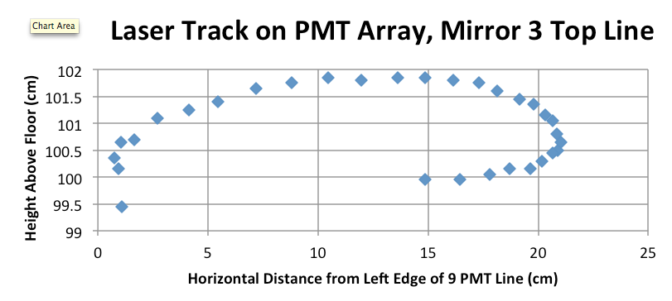
W&M Mirror Assembly
S. Barcus, W&M, Mathematica GUI for geometry, alignment studies
Adjustable location and angle of all components, variable ROC for mirror
Predicted
Typical measured laser position on PMT array as scanned across entrance window.
Vertical mis-steering +/- 1 cm
Retrograde motion due to changing ROC near edges
BUT, all tracks are on the array.
Measured

Slide 11
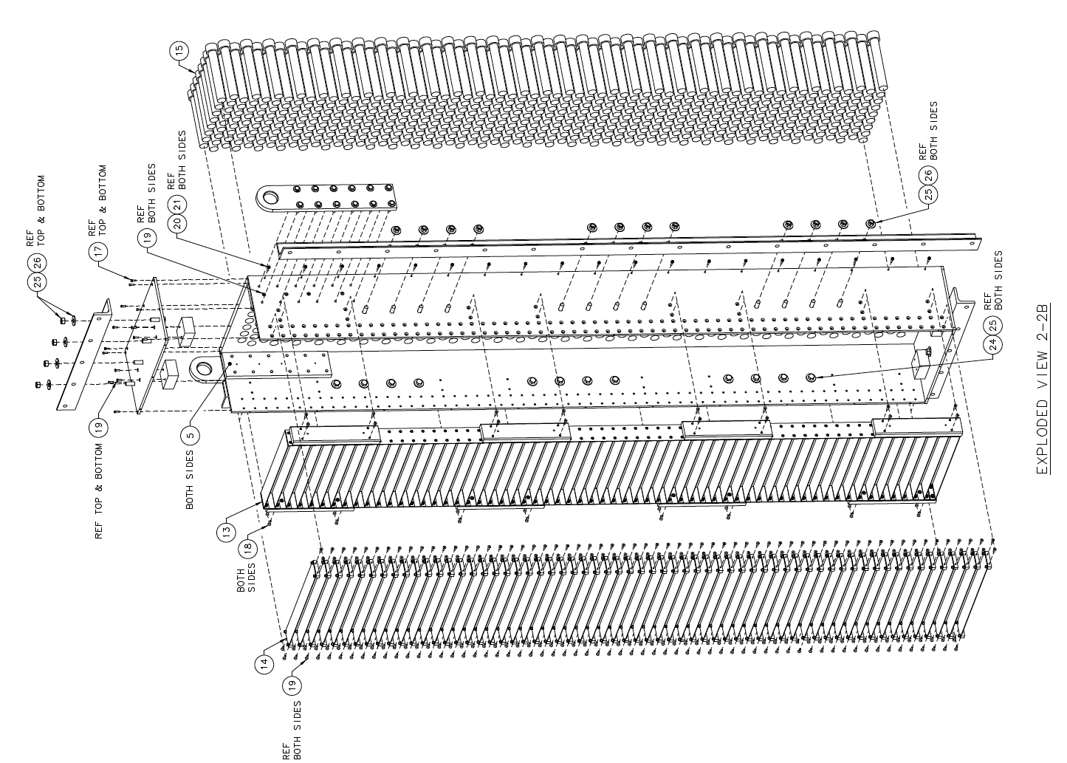
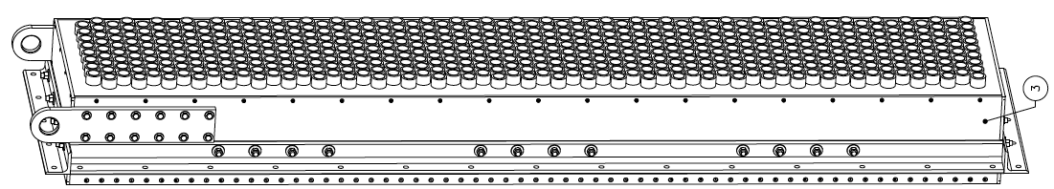
PMT Array Design (NC A&T, S. Esp)
Status:
Difficult to find vendor for 5/8” soft iron backplate
Exploring thinner plate with PMT spacers?
Counterbore holes in thicker plate?
NC A&T ready to purchase and fabricate once details of machining/materials worked out.

Slide 12
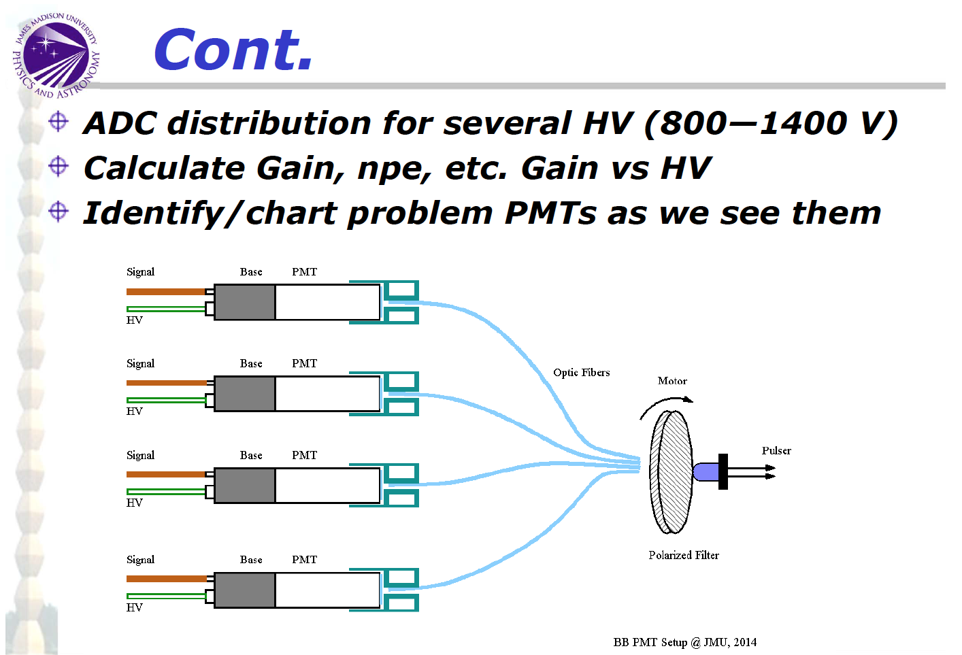
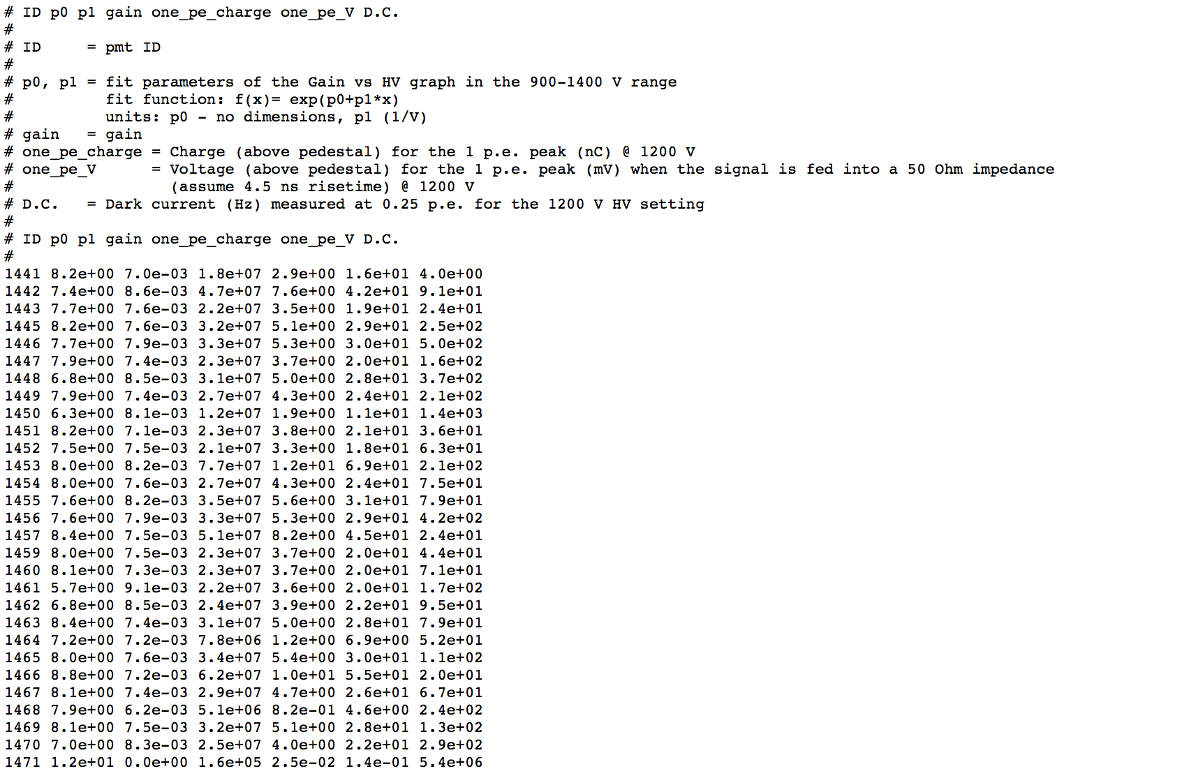
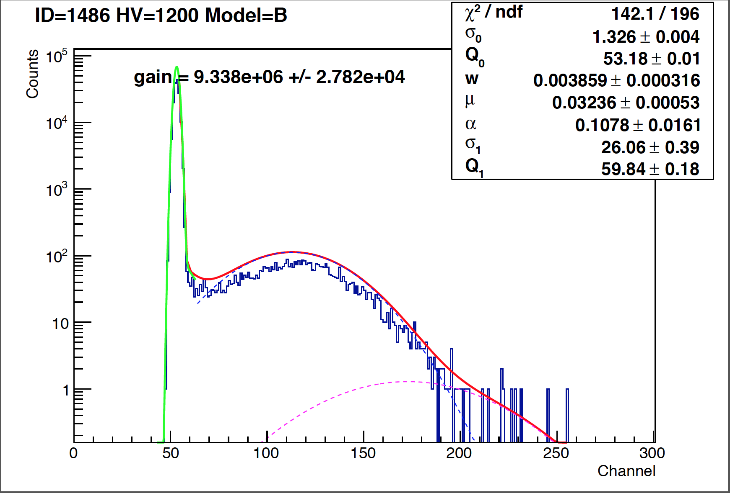
PMT Testing at JMU

Slide 13
GRINCH DAQ Scheme

Slide 14
Prototype NINO mounting for GRINCH
T. Averett, D. Greene
W&M, 4/10/14
Using the dimensions of the panel available for mounting the NINO cards to the GRINCH, we propose:
  NINO cards assembled in stacks of 2 cards with shielding plates between each.
  4 stacks will serve 15 rows of PMTs
  Three of the stacks (96 channels) will have 12 rows of 8 PMT’s connected.
  The fourth stack of will have 3 rows of 8 plus the 7 or 8 extra channels from rows with 9 tubes.
Total NINO cards for the entire array will require 36 total NINO cards.

Slide 15
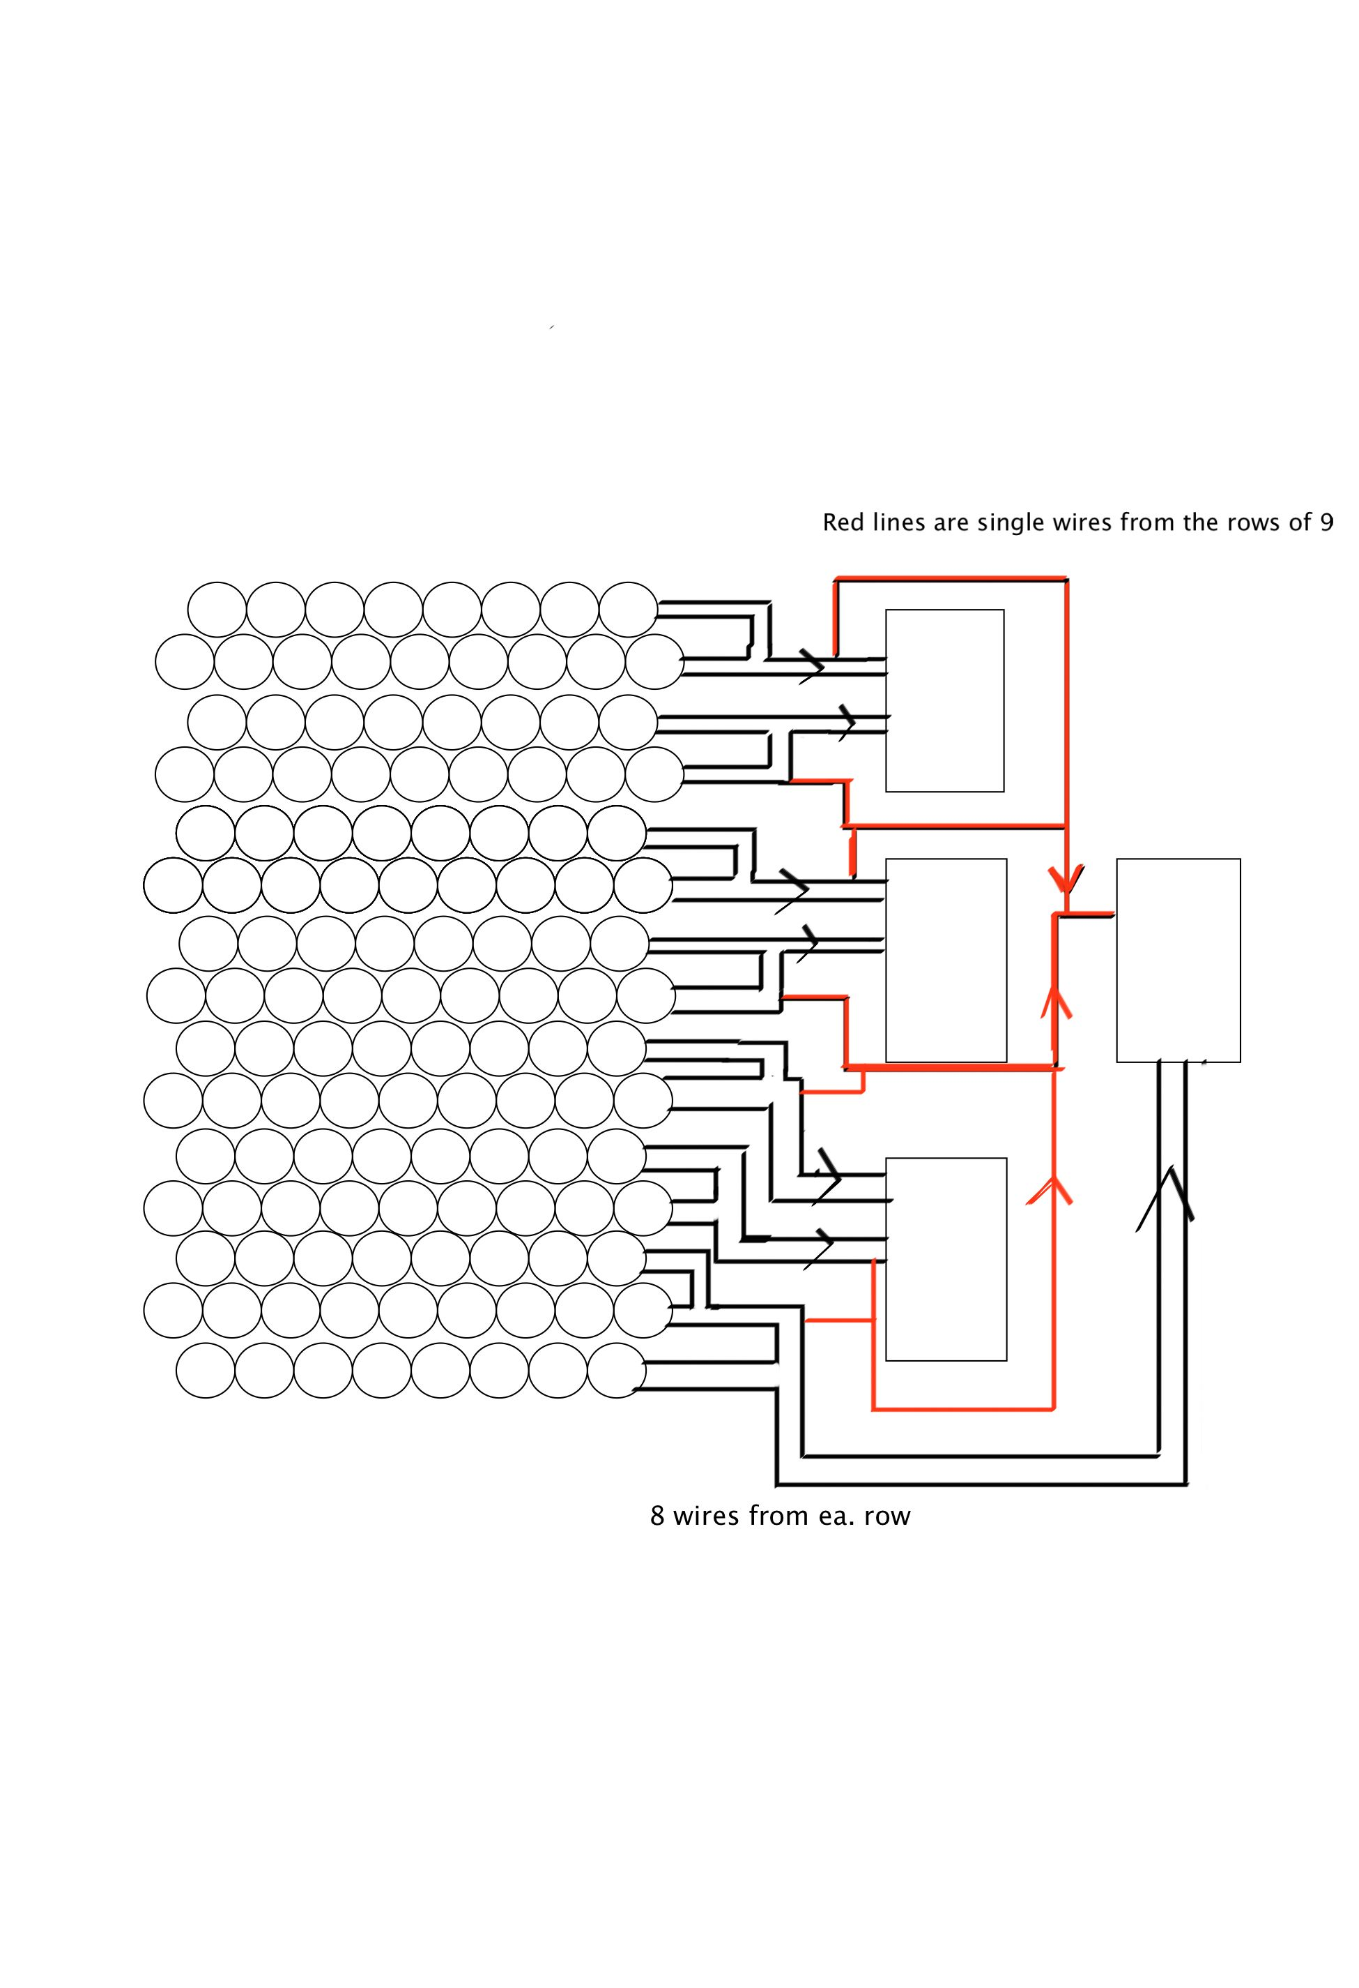
Prototype wiring diagram for 15 rows of PMTs
2 cards per stack
(32 channels)
Available geometry
on GRINCH

Slide 16
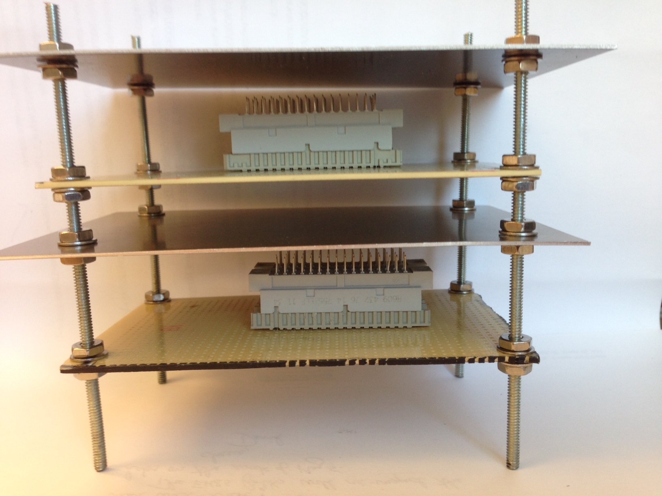
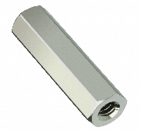
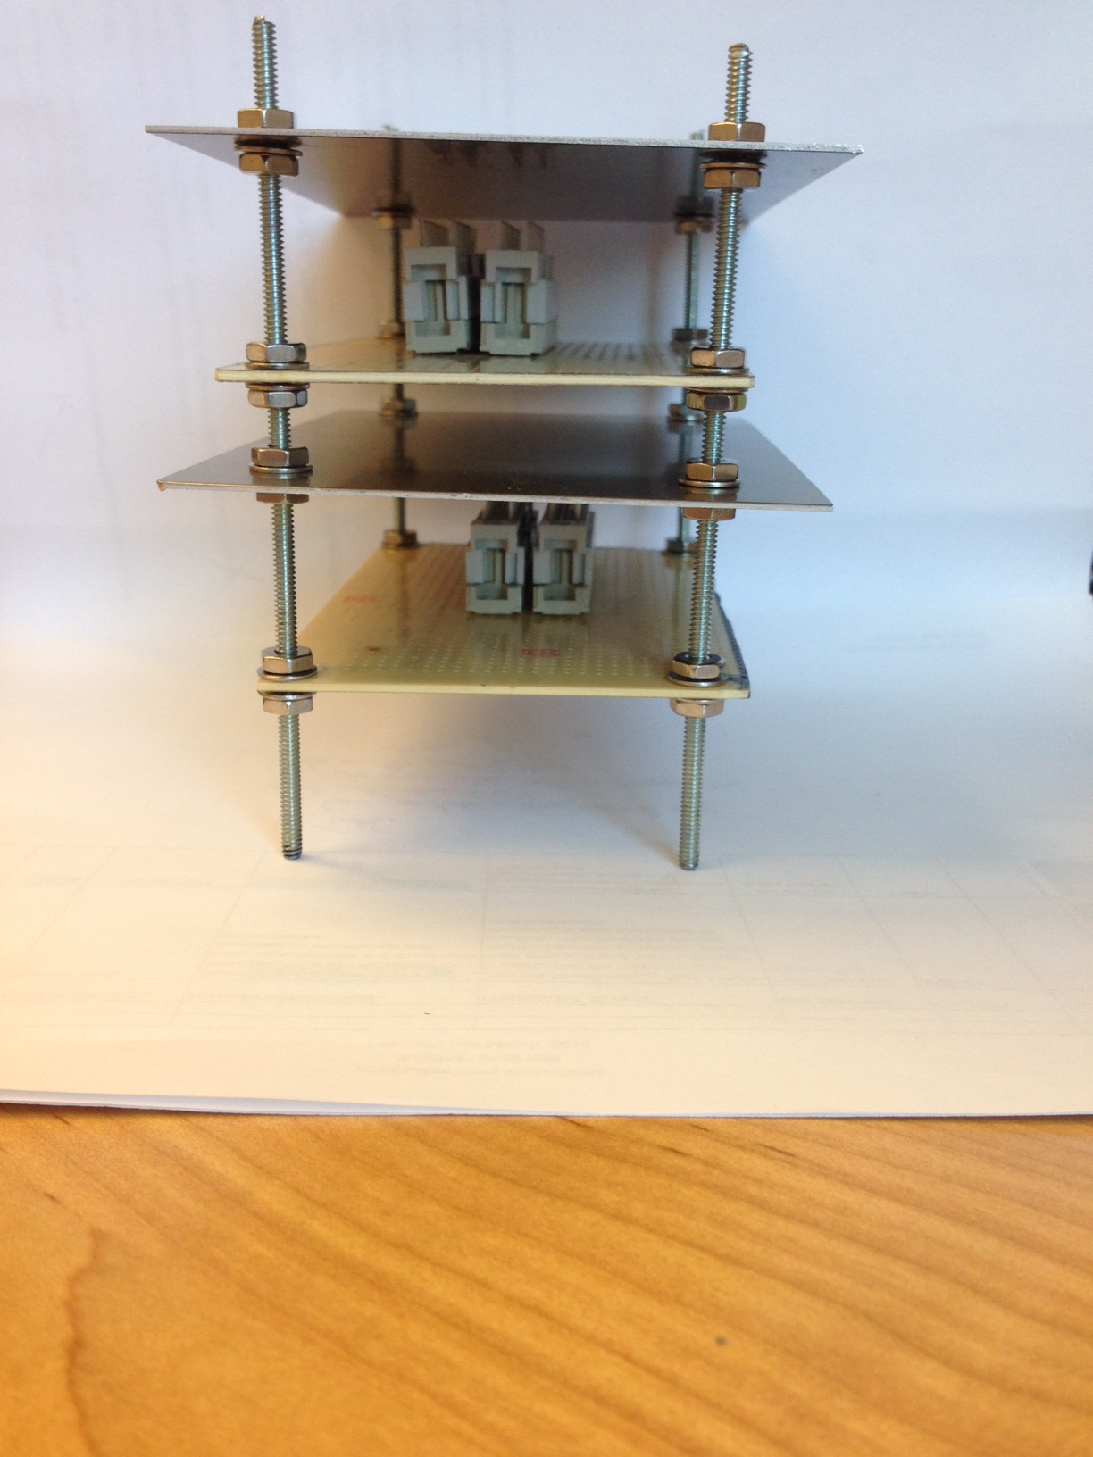
Aluminum Shielding plate
NINO board
Grounding between all
pieces through rods
Attach here to aluminum
plate on GRINCH frame
PMT cables
in
Ribbon cables
out
Use these hex spacers between levels
instead of nuts shown.

Slide 17
Plans
Finalize bids for PMT array; fabricate and construct. Install PMTs, test with NINO card.
Finish design for vessel; bid; fabricate
Finish PMT testing
Investigate PMT coating; possibly 1.4x improvement in QE based on HRS Cherenkov tests.
Begin full assembly and testing once vessel fabricated.

