Slide 1
SIDIS/A1n
Andrew Puckett
University of Connecticut
SBS Summer 2017 Collaboration Meeting
July 13, 2017

Slide 2
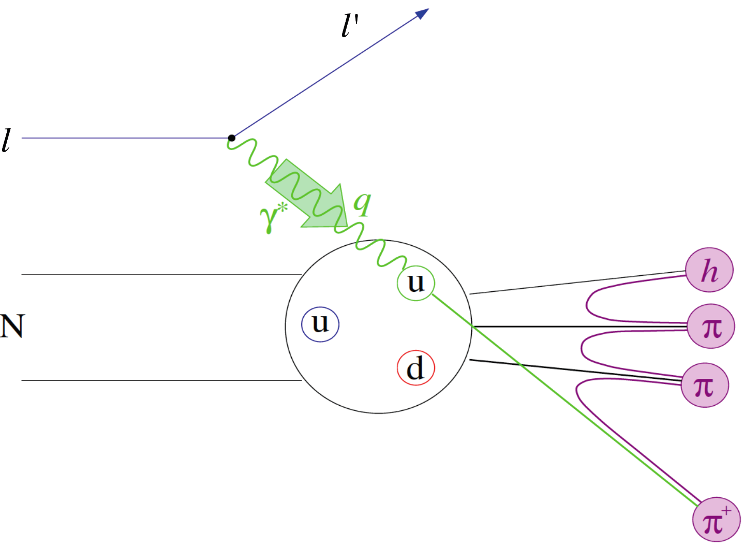
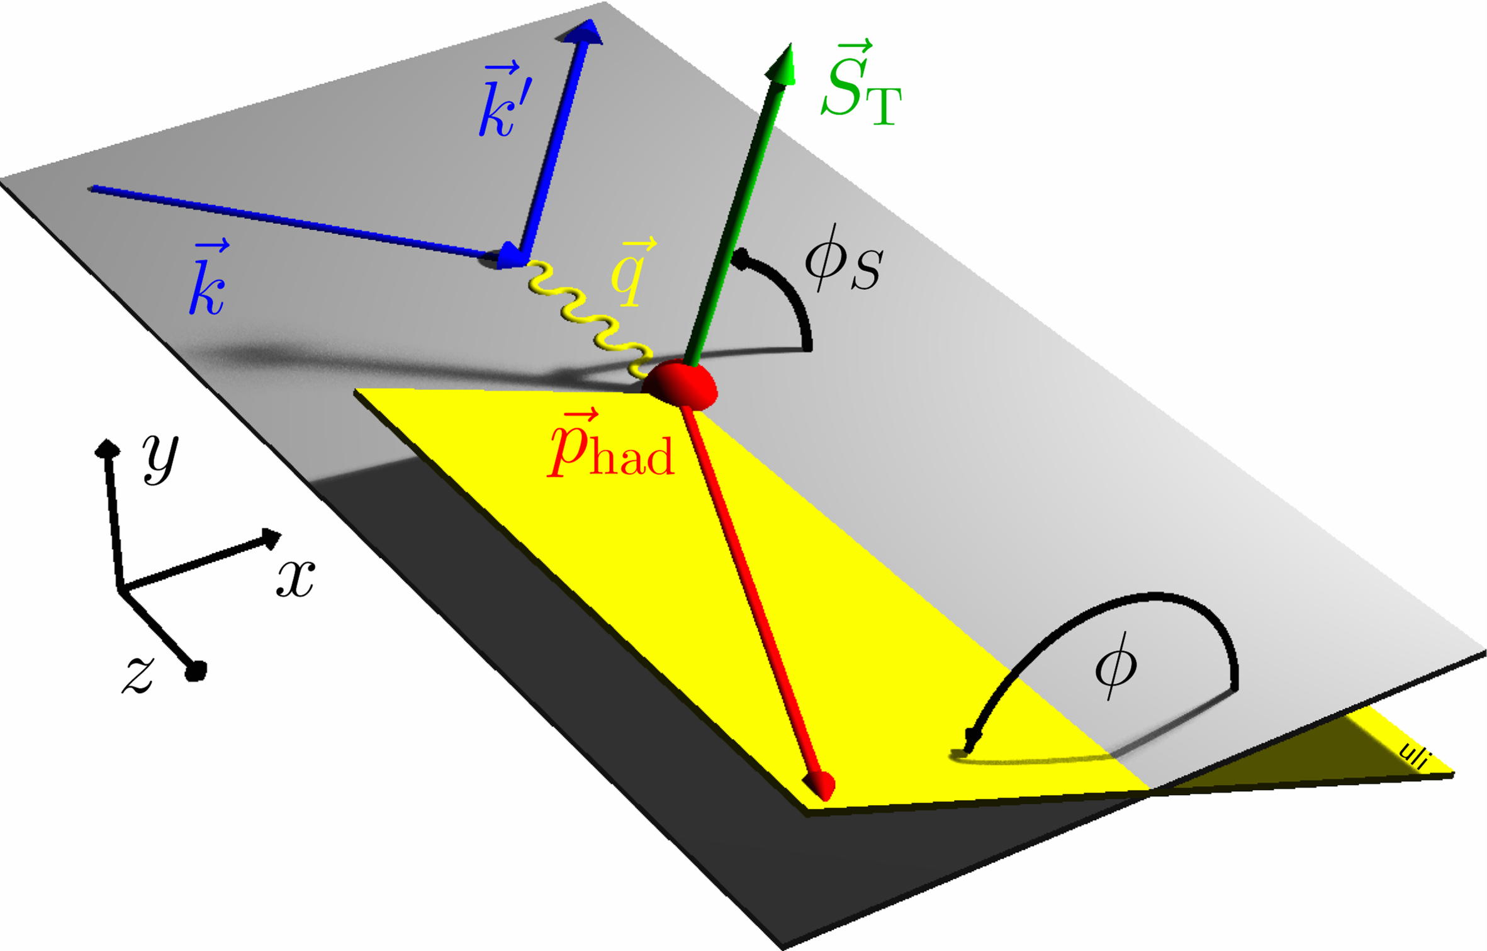
Semi-Inclusive Deep Inelastic Scattering
Detecting the leading (high-energy) hadrons in DIS collisions; i.e., the single inclusive hadron electroproduction N(e,e’h)X process provides sensitivity to additional aspects of the nucleon’s partonic structure not accessible in inclusive DIS, including:
  quark flavor
  quark transverse momentum
  quark transverse spin
Goal of SIDIS studies is (spin-correlated) 3D imaging of nucleon’s quark structure in momentum space.
Transverse Momentum Dependent (TMD) PDF formalism: Bacchetta et al. JHEP 02 (2007) 093, Boer and Mulders, PRD 57, 5780 (1998), etc, etc...

Slide 3
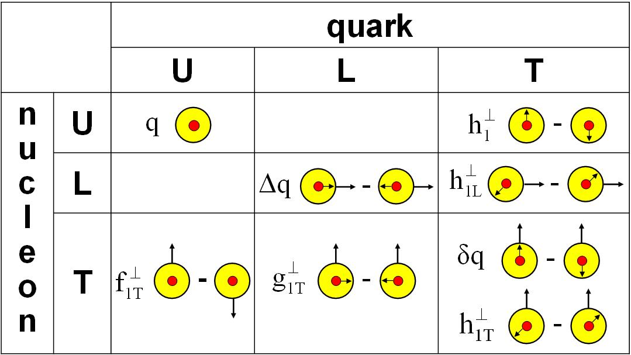
Transverse target spin effects in SIDIS
Transverse target spin-dependent cross section for SIDIS
Collins effect—chiral-odd quark transversity DF; chiral-odd Collins FF
Sivers effect—access to quark OAM and QCD FSI mechanism
“Transversal helicity” g_{1T}—real part of S wave-P wave interference (Sivers = imaginary part) (requires polarized beam)
“Pretzelosity” or Mulders-Tangerman function—interference of wavefunction components differing by 2 units of OAM

Slide 4
Transversity and Collins Functions: Existing Knowledge
Anselmino et al., Phys. Rev. D 92, 114023 (2015) arXiv:1510.05389v1: latest extractions of valence u and d quark transversities and favored/unfavored Collins FFs
SIDIS data from HERMES on proton target, COMPASS on proton and deuteron targets
Data on azimuthal asymmetries in e⁺/e⁻ annihilation to pion pairs from BELLE and BaBar collaborations—very recent, high statistical precision
First look at combined z and p_{T} dependencies of Collins FFs.
Note—d quark transversity is poorly constrained—proton data dominated by u quarks, limited sensitivity to d from COMPASS deuteron and JLab Hall A ³He data.

Slide 5
Sivers effect—Existing knowledge
Anselmino et al., Phys.Rev. D86 (2012) 014028, arXiv:1204.1239v1
Fits to most recent HERMES and COMPASS SIDIS Sivers data with TMD/DGLAP evolution
As in the case of Collins/Transversity, d-quark Sivers is poorly constrained by existing data
  Proton data dominated by u-quarks
  Limited precision/sensitivity to d quark from COMPASS deuteron/JLab Hall A ³He data

Slide 6
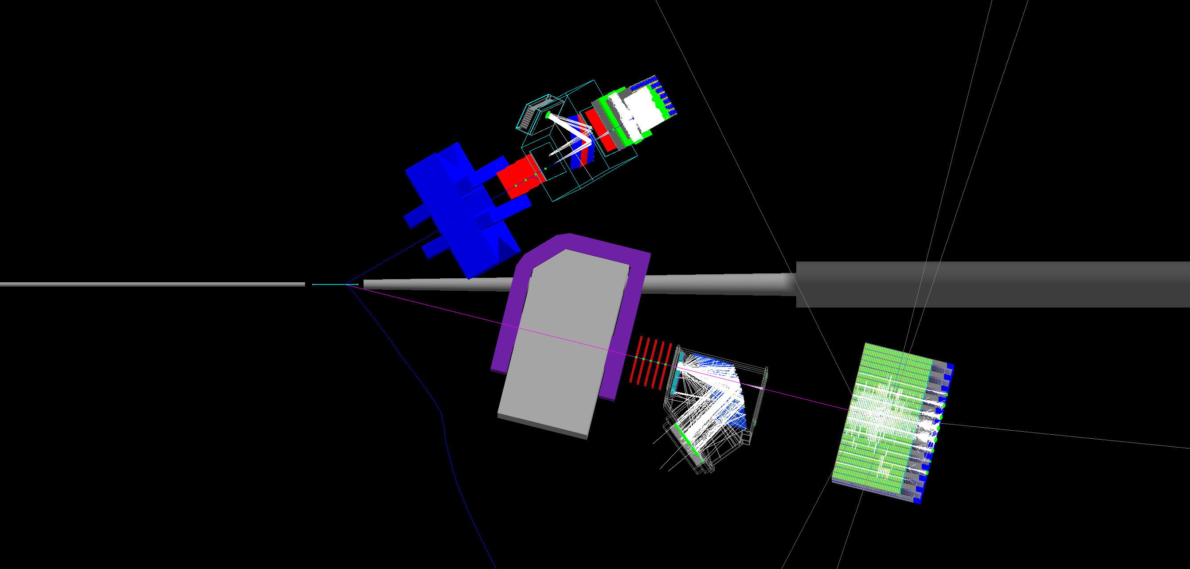
E12-09-018: Transverse Target SSA in ³He(e,e’h)X
JLab E12-09-018 in Hall A: Approved for 64 beam-days, A⁻ rating by PAC38 (2011)
Electron Arm: BigBite Spectrometer @30 deg.
High-luminosity Polarized ³He Target (1.2 × 10³⁷ cm⁻² s⁻¹)
Hadron Arm: Super BigBite Spectrometer @14 deg.
E12-09-018 in Hall A: transverse spin physics with high-luminosity polarized ³He.
40 (20) days production at E = 11 (8.8) GeV—significant Q² range at fixed x
Collins, Sivers, Pretzelosity, A_{LT} for n(e,e’h)X, h = 𝝅⁺/𝝅⁻/𝝅⁰/K⁺/K⁻
Re-use HERMES RICH detector for charged hadron PID
Reach high x (up to ~0.7) and high statistical FOM (~1,000X Hall A E06-010 @6 GeV)

Slide 7
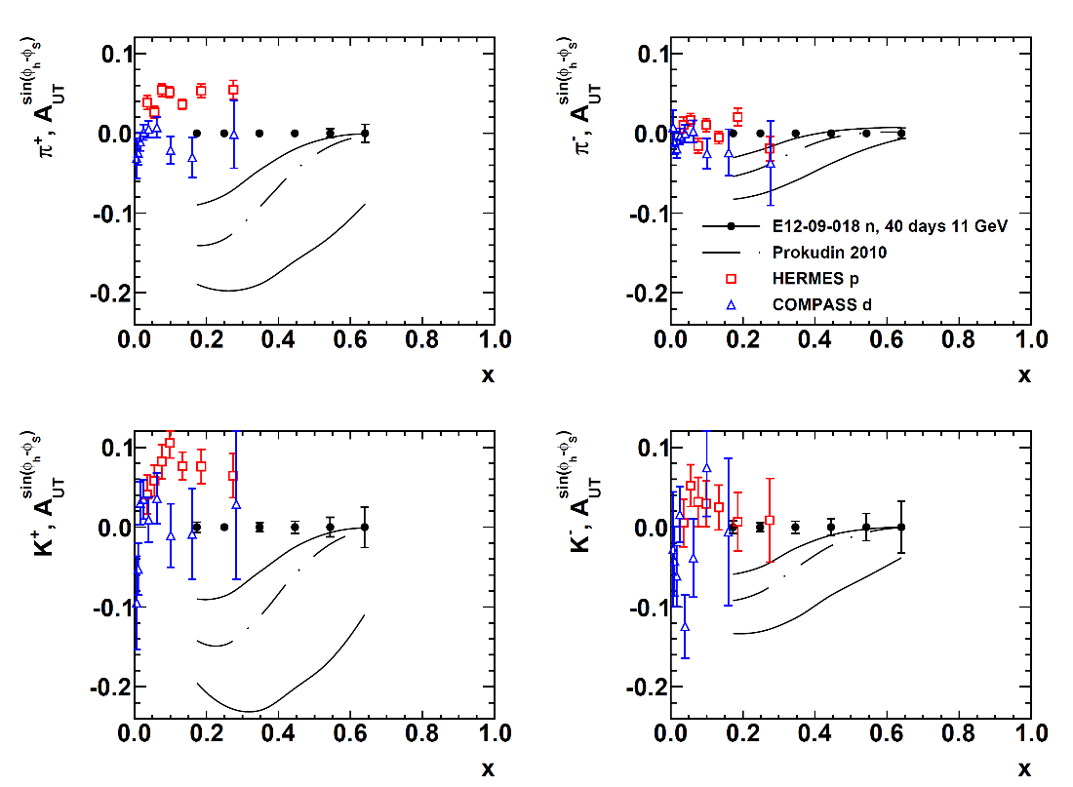
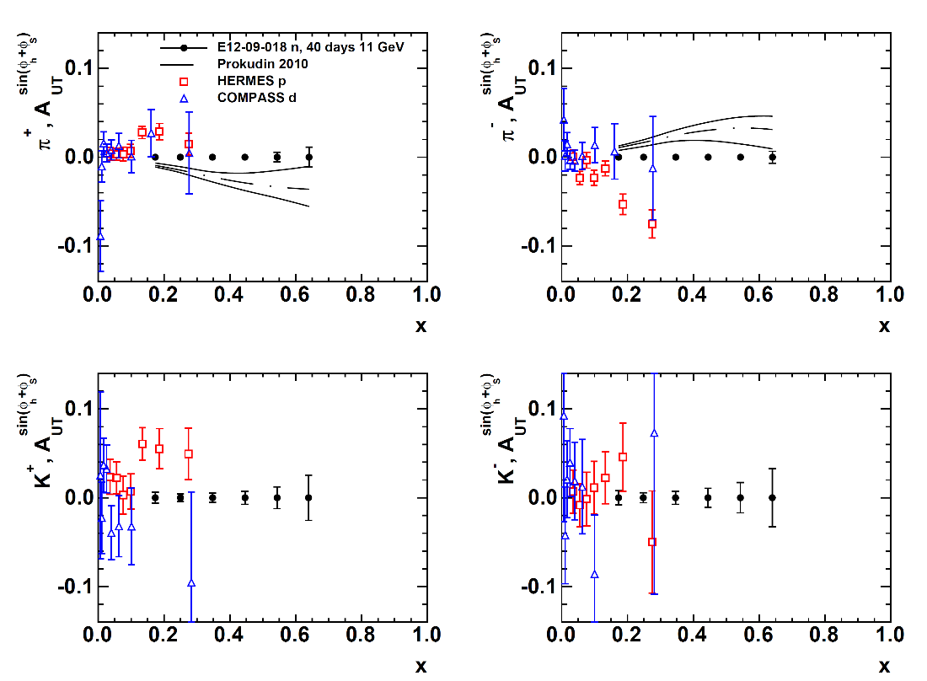
SBS+BB Projected Results: Collins and Sivers
Projected A_{UT}^{Sivers} precision vs. x
Projected A_{UT}^{Collins} precision vs. x
E12-09-018 will achieve statistical FOM for the neutron ~100X better than HERMES proton data and ~1000X better than existing neutron data from Hall A at 6 GeV a
Kaon and neutral pion data will aid flavor decomposition, and understanding of reaction-mechanism effects.

Slide 8
Summary of E12-09-018 Physics Impact
Pioneering HERMES+COMPASS experiments conclusively demonstrated the existence of the Collins and Sivers effects in SIDIS.
SSAs in SIDIS are large, especially in the valence region
Experiment E12-09-018 will be the first SIDIS experiment in the JLab 12 GeV era on a transversely polarized neutron (³He) target.
  First precise measurements of Collins/Sivers effects in multi-dimensional phase space.
  Extend knowledge further into the valence region (where asymmetries are large) to x ~ 0.7 at Q² values between those of HERMES and COMPASS
  Polarized neutrons→ unrivaled d quark sensitivity
  Large impact to global TMD extraction

Slide 9
E12-06-122: A1n in the valence region using BigBite in Hall A

Slide 10
Polarized DIS and Spin Structure Functions
Helicity asymmetries in the scattering of longitudinally polarized electrons on longitudinally and transversely (in the scattering plane) polarized nucleons provide access to spin structure functions g₁, g₂.
The longitudinal virtual photon asymmetry A₁ is defined as the asymmetry between parallel and antiparallel virtual photoabsorption cross sections and is related to the spin structure function g₁(x,Q²):
In the naïve parton model, g₁ is an incoherent sum over parton helicity distributions Δq_{i}, equal to the difference in number density of quarks polarized parallel and antiparallel to the nucleon spin:

Slide 11
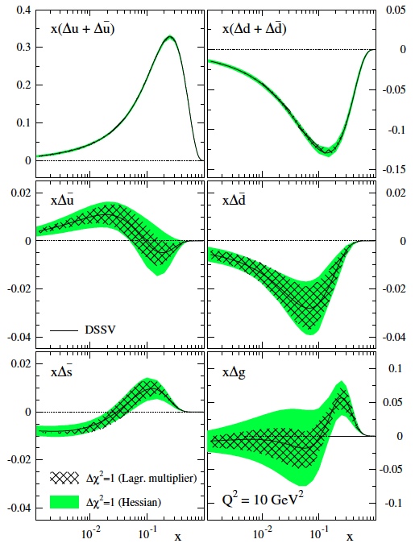
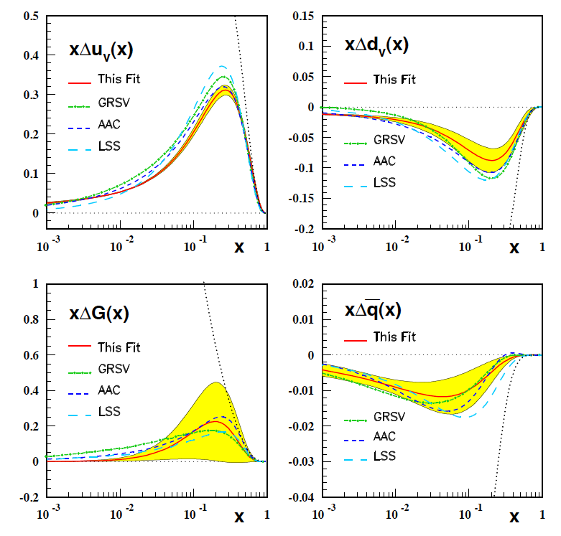
Experimental Status of Δq
Blumlein and Bottcher, hep-ph/1005.3113
Recent Global Analyses:
  DSSV, includes SIDIS and pp data, asymmetric sea
  BB, DIS data only
DSSV: PRD 80, 034030 (2009)

Slide 12
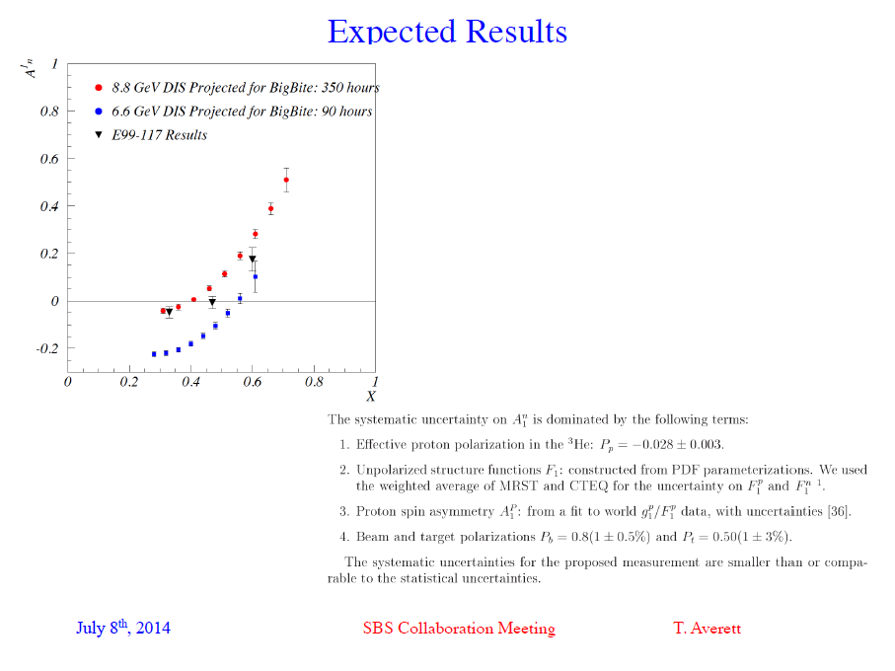
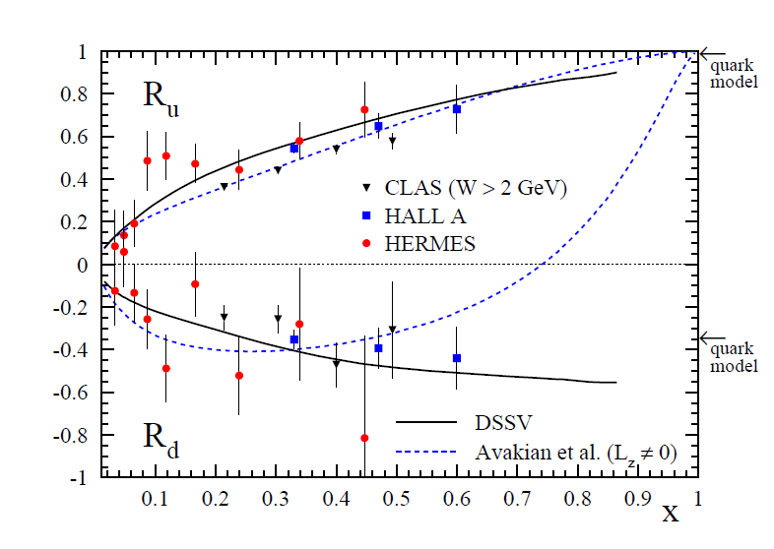

Slide 13
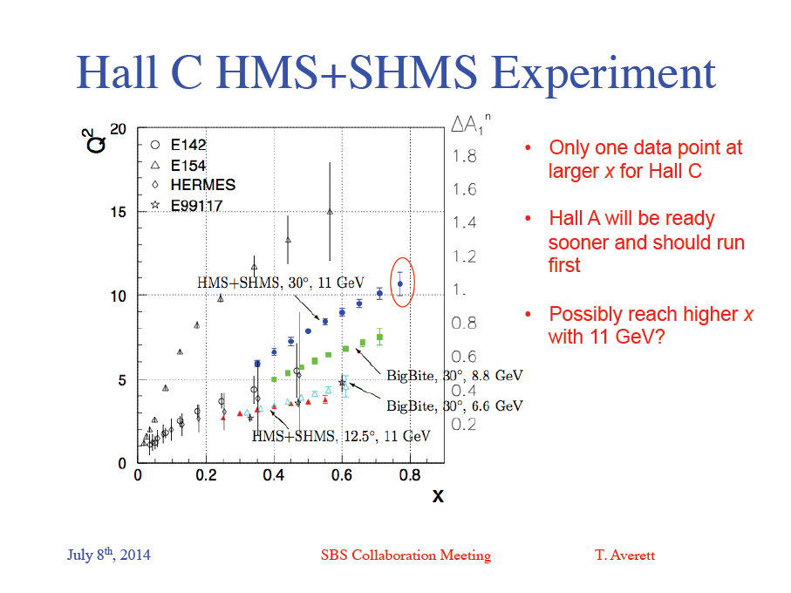

Slide 14
A1n Requirements and Status
High-luminosity polarized ³He target
BigBite detector upgrades:
  GRINCH
  Replace MWDCs with GEMs
  Upgraded BigBite Timing hodoscope
BigBite configurations are largely identical between A1n and neutron SIDIS proposal
Status—A1n still approved but not scheduled.
Jeopardy process for proposals approved for more than 4 years but not scheduled will start in 2019 (according to draft policy presented by B. McKeown at recent Users’ Group Meeting).

Slide 15
A1n Resubmission
Hall A BigBite + HRS proposal E12-06-122 with 8.8 and 6.6 GeV beam energy was submitted assuming it could run as an early/”commissioning experiment”, prior to the main SBS program, and (potentially) prior to establishment of reliable, 11 GeV CEBAF ops.
Given schedule realities and evolution of BigBite/SBS apparatus, this no longer entirely makes sense
A1n resubmission in preparation—target submission in 2018
Hall A A1n faces jeopardy as soon as 2019.

Slide 16
A1n with SBS+BB @11 GeV, 250h, 50 uA, P_{b}P_{T} ~= 0.5, 10.5 atm ³He
BigBite @35 deg
BigBite @30 deg
SBS @20 deg.
PRELIMINARY

Slide 17
Summary
SBS Transversity (E12-09-018), first submitted to PAC34, fully approved by PAC38, has the most approved beam time of any SBS experiment
Original Hall A E06-010 produced a large number of physics publications beyond the main physics goal and scope of the experiment.
Similarly large output could be expected from E12-09-018.
A1n with BigBite @8.8 and 6.6 GeV, approved over 10 years ago, is sub-optimal in light of current realities
Resubmission in preparation for 11 GeV beam with BigBite and SBS to reflect evolution of Hall A status and equipment

Slide 18
Backups

Slide 19
General Expression for SIDIS Cross Section: Bacchetta et al., JHEP 02, 093 (2007)
SIDIS structure functions F depend on x, Q², z, p_{T}
U, L, T subscripts indicate unpolarized, longitudinally and transversely polarized beam, target, respectively
S = nucleon spin
λ = lepton helicity
18 structure functions up to twist-three
Eight terms survive at leading twist; the rest are twist-3 (M/Q suppressed)
Sivers
Collins
“Pretzelosity”

Slide 20




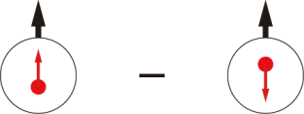
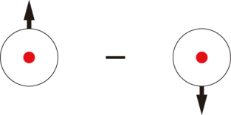
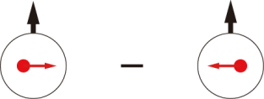
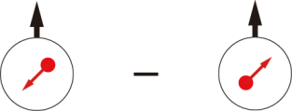
Quark-parton Model Interpretation of SIDIS: Transverse Momentum Dependent PDFs (TMDs)
 |  | Quark polarization
 |  | Unpolarized (U) | Longitudinally Polarized (L) | Transversely Polarized (T)
Nucleon Polarization | U
 | L
 | T

Slide 21
SIDIS Structure Functions in Terms of TMDs
Only f₁, g₁, h₁ survive integration over quark k_{T}
All eight leading-twist TMDs are accessible in SIDIS with polarized beams/targets via azimuthal angular dependence of the SIDIS cross section
Physical observables are convolutions over two (unobserved) transverse momenta:
  Initial quark k_{T}
  Hadron p_{T} relative to recoiling quark, generated during fragmentation

Slide 22
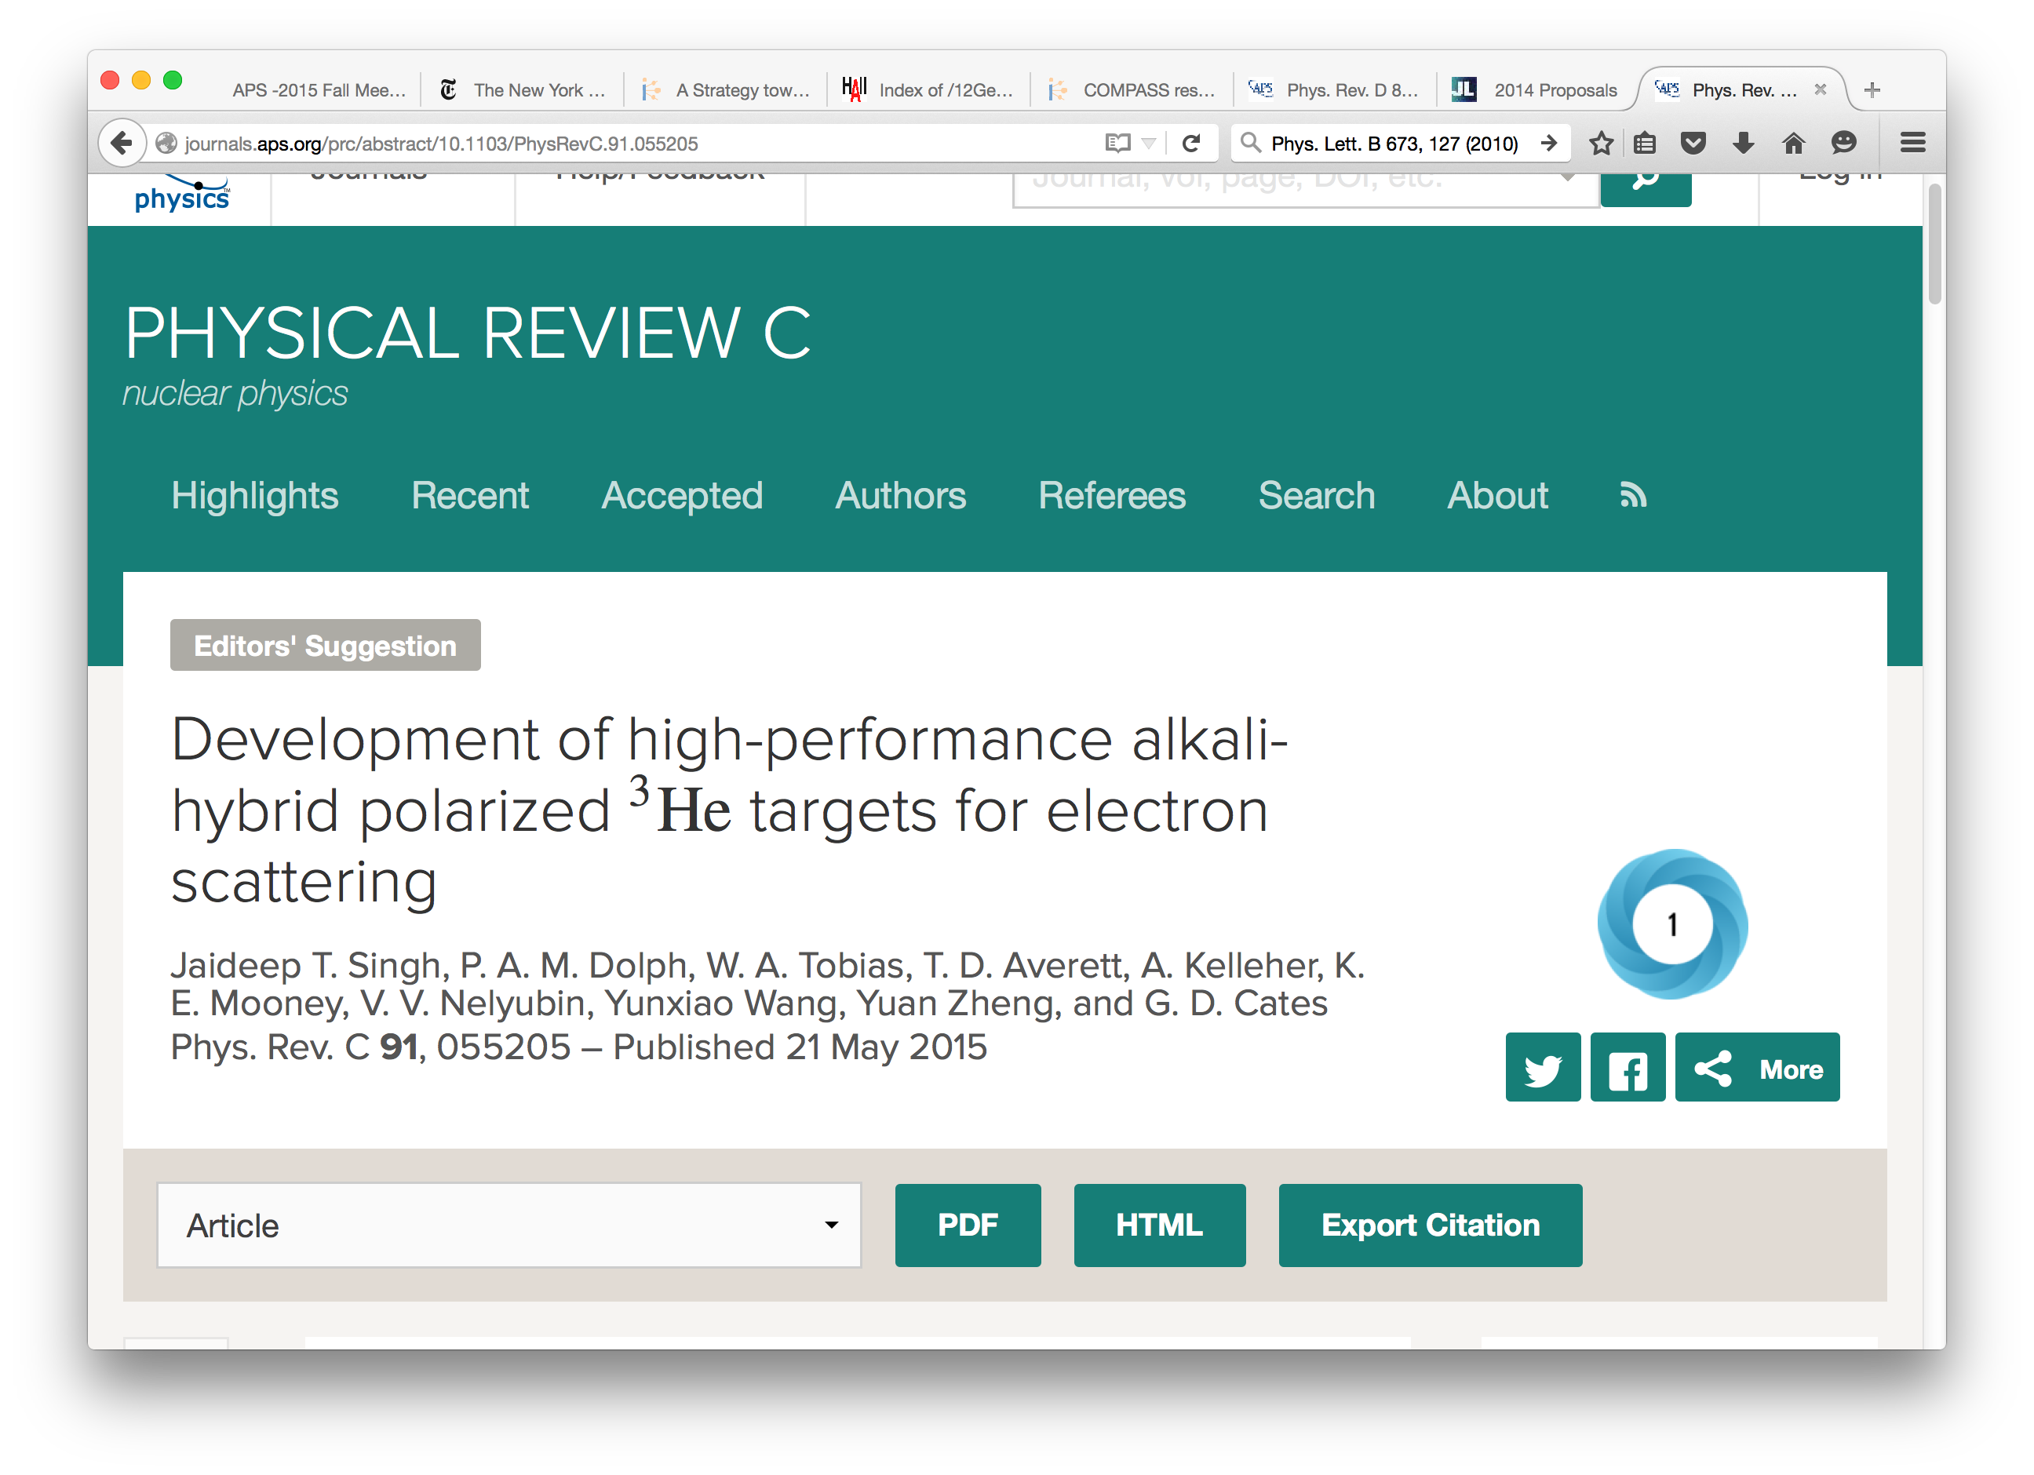
High-luminosity Polarized ³He target development
Significant recent progress by UVA group (Cates) in the development of high-luminosity polarized ³He targets for SBS SIDIS and GEN experiments based on convection-driven circulation of polarized gas
Now published in Phys. Rev. C 91, 055205 (2015)
  See also: Phys.Rev. C84 (2011) 065201 and https://arxiv.org/abs/1706.02747
Acceptable spin relaxation times now demonstrated in prototype cells with glass-to-metal seals
Conceptual and engineering designs for GEn-II target underway

Slide 23
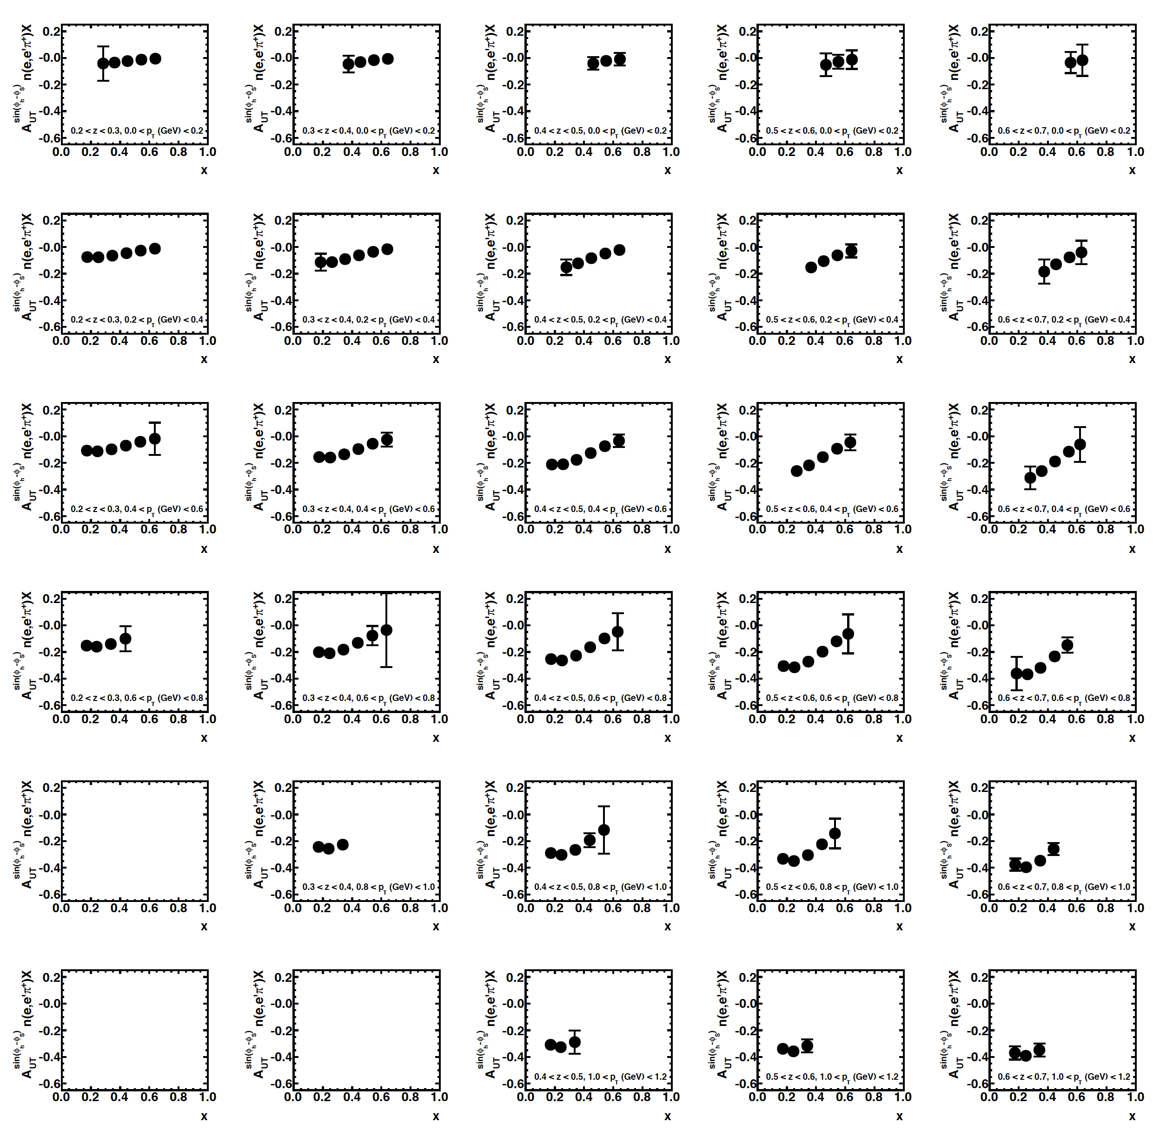
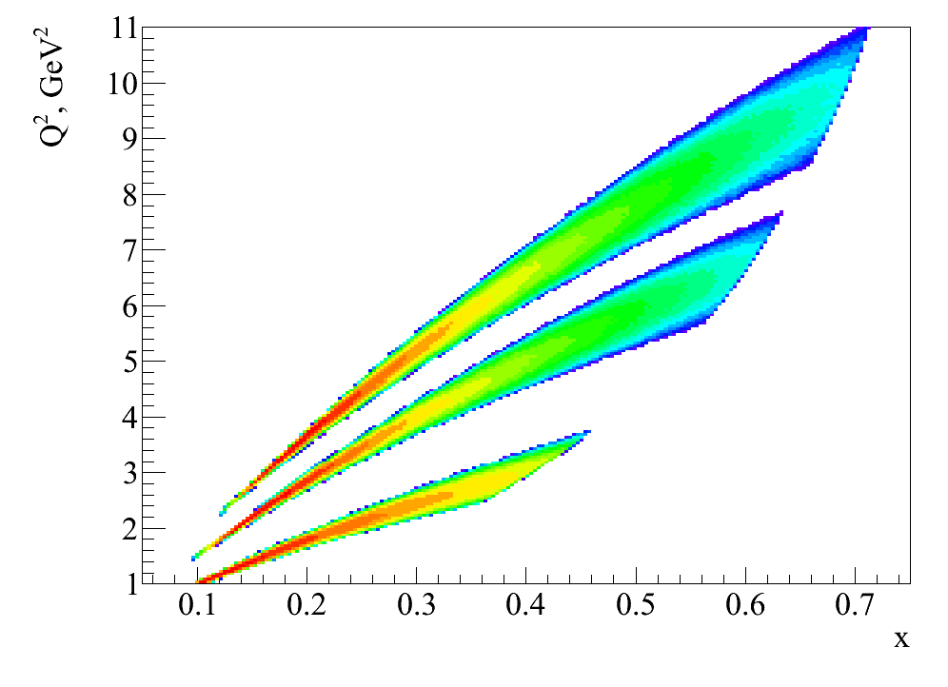
3D and “4D” extraction of SIDIS SSAs with SBS
Example result for 3D binning (x,z,p_{T})
E = 11 GeV, 40 days
Increasing z ➔
“4D” with Q² dependence from 20 days at 8.8 GeV:
⬅ Increasing p_{T}
E = 11 GeV
E = 8.8 GeV
E = 5.9 GeV (E06-010 Hall A)

Slide 24
Example Impacts of SBS SIDIS Experiment
2011 impact study by A. Prokudin, global fit with E12-09-018 projected results, π⁺ Sivers moments at E = 11 GeV, ½ of projected statistics.
Left: >5X shrinking of n(e,e’ π⁺)X Sivers A_{UT} band
Right: reducing the uncertainty in d quark Sivers in six-flavor extraction
E12-09-018 will provide π±/π⁰/K± at similar precision (Kaon errors 2-3X pion errors) for both E = 8.8 GeV and E = 11 GeV Collins/Sivers (and Pretzelosity)

Slide 25
Example Impacts of SBS SIDIS Experiment
2011 impact study by A. Prokudin, global fit with E12-09-018 projected results, π⁺ Sivers moments at E = 11 GeV, ½ of projected statistics.
Left: >5X shrinking of n(e,e’ π⁺)X Sivers A_{UT} band
Right: reducing the uncertainty in d quark Sivers in six-flavor extraction
E12-09-018 will provide π±/π⁰/K± at similar precision (Kaon errors 2-3X pion errors) for both E = 8.8 GeV and E = 11 GeV Collins/Sivers (and Pretzelosity)

Slide 26
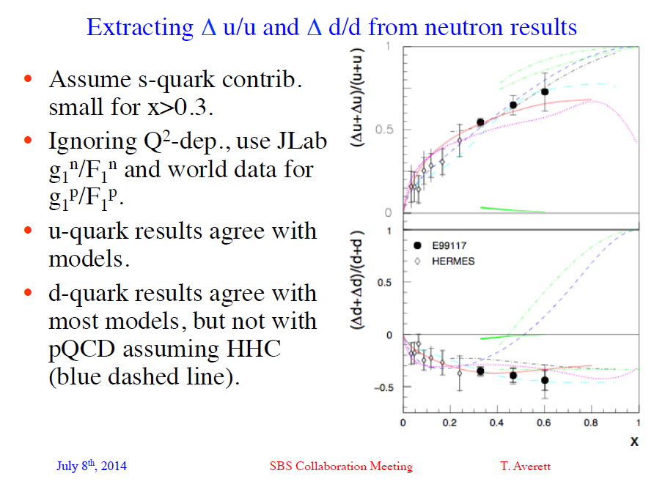

Slide 27
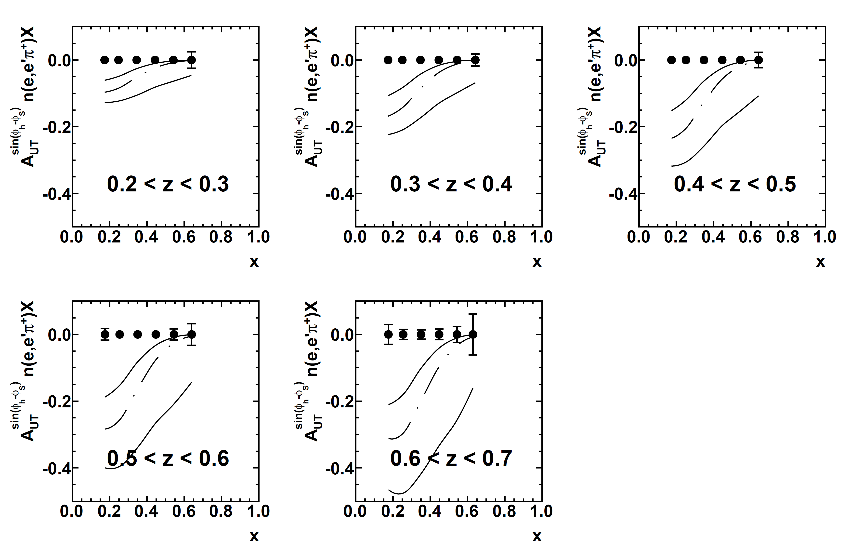
SBS+BB Projected Precision in 2D (x,z) binning
Uncertainty in this x, z bin ~ 0.6%
Large neutron π⁺ asymmetry expected at high z, large uncertainty in global fit
2D Extraction: Sivers A_{UT} in n(e,e’π⁺)X, 6 x bins 0.1<x<0.7, 5 z bins 0.2<z<0.7
Curves are phenomenological predictions from global analysis (Anselmino et al.) with central value and error band

Slide 28
3D and “4D” extraction of SIDIS SSAs with SBS
Example result for 3D binning (x,z,p_{T})
E = 11 GeV, 40 days
Increasing z ➔
“4D” with Q² dependence from 20 days at 8.8 GeV:
⬅ Increasing p_{T}
E = 11 GeV
E = 8.8 GeV
E = 5.9 GeV (E06-010 Hall A)

Slide 29
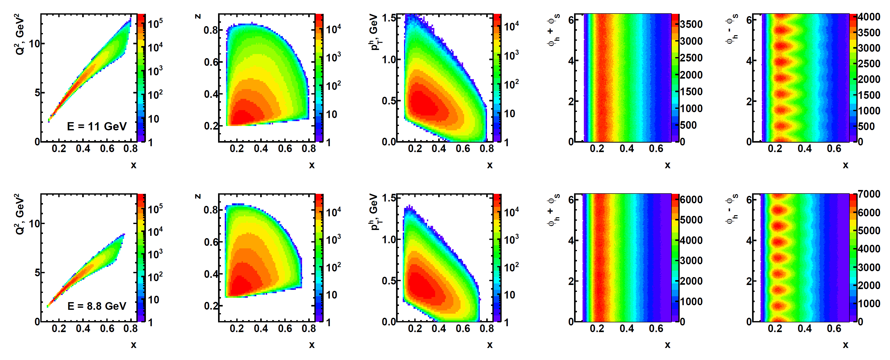
SIDIS Kinematic Coverage in E12-09-018
Wide, independent coverage of x, z, p_{T}, ϕ_{h} ± ϕ_{S} in a single kinematic configuration.
At least four (preferably 8) target spin directions to achieve full ϕ_{S} coverage
Q², x strongly correlated due to dimensions of BigBite magnet gap.
Data at E = 11, 8.8 GeV provide data for significantly different Q² at same x
Systematics control → independent spectrometers, detectors in field-free regions, straight-line tracking, simple, well-defined (but adequately large) acceptance, etc.

Slide 30
(Some) Unique Challenges for SBS-SIDIS
Small raw asymmetries ⬄ tight control of systematics => As fast as possible change of spin orientation—with adiabatic rotation of target holding field expect T ~ 120 s?
Inclusive kinematics—low trigger thresholds ⬄ high accidental coincidence rates. Proposal estimate was ~20 kHz online coincidence trigger rate.
  Addition of GRINCH to the trigger for BigBite would be extremely helpful here, since ~90% of BigBite calorimeter-based triggers are photon-induced!
GEM-based tracking with no real constraints on track search area (other than HCAL hadronic shower signal and SBS acceptance) due to inclusive kinematics (but 40X lower luminosity than GEP helps)

Slide 31
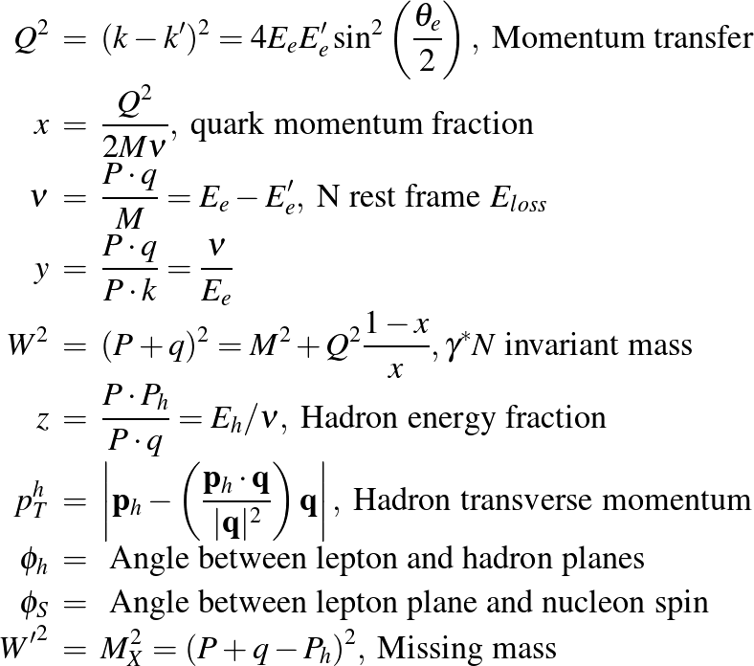
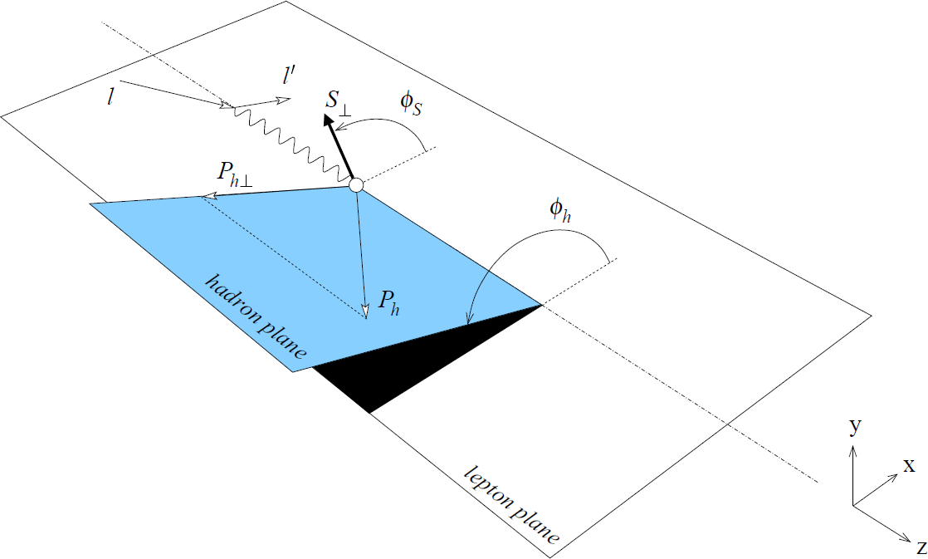
SIDIS Kinematics—Notation and Definitions

Slide 32
E12-09-018 Apparatus and Requirements
Target: High-luminosity polarized ³He; similar to GEN target, but requires (almost) complete freedom in target polarization orientation. Required orientations include (at a minimum) horizontal and vertical polarization transverse to the beamline (and preferably ±45∘ as well), plus longitudinal polarization for calibrations/corrections.
Hadron arm: SBS at 14 deg. central angle, equipped with:
  HCAL for hadron trigger
  Large-area GEM-based tracker
  RICH for charged hadron PID
Electron arm: BigBite at 30 deg. central angle equipped with:
  Pre-shower and shower for electron trigger
  Timing hodoscope
  GEM-based tracker
  GRINCH
DAQ and trigger:
  HCAL threshold low enough to be efficient for SIDIS charged hadrons p > 2-3 GeV
  BigBite threshold low enough to be efficient for electrons p > 1 GeV

Slide 33
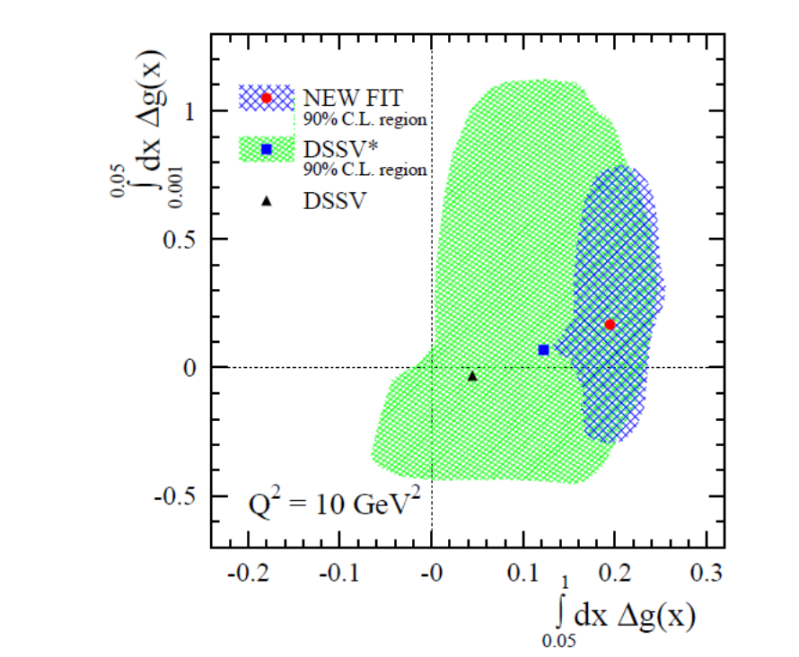
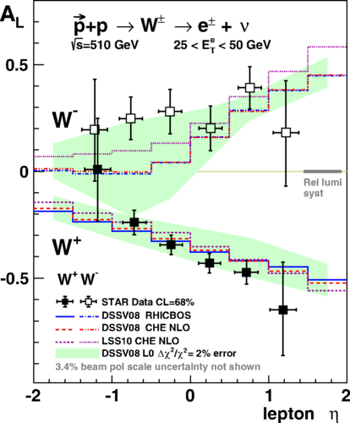
Progess in gluon and sea polarization from RHIC-spin
DSSV→ RHIC spin program constraints to gluon polarization (arXiv:1404.4293v1)

Slide 34
