Slide 1
RICH Detector Status
Andrew Puckett
University of Connecticut
SBS Collaboration Meeting
July 14, 2017

Slide 2
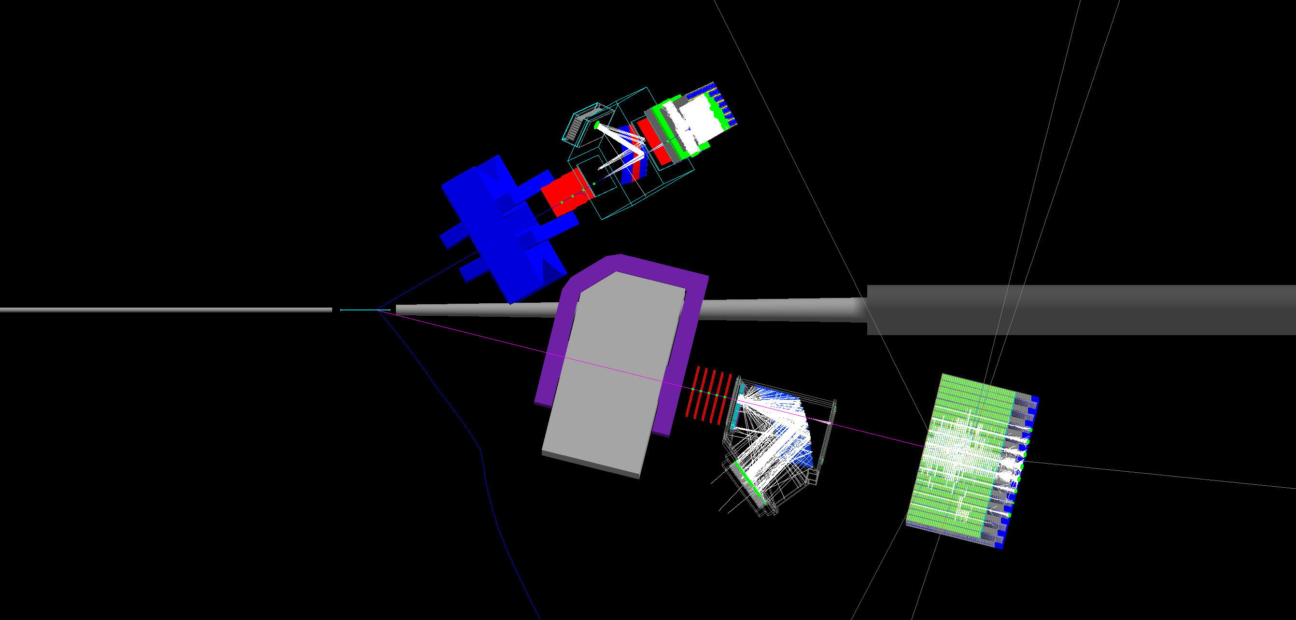
E12-09-018: Transverse Target SSA in ³He(e,e’h)X
JLab E12-09-018 in Hall A: Approved for 64 beam-days, A⁻ rating by PAC38 (2011)
Electron Arm: BigBite Spectrometer @30 deg.
High-luminosity Polarized ³He Target (1.2 × 10³⁷ cm⁻² s⁻¹)
Hadron Arm: Super BigBite Spectrometer @14 deg.
E12-09-018 in Hall A: transverse spin physics with high-luminosity polarized ³He.
40 (20) days production at E = 11 (8.8) GeV—significant Q² range at fixed x
Collins, Sivers, Pretzelosity, A_{LT} for n(e,e’h)X, h = 𝝅⁺/𝝅⁻/𝝅⁰/K⁺/K⁻
Re-use HERMES RICH detector for charged hadron PID
Reach high x (up to ~0.7) and high statistical FOM (~1,000X Hall A E06-010 @6 GeV)

Slide 3
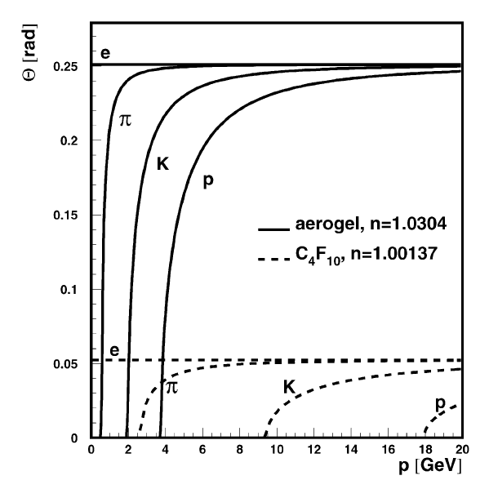
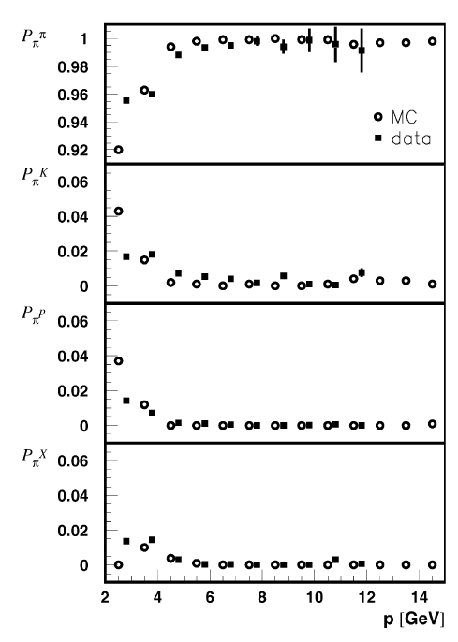
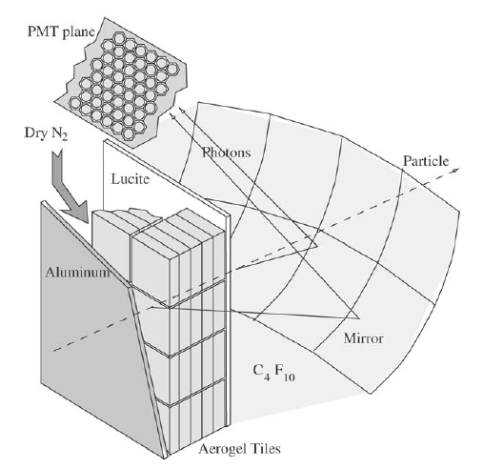
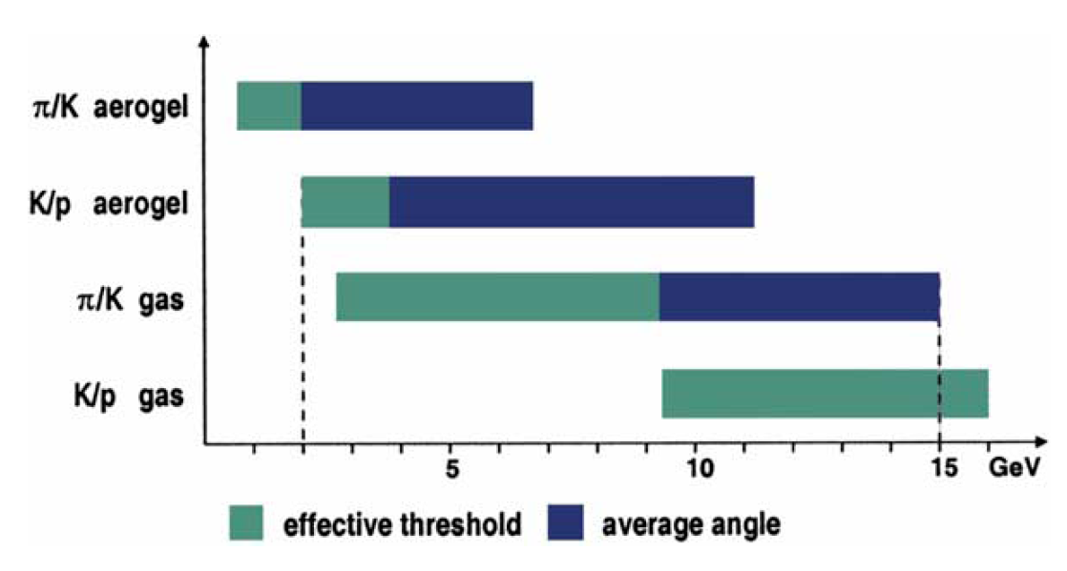
The HERMES RICH detector
HERMES RICH geometry, performance characteristics well matched to SBS needs.
π/K/p separation for p from 2-15 GeV based on dual-radiator design.
Re-use one half of detector, both aerogels
5.5 GeV K+
REAL DATA from NIMA 479 (2002) 511
1.5 GeV π-
14.6 GeV e-
Pion ID results from HERMES

Slide 4
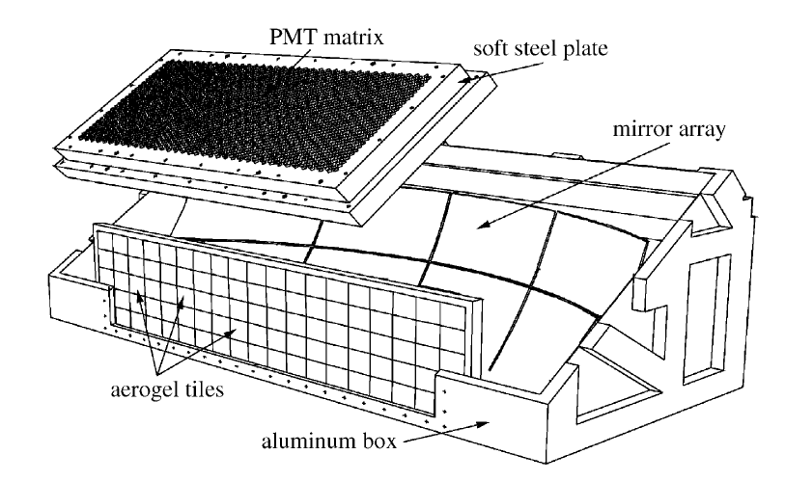
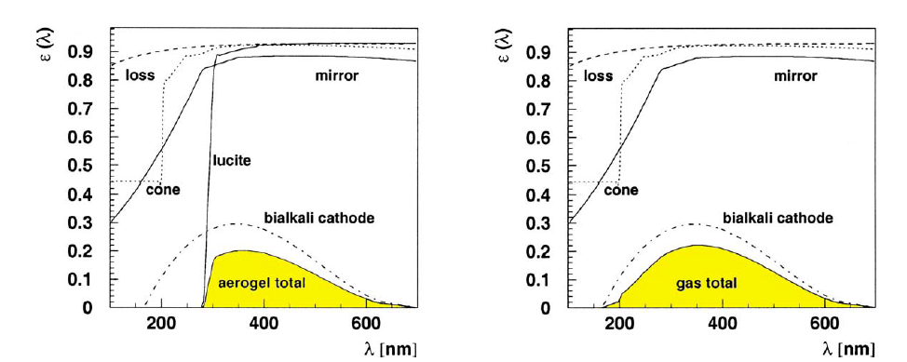
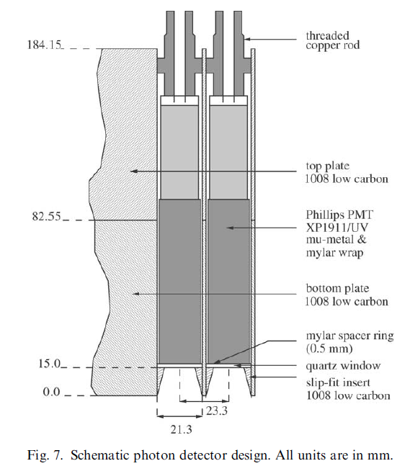
HERMES RICH Design Aspects
Optical properties contributing to overall detection efficiency
Aerogel wall: tiles 11.4 x 11.4 x 1.13 cm³, stacked in 5 rows, 17 columns, 5 tiles deep.
Sheets of Tedlar between tiles reduce distortion from photons crossing track boundaries
UVT-lucite window protects aerogel from C₄F₁₀ and absorbs UV photons λ < 300 nm (Rayleigh scattering dominates at UV wavelengths)
Windows:
  Entry: 1 mm-thick Al, dimensions 187.7 x 46.4 cm²
  Exit: 1 mm-thick Al, dimensions 257 x 59 cm²
Mirrors: Carbon-fiber composite, 0.01 X₀ thickness, spherical geometry, R = 2.2 m
Photon detector: Phillips XP1911/UV PMTs, 0.75”-diameter (15 mm active diameter). Hexagonal close-packed arrangement, packing fraction ~0.38. Light-collecting funnels increase collection efficiency.

Slide 5
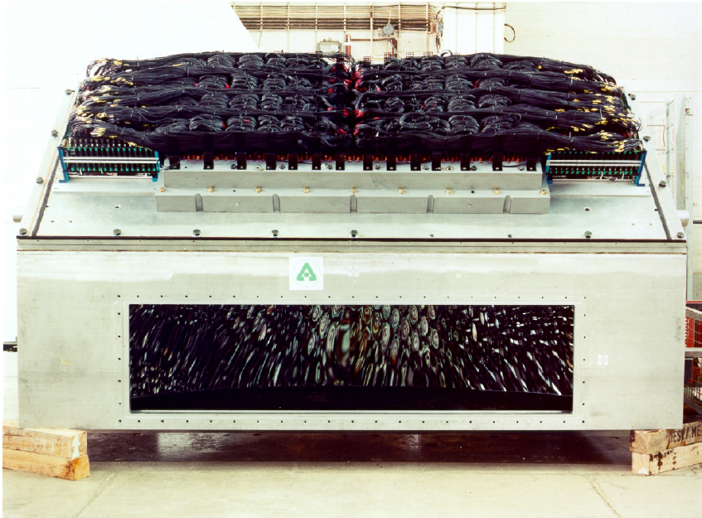
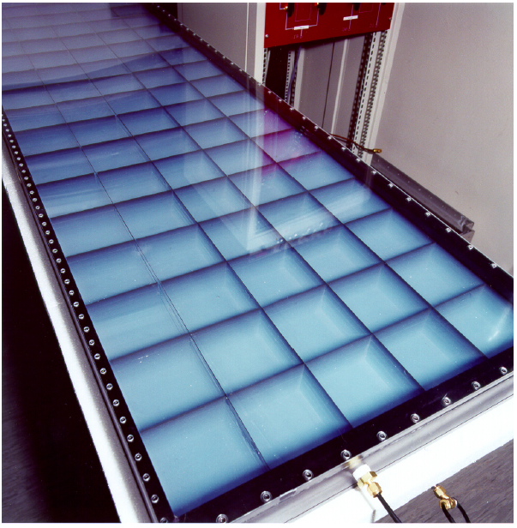
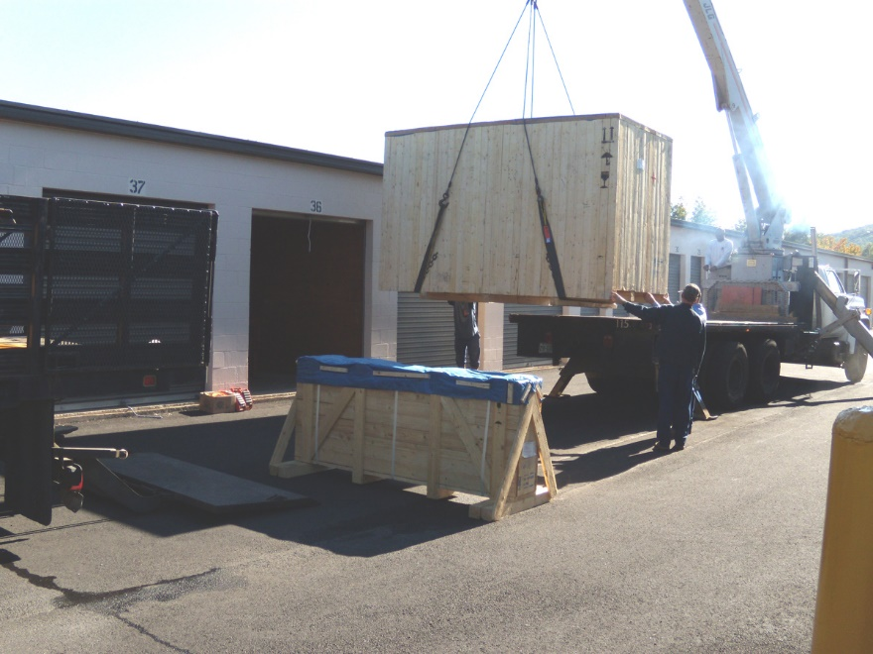
SBS RICH Detector Photos
Above, left: Old picture of one half of RICH with aerogel wall removed
Above, right: Old picture of one aerogel wall w/containment vessel
Bottom right: RICH delivery to storage facility @UVA, 2009

Slide 6
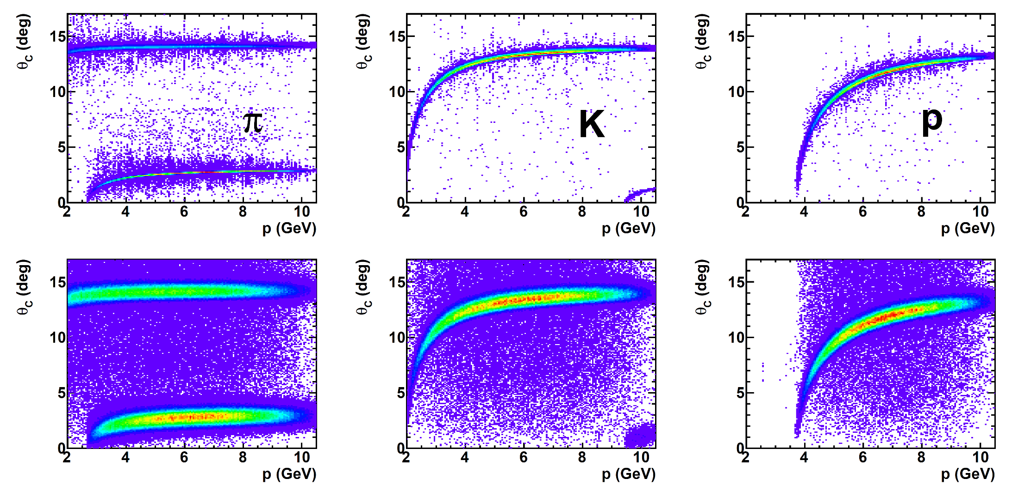
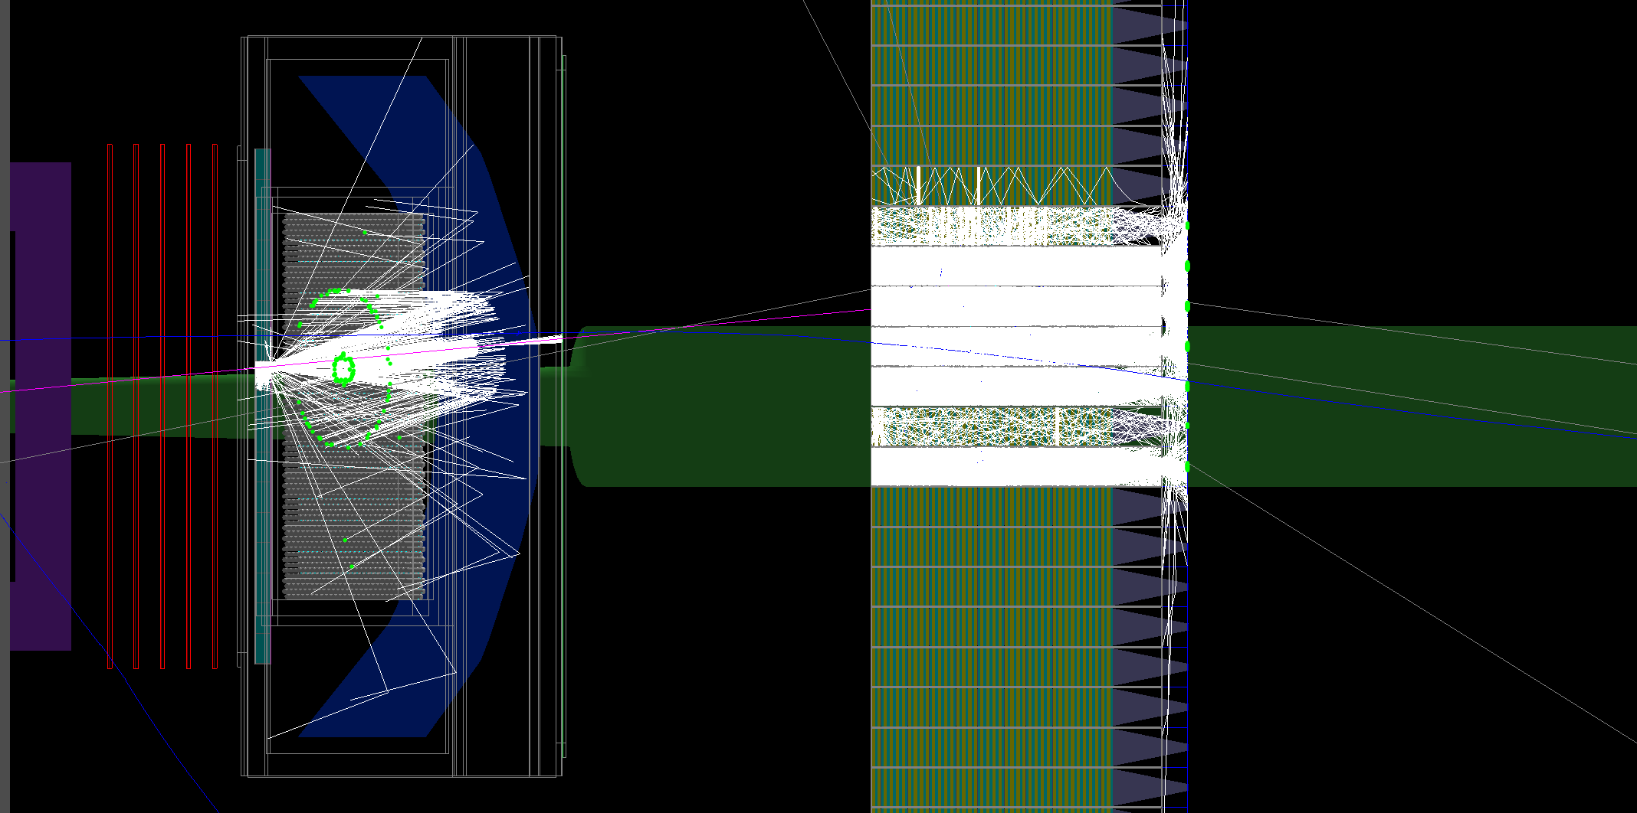
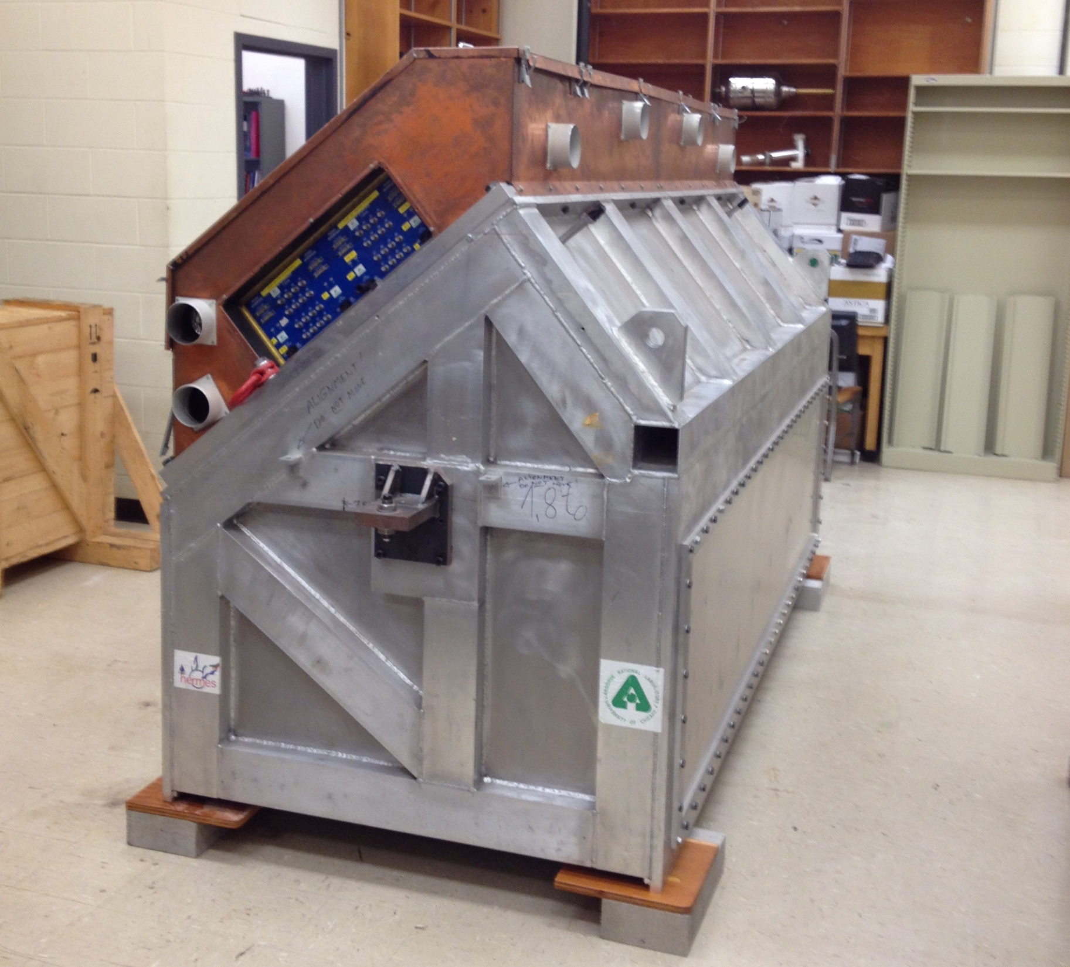
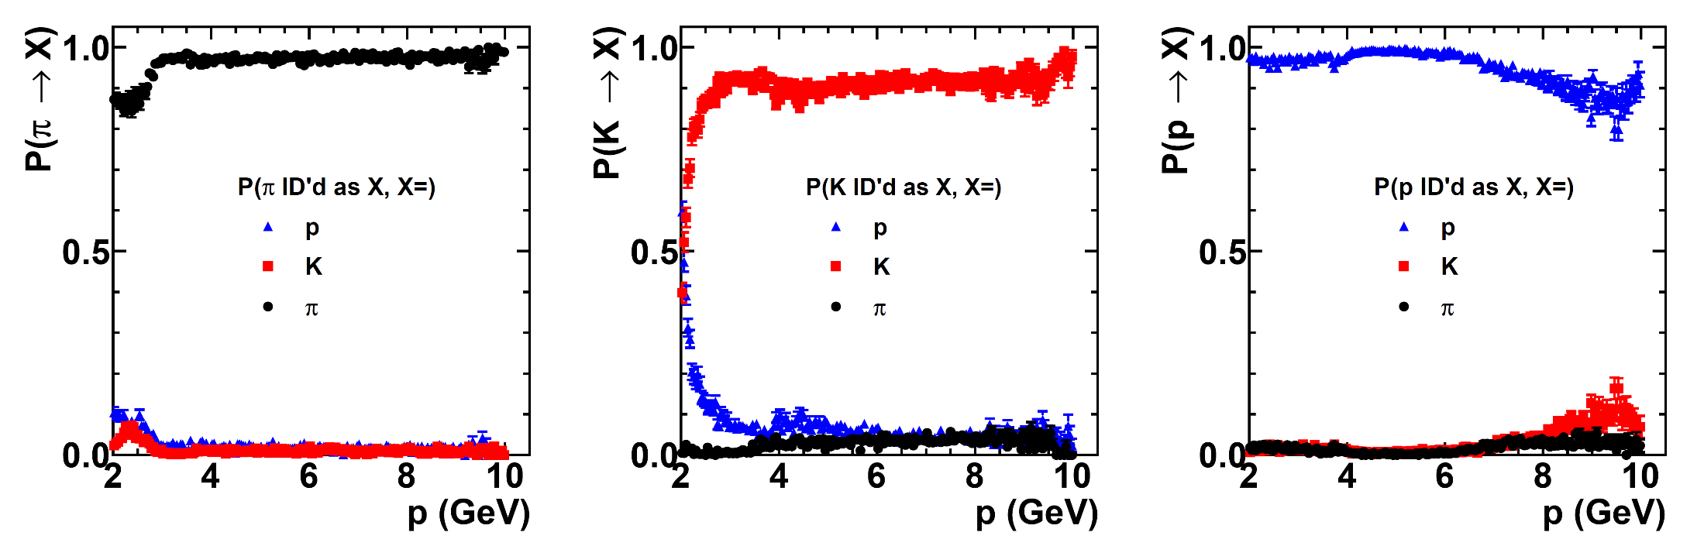
HERMES RICH in SBS
GEANT4-simulated RICH performance in SBS
GEANT4 simulated RICH PID performance in SBS for π/K/p
HERMES/SBS RICH @UConn, Sept. 2014

Slide 7
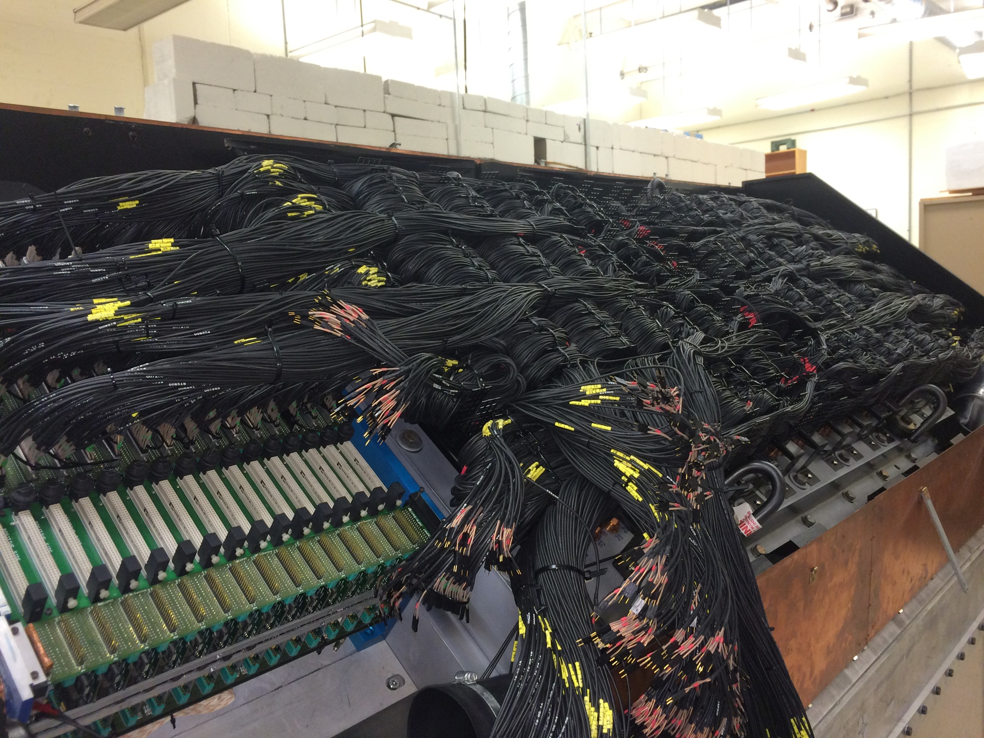
HERMES RICH at UConn
1,934 PMTs removed from the matrix, old front-end electronics removed, one HV interface removed for use in testing.

Slide 8
Summary of PMT test results (so far)
All PMTs have been tested (1,934 RICH + 224 spare). Main battery of tests completed Oct. 2016
32 PMTs rejected either because they were “dead” (no signals, couldn’t hold HV), were extremely noisy, exhibited extremely low gain/poor signal quality, or had obvious visible defects on inspection.
  This is 1.5% of the total number of PMTs available
  These PMTs were manufactured in 1997-1998
With all the “good” PMTs on hand, we have enough to instrument the RICH with 192 to spare (~10% spare capacity)

Slide 9
RICH requirements
C₄F₁₀ (or similar heavy gas). Recovery/recirculation system was used in HERMES.
  Volume: ~2X GRINCH volume
  RICH AND GRINCH both required for SIDIS. Both use C₄F₁₀. Would GRINCH perform with CO₂?
  Reaching out to HERMES RICH experts for details of HERMES RICH gas system
  Coordinate with/piggyback on GRINCH solution
Readout electronics:
  CDET version NINO card—choose operating gain such that minimum NINO discriminator threshold corresponds to ~0.1-0.2 ph.e.
  Fastbus TDC readout: NO amplitude readout currently planned.
  1,934 RICH PMTs < 2,352 CDET pixels
    Re-use most cabling/electronics from CDET, which is not used for SIDIS, as much as possible.
  RICH signal connector (IDC, two-pin) compatible with CDET version NINO card input header, but signal cable is short (~1.5 m)
  Likely need simple patch panel to connect PMTs → ribbon cable → NINO cards. Location of NINO cards relatively flexible—preferably close to RICH
HV: at typical HV, divider current is 40-50 uA; power 32 PMTs on a single HV channel: 61 channels of HV power supply and associated cabling needed
  Use pre-existing HV distribution boards mounted directly on RICH
Installation in SBS and support frame:
  Have RICH drawings, will provide to JLab engineering in the near future
Plan for SIDIS is to operate with vertically symmetric orientation of detector package for up/down symmetric acceptance, and periodic polarity reversals of SBS magnet.

Slide 10
Near-term activities for RICH
Preparing to inspect/check optical properties of spare aerogel tiles at UConn
Preparations for RICH shipment to JLab underway
Obtaining cost estimate/formal quote for rigging/crating/shipping RICH to JLab
Coordination with JLab on space for storage/testing
Prepare “white paper” detailing system requirements for SIDIS/TDIS
Need new simulations: optimize SBS detector layout for SIDIS:
  SBS magnetic field strength → lower is better for acceptance and fringe field near polarized target. Clarify minimum momentum resolution requirements for PID
  HCAL distance → with lower SBS field, increase distance to HCAL to lower background rates without cutting acceptance (and improve pi0 resolution).
    Also improve HCAL angular + TOF resolution, improved constraints for tracking
  Revisit background rates/PID performance
  Develop analysis framework for SBS in SIDIS: trigger, tracking and PID
  Trigger/DAQ rates and occupancies
Start to think about beamline and SIDIS target design.
  What is truly needed vs. what is “nice to have”?

Slide 11
Summary/conclusions
Re-use of HERMES RICH in SBS is a low-cost PID solution enabling high-impact SIDIS physics with SBS, can be adapted to future novel applications such as TDIS.
Mass testing of 2,158 RICH PMTs was completed Oct. 2016:
  Single-ph.e. spectra
  Gain curves
PMTs are in good condition; less than 2% of tested PMTs rejected → we have ~10% spare capacity to run SIDIS
High near-term priorities: check aerogel condition and prepare to move RICH to JLab, where UConn student and postdoc workforce is stationed

Slide 12
Backups

Slide 13
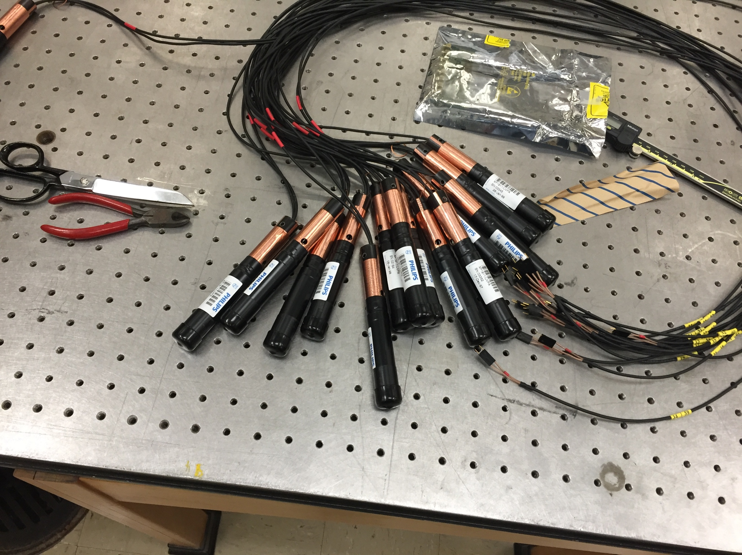
RICH PMTs

Slide 14
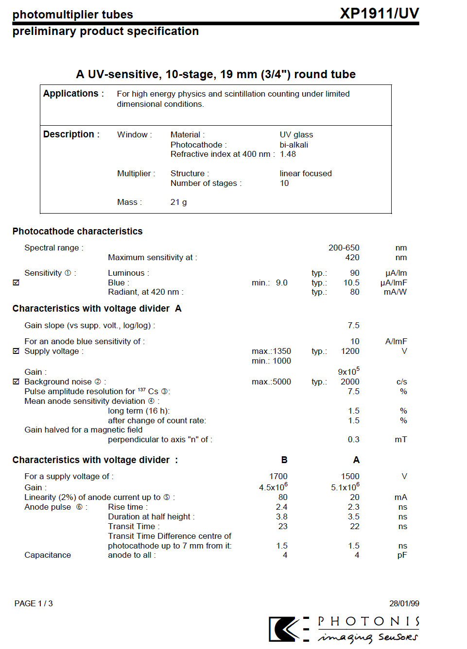
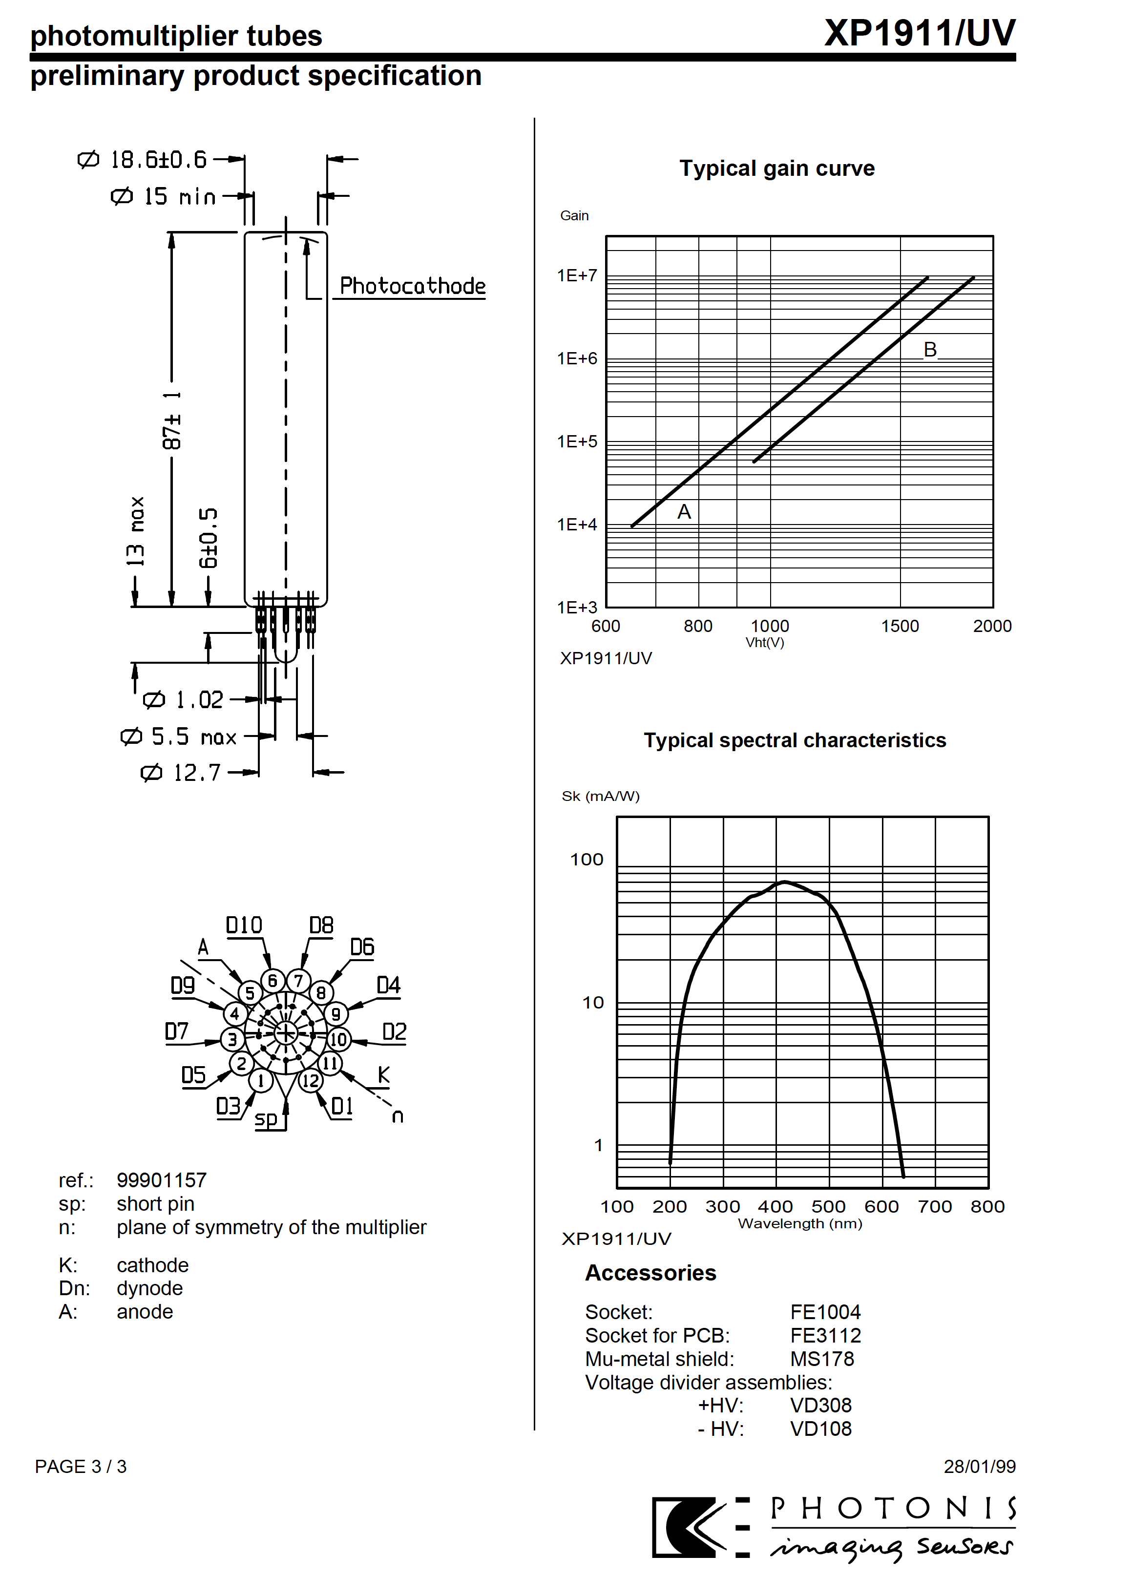
Philips XP1911/UV Specs
Pulse characteristics in HERMES w/custom voltage divider @typical HV ~ +1,350 V: ~5 mV single p.e., 10 ns FWHM, gain of 3 × 10⁶
Current draw per PMT ~0.05 mA → Group 32 PMTs on a single HV channel

Slide 15
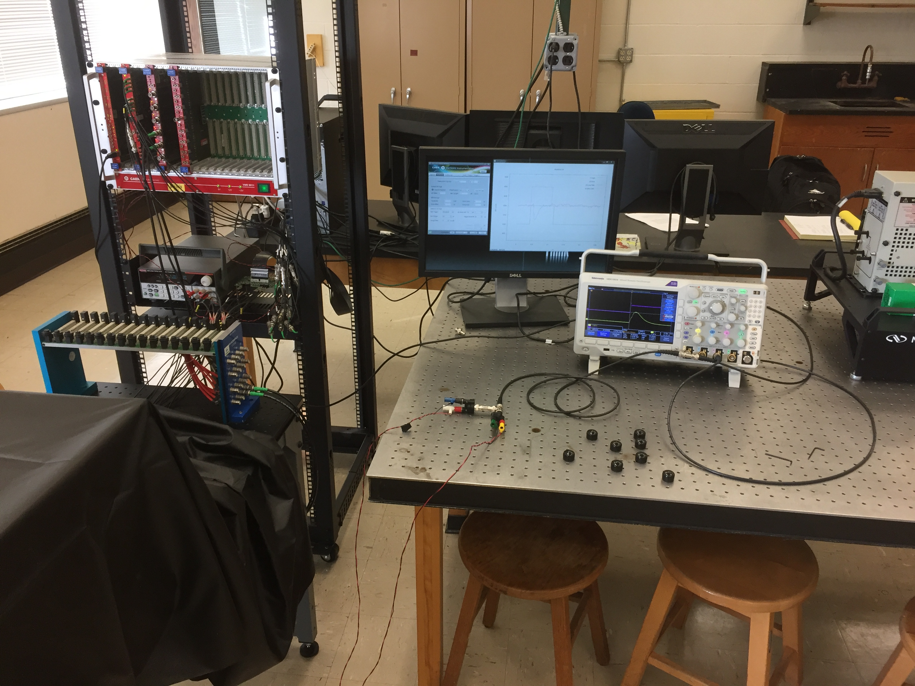
RICH PMT test stand @UConn
VME Crate w/USB bridge/controller, 500 MHz 14-bit, 8-channel Flash ADC digitizer (V1730C), and HV power supply
CDet version NINO card w/benchtop DC power supply
HV distribution board, taken from RICH
Oscilloscope w/built-in function generator (drives LEDs)
Dark box containing 8 PMTs, 2X LED illuminating 1→4 fan-out optical fiber bundle

Slide 16
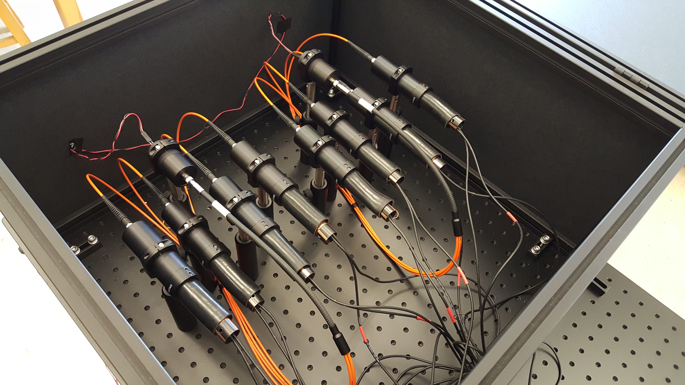
Dark box
1→4 optical fiber bundles: each LED illuminates 4 PMTs
Blue LEDs, 465 nm

Slide 17
Pedestal mean and width (5 fC/LSB charge sensitivity)
The DAQ performs automatic baseline determination and subtraction; however, we configured it to insert a charge “pedestal” so that we can easily determine the noise level in each channel and optimally separate the small single-ph.e. signals from noise.
The individual sample noise width is related to the pedestal width by statistical factors depending on the number of samples used for the baseline determination and the number of samples in the gate for charge integration

Slide 18
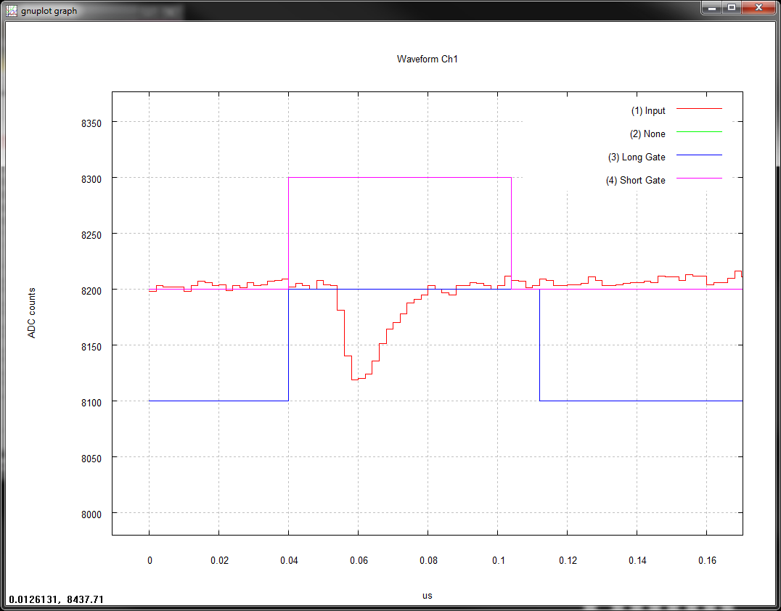
Single Photo-electron Signals
ADC input range = 2 Vpp; 1 count = 0.12 mV
FWHM of NINO analog output ~14 ns
This signal ~9.6 mV (after NINO amplifier) = ~2.4 mV raw signal amplitude
PMT in this example is at HV = +1,340 V
Gate width for charge integration = 72 ns

Slide 19
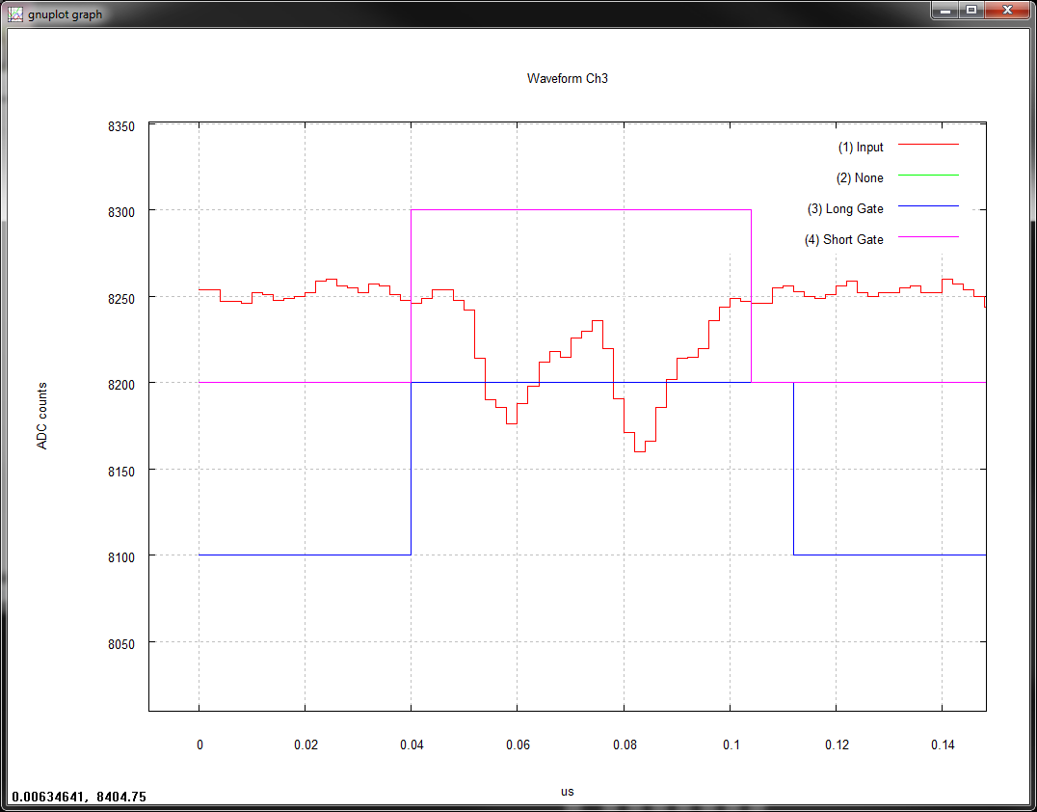
A Pileup Event
Example of an event with two photon detections within the same gate

Slide 20
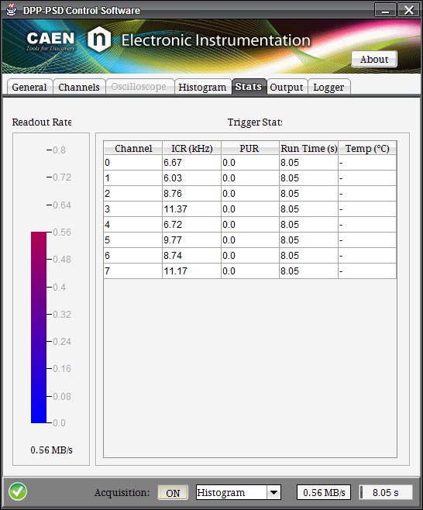
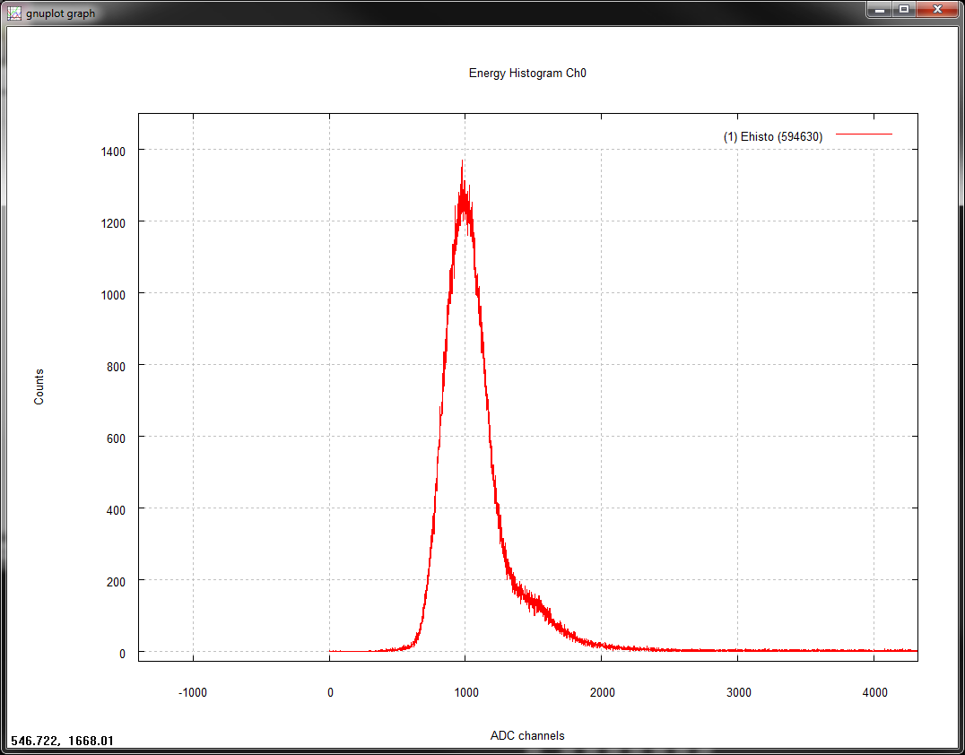
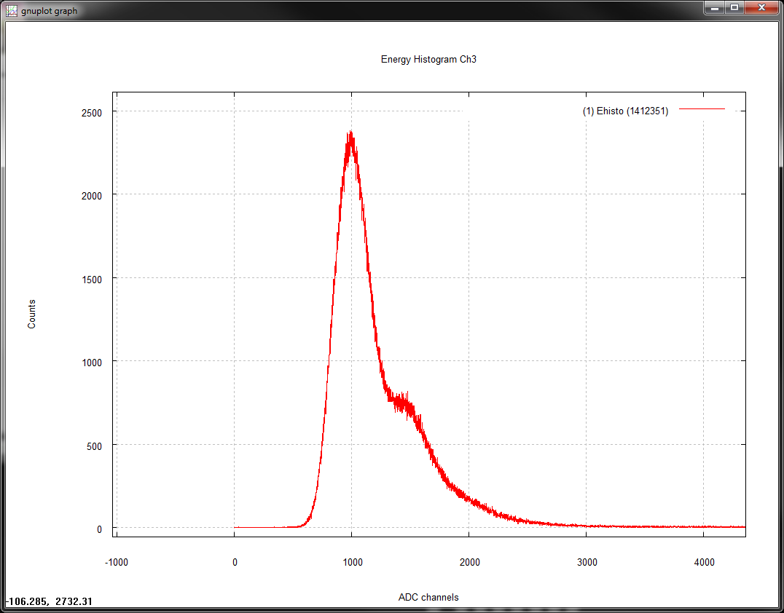
“Histogramming mode” DAQ
Examples of single-ph.e. charge spectra
To obtain single-photoelectron spectra, the LED driving voltage is increased until PMTs see ~few kHz of single photon detections above dark rate, while keeping the number of multiple-photon detections small. Recall LED pulse repetition rate = 20 kHz
One-ph.e. peak
Two-ph.e. shoulder

Slide 21
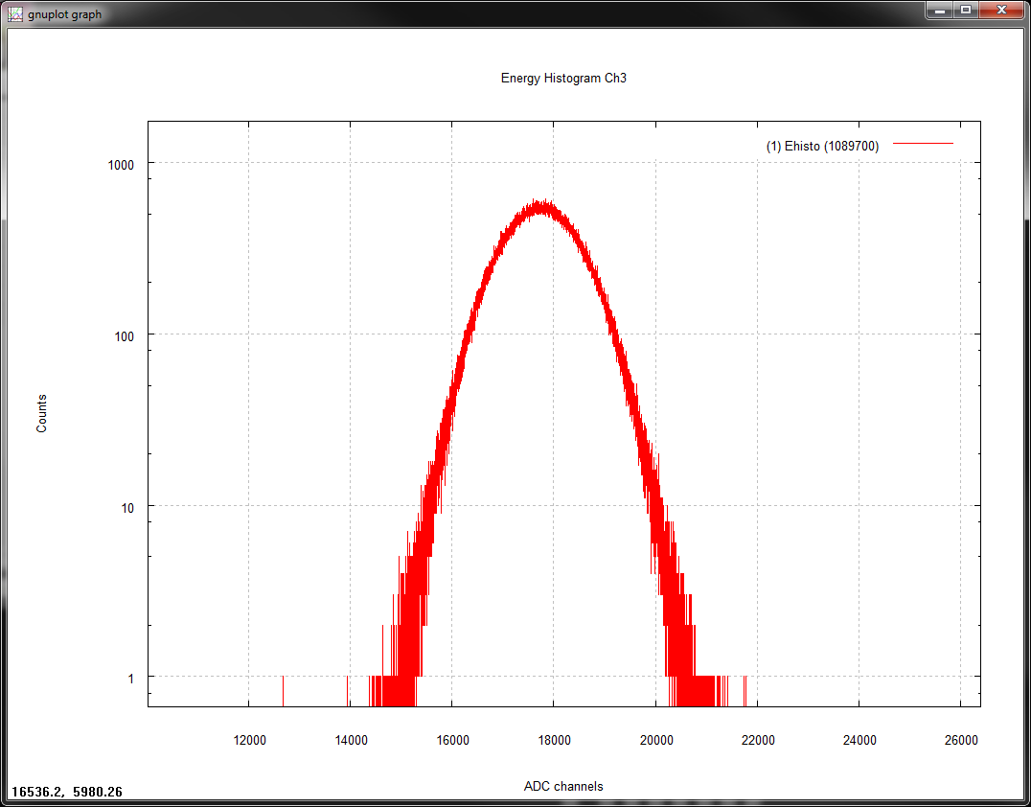
Charge spectrum for “Big” light pulses and determination of number of photoelectrons
Example of “online” big-light charge spectrum at 80 fC/LSB charge sensitivity
Example Poisson fit to ADC spectrum:

Slide 22
Gain results
Above, left: Absolute gain at 1,350 V
Above, right: Gain at 1,350 V by PMT number
Below, right: Gain “slope” parameter (from exponential fit to HV scan data)
Compromise: Gain slope fixed by “Big Light” data, normalization determined by single-ph.e. spectra

Slide 23
Single-Photoelectron peak width
Ratio of width/mean of single-photoelectron peak is about 0.33, without much variation among PMTs
Largely determined by HV divider circuit (large gain at first stage)

Slide 24
Dark Counting Rates
Dark counting rate measured at end of testing procedure for each PMT;
Caveat: PMTs have only been under high voltage for 30-40 minutes when dark counting rates are measured! Noise levels expected to go down for longer “settling” times
Very few PMTs noisy enough to be concerned about even with this caveat
During SIDIS expect up to 1 MHz/PMT background counting rate

Slide 25
“Relative Quantum Efficiency”
This is the average ratio of the variance to the mean of the “BigLight” runs by PMT, where μ is the mean number of photoelectrons, and σ² is the variance in the number of photoelectrons/pulse, with the gain fixed at the value determined from the single-photoelectron runs. Very crudely speaking, a larger value of this ratio indicates a lower relative quantum efficiency at 465 nm (lots of caveats to this)

