Slide 1
SBS DAQ
SBS collaboration Meeting
Alexandre Camsonne
July 13th 2017

Slide 2
Outline
GMn ERR
GEp plan
GEM data reduction
HCAL progress
Fastbus
Network upgrade
DAQ disks
SILO capability
Tape cost
TDIS TPC
Manpower
Simulation work
Conclusion

Slide 3
Expected trigger rates GMn
Preferably single electron trigger to avoid biased in neutron detector
Q^2 | n+p QE xsec | L(per atom) | QE rate | Beam time | Total
GeV^2 | fb | 10^38/cm^2/s design | Hz | Hours | Hz
3.5 | 6700 | 0.35 | 235 | 12 | 2100
4.5 | 1015 | 0.7 | 70 | 12 | 1400
5.7 | 97.9 | 1.4 | 13.5 | 18 | 140
8.1 | 47.4 | 1.4 | 6.6 | 18 | 390
10.2 | 31.6 | 0.7 | 1.5 | 24 | 210
12 | 5.04 | 1.4 | 0.7 | 36 | 200
13.5 | 6.25 | 1.4 | 0.87 | 96 | 100
Maximum trigger rate 2.1 KHz, assume factor 2 safety margin for 4.2 KHz for low Q²
less than 500 Hz at high Q²
Single electron trigger is a good option
( possibility to add Cerenkov in the trigger if needed )

Slide 4
GEM occupancy and data rates
occupancies from Q2 = 13.5 GeV2, with luminosity 2.8 10^38 A⁻¹ cm⁻² s⁻¹ (44uA on 10cm LD2 target) and rates from low Q2 point : 1.3 KHz
 | Rate per (KHz/cm2) | Rate per plane (MHz) | hits in 325 ns | Occupancy (%) | strip hits | x2 XY (strips) | x6 samples | Evt size (bytes) | Rate MB/s
1 | 89.6 | 537.6 | 174.72 | 27% | 612 | 1223 | 7338 | 29357 | 123.30
2 | 101.6 | 609.6 | 198.12 | 31% | 693 | 1387 | 8321 | 33284 | 139.79
3 | 101.4 | 608.4 | 197.73 | 30% | 692 | 1384 | 8305 | 33219 | 139.52
4 | 98.1 | 588.6 | 191.295 | 29% | 670 | 1339 | 8034 | 32138 | 134.98
5 | 89.3 | 535.8 | 174.135 | 27% | 609 | 1219 | 7314 | 29255 | 122.87
 |  |  |  |  |  |  |  | Total | 660.46
Worse case scenario using High Q2 occupancies with low Q2 rates
Deconvolution on SSP : expect factor of 3 reduction about 220 MB/s

Slide 5
Data rates GEp5
Detector | Rate | Channels | Occupancy | Data size Bytes | Data rate MB/s 5 KHz 3 samples | Geometrical factor | Data size geo Reduc MB/s | Double for 6 samples MB/s
Front Tracker | 400.00 | 49000.00 | 1 | 589149 | 2946 | 3.00 | 919
Second Tracker | 130.00 | 61440.00 | 1 | 738720 | 3694 | 5.00 | 660
Third Tracker | 64.00 | 61440.00 | 1 | 738720 | 3694 | 5.00 | 660
Total |  | 171880.00 |  | 2066589 | 10332 |  | 2459 | 4918
Need further reduction by using deconvolution and maybe clustering on SSP

Slide 6
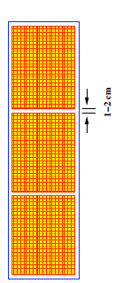
Front Tracker layout
2048 channel
1 MPD
2048 channel
1 MPD

Slide 7
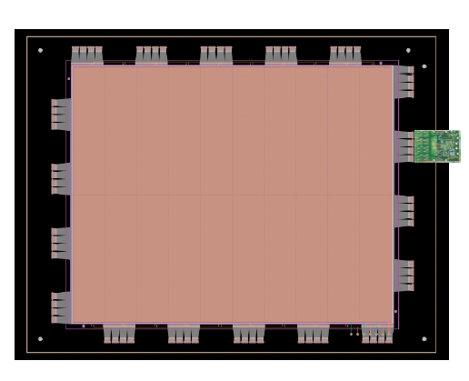
Trackers layout
Back tracker
Region of
Interest from
HCal position
1 MPD
2048
Front tracker
Region of
Interest from
BigCal position
1 MPD
2048
Middle tracker
Interpolated from both front
and
back information

Slide 8
Trackers layout
Worst
case
configuration

Slide 9
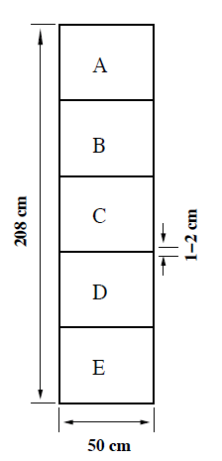
FPP Tracker layout
2560
512
2048

Slide 10
Geometrical MPD suppression
Different methods
Use on user input Fast clear MPD
pro : MPD stay in synch
con : need more MPD firmware work
only issue trigger for modules of interest and have SSP keep track of number of events to be read
pro : no change to MPD
con : MPDs out of synch and rely on SSP for synchronization, more firmware work
do on SSP or VTP
pro : no hardware change
con : resource intensive, synchronization issues, more work for Ben !

Slide 11
MPD fastclear
L2A
FC1
FCn
HCAL
ECAL

Slide 12
MPD Fastclear timing
0
200 ns
1000 ns
2000 ns
4525 ns
21150 ns
25000 ns
L1
L2
Start reading APV
FC
1
Samp
L
E
6th
S
a
m
p
l
e
Send data to
SSP

Slide 13
SSP readout performances
1 backplane, 3 APVs, no zero suppression
Nb samples | Blocklevel | Rate (kHz) | Effective rates (kHz) | Effective rates 8 APV (kHz) | Data rate
1 | 1 | 23 | 23 | 8.6 | 26
3 | 1 | 15 | 15 | 5.6 | 50
3 | 2 | 15 | 15 | 5.6 | 100
3 | 4 | 7 | 28 | 10.5 | 85
3 | 4 | 10 | 40 | 15 | 100 | No transfer
Disk speed : 98.2 MB/s
Network : 117 MB/s
Backplane VME : 100 MB/s
Can saturate backplane
Expected rate around 15 KHz per MPD

Slide 14
Timeline GEM
Implement first pass SSP data reduction this summer: common noise suppresion running average, 6 samples discard first and 6th sample if highest amplitude
Second pass if required January 2018 with higher priority from Electronics group
( CLAS12 run in October )

Slide 15
Fastbus readout
Time : 1877S
Amplitude 1881M
Fastbus max transfer speed : 40 MB/s can use either Intel or Old vxworks VME CPU
ECal : 4 sets of 3 crates, will be able to test performance about 50 MB/s at 100 % occupancy
Cdet : 9 Fastbus crates about 11 MB/s at 10 % occupancy

Slide 16
Fastbus
Good progress from Bob
Tools to check synchronization available
still development to handle event blocking in decoding

Slide 17
HCAL readout
288 channels
2 VXS crates , 18 FADCs
1.5 MHz singles
16 block clusters
FADC 250 MHz 12 bit = 2 bytes
10 samples : 320 bytes , 57.6 MB/s at 100 % occupancy
VETROC or F1 : high resolution TDC, need NINO
VTP need to developped
2 VETROC for ECAL sums input and MPD fast clear

Slide 18
VTP
New Hall B CTP
Larger FPGA than GTP
2x10 Gig optical links
Plan development of VXS readout for FADC and possibly SSP
7 K$
Have 2 for HCAL

Slide 19
HCAL trigger status
VTP installed
Firmware loaded, need testing
No CODA ROC planned for CODA 2.6 only for CODA3 so no VTP readout
Need to negotiate with DAQ group for CODA 2.6 for readout
Or need to upgrade all Fastbus CPU to Intel for VTP readout ( 10 GigE )
or readout VTP with a CPU or PC at 10 gigE

Slide 20
Network upgrade
Replace hall A router with an Arista switch, reuse existing hall A router as the switch for the racks. This provides dense 10Gig aggregation, with 40Gig expandability. Estimate $30K, 3 month lead time.
Single Mode Fiber Installation in the hall ( required for any speeds>1Gbit/sec), rough estimate $30K, 6 month lead time.
Counting House to left arm, 24 strand
Counting House to right arm, 24 strand
Counting House to Labyrinth, 24 strand
Counting House to Hall Floor Rack Area, 24 strand
40Gig uplinks to CEBAF center ($20K upgrade to item 2).
Bottomline : 10 Gig capability 30 K$ + temporary fiber 10 gigE

Slide 21
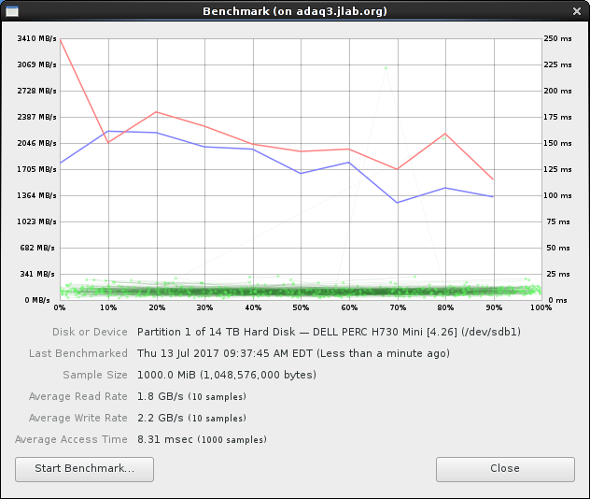
Counting house DAQ disks
Raid array on adaq3
several disks
1GB/s seems doable
Might need to upgrade to hold 72 hours of data : 259 TB
( Hall D about 28 K$ per raid array )

Slide 22
SILO capabilities
Mix of LTO 5 and 6
14 drives LTO 5 and 6 = 2 GB/s
up to 16 drives
each LTO7 drive is 300 MB/s about 10 K$ each
Max : 16 * 300 = 4.8 GB/s
to handle 1 GB/s : 4 drives about 30 K$
increase to 4 GB/s ( 1GB + dup + read ) about 120 K$
need to write and read at same time
LTO8 available in 4 to 5 years
Need to let IT know our real needs might need more drives

Slide 23
Tape cost
 |  | Days | Weeks | Data rate | Seconds | Total data TB | Double | LTO5 in k$ | LTO6 in k$ | LTO7 in k$ | LTO8 in k$
E12-12-09-019 | GMN | 25 | 3.57 | 500 | 2160000 | 1080 | 2160 | 108 | 65 | 27 | 13
E12-09-016 | GEN | 50 | 7.14 | 500 | 4320000 | 2160 | 4320 | 216 | 130 | 54 | 25
E12-07-109 | GEP/GMP | 45 | 6.43 | 1000 | 3888000 | 3888 | 7776 | 389 | 233 | 97 | 46
E12-09-018 | SIDIS | 64 | 9.14 | 1000 | 5529600 | 5529.6 | 11059.2 | 553 | 332 | 138 | 65
 | Total | 184 | 26.29 |  | 15897600 | 12657.6 | 25315.2 | 1,265.76 | 759.46 | 316.44 | 148.33

Slide 24
TDIS
BNL TPC readout
https://eic.jlab.org/wiki/index.php/Trigger/Streaming_Readout
streaming TPC readout

Slide 25
Streaming Readout concept
The streaming data are recorded all the time, and broken up in chunks above threshold
25
Only chunks correlated with triggered events are then kept
✖
✖
✖
✖
This results in a greatly reduced data stream
The real-time processing demands are very high

Slide 26
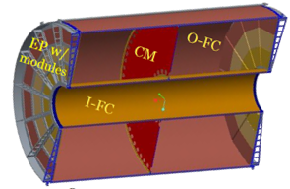
The streaming TPC readout
FEE
DAM
EBDC
10+ Gigabit
Crossbar
Switch
DCM
DCM
DCM
FEE
DCM
DAM
EBDC
Buffer Box
DCM
DCM
FEE
DCM
DAM
EBDC
Buffer Box
DCM
DCM
Buffer Box
FEE
DCM
EBDC
Buffer Box
To RCF/
HPSS
DCM
DAM
DCM
Buffer Box
TPC
FEE
DCM
Buffer Box
DCM
DAM
EBDC
DCM
FEE
DCM
Buffer Box
DCM
DAM
EBDC
DCM
Data Concentration
Same components as shown before
DAM Data Aggregation Module
EBDC Event Buffering and Data Compressor

Slide 27
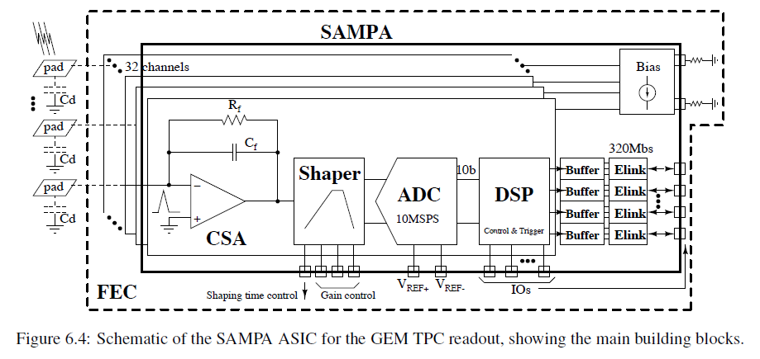
Front-End – ALICE SAMPA Chip
ASIC developed for ALICE for the TPC
More functionality than we would need while streaming
10Ms/s @ 10Bit -> 100Mbit/s internally, 32channels
This oversubscribes its external links
Above-threshold waveform delivery – send chunks of the waveform around samples “sticking out” above a threshold + bookkeeping
Estimate 5 samples/channel/hit and 3 channels -> 15 samples/”hit”
8 Sampa chips on one Front-end card – 256 channels
~400 FEE cards

Slide 28
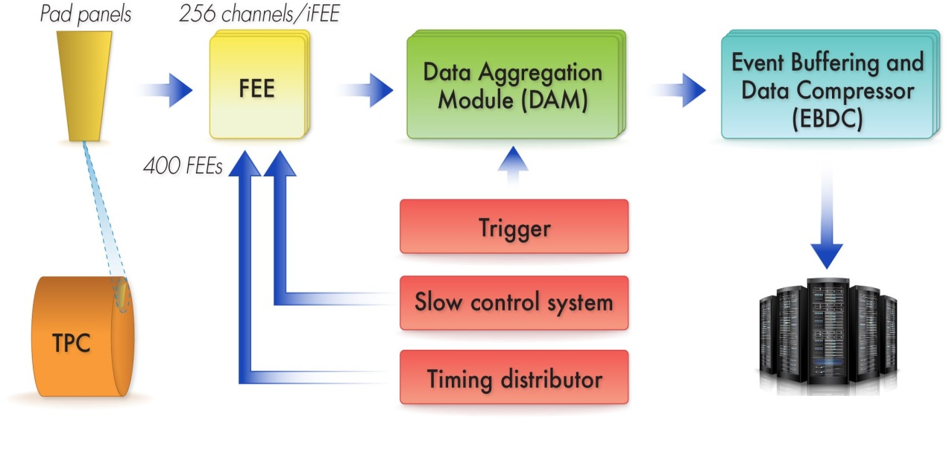
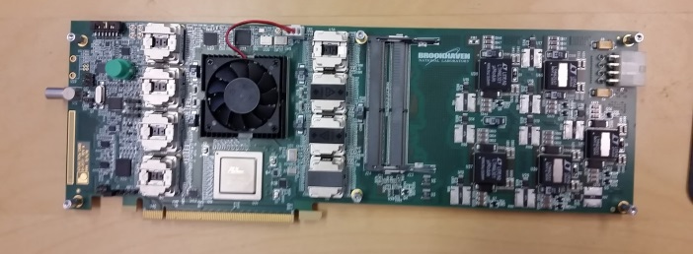
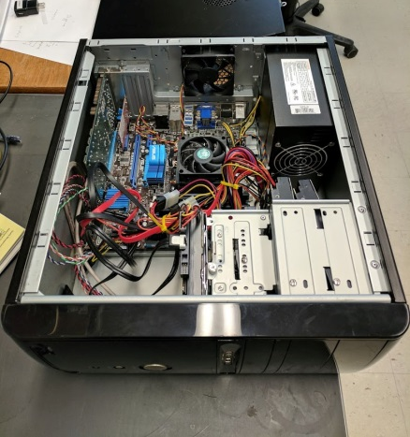
Data path overview
Buffer box
About 10 PCs (EBDC) with
one FELIX card each
+
Up to 48 FEE->Card
(48 fibers)
ATLAS Felix PCIe card

Slide 29
Man power
Fastbus/ECAL
M. Jones, B. Michaels, J. Gu, B. Moffit
HCAL
B. Raydo, A. Camsonne
GEM readout
E. Cisbani, B. Moffit, A. Camsonne, P. Musico, B. Raydo, S. Riordan, D. Di
BigBite : E. McLelan

Slide 30
Simulation work
Test data reduction algorithm on simulated data for GEM
Occupancies different detectors GMn, Gep for different kinematics start to look at SIDIS, TDIS

Slide 31
Conclusion
Need evaluate data rates after reduction for all experiments especially GEp5 aiming at 500 MB/s (no major upgrafe )
If more than 1 GB/s need network/SILO/disks upgrade need to discuss with IT
Ongoing development on SSP : first iteration end of summer
HCAL trigger in testing
Good progress Fastbus
Look ahead future experiments SIDIS, TDIS

