Slide 1
Silicon Microstrip Detectors
F. De Persio, F. Meddi, G.M. Urciuoli

Slide 2
Summary
Last studies on the prototype with cosmic rays.
Solving the wirebondings breakup issue.
Future activities at the Rome laboratory (Laser test station).
Production at the INFN Bari bonding facility.
Silicon microstrip production schedule.

Slide 3
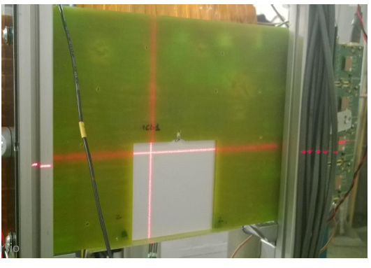
Last studies on the Prototype
PCB
Detector

Slide 4
Analysis first step:
«Hot» strips detection.
A strip is defined as «hot» if its ADC value is smaller (bigger in absolute value) than a certain threshold more than 5 times each 1000 events.
This becasuse the probability of a strip to be fired by a cosmic ray in 1000 events is 1000/2070 and hence the probability to be fired 6 times is, according to the Poisson distribution, 0.00001.
The threshold is set tipically to 5σ times the ADC strip pedestal
Hot strips are not considered in the analysis.

Slide 5
Analysis second step:
«Noisy» events detection.
A strip is defined «fired» when its ADC value is smaller than a certain threshold
The threshold is set tipically to 5σ times the ADC strip pedestal
An event is defined «noisy» when the number of strips fired in it is 6 or bigger
This because we expect, on average, 1 MIP for trigger and hence the probability to have 5 strips fired in one event is, according to the Poisson distribution, 0.0005.
Noisy events are not considered in the analysis

Slide 6
Analysis third step:
Right Latency search.
Background
Number of events out of 1000 with at least one strip «fired» as function of the latency.
Average number of strips fired in one event as function of the latency.
Right Latency = 106!

Slide 7
Analysis fourth step:
«Cluster» Analysis.
The Cluster analysis allows to reduce the background:
A «Cluster» is defined as three contigous strips. If the probability of a strip to generate a signal from noise (for example a signal 5σ times bigger than the pedestal) and hence a «false» MIP is P, the probability that three contigous strips to generate simultaneously three noisy (big) signals OF THE SAME SIGN is smaller than P. We can define, as in the case of the single strips, a threshold for clusters. If a group of three contigous strips produces three ADC values whose sum is smaller (bigger in absolute value) than the threshold set for the clusters, a MIP is supposed to have fired the cluster. Often (but not always) the cluster threshold is set equal to the single strip threshold.
Reduced
Background
Single Strip Threshold = Cluster Threshold = - 150

Slide 8
Analysis fifth step:
«Summing up all the latency in a run».
For zeroing the background one has to maximize the ratio signal to noise. This is achieved collecting as much as possible of the signal . A signal lasts 8-9 latencies. In one event MPDs register the ADC values produced in 6 contigous latencies. We hence sum up for each strip all the 6 ADC values registered by the MPDs in the single events. An event is considered detecting a MIP when the sum of the 6 ADC values is smaller (bigger in absolute value) than a certain threshold.
Run containing latencies
97-103 (part of the signal)
Run containing latencies 103-108
(most of the signal)
Runs containing only background

Slide 9
Three examples of MIPS
Performing the sum over the six latencies in one event MIPS are identified without any doubt.

Slide 10
An example of a MIP (zoomed)

Slide 11
Landau Distribution
Performing, for all the MIPs, the sum over the six latencies registered by the MPDs, the ADC sums (proportional to the energies deposited by the MIPS in the silicon microstrip detector) follows the Landau distribution:

Slide 12
Efficiency (1)
To get a good efficiency, because the pedestals drift during the long time needed to collect 1000 cosmic ray events, it is better to calculate for each strip the average of the ADC values over the 1000 events and check then for each event if one strip produced an ADC sum over the six latencies smaller (bigger in absolute value) than a certain threshold. At the moment APV25 cards seem apparently have different behavior from each other. Different appropiate thresholds were then chosen for each silicon region. The thresholds were chosen in order that in the runs that do not contains the latencies interested by the MIP signals, the background was on average less than 1%.
Run 778 ➔ Number of Events Fired 2 (does not contain latencies of interest)
Run 779 ➔ Number of Events Fired 0 (does not contain latencies of interest)
Run 780 ➔Number of Events Fired 103 (does contain most of the signal)
Run 781 ➔ Number of Events Fired 14 (it contains some signal residual)
Run 782 ➔ Number of Events Fired 1 (does not contain latencies of interest)

Slide 13
Efficiency (2)
Zone plagued by
wirebondings breakups
Efficiency vs Number of Strip

Slide 14
MIP molteplicity
The MIP molteplicity (distribution of the number of MIPS for event) follows nearly the expected Poisson distribution. Small deviations from this distribution are (likely) due to the presence of small amount of background (to be proved quantitatively)

Slide 15
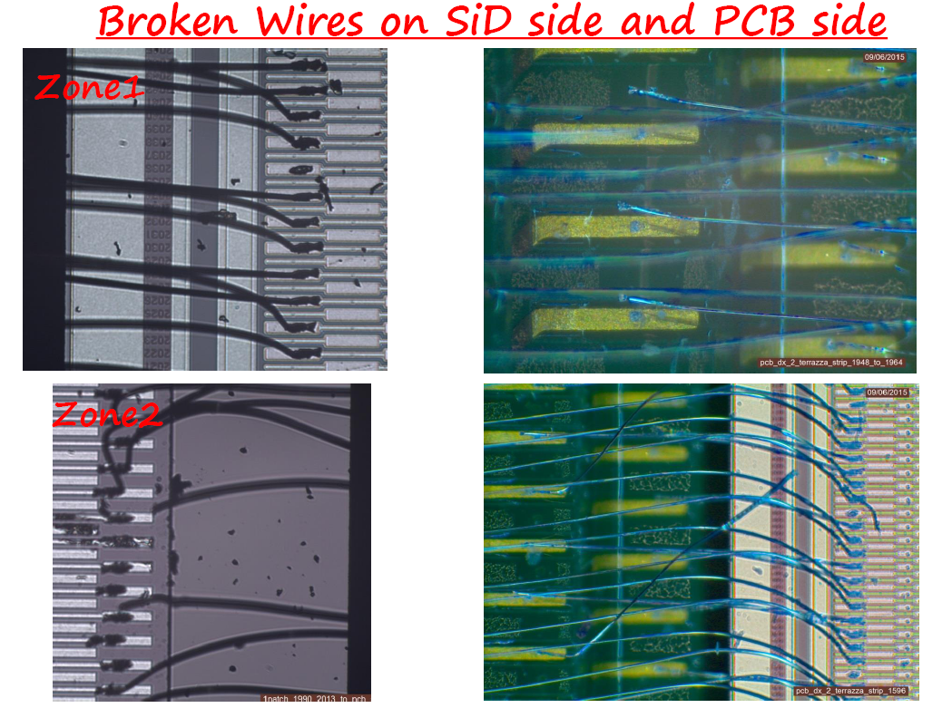
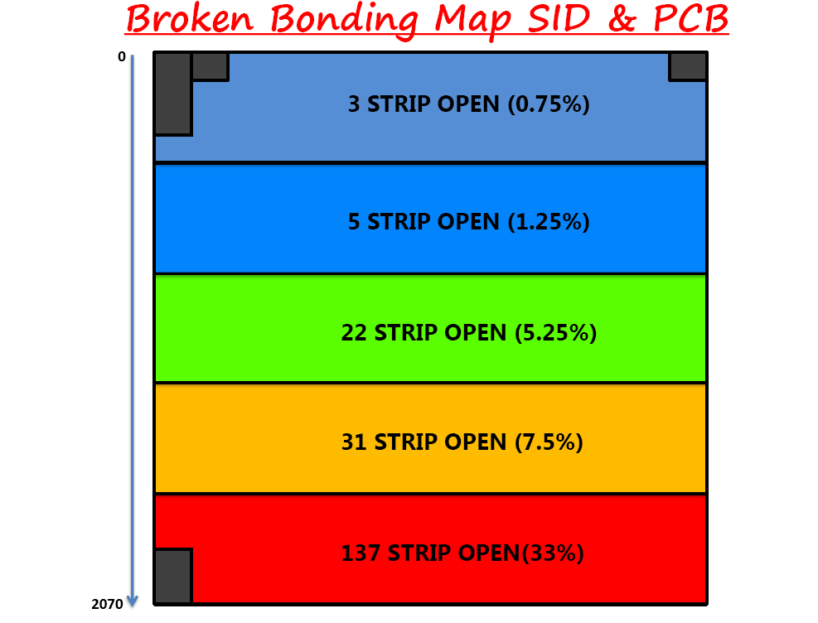
Wirebonding breakup issue
The prototype experienced wirebonding breakups

Slide 16
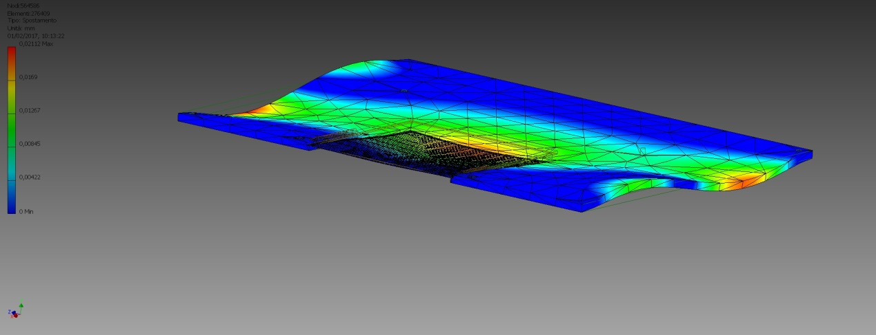
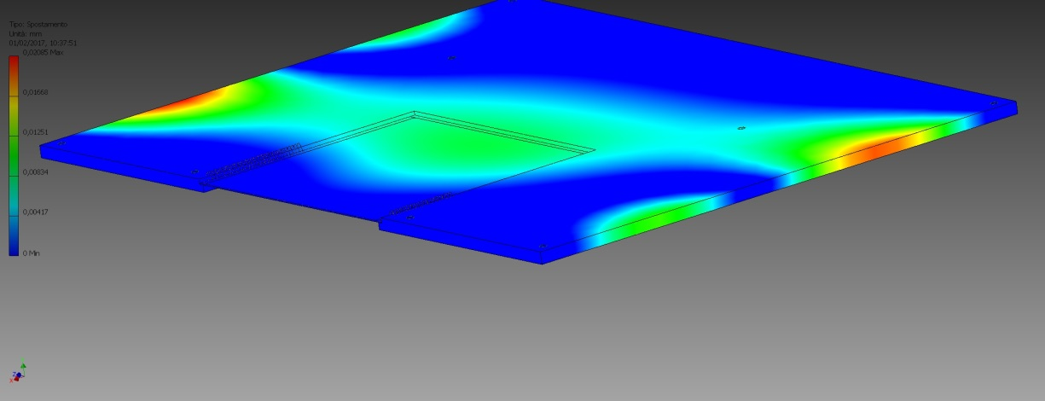
Wirebonding breakup issue solution
Simulations performed by F. Noto, LNS engineer, shows that even an uincorrect handling cannot breakup
or remove wirebondings. The problem was caused hence only by Silicon detector transportation. F. Noto
is performing numerical simulations to design a safe transport system for silicon detector delivery to Jlab.

Slide 17

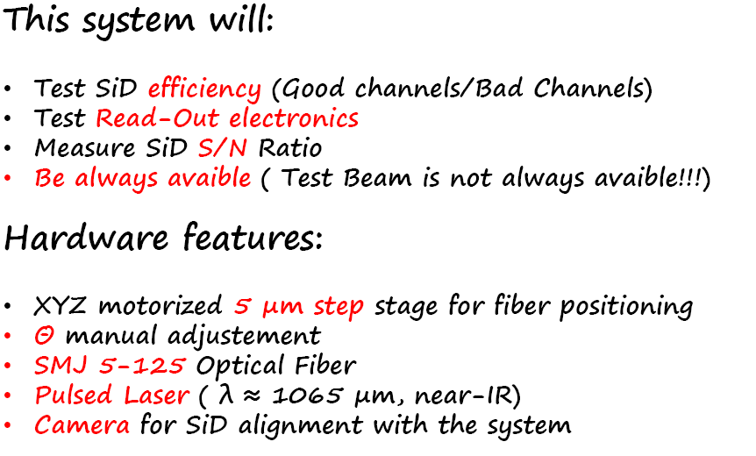
Pulse Laser test station at the Rome Laboratory (1)

Slide 18
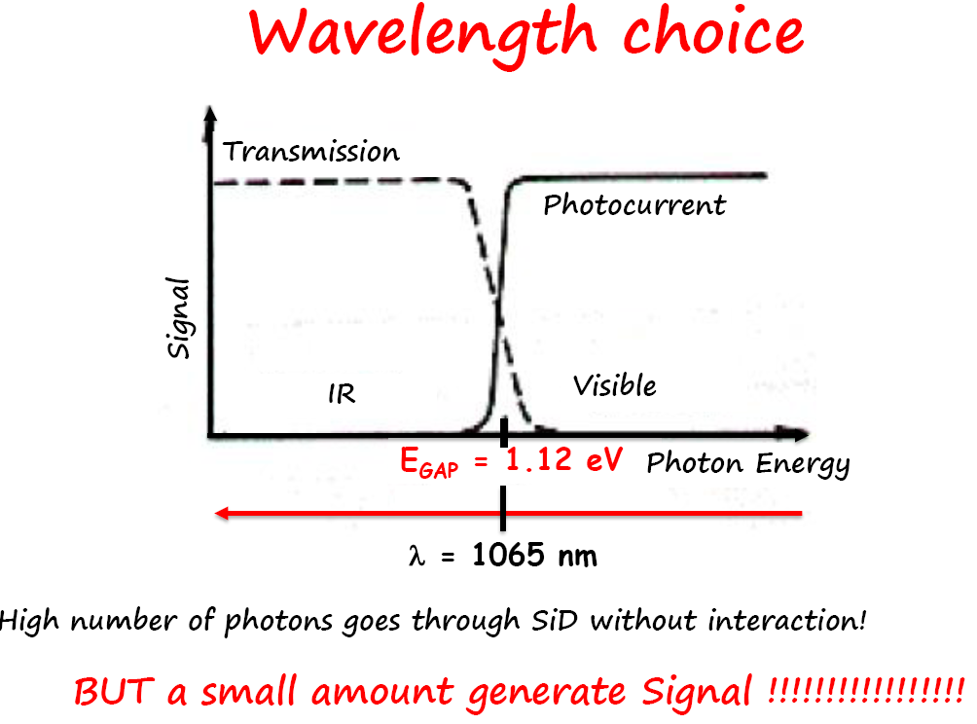
Pulse Laser test station at the Rome Laboratory (2)

Slide 19
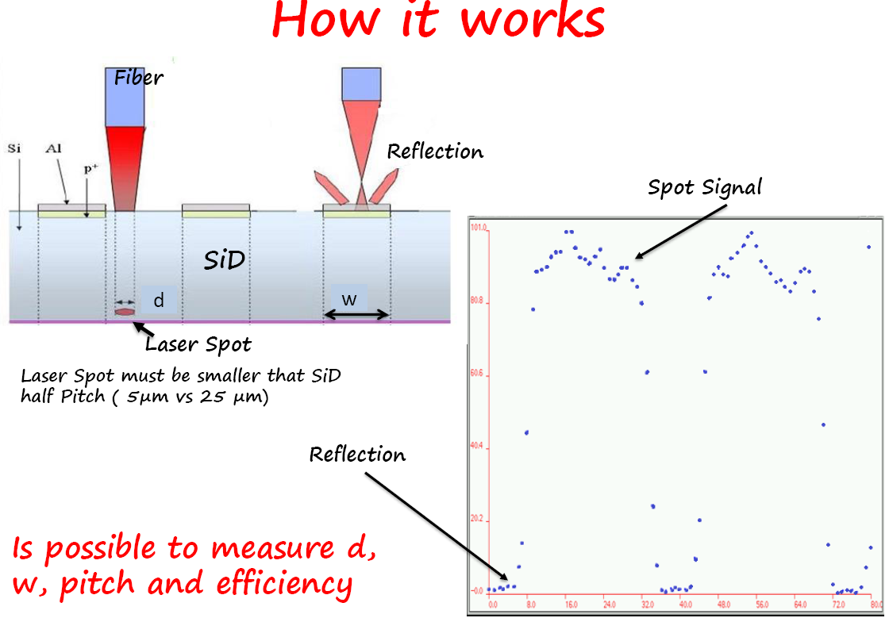
Pulse Laser test station at the Rome Laboratory (3)
The test station is ready and will operate as soon as it will be validated by the Rome Physics Department Laser Safety Officer (LSO)

Slide 20
Future Activities:
Production at the INFN Bari clean room.
The INFN-Bari is taking over the automatic wirebonding of silicon microstrip detector.
Tests on dummy detectors and spare PCBs already performed succesfully. Tests on glues and resins on dummies already succesfully too.
The transportation of wirebonded PCB + detector dummy systems SUCCESFULLY tested the new transportation system.

Slide 21
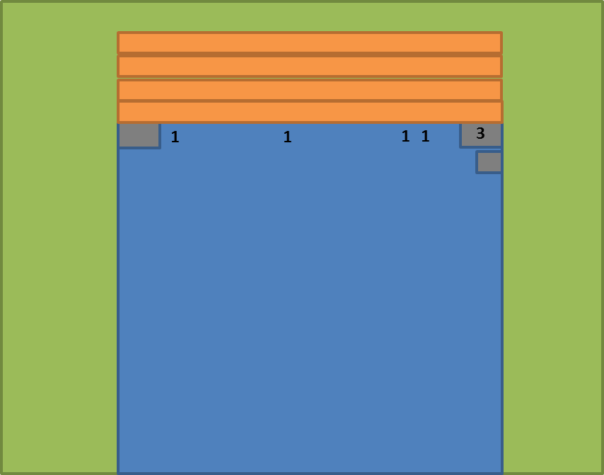
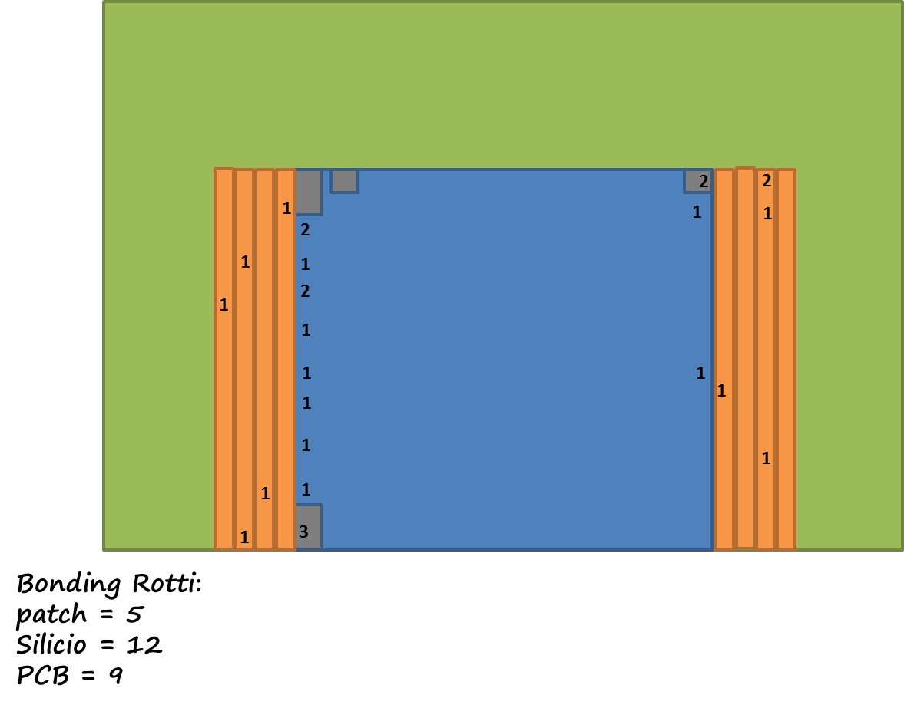
Visual inpsection of a plane Y and of a plane X wirebonded with an automatic machine at Bari and delivered (by courier) to Rome
Broken bondings: (out of 5500 bondings)
patch = 3
Silicio = 4
PCB = 0
Broken bondings: (out of 5500 bondings)
X Plane Detector
Y Plane Detector

Slide 22
Schedule:
- End of june 2017: production of a detector wirebonded to a PCB with reduced ground plane area in order to test the PCB noise. The test results will be compared with the ones obtained with a new X plane detector to be wirebonded to a «standard» PCB.
- End of July (September) 2017 : production of final silicon microstrip detectors wirebonded to their PCBs, and their tests. Step expected to be completed by August 2017, unless significant improvements are observed with the PCB with reduced ground plane area (see item above). In this case, the production of new reduced ground plane PCBs will shift the final silicon microstrip detector production to October 2017
- December 2017: construction of the final trasportation system for delivering the silicon detectors to Jlab.

