Slide 1

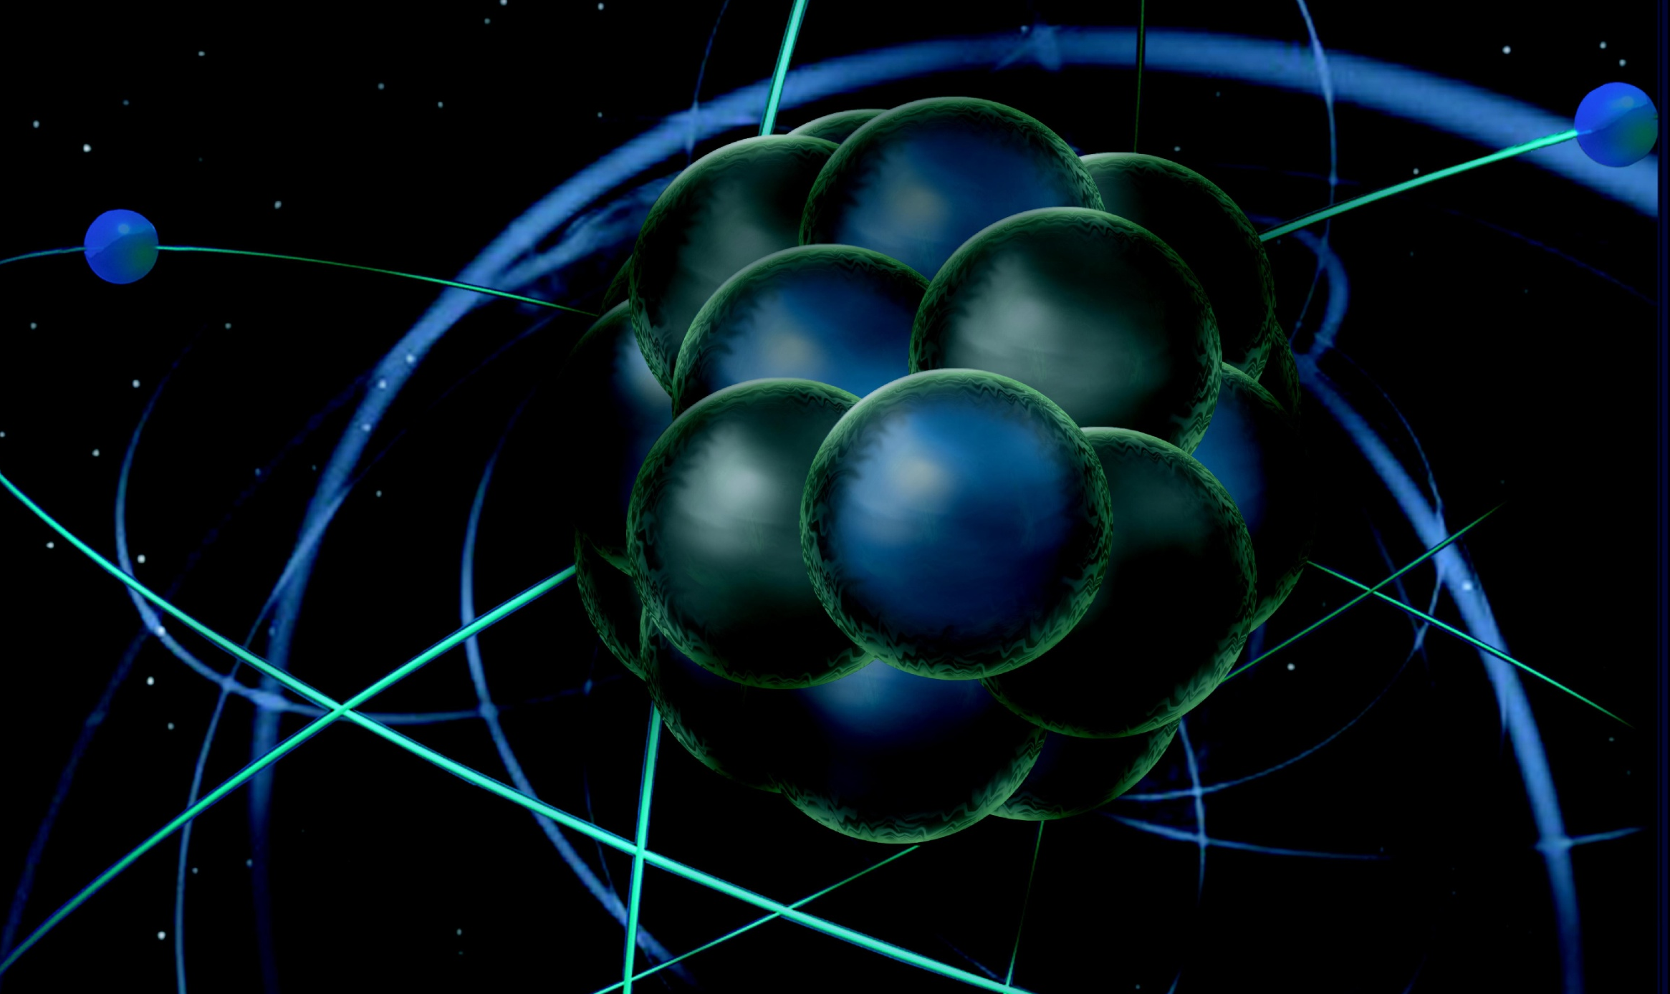
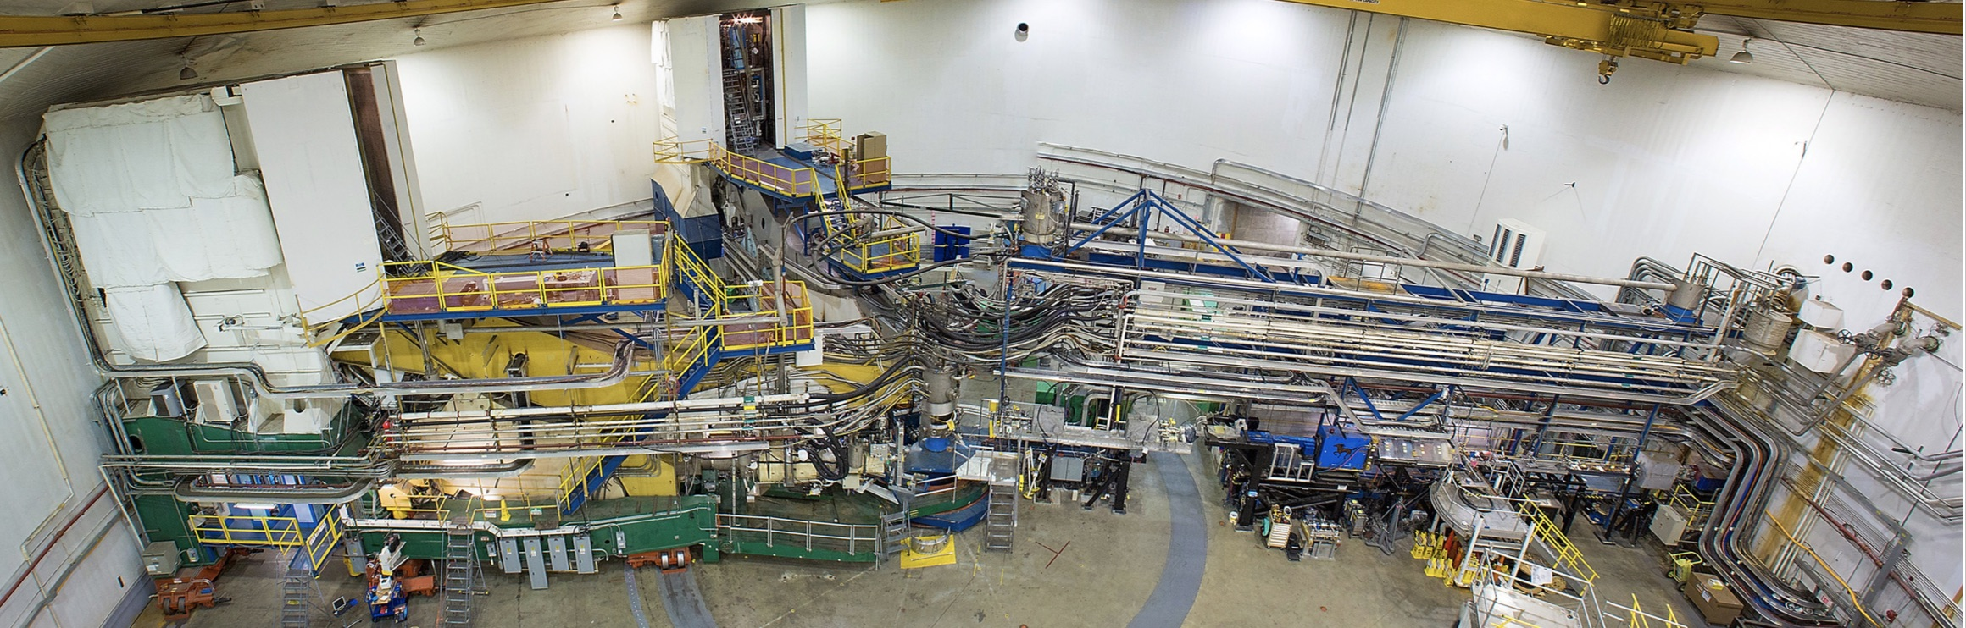
Pion Tagged Deep Inelastic Scattering
Thia Keppel
SBS Collaboration Meeting
August 2019
Notes:
1

Slide 2
Tagged Deep Inelastic Scattering (TDIS)
Semi-inclusive deep inelastic scattering technique
  but not to access the current regime
“Tagging” facilitates effective targets not readily found in nature
Tagged DIS provides novel probe of partonic structure of these effective targets
Three examples:
Neutron
Pion
Kaon (Rachel’s talk)
SBS Collaboration Meeting
August 2019

Slide 3
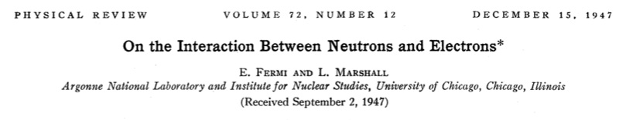

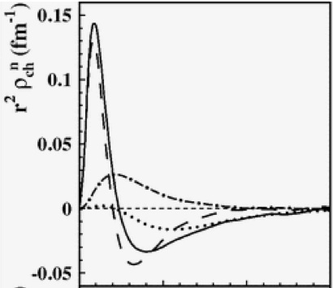
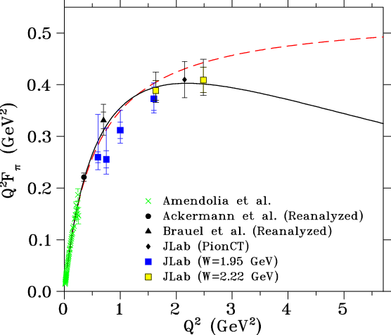
Abundant Evidence for Some Mesonic Content of the Nucleon
Neutron Charge Density
Pasquini and Boffi, Phys. Rev. D 76, 074011 (2007) Kelly, Phys. Rev. C 66, 065203 (2002)
Pion Form Factor
Blok et al., Phys.Rev. C78 (2008) 045202
Partially conserved axial current, chiral quark models, vector meson dominance models - substantial, successful theory development
In contrast, scant experimental data – do not know magnitude of mesonic content
How does mesonic content affect structure functions, parton distributions?

Slide 4
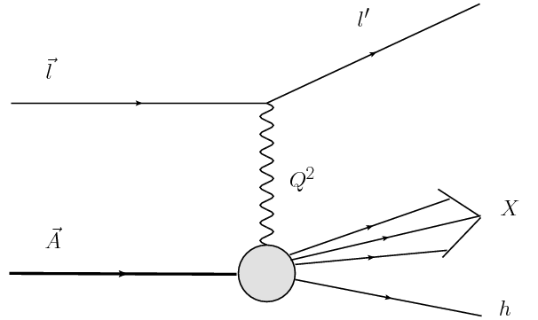
Tagged Deep Inelastic Scattering:
Basic Experimental Approach
incoming electron
detect scattered electron
DIS event – reconstruct missing mass W, and also M_{X}, of undetected recoiling hadronic system(s)
incoming target
A or N
This is the “tag”!
N’
Describe with standard DIS variables x_{Bj}, Q², W², plus:
M_{x} = mass of system X
t = four-momentum transfer squared at the nucleon vertex
detect outgoing target nucleon

Slide 5
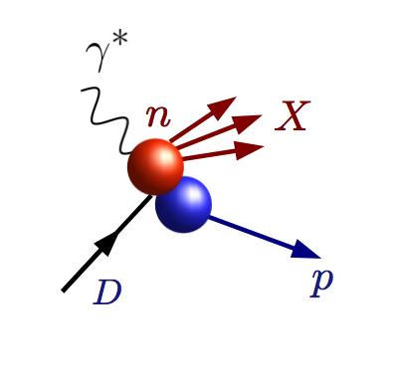
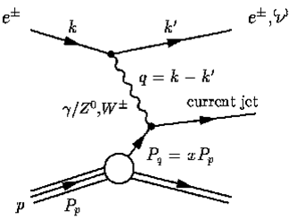
Example 1: TDIS to access neutron valence structure
”BONuS” Experiment at Jefferson Lab – use fixed target tagging to create an effective free neutron target
Measure DIS electron in coincidence with proton tag
n
p
“Hard” scattering inelastic event (high Q, W)
Proton remains intact
Low momentum proton = nucleons barely off shell
Neutron target!
p
Deuteron Target

Slide 6
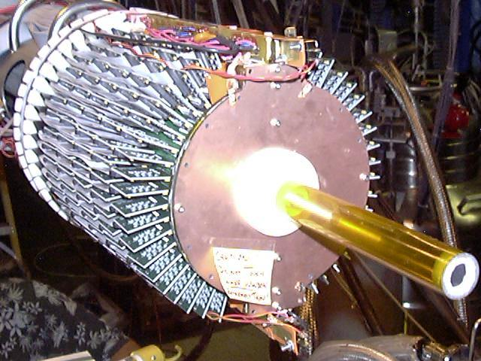
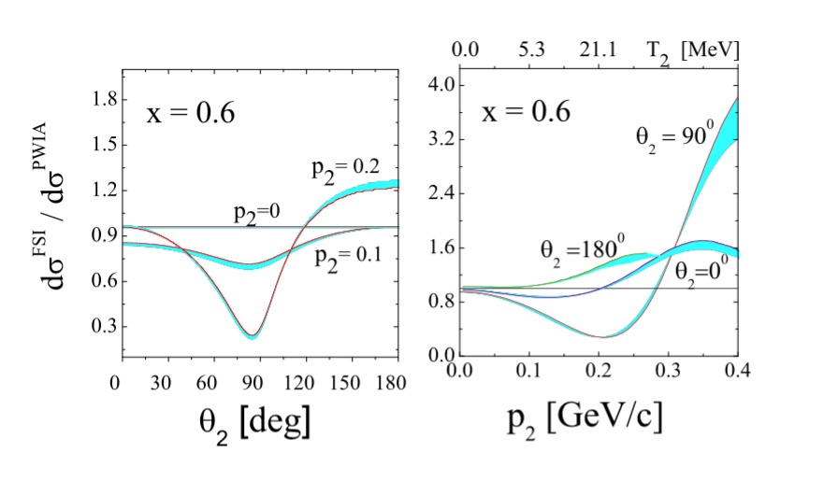
The BONuS experimental approach: use low mass radial TPC detector / target in magnetic field to TAG “spectator” proton at (very) low momenta (~65 MeV/c) and large angles (> 90º in lab) ….difficult but doable
Bound / free neutron structure
O (1%)
V. Palli, C. Ciofi degli Atti, L.P. Kaptari, C.B. Mezzetti, M. Alvioli
Phys.Rev. C80 (2009) 054610
W. Melnitchouk et al, Phys. Lett. B 335(1994) 11
(updated 2010)
Final state interactions
O (5%)

Slide 7
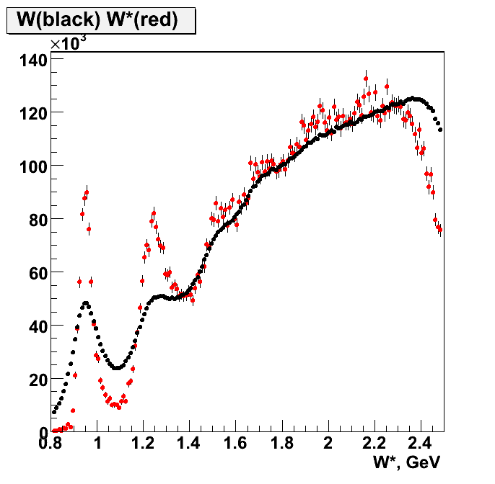
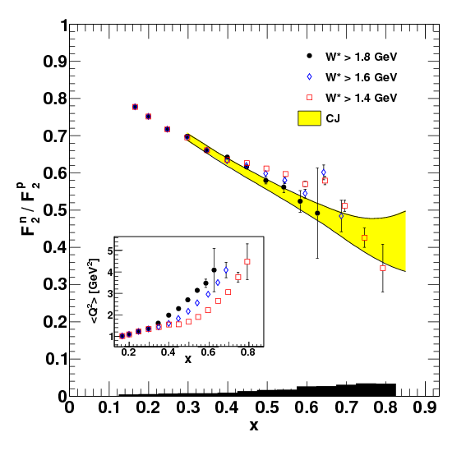

BONUS effective neutron target via TDIS achieved!
Textbook Physics
E = 4.223 GeV
F₂^{n}/F₂^{p}
F₂^{D}
F₂^{n}
<Q²> = 1.19 (GeV/c)²
Nucl. Instrum. Meth. A592 (2008) 273-286
Phys. Rev. Lett. 108 (2012) 199902
Phys. Rev. C89 (2014) 045206 – editor’s suggestion
Phys. Rev. C92 (2015) 1, 015211
Phys. Rev. C91 (2015) 5, 055206
> 200 neutron data points

Slide 8
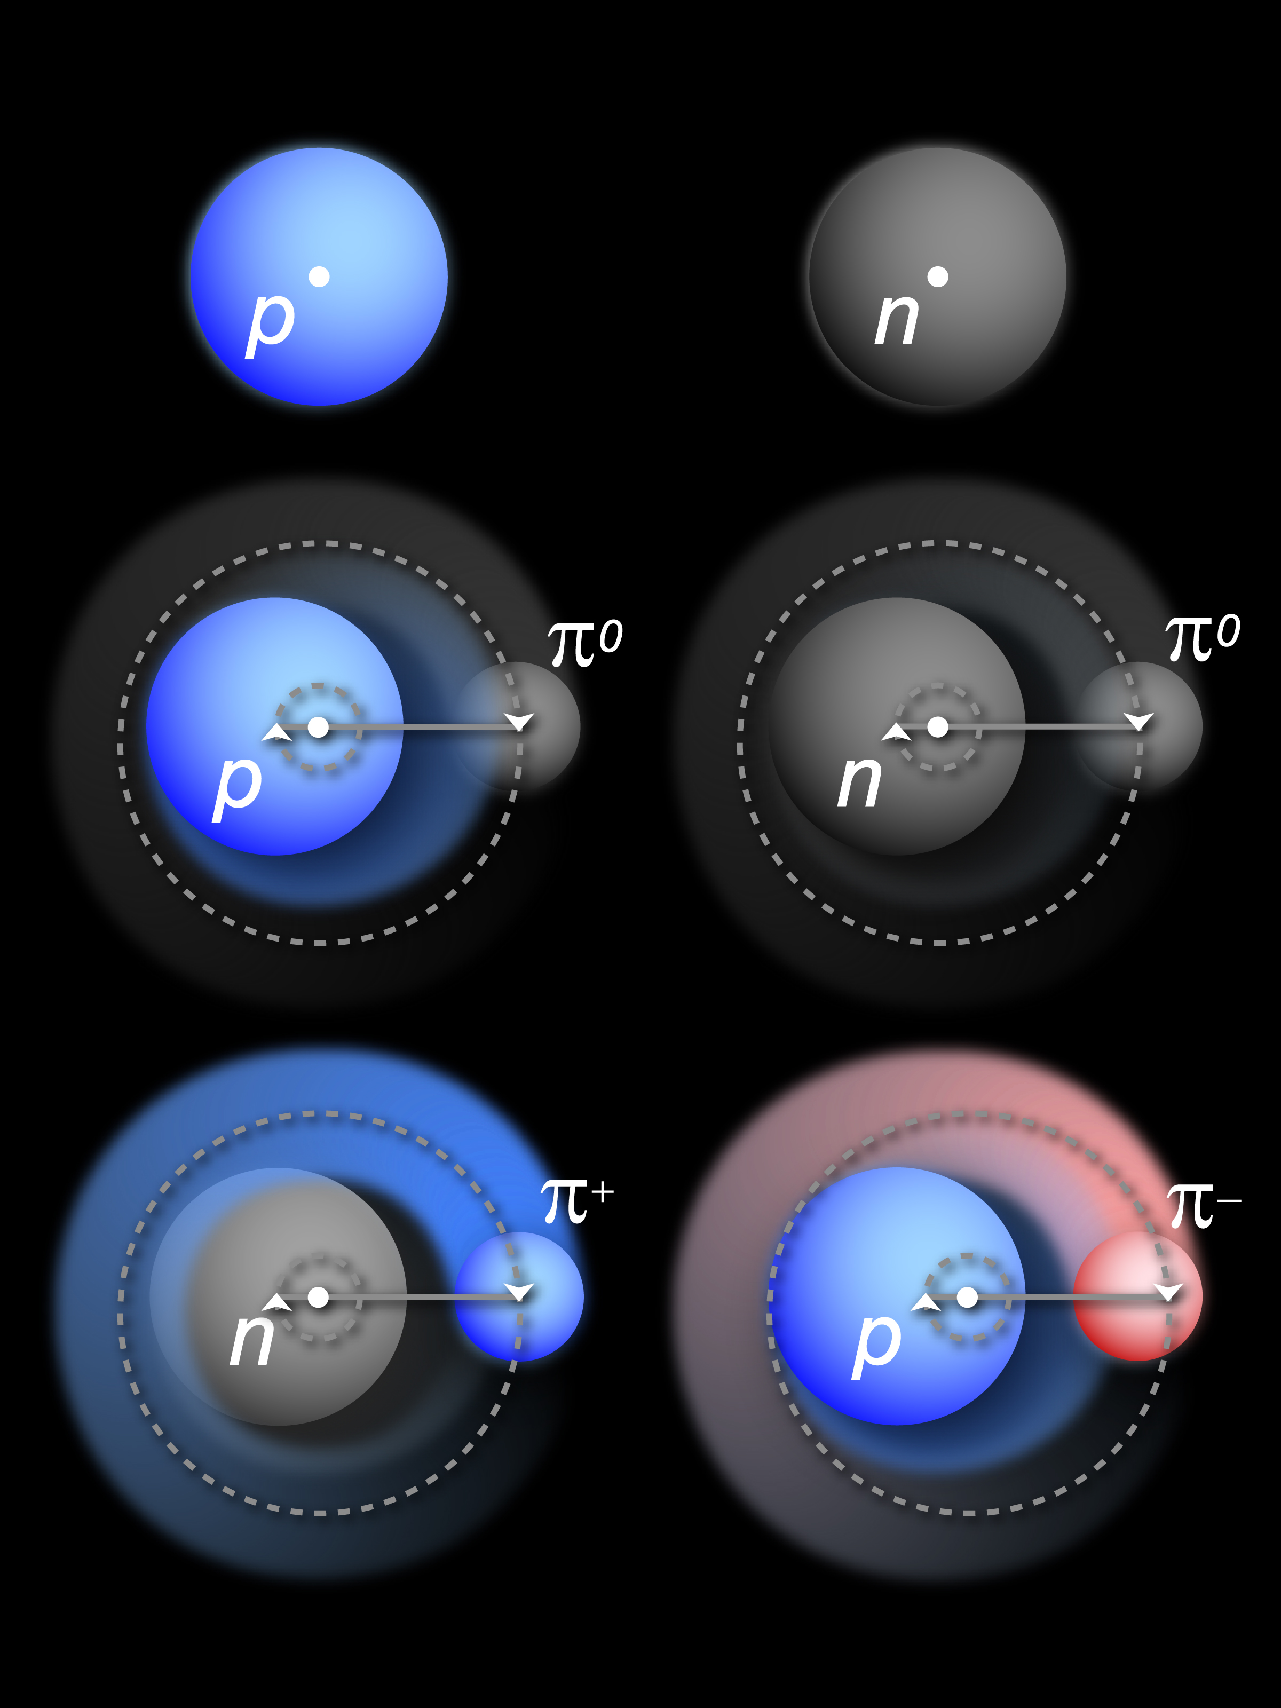
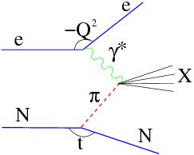
Example 2: TDIS to access pion structure function
- use Sullivan process scattering from nucleon-pion fluctuation
detect scattered electron
incoming electron
DIS event – reconstruct x, Q², W², also M_{X} (W_{π}) of undetected recoiling hadronic system
pion target (undetected)
Initial state nucleon
tagged outgoing target nucleon
t = four-momentum transfer squared at the nucleon vertex

Slide 9
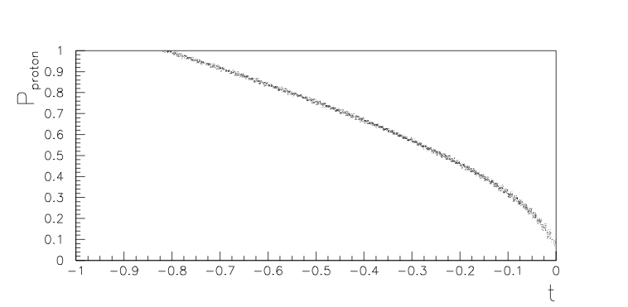
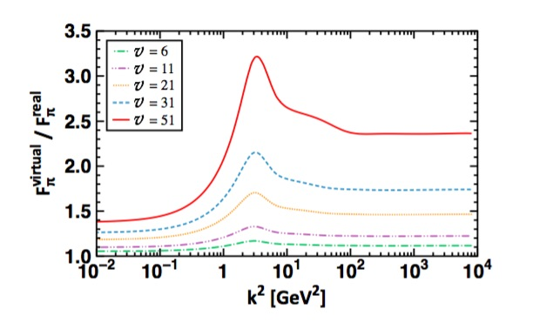
p_{p}
^{Extrapolation}
^{to the pole}
Need range of low momentum protons
The ratio of off-shell to on-shell pion electromagnetic form factor
Si-Xue Qin, Chen Chen, Cedric Mezrag, Craig D. Roberts Phys.Rev. C97 (2018) no.1
“…we demonstrated that for v < v_{S} ~ 31, which corresponds to −t < ~0.6 GeV²….the off-shell correlation serves as a valid pion target.”
Within ~10% at JLab TDIS kinematics, best at lowest t values
GeV/c
~100
MeV/c
Like BONUS, a challenging low p proton tag experiment

Slide 10
TDIS+BONUS Technique Provides
Sullivan Process scattering from neutron-pion fluctuation
detect scattered electron – large acceptance a plus
Incoming electron – Signal is orders of magnitude smaller than inclusive DIS – need high luminosity
DIS event – reconstruct x, Q², W², also M_{X} of undetected recoiling hadronic system
Want charged pion target (undetected)
need fluctuating nucleon to be a neutron…….
…..for detected nucleon to be a proton
p
p
detected spectator proton tags neutron target (BONUS experiment technique)
neutron in deuteron target
Detected protons need to be low momentum
- Tag target hadron
- Extrapolate to pole
Barely off-shell neutron
detecting two protons with common vertex in coincidence tags “pion” target!
Note: only need one p for hydrogen target

Slide 11
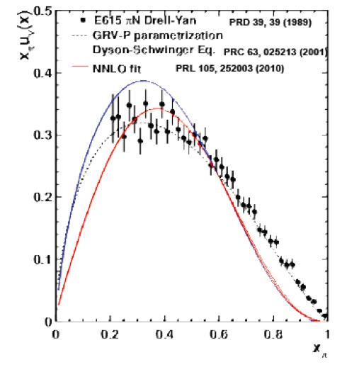
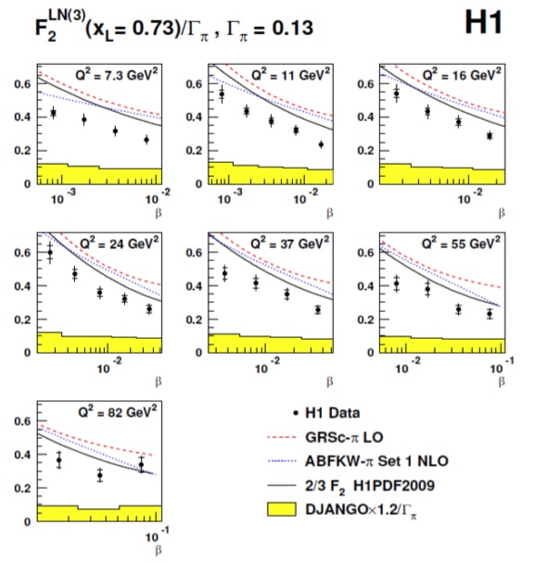
Pion Structure Function Measurements
Knowledge of the pion structure function is very limited:
  HERA TDIS data - at low x
  Pionic Drell-Yan from nucleons in nuclei - at large x
x_pi
Initial observations:
PDF ~ (1-x_{π}) as x_{π}->1
Agrees with structureless model
Differs from pQCD prediction of (1-x_{π})²

Slide 12
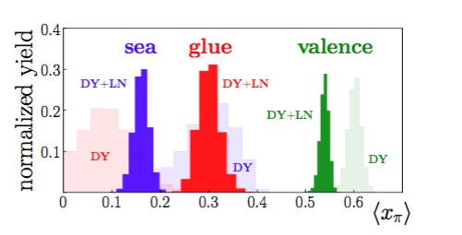
Web-based Self-Serve Pion PDF: More Large x Concern
From combined HERA TDIS Leading-Neutron and Drell-Yan analysis…
Web-based self-server performs a combined data analysis – can test sensitivity to new data
Github: https://github.com/JeffersonLab/jamfitter
Jupyter notebook: https://jupyter.jlab.org/
P.C. Barry, N. Sato, W. Melnitchouk, C-R Ji
arXiv: 1804.01965 (2018)
Tension at large x!
Need new data!
Notes:
12

Slide 13
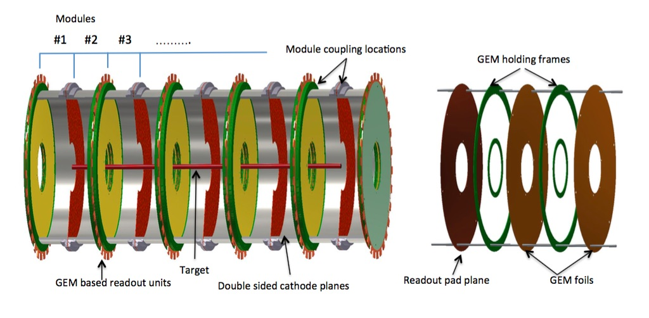
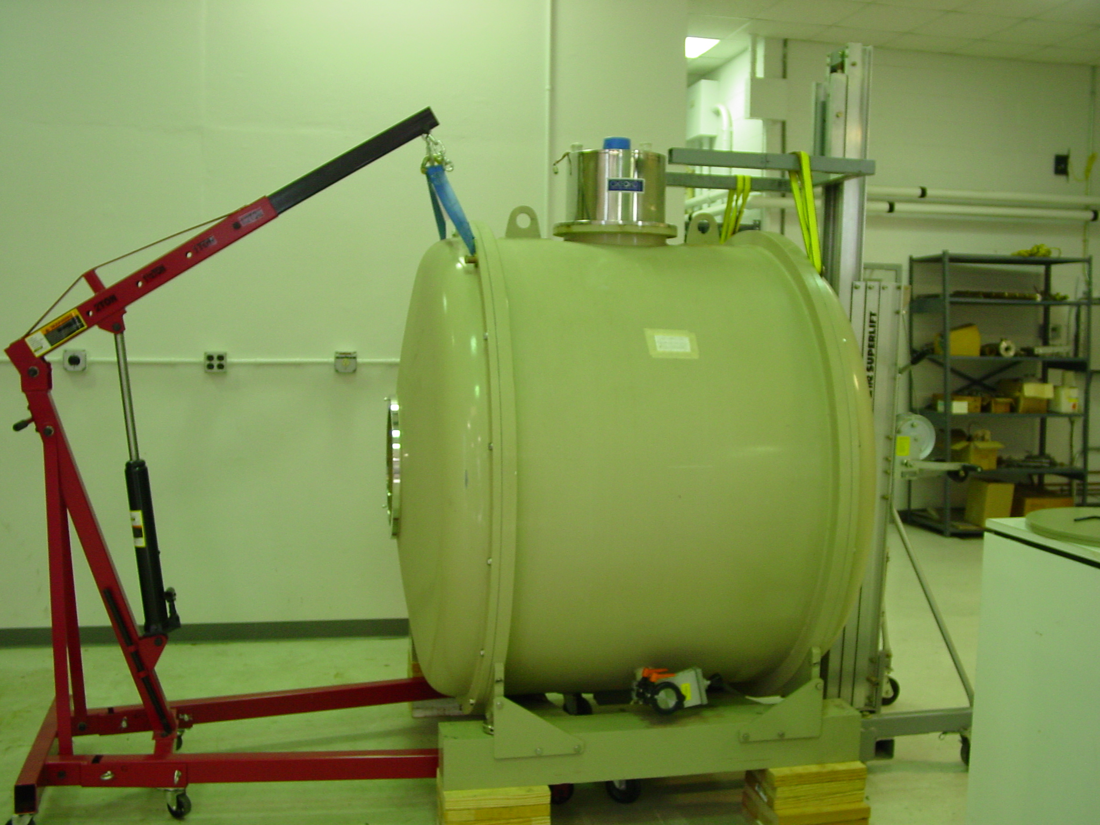
JLab Hall A TDIS Experiment
Hall A with SBS:
High luminosity,
50 μAmp,
L = 3x10³⁶/cm² s
Large acceptance
~70 msr
Important for small cross sections
proton tag detection in GEM-based mTPC at pivot
e- beam
mTPC inside superconducting solenoid
Scattered electron detection in Super Bigbite Spectrometer (SBS)

Slide 14
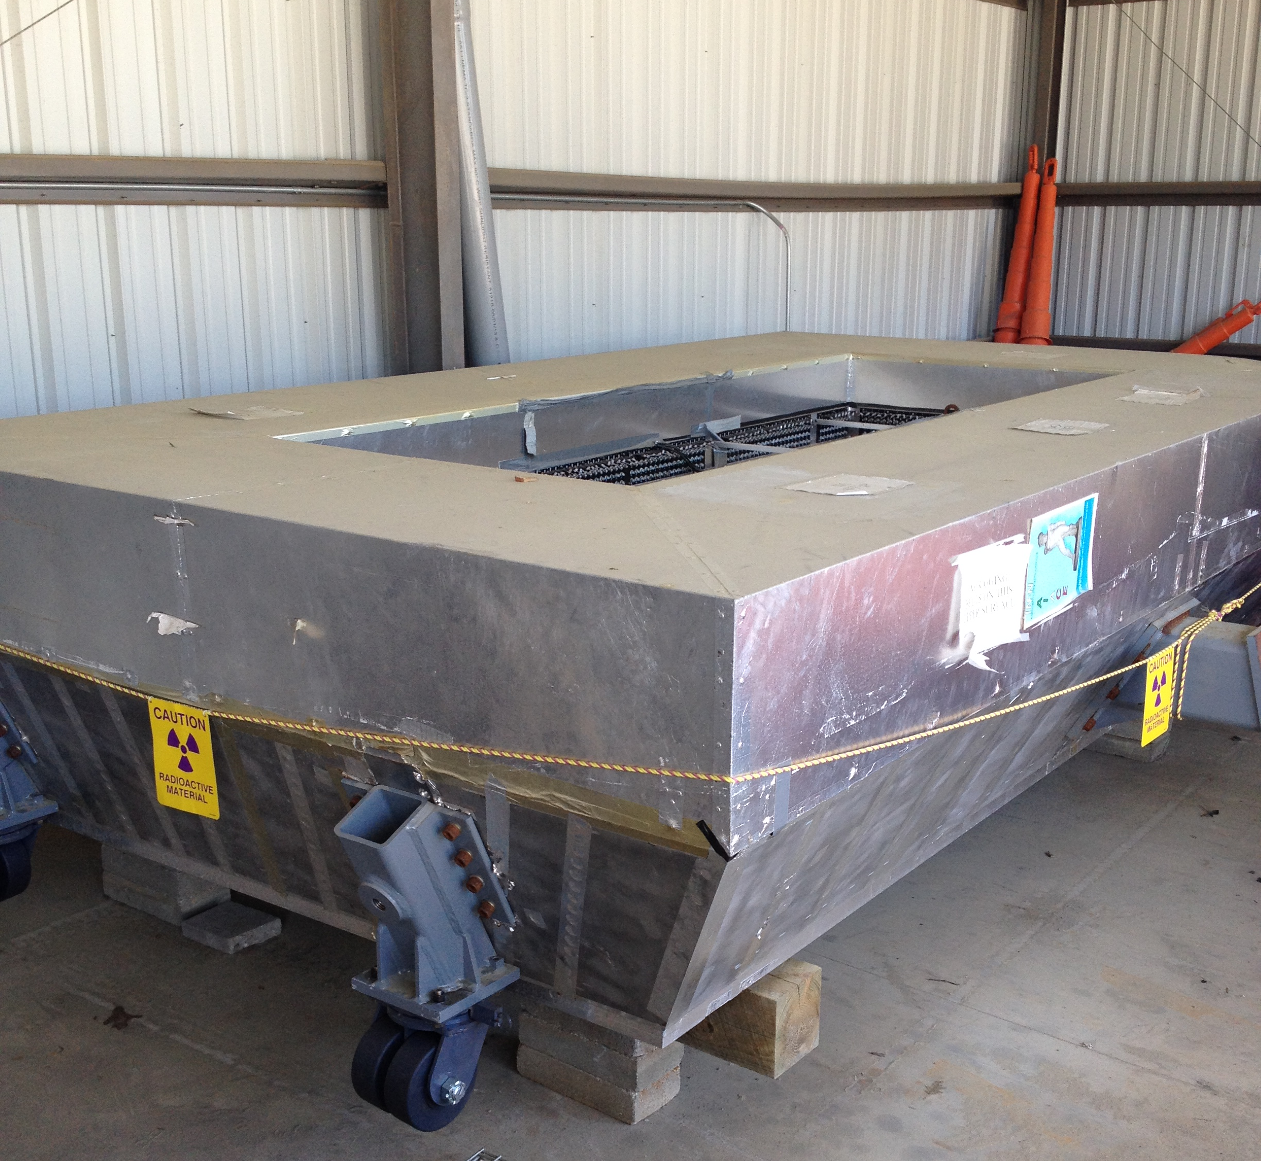
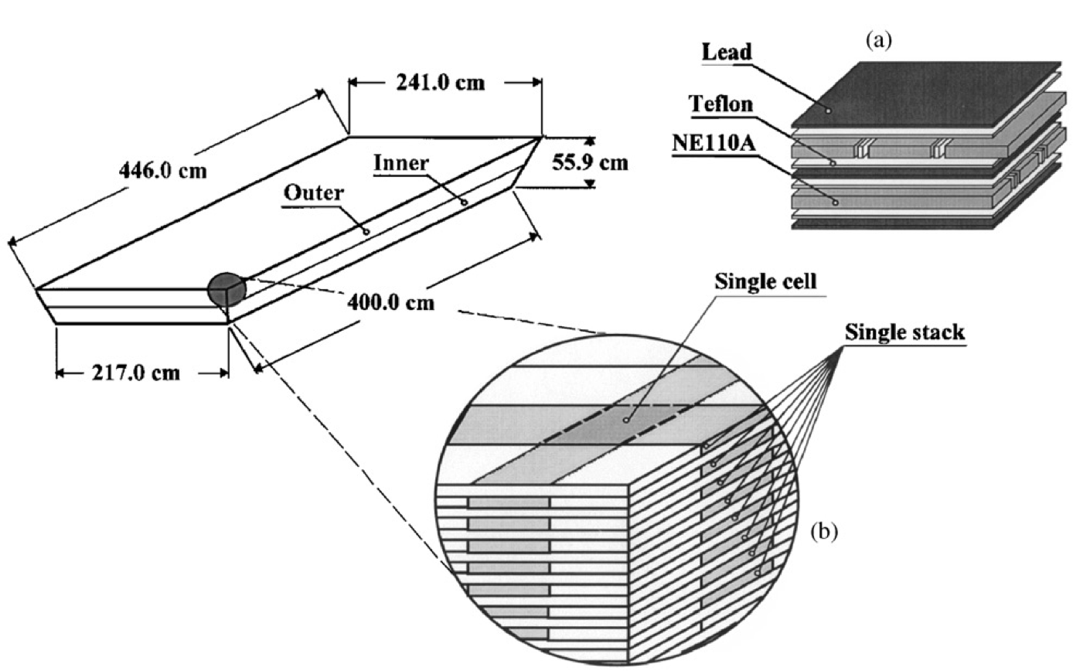
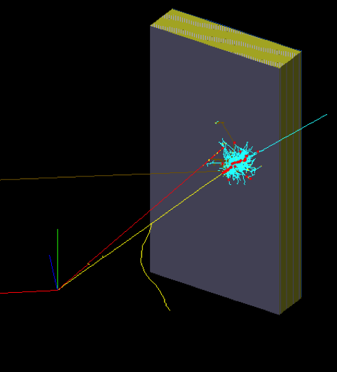
SBS Electron Detection
MSU refurbishing in ESB
CLAS6 Large Angle Calorimeter
NIM A 537 (2005) 562
217 cm x 400 cm active area
33 layers (17 + 16)
Time resolution ~ 0.25 ns
Energy resolution 7.5%/E^{1/2}
π⁻ rejection factor ~ 10-20
GEANT simulation
SBS SIDIS (HERMES) RICH
Gas radiator: C₄F₈
Group small PMTs, TDC readout
N_{ph.e}. ~ 12 in the 5x5 PMT group
NIM A479 (2002) 511
Combine to form electron trigger
+ electron PID
aerogel
1.5 GeV π-
14.6 GeV e-

Slide 15
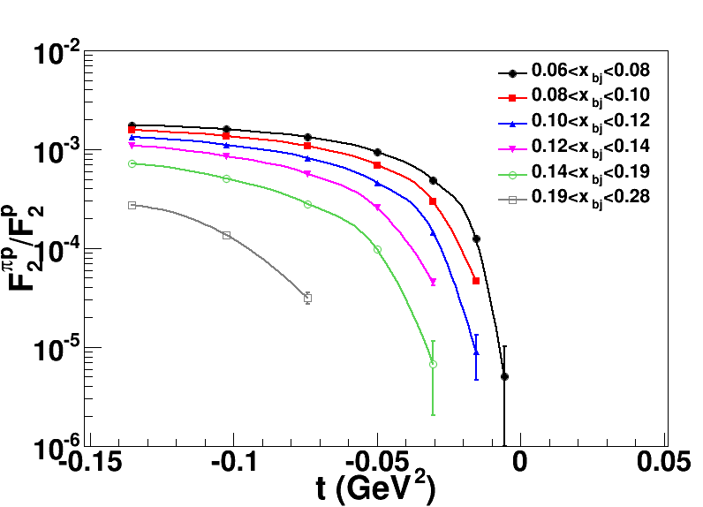
Projected Results – Pion Structure Function from TDIS at JLab
- Large x structure of the pion is of particular interest, verify (?) resummed Drell-Yan results
- Large x, low Q complementary to HERA low x, high Q via evolution
Projected data in x_{π}
J. R. McKenney, et al., Phys. Rev. D93 (2016), 054011
T. J. Hobbs et al, Few Body Syst. 56 (2015) no.6-9
Low t extrapolation to the pion pole

Slide 16
Status
C2 approval
- Physics rating, days approved – no need to return to PAC
- Full approval requires passing laboratory technical review
Concerns:
  Thin, cold target – now room temperature (D. Dutta)
  (Nitrogen) cold detector (K. Gnanvo, N. Liyanage)
  High rate data acquisition and tracking
    New detector design (K. Gnanvo, N. Liyanage)
    Simulation (J. Annand, E. Fuchey, R. Montgomery, A. Tadepalli)
    Streaming data acquisition (E. Jastrzembski, E. Pooser)
    Tracking (R. Montgomery, A. Tadepalli, S. Wood)
More going on (LAC, magnet,…) and more people helping – just a snapshot!
SBS Collaboration Meeting
August 2019

Slide 17
Summary
TDIS provides unique access to effective neutron, pion, kaon.. targets
- Nucleons and mesons are the basic building blocks of matter.
- Critical, fundamental hadron structure measurements!
TDIS can directly probe the meson cloud of the nucleon
- Direct measurement of nucleon-meson fluctuation component of DIS
- Access pion and kaon structure functions
Very few experiments to date
- Neutron at JLab BONUS, pion at HERA
- Neutron and pion, also kaon, with SBS TDIS
- TDIS can perhaps also provide a new window on neutron DVCS, perhaps highest Q n/p, other ideas?….
Challenging measurement - working towards full approval
SBS Collaboration Meeting
August 2019

Slide 18
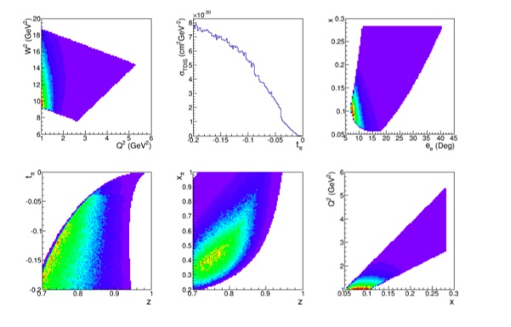
TDIS Kinematics – optimized for meson cloud
High W²
- High M_{x}²
- DIS!
All data obtained simultaneously at one E = 11 GeV setting, only a target change – will run hydrogen and deuterium (neutron)
Low t, high (1-z)
x range ~ 0.1
1 < Q² < 2 GeV²

