Slide 1
BigBite Detector Integration
(bringing GEMs, GRINCH, Preshower, Hodoscope, and Shower together)

Slide 2
BigBite Highly Cited Papers
R. Subedi et al., Probing Cold Dense Nuclear Matter, Science 320 (2008) 1476. (263 citations) [JLab / Proton Arm ]
I. Passchier et al., The Charge Form-factor of the Neutron from the Reaction Pol. D(pol. e, e’n) p, Phys. Rev. Lett. 82 (1999) 4988. (223 citations) [NIKHEF / Electron Arm] ( part of my dissertation research )
X. Qian et al., Single Spin Asymmetries in Charged Pion Production from Semi-Inclusive Deep Inelastic Scattering on a Transversely Polarized ³He, Phys. Rev. Lett. 107 (2011) 072003. (196 citations) [JLab / Electron Arm]
R. Shneor et al., Investigation of proton-proton short-range correlations via the ¹²C(e, e’pp), Phys. Rev. Lett. 99 (2007) 072501. (142 citations) [ JLab /Proton Arm ]
S. Riordan et al., Measurements of the Electric Form Factor of the Neutron up to 𝑄²=3.4𝐺𝑒𝑉² using the Reaction Pol. ³𝐻e(pol. e,𝑒′𝑛)pp, Phys. Rev. Lett. 105 (2010) 262302. (108 citations) [JLab /Electron Arm]

Slide 3
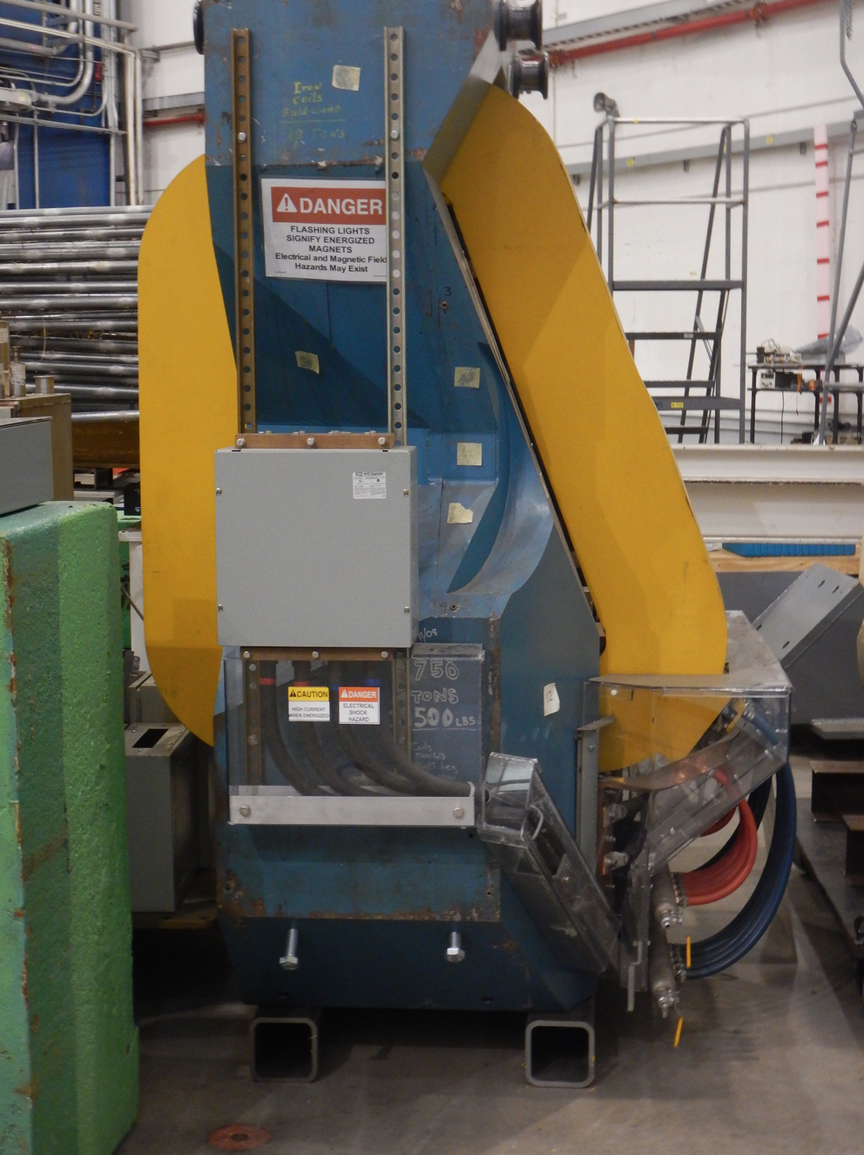
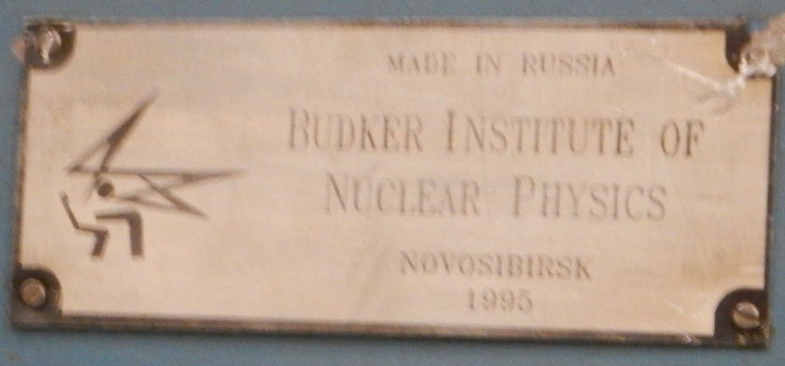
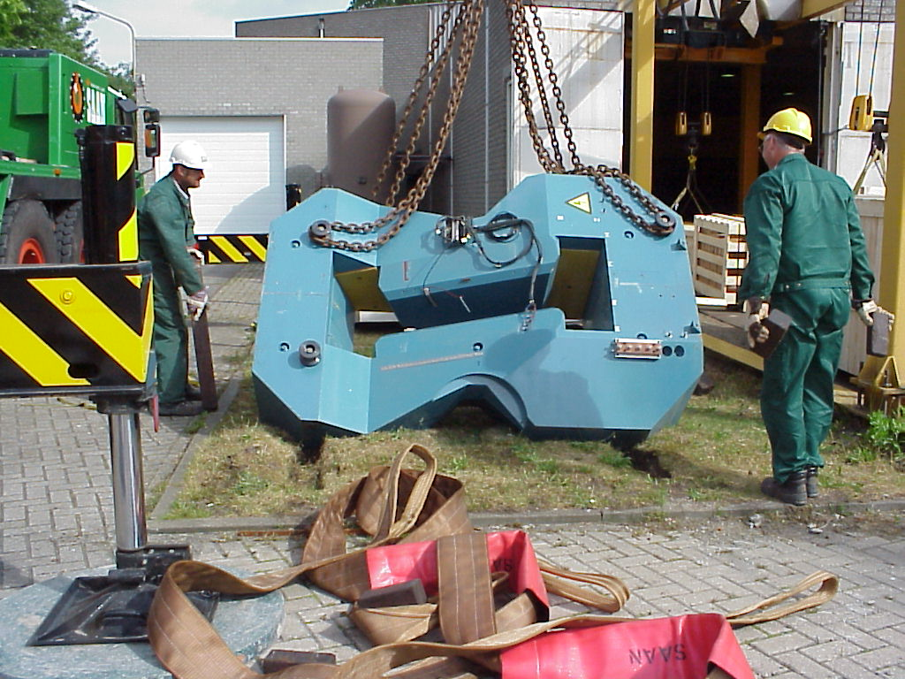
Avoiding The Ship of Theseus Paradox
Is an object which has all its parts replaced still the same object?!
Built in Russian in 1995 by the Budker Institute
Fortunately The BigBite Magnet And The Built in Novosibirsk Label Are Still The Same!

Slide 4
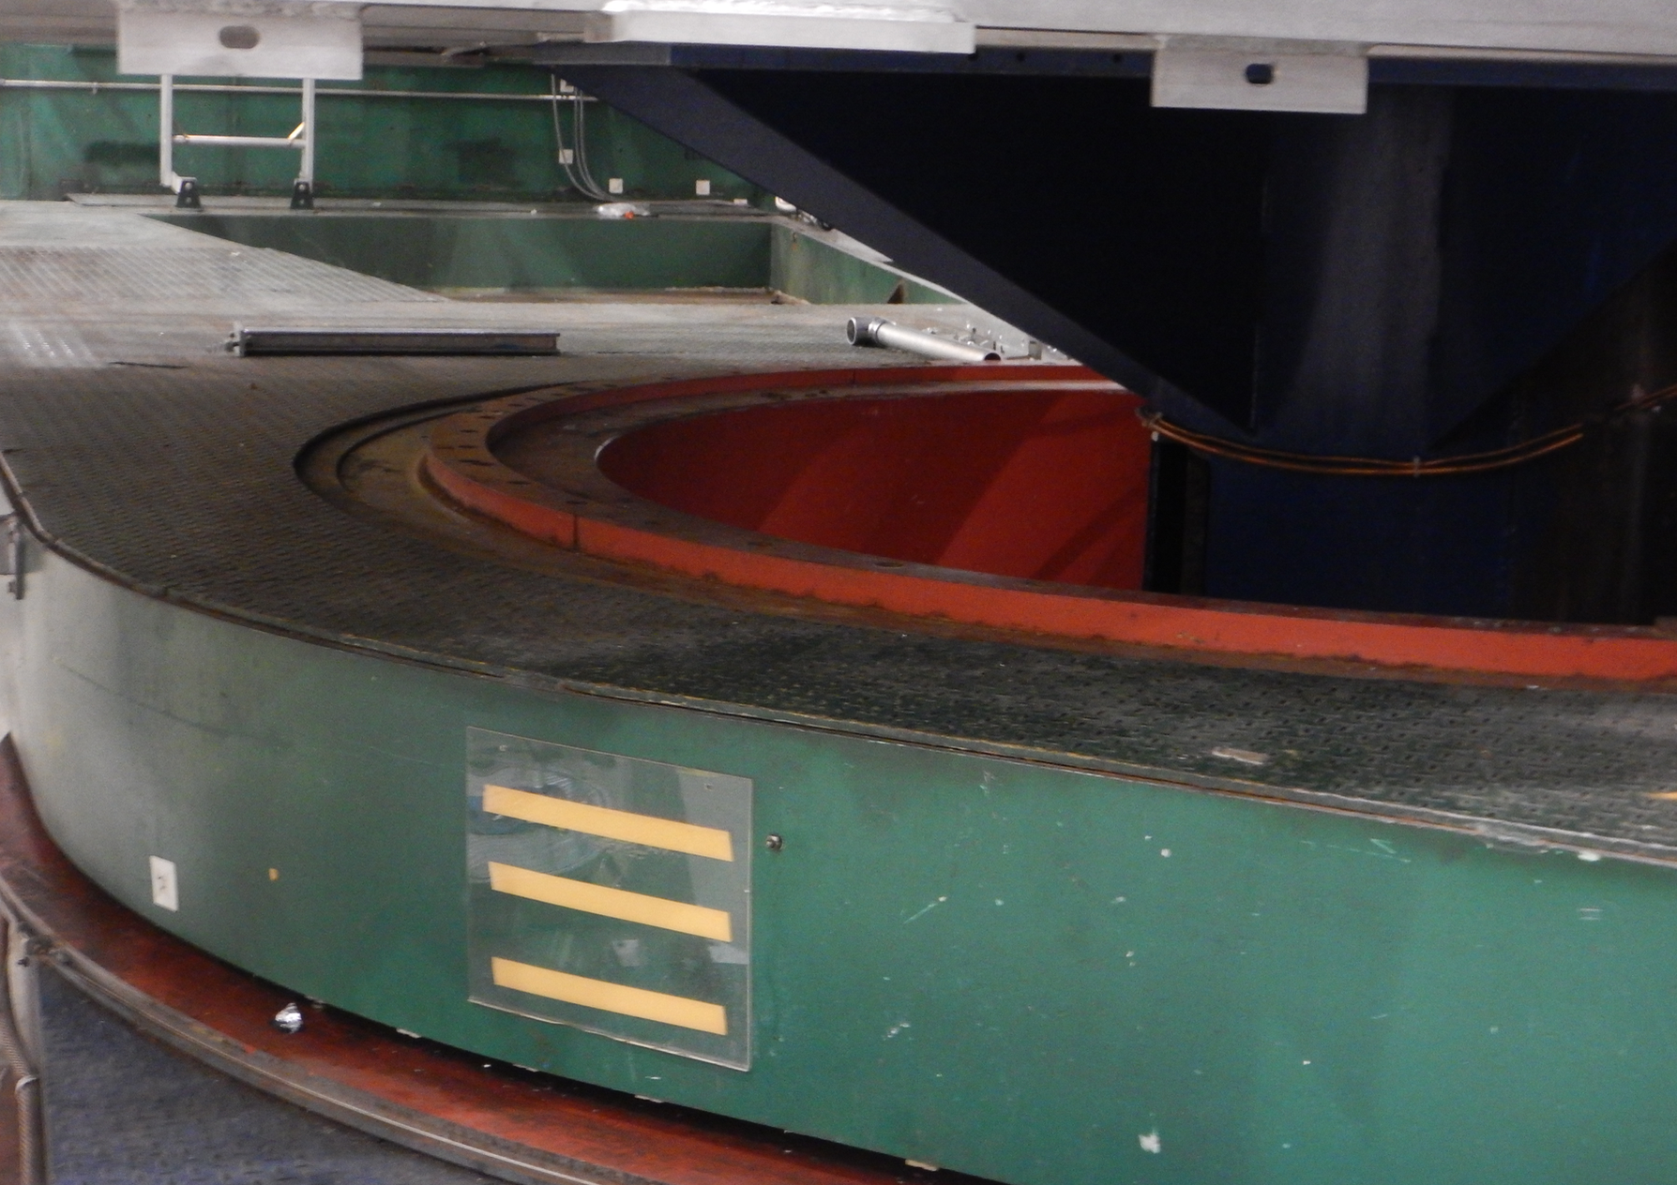
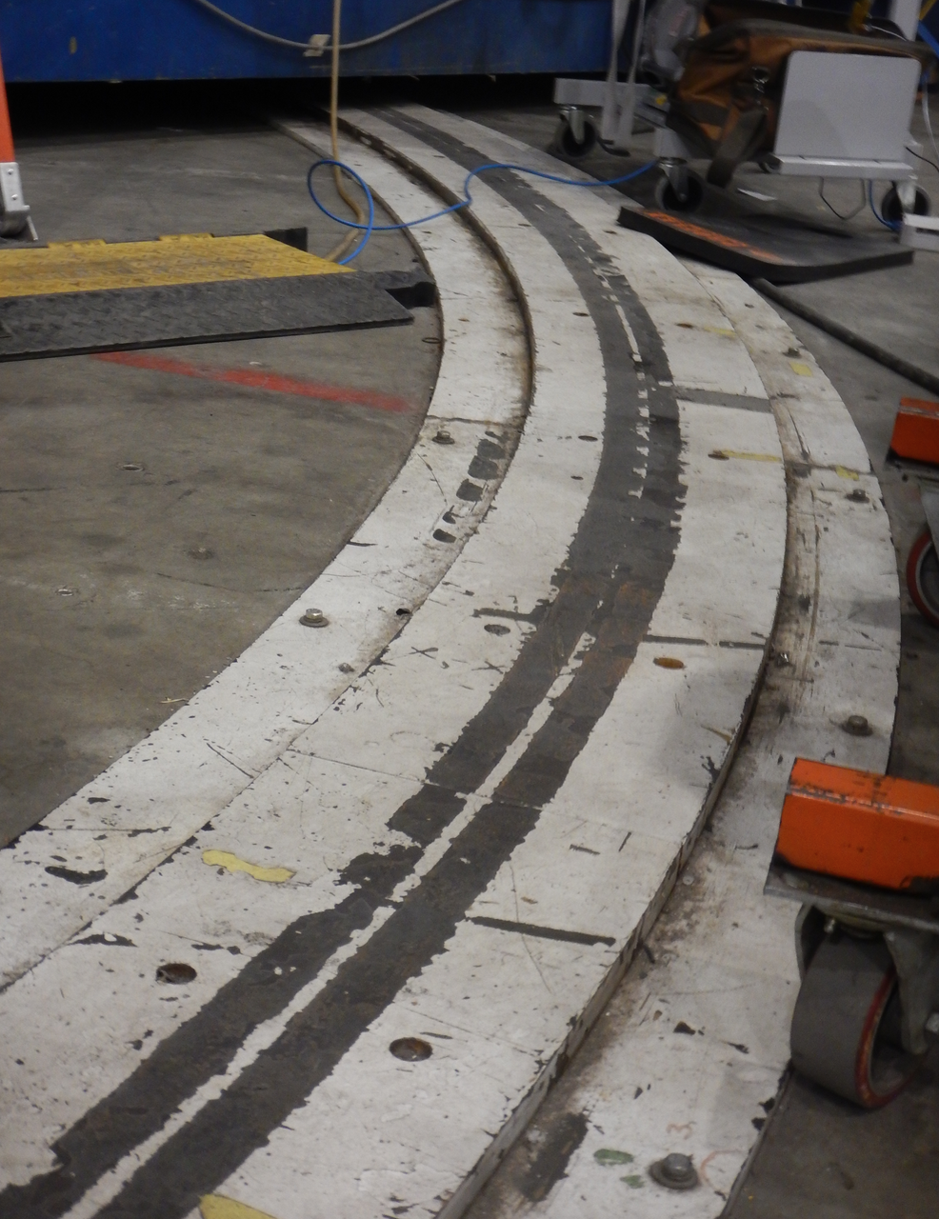
Other BigBite Infrastructure Items
Right side inner rail (top of HRS link) clear.
Outer rail still located on left side
needs to move and be surveyed.

Slide 5
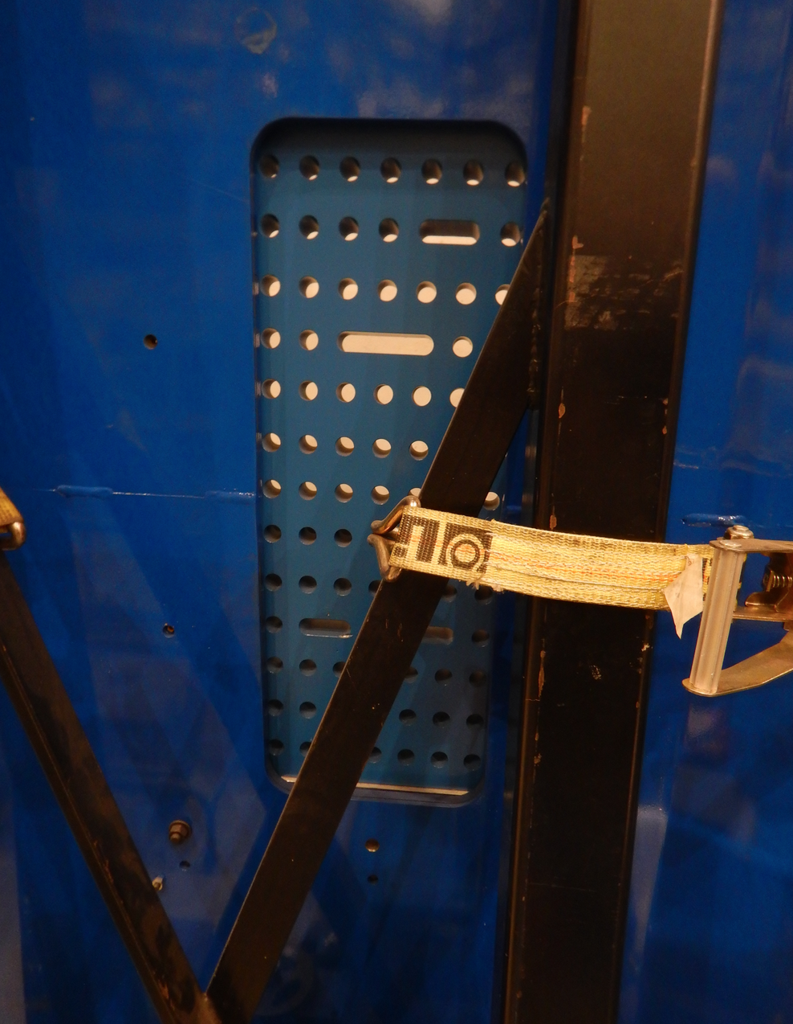
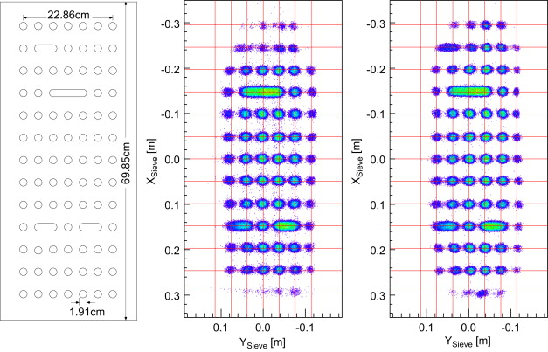
BigBite Sieve Plate
BigBite sieve is currently located in the “Transversity/d2n” field clamp assembly, do we need it moved it to the original NIKHEF field clamp (?)
The sieve is 2” lead and worked well for Transersity/d2n & p/d experiments.
  https://doi.org/10.1016/j.nima.2012.04.085

Slide 6
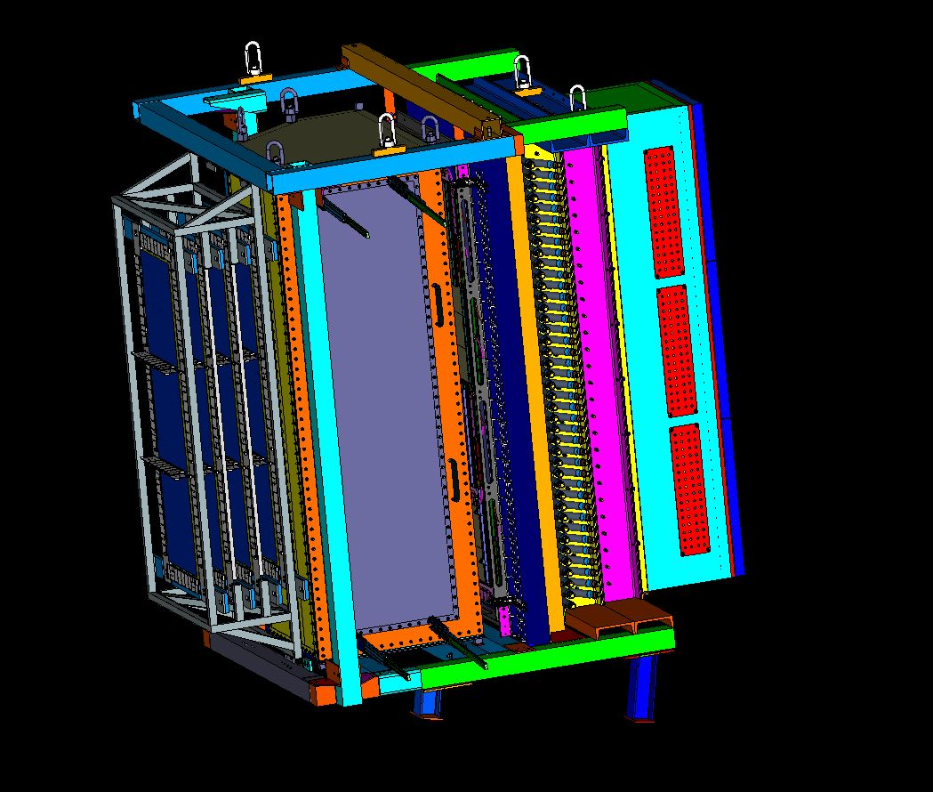
Latest Generation BigBite Package
GEM x 3
Cherenkov
PreSh
Shower
GEM
Hodo

Slide 7
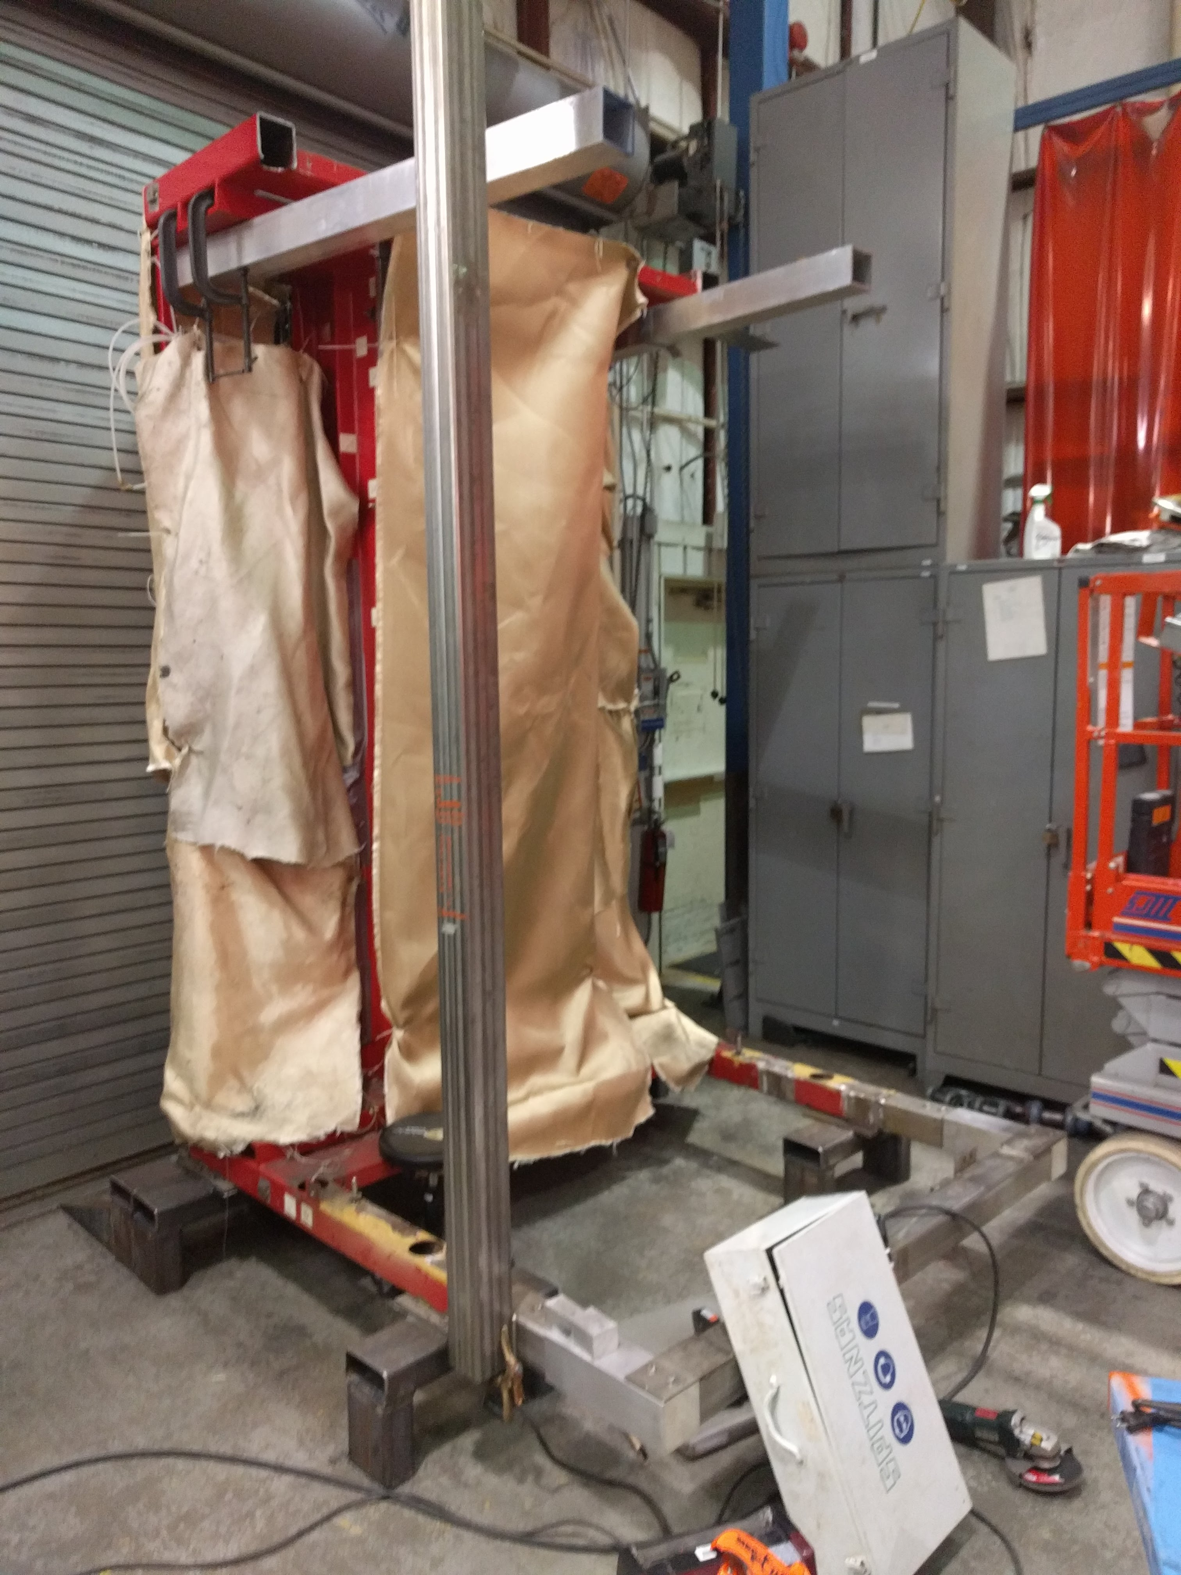
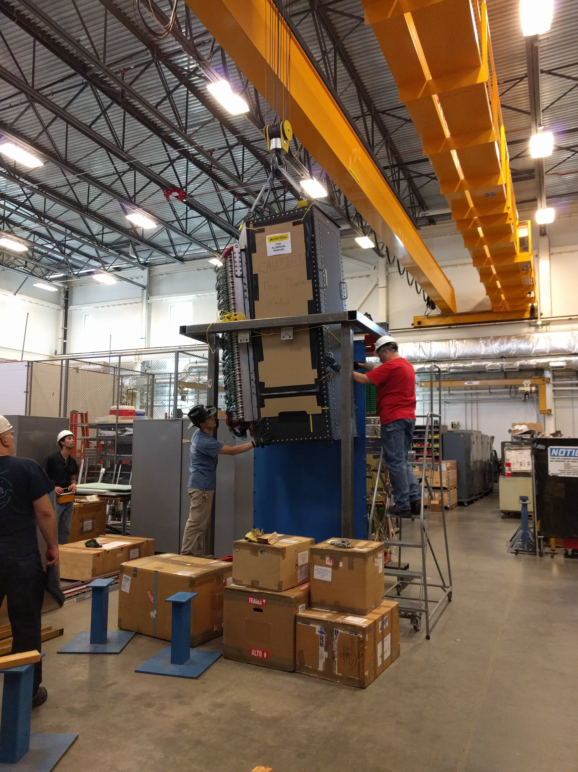
Modification Of Frame For The Grinch
Thanks to the Hall C technical staff for modifying the frame & Hall A staff for installation of Grinch.
( Shower detectors remained in the frame during the modifications. )
During Modification In Hall C Shop
After Modifications With Grinch Being Installed

Slide 8
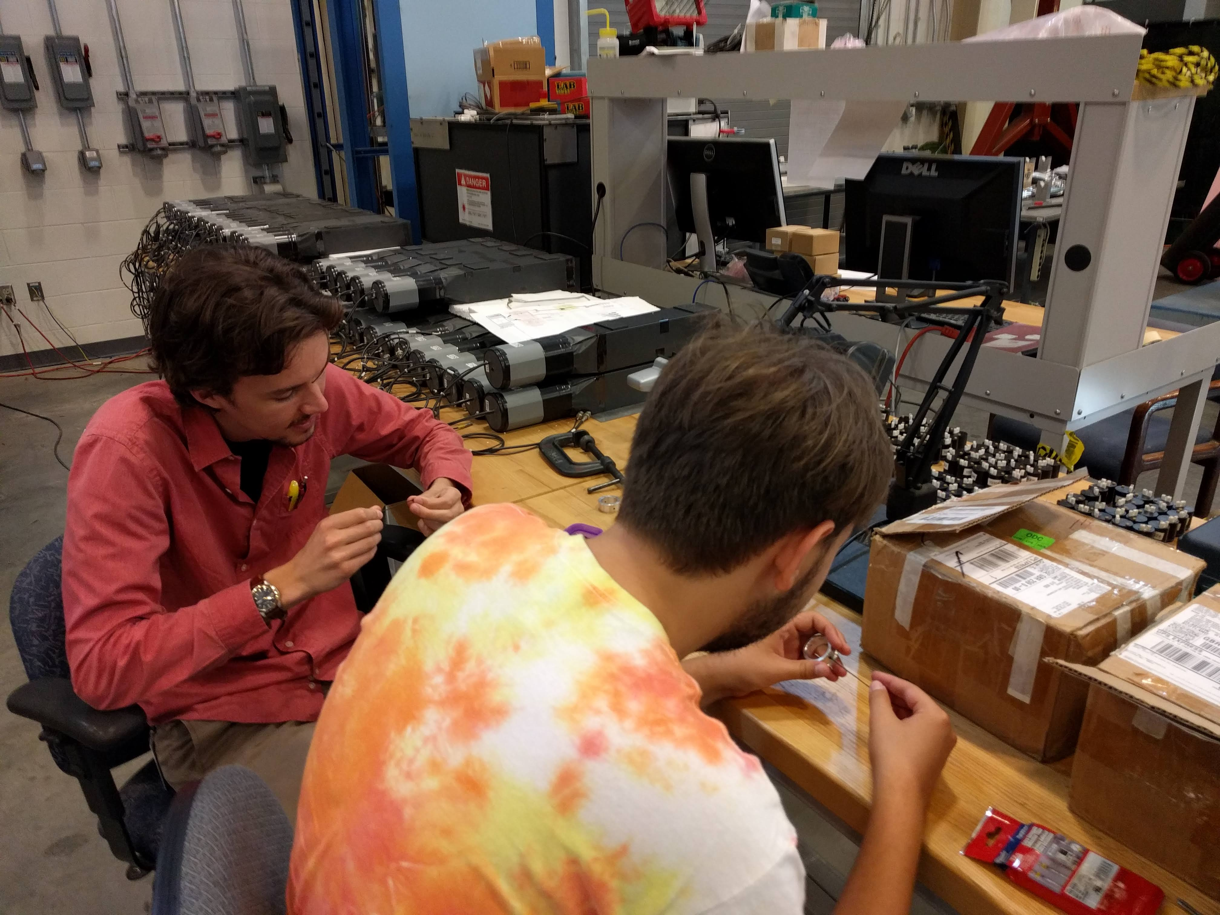
SULI Students Working On Hodoscope
Mentored and trained by the Glasgow group

Slide 9
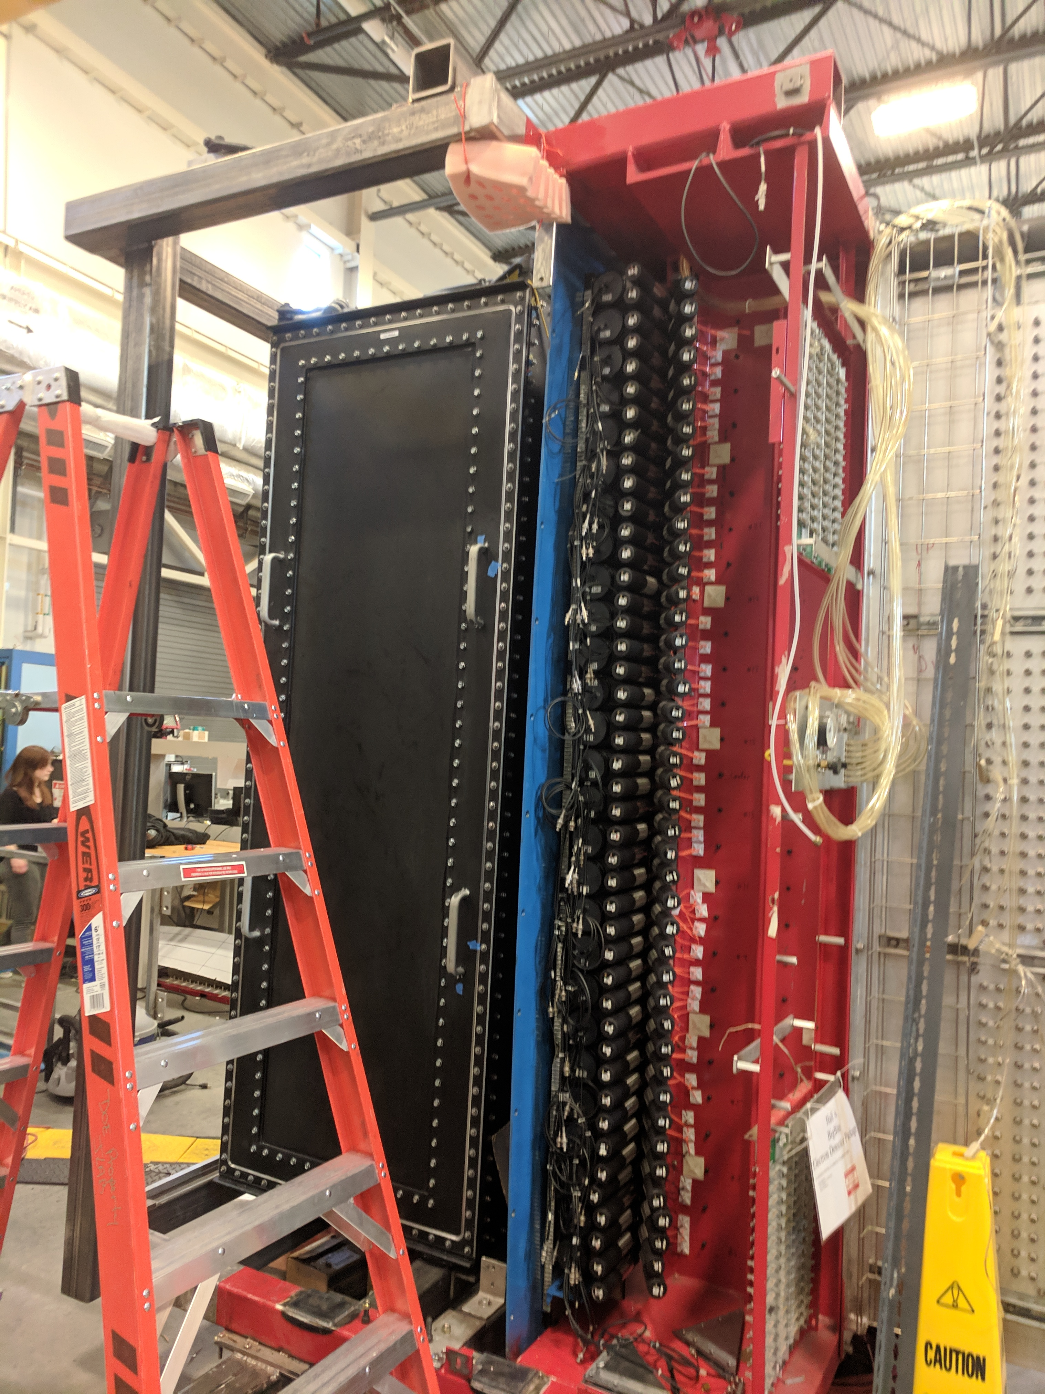
Current Status of BigBite Detector Package
Shown are the Grinch, Preshower, Hodoscope,
and the Shower detectors in the modified BigBite frame.

Slide 10
BigBite Preshower & Shower Detector
Total of 243 Lead Glass Blocks
  Preshower 2 by 27 blocks
  Shower 7 by 27 blocks
Shower was tested by Marathon students 2016 and just tested again (Jan/Feb. 2019).
Preshower blocks all individually tested during the summer (individual after being removed) and again after we restacked them (Jan/Feb. 2019)
Many thanks to Eric Fuchey and Kai Vylet.

Slide 11
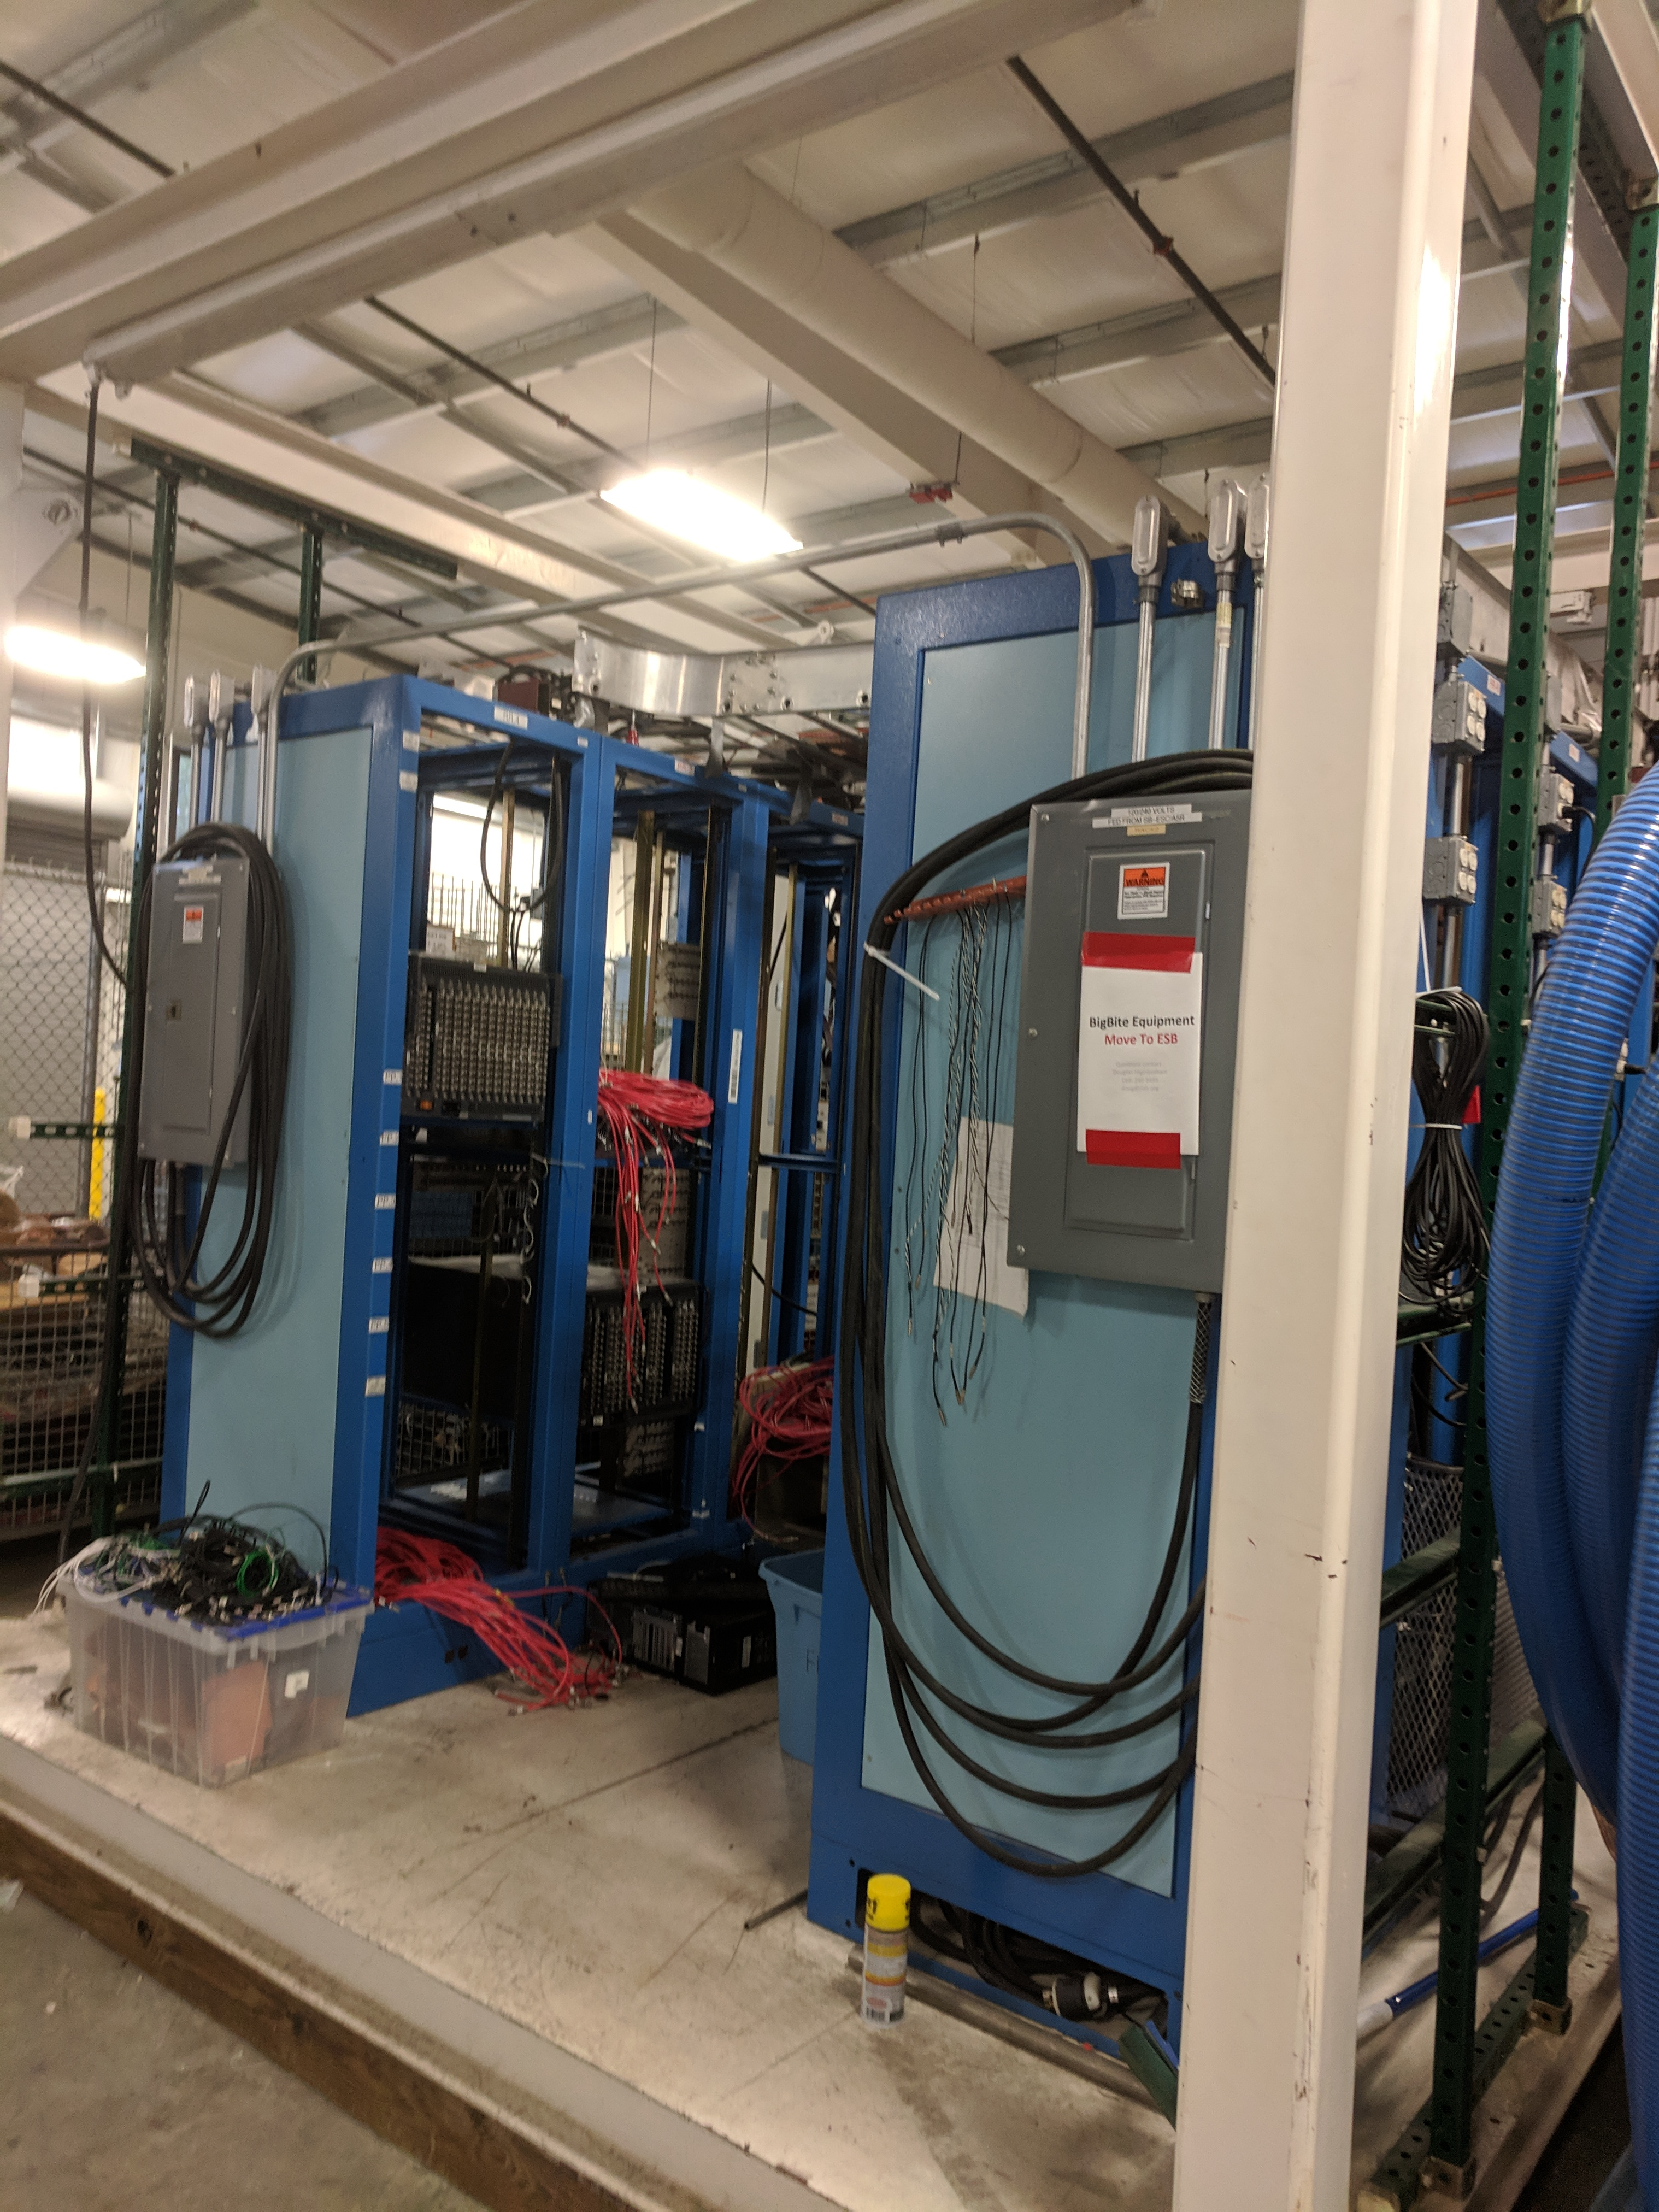
New Electronics / DAQ Weldment
The weldment we had planned to use was fine for test lab high bay BUT doesn’t fit through the door of the TED high bay.
NOTE: LCLS-II module production and refurbishing pushed us out of the test lab.
Material cost ~7k and hopefully can be done in-house.
old 8 rack weldment in ESB
new weldment (holds same 8 racks, just smaller)

Slide 12
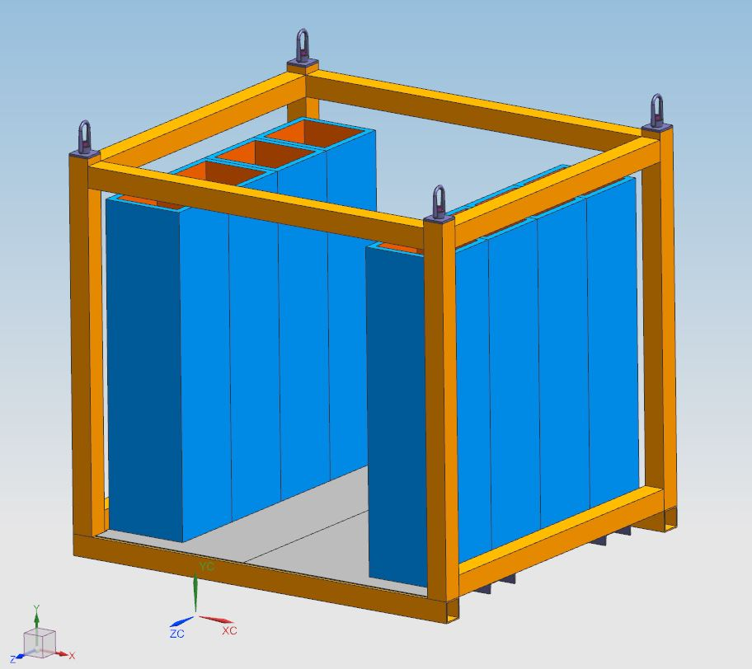
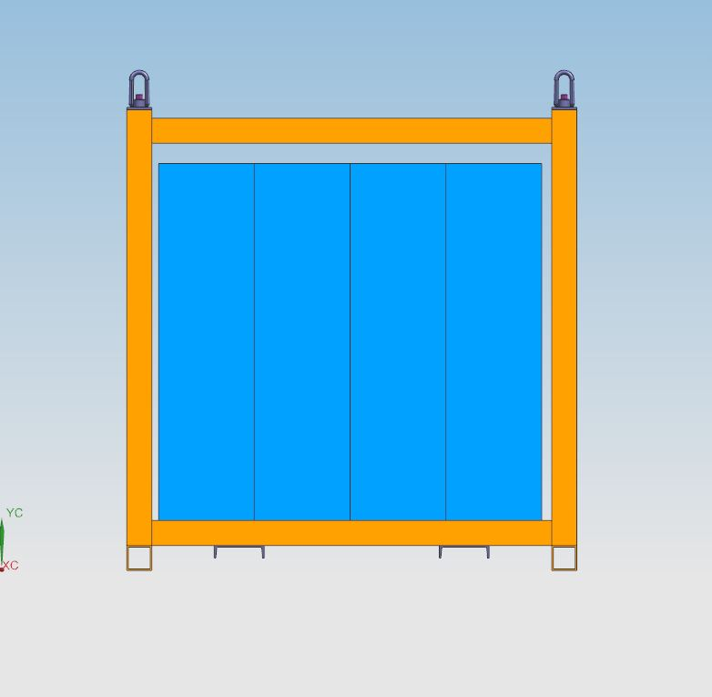
New Smaller Design
With input from Jessie, the new design can be lifted with a crane or forklift.

Slide 13
Status of Detector Integration
Front GEMs: empty holding frame in TED
Back GEMs: inserted from top, frame in clean room (?)
Grinch: installed in BigBite frame with NINO electronics!
Pre-shower: installed in BigBite frame with patch panel
Hodo-scope: installed in BigBite frame but needs cables
  See Rachel’s talk
Shower: still installed in BigBite frame with patch panel
  Fully tested

Slide 14
High Voltage & DAQ (see Alex’s talk)
Preshower & Shower LeCroy HV & OLD Fastbus
  Creates located in “old” BigBite weldment
  Will Tireman & student will be helping with HV cables next week.
  Just started moving signal cables to TED high-bay.
Hodoscope CAEN HV & VME (see Rachel’s talk)
  CAEN HV Create on-loan from Glasgow, on-site
  Special HV cables being made by Glasgow
  Other cables combination of Jlab & Glasgow. (check!)
Grinch LeCroy HV & VME (see Todd’s talk)

Slide 15
BigBite Timeline (work one in 2018 and to be done in 2019)
BigBite Frame Modification
  Drawings were done and checked by Robin’s group.
  10k (hardware) approved by Thia & nicely welded by Hall C technical staff.
  Welding work completed and moved to Walter’s group and should be done soon.
Summer 2018, integration of BigBite detectors
  Added Grinch to the BigBite frame
  Built and added Hodoscope and reinstalled the preshower
  New Burthe arrived.
It was agreed that BigBite could stay in TED highbay until installation in Hall A.
In TED high-bay, need to test full DAQ & trigger electronics summer 2019
  Working on getting new smaller weldment
  Gathering and Testing Cables
Likely move directly from TED to Hall A when Jessie is ready for us.
  DAQ / HV / cables needs to be fully tested and ready by end of end summer.
  Need to be ready to go to Hall A late 2019 / early 2020 (i.e. whenever Jessie wants us)
Manpower support is ramping up and the coming months will be about integrating the sub-systems together.

Slide 16
On-site Manpower
Hall A and Hall A/C are hiring two new postdocs
  interviews complete
  recommendations with JLab human resources
Masters student Ashley Yoon from CNU
Eric Fuchey (UConn)
  Mentoring High School Honor Student Kai Vylet
GEM team (Kondo et al.)
Grinch team (Carlos et al.)
Hodoscope team group does not have team on-site, but their trips to JLab and supplies have been extremely very useful as have been the DOE/SULI students.
Could really use at least one on-site Ph.D. student focused on BigBite.

Slide 17
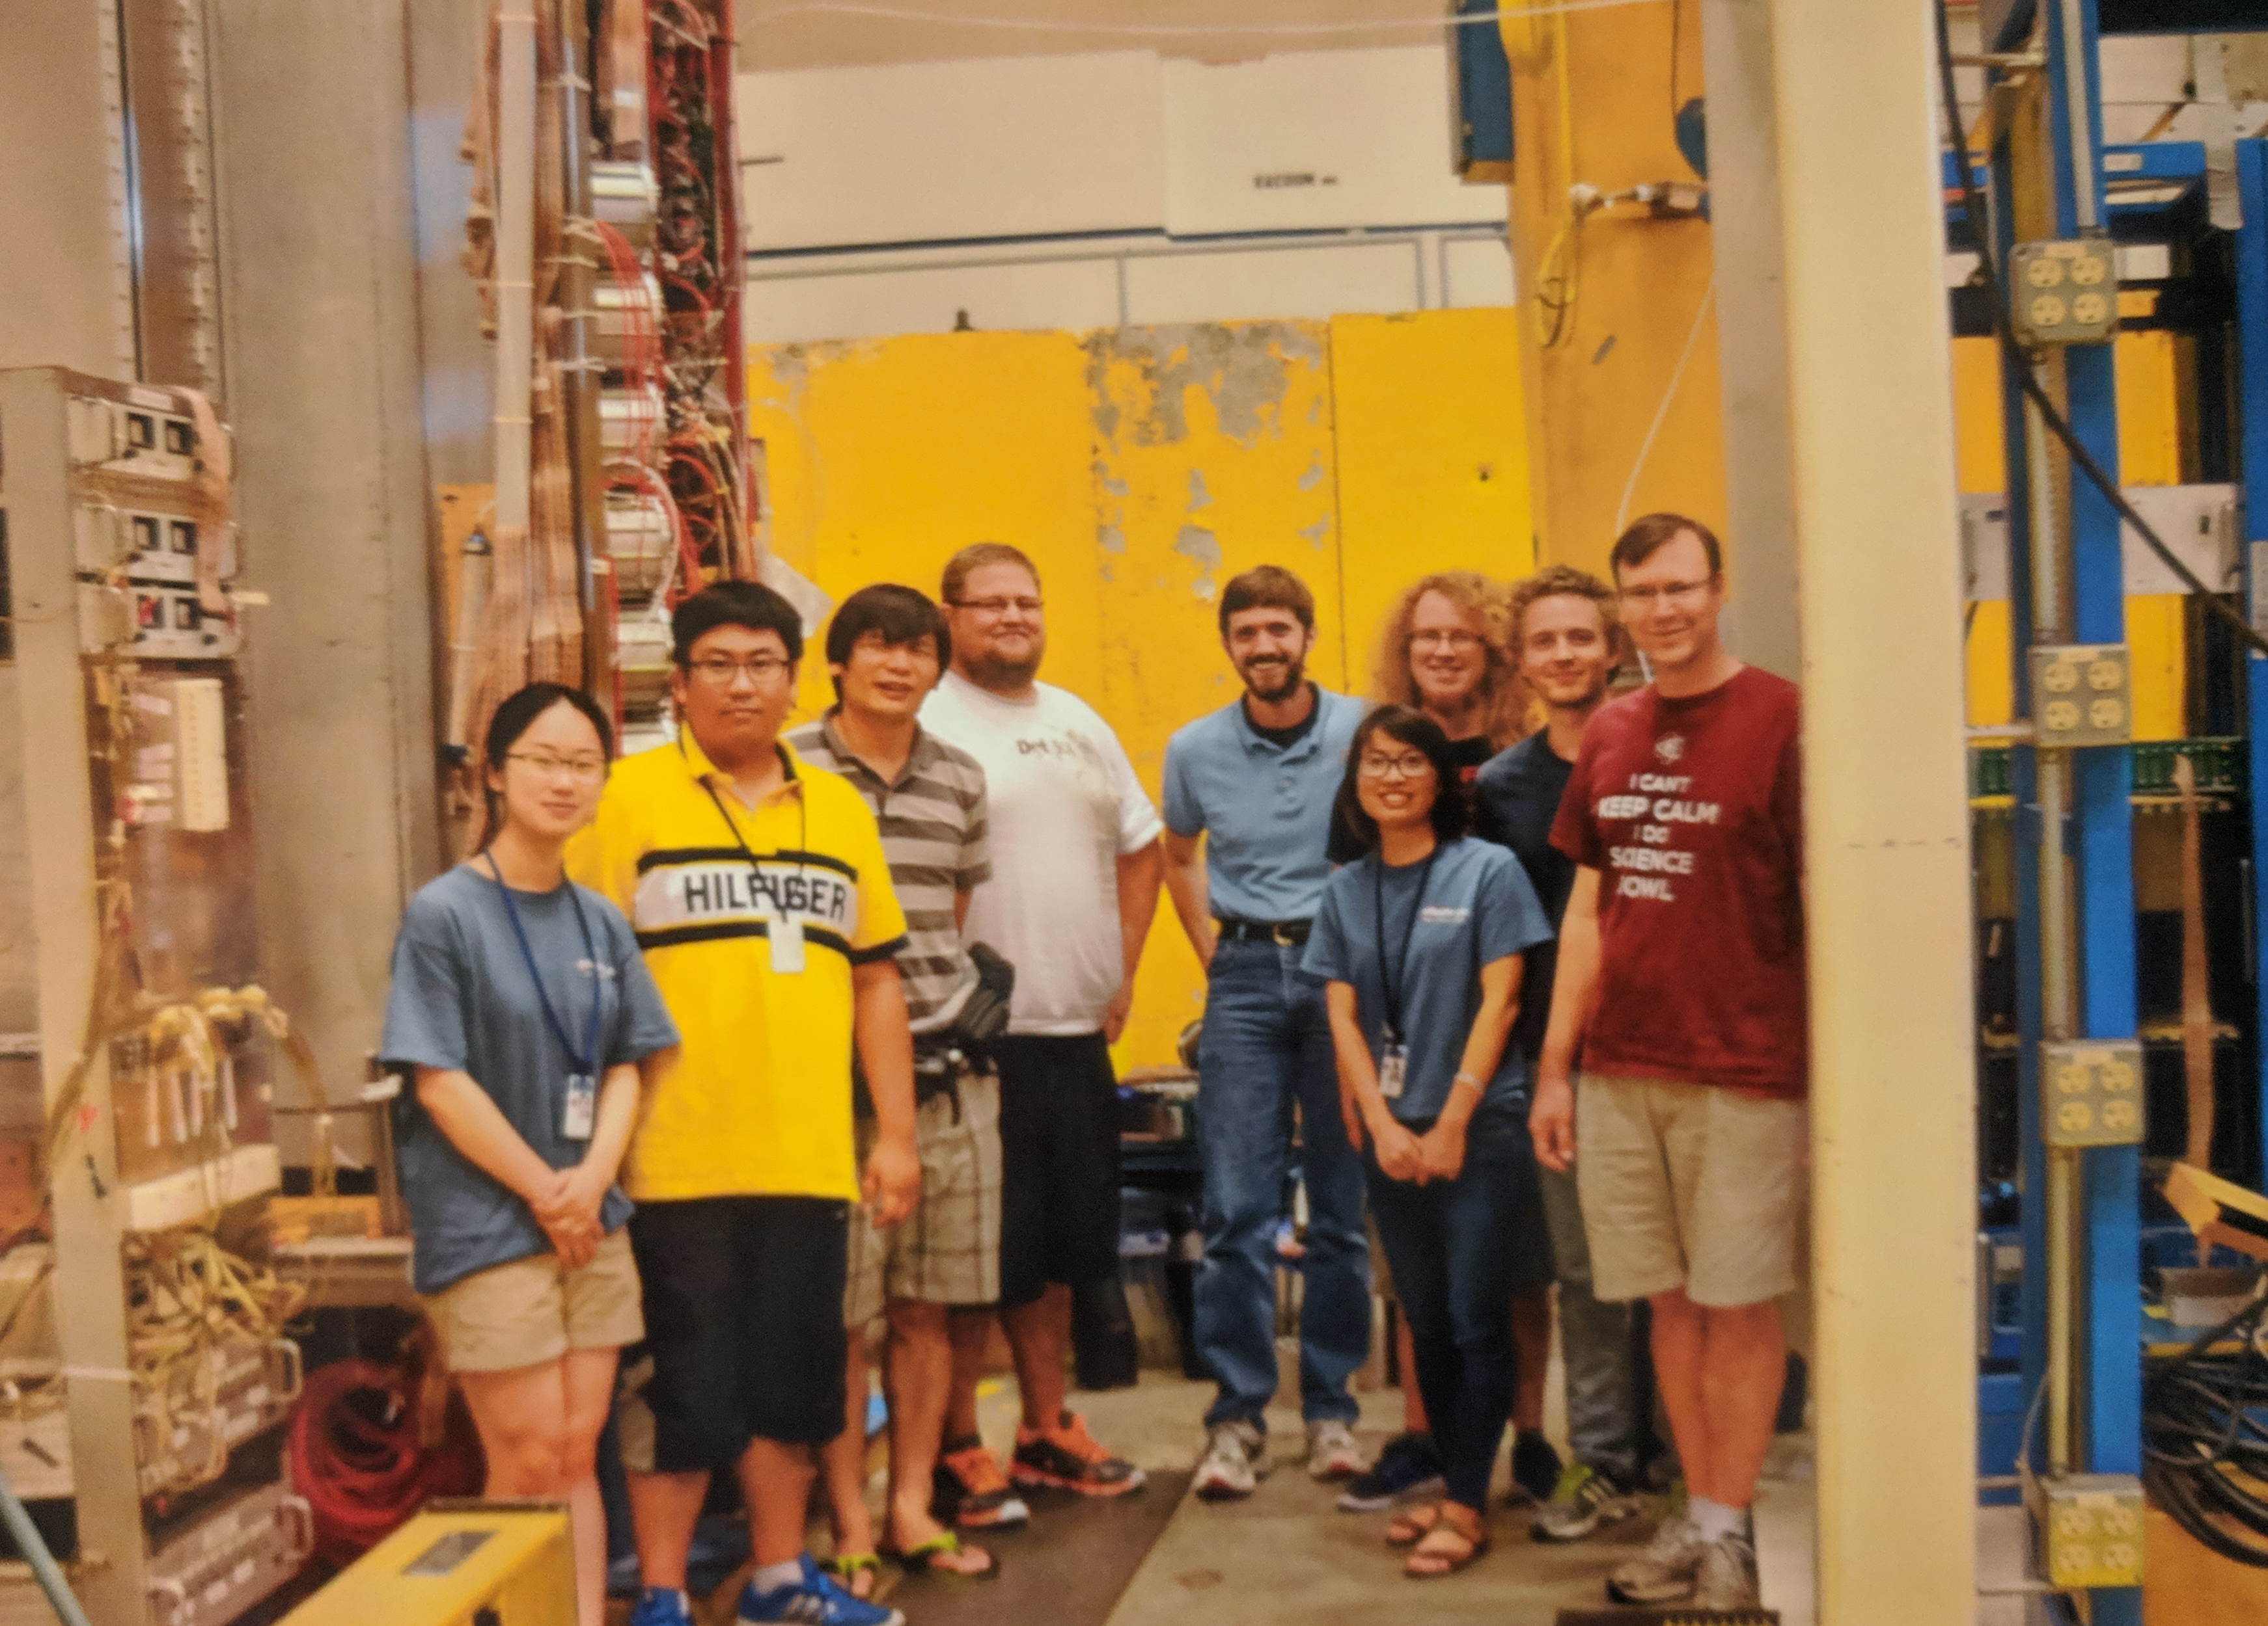
Looking forward to our new BigBite group photo.
Shown is the previous group that worked on getting BigBite together for Marathon.

Slide 18
In Summary
Much of the BigBite detector is now together in the TED high-bay.
Need to double check we have items & a budget for items outside groups are assuming we have
  Gas (both for chambers and Cherenkov)
  Cables & Connectors
    e.g. NINO to QDC connectors mented in Rachel’s talk
  Electronics
Need to check all lengths and locations.
  As noted yesterday, some small items need to find radiation safe spots (e.g. the NINO card low voltage supplies)
And until we have it all assembled, I will continue to have nightmares about double counting …
This Summer Is Very Important
  Need to have DAQ running and taking cosmic data, so that we have time to address any issues prior to installation.
  Making progress, but going slower then I would like.

