Slide 1
SBS Monte Carlo Simulation—status and results
Andrew Puckett
University of Connecticut
SBS Winter Collaboration Meeting
February 27, 2019

Slide 2
Outline
Status of g4sbs software package and documentation
Review and discussion of existing and missing geometry/event generators/features
Highlights of g4sbs simulation studies/results
Near-term simulation priorities

Slide 3
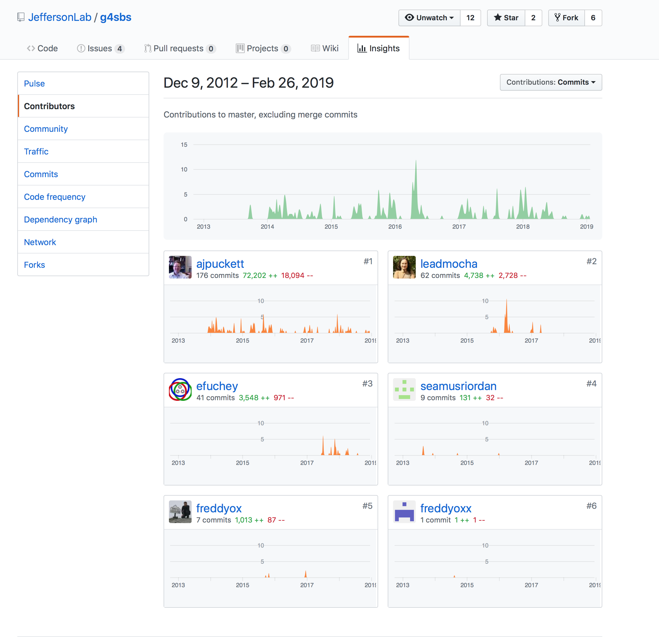
g4sbs Package Status
Source code is maintained in a github repository controlled by JLab: https://github.com/JeffersonLab/g4sbs
Master branch is most stable/full-featured
Active development of the core framework and geometries of the “core” experiment geometries is done in uconn_dev
uconn_dev merged into master as of Feb. 20, 2019.
  First update to master since summer 2016—2.5 years worth of uconn_dev commits
18 branches of g4sbs currently exist, many (most?) obsolete/defunct.
Six “forks” of g4sbs exist, mostly not in active development (according to repo)
Glasgow group maintains a separate GEANT4 simulation derived from an older version of g4sbs, with GEANT4 source code modifications to accommodate models for spin-dependent nuclear scattering physics
  Glasgow simulation is not part of g4sbs repository; not publicly available.

Slide 4
G4SBS team (core group)
Name | Institution | Major Contributions/Responsibilities
Seamus Riordan | ANL | Github repository creation, GEANT4 application framework, cmake build system, BB+SBS magnets, magnetic field implementation, event generators, GEMs, field clamps, targets, beamline, example scripts, UI commands, etc.
Andrew Puckett, Eric Fuchey, Freddy Obrecht (former) | UConn | RICH, GEP beamline and scattering chamber, CDET, LAC, dynamic ROOT Tree output w/STL vectorization of array-valued branches, sensitive detector classification, organization and signal processing (hit aggregation), LUND/PYTHIA interface, more event generators, GEP ECAL, documentation, ROOT macros for analysis of simulation output, more example scripts, more UI commands, GMN/GEN beamline, GMN scattering chamber, GRINCH, BB shielding, GEP ECAL, TDIS geometry
Juan Carlos Cornejo | CMU | HCAL, GMN event generators, command-line interface improvements, example script organization and maintenance, more UI commands
John Annand, David Hamilton, Rachel Montgomery | Glasgow U | GEN-RP simulation, TDIS simulations, BB timing hodoscope
Ole Hansen | JLab | Hall A software, repository maintenance, write access control

Slide 5
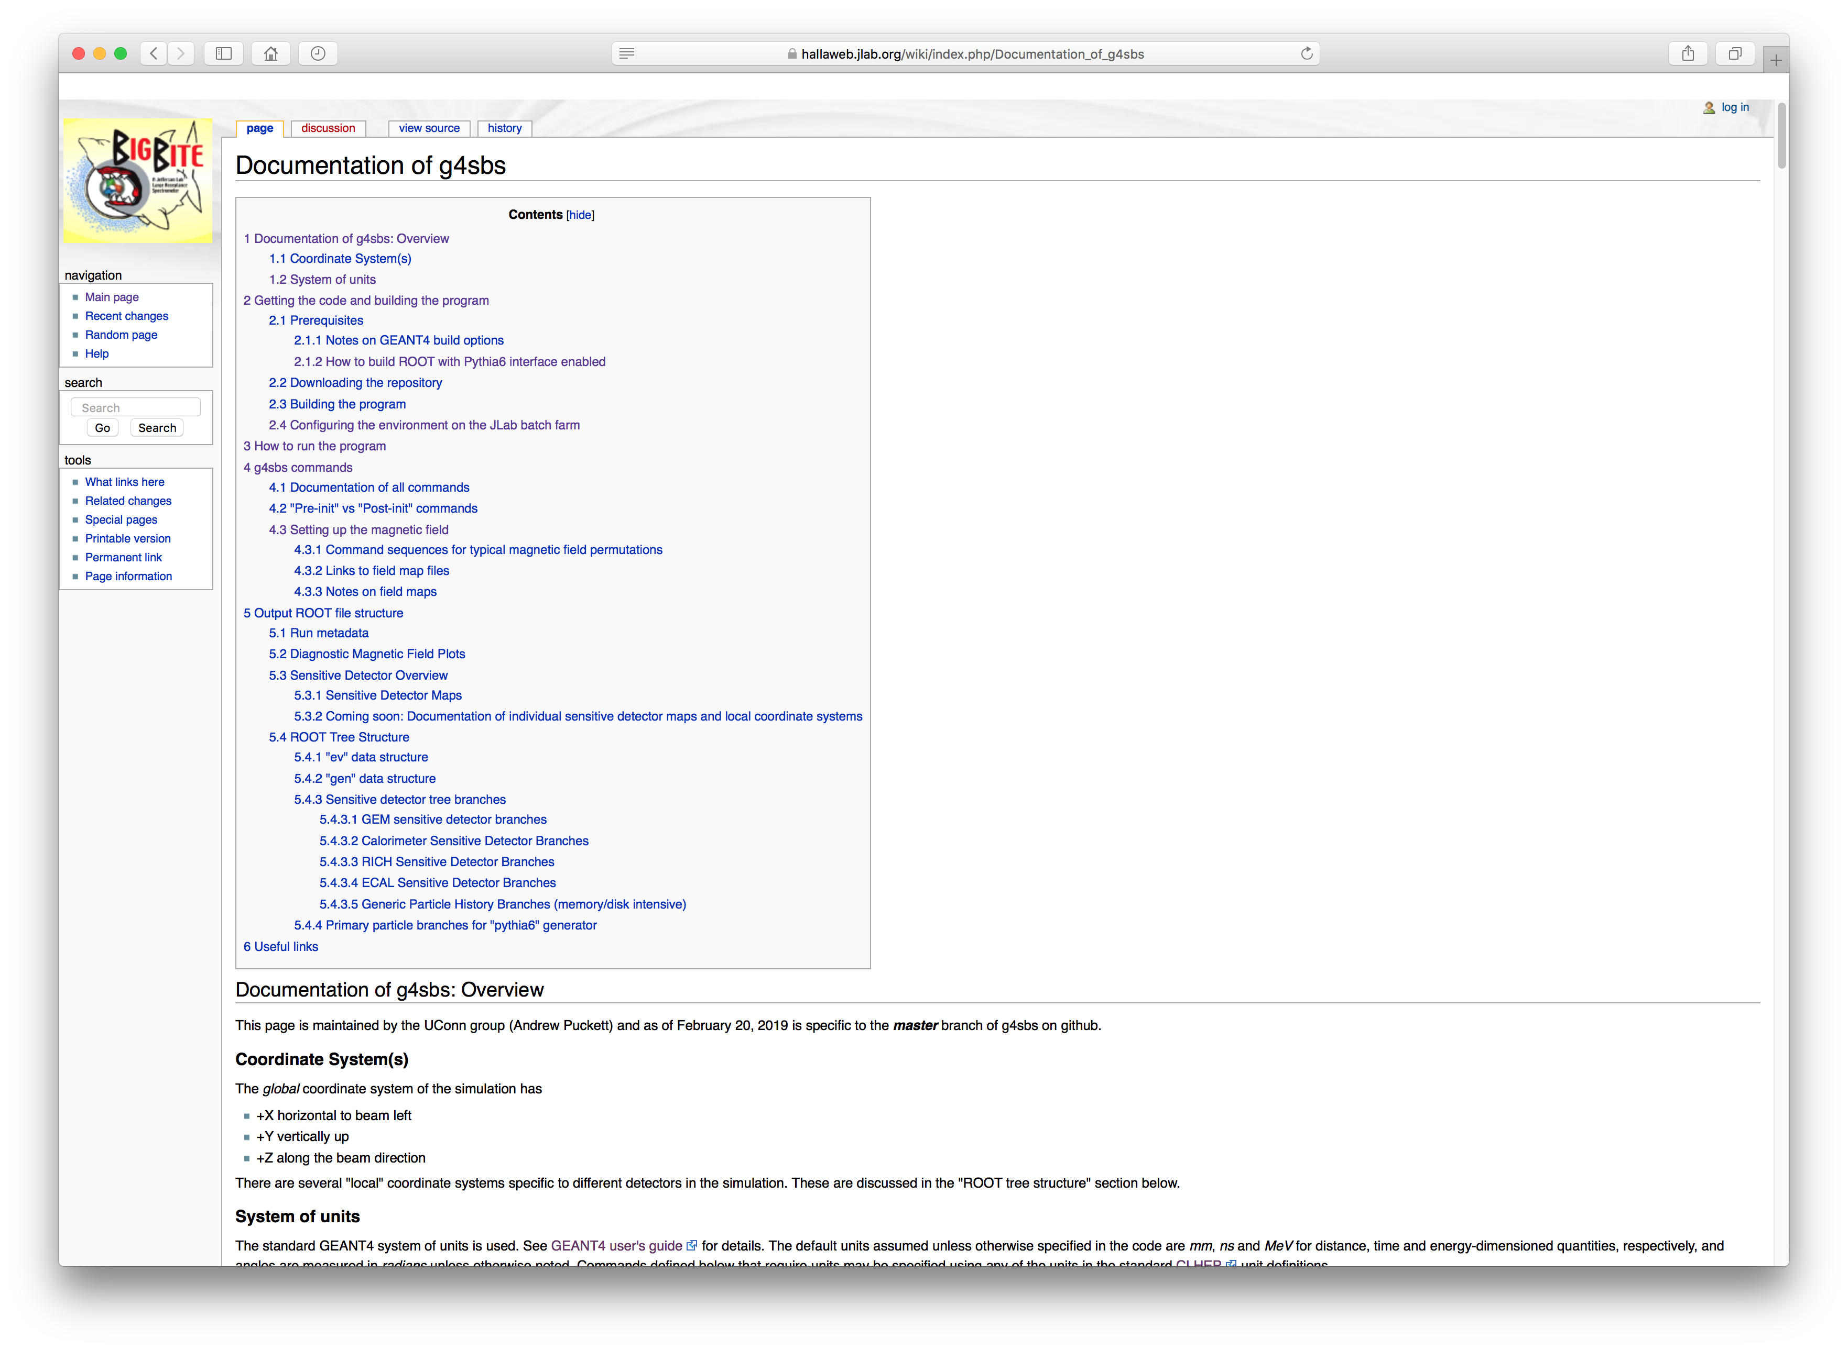
Documentation wiki and status
https://hallaweb.jlab.org/wiki/index.php/Documentation_of_g4sbs
As comprehensive as possible
Last major update summer 2016
Most information is still accurate
Update in progress to reflect most recent additions/modifications
Some UI commands added, minor modifications and additions to ROOT output file.

Slide 6
Four core experiments: ”inventory” of (default) simulation geometry

Slide 8
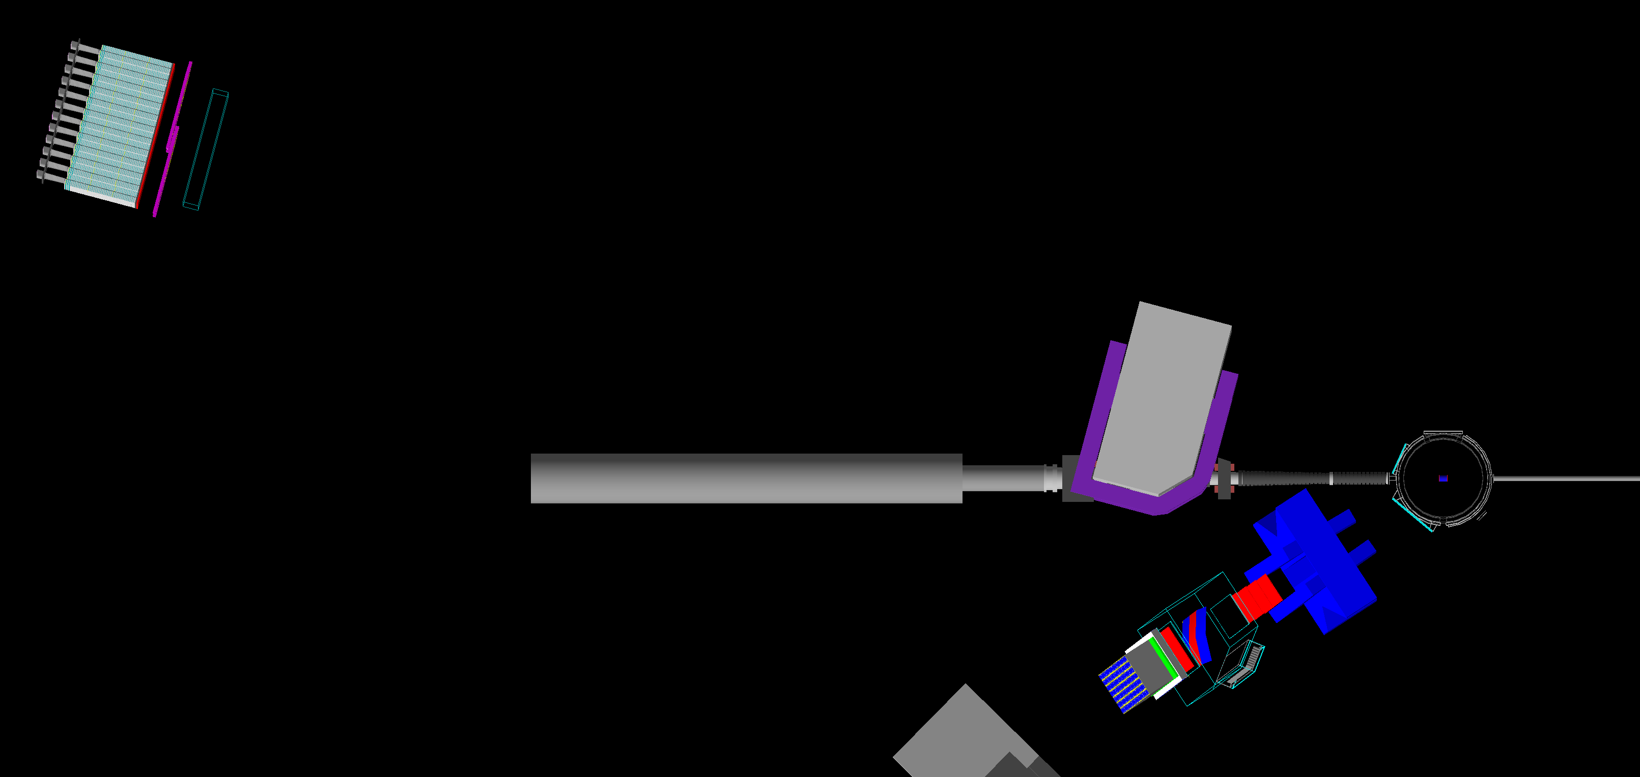
GMN simulation inventory
Existing: Beamline (both configurations), LH2/LD2 target, scattering chamber, SBS magnet, HCAL, CDET (layout not final), BigBite magnet, GEMs, GRINCH, PS, hodoscope, shower, final TOSCA map for 13.5 GeV², BigBite field map
Missing: TOSCA maps for all configurations other than highest Q²
Details to be finalized: field clamps (if any), exact target cell geometry, CDET layout, local shielding layout (if any), check simulation default layout against final CAD design

Slide 9
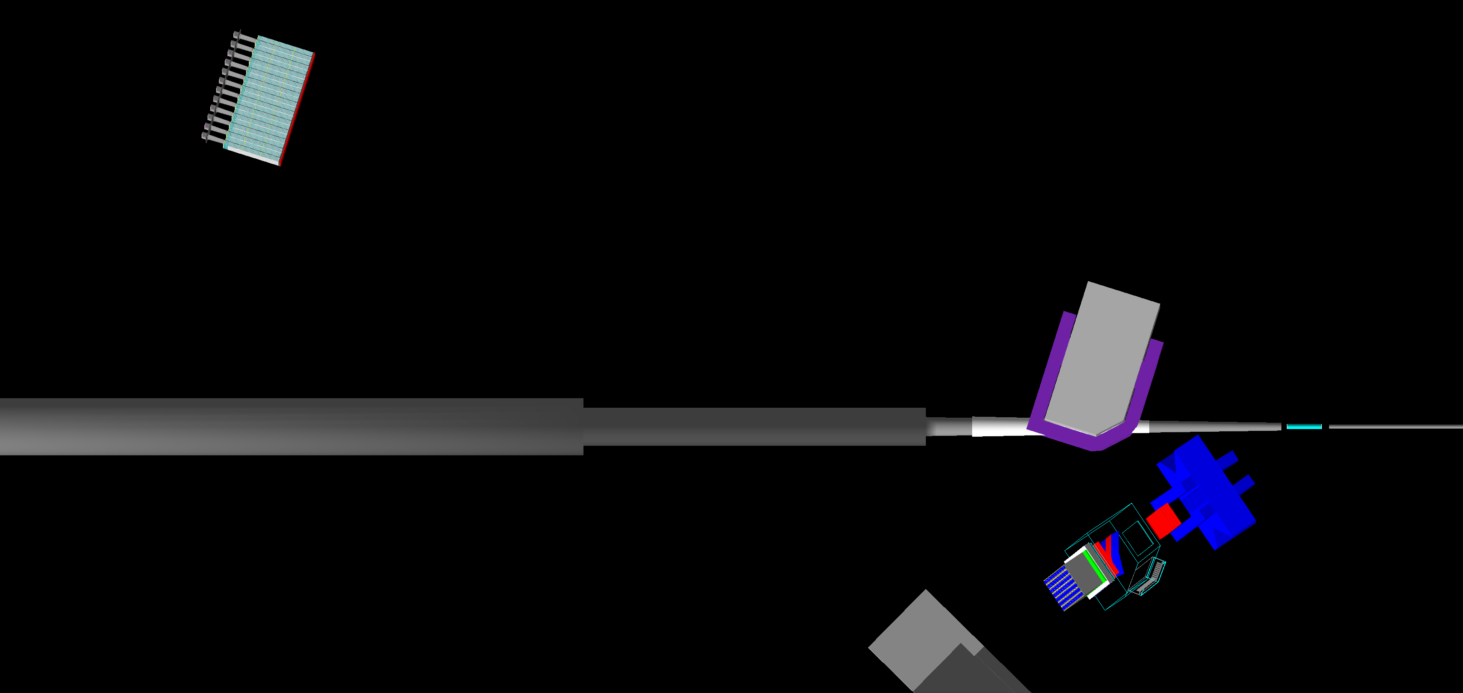
GEN simulation inventory
Existing: BigBite magnet and detectors, HCAL, SBS magnet, ³He target, BigBite field map
Missing: beamline details (design exists, just needs to be imported), (simulation-relevant) target details (again, design exists), field clamps, TOSCA maps for all four configurations
Details to be finalized: see ”missing”, + detailed ³He target cell geometry w/collimators, metal end windows/etc.

Slide 10
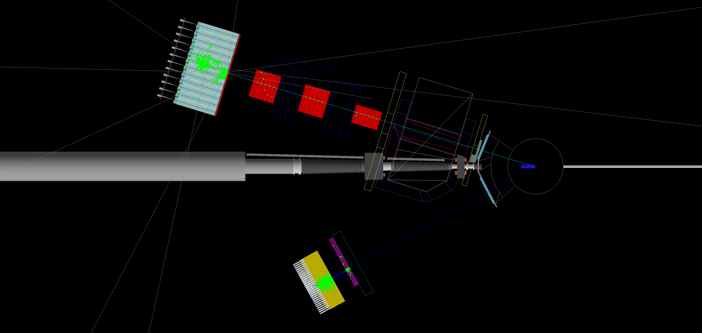
GEP simulation inventory
Existing: beamline + scattering chamber w/snout + basic LH₂ target cell geometry + SBS magnet + field clamps + pole shims + lead shielding + FT+FPP1+FPP2 GEMs + CH₂ + HCAL + CDET + ECAL + TOSCA map for 12 GeV² + thermal annealing model
Missing: TOSCA maps for 5 and 8 GeV², SBS sieve slit
Details to be finalized: Final ECAL supermodule layout and lead-glass blocks, final CDET layout, final GEM+CH₂ layout

Slide 11
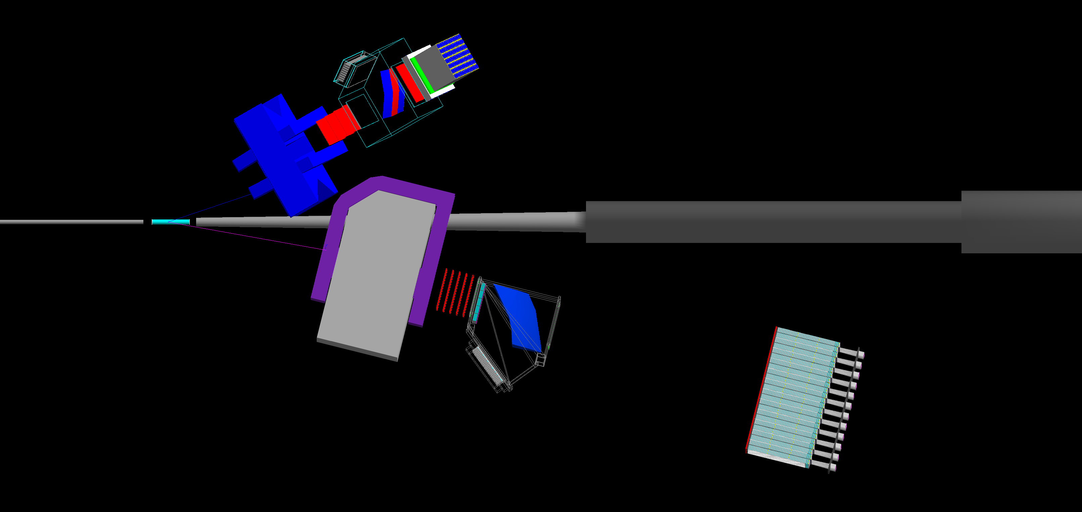
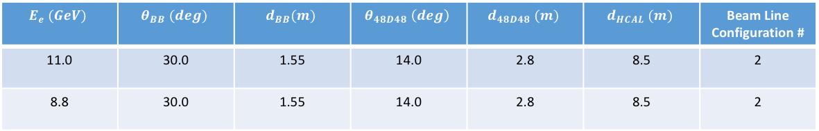
SIDIS simulation inventory
Existing: BigBite + SBS magnet + SBS GEMs + RICH + HCAL + ³He target + BigBite field map
Missing: Beamline, (simulation-relevant) target details, TOSCA maps (design for most of these missing geometries doesn’t exist yet for SIDIS), field clamps, etc.
Details to be finalized: finalize SIDIS layout and specifications—minimize differences from GEN wrt beamline, target, etc with notion of running SIDIS after GEN w/minimal config. changes
$$E_{e} (GeV)$$ | $$θ_{BB} (deg)$$ | $$d_{BB}(m)$$ | $$θ_{48D48} \left(deg\right)$$ | $$d_{48D48} (m)$$ | $$d_{HCAL} (m)$$ | Beam Line Configuration #
11.0 | 30.0 | 1.55 | 14.0 | 2.8 | 8.5 | 2
8.8 | 30.0 | 1.55 | 14.0 | 2.8 | 8.5 | 2

Slide 12
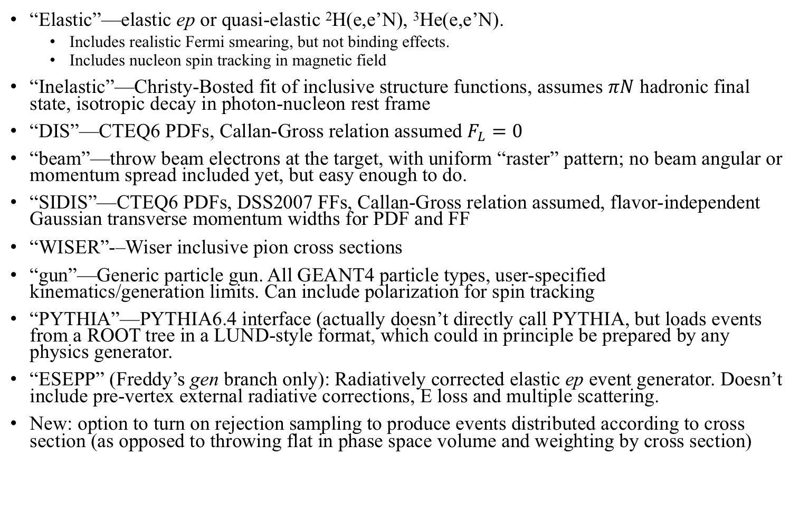
“Built-in” event generator inventory
“Elastic”—elastic ep or quasi-elastic ²H(e,e’N), ³He(e,e’N).
  Includes realistic Fermi smearing, but not binding effects.
  Includes nucleon spin tracking in magnetic field
“Inelastic”—Christy-Bosted fit of inclusive structure functions, assumes $πN$ hadronic final state, isotropic decay in photon-nucleon rest frame
“DIS”—CTEQ6 PDFs, Callan-Gross relation assumed $F_{L}=0$
“beam”—throw beam electrons at the target, with uniform “raster” pattern; no beam angular or momentum spread included yet, but easy enough to do.
“SIDIS”—CTEQ6 PDFs, DSS2007 FFs, Callan-Gross relation assumed, flavor-independent Gaussian transverse momentum widths for PDF and FF
“WISER”-–Wiser inclusive pion cross sections
“gun”—Generic particle gun. All GEANT4 particle types, user-specified kinematics/generation limits. Can include polarization for spin tracking
“PYTHIA”—PYTHIA6.4 interface (actually doesn’t directly call PYTHIA, but loads events from a ROOT tree in a LUND-style format, which could in principle be prepared by any physics generator.
“ESEPP” (Freddy’s gen branch only): Radiatively corrected elastic ep event generator. Doesn’t include pre-vertex external radiative corrections, E loss and multiple scattering.
New: option to turn on rejection sampling to produce events distributed according to cross section (as opposed to throwing flat in phase space volume and weighting by cross section)

Slide 13
Selected results from g4sbs
Recent and not-so-recent…

Slide 14
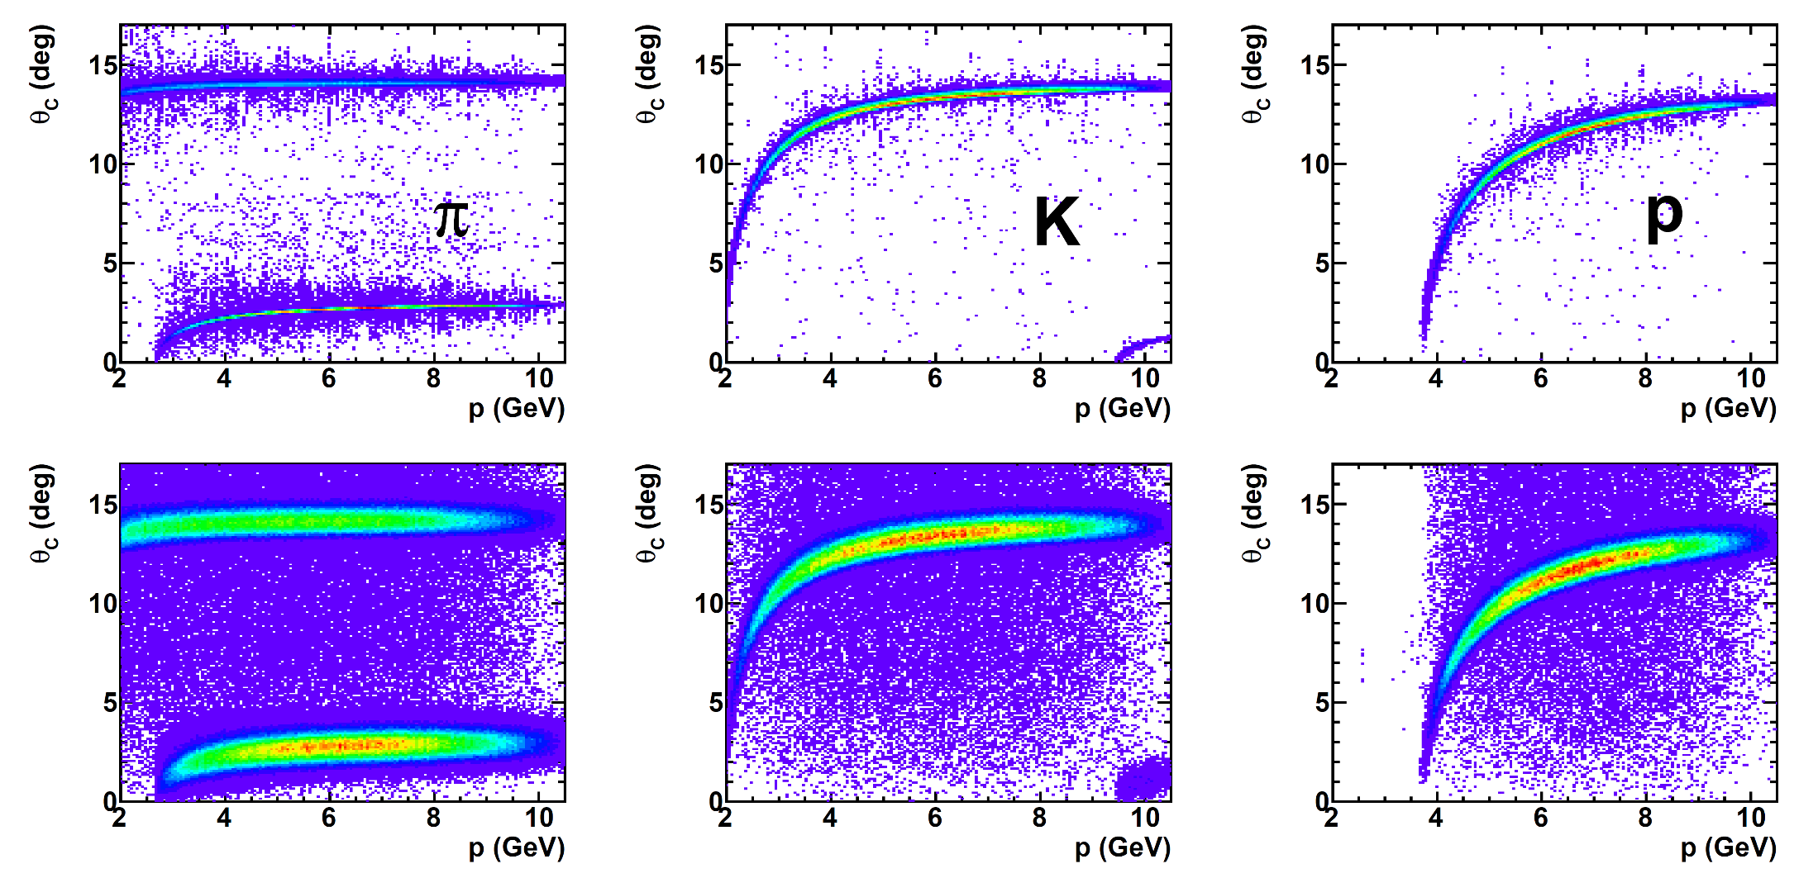
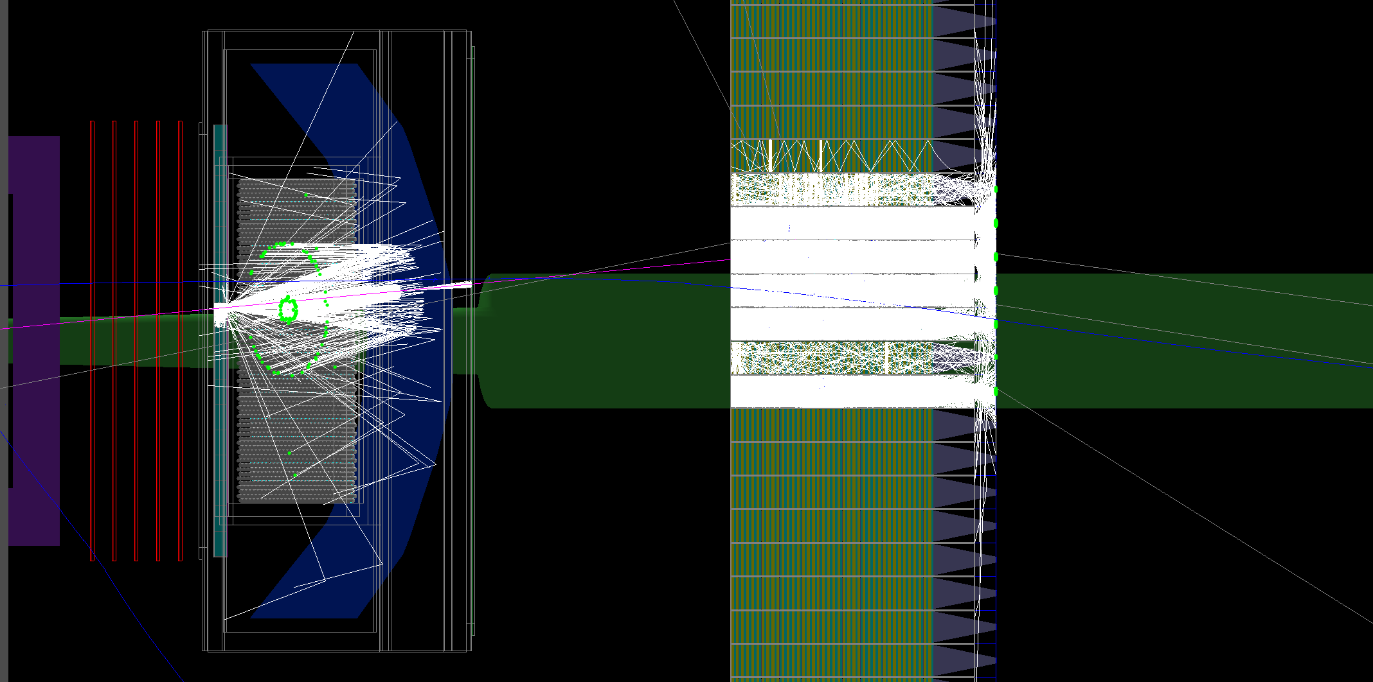
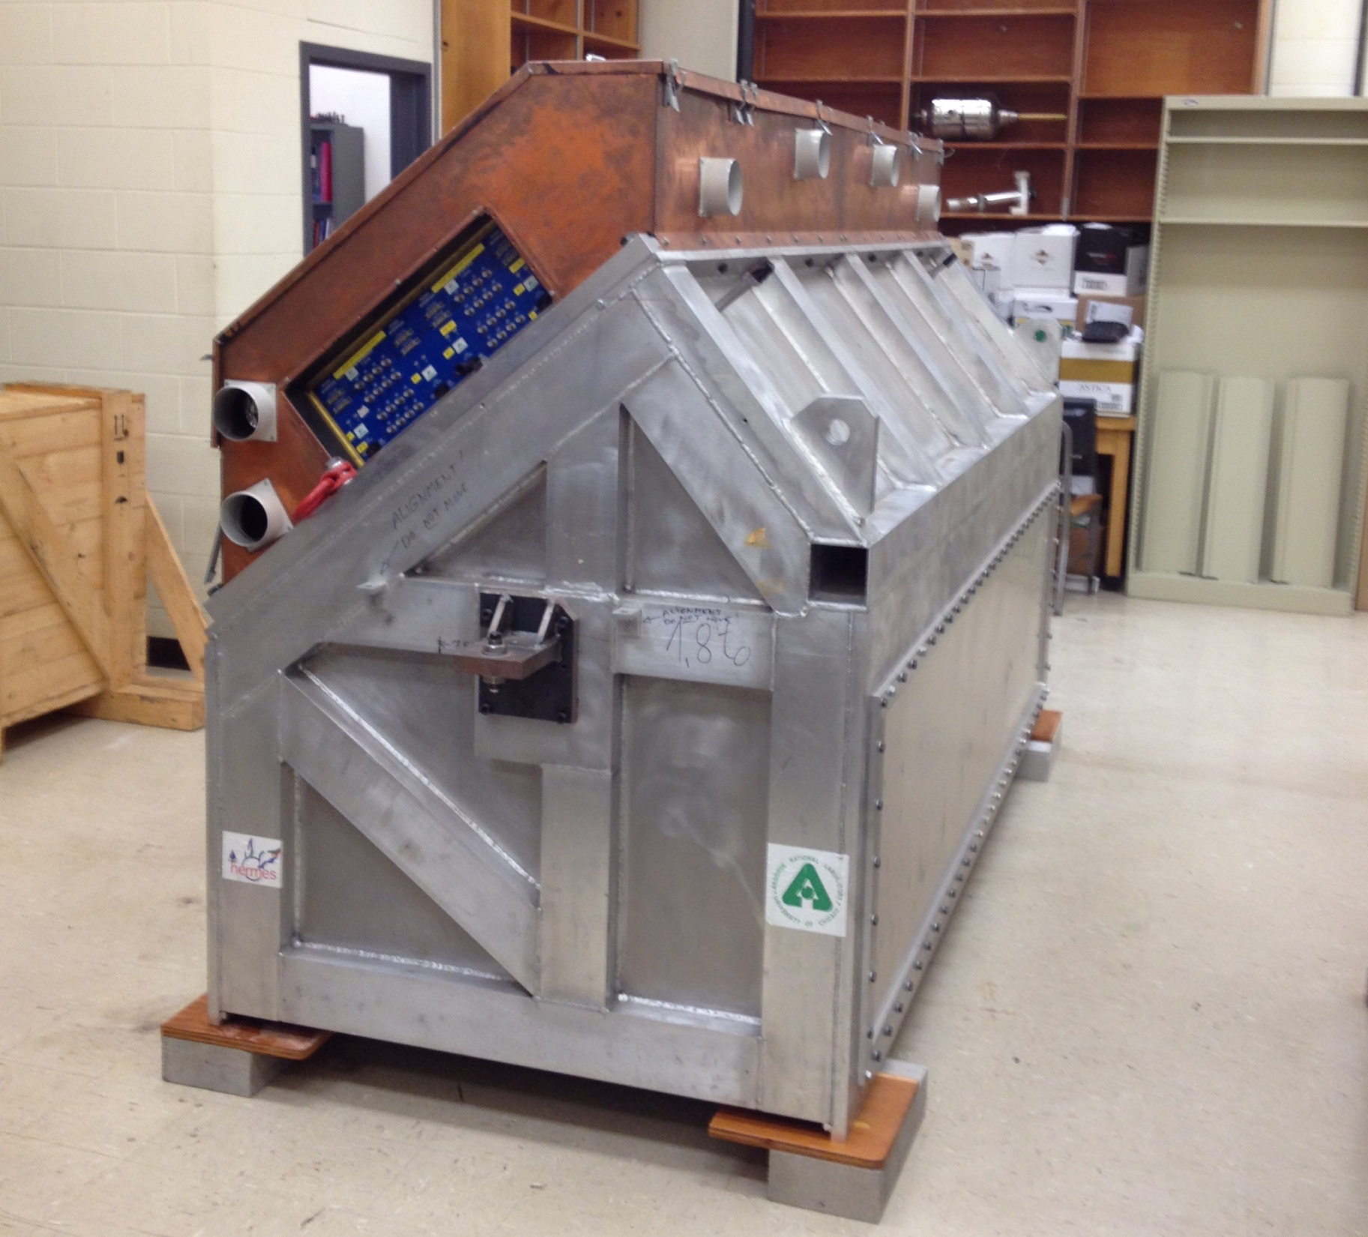
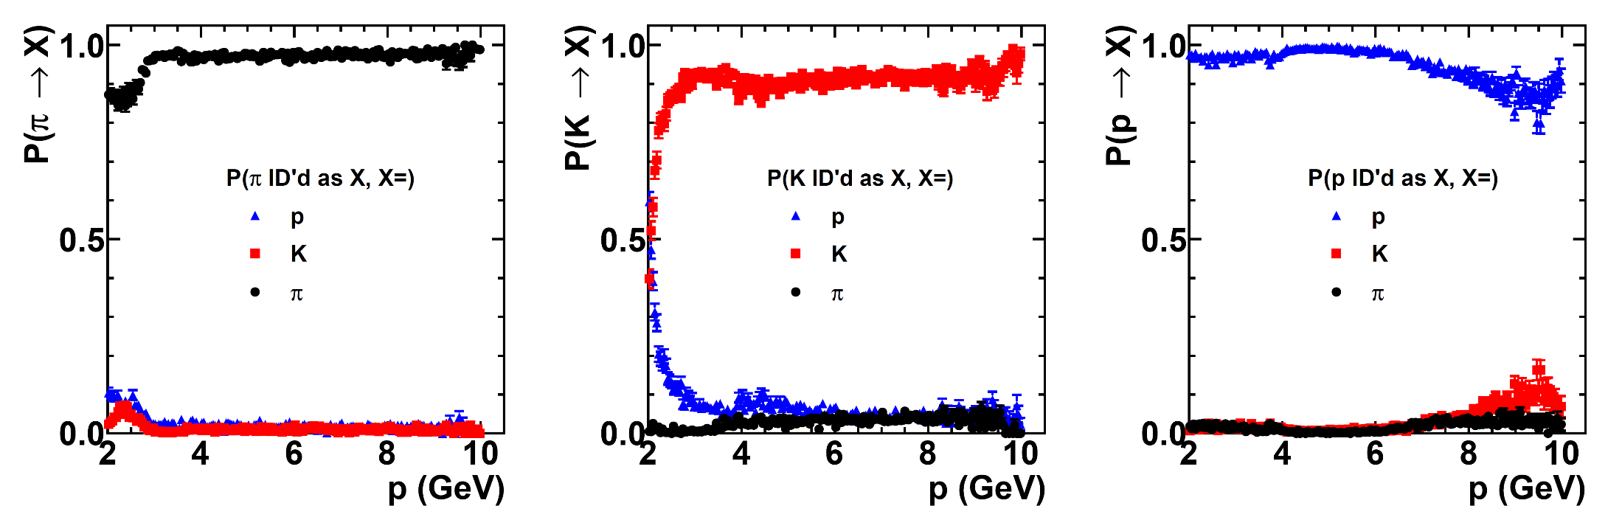
Detailed simulation of RICH PID performance
GEANT4-simulated RICH performance in SBS
GEANT4 simulated RICH PID performance in SBS for π/K/p: https://hallaweb.jlab.org/12GeV/SuperBigBite/SBS-minutes/2014/Puckett_RICH_MC_update.pdf
HERMES/SBS RICH @UConn, Sept. 2014

Slide 15
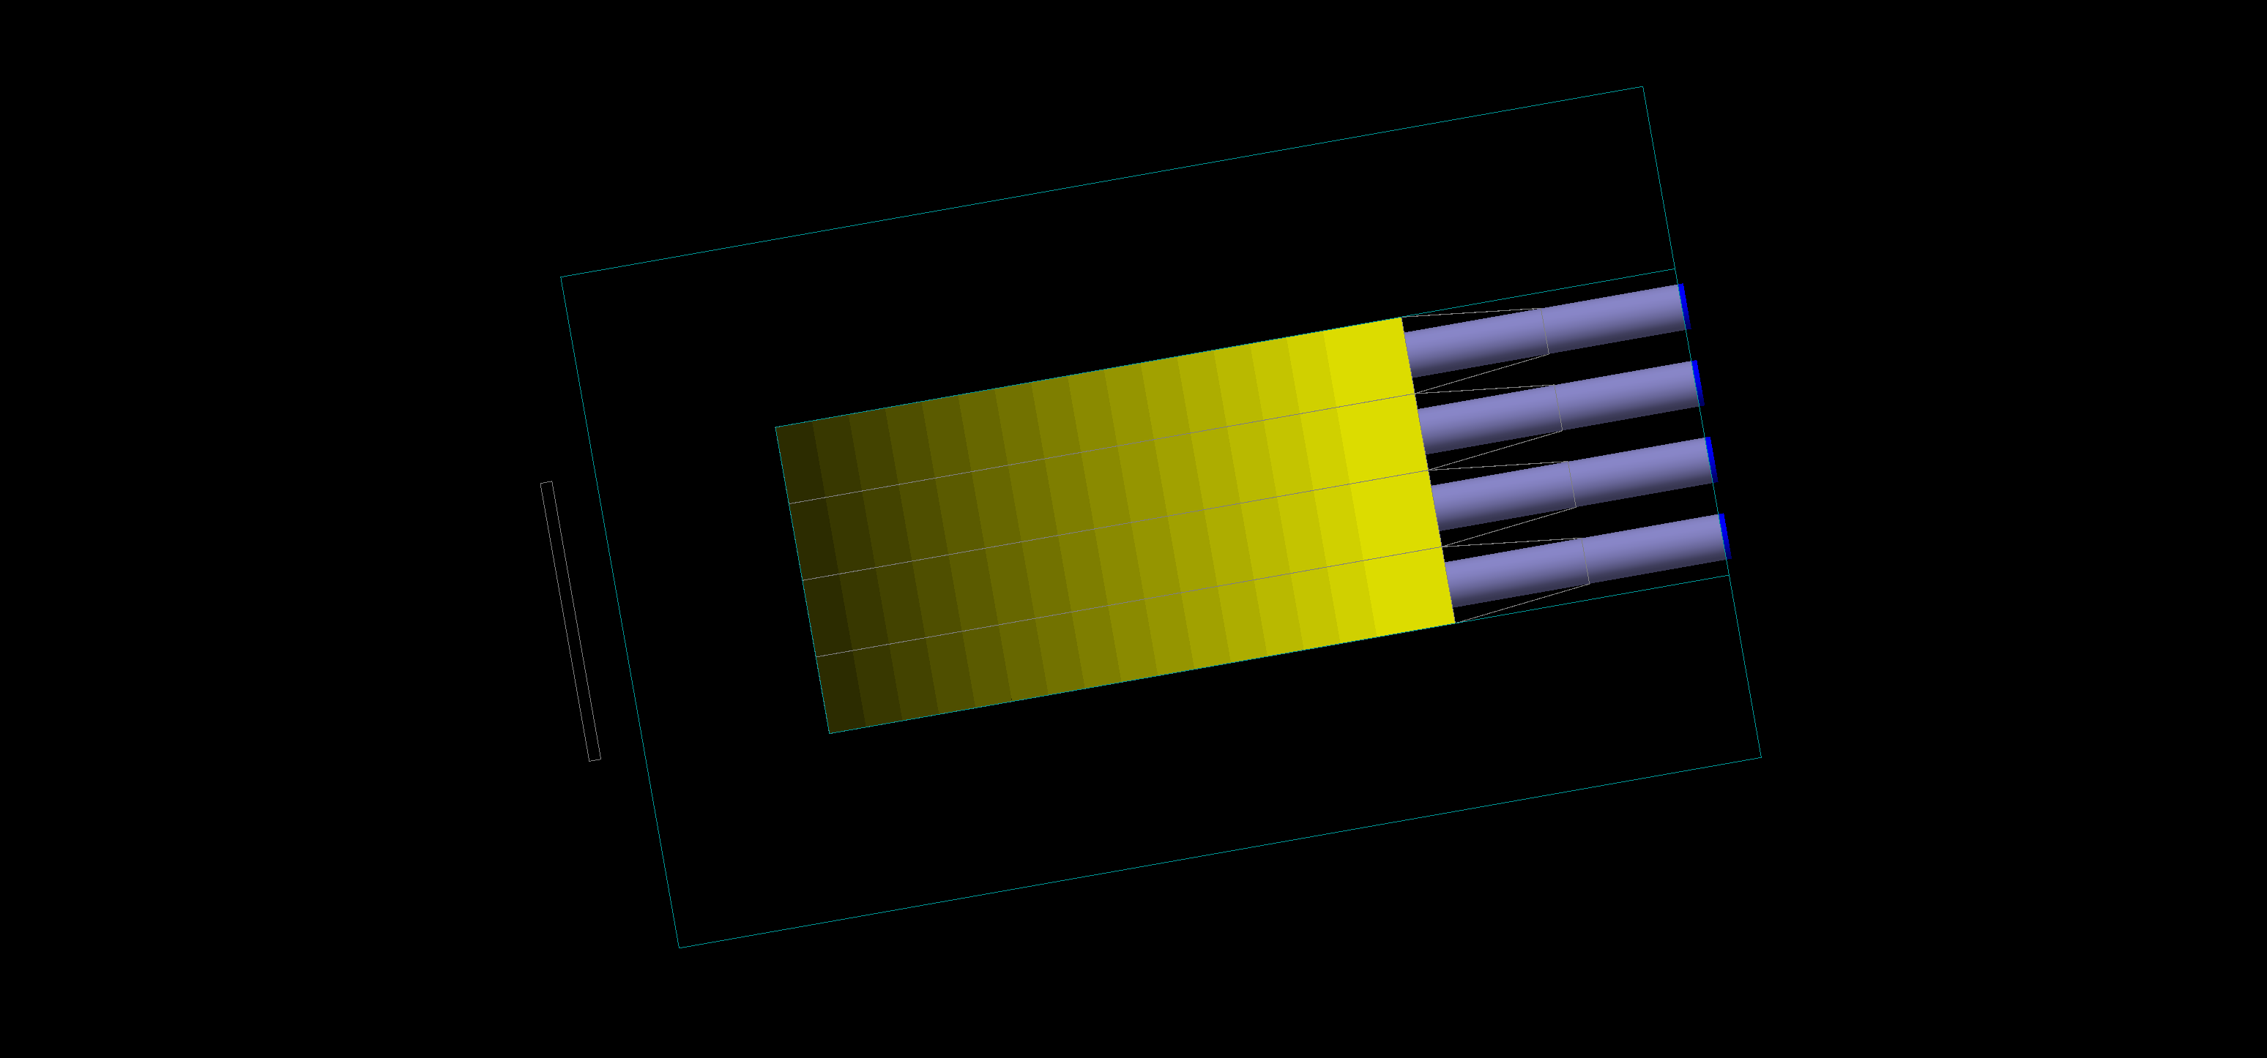
C16/ECAL Thermal Annealing Simulation
Longitudinal segmentation of C16 lead-glass to implement depth-dependent radiation-induced darkening

Slide 16
Projected ECAL Performance
Left: ECAL photoelectron yield vs. energy deposition, undamaged case
Right: ECAL photoelectron yield vs. energy deposition, thermal equilibrium state in GEP 12 GeV² point
Average ratio equilibrium/undamaged = (96.3 +/- 0.2) %
More details in final report to DOE (see Mark's final report to DOE (requires login) )

Slide 17

GEP GEM rates vs. target thickness, $I_{beam}=75 μA$
Rates vs. thickness fitted with a power-law: $R=p_{0}L^{p_{1}}$
For the front tracker, the power appears to be about 3/2.
For a given beam current, GEM background rate in FT increases non-linearly with target thickness
This is an expected result, as the primary beam and the secondary interactions of Bremsstrahlung photons contribute to the background rates
Results imply that for a given luminosity, higher current on a thinner target leads to a better background situation

Slide 18
GEP Trigger Logic Definition and Simulations

Slide 19
GEP Trigger Analysis—Latest ECAL geometry
Left—near-final layout of GEP ECAL, color-coded by “level 1” sums—2 (horizontal) x 4 (vertical) lead-glass blocks, non-overlapping. Note that these don’t neatly correspond to 3x3 ”supermodules”
Right—color-coded by “level 2” sums. L2 sums are a combination of 2 (horizontal) x 2 (vertical) L1 sums, with 1 L1-sum of horizontal and vertical overlap with adjacent L2 sums.
Non-rectangular geometry is awkward, but straightforward for trigger organization.
Every block is included in at least one L2 sum with at least 17 blocks.
Total of 213 independent trigger logic sums—overlap increases efficiency with high threshold we want to use

Slide 20
ECAL Trigger Efficiency vs threshold, Q²
ECAL Trigger Efficiency vs. threshold, expressed as a fraction of the elastic peak position, for ”final” ECAL layout/logic
ECAL Trigger Efficiency vs. Q², for events with a proton track in the FT.

Slide 21
Reminder: HCAL Trigger analysis with “L2” logic
Signal in HCAL logic group with max signal for elastic ep events, with different cuts on FPP event topology (top left)
Top right: HCAL trigger efficiency vs. threshold for different event topologies
Bottom right: Dependence of efficiency on FPP scattering angle in FPP1 (2)

Slide 22
Correlated ECAL-HCAL trigger efficiency
For events with a “good” scattering in FPP1 (left) and events with a “good” scattering in FPP2 (right).

Slide 23
PYTHIA: GEP Singles and Coincidence Trigger rates with “L2” HCAL logic
Top left: ECAL trigger rate vs threshold
Top right: HCAL L2 trigger rate vs threshold (based on global OR of all possible 4x4 sums of HCAL signals)
Bottom left: real coincidence rate (PYTHIA6 events) vs ECAL/HCAL thresholds.
TO DO: analysis of accidentals (not trivial for correlated coincidence trigger with many overlapping logic combinations)

Slide 24
FPP FOM considerations
 | Full FPP2 CH2 thickness | 50% FPP2 CH2 thickness | 75% FPP2 CH2 thickness
FPP1 rate, 0.4 < theta < 12 deg. (Hz) | 1.66 | 1.92 | 1.85
FPP2 rate, 0.4 < theta < 12 deg. (Hz) | 0.93 | 0.75 | 0.77
Total ”good event” rate | 2.59 | 2.67 | 2.62
Ratio to default scenario | 1 | 1.03 | 1.01

Slide 25
SBS GEP Optics and Spin Transport

Slide 26
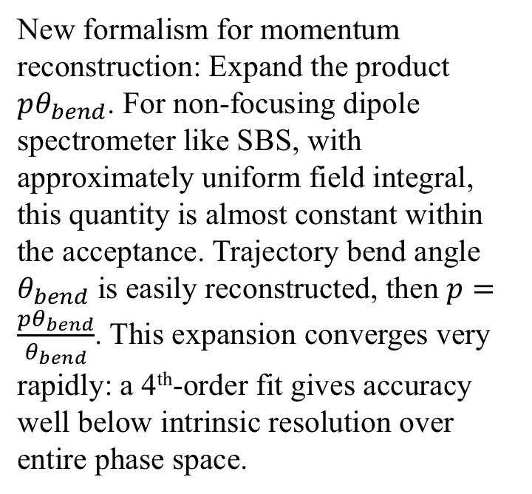
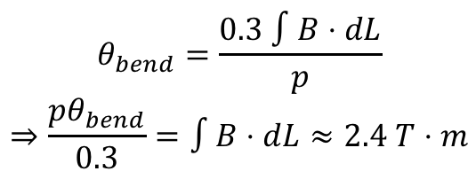
SBS Optics
New formalism for momentum reconstruction: Expand the product $pθ_{bend}$. For non-focusing dipole spectrometer like SBS, with approximately uniform field integral, this quantity is almost constant within the acceptance. Trajectory bend angle $θ_{bend}$ is easily reconstructed, then $p=\frac{pθ_{bend}}{θ_{bend}}$. This expansion converges very rapidly: a 4th-order fit gives accuracy well below intrinsic resolution over entire phase space.
$$θ_{bend}=\frac{0.3 ∫B⋅dL}{p}$$
$$⇒\frac{pθ_{bend}}{0.3}=∫B⋅dL≈2.4 T⋅m$$

Slide 27
SBS Optics: Angle, vertex, momentum resolution

Slide 28
SBS forward optics expansion
Forward optics also needed to translate electron arm reconstructed track into a search region for elastically scattered protons in the SBS FT

Slide 29
SBS Forward Optics: resolution of “fp” coordinates and angles

Slide 30
SBS Optics—”physics angles”, proton angle-momentum correlation, etc.

Slide 31
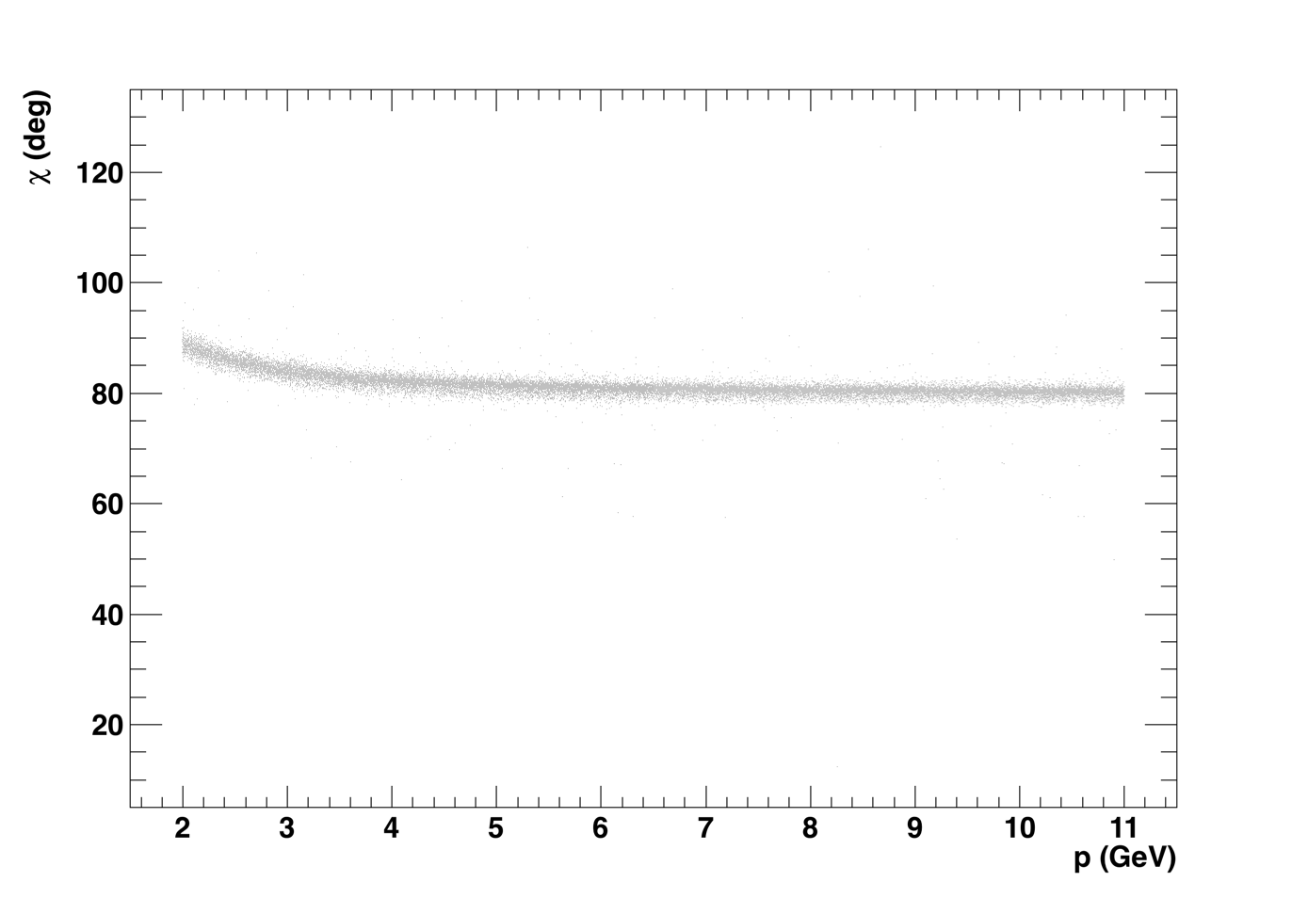
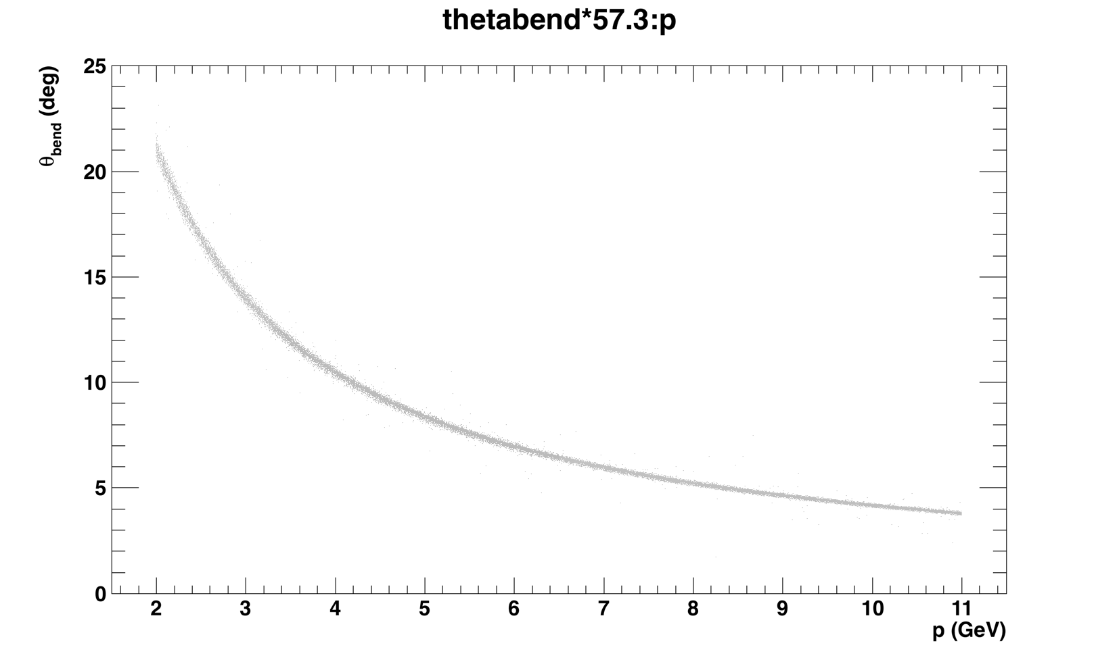
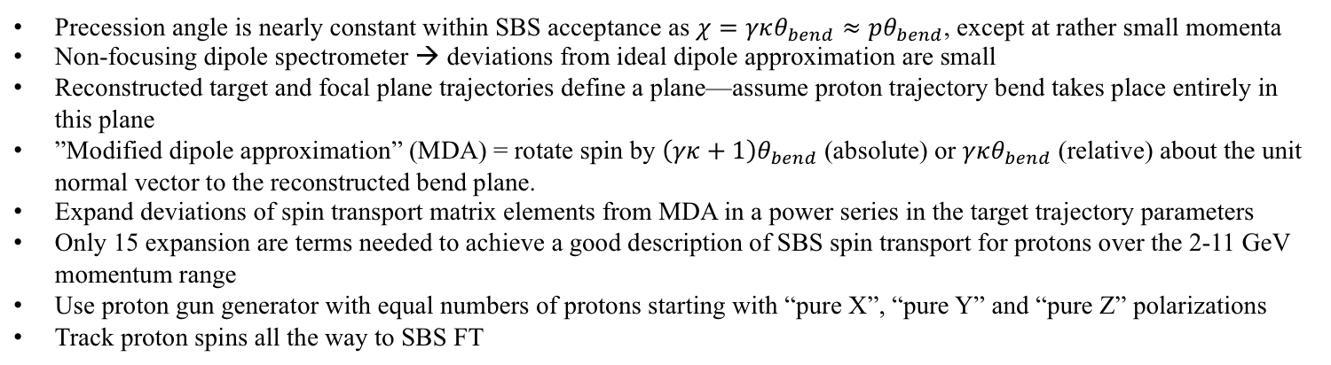
SBS Spin Transport—updated formalism
Precession angle is nearly constant within SBS acceptance as $χ=γκθ_{bend}≈pθ_{bend}$, except at rather small momenta
Non-focusing dipole spectrometer → deviations from ideal dipole approximation are small
Reconstructed target and focal plane trajectories define a plane—assume proton trajectory bend takes place entirely in this plane
”Modified dipole approximation” (MDA) = rotate spin by $\left(γκ+1\right)θ_{bend}$ (absolute) or $γκθ_{bend}$ (relative) about the unit normal vector to the reconstructed bend plane.
Expand deviations of spin transport matrix elements from MDA in a power series in the target trajectory parameters
Only 15 expansion are terms needed to achieve a good description of SBS spin transport for protons over the 2-11 GeV momentum range
Use proton gun generator with equal numbers of protons starting with “pure X”, “pure Y” and “pure Z” polarizations
Track proton spins all the way to SBS FT

Slide 32
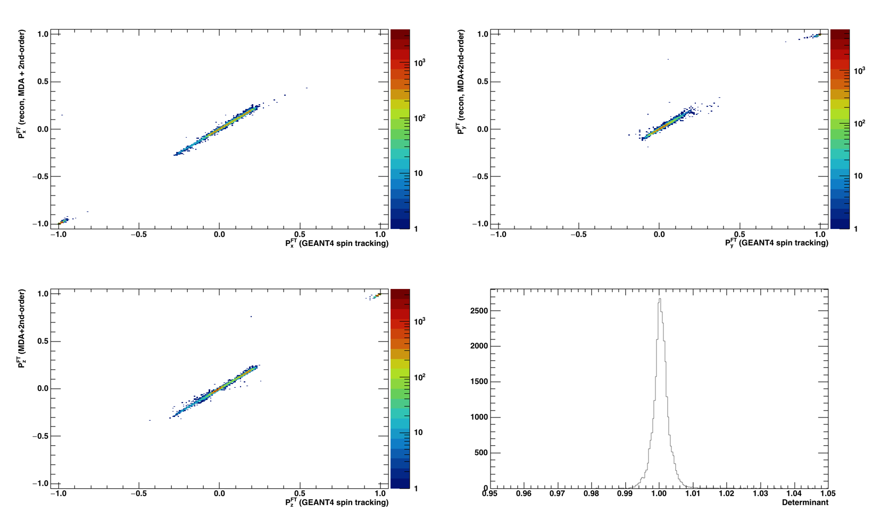
SBS Spin Transport—Quality of 2nd-order fit

Slide 33
GEP electron arm reconstruction and FT track search constraint

Slide 34
Electron Arm Reconstruction—ECAL Clustering
Note: pure elastic ep events, no background!
Curiously, the “missing” energy fraction is about 15% on average. Where is it going? Resolution still about 6%

Slide 35
ECAL final shower coordinate resolution
Note: y offset of ~7.5 mm results from vertical deflection in SBS fringe field

Slide 36
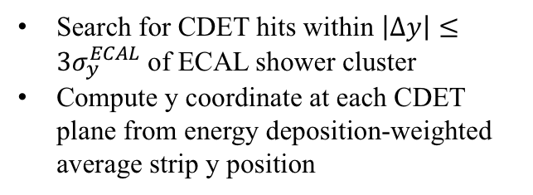
CDET Reconstruction
Search for CDET hits within $\left|Δy\right|≤3σ_{y}^{ECAL}$ of ECAL shower cluster
Compute y coordinate at each CDET plane from energy deposition-weighted average strip y position

Slide 37
Projecting expected elastically scattered proton track to SBS FT—with and without vertex information

Slide 38
FT track projections vs. true vertex z position
Electron angles reconstructed from ECAL/CDET assuming $v_{z}=0$

Slide 39
ECAL shower coordinates—measured vs SBS predicted
Top row: using $θ_{e}(θ_{p})$. Bottom row: using $θ_{e}(p_{p})$

Slide 40
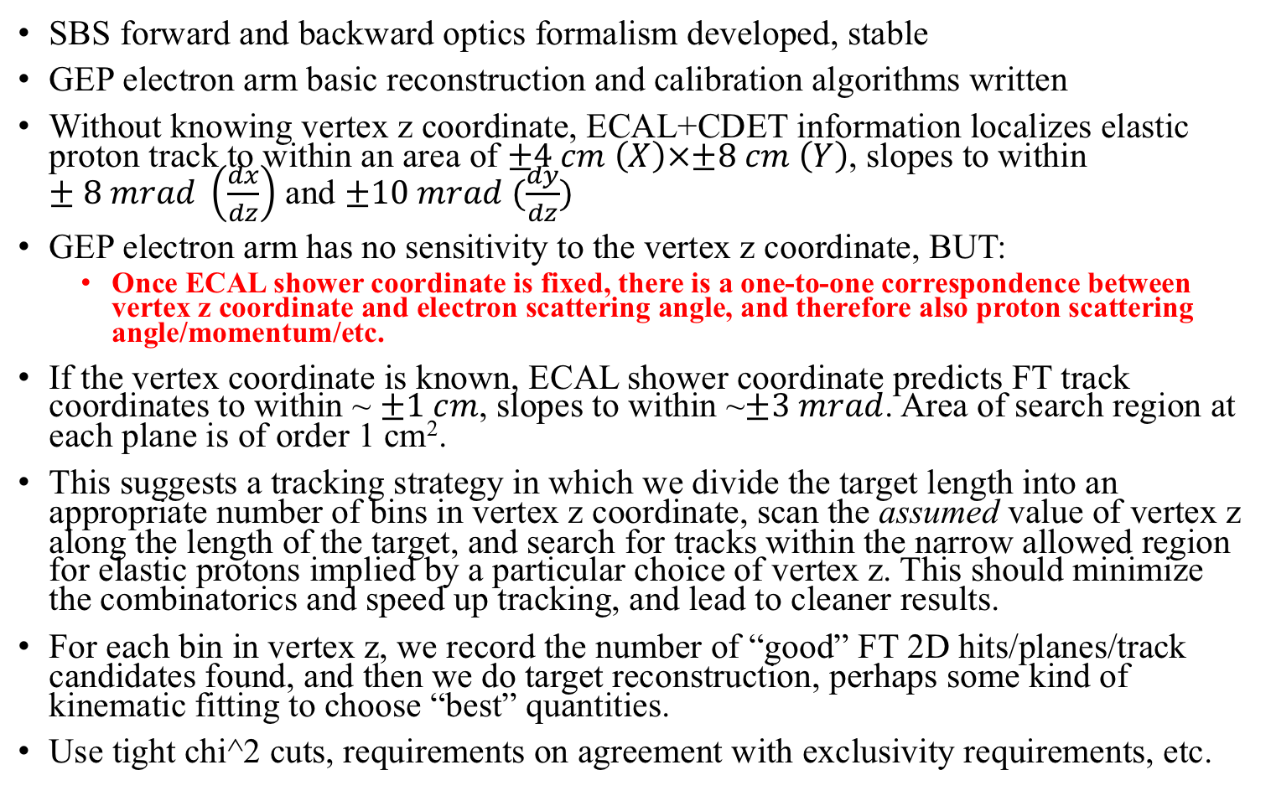
GEP electron arm constraint to FT tracking—conclusions
SBS forward and backward optics formalism developed, stable
GEP electron arm basic reconstruction and calibration algorithms written
Without knowing vertex z coordinate, ECAL+CDET information localizes elastic proton track to within an area of $±4 cm \left(X\right)×±8 cm \left(Y\right)$, slopes to within $±8 mrad \left(\frac{dx}{dz}\right)$ and $±10 mrad (\frac{dy}{dz})$
GEP electron arm has no sensitivity to the vertex z coordinate, BUT:
  Once ECAL shower coordinate is fixed, there is a one-to-one correspondence between vertex z coordinate and electron scattering angle, and therefore also proton scattering angle/momentum/etc.
If the vertex coordinate is known, ECAL shower coordinate predicts FT track coordinates to within ~ $±1 cm$, slopes to within ~$±3 mrad$. Area of search region at each plane is of order 1 cm².
This suggests a tracking strategy in which we divide the target length into an appropriate number of bins in vertex z coordinate, scan the assumed value of vertex z along the length of the target, and search for tracks within the narrow allowed region for elastic protons implied by a particular choice of vertex z. This should minimize the combinatorics and speed up tracking, and lead to cleaner results.
For each bin in vertex z, we record the number of “good” FT 2D hits/planes/track candidates found, and then we do target reconstruction, perhaps some kind of kinematic fitting to choose “best” quantities.
Use tight chi^2 cuts, requirements on agreement with exclusivity requirements, etc.

Slide 41
Near-term simulation priorities
Finalize SIDIS layout—minimize deviations from GEN with the idea of running SIDIS after GEN (before GEP)
Finish simulation digitization (interface to SBS-offline reconstruction code)
Put as much brainpower on the GEP tracking problem as possible (GEP PAC47 jeopardy, UVA “UV” GEM project)
Carry out full simulated experiment analysis for GMN with realistic signal and superimposed background, test offline reconstruction (see Seamus’ talk)

Slide 42
Backup

Slide 43
ECAL-HCAL Kinematic Correlations in “Level 2” Coincidence Trigger
Implement ep angular correlations in the coincidence trigger, by listing for each HCAL trigger sum all ECAL trigger sums exceeding 0.1% of the total event rate

Slide 44
Note on elastic event rates and FOM
Total FT (10.5 < Q² < 14 GeV²): ~25 Hz
Total FPP1 (10.5 < Q² < 14 GeV²): 12 Hz (including small-angle Coulomb)
Total FPP2 (10.5 < Q² < 14 GeV²): 5 Hz (including Coulomb)
If HCAL trigger efficiency for FPP1 events is 70% and FPP2 efficiency is 90%, the total “good event” rate is:
  Rate = 0.7*12 Hz + 0.9 * 5 Hz = 12.9 Hz
Suppose instead that we only used one FPP, with an efficiency of 90%. Then we would have:
  Rate = 0.9*12 Hz = 10.8 Hz
Therefore, efficiency gain from using double-FPP in SBS is about 1.2, not ~1.5 as in GEp-III.
I have assumed that the angular distribution and the average analyzing power are the same for both FPPs

Slide 45
SBS Forward Optics: Recon. Vs. True

Slide 46
SBS Optics: Correlation between “recon” and “true” quantities

Slide 47
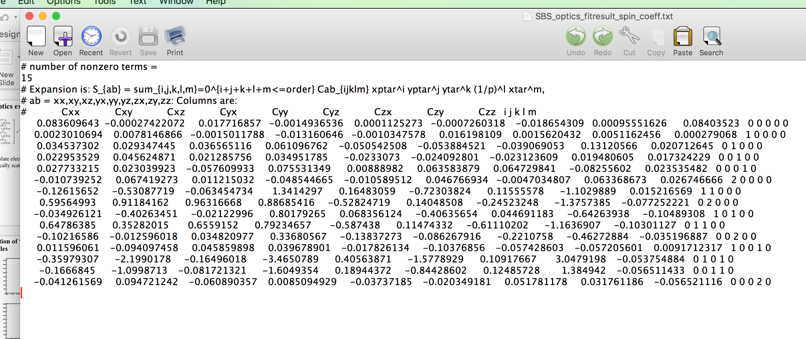
SBS Spin Transport—MDA + 2nd-order corrections
Only 15 expansion terms needed to achieve a good description of SBS spin transport for protons over the 2-11 GeV momentum range

Slide 48
C16 Individual block spectra
Left: Simulated number of photoelectrons in C16 blocks, elastic events
Right: Actual data from prototype (assumption of identical spectra in “undamaged” state, validated by GEANT4, used to simplify gain matching)

Slide 49
C16 Signal Reduction after calibration of model

