Slide 1
SBS physics program—proposed and new
Andrew Puckett
University of Connecticut
SBS Collaboration Winter Meeting
February 26, 2019

Slide 2
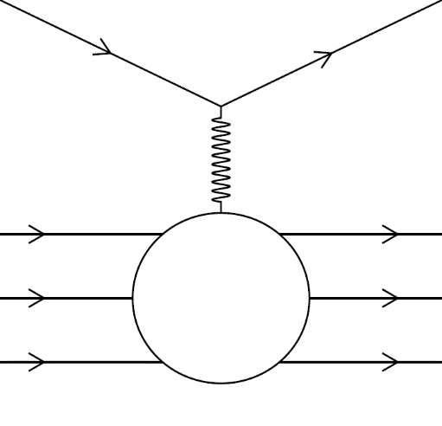





Elastic eN scattering and form factors: formalism
Invariant amplitude for elastic eN scattering in the one-photon-exchange approximation
The most general possible form of the virtual photon-nucleon vertex consistent with Lorentz invariance, parity conservation and gauge invariance is described by two form factors F₁ (Dirac) and F₂ (Pauli):
  F₁ describes the helicity-conserving amplitude (charge and Dirac magnetic moment)
  F₂ describes the helicity-flip amplitude (anomalous magnetic moment contribution)
Sachs Form Factors G_{E} (electric) and G_{M} (magnetic), are experimentally convenient linearly independent combinations of F₁, F₂
Differential cross section in the nucleon rest frame: Rosenbluth formula
Rosenbluth Separation Method: Measure cross section at fixed Q² as a function of ε to obtain G_{E}² (slope) and G_{M}² (intercept).

Slide 3
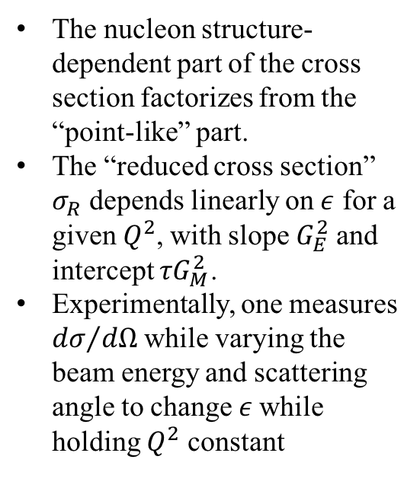
Rosenbluth Separation Method
The nucleon structure-dependent part of the cross section factorizes from the “point-like” part.
The “reduced cross section” $σ_{R}$ depends linearly on $ε$ for a given $Q^{2}$, with slope $G_{E}^{2}$ and intercept $τG_{M}^{2}$.
Experimentally, one measures ${dσ}/{dΩ}$ while varying the beam energy and scattering angle to change $ε$while holding $Q^{2}$ constant
Qattan et al., Phys. Rev. Lett. 94, 142301 (2005)
Andivahis et al., Phys. Rev. D 50, 5491 (1994)

Slide 4
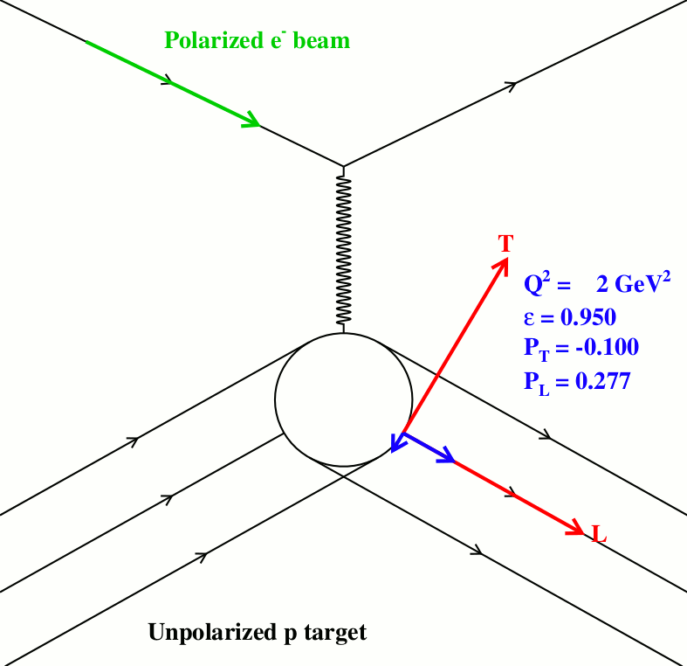
Polarization Transfer in Elastic eN scattering
The polarization transferred to the recoiling proton in the elastic scattering of longitudinally polarized electrons by unpolarized target protons has nonzero components parallel and perpendicular to the momentum transfer in the scattering plane.
The transferred polarization components provide enhanced sensitivity to the electric (magnetic) form factor at large (small) Q².
A simultaneous measurement of both components in a proton polarimeter allows a precise determination of the ratio of form factors in a single kinematic setting, and provides exact cancellations of many systematic uncertainties, such as acceptance/efficiency, polarimeter instrumental asymmetry and analyzing power, beam polarization, etc., making the method both statistically precise and systematically robust.
Rapidly falling elastic ep cross section and polarimeter figure-of-merit at large Q² necessitate high luminosity, high duty-cycle, and large acceptance. Such measurements can only presently be performed using CEBAF@JLab.
The ratio of transferred polarization components is directly proportional to G_{E}/G_{M}, and therefore much more sensitive to G_{E} at large Q² than the cross section

Slide 5
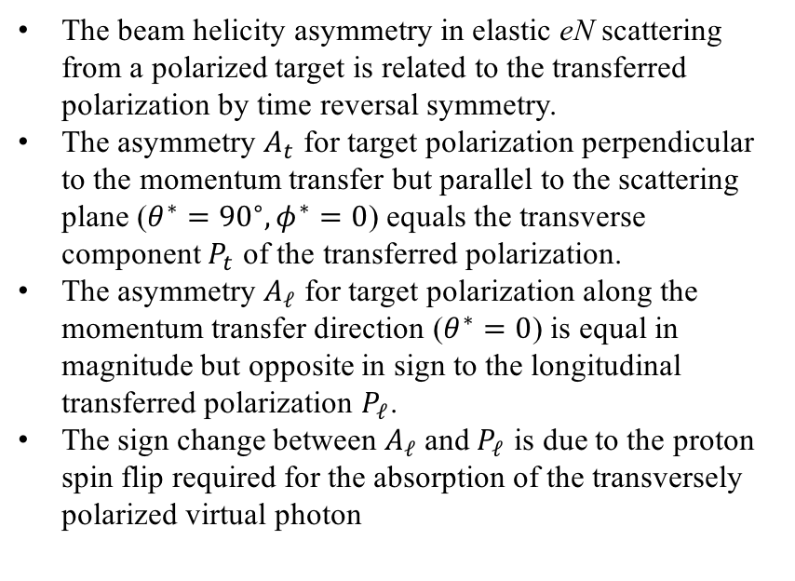
Polarized Beam-Polarized Target Asymmetry
The beam helicity asymmetry in elastic eN scattering from a polarized target is related to the transferred polarization by time reversal symmetry.
The asymmetry $A_{t}$ for target polarization perpendicular to the momentum transfer but parallel to the scattering plane ($θ^{∗}={90}^{∘}, φ^{∗}=0$) equals the transverse component $P_{t}$ of the transferred polarization.
The asymmetry $A_{ℓ}$ for target polarization along the momentum transfer direction ($θ^{∗}=0$) is equal in magnitude but opposite in sign to the longitudinal transferred polarization $P_{ℓ}$.
The sign change between $A_{ℓ}$ and $P_{ℓ}$ is due to the proton spin flip required for the absorption of the transversely polarized virtual photon

Slide 6
Motivation—Why are we still interested in pushing elastic FF measurements to yet higher Q², when the measurements are so difficult?

Slide 7
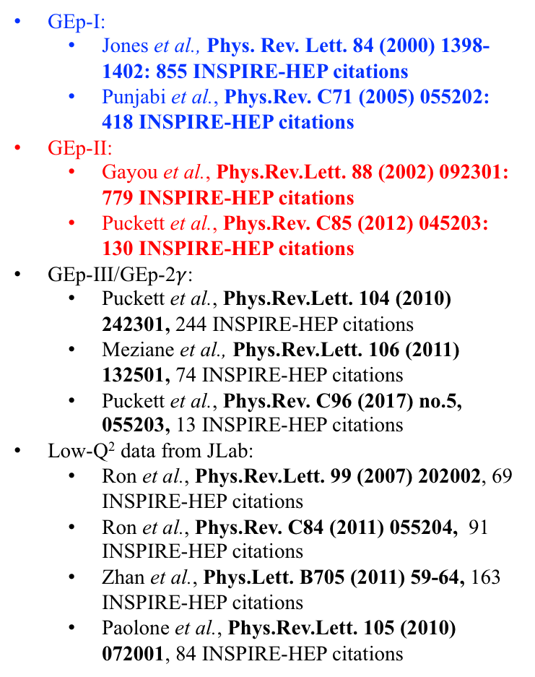
GEp/GMp polarization transfer data are among the most-cited JLab results
GEp-I:
  Jones et al., Phys. Rev. Lett. 84 (2000) 1398-1402: 855 INSPIRE-HEP citations
  Punjabi et al., Phys.Rev. C71 (2005) 055202: 418 INSPIRE-HEP citations
GEp-II:
  Gayou et al., Phys.Rev.Lett. 88 (2002) 092301: 779 INSPIRE-HEP citations
  Puckett et al., Phys.Rev. C85 (2012) 045203: 130 INSPIRE-HEP citations
GEp-III/GEp-2$γ$:
  Puckett et al., Phys.Rev.Lett. 104 (2010) 242301, 244 INSPIRE-HEP citations
  Meziane et al., Phys.Rev.Lett. 106 (2011) 132501, 74 INSPIRE-HEP citations
  Puckett et al., Phys.Rev. C96 (2017) no.5, 055203, 13 INSPIRE-HEP citations
Low-Q² data from JLab:
  Ron et al., Phys.Rev.Lett. 99 (2007) 202002, 69 INSPIRE-HEP citations
  Ron et al., Phys.Rev. C84 (2011) 055204, 91 INSPIRE-HEP citations
  Zhan et al., Phys.Lett. B705 (2011) 59-64, 163 INSPIRE-HEP citations
  Paolone et al., Phys.Rev.Lett. 105 (2010) 072001, 84 INSPIRE-HEP citations

Slide 8
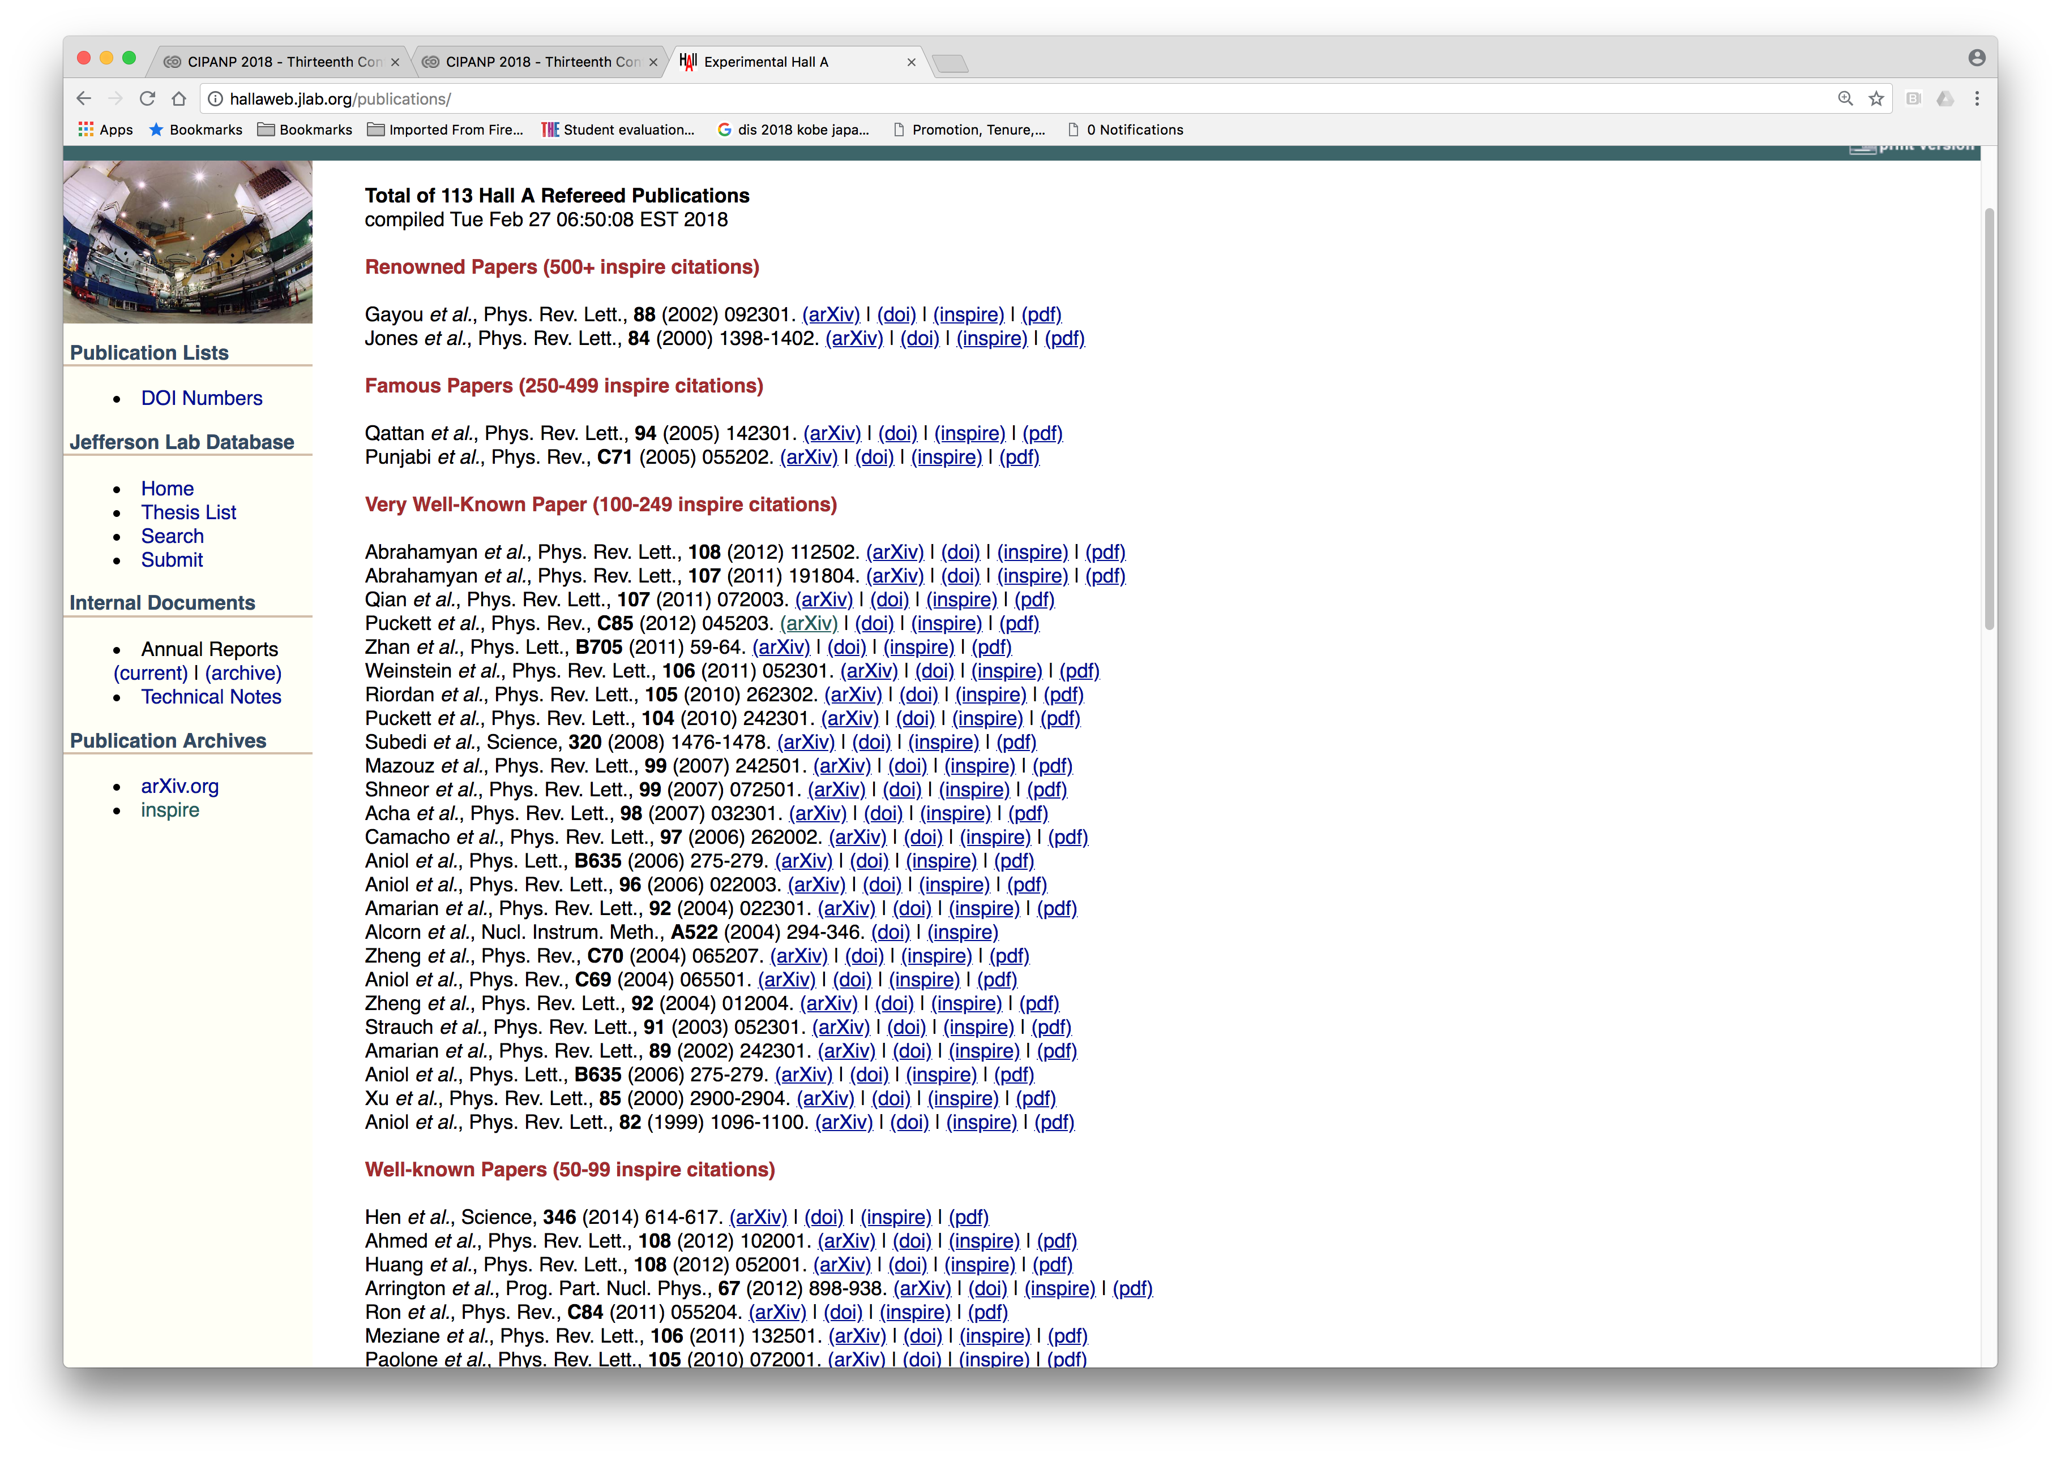
Doug Higinbotham’s listing of “Hall A” publications by citation count:
Papers directly related to Elastic nucleon EMFFs

Slide 9
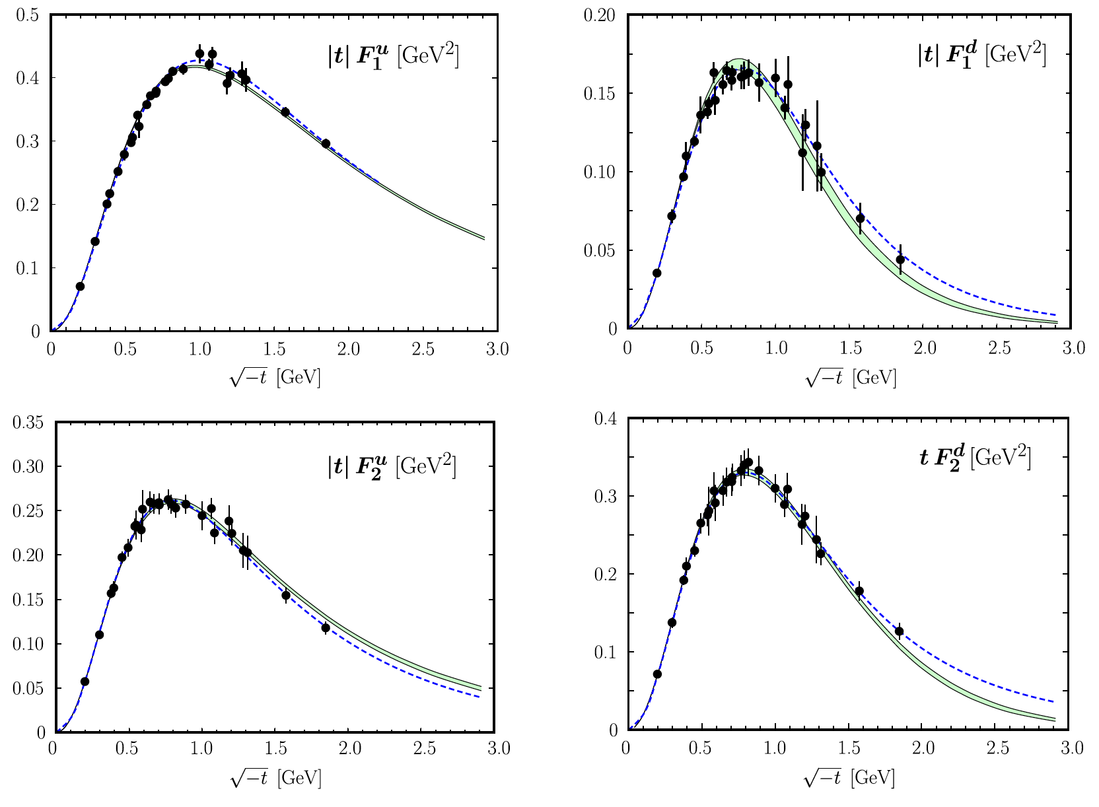
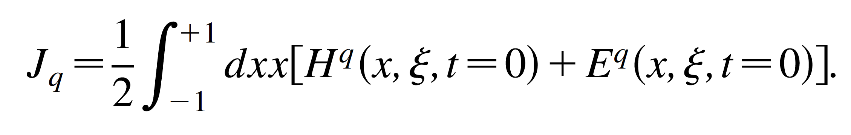
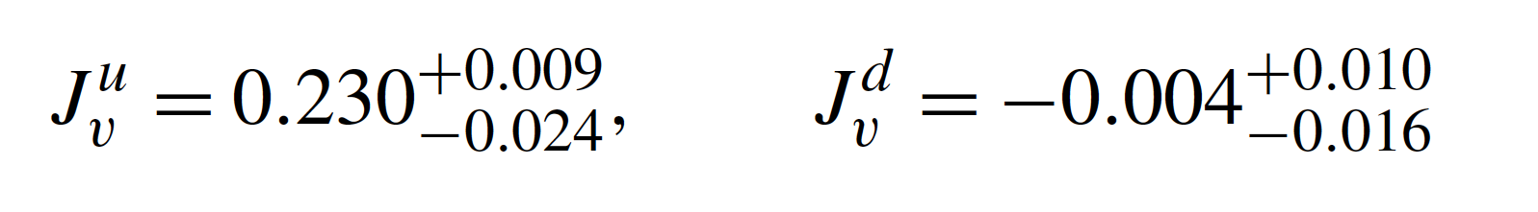
High-Q² Nucleon Form Factors, GPDs and Spin
Flavor decomposition of nucleon EMFFs (neglecting strangeness):
Quark flavor FFs are integrals of valence quark GPDs H and E at zero skewness :
Phys.Rev.Lett. 78 (1997) 610-613: Ji sum rule for total angular momentum
Diehl, Kroll. Eur. Phys. J. C (2013) 73:2397
FF data + forward PDFs from global DIS fits → model-dependent extraction of GPDs
Compute valence-quark contributions to the Ji sum rule:

Slide 10
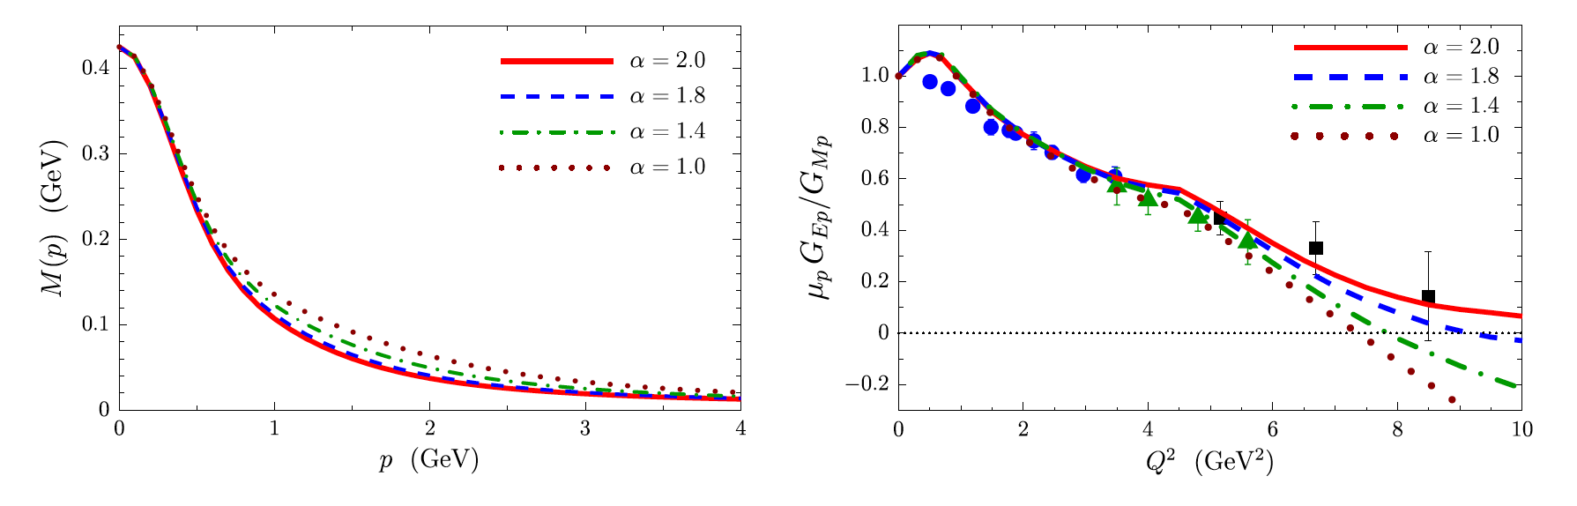
Exposing the dressed-quark mass function
In the framework of Dyson-Schwinger equations, the high-Q² nucleon FFs (Q² > 5 GeV²) are especially sensitive to momentum-dependent dressed-quark mass function in the few-GeV region, see e.g.,:
I. Cloet, C. Roberts, A. Thomas: “Revealing Dressed Quarks via the Proton’s Charge Distribution”, PRL 111, 101803 (2013)
I. Cloet and C. Roberts: “Explanation and Prediction of Observables Using Continuum Strong QCD”, arxiv:1310.2651v2 (2013), PPNP 77 (2014), 1-69

Slide 11
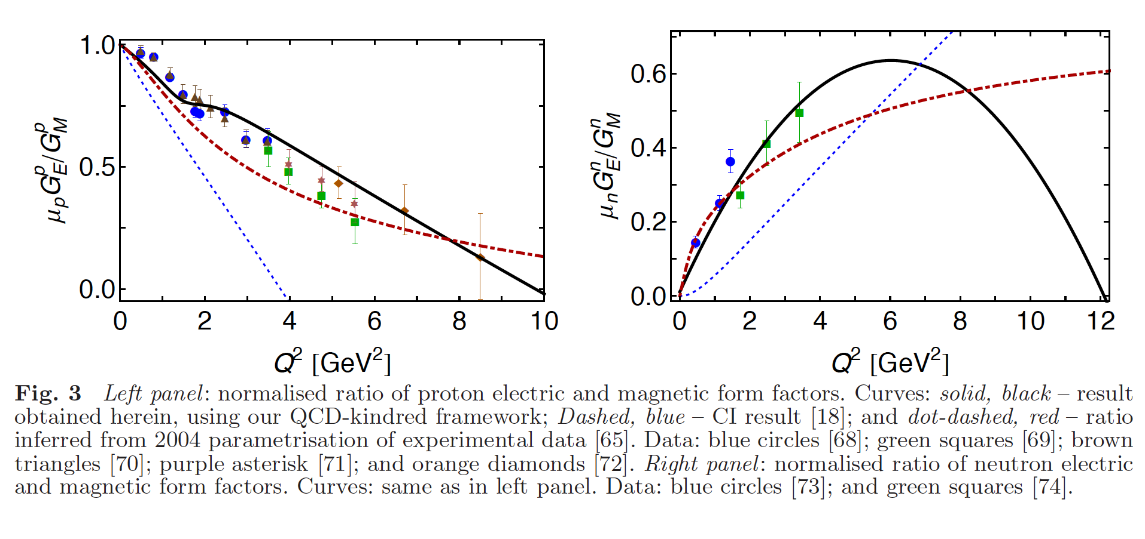
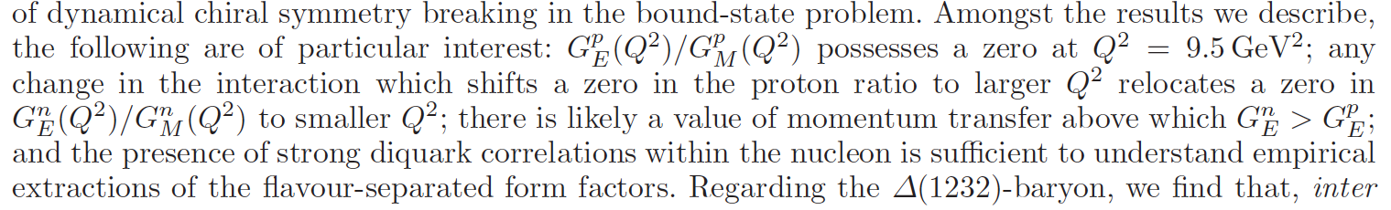
Dyson-Schwinger Equations, diquark correlations, and zero crossings of G_{Ep}, G_{En}
J. Segovia, I. Cloet and C. Roberts: Few-Body Syst. 55, 1185 (2014)
Quote from the abstract:

Slide 12
Reaching high Q² in Lattice QCD
A. J. Chambers et al., (QCDSF/UKQCD/CSSM Collaborations) Phys. Rev. D 96, 114509 (2017)
Novel application of the Feynman-Hellman method: relates hadronic matrix elements to energy shifts, allowing access to form factors via two-point correlators as opposed to more complicated three-point functions; improves signal-to-noise ratio for high-momentum states

Slide 13
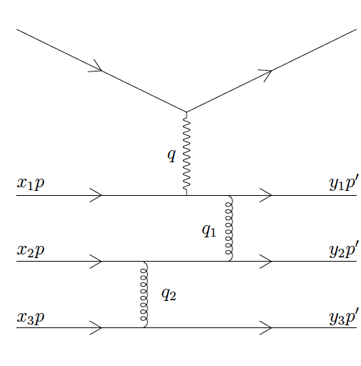
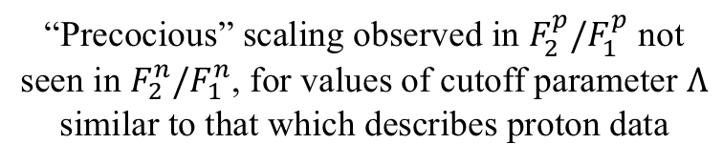
Transition to pQCD–onset of dimensional scaling?
Brodsky, Farrar, PRD 11, 1309 (1975)
Brodsky, Lepage PRL 43, 545 (1979)
Belitsky, Ji, Yuan, PRL 91, 092003 (2003)
“Precocious” scaling observed in $F_{2}^{p}/F_{1}^{p}$ not seen in $F_{2}^{n}/F_{1}^{n}$, for values of cutoff parameter $Λ$ similar to that which describes proton data

Slide 14
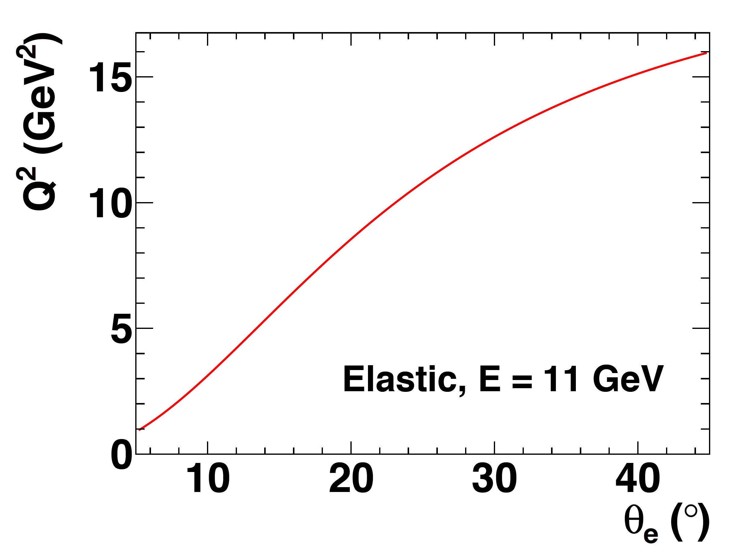
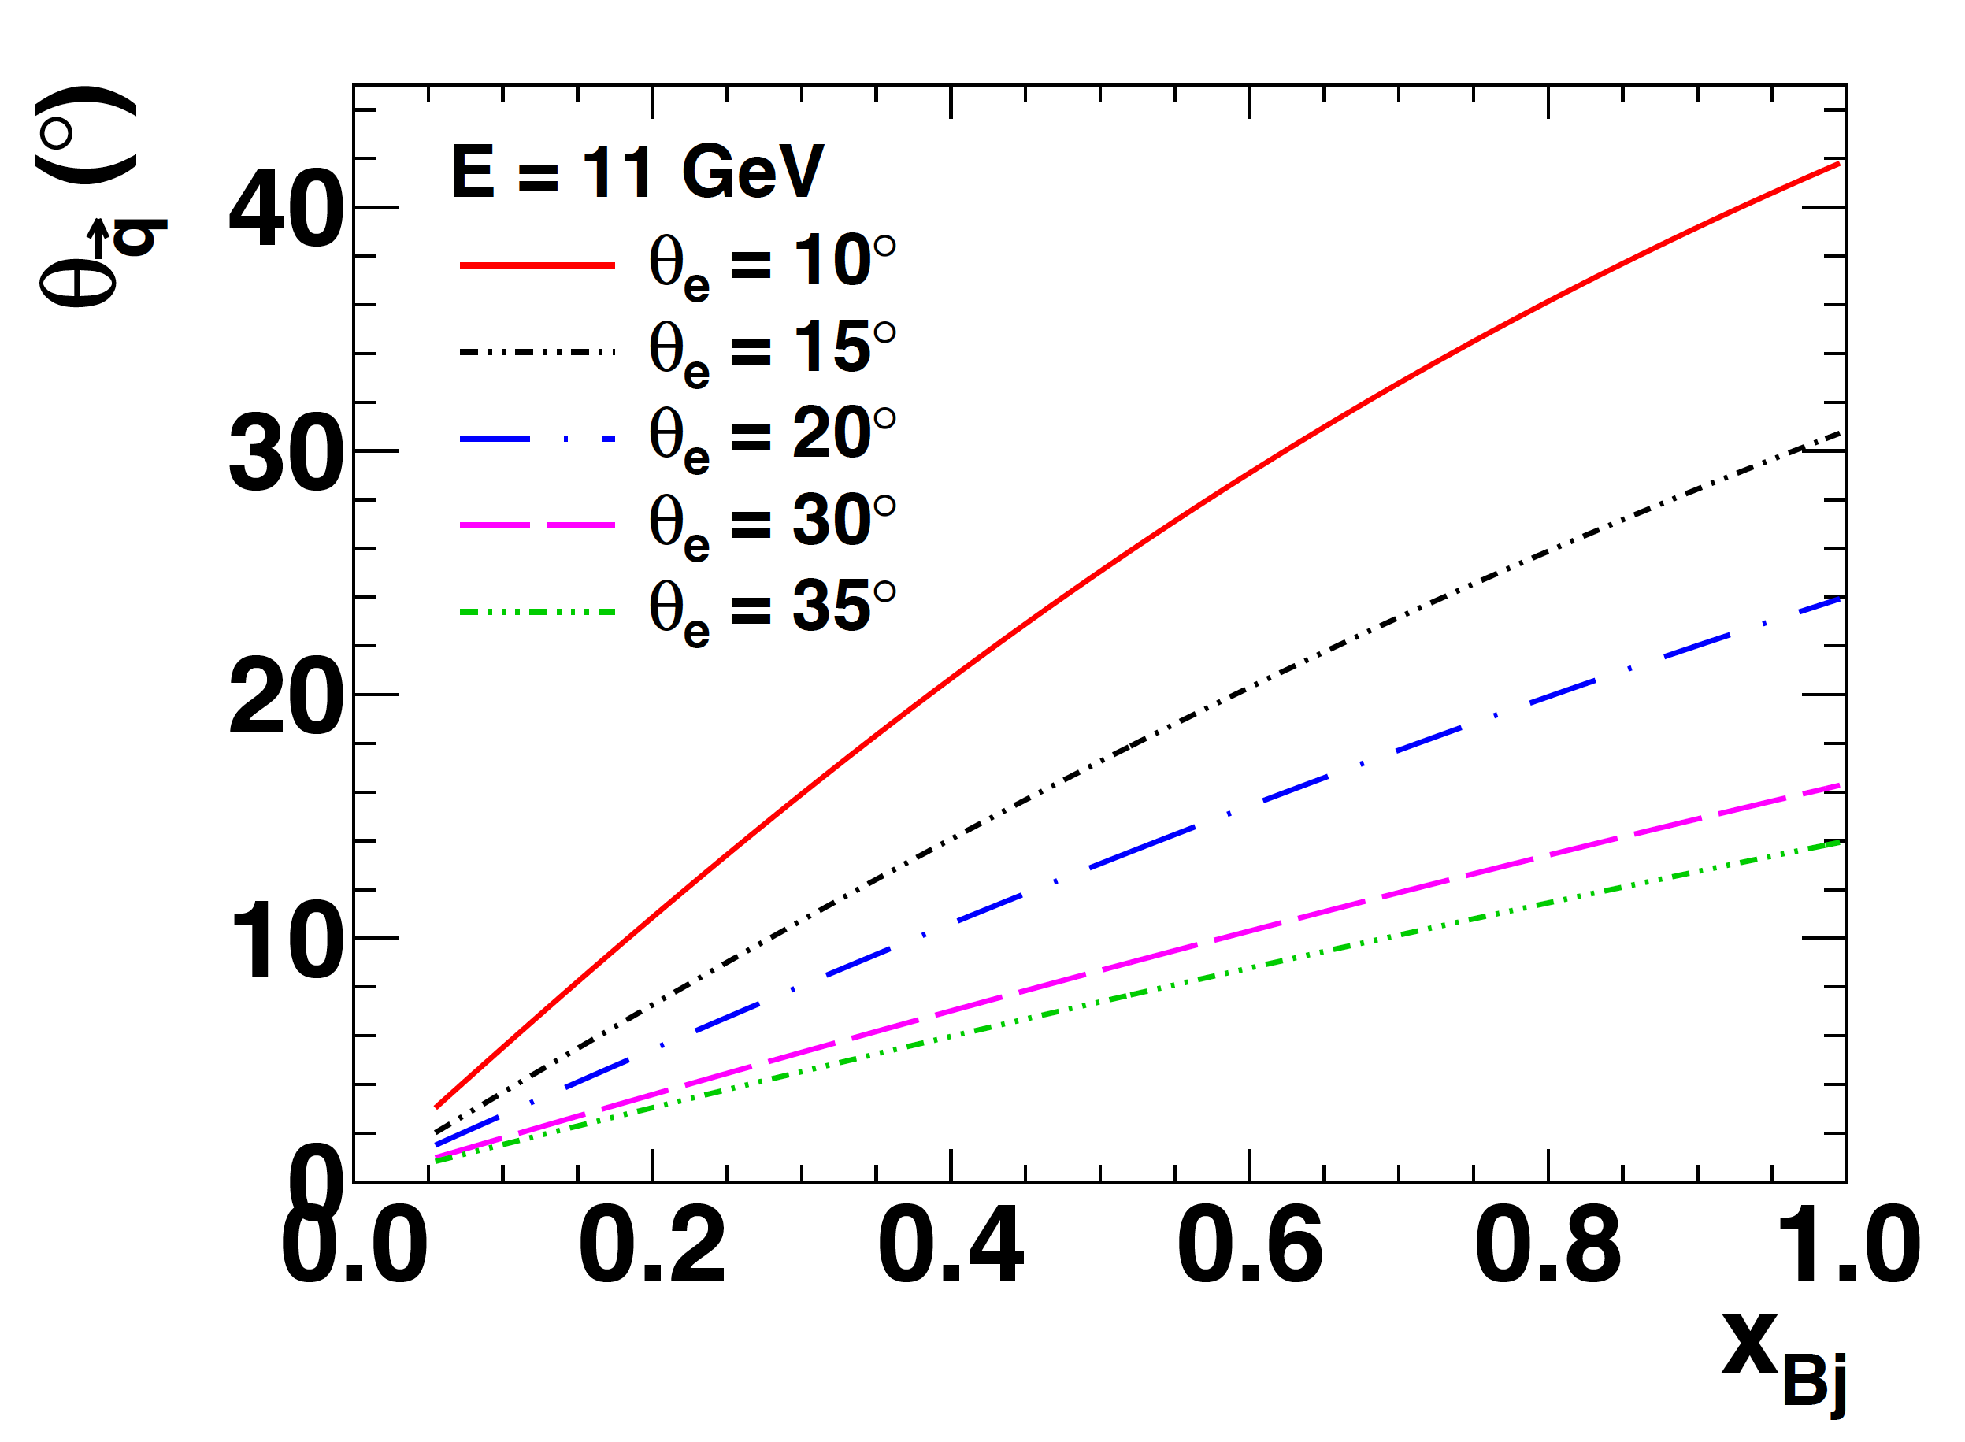
Electron Scattering Kinematics @11 GeV
Measurements of elastic FFs, SIDIS, DVCS, etc involve coincidence N(e,e’X) (electroproduction) reactions, where X =
  N’ (elastic or quasi-elastic)
  h (SIDIS or DVMP)
  γ (DVCS)
Virtual photon angle decreases as “inelasticity” increases:
Particles associated with the partonic (or other) degree of freedom that absorbed the virtual photon are found predominantly near the direction of the momentum transfer q
Partonic interpretation of electron scattering data is accessible at large Q²→ particles of interest are located at forward angles and high momentum

Slide 15
Figure credit: B. Wojtsekhowski (JLab)
LH₂/LD₂
SoLID-SIDIS (6-22 deg)
Polarized ³He
Polarized NH₃/ND₃
Complementary equipment/capabilities of Halls A, B, C allow optimal matching of (Luminosity x Acceptance) of the detectors to the luminosity capabilities of the targets, including state-of-the-art polarized target technology.

Slide 16
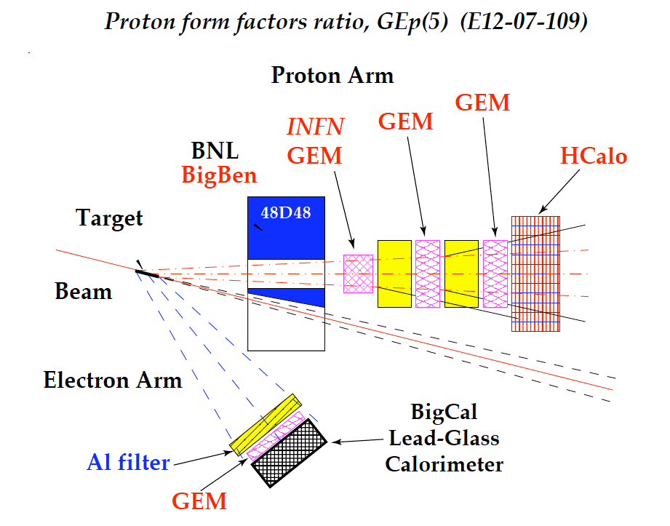
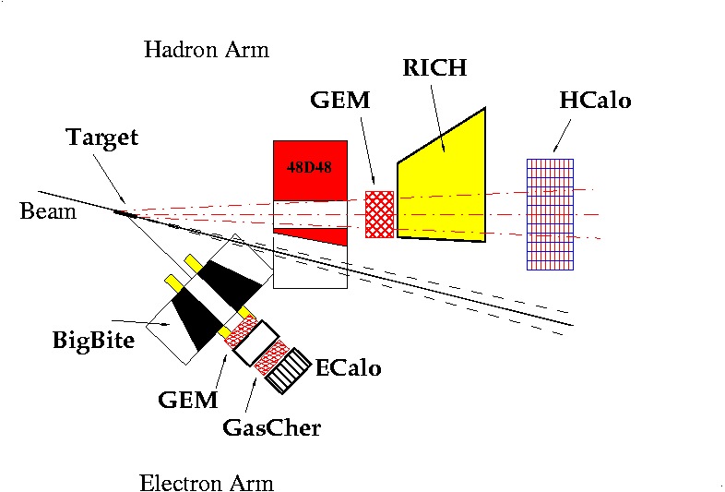
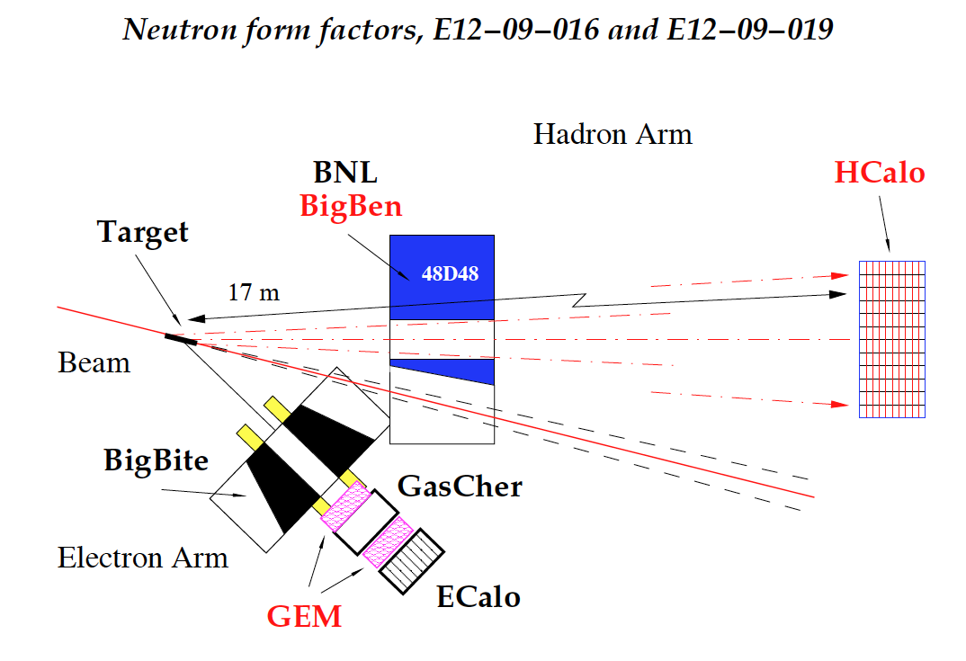
The Super BigBite Spectrometer in Hall A
SIDIS transverse single-spin asymmetry experiment: E12-09-018
What is SBS? → A 2.5 T*m dipole magnet with vertical bend, a cut in the yoke for passage of the beam pipe to reach forward scattering angles, and a flexible/modular configuration of detectors.
Designed to operate at luminosities up to 10³⁹ cm⁻² s⁻¹ with large momentum bite, moderate solid angle
Time-tested “Detectors behind a dipole magnet”, two-arm coincidence approach—historically most productive in fixed-target expts.
Large solid-angle + high luminosity @ forward angles = most interesting physics!

Slide 17
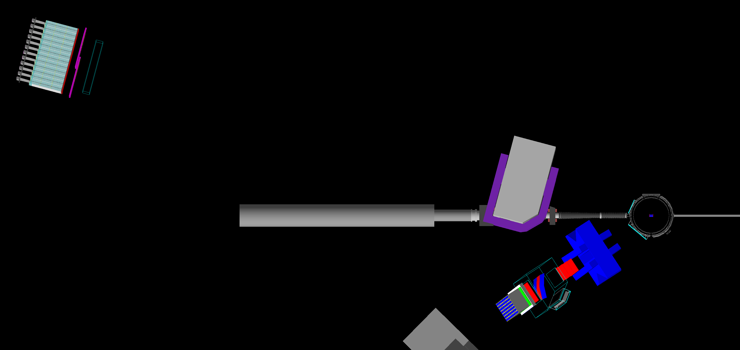
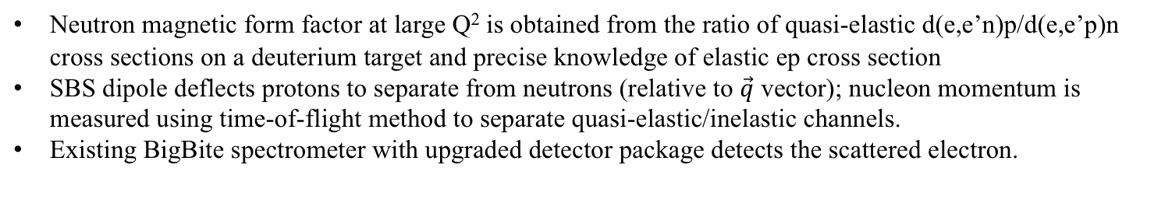
E12-09-019—Neutron Magnetic FF $G_{M}^{n}$ to $Q^{2}=13.5 GeV^{2}$
First SBS experiment: JLab Experimental Readiness Review (ERR) completed 2017, projected installation/start of SBS program in 2020
Neutron/proton Arm: SBS dipole, HCAL, and coordinate detector (not shown) for charged-particle veto
10-cm liquid deuterium/hydrogen target (luminosity ~ 2 × 10³⁸)
Electron arm: BigBite Spectrometer
Neutron magnetic form factor at large Q² is obtained from the ratio of quasi-elastic d(e,e’n)p/d(e,e’p)n cross sections on a deuterium target and precise knowledge of elastic ep cross section
SBS dipole deflects protons to separate from neutrons (relative to $\vec{q}$ vector); nucleon momentum is measured using time-of-flight method to separate quasi-elastic/inelastic channels.
Existing BigBite spectrometer with upgraded detector package detects the scattered electron.

Slide 18
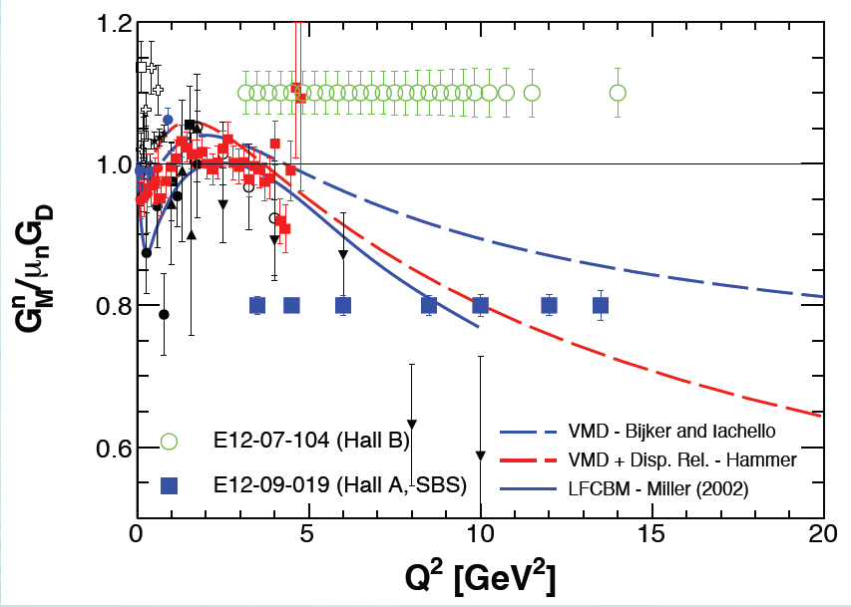
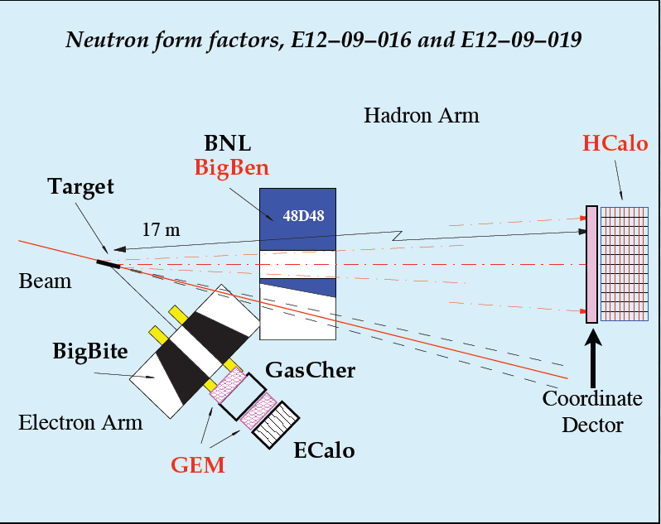
SBS G_{Mn} projected Results
SBS as neutron arm w/48D48 + HCAL
Magnet sweeps charged particles out of acceptance, limiting backgrounds and ”CDet” acts as charged-particle veto
BigBite as electron arm w/upgraded 12 GeV detector package (including re-use of GEMs, built for GEP, not otherwise in use during BigBite expt’s.)
Standard LH2/LD2 target
Different detection method—different (and smaller) systematics; complementary to CLAS12 G_{Mn} measurement
  Overlapping collaborations between CLAS12 and SBS experiments.

Slide 19
Neutron form factors—G_{En} existing data
Riordan et al., Phys. Rev. Lett. 105, 262302 (2010)
Schlimme et al., Phys.Rev.Lett. 111 (2013), 132504
G_{En} is the least well-known and most difficult to measure of the nucleon EMFFs:
  Goes to zero at low Q² and cross-section contribution is small at large Q²
Existing knowledge at “large” Q² (considered to be reliable) is based on polarization observables:
  Beam-target double-spin asymmetry in semi-exclusive quasi-elastic ³He(e,e’n)pp
  Beam-target double-spin asymmetry in semi-exclusive quasi-elastic ²H(e,e’n)p
  Neutron recoil polarimetery: d(e,e’n)p

Slide 20
GEN via Recoil Polarization—E12-17-004

Slide 21
E12-17-004 (Continued)

Slide 22
E12-17-004 Projected Results

Slide 23
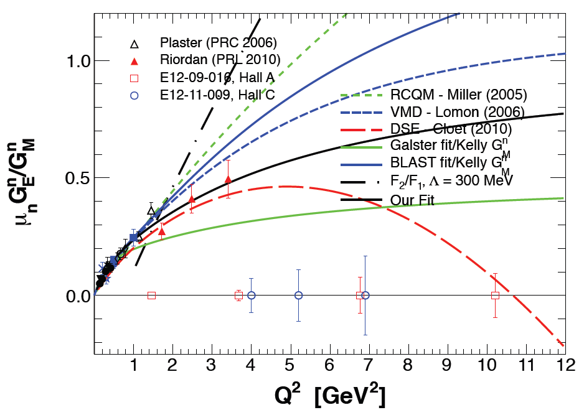
Experiment E12-09-016 (G_{En} at large Q²)
Detector configuration same as GMN experiment
Upgraded, high-luminosity polarized ³He target based on spin-exchange optical pumping and convection-driven circulation of polarized gas between optical pumping chamber and target chamber.
Will reach Q² = 10 GeV² in 50 days (approximately tripling Q² reach of the data)
Conceptual and Engineering Designs of Polarized ³He target

Slide 24
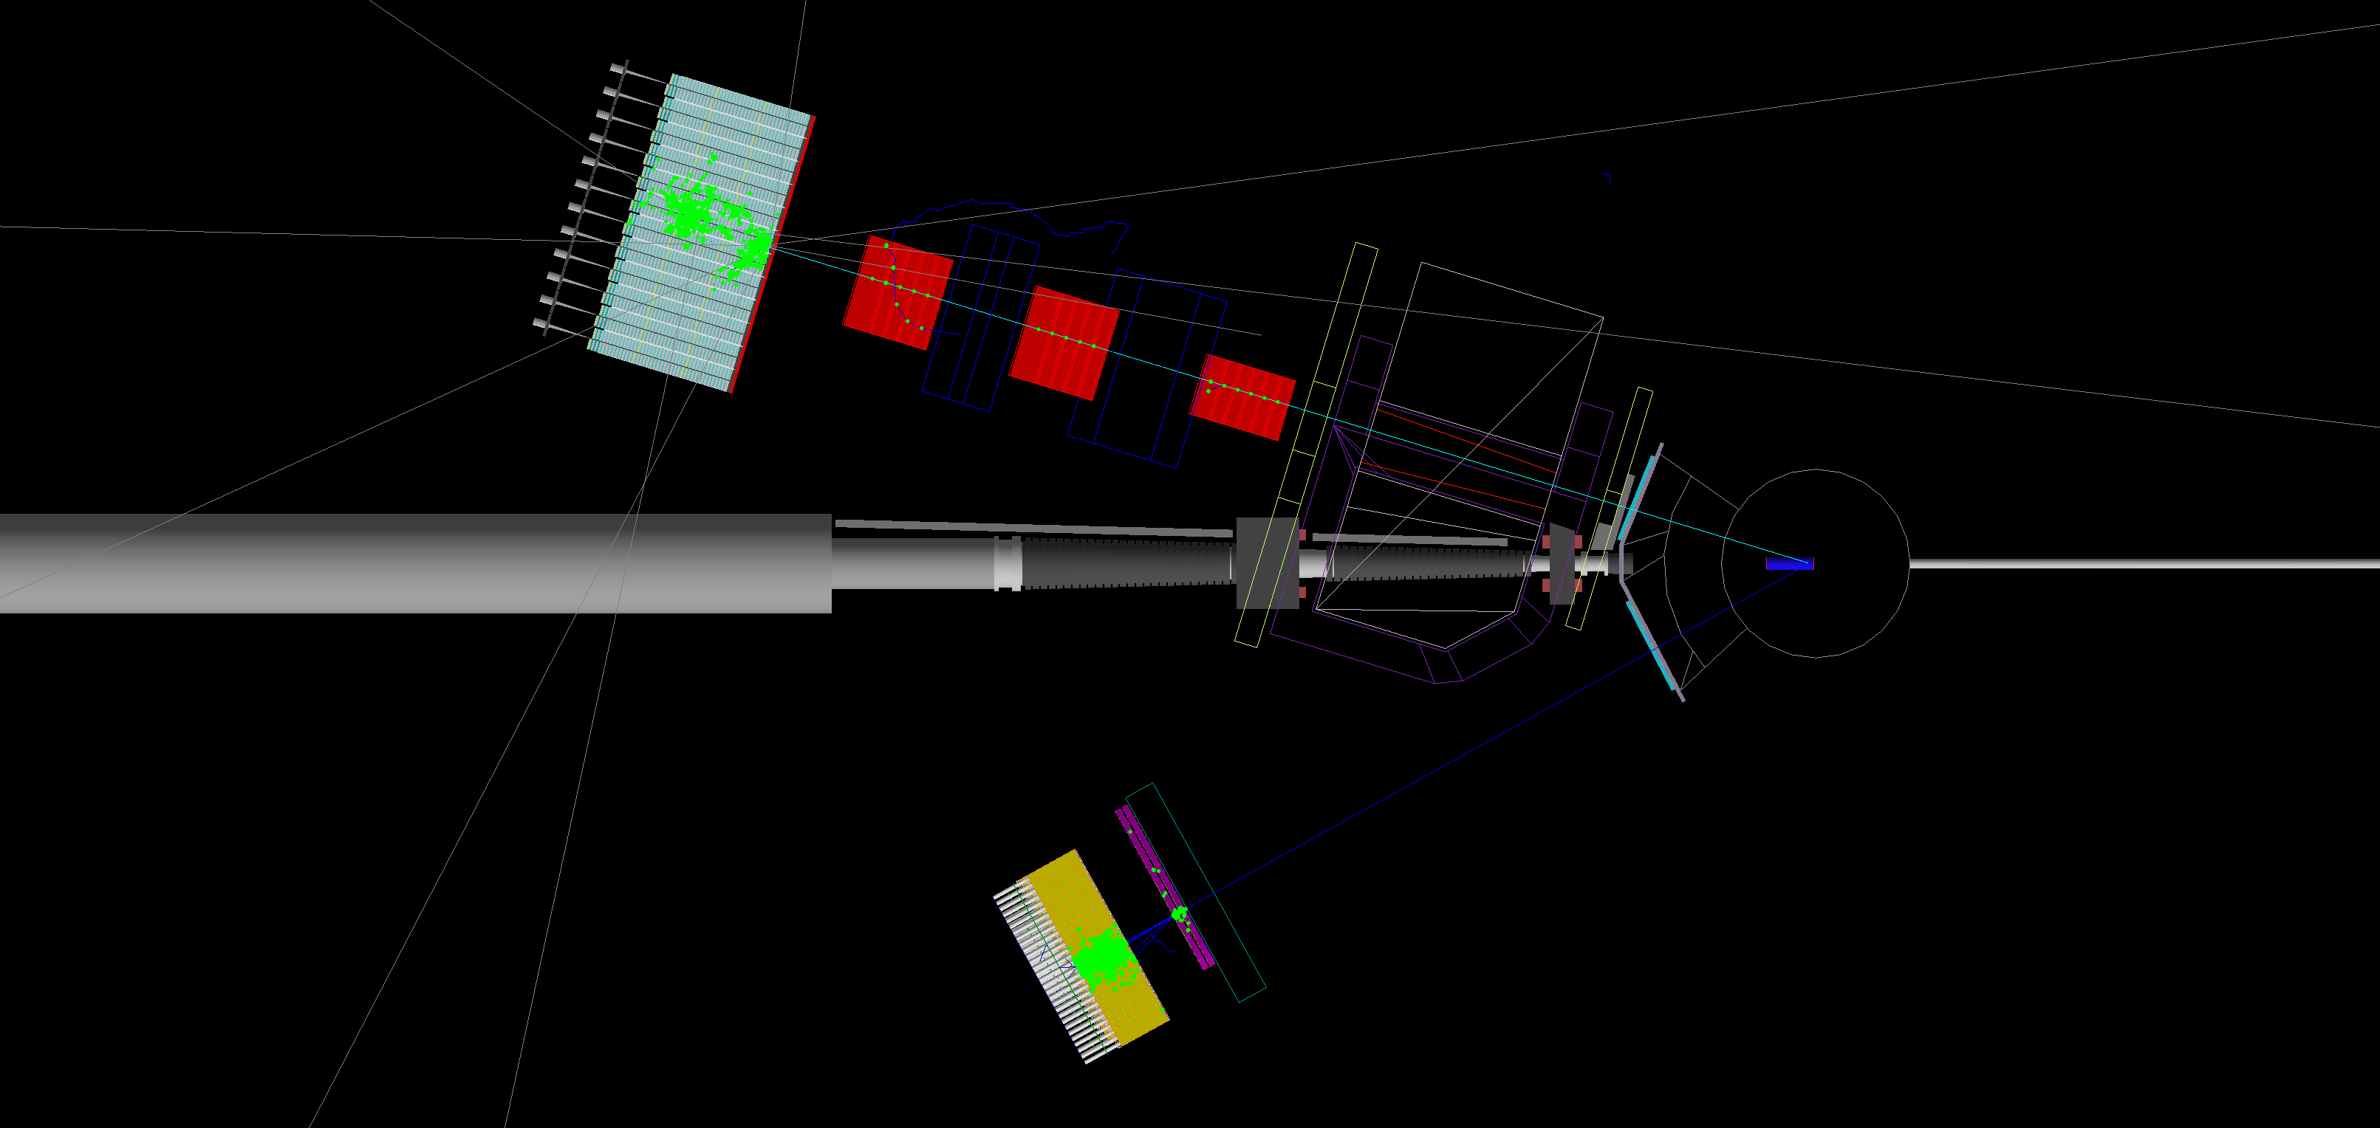
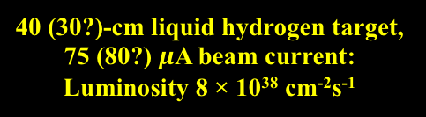
Experiment E12-07-109 (G_{Ep}/G_{Mp} at large Q²)
Proton Arm: SBS dipole, GEM trackers and CH₂ analyzers for proton polarimetry, iron-scintillator HCAL for trigger
40 (30?)-cm liquid hydrogen target, 75 (80?) $μ$A beam current: Luminosity 8 × 10³⁸ cm⁻²s⁻¹
Electron arm: Lead-glass EM calorimeter and scintillator based coordinate detector
(Screenshots from SBS GEANT4 simulation)
Original motivation for SBS concept. Need large solid angle to overcome rapidly falling cross section at large Q² in elastic ep scattering. New double proton polarimeter with GEM-based tracking and hadronic calorimeter-based trigger
Lead-glass electromagnetic calorimeter to detect the scattered electron in coincidence (using two-body kinematic correlations to aid tracking in high-rate environment and reject inelastic background events); also provides a selective trigger for high-energy electrons.

Slide 25
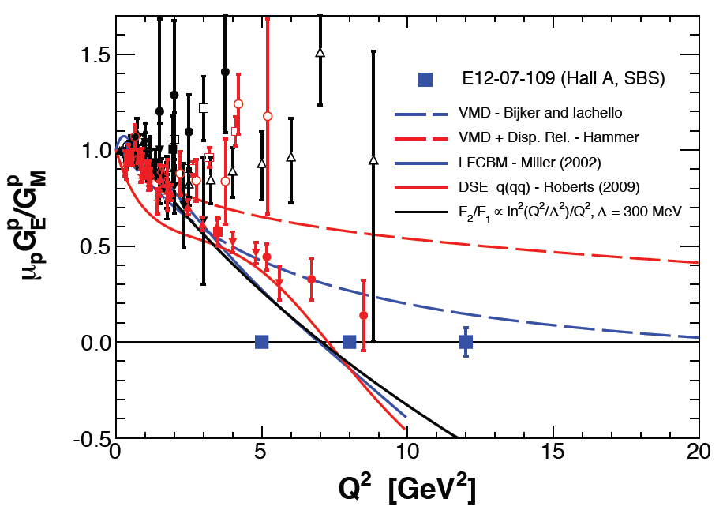
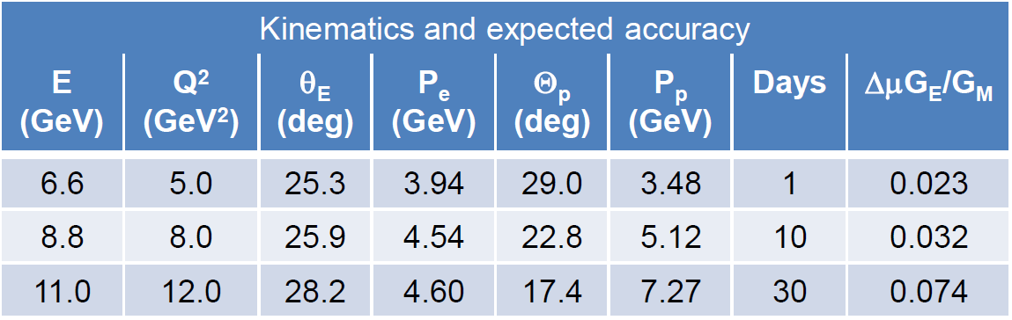
SBS G_{E}^{p} Projected Results
The SBS GEP experiment in ~11 days running will dramatically improve the statistical precision in μG_{E}/G_{M} at Q² in the range overlapping GEp-II/III, and in 30 days will reach comparable precision at 12 GeV² to that of GEp-II/III at 5-6 GeV²
Data of such precision carry significant discovery potential and may (or may not) settle the questions of a zero crossing of G_{E}^{p} and the onset (or lack thereof) of dimensional scaling.
Combined with GEN, GMN, GMP experiments, full flavor decomposition of F₁ and F₂ becomes possible up to 10 GeV²

Slide 26
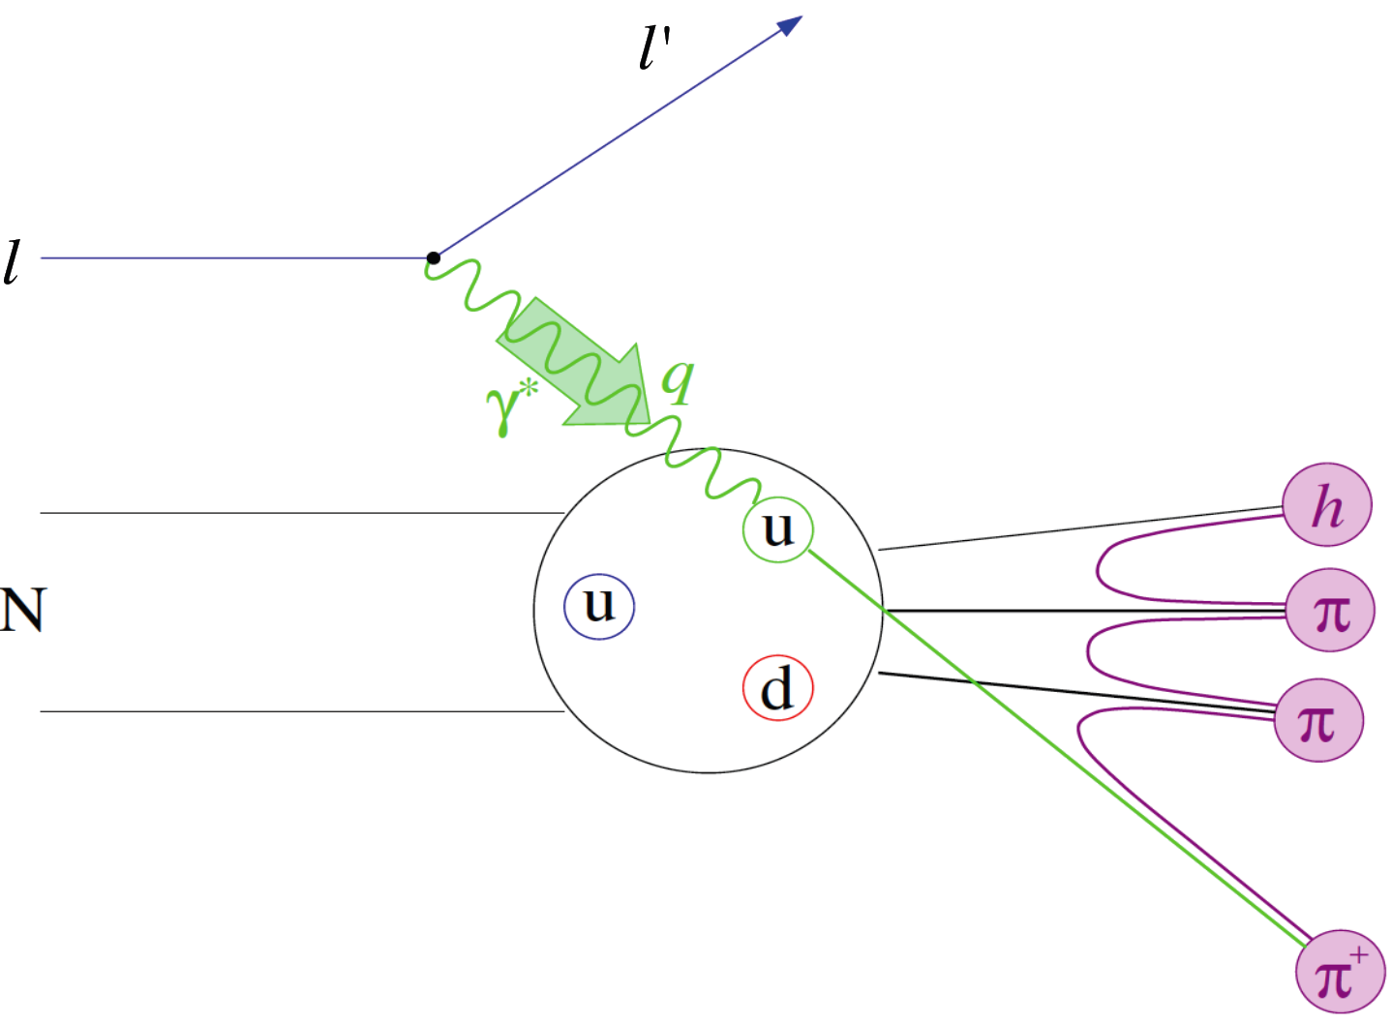
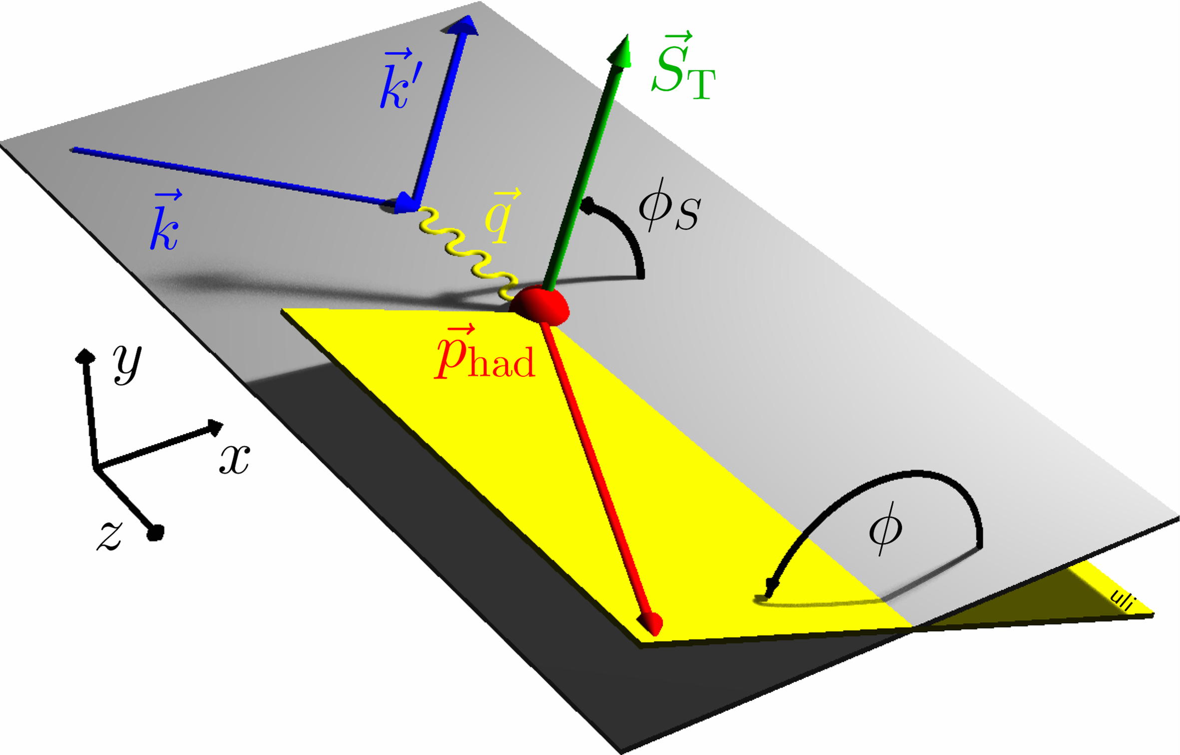
Semi-Inclusive Deep Inelastic Scattering
Detecting leading (high-energy) hadrons in DIS, N(e,e’h)X provides sensitivity to additional aspects of the nucleon’s partonic structure not accessible in inclusive DIS:
  quark flavor
  quark transverse motion
  quark transverse spin
Goal of SIDIS studies is (spin-correlated) 3D imaging of nucleon’s quark structure in momentum space.
Transverse Momentum Dependent (TMD) PDF formalism: Bacchetta et al. JHEP 02 (2007) 093, Boer and Mulders, PRD 57, 5780 (1998), etc, etc...

Slide 27




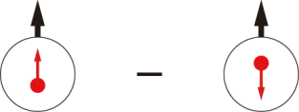
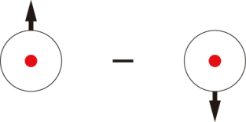
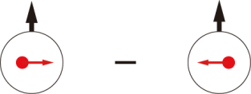
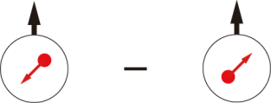
Quark-parton Model Interpretation of SIDIS: Transverse Momentum Dependent PDFs (TMDs)
 |  | Quark polarization
 |  | Unpolarized (U) | Longitudinally Polarized (L) | Transversely Polarized (T)
Nucleon Polarization | U
 | L
 | T

Slide 28
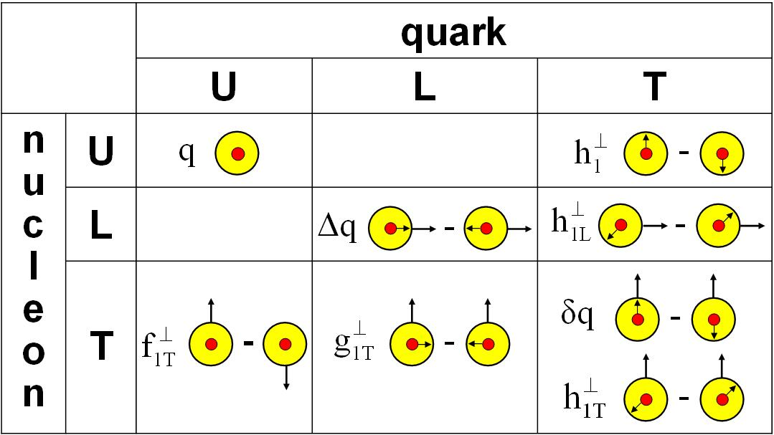
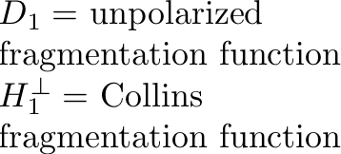
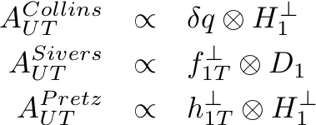
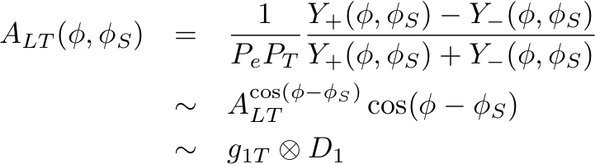
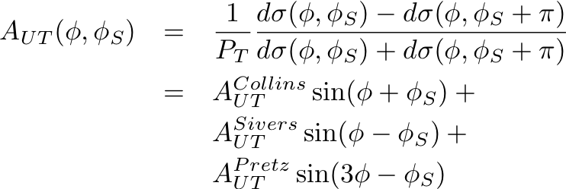
Transverse target spin effects in SIDIS
Transverse target spin-dependent cross section for SIDIS
Collins effect—chiral-odd quark transversity DF; chiral-odd Collins FF
Sivers effect—access to quark OAM and QCD FSI mechanism
“Transversal helicity” g_{1T}—real part of S wave-P wave interference (Sivers = imaginary part) (requires polarized beam)
“Pretzelosity” or Mulders-Tangerman function—interference of wavefunction components differing by 2 units of OAM

Slide 29
Transversity and Collins Functions: Existing Knowledge
Anselmino et al., Phys. Rev. D 92, 114023 (2015) arXiv:1510.05389v1: latest extractions of valence u and d quark transversities and favored/unfavored Collins FFs
SIDIS data from HERMES on proton target, COMPASS on proton and deuteron targets
Data on azimuthal asymmetries in e⁺/e⁻ annihilation to pion pairs from BELLE and BaBar collaborations—recent, high statistical precision
First look at combined z and p_{T} dependencies of Collins FFs.
Note—d quark transversity is poorly constrained—proton data dominated by u quarks, limited sensitivity to d from COMPASS deuteron and JLab Hall A ³He data.

Slide 30
Sivers effect—Existing knowledge
Anselmino et al., Phys.Rev. D86 (2012) 014028, arXiv:1204.1239v1
Fits to most recent HERMES and COMPASS SIDIS Sivers data with TMD/DGLAP evolution
As in the case of Collins/Transversity, d-quark Sivers is poorly constrained by existing data
  Proton data dominated by u-quarks
  Limited precision/sensitivity to d quark from COMPASS deuteron/JLab Hall A ³He data

Slide 31
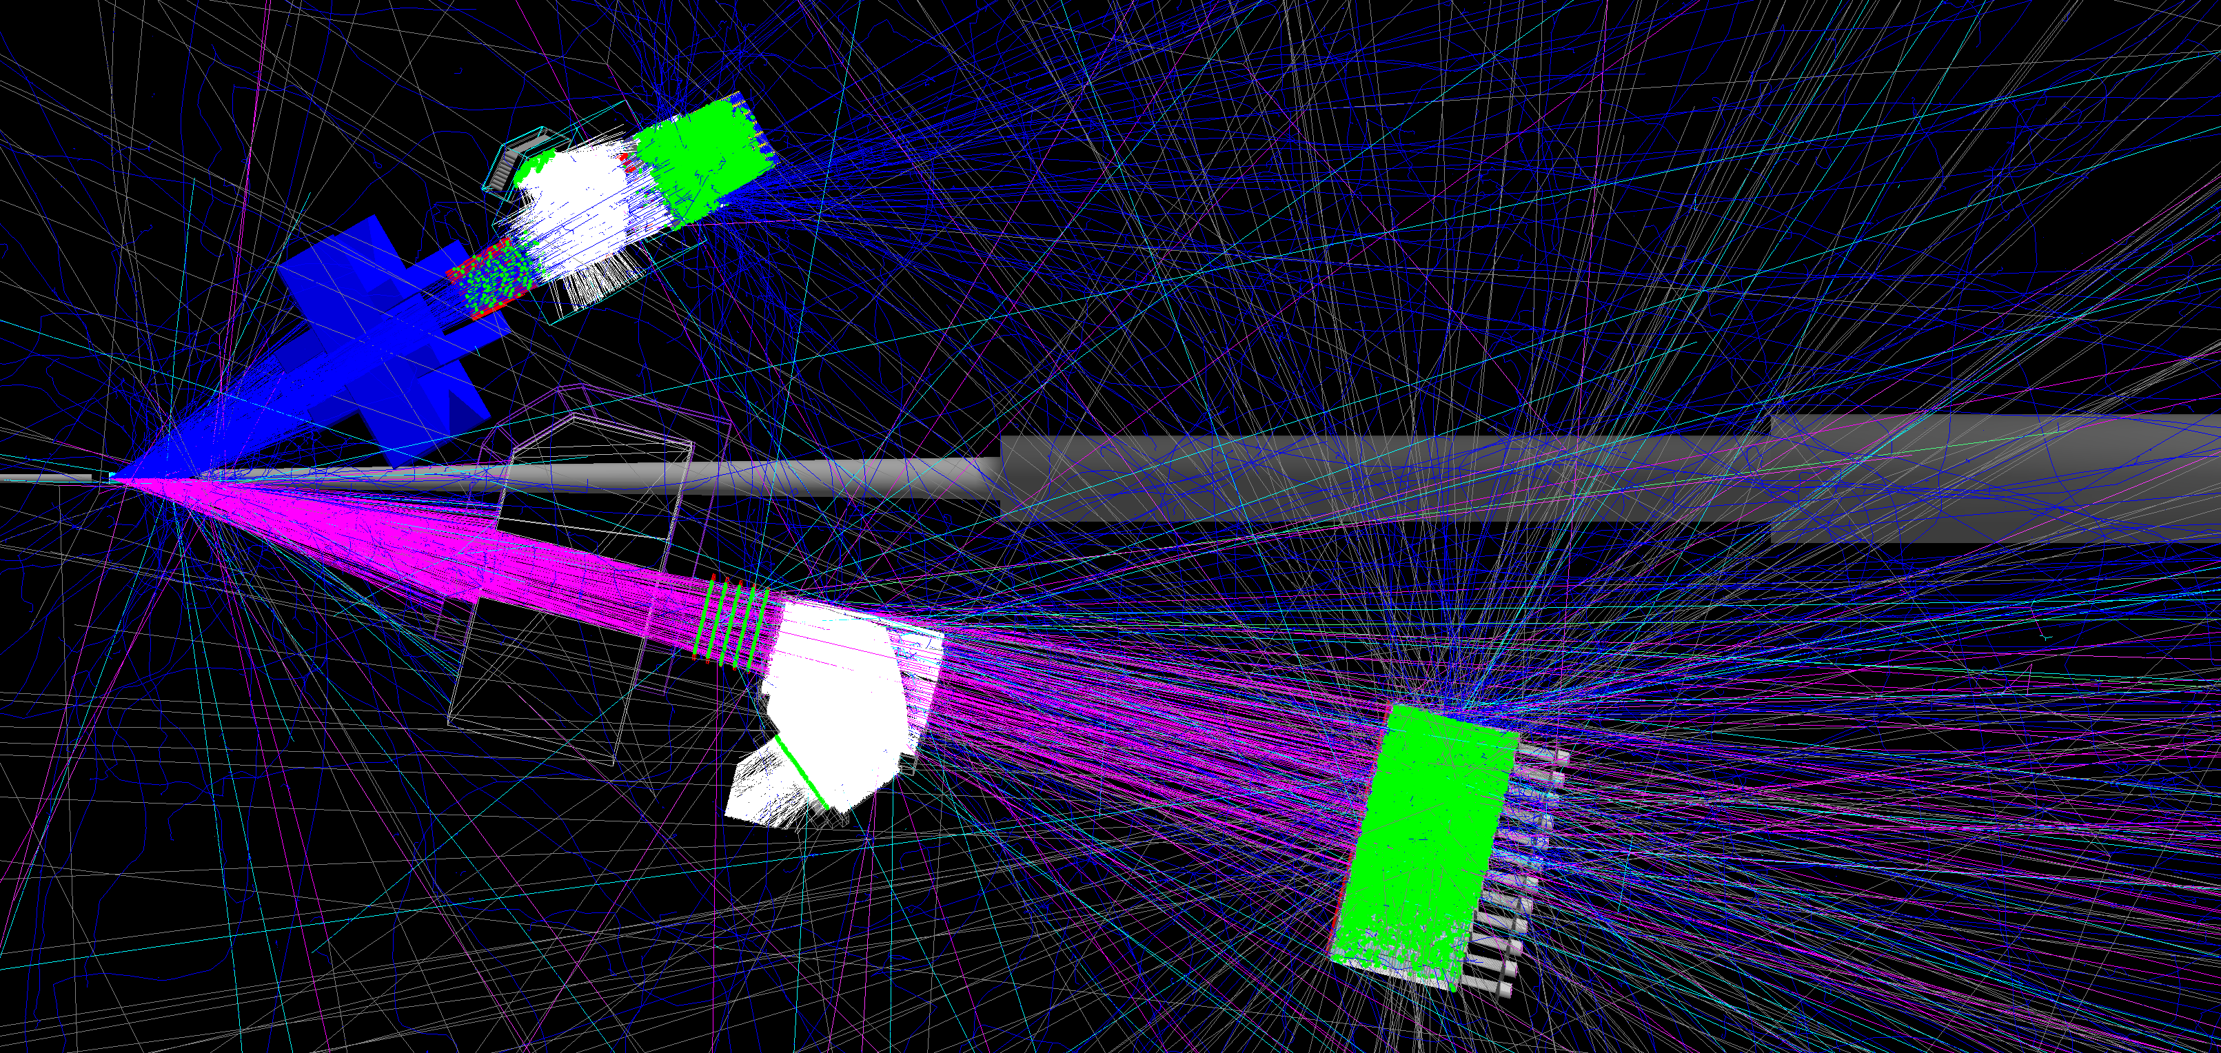
E12-09-018—Transversely Polarized SIDIS
JLab E12-09-018 in Hall A: Approved for 64 beam-days, A⁻ rating by PAC38 (2011)
Electron Arm: BigBite Spectrometer @30 deg.
Hadron Arm: Super BigBite Spectrometer @14 deg.
High-luminosity Polarized ³He Target (1.2 × 10³⁷ cm⁻² s⁻¹)
E12-09-018 in Hall A: transverse spin physics with high-luminosity polarized ³He.
40 (20) days production at E = 11 (8.8) GeV—significant Q² range at fixed x
Collins, Sivers, Pretzelosity, A_{LT} for n(e,e’h)X, h = 𝝅⁺/𝝅⁻/𝝅⁰/K⁺/K⁻
Re-use HERMES RICH detector for charged hadron PID
Reach high x (up to ~0.7) and high statistical FOM (~1,000X Hall A E06-010 @6 GeV)

Slide 32
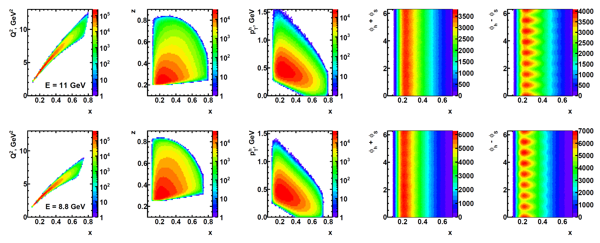
SIDIS Kinematic Coverage in E12-09-018
Wide, independent coverage of x, z, p_{T}, ϕ_{h} ± ϕ_{S} in a single spectrometer configuration.
At least four (preferably 8) target spin directions to achieve full ϕ_{S} coverage
Q², x strongly correlated due to dimensions of BigBite magnet gap.
Data at E = 11, 8.8 GeV provide data for significantly different Q² at same x
Systematics control → independent spectrometers, detectors in field-free regions, straight-line tracking, simple, well-defined (but adequately large) acceptance, etc.

Slide 33
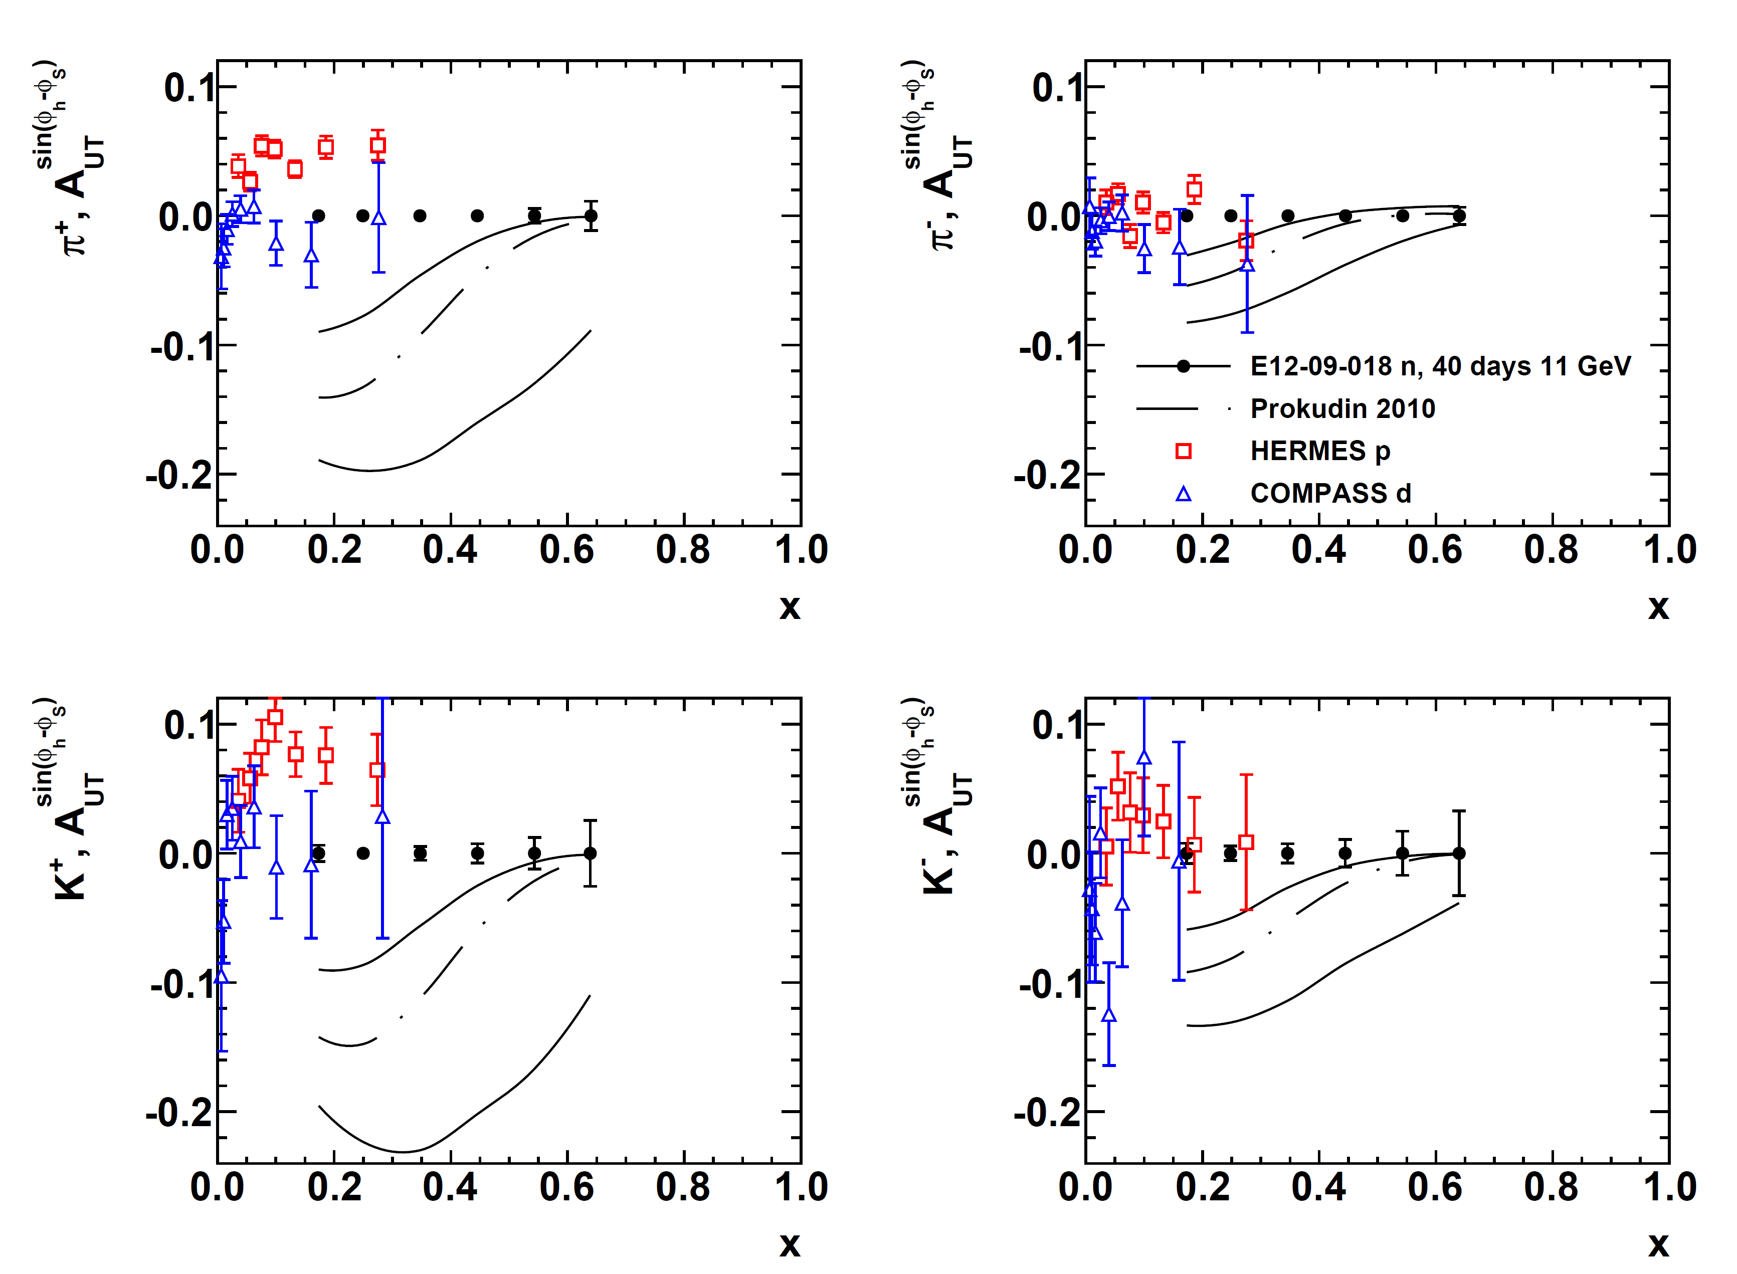
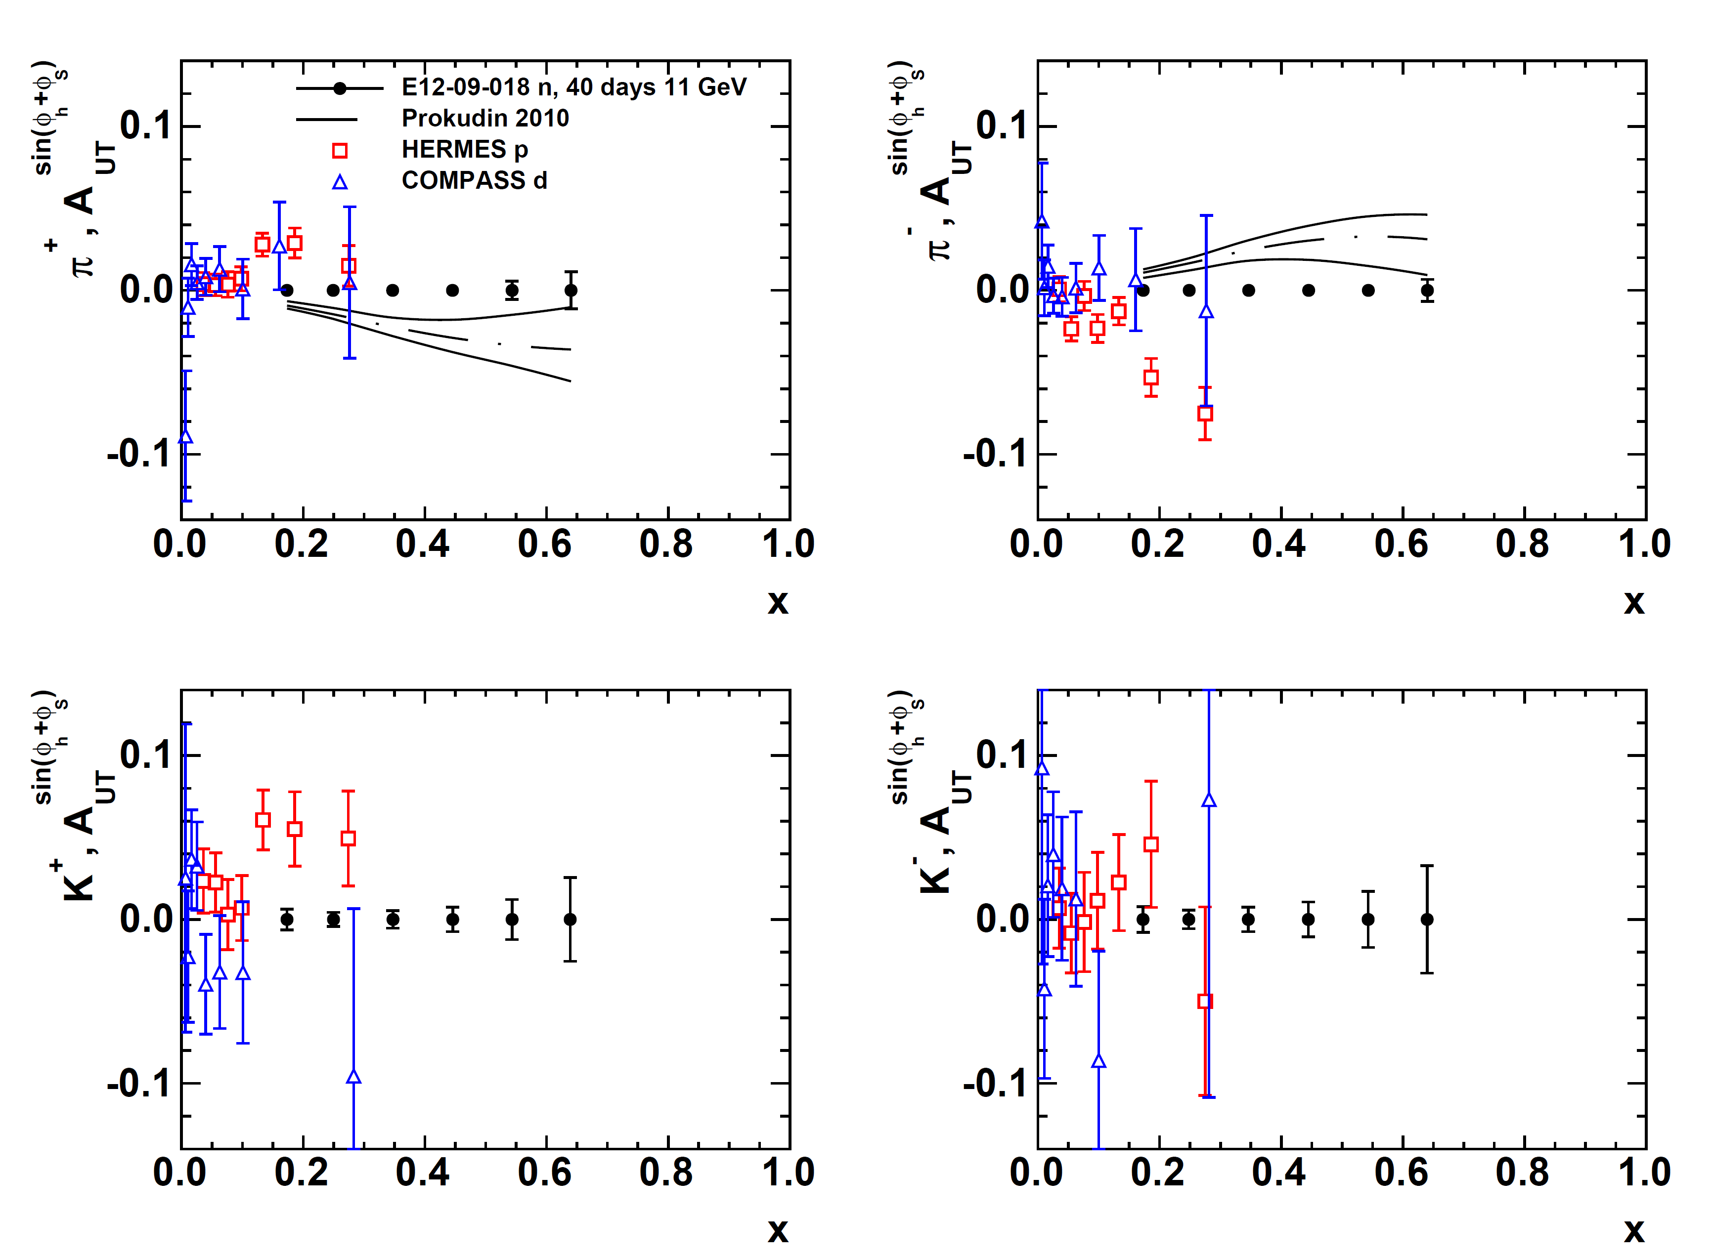
SBS+BB Projected Results: Collins and Sivers SSAs
Projected A_{UT}^{Sivers} vs. x (11 GeV data only)
Projected A_{UT}^{Collins} vs. x (11 GeV data only)
E12-09-018 will achieve statistical FOM for the neutron ~100X better than HERMES proton data and ~1000X better than E06-010 neutron data.
Kaon and neutral pion data will aid flavor decomposition, and understanding of reaction-mechanism effects.

Slide 34
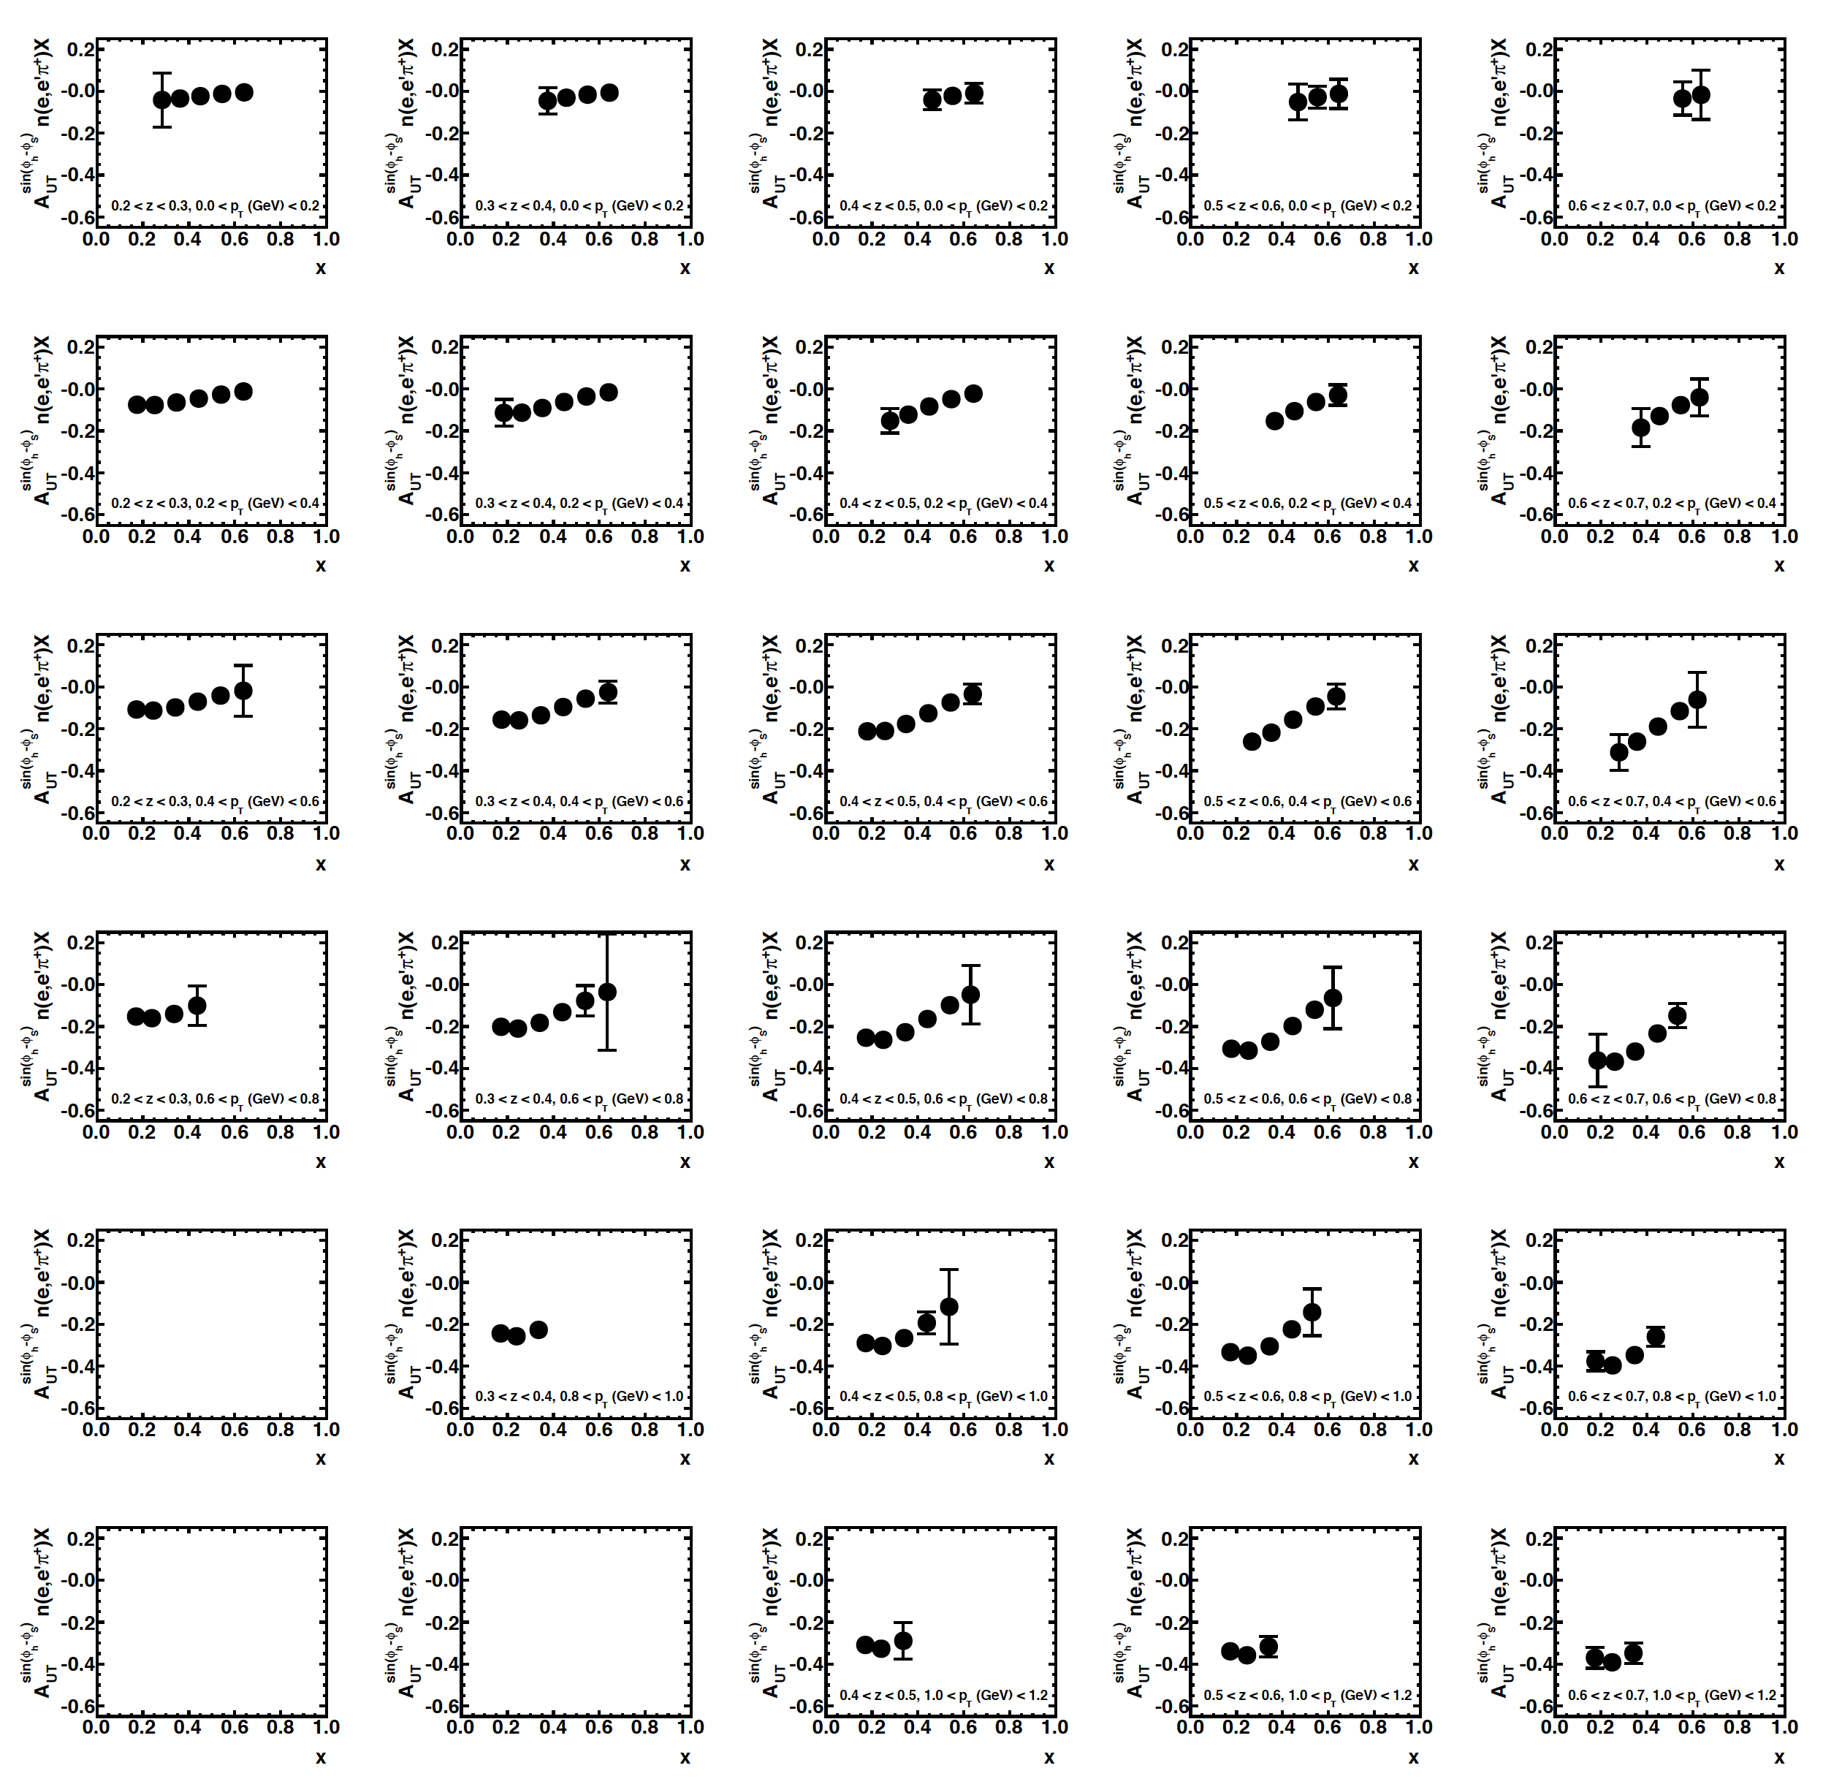
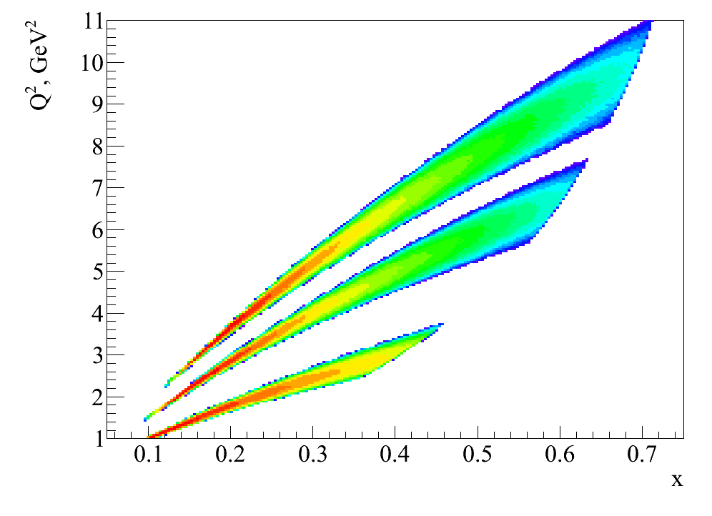
3D and “4D” extraction of SIDIS SSAs with SBS
Example result for 3D binning (x,z,p_{T})
E = 11 GeV, 40 days
Increasing z ➔
“4D” with Q² dependence from 20 days at 8.8 GeV:
⬅ Increasing p_{T}
E = 11 GeV
E = 8.8 GeV
E = 5.9 GeV (E06-010 Hall A)

Slide 35
Example Impacts of SBS SIDIS Experiment
2011 impact study by A. Prokudin, global fit with E12-09-018 projected results, π⁺ Sivers moments at E = 11 GeV, ½ of projected statistics.
Left: >5X shrinking of n(e,e’ π⁺)X Sivers A_{UT} band
Right: reducing the uncertainty in d quark Sivers in six-flavor extraction
E12-09-018 will provide π±/π⁰/K± at similar precision (Kaon errors 2-3X pion errors) for both E = 8.8 GeV and E = 11 GeV Collins/Sivers (and Pretzelosity)

Slide 36
Example Impacts of SBS SIDIS Experiment
2011 impact study by A. Prokudin, global fit with E12-09-018 projected results, π⁺ Sivers moments at E = 11 GeV, ½ of projected statistics.
Left: >5X shrinking of n(e,e’ π⁺)X Sivers A_{UT} band
Right: reducing the uncertainty in d quark Sivers in six-flavor extraction
E12-09-018 will provide π±/π⁰/K± at similar precision (Kaon errors 2-3X pion errors) for both E = 8.8 GeV and E = 11 GeV Collins/Sivers (and Pretzelosity)

Slide 37
C12-15-006: Tagged Deep Inelastic Scattering

Slide 38
Physics Motivation: DIS from the pion cloud of the nucleon
DIS from the pion cloud of the nucleon can be ”tagged” by detecting low-energy recoil nucleons in coincidence with DIS electrons, in suitably chosen kinematics:
  8 < W² < 18 GeV²
  1 < Q² < 3 GeV²
  0.05 < x < 0.2
Nucleon exists ~20% of the time in a virtual pion-nucleon (5-quark) configuration
Measurement at low-t can provide for a model-dependent extraction of pion structure function
d(e,e’pp) and p(e,e’p) to measure charged and neutral pion
Flavor asymmetry of the nucleon sea as observed in Fermilab E866 (Drell-Yan) has been interpreted as evidence for significant pion-cloud contributions to the nucleon structure

Slide 39
Some projected results from TDIS
Projected results of 𝛑p semi-inclusive structure function with experimental kinematic cuts, compared to inclusive structure function, and expected contributions from other channels
Projected pion structure function results

Slide 41
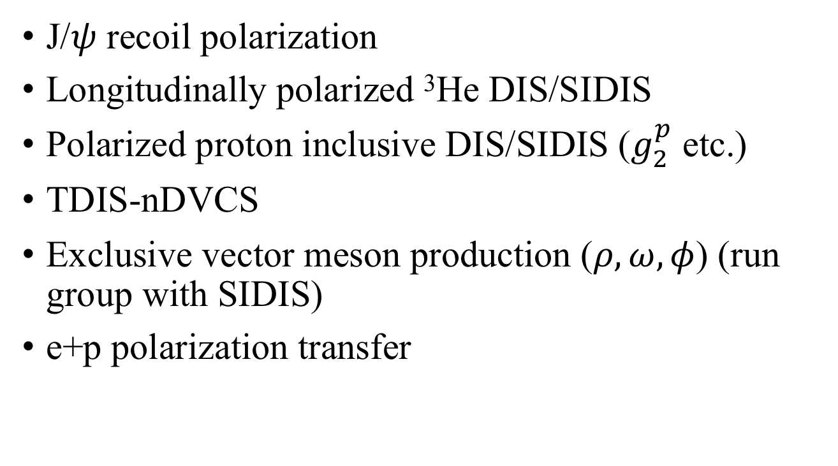
Other potential future physics with BB/SBS (speculative, not yet approved)
J/$ψ$ recoil polarization
Longitudinally polarized ³He DIS/SIDIS
Polarized proton inclusive DIS/SIDIS ($g_{2}^{p}$ etc.)
TDIS-nDVCS
Exclusive vector meson production ($ρ, ω, φ$) (run group with SIDIS)
e+p polarization transfer

Slide 42
Summary and Conclusions
The SBS/BB family of experiments is a large and complex, decade-plus effort that will produce high-impact, “flagship” results of the JLab 12 GeV upgrade and hadronic physics more generally.
Relatively small (for now), but dedicated collaboration.
The development of SBS adds a unique experimental capability to Hall A that could facilitate a rich science program even beyond what is currently approved
Significant expansion of the program is unlikely in the short-term, at least until status of MOLLER/SOLID is more certain…
However, it is a good idea to have “shovel-ready” new ideas in the event of “openings” in the Hall A schedule due; e.g., to possible delays in large post-SBS projects: SBS as de facto ”baseline” equipment of Hall A in the post-HRS era.

Slide 43
Backup Slides

Slide 44
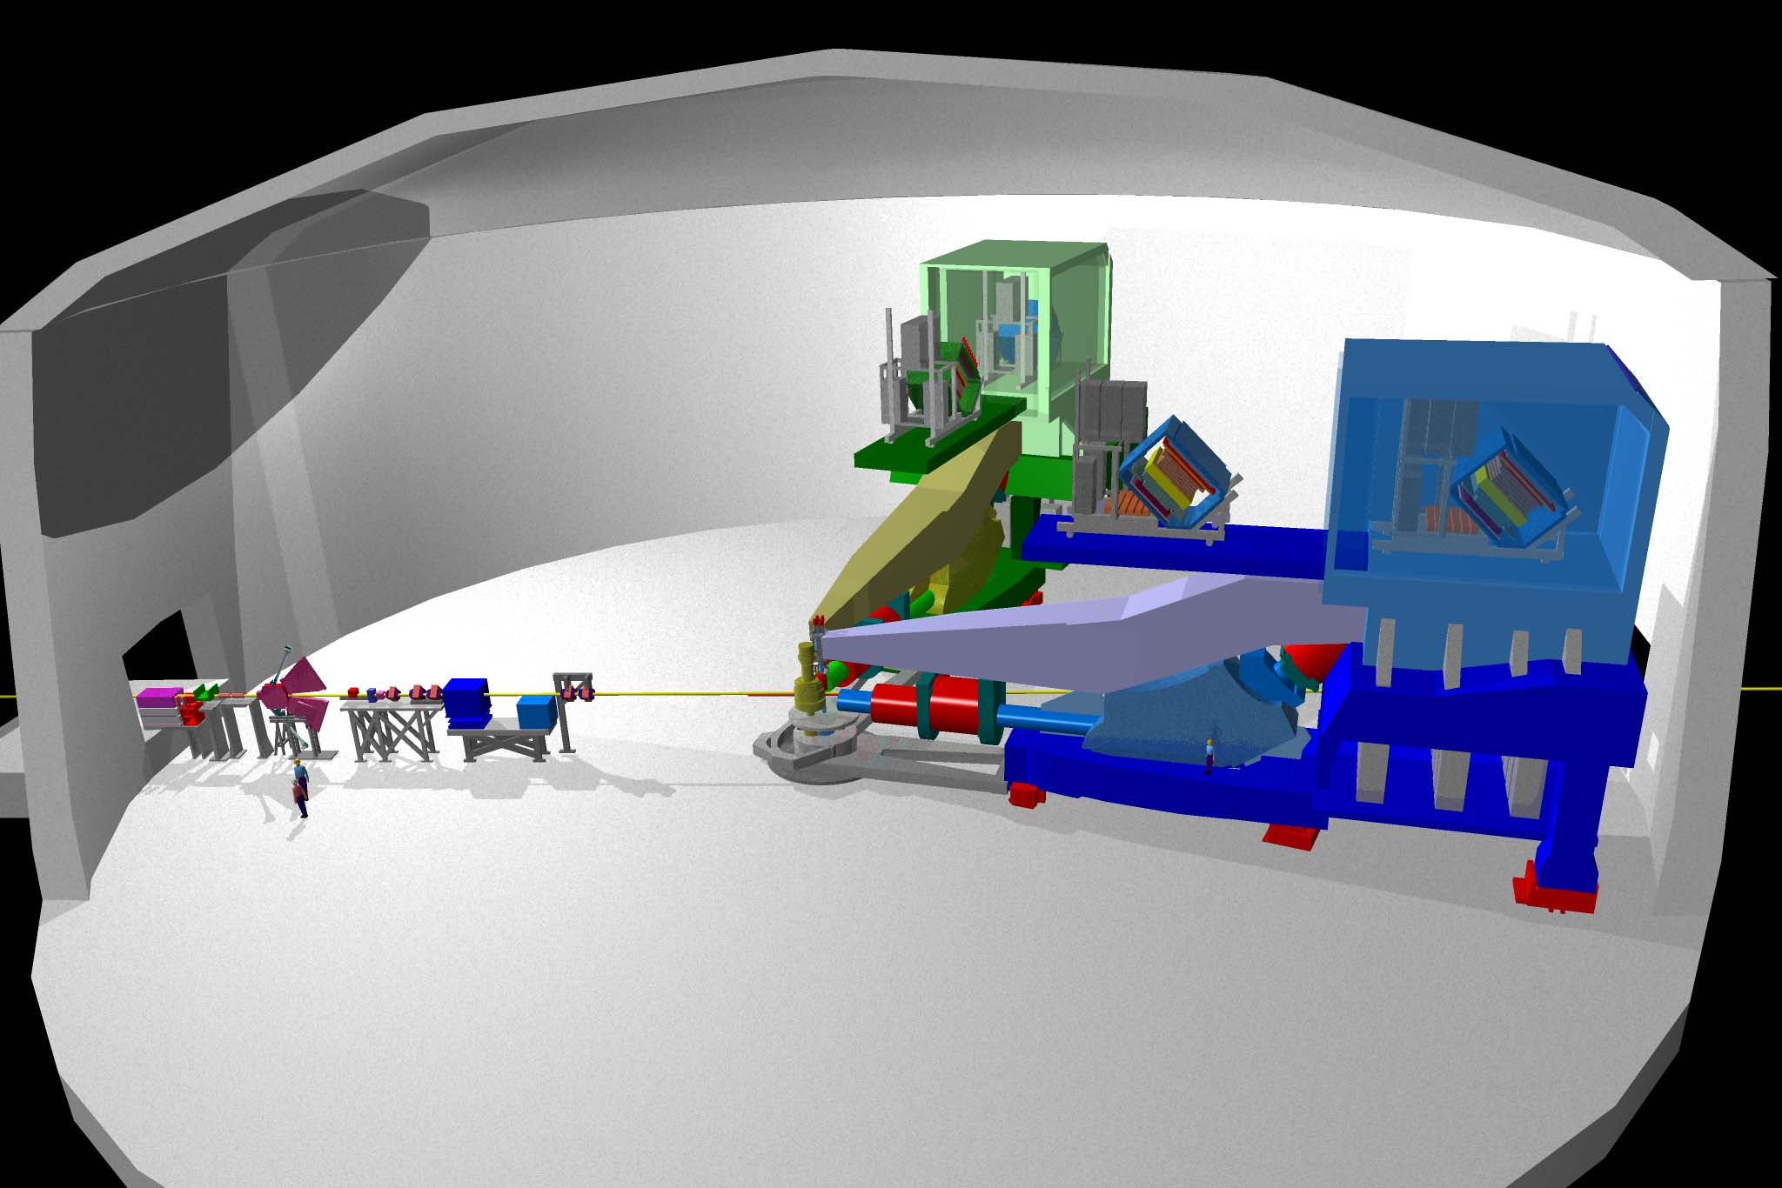
Precision elastic ep cross sections in Hall A
Hall A: Two identical HRSs
Elastic ep → ep cross section at large Q² is dominated by G_{Mp}.
Existing data for Q² ≥ 10 GeV² come from two SLAC experiments (Kirk et al., Phys. Rev. D 8, 63 (1973) and Sill et al.,Phys. Rev. D, 48(1), 29 (1993)) with large uncertainties
The absolute elastic ep cross section data serve as the “anchor” for the determination of all four nucleon EMFFs
Projected uncertainties from recently completed Hall A high-Q² G_{Mp} run: 2018 publication anticipated

Slide 45
PRELIMINARY results from GMP collaboration: Presented by Thir Gautam at recent

Slide 46
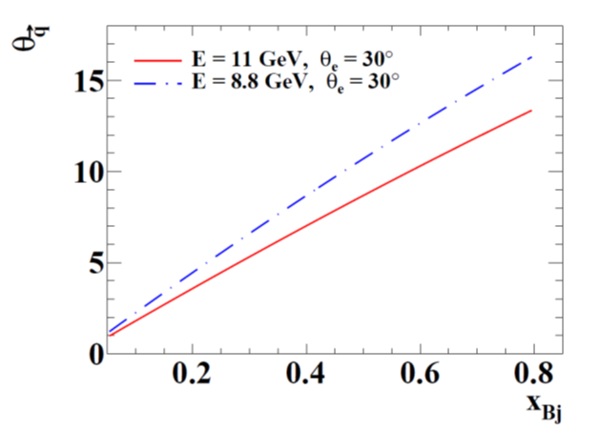
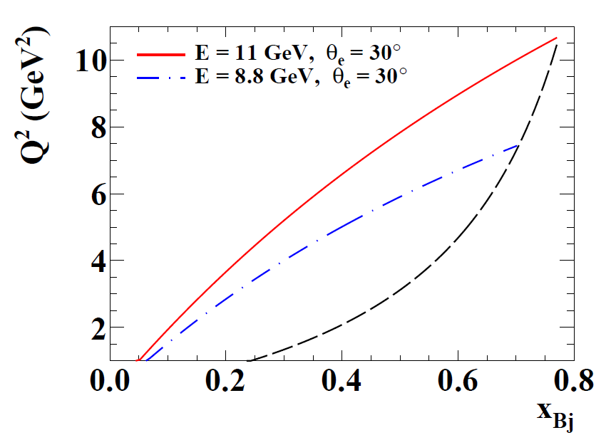
JLab 11/8.8 GeV SIDIS Kinematics
W > 2 GeV
Optimal orientation of hadron arm is along virtual photon direction—q-direction varies ~linearly with x for fixed electron scattering angle
Need forward-angle hadron detection capability!
To reach high x in the DIS regime, need large scattering angles/high-Q²:
  Small xsec → High Luminosity!
  Large detector background rate/occupancy

Slide 47
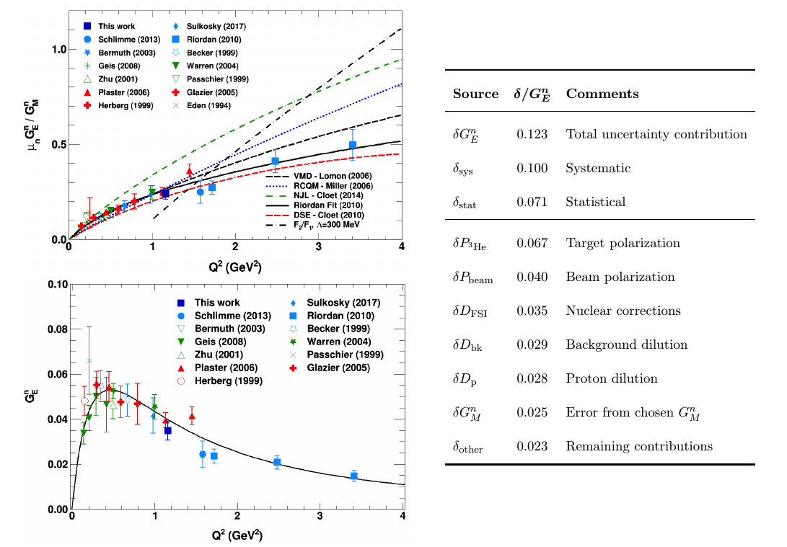
Results
Result at 1.16 GeV² consistent with other data in this region.
Total uncertainty ~12% relative. Systematics dominated by target polarization. Statistical error slightly smaller than total systematics.

Slide 48


General Expression for SIDIS Cross Section: Bacchetta et al. JHEP 02, 093 (2007)
SIDIS structure functions F depend on x, Q², z, p_{T}
U, L, T subscripts indicate unpolarized, longitudinally and transversely polarized beam, target, respectively
S = nucleon spin
λ = lepton helicity
Eight terms survive at leading twist; the rest are M/Q suppressed
Sivers
Collins
“Pretzelosity”

Slide 49


SIDIS Structure Functions in Terms of TMDs
Only f₁, g₁, h₁ survive integration over quark k_{T}
All eight leading-twist TMDs are accessible in SIDIS with polarized beams/targets via azimuthal angular dependence of the SIDIS cross section
Physical observables are convolutions over two (unobserved) transverse momenta:
  Initial quark k_{T}
  Hadron p_{T} relative to recoiling quark, generated during fragmentation

Slide 50
Unique Advantages of SBS+BB for SIDIS Physics
The combination of moderate solid angle, large momentum acceptance and high-rate capability at forward angles is ideal for high-luminosity experiments (e.g., polarized ³He), SIDIS at high Q²
Independent electron and hadron arms—straight-line tracking in “field-free” regions behind dipole magnets
  Simple, reliable reconstruction and data analysis
  Change magnet polarity of e(h) arm without changing h(e) acceptance:
    Accurate measurement of pair-production contamination of DIS electrons (important background for ³He targets w/thick glass walls, especially at low x)
    SBS polarity reversals to increase ϕ_{h} coverage and make h⁺/h⁻ acceptances identical
    Full azimuthal coverage at high-x, where the measurements are statistically challenged
  Ability to measure charged K and π⁰ simultaneously in addition to charged pions
  Excellent systematics control for charge-sum and difference asymmetries used to separate valence/sea quark polarizations
Complementarity with CLAS12/SOLID/Hall C experiments—precise, timely neutron data w/unique kinematic coverage; can run within first few years of 12 GeV era—part of DOE-funded SBS program, starting 2020: SIDIS run = 2022-2023?
For polarized proton SIDIS at lower luminosity, competitiveness of SBS+BB less clear; large acceptance detectors have a bigger advantage

Slide 51
Polarized DIS and Spin Structure Functions
Helicity asymmetries in the scattering of longitudinally polarized electrons on longitudinally and transversely (in the scattering plane) polarized nucleons provide access to spin structure functions g₁, g₂.
The longitudinal virtual photon asymmetry A₁ is defined as the asymmetry between parallel and antiparallel virtual photoabsorption cross sections and is related to the spin structure function g₁(x,Q²):
In the naïve parton model, g₁ is an incoherent sum over parton helicity distributions Δq_{i}, defined as the differences in number density between quarks polarized parallel and antiparallel to the nucleon spin:

Slide 52


Experimental Status of Δq
Blumlein and Bottcher, hep-ph/1005.3113
Recent Global Analyses:
  DSSV, includes SIDIS and pp data, asymmetric sea
  BB, DIS data only
DSSV: PRD 80, 034030 (2009)

Slide 53


A1n redesign: A_{1n}+ SIDIS A_{1n}^{h} with 11 GeV and BB+SBS
Electron Arm: BigBite Spectrometer @30 deg, high Q²/high-x DIS/SIDIS data
A1n redesigned: SBS as combined electron/hadron spectrometer with LAC+HCAL+RICH
High-luminosity (longitudinally) Polarized ³He Target (1.2 × 10³⁷ cm⁻² s⁻¹)
Electron/Hadron Arm: Super BigBite Spectrometer @12 deg. High-x/Resonance region inclusive ³He(e,e’) and charged hadron detection for longitudinally polarized SIDIS ³He(e,e’h) X
Given the availability of SBS and the evolution of the BigBite and SBS detector packages, polarized ³He target capability, one possible vision is to combine a drastically improved version of the approved Hall A A1n proposal with the same (or less) beam time with the longitudinally polarized SIDIS physics of PR12-14-008, in a single run $≤500$hours, by converting the SBS into a combined electron/hadron spectrometer.

Slide 54
A1n SBS+BB PRELIMINARY projections
BigBite
SBS
W = 2 GeV
Very crude estimates of A1n statistical precision, with inclusive ³He(e,e’)X rates computed from Christy-Bosted parametrization of inclusive structure functions, basic Fermi smearing model

Slide 55



Proton FFs—Rosenbluth data
The problem—G_{E} sensitivity of σ_{R} vanishes at large Q²
Maximum contribution of $G_{E}^{2}$ term to $σ_{R}$ vanishes at large $τ$. Fits to FF data are described in Phys. Rev. C, 96, 055203 (2017) (more on these later)
$G_{E}^{p}$ and $G_{M}^{p}$ Rosenbluth Data: $G_{E}^{p}≈\frac{G_{M}^{p}}{μ_{p}}≈G_{D}$
Elastic ep cross sections have been measured for ${0.003≤Q}^{2}≤31.2$ GeV².
Rosenbluth data for $G_{E}^{p}$ and $G_{M}^{p}$ are qualitatively described by the “dipole” form factor, which is the Fourier transform of a spherically symmetric, exponentially decreasing radial charge/magnetization density.

Slide 56
Proton FFs—Polarization Data
GEp-III/GEp-2$γ$ final results (Puckett et al., Phys. Rev. C 95, 055203 (2017))

Slide 57
Neutron form factors—G_{Mn} existing data
Lachniet et al., CLAS Collaboration, Phys.Rev.Lett. 102 (2009) 192001
Three main methods have been used to measure G_{Mn}:
  “Ratio” method: measure cross section ratio of d(e,e’n)p/d(e,e’p)n in quasi-elastic kinematics
  Absolute d(e,e’n)p quasi-elastic cross section measurement
  Beam-target double-spin asymmetry* in inclusive quasi-elastic ³He(e,e’)
*Note: double-spin asymmetry method for G_{Mn} would not work for a free neutron target, as the free nucleon asymmetry depends only on the ratio G_{E}/G_{M}, and not G_{E} or G_{M} independently.
Widest combined Q² coverage and precision from recent CLAS 6 GeV data from 1 < Q² < 5 GeV²—consistent with “standard” dipole
Consistency issues in low-Q² data

