Slide 1
Visual Status of Hall A Beamline
- beam current, position, energy, and polarization -
by
Douglas W. Higinbotham

Slide 2

Hall A Beamline 24 Sept. 2012

Slide 3
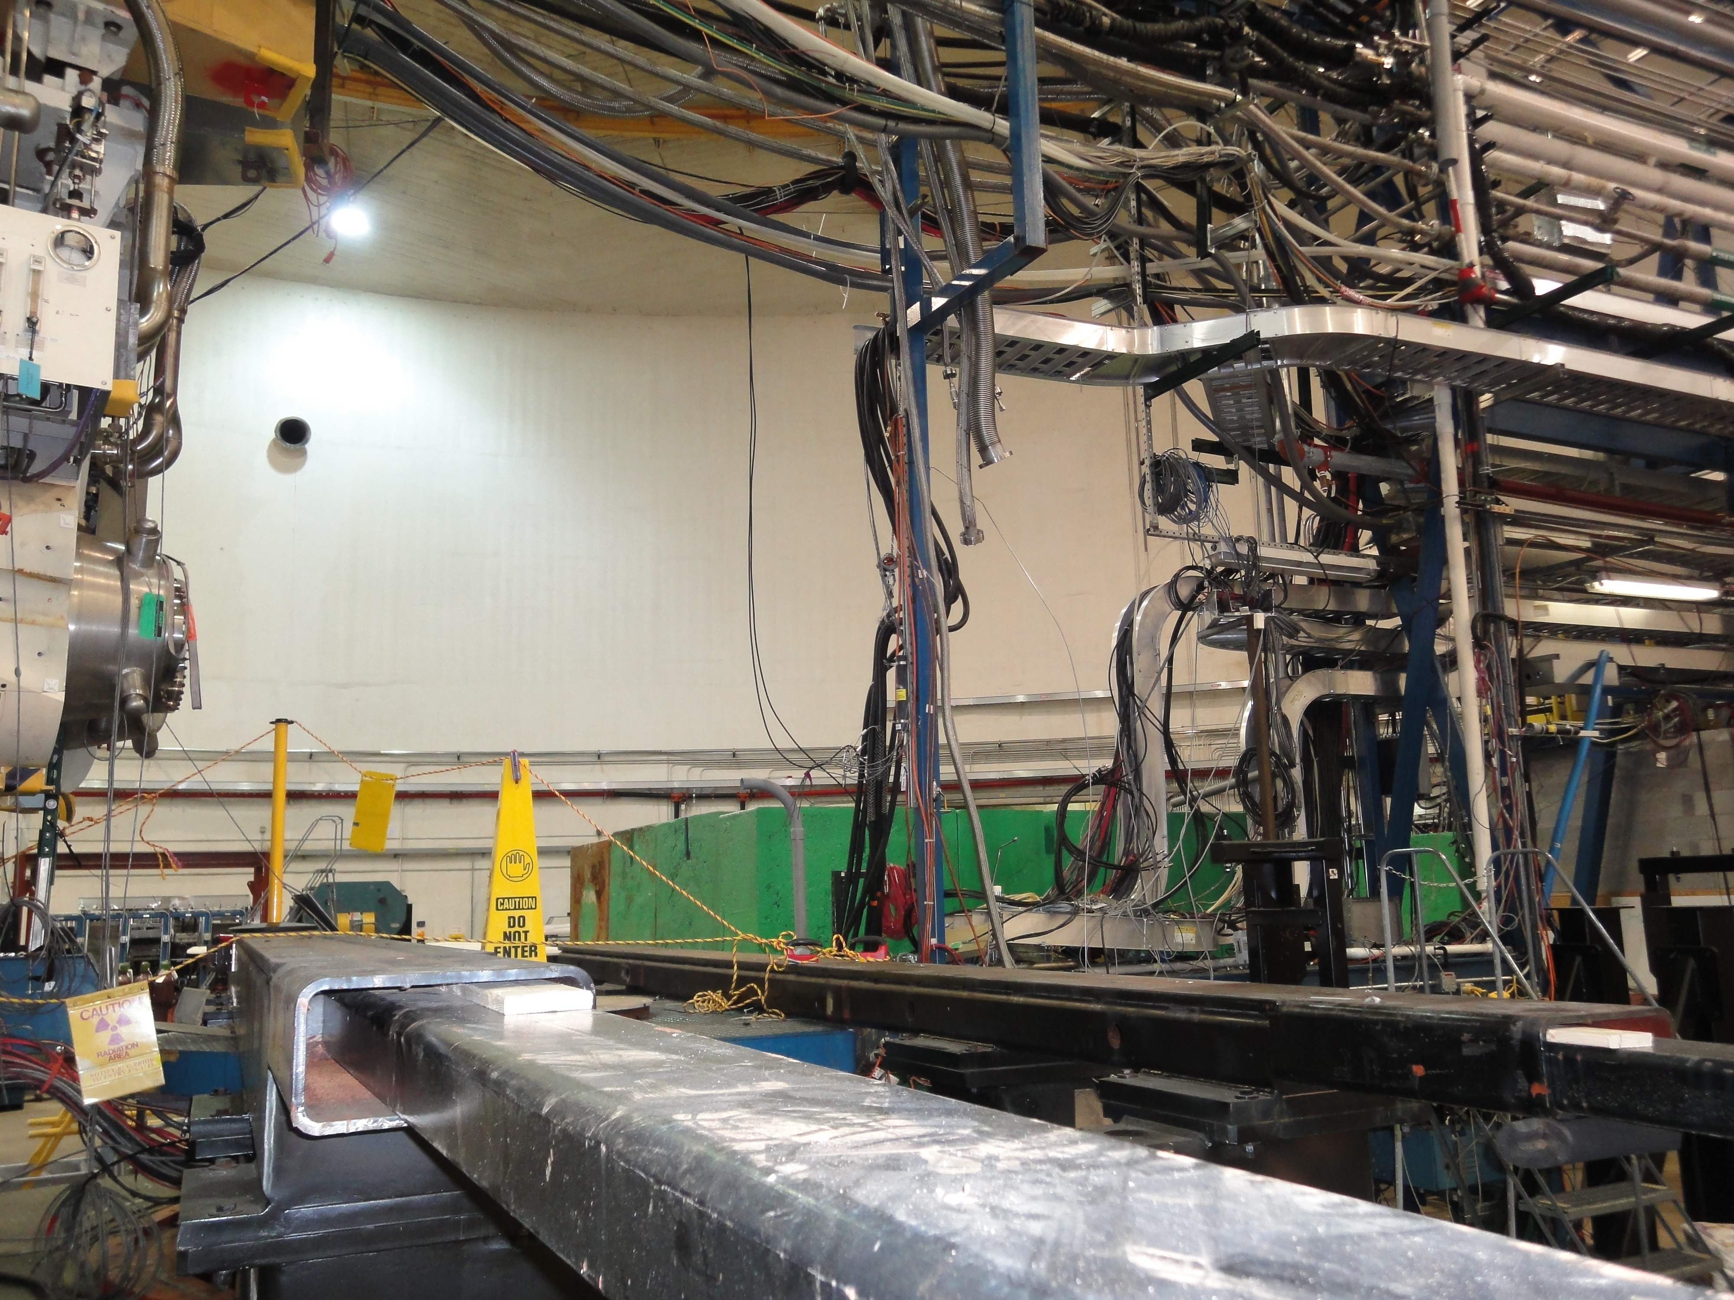
“Missing” Section of Beamline

Slide 4
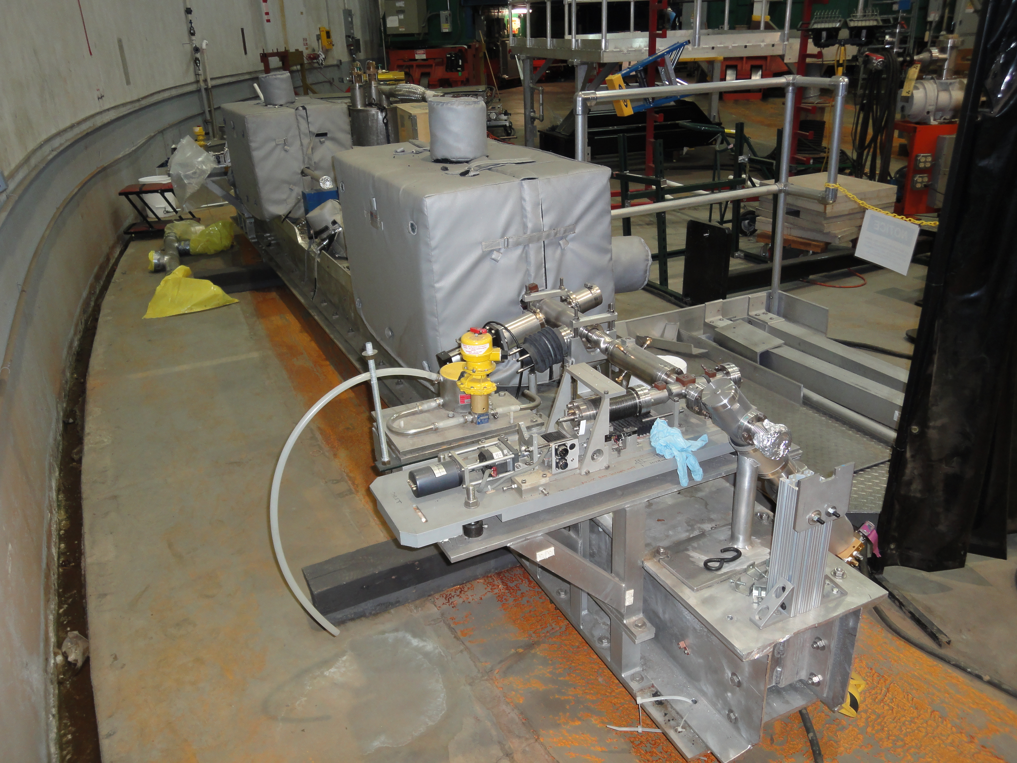
Safely Waiting For Installation

Slide 5
Action Item List
Finish Arc Refurbishments (includes 9th)
Fix ARC Bdl Mapping Unit (~30k parts)
Install Box-beam with Beamline Comments
Recalibrate All Systems Once Beam Returns
  ARC Energy vs. HRS 2.2 GeV elastic H and Ta
  BCM vs. Farriday Cup at Injector (standard procedure)
  BPM vs. Harp (standard procedure)
  Moller and Compton will need re-commissioning

