Slide 1
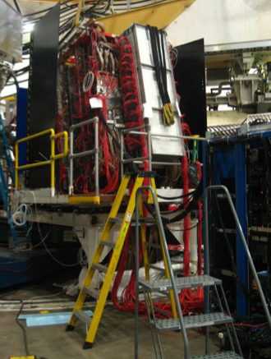
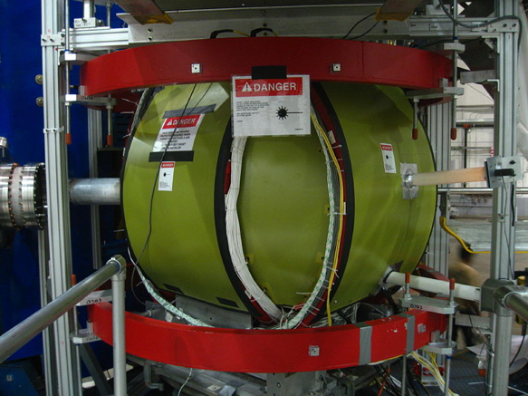
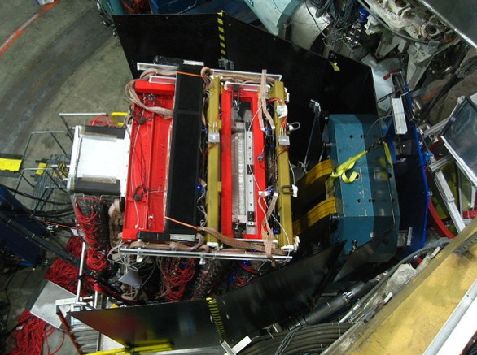


A₁ Analysis for E06-014
Diana Parno
for the E06-014 collaboration
CENPA, University of Washington
June 10, 2011

Slide 2
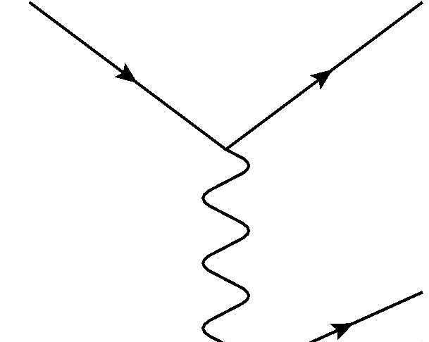
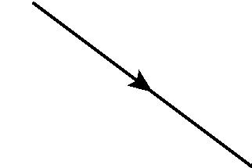
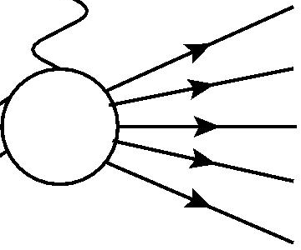
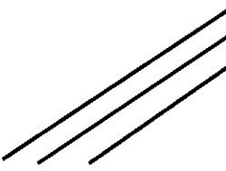
Introduction: Deep Inelastic Scattering
k
k’
Start with a polarized electron and a polarized nucleon
Incident electron
Scattered electron
They exchange a virtual photon
q
Virtual photon
Virtual photon probes single quasi-free quark inside nucleon
Incident nucleon
We measure scattered electron
p

Slide 3
Virtual Photon Asymmetries
What spin information do we have at the hadron vertex?
Photon spin
Nucleon spin
Photon spin
Nucleon spin
Same helicities:
Opposite helicities:
We can form an asymmetry based on this relationship

Slide 4
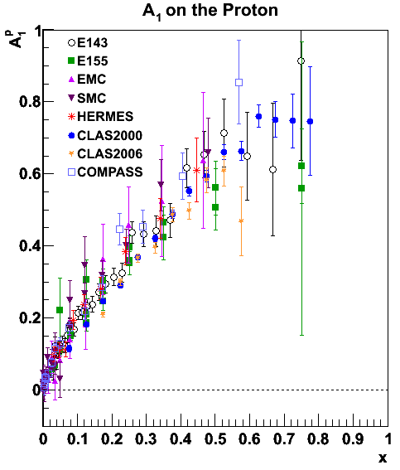
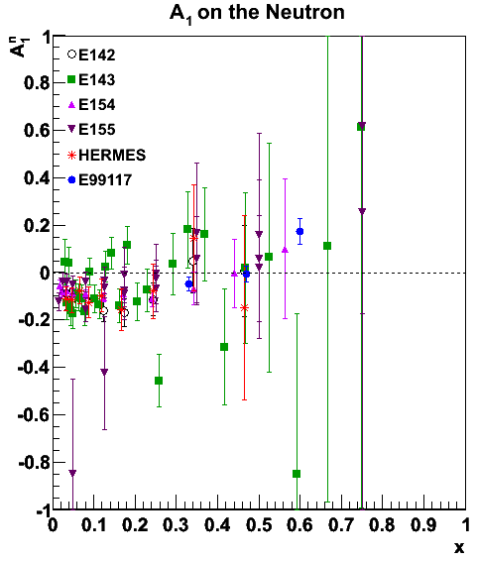
Existing DIS Data on Nucleon A₁

Slide 5
Measurement Strategy
E06-014 ran in February-March 2009
Large x range from BigBite
Form double-spin asymmetries (parallel and perpendicular target spin) corrected for polarization
Kinematics, world F₂ data then give us A1

Slide 6
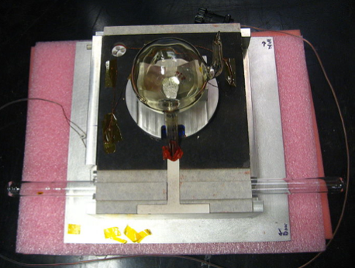

E06-014 Setup in Hall A
Beam direction
Compton
Polarimeter
Polarized ³He target
BigBite spectrometer
Photos from Transversity (E06-010) Photo Diary

Slide 7
Final Beam Polarization Results
Combine Compton and Møller results to achieve error of ~1.6%

Slide 8
Measuring ³He Polarization
NMR every four hours (target chamber)
EPR every spin rotation (pumping chamber)
Calculation by Yawei Zhang

Slide 9
Scattered Electron Sample
Negligible pion contamination
Errors in momentum reconstruction form primary background

Slide 10
Nitrogen Dilution Factor
Target’s nitrogen content dilutes asymmetry

Slide 11
A₁ on ³He with 4.74-GeV electrons
Low-x bins will be more affected by radiative corrections and pair-production (not yet applied)
Preliminary
E142: Phys. Rev. D 54: 6620 (1996)
E99117: Phys. Rev. C 70: 065207 (2004)

Slide 12
Conclusion
We’ve measured A₁ on ³He from part of the E06-014 dataset
  Wide x range (0.15 ≤ x ≤ 0.55 DIS, 0.60≤x≤1.0 resonance)
  Support for previous measurements
  Details in thesis (available at http://hallaweb.jlab.org/experiment/E06-014/talks/)
Future work
  Analysis tweaks
  Radiative corrections, pair-production corrections
  New dataset: E_{e} = 5.9 GeV
  Extraction of neutron A₁

Slide 13
Thank you!
Thanks go to the Hall A collaboration and staff who made this experiment possible
Special thanks go to the primary analysis team:
  Brad Sawatzky
  David Flay
  Matt Posik
  Yawei Zhang
  Gregg Franklin
  Zein-Eddine Meziani

Slide 14
BigBite Spectrometer
Magnet
  Separates by charge and momentum
Scattered
particles
MWDCs
  Reconstruct trajectory, forward and back
Gas Čerenkov
  Removes pions from online trigger
Adapted from Xin Qian, PhD thesis, 2010
Calorimeter
  Measures energy
  Particle identification

Slide 15
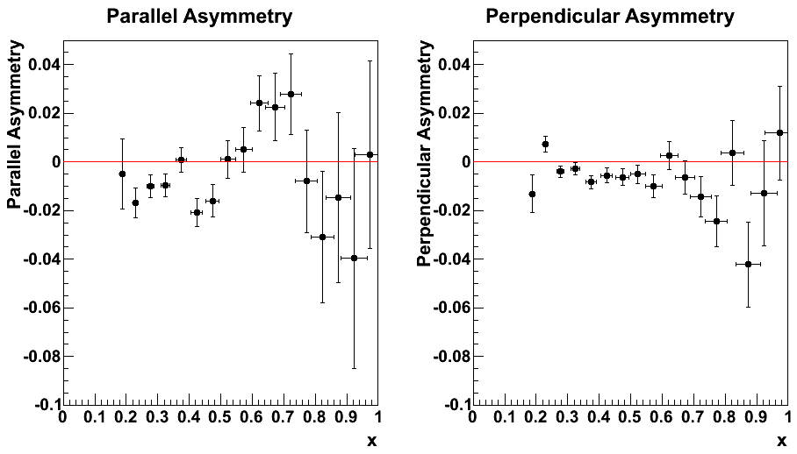
Electron-³He Asymmetries

Slide 16
A₁ and A₂ on ³He

