Slide 1
Summary streaming readout workshop
Alexandre Camsonne

Slide 2
Streaming readout workshop
Jan 29-30, 2018
https://eic.jlab.org/wiki/index.php/Streaming_Readout_II

Slide 3
Streaming readout definition
Triggerless DAQ
Each detector just stream events it considers of interest independently : no event building
Global timestamp to put events together

Slide 4
Slide from Graham

Slide 5
LHCb
Talk by Mike Williams
https://eic.jlab.org/wiki/images/9/96/Mike_Williams.pdf

Slide 8
New JLAB developements
Chris Cuevas talk
https://eic.jlab.org/wiki/index.php/File:Chris_Cuevas.pdf

Slide 9
CLAS12 RICH readout

Slide 10
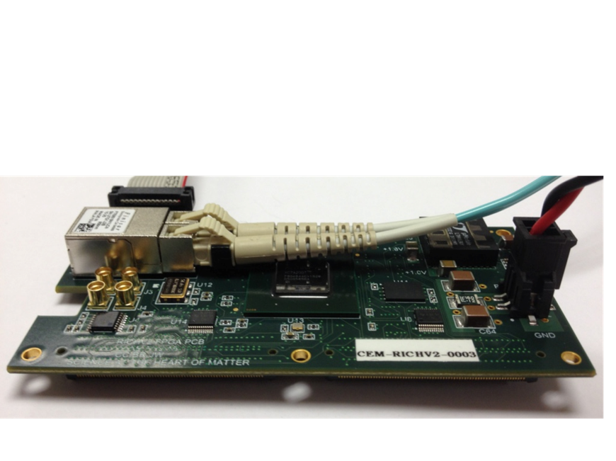
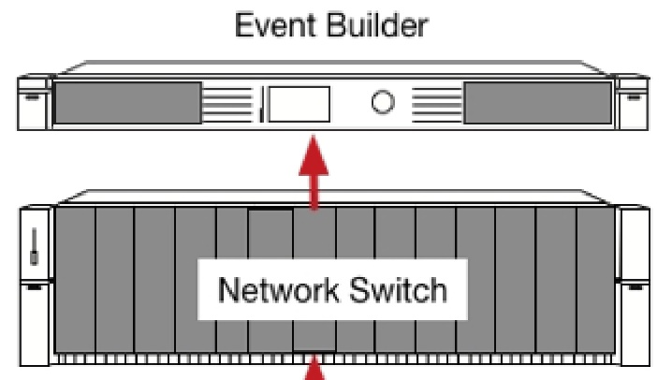
Streaming without crates
Readout/Control of ASIC <-->Network
C. Dickover
B. Raydo
DAQ Group
DATA PROCESSOR
MAROC3
Or
Use Internally Generated Data
Xilinx Artix7
JLAB FPGA Readout/Control Board
192 Channel Interface
Algorithms
  1ns TDC
  Scaler
Fixed Latency up to 8us
Optical Ethernet – Use Commercial 1Gbe
  Finisar Transceiver capable of 10Gbps
  Artix could run @3.125Gpbs
Mates to MAROC3 or other ASIC
+5VDC @1A
Commercial 1Gbe LC Fiber Network Switch
Test with many ports
  Will need SYNC to each card
  How will Network manage SYNC?
  Need Firmware Change
Test Data Rates
Test Ability to synchronize data from each FPGA card.
Scale of test can increase quickly
  i.e. 10 FPGA boards ~2K channels
  Streaming Data

Slide 11
FADC
FADC can inherently stream data
Just need bandwidth to ship all the data :
  16 channels x 250 MHz x 16 bits (12 bits ADC ) = 8 GB/s per board
Fast serial readout : optical, PCI express, VXS or Ethernet ( 40 Gbit )

Slide 12
New 500 MHz FADC

Slide 14
Standalone FADC

Slide 15
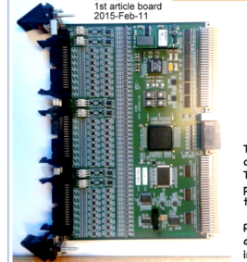
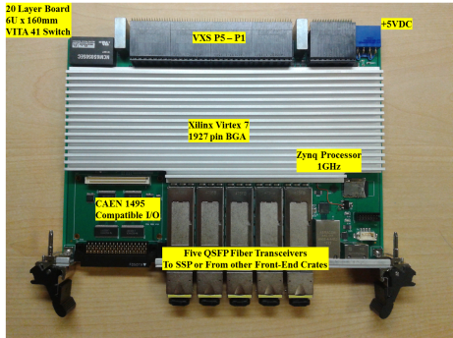
Streaming DAQ through VXS trigger processor
C
Bypassing VME64x Example
DCRB
VTP
Built In Self Test
Hits Generate TDC Data
14 Boards
1344 Wires
SSP
SSP
SBC
‘64x
SSP
A
VXS
B
1GHz Dual Core ARM
Processor [Xilinx Zynq] (Linux OS)
Simulated Wire Chamber ‘Hits’
  DATA
  24bit words; 17 bits time; 7 bits Channel
  This is a large range but 1ns resolution!
Each DCRB board has 10Gb/s [1.25GB/s] link to VTP [ 4 lanes/@3.125bps * (0.8 Encoding) ]
  Test limitations of VTP serial collection of 14 DCRB ‘Payload’ boards
  Synchronous data is not an issue because all boards are in the same crate
  VTP must consume 17.5GB/s [14 Boards]
40Gbe from VTP “CODA Read_Out_Controller”
Test VTP data processing capabilities and throughput
  96 channels from each DCRB will probably be an issue for DDR memory on VTP
  What problems will we face to interface with 40Gbe network switch?
  What happens when we have more than one crate?
A
VME
B
C

Slide 16
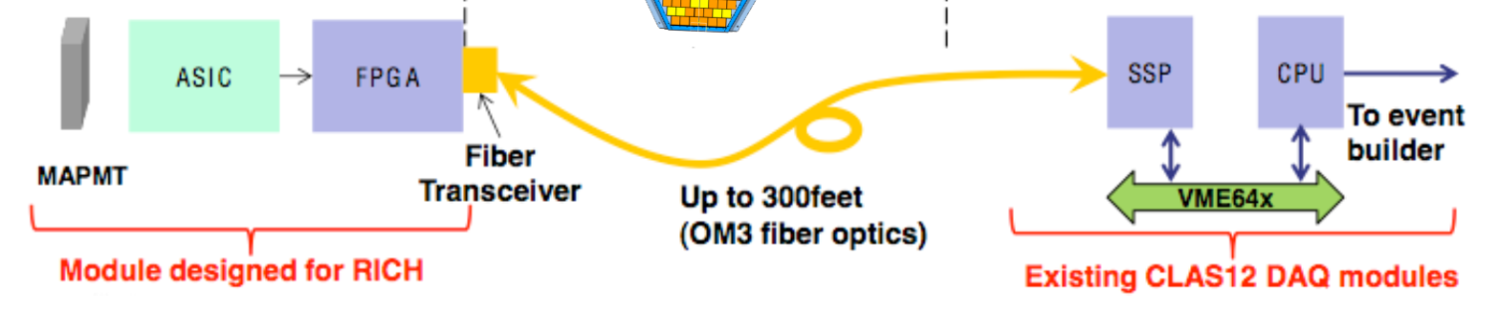
More examples of VXS readout/control of ASIC
2.5Gbps line rate 16bit bus @ 125MHz for transmit and receive
RICH 25,000 pixels
C. Dickover
B. Raydo
CEA Saclay**
INFN*
2.5Gbps line rate 16bit bus @ 125MHz for transmit and receive
SBS GEM
+40K pads
APV25
FPGA
MPD*
Imagine using
VTP in each of
these examples
to bypass VME
2.5Gbps line rate 16bit bus @ 125MHz for transmit and receive
MicroMegas
+20K strips
DREAM
FPGA
FEC**
Forward Tracker
+3300 uMegas Strips
VME64x Readout Bandwidth [~200MBs]
OK Because
Detector occupancy
Is low (~1%)

Slide 17
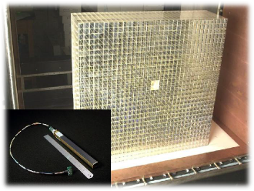
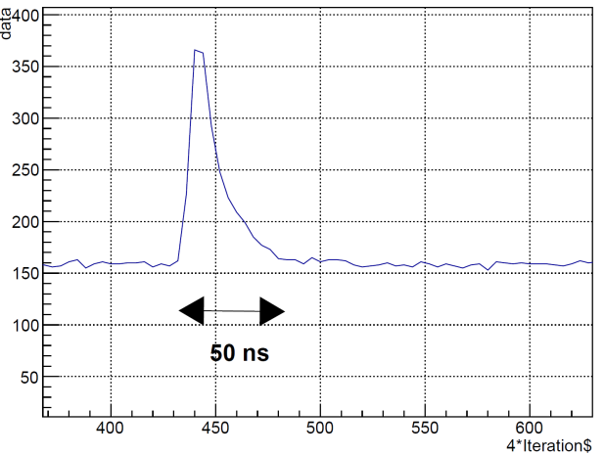
FADC calorimeter readout
Use Existing PbWO4 Crystals as prototype detector
    Neutral Particle Spectrometer (preferred, as want to make 25-100 crystal prototype anyways)
    GlueX Forward Calorimeter Upgrade
    Heavy Photon Search Calorimeter
Hall A DVCS (PbF2) Calorimeter recorded full waveform 128 samples
Now: Test readout & resulting resolution to constrain full waveform with 4 samples
NPS Pulse Fairly Fast, ~ 50 ns total
Develop parallel readout of flash ADCs through serial link = 16 x 125 Mb/s
Test readout & resulting resolution to constrain full waveform with 4 samples
Can also test to transfer only clusters from flash ADCs

Slide 18
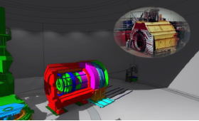
Future Experiments: JLab NPS & SoLID
Neutral Particle Spectrometer:
1000+ channel electromagnetic PbWO4 calorimeter in high background area
SoLID:
Large Acceptance Detector operable at High (10³⁷⁻³⁹) Luminosity
Sweeping magnet before EM calorimeter to reduce background rates and achieve up to 10³⁹ luminosity
Readout with PMT and HV divider linear to within 2% for up to 2 MHz/crystal.
Plan to use flash ADCs to read full wave form
vertex
tracking
PID
EMCAL
HCAL
muon
e
γ
The detector has two configurations. In the PVDIS configuration electrons are scattered of a fixed target at high luminosity.
The detector is split into 30 sectors with a single track event topology.
Current proposal 30 DAQ systems to be run in parallel at rates of 1 GByte/s each with custom electronics to deal with tracks that cross sector boundaries.
Complex system relying on coordination of the semi-independent DAQs
K/π/p
absorber
jets
μ
ν
P_{T}miss
Prediction: all calorimeter readout will start using full wave forms

Slide 19
Streaming readout on hit level
RF
EIC detector
synchronized
streaming readout
Detector response (t)
use RF as t₀
select time windows
build events
machine learning
machine learning
Data monitoring Anomaly detection
Events
Detector modelling
Learn detector responses

Slide 20
Streaming readout on event level
Stream of events
Storage
Physics analysis
Event
Operation
Event
Operation
Event
Physics analysis
Data monitoring
Anomaly detection
Type of operations
Align
Calibrate
Filter
Tracking
PID
Alignment and calibration obtained from set of events
Filter for data quality
Selection of events according to type (trigger)

Slide 21
Conclusion
Progress in technologies is making streaming DAQ more and more accessible
Straightforward for simple detectors and already existing
Still main issue is data reduction for large granularity and high background detectors such as GEM trackers
Needs more computing and or storage power but gives more flexibility

