Slide 1
SoLID PVDIS deadtime measurement
Alexandre Camsonne

Slide 2
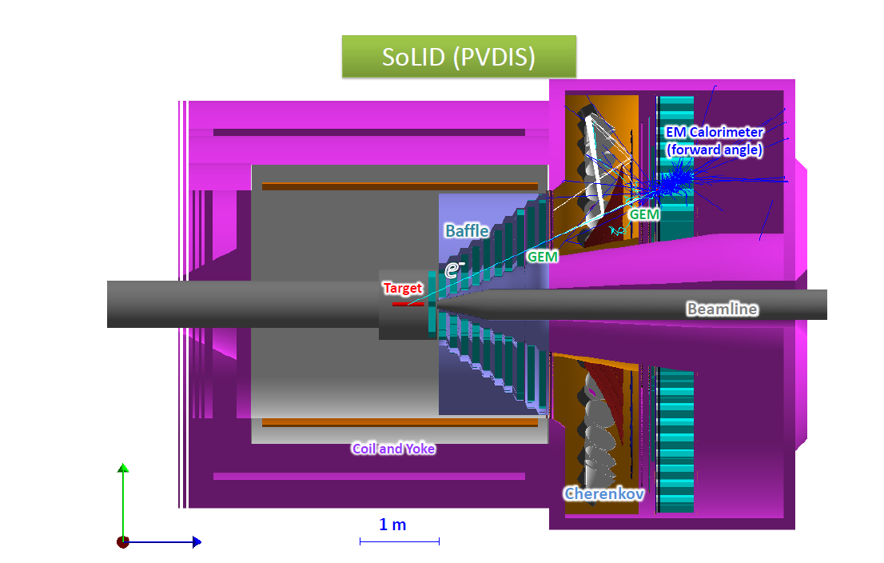
SoLID PVDIS

Slide 3
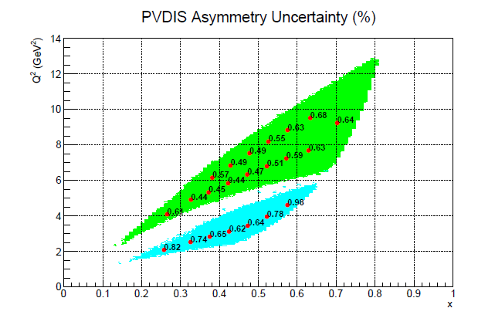
Asymmetry of order of 100 ppm

Slide 4
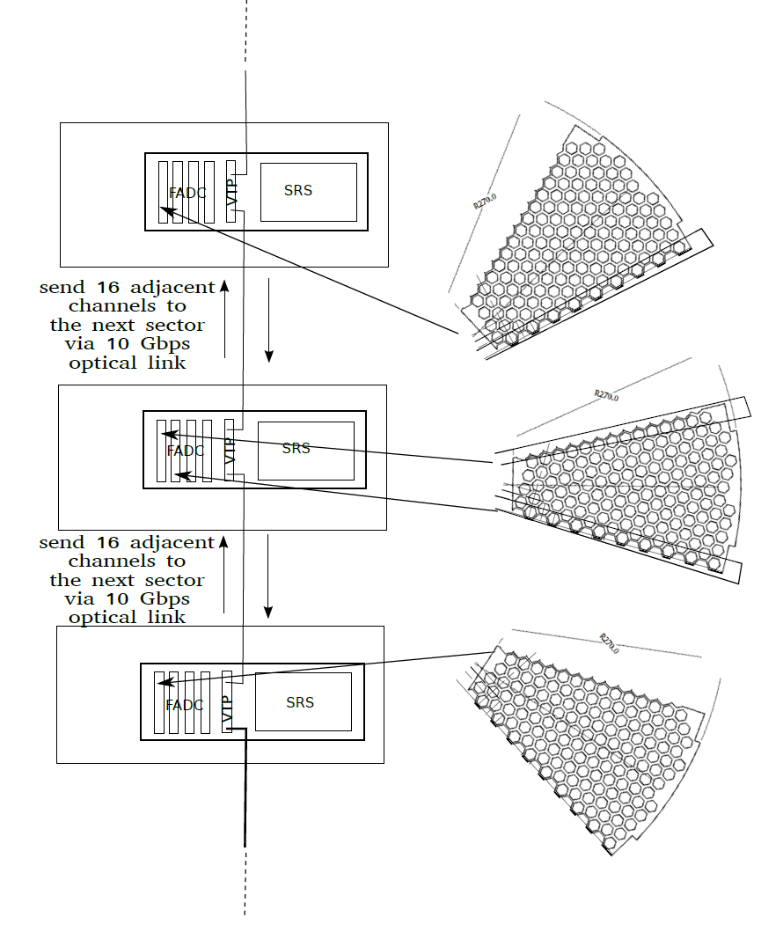
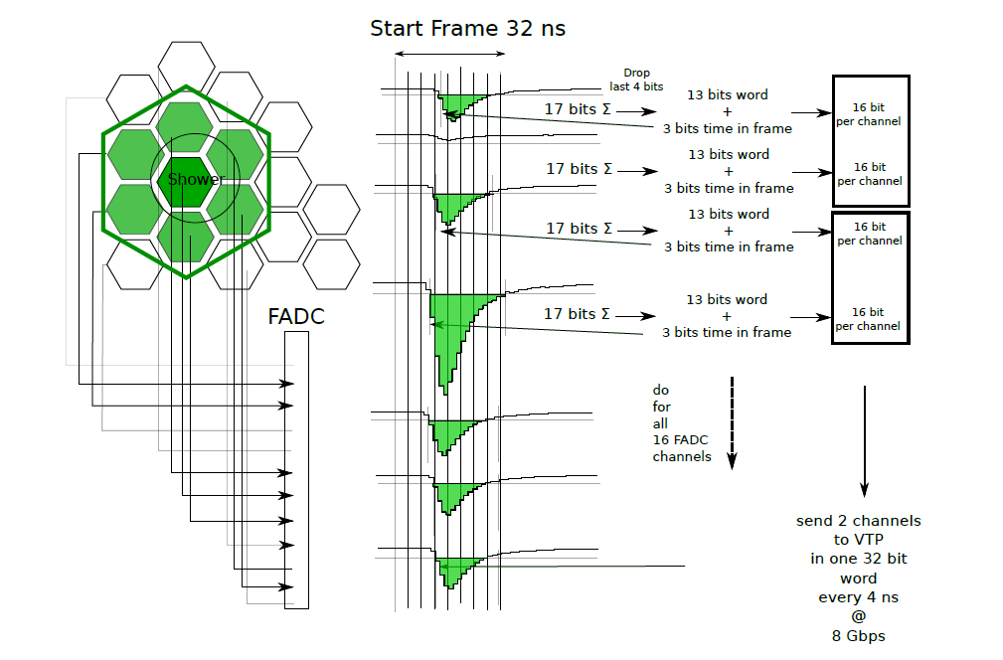
PVDIS trigger and readout

Slide 5
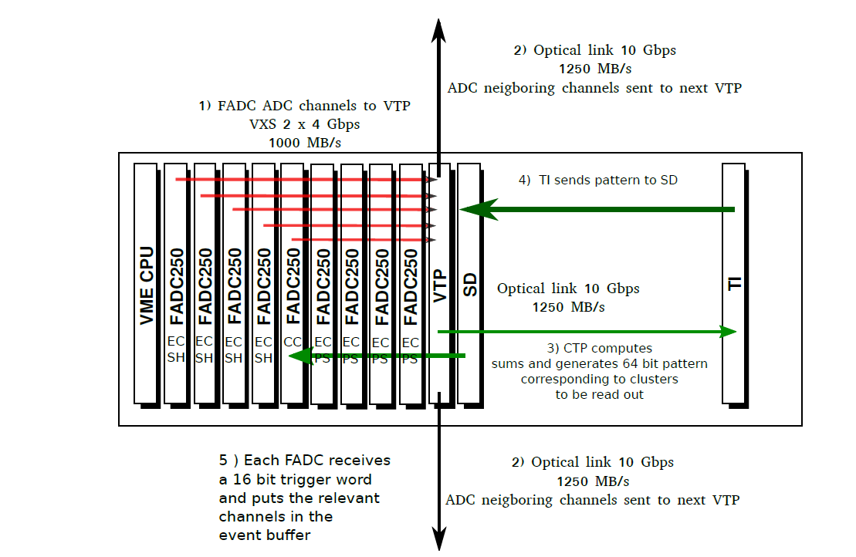
Crate layout

Slide 6
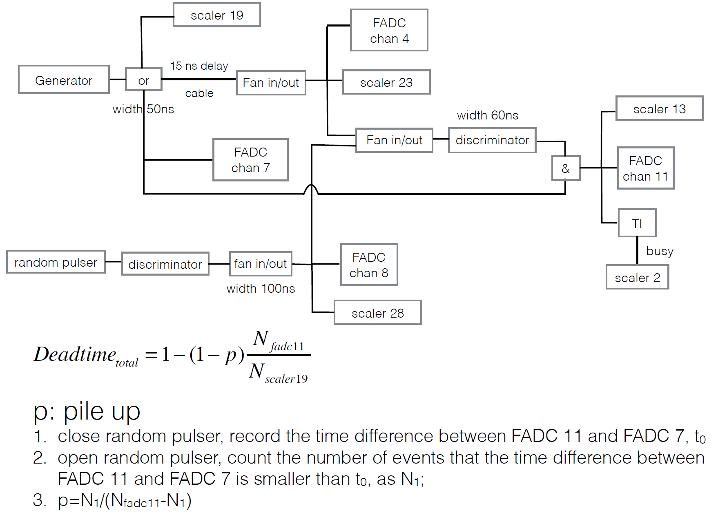
Compton single FADC setup
PVDIS deadtime measurement setup

Slide 7
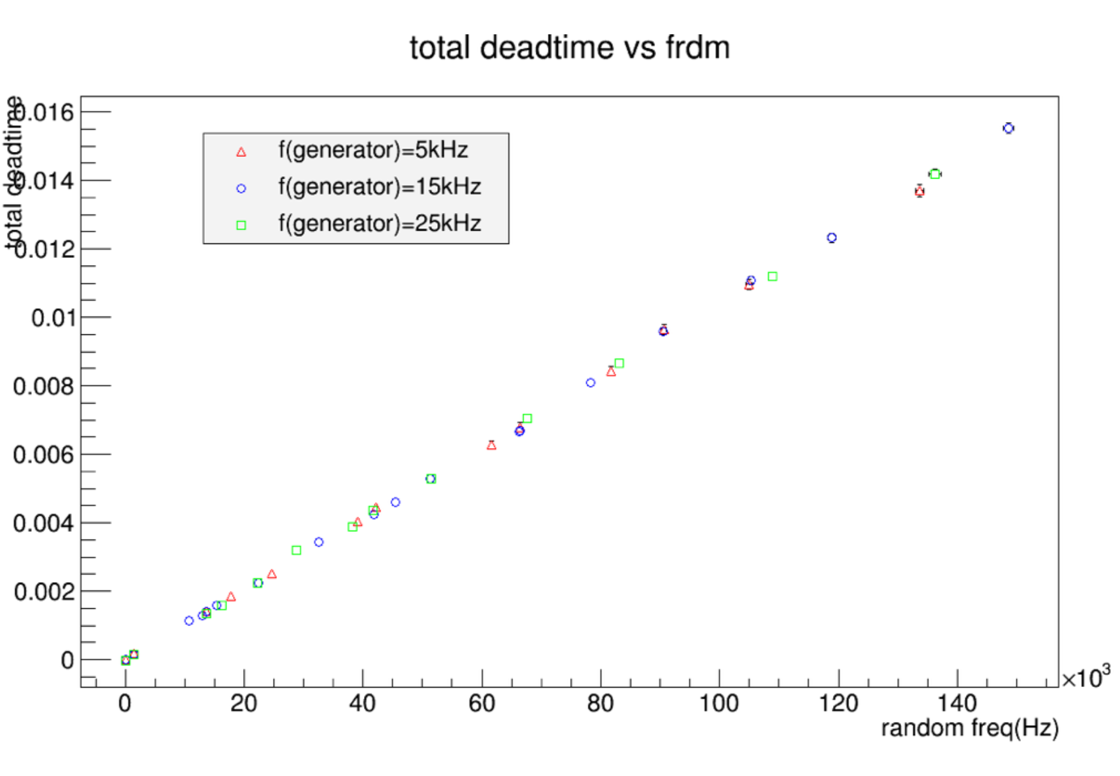
Deadtime measurement with setup

Slide 8
Deadtime measurement
TS helicity gated dead time implemented
FADC scalers
External scalers
Measure accuracy and model deadtime in raw mode 10 samples ( Ed )
Measure PVDIS asymmetry with FADC Compton setup ( need borrow a TS to test helicity gated deadtime )
Results for November/December SoLID science review

