Slide 1
ECAL FADC DAQ

Slide 2
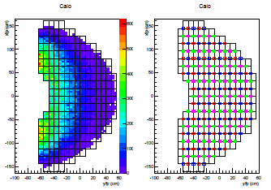
Gep5 calorimeter geometry
1792 channels of lead glass

Slide 3
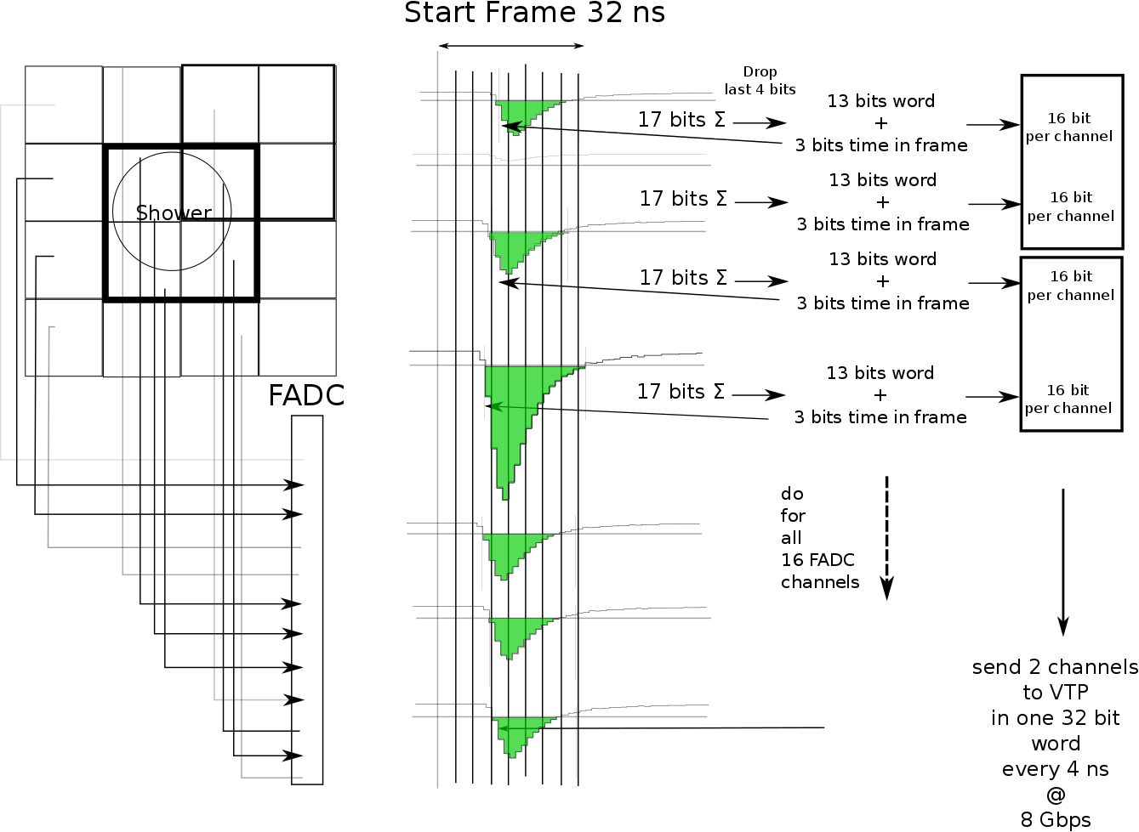
HPS scheme

Slide 4
VTP trigger
Same as HCAL with 2x2 clusters

Slide 5
FADC crates ECAL SBS
FADC
FADC
CPU
VTP
CPU
SD
TI
SSP
VTP
SD
TI
FADC
FADC
FADC
FADC
CPU
VTP
CPU
SD
TI
VTP
SD
TI
FADC
FADC
FADC
FADC
CPU
VTP
CPU
SD
TI
VTP
SD
TI
FADC
FADC
FADC
FADC
CPU
VTP
CPU
SD
TI
VTP
SD
TI

Slide 6
Neighbors only
One crate = 16 x16 channels

Slide 7
FADC crates ECAL SBS
FADC
FADC
Transfer neighbors and do clustering on each VTP : 64 channels instead of 256
CPU
VTP
SD
TI
FADC
FADC
FADC
FADC
CPU
VTP
CPU
SD
TI
VTP
SD
TI
FADC
FADC
FADC
FADC
CPU
VTP
CPU
SD
TI
VTP
SD
TI
FADC
FADC
FADC
FADC
CPU
VTP
CPU
SD
TI
VTP
SD
TI

Slide 8
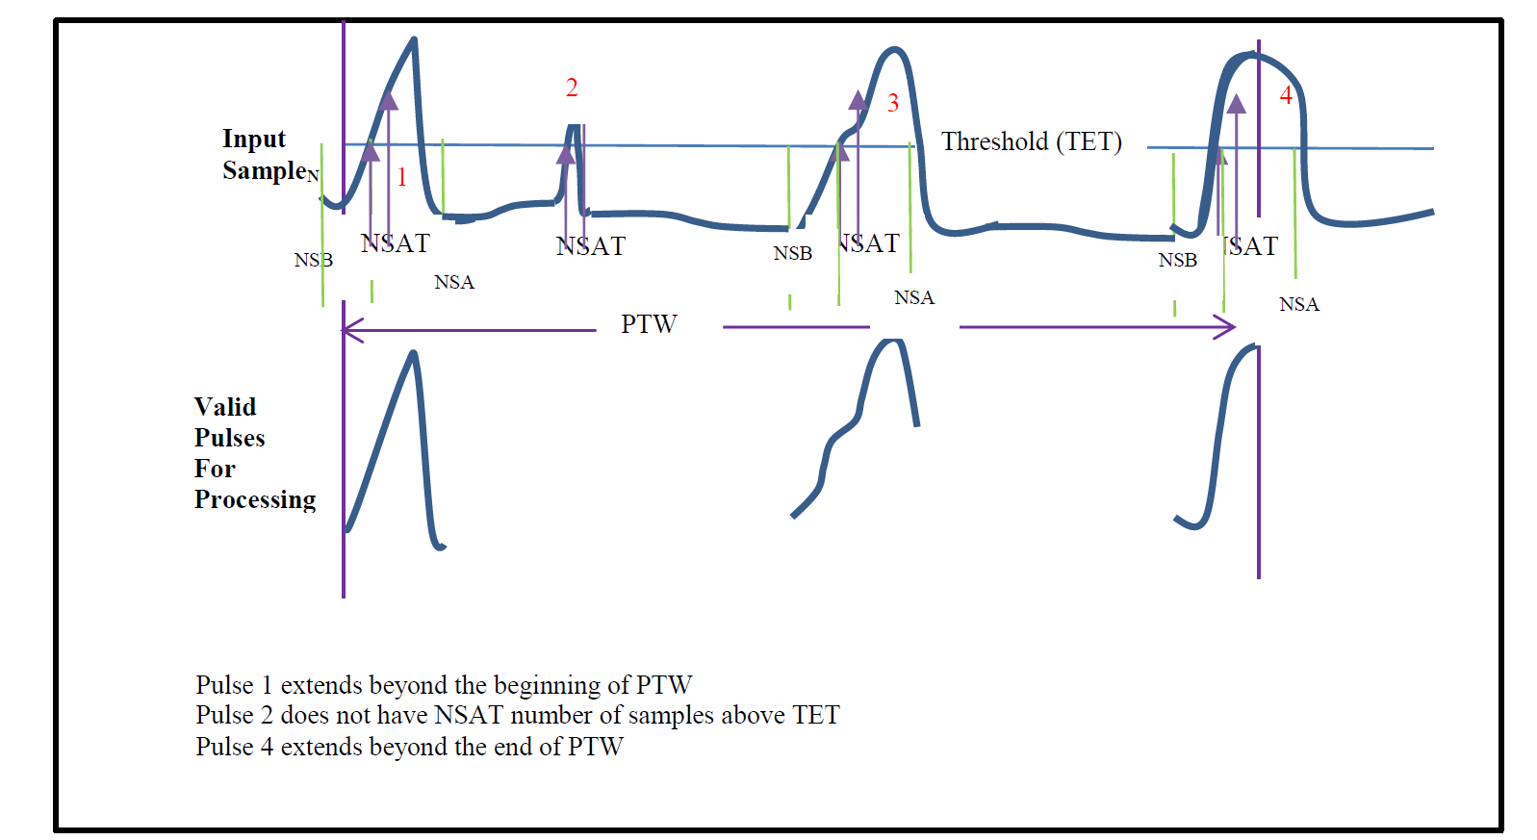
Integral + time
FADC can record up to 4 pulses in time window
Data about 10 times smaller if reading 25 samples

Slide 9
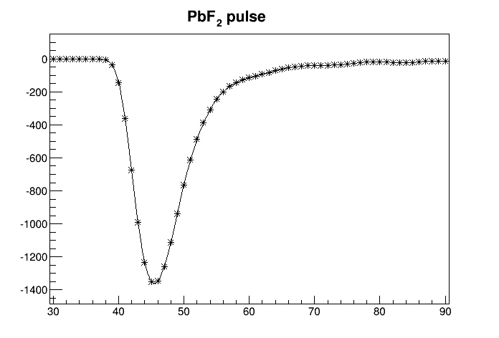
Waveform
Hall A DVCS recorded full waveform 128 samples

Slide 10
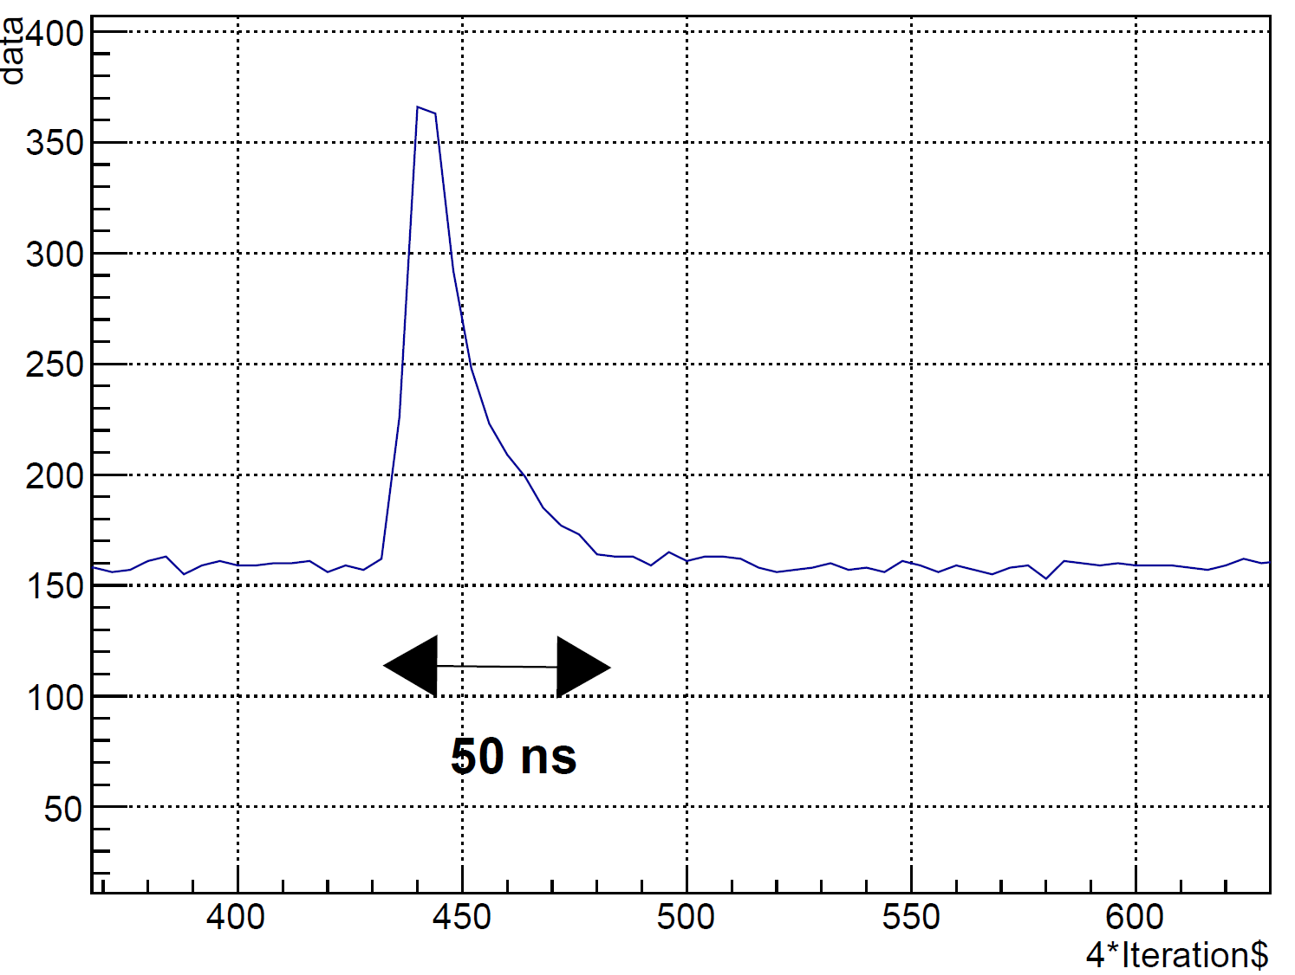
Waveform
NPS pulse fairly fast, need to check with final base and cable length

Slide 11
VTP readout
VTP readout
VME backplane limited to 100 MB/s
Development of parallel readout of FADC through serial link = 16x 125 MB/s
good option for cluster readout ( read all FADC and only transfer clusters )

Slide 12
Cost estimates total
 | Number needed | Unit price K$
1792 channels | 112
Cost estimation
FADC 250 | 4500 | 112 | 504000
TD | 3000 | 1 | 3000
SSP | 4000 | 1 | 4000
Transceiver | 400 | 7 | 2800
VTP | 7000 | 8 | 56000
TID | 3000 | 8 | 24000
SD | 2500 | 8 | 20000
VXS crate | 15000 | 8 | 120000
VME CPU | 3400 | 8 | 27200 | No FADC
 |  | Total | 761000 | 257000

Slide 13
Conclusion
For 1792 calorimeter channels
7 VXS crates
VTP readout to be able to read cluster only
About 257 K$ assuming all 112 FADC can be borrowed from electronics pool

