Slide 1
HRS TOF setup
Alexandre Camsonne

Slide 2
Single arm and coincidence
TOF between S0 and S2
information on particle momentum ( usually much worse than momentum ), can be used for PID
TOF between Left S2m and Right S2m
best timing resolution
long path length
also used for PID
useful for ee’p, Kaon, APEX

Slide 3
Corrections
Offsets : cable, TDC offset fixed, usually use overlap or reference scintillator to calibrate
Time propagation in scintillator
Timewalk effect
Pathlength correction
RF timing

Slide 4
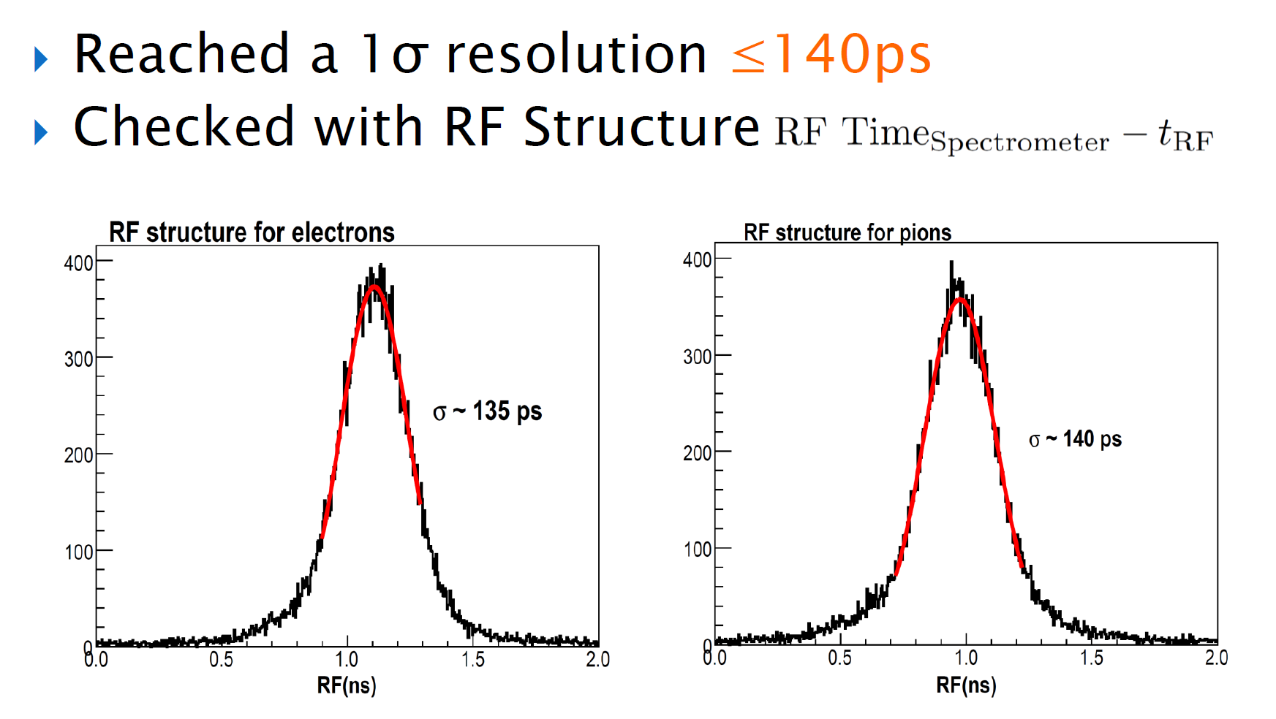
Example transversity experiment
http://hallaweb.jlab.org/data_reduc/AnaWork2009/BigBite-Coincidence-Time-Calibration-Jin.pdf

Slide 5
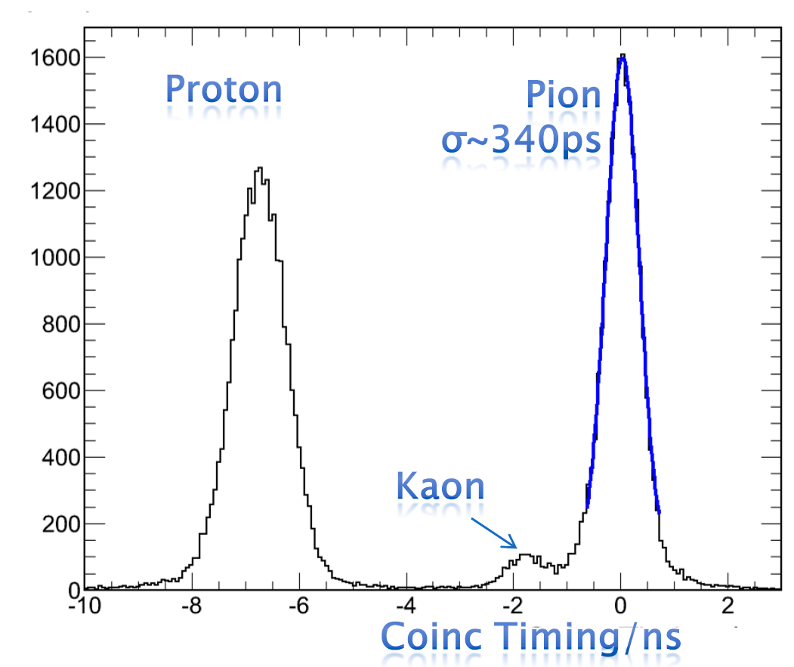
Coincidence TOF
BigBite was 270 ps timing resolution : should be able to do better with two HRS

Slide 6
Readout
Old way : Fastbus 1875 50 ps
New TDCs
F1 : 60 ps 32 channels
V1290 : 25 ps 32 channels
VETROC : 20 ps 128 channels

Slide 7
RF signal
499 MHz signal from accelerator
Allow to know the time with reference to the bunch
250 MHz now if 4 halls are running

Slide 8
Plan
Deploy 2F1 TDC in both HRS
copy of S2m
test V1290 and VETROC in Test Lab
add V1290 and VETROC in one arm to compare performance and split F1 signal
Send RF signal to TDC
found signal
most likely prescaled by 8 to be easier to handle

