Slide 1
Brief overview of
the Hall A scintillators
Reynier Cruz Torres

Slide 2
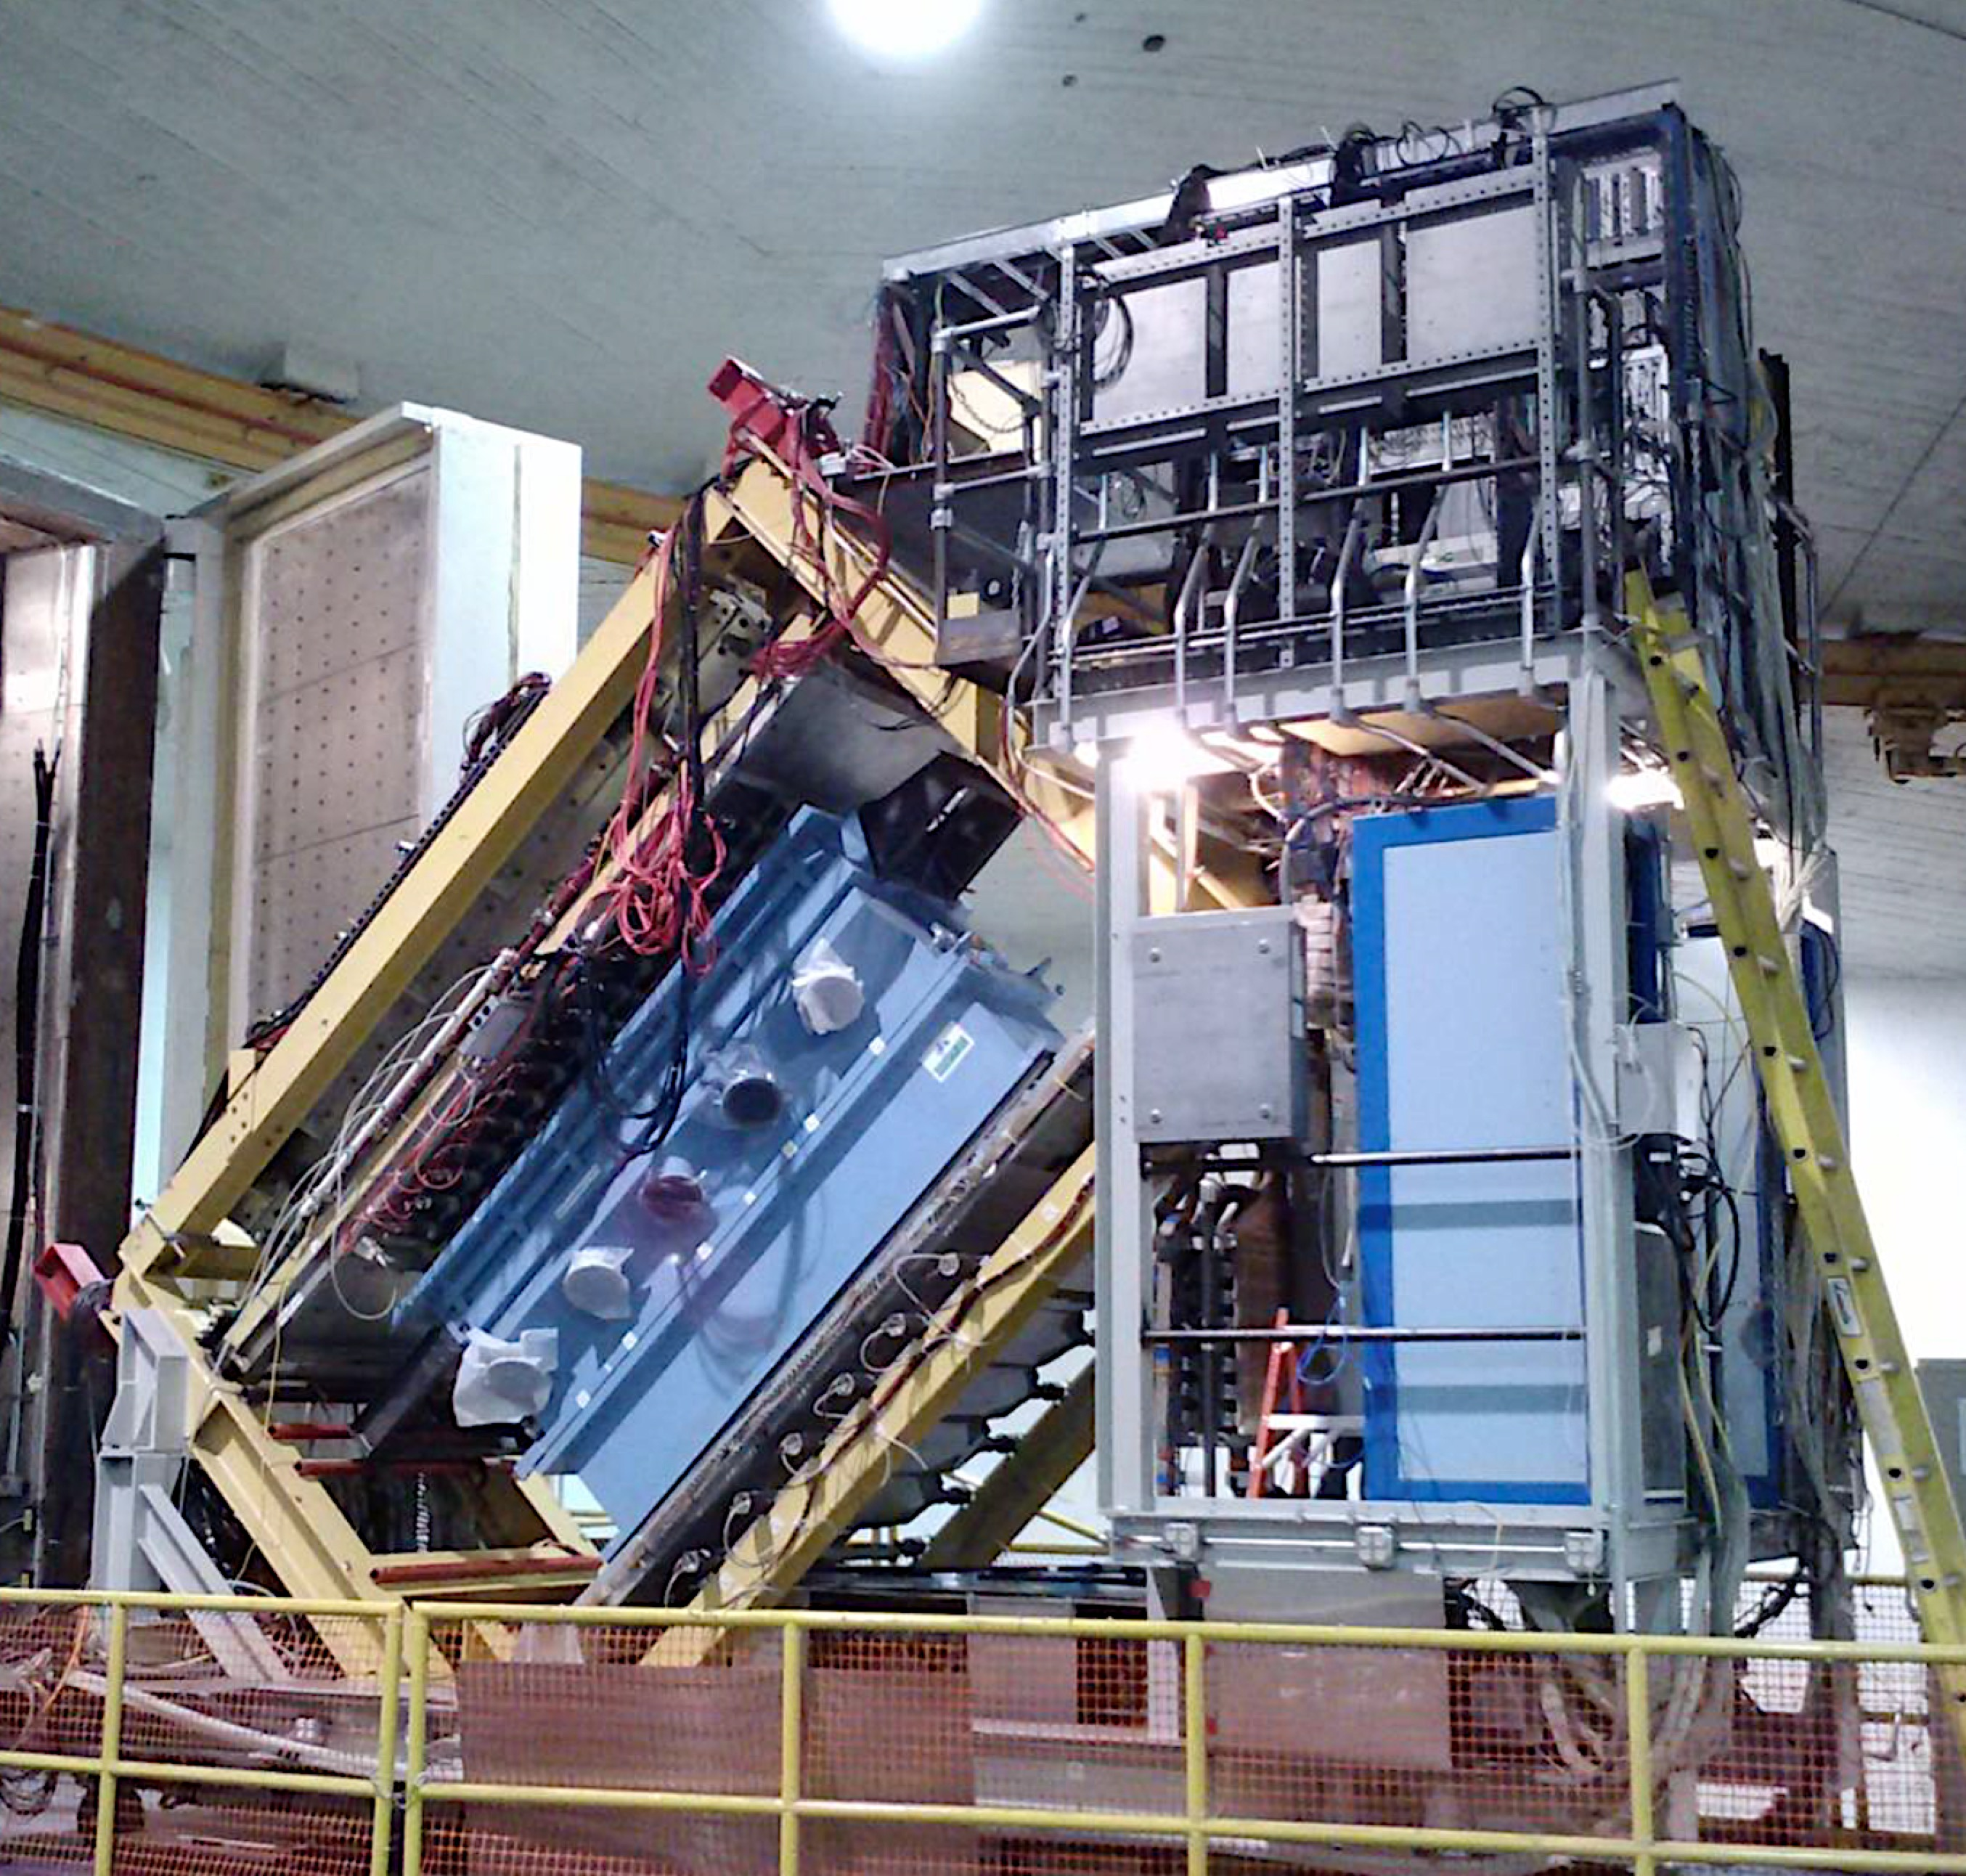
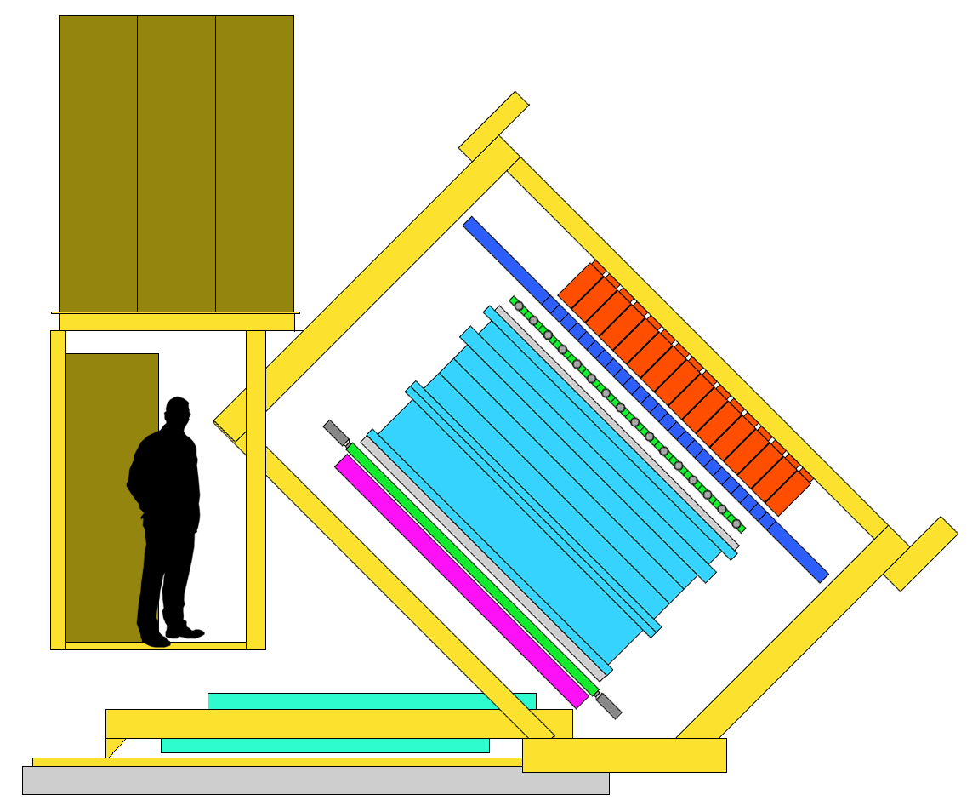
HRS Detector Configuration
S0 S2
Lead-Glass Calorimeter
Gas Cherenkov
Straw Chamber
VDC

Slide 3
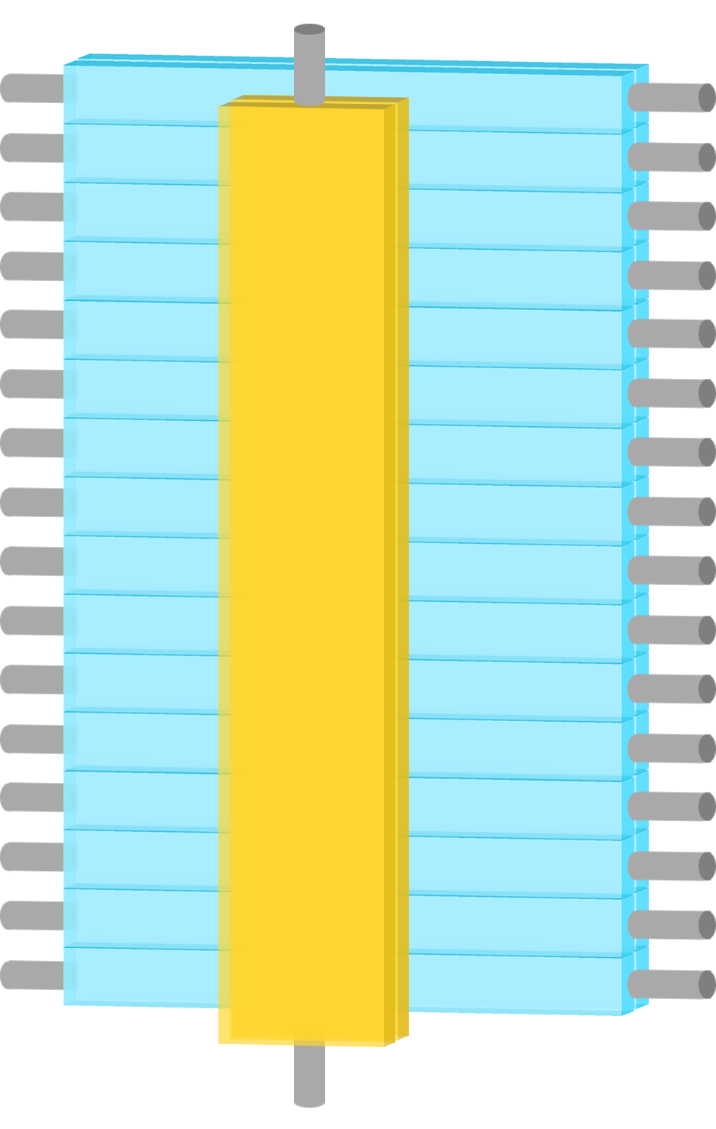
S0 and S2
1
2
3
4
5
6
7
8
9
10
11
12
13
14
15
16
S0
up
S0 S2
S2 Left
S2 Right
S0 down

Slide 4
S0
Amplifier
S0
downstairs upstairs
Scintillator
PMT

Slide 5
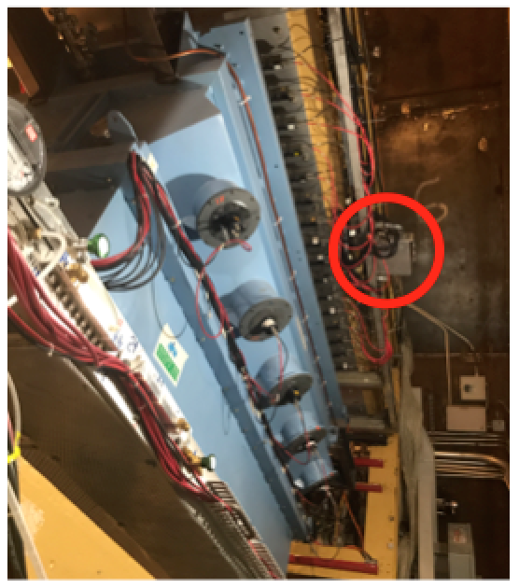
S2
Mixer/Splitter
+ Disc
Level Translator
fadc
S0 S2
downstairs upstairs
Discriminator
Mixer/Splitter
Scintillator
PMT

Slide 6
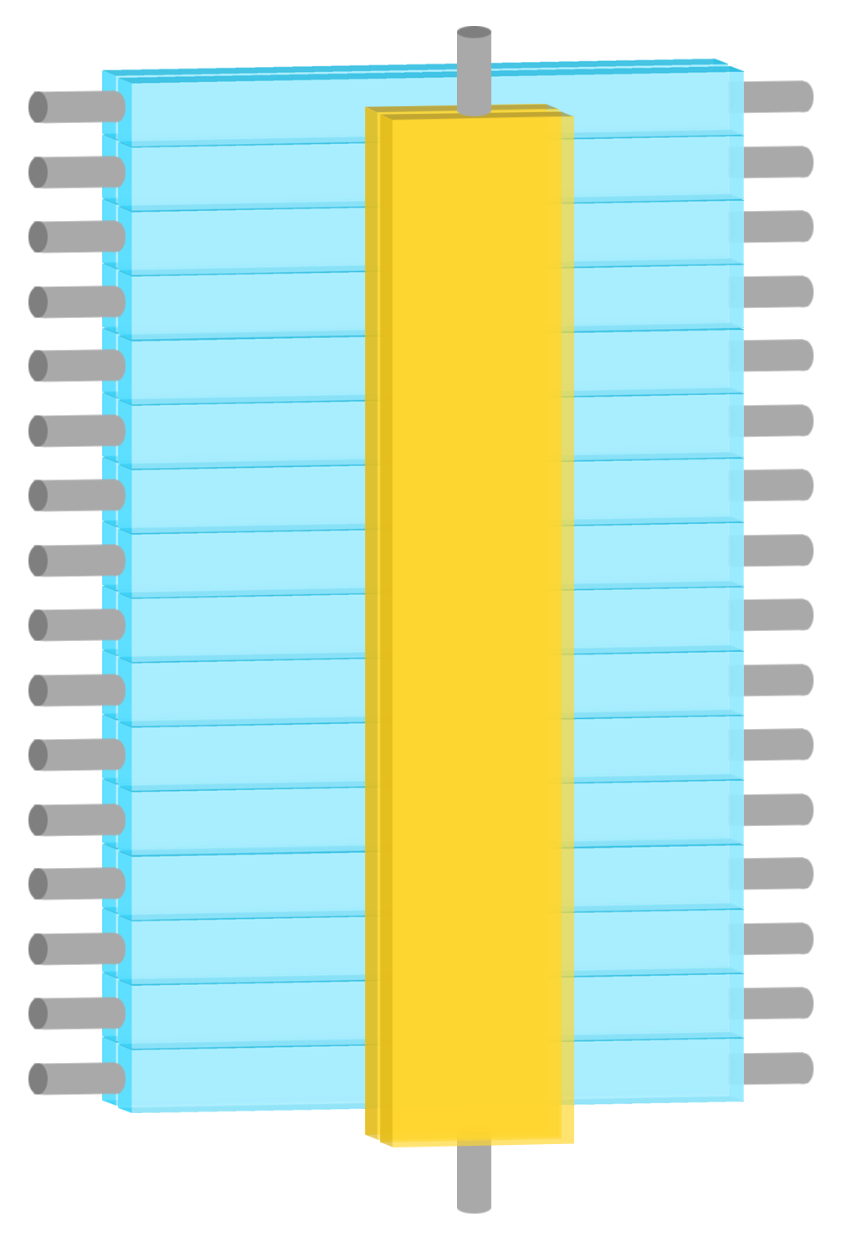
S0A and S0B have different meanings in the two arms
1
2
3
4
5
6
7
8
9
10
11
12
13
14
15
16
S0A
S0B
1
2
3
4
5
6
7
8
9
10
11
12
13
14
15
16
S2 Left
S0
S2 Right
S2 Left
S0
S2 Right
S0B
S0A
LHRS
RHRS

Slide 7
LHRS
Level
Translator
Amplifier
Level
Translator
fadc
fadc
69 ns
69 ns
46 ns
88 ns
1
2
3
4
5
6
7
8
9
10
11
12
13
14
15
16
S0A
76 ns
84 ns
S2 Left
S0
S2 Right
DISC
DISC
7 ns
8 ns
Mixer
Mixer
12 ns
S0B
11 ns
Italic = calculated

Slide 8
RHRS
Level
Translator
Amplifier
Level
Translator
fadc
fadc
57 ns
57 ns
55 ns
94 ns
S0B
1
2
3
4
5
6
7
8
9
10
11
12
13
14
15
16
57 ns
94 ns
S2 Left
S0
S2 Right
DISC
DISC
8 ns
7 ns
Mixer
Mixer
12 ns
S0A
11 ns
Italic = calculated

Slide 9
t0 + 5ns + 65ns
t0 + 20ns + 5ns+ 75ns
Level
Translator
Level
Translator
t0 + 5ns + 95ns
t0 + 20ns + 5ns+ 75ns
Level
Translator
t0 + 69ns
t0 + 20ns + 57ns
Level
Translator
Amplifier
Amplifier
65 ns
95 ns
69 ns
57 ns
75 ns
75 ns
s2R
s2L
5 ns
S0
S0
s2L
t0 + 20 ns
s2R
t0
5 ns
LHRS
RHRS

Slide 10
t0 + 70ns
t0 + 100ns
Level
Translator
Level
Translator
t0 + 100ns
t0 + 100ns
Level
Translator
t0 + 69ns
t0 + 77ns
Level
Translator
Amplifier
Amplifier
65 ns
95 ns
69 ns
57 ns
75 ns
75 ns
s2R
s2L
5 ns
S0
S0
s2L
t0 + 20 ns
s2R
t0
5 ns
LHRS
RHRS

Slide 11
t1 + 1ns
t1 = t0 + 69ns
t1 + 31ns
Level
Translator
Level
Translator
t1 + 31ns
t1 + 31ns
Level
Translator
t1
t1 + 8ns
Level
Translator
Amplifier
Amplifier
LHRS
RHRS

Slide 12
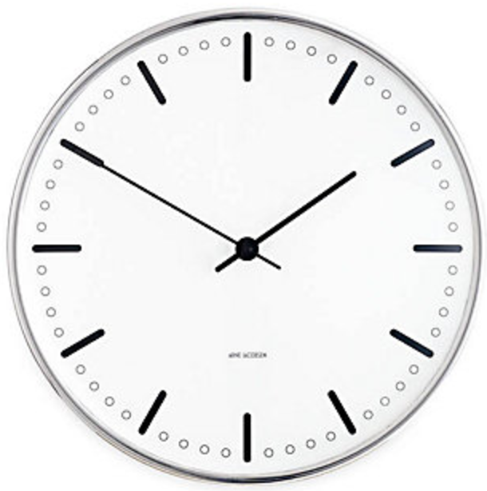
Level
Translator
Level
Translator
Level
Translator
Level
Translator
Amplifier
Amplifier
t1 + 1ns
t1 + 31ns
t1
t1 + 8ns
t1 + 31ns
t1 + 31ns
FIFO
FIFO
222 ns delay
222 ns
Clock on the LHRS
LHRS
RHRS

