Slide 1
Trigger Setup
Reynier Cruz Torres

Slide 2
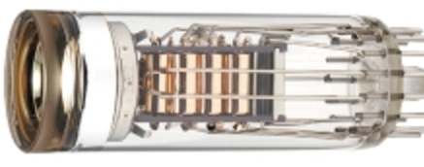
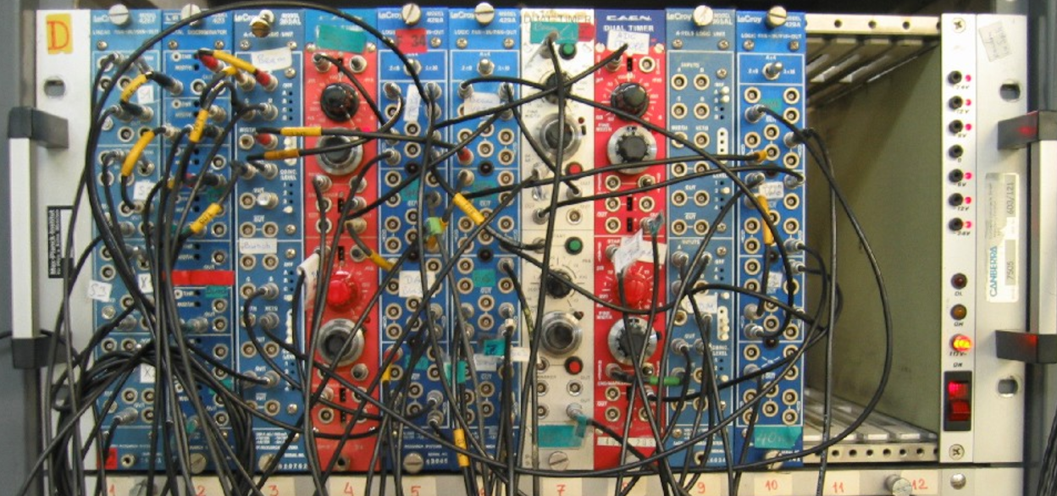
Elements to take into account for trigger setup
light TOF inside scintillators
PMT output delays
cables to electronics
electronics delay

Slide 3
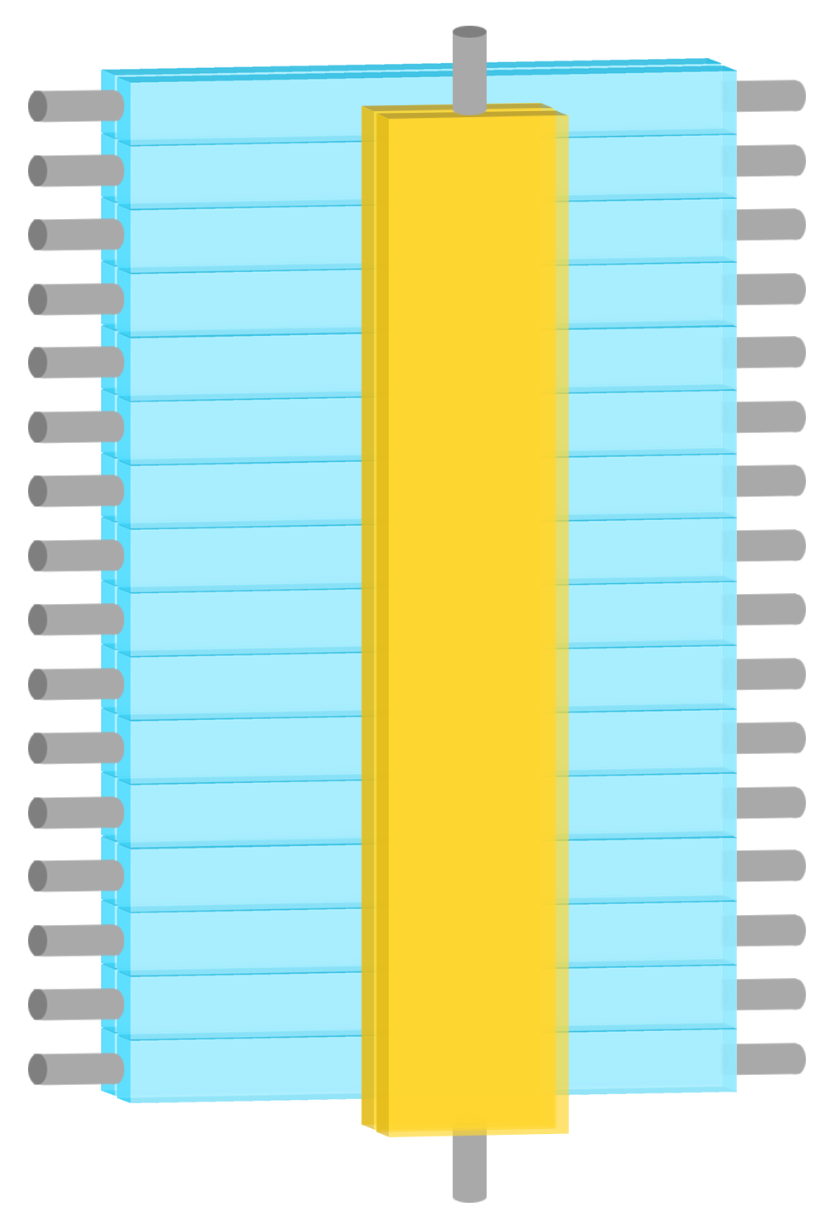
LHRS
Level
Translator
Amplifier
Level
Translator
fadc
fadc
69 ns
69 ns
46 ns
88 ns
1
2
3
4
5
6
7
8
9
10
11
12
13
14
15
16
S0A
76 ns
84 ns
S2 Left
S0
S2 Right
DISC
DISC
7 ns
8 ns
Mixer
Mixer
12 ns
S0B
11 ns
Italic = calculated

Slide 4
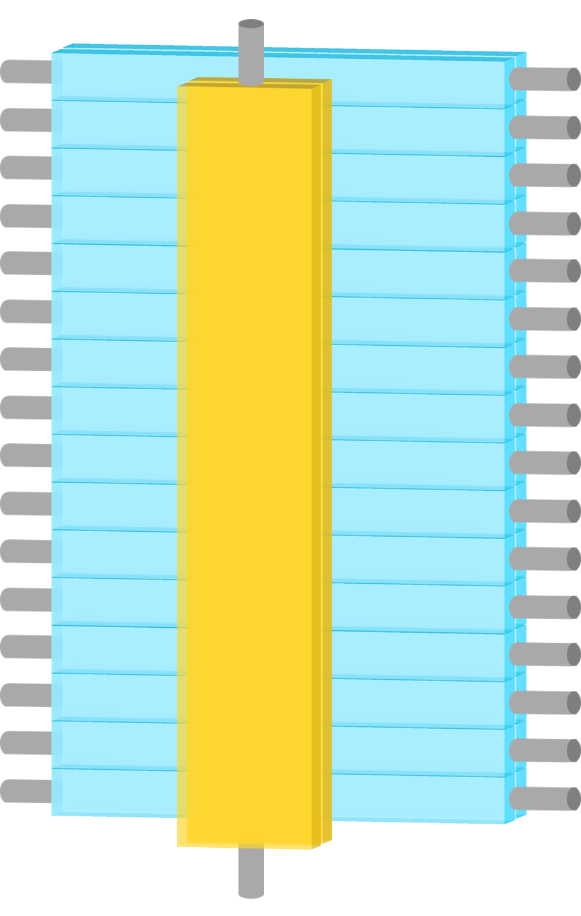
RHRS
Level
Translator
Amplifier
Level
Translator
fadc
fadc
57 ns
57 ns
55 ns
94 ns
S0B
1
2
3
4
5
6
7
8
9
10
11
12
13
14
15
16
57 ns
94 ns
S2 Left
S0
S2 Right
DISC
DISC
8 ns
7 ns
Mixer
Mixer
12 ns
S0A
11 ns
Italic = calculated

Slide 5
LHRS
S2 Logic Unit
10 ns delay (09/26/17)
L
S2_R gets here delayed by 25 ns with respect to S2_L
1 ns
R
1 ns
1 ns
8 ns
FIFO
1 ns
(S0||S2)
S2 coinc
Delay
20 ns
Delay
10 ns
Delay
5 ns
8 ns
0.5 ns
10 ns
S0
1 ns
(S0&S2)
S2
1 ns
1 ns
GC
(S0||S2)&GC
8 ns
S0A disc
3 ns
Delay
20 ns
3 ns
8 ns
1 ns
1 ns
S0 coinc
S0B disc
(S0&S2)&GC
1 ns
GC disc
1 ns
GC coinc
3 ns
Delay
20 ns
8 ns
Analog sum

Slide 6
RHRS
S2 Logic Unit
L
6 ns
Delay
10 ns
1 ns
R
1 ns
8 ns
16 ns
FIFO
1 ns
(S0||S2)
S2 coinc
Delay
20 ns
8 ns
8 ns
S0
1 ns
(S0&S2)
S2
1 ns
1 ns
GC
(S0||S2)&GC
S0B disc
6 ns
Delay
10 ns
1 ns
Delay
5 ns
3 ns
Delay
5 ns
1 ns
S0 coinc
17 ns
1 ns
S0A disc
(S0&S2)&GC
0.5 ns
9 ns delay (10/02/17)
GC disc
0.3 ns
GC coinc
2 ns
Delay
20 ns
8 ns
Analog sum

Slide 7
RHRS
S2 Logic Unit
L
6 ns
Delay
10 ns
1 ns
R
1 ns
8 ns
16 ns
FIFO
1 ns
(S0||S2)
S2 coinc
Delay
20 ns
8 ns
8 ns
S0
1 ns
(S0&S2)
S2
1 ns
1 ns
GC
(S0||S2)&GC
S0B disc
6 ns
Delay
10 ns
1 ns
Delay
5 ns
3 ns
Delay
5 ns
1 ns
S0 coinc
17 ns
1 ns
S0A disc
(S0&S2)&GC
0.5 ns
9 ns delay (10/02/17)
This delay was adjusted
A and B delays were swapped since my last presentation (on Sept 27, 2017)
GC disc
0.3 ns
GC coinc
2 ns
Delay
20 ns
8 ns
Analog sum

Slide 8
Elements to take into account for trigger setup
light TOF inside scintillators
PMT output delays
cables to electronics
electronics delay

Slide 9
LHRS

Slide 10
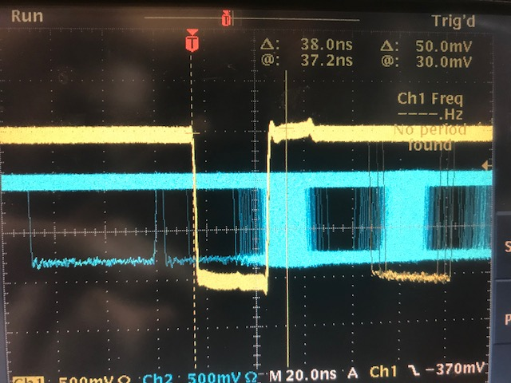
S2_R & S0_A
LHRS
S2 Logic Unit
S2 PMT
delay
95 ns
L
S2_R
Level translator
1 ns
S2 coinc
1 ns
R
15.8 ns
COSMICS
S0 PMT
delay
S0B disc
S0_A
69 ns
Amplifier
26 ns
S0 coinc
S0A disc
15.4 ns
(S0_A PMT delay) + 69 + 15.4 + 26 + 8 + TOF - [(S2_R PMT delay) + 95 + 15.8 + 1 + 8] = 38
(S0_A PMT delay) - (S2_R PMT delay) = 38 – 3.6 = 34.4
* where we assumed TOF = 5 ns
* all numbers in nano-seconds
COSMICS
(S0_A PMT delay) - (S2_R PMT delay) = 34.4 ns
38 ns

Slide 11
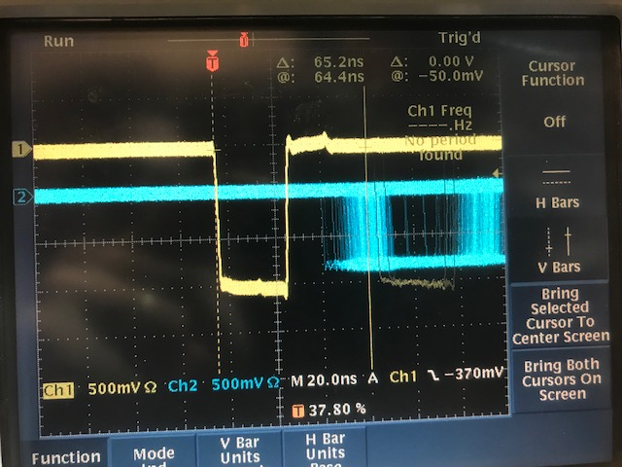
S2_L & S0_A
LHRS
S2 Logic Unit
S2 PMT
delay
65 ns
1 ns
L
1 ns
S2_L
Level translator
S2 coinc
R
15.8 ns
COSMICS
S0 PMT
delay
S0B disc
S0_A
69 ns
Amplifier
26 ns
S0 coinc
S0A disc
15.4 ns
(S0_A PMT delay) + 69 + 15.4 + 26 + 8 + TOF - [(S2_L PMT delay) + 65 + 15.8 + 1 + 8] = 65
(S0_A PMT delay) - (S2_L PMT delay) = 65 – 33.6 = 31.4
* where we assumed TOF = 5 ns
* all numbers in nano-seconds
COSMICS
65 ns
(S0_A PMT delay) - (S2_L PMT delay) = 31.4 ns

Slide 12
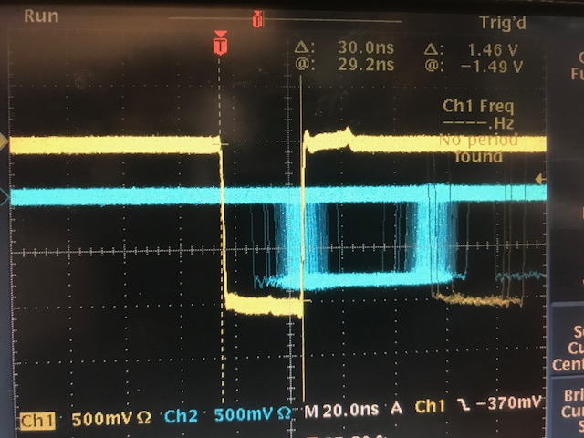
S2_L & S0_B
LHRS
S2 Logic Unit
S2 PMT
delay
65 ns
1 ns
L
1 ns
S2_L
Level translator
S2 coinc
R
15.8 ns
COSMICS
S0 PMT
delay
S0B disc
1 ns
S0_B
69 ns
Amplifier
S0 coinc
S0A disc
15.4 ns
(S0_B PMT delay) + 69 + 15.4 + 1 + 8 + TOF - [(S2_L PMT delay) + 65 + 15.8 + 1 + 8] = 30
(S0_B PMT delay) - (S2_L PMT delay) = 30 – 8.6 = 21.4
* where we assumed TOF = 5 ns
* all numbers in nano-seconds
COSMICS
30 ns
(S0_B PMT delay) - (S2_L PMT delay) = 21.4 ns

Slide 13
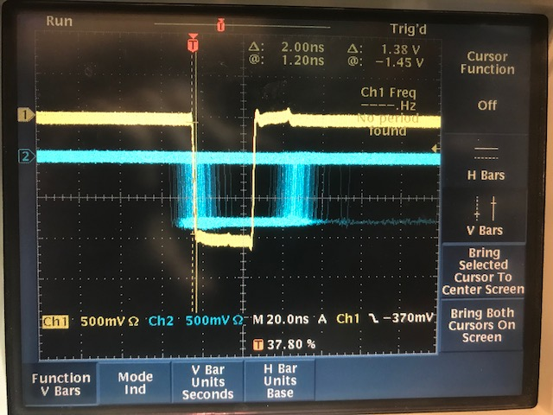
S2_R & S0_B
LHRS
S2 Logic Unit
S2 PMT
delay
95 ns
L
S2_R
Level translator
1 ns
S2 coinc
1 ns
R
15.8 ns
COSMICS
S0 PMT
delay
S0B disc
1 ns
S0_B
69 ns
Amplifier
S0 coinc
S0A disc
15.4 ns
(S0_B PMT delay) + 69 + 15.4 + 1 + 8 + TOF - [(S2_R PMT delay) + 95 + 15.8 + 1 + 8] = 2
(S0_B PMT delay) - (S2_R PMT delay) = 2 + 21.4 = 23.4
* where we assumed TOF = 5 ns
* all numbers in nano-seconds
COSMICS
2 ns
(S0_B PMT delay) - (S2_R PMT delay) = 23.4 ns

Slide 14
LHRS
(S0_A PMT delay) - (S2_R PMT delay) = 34.4 ns
(S0_A PMT delay) - (S2_L PMT delay) = 31.4 ns
(S0_B PMT delay) - (S2_L PMT delay) = 21.4 ns
(S0_B PMT delay) - (S2_R PMT delay) = 23.4 ns
S2_R delay = l₀
S2_L delay = l₀ + 3 ns
S0_A delay = l₀ + 34.4 ns
S0_B delay = l₀ + 23.4 ns

Slide 15
LHRS
(S0_A PMT delay) - (S2_R PMT delay) = 34.4 ns
(S0_A PMT delay) - (S2_L PMT delay) = 31.4 ns
(S0_B PMT delay) - (S2_L PMT delay) = 21.4 ns
(S0_B PMT delay) - (S2_R PMT delay) = 23.4 ns
S2_R delay = l₀
S2_L delay = l₀ + 3 ns
S0_A delay = l₀ + 34.4 ns
S0_B delay = l₀ + 23.4 ns
This could be: only PMT delay, only light TOF delay, or both. Which one is it?

Slide 16
Estimation: Light TOF in S0
S0 scintillators ~ 2m long
Speed of light in scintillator ~ (3x10⁸ m/s)/(1.6)
Light TOF: ~ (2 m x 1.6)/(3x10⁸ m/s) ~ 10 ns
n ~ 1.6
~2 m

Slide 17
Triggering externally on S2_L(16) & S2_R(16) & S0A & S0B
LHRS
Triggering externally on S2_L(1) & S2_R(1) & S0A & S0B
A
A
B
B
20 ns
20 ns
S0B
S0B
S0A
S0A
2 ns
10 ns
*Expectation under assumption of no PMT delay
*Expectation under assumption of no PMT delay

Slide 18
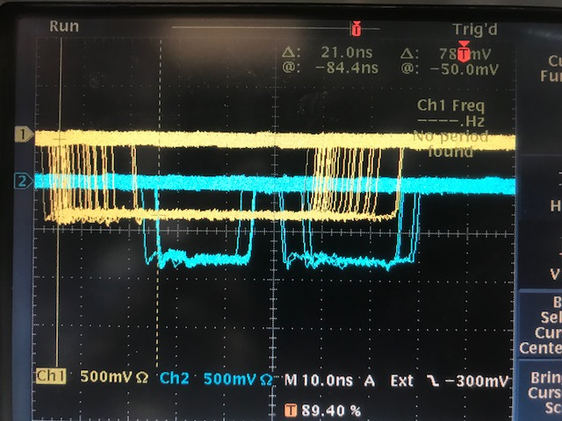
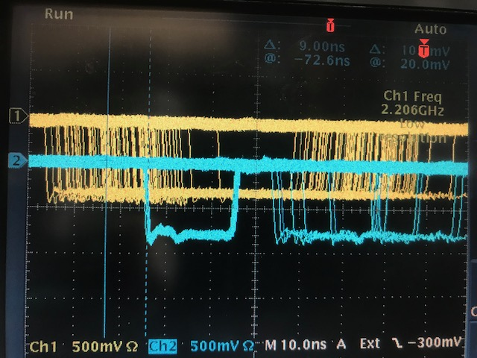
Triggering externally on S2_L(16) & S2_R(16) & S0A & S0B
LHRS
Triggering externally on S2_L(1) & S2_R(1) & S0A & S0B
A
A
B
B
S0B
S0B
S0A
S0A
9 ns
21 ns

Slide 19
LHRS
(S0_A PMT delay) - (S2_R PMT delay) = 34.4 ns
(S0_A PMT delay) - (S2_L PMT delay) = 31.4 ns
(S0_B PMT delay) - (S2_L PMT delay) = 21.4 ns
(S0_B PMT delay) - (S2_R PMT delay) = 23.4 ns
S2_R delay = l₀
S2_L delay = l₀ + 3 ns
S0_A delay = l₀ + 34.4 ns
S0_B delay = l₀ + 23.4 ns
This difference is due to PMT delay!

Slide 20
RHRS

Slide 21
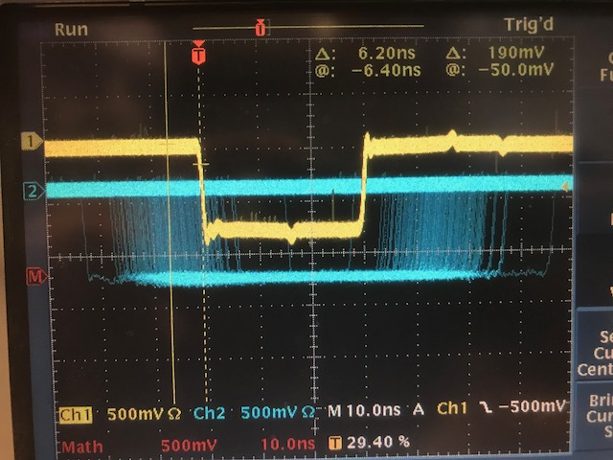
S2_R & S0_A
RHRS
S2 Logic Unit
S2 PMT
delay
75 ns
L
S2_R
Level translator
24 ns
S2 coinc
1 ns
R
16 ns
COSMICS
S0 PMT
delay
S0B disc
S0_A
57 ns
Amplifier
1 ns
S0 coinc
S0A disc
9.8 ns
9 ns
(S0_A PMT delay) + 57 + 9.8 + 1 + 8 + TOF - [(S2_R PMT delay) + 75 + 16 + 24 + 8] = - 6.2
(S0_A PMT delay) - (S2_R PMT delay) = -6.2 + 42.2 = 36
* where we assumed TOF = 5 ns
* all numbers in nano-seconds
COSMICS
(S0_A PMT delay) - (S2_R PMT delay) = 36 ns
6.2 ns

Slide 22
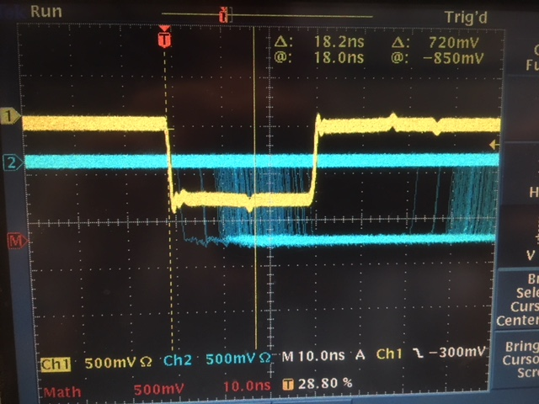
S2_L & S0_A
RHRS
S2 Logic Unit
S2 PMT
delay
75 ns
1 ns
L
1 ns
S2_L
Level translator
S2 coinc
R
16 ns
COSMICS
S0 PMT
delay
S0B disc
S0_A
57 ns
Amplifier
1 ns
S0 coinc
S0A disc
9.8 ns
9 ns
(S0_A PMT delay) + 57 + 9.8 + 1 + 8 + TOF - [(S2_L PMT delay) + 75 + 16 + 1 + 8] = 18
(S0_A PMT delay) - (S2_L PMT delay) = 18 + 19.2 = 37.2
* where we assumed TOF = 5 ns
* all numbers in nano-seconds
COSMICS
18 ns
(S0_A PMT delay) - (S2_L PMT delay) = 37.2 ns

Slide 23
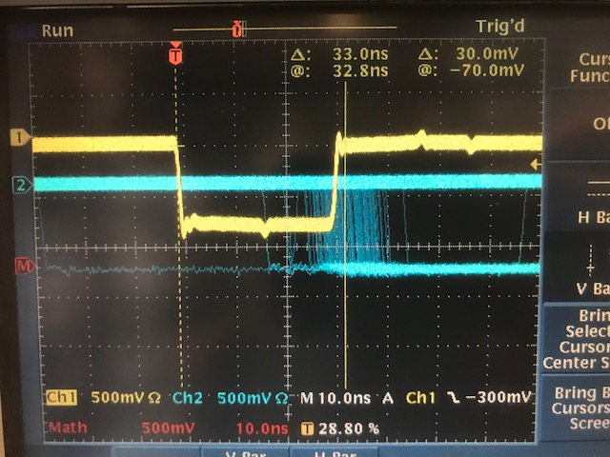
S2_L & S0_B
RHRS
S2 Logic Unit
S2 PMT
delay
75 ns
1 ns
L
1 ns
S2_L
Level translator
S2 coinc
R
16 ns
COSMICS
S0 PMT
delay
S0B disc
25 ns
S0_B
57 ns
Amplifier
S0 coinc
S0A disc
10 ns
9 ns
(S0_B PMT delay) + 57 + 10 + 25 + 8 + TOF - [(S2_L PMT delay) + 75 + 16 + 1 + 8] = 33
(S0_B PMT delay) - (S2_L PMT delay) = - 5 + 33 = 28
* where we assumed TOF = 5 ns
* all numbers in nano-seconds
COSMICS
33 ns
(S0_B PMT delay) - (S2_L PMT delay) = 28 ns

Slide 24
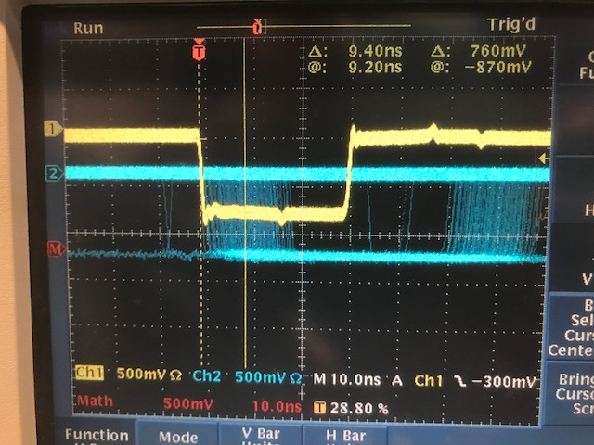
S2_R & S0_B
RHRS
S2 Logic Unit
S2 PMT
delay
75 ns
L
S2_R
Level translator
24 ns
S2 coinc
1 ns
R
16 ns
COSMICS
S0 PMT
delay
S0B disc
25 ns
S0_B
57 ns
Amplifier
S0 coinc
S0A disc
10 ns
9 ns
(S0_B PMT delay) + 57 + 10 + 25 + 8 + TOF - [(S2_R PMT delay) + 75 + 16 + 24 + 8] = 9.4
(S0_B PMT delay) - (S2_R PMT delay) = 9.4 + 18 = 27.4
* where we assumed TOF = 5 ns
* all numbers in nano-seconds
COSMICS
9.4 ns
(S0_B PMT delay) - (S2_R PMT delay) = 27.4 ns

Slide 25
RHRS
(S0_A PMT delay) - (S2_R PMT delay) = 36 ns
(S0_A PMT delay) - (S2_L PMT delay) = 37.2 ns
(S0_B PMT delay) - (S2_L PMT delay) = 28 ns
(S0_B PMT delay) - (S2_R PMT delay) = 27.4 ns
S2_L delay = l₁
S2_R delay = l₁ + 1 ns
S0_A delay = l₁ + 37 ns
S0_B delay = l₁ + 28 ns

Slide 26
Fake signal for coincidence trigger

Slide 27
t0+ t_{PMT} + 1ns + 20ns + 5ns+ 75ns
Level
Translator
t0 + t_{PMT} + 5ns + 95ns
Level
Translator
t0 + t_{PMT} + 34ns + 69ns
t0 + t_{PMT} + 28ns+ 20ns + 57ns
Amplifier
Amplifier
95 ns
69 ns
57 ns
75 ns
t_{PMT}
s2R
t_{PMT}+34 ns
t_{PMT}+28 ns
5 ns
t_{PMT}+1 ns
S0
S0
s2L
t0 + 20 ns
s2R
t0
5 ns
LHRS
RHRS

Slide 28
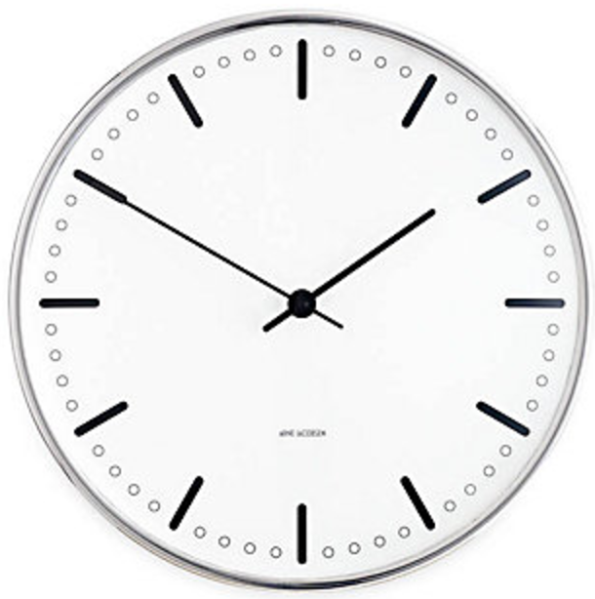
input to S2_L&R coinc
input to S2_L&R coinc
input to S0 coinc
input to S0 coinc
8ns
35ns
39ns
32ns
s2R
S0A
S0
s2R
FIFO
FIFO
10 ns
10 ns
8 ns
8 ns
222 ns delay
222 ns
Clock on the LHRS
LHRS
RHRS

Slide 29
Single arm triggers with fake signal

Slide 30
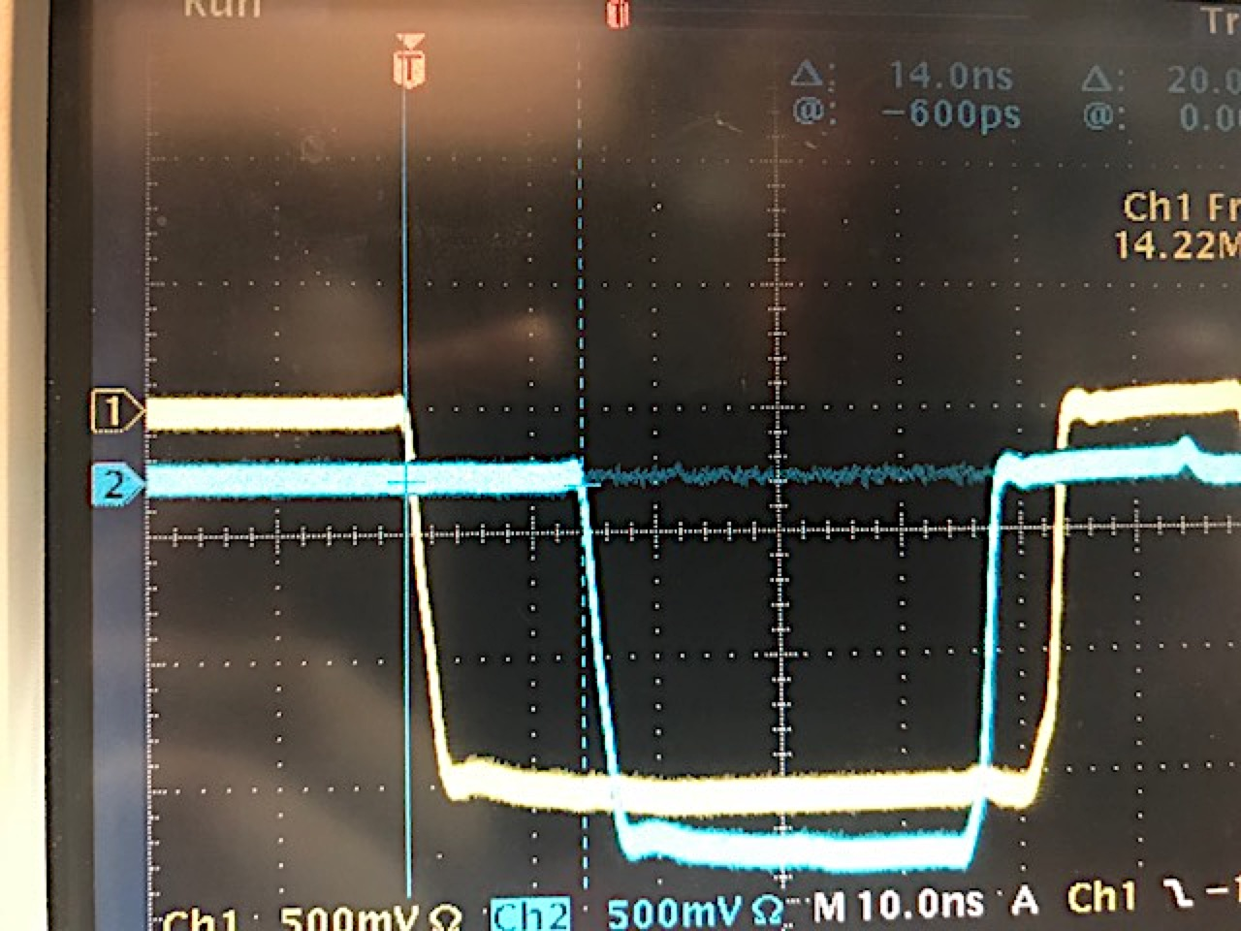
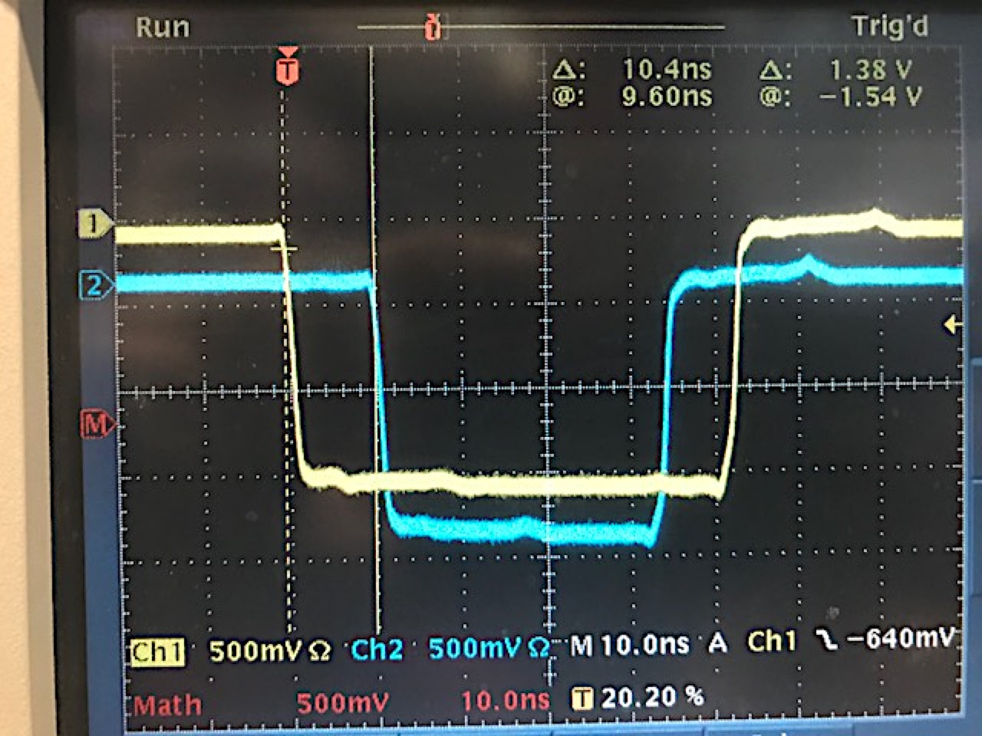
S2
Expectation
S0
20ns
30ns
50ns
LHRS
RHRS
S0
S0
S2
S2
14 ns
10 ns
* (S0-S2 delay should be ~20ns) Might need adjustment for real electrons

Slide 31
Coincidence trigger with fake signal

Slide 32
Coincidence triggers
LHRS signals on RHRS
(S0&S2)&GC
(S0||S2)&GC
S0&S2 (T1)
≈220ns
A
Disc
≈50ns
delay
delay
TS
LHRS
B
Disc
NIM
ECL
delay
C
delay
Disc
FIFO
delay
delay
Delay Gen.
(>200ns)
(S0&S2)_{L}
&S0_{R}
S0_{R}
T1
S0 FIFO
60ns (e’p)
60ns
20ns (e’d)
RHRS
Delay Gen.
(>200ns)
(S0&S2)_{L}
&S2_{R}
S2 FIFO
150ns
S2_{R}
T1
Delay Gen.
(>200ns)
(S0&S2)_{L}
&(S0&S2)_{R}
60ns (e’p)
60ns
S0&S2 coinc
20ns (e’d)
150ns
(S0&S2)_{R}
T1
All coincidence trigger timed on T1 which
corresponds to S2_{LHRS}
-> all trigger but (S0||S2)&GC_{LHRS} timed on S2_{LHRS}
(S0||S2)&GC_{LHRS} timed on S0_{LHRS} if S0 fires
60ns (e’p)
60ns
20ns (e’d)
150ns

Slide 33
LHRS
T1 – S0_{R} = T1 – S2_{R} = T1 – (S0&S2)_{R} = 60 ns
S2 Logic Unit
t3 + 336.5 ns
Patch pannel on RHRS
t3
T1
Coinc unit for coinc trigger
Disc
FIFO
8 ns
3 ns
2 ns
t3 + 307.5 ns
0.5 ns
0.5 ns
0.5 ns
Disc 711 or Logic 755
0.5 ns
0.5 ns
0.5 ns
Delay Generator
x x x
RHRS
t3 + 31 ns
S0 coinc
17 ns
t3+77ns
t3+65ns
t3+86ns
S2 Logic Unit
t3 + 24 ns
S2 coinc
FIFO
Delay
20 ns
8 ns
8 ns
S0
1 ns
1 ns
(S0&S2)
S2
t3 + 85 ns

Slide 34
Prediction for the delays on RHRS for coinc trigger
Need to set delay in RHRS delay generator for S2 (RHRS) to:
t3 + 336.5 – (t3 + 77 + x + 0.5 + 8 + 0.5) ns = 60 ns
x = 190.5 ns
Need to set delay in RHRS delay generator for S0 (RHRS) to:
t3 + 336.5 – (t3 + 65 + x + 0.5 + 8 + 0.5) ns = 60 ns
x = 202.5 ns
Need to set delay in RHRS delay generator for S0&S2 (RHRS) to:
t3 + 336.5 – (t3 + 86 + x + 0.5 + 8 + 0.5) ns = 60 ns
x = 181.5 ns

Slide 35
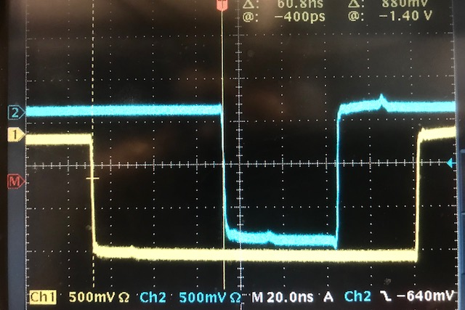
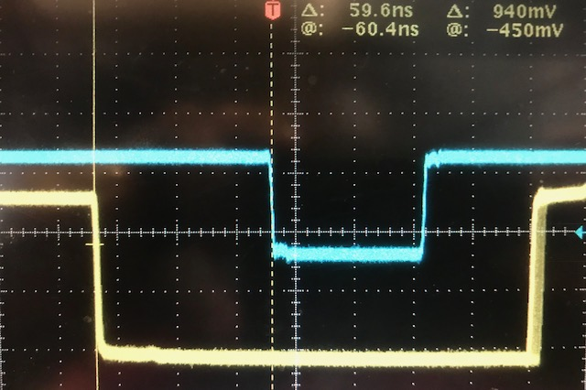
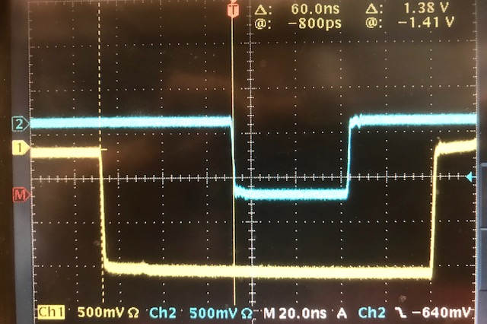
Coincidence triggers
150 ns
(S0&S2)_{R}
T1
T1
C1:
C2:
C3:
60ns (e’p)
60ns
20ns (e’d)
60 ns
150ns
(S0&S2)_{R}
S2_{R}
T1
150 ns
T1
60ns (e’p)
60ns
20ns (e’d)
60 ns
S2_{R}
150ns
S0_{R}
150 ns
T1
T1
60ns (e’p)
60ns
20ns (e’d)
60 ns
S0_{R}
150ns

Slide 36
To-do list
Trigger delays for coincidence setup
Test switching between single arm and coincidence
Plug all connections between spectrometers
Update schematics and labeling in the hall
Summary
Both, single and coincidence triggers are finished. Please, do not modify anything. See handout!

Slide 37
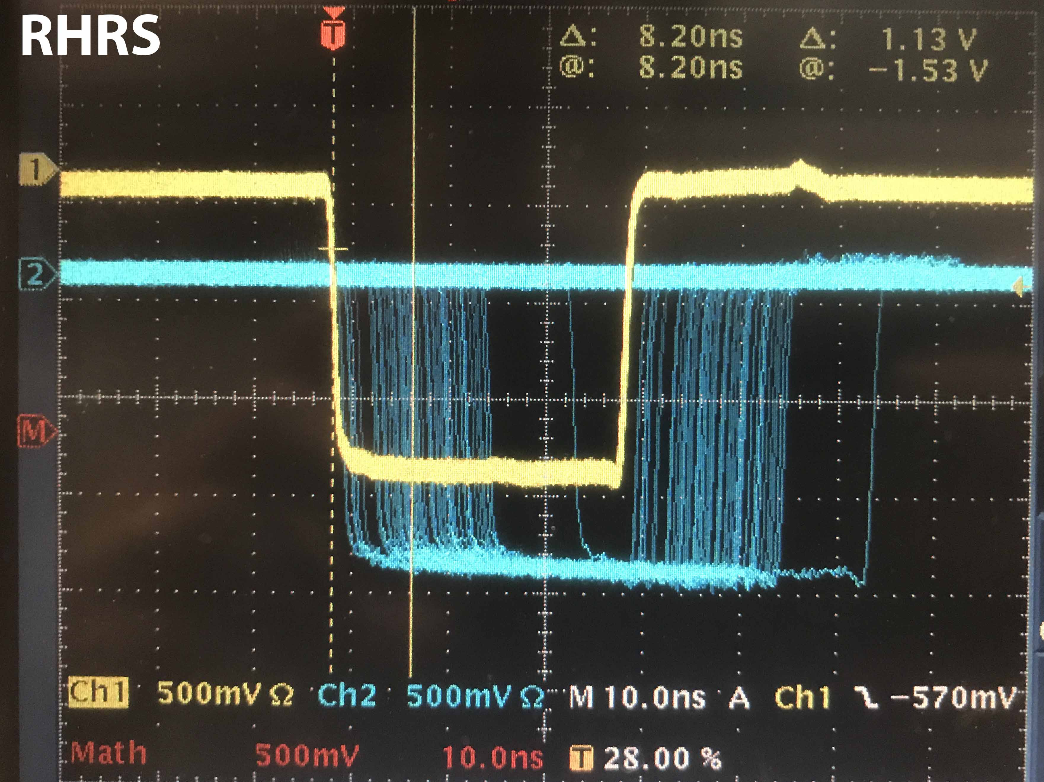
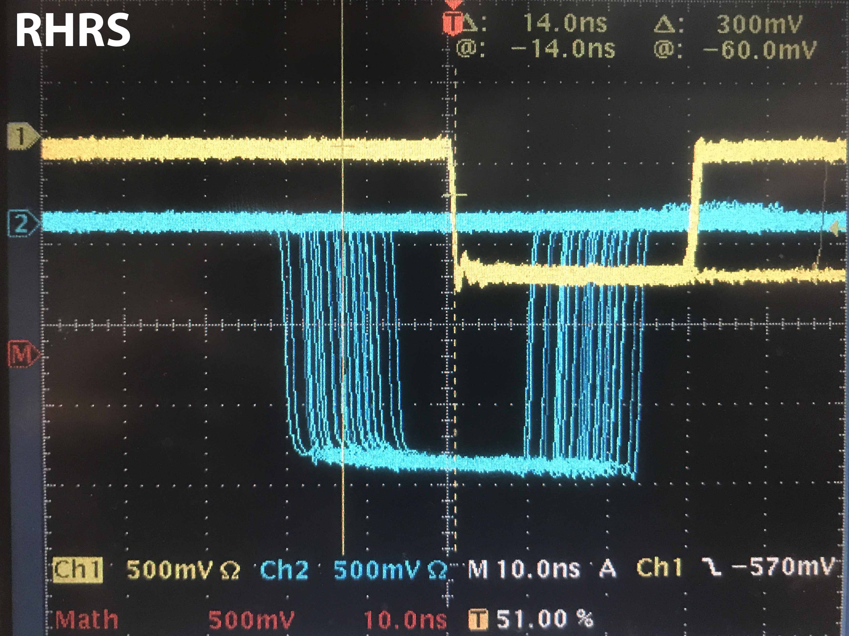
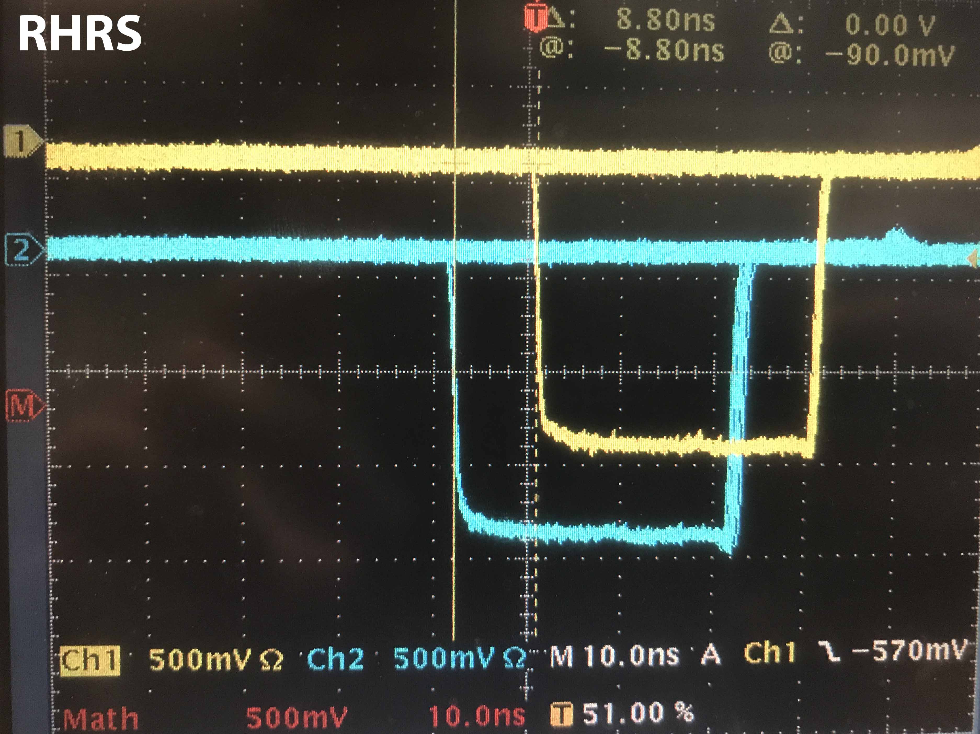
S0||S2
8.20 ns
S0&S2
(S0||S2)&GC
14.0 ns
S0&S2
(S0&S2)&GC
8.80 ns
S0&S2

Slide 38
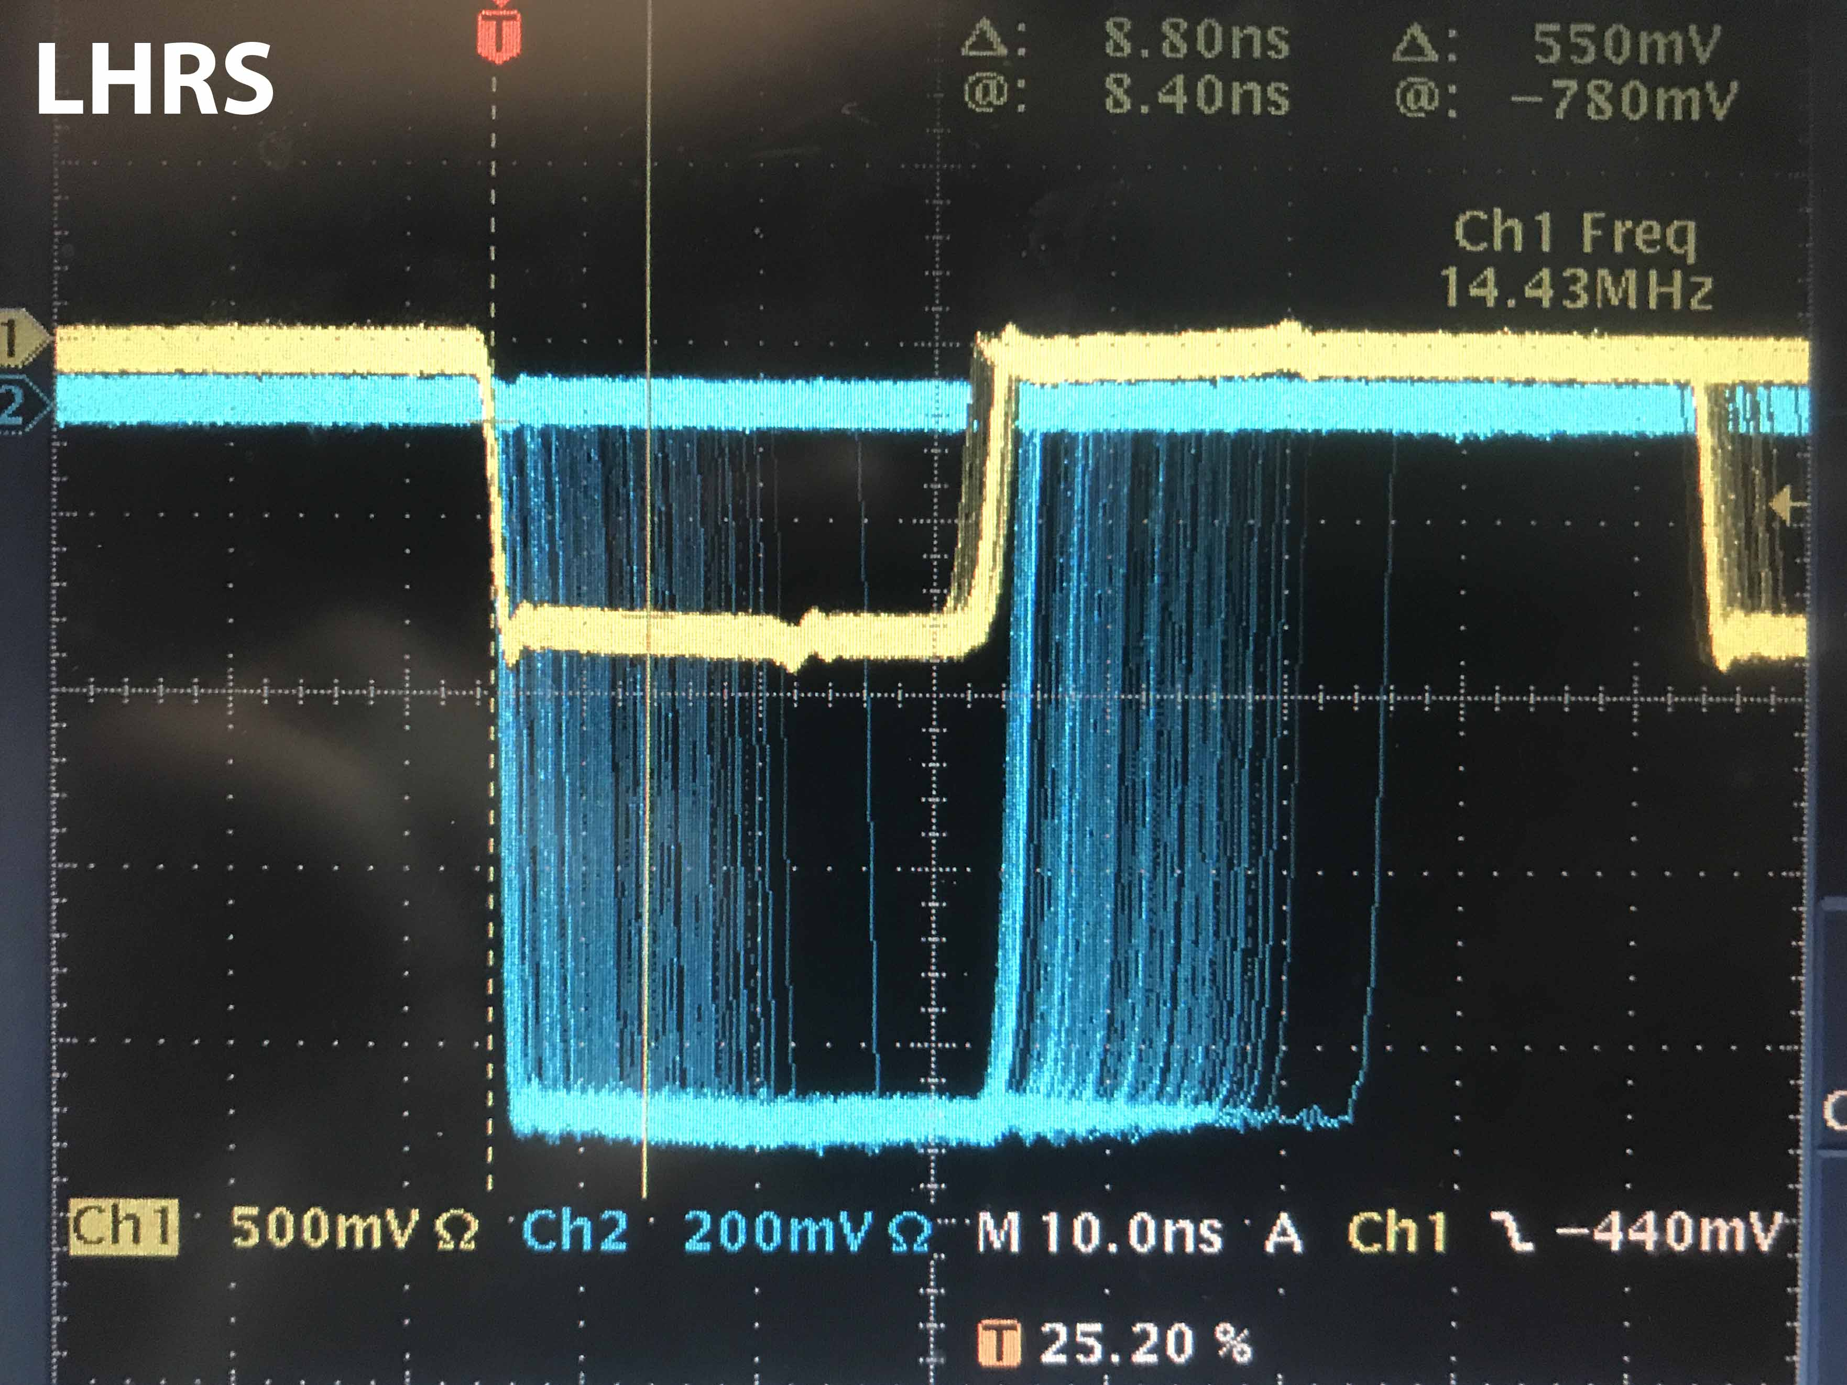
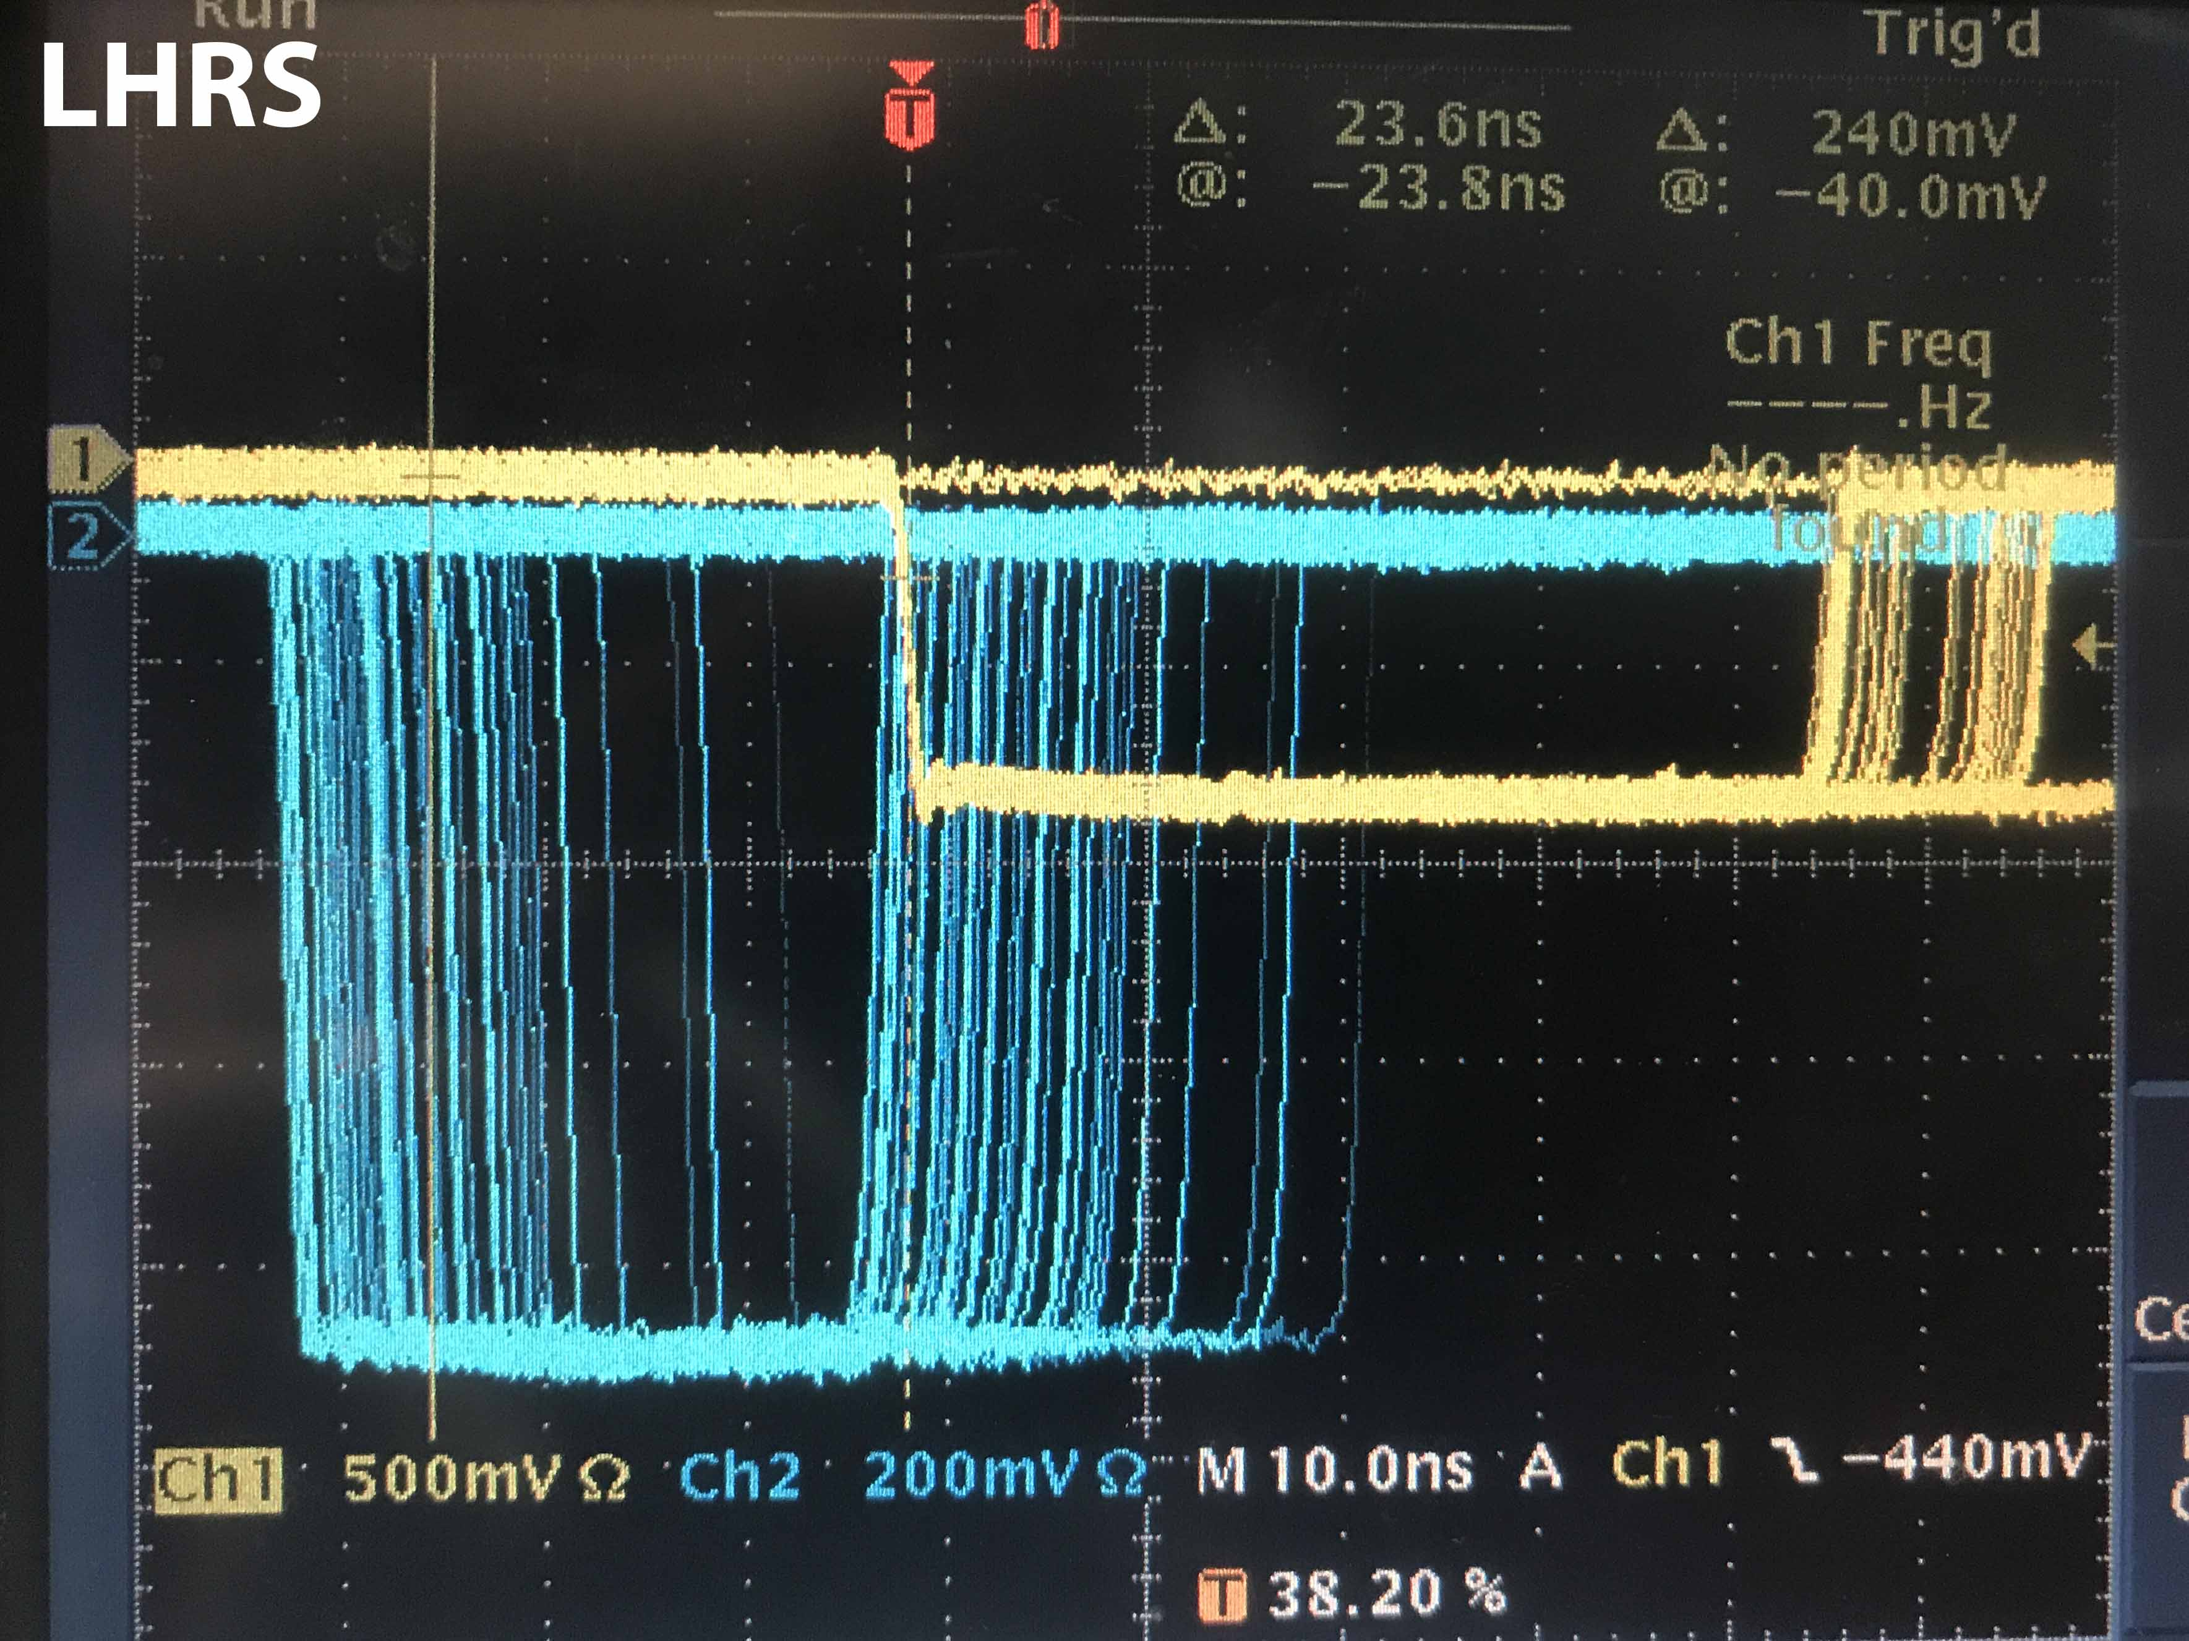
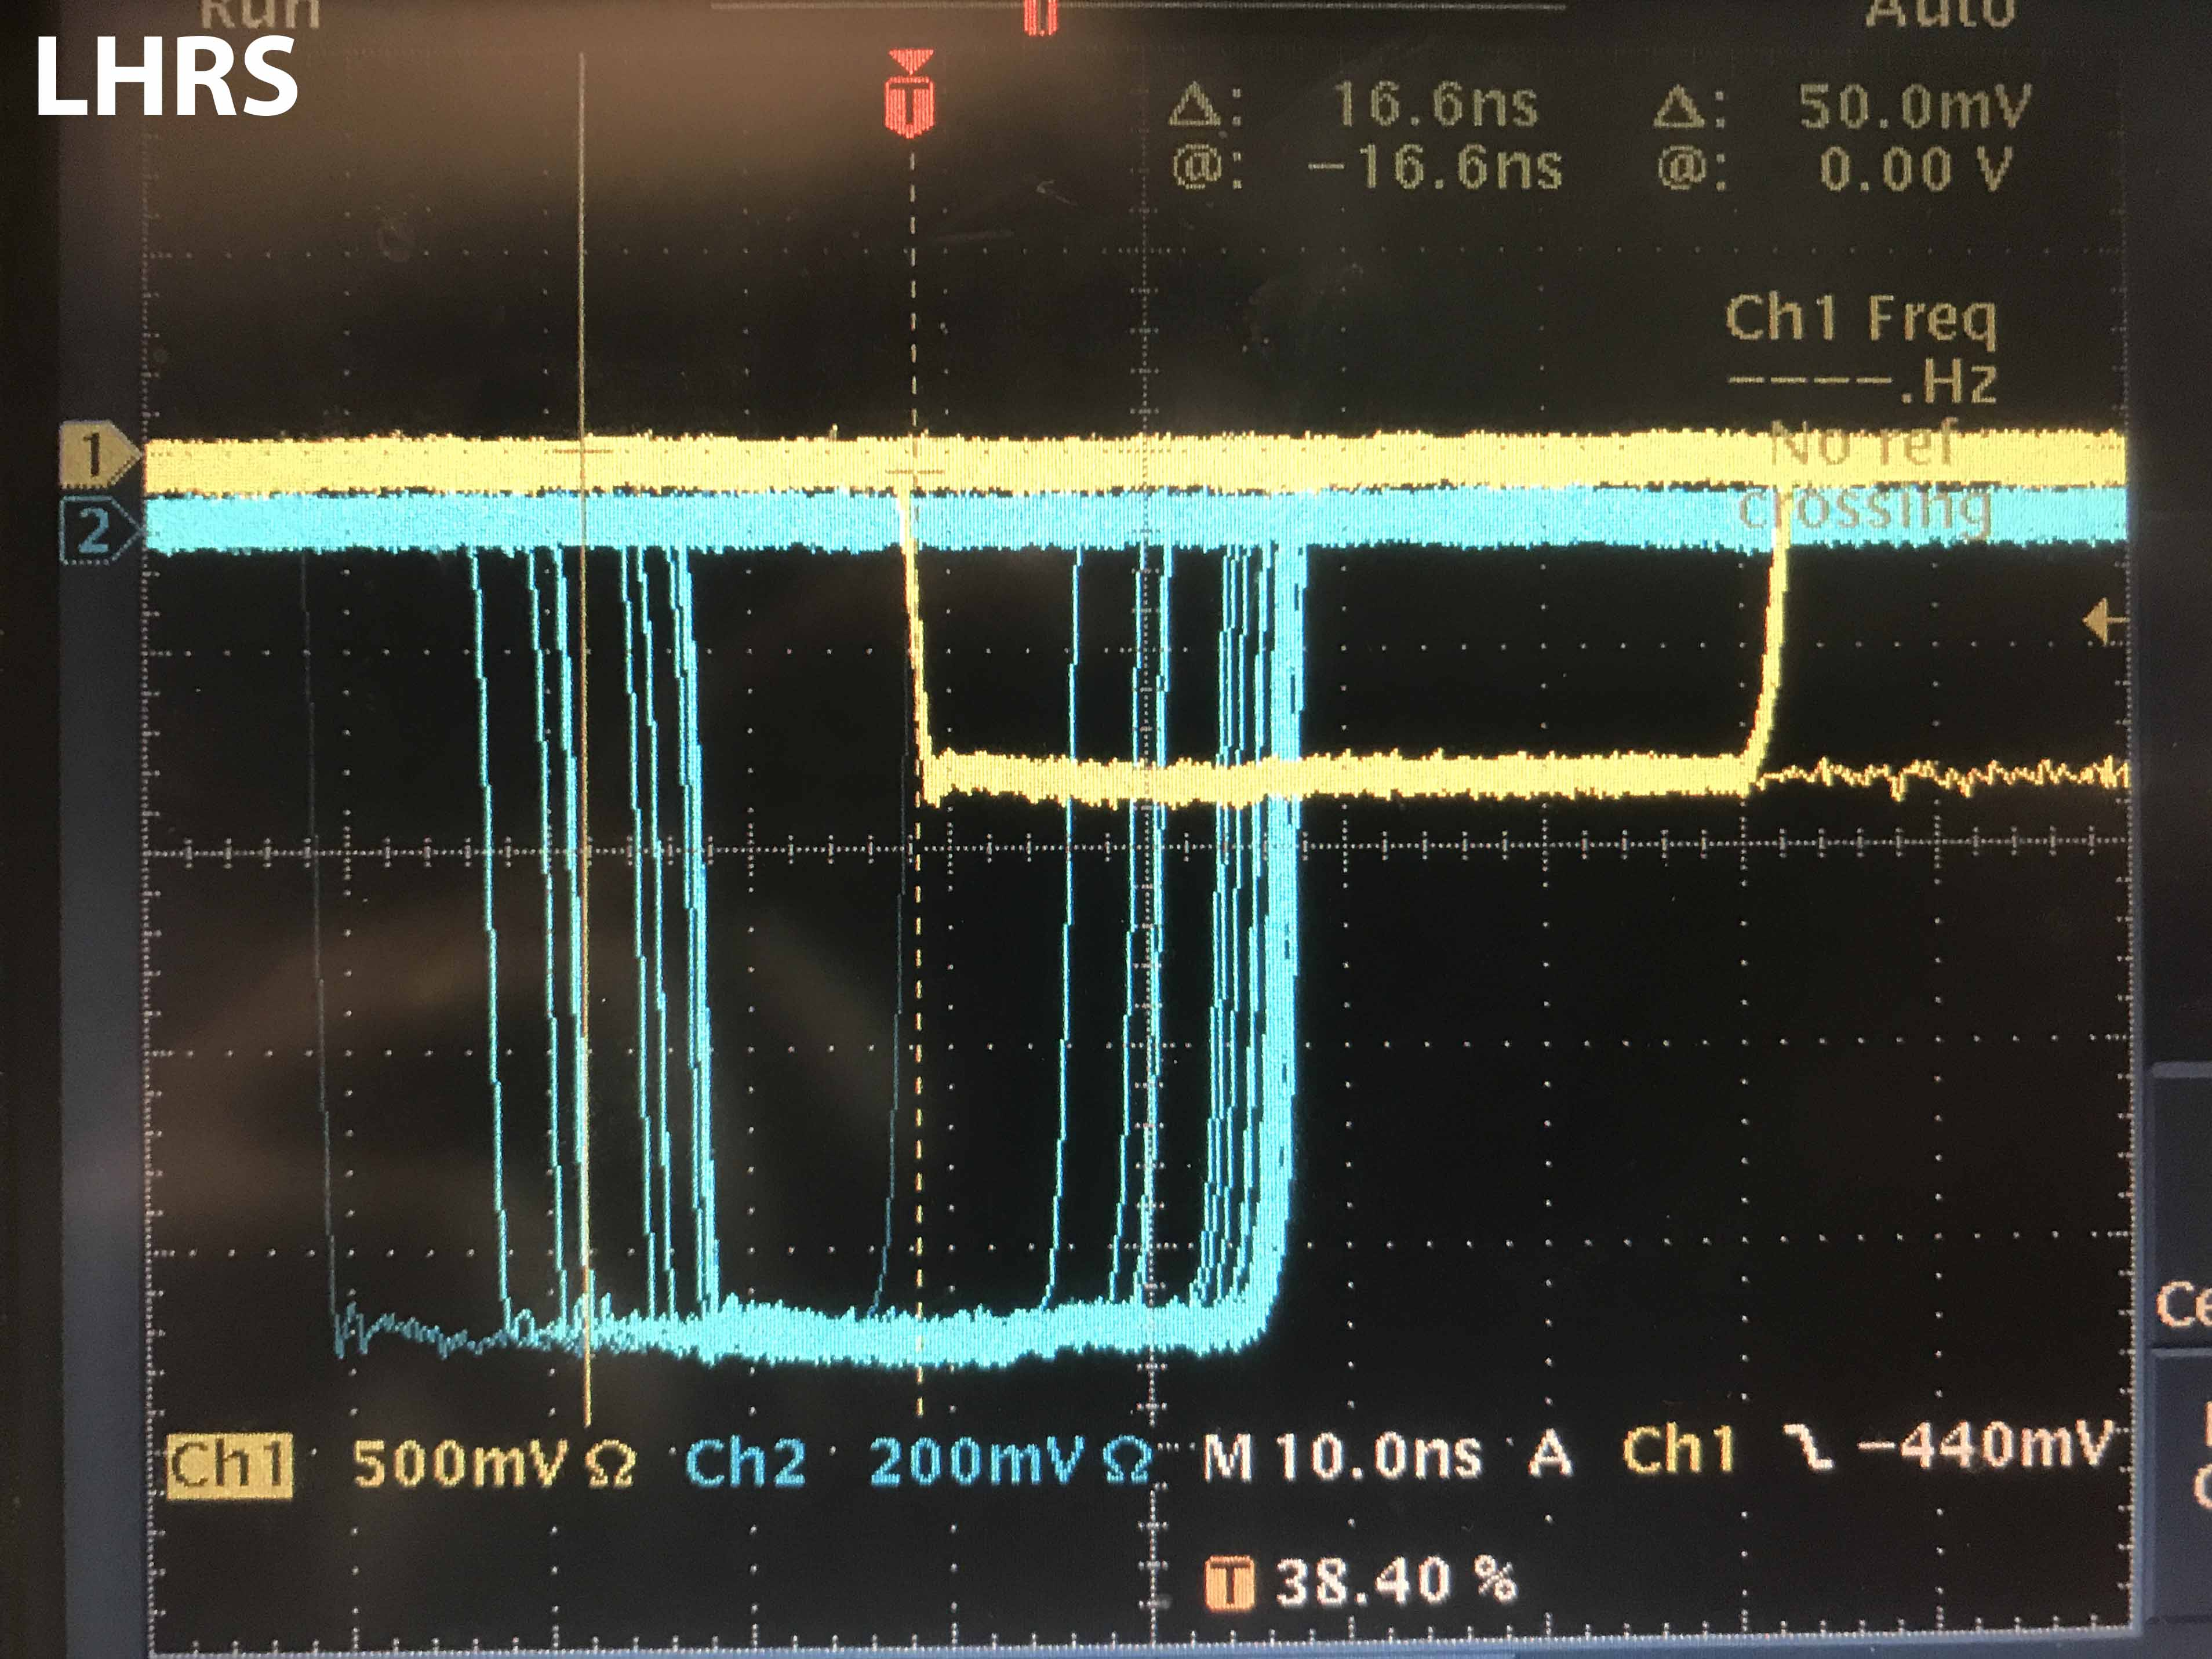
S0||S2
8.80 ns
S0&S2
(S0||S2)&GC
23.6 ns
S0&S2
(S0&S2)&GC
16.6 ns
S0&S2

Slide 39
RHRS
(S0||S2)&GC
S0&S2&GC
S0&S2
S0||S2
8.2 ns
8.8 ns
5.2 ns
LHRS
(S0||S2)&GC
S0&S2&GC
S0&S2
8.8 ns
16.6 ns
7 ns
S0||S2

Slide 40
Current Status (calculated)
Cosmics
S0||S2
S0&S2
S0&S2&GC
10 ns
(S0||S2)&GC
10 ns
10 ns
30 ns
Beam
S0||S2
S0&S2
S0&S2&GC
20 ns
(S0||S2)&GC
10 ns
30 ns

Slide 41
LHRS
RHRS
S0
S2
S2
14 ns
10.4 ns
* (S0-S2 delay should be ~20ns) Might need adjustment for real electrons

