Slide 1
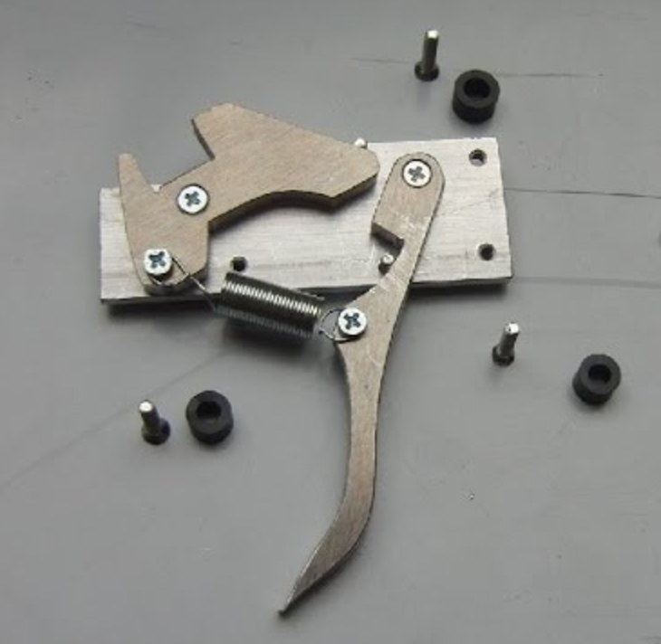
Update on triggers
Florian, Tyler, & Rey
(with lots of help from Jonathan and Shujie)

Slide 2
Previously, on Florian’s talk
Single Arm Triggers (S0&S2); (S0&S2)&GC; (S0||S2)&GC
S0
S2
S0 coinc
FIFO
width 50ns
delay
20ns
30ns
To adjust S0 and S2 relative to each other for S0&S2 and S0||S2
S0||S2
50ns
S0
S2
S2 coinc
FIFO
S0&S2
width 30ns
delay
20ns
30ns
50ns
GC
S0||S2
(S0||S2)&GC
GC analog
sum disc.
20ns
30ns
FIFO
(S0&S2)&GC
delay
50ns
To adjust GC analog sum to S0&S2
S0&S2
GC
One to (NIM => ECL)->TS
One to other arm
20ns
30ns
S0&S2, S0&S2&GC timed on S2
(S0||S2)&GC timed on S0 if S0 fires
50ns

Slide 3
LHRS

Slide 4
LHRS
S2 Logic Unit
10 ns delay (09/26/17)
L
S2_R gets here delayed by 25 ns with respect to S2_L
1 ns
R
1 ns
1 ns
8 ns
FIFO
1 ns
(S0||S2)
S2 coinc
Delay
20 ns
Delay
10 ns
Delay
5 ns
8 ns
0.5 ns
10 ns
S0
1 ns
(S0&S2)
S2
1 ns
1 ns
GC
(S0||S2)&GC
8 ns
S0A disc
3 ns
Delay
20 ns
3 ns
8 ns
1 ns
1 ns
S0 coinc
S0B disc
(S0&S2)&GC
1 ns
GC disc
1 ns
GC coinc
3 ns
Delay
20 ns
8 ns
Analog sum

Slide 5
Legend
Clock input
(Same length) cables used to project information onto the scope.

Slide 6
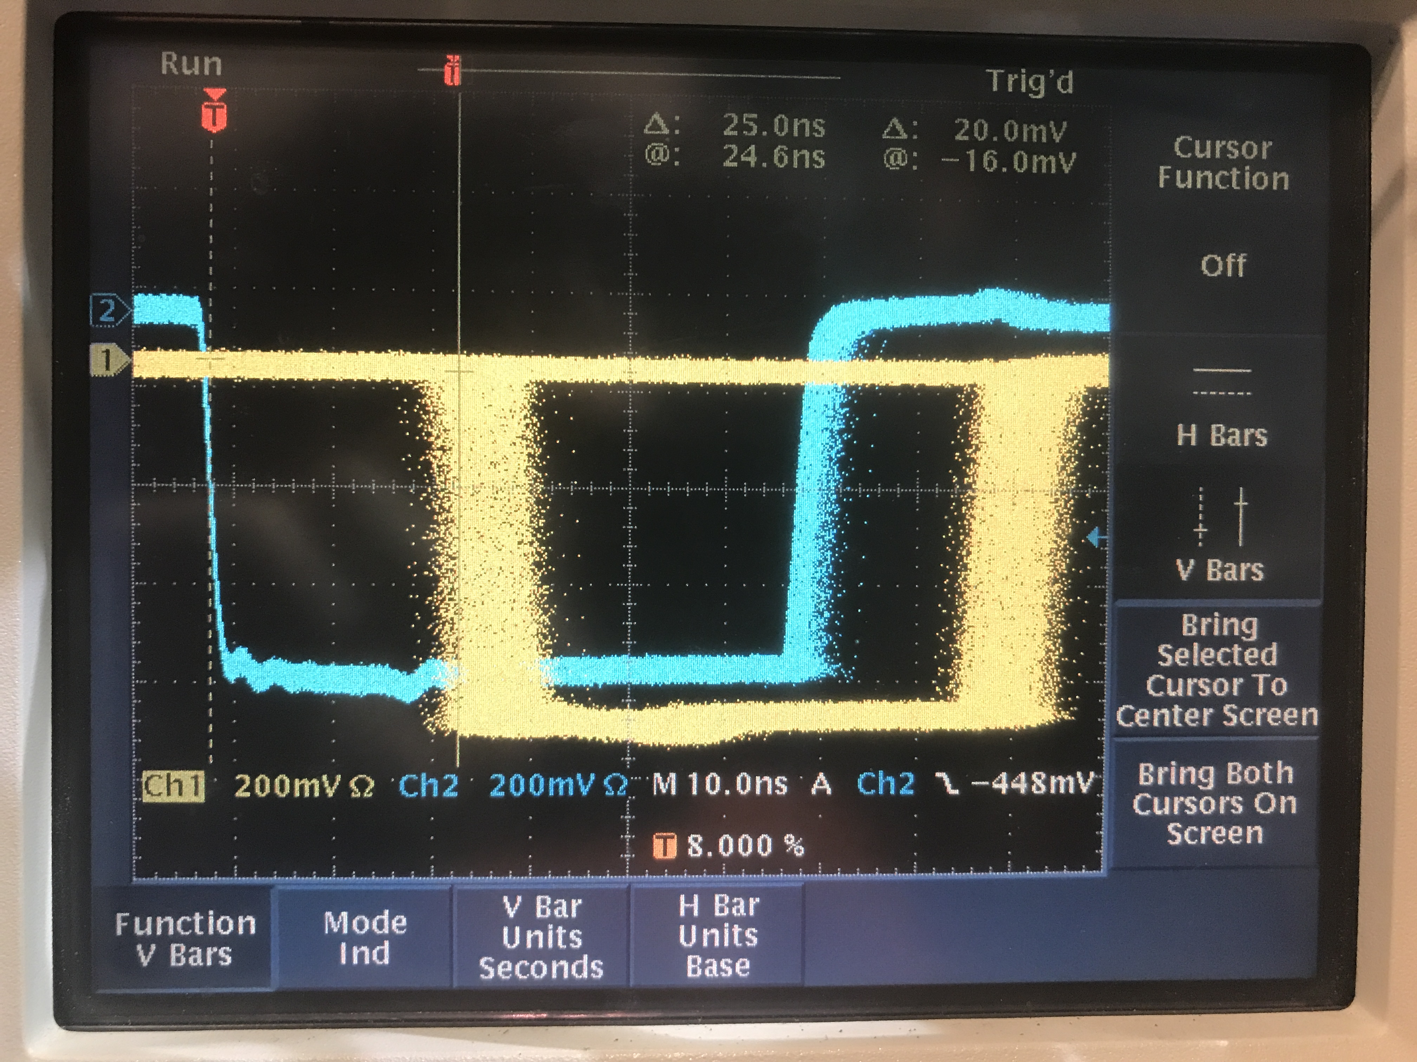
LHRS
S2 Logic Unit
L
S2_R gets here delayed by 25 ns with respect to S2_L
COSMICS
1 ns
R
1 ns
S2 coinc
Delay
20 ns
Delay
10 ns
8 ns
0.5 ns
10 ns
S0A disc
3 ns
Delay
20 ns
3 ns
S0 coinc
8 ns
S0B disc
1 ns
GC disc
1 ns
3 ns
8 ns
25 ns
GC coinc
Delay
20 ns
We wanted for S2_R to lead the S2 time, and S2_R is already delayed (by 25 ns) with respect to S2_L in the cables from the detectors to the electronics

Slide 7
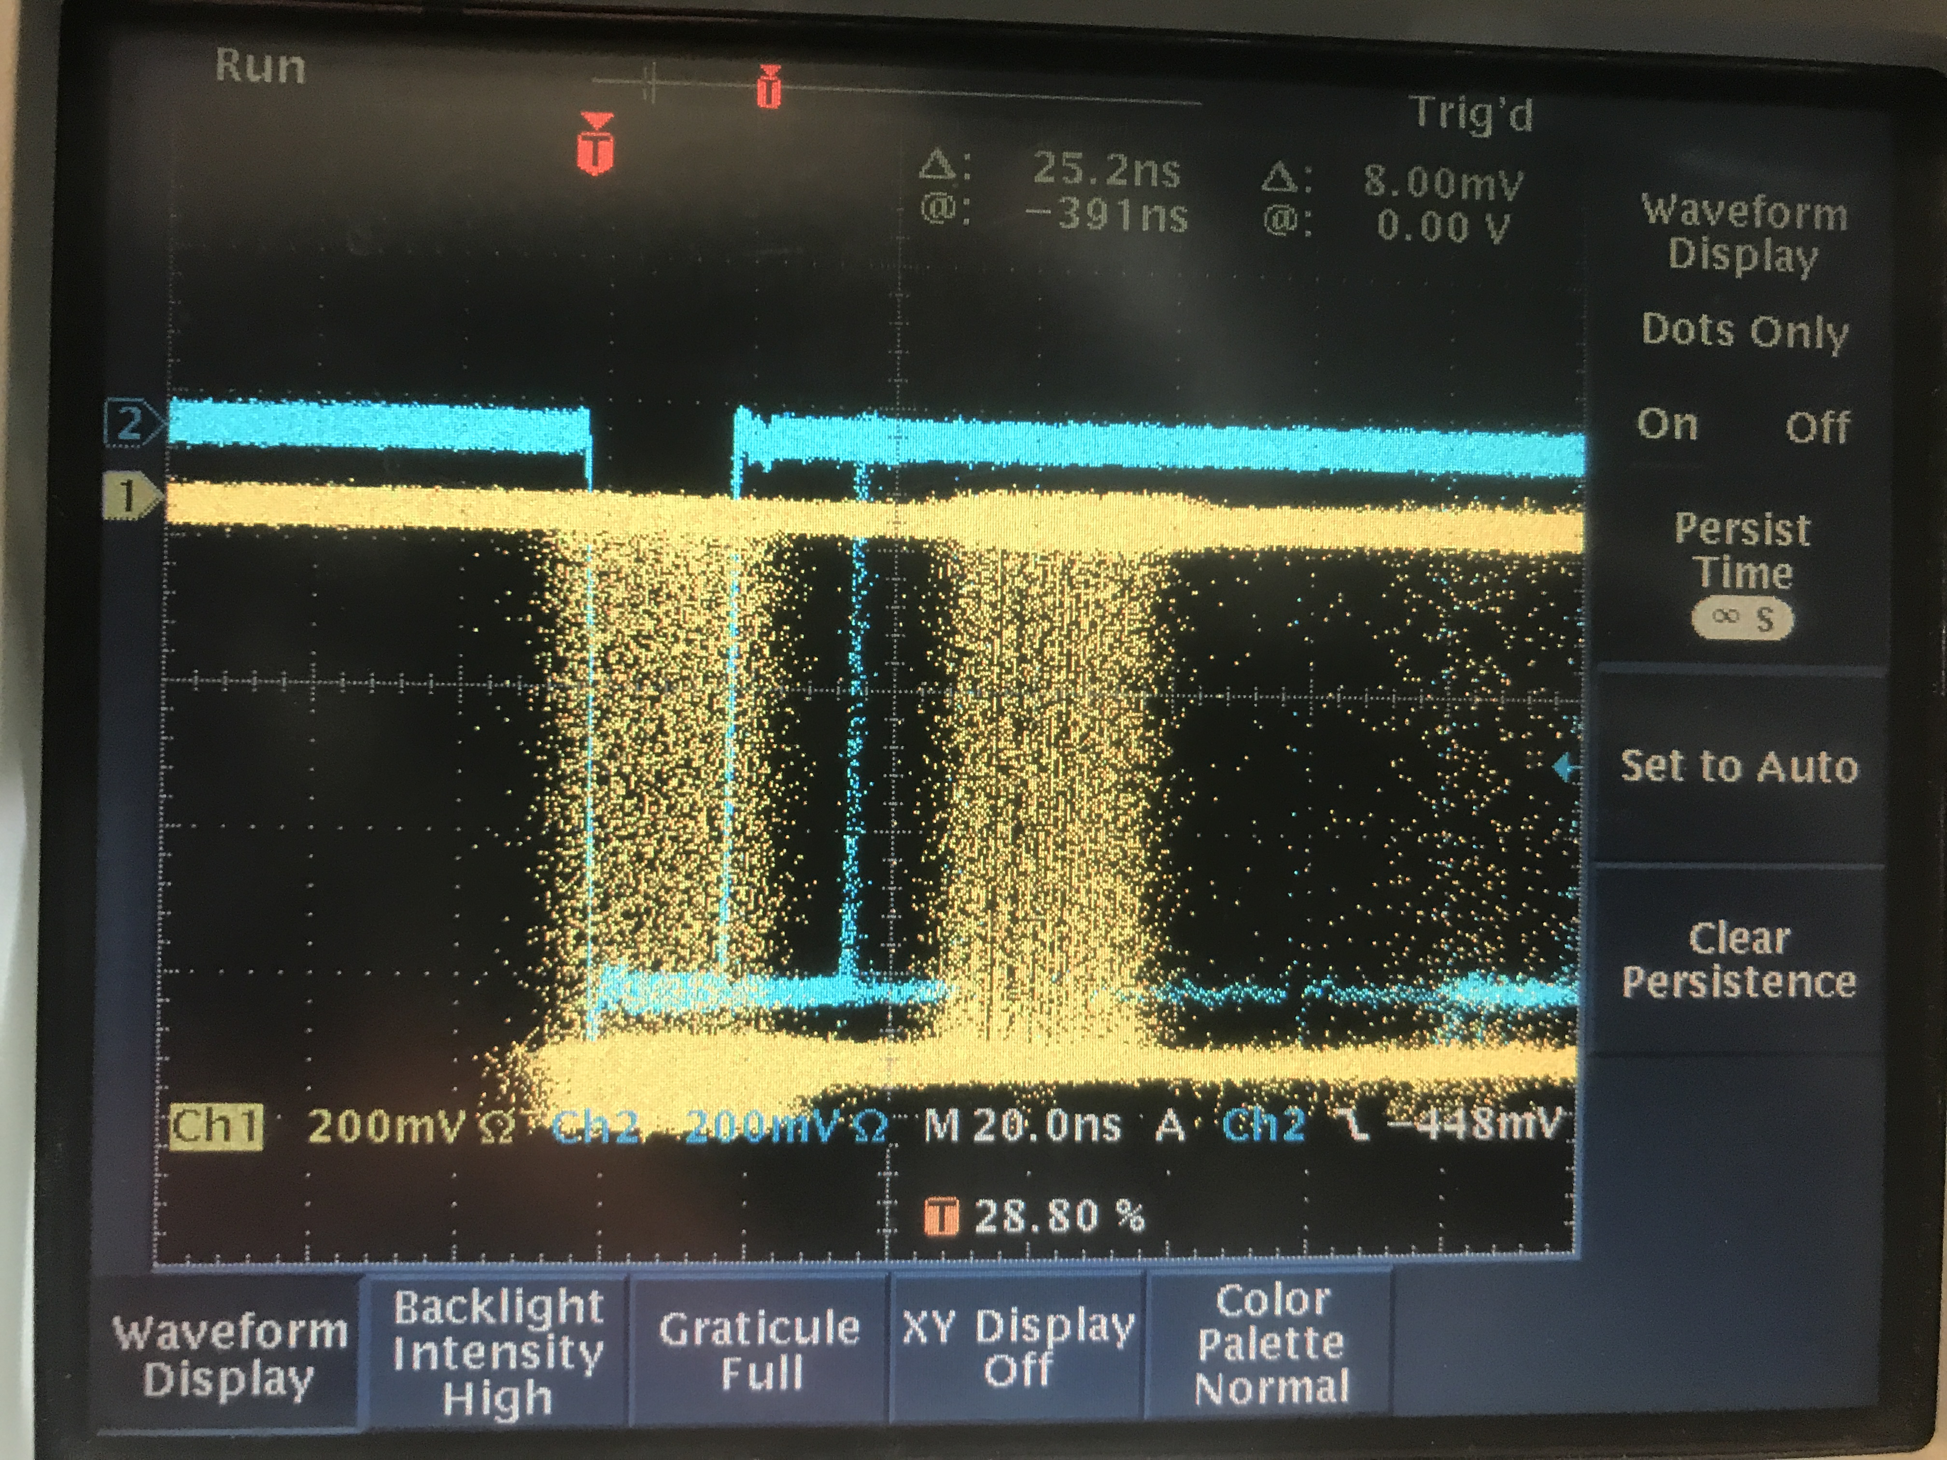
LHRS
S2 Logic Unit
L
S2_R gets here delayed by 25 ns with respect to S2_L
We wanted for S0A to lead the S0 time, and in this case there is no delay in the cables from the detectors to the electronics, so we need to create this delay ourselves.
1 ns
R
1 ns
S2 coinc
Delay
20 ns
Delay
10 ns
8 ns
0.5 ns
10 ns
COSMICS
S0A disc
3 ns
Delay
20 ns
3 ns
S0 coinc
8 ns
S0B disc
1 ns
GC disc
1 ns
GC coinc
3 ns
Delay
20 ns
8 ns
0 ns

Slide 8
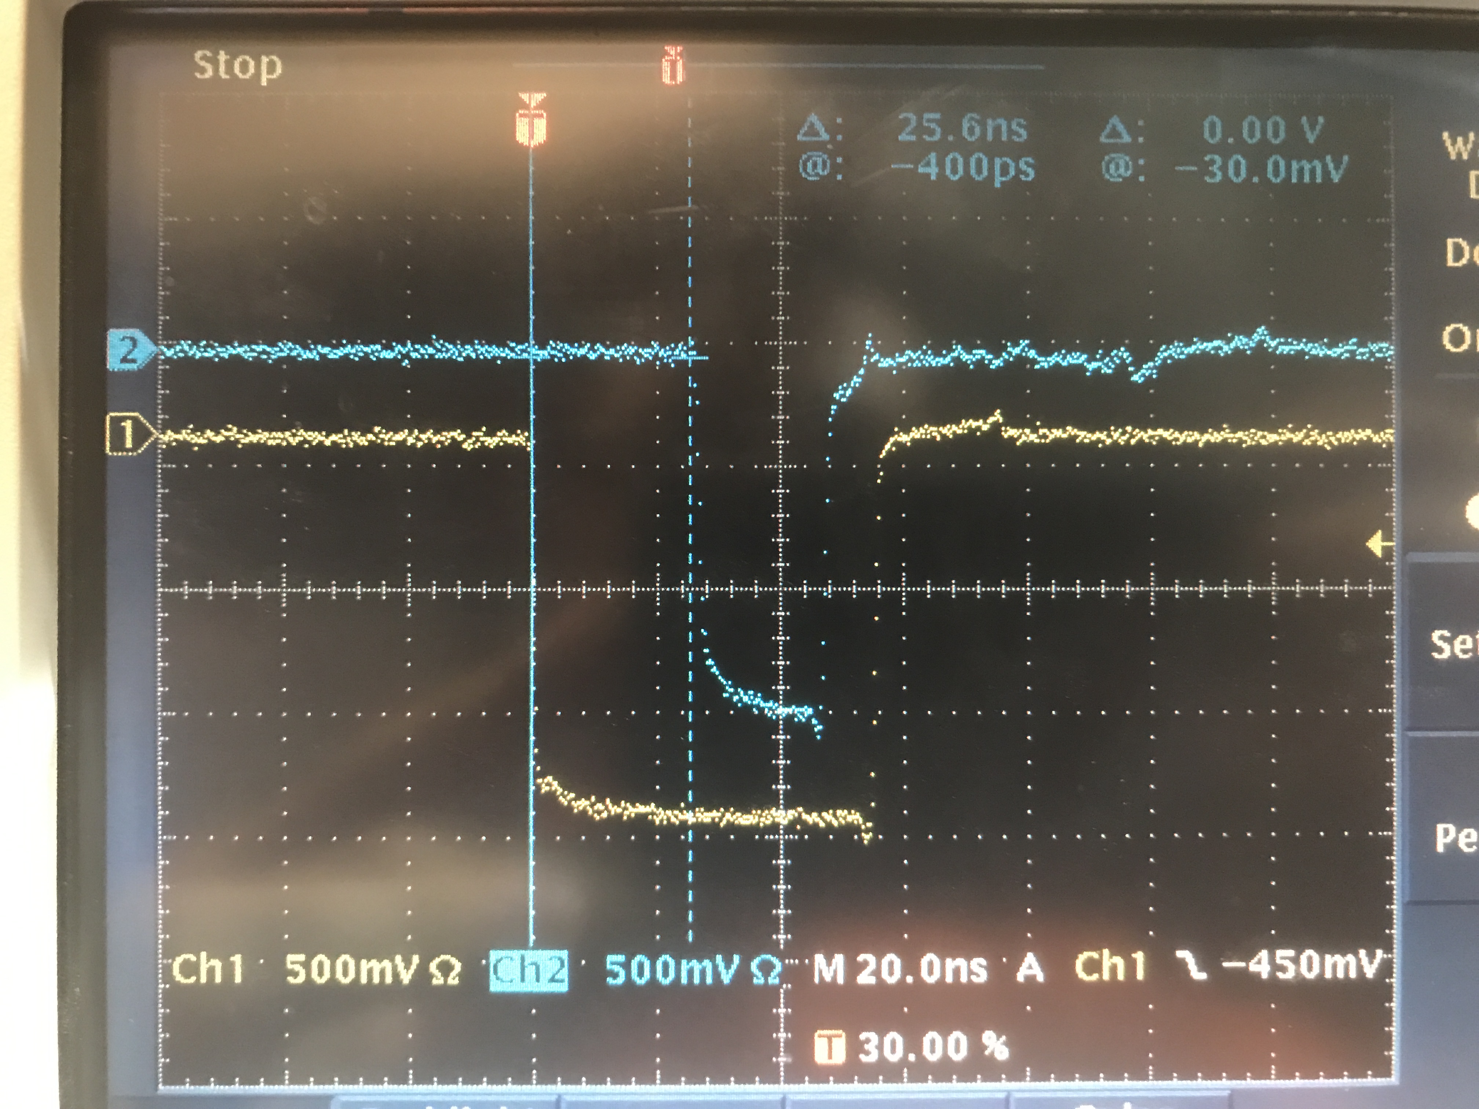
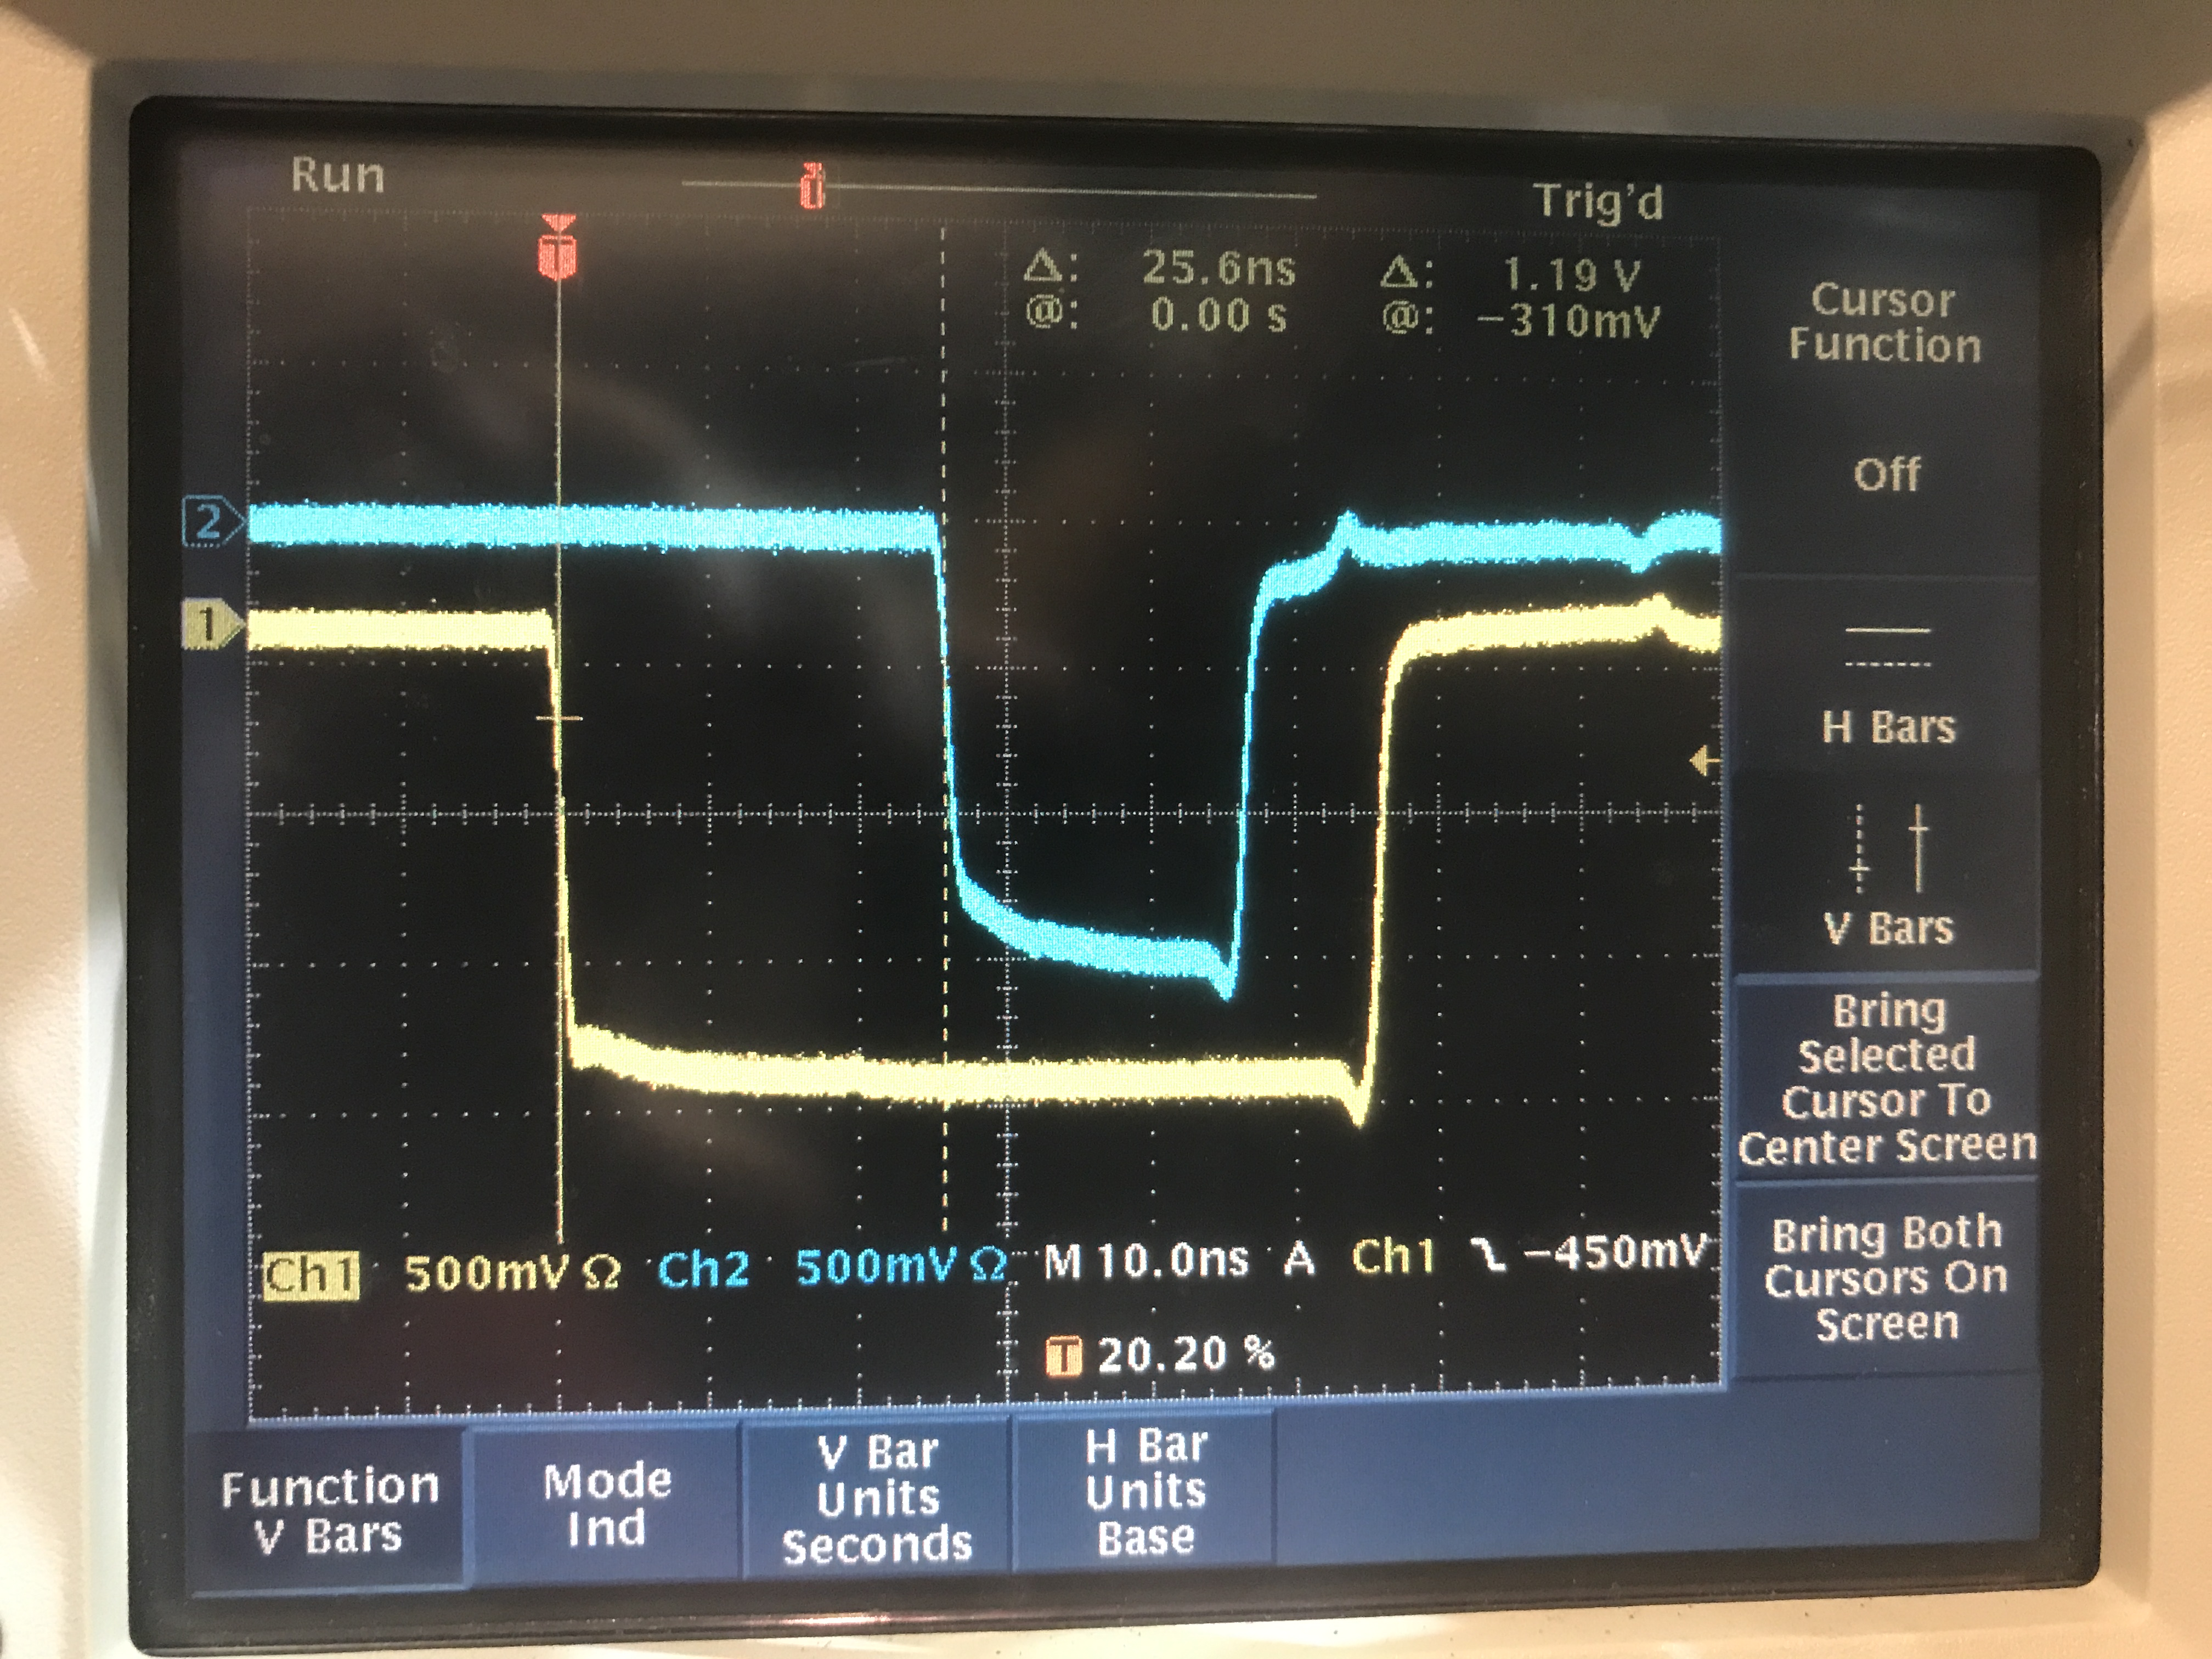
25 ns
LHRS
S2 Logic Unit
L
S2_R gets here delayed by 25 ns with respect to S2_L
1 ns
R
1 ns
S2 coinc
Delay
20 ns
Delay
10 ns
8 ns
0.5 ns
10 ns
COSMICS (single shot)
S0A disc
3 ns
Delay
20 ns
3 ns
S0 coinc
8 ns
CLOCK
S0B disc
1 ns
GC disc
1 ns
GC coinc
3 ns
Delay
20 ns
8 ns
S0A delayed with respect to S0B by ~25ns
25 ns

Slide 9
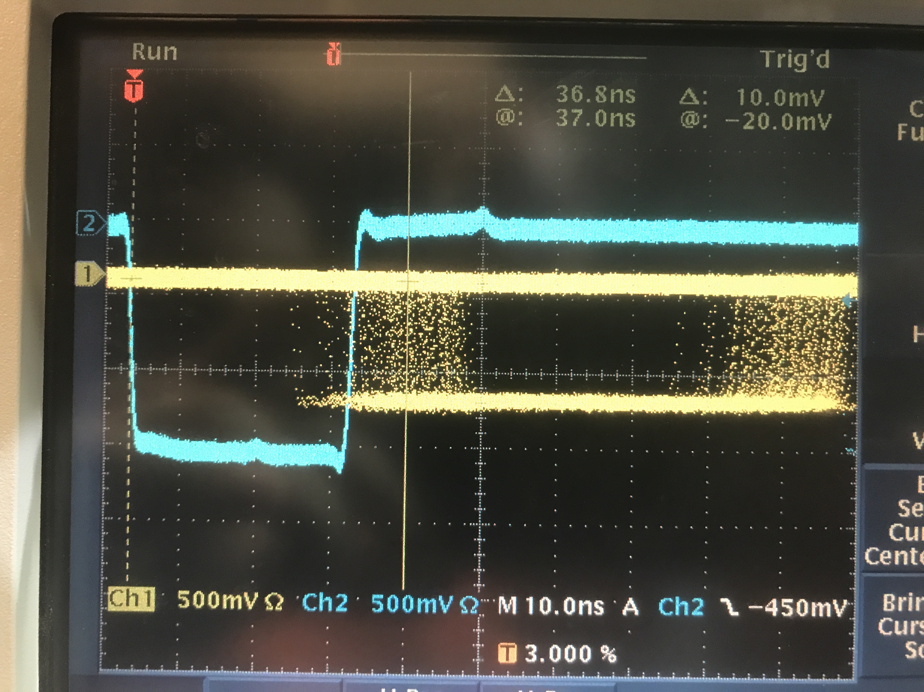
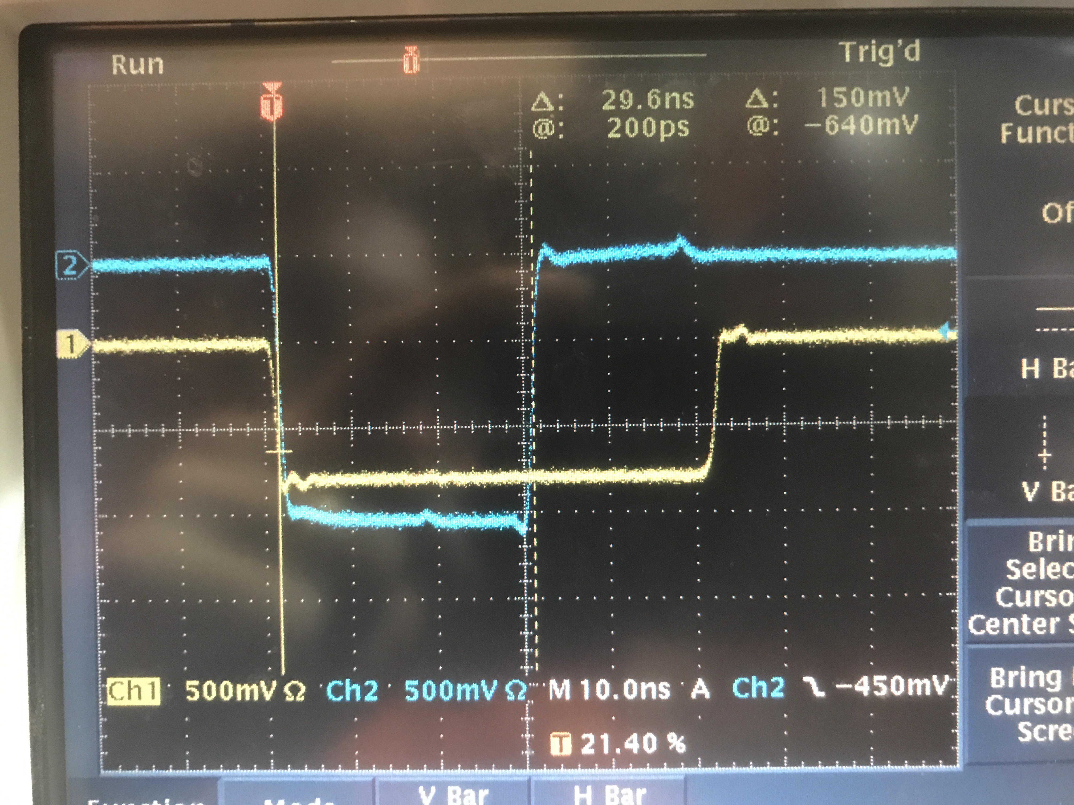
LHRS
S2 Logic Unit
L
S2_R gets here delayed by 25 ns with respect to S2_L
1 ns
R
1 ns
S2 coinc
COSMICS
Delay
20 ns
Delay
10 ns
8 ns
0.5 ns
10 ns
3 ns
3 ns
37 ns
S0A disc
Delay
20 ns
S0 coinc
8 ns
S0B disc
1 ns
CLOCK
GC disc
1 ns
GC coinc
3 ns
Delay
20 ns
8 ns
0 ns

Slide 10
COSMICS
S2 Logic Unit
cable to electronics
L
S2
1 ns
R
1 ns
S2 coinc
cable to electronics
3 ns
3 ns
S0A disc
Delay
20 ns
S0
S0 coinc
S0B disc
1 ns
(S0 cable to electronics) + 8ns + 26ns + 8ns + TOF
- (S2 cable to electronics + 8ns + 1ns + 8ns) = 37ns
COSMICS
Δ(S2-S0 cable length) = 12ns - TOF
TOF ~ 5ns
Δ(S2-S0 cable length) = 7ns
37 ns
S0A cable is longer than S2_R by 7ns

Slide 11
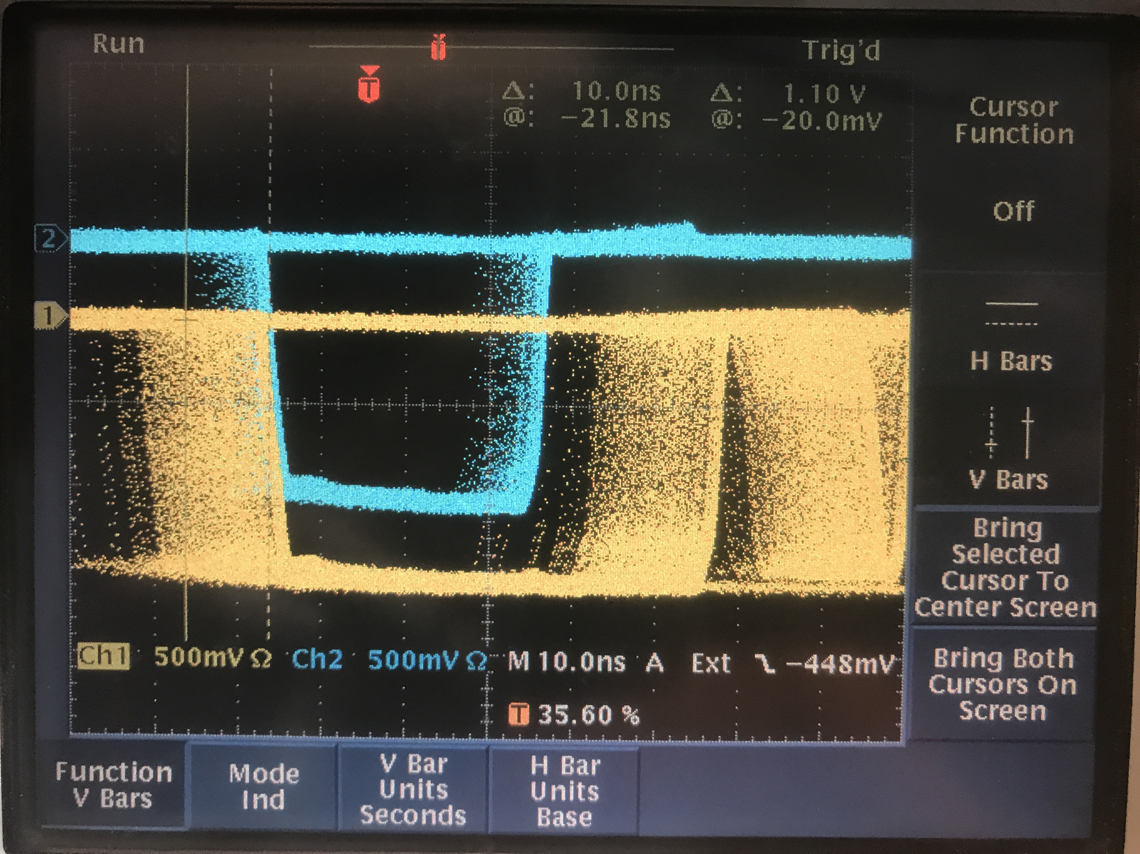
LHRS
S2 Logic Unit
This implies the S2 signal will come 20ns after the S0 one because of TOF and opposite direction of real signal with respect to cosmics
L
S2_R gets here delayed by 25 ns with respect to S2_L
1 ns
R
1 ns
COSMICS
S2 coinc
FIFO
COSMICS
Delay
20 ns
Delay
10 ns
8 ns
0.5 ns
10 ns
S0
S2
10 ns
GC
S0A disc
3 ns
Delay
20 ns
3 ns
CLOCK
S0 coinc
8 ns
S0B disc
1 ns
CLOCK
REAL
S0
S2
GC disc
1 ns
GC coinc
3 ns
Delay
20 ns
8 ns
20ns
30ns
50ns

Slide 12
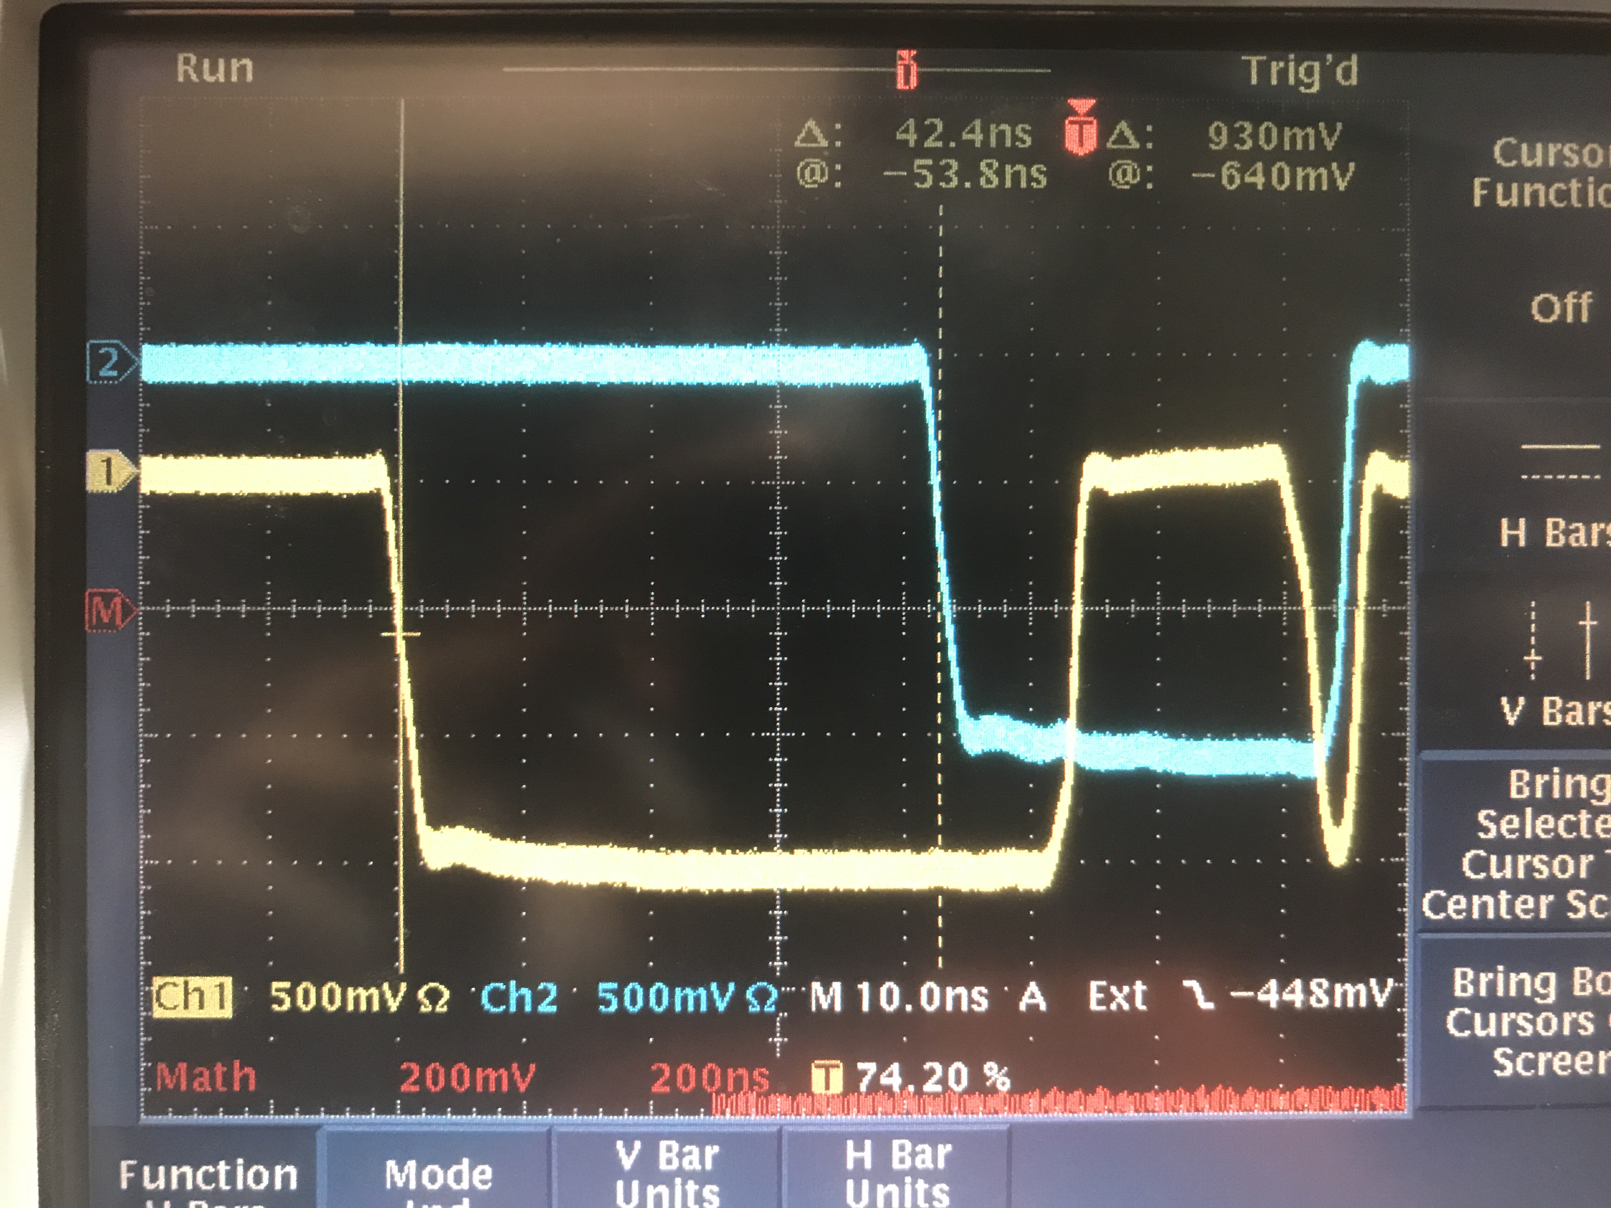
LHRS
S2 Logic Unit
This implies the S2 signal will come 20ns after the S0 one because of TOF and opposite direction of real signal with respect to cosmics
L
S2_R gets here delayed by 25 ns with respect to S2_L
1 ns
R
1 ns
COSMICS
S2 coinc
FIFO
COSMICS
Delay
20 ns
Delay
10 ns
8 ns
0.5 ns
10 ns
S0
S2
10 ns
GC
S0A disc
3 ns
Delay
20 ns
3 ns
CLOCK
S0 coinc
8 ns
S0B disc
1 ns
CLOCK
GC disc
1 ns
GC coinc
3 ns
Delay
20 ns
8 ns
42 ns

Slide 13
(Assuming 2.5ns TOF between scintillator and GC)
(S0&S2)&GC
REAL
COSMICS
S0&S2
S0&S2
GC
GC
20ns
30ns
15ns
30ns
50ns
50ns
(S0||S2)&GC
S0||S2
REAL
S0||S2
COSMICS
GC
GC
20ns
30ns
25ns
30ns
50ns
50ns

Slide 14
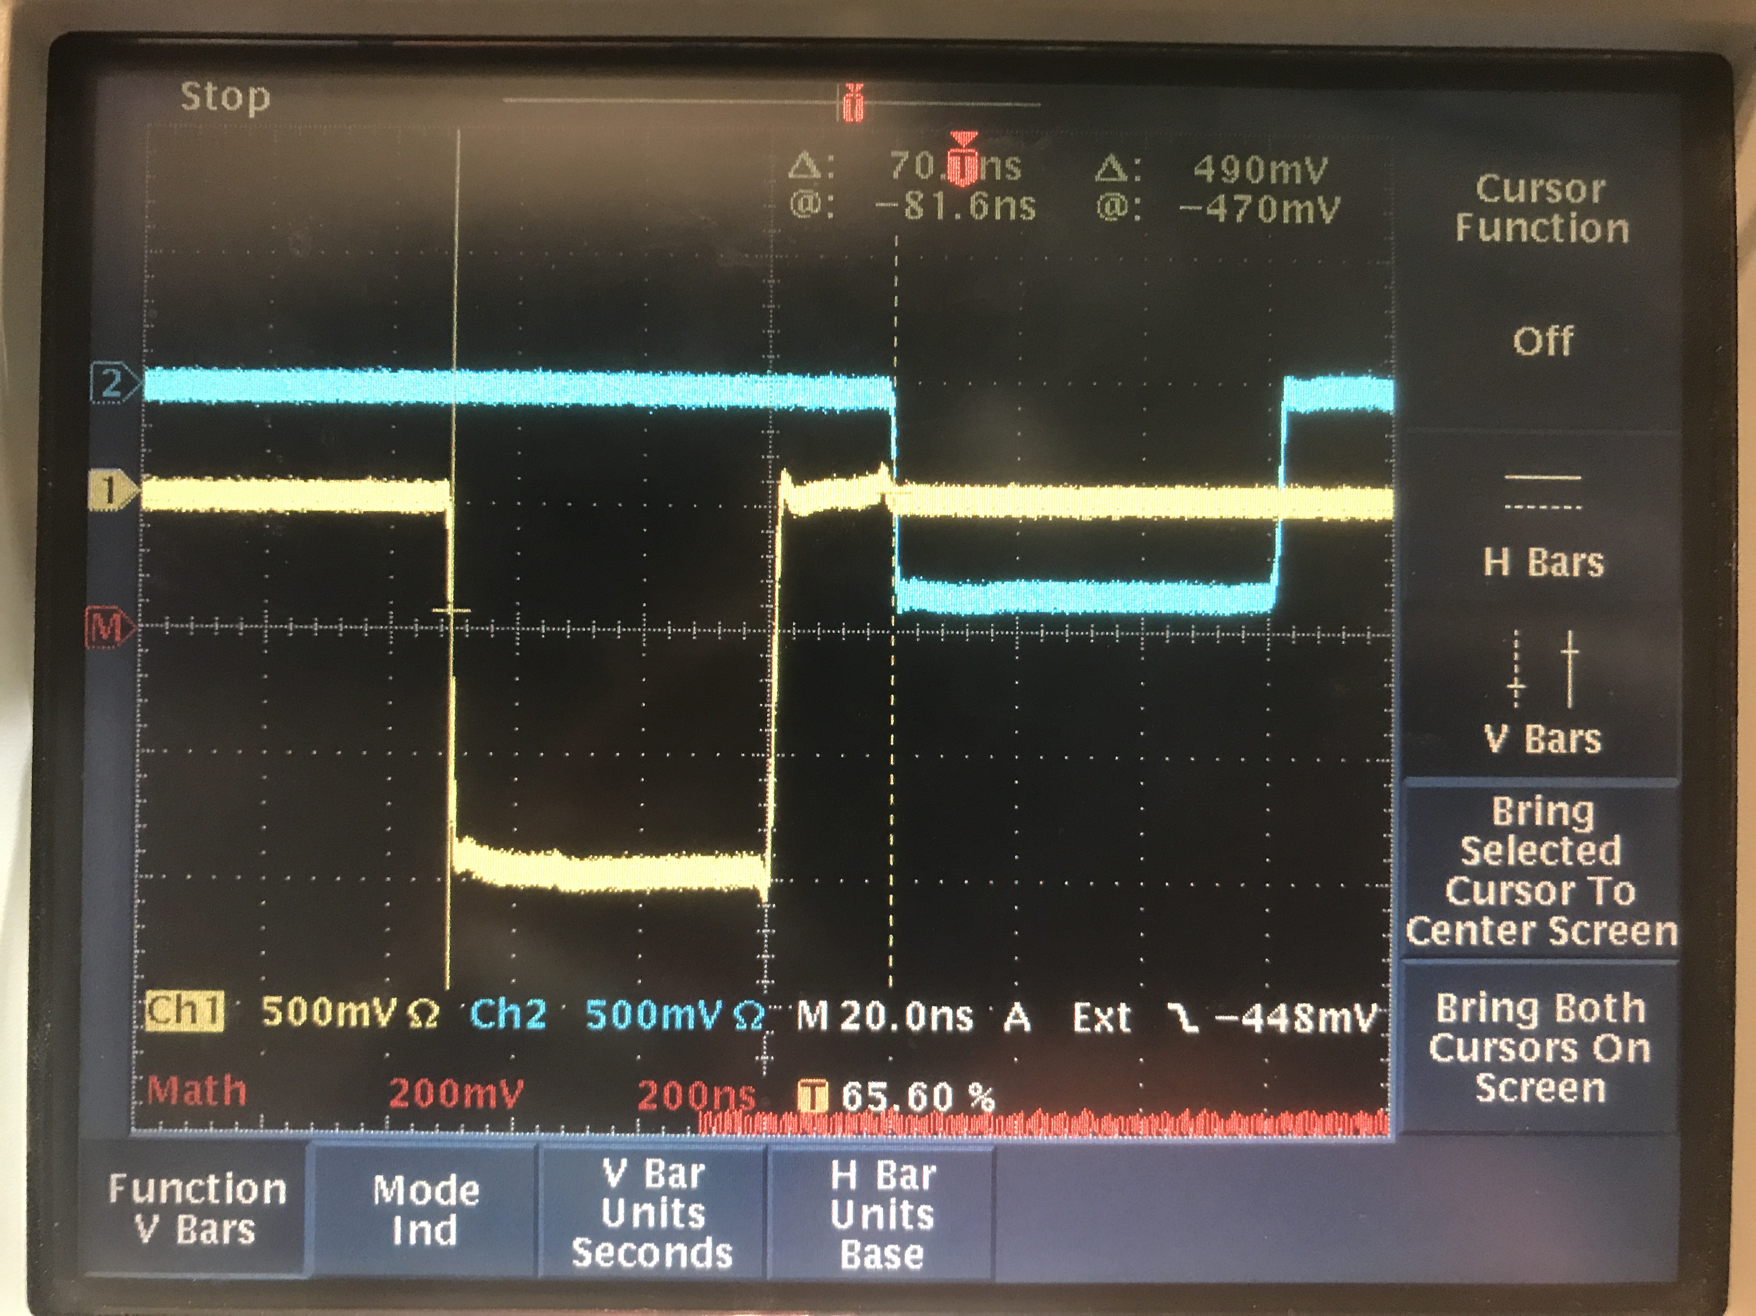
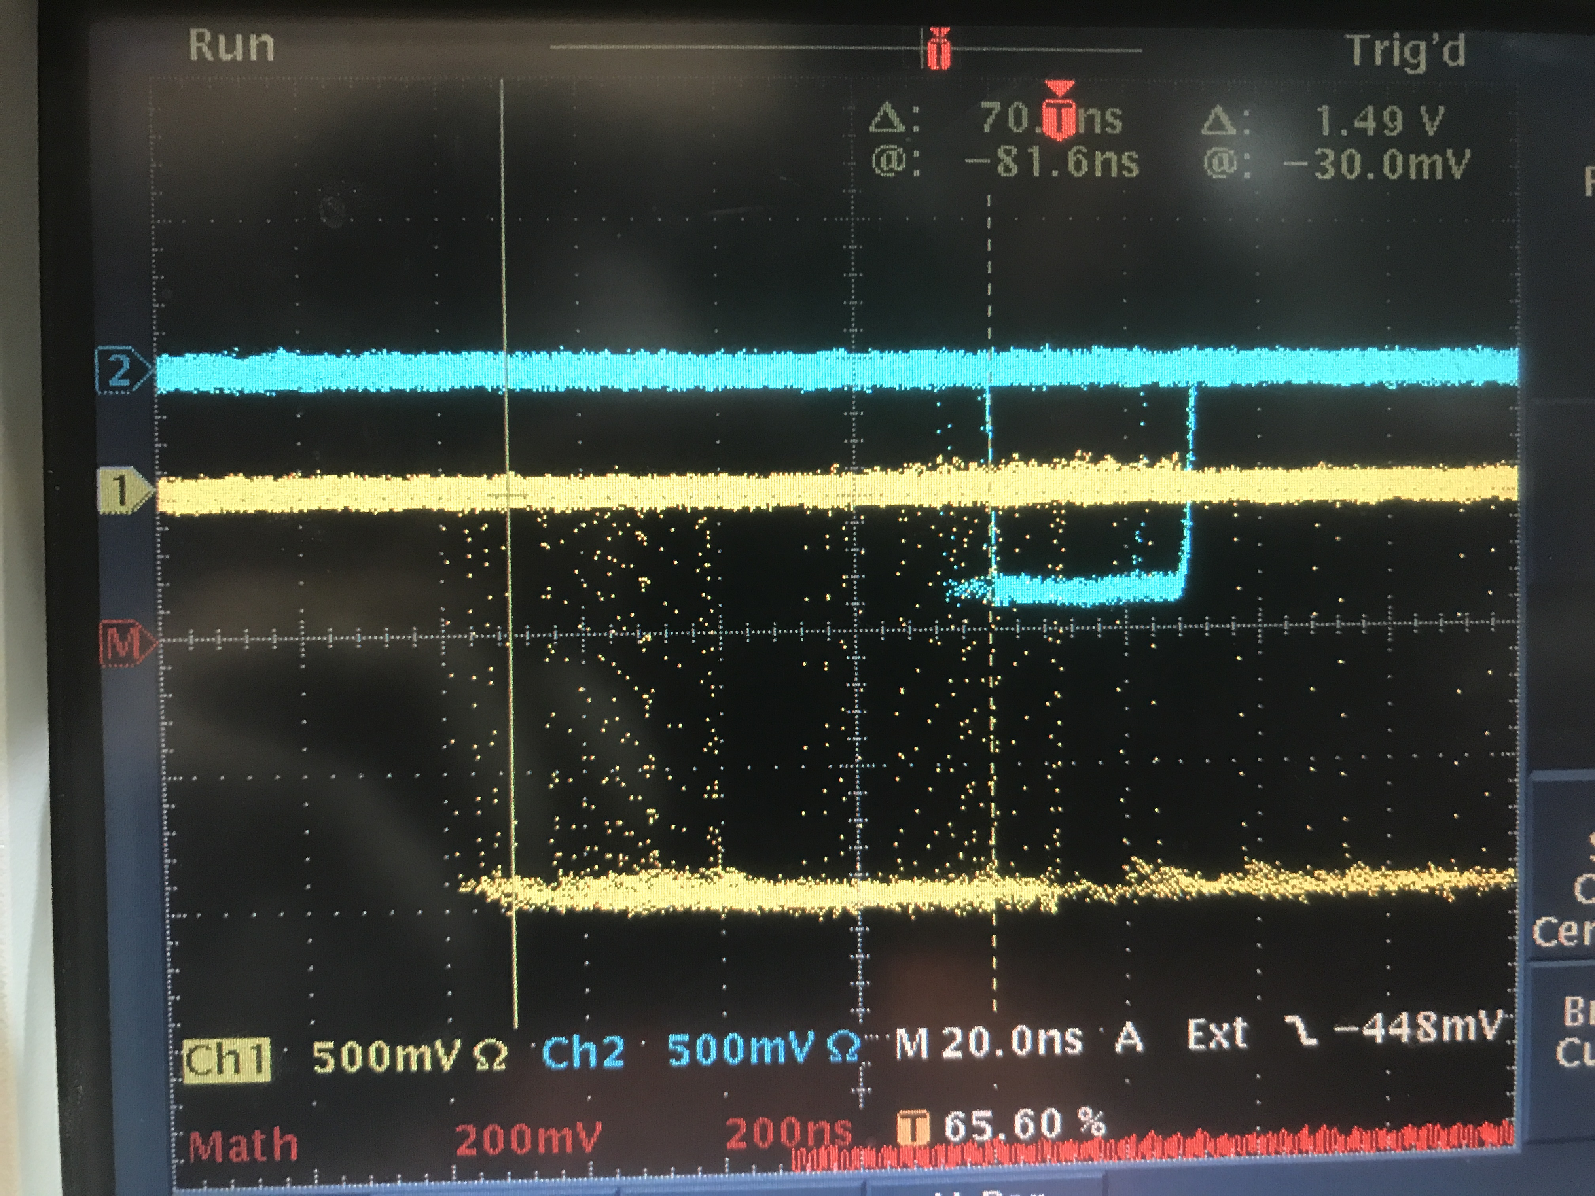
LHRS
S2 Logic Unit
L
S2_R gets here delayed by 25 ns with respect to S2_L
1 ns
R
1 ns
1 ns
8 ns
FIFO
1 ns
(S0||S2)
S2 coinc
Delay
20 ns
Delay
10 ns
Delay
5 ns
8 ns
0.5 ns
10 ns
S0
1 ns
CLOCK
(S0&S2)
S2
1 ns
1 ns
70 ns
GC
(S0||S2)&GC
8 ns
S0A disc
3 ns
Delay
20 ns
3 ns
8 ns
1 ns
1 ns
S0 coinc
S0B disc
(S0&S2)&GC
1 ns
COSMICS
GC disc
1 ns
GC coinc
3 ns
Delay
20 ns
8 ns
70 ns

Slide 15
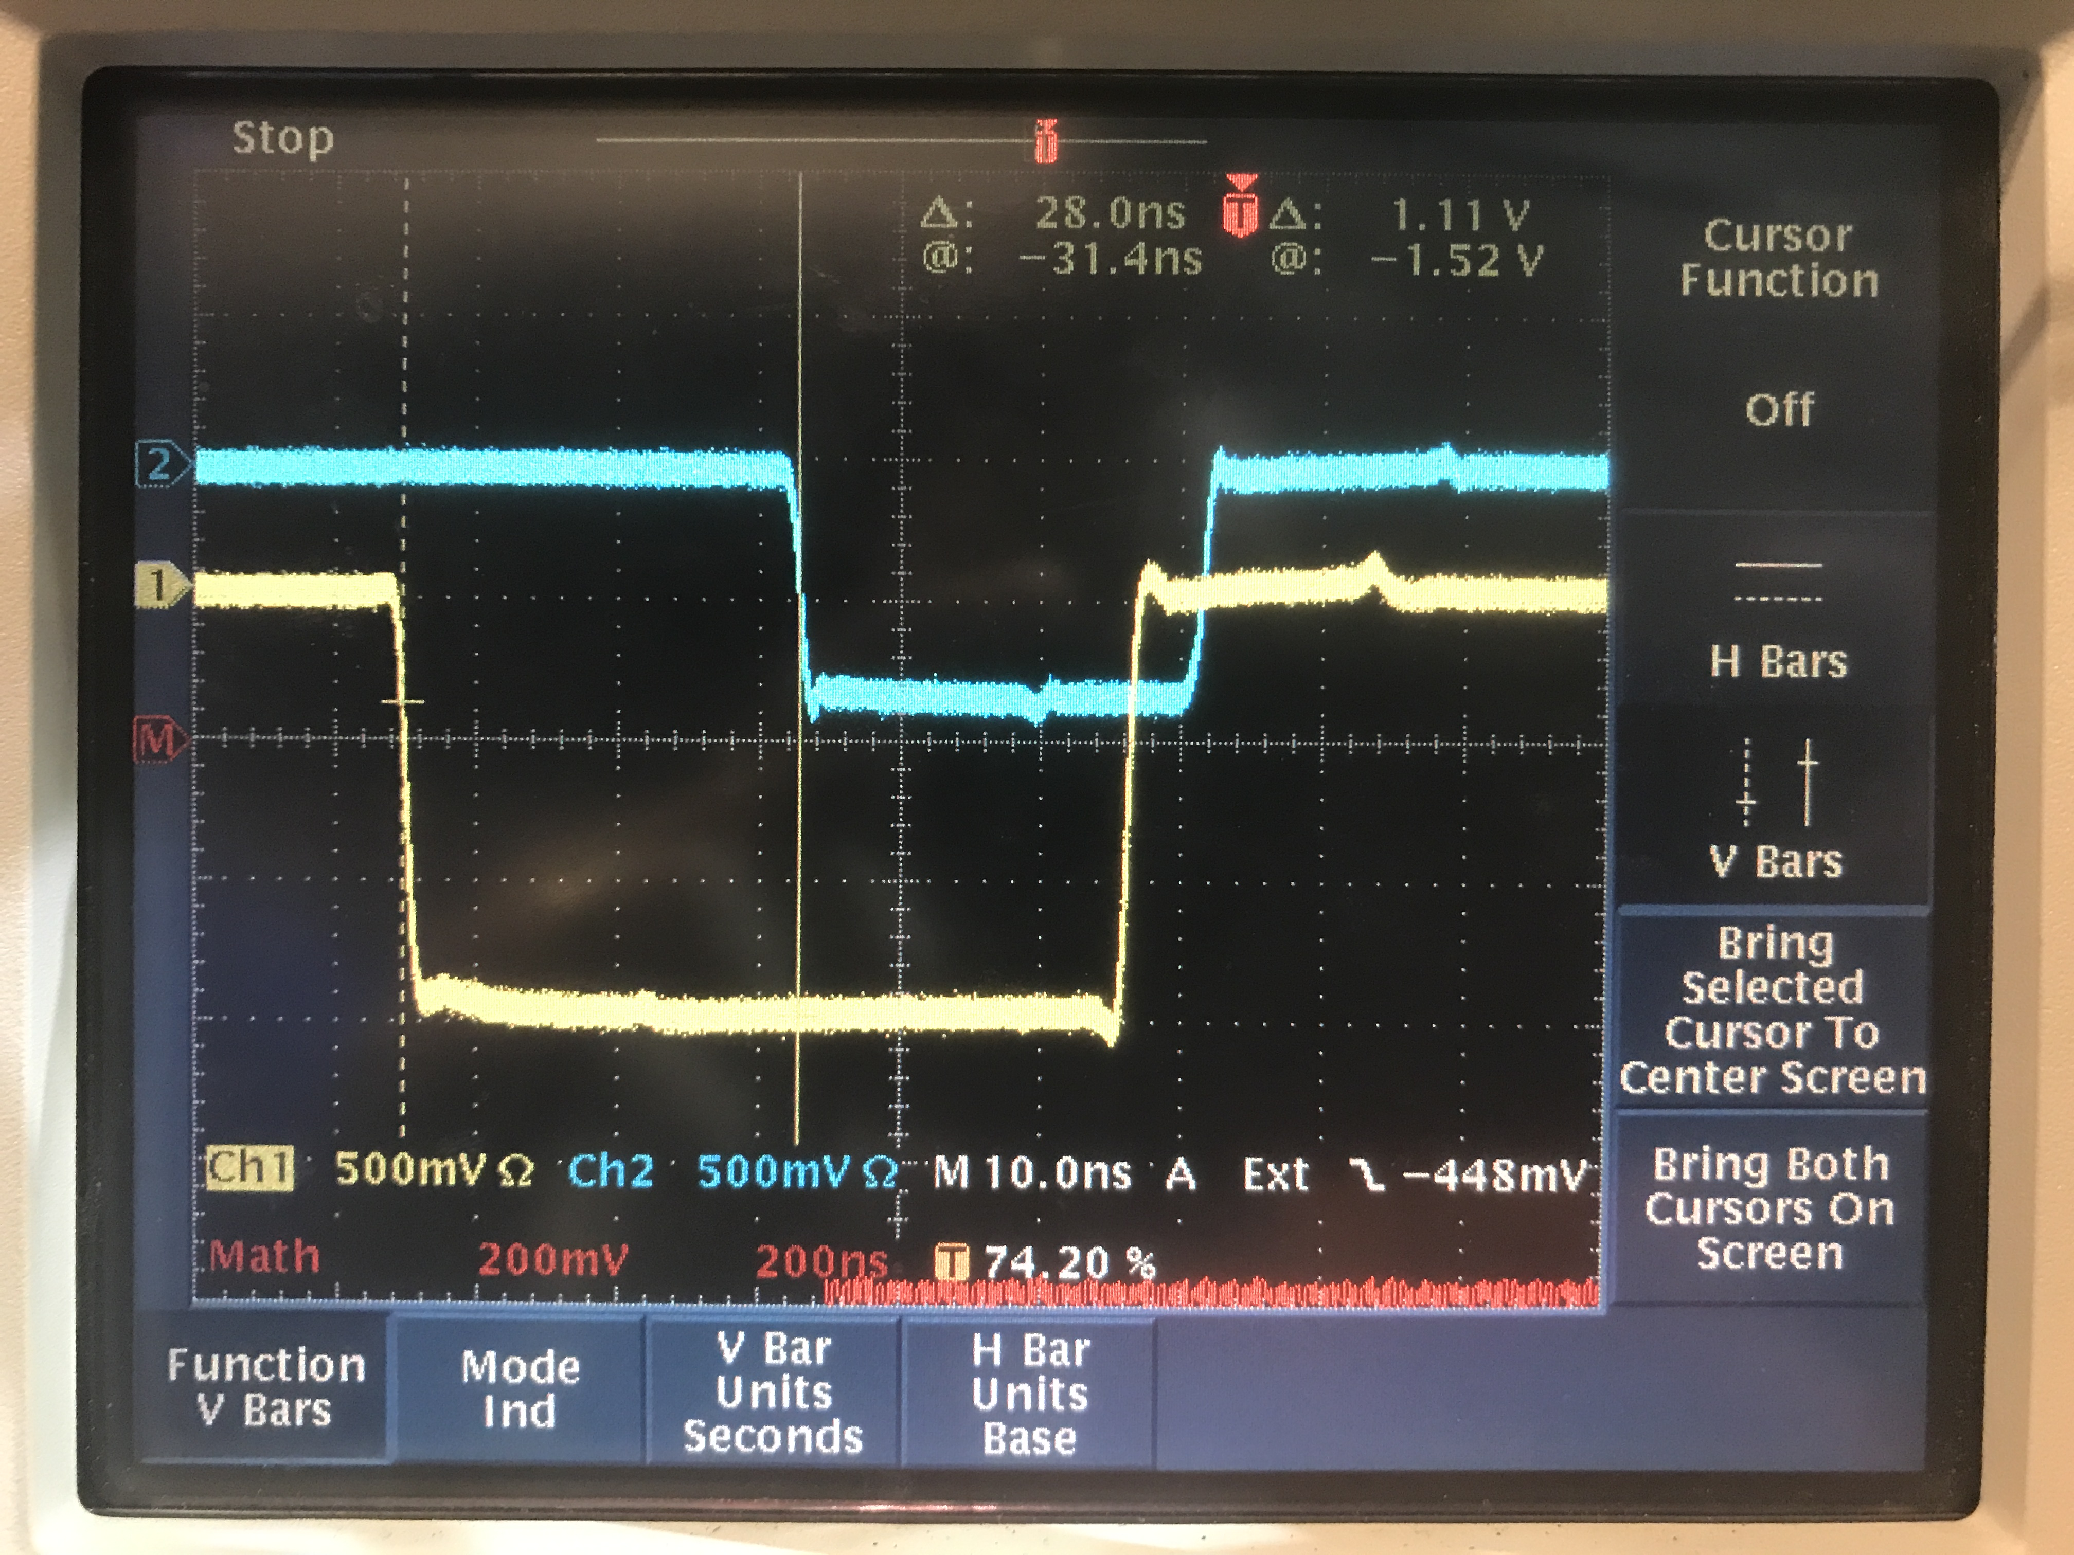
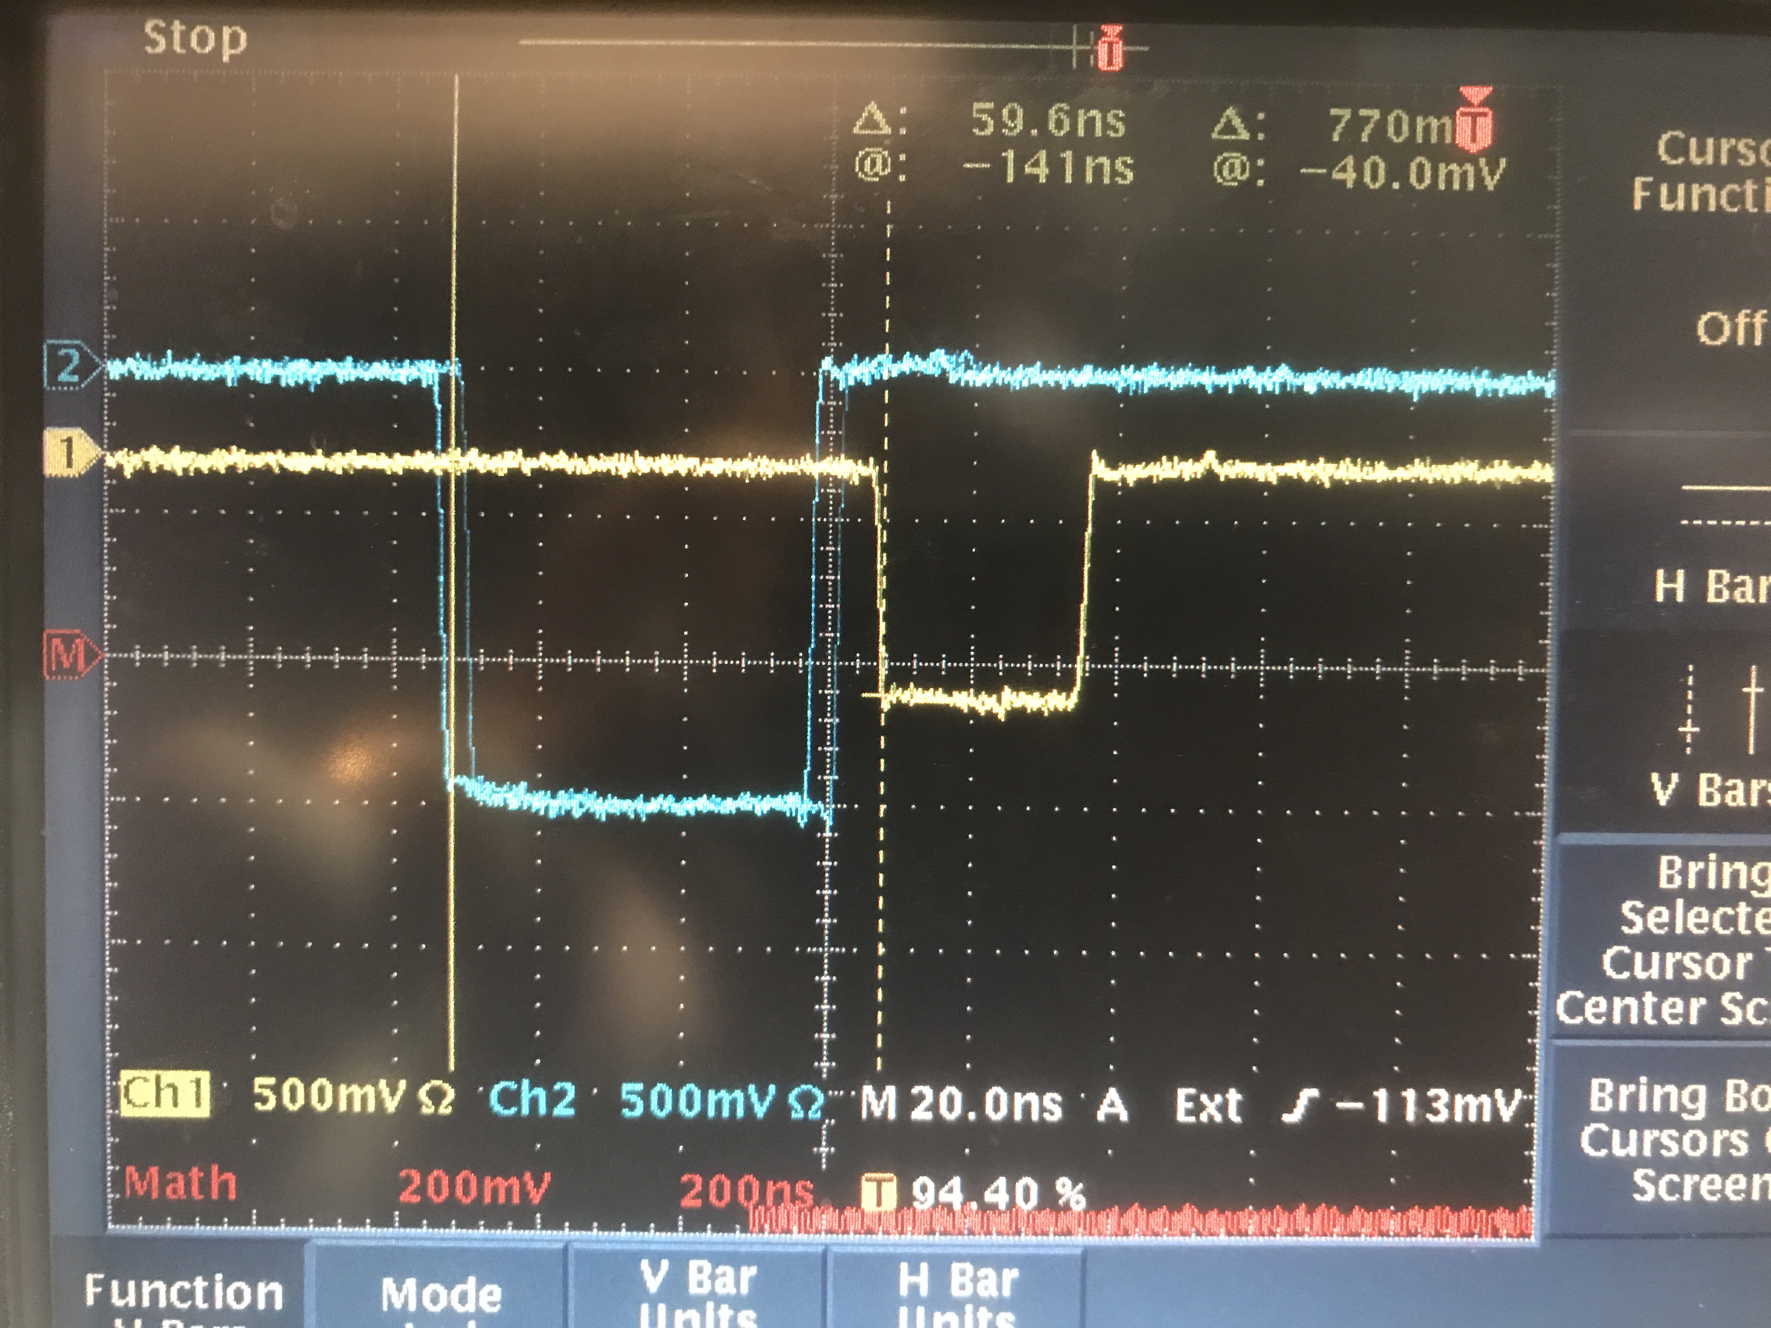
LHRS
S2 Logic Unit
L
S2_R gets here delayed by 25 ns with respect to S2_L
1 ns
R
1 ns
1 ns
8 ns
FIFO
1 ns
(S0||S2)
S2 coinc
Delay
20 ns
Delay
10 ns
Delay
5 ns
8 ns
0.5 ns
CLOCK
S0
1 ns
10 ns
(S0&S2)
S2
1 ns
28 ns
1 ns
GC
(S0||S2)&GC
8 ns
S0A disc
3 ns
Delay
20 ns
3 ns
8 ns
1 ns
1 ns
S0 coinc
S0B disc
(S0&S2)&GC
1 ns
COSMICS
(Single shot)
COSMICS
GC disc
1 ns
GC coinc
3 ns
Delay
20 ns
8 ns
60 ns

Slide 16
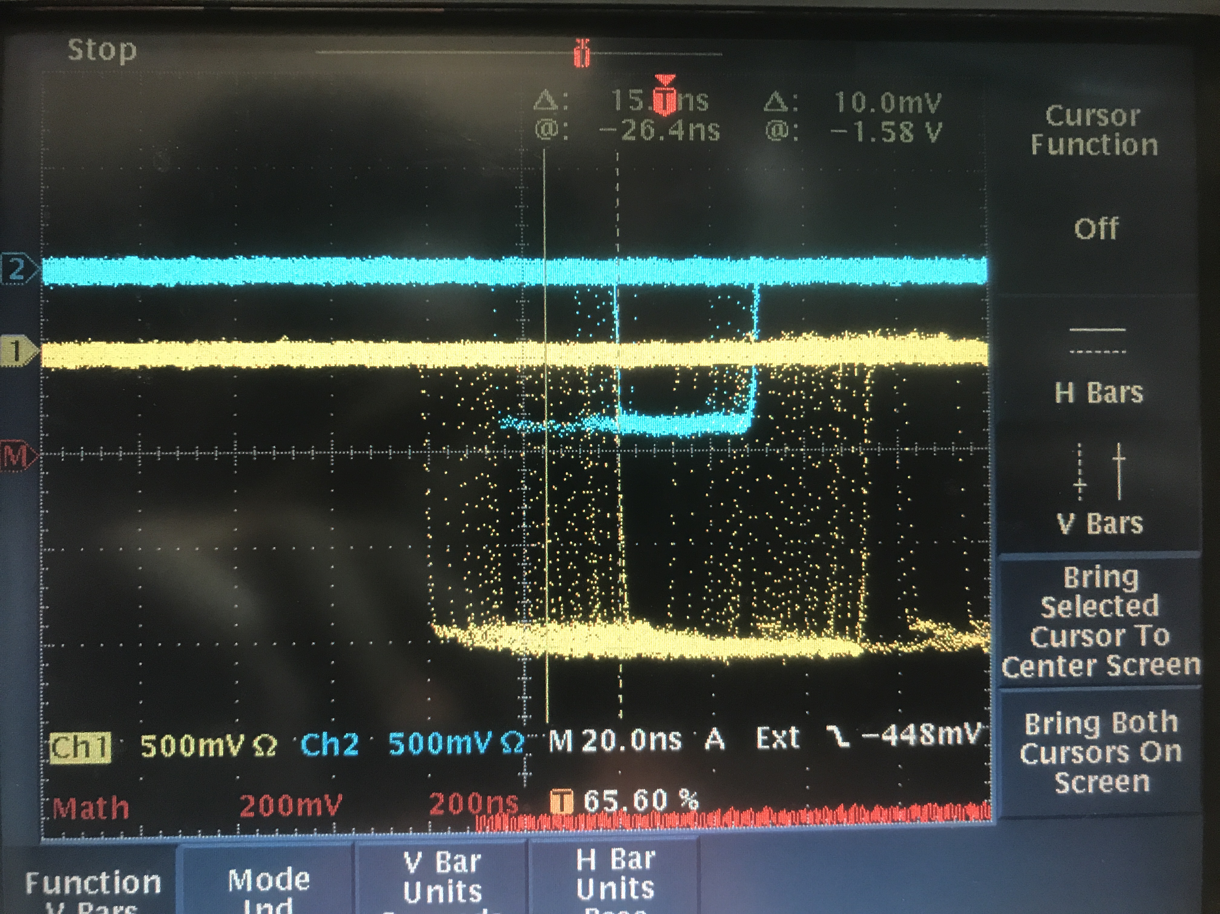
LHRS
S2 Logic Unit
L
S2_R gets here delayed by 25 ns with respect to S2_L
1 ns
R
1 ns
1 ns
8 ns
FIFO
1 ns
(S0||S2)
S2 coinc
Delay
20 ns
Delay
10 ns
Delay
5 ns
8 ns
0.5 ns
10 ns
S0
1 ns
(S0&S2)
S2
1 ns
1 ns
GC
(S0||S2)&GC
8 ns
S0A disc
3 ns
Delay
20 ns
3 ns
8 ns
1 ns
1 ns
S0 coinc
S0B disc
(S0&S2)&GC
1 ns
COSMICS
GC disc
1 ns
GC coinc
3 ns
Delay
20 ns
8 ns
15 ns

Slide 17
LHRS
S2 Logic Unit
L
S2_R gets here delayed by 25 ns with respect to S2_L
1 ns
R
1 ns
1 ns
8 ns
FIFO
1 ns
(S0||S2)
S2 coinc
Delay
20 ns
Delay
10 ns
Delay
5 ns
8 ns
0.5 ns
10 ns
S0
1 ns
(S0&S2)
S2
1 ns
1 ns
GC
(S0||S2)&GC
8 ns
3 ns
3 ns
1 ns
S0A disc
Delay
20 ns
1 ns
S0 coinc
8 ns
S0B disc
(S0&S2)&GC
1 ns
COSMICS
GC
S0&S2
GC disc
1 ns
GC coinc
3 ns
Delay
20 ns
8 ns
15ns
30ns
50ns

Slide 18
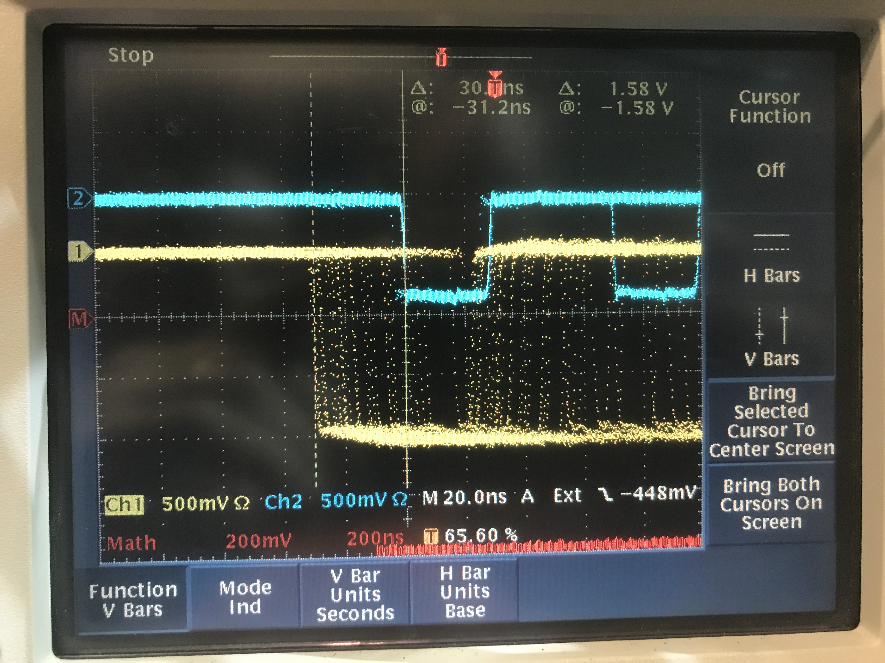
LHRS
S2 Logic Unit
L
S2_R gets here delayed by 25 ns with respect to S2_L
1 ns
R
1 ns
1 ns
8 ns
FIFO
1 ns
(S0||S2)
S2 coinc
Delay
20 ns
Delay
10 ns
Delay
5 ns
8 ns
0.5 ns
10 ns
S0
1 ns
(S0&S2)
S2
1 ns
8 ns
1 ns
GC
(S0||S2)&GC
S0A disc
3 ns
Delay
20 ns
3 ns
8 ns
1 ns
1 ns
S0 coinc
S0B disc
(S0&S2)&GC
1 ns
COSMICS
GC disc
1 ns
GC coinc
3 ns
Delay
20 ns
8 ns
26 ns

Slide 19
LHRS
S2 Logic Unit
L
S2_R gets here delayed by 25 ns with respect to S2_L
1 ns
R
1 ns
1 ns
8 ns
FIFO
1 ns
(S0||S2)
S2 coinc
Delay
20 ns
Delay
10 ns
Delay
5 ns
8 ns
0.5 ns
10 ns
S0
1 ns
(S0&S2)
S2
1 ns
8 ns
1 ns
GC
(S0||S2)&GC
S0A disc
3 ns
Delay
20 ns
3 ns
8 ns
1 ns
1 ns
S0 coinc
S0B disc
(S0&S2)&GC
1 ns
COSMICS
GC
S0||S2
GC disc
1 ns
GC coinc
3 ns
Delay
20 ns
8 ns
25ns
30ns
50ns

Slide 20
RHRS

Slide 21
RHRS
S2 Logic Unit
L
6 ns
Delay
10 ns
1 ns
R
1 ns
8 ns
16 ns
FIFO
1 ns
(S0||S2)
S2 coinc
Delay
20 ns
8 ns
8 ns
S0
1 ns
(S0&S2)
S2
1 ns
1 ns
GC
(S0||S2)&GC
S0B disc
6 ns
Delay
10 ns
1 ns
Delay
5 ns
3 ns
Delay
5 ns
1 ns
S0 coinc
17 ns
1 ns
S0A disc
(S0&S2)&GC
0.5 ns
GC disc
0.3 ns
GC coinc
2 ns
Delay
20 ns
8 ns
Analog sum

Slide 22
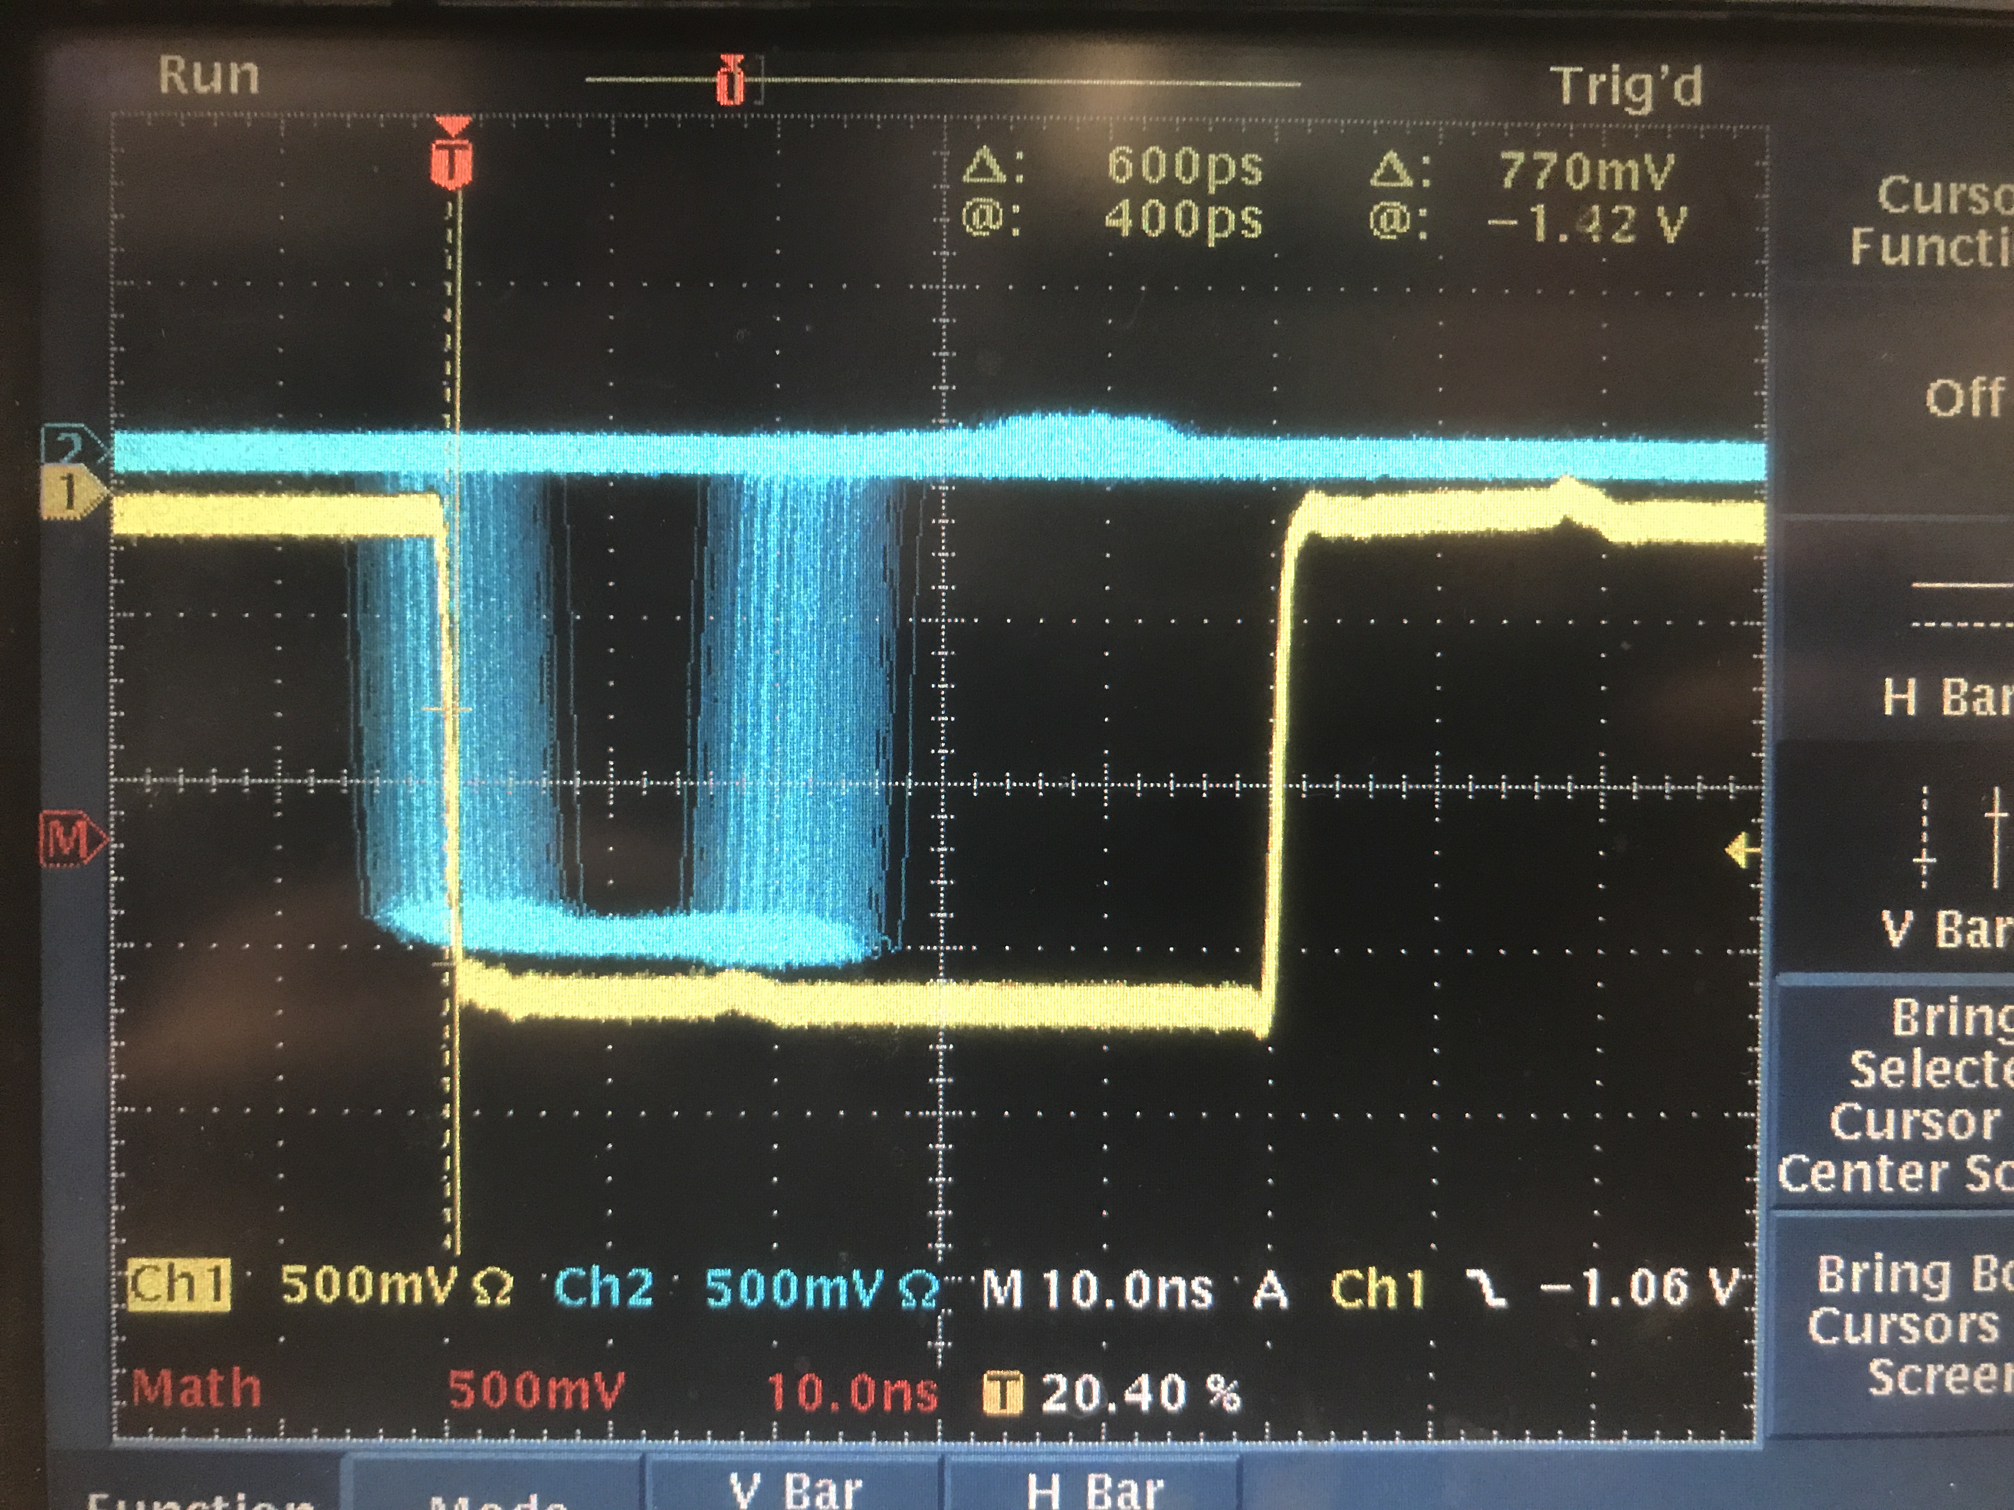
RHRS
S2 Logic Unit
L
6 ns
COSMICS
1 ns
R
Delay
10 ns
8 ns
S2 coinc
Delay
20 ns
8 ns
8 ns
S0B disc
6 ns
Delay
10 ns
1 ns
Delay
5 ns
3 ns
Delay
5 ns
S0 coinc
17 ns
S0A disc
0.5 ns
0 ns
GC disc
0.3 ns
GC coinc
2 ns
Delay
20 ns
8 ns
Analog sum

Slide 23
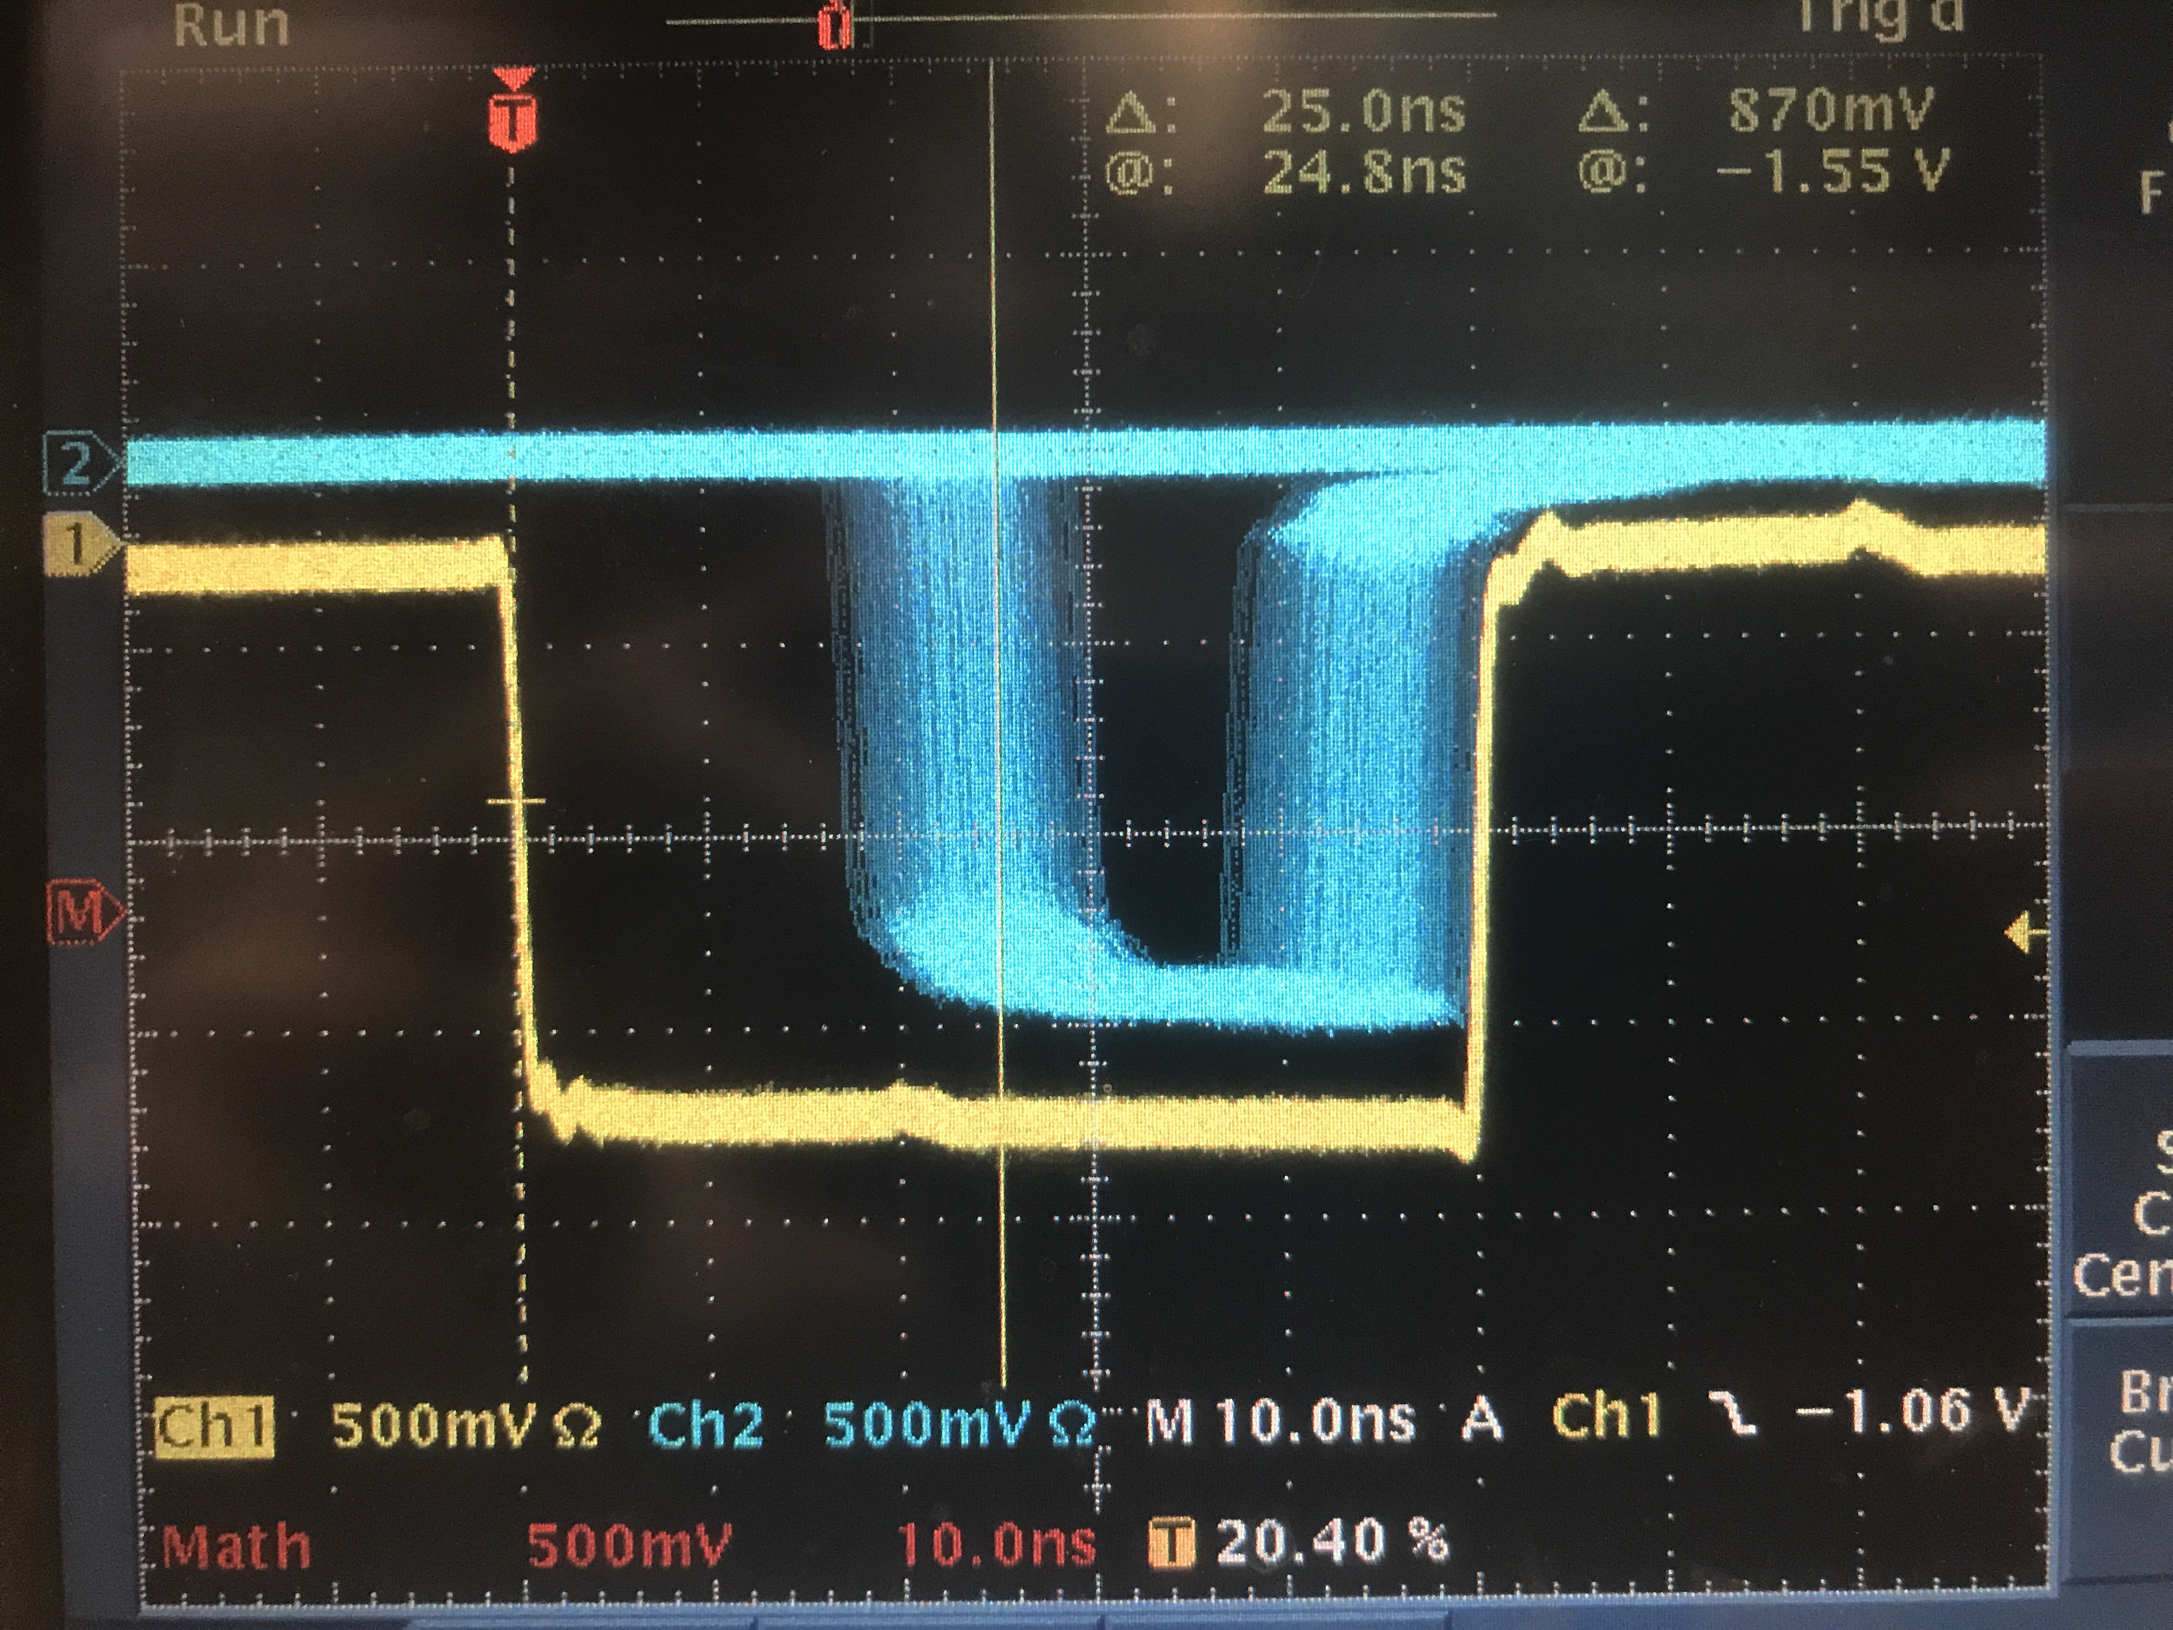
RHRS
S2 Logic Unit
L
6 ns
COSMICS
1 ns
R
Delay
10 ns
8 ns
S2 coinc
Delay
20 ns
8 ns
8 ns
S0B disc
6 ns
Delay
10 ns
1 ns
Delay
5 ns
3 ns
Delay
5 ns
S0 coinc
17 ns
S0A disc
0.5 ns
25 ns
GC disc
0.3 ns
GC coinc
2 ns
Delay
20 ns
8 ns
Analog sum

Slide 24
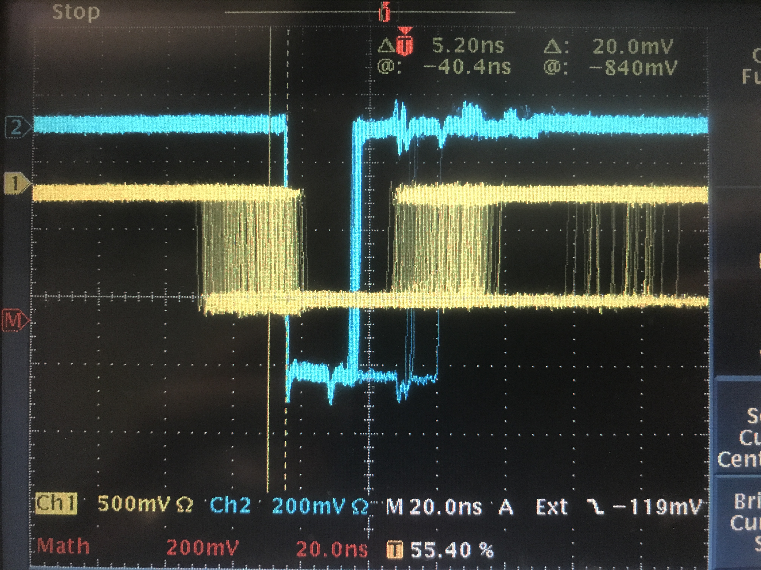
RHRS
S2 Logic Unit
L
6 ns
Delay
10 ns
1 ns
R
8 ns
trigger on S0 coinc (external)
S2 coinc
Delay
20 ns
8 ns
8 ns
COSMICS
S0B disc
6 ns
Delay
10 ns
1 ns
Delay
5 ns
3 ns
Delay
5 ns
S0 coinc
17 ns
S0A disc
0.5 ns
GC disc
0.3 ns
GC coinc
2 ns
Delay
20 ns
8 ns
10 ns
Analog sum

Slide 25
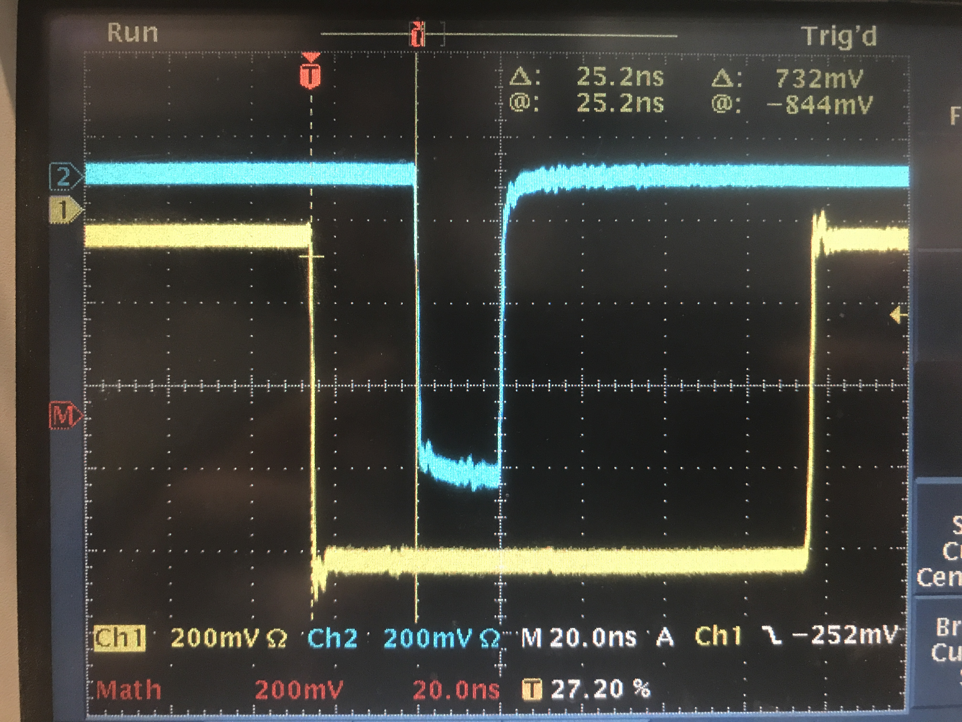
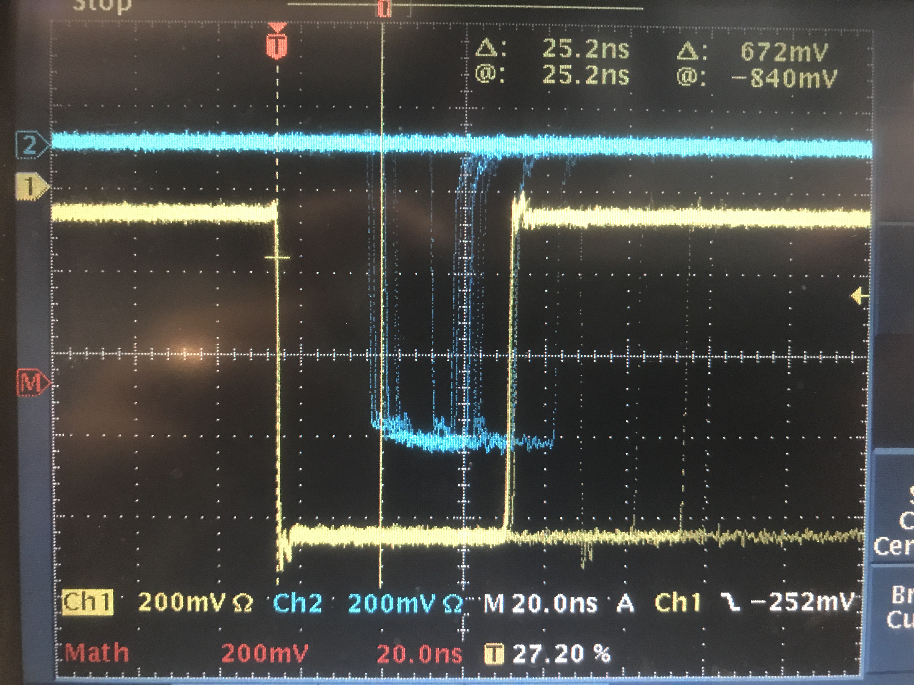
RHRS
S2 Logic Unit
L
6 ns
Delay
10 ns
1 ns
R
8 ns
S2 coinc
Delay
20 ns
8 ns
8 ns
25 ns
S0B disc
6 ns
Delay
10 ns
1 ns
Delay
5 ns
3 ns
Delay
5 ns
S0 coinc
17 ns
COSMICS
S0A disc
0.5 ns
GC disc
0.3 ns
2 ns
8 ns
25 ns
GC coinc
Delay
20 ns
Analog sum

Slide 26
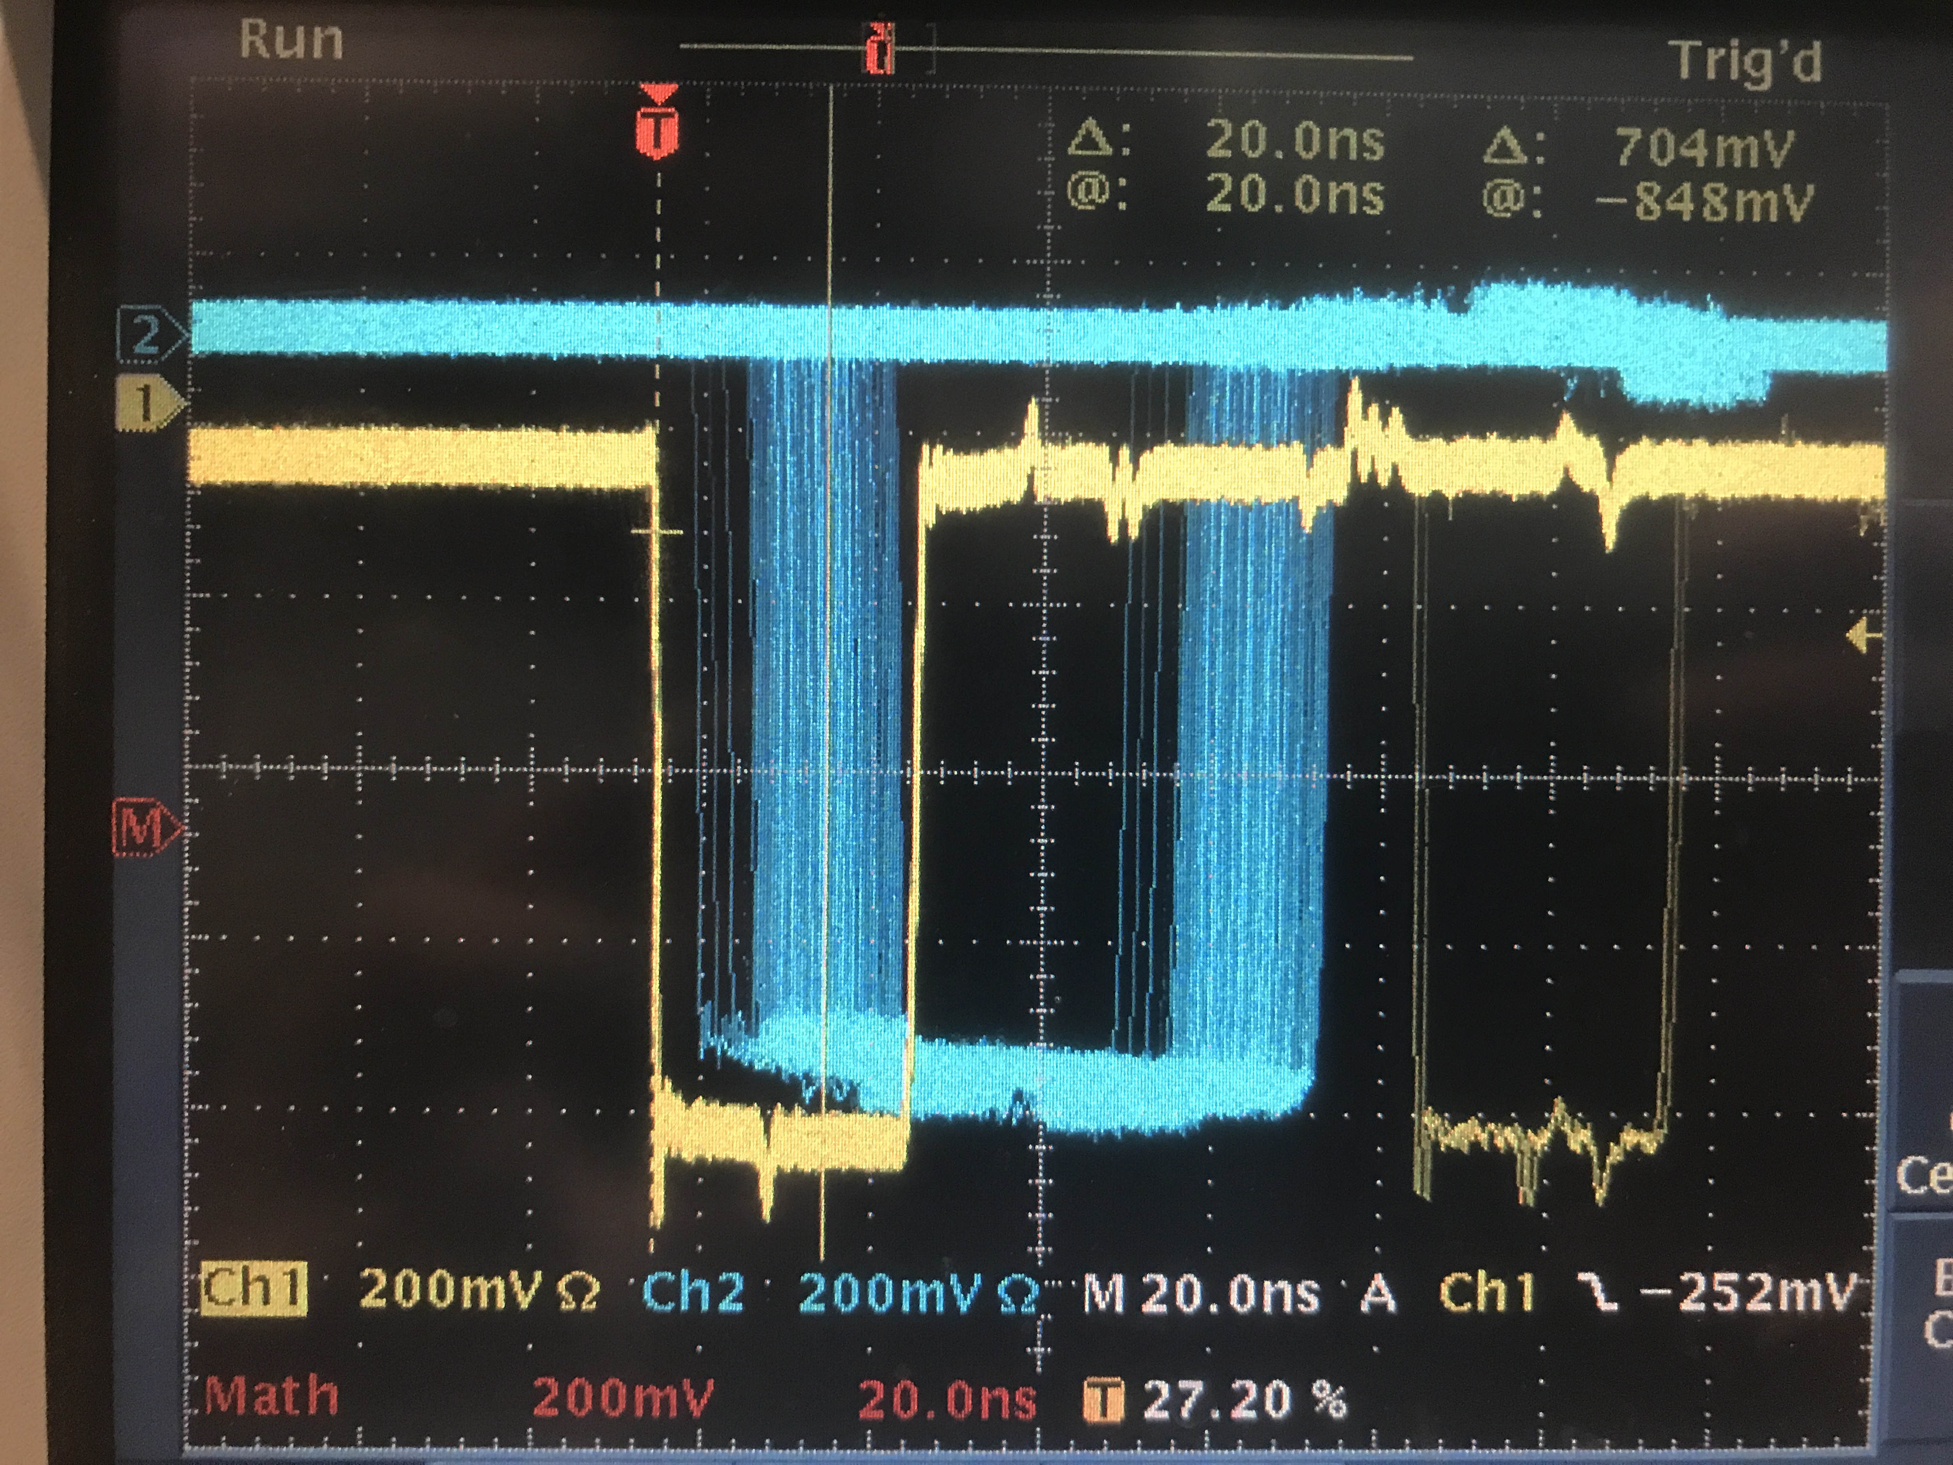
RHRS
S2 Logic Unit
L
6 ns
Delay
10 ns
1 ns
R
8 ns
S2 coinc
Delay
20 ns
8 ns
8 ns
COSMICS
S0B disc
6 ns
Delay
10 ns
1 ns
Delay
5 ns
3 ns
Delay
5 ns
S0 coinc
17 ns
S0A disc
0.5 ns
21 ns
GC disc
0.3 ns
GC coinc
2 ns
Delay
20 ns
8 ns
Analog sum

Slide 27
COSMICS
S2 Logic Unit
cable to electronics
L
S2
1 ns
R
24 ns
S2 coinc
cable to electronics
25 ns
S0B disc
S0
S0 coinc
S0A disc
0.5 ns
(S0 cable to electronics) + 8ns + 25ns + 8ns + TOF
- (S2 cable to electronics + 8ns + 24ns + 8ns) = 21ns
COSMICS
Δ(S2-S0 cable length) = 21ns – TOF – 1ns
TOF ~ 5ns
Δ(S2-S0 cable length) = 15ns
21 ns
S0A cable is longer than S2_R by 15ns

Slide 28
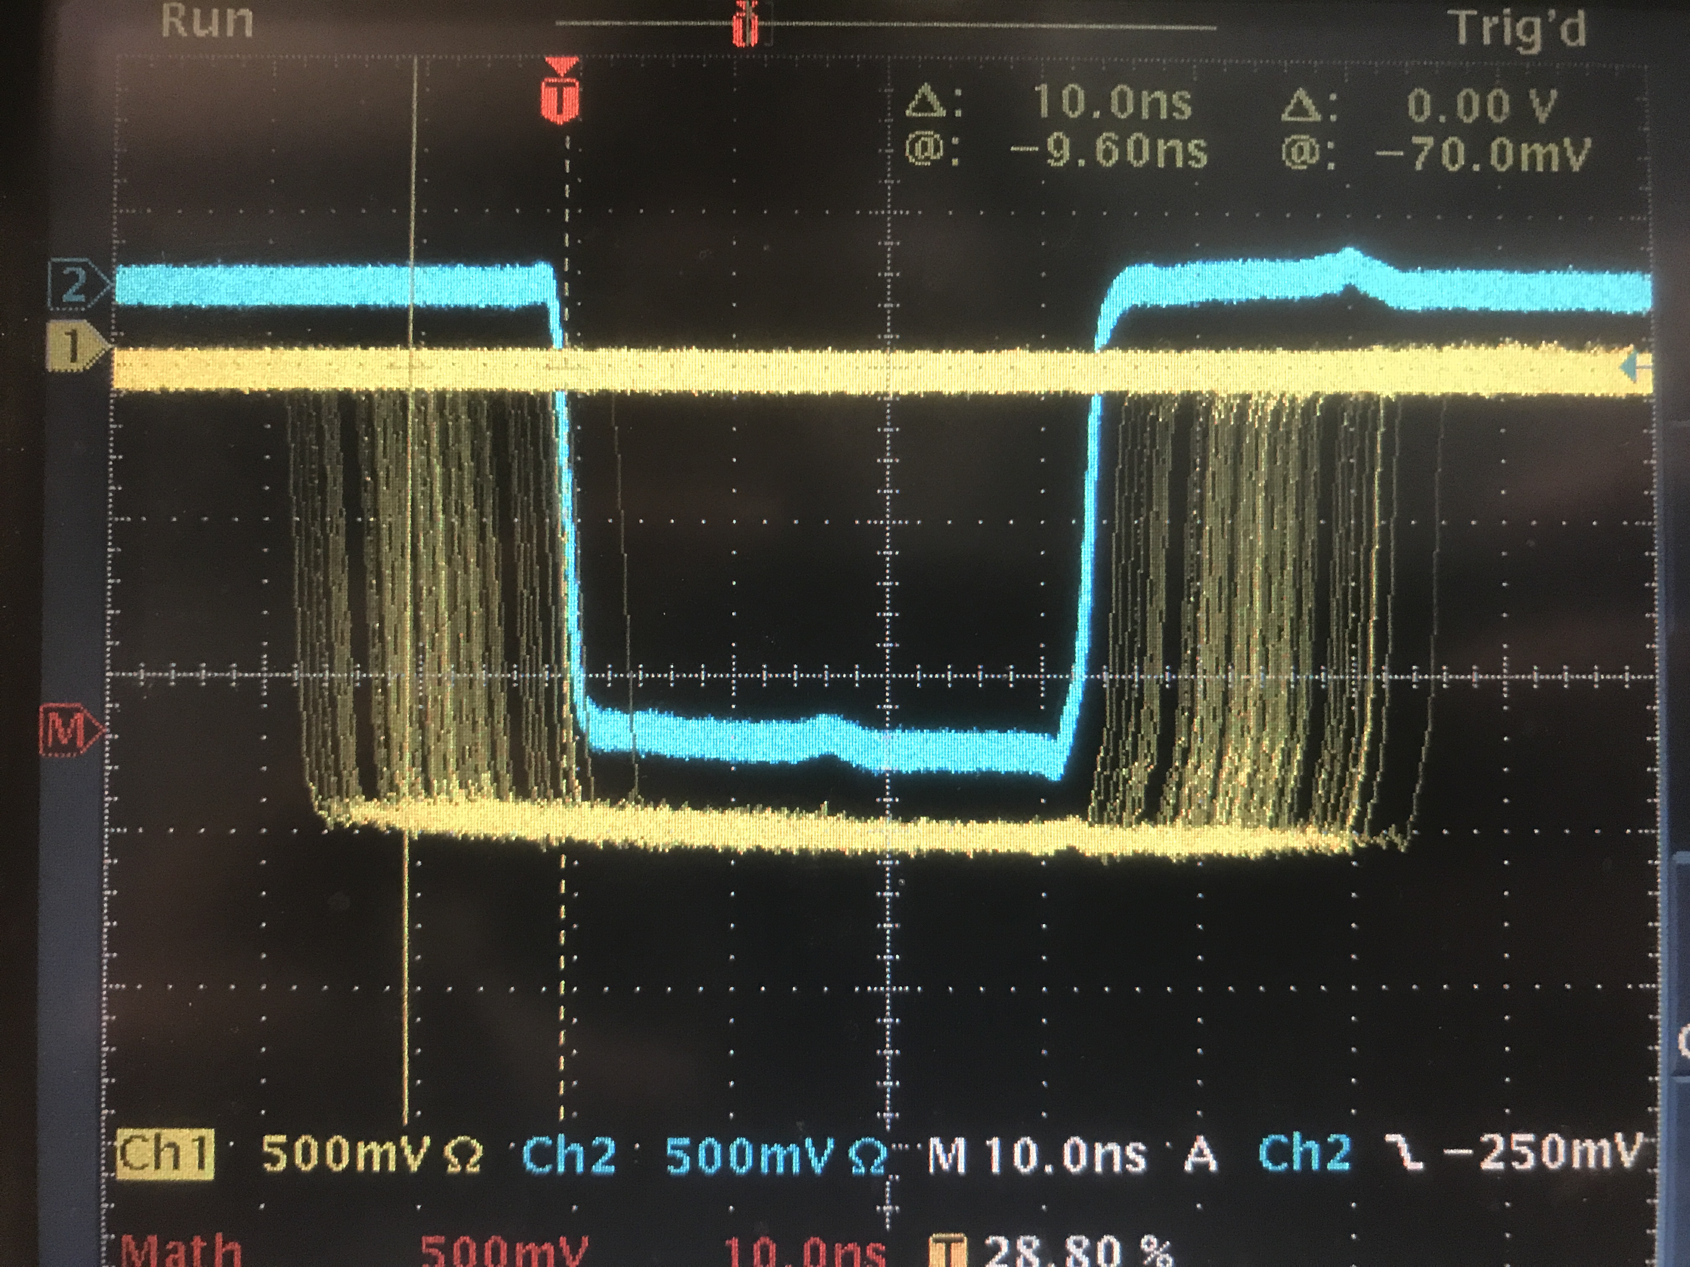
RHRS
S2 Logic Unit
L
6 ns
Delay
10 ns
COSMICS
1 ns
R
8 ns
S2 coinc
FIFO
Delay
20 ns
8 ns
8 ns
S0
S2
10 ns
GC
S0B disc
6 ns
Delay
10 ns
1 ns
Delay
5 ns
3 ns
Delay
5 ns
S0 coinc
17 ns
S0A disc
0.5 ns
REAL
S0
S2
GC disc
0.3 ns
GC coinc
2 ns
Delay
20 ns
8 ns
20ns
30ns
Analog sum
50ns

Slide 29
(Assuming 2.5ns TOF between scintillator and GC)
(S0&S2)&GC
REAL
COSMICS
S0&S2
S0&S2
GC
GC
20ns
30ns
15ns
30ns
50ns
50ns
(S0||S2)&GC
S0||S2
REAL
S0||S2
COSMICS
GC
GC
20ns
30ns
25ns
30ns
50ns
50ns

Slide 31
S2_R & S0_A
RHRS
S2 Logic Unit
signal to electronics
L
S2
R
24 ns
S2 coinc
COSMICS
S0B disc
25 ns
S0
signal to electronics
S0 coinc
S0A disc
(S0 cable to electronics) + 8ns + 25ns + 8ns + TOF
- (S2 cable to electronics + 8ns + 24ns + 8ns) = 21ns
COSMICS
Δ(S0-S2 cable length) = 21ns – TOF – 1
TOF ~ 5ns
Δ(S0-S2 cable length) = 15ns
21 ns
S0A cable is longer than S2_R by 15ns

Slide 32
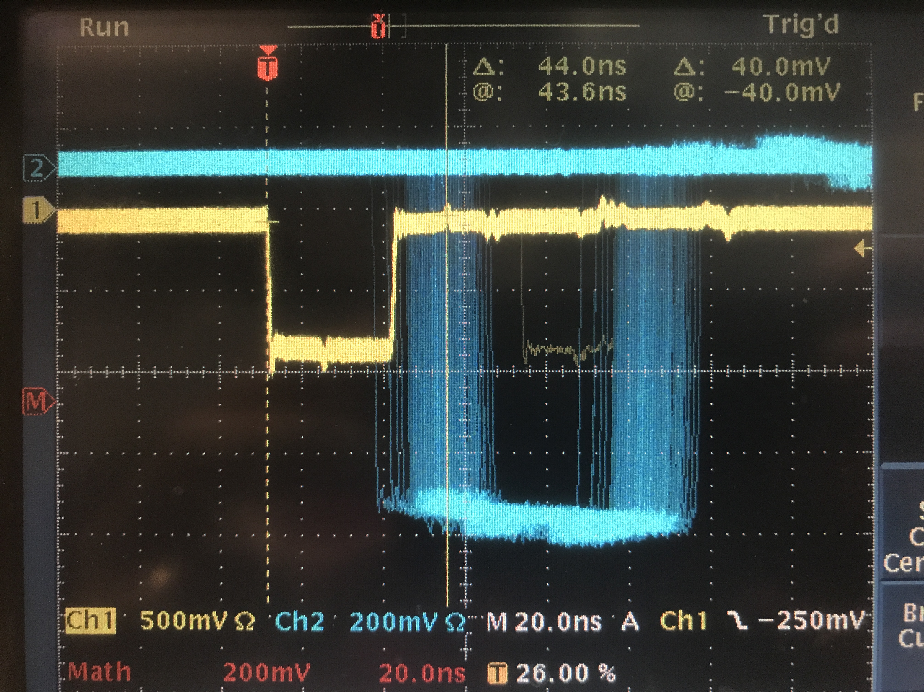
S2_L & S0_A
RHRS
S2 Logic Unit
signal to electronics
L
S2
1 ns
R
S2 coinc
COSMICS
S0B disc
25 ns
S0
signal to electronics
S0 coinc
S0A disc
(S0 cable to electronics) + 8ns + 25ns + 8ns + TOF
- (S2 cable to electronics + 8ns + 1ns + 8ns) = 44ns
COSMICS
Δ(S0-S2 cable length) = 44ns – TOF – 24ns
TOF ~ 5ns
Δ(S0-S2 cable length) = 15ns
44 ns
S0A cable is longer than S2_L by 15ns

Slide 33
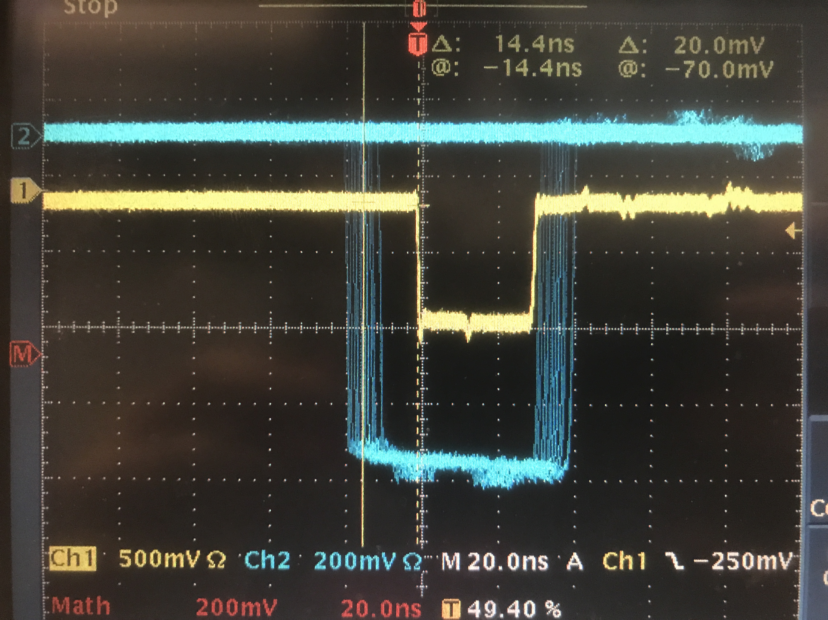
S2_R & S0_B
RHRS
S2 Logic Unit
signal to electronics
L
S2
R
24 ns
S2 coinc
COSMICS
S0B disc
S0
signal to electronics
S0 coinc
S0A disc
0.5 ns
(S0 cable to electronics) + 8ns + 0.5ns + 8ns + TOF
- (S2 cable to electronics + 8ns + 24ns + 8ns) = -14ns
COSMICS
Δ(S0-S2 cable length) = -14ns – TOF + 24ns – 0.5
TOF ~ 5ns
Δ(S0-S2 cable length) = 4.5ns
14 ns
S0B cable is longer than S2_R by 4.5ns

Slide 34
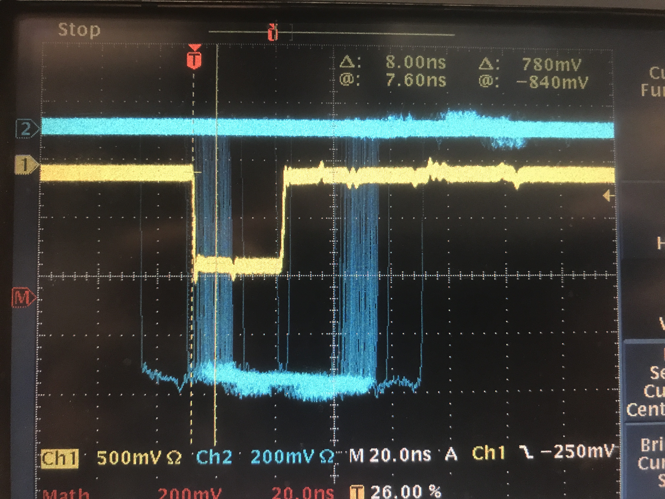
S2_L & S0_B
RHRS
S2 Logic Unit
signal to electronics
L
S2
1 ns
R
S2 coinc
COSMICS
S0B disc
S0
signal to electronics
S0 coinc
S0A disc
0.5 ns
(S0 cable to electronics) + 8ns + 0.5ns + 8ns + TOF
- (S2 cable to electronics + 8ns + 1ns + 8ns) = 9ns
COSMICS
Δ(S0-S2 cable length) = 9ns – TOF – 0.5 + 1
TOF ~ 5ns
Δ(S0-S2 cable length) = 4.5ns
9 ns
S0B cable is longer than S2_L by 4.5ns

Slide 35
In conclusion
RHRS
S2_L
signal to electronics
l₀
S2_R
signal to electronics
l₀
S0A
signal to electronics
l₀+15ns
S0B
signal to electronics
l₀+4.5ns
S0A cable is longer than S2_R by 15ns
S0A cable is longer than S2_L by 15ns
S0B cable is longer than S2_R by 4.5ns
S0B cable is longer than S2_L by 4.5ns

