Slide 1
Trigger Setup
Reynier Cruz Torres

Slide 2
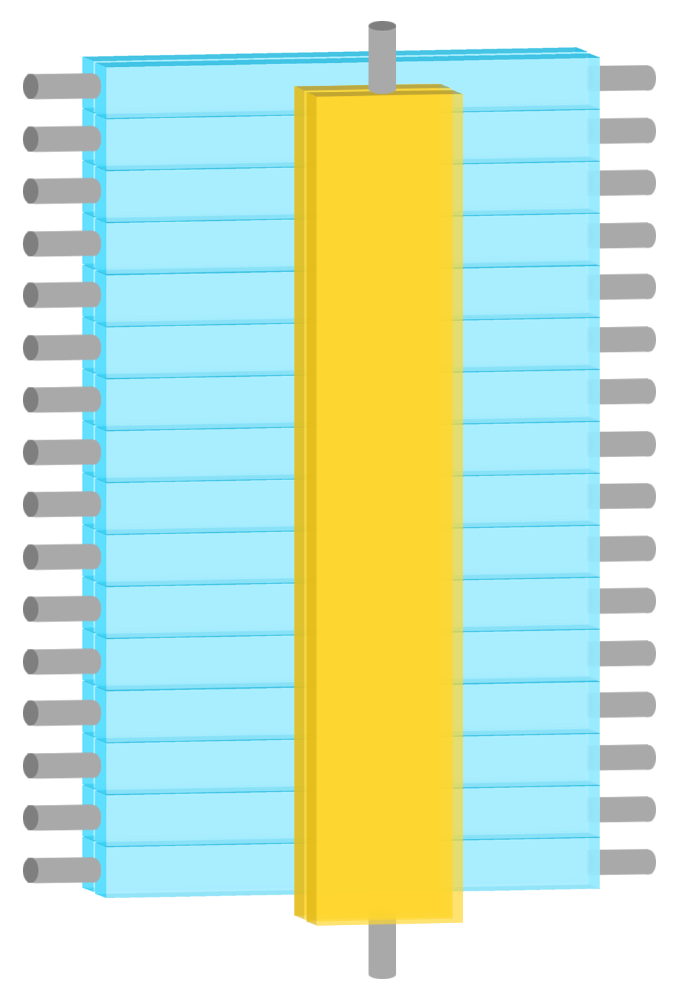
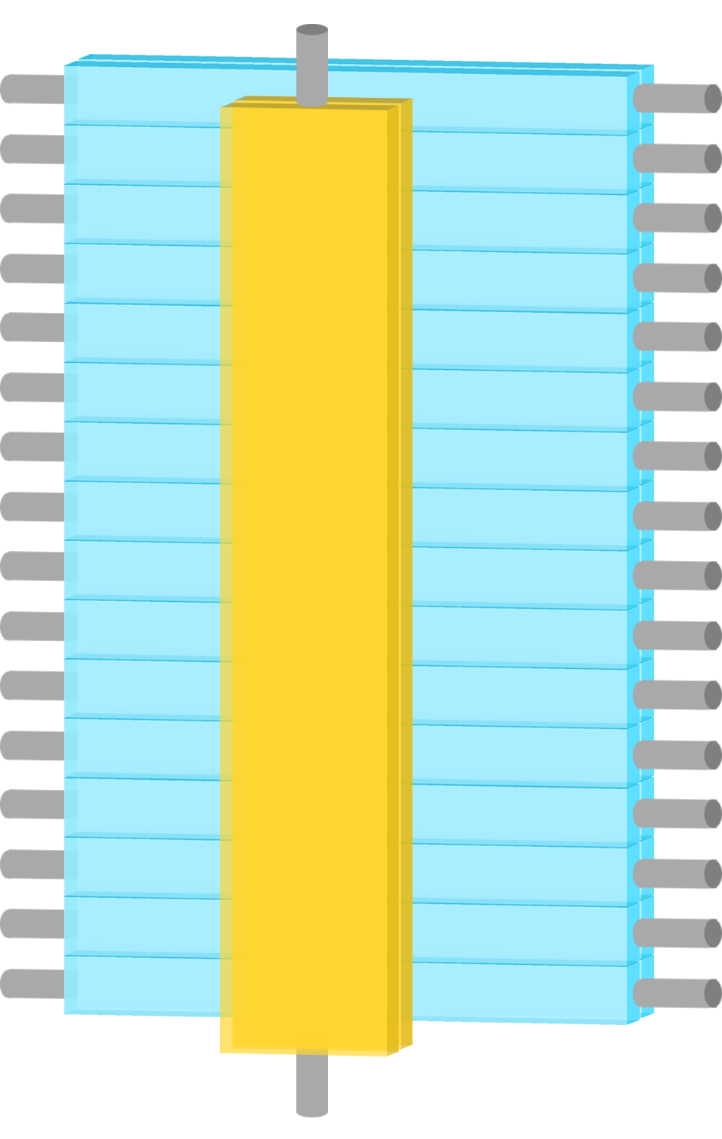
S0A and S0B have different meanings in the two arms
1
2
3
4
5
6
7
8
9
10
11
12
13
14
15
16
S0A
S0B
1
2
3
4
5
6
7
8
9
10
11
12
13
14
15
16
S2 Left
S0
S2 Right
S2 Left
S0
S2 Right
S0B
S0A
LHRS
RHRS

Slide 3
LHRS

Slide 4
LHRS
Level
Translator
Amplifier
Level
Translator
fadc
fadc
69 ns
69 ns
46 ns
88 ns
1
2
3
4
5
6
7
8
9
10
11
12
13
14
15
16
S0A
76 ns
84 ns
S2 Left
S0
S2 Right
DISC
DISC
7 ns
8 ns
Mixer
Mixer
12 ns
S0B
11 ns
Italic = calculated

Slide 5
LHRS
S2 Logic Unit
10 ns delay (09/26/17)
L
S2_R gets here delayed by 25 ns with respect to S2_L
1 ns
R
1 ns
1 ns
8 ns
FIFO
1 ns
(S0||S2)
S2 coinc
Delay
20 ns
Delay
10 ns
Delay
5 ns
8 ns
0.5 ns
10 ns
S0
1 ns
(S0&S2)
S2
1 ns
1 ns
GC
(S0||S2)&GC
8 ns
S0A disc
3 ns
Delay
20 ns
3 ns
8 ns
1 ns
1 ns
S0 coinc
S0B disc
(S0&S2)&GC
1 ns
GC disc
1 ns
GC coinc
3 ns
Delay
20 ns
8 ns
Analog sum

Slide 6
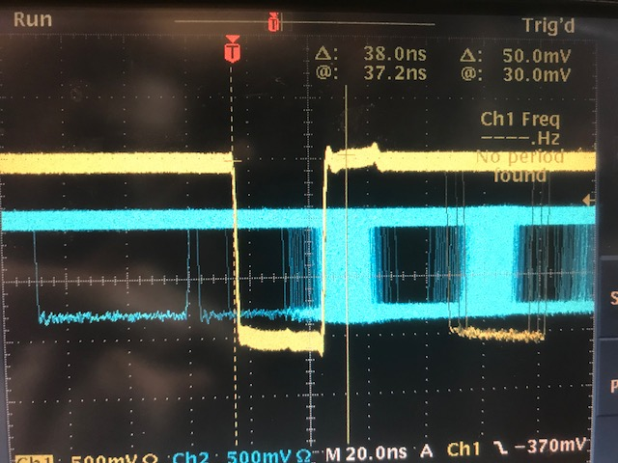
S2_R & S0_A
LHRS
S2 Logic Unit
S2 PMT
delay
95 ns
L
S2_R
Level translator
1 ns
S2 coinc
1 ns
R
15.8 ns
COSMICS
S0 PMT
delay
S0B disc
S0_A
69 ns
Amplifier
26 ns
S0 coinc
S0A disc
15.4 ns
(S0_A PMT delay) + 69 + 15.4 + 26 + 8 + TOF - [(S2_R PMT delay) + 95 + 15.8 + 1 + 8] = 38
(S0_A PMT delay) - (S2_R PMT delay) = 38 – 3.6 = 34.4
* where we assumed TOF = 5 ns
* all numbers in nano-seconds
COSMICS
(S0_A PMT delay) - (S2_R PMT delay) = 34.4 ns
38 ns

Slide 7
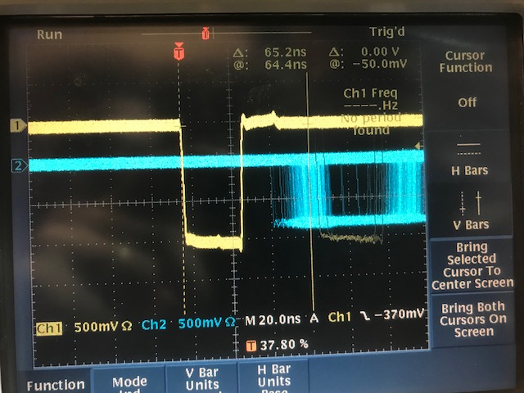
S2_L & S0_A
LHRS
S2 Logic Unit
S2 PMT
delay
65 ns
1 ns
L
1 ns
S2_L
Level translator
S2 coinc
R
15.8 ns
COSMICS
S0 PMT
delay
S0B disc
S0_A
69 ns
Amplifier
26 ns
S0 coinc
S0A disc
15.4 ns
(S0_A PMT delay) + 69 + 15.4 + 26 + 8 + TOF - [(S2_L PMT delay) + 65 + 15.8 + 1 + 8] = 65
(S0_A PMT delay) - (S2_L PMT delay) = 65 – 33.6 = 31.4
* where we assumed TOF = 5 ns
* all numbers in nano-seconds
COSMICS
65 ns
(S0_A PMT delay) - (S2_L PMT delay) = 31.4 ns

Slide 8
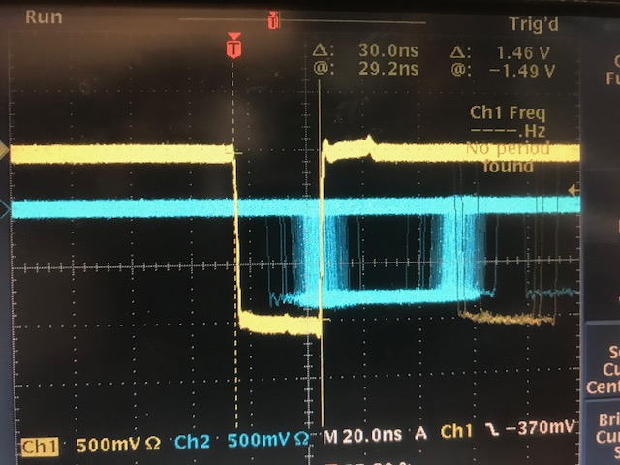
S2_L & S0_B
LHRS
S2 Logic Unit
S2 PMT
delay
65 ns
1 ns
L
1 ns
S2_L
Level translator
S2 coinc
R
15.8 ns
COSMICS
S0 PMT
delay
S0B disc
1 ns
S0_B
69 ns
Amplifier
S0 coinc
S0A disc
15.4 ns
(S0_B PMT delay) + 69 + 15.4 + 1 + 8 + TOF - [(S2_L PMT delay) + 65 + 15.8 + 1 + 8] = 30
(S0_B PMT delay) - (S2_L PMT delay) = 30 – 8.6 = 21.4
* where we assumed TOF = 5 ns
* all numbers in nano-seconds
COSMICS
30 ns
(S0_B PMT delay) - (S2_L PMT delay) = 21.4 ns

Slide 9
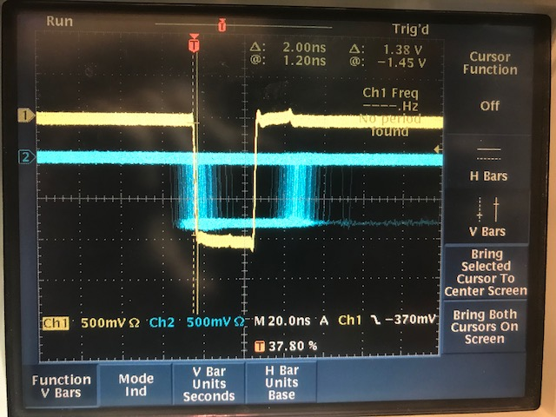
S2_R & S0_B
LHRS
S2 Logic Unit
S2 PMT
delay
95 ns
L
S2_R
Level translator
1 ns
S2 coinc
1 ns
R
15.8 ns
COSMICS
S0 PMT
delay
S0B disc
1 ns
S0_B
69 ns
Amplifier
S0 coinc
S0A disc
15.4 ns
(S0_B PMT delay) + 69 + 15.4 + 1 + 8 + TOF - [(S2_R PMT delay) + 95 + 15.8 + 1 + 8] = 2
(S0_B PMT delay) - (S2_R PMT delay) = 2 + 21.4 = 23.4
* where we assumed TOF = 5 ns
* all numbers in nano-seconds
COSMICS
2 ns
(S0_B PMT delay) - (S2_R PMT delay) = 23.4 ns

Slide 10
LHRS
(S0_A PMT delay) - (S2_R PMT delay) = 34.4 ns
(S0_A PMT delay) - (S2_L PMT delay) = 31.4 ns
(S0_B PMT delay) - (S2_L PMT delay) = 21.4 ns
(S0_B PMT delay) - (S2_R PMT delay) = 23.4 ns
S2_R delay = l₀
S2_L delay = l₀ + 3 ns
S0_A delay = l₀ + 34.4 ns
S0_B delay = l₀ + 23.4 ns

Slide 11
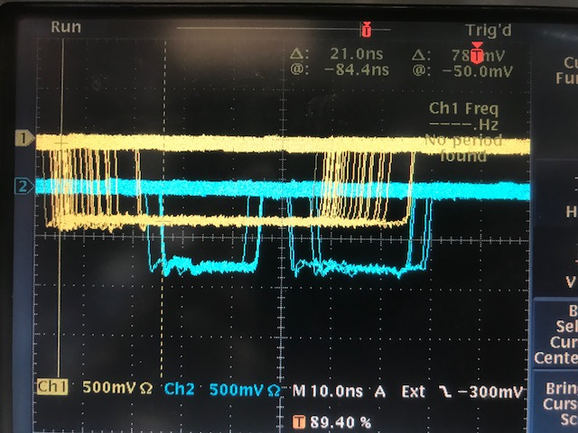
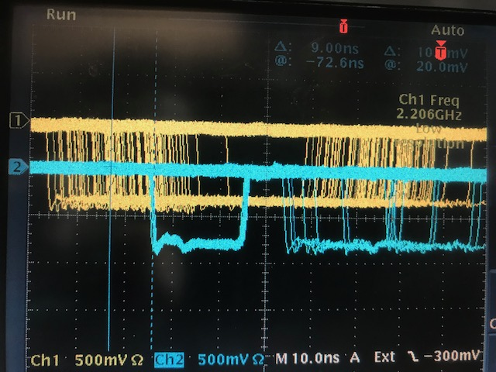
Triggering externally on S2_L(16) & S2_R(16) & S0A & S0B
LHRS
Triggering externally on S2_L(1) & S2_R(1) & S0A & S0B
A
A
B
B
S0B
S0B
S0A
S0A
9 ns
21 ns

Slide 12
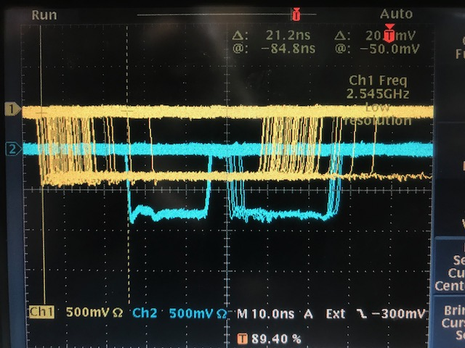
LHRS
Triggering externally on S2_L(8) & S2_R(8) & S0A & S0B
A
B
S0B
S0A
21 ns

Slide 13
RHRS

Slide 14
RHRS
Level
Translator
Amplifier
Level
Translator
fadc
fadc
57 ns
57 ns
55 ns
94 ns
S0B
1
2
3
4
5
6
7
8
9
10
11
12
13
14
15
16
57 ns
94 ns
S2 Left
S0
S2 Right
DISC
DISC
8 ns
7 ns
Mixer
Mixer
12 ns
S0A
11 ns
Italic = calculated

Slide 15
RHRS
S2 Logic Unit
L
6 ns
Delay
10 ns
1 ns
R
1 ns
8 ns
16 ns
FIFO
1 ns
(S0||S2)
S2 coinc
Delay
20 ns
8 ns
8 ns
S0
1 ns
(S0&S2)
S2
1 ns
1 ns
GC
(S0||S2)&GC
S0B disc
6 ns
Delay
10 ns
1 ns
Delay
5 ns
3 ns
Delay
5 ns
1 ns
S0 coinc
17 ns
1 ns
S0A disc
(S0&S2)&GC
0.5 or 1? ns
9 ns delay (10/02/17)
GC disc
0.3 ns
GC coinc
2 ns
Delay
20 ns
8 ns
Analog sum

Slide 16
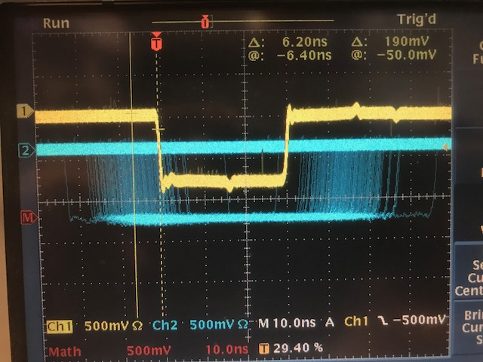
S2_R & S0_A
RHRS
S2 Logic Unit
S2 PMT
delay
75 ns
L
S2_R
Level translator
24 ns
S2 coinc
1 ns
R
16 ns
COSMICS
S0 PMT
delay
S0B disc
S0_A
57 ns
Amplifier
1 or 0.5?
ns
S0 coinc
S0A disc
9.8 ns
9 ns
(S0_A PMT delay) + 57 + 9.8 + 1 + 8 + TOF - [(S2_R PMT delay) + 75 + 16 + 24 + 8] = - 6.2
(S0_A PMT delay) - (S2_R PMT delay) = -6.2 + 42.2 = 36
* where we assumed TOF = 5 ns
* all numbers in nano-seconds
COSMICS
(S0_A PMT delay) - (S2_R PMT delay) = 36 ns
6.2 ns

Slide 17
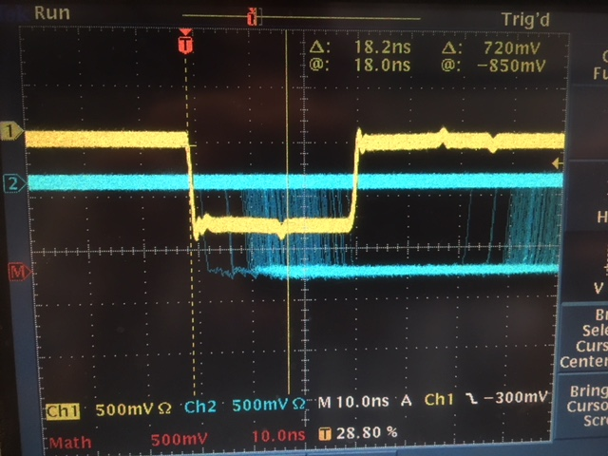
S2_L & S0_A
RHRS
S2 Logic Unit
S2 PMT
delay
75 ns
1 ns
L
1 ns
S2_L
Level translator
S2 coinc
R
16 ns
COSMICS
S0 PMT
delay
S0B disc
S0_A
57 ns
Amplifier
1 or 0.5
ns
S0 coinc
S0A disc
9.8 ns
9 ns
(S0_A PMT delay) + 57 + 9.8 + 1 + 8 + TOF - [(S2_L PMT delay) + 75 + 16 + 1 + 8] = 18
(S0_A PMT delay) - (S2_L PMT delay) = 18 + 19.2 = 37.2
* where we assumed TOF = 5 ns
* all numbers in nano-seconds
COSMICS
18 ns
(S0_A PMT delay) - (S2_L PMT delay) = 37.2 ns

Slide 18
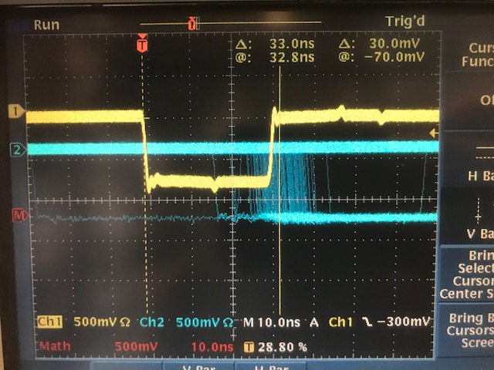
S2_L & S0_B
RHRS
S2 Logic Unit
S2 PMT
delay
75 ns
1 ns
L
1 ns
S2_L
Level translator
S2 coinc
R
16 ns
COSMICS
S0 PMT
delay
S0B disc
25 ns
S0_B
57 ns
Amplifier
S0 coinc
S0A disc
10 ns
9 ns
(S0_B PMT delay) + 57 + 10 + 25 + 8 + TOF - [(S2_L PMT delay) + 75 + 16 + 1 + 8] = 33
(S0_B PMT delay) - (S2_L PMT delay) = - 5 + 33 = 28
* where we assumed TOF = 5 ns
* all numbers in nano-seconds
COSMICS
33 ns
(S0_B PMT delay) - (S2_L PMT delay) = 28 ns

Slide 19
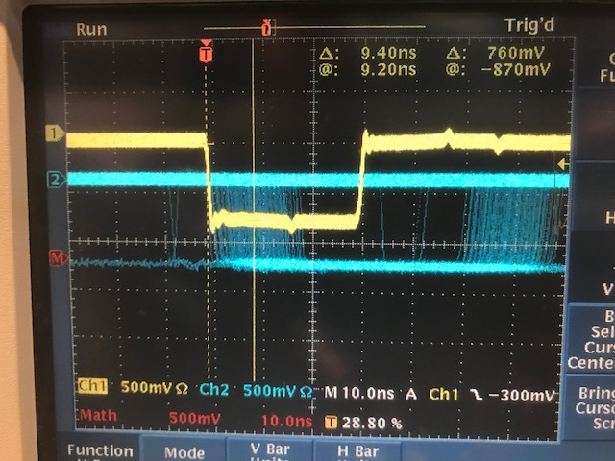
S2_R & S0_B
RHRS
S2 Logic Unit
S2 PMT
delay
75 ns
L
S2_R
Level translator
24 ns
S2 coinc
1 ns
R
16 ns
COSMICS
S0 PMT
delay
S0B disc
25 ns
S0_B
57 ns
Amplifier
S0 coinc
S0A disc
10 ns
9 ns
(S0_B PMT delay) + 57 + 10 + 25 + 8 + TOF - [(S2_R PMT delay) + 75 + 16 + 24 + 8] = 9.4
(S0_B PMT delay) - (S2_R PMT delay) = 9.4 + 18 = 27.4
* where we assumed TOF = 5 ns
* all numbers in nano-seconds
COSMICS
9.4 ns
(S0_B PMT delay) - (S2_R PMT delay) = 27.4 ns

Slide 20
RHRS
(S0_A PMT delay) - (S2_R PMT delay) = 36 ns
(S0_A PMT delay) - (S2_L PMT delay) = 37.2 ns
(S0_B PMT delay) - (S2_L PMT delay) = 28 ns
(S0_B PMT delay) - (S2_R PMT delay) = 27.4 ns
S2_L delay = l₁
S2_R delay = l₁ + 1 ns
S0_A delay = l₁ + 37 ns
S0_B delay = l₁ + 28 ns

Slide 21
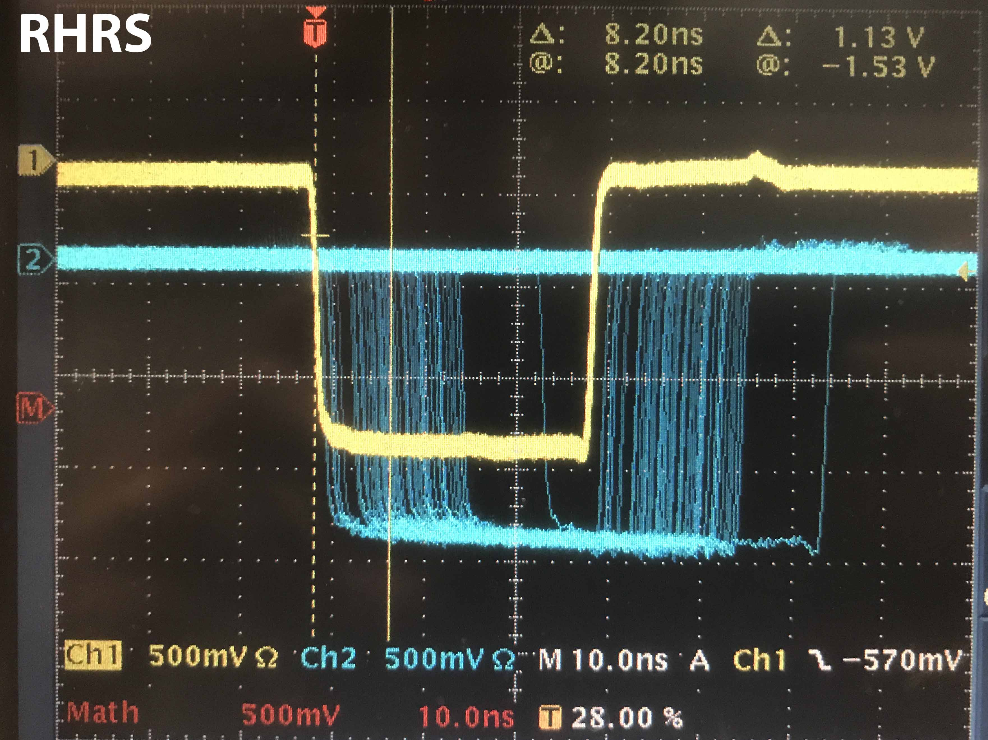
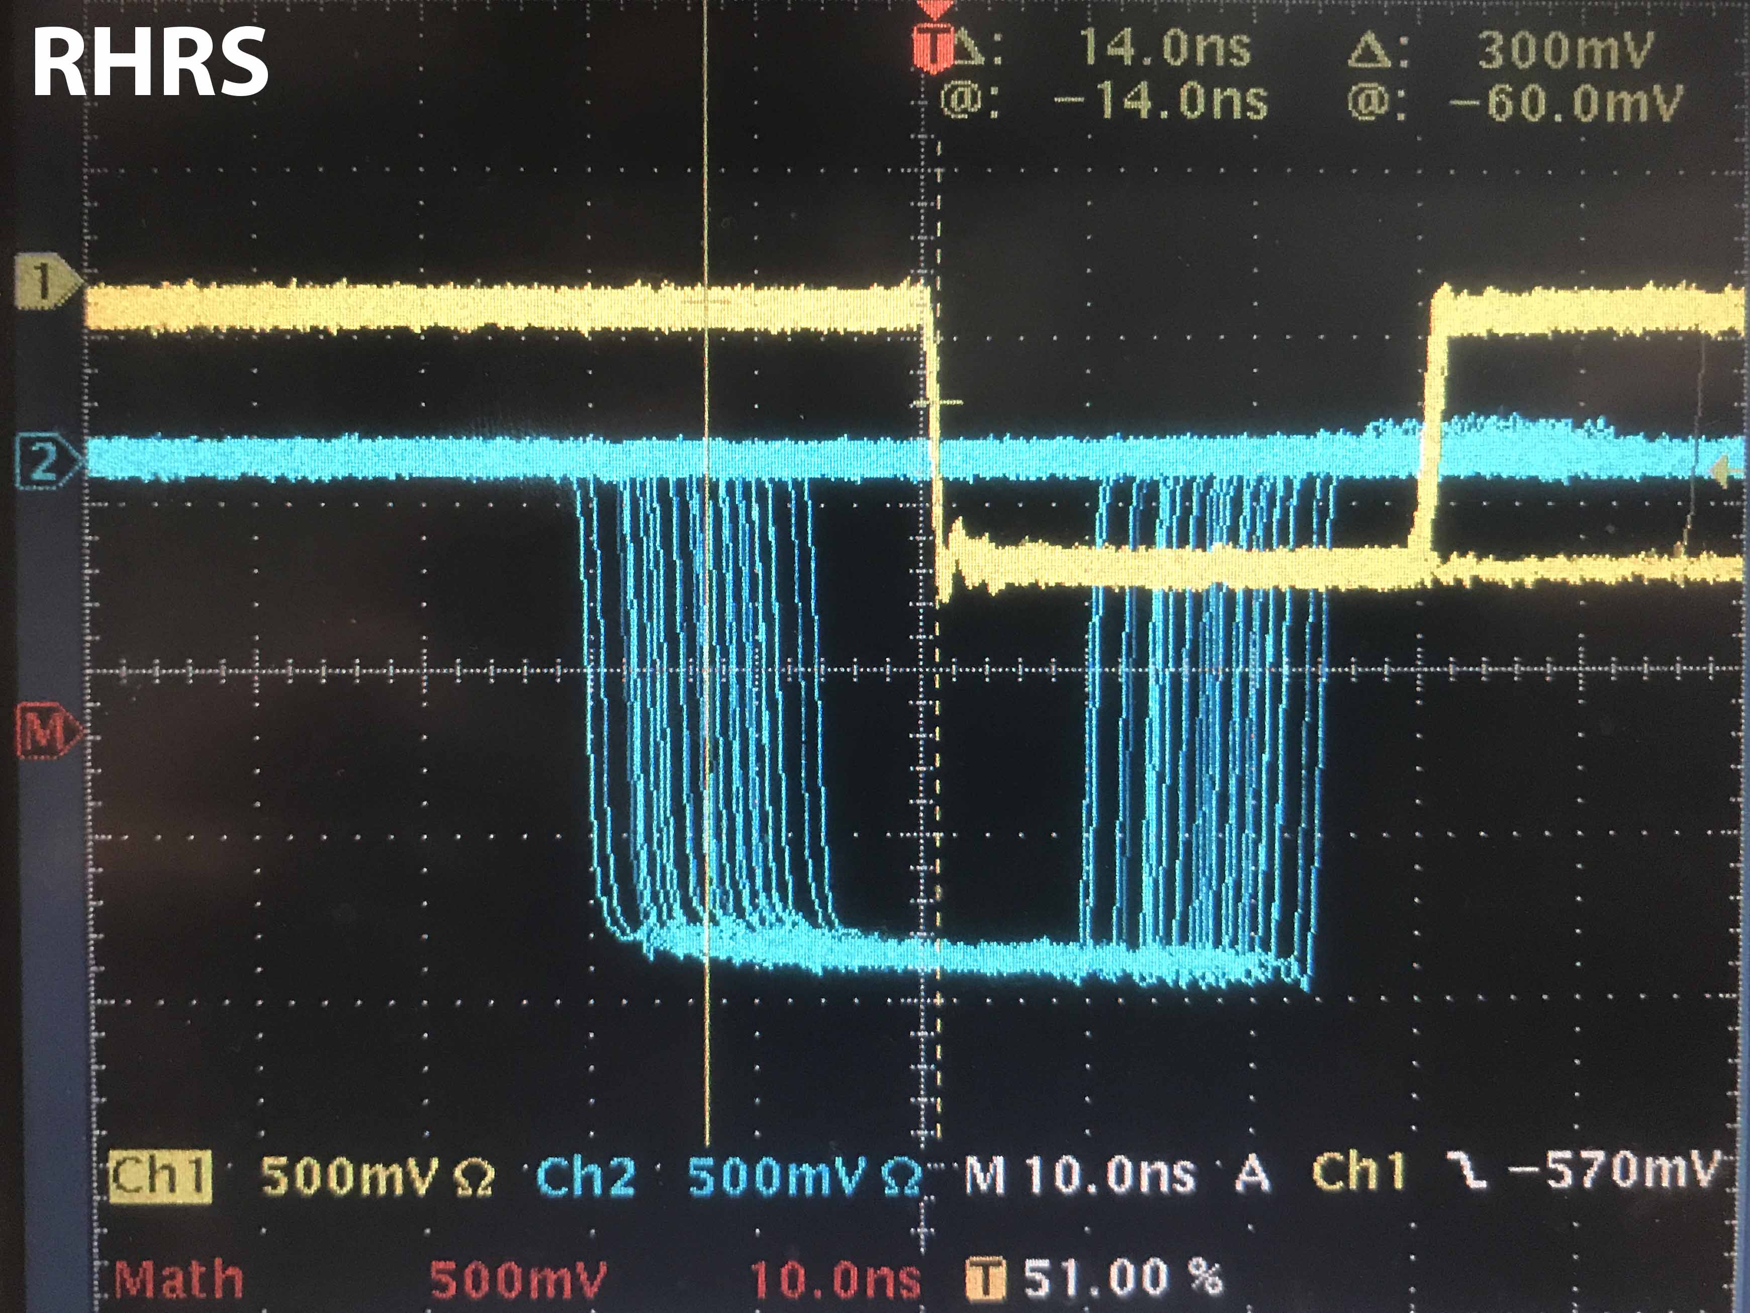
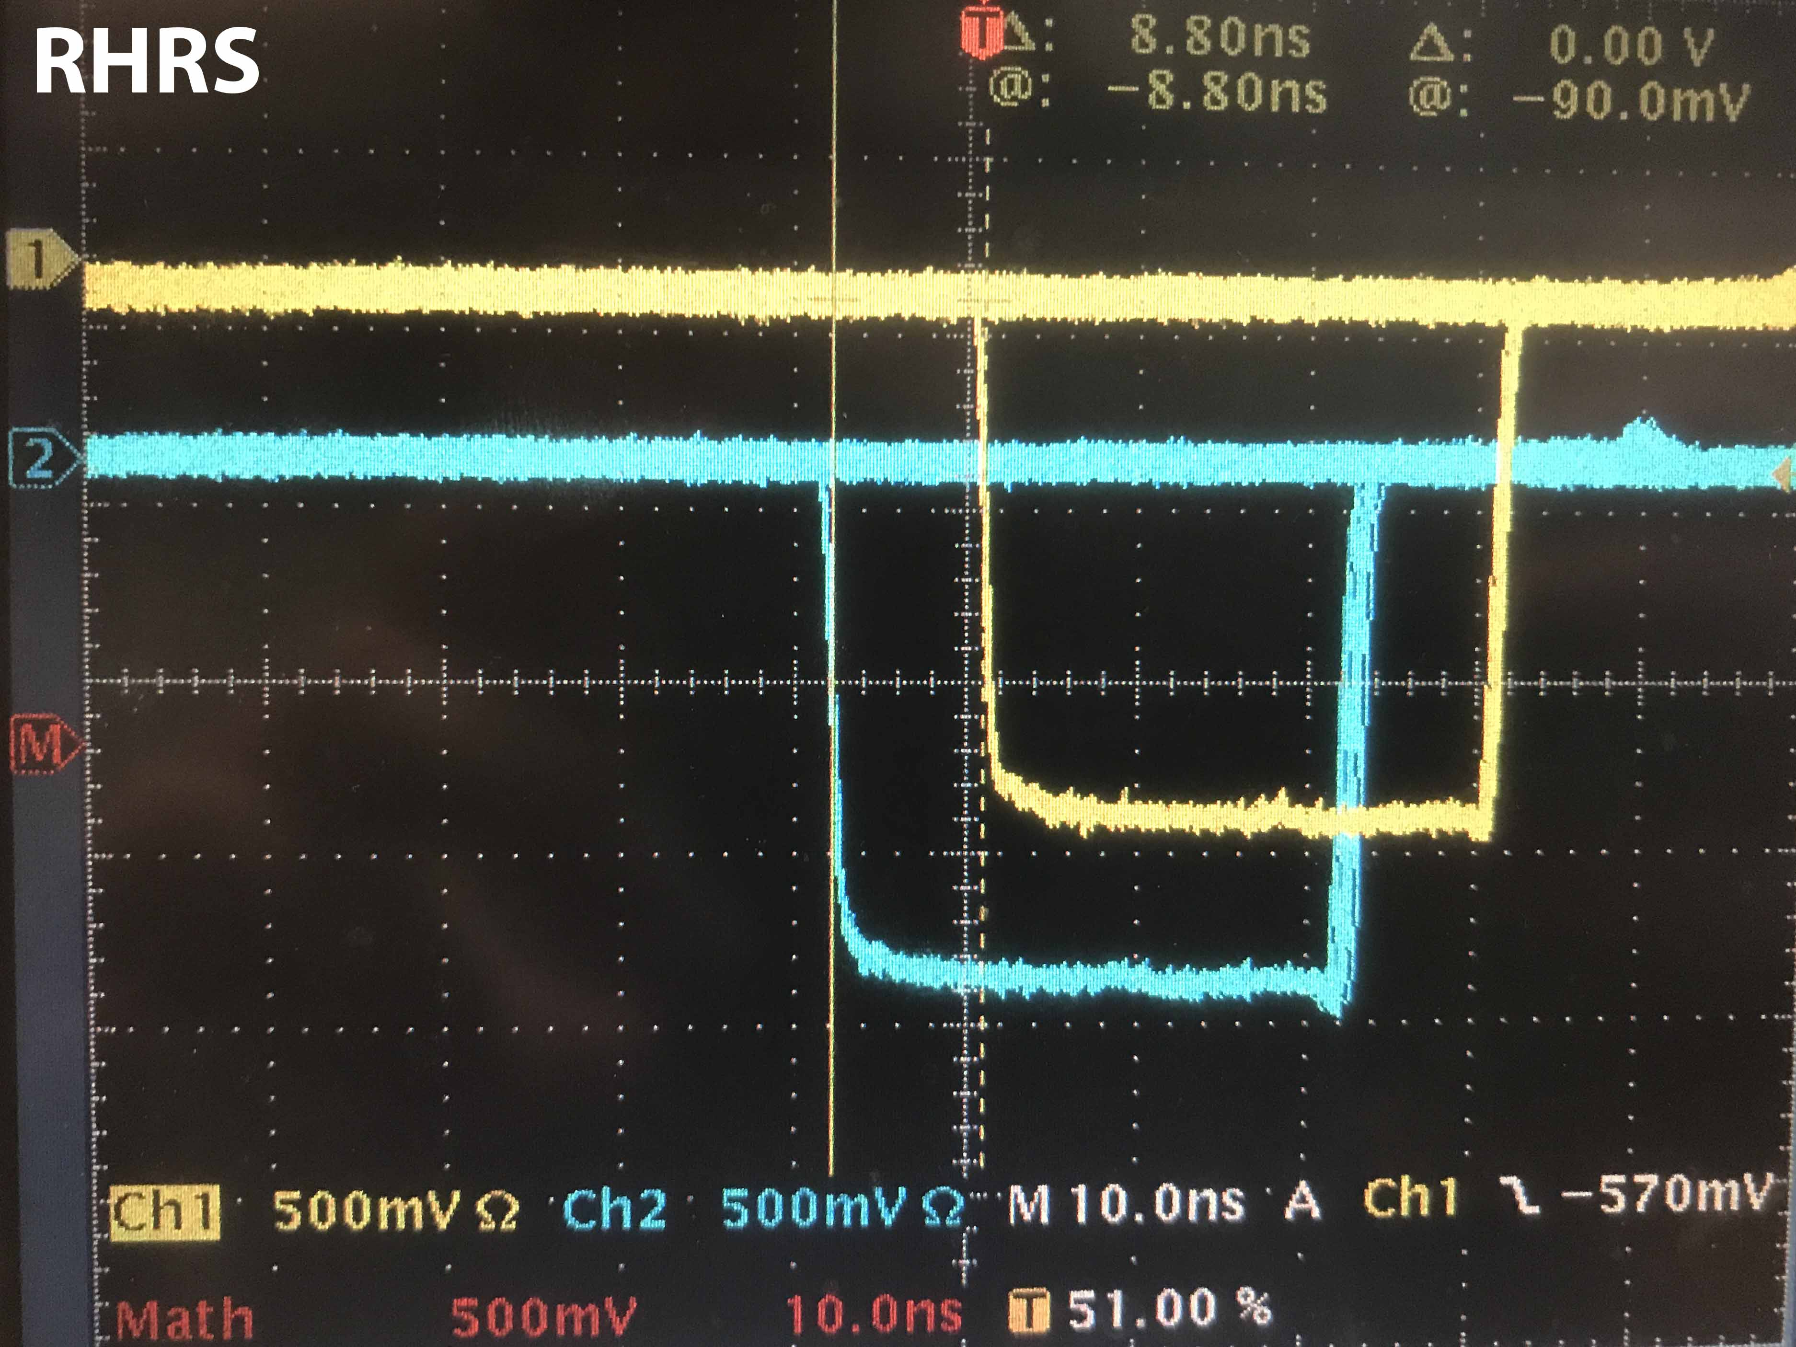
S0||S2
8.20 ns
S0&S2
(S0||S2)&GC
14.0 ns
S0&S2
(S0&S2)&GC
8.80 ns
S0&S2

Slide 22
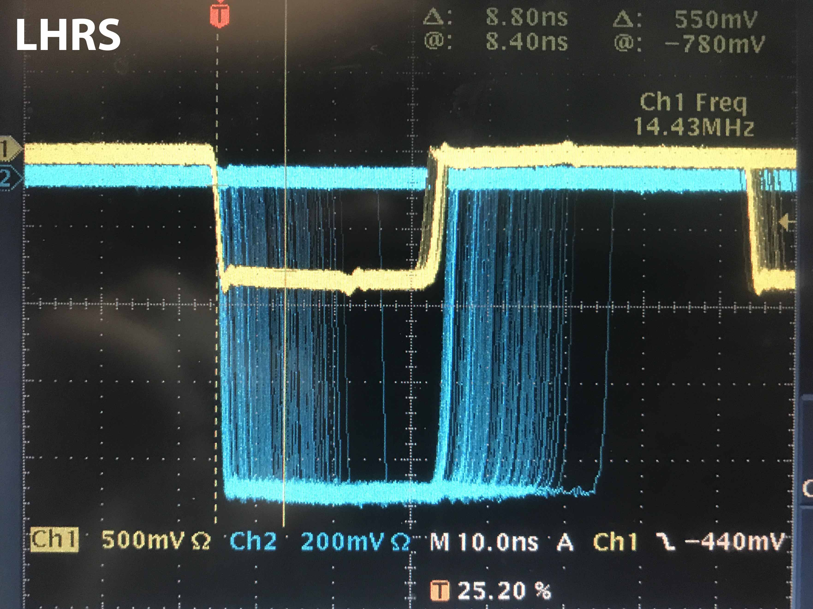
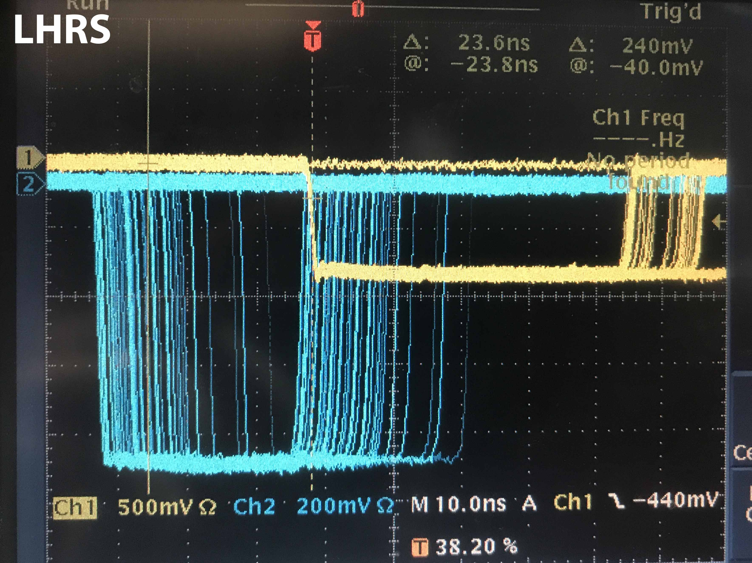
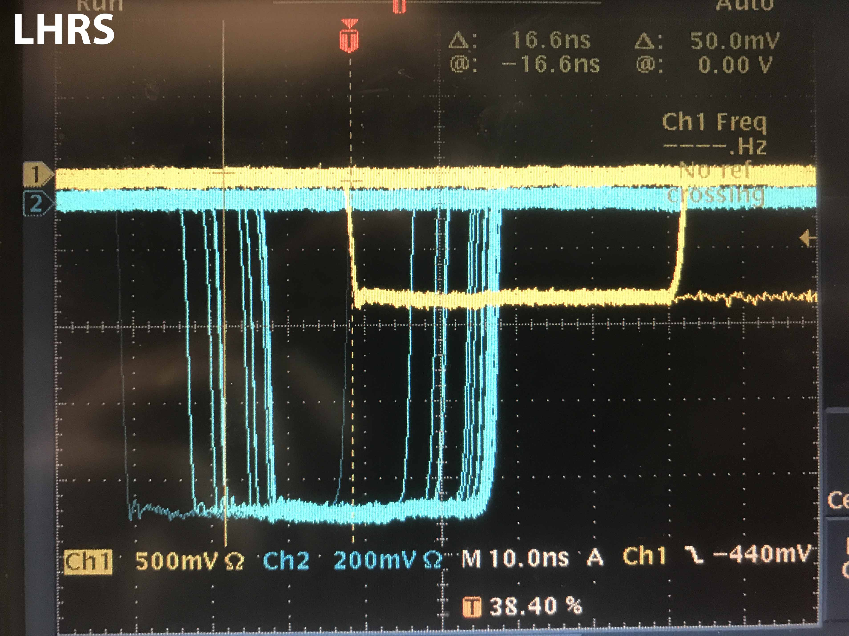
S0||S2
8.80 ns
S0&S2
(S0||S2)&GC
23.6 ns
S0&S2
(S0&S2)&GC
16.6 ns
S0&S2

Slide 23
RHRS
(S0||S2)&GC
S0&S2&GC
S0&S2
S0||S2
8.2 ns
8.8 ns
5.2 ns
LHRS
(S0||S2)&GC
S0&S2&GC
S0&S2
8.8 ns
16.6 ns
7 ns
S0||S2

Slide 24
Fake signal for coincidence trigger

Slide 25
t0+ t_{PMT} + 1ns + 20ns + 5ns+ 75ns
Level
Translator
t0 + t_{PMT} + 5ns + 95ns
Level
Translator
t0 + t_{PMT} + 34ns + 69ns
t0 + t_{PMT} + 28ns+ 20ns + 57ns
Amplifier
Amplifier
95 ns
69 ns
57 ns
75 ns
t_{PMT}
s2R
t_{PMT}+34 ns
t_{PMT}+28 ns
5 ns
t_{PMT}+1 ns
S0
S0
s2L
t0 + 20 ns
s2R
t0
5 ns
LHRS
RHRS

Slide 26
t0+ t_{PMT} + 101ns
Level
Translator
t0 + t_{PMT} + 100ns
Level
Translator
t0 + t_{PMT} + 103ns
t0 + t_{PMT} + 105ns
Amplifier
Amplifier
95 ns
69 ns
57 ns
75 ns
t_{PMT}
s2R
t_{PMT}+34 ns
t_{PMT}+28 ns
5 ns
t_{PMT}+1 ns
S0
S0
s2L
t0 + 20 ns
s2R
t0
5 ns
LHRS
RHRS

Slide 27
t1 = t0 + t_{PMT} + 100
t1+1ns
Level
Translator
t1
Level
Translator
t1+3ns
t1+5ns
Amplifier
Amplifier
s2R
S0
S0
s2R
LHRS
RHRS

Slide 28
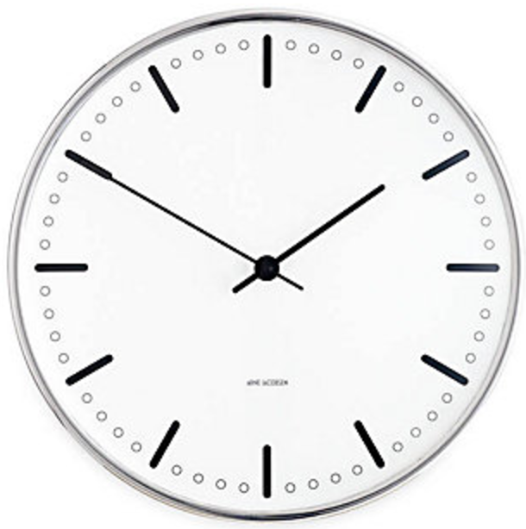
Level
Translator
Level
Translator
Amplifier
Amplifier
t1
t1+3ns
t1 + 5ns
t1 + 1ns
s2R
S0
S0
s2R
FIFO
FIFO
10 ns
10 ns
8 ns
8 ns
222 ns delay
222 ns
Clock on the LHRS
LHRS
RHRS

Slide 29
input to S2_L&R coinc
input to S2_L&R coinc
input to S0 coinc
input to S0 coinc
1ns
26ns
25ns
24ns
S2_R coinc module
Disc module
Disc module
S2_R coinc module
15.8ns
15.4ns
18ns
16ns
Level
Translator
Amplifier
Amplifier
Level
Translator
t1
t1+3ns
t1 + 5ns
t1 + 1ns
s2R
S0A
S0
s2R
FIFO
FIFO
10 ns
10 ns
8 ns
8 ns
222 ns delay
222 ns
Clock on the LHRS
LHRS
RHRS

Slide 30
input to S2_L&R coinc
input to S2_L&R coinc
input to S0 coinc
input to S0 coinc
t2 = t1+16.8ns
t1 + 16.8ns
t1 + 44.4ns
t1 + 48.0ns
t1 + 41ns
s2R
S0A
S0
s2R
FIFO
FIFO
10 ns
10 ns
8 ns
8 ns
222 ns delay
222 ns
Clock on the LHRS
LHRS
RHRS

Slide 31
input to S2_L&R coinc
input to S2_L&R coinc
input to S0 coinc
input to S0 coinc
t2 = t1+16.8ns
t2
t2 + 27ns
t2 + 31ns
t2 + 24ns
s2R
S0A
S0
s2R
FIFO
FIFO
10 ns
10 ns
8 ns
8 ns
222 ns delay
222 ns
Clock on the LHRS
LHRS
RHRS

Slide 32
input to S2_L&R coinc
input to S2_L&R coinc
input to S0 coinc
input to S0 coinc
t2 = t1+16.8ns
Use t2 = 8 ns
8ns
35ns
39ns
32ns
s2R
S0A
S0
s2R
FIFO
FIFO
10 ns
10 ns
8 ns
8 ns
222 ns delay
222 ns
Clock on the LHRS
LHRS
RHRS

Slide 33
Single arm triggers with fake signal

Slide 34
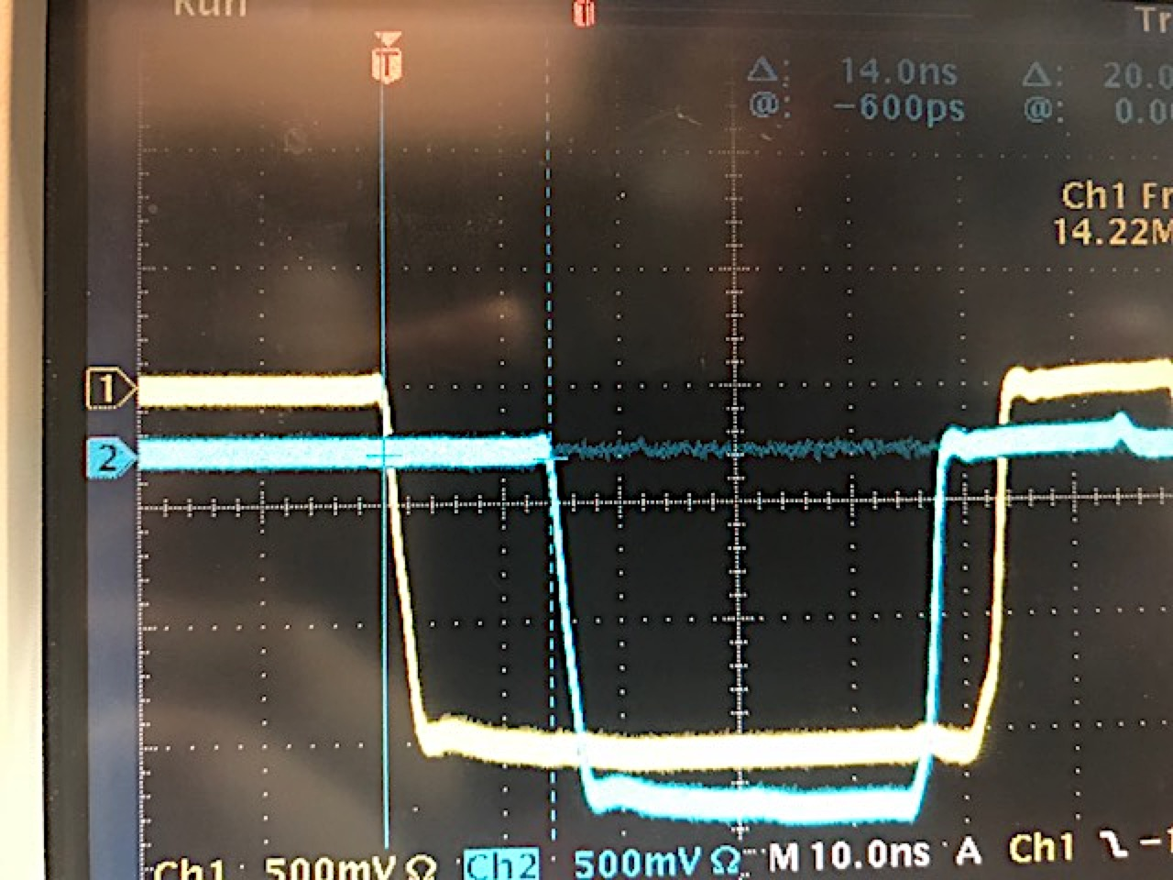
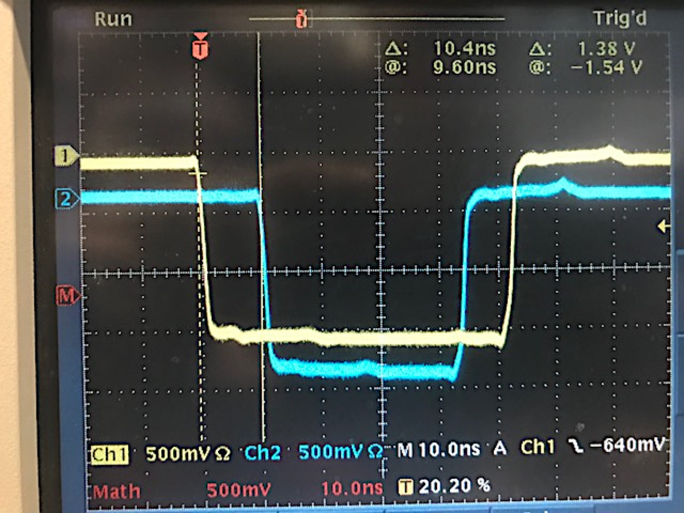
LHRS
RHRS
S0
14 ns
10.4 ns

Slide 35
Coincidence trigger with fake signal

Slide 36
Coincidence triggers
LHRS signals on RHRS
(S0&S2)&GC
(S0||S2)&GC
S0&S2 (T1)
≈220ns
A
Disc
≈50ns
delay
delay
TS
LHRS
B
Disc
NIM
ECL
delay
C
delay
Disc
FIFO
delay
delay
Delay Gen.
(>200ns)
(S0&S2)_{L}
&S0_{R}
S0_{R}
T1
S0 FIFO
60ns (e’p)
60ns
20ns (e’d)
RHRS
Delay Gen.
(>200ns)
(S0&S2)_{L}
&S2_{R}
S2 FIFO
150ns
S2_{R}
T1
Delay Gen.
(>200ns)
(S0&S2)_{L}
&(S0&S2)_{R}
60ns (e’p)
60ns
S0&S2 coinc
20ns (e’d)
150ns
(S0&S2)_{R}
T1
All coincidence trigger timed on T1 which
corresponds to S2_{LHRS}
-> all trigger but (S0||S2)&GC_{LHRS} timed on S2_{LHRS}
(S0||S2)&GC_{LHRS} timed on S0_{LHRS} if S0 fires
60ns (e’p)
60ns
20ns (e’d)
150ns

Slide 37
LHRS
10 ns delay (09/26/17)
S2 Logic Unit
S2 coinc
FIFO
Delay
20 ns
Delay
10 ns
8 ns
0.5 ns
10 ns
S0
1 ns
1 ns
(S0&S2)
S2
77.5 ns
RHRS
S0 coinc
17 ns
S2 Logic Unit
S2 coinc
FIFO
Delay
20 ns
8 ns
8 ns
S0
1 ns
1 ns
(S0&S2)
S2
61 ns

Slide 38
LHRS
10 ns delay (09/26/17)
S2 Logic Unit
S2 coinc
FIFO
Delay
20 ns
Delay
10 ns
8 ns
0.5 ns
10 ns
S0
1 ns
(S0&S2)
8 + 222 ns
S2
1 ns
307.5 ns
RHRS
S0 coinc
17 ns
S2 Logic Unit
S2 coinc
FIFO
Delay
20 ns
8 ns
8 ns
S0
1 ns
1 ns
(S0&S2)
S2
61 ns

Slide 39
LHRS
10 ns delay (09/26/17)
S2 Logic Unit
t3
S2 coinc
FIFO
Delay
20 ns
Delay
10 ns
8 ns
0.5 ns
10 ns
S0
1 ns
(S0&S2)
8 + 222 ns
S2
1 ns
t3 + 307.5 ns
RHRS
t3 + 31 ns
S0 coinc
17 ns
S2 Logic Unit
t3 + 24 ns
S2 coinc
FIFO
Delay
20 ns
8 ns
8 ns
S0
1 ns
1 ns
(S0&S2)
S2
t3 + 85 ns

Slide 40
LHRS
S2 Logic Unit
Patch pannel on RHRS
t3
T1
Coinc unit for coinc trigger
Disc
FIFO
8 ns
3 ns
2 ns
t3 + 307.5 ns
Delay Generator
RHRS
t3 + 31 ns
S0 coinc
17 ns
1 ns
1 ns
1 ns
S2 Logic Unit
t3 + 24 ns
S2 coinc
FIFO
Delay
20 ns
8 ns
8 ns
S0
1 ns
1 ns
(S0&S2)
S2
t3 + 85 ns

Slide 41
LHRS
T1 – S0_{R} = T1 – S2_{R} = T1 – (S0&S2)_{R} = 60 ns
S2 Logic Unit
t3 + 336.5 ns
Patch pannel on RHRS
t3
T1
Coinc unit for coinc trigger
Disc
FIFO
8 ns
3 ns
2 ns
t3 + 307.5 ns
0.5 ns
0.5 ns
0.5 ns
Disc
0.5 ns
0.5 ns
0.5 ns
Delay Generator
x x x
RHRS
t3 + 31 ns
S0 coinc
17 ns
t3+77ns
t3+65ns
t3+86ns
S2 Logic Unit
t3 + 24 ns
S2 coinc
FIFO
Delay
20 ns
8 ns
8 ns
S0
1 ns
1 ns
(S0&S2)
S2
t3 + 85 ns

Slide 42
Prediction for the delays on RHRS for coinc trigger
Need to set delay in RHRS delay generator for S2 (RHRS) to:
t3 + 336.5 – (t3 + 77 + x + 0.5 + 8 + 0.5) ns = 60 ns
x = 190.5 ns
Need to set delay in RHRS delay generator for S0 (RHRS) to:
t3 + 336.5 – (t3 + 65 + x + 0.5 + 8 + 0.5) ns = 60 ns
x = 202.5 ns
Need to set delay in RHRS delay generator for S0&S2 (RHRS) to:
t3 + 336.5 – (t3 + 86 + x + 0.5 + 8 + 0.5) ns = 60 ns
x = 181.5 ns

Slide 43
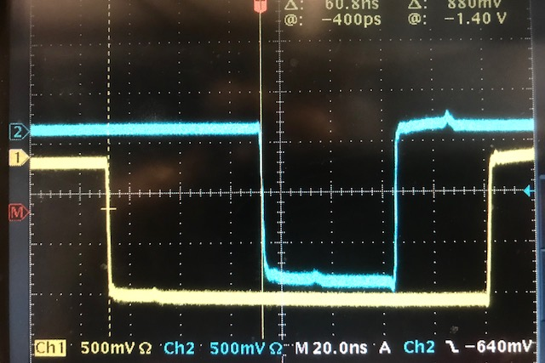
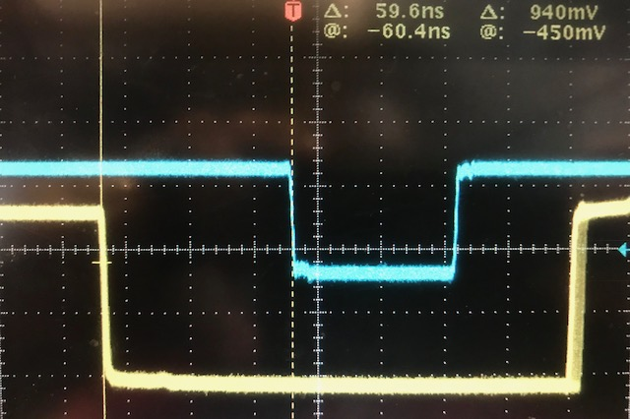
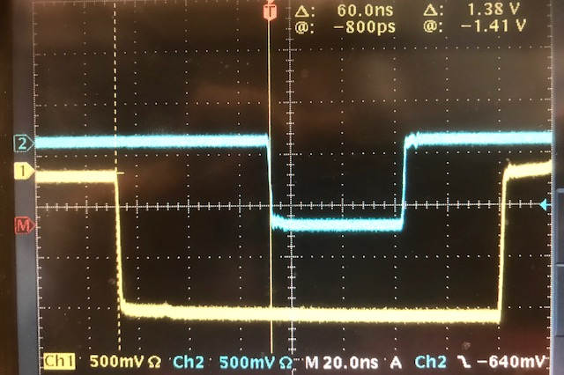
Coincidence triggers
150 ns
(S0&S2)_{R}
T1
T1
C1:
C2:
C3:
60ns (e’p)
60ns
20ns (e’d)
60 ns
150ns
(S0&S2)_{R}
S2_{R}
T1
150 ns
T1
60ns (e’p)
60ns
20ns (e’d)
60 ns
S2_{R}
150ns
S0_{R}
150 ns
T1
T1
60ns (e’p)
60ns
20ns (e’d)
60 ns
S0_{R}
150ns

Slide 44
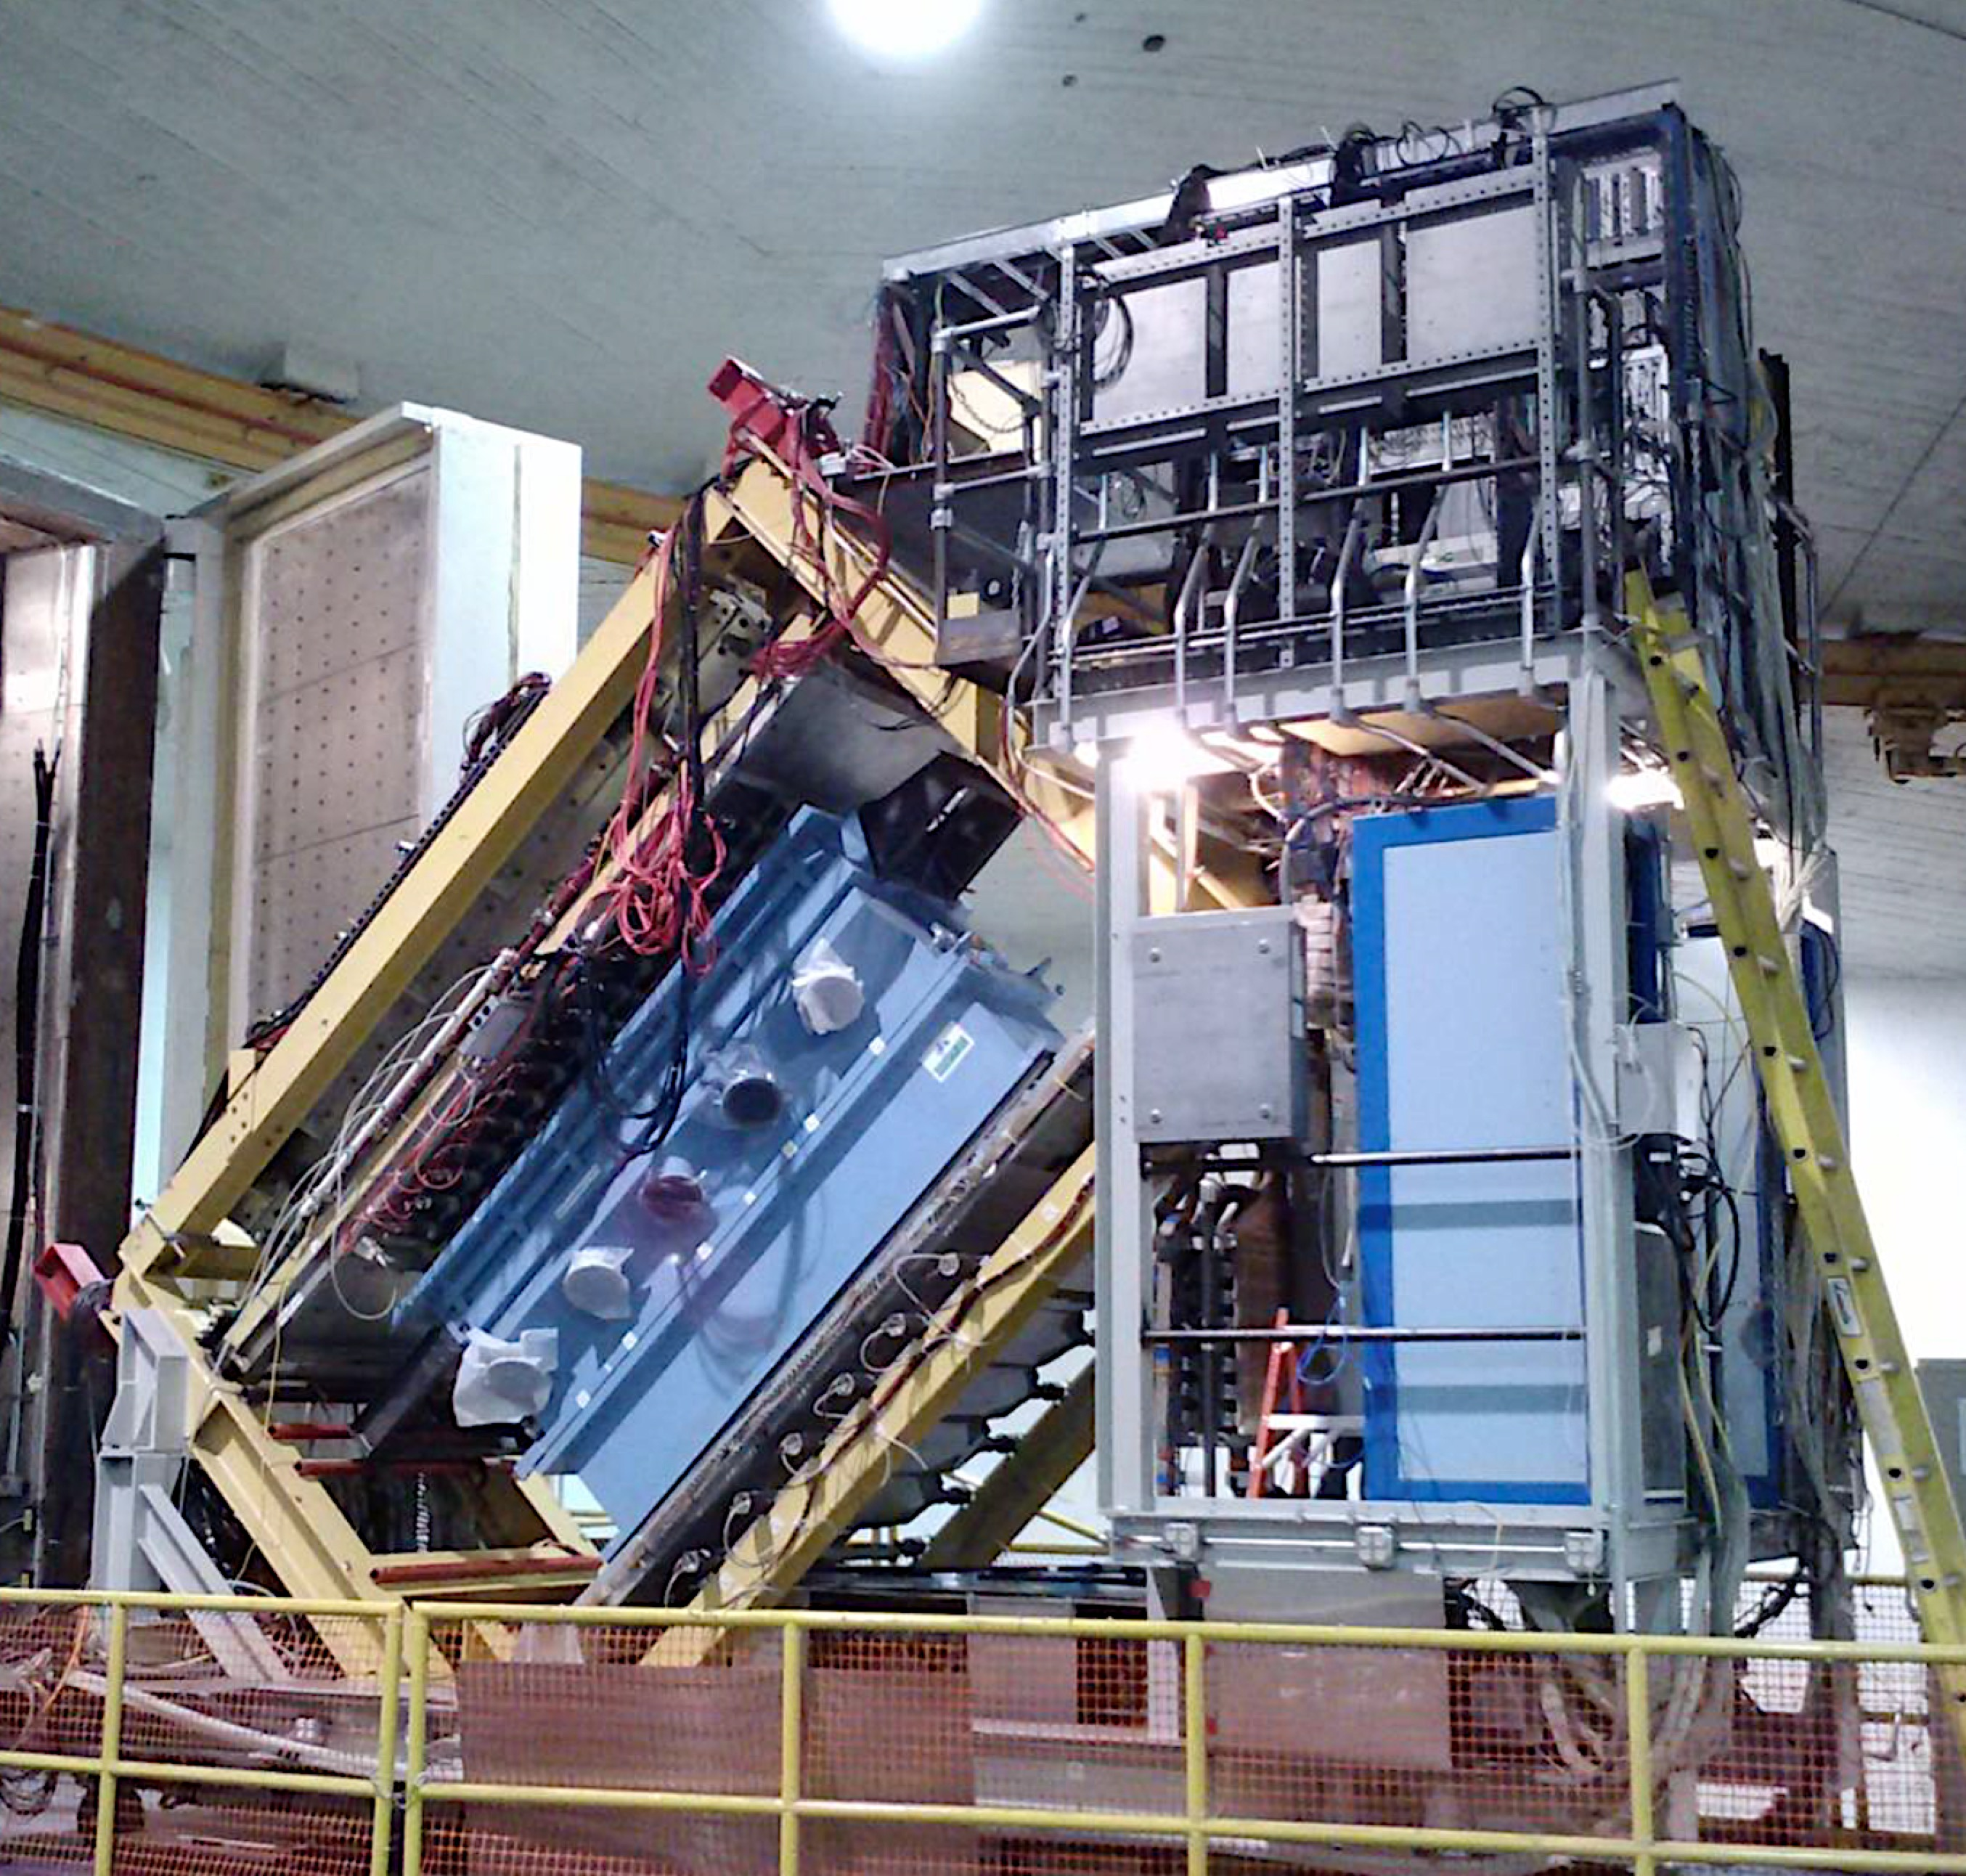
HRS Detector Configuration
S0 S2
Lead-Glass Calorimeter
Gas Cherenkov
Straw Chamber
VDC

Slide 45
S0 and S2
1
2
3
4
5
6
7
8
9
10
11
12
13
14
15
16
S0
up
S0 S2
S2 Left
S2 Right
S0 down

Slide 46
S0
Amplifier
S0
downstairs upstairs
Scintillator
PMT

Slide 47
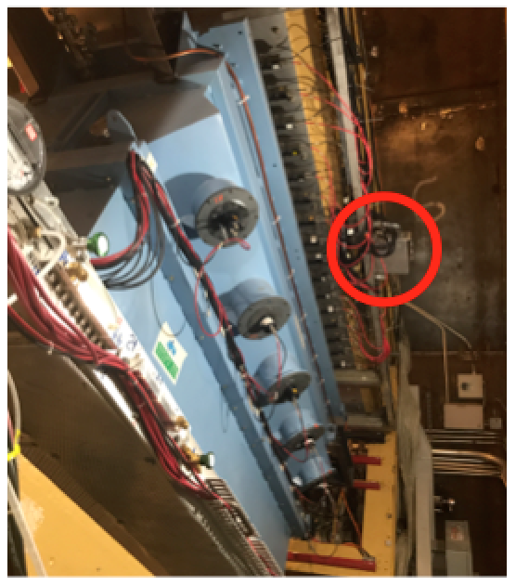
S2
Mixer/Splitter
+ Disc
Level Translator
fadc
S0 S2
downstairs upstairs
Discriminator
Mixer/Splitter
Scintillator
PMT

Slide 48
Junk

Slide 49
t0 + 70ns
* We were originally setting up the fake signal for coinc trigger this way (we forgot to include the pmt delays)
t0 + 100ns
Level
Translator
Level
Translator
t0 + 100ns
t0 + 100ns
Level
Translator
t0 + 69ns
t0 + 77ns
Level
Translator
Amplifier
Amplifier
65 ns
95 ns
69 ns
57 ns
75 ns
75 ns
s2R
s2L
5 ns
S0
S0
s2L
t0 + 20 ns
s2R
t0
5 ns
LHRS
RHRS

Slide 50
t1 + 1ns
* We were originally setting up the fake signal for coinc trigger this way (we forgot to include the pmt delays)
t1 + 31ns
Level
Translator
Level
Translator
t1 + 31ns
t1 + 31ns
Level
Translator
t1
t1 = t0 + 69ns
t1 + 8ns
Level
Translator
Amplifier
Amplifier
s2L
s2R
S0
S0
s2L
s2R
LHRS
RHRS

Slide 51
* We were originally setting up the fake signal for coinc trigger this way (we forgot to include the pmt delays)
Level
Translator
Level
Translator
Level
Translator
Level
Translator
Amplifier
Amplifier
t1 + 1ns
t1 + 31ns
t1
t1 + 8ns
t1 + 31ns
t1 + 31ns
s2L
s2R
S0
S0
s2L
s2R
FIFO
FIFO
15 ns
15 ns
8 ns
8 ns
222 ns delay
222 ns
Clock on the LHRS
LHRS
RHRS

Slide 52
* We were originally setting up the fake signal for coinc trigger this way (we forgot to include the pmt delays)
input to S2_L&R coinc
input to S2_L&R coinc
input to S0 coinc
input to S0 coinc
1ns
26ns
25ns
24ns
S2_R coinc module
Disc module
Disc module
S2_R coinc module
15.8ns
15.4ns
18ns
16ns
Level
Translator
Amplifier
Amplifier
Level
Translator
t1 + 31ns
t1
t1 + 8ns
t1 + 31ns
s2R
S0A
S0
s2R
FIFO
FIFO
15 ns
15 ns
8 ns
8 ns
222 ns delay
222 ns
Clock on the LHRS
LHRS
RHRS

Slide 53
* We were originally setting up the fake signal for coinc trigger this way (we forgot to include the pmt delays)
input to S2_L&R coinc
input to S2_L&R coinc
input to S0 coinc
input to S0 coinc
t2 = t1+41ns
t2 + 7ns
t2
t2 + 10ns
t2 + 30ns
s2R
S0A
S0
s2R
FIFO
FIFO
15 ns
15 ns
8 ns
8 ns
222 ns delay
222 ns
Clock on the LHRS
LHRS
RHRS

Slide 54
* We were originally setting up the fake signal for coinc trigger this way (we forgot to include the pmt delays)
input to S2_L&R coinc
input to S2_L&R coinc
input to S0 coinc
input to S0 coinc
t2 = t1+41ns
use: t2 = 8ns
15ns
8ns
18ns
38ns
s2R
S0A
S0B
s2R
FIFO
FIFO
15 ns
15 ns
8 ns
8 ns
222 ns delay
222 ns
Clock on the LHRS
LHRS
RHRS

