Slide 1
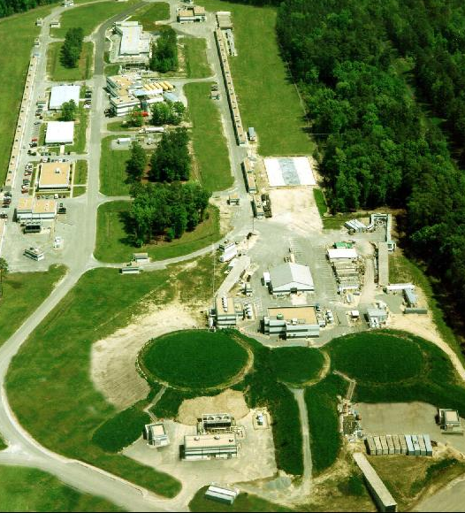
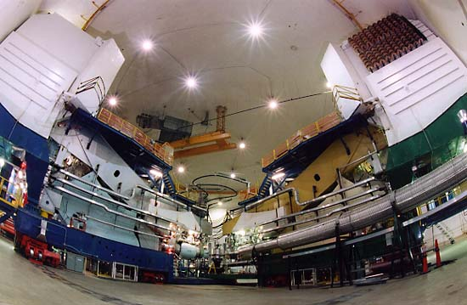
High Precision Measurement of the Proton Elastic Form Factor Ratio at Low Q²
Hall A Collaboration Meeting Dec. 15, 2009
Xiaohui Zhan (MIT)
Introduction
E08-007
Analysis Status
Preliminary Results
Summary

Slide 2
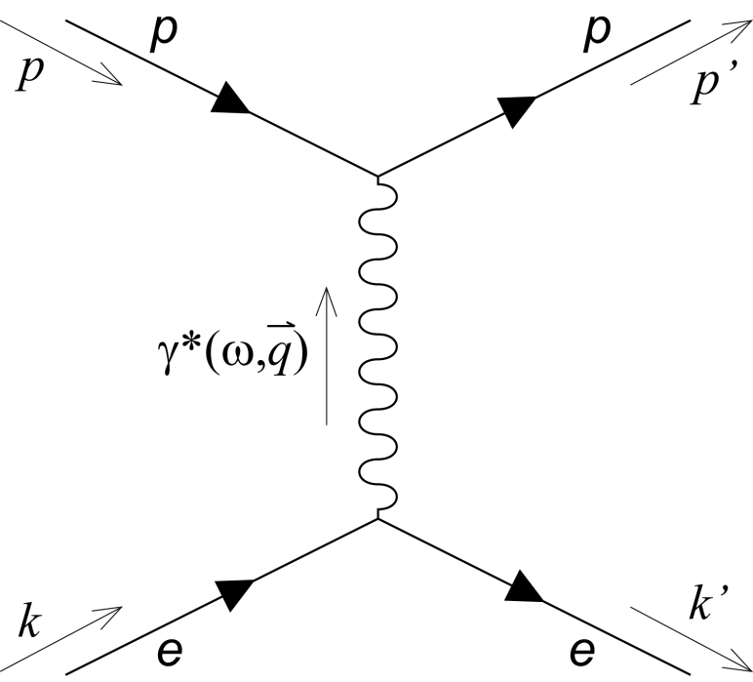
Electron Elastic Scattering Formalism
Typically treated in one-photon-exchange picture, from QED, lowest-order amplitude is given by:
Dirac and Pauli form factors: F₁ , F₂
Cross section:
single photon exchange
(Born approximation)
Notes:
How electron nucleon scattering access the nucleon structure? For EES, the interaction is typically treated in OPE due to the smallness of the fine structure constant, and the amplitude is given as the following. While the leptonic part of the vertex is well understood in QED, the most general form for the hadronic current for a spin ½ nucleon with internal structure can be expressed, satisfying relativistic invariance and current parity conservation. F1 and F2 which are only as a function of Q2.
Follow the introduction above, we can write down the differential cross section for ep elastic scattering.

Slide 3
Sachs Form Factors
Linear combination of F₁ and F₂, Fourier transform of the charge (magnetization) densities in the Breit frame at non relativistic limit.
Electric:
Magnetic:
Early experiments found ~ dipole form (Q² < 2 GeV²), naively corresponds to a exponential shape in space.
Normalized to static properties at Q²=0 Limit
Notes:
To be more physical intuitive, the Sachs form factors are defined as the linear combination of F1 and F2. At small momentum transfer, one can interpret them as the Fourier transforms of the nucleon charge and magnetization densities in space. And we can rewrite the XS as a function of the linear combination of Ge and Gm.

Slide 4
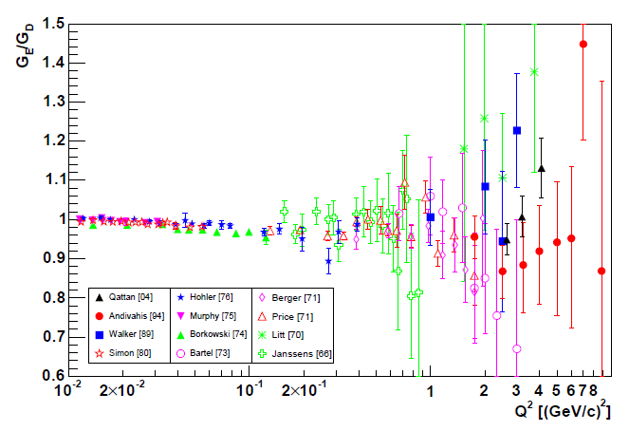
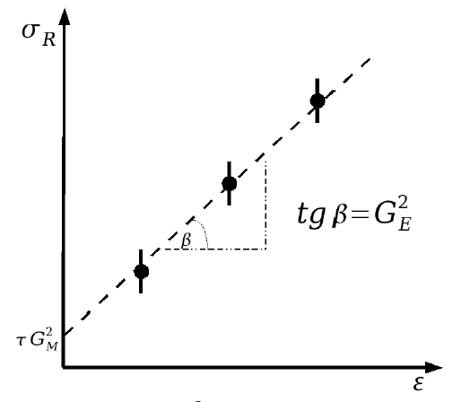
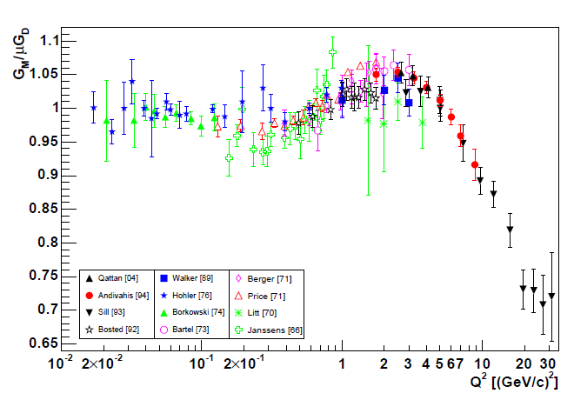
Rosenbluth Separation
No interference between G_{E} and G_{M}
Method: Vary ε at fixed Q², fit σ_{R}, linearly
Slope G²_{E}
Intercept G²_{M}
σ is not sensitive to G_{E} at large Q² and to G_{M} at small Q²
Limited by accuracy of cross section measurement at
different settings.
Radiative correction 10-30%, 2-γ exchange (ε dependent).
Difficulties:

Slide 5
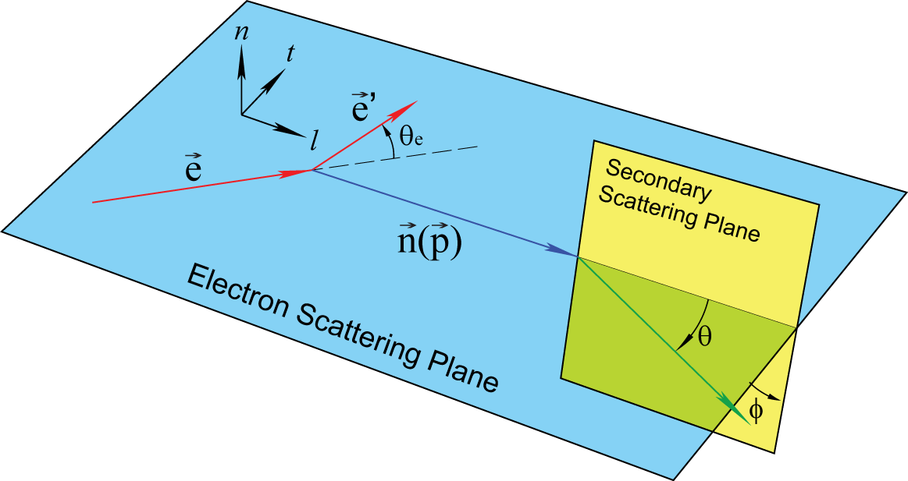
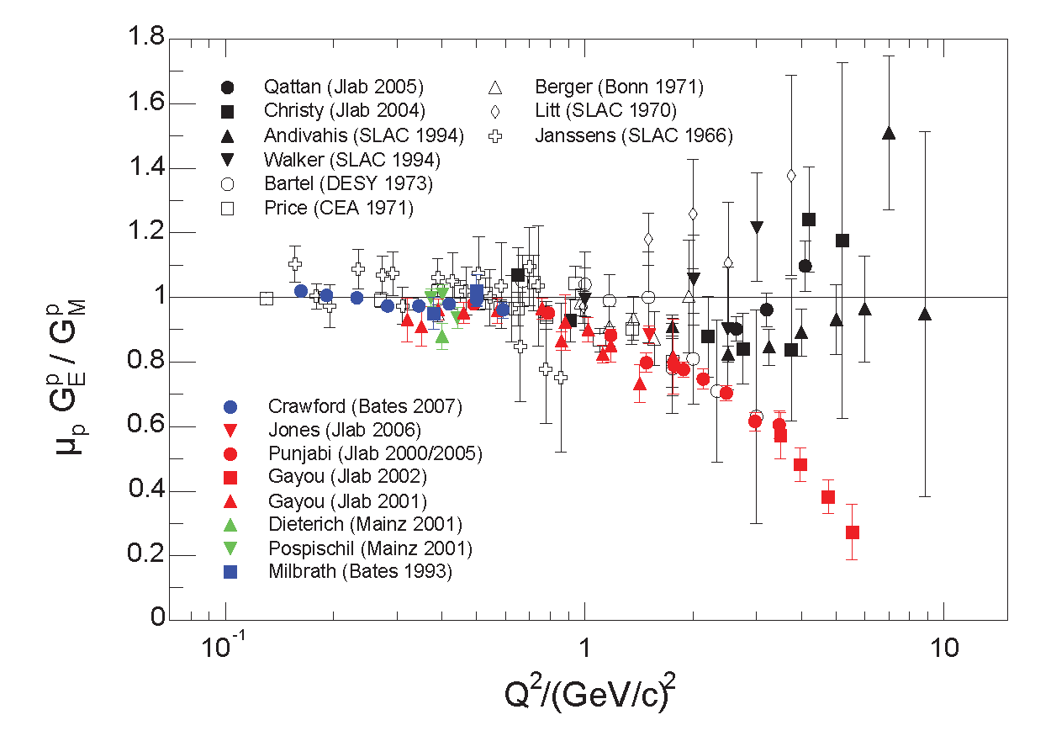
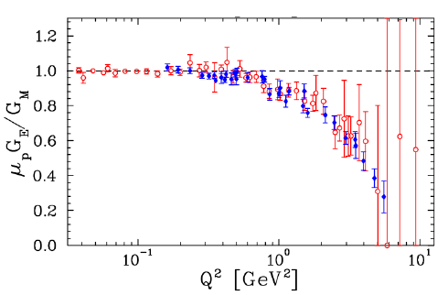
Recoil Polarimetry
Direct measurement of form factor ratios by measuring the ratio of the transferred polarization P_{t} and P_{l} .
Advantages:
Only one measurement is needed for each Q².
Much better precision than a cross section measurement.
Complementary to XS measurements.
Famous discrepancy between Rosenbluth and polarized measurement, mostly explained by 2-γ exchange.
(J. Arrington, et al., Phys. Rev. C 76 035205 (2007))
Notes:
A practical way to measure a small quantity at the presence of the large quantity is by measuring the interference between them. And the polarization observables provide such information.

Slide 6
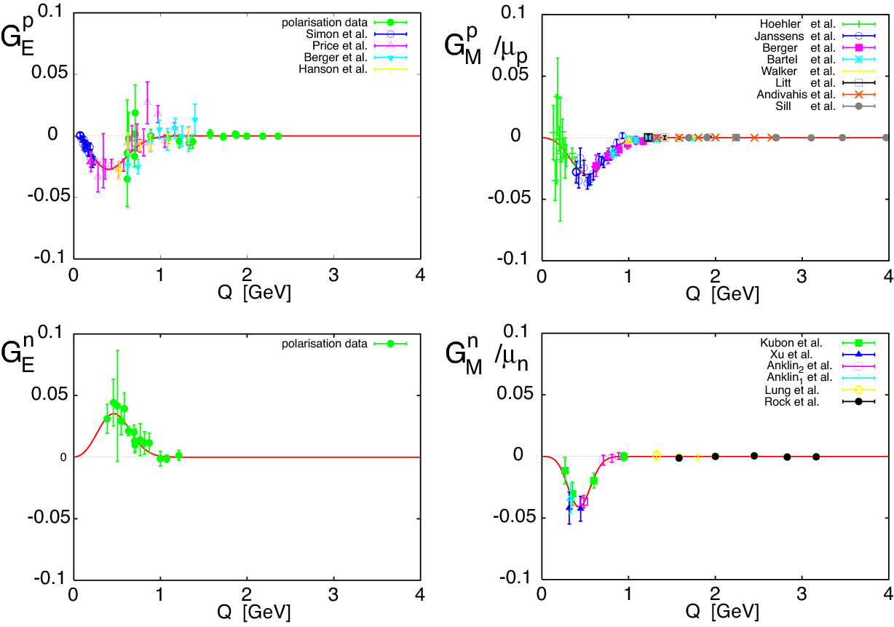
Why Low Q² ?
Low Q² could minimize the relativistic effect in the interpretation, more closely related to our intuitive picture.
Tests of various models:
VMD, LFCQM, Diquark…
2003 – Fit by Friedrich & Walcher Eur. Phys. J. A17, 607 (2003):
  Smooth dipole form + “bump & dip”
  All four FFs exhibit similar structure at small momentum transfer.
  Proposed interpretation: effect of pion cloud.
At non-relativistic limit:
Notes:
Coincides with the old idea accounting for the chiral symmetry in quark bag models of the nucleon and has been used for many years.

Slide 7
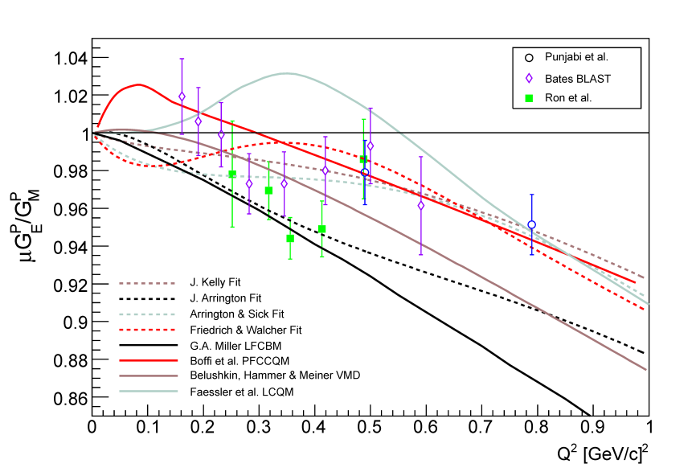
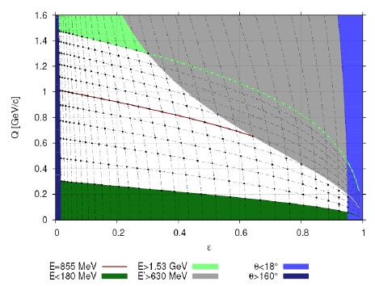
Proton FFs at Low Q²
Bates BLAST result consistent with 1.
Crawford et al., Phys. Rev. Lett 98 052301 (2007)
Substantial deviation from unity is observed in LEDEX (Ron et al.).
Inconsistent with F&W fit.
Tests for various models at low Q^{2.}
Led to this new dedicated experiment E08-007.
Complementary to the high precision XS measurement at Mainz.
Improved EMFFs:
  strange form factors through PV
  proton Zemach radius and hydrogen hyperfine splitting
A^{PV} + G_{E,M}^{p,nγ} + G_{A}^{pZ} (calculated) --> G_{E,M}^{s}

Slide 8
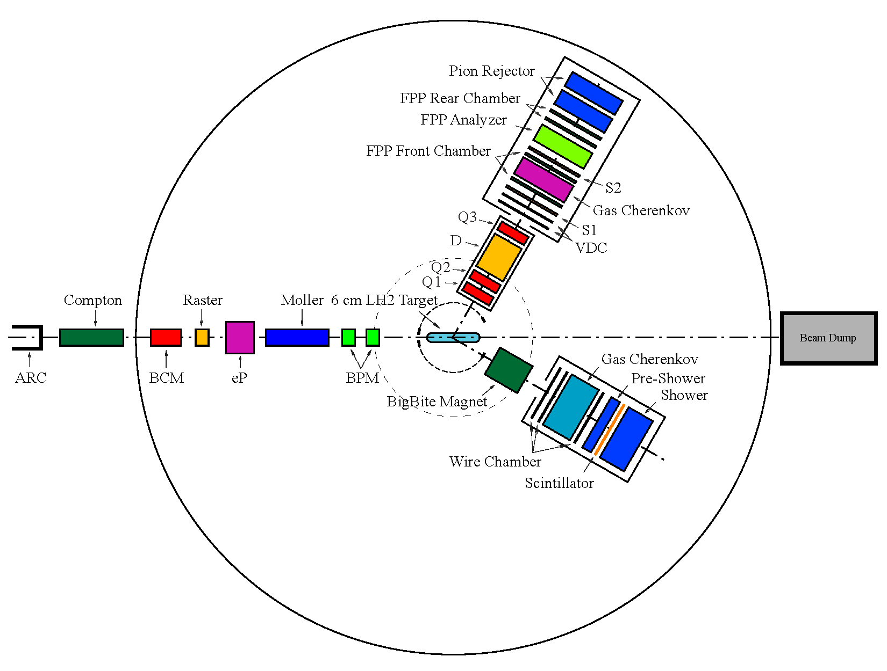
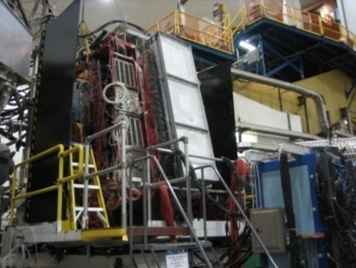
Experimental Setup
LHRS
Δp/p0: ± 4.5% ,
out-of-plane: ± 60 mrad
in-plane: ± 30 mrad
ΔΩ: 6.7msr
QQDQ
Dipole bending angle 45º
VDC+FPP
P_{p} : 0.55 ~ 0.93 GeV/c
BigBite
E_{e}: 1.192GeV
Polarization:
~ 83%
Dipole
Δp: 200-900MeV
ΔΩ: 96msr
PS + Scint. + SH

Slide 9
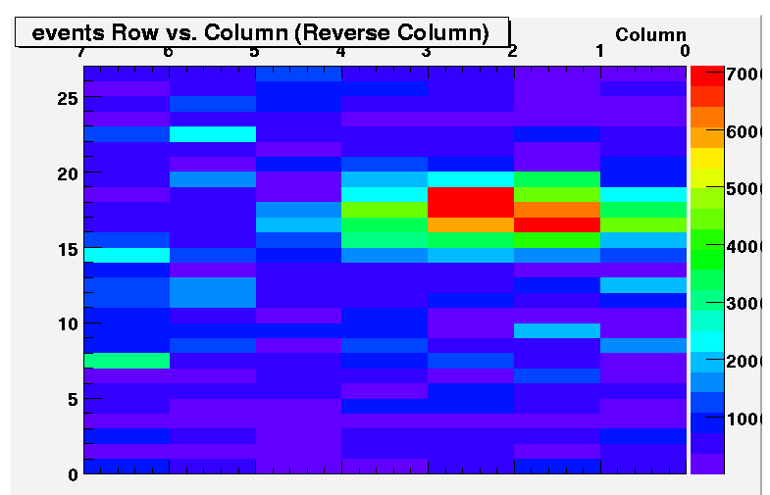
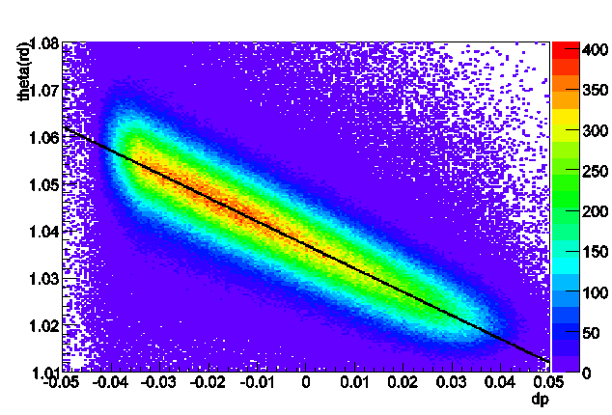
BigBite
Scintillator
Detect scattered electrons.
Only elastic-peak blocks were in the trigger.
Background minimized with tight elastic cut.
e’
Pre-shower
Shower

Slide 10
Elastic Events Selection
proton dpkin
HRS acceptance cut:
  out of plane: +/- 60 mr
  in plane: +/-25 mr
  momentum: +/- 0.04 (dp/p₀)
  reaction vertex cut
FPP cuts:
  scattering angle θ_{fpp} 5º ~ 25º
  reaction vertex (carbon door)
  conetest cut
Other cuts:
  Coin. Timing cut
  Coin. event type (trigger)
  single track event
  dpkin (proton angle vs. momentum)

Slide 11
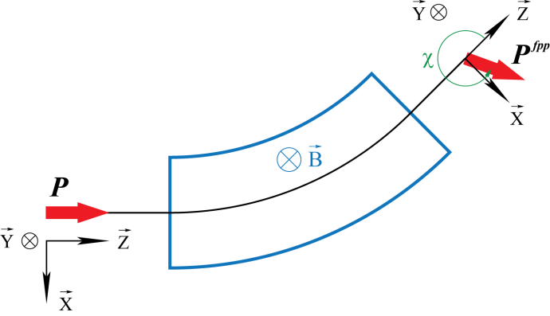
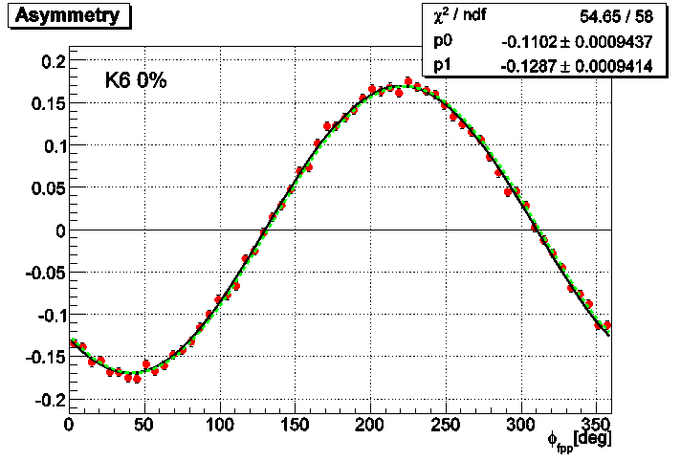
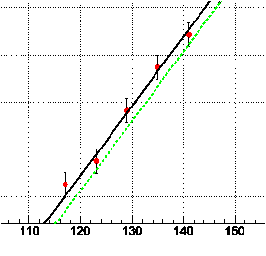
Focal Plane Asymmetry
Detection probability at focal plane with azimuthally angle
Helicity difference:
By simple dipole approximation:
(K: kinematic factor)

Slide 12
Maximum likelihood Method
Dipole approximation too simple: dipole fringe field, quadrupoles, misalignment…
Full spin precession by COSY:
  differential algebra-based.
  defines the geometry and related setup of the transport system.
  quadrupole alignment study in 2001.
Focal plane
Scattering frame
Extract target polarization components by maximizing the product of all the individual probabilities:
Notes:
However, in reality, the magnetic structure of the spectrometer is more complicated than that. The field is not uniform inside the dipole, it is distorted at the entrance and exit faces from the fringe field, the there are three quadrupoles.

Slide 13
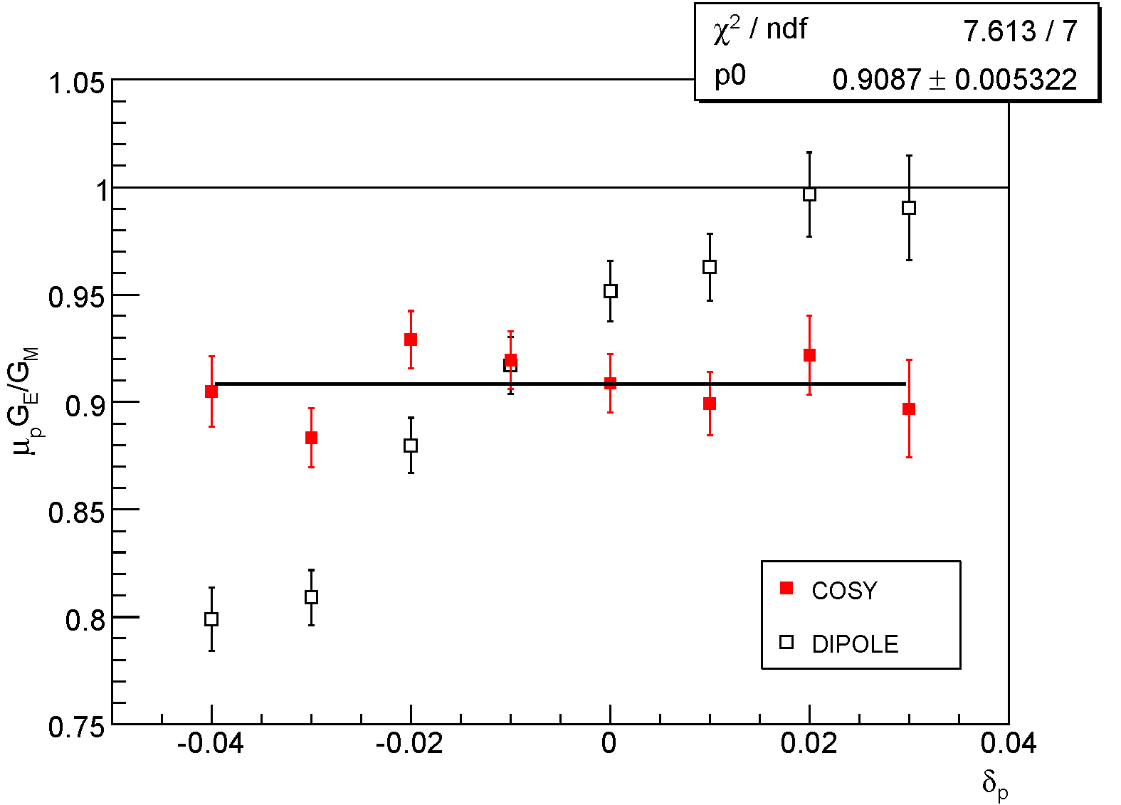
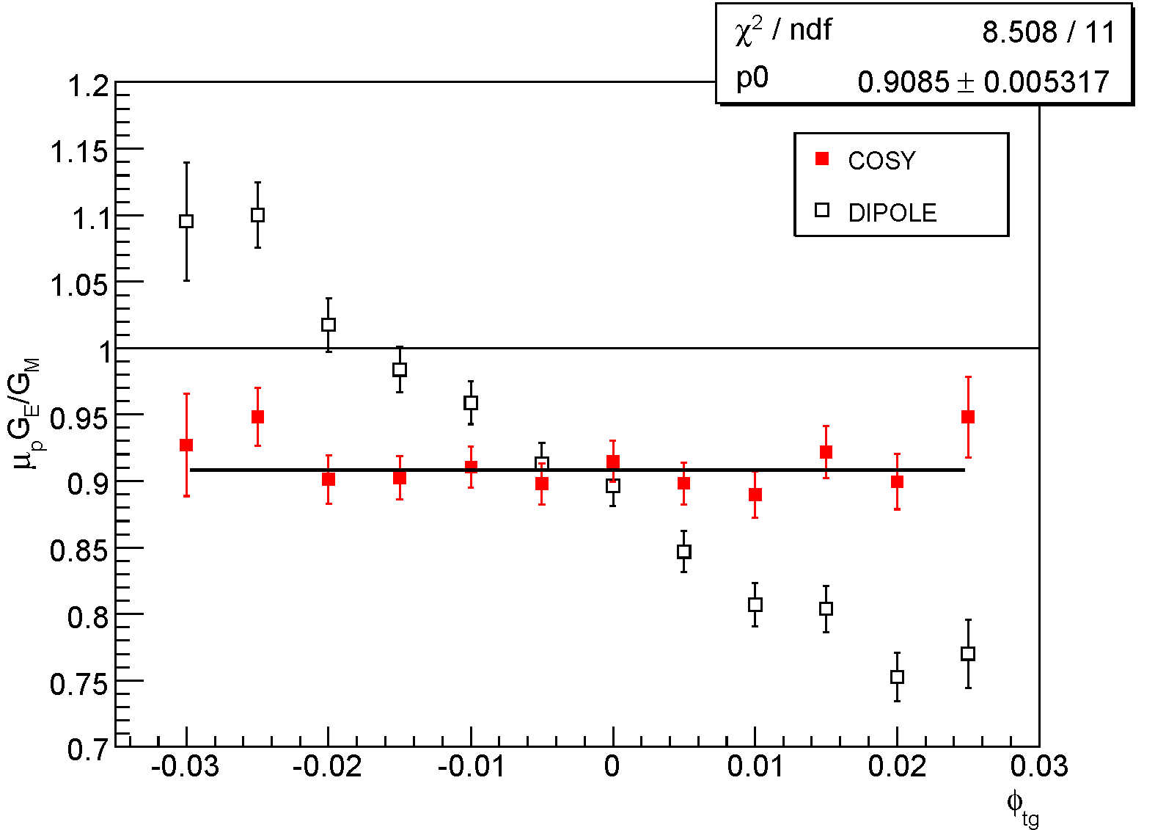
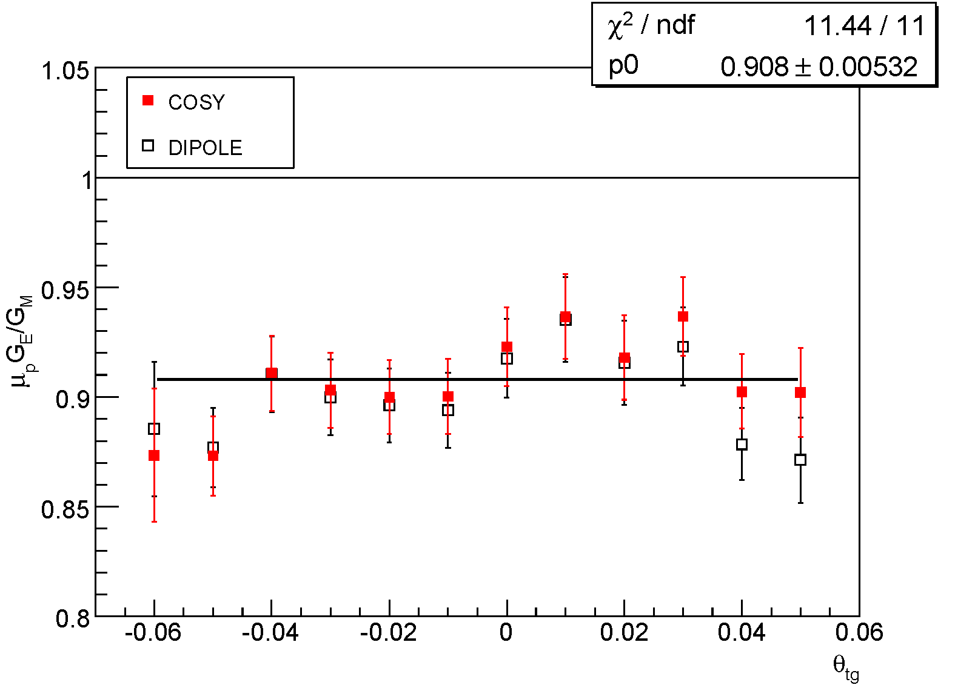
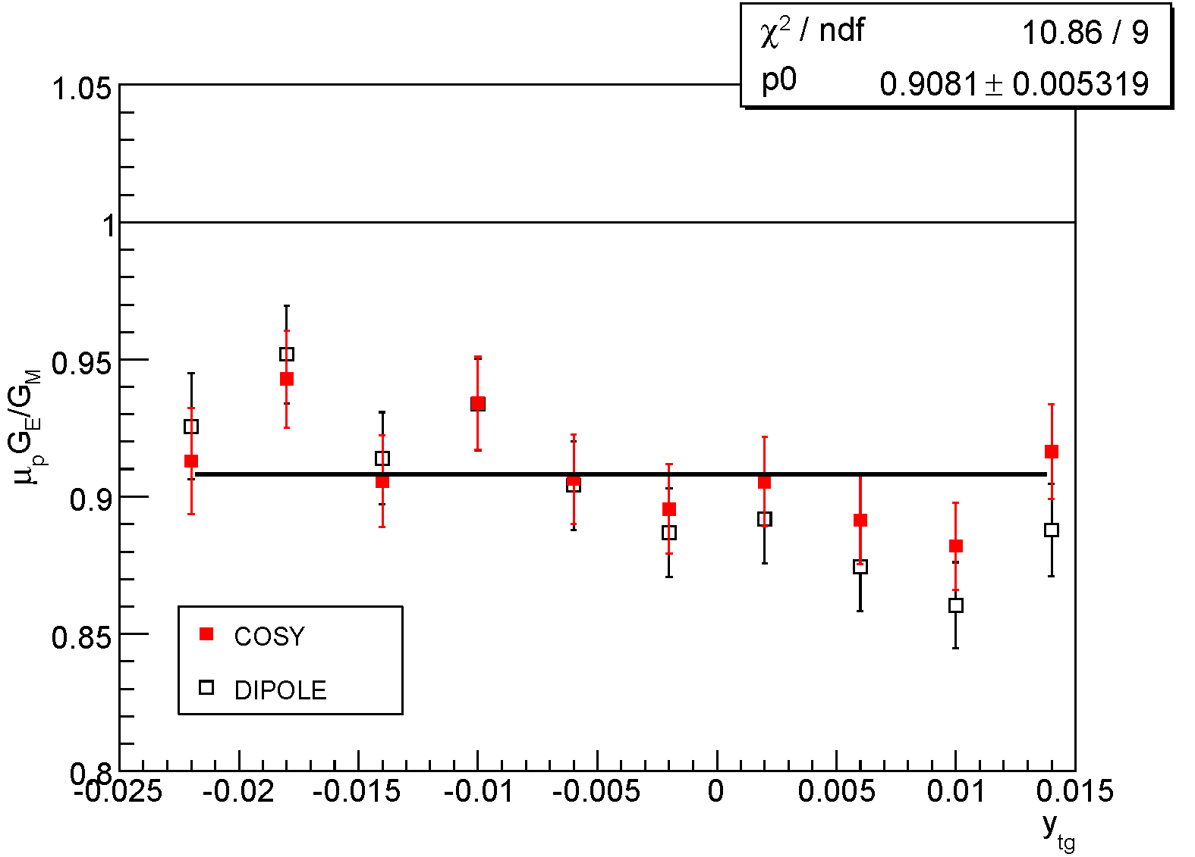
Spin Transport in HRS

Slide 14
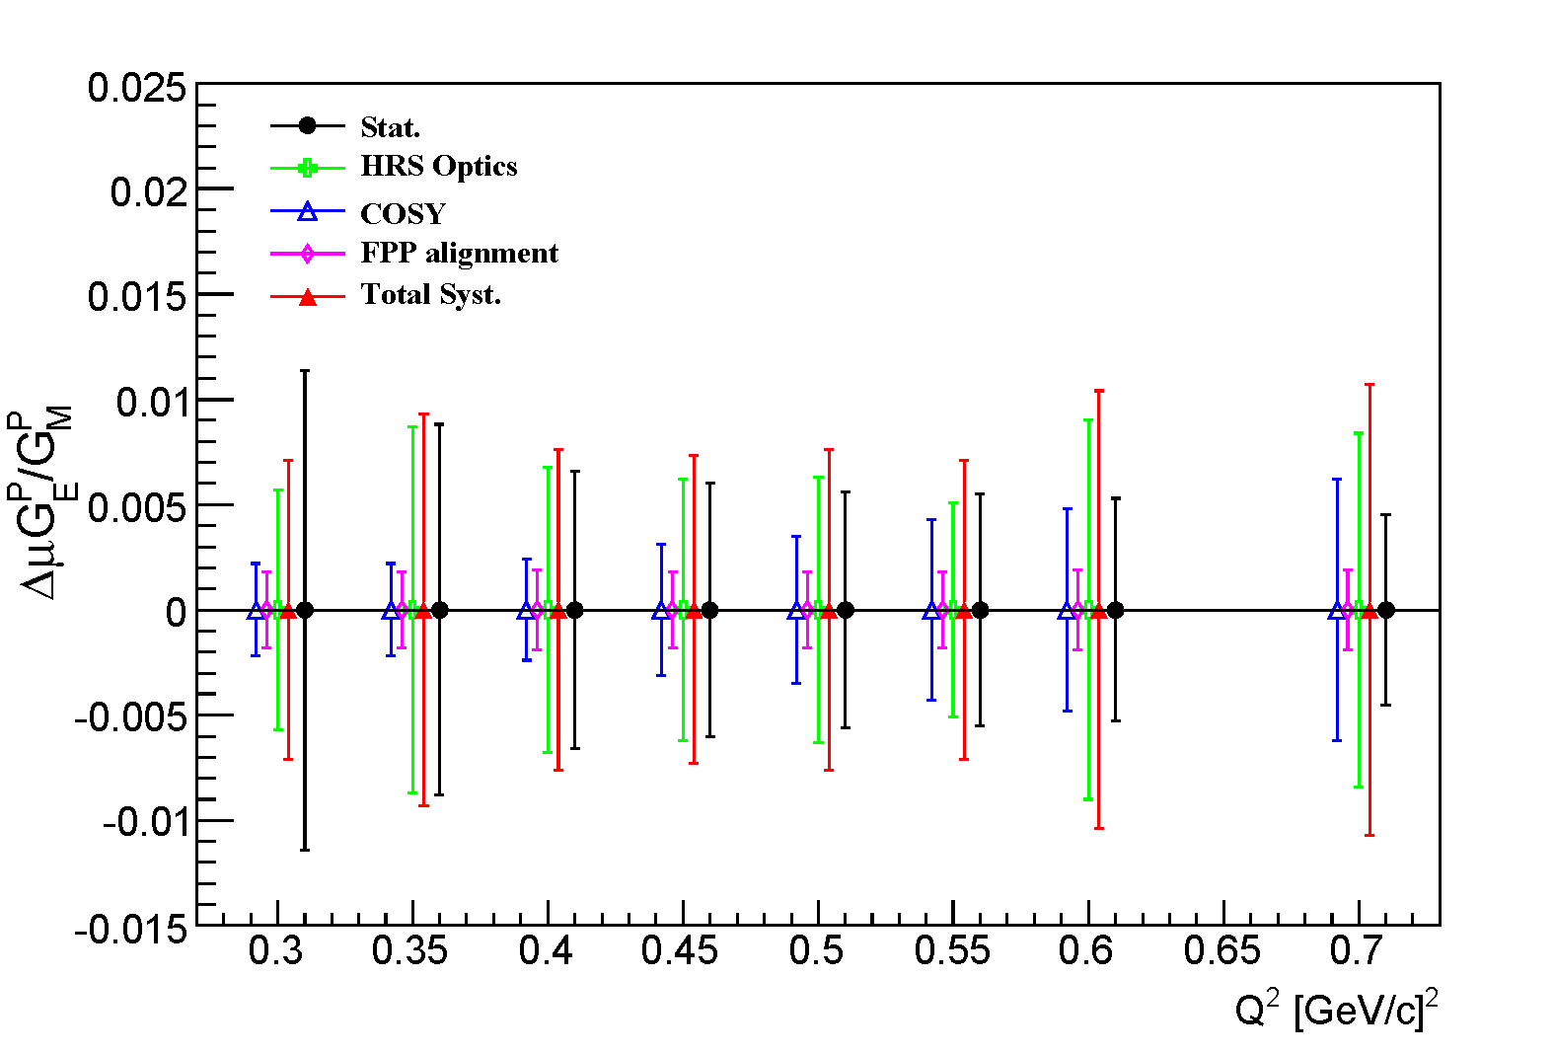
Systematic Budget
Dominated by spin transport: OPTICS and COSY model (0.7 ~ 1.2 %)

Slide 15
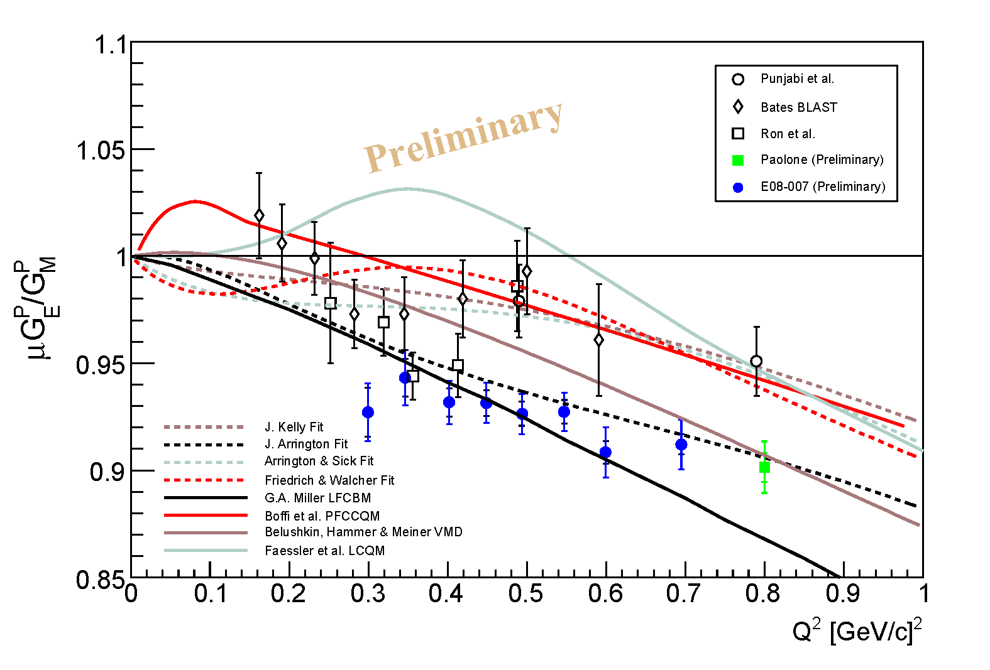
Preliminary Results
Smooth slow falling off. A few percent below typical expectations.
No obvious indication of “Structure”, inconsistent with F&W fit.
Agreement with independent analysis of Paolone at 0.8 GeV².
Disagreement with
  GEp-I : discrepancy investigation at 0.5 GeV² is underway (M. Jones).
  LEDEX : preliminary reanalysis lowers into agreement (G. Ron).
  BLAST: origin of difference needs to be investigated.

Slide 16
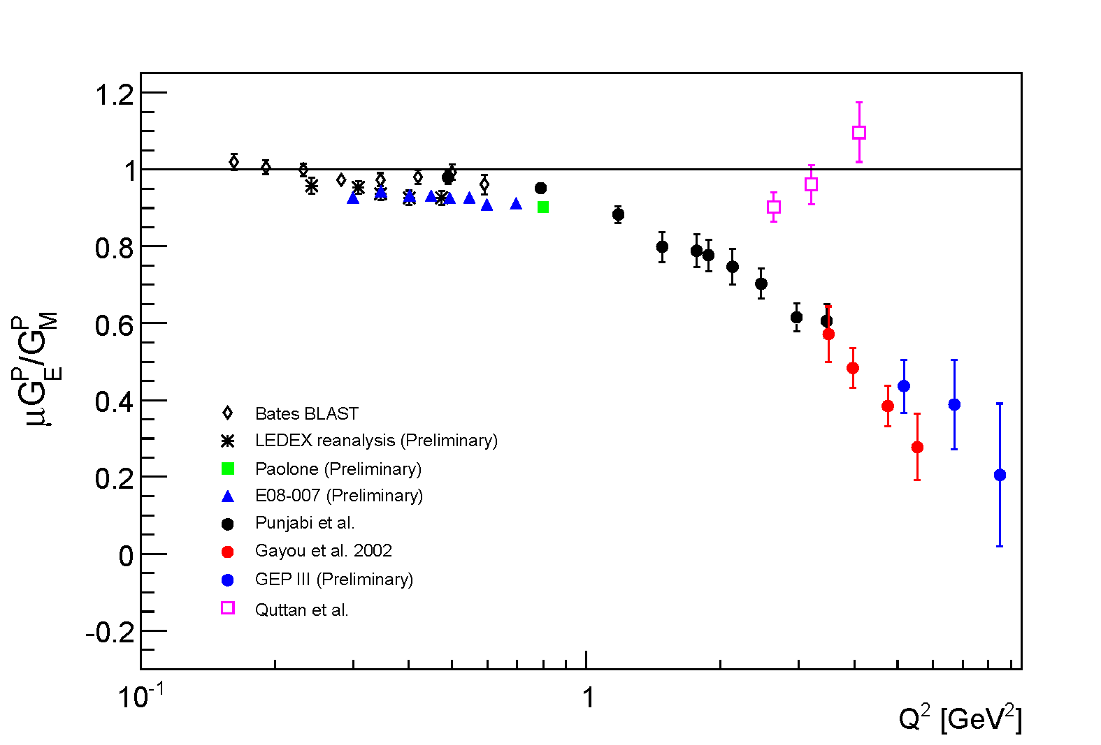
Preliminary Results

Slide 17
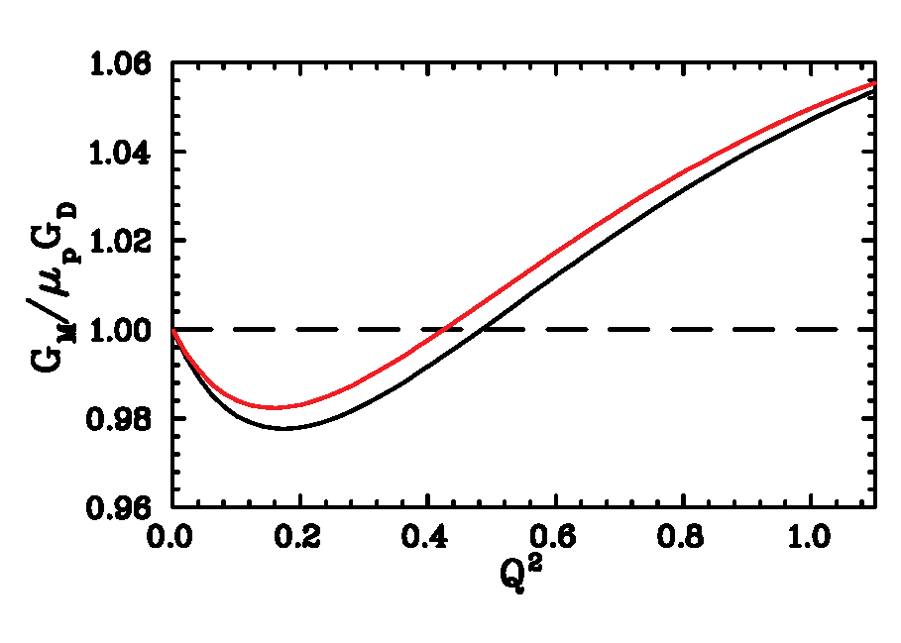
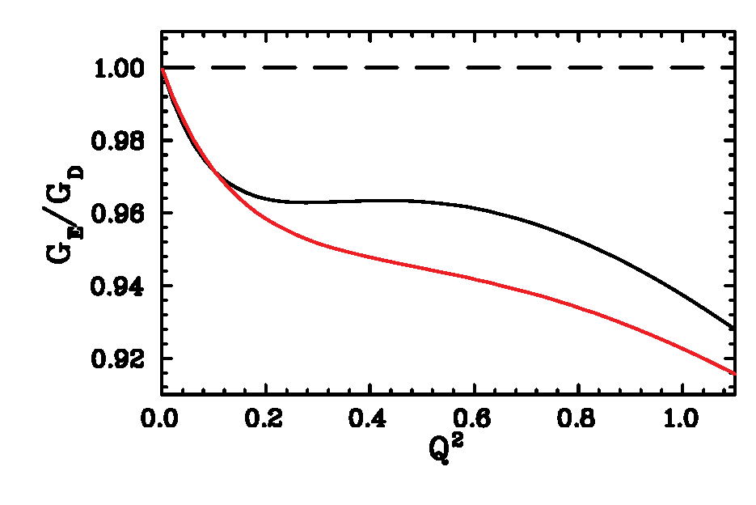
Impacts
Preliminary global fits by John Arrington.
Old fit (black) : include all previous data (AMT).
New fit (red) : suggest lower G_{E} (~2%).
Strange form factor by PV: interference between EM and neutral weak .
Rely on knowledge of EMFFs
New results can shift ~ 0.5σ for HAPPEX III
Q² | ΔA | ΔA/σ | ΔA/A
0.38 | -0.178 | 0.42 | 1.6% | G0 FWD
0.56 | -0.347 | 0.50 | 1.6% | G0 FWD
1.0 | -0.414 | 0.30 | 0.8% | G0 FWD
0.50 | -0.299 | 0.50 | 1.7% | HAPPEX III
0.231 | +0.038 | 0.12 | 0.2% | G0 BCK
0.65 | 0.142 | 0.14 | 0.3% | G0 BCK

Slide 18
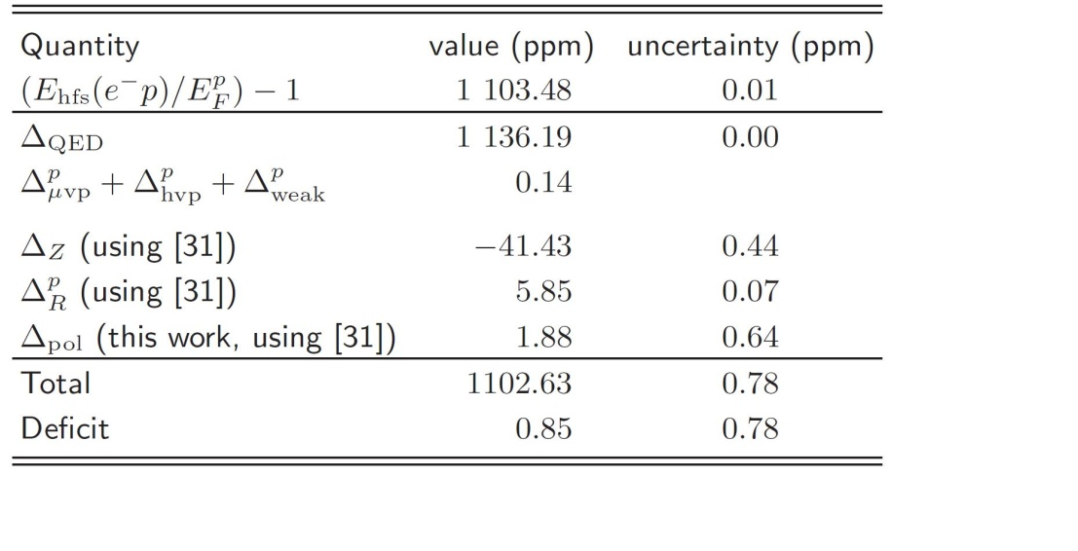
Impacts
Proton Zemach radius:
FFs | r_{z} (fm) | Δz | year
Dipole | 1.025 | -39.29 | -
FW | 1.049 | -40.22 | 2003
Kelly | 1.069 | -40.99 | 2004
AS | 1.091 | -41.85 | 2007
AMT | 1.080 | -41.43 | 2007
New fit | 1.075 | -41.21 | 2009
  Carlson, Nazaryan, and Griffioen, arXiv:0805.2603v1
Notes:
The most recent analysis shows the total of the hfs corrections gives a result that is 0.85 ppm short of the data, with a quoed uncertainty of 0.78 ppm. The uncertainty in the polarizability term is now comparable to the uncertainty in the zemach term.
Inelastic intermideate states in ep scattering.

Slide 19
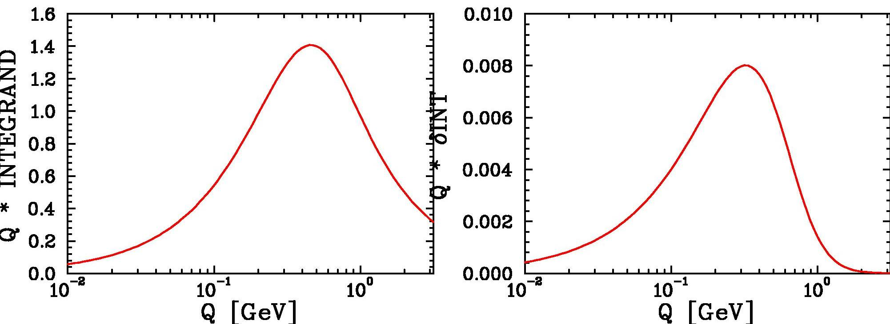
Impacts
Phase I (complete)
Phase II (2012)
Significant contribution to integral above Q²=1 GeV² and below Q²=0.01 GeV²
Negligible contribution to uncertainty above Q²=1 GeV²

Slide 20
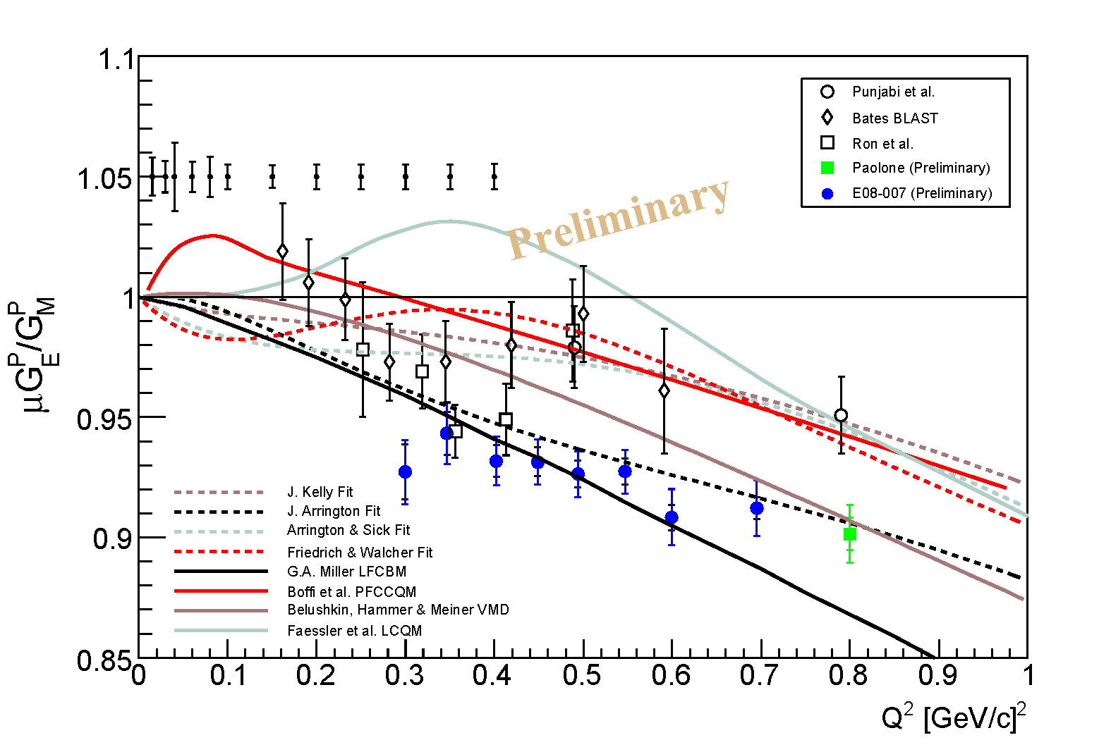
Summary & Future Outlook
Finalized systematic analysis
Impacts & paper in preparation.
Erratum for LEDEX (G. Ron et al.) in preparation.
Second phase of the experiment (DSA) is tentatively scheduled in early 2012
Opportunity to see the FFR behavior at even lower Q² (0.05-0.4 GeV²) region.
Direct comparison with BLAST.
Challenges: Solid polarized proton target & effect of target field to septum magnets.
Stay tuned …

Slide 21
Acknowledgements
J. Arrington, D. Higinbotham, J. Glister, R. Gilman, S. Gilad, E. Piasetzky, M. Paolone, G. Ron, A. Sarty, S. Strauch and the entire E08-007 collaboration
&
Jefferson Lab Hall A Collaboration

Slide 22
E08-007 Collaboration
Argonne National lab
Jefferson Lab
Rutgers University
St. Mary’s University
Tel Aviv University
UVa
CEN Saclay
Christopher Newport University
College of William & Mary
Duke University
Florida International University
Institut de Physique Nuclaire d’Orsay
Kent State University
MIT
Norfolk State University
Nuclear Research Center Negev
Old Dominion University
Pacific Northwest National Lab
Randolph-Macon College
Seoul National University
Temple University
Universite Blaise Pascal
University of Glasgow
University of Maryland
University of New Hampshire
University of Regina
University of South Carolina

Slide 23
Thank you!

