Slide 1
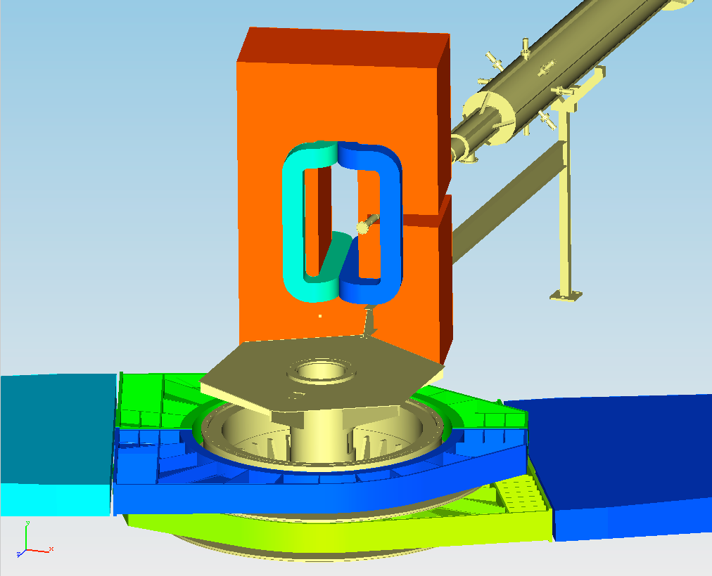
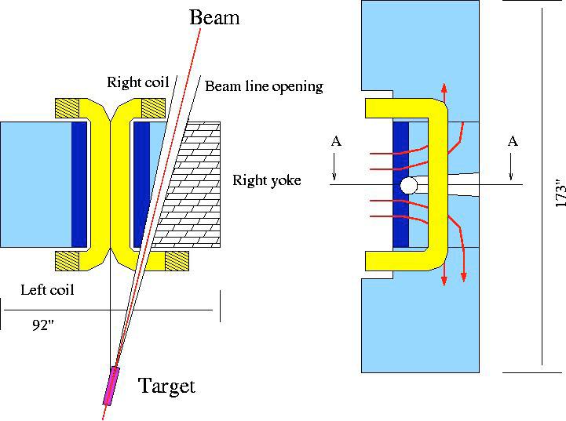
SBS Magnet
John J. LeRose

Slide 2
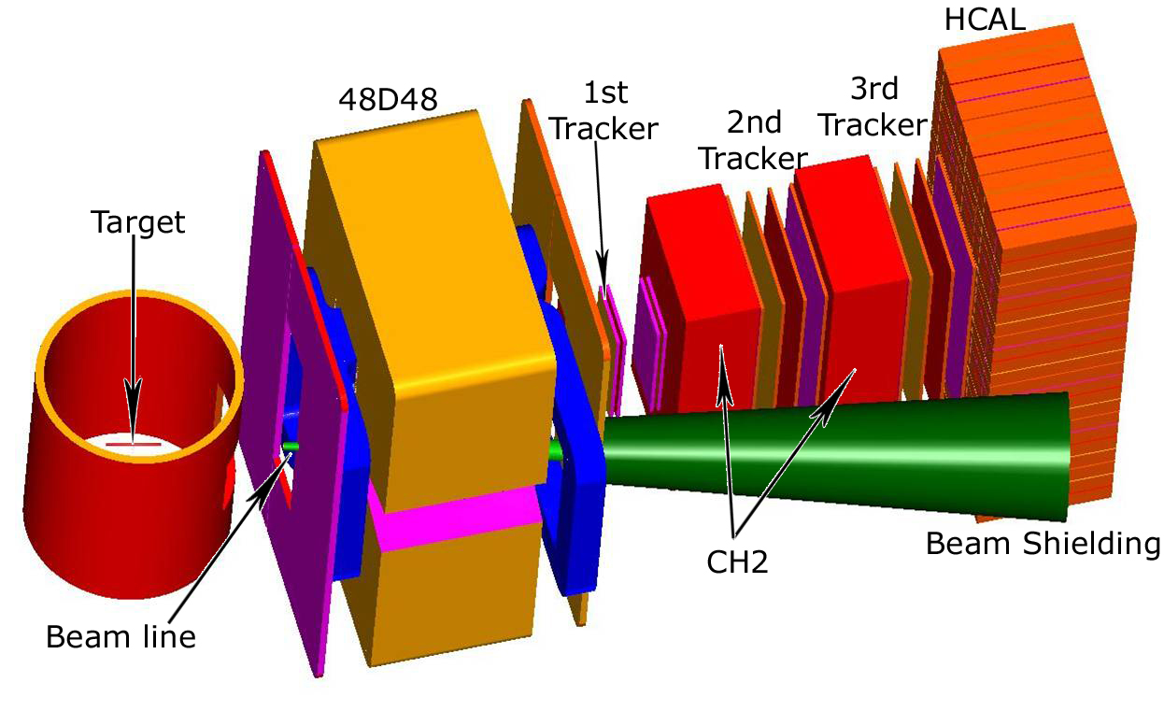

Slide 3
Magnet: 48D48 - 46 cm gap, 2-3 Tesla*m
Solid angle is 70 msr at 15°
GEM chambers with 70 μm resolution
Momentum resolution is 0.5% for 5 GeV/c
Angular resolution is 0.5 mr

Slide 4
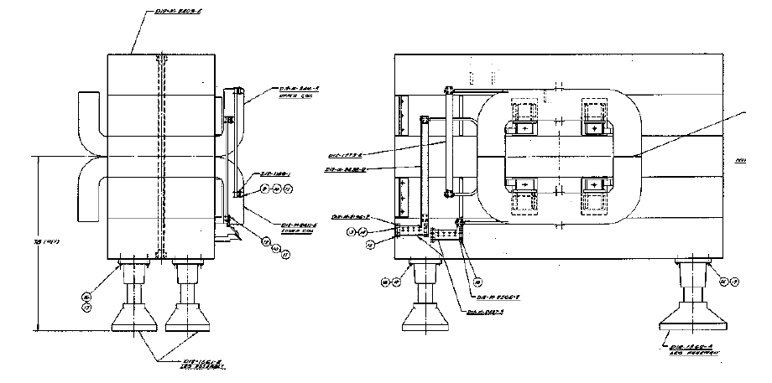
Magnet as it exists at BNL
Assembly drawing of 48D48 magnet as used at BNL (vertical field)
The magnet weighs 100 tons total. It consists of five iron slabs and can be assembled inside Hall A with the existing overhead crane.

Slide 5
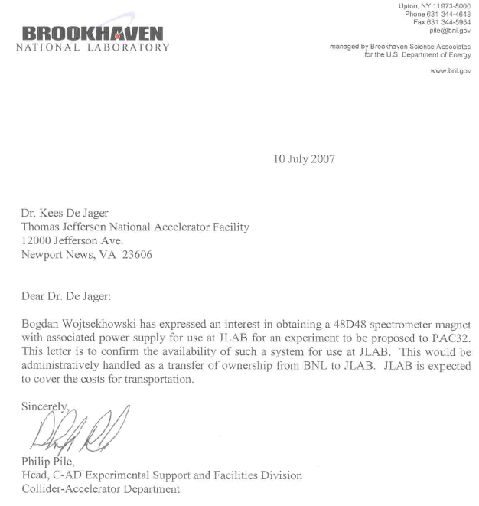
The magnet is “available”.
To guarantee that it’s ours we need to formally transfer ownership.

Slide 6
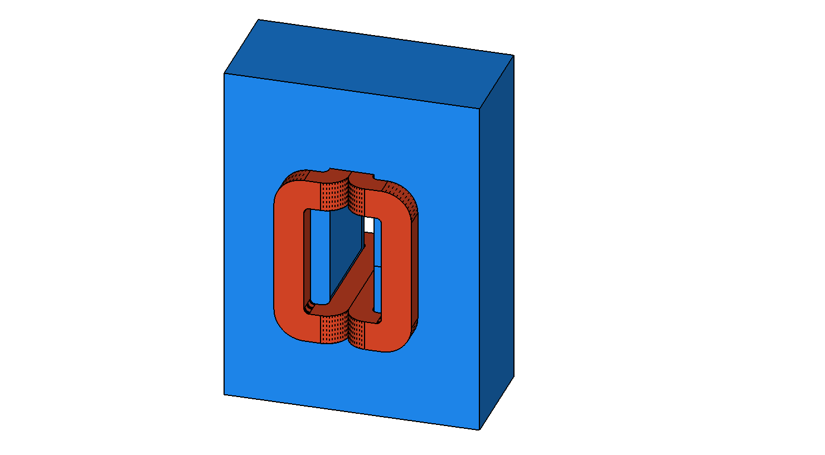
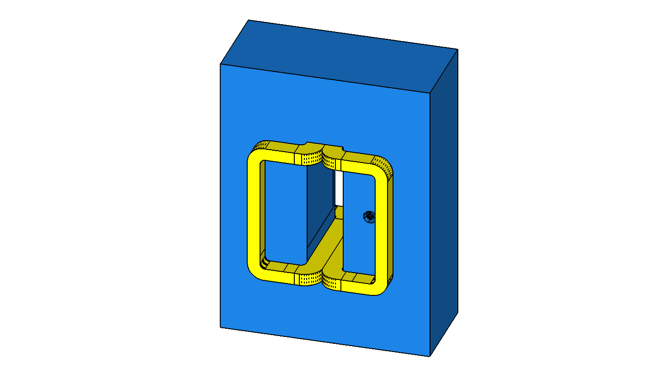
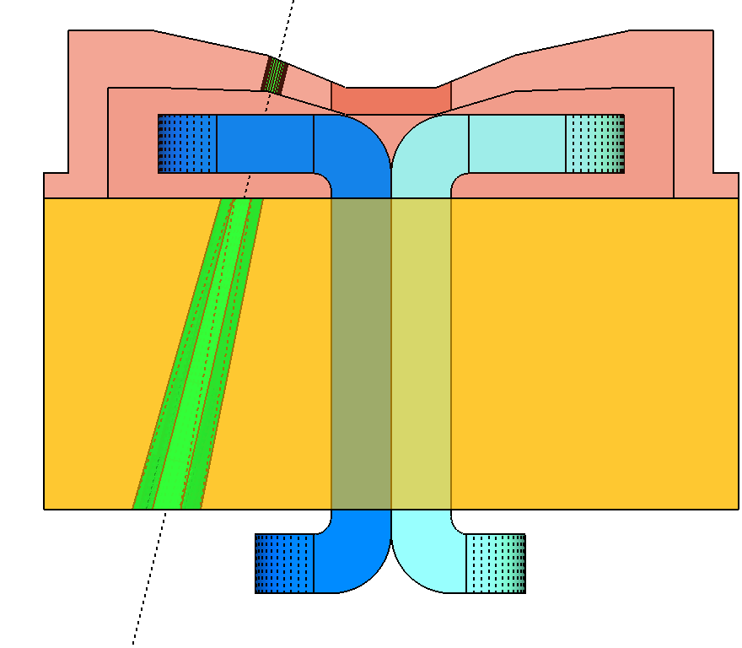
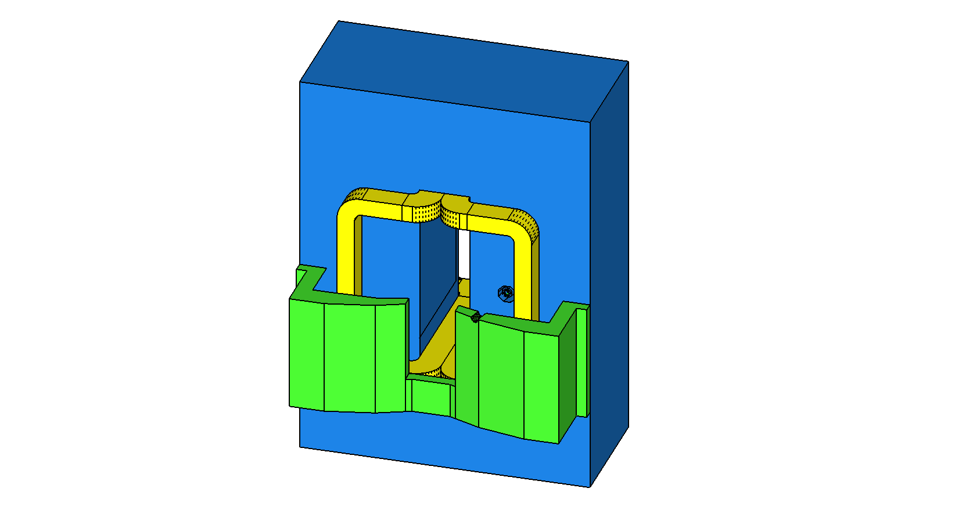

Slide 8
48D48 Required Modifications
Horizontal field (tip it on its side)
Beam path through the yoke
Coil Modifications, i.e. New Coil(s)!
Field Clamp
Bucking coil(s) (reduce field on the beam line)

Slide 9
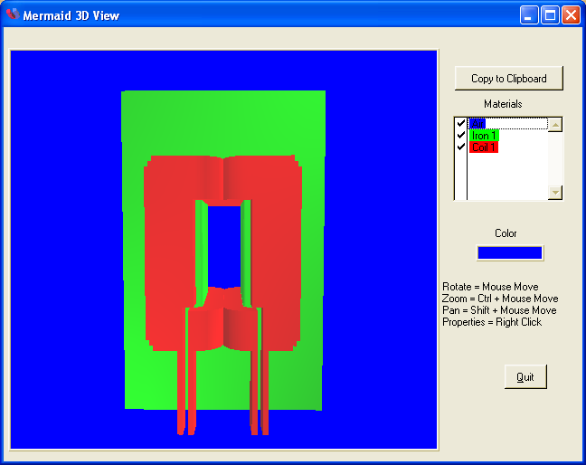
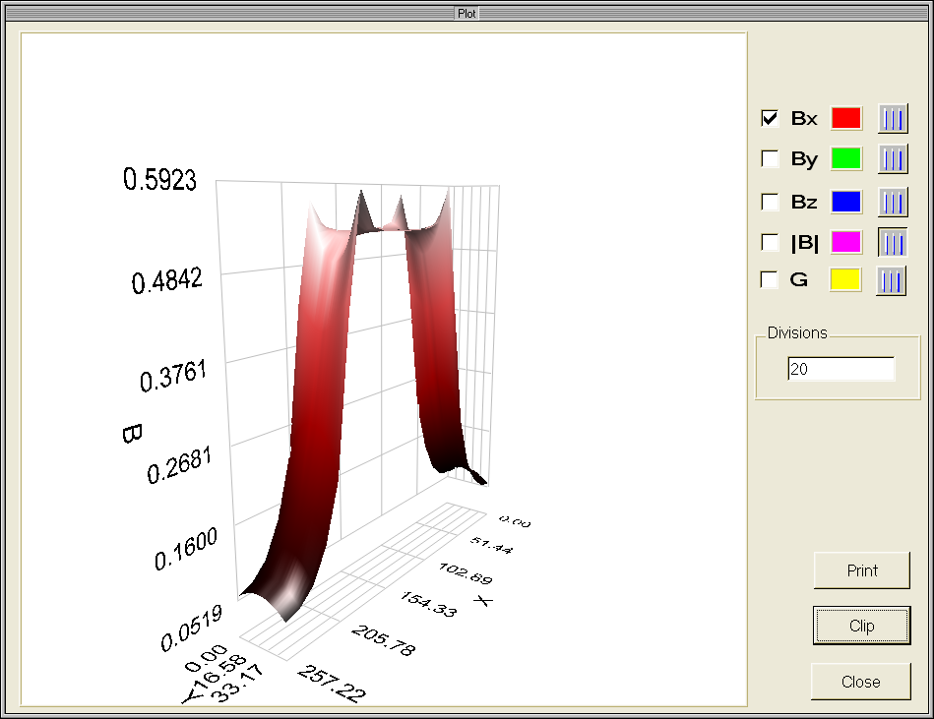
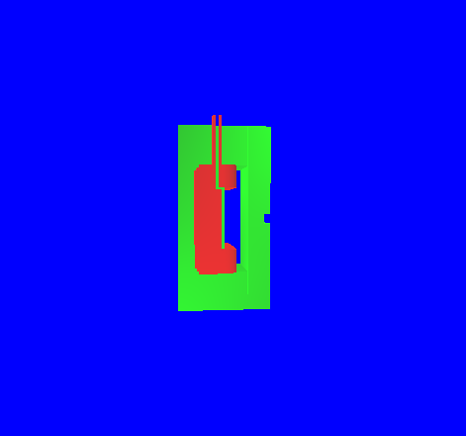
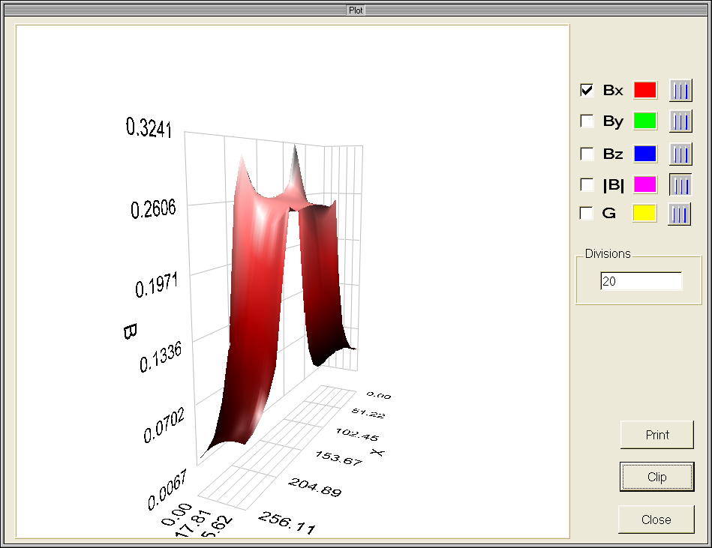
Another game we’ve played

Slide 10
The 48D48 magnet would be very useful for future experiments in Hall A. (see the rest of this session)
The magnet is presently ours for the cost of transportation.
How long it will remain so is anybody’s guess.
We should get it while we can.

