Slide 1
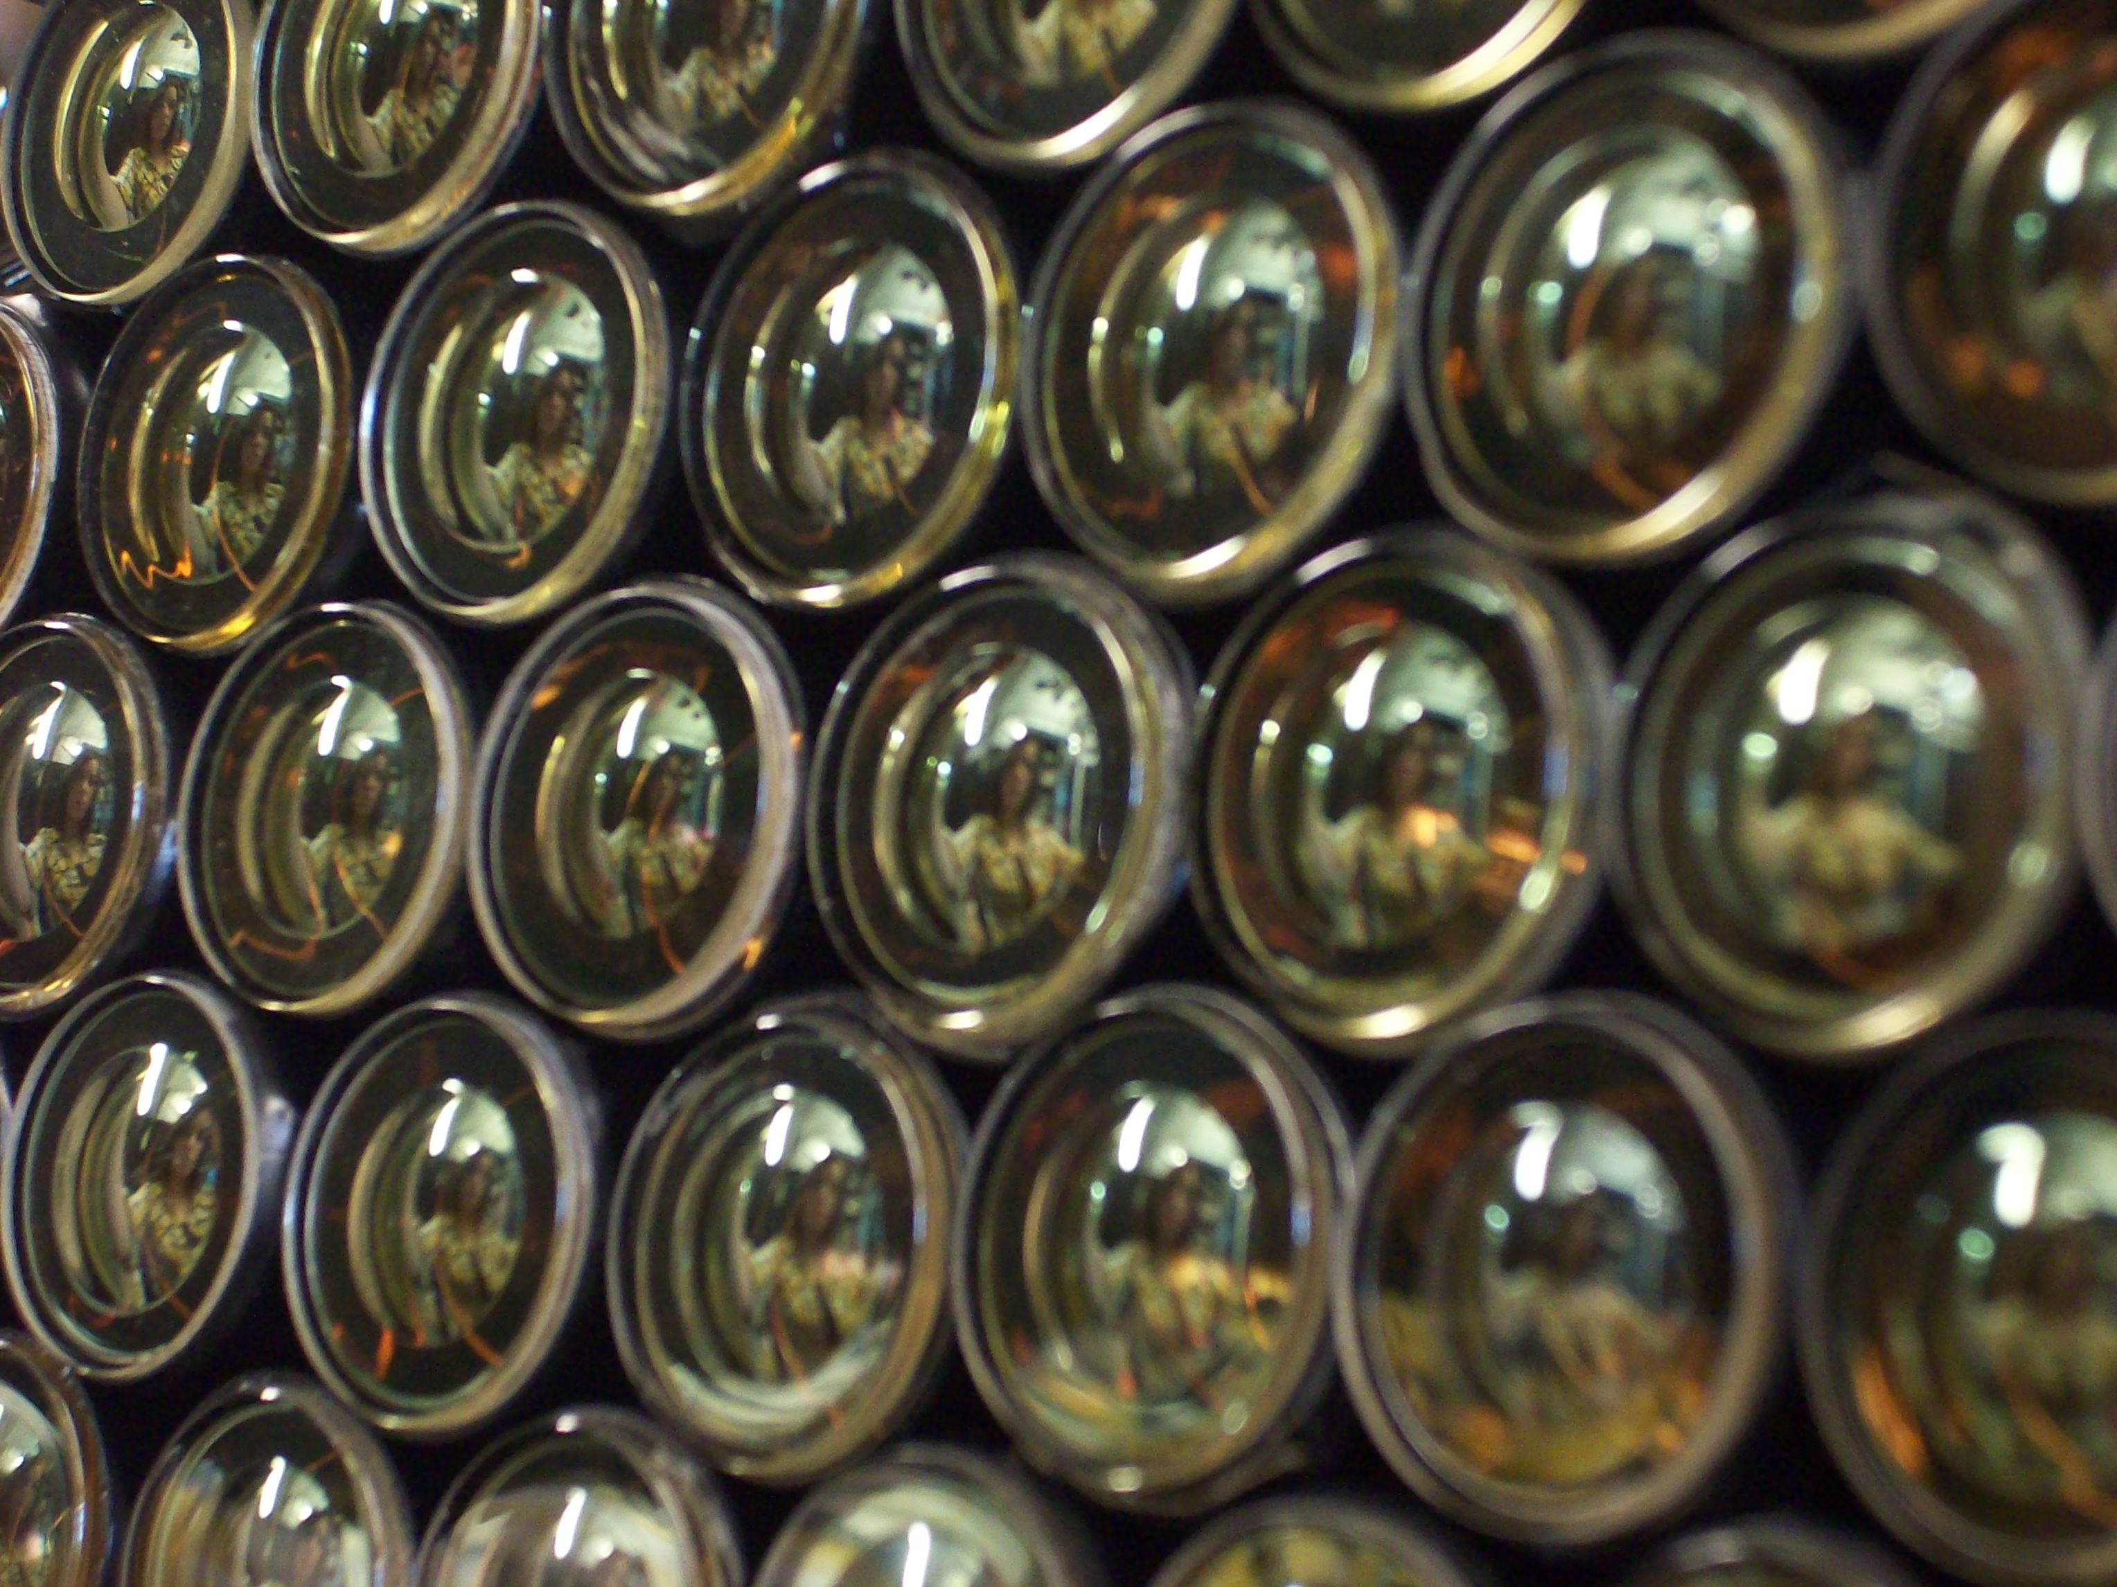
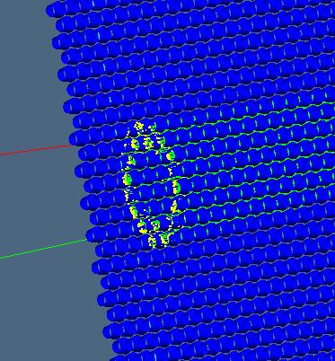
THE GRINCH
Gas Ring Imaging Cherenkov Detector
T. Averett, M. Cummings, Bo Zhao, Valerie Gray William and Mary
B. Wojtsekhowski, Jefferson Lab

Slide 2
BigBite Gas Cherenkov for A₁^{n} at 12 GeV
T. Averett, M. Cummings, Bo Zhao, William and Mary
B. Wojtsekhowski, Jefferson Lab
12 GeV A₁^{n} will run with BB at 30 deg. Need good PID in noisy
Environment. Commissioning expt for Hall A at 6.6, 8.8 GeV.
W&M responsibility—design, simulation, prototype, detector construction
Glasgow—Electronics, BB detector package coordination
Previous Concept—2,000 tube array of 0.75” diameter PMT’s
from HERMES RICH
New Concept—Narrow array of 550 29 mm diameter PMT’s
Low threshold, high singles rates
Find timing clusters of ~10 PMT’s using TDC spectrum
Timing cut ~10 ns
Expect to be able to handle 2 MHz or higher background rate
per tube.

Slide 3
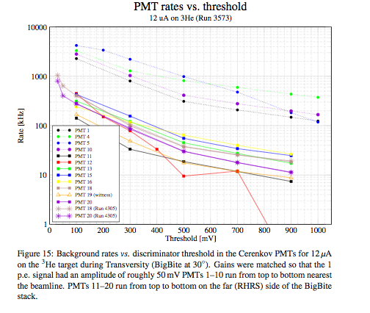
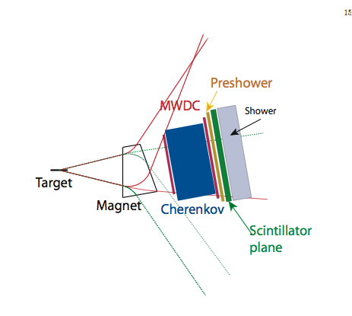
BigBite Spectrometer with Cherenkov at 30 deg

Slide 4
Update on Simulation
GEANT4 simulation-Bo Zhao
Basic detector and mirror concept complete
Results showed narrow stripe of PMT’s are sufficient.
Basic Design Determined
Design specs:
1.5 atm C₄F₈O (1.0 atm, prev BB Cherenkov)
Path length=60-80 cm (40cm)
4 cylindrical mirrors, height=60cm, width=70cm, radii=130cm (40 mirrors)
29mm PMT array on large angle side,
Total PMT’s needed=550
Previous BB Cherenkov—20, 5”PMTs

Slide 5
Cherenkov Ring

Slide 6
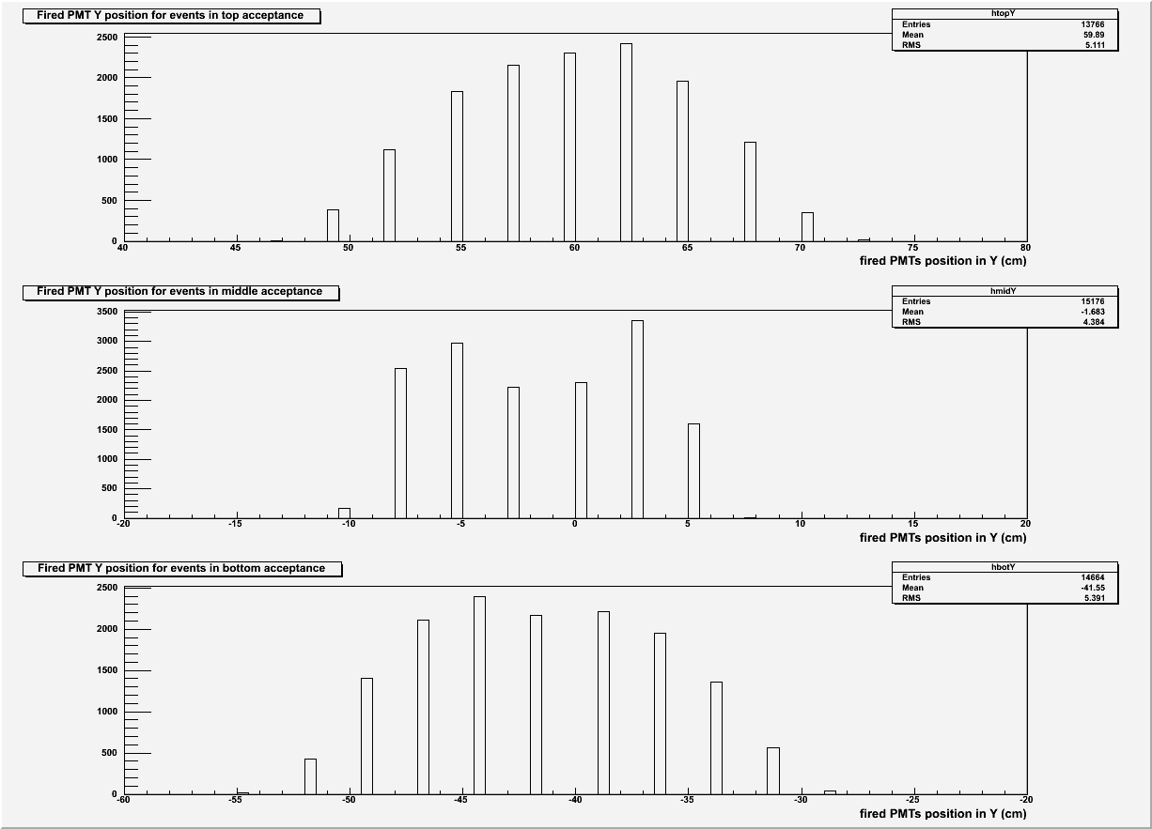
X and Y hit positions at PMTs
Horizontal width ΔX=20 cm
Vertical height ΔY=140 cm

Slide 7
HERMES RICH. 2,000 PMT array

Slide 8
PMT’s

Slide 9
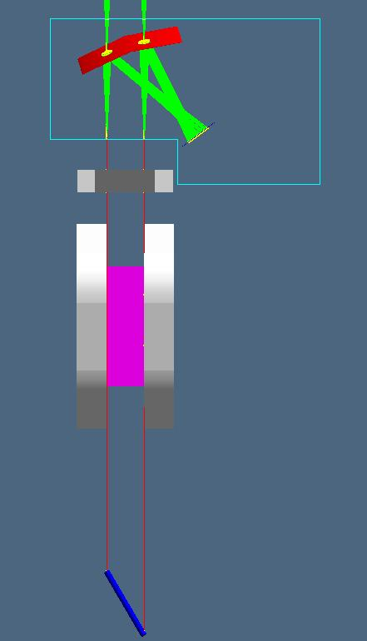
Proposed detector
Side View
Top View

Slide 10
Number of photon hits per PMT

Slide 11
PMT’s fired per event ➔about 15-16

Slide 12
Expected number of p.e.’s per tube

Slide 13
Update on Prototype Detector
Fall 2010—Received 70 PMT’s on loan from Dirk Ryckbosch at Univ. of Gent, Belgium. Thanks!
Prototype array and housing complete--M. Cummings, W&M
HV distribution complete--M. Cummings, W&M
All DAQ components acquired
Prototype detector and electronics—Recently moved to Jefferson Lab
DAQ running in Hall A—B. Zhao
Assembled array of 8x8=64 PMT’s
Begin testing with aerogel, acrylic, gas
VME QDC, TDC ready.
Cabling finished on PMT’s
Test run during g2p in Fall

Slide 14
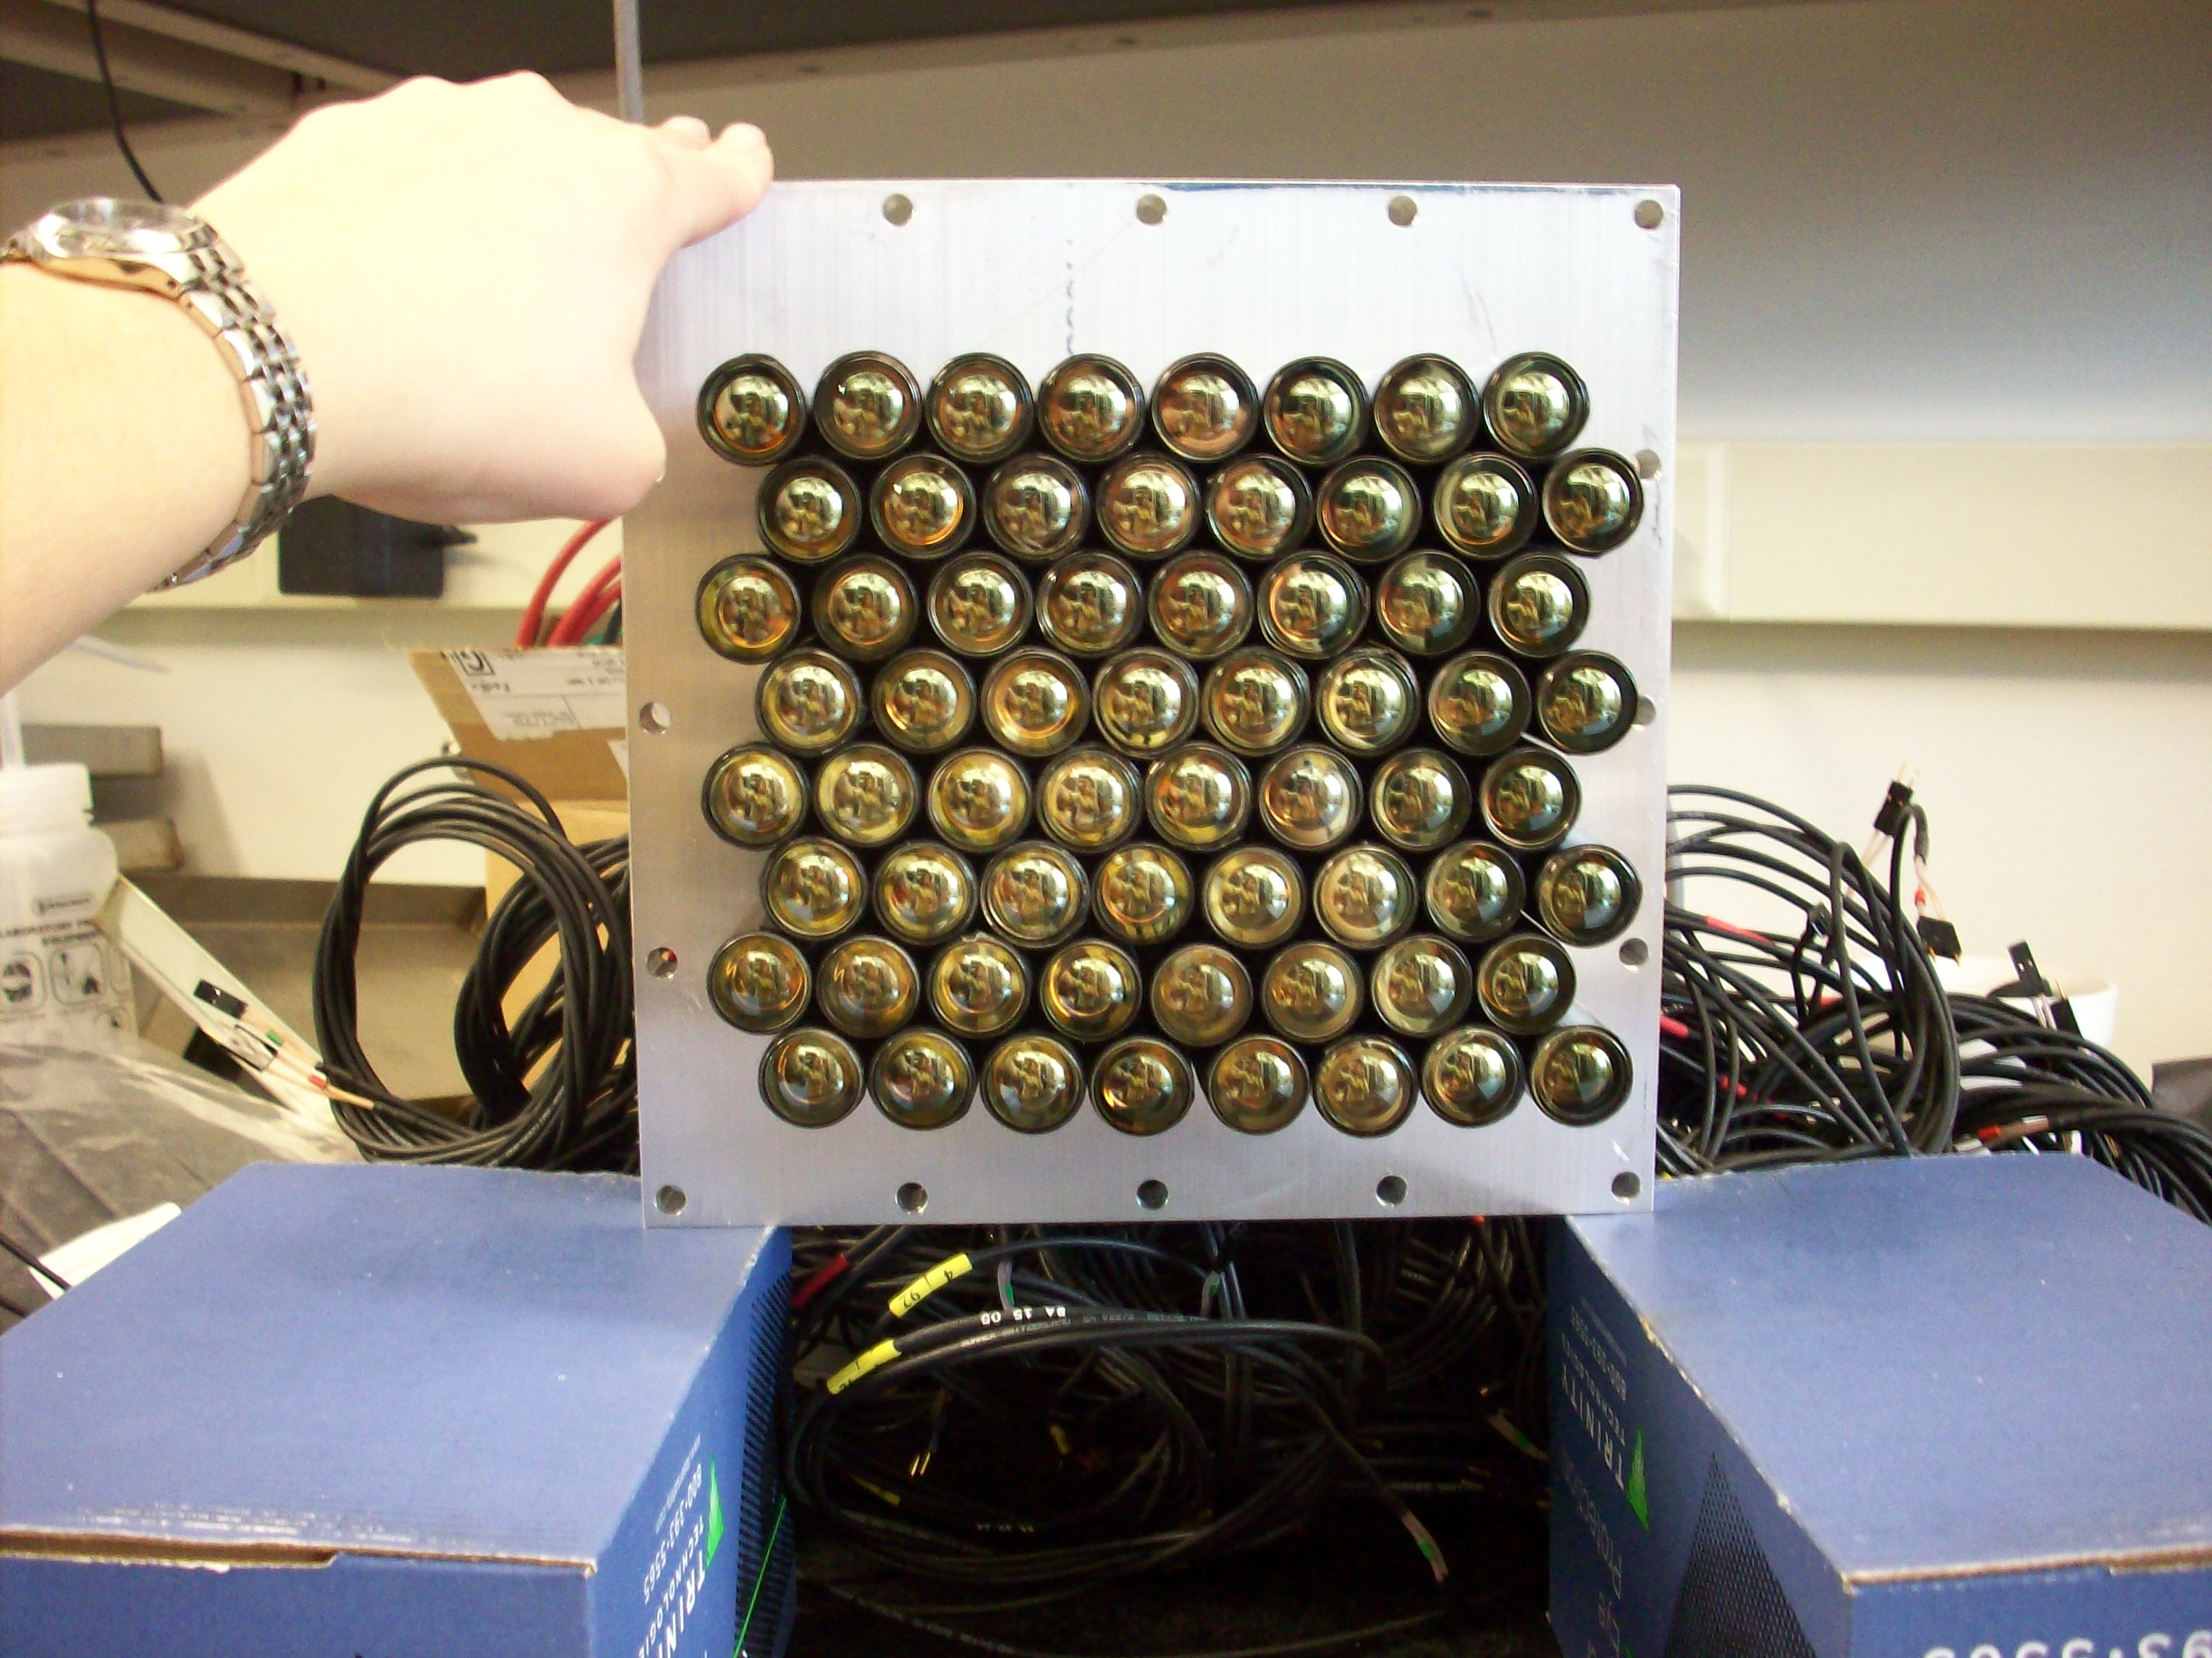
Prototype PMT array

Slide 15
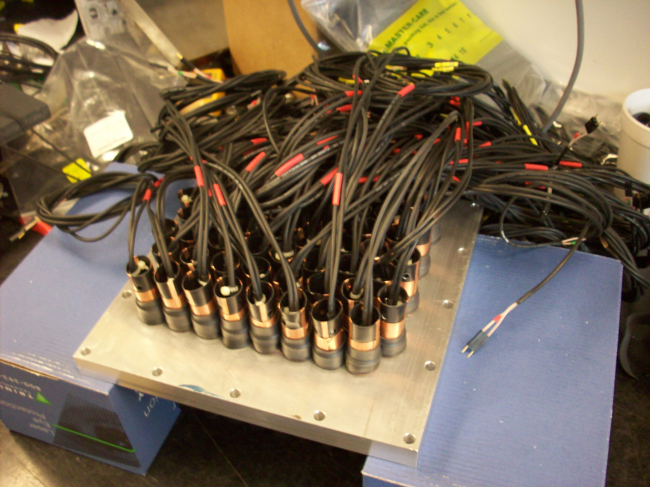
Prototype PMT array

Slide 16
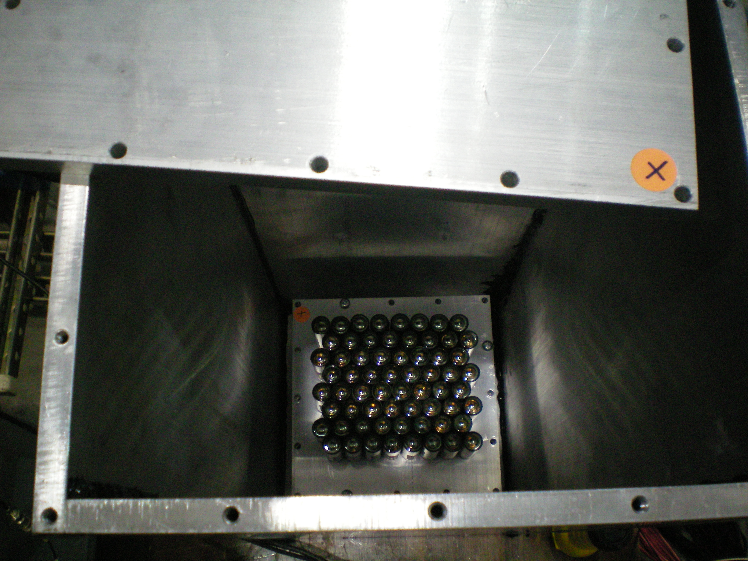
Prototype Detector

Slide 17
Prototype Detector and Electronics in Hall A—Bo Zhao, W&M

Slide 18
Raw Data from CODA/VME System

Slide 19
Update on Design
Nothing yet really
Simulation complete—now time to start engineering and get price quotes, etc.

Slide 20
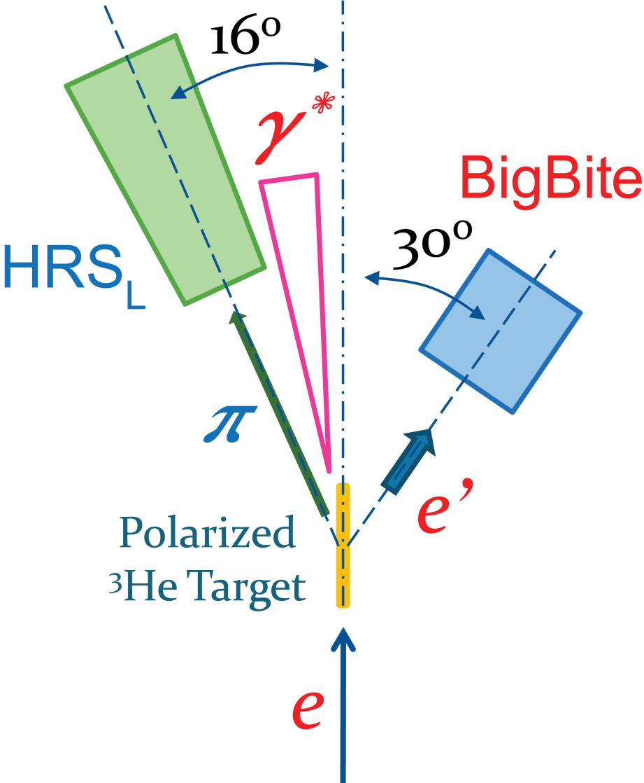
Transversity kinematics
Luminosity
Monitor
Measure ³He(e,e’) SSA using BB
and LHRS in singles mode.
E=5.89 GeV
Beam Polarimetry
(Møller + Compton)

