Slide 1
Hall A DAQ status and upgrade plans
Alexandre Camsonne
Hall A Jefferson Laboratory
Hall A collaboration meeting
June 10th 2011

Slide 2
Outline
HRS DAQ upgrade
Motivation
Current
Possible trigger layout
Timeline
Intel VME CPU
CAMAC
Future experiments
Pipelined electronics
Fastbus
L3 Farm
Summary

Slide 3
HRS DAQ upgrade motivations
Upgrade rate capability and deadtime : current rate limited to 4 KHz at about 15 % dead time
CAMAC modules obsolete : replace with NIM and VME
High resolution TDC 1875 replacement
http://hallaweb.jlab.org/equipment/daq/daq_12gev.pdf

Slide 4
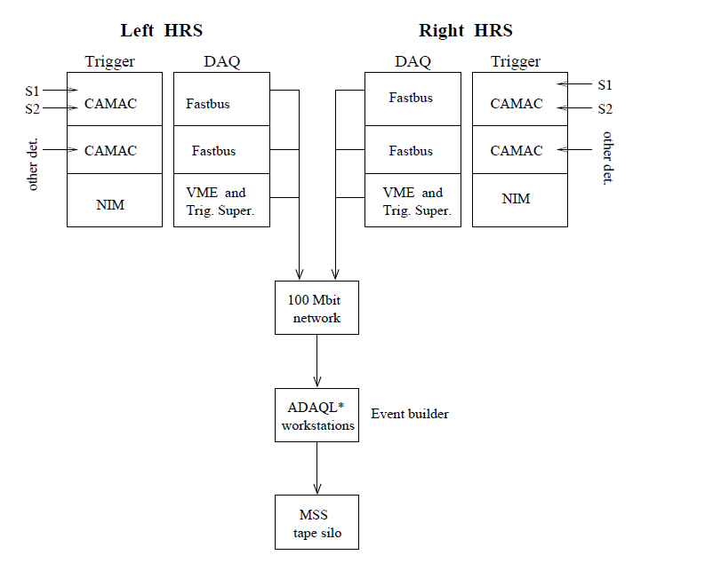
Current HRS

Slide 5
Possible trigger layout
Other HRS trigger
VME VXS
NIM
S1m
Delay
Logic
Delay
Logic
To FADC
VME VXS
triggers
S2m
TS
+
Scalers
Delay
Discr
Delay
To FADC
NIM
Cerenkov
Σ
AMP
Replace CAMAC by VME/VXS
Keep usual trigger for for compatibility
Split signal to pipelined electronics for recording and digital trigger
NIM
To FADC
L1A for other arms electronics

Slide 6
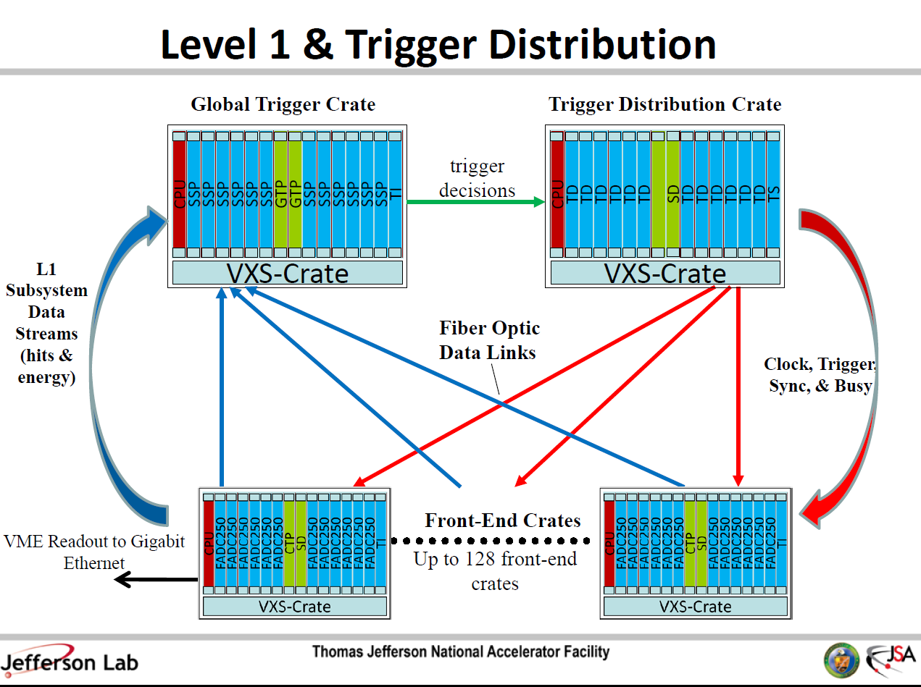
Ben Raydo’s
Talk

Slide 7
HRS 12 GeV Hall A DAQ upgrade milestones
Milestone Planned completion
Test 1190 and 1290 TDCs on HRS Oct-11
Implement Fastbus upgrade with Intel Quad cpus Nov-11
Complete the Design of Test Stand for Pipelined Electronics Dec-11
Obtain prototype TIR boards, new ROC and EB components for CODA 3 Jan-12
Complete the Design of the Delay Modules (Ben Raydo) Feb-12
Parts for Test Stand Delivered (FADC, TDCs, TIR, etc) Mar-12
Test of Delay Module Prototype Completed Apr-12
Initial Testing of Pipelined Electronics, informing final design May-12
Preliminary Design of DAQ and Trigger Jun-12
Order Delay Modules and other Trigger Modules Jul-12
Completed Tests of Pipeline Electronics Aug-12
Final Design of DAQ and Trigger Sep-12
Order ADCs and TDCs (at this point, looks like Jlab FADC and CAEN 1190) Oct-12
Order Crate Trigger Supervisor, Subsystem Decision Modules, etc. Nov-12
Order Fibers and Gigabit Ethernet Dec-12
All DAQ and Trigger modules delivered Jan-13
Analysis Software Upgrades Completed (based on Test Stand) Feb-13
Assembly of Full DAQ System Complete Mar-13
Preliminary Tests of Full DAQ System Apr-13
Final Tests of Full DAQ System May-13

Slide 8
Intel VME CPUs
Dual Core CPU
Running Linux
Deploy infrastructure for operating
Support from DAQ group : Bryan Moffit and David Abbott Fastbus library adapted for the new CPU
CPUs ordered and will be tested this summer
Possible improvement of rate capability by a factor of 2 will be tested for g2p

Slide 9
CAMAC replacement
Lecroy 4518 delay module
Development by Jlab electronics group
Lecroy 4413 discriminator
JLAB VME discriminator available
16 channels
2 outputs with two different thresholds
Or output
Possibility to implement logic
MLU 2373
CAEN V1495 : multipurpose FPGA logic module
very versatile logic but need to be careful for accurate timing

Slide 10
Future experiments
SuperBigBite
GEM
Fastbus
DVCS
Calorimeter
Analog sampling electronics
SoLID
Fully pipelined electronics
L3 Farm

Slide 11
Pipelined electronics
Continuous readout of data
No dead time
Fully digital logic
Digital sum and trigger generation for calorimeter / scintillators
Drawbacks
need fully pilelined to take full advantage of DAQ
L1A latency of 2 us
Possibilty to use as regular ADC with look back in time
( No more delay lines )

Slide 12
Pipelined electronics
JLAB FADC 250
Flash ADC 12 bit 250 MHz 16 channels
VXS option for summing and triggering purpose
Jlab F1 TDC
CAEN V1190
CAEN V1290
APV25 GEM readout : 40 MHz
DAQ group will handle event repacking from the block of events

Slide 13
Fastbus
Large amount of channels available
Will be used for SuperBigBite
Drawback no pipelining/ event blocking
20 Mb/seconds transfer rate
Sufficient for low rate experiments
Might benefit from new Intel VME CPU

Slide 14
L3 Farm
For data reduction for SoLID maybe SBS
Do treatment of event for data reduction : expect factor of 5 reduction of data amount
Need to implement test bench
Choose algorithms : coarse reconstruction, look up table, coincidence between detectors to optimize speed and data reduction
Determine efficiency and systematical effects

Slide 15
Summary
HRS DAQ upgrade ongoing by stage
Support legacy electronics while allowing fully pipelined operation
New electronics being tested in different setups
Availability of 100 KHz rate capabilities for future experiments
HRS upgrade is building block of DAQ for future large experiment SBS and SoLID

