Slide 1


SoLID Simulation
Zhiwen Zhao
UVa
Hall A Collaboration Meeting
2011/6/10
Introduction
Simulation framework
Simulation study

Slide 2

SoLID - Solenoidal Large Intensity Device
One of three major new equipments of Hall A 12GeV upgrade besides SBS and Moller
General purpose device.
Physics
approved proposals:
  PVDIS (N. Liyanage’s talk)
  SIDIS (Xin Qian’s talk and Jin Huang’s talk)
  proposals under work:
  b1, deuteron tensor structure function (LOI, Patricia Solvignon’s talk at the last winter Hall A meeting).
  Proton transversely (K. Allada’s talk).
  g3, parity violating spin structure function.
  PVRES, parity violation in resonance region.

Slide 3
Comgeant
The Past
Geant3 based simulation program.
geometry/sensitivity/digitization/field as input files and detached from main code, run different settings without recompilation.
Successfully used for PVDIS and SIDIS proposals.

Slide 4
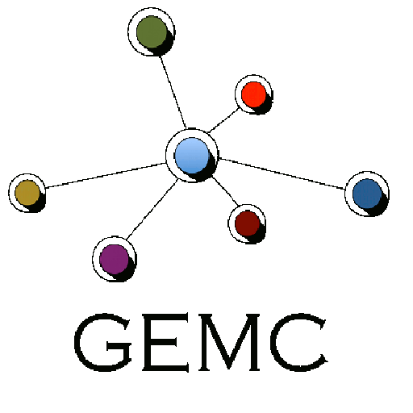
GEMC (GEant4 MonteCarlo)
The Present and Future
http://gemc.jlab.org
https://hallaweb.jlab.org/wiki/index.php/Solid_sim_geant4
C++ program that simulates particles through matter using the Geant4 libraries.
Written mainly by Maurizio Ungaro, used for CLAS12.
Detectors information are stored on a mysql server. configuration changes are immediately available to the users without need to recompile the code.
Hit process factory: associate detectors with external digitization routines at run time.
Users interact with database, do not need to know C++ or Geant4 to build detector and run the simulation.
GEOMETRY, BANKS, DIGITIZATION DATABASE
gemc
network
Notes:
The main feature of gemc is the ability to read, as input:
The software being developed in the framework of these objectives is called gemc
Well defined objects to not only to compartmentalize software, but also big advantage: once code is debugged for one object, we’re done. Example: detector objects.
Change geometry w/o accessing or even knowing the code.
Processes are like “plugins”: external and easily maintainable pieces of code
I/O formats are plugins as well
Adding, removing plugins is very easy

Slide 5
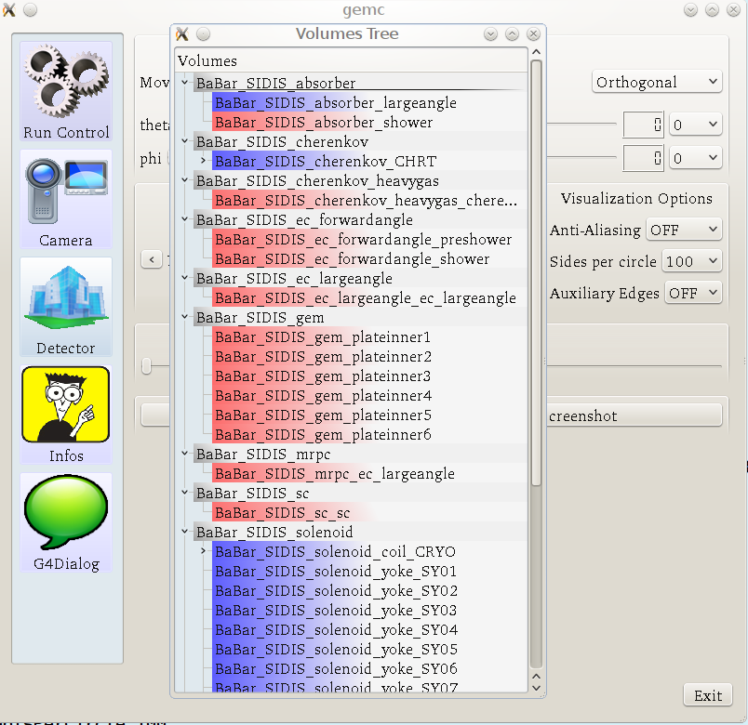
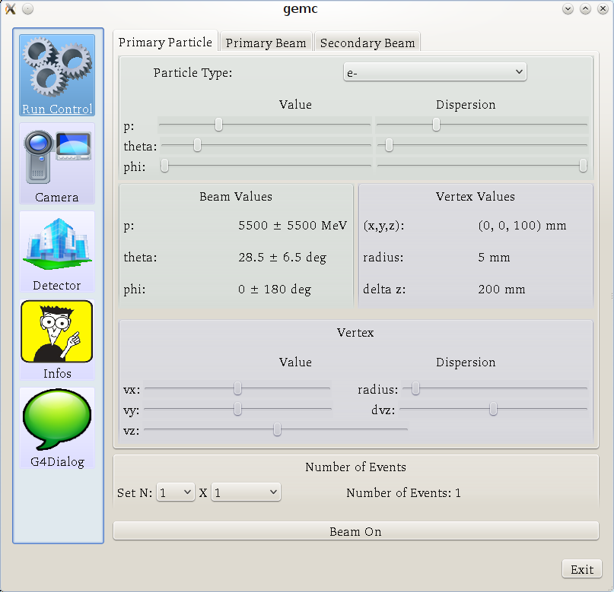
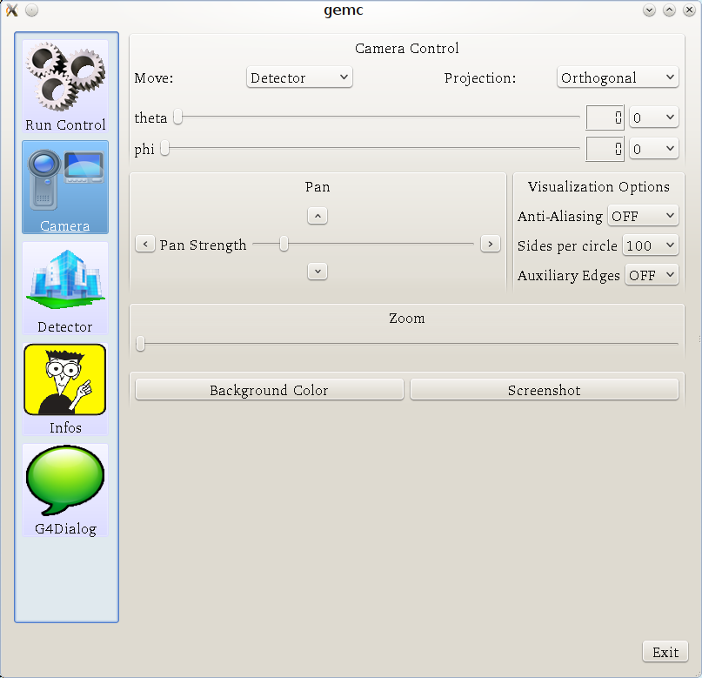
GEMC interface
Detector
Interactive mode
Run Control
Camera

Slide 6
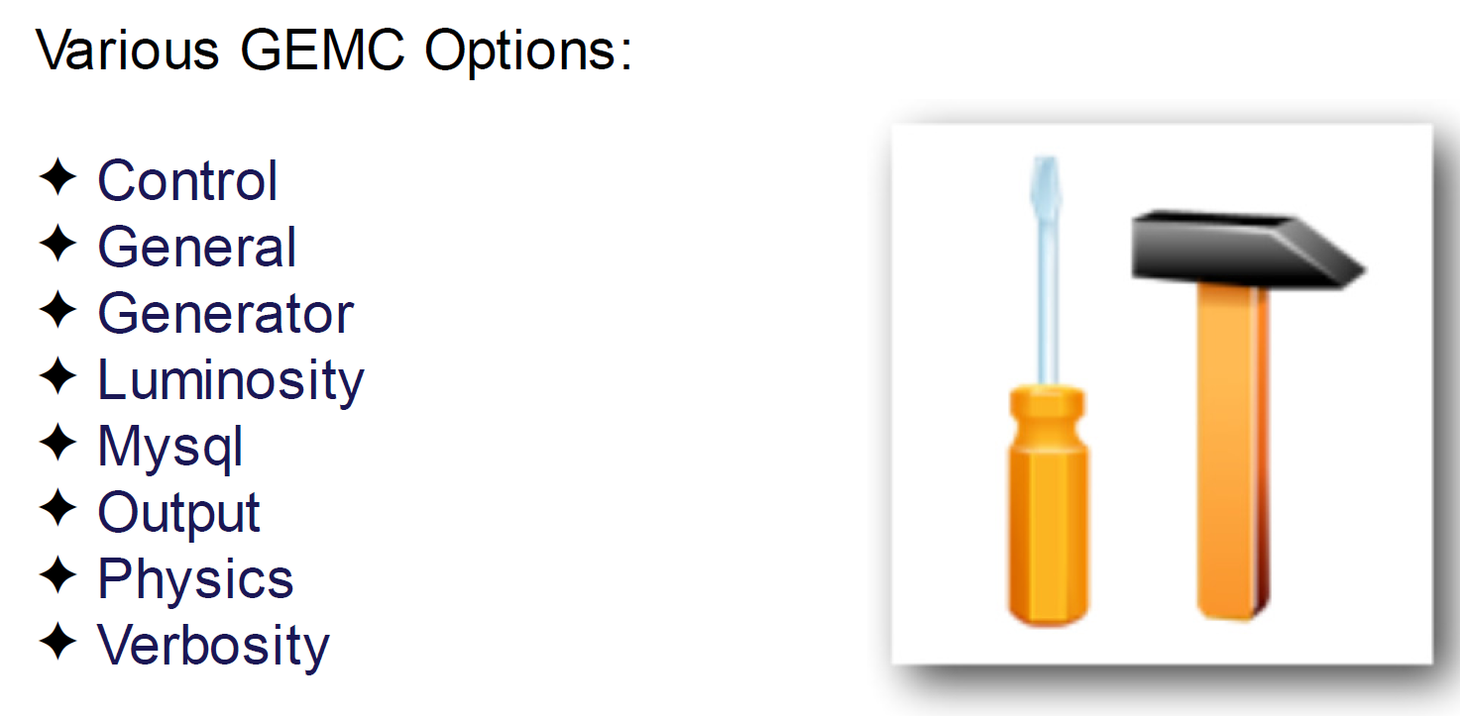
GEMC interface
Batch mode

Slide 7
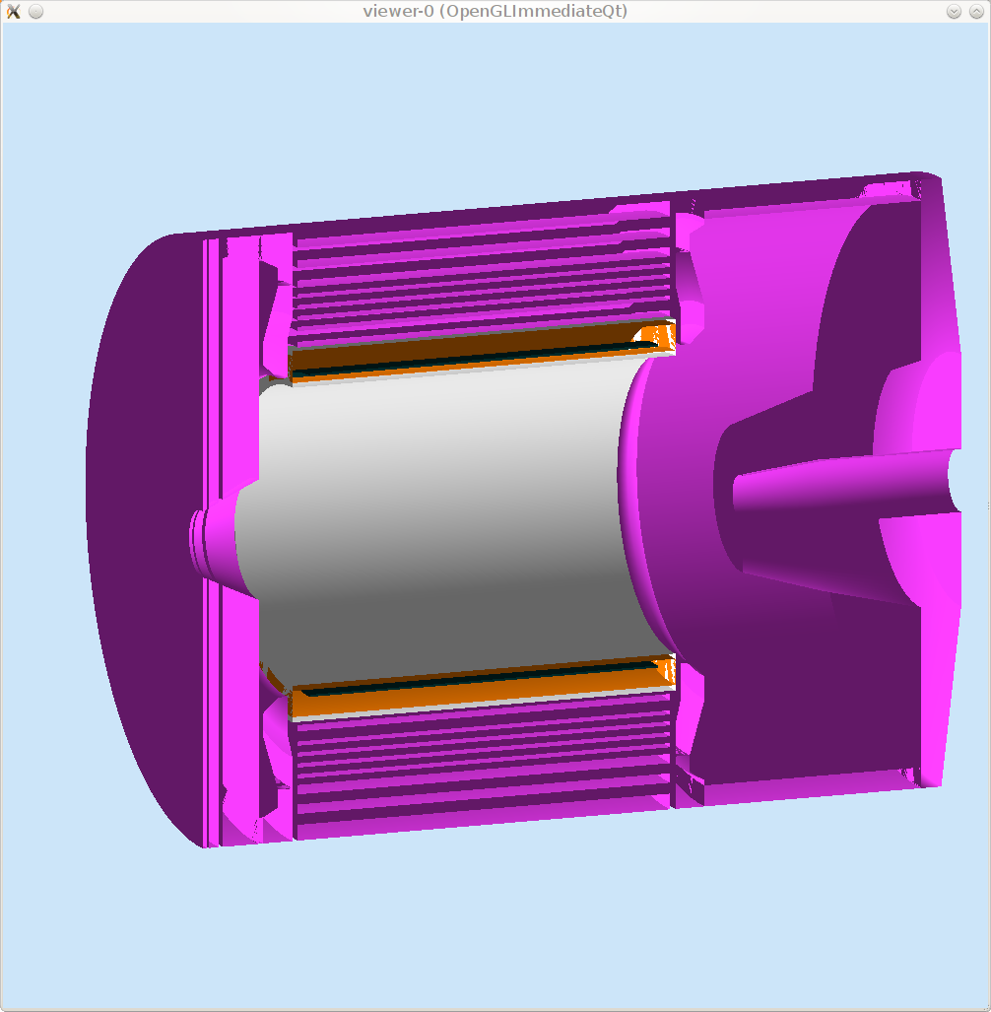
Magnet/coil/yoke
SIDIS with BaBar Magnet

Slide 8
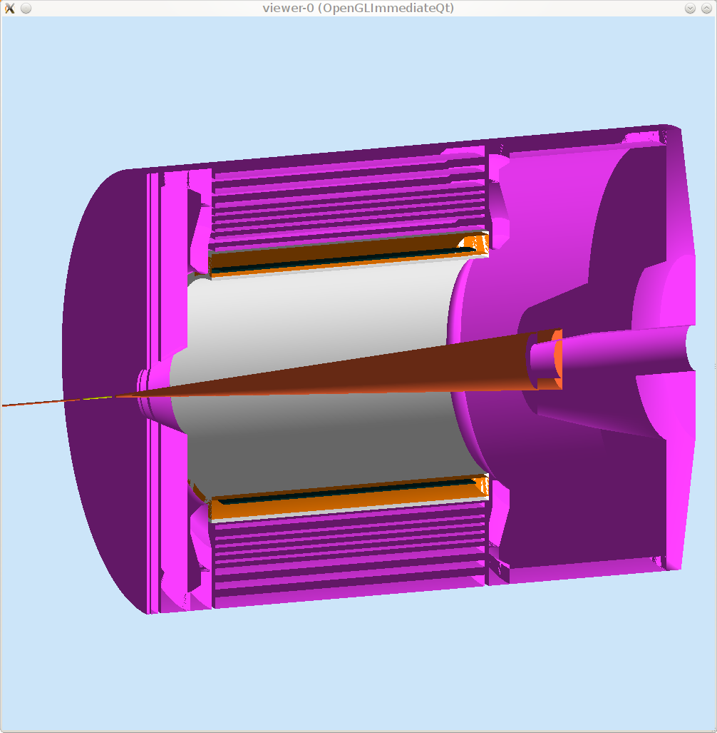
Target/Beam line
SIDIS with BaBar Magnet

Slide 9
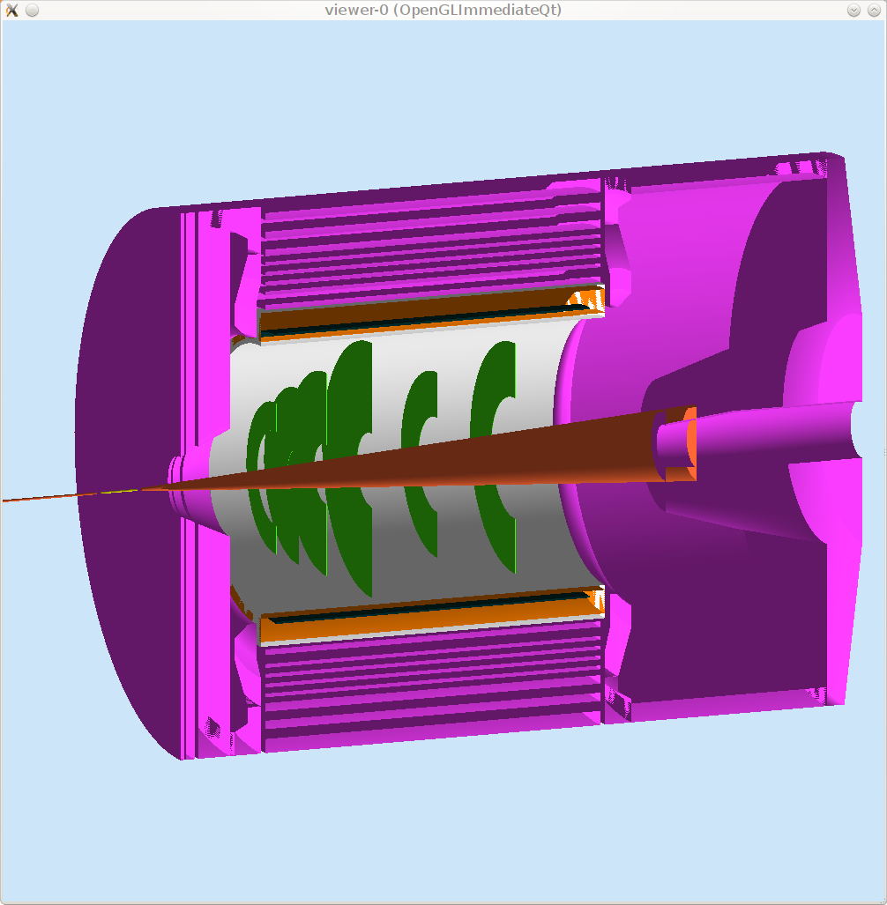
GEM
SIDIS with BaBar Magnet

Slide 10
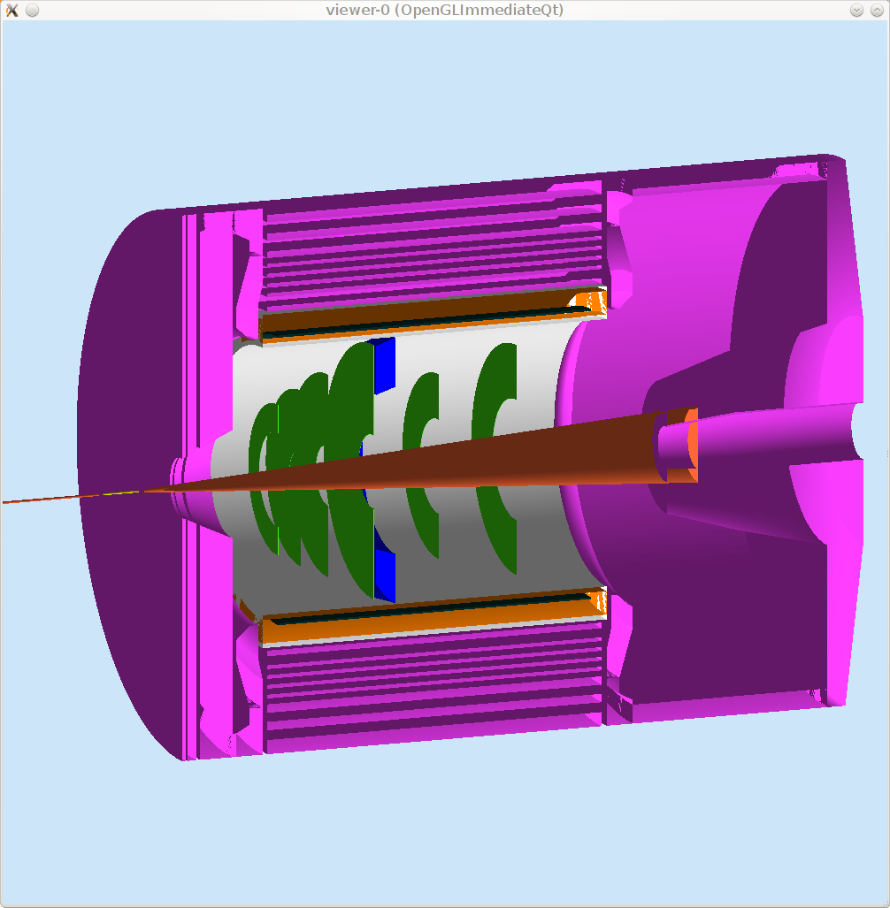
EC, large angle
SIDIS with BaBar Magnet

Slide 11
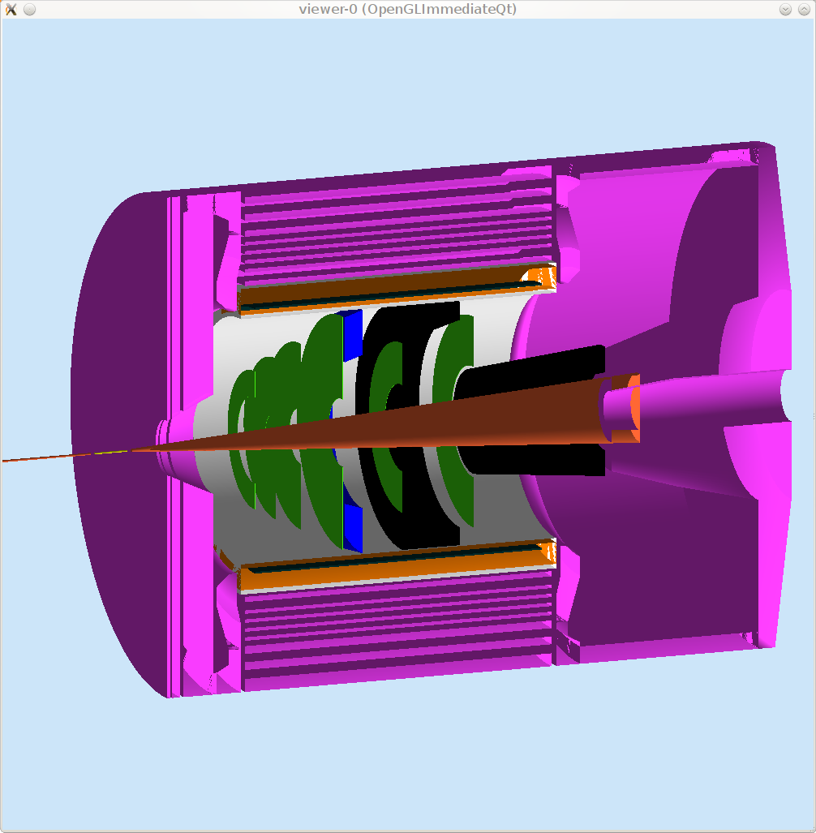
Collimator
SIDIS with BaBar Magnet

Slide 12
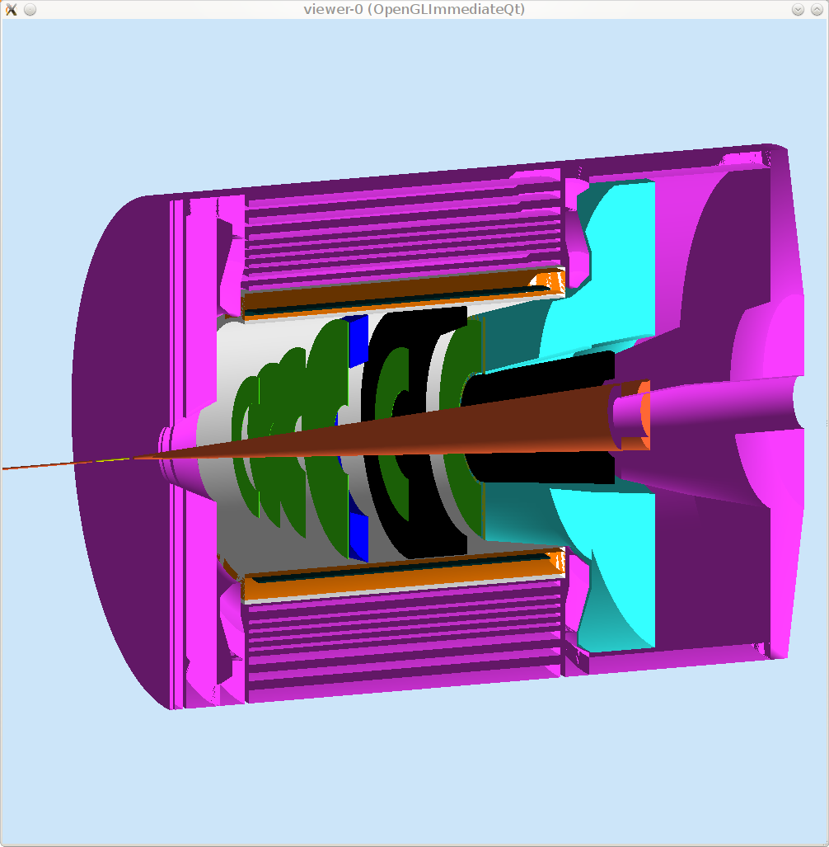
Cherenkov, light gas
SIDIS with BaBar Magnet

Slide 13

Scintillator
SIDIS with BaBar Magnet

Slide 14
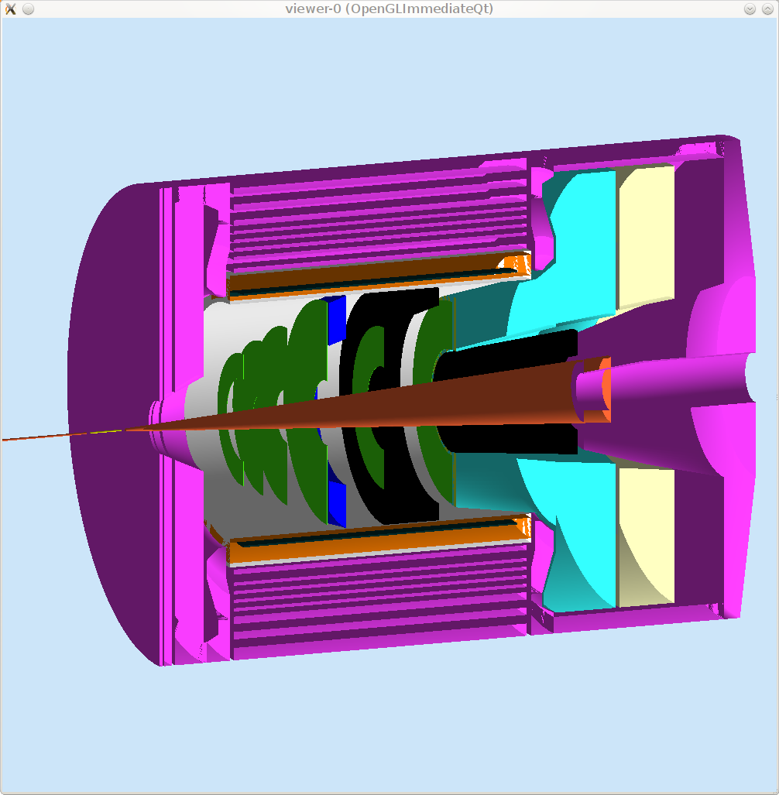
Cherenkov, heavy gas
SIDIS with BaBar Magnet

Slide 15

MRPC (Multigap Resistive Plate Chambers)
SIDIS with BaBar Magnet

Slide 16
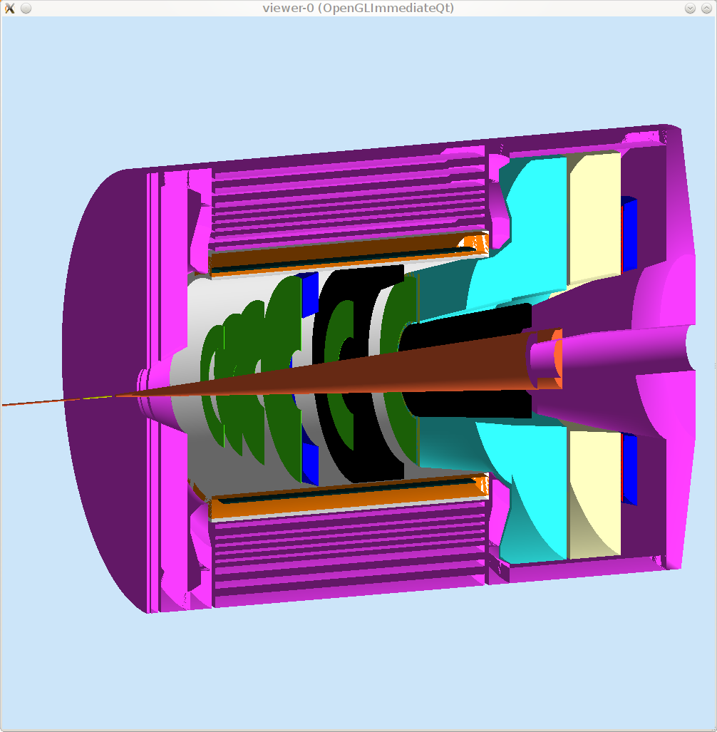
EC, forward angle
SIDIS with BaBar Magnet

Slide 17
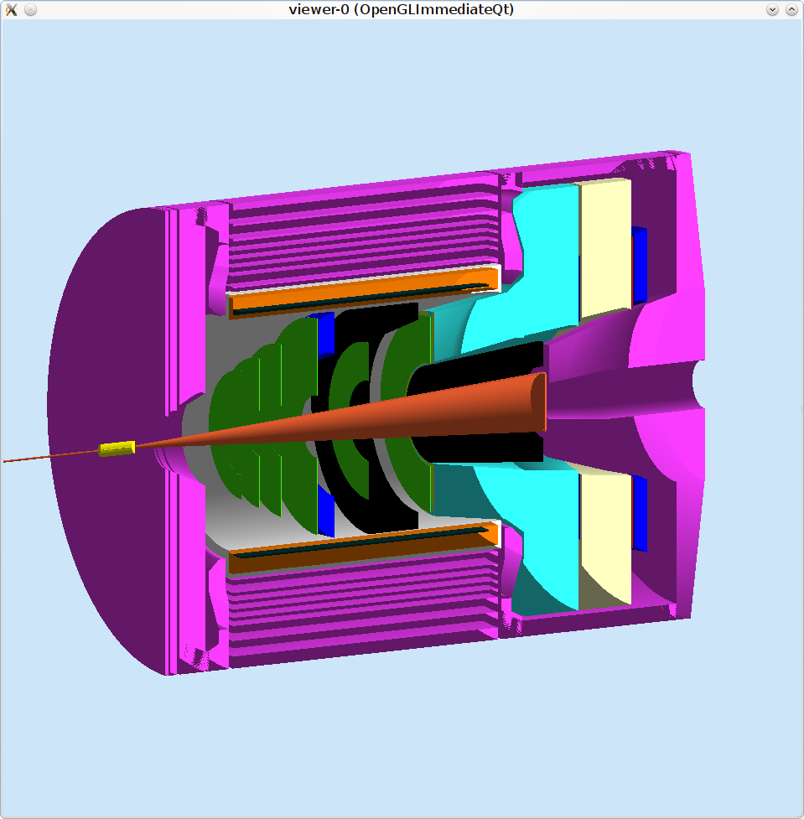
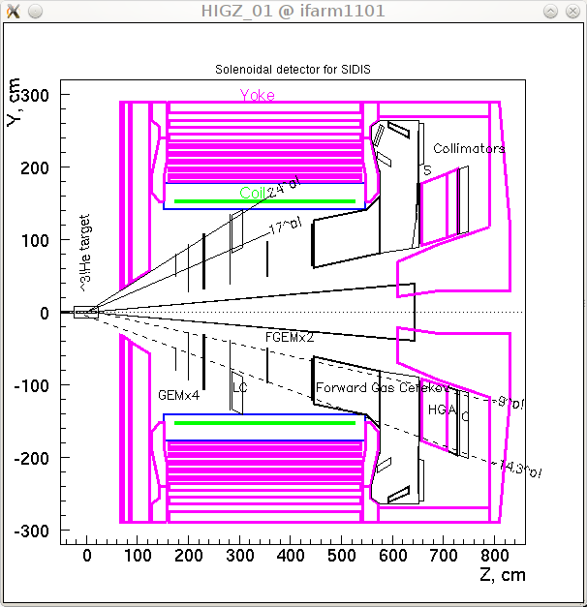
SIDIS with BaBar Magnet
geant4
geant3

Slide 18
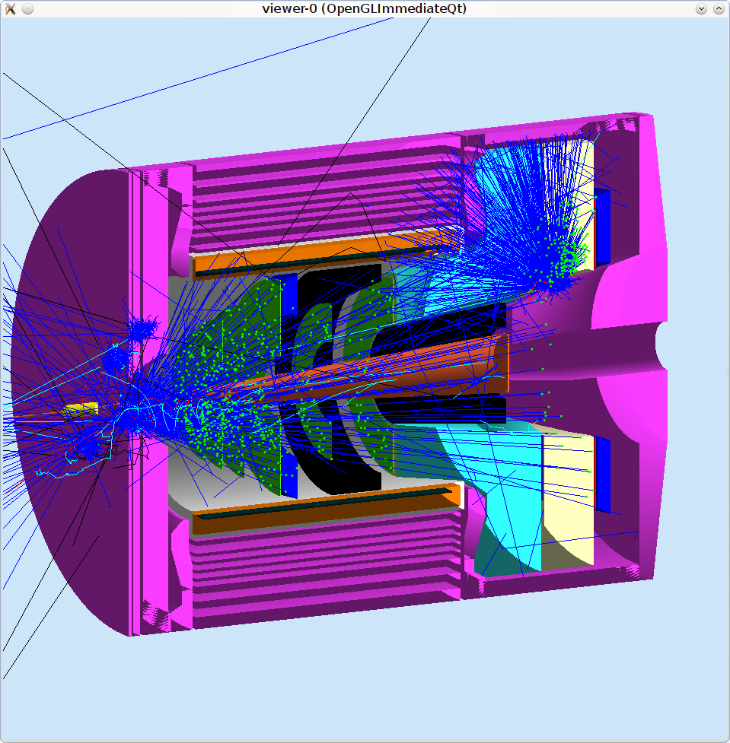
SIDIS with BaBar Magnet
geant4
geant3

Slide 19
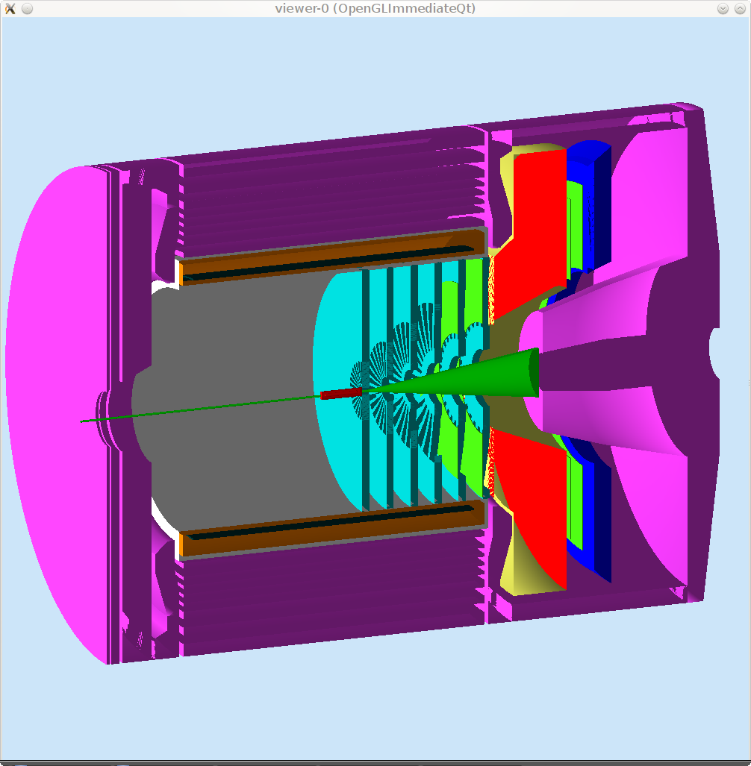
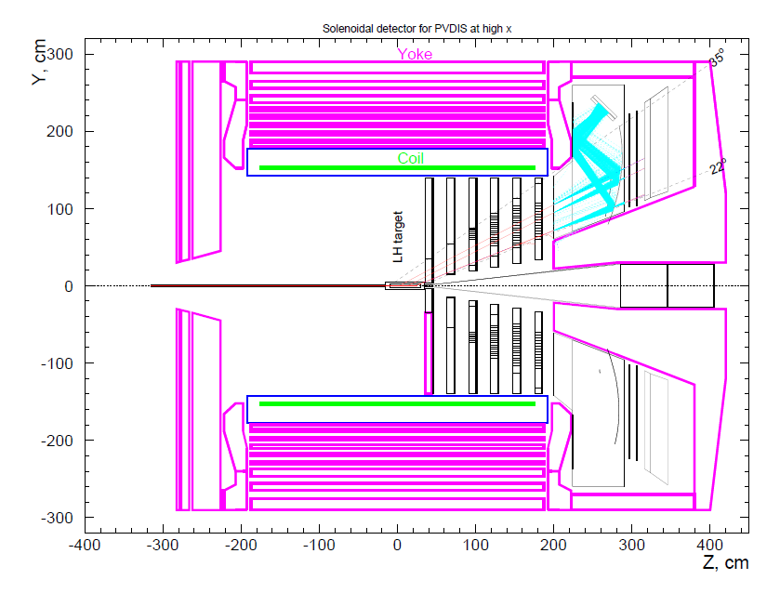
PVDIS with BaBar Magnet
geant4
geant3
Baffle

Slide 20
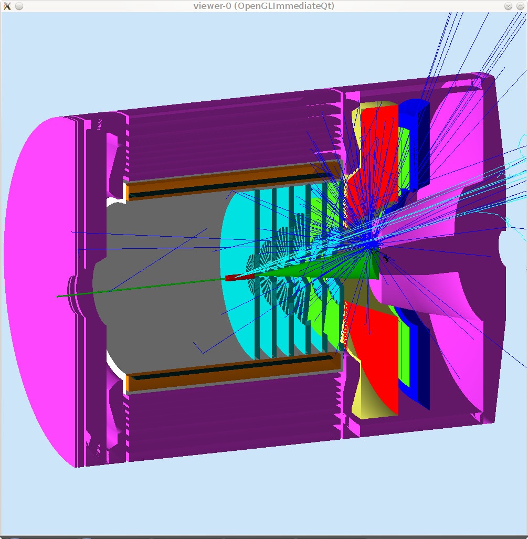
PVDIS with BaBar Magnet
geant4
geant3

Slide 21
SoLID GEMC Framework
geometry/sensitivity/digitization/field in mysql databases.
Customized hit processing for various detectors.
Unified individual detector simulation and the whole SoLID simulation.
Share the knowledge and use it for other projects.

Slide 22
Simulation Study
Magnet Option
SIDIS Kinematics Study
Background rate and GEM tracking
Energy flux and EC
PVDIS baffle design and FOM
Cherenkov
Neutron background
Other progress

Slide 23

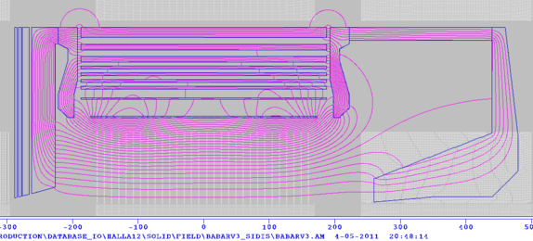
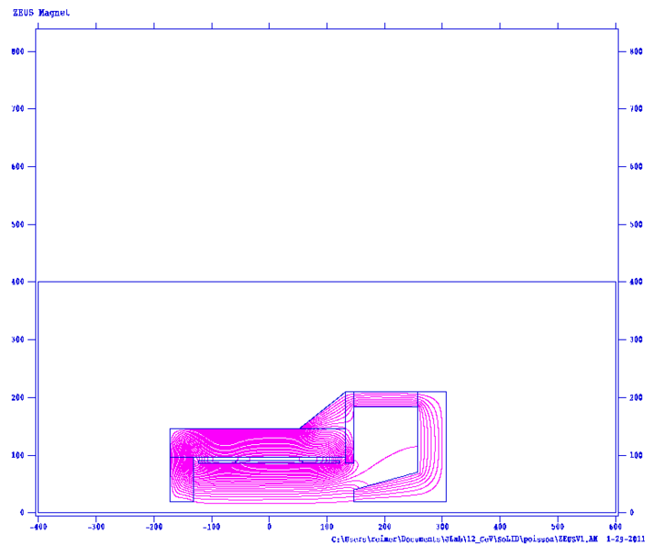
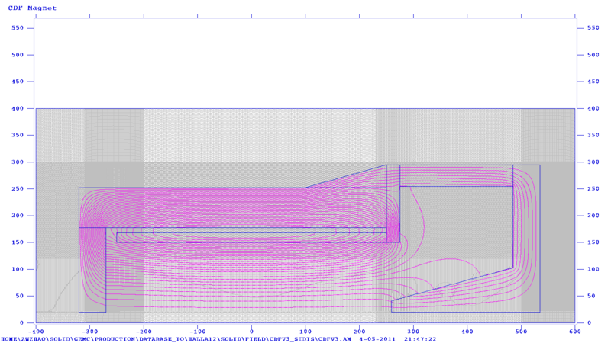

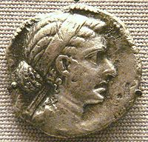
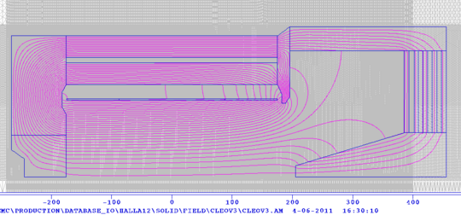
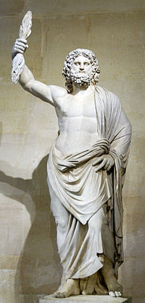
Magnet Option
Poisson 2D
BaBar
CDF
CLEO
ZEUS

Slide 24
Magnet Comparison
 | BaBar | CLEO | ZEUS | CDF | Glue-X |  | New
 |  |  |  |  | Old SLAC | New
Cryostat Inner Radius | 150 cm | 150 cm | 86 cm | 150 cm | 90 cm |  | Whatever we need
Length | 345 cm | 350cm | 245cm | 500 cm | 350 cm
Central Field | 1.49T | 1.5T | 1.8T | 1.47T | 2 T
Flux Return Iron | Yes | Yes | No | No | No
Cool Icon | Yes | Yes | Yes | No | No
Variation in Current density with z? | 2x more in end than central | 4.2% more in end than central | 40% more in end than central | No | Yes | Yes
Available | Probably Not?? | Probably | Probably | Probably | One will be available |  | ?

Slide 25
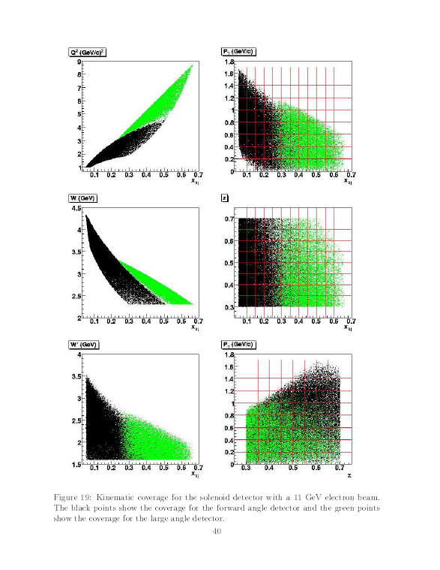
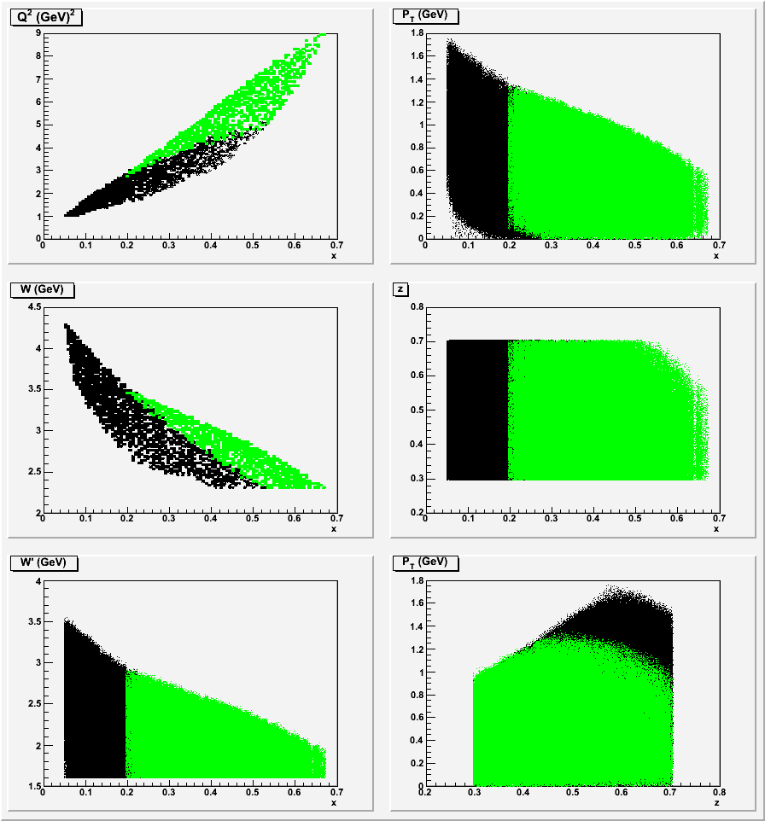
Kinematics for SIDIS
BaBar
geant4
geant3

Slide 26
SIDIS Kinematic Coverage@11GeV
 | ZEUS | BaBar/CLEO | CDF
x | 0.05-0.58 | 0.05-0.65 | 0.05-0.64
z | 0.3-0.7 | 0.3-0.7 | 0.3-0.7
Q² | 1-6 | 1-9 | 1-7.2
W | 2.3-4.2 | 2.3-4.4 | 2.3-4.2
W’ | 1.6-3.4 | 1.6-3.5 | 1.6-3.4
P_{T} | 0-1.45 | 0-1.7 | 0-1.45

Slide 27
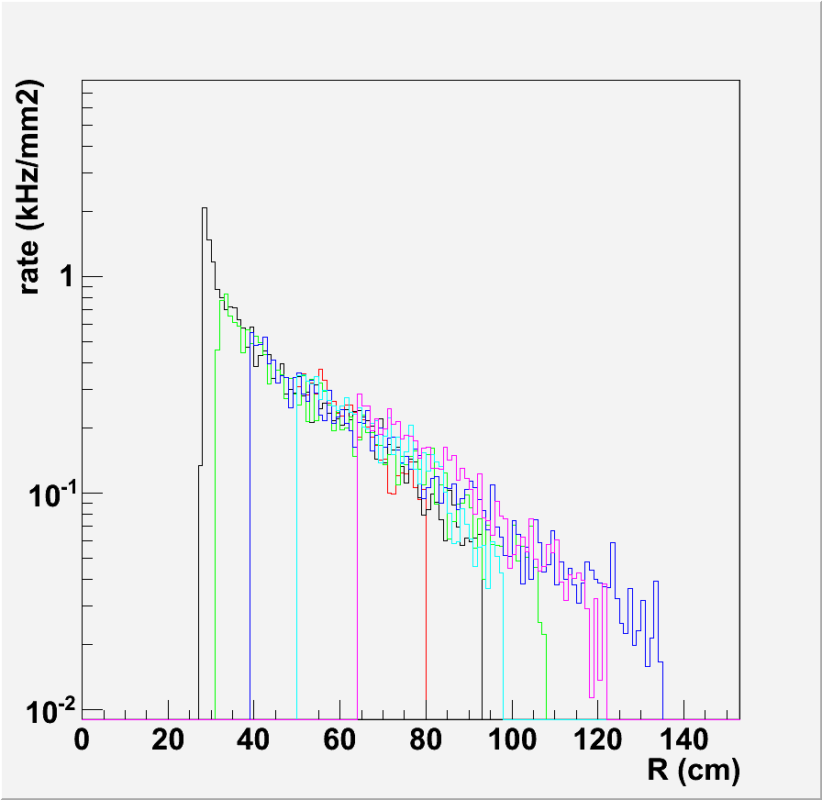
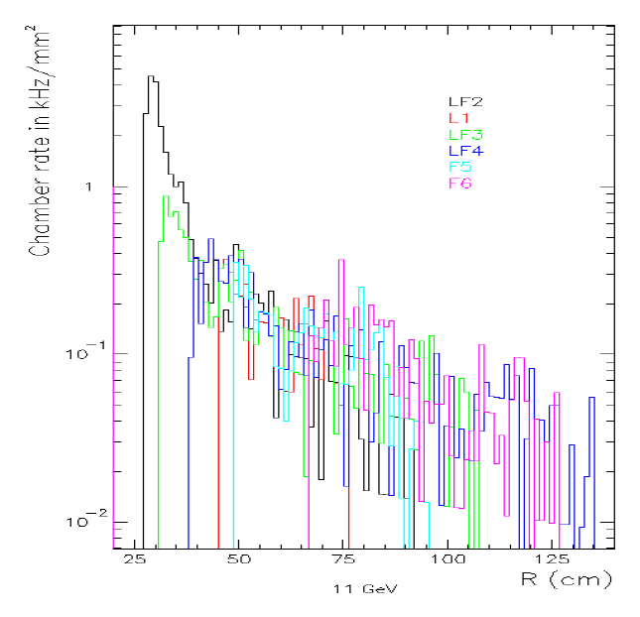
Background Rate on GEM for SIDIS
geant4
geant3
BaBar
CDF
Condition: 15uA 11GeV e- beam, 40cm 3He 10amg gas target
Result: geant4 is about 1/2 of geant3 with a different magnet

Slide 28
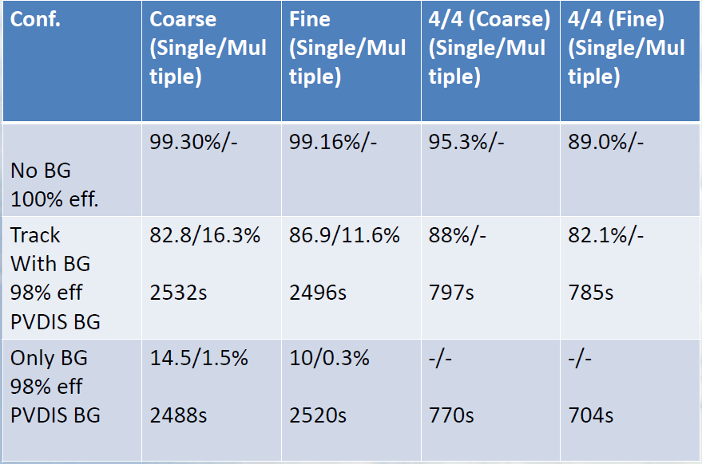
Tracking Progressive Method (curved tracks)
PVDIS, based on simulated background on GEM
3/4
3/4
No EC
  Add EC, with BG Single/Multi : 97.5/0.27% time: 100 s

Slide 29
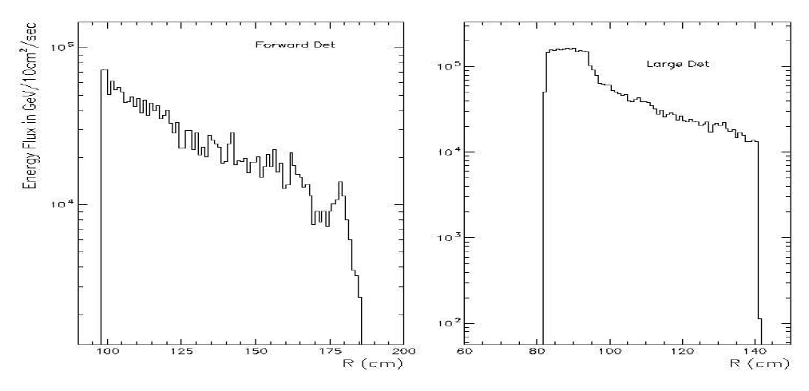
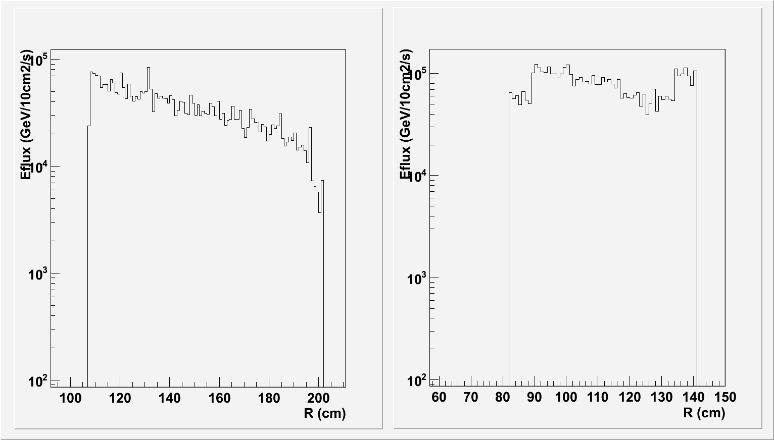
Energy Flux Rate on EC for SIDIS with BaBar Magnet
BaBar
Forward angle
Large angle
geant3
60krad/y
geant4
Condition: 15uA 11GeV e- beam, 40cm 3He 10amg gas target
Result: geant4 is close to geant3 with the same magnet

Slide 30
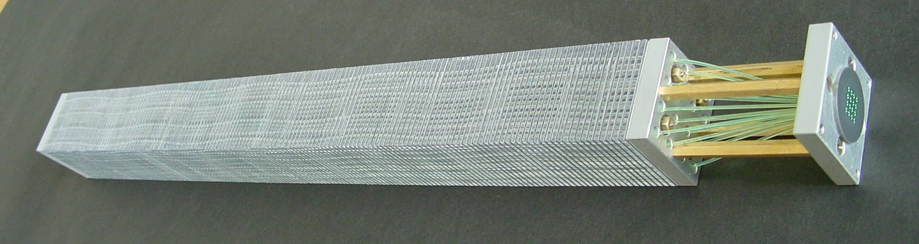
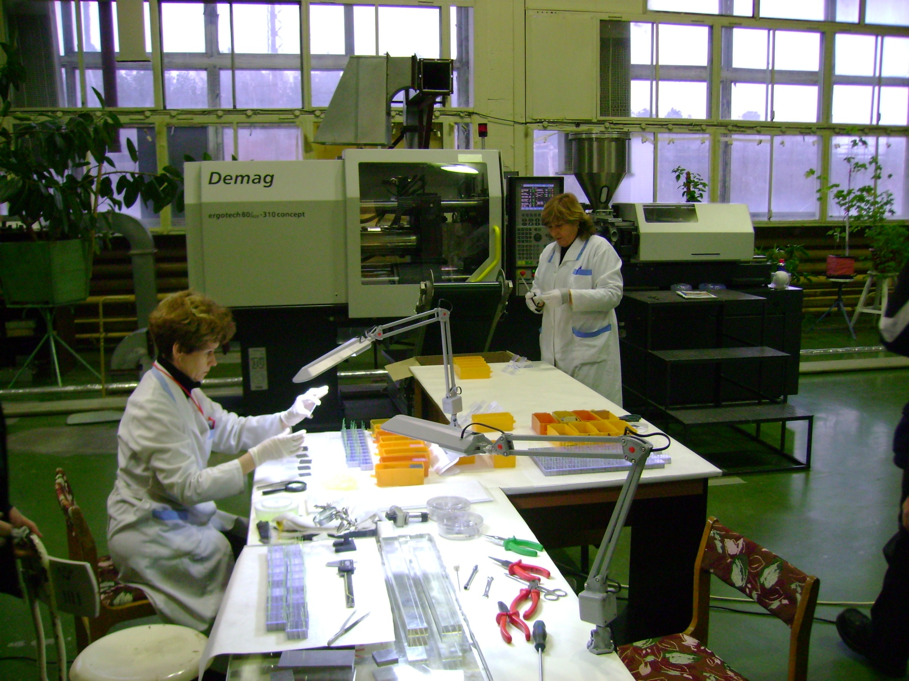
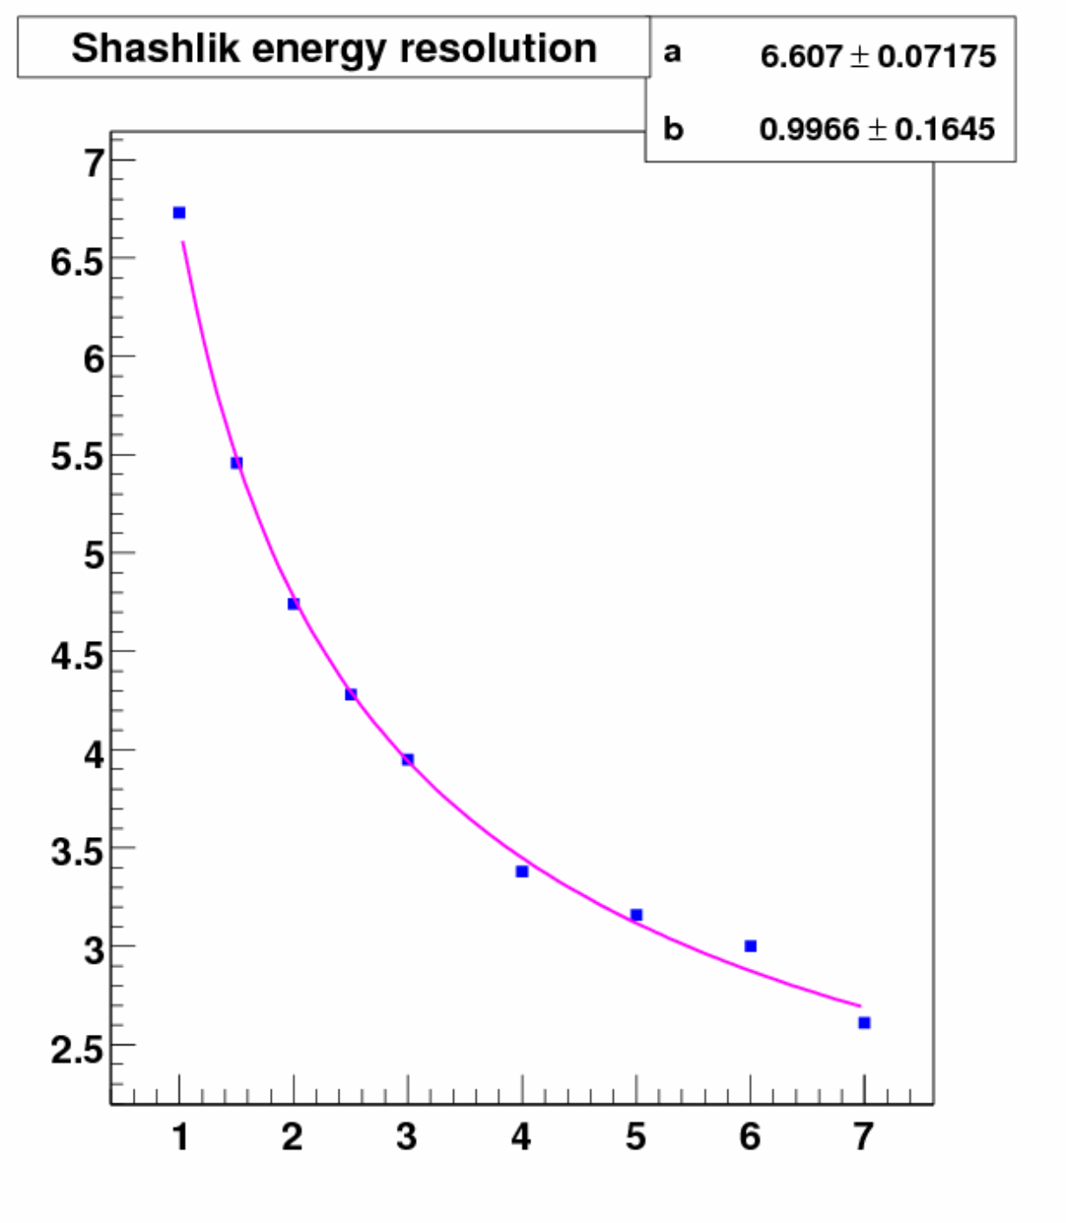
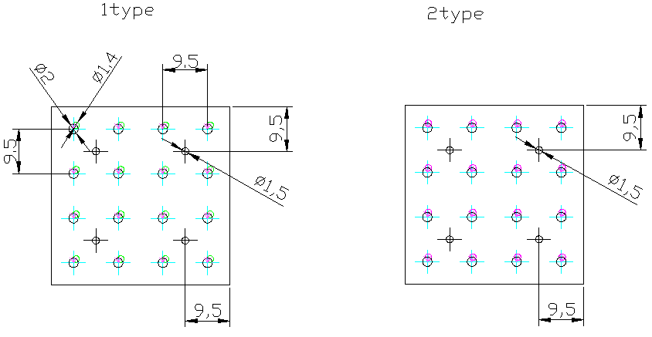
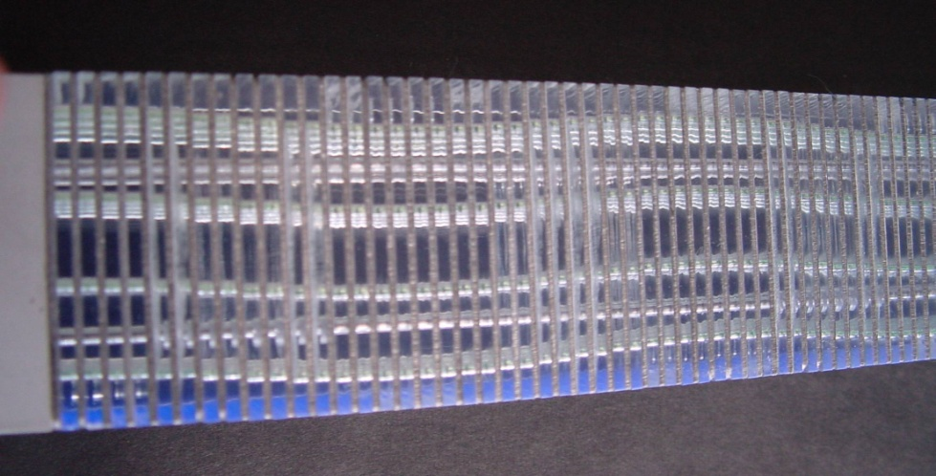
EC (Shashlik)
IHEP 2010 module
Dimensions 38.2x38.2 mm²
Radiation length 17.5mm
Moliere radius 36mm
Radiation thickness 22.5 X₀
Scintillator thickness 1.5mm
Lead thickness 0.8mm
Radiation hardness 500 krad
Energy resolution 6.5%/√E 1%

Slide 31
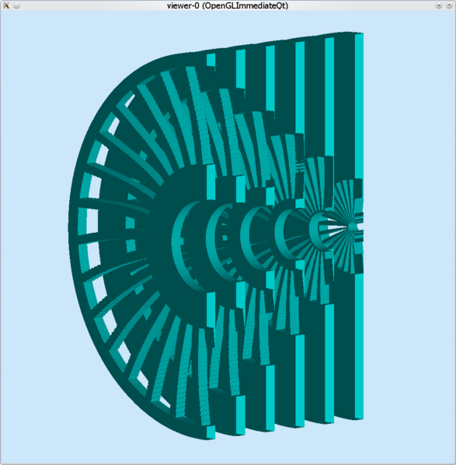
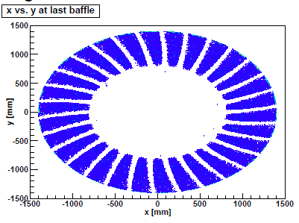
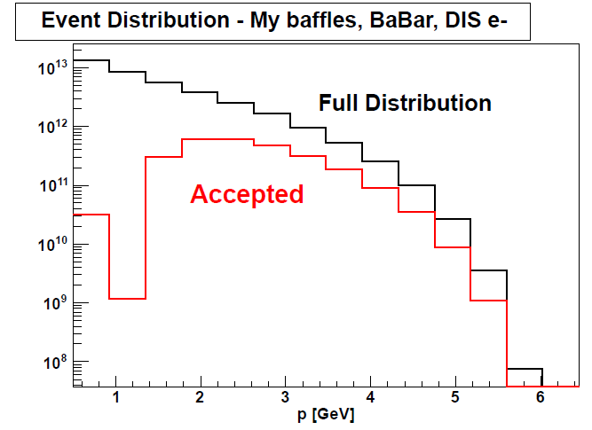
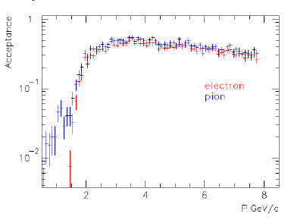
PVDIS Baffle
Reduce background by 50

Slide 32
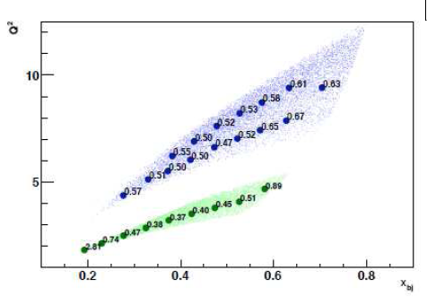
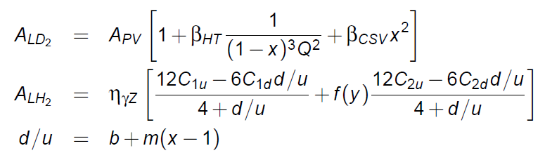
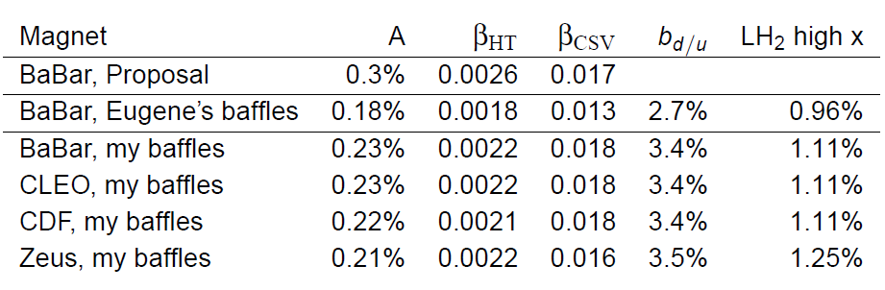
PVDIS FOM

Slide 33
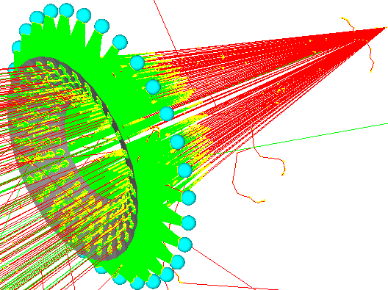
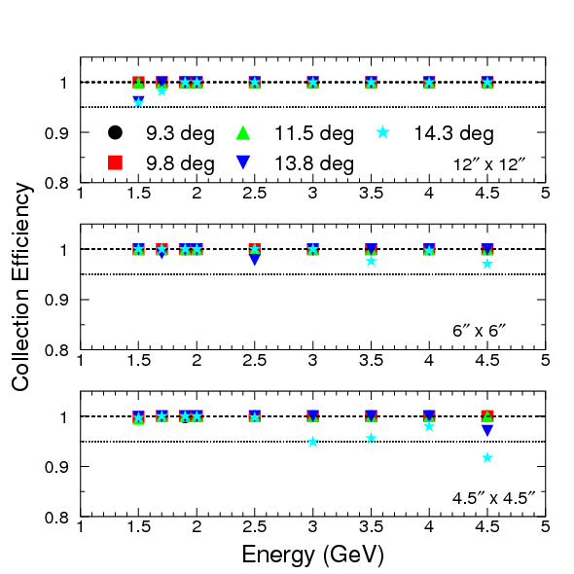
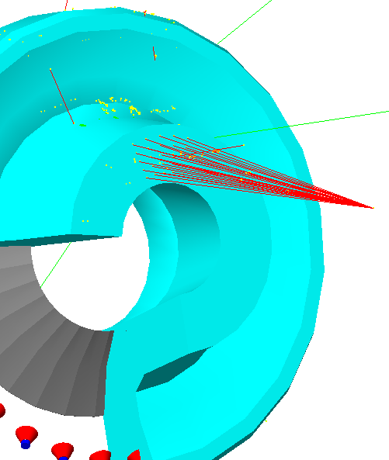
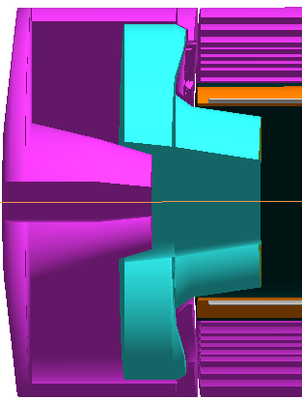
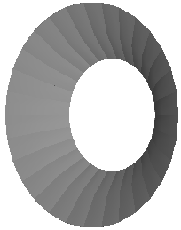
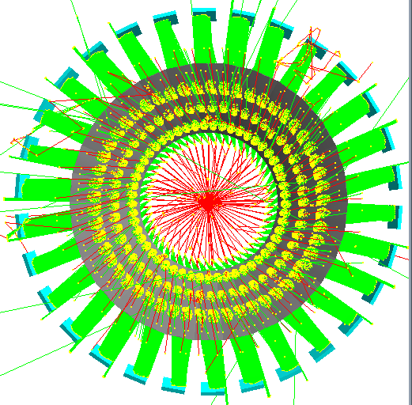
SIDIS Cherenkov: Optics
One spherical mirror

Slide 34

SIDIS Cherenkov: Detector
(Some) Requirements: 1) resistant in magnetic field
3) decent size
2) “quiet”
yes
yes
?
Used by PHENIX successfully
Gaseous Electron Multiplier + CsI
GEMs + CsI: resistant in magnetic field, size is not a problem
Consists of 3 layers of GEMs, first coated with CsI which acts as a photocathode
First GEM metallic surface overlayed with Ni and Au to ensure stability of CsI (CsI not stable on Cu)

Slide 35


Neutron Background
Use FLUKA
Work in progress

Slide 36
Other Progress
GEM
Small prototype tested in Jlab. R&D Efforts from UVa/INFN/Jlab/China are combined with the GEM R&D for the Super-BigBite & EIC. Several large prototypes are being built in China and US.
MRPC
Chinese collaborators will come onsite and have beam test in November.
DAQ
Collaborating with Hall D.

Slide 37
Summary
Solid collaboration has successfully adopted GEMC as its Geant4 simulation and joined in GEMC development. The simulation is ready to be used for various studies to help detector design.
A lot of subsystem design and simulation progresses have been made. More studies are under way.
In preparation for the director review.

Slide 38
Thanks
Maurizio Ungaro (GEMC)
Paul Reimer (Magnet)
Seamus Riordan (Baffle, PVDIS FOM)
Lorenzo Zana (Neutron BG)
Simona Malace (Cherenkov)
Jin Huang (Calorimeter)
Yang Zhang (ZUES kinematics)
Eugene Chudakov (Comgeant PVDIS)
Xin Qian (Comgeant SIDIS)

Slide 39
Backup

Slide 40
Welcome to join in
http://hallaweb.jlab.org/12GeV/SoLID/
https://hallaweb.jlab.org/wiki/index.php/SoLID
halla12_software@jlab.org
Weekly meeting on Wednesday 1:30PM at F226
Share the knowledge
Use it for other projects

Slide 41
How To: new detector, hits
$detector{"pos"} = ”10*cm 20*cm 305*mm";
$detector{"rotation"} = "90*deg 25*deg 0*deg";
$detector{"color"} = "66bbff";
$detector{"type"} = "Trd";
$detector{"dimensions"} = ”1*cm 2*cm 3*cm 4*cm 5*cm";
$detector{"material"} = "Scintillator";
$detector{"mfield"} = "no";
$detector{"ncopy"} = 12;
$detector{"pMany"} = 1;
$detector{"exist"} = 1;
$detector{"visible"} = 1;
$detector{"style"} = 1;
$detector{"sensitivity"} = "CTOF";
$detector{"hit_type"} = "CTOF";
$detector{"identifiers"} = "paddle manual 2";
16th: Bank
17th: Digitization Routine
In general, 1 bank ←→ 1 digitization routine… but not necessary

Slide 42
Factory Method for Hit Processes
Hit Process, Digitizations External
Routines
SVT
CTOF
Automatic Process
Routines Still External
Easy to:
add new routine
debug
modify
gemc DC
gemc FTOF
Notes:
Factory method is a plug-in type approach.
A template is made for all hit routines. It’s c++ so called virtual class with pure virtual methods.
This is the empty box you see here.
The advantage of this is that the I/O to the code is already taken care of, so the routines are stand alone code (i.e. plug-in) with fixed input and dynamic output.
Programmers don’t have to look in the code for anything, just worry on how to process and digitized the hit based on position, energy, timing, etc of each step.
They just have to “fill the box”

Slide 43
Digitization
Available For every G4 step Hit Process Example
Hit Position
Volume Local Hit Position
Deposited energy
Time of the hit
Momentum of the Track
Energy of the track
Primary Vertex of track
Particle ID
Identifier
Mother Particle ID
Mother Vertex
Average (x,y,z)
Average (lx, ly, lz)
Total E
Average t
Average p (final p)
Energy
Primary Vertex of track
Particle ID
Strip, Layer, Sector

Slide 44
Event Generation
Particle gun built in, two luminosity beams can be added
LUND Format (txt) for physics events
Data Output
evio, bank alike binary format by Jlab DAQ group
Root tree, convert from evio
text

Slide 45
SoLID Event Generator
DIS e- and pion generators are ready in C++
e- and pion coincidence generator is ready in C++
FLUX, raw, EC …
SoLID Hit Processing

Slide 46

SoLID Simulation Databasre soliddb.jlab.org
Mysql 5 cluster server. It is highly efficient and has minimum downtime.
Flexible development structure.

Slide 47

Documentation
gemc.jlab.org
https://hallaweb.jlab.org/wiki/index.php/Solid_sim_geant4

Slide 48

Netpbm

Slide 49

CLAS12 SVT

Slide 50
GEMC update
Progress
Mirrors, done in the “identifiers” entry of the geometry, control optical property on fly.
Right click to output geometry in GDML format.
Mother particle tracking becoming optional to optimize speed.
Todo list
Move material definition into database also.
Move svn repository out of clas12svn and restructure.
Improve database I/O.
Adapt to Geant4.9.4.

Slide 51
SoLID GEMC update
Progress
Add “solid” HIT_PROCESS_LIST
More database added in soliddb.jlab.org to allow for the full SoLID, its subsystems simulation. Also database for individual developers.
PVDIS and SIDIS yoke designs and field maps are unified
More materials added for our setup.
More instructions on wiki
Rewrote many geometry to avoid overlap and added more
EC simulation in GEMC is under work.
Baffle redesign for various magnets
Event generators updated for PVDIS and SIDIS
Study configuration with ZEUS magnet.
Todo list
Move subsystem simulation to GEMC
Customize hit routine
Direct root output

Slide 52
Compare geant4 to geant3 results
Progress
SIDIS kinematics and angle distribution
SIDIS and PVDIS low energy background rate.
Todo list
Acceptance
Detector resolution

