Slide 1



12 GeV MOLLER
Update to the Hall A Collaboration
Juliette M. Mammei

Slide 2
Outline
Physics motivation
Description of the experiment
Update on spectrometer design
(since Magnet Advisory Meeting)
Status and Future Plans

Slide 3
PV Moller scattering
e-
e-
e-
e-
Z⁰
e-
e-
e-
e-
12 GeV MOLLER A_{PV} ≈ 35 ± 0.7 ppb
A search for new physics
Notes:
Parity violation in the weak interaction can be exploited to measure things like the strange quark content of the nucleon as in HAPPEx, or the neutron skin, as in PREx. But precision measurements of the parity-violating asymmetry, such as Qweak and MOLLER, allow us to measure sin2thw, the weak mixing angle. The asymmetry arises because of the interference term in the scattering via a photon and neutral Z boson, leading to a quantity which is proportional to the weak mixing angle. Technically speaking, MOLLER is a measurement of the weak charge of the electron, just as Qweak is a measure of the weak charge of the proton. However, the real motivation for performing the measurement is because of its precision; deviations in the measured value of sin2thW would be indications of physics beyond the standard model.

Slide 4
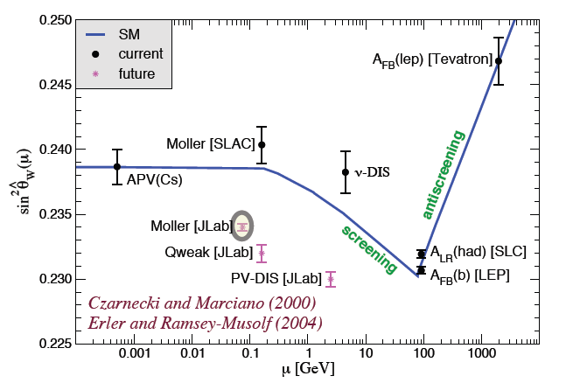
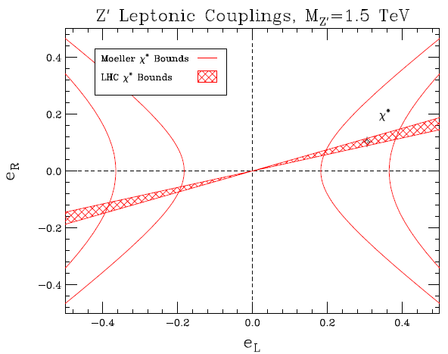
Complementary to the LHC
0.1% measurement of sin²θ_{W}!
Petriello et. al. (2009)
Notes:
The MOLLER measurement will be complementary to measurements made at the LHC. While a discovery-type experiment at a high energy collider will measure the mass of possible new exchange particles, experiments like Qweak and MOLLER will be able to tell something about the properties of the new particles, such as their couplings. On the lower left is an example of how, for a Z’ model at a particular mass scale, the MOLLER measurement will complement the LHC measurements to tell us something about the left-right couplings.
The energy reach is directly related to the precision of the experiment – the more precise, the higher the mass scale of new physics one is sensitive to. On some versions of this plot the measurements at the Z-pole are combined to give a really precise average, when actually the two measurements don’t agree! MOLLER will be a low energy measurement as precise as either of these two measurements – 0.1% measurement of sin2thW.

Slide 5

Comparison to Qweak
MOLLER Qweak
Target 150 cm, 5kW 35 cm, 2.5 kW
Magnet 1550 A/cm² 500 A/cm²
Incident rate 20 GHz/sector 0.8 GHz/sector
Asymmetry 35 ± 0.7 ppb 200 ± 5 ppb
“Beam properties” ~0.2 ppb ~2 ppb

Slide 6
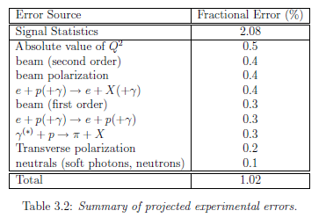
Error Budget
Dedicated measurements with auxiliary detectors
  Q2, transverse and inelastic asymmetries, pions
Careful design
  beam properties (1st and 2nd order – work at laser table)
  transverse (take advantage of cancellations)
  neutrals (design a “2-bounce” collimation system)
Improvements to polarimeters

Slide 7
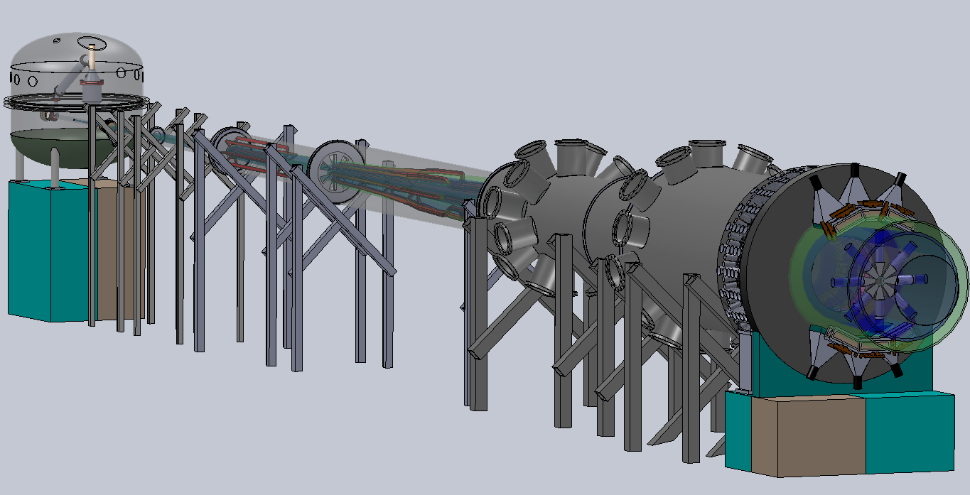
The Experiment
two-toroid spectrometer (focus Møller electrons from 5.5-19 mrads)
detectors located 28 m downstream (~150 GHz rate, <10% bkgd)
150 cm high power liquid hydrogen target
11 GeV, 75 μA beam
SOLIDWORKS STUDENT EDITION
Picture thanks to Patrick Rogan, UMass undergrad
Notes:
The experiment is a special installation experiment that will run after the 12 GeV Upgrade. It consists of two toroidal spectrometers which focus Moller electrons from 5.5 to 19 mrads onto main detectors located 28 m downstream of the 150 cm long LH2 target. A lot of work has gone into conceptual designs of the experiment in SolidWorks which include a model of the scattering chamber, the two toroids, beamline and supports and main detectors, as well as inserts for tracking detectors and luminosity monitors. The scattered electron envelop will be in vacuum until it reaches the main detectors.

Slide 8
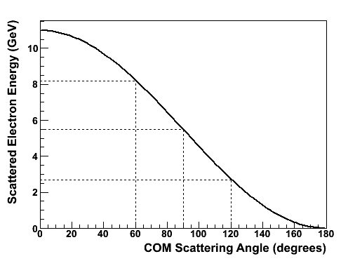
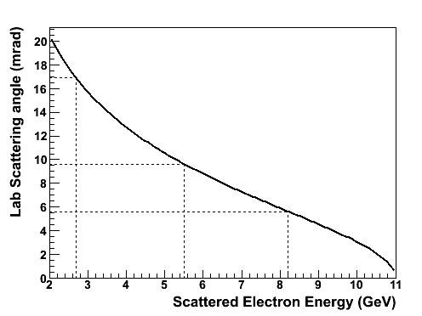
100% Azimuthal Acceptance
Identical particle scattering!
e-
Forward
e-
e-
Backward
e-
COM Frame
e-
e-
e-
e-
Lab Frame
Backward
Forward
Notes:
A unique feature of the identical particle scattering is that full phi acceptance is theoretically possible by considering the backward scattered electrons in the same sector, which correspond to the forward scattered electrons in the opposite sector. This leaves space for the coils, which can be placed behind shielding in the closed sectors. The implication is that a large range of scattered electron energies and angles have to be focused at the detector plane.

Slide 9
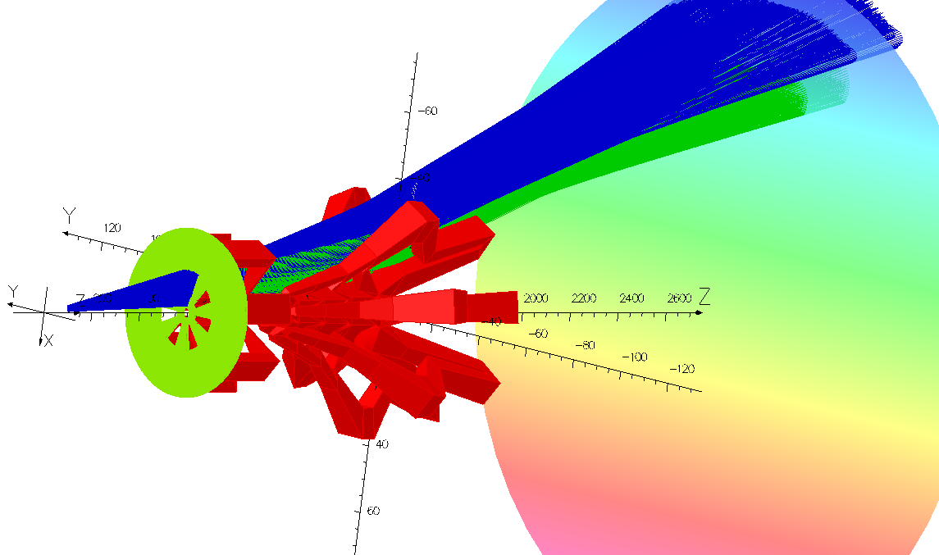
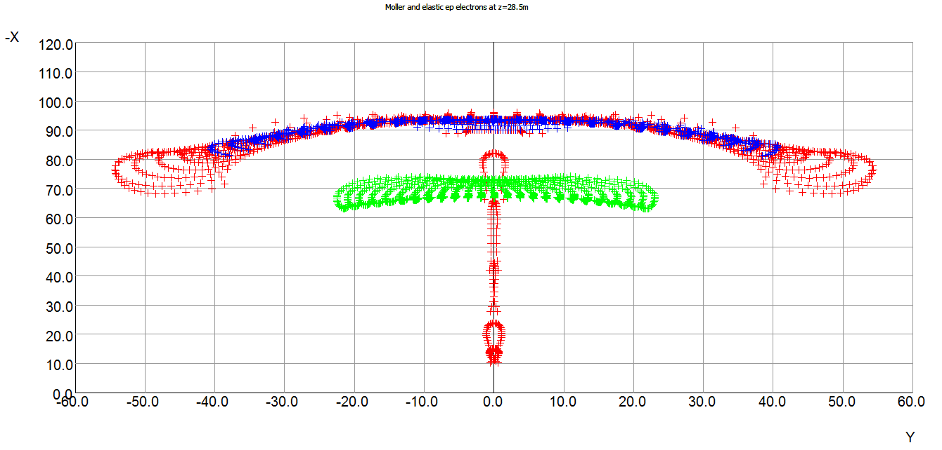
TOSCA
Commercial software available from Vector Fields
for finite element analysis
Tracking of particles with no radiative effects
Magnetic Forces
CAD-like capability
Physical layout of coils
Support structure
Export to step file
Use GEANT4 with a TOSCA-
generated field map
Notes:
Much recent work has been done on the design of the spectrometer using a commercial software package called TOSCA, which is frankly, really cool. It is designed to be used for finite element analysis, but can also be used in “coils-only” mode where it essentially does a Biot-Savart calculation of the fields if there are only linear materials. It can also do tracking of particles (with no radiative effects) and provide estimates of the magnetic forces of the coils. I used the CAD-like capability to design a realistic physical layout of the coils and am working on a conceptual design of the support structure. JLAB recently purchased a license for the step file translator, so that the geometry can be exported to CAD (and back).
For full simulations, which radiation and interaction in the materials, GEANT4 was used with a TOSCA-generated field map.

Slide 10
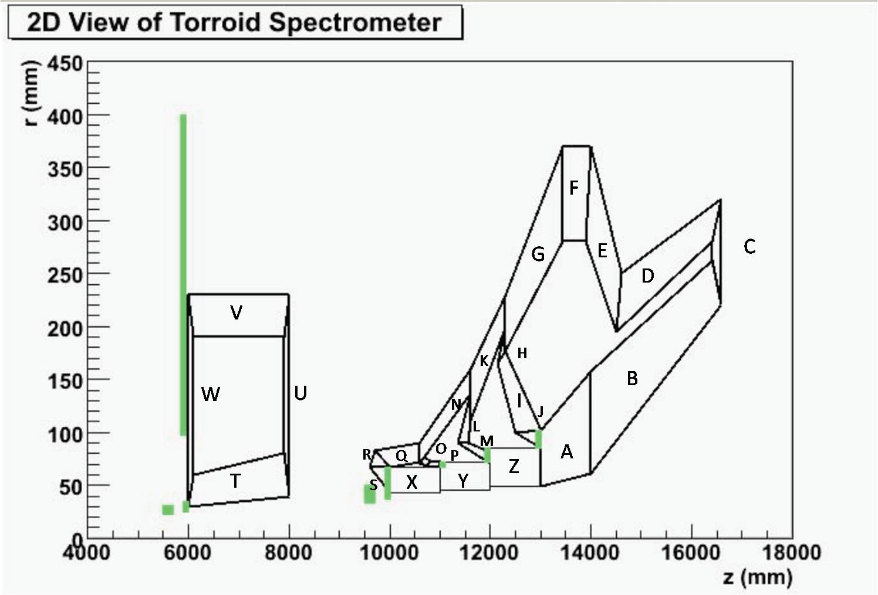
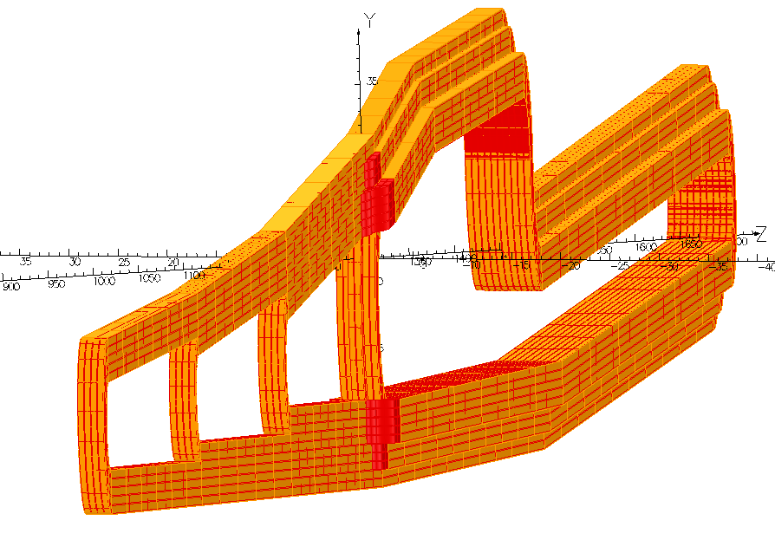
Conductor Layout
Biot-Savart calculation optimized current returns
Actual conductor layout
3L
3R
4L
4C
4R
2L
2R
1BL
1BR
1AL
1AR
Notes:
One of the magnets is a relatively standard, 7-sector, toroidal magnet. The other is a “hybrid” magnet with multiple current returns, which are necessary to tailor the field to bend the high energy, low angle moller electrons, while barely nudging the lower energy high angle mollers. Complicating the design is the necessity to keep separation between the moller and elastic ep electrons. For the proposal, a “home-grown” Biot-Savart calculation was used to optimize the amount of current in each of the returns, which didn’t account for the necessity of having integer multiples of some current. I used TOSCA to design an actual conductor layout which achieves the focus of the proposal and that can also actually be built.

Slide 11
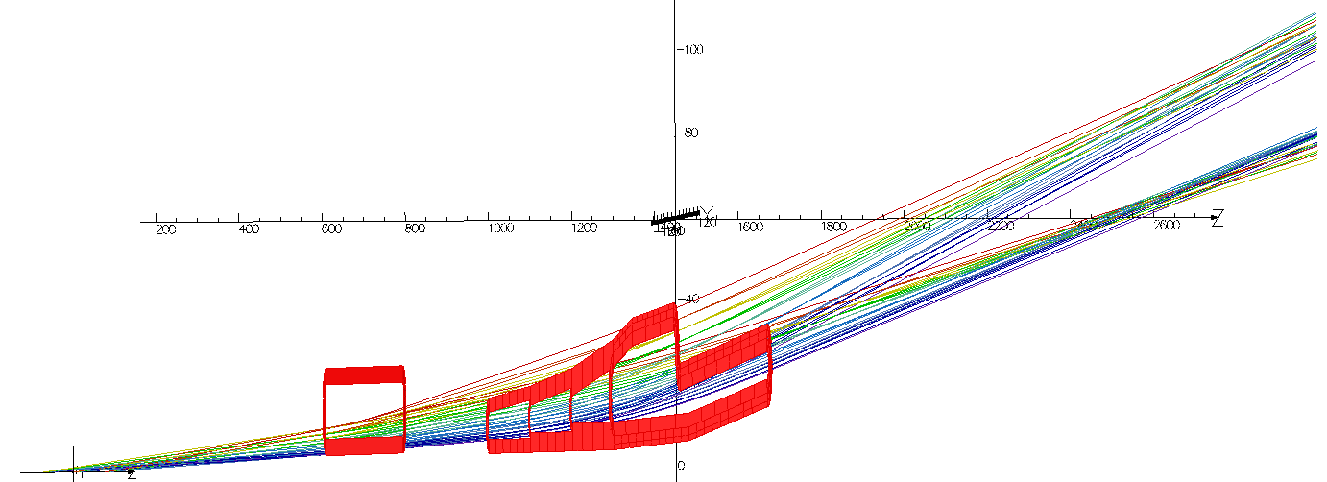
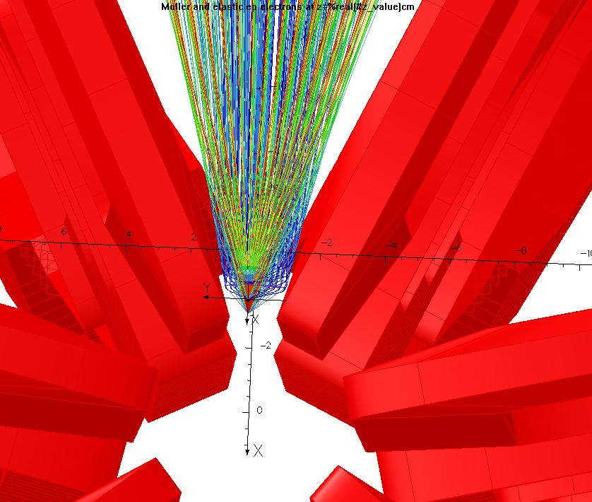
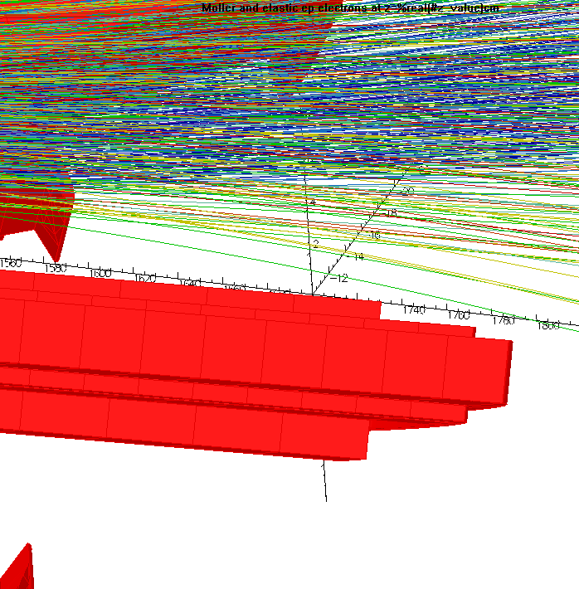
Tracking in TOSCA
Notes:
This slide shows the moller and elastic ep tracks, colored by scattering angle, going through the top sector. You can see the separation and the focus of the elastic eps. The moller focus is harder to see, partially because of the phi defocussing. TOSCA can also be used to look for interferences of the tracks with the coils; working iteratively I was able to design away some interferences.

Slide 12
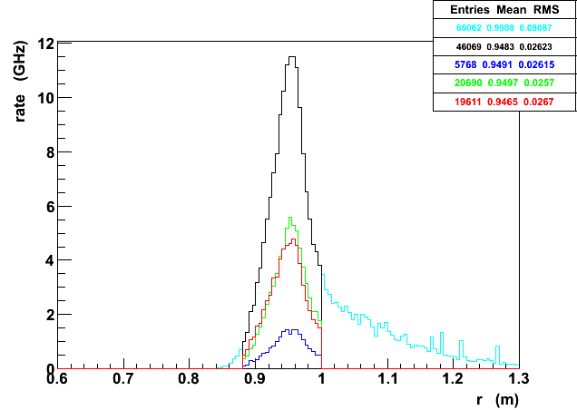
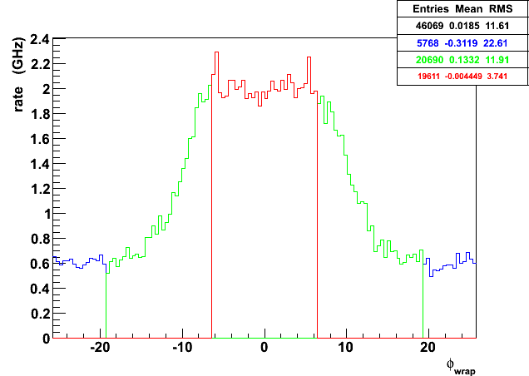
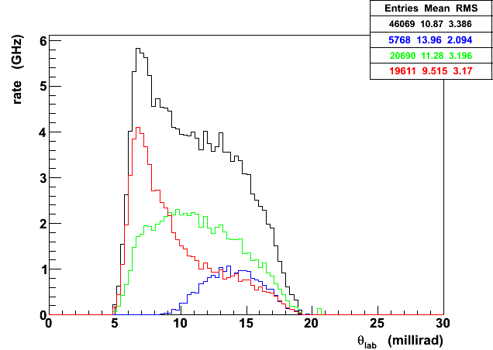
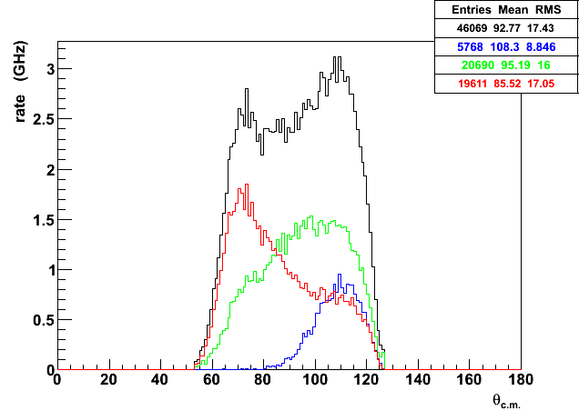
GEANT4 Results (Original Proposal Model)
Radius
(m)
ϕ
(degrees)
θ_{lab}
(degrees)
θ_{cm}
(degrees)
Notes:
This slide shows the GEANT4 focal plane distributions using the TOSCA-generated map to verify the results in the proposal. The upper left shows the radial distribution, the upper right shows the phi defocussing, and the bottom plots are of the accepted lab and center of momentum angular distributions.

Slide 13
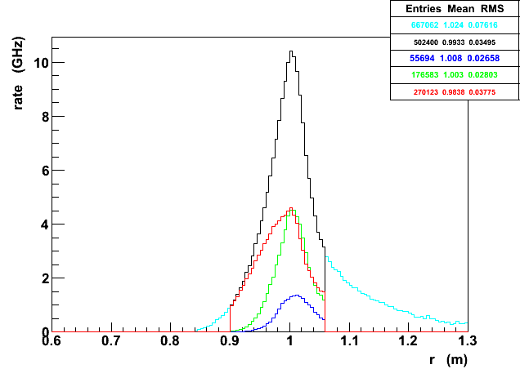
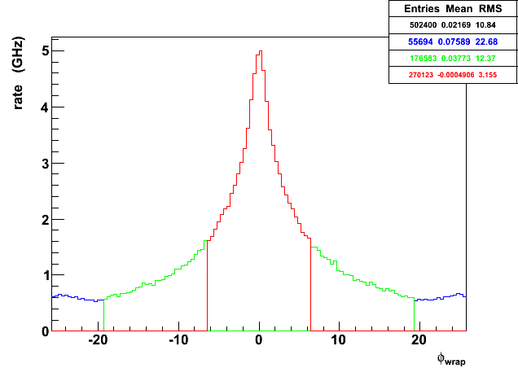
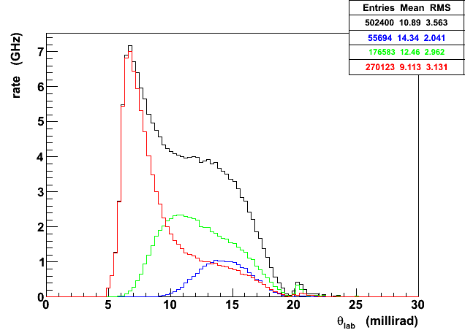
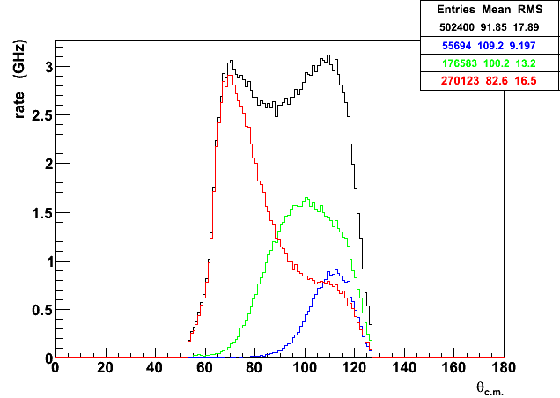
GEANT4 Results (TOSCA Model – actual Conductor Layout)
Radius
(m)
ϕ
(degrees)
θ_{lab}
(degrees)
θ_{cm}
(degrees)
Notes:
This slide shows the same plots, for the partially optimized actual conductor layout designed after taking into account suggestions from the engineers that we received during the magnet review in August. The phi distribution is because of the pre-focussing that occurs in the upstream torus. The radial and scattering angle distributions are nicely reproduced, though the moller peak occurs at a slightly larger radius than in the proposal. We are hoping that further tweaks could help reduce the width of the radial distribution a bit.

Slide 14
Magnet Stats
Property | Upstream | Hybrid | Qweak
Field Integral (T·m) | 0.15 | 1.1 | 0.89
Total Power (kW) | 40 | 765 | 1340
Current per wire (A) | 298 | 384 | 9500
Voltage per coil (V) | 19 | 285 | 18
Current Density (A/cm²) | 1200 | 1550 | 500
Wire cross section (ID: water hole, in) | 0.229x0.229 (0.128) | 0.229x0.229 (0.128) | 2.3x1.5 (0.8)
Weight of a coil (lbs) | 44 | 555 | 7600
Magnetic Forces (lbs) | 100 | 3000 | 27000
Notes:
Here are some stats comparing the upstream and hybrid toroids to the Qweak magnet. Our main concern was initially the high current density, however the engineers were more concerned with the size of the water-cooling hole. In the preliminary design I presented to them, this hole was too small, and especially because we will have to have a high flow rate of the water, plugs could develop because of eddies in the bends. They recommended a minimum size water-cooling hole and the design I have presented here takes that into account.

Slide 15
Backgrounds
Field Map | Moller (GHz) | Elastic ep (GHz) | Inelastic ep (GHz) | Background (%)
Proposal | 133 | 12 | 0.4 | 9
TOSCA | 155 | 14 | 0.5 | 8
Other sources of background include:
  scattering from aluminum target windows
  multiple-bounce photons (minimize 1-bounce)
  neutrons
  weak decays with large analyzing power
To be studied with GEANT4 simulation!
Notes:
Simulation work is underway to study the backgrounds. It is hoped that reducing the width of the moller peak will reduce the backgrounds, though the backgrounds from elastic and inelastic eps seem to be similar to that of the proposal. Other sources of background include scattering from the target windows, multiple bounce photons (collimator design) neutrons (as in PREx) and weak decays with large analyzing power.

Slide 16
Status and Future Plans
Plan to do 3 runs:
  14 PAC days – Achieve statistical precision of E158
  95 PAC days – Focus on systematics, 25% statistical
  235 PAC days – All the kinks ironed out
FY 2011 MIE proposal to be submitted to DOE DNP
by end of June (start of CD process)
FY 2012-13 Complete design and engineering
FY 2014-16 Construction funding
2016 Assembly in Hall for first run, ~3 months
(commissioning + 14 PAC days)
Notes:
The experiment will have 3 run periods. The first is to do commissioning and consist of 14 PAC days which will allow us to achieve the statistical precision of E158. Then we plan to do a 25% measurement and complete the measurement with a 3rd run, after all the kinks have been ironed out. An MIE proposal is in the works to be submitted by the end of June, and we will complete design and engineering to begin construction in 2014. We plan to be on the floor in the hall in 2016 for the first run of approximately 3 months (commissioning + 14 PAC days.)

Slide 17
Extra Slides

Slide 18
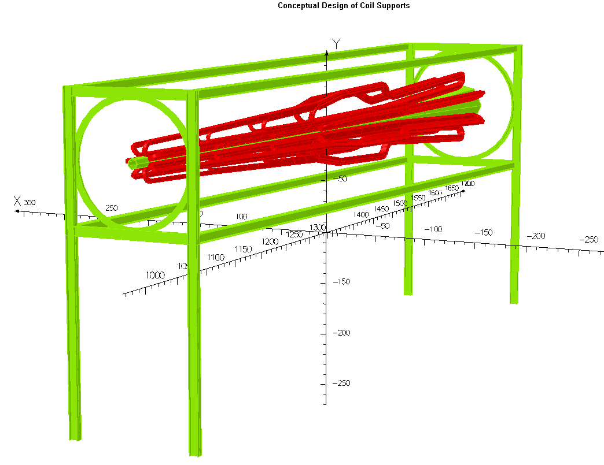

Support Structure
7 m
3.6 m
Notes:
Example of the CAD-like capabilities – the support structure can be designed right in TOSCA, and I can check that it doesn’t interfere with the tracks. To show the scale here – I bet most of you didn’t think about the fact that the Hall A beamline was about as high as an elephant’s back, did you?

Slide 19
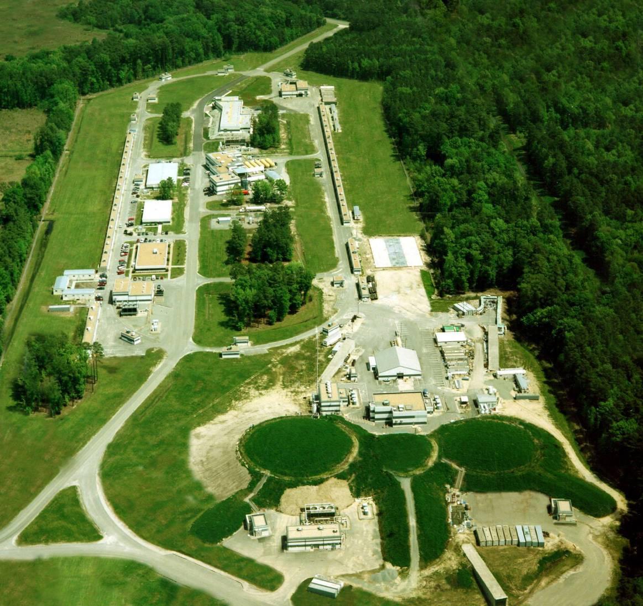
Jefferson Lab
SOLIDWORKS STUDENT EDITION
Picture thanks to Patrick Rogan, UMass undergrad
Parity quality beam >85% using strained GaAs photocathodes
Upgrade to 12 GeV beam energy, addition of a new Hall “D”
12 GeV MOLLER will run in Hall A with an 11 GeV, 75 μA beam
150 cm high power liquid hydrogen target
detectors located 28 m downstream (~150 GHz rate, <10% bkgd)
two-toroid spectrometer (focus Møller electrons from 5.5-19 mrads)

Slide 20
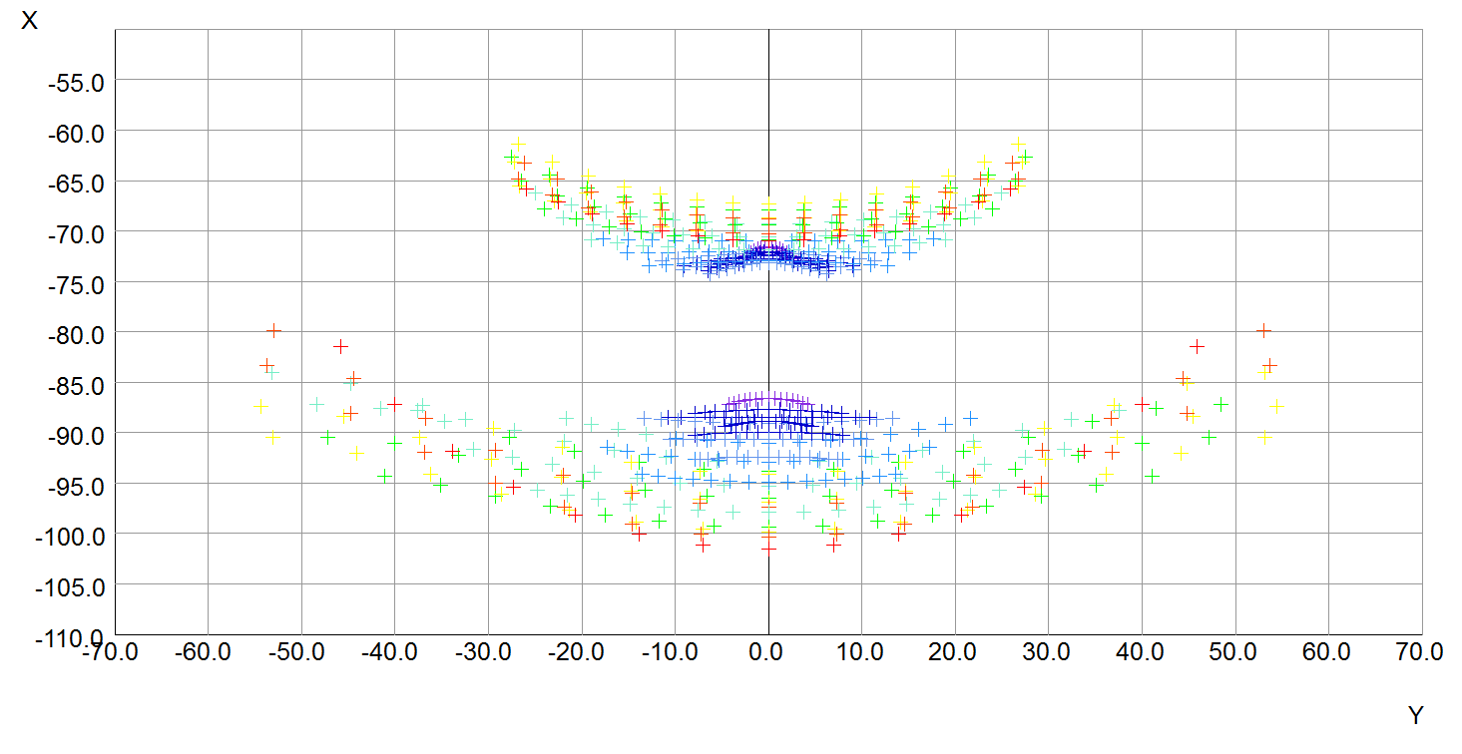
Tweaking the optics
Beam (centered at x=0, y=0)
Mott (ep)
Moller (ee)

Slide 21
100% Azimuthal Acceptance
e-
Forward
e-
e-
Backward
e-
COM Frame
e-
e-
e-
e-
Lab Frame
Backward
Forward

Slide 22
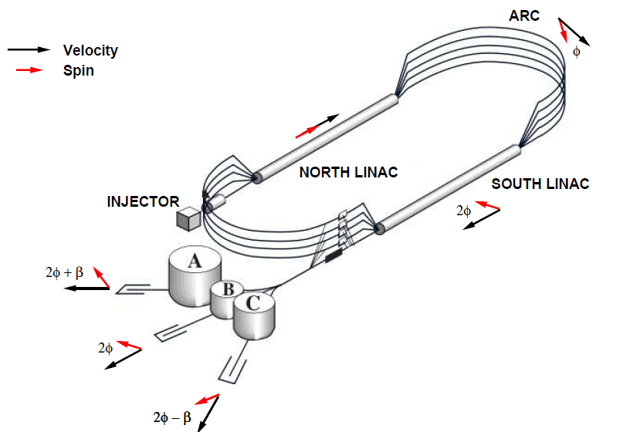
Spin Precession at Jefferson Lab

Slide 23
Error Budget
Simulation, dedicated
tracking detectors
Careful work at laser table, cancellation with helicity reversal
Compton/ Moller polarimeters
Measurements of asymmetry between peaks
Dedicated detectors
Average over sectors, forward/backward cancellation

Slide 24
Outline
sin²θ_{W}
Interference of Z boson with single photon
Moller scattering
Comparable to 2 highest energy exp.
Description of the 12 GeV MOLLER experiment apparatus
High rate, small backgrounds – 150 GHz, 8% backgrounds
Two toroids
Novel toroid design (TOSCA and GEANT4)
  Angular acceptance 5.5-19 mrads
  150cm target, detectors at 28m
  Multiple current returns
  High power

