Slide 1
SBS
John J. LeRose
Hall A Collaboration Meeting
June 14, 2013
Most of the slides contained herein were shamelessly stolen from presentations made at the SBS Collaboration Meeting June 4-5, 2013†
See: http://hallaweb.jlab.org/12GeV/SuperBigBite/meetings/Collab-meeting-6-13/working.htm
† Thanks to: Robin Wines, Nilanga Liyanage, Kondo Gnanvo, Christian Weiss, Andrew Puckett, Vahe Mamyan, Gregg Franklin, Mark Jones, Sam Danagoulian, Gordon Cates, Guido Urciuoli, Evaristo Cisbani, Paolo Musico, et al.

Slide 2
What is SBS?
Super Bigbite Spectrometer
A DOE approved program of 3 projects to build the spectrometer
  SBS Basic
  Neutron Form Factor
  Proton Form Factor
A Collaboration that will use SBS (and other things) to perform assorted experiments

Slide 3
The PMP
Program Management Plan
  http://hallaweb.jlab.org/12GeV/SuperBigBite/PMP/new-2013/SBS_PMP-1-31-13.pdf
  SBS Basic:
    The magnet with modifications
    The magnet stand
    The beamline
  Neutron Form Factor
    GEM’s and electronics
    Electronics hut, shielding, detector frames
    Coordinate detector (GEM based)

Slide 4
PMP cont’d
Proton Form Factor
  Magnet Pole shims and exit field clamp
  GEM’s and electronics
  Trigger

Slide 5
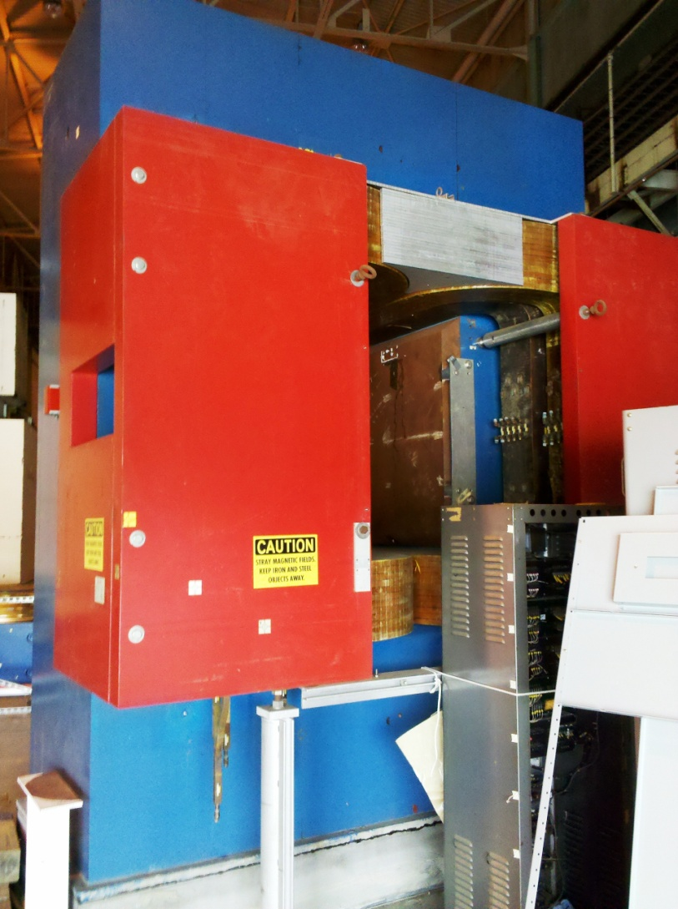
Magnet Status
48D48 Dipole Magnet Yoke from BNL
BNL had difficulties in getting magnet steel cleared for shipping
Presently conducting radiation surveys of steel
Optimistic to be ready for mid-June shipping date
Continue negotiations for additional steel plates and 2nd magnet

Slide 6
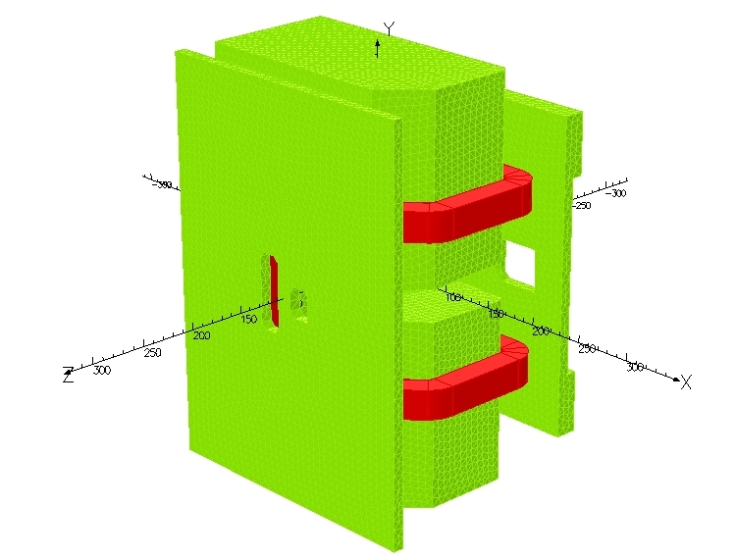
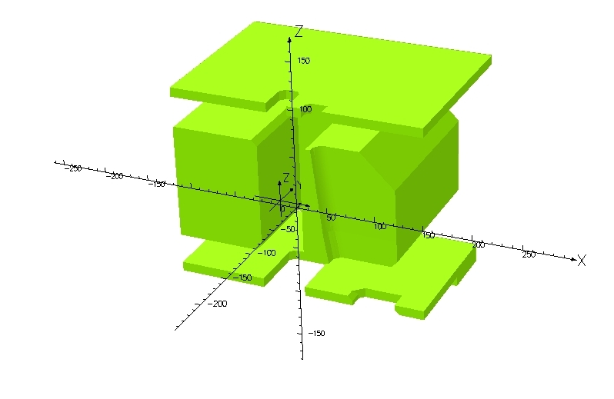
Magnet Yoke
Magnet Parameters
Integral field strength 1.82 T-m
2.28 T-m with pole shims
Yoke length 1.22m
Gap 47cm x 121.9cm
Yoke Weight 85 tons
6 1008 steel sectors, largest is 18.3 tons
Magnet Yoke Modifications
Magnet analysis complete
2 sectors to be machined
Yoke modifications modeled,
progressing on drawings
Yoke machining complete Sep. 2013

Slide 7
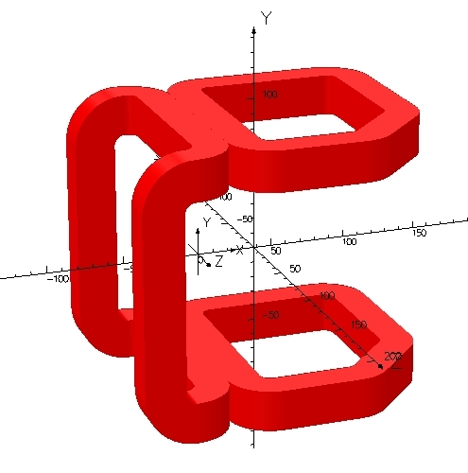
Magnet Coils
3 coils, 120 turns per coil
Conductor: 1.96cm x
2.01cm with 1.1 cm dia
hole
Weight of coil ~5 ton per
coil
Current 2050A
Voltage 281V
Power 576 kW
Water cooled: dT=17.6 C
with velocity =9.6ft/sec
and total 158 GPM
New coils delivery Jan 2014
Power Supply in
procurement process,
sole source requirement
delivery Dec. 2013

Slide 8
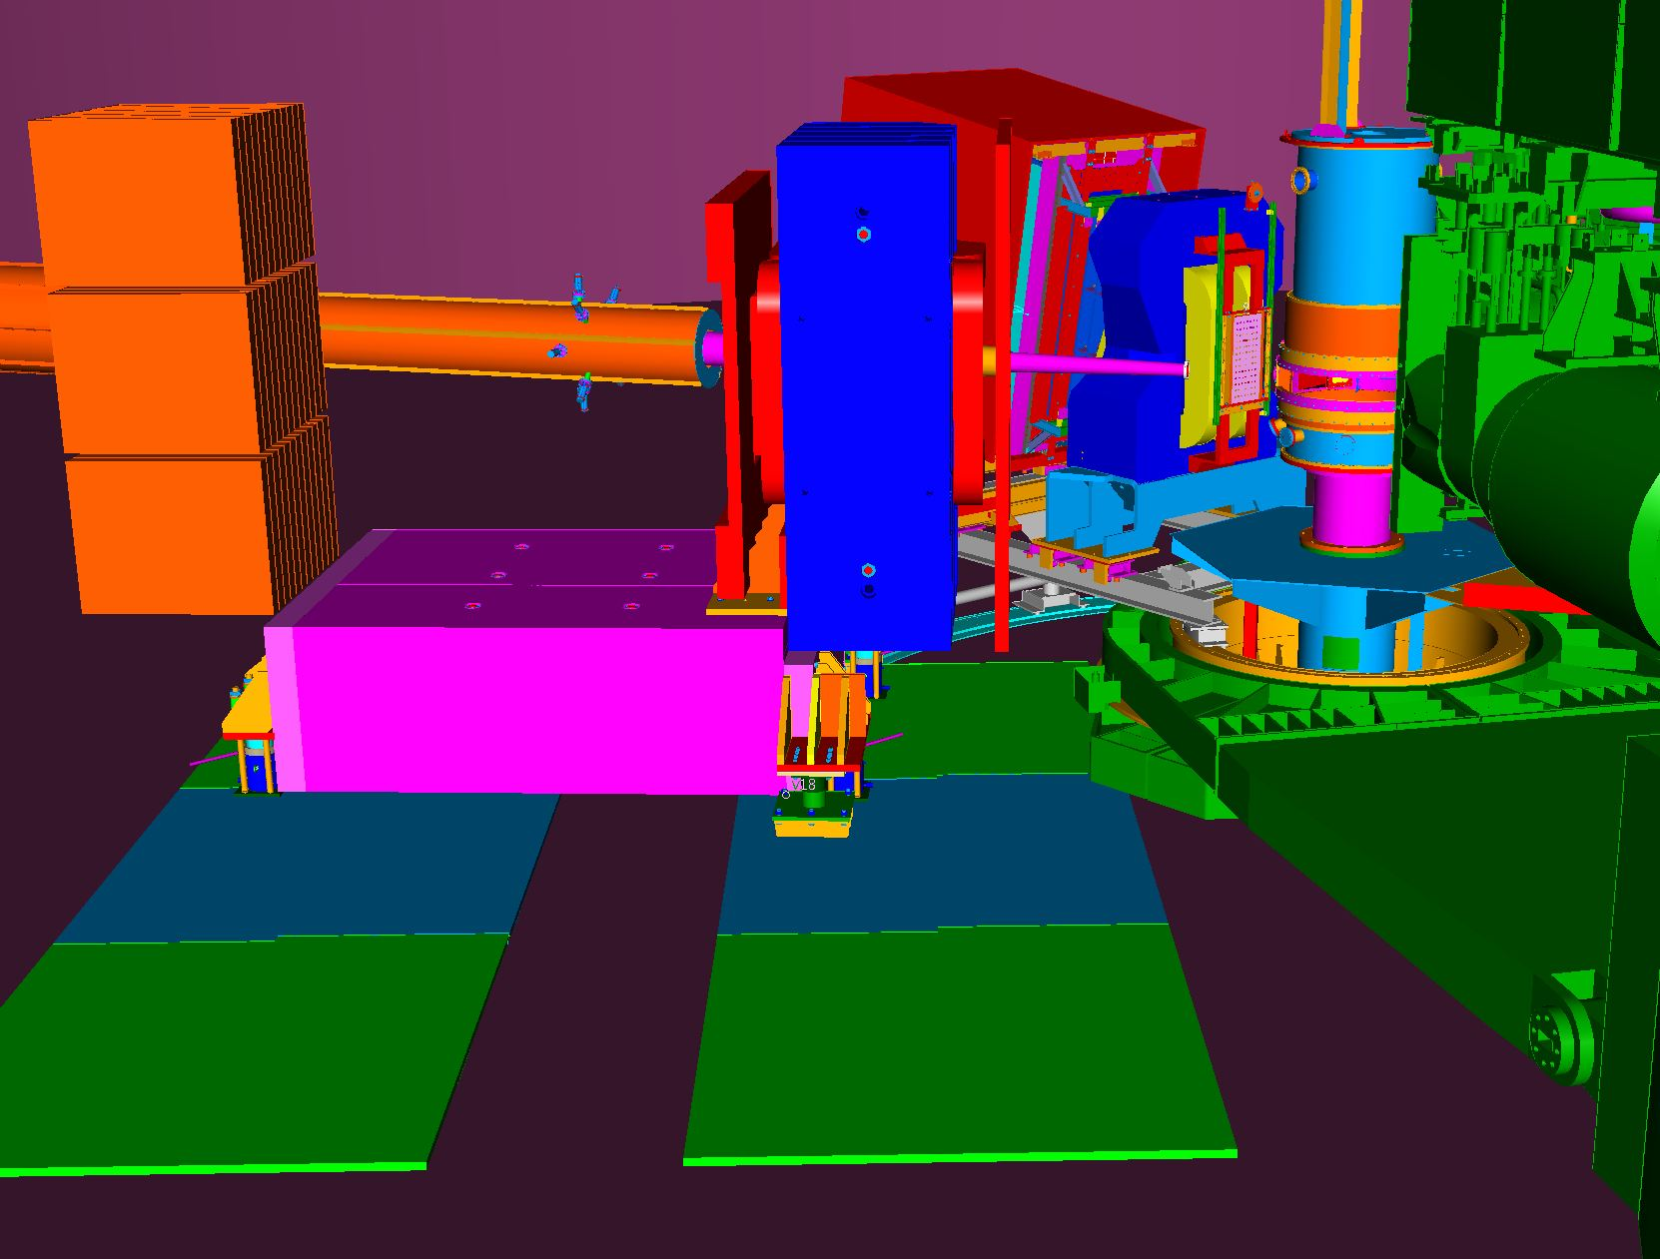
Magnet & Detector Supports
Continue design of SBS & BB detector supports
Counterweight support depends on BNL material
2” thick floor plates designed for spectrometer motion

Slide 9
Beamline
Beamline designed in sections to be changed for different configurations
Analyzing shielding and solenoid needs

Slide 10
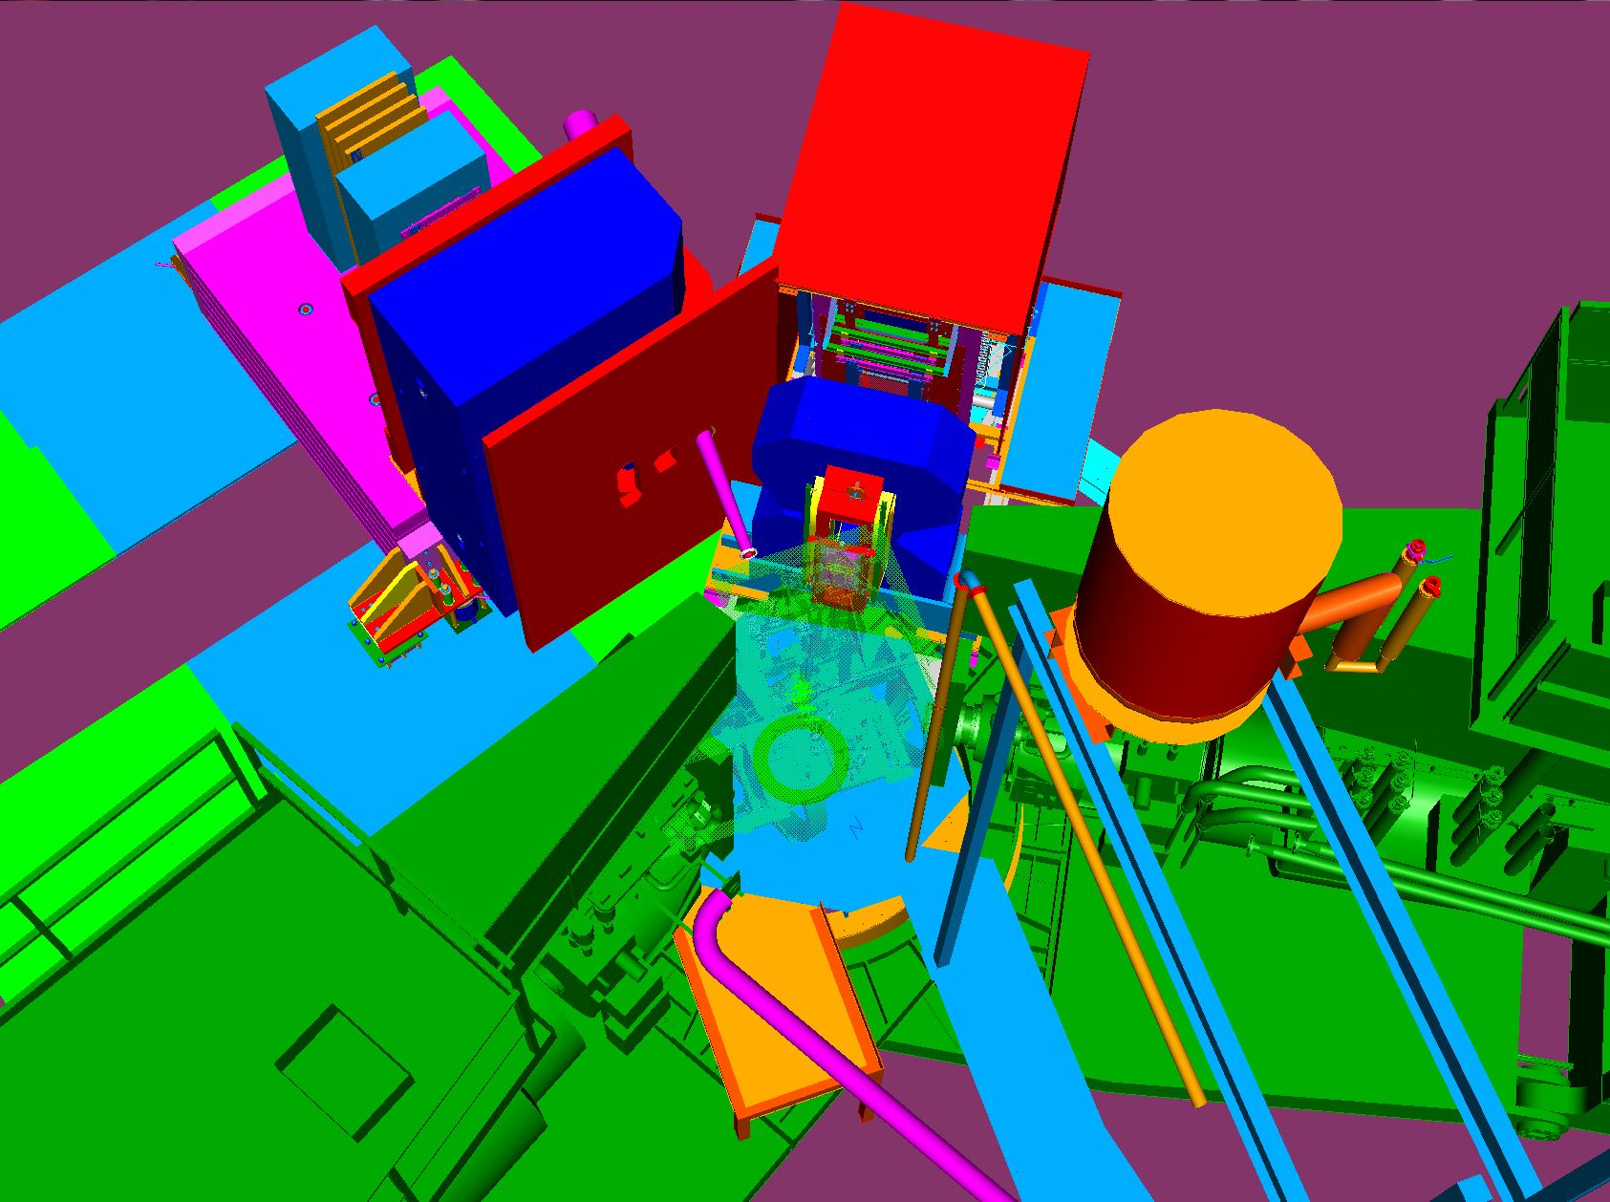
Field Clamps
Continue analysis and design iterations for field clamp shapes to allow all configurations

Slide 11
Summary SBS Basic
-Continue yoke modification drawings.30% September 2013
-Continuing design work on magnet counter weight support to incorporate movement of support to relocate magnet as needed. Working on design details of rollers,jack mounts,magnet bracket,and floor plates.65% April 2014
-Continue detail drawings of new coils.25% January 2014
-power supply specification completed, in procurement for sole source processing.75% August 2013 (delivery December 2013)
-Layout and design of shielded beampipe and vacuum snout. 20% April 2014
- Defining field clamps and design of clamp supports.15% September 2013
-Designing detector supports. 20% July 2013
-BNL continues surveying the yoke and support material for transporting. Jlab submit request for shipping, rigging and storage. Mid-June delivery.

Slide 12
GEM’s at UVa
Design for the SBS Back tracker GEM chamber, successfully built the first prototype.
Preliminary test in the lab shows expected performances were satisfied.
A few small modification are being implemented to further improved assembly of the chambers and performances.
Plan to build 3 to 4 more prototypes in the coming month to finalize the design and conclude the R&D phase.
Acquisition of a medium size SRS electronics, upgrade our capability to 10K channels.
Acquisition of new version of the APV25-MPD electronics, will start the test soon.
Test beam at FermiLab in October 2013 to test SBS Back tracker prototype and rate capabilities of the APV25 electronics

Slide 13
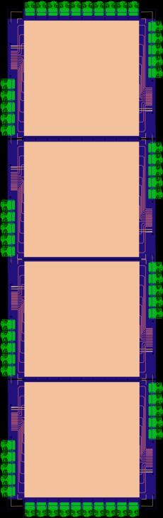
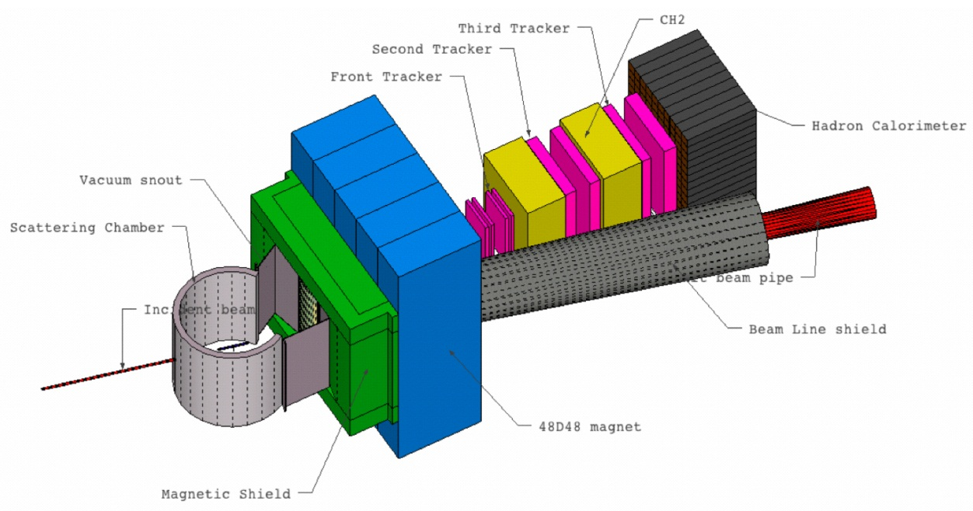
SBS Back Tracker GEM Chambers
Layout of the Super Bigbite Spectrometer (SBS) for GEp(5)
SBS Back Tracker Chamber
Four 50 × 50 cm² modules assembled in a large (200 × 50 cm²) Back Tracker
Cross section view of Back Tracker 50 x 50 cm² Triple GEM module
Entrance
window foil
Drift foil
Frame_GEM
GEM foils
Frame_GEM
Readout
board
Honeycomb support

Slide 14
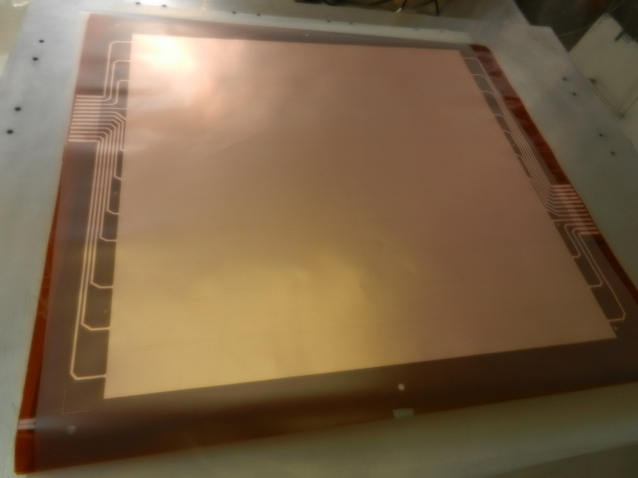
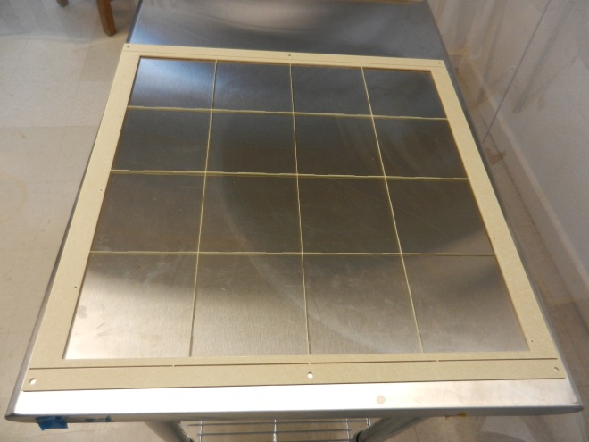
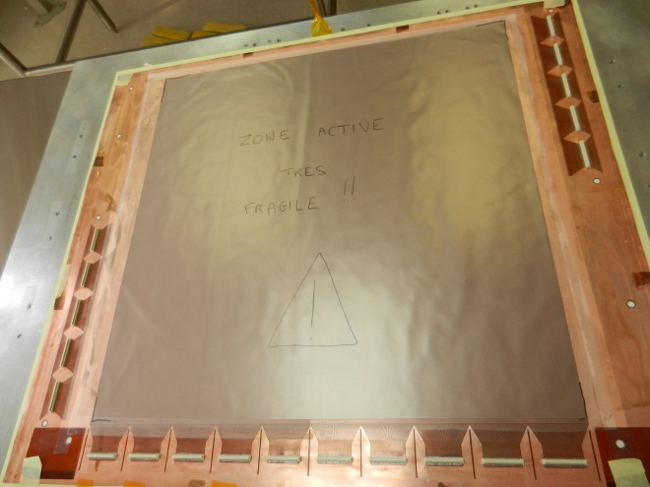
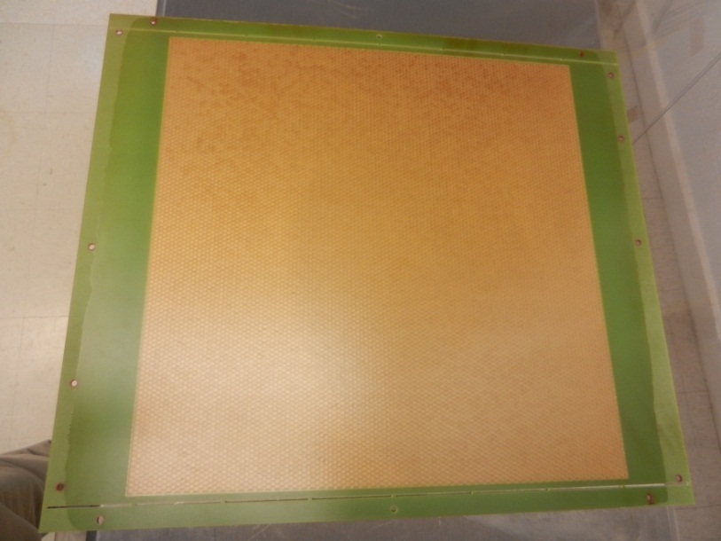
SBS Back Tracker Module Design
GEM foil (CERN PCB workshop)
Support frame with spacers (RESARM Belgium)
Flexible 2D readout board (CERN PCB workshop)
Honeycomb support board (CERN PCB workshop)

Slide 15
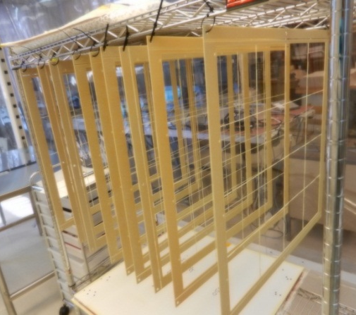
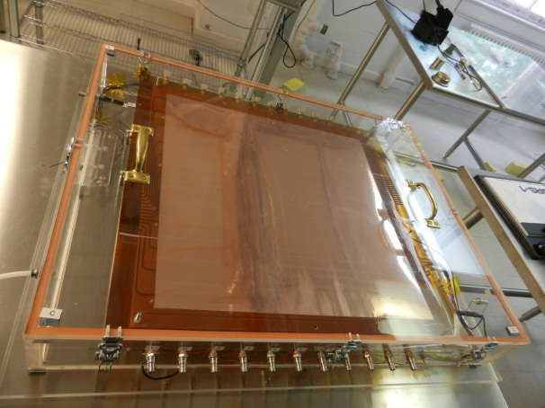
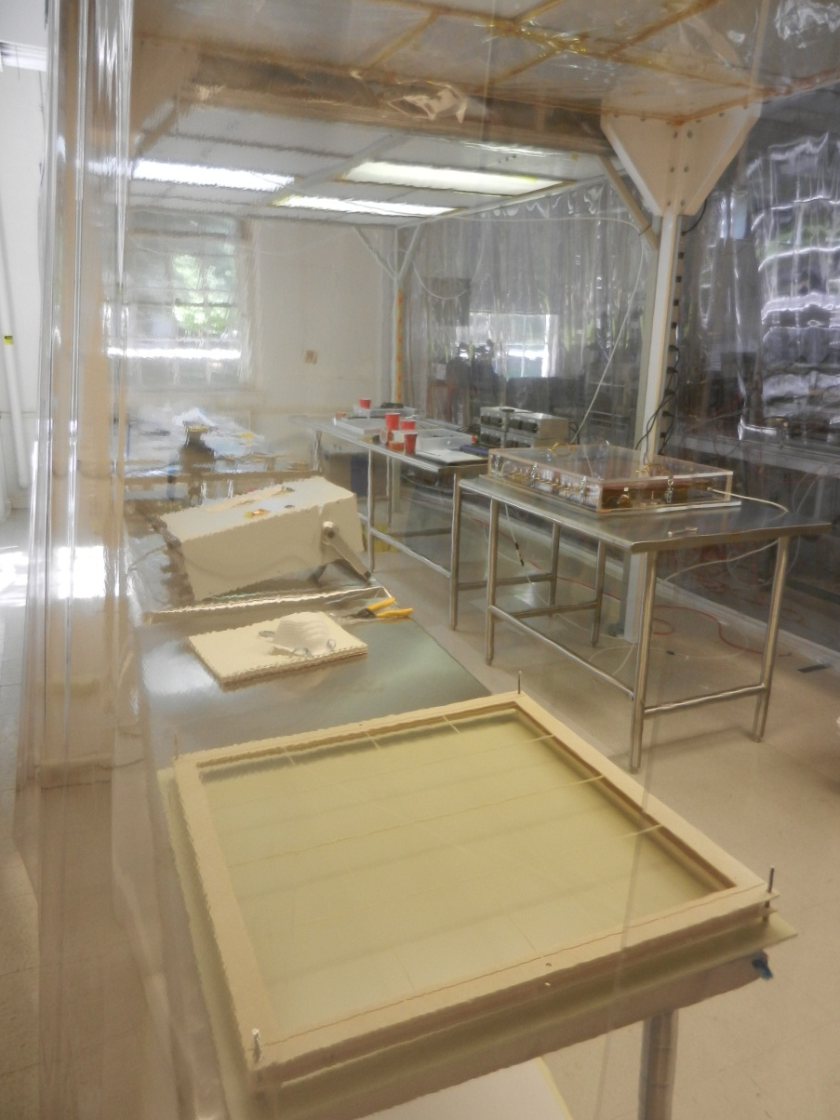
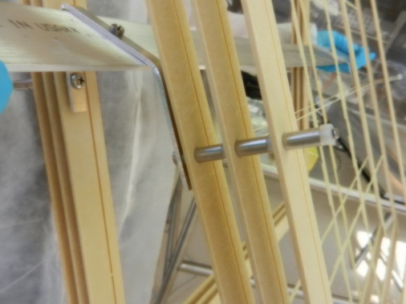
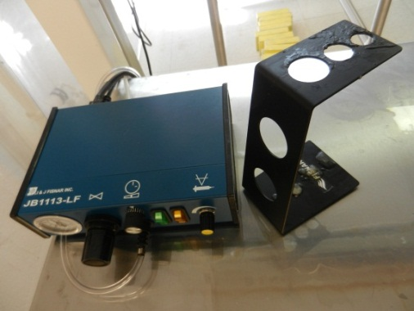
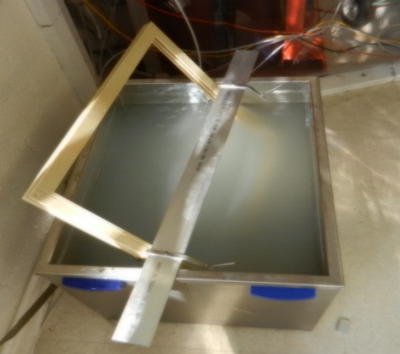
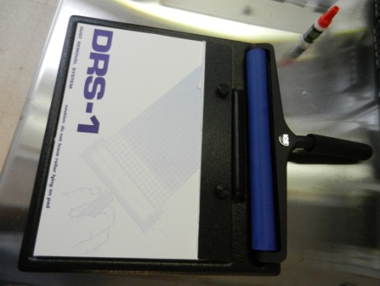
Clean Room & Equipment for the assembly
Storage of the frames
Large area (3 × 7 m²) Class 1000 Clean Room
Storage of the framed foils
Frames holder for cleaning in USB
Glue dispenser
Ultra sonic bath (USB) with demineralized Water
Tacky roller ➔ dust removal

Slide 16
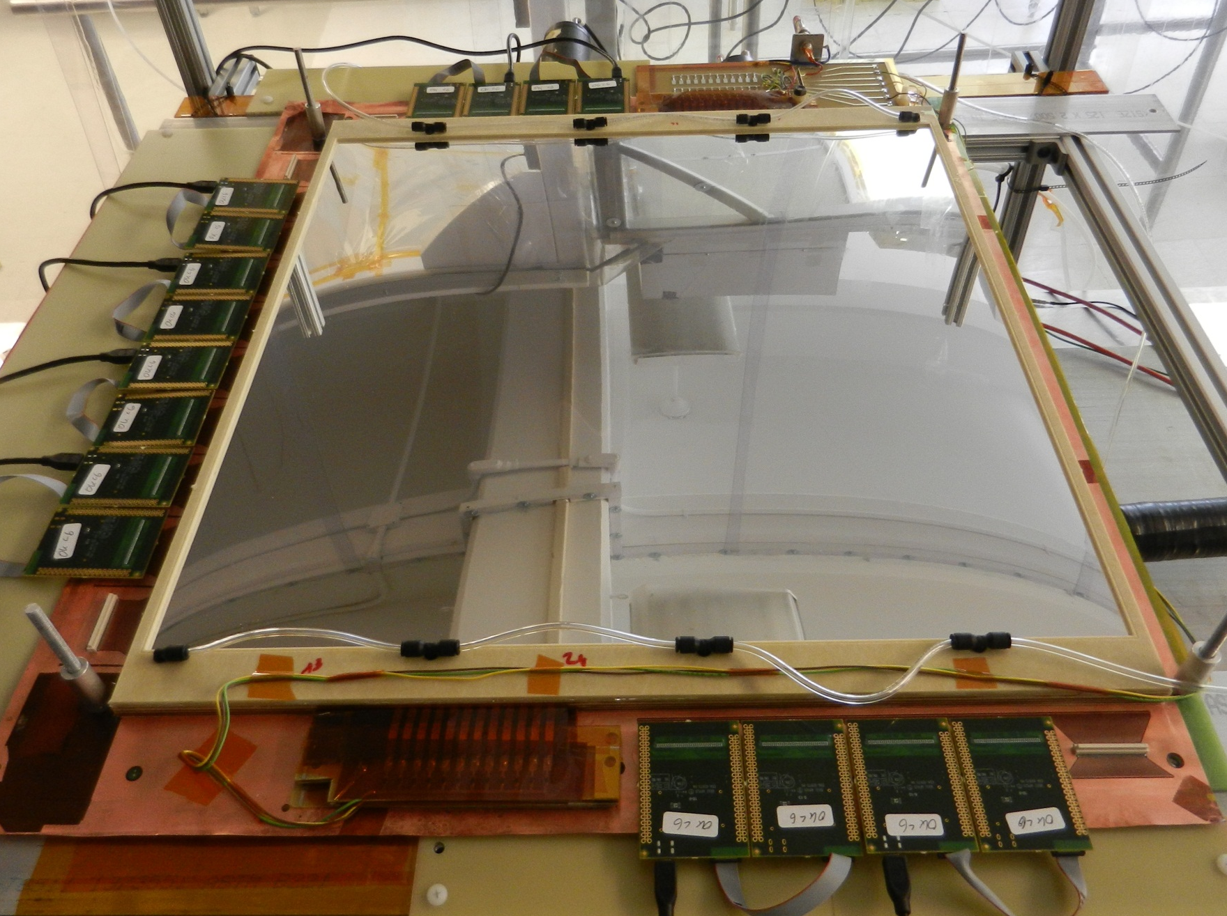
SBS Back Tracker Prototype I
APV25-SRS
FE cards
HV divider
Spark protection
resistors Board

Slide 17
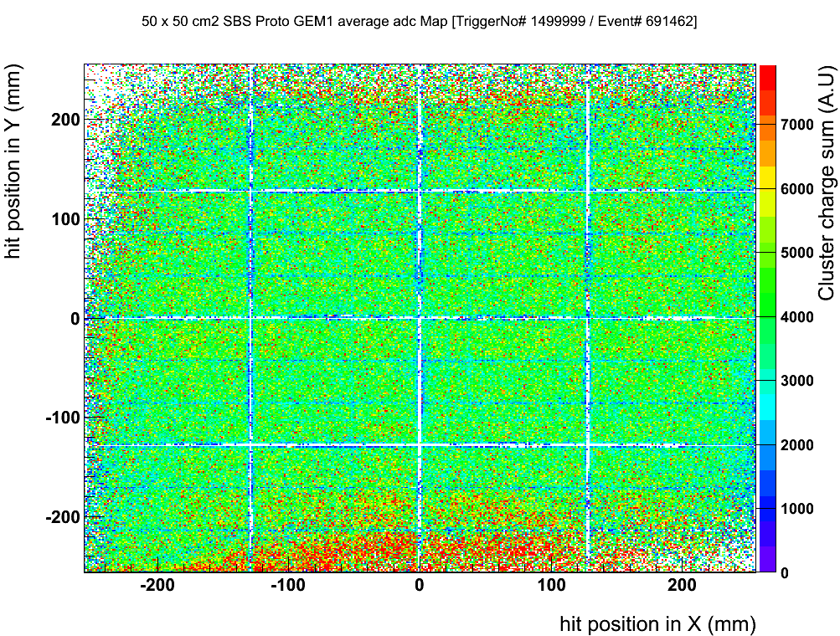
Plans for Proto II: Reduce number of spacers in the active area
Proto I (February-March 2013) : Current spacer design
gas
window
Drift foil
GEM
Frame
GEMs
R/O
board
Honeycomb support
Proto II (will be built in June 2013): suggested spacer design
gas
window
Drift foil
GEM
Frame
GEMs
R/O
board
Honeycomb support

Slide 18
Plans for Proto III: New Gas distribution design
Proto I (built February-March 2013) : Current spacer design
gas
window
Drift foil
GEM
Frame
GEMs
R/O
board
Honeycomb support
Proto III (will be built in September 2013):
OR

Slide 19
UVa GEM’s cont’d
Other small modifications also planned
Electronics modifications/upgrades underway
Plans for tests at FermiLab
Proposal for Jlab LDRD to build larger GEM chambers in FY14.
  explicitly NOT part of the PMP

Slide 20
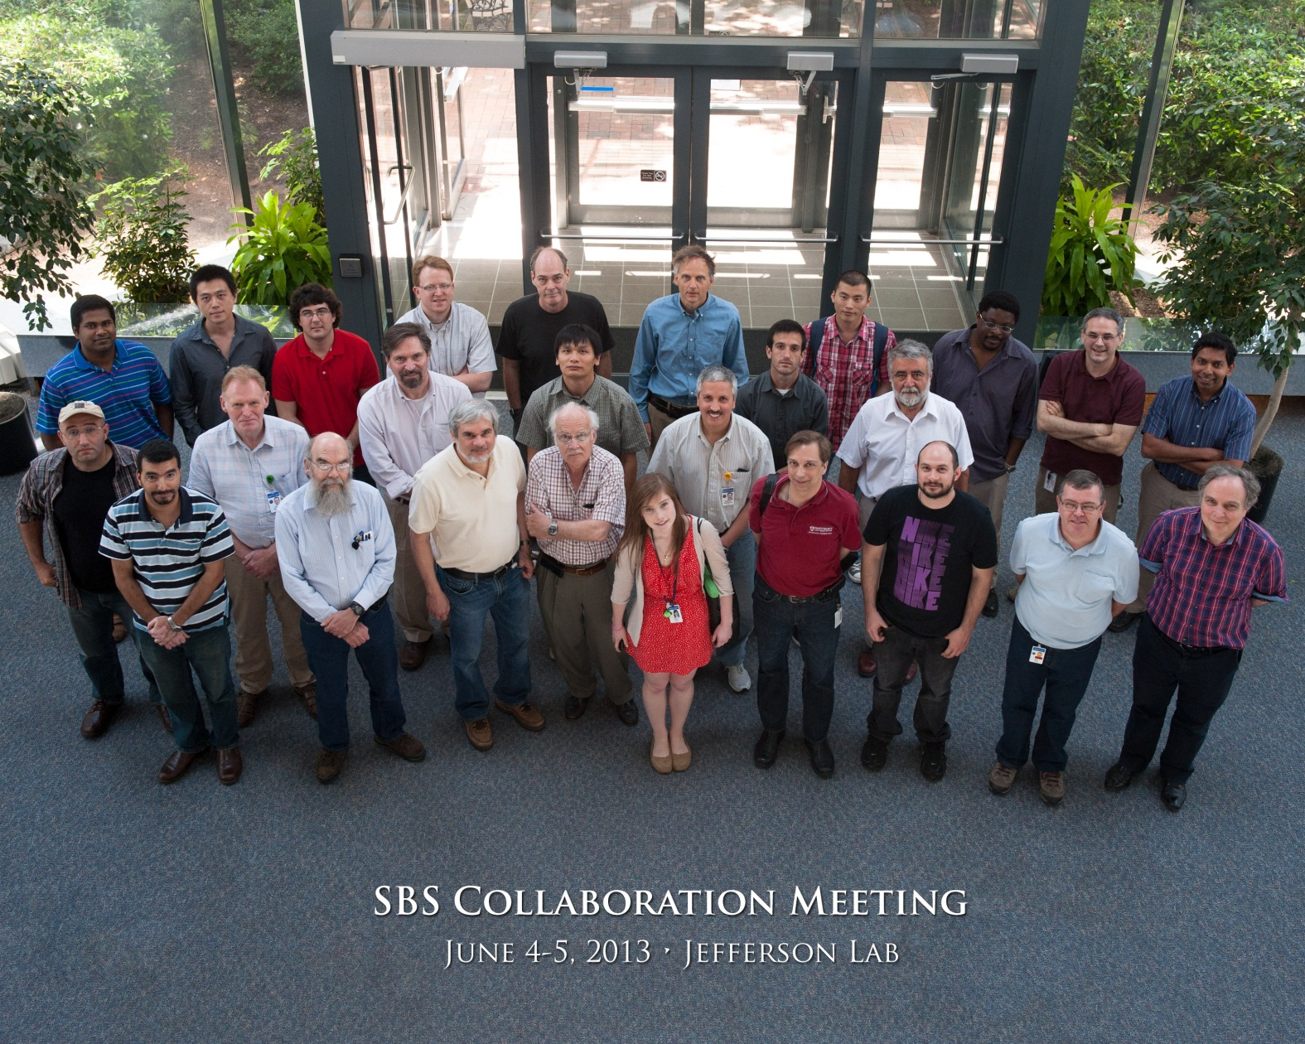
http://hallaweb.jlab.org/12GeV/SuperBigBite/meetings/Collab-meeting-6-13/working.htm

Slide 21
Collaboration Meeting
Two days of intensive review of various Collaboration projects/issues
Physics
Hall Status
SBS design status
Polarized ³He target status
μ detection ideas
HCAL status
FASTBUS

Slide 22
Meeting Cont’d
NINO front end cards
VME DAQ
Coordinate Detector
ECAL status
Silicon Tracker
A1n Cherenkov
GEM’s at INFN
GEM’s at UVa

Slide 23
Physics

Slide 24
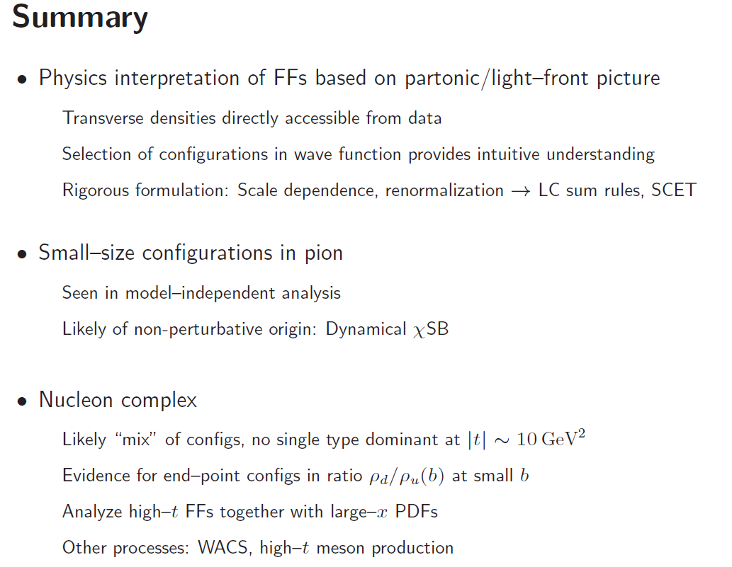
High–t form factors and short–range nucleon structure: C. Weiss

Slide 25
Neutron Transversity with BigBite & SBS – Andrew Puckett
Goal of SIDIS studies is (spin-correlated) 3D imaging of quarks in momentum space.

Slide 26
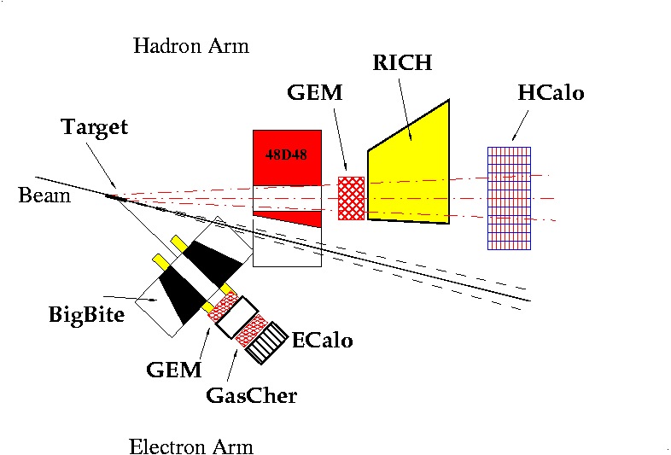
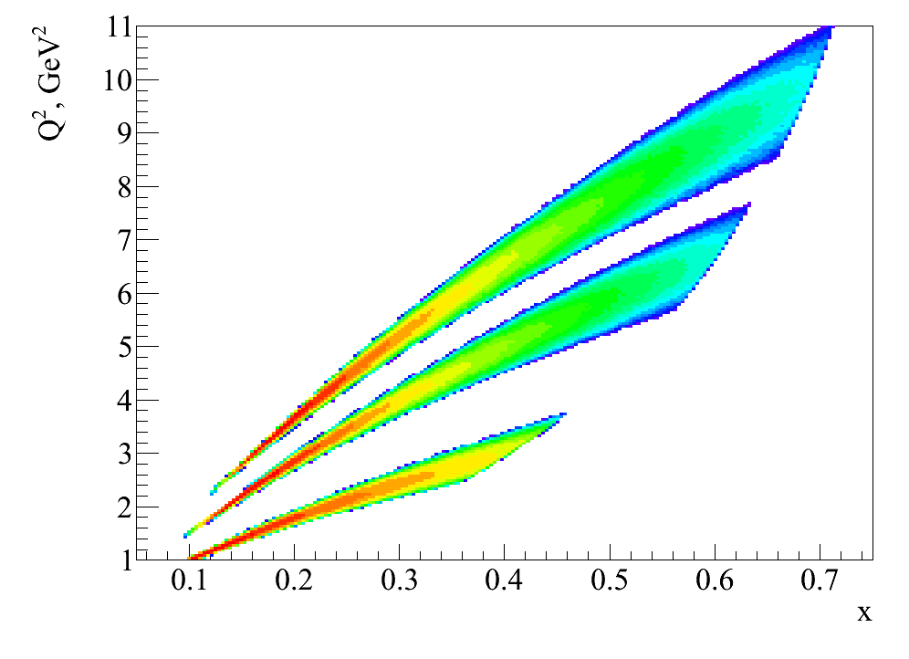
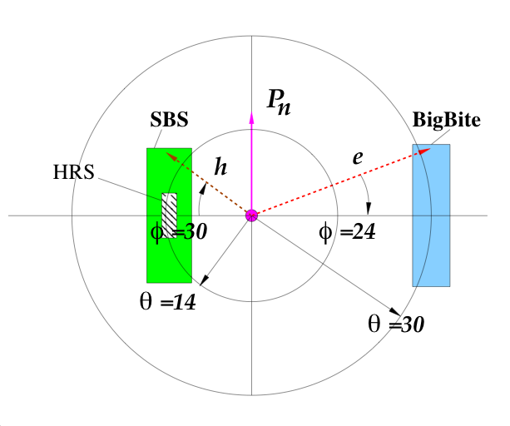
E12-09-018: SIDIS on polarized ³He @ 12 GeV
Experiment E12-09-018
Approved by JLab PAC38 (August 2011), 64 days, A- rating
Spokespersons:
  G. Cates (UVA)
  E. Cisbani (INFN)
  G. Franklin (CMU)
  A. Puckett (LANL—currently JLab, near future UConn)
  B. Wojtsekhowski (JLab)
In two-months production run, E12-09-018 will reach ~1000X statistical FOM of E06-010 n, ~100X HERMES p
Electron arm: BigBite at 30 deg as in E06-010 + A₁^{n} detector upgrades
Hadron arm: Super BigBite (SBS) at 14 deg.
Target: high-luminosity polarized Helium-3
E12-09-018, 11 GeV
E12-09-018, 8.8 GeV
E06-010, 5.9 GeV

Slide 27
Conclusions
Transverse spin phenomena in SIDIS→wealth of new fundamental information on nucleon structure
Relevant to the nucleon spin puzzle
Test fundamental predictions of QCD
Theoretical groundwork ~1990s (still rapidly evolving/maturing) experimental study has just begun ~2000s
JLab 12 GeV upgrade is the first opportunity for next-generation (precision) studies in the “valence” quark region ( = high-x = fast quarks)
SIDIS: E12-09-018
Exclusive and semi-inclusive reactions form the core of the JLab 12 GeV “nucleon imaging” program.
Super BigBite Spectrometer = progress toward the “holy grail” of fixed-target electron scattering experiments:
  Large acceptance
  High luminosity
  Forward angles
JLab 12 GeV promises new discoveries and insights into QCD by comprehensive mapping of nucleon structure with unprecedented precision!
Notes:
All aspects of GEM detectors, needed for all proposals/all experiments/SOLID/SBS/PVDIS/SIDIS, strong contribution to GEM detectors. Moller polarimeter, Jobs need to be filled are specific. Data analysis support; no intention to replace Ole Hansen. Alex Camsonne/Bob Michaels. Moller polarimeter, GEM detectors, essentially no one right now.

Slide 28
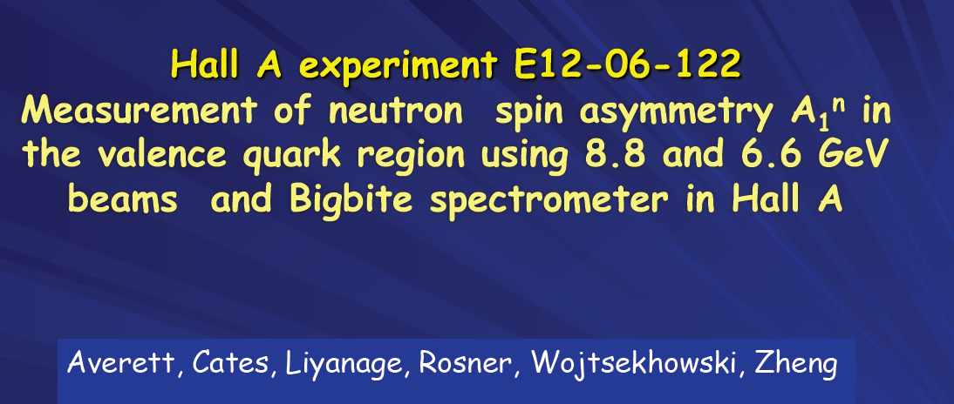
Todd spoke yesterday
Notes:
Todd yesterday!

Slide 29
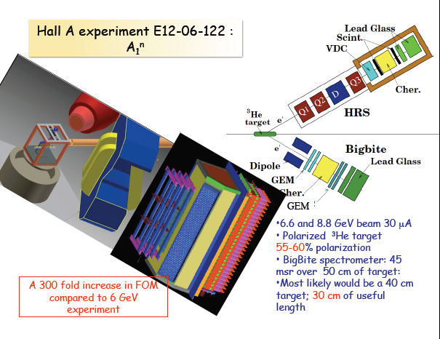

Slide 30
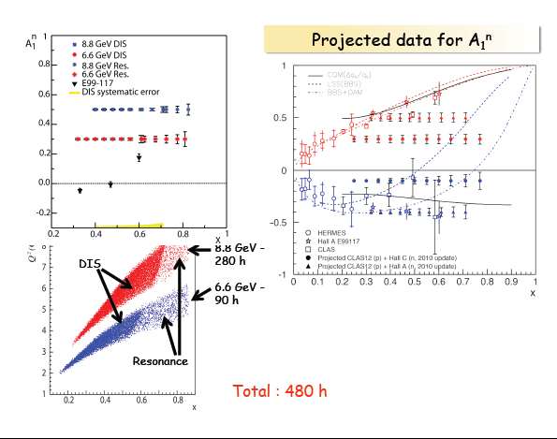
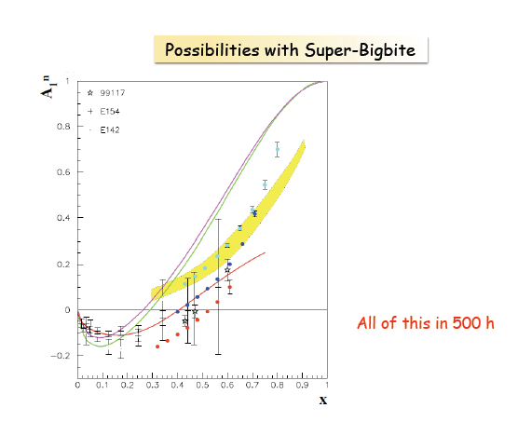

Slide 31
Equipment outside the PMP
HCAL
ECAL
GRINCH
Polarized ³He Target
Silicon Tracker
INFN GEM’s (front tracker)
Various DAQ components

Slide 32
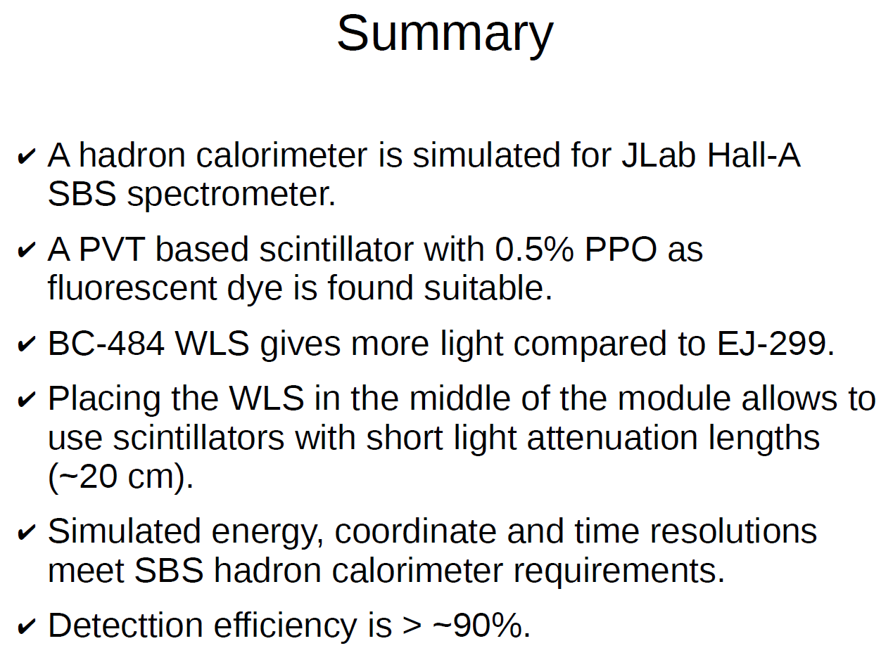
HCAL Simulations
one

Slide 33
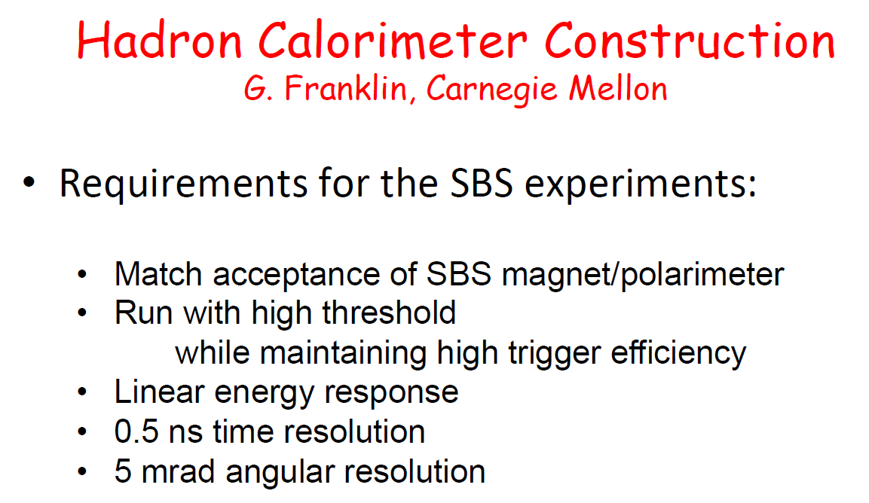
HCAL Construction

Slide 34
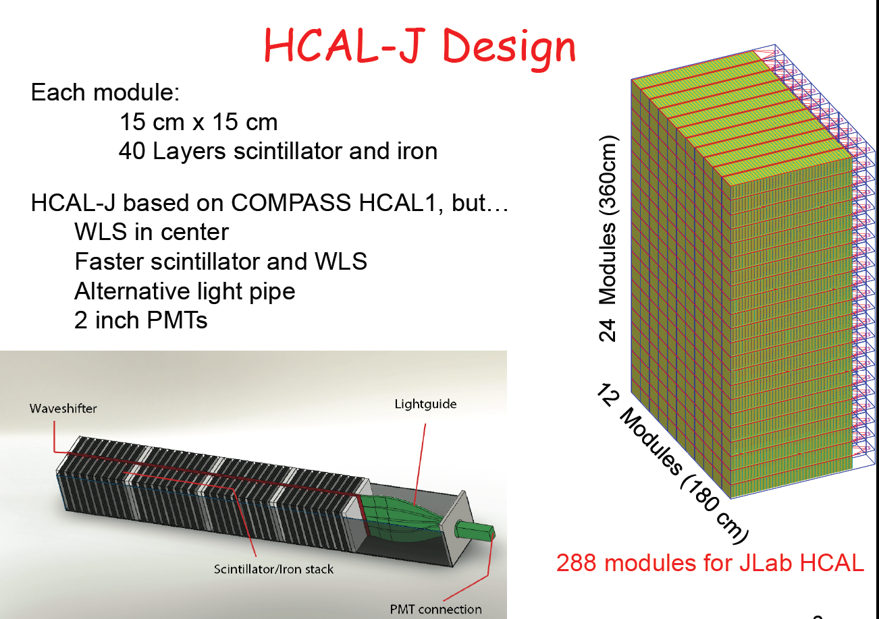

Slide 35
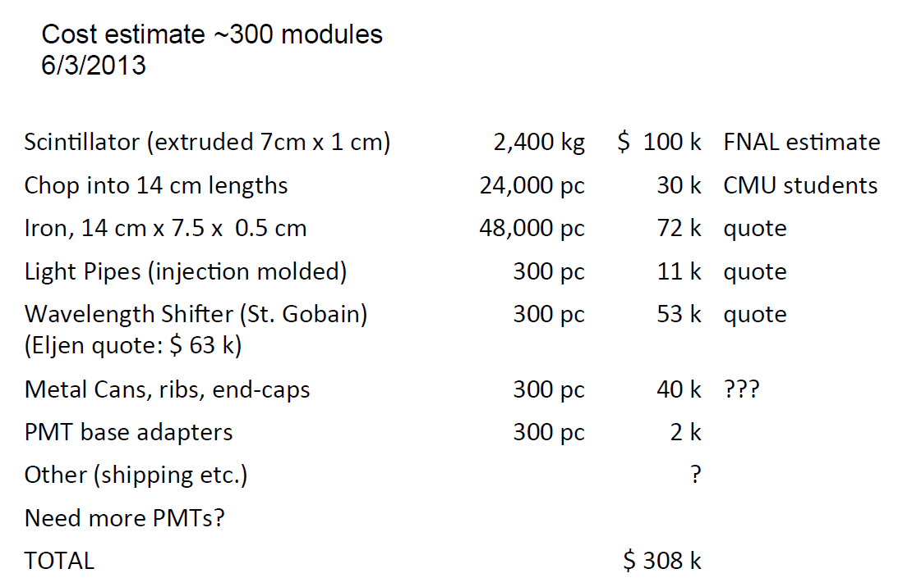

Slide 36
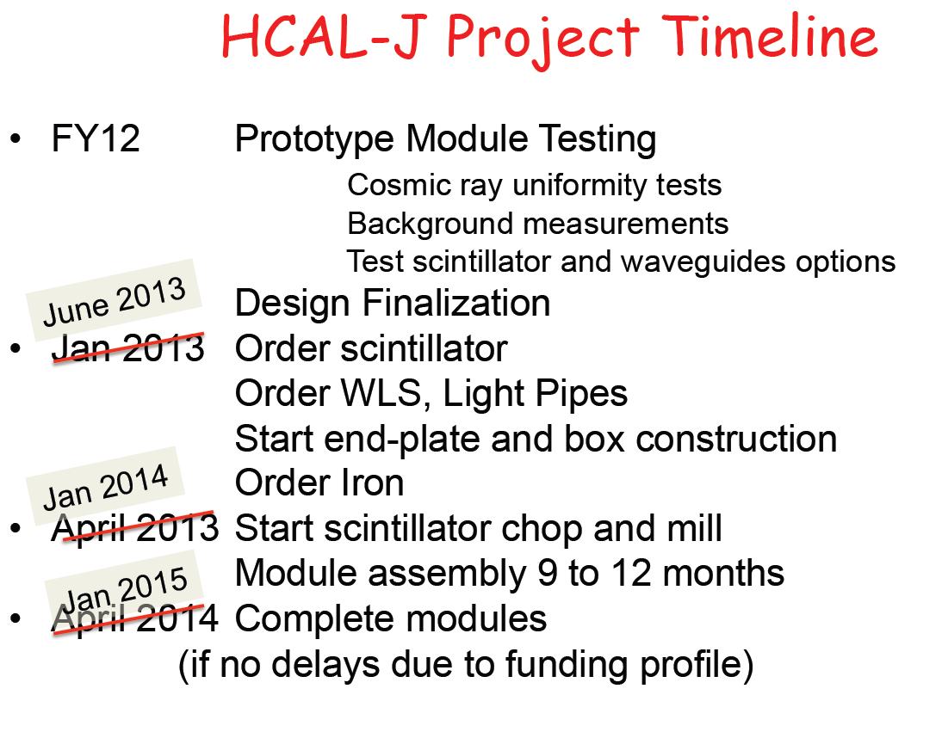

Slide 37
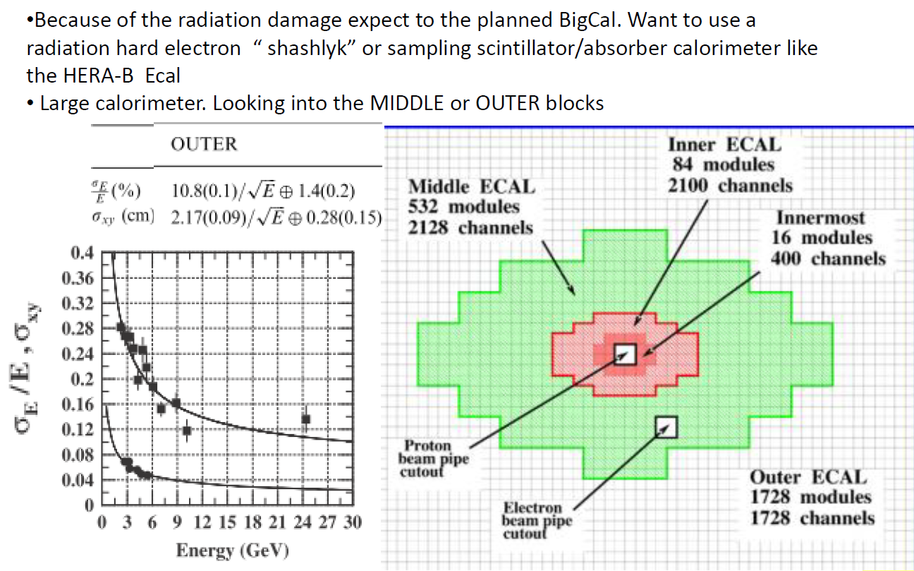
ECAL

Slide 38
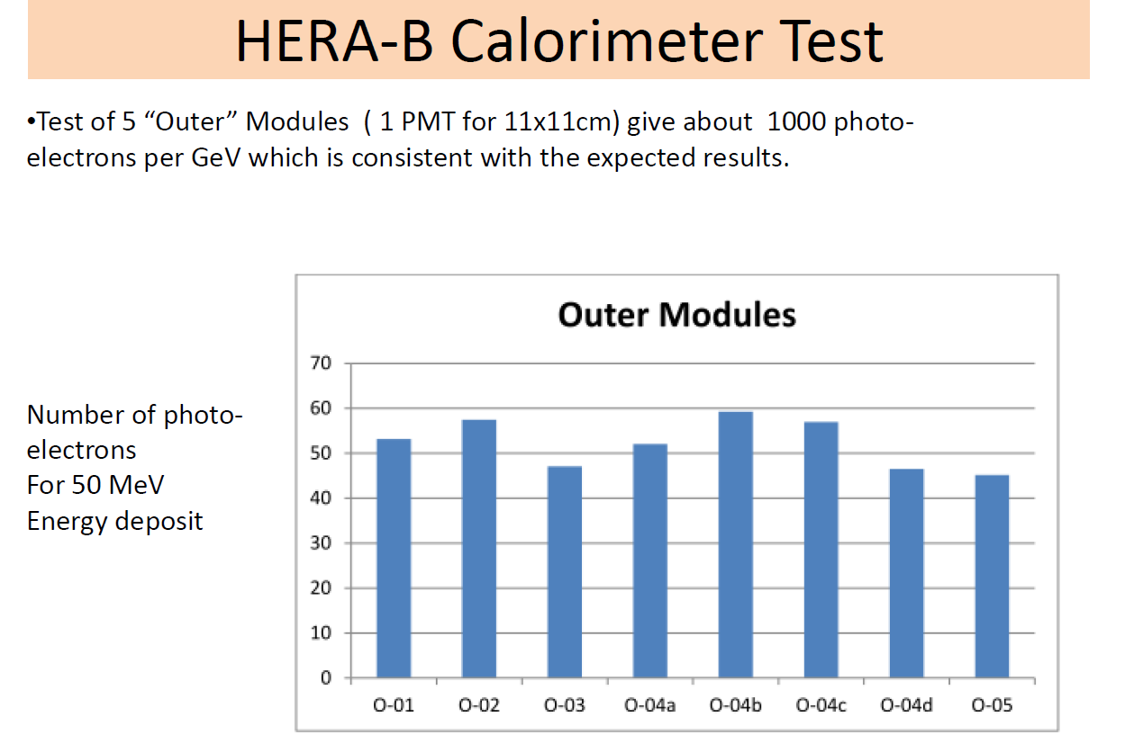
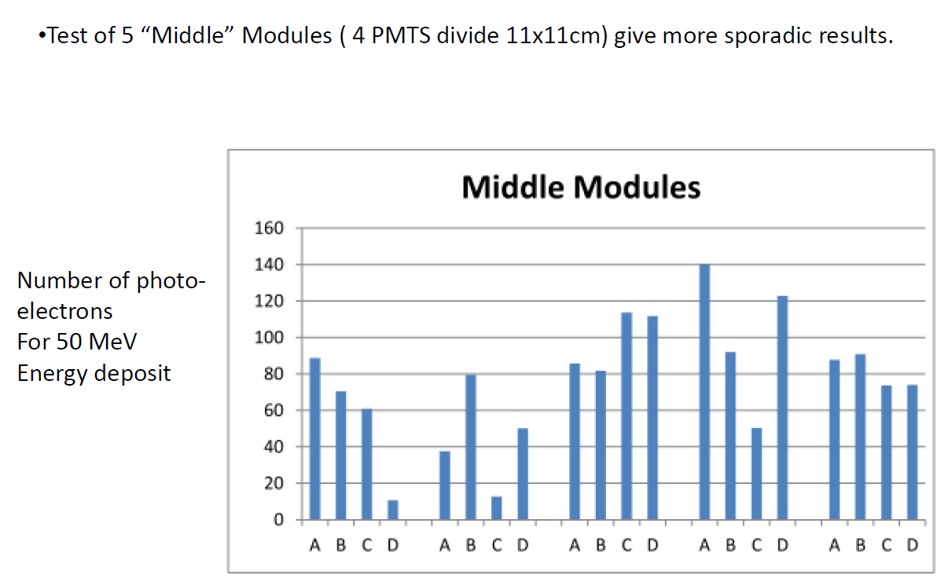

Slide 39
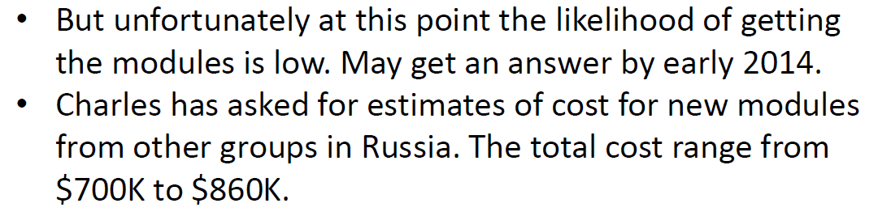
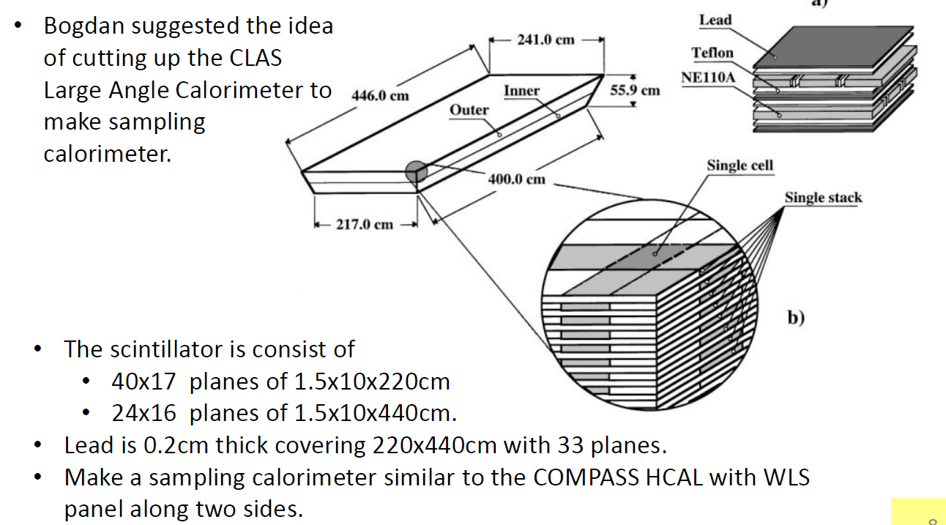

Slide 40
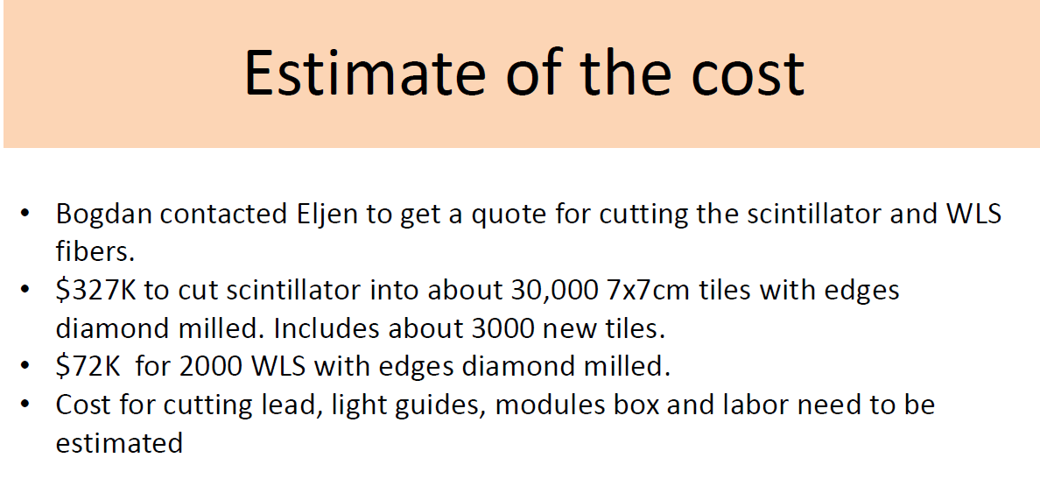

Slide 41
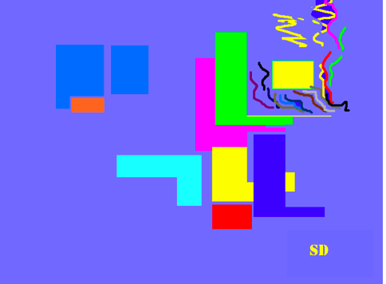

Gas Ring Imaging Cherenkov (GRINCH) Detector for BigBite
Abdellah Ahmidouch and Samuel Danagoulian
Department of Physics
NC A&T State University, Greensboro, NC
Doug and Todd talked about it yesterday
Todd Averett, H. Yao, William and Mary
B. Wojtsekhowski, S. Esp, Jefferson Lab
K. Aniol, Cal. State LA
J. Annand, Glasgow

Slide 42
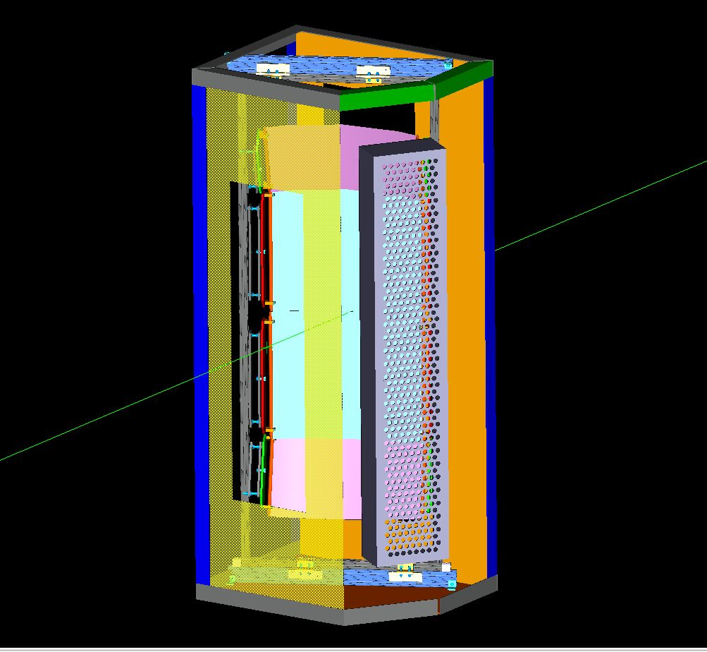
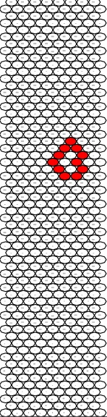
Design

Slide 44
Front end Electronics
J. Annand has produced phase II prototype of NINO front-end card.
Successfully tested phase I card using signals similar to expected small-amplitude single PE signals from GRINCH.
K. Aniol recently completed purchase for all NINO cards.

Slide 45
Budget (A&T)
PMT detector array:
Magnetic Shielding Box, Steel 1008 ~$6000.00
Mu-metal shelf ~$1000.00
Light catchers. Molding is done (~$10,000.00). Each row is $3, we need 60 rows.
Mirror deposition: ?

Slide 46
Summary
The Gas Cherenkov (GRINCH) will be completed and tested by Spring 2014 and ready to install by June 2014
  Vessel, mirror mounting system, mirrors (JLAB, W&M)
  Photon Detector Array (NC A&T)
  Front electronics (Cal. State LA, Glasgow)
Total Budget: ~$25 K (NCA&T) ~$50 K (W&M), $10 K (Glasgow University), $50 K (JLAB)

Slide 47
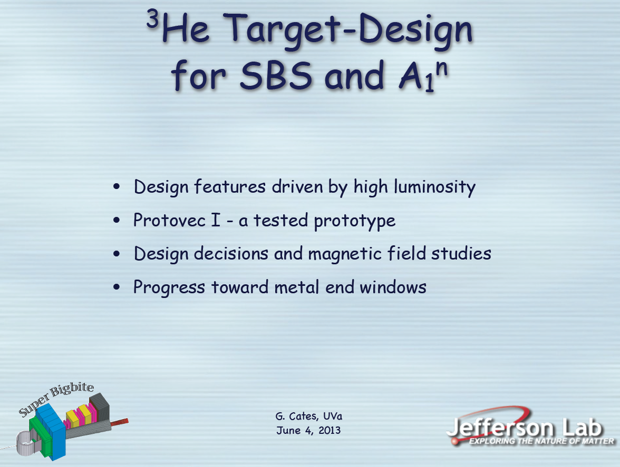
Jie Liu gave details yesterday

Slide 48
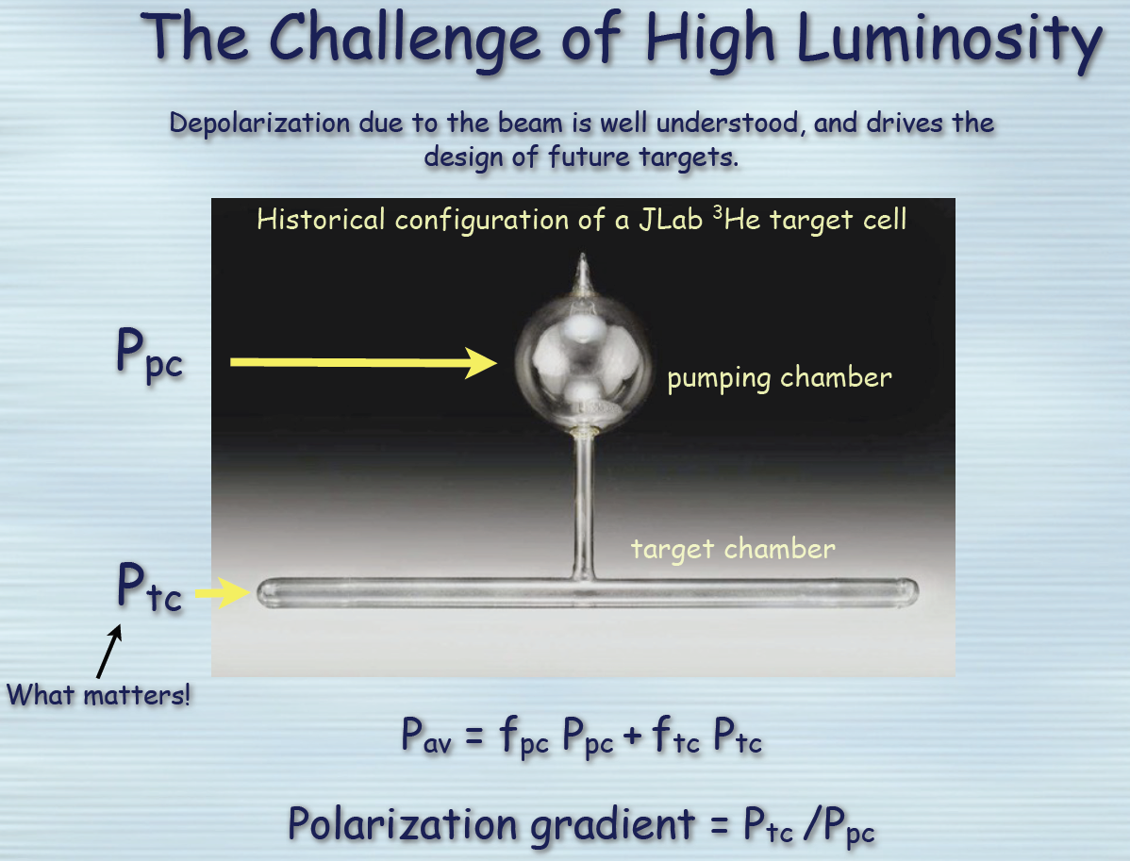

Slide 49
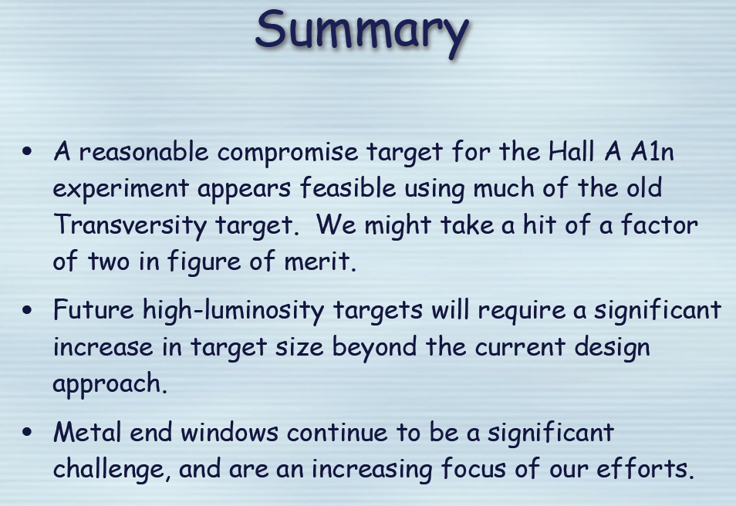
There were lots of great slides detailing the design problems and solutions. Alas, too many to go into here.

Slide 50




INFN Rome Silicon microstrip Detector for SBS
Guido Maria Urciuoli - Fulvio De Persio – Franco Meddi

Slide 51
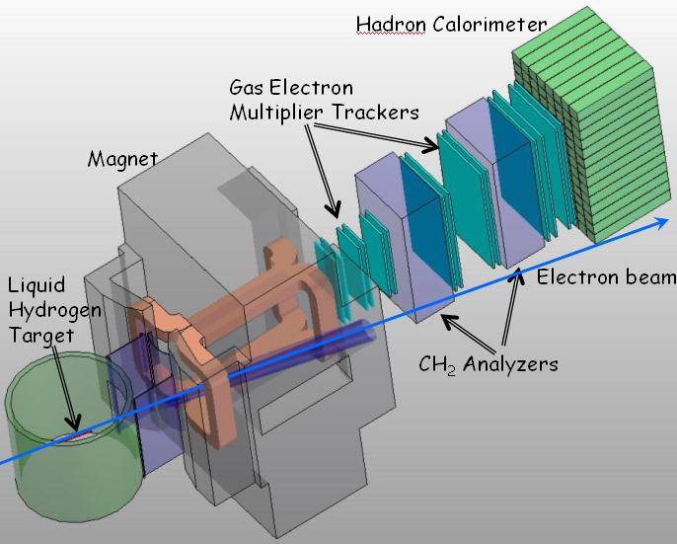
Silicon Tracker
14°
I_{max}=85 μA
L_{max}= 10³⁹cm⁻²s⁻¹
I=2 kA
B= 2 Tm

Slide 52
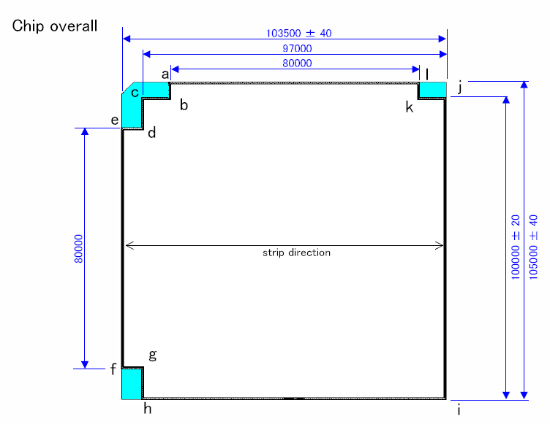

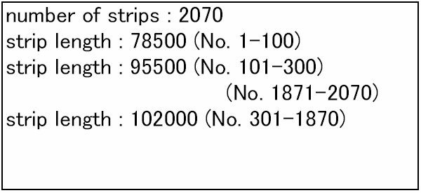
Detector Sketch
6.5mm
8.5mm
8.5mm
5mm
A
10mm
B
5mm
Custom Design maximum active area from a 6” Wafer
D
A
B
C
103500
D
10mm
C

Slide 53



Silicon Microstrip Detector: Close Up
Strip Pitch
50 µm
Silicon Microstrip Detector
DC PAD
for bonding
(200x40 µm²)
Guard Ring PAD
(500x90 µm²)
Notes:
Lots of stuff to demonstrate that they have the capability to build such things.

Slide 54
Timeline and Milestones
Silicon Detector In Hand
Detector Glued on PCB and wire-bonded
Detector Prototype Ready for Testing
PCB X
In Hand
PCB Y
In Hand
Project
Start
End of Test on Prototype
2010
2010
2011
2012
2013
2014
2014
Today
Simulation (Detector and PCB)
Work on Read Out Electronics
Work on Clean Room
Prototype Assembly
Prototype Test
Plane X and Y Assembly

Slide 55
Status of the Front Tracker GEM
Evaristo Cisbani
2013 –June– 5
SBS Collaboration Meeting
INFN – Catania, Genova, Bari and Rome
GEM Test @ DESY
Production

Slide 56
Production Current Status
Procured and available:
  All PERMAGLAS frames procured and available
  Almost all drifts foils procured and available
  10 readout foils + 3 honeycomb planes
Ordered:
  30 GEM foils (new design revision)
  Outer frame prototype (support 3 modules + electronics + gas pipes ...)
Electronics ... (Paolo Musico, next)

Slide 57

Test @ DESY Apr/22 to May/5
Overall test in experimental area of:
First GEM modules
Electronics (new MPD, ...)
Gas Mixing System
HV
Measure in magnetic field
(up to 1000 G)
at different impact angles w.r.t. field and chamber
scan HV and position (centre/border)
Part of the team

Slide 58
Test @ DESY / Very short summary
Spent 5 days for installation and «commissioning»
Apr/27: first «good»
Apr/28: During HV scan we notice drop in gain/efficiency of all chambers (almost) simultaneously
Apr/29-May/1: Try to fix this gain drop – everything has been rechecked (Gas, HV, electronics ...) ... No apparent explanation
May/2: Get bach large gain for few hours than back to «sub-normal» gain for the rest of the test
May/2-May/5: Magnetic field scan from 50 G to 1000 G, HV scan, position scan, beam momentum scan, gas mixture scan (70/30 to 90/10)
Noise level down to 15 ADC unit (better than in Lab)
We took about 300 runs (50000 events each)

Slide 59


GEM Electronic System Status
New releases of electronic boards:
  MPD v 4.0
  Backplane 5 slot short (for UVa design)
  APV Front-End with Panasonic connector
Firmware Update on MPD v 4.0
  Some preliminary tests on VME intrerface
Paolo Musico and Evaristo Cisbani

Slide 60

MPD v 4.0
2 prototypes ready (1 @UVa)
Hardware modifications:
Used HDMI-A connectors
for analog and digital signals
Adopted larger FPGA (+20%)
Replaced DDR with DDR2 (128 MB)
110 MHz system clock
Removed USB support
Moved from Flash to SD-Card
Added front panel coax clock
All spare signals go to PMC
compliant connectors
Improved ADC power distribution
Added optional termination on
ADC inputs

Slide 61
MPD v 4.0 firmware update
Revised memory mapping
  Older map was too fragmented and A32 only
  New release adopt A24 addressing for configuration and debug and A32 for data readout
VME interface state machine rewritten
  D64 read only cycles: MBLT, 2eVME, 2eSST
  2eSST simulated peak speed: 148, 222, 296 MB/s
TBD
  Slave termination
  Multiboard block transfer

Slide 62
Cost Estimate
BOARD | Quantity | Unit Price (€)
APV Front End | 5 (prototypes) | 320-390
APV25 & bonding | 100 | 120-150
not included | 600 | 110-130
Backplane | 5 (prototypes) | 320-360
 | 30 | 160-190
 | 120 | 120-140
MPD | 1 (prototype) | 3900-4500
 | 10 | 2300-2700
 | 40 | 2100-2400
Estimate based on what we paid
Some discount can be negotiated with EES for large quantities
VAT, other taxes, customs duties, transportation not included

Slide 63
Summary
SBS (the DOE thing) is on track and moving ahead
SBS (the collaboration) is large (could be larger) and very active.
  There are many projects
  There is limited manpower (and funding)
  All volunteers are welcome!

