Slide 1
E12-07-108: (GMp) Precision Measurement of the Proton Elastic Cross Section at High Q²
Vincent Sulkosky
Massachusetts Institute of Technology
for the E12-07-108 Collaboration
Spokespeople: J. Arrington, E. Christy, S. Gilad, B. Moffit,
V. Sulkosky, B. Wojtsekhowski
Hall A Collaboration Meeting
June 13th, 2013

Slide 2
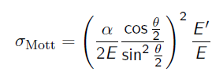
Goals for GMp
Accurately measure e-p elastic cross section in
kinematics similar to other JLab form factor
measurements
Improve accuracy of the cross section by as much as a
factor of 4 (< 2%) over previous measurements
Key input to all form factors and many of other
experiments, where elastic scattering is a background
Provide measurement of power scaling for GMp
in the range Q² = 7-14 GeV²
Approved for 24 PAC days

Slide 3
Control of Systematics
DAQ and Trigger:
EDTM pulser for dead time measurements
Achieved 10 kHz with 20% dead time
Tracking efficiency:
Use front chambers of FPP with VDCs
Target density
Use precise optics to provide software cuts on vertex
Use race-track cell targets with vertical flow to
minimize fluctuations
Solid angle: a benefit of improved optics
Scattering angle: precise determination of
target location using strong arm wire target

Slide 4
Modifications to Instrumentation
Strong arm wire target:
Design completed
Cost: $3k to $5k, saved $8k by using old radiator mechanism
HRS detector stacks:
Design completed
Add one chamber of FPP to both stacks
Attach S0 to FPP chamber
Shorten extension box for LHRS gas Cherenkov by 10 cm
Cost: $20k (mostly from labor, trying to reduce this cost)
Target scattering chamber
Design completed, though there maybe modifications
Allows to run DVCS (LHRS) and GMp (RHRS) concurrently
Cost: ~ $50k

Slide 5
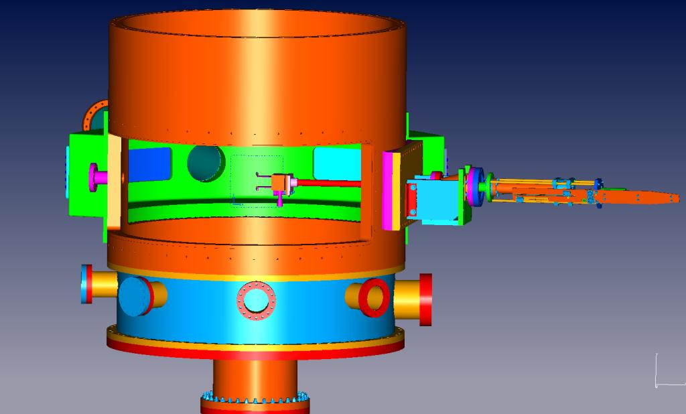
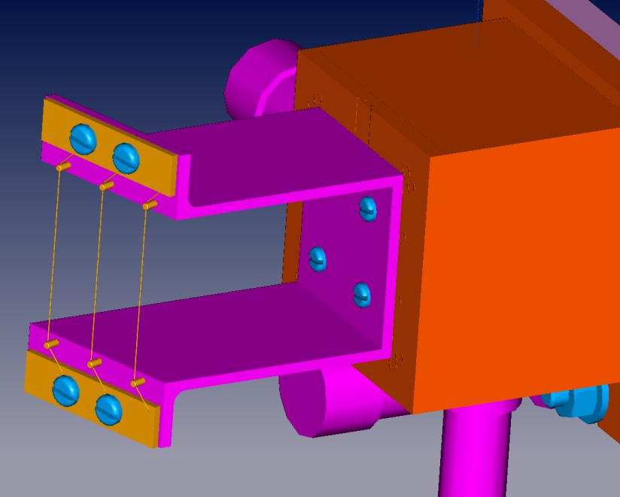
HRS Optics and Angle: Wire Target
Wires:
0.5” apart along the
beamline
1/16” (~1.6 mm)
apart transverse to
beam
Wire target, reproducibility of 100 microns sufficient Design completed, waiting on order of parts

Slide 6
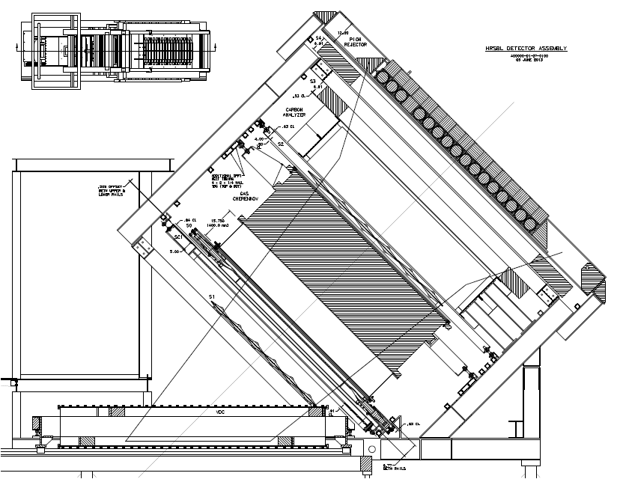
HRS Detector Stacks
Standard detectors with one plane of FPP
S0
Pion rejector
Fpp
Gas Cherenkov
VDCs

Slide 7
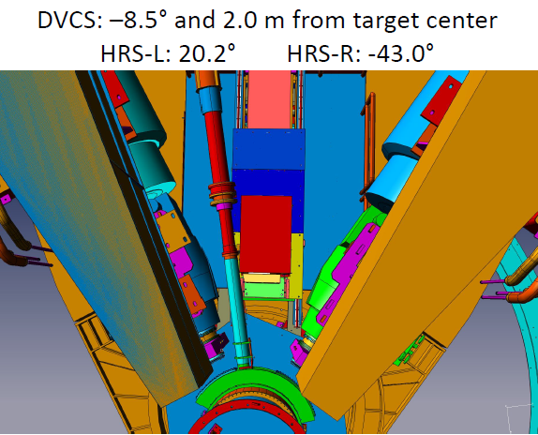
New Narrow DVCS Support Stand

Slide 8
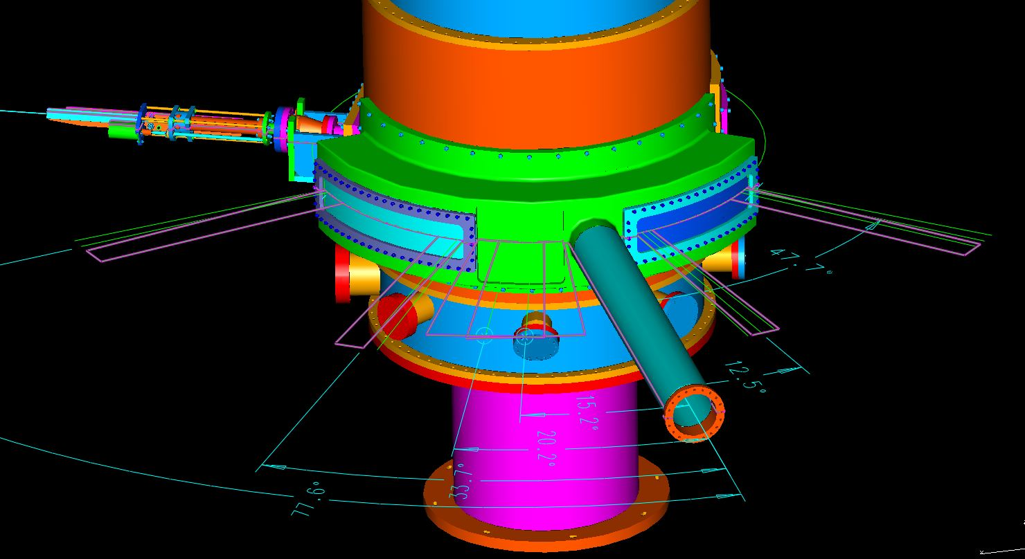
Angle Restrictions
Restrictions from scattering chamber design:
LHRS: 12.5º to < 48º (> 18º with calorimeter)
RHRS: -33.7º to < -78º (> 45º with calorimeter)
DVCS calorimeter: < -20º

Slide 9
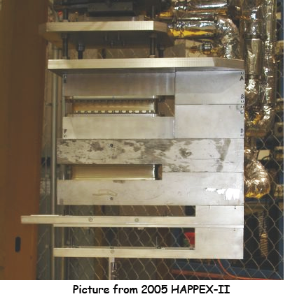
Target Configuration
LH₂: 15 cm Racetrack:
Vertical flow design
Dedicated studies of density
Luminosity monitors in
datastream
Not compatible with DVCS
Solid Al Foils (Dummy):
Endcap subtraction
Carbon Optics Targets:
1-2 cm spacing along z_{vertex} for extended target acceptance
Solid targets/Endcaps measured with x-ray attenuation

Slide 10
Target Density/Boiling
Results from x>2, Z. Ye (UVA)
Simulation by Silviu Covrig

Slide 11
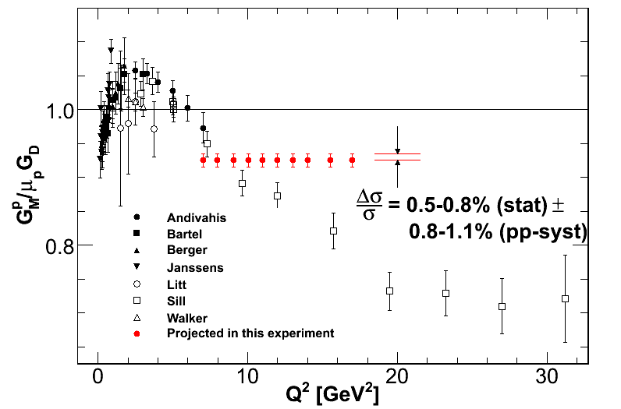
Expected Precision

Slide 12
Systematic Uncertainties
Uncertainties give in Δσ/σ (%)
Source | Point-to-point | Normalization
Incident energy | <0.3
Scattering Angle | 0.1-0.3
Incident Beam Angle | 0.1-0.2
Radiative Corrections* | 0.3 | 0.4
Beam Charge | 0.3 | 0.4
Target Thickness/Density Fluctuations | 0.2 | 0.5
Spectrometer Acceptance | 0.4-0.8 | 0.6-1.0
Endcap Subtraction | 0.1 | 0.1
Detector efficiencies/dead time | 0.3 | 0.4
Sum in quadrature | 0.8-1.1 | 1.0-1.3

Slide 13
Tasks & Responsibilities
Tasks | Commitments
Scattering chamber design | JLAB – A. Gavalya
Strong arm wire target design | Hall A – J. Miller
Online analysis software | JLAB – A. Camsonne, O. Hansen
LH₂ Target | JLAB – D. Meekins, J.-P. Chen
Beam line | Hall A – D. Higinbotham, B. Michaels, E. Christy
Refurbish Gas Č counter ( measure mirrors, test/replace PMTs) | MIT – K. Allada, V. Sulkosky, L. Ou, Y. Wang
VDC electronics, crates | YerPhi – A. Shahinyan
FPP | YerPhi – A. Shahinyan et al.
NIM trigger electronics | Hall A – B. Wojtsekhowski
Analysis for absolute cross-sections | HU – E. Christy
Scattering and solid angle determination | ANL – J. Arrington

Slide 14
Graduate Students
Longwu Ou (MIT)
Yang Wang (W&M)
Mohamed Nuh Hashir Rashad (ODU);
DVCS graduate student
Potential student from HU and perhaps another
from MIT (Barak Schmookler)

Slide 15
Commitments in Manpower
FPP work: Albert Shahinyan, Galust Sargsyan and Karen (YerPHI)
HRS detectors:
Milan Dukic (NCCU technician) for three weeks
Hamza Atac (Temple) for two weeks
NSU student for one month
Longwu Ou (MIT); (GMp student)
Kai Pan (UVa student) for two weeks
Puneet Khetarpal (FIU postdoc) for two weeks
John LeRose (JLab) part time
Mohamed Nuh Hashir Rashad (ODU); DVCS graduate student
Yang Wang (WM); graduate student (GMp student)

Slide 16
Summary
GMp will provide a baseline for the 21st century level of accuracy in form factor measurements by precisely measuring the cross section at Q² up to 14 GeV².
It is the only measurement of the cross section; key input to all form factors and many of other experiments.
Some progress is being made with many of the improvements aiding other experiments that plan on using the HRS’s during 12 GeV.
GMp requires high precision at full 11 GeV beam energy!
Collaborators are welcome to participate; much work is still required before 2014.
Additional manpower is needed and welcome,
especially for testing of both spectrometers’
detector packages

Slide 17
Backup

Slide 18
Systematic Uncertainties
Point to point uncertainties
Source | Δσ/σ (%) | Parameters
Incident energy | <0.3 | 3×10⁻⁴
Scattering Angle | 0.1-0.3
Incident Beam Angle | 0.1-0.2
Radiative Corrections* | 0.3
Beam Charge | 0.3 | 1×10⁻³
Target Density Fluctuations | 0.2
Spectrometer Acceptance | 0.4-0.8 | 0.1 mrad
Endcap Subtraction | 0.1
Detector efficiencies/dead time | 0.3
Sum in quadrature | 0.8-1.1

Slide 19
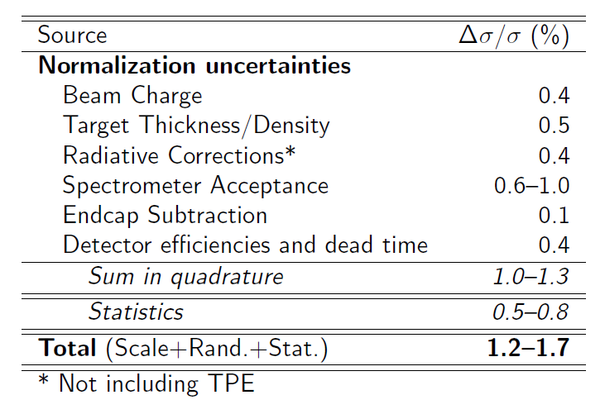
Systematic Uncertainties

Slide 20
FPP (front chambers)
Problems: gas consumption > 50 l/h HV trips often
due to gas, many dead wires/some electronics.
Done: repair of dead electronics; built parallel gas
distribution.
Still to do: HV distribution in one PC; gas distribution
should be as wide as a straw block; HV test
wires.
Recent: First chamber main work is completed;
second in progress and expect completion in
1 month; hardware electronics not yet started.
Already 1 FTE year has been spent on FPP

Slide 21
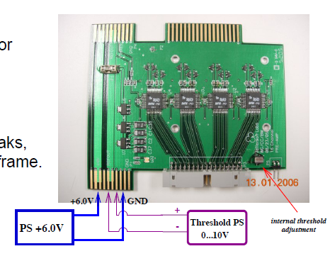
VDC Improvements
Upgrade electronics to use
1877S, which allows sparsification
Replace aging A/D cards and reuse BigBite cards
Provide very good stability against
oscillations and rate capability
of 8 MHz (in full chamber)
LHRS and RHRS completed
and tested
Software still needed for Fpp
chamber and for cosmics
checks

Slide 22
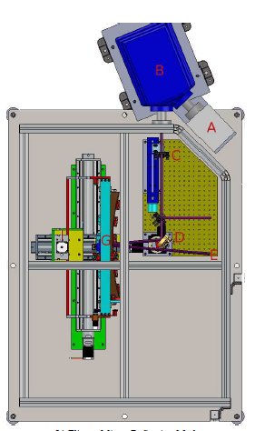
Gas Cherenkov Improvements
Reflectivity measurements of HRS GCC mirrors in progress
Both HRS mirrors completed
Two spare mirrors recoated and checked
Reflectivity is within a few percent of published results
In progress of checking relative response of PMTs and will replace those as needed; ~ 70 to test
Cosmic mirror calibration

Slide 23
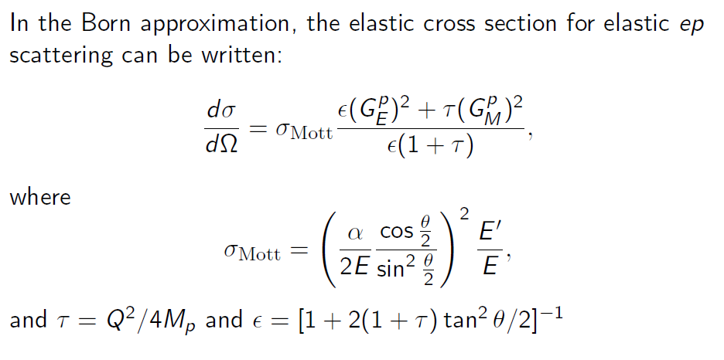
Introduction

Slide 24
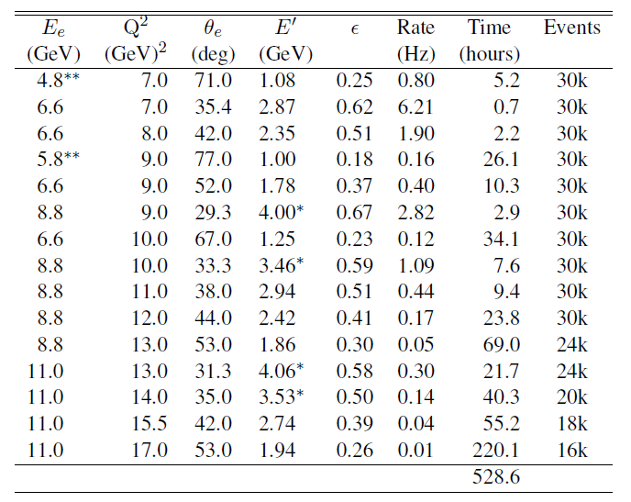
Kinematics
PAC Approved 24 days

Slide 25
DVCS-GMp Cooperation: Dual Running
GMp and DVCS install together (except DVCS calorimeter)
GMp runs independently:
Restrictions on HRS angles from vacuum chamber and DVCS stand
Restrictions on HRS movement from DVCS cables and stand, HRS movement will require manual assistance
One week shutdown to install DVCS calorimeter
DVCS runs ~ 3 PAC months:
GMp takes parasitic data with right HRs at large angles

