Slide 1




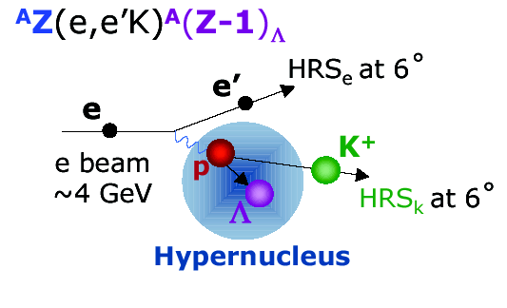
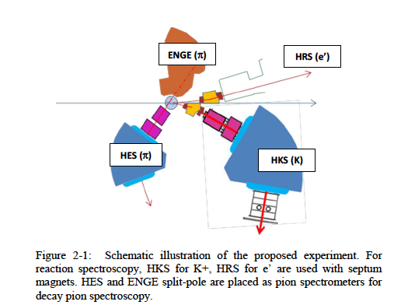
A Study with High Precision on
the Electro-production of the ☹ and ☹-Hypernuclei
in the Full Mass Range
F. Garibaldi - PAC Jlab – 18 June 2013
Tohoku
The physics
Experimental challenges
The proposal(s)
  Elementary reaction (& ¹⁶O)
  Few body systems (ΛN, ⁴_{Λ}H)
  Medium mass nuclei (⁴⁰Ca, ²⁷Al,⁴⁸Ti)
  Heavy nuclei: ²⁰⁸Pb
  Summary and conclusions

Slide 2
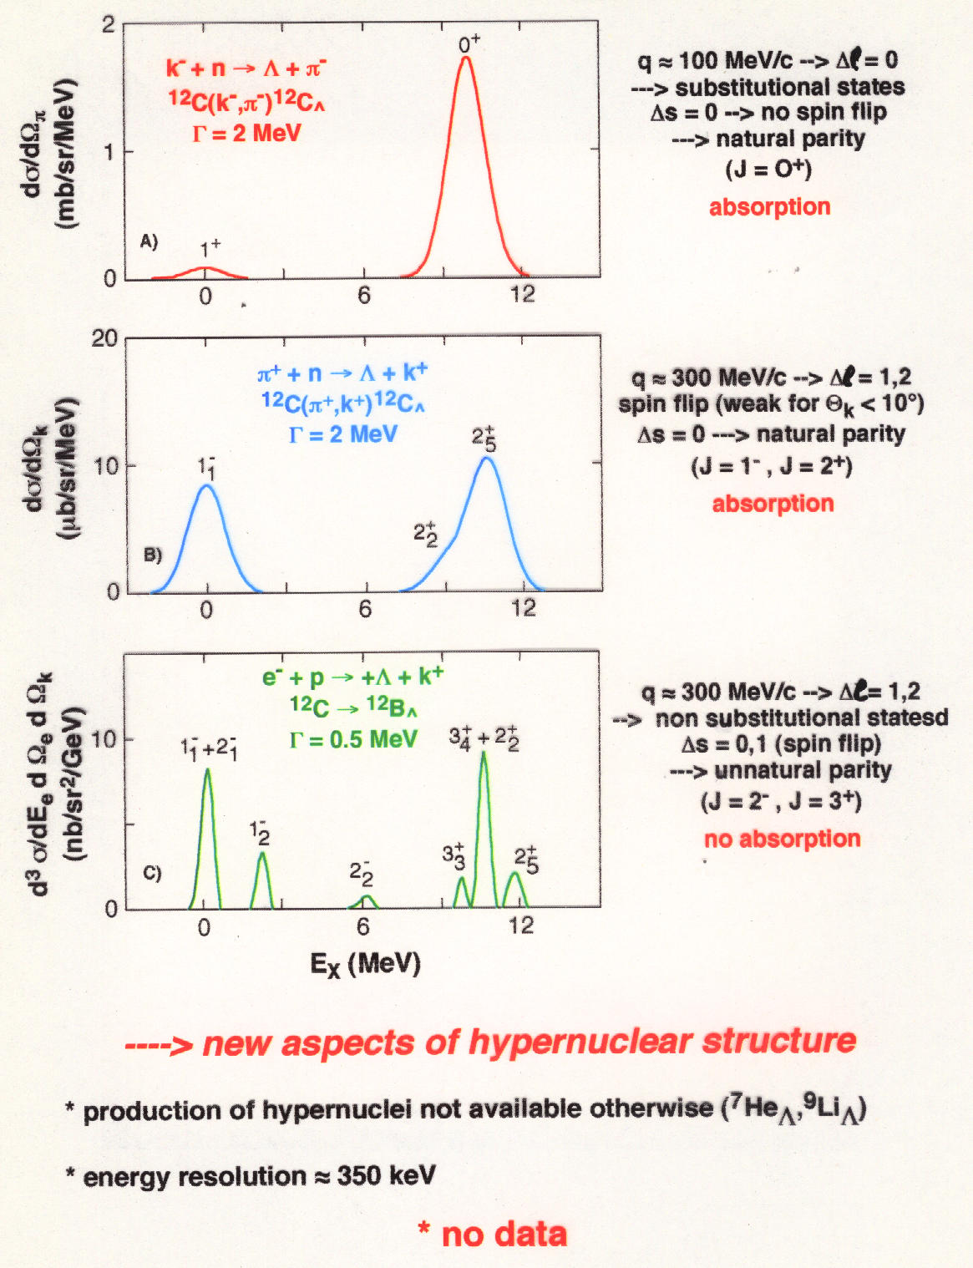
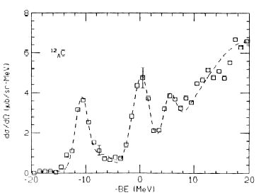
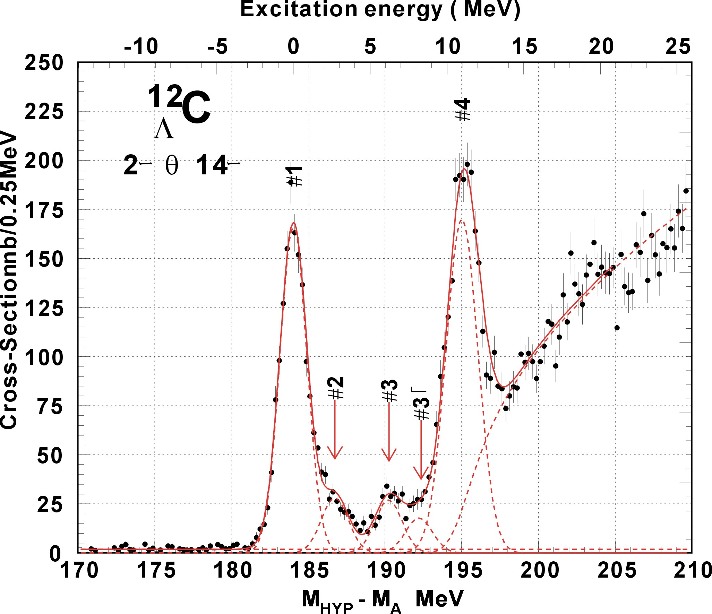
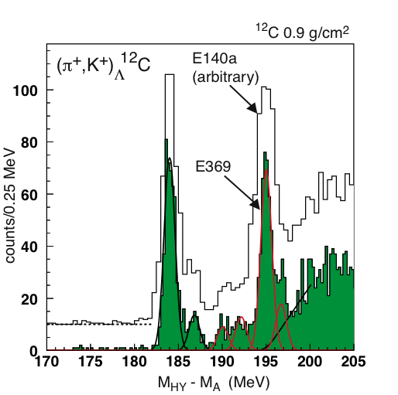
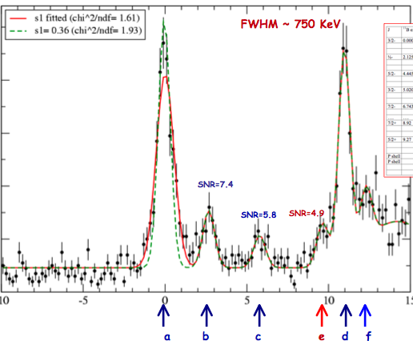
BNL 3 MeV
KEK336 2 MeV
Improving energy resolution
~ 1.5 MeV
and
using electromagnetic probe
670 KeV
635 KeV
new aspects of hyernuclear structure
High resolution, high yield, and systematic study is essential
production of mirror hypernuclei
energy resolution ~ 500 KeV

Slide 3
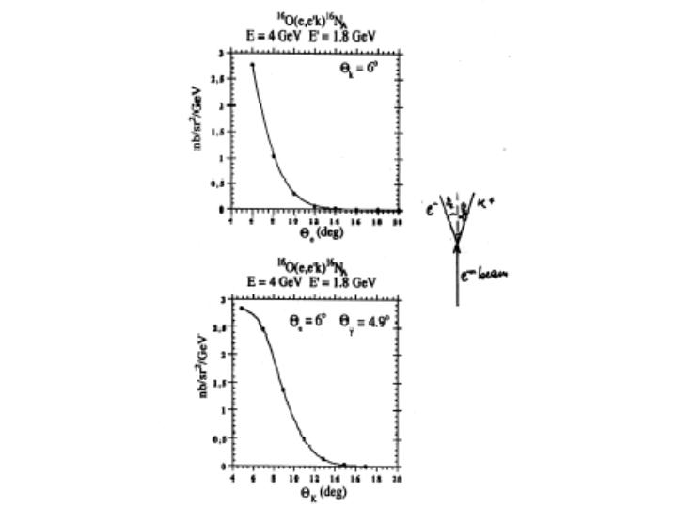
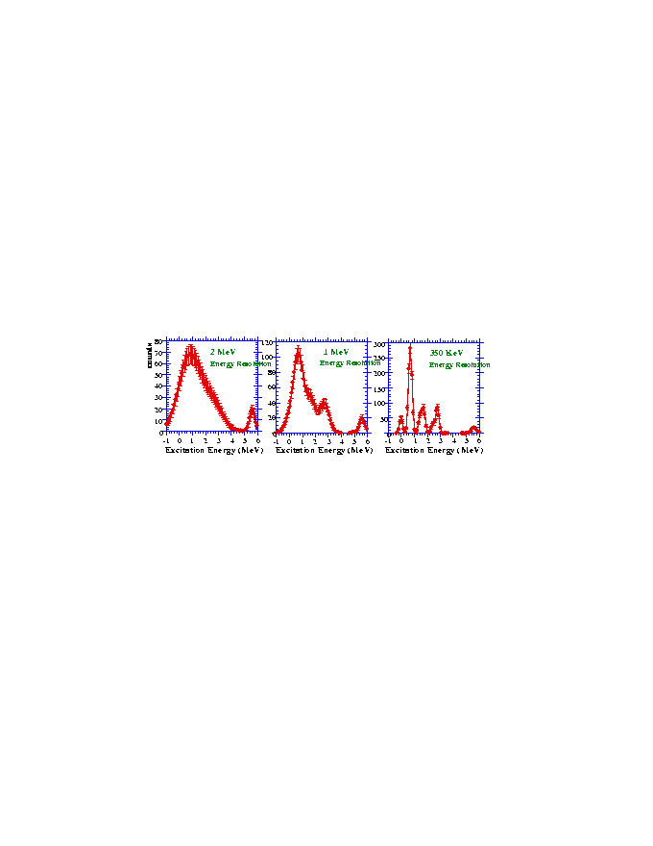
reasonable counting rates
forward angle
DE_{beam}/E : 2.5 x 10⁻⁵
2. DP/P : ~ 10⁻⁴
3. Straggling, energy loss…
septum magnets
~ 600 keV
good energy resolution
do not degrade HRS
minimize beam energy instability
“background free” spectrum
unambiguous K identification
High P_{k}/high E_{in} (Kaon survival)
RICH detector

Slide 4
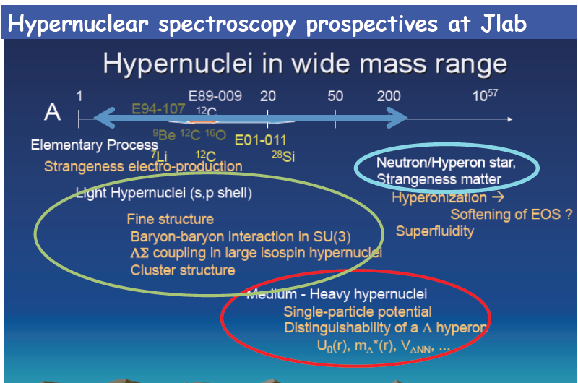
The program
1. Elementary Λ, Σ⁰
                Reliable data ¹H(e,e’K⁺)Λ, Σ⁰ at low Q²
Dynamics, f.f, …
2. Few-body
²D(e,e’K⁺) [ΛN] Exotic bound state, ΛN interaction
⁴He(e,e’K⁺)⁴_{Λ}Η ΛN, CSB
3. Medium-heavy
^{40,44,48}Ca(e,e’K⁺) ^{40,44,48}_{Λ}K ΛN, Λ’s S.E., iso-spin, A dependence of B_{Λ} , single particle nature of Λ,….
²⁷Al(e,e’K⁺) ²⁷_{Λ}Mg Tri-axial deformation
⁴⁸Ti(e,e’K⁺) ⁴⁸_{Λ}Sc Level inversion due to Λ
4. Heavy
²⁰⁸Pb(e,e’K⁺) ²⁰⁸_{Λ}Tl Λ in heaviest nucleus
A dependence of B_{Λ}, single particle nature of Λ
The role of three body forces
Neutron stars structure and dynamics
CSB

Slide 5
Elementary production of L in ¹H(e,e’K+)L
Calculations of the cross section for the electroproduction of hypernuclei use the elementary amplitudes and a nuclear and hypernuclear wavefunction.
The cross sections are sensitive only to the elementary amplitude for very small kaon angles.
Measure the elementary production cross section as input for the hypernuclear calculations and determine its small-angle behavior
Dynamics of the elementary reaction itself is also interesting in this unexplored kinematics region.
By measuring the ratio of hypernuclear/elementary reaction makes the interpretation the hypernuclear structure simpler

Slide 6
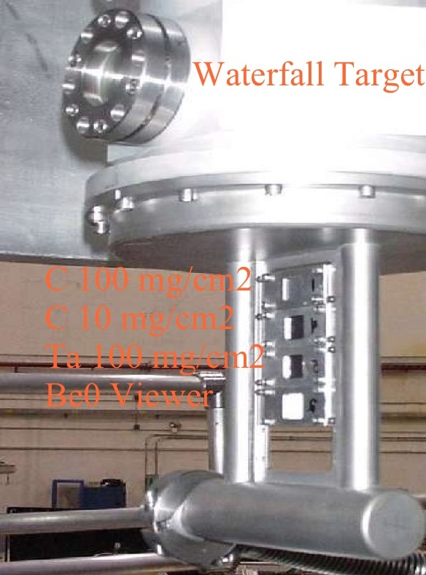
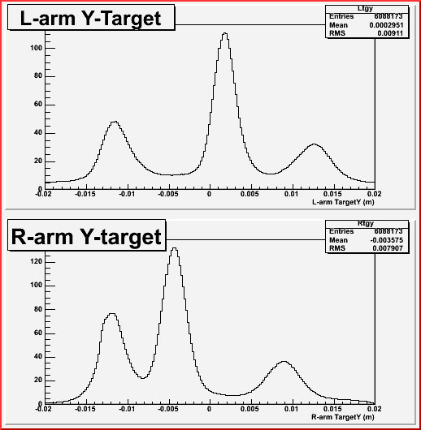
The WATERFALL target: reactions on ¹⁶O and ¹H nuclei
Be windows
H₂O “foil”
H₂O “foil”

Slide 7
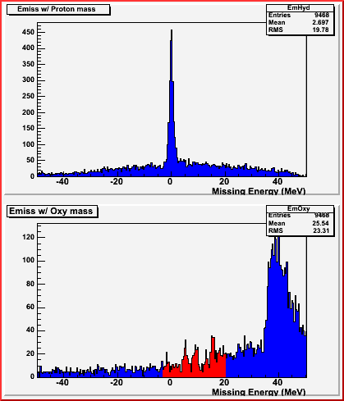
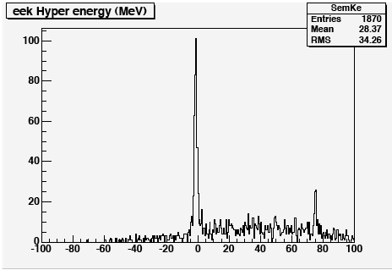
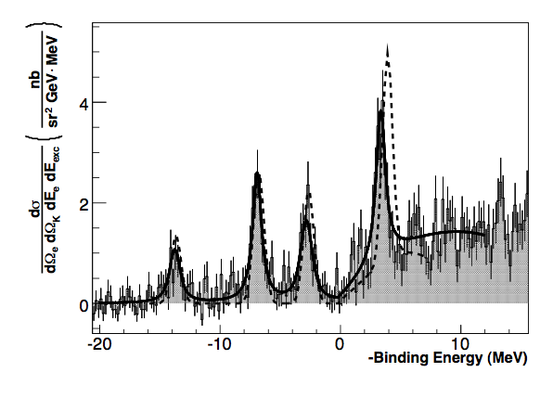
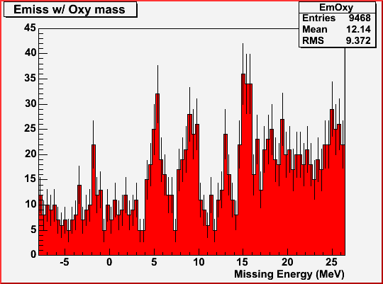
Results on the WATERFALL target - ¹⁶O and ¹H
¹H (e,e’K)L
¹H (e,e’K)L,S
L
Energy Calibration Run
S
¹⁶O(e,e’K)¹⁶N_{L}
Water thickness from elastic cross section on H
Precise determination of the particle momenta and beam energy
using the Λ and Σ peak reconstruction (energy scale calibration)

Slide 8
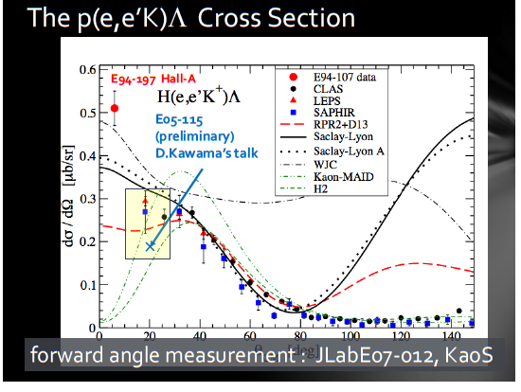
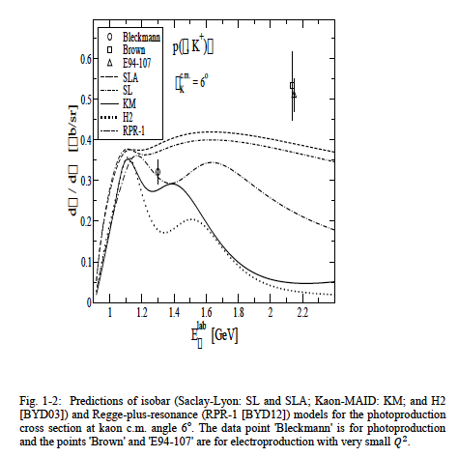
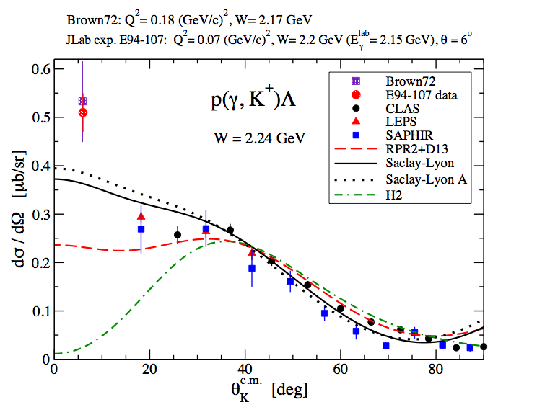
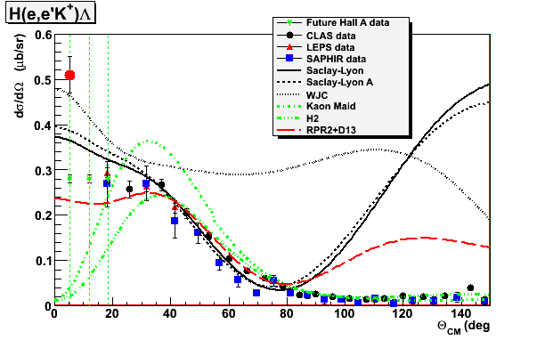
Results on H target – The p(e,e’K)L Cross Section
W=2.2 GeV
study the angular dependence of
p(e,e’K)L and ¹⁶O(e,e’K)¹⁶N_{L}
at small kaon angles and at low Q²
The small angle behavior of the cross section is poorly known (results from E94-107 running at higher W).
CLAS, SAPHIR and LEPS have difficulty reaching angles smaller than ~20º.
This experiment will cover the range θ_{γκ} ~ 0 and allow for several bins.
➔ None of the models is able to describe the data over the entire range
➔ New data in electroproduction allows studying dynamics of the models – hadronic form factors, longitudinal couplings…..

Slide 9
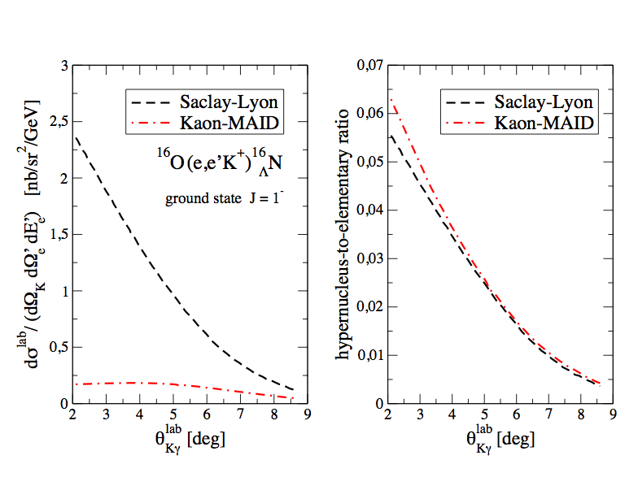
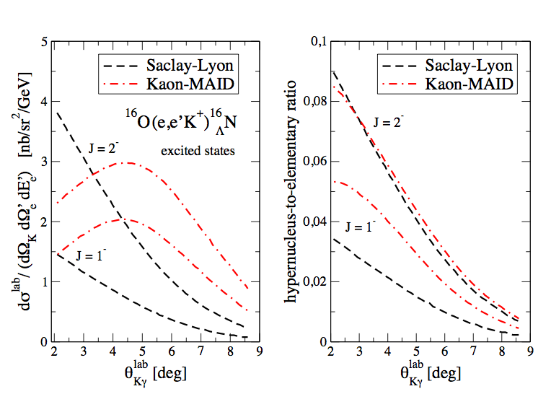
Dividing up by the elementary cross section allows to remove the strong model dependence in the hypernuclear cross section
The remaining angular dependence comes mainly from the nuclear hypernuclear sructure
In the doublet case the sipn flip part is coupled in different way to the members
(allows to study the elementary part)
The ratio of the hypernuclear and elementary cross section doesn’t depend strongly on the electroproducion model and contains direct information on hypernuclear structure and production mechanism

Slide 10
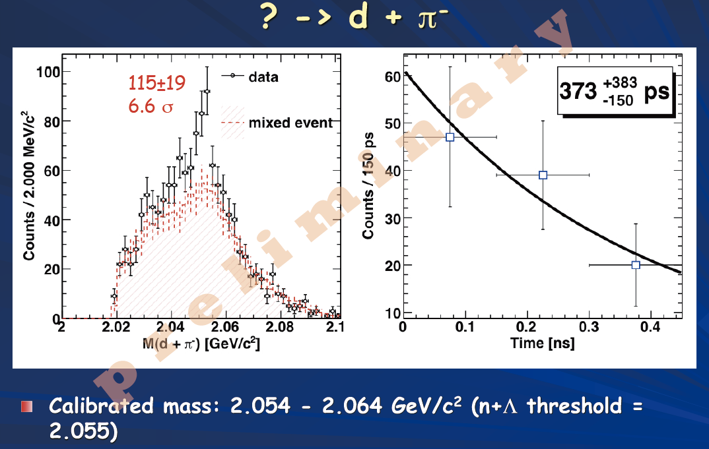
Few-body physics with strangeness
1. Search of [nL] bound state and study of n-Λ interaction through FSI.
Established lightest hypernuycleus = ³_{Λ}H
Hyp-HI experiment at GSI; indication of a structure in d + p⁻ invariant mass
Indication of a nΛ bound state ?
²d(e,e’K⁺)[nΛ]
Direct method to search or set upper limit on this exotic system.
(charge 0, S=-1 nuclei)
T.R.Saito, NUFRA2011
Electro-production data of ²d(e,e’K⁺) provide also information of n-Λ interaction through FSI. (not very sensitive to deuteron w.f.and basic production mechanism)
R.A.Adelseck & L.E.wright
PRC 39(1989) 580.

Slide 11
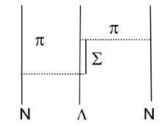
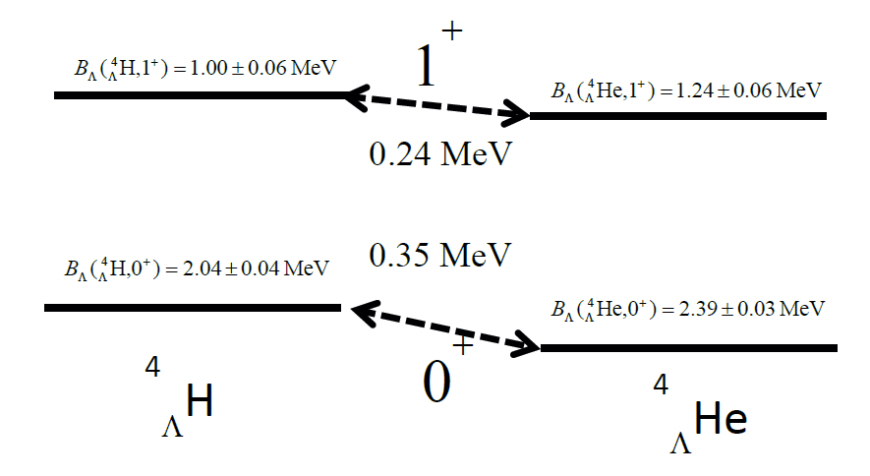
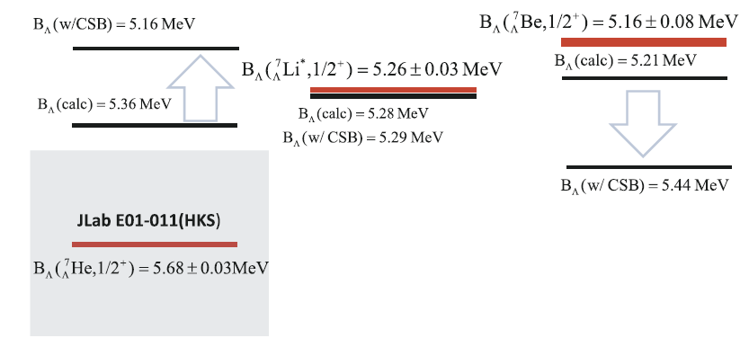
Few-body physics with strangeness
2. Charge Symmetry Breaking of ΛN interaction
Measurinng binding energies of the g.s. 0+ and 1+
⁴He(e,e’K⁺) ⁴_{Λ}H
A=4,iso-doublet hypernucleus
^{E13 @ J-PARC}
Introduced to explain A=4.
Decay π
Phenomenological CSB potential
Re-check of A=4 system
NOT necessary for A=7
JLab E01-011 (HKS)
Recently measured
at JLab Hall-C
A=7,iso-triplet hypernuclei

Slide 12
Medium heavy hypernuclei
Λ in nuclear medium
Single particle nature of Λ in nuclear medium
A dependence of Λ potential
Effective ΛN interaction
ls splitting in the heavy nuclei beyond p shell
Inputs for (relativistic and non) mean-field theories
High quality
medium heavy
hypernuclear
spectroscopy
Λ as a probe
Λ as an impurity
Collective motion of core nucleus
Tri-axial deformation of core nucleus
Modify nature of core
energy level inversion
To what extent does a Λ hyperon keep its identity as a baryon inside the nucleus?

Slide 13
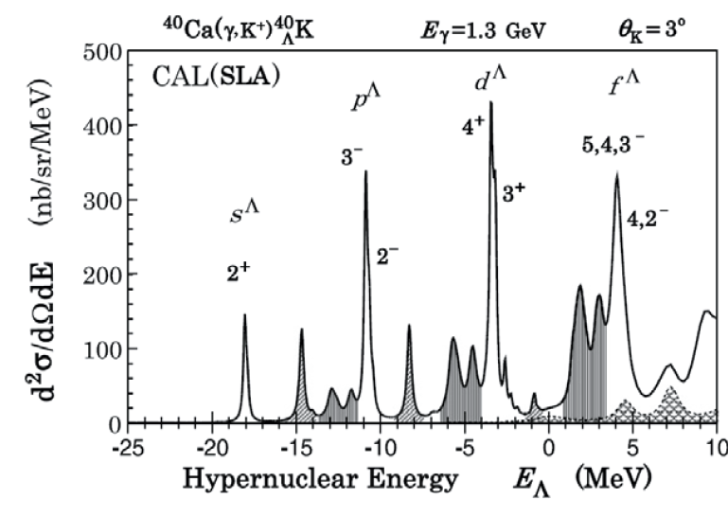
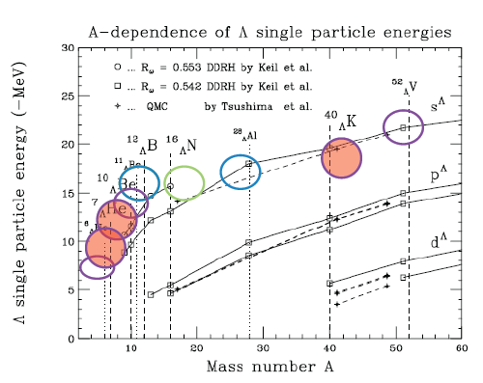
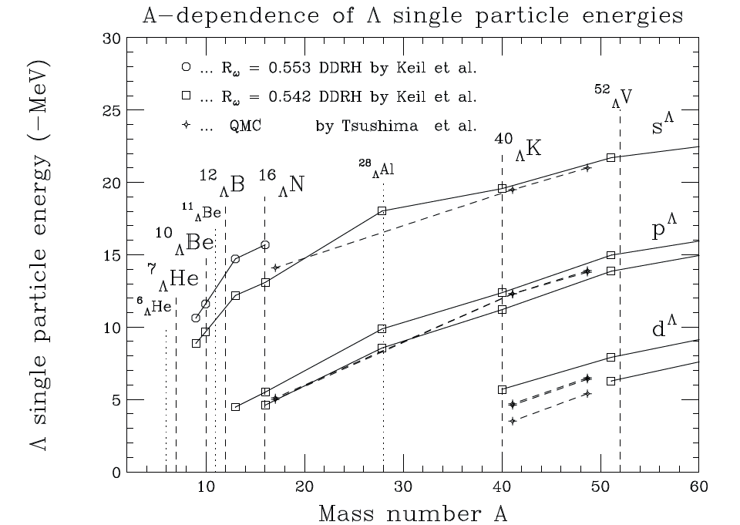
1. Ca (e,e’K⁺) _{Λ}Κ
Clean Spectrum
Missing in (e,e’K) data
Complete A dependence of L S.P.Energy
Doubly LS closed ⁴⁰Ca target
Systematic study of isotope effect of core nuclei for the first time
⁴⁰Ca, ⁴⁴Ca (, ⁴⁸Ca) targets (charge radii similar)
-Comparison with advanced mean field calculatins (QMC, Thomas et al.) and DDHR (Lenske et al).
-Disentagle degenerate hypernuclear states and clarify the origin of the splitting.

Slide 14
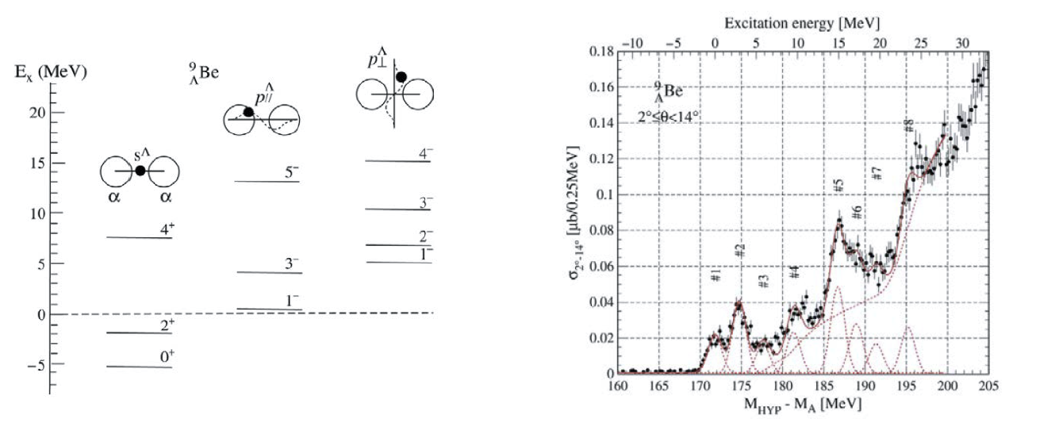
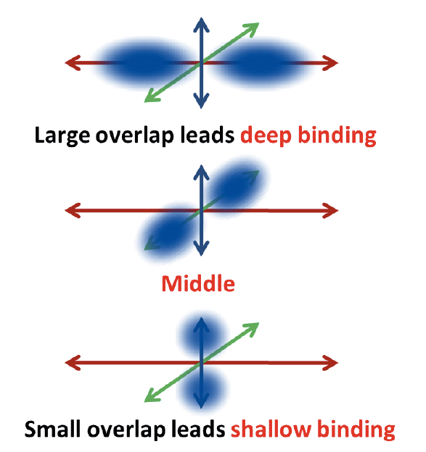
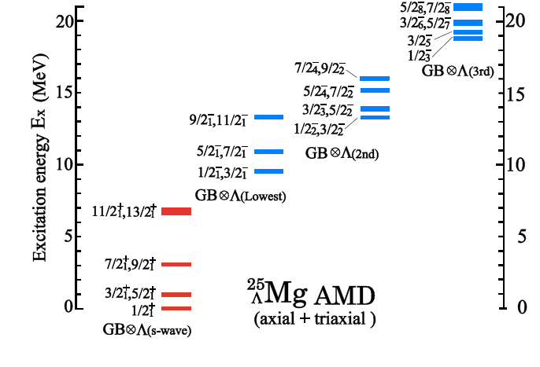
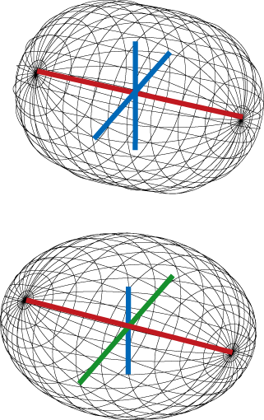
2. ²⁷Al (e,e’K⁺) ²⁷_{Λ}Mg
⁹_{Λ}Be = α + α + Λ
New field. Collective motion, deformation properties not studied yet in hypernuclei
Genuine hypernuclear state
Tri-axially deformed ²⁶Mg core + Λ in p-shell
Totally new method to search shape of nucleus with Λ!

Slide 15
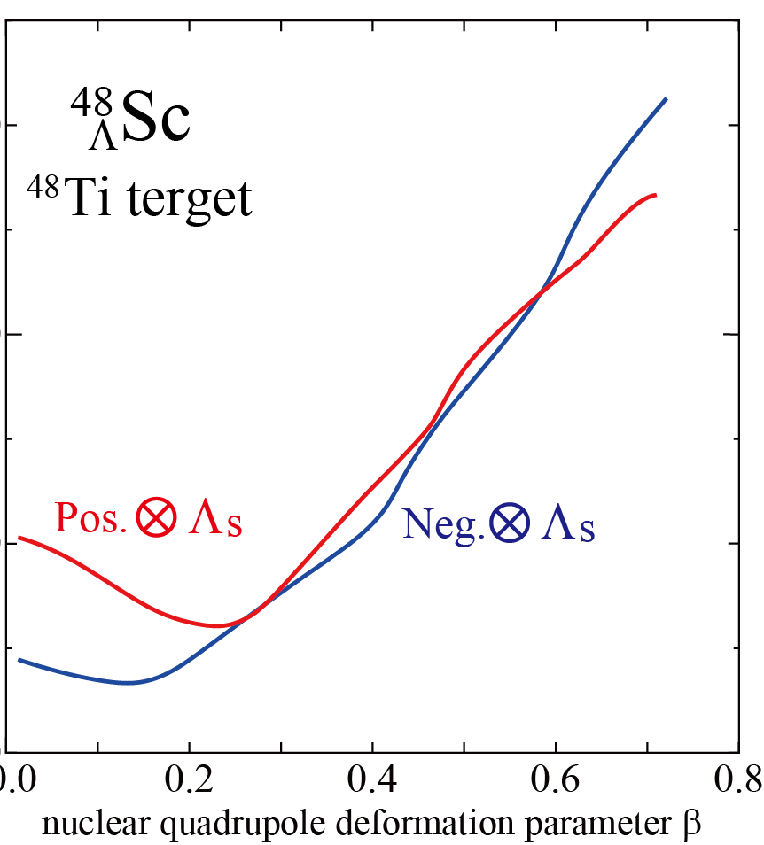
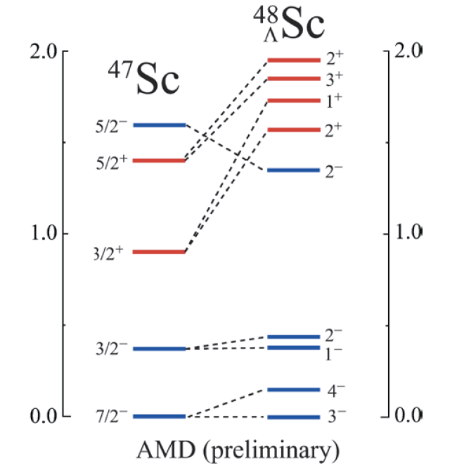
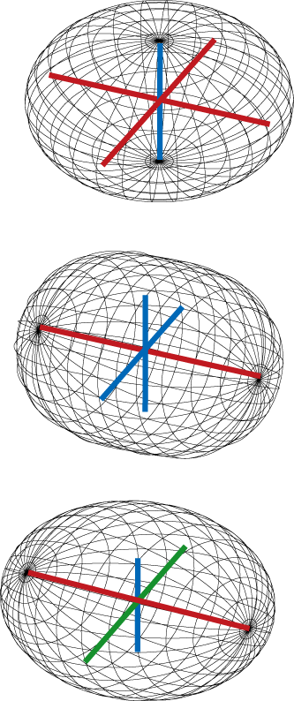
3. ⁴⁸Ti (e,e’K⁺) ⁴⁸_{Λ}Sc
Isaka Hyper-AMD
Positive
Energy surface
Negative
Λ impurity causes energy level inversion !

Slide 16
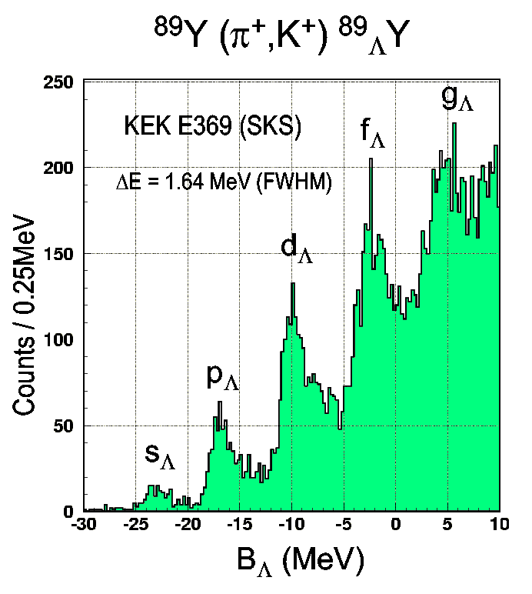
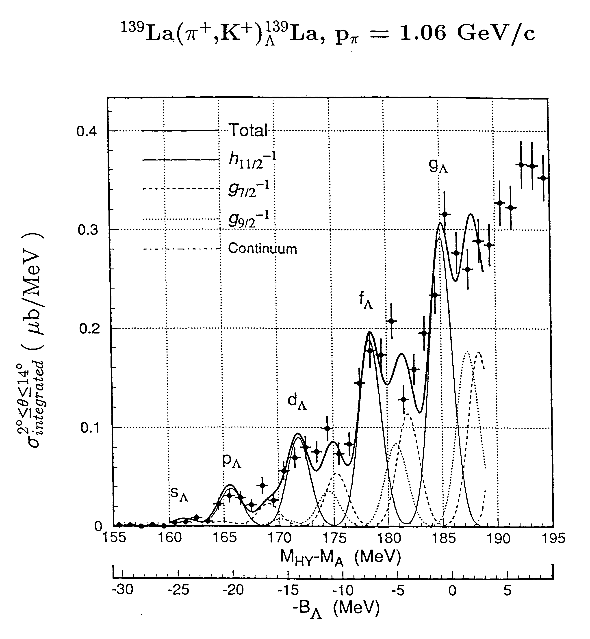
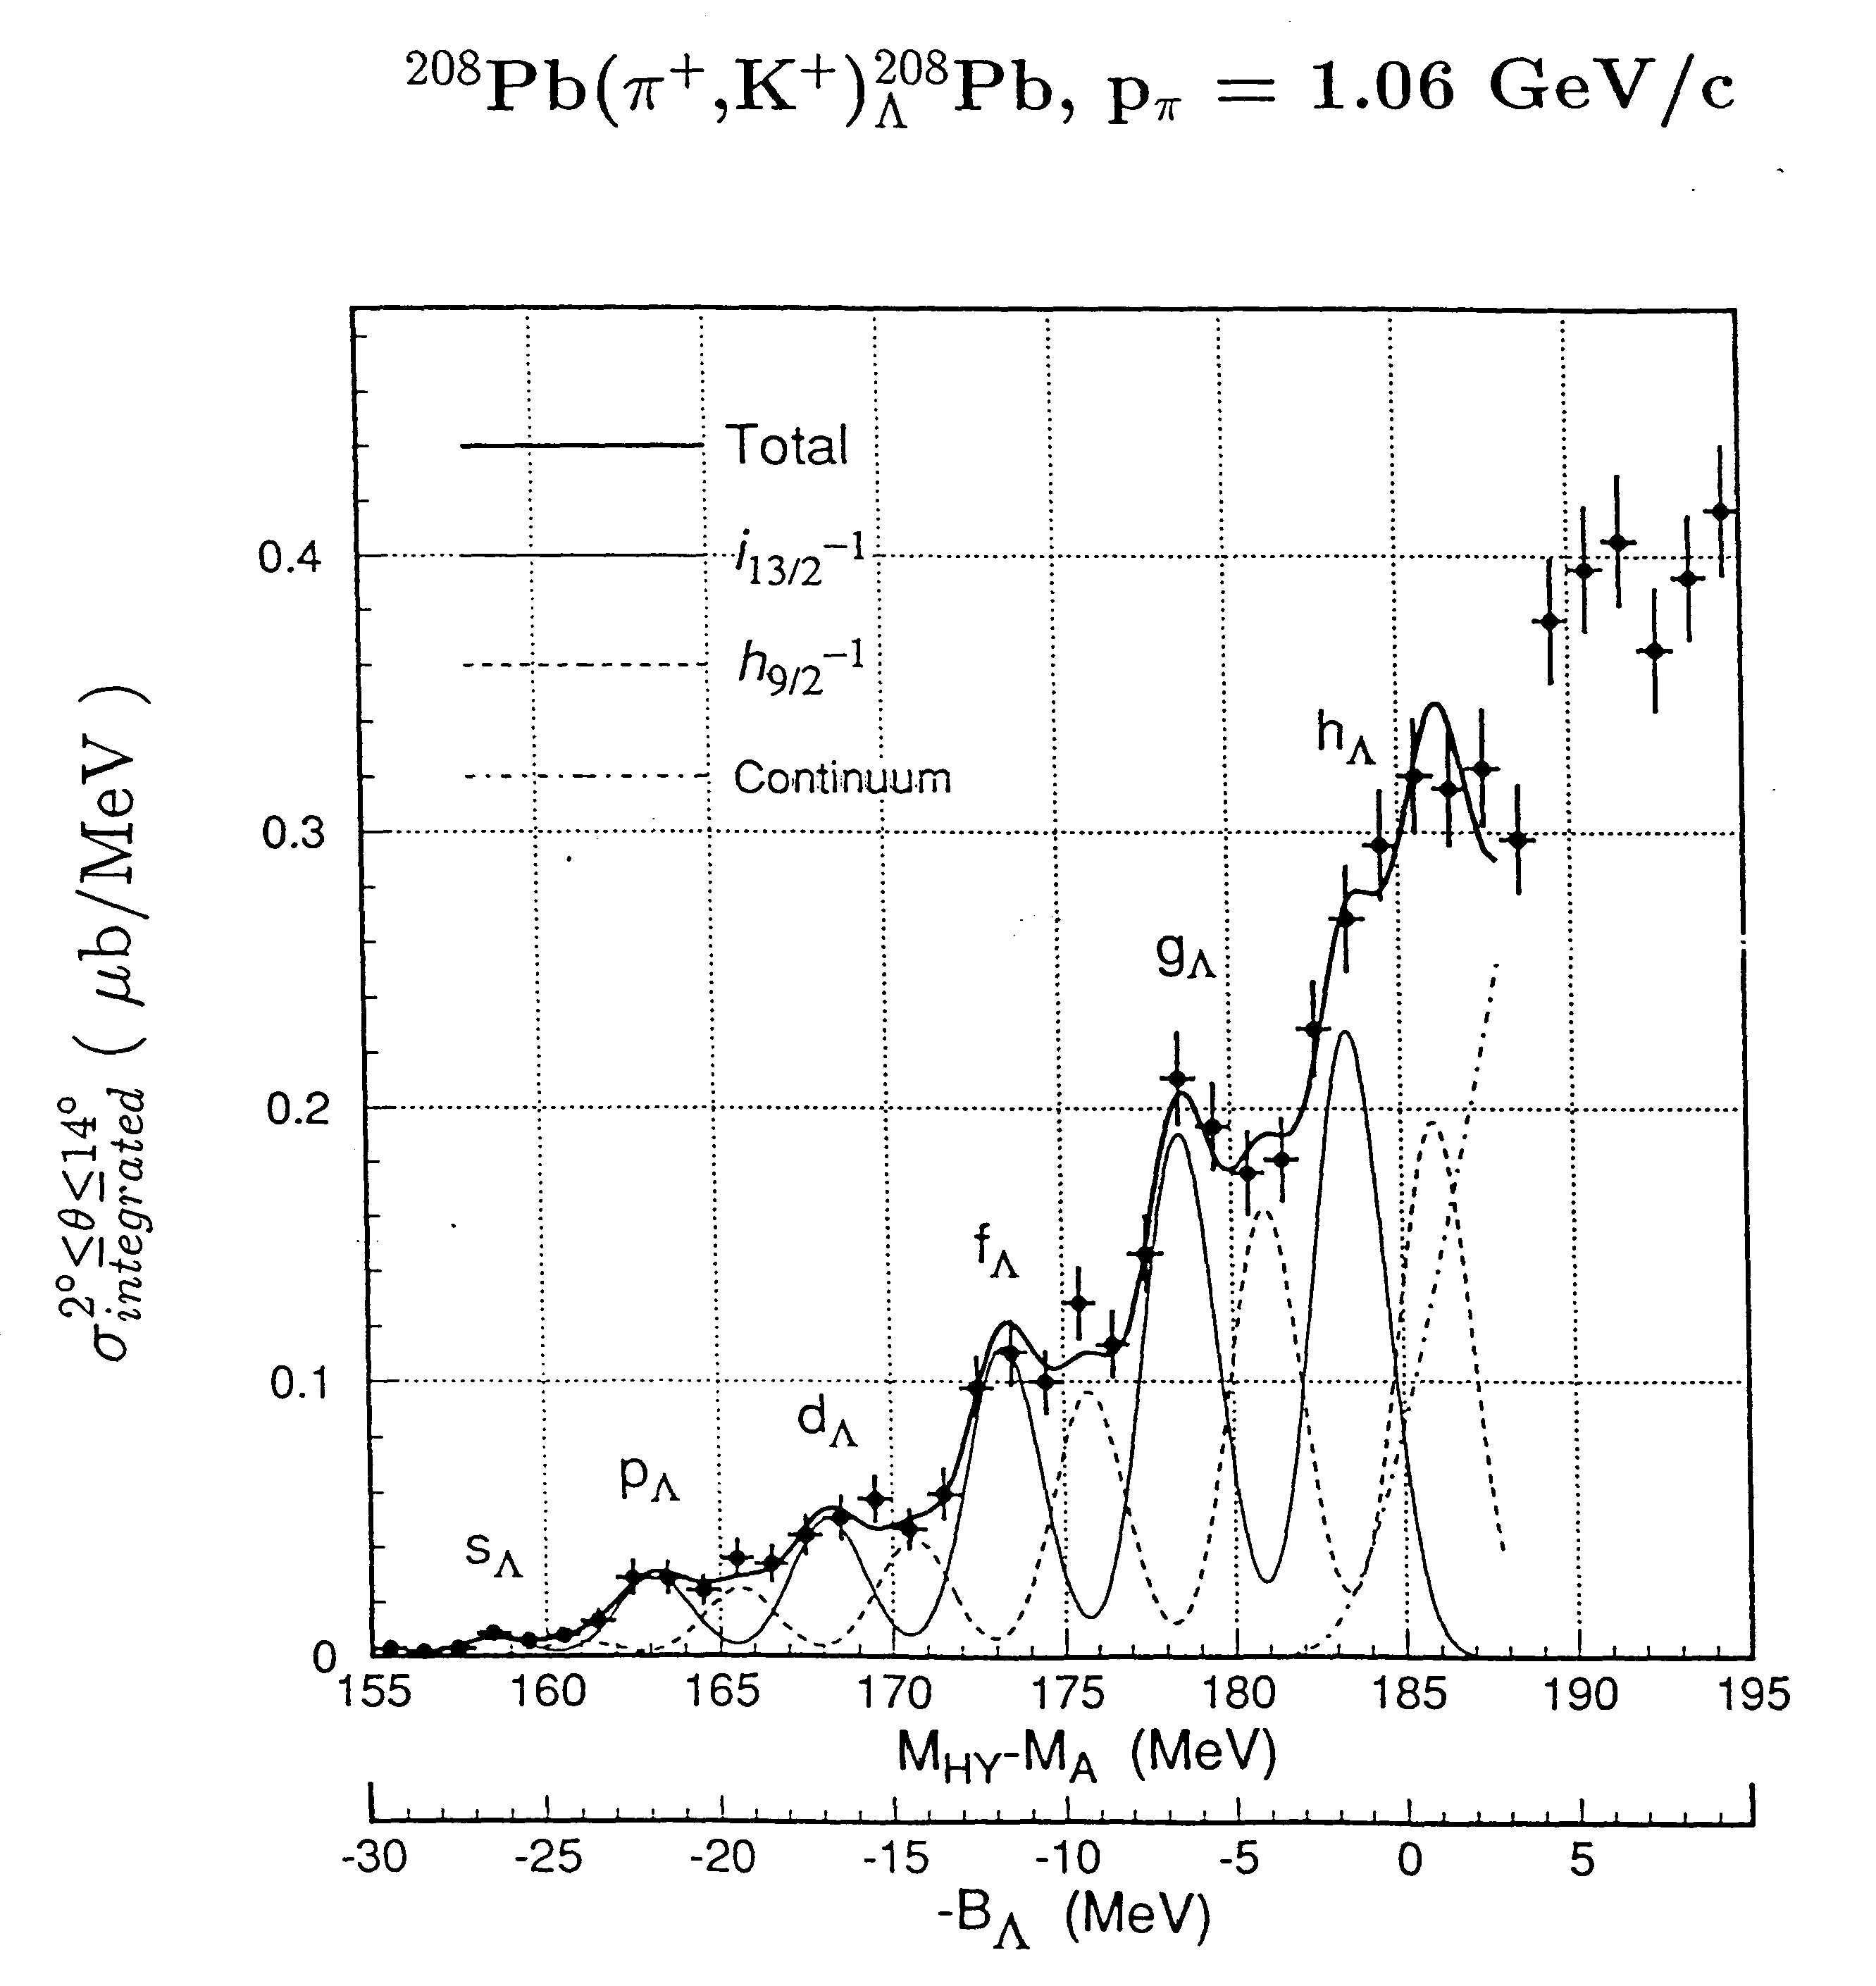
Λ Hyperon in heavier nuclei – ²⁰⁸(e,e’K+)²⁰⁸_{Λ}Ti
✔ A range of the mass spectroscopy to its extreme
✔ In the A →∞ limit the ambiguity due to parameters in the relativistic mean field theorie becomes smaller
✔ Limits of mean-field approximation and the role that the sub-structure of nucleons plays in the nucleus.
✔ Studied with (π,k) reaction, levels barely visible (poor energy resolution)
Hotchi et al., PRC 64 (2001) 044302
Hasegawa et. al., PRC 53 (1996)1210
(e,e’K) reaction can do much better
Energy resolution → Much more precise Λ single particle energies. Complementarity with (π,k) reaction

Slide 17
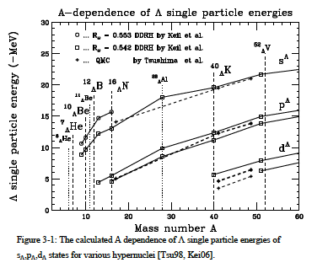
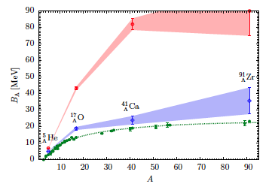
✔ the mass dependence of the binding energy for each shell model orbital will be extended to A = 208, where the ambiguity in the relativistic mean field theories become smaller.
✔ Distinguishability of the hyperon in the nuclear medium
Separation energy as a function of the baryon number A.
Plain green dots [dashed curve] are the available B_{Λ} experimental values. Empty red dots [upper banded curve] refer to the AFDMC results for the nuclear AV4' potential plus the two-body ΛN interaction alone.
Empty blue diamonds [lower banded curve] are the results with the inclusion of the three-body hyperon-nucleon force.
Result possibly improved by refitting the terms of the ΛNN force and also CSB
Lonardoni et al,(arXiv:1301.7472v1 [nucl-th] 30 Jan 2013)
✔ neutron stars structure and dynamics

Slide 18
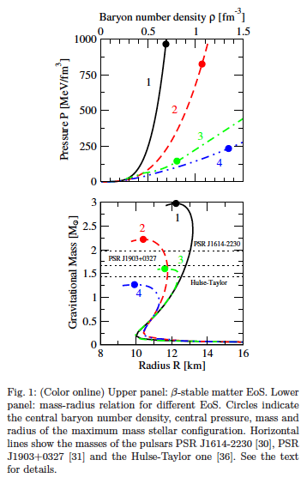
Appearence of hyperons brings the maximum mass of a stable neutron star down to values incompatible with the recent observation of a star of about two solar masses.
It clearly appears that the inclusion of YNN forces (curve 3) leads to a large increase of the maximum mass, although the resulting value is still below the two solar mass line.
A precise knowledge of the level structure can, by constraining the hyperon-nucleon potentials, contribute to more reliable predictions regarding the internal structure of neutrons stars, and in particular their maximum mass
It seems that only simultaneous strong repulsion in all relevant channels could significantly raise the maximum mass
It is a motivation to perform more realistic and sophisticated studies of hyperonic TBF and their effects on the neutron star structure and dynamics, since they have a pivotal role in this issue

Slide 19
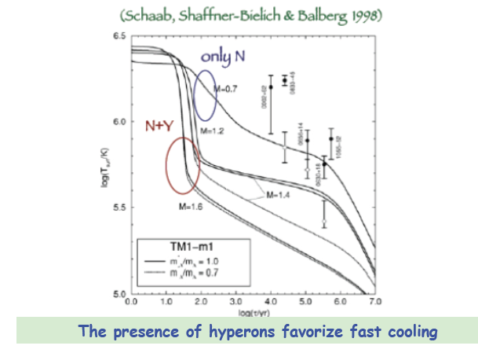
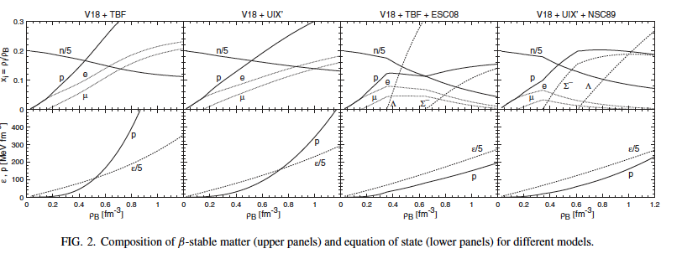
Appearence of hyperons brings the maximum mass of a stable neutron star down to values incompatible with the recent observation of a star of about two solar masses.
It clearly appears that the inclusion of YNN forces (curve 3) leads to a large increase of the maximum mass, although the resulting value is still below the two solar mass line.
A precise knowledge of the level structure can, by constraining the hyperon-nucleon potentials, contribute to more reliable predictions regarding the internal structure of neutrons stars, and in particular their maximum mass
It is a motivation to perform more realistic and sophisticated studies of hyperonic TBF and their effects on the neutron star structure and dynamics, since they have a pivotal role in this issue

Slide 20
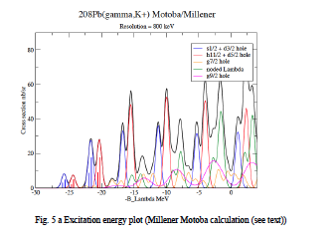
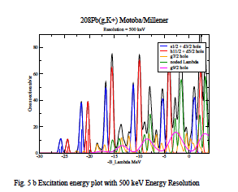
Millener-Motoba calculations
particle hole calculation, weak-coupling of the Λ hyperon to the hole states of the core (i.e. no residual Λ-N interaction).
Each peak does correspond to more than one proton-hole state
- Interpretation will not be difficult because configuration mixing effects should be small
- Comparison will be made with many-body calculations using the Auxiliary Field Diffusion Monte Carlo (AFDMC) that include explicitely the three body forces.
- Once the Λ single particle energies are known the AMDC can be used to try to determine the balance between the spin dependent components of the ΛN and ΛNN interactions required to fit Λ single-particle energies across the entire periodic table.
“Up to now these data are the best proof ever of quasi particle motion in a strongly interacting system”

Slide 21
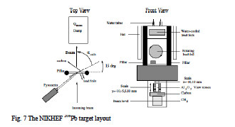
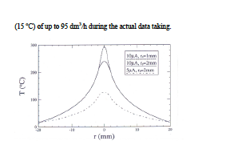
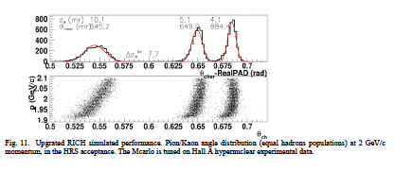
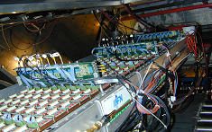

The target
<i> = 25 mA - 100 mg/cm²
cryocooling
Target calibration and monitoring
Elastic scattering measurement off Pb-208 to know the actual thickness of the target then monitor continuously by measuring the electron scattering rate as a function of two-dimensional positions by using raster information.
PID π rejection ratio ∼ 10−¹⁰
^{(threshold + RICH)}
RICH Detector

Slide 22
<I> (mA)å | Target thickness (mg/cm2) | Peak significance | Peak
10 | 100 | 3.48 | s-shell
10 | 200 | 4.13 | s-shell
10 | 300 | 4.48 | s-shell
10 | 100 | 7.54 | p-shell
10 | 200 | 9.21 | p-shell
10 | 300 | 11.52 | p-shell
20 | 100 | 4.13 | s-shell
20 | 200 | 4.63 | s-shell
20 | 300 | 4.84 | s-shell
25 | 100 | 4.3 | s-shell
25 | 200 | 4.7 | s-shell
25 | 300 | 4.9 | s-shell
25 | 100 | 10.5 | p-shell
25 | 200 | 12.8 | p-shell
25 | 300 | 14.0 | p-shell

Slide 23
Beam time request
Target | Beam time (hours)
waterfall | 168
d | 72
4He | 263
Medium mass | 840
208Pb | 840
Total | 2183

Slide 24
Summary and conclusions
- The (e,e’K) experiments in the 6 GeV era confirmed the specific, crucial role of this technique
The new experiments will allow to obtain important information on
ΛN interaction
Charge Symmetry Breaking (CSB) in the Λ-N interaction
Limits of the mean field description of nuclei and hypernuclei, identity of Λ in the nuclear medium
Λ binding energy as a function of A for different nuclei than those probed with hadrons,
Energy level modification effects by adding a Λ
- The role of the 3 body ΛNN interaction in Hypernuclei and Neutron Stars (structure and dynamics)
The study of few body will provide important information about Charge Symmetry Breaking.
Comparison of lattice QCD and microscopic Mcarlo calculations for ⁴He, microscopic Mcarlo calculation with “standard” calculations up to ²⁰⁸Pb

Slide 25
The collaboration is the right one to perform this experiment(s)
Designed and built several detectors in Hall A and C
    Waterfall target
    Septum magnets
    Shower counter and gas Cherenkov detectors for HRS
    Aerogel detectors for HRS and HKS
    Ring Imaging Cherenkov Detector (HRS → HKS)
    HES and HKS spectrometers
    Several papers show the successfull outcome of the experiments
    Analysis tools under control. Several things were new during the 6 GeV experiments both in Hall A and C (beam quality, software, completely new detectors and spectrometers, …)
    The proposed experiments together with the results of 6 GeV, in the framework of experiments performed and planned in other facilities, will allow a step forward in understanding the “strange world”

Slide 26
Backup slides

Slide 27


Slide 28
● Assumiing 25 A beam on 100 mg/cm2 (or 13 A beam on 200 mg/cm2), signal counting
rates will range from 0.06 (g.s.) to 0.21 (first p-shell doublet) counts/h
● Corresponding background will be around 0.1 counts/h/MeV. Background in the spectral
region of interest is flat, very uniform after few days of beam time. Expected spectrum is
“simple”, as shown in Fig. 5-4 of the Proposal
● Background is due to random coincidences of e' (rates of the order of 40 kHz) and
kaons (rates of the order of 100 Hz)
● Despite of the small signal rate and relatively high background, calculations show that
also the g.s. peak can be observed (peak significance>4) in about 5 weeks of beam time
(a day will be sufficient for 12C(e,e'K)12
☹B spectrum)
Additional remarks:
● Hadron rates will be of the order of 50 kHz (not an issue)
● kaon identification can be performed by HKS detectors and selection in coincidence time
(not an issue)
● Signal calculations are performed by Millener-Motoba (reliable)
● Rates of e' in HRS are based on calculation and previous experiments (reliable)
● Rates of kaons in HKS are based on previous experiments and MonteCarlo simulations
(reliable)
● Radiative loss are not taken into accounts in the calculations, however it is a 10% effect
and it could be partially recovered In the data analysis

Slide 29
1) con 25 microA e 100 mg/cm^2 si ha un fondo di 0.1 conteggi/ora/MeV, che è confrontabile con il fondo del nostro C-12, ma i conteggi nei picchi vanno da 0.06 conteggi/ora a 0.21 conteggi l'ora, cioè da 15 a 50 volte inferiori al nostro C-12. Questo lo rende "challenging". Ad ogni modo con i nostri calcoli mostriamo che si osserva anche il g.s. con cinque settimane di fascio (il nostro C-12 ha preso dati dal 17 al 24 Aprile 2004, con il futuro setup sarebbe bastato un solo giorno di fascio). 2) In questi conti c'è una sovrastima di segnale perché non teniamo conto delle perdite radiative (che comunque almeno in parte possono essere recuperate), questo è il 10% di errore che dice Nue.3) come detto al punto 1), in realtà il fondo non è enorme, è il segnale che è piccolo. In effetti il fondo viene dalle (moderatamente) alte rate di e', che tornano molto bene con conti e misure di Bogdan (se non sbaglio le abbiamo corrette di conseguenza, ma erano già molto simili). Almeno fino alla shell f lo spettro è "semplice" e il fondo uniforme, quindi non esistono problemi di "peak searching" o sottrazione del fondo.4) Per il segnale abbiamo usato i calcoli di Millener-Motoba, nel calcolo delle rate di adroni abbiamo usato le misure e le simulazioni di HKS, quindi lo spettro previsto è realistico, seppur ottenuto da calcoli analitici e non da MonteCarlo.

Slide 30
Responses to
Physics Technical Reviews
Drafted by
Satoshi N Nakamura
Tohoku Univ.
11 June 2013

Slide 31
C2. Should be check the beam energy spread (5x10⁻⁵) for 4.5 GeV beam.
SLI should be brought back into service
A2. Check of available beam stability and SLI re-installation will be
done in close contact with Acc group. (Can we check stability before presentation?)
C3. Heat problem about super-SC should be considered.
A3. Heat load on super-SC will be carefully estimated with experts.
But HAPPEX used 1g/cm2 target with 50uA and our hydrogen target is
0.283g/cm with 100uA.
Our luminosity is less than 60% of HAPPEX and should not be problem.
Re-installation of SLI will be discussed with Acc. Group.

Slide 32



C4. Second (unuse) HRS location.
A4. Second HRS will be stayed at most forward position (HKS side).
Original configuration conflict
between HRS and HES.
I prepared two drawings.
Are they realistic?
We need designer’s opinion (Robin?).

Slide 33
C5. Infrastracture like power, cooling .
A5. As PTAC comments, we should ask JLab to plan preparation of infrastructure.
They will be shared with other projects.
C6. Commissioning time
A6. Though we have experienced the operation of HKS, HES and ENGE in Hall-C,
Combination with Septa are new. We need one month of commissioning time for setup
of spectrometers in addition to physics and calibration beamtime.
The commissioning does not require high-quality or high-intensity beam.

Slide 34

C7. Energy loss and straggling for 100mg/cm² thick ²⁰⁸Pb and ¹²C.
A7. From view point of energy deposit 1.6%X₀ thick of ²⁰⁸Pb is much larger than 0.2%X₀ ¹²C.
GEANT simulation shows average energy loss
for 2.4 GeV electron is about 30MeV.
It is roughly consistent with
2.4 GeV x (1-exp(-0.016)).
But most probable energy loss is ~ 50 keV.
Radiation tail cannot be used in the high-precision spectroscopy and it should be treated as background in the missing mass spectrum or beam loss (about 10% of electrons).
The energy straggling effect for missing mass resolution was estimated with only sharp peak with small energy losses. This sharp peak width is governed by ionization .
dE/dx (per unit g/cm²) is in propotional to Z/A while A/Z(Z+1) for X₀.
Z/A for ²⁰⁸Pb is only 0.395 while it for ¹²C is 0.5.

Slide 35
C8. Design of Pb target is challenge.
A8. The Nikhef target, water-cooled worked successfully with 100 mg/cm2 Pb target and 10 μA. We used the same approximate formula they used at Nikhef. They measured a maximum temperature of ~ 400 K. The melting temperature is 601 K. So the calculation showed to be reliable. We plan to use cryo-cooling. Using the same formula brought us to a maximum current of ~ 35 μA on 100 mg.cm2. Conservatively we planned to use 25 μA.
In any case tests will be performed before production data taking to check the limits. Moreover we don’t depend on the 25 μA. The table shows what we can get with decreasing beam current with a 100 mg/cm2 target
The formula
Where <i> is the beam current, K~ 35.3W.K⁻¹m⁻¹, ρ ~ 11.235 g.cm-3. T-meltin is 601 K for Pb

Slide 36
<I> (mA) | Target thickness (mg/cm2) | Peak significance | Peak
10 | 100 | 3.48 | s-shell
10 | 200 | 4.13 | s-shell
10 | 300 | 4.48 | s-shell
10 | 100 | 7.54 | p-shell
10 | 200 | 9.21 | p-shell
10 | 300 | 11.52 | p-shell
20 | 100 | 4.13 | s-shell
20 | 200 | 4.63 | s-shell
20 | 300 | 4.84 | s-shell
25 | 100 | 4.3 | s-shell
25 | 200 | 4.7 | s-shell
25 | 300 | 4.9 | s-shell
25 | 100 | 10.5 | p-shell
25 | 200 | 12.8 | p-shell
25 | 300 | 14.0 | p-shell

Slide 37








C9. Switching of cryo-targets should be done in coordination with the target Gr.
A9. We will do so.
C10. Yield estimation for decay pion from MAMI data.
A10. MAMI’s results are still very preliminary.
20 days
80 days
80 days
80 days
Nagao’s estimation
⁹Be 28mg/cm², 100mA

Slide 38
C11. Trigger rate.
A11. Trigger rate for E05-115 (heaviest target ⁵²Cr 100mg/cm²) was controlled to be
less than 2kHz to have reasonable computer livetime.
Kaon PID system of HKS has 6.5 x 10⁻⁴ and 6.1 x 10⁻⁵ rejection powers for p⁺ and p.
In the trigger level, modest rejection thresholds for Cherenkov counters were set
to minimize kaon loss in trigger level .
Trigger rate can be adjusted by this threshold level.
With smaller solid angle of HRS than HES, trigger rates are expected to be smaller
than it except for ²⁰⁸Pb.
RICH will not be a part of trigger system and will be used to have ultra clean kaon
only in off-line analysis.
Therefore dead time of RICH will not affect the total trigger rate.
C13. Design of Calcium target
A13. Target window should be avoided to have clean spectrum.
We will consider optimized target design.
C14. instability of 100μA beam
A14. Lower beam intensity with longer beam time is actually preferable in terms of S/N ratio.
We will design the system to handle 100mA beam at maximum, but 100 mA is not
essential as far as total yields of hypernuclei are kept.

Slide 39
C12. Freon gas in RICH
A12. The answer of Brian Kross (who built the Freon System and handled it with Jack Segal):
The Freon (actually C6F14) is filtered, degassed, and recirculated. On start-up the losses can be high on the order of one liter/day. Once the Oxygen level is low, the flow of the Nitrogen that scavenges the Oxygen can be reduced which reduces the Freon loss to about one liter/week. It takes about two weeks to get it stabilized so assume that you will sacrifice around 10 liters. We did see rings within a few hours of beginning filtering. It is best to have an estimate of the length of the run and fill the sump with enough Freon to last the entire run. Adding more introduces new Oxygen which has to be filtered out and creates a blip in detector performance.Brian

Slide 40


Ground state degenerate, but different deformations. Λ might separate these states by different copupling to parity states. Pushed up adding a Λ, level order between positive and negative parity states changed
Does the Λ affect the core structure?
Λ impurity causes energy level inversion !

Slide 41
Goals of the proposal(s)
. Elementary kaon electroproduction
. Spectroscopy of light Λ-Hypernuclei
. Spectroscopy of medium-heavy Λ-Hypernuclei
. Spectroscopy of heavy Λ-Hypernuclei
They provide invaluable information on
ΛN interaction
Charge Symmetry Breaking (CSB) in the Λ-N interaction
Limits of the mean field description of nuclei and hypernuclei
Λ binding energy as a function of A for different nuclei than those probed with hadrons and structure of tri-axially deformed nucleus using a Λ as a probe.
Energy level modification effects by adding a Λ
- The role of the 3 body ΛNN interaction in Hypernuclei and Neutron Stars

Slide 42


Slide 43




✓ p(e,e′K+)Λ/Σ The data suggest that not only do the present models fail to describe the data over the full angular range, but that the cross section rises at the forward angles. The failure of existing models to describe the data suggests the reaction mechanisms may be incomplete.
✓ ⁷Li(e,e’k) ⁷_{Λ}He A clear peak of the ⁷He ground state for the first time. CSB term puzzle experiment and theory worse, (CSB term is essential for A=4 hypernuclei). → understanding of the CSB effect in the Ν Λ interaction potential is still imperfect.
✓ ⁹Be(e,e’K+)⁹_{Λ}Li: Disagreement between the standard model of p-shell hypernculei and the measurements, both for the position of the peaks and for the cross section.
✓ ¹²C(e,e’K+) ¹²_{Λ}B: for the first time a measurable strength with sub-MeV energy resolution has been observed in the core-excited part of the spectrum. The s part of the spectrum is well reproduced by the theory, the p shell part isn’t.
✓.¹⁶O(e,e’K+)¹⁶_{Λ}N: The fourth peak ( in p state) position disagrees with theory. This might be an indication of a large spin-orbit term SΛ. Binding Energy B_{Λ}=13.76±0.16 MeV measured for the first time with this level of accuracy

Slide 44


Θγ = 6; Assuming 12.36 nb/sr (E-91-016) and scaling the c.r. from ¹²_{Λ}B (normalized to the target thickness (500 mg/cm2)), 10μA beam
To have 500 events in the g.s.
~ 263 hours of beam time

Slide 45


⁷Li(e,e’K⁺)⁷_{Λ}He
First observation of ⁷_{Λ}He w/ good statistics
Last missing information of
A=7 hypernuclear iso-triplet
FWHM 0.63 MeV
JLab E01-011 collaboration,
SNN et al., Phys. Rev. Lett. 110 (2013) 012502.

Slide 46

HKS PID
3 TOF, 2 water Cherenkiv, three aerogel Cerenkov
Power rejection capability is:
- In the beam p:K:p 10000:1:2000
- in the on-line trigger 90:1:90
- after analysis it is 0.01:1:0.02
- so for π the rejection power is 10⁶
- and for p 10⁵
HKS PID
(gas Cherenkof + shower counter)
e,π rejection 10⁵
RICH Detector
Targets
standard solid + waterfall + solid cryocooled for Pb
PID π/Κ ∼ 10¹² ^{(threshold + RICH)}
<i> = 25 mA - 100 mg/cm cryocooling
Elastic scattering measurement off Pb-208 to know the actual thickness of the target then monitor continuously by measuring the electron scattering rate as a function of two-dimensional positions by using raster information.

Slide 47




RICH detector –C₆F₁₄/CsI proximity focusing RICH
“MIP”
Cherenkov angle resolution
Separation Power
N. of detected photoelectrons
Performances
- N_{p.e.} # of detected photons(p.e.)
- and  (angular resolution)
maximize
minimize

Slide 48

The PID Challenge
Very forward angle ---> high background of p and p
TOF and 2 aerogel in not sufficient for unambiguous K identification !
Kaon Identification through Aerogels
p_{h} = 1.7 : 2.5 GeV/c
p
p
All events
k
k
p
p
AERO1
n=1.015
AERO2
n=1.055
k
Pions = A1•A2
Kaons = A1•A2
Protons = A1•A2

Slide 49




The RICH detector at Jefferson Lab
RICH flying to hunt kaons
into the detector hut

Slide 50





HYPERNUCLEAR PHYSICS
Hypernuclei are bound states of nucleons with a strange baryon (L)
Extension of physics on N-N interaction to system with S#0
Internal nuclear shell
are not Pauli-blocked
for hyperons
Spectroscopy
This “impurity” can be used as a probe to study both the structure and properties of baryons in the nuclear medium and the structure of nuclei as baryonic many-body systems
Ideal laboratory to study
☹-N interaction, mirror hypernuclei,CSB, L binding energy, limits of mean field description, the role of 3 body interaction in hypernucley and neutron stars….

Slide 51





LN interaction
V
(r)
D
S_{L}
S_{N}
T
Each of the 5 radial integral (V, D, S_{L} , S_{N}, T) can be phenomenologically determined from the low lying level structure of p-shell hypernuclei
✔ most of information is carried out by the spin dependent part
✔ doublet splitting determined by D, s_{L}, T

Slide 52
YN, YY Interactions and Hypernuclear Structure
Free YN, YY interaction
Constructed from limited hyperon scattering data
(Meson exchange model: Nijmegen, Julich)
G-matrix calculation
YN, YY effective interaction in finite nuclei
(YN G potential)
Hypernuclear properties, spectroscopic information
from structure calculation (shell model, cluster model…)
Energy levels, Energy splitting, cross sections
Polarizations, weak decay widths
high quality (high resolution & high statistics) spectroscopy plays a significant role

Slide 53
Medium heavy hypernuclei
• to what extent does a Λ hyperon keep its identity as a baryon inside a nucleus?”
• the mean-field approximation and the role that the sub-structure of nucleons plays in the nucleus.
• the existing data from (π+, K⁺) reactions obtained at KEK, do not resolve the fine structure in the missing mass spectra due to limited energy resolution (a few MeV), and theoretical analyses suffer from those uncertainties
• the improved energy resolution (600 ∼ 800keV) of (e,e’K) hypernuclear spectroscopy, which is comparable to the spreading widths of the excited hypernuclear states, will provide important information

Slide 54
The mass (A) dependence of the central binding potential depth from the absolute Λ binding energies
Information about the spin-orbit splitting as a function of the core nucleus mass
Self-consistent interaction parameters for non-relativistic Hartree-Fock or relativistic mean-field theories.
    - Access to deformation of the core nucleus, utilizing the Λ as a probe.
    Modify energy levels of a core nucleus by adding a Λ as an impurity.

Slide 55


⁴⁰☹K is clean, since the ⁴⁰Ca is doubly LS-closed up to the 0d3/2 shell. A precise mass spectrum of ⁴⁰☹K will complete the A dependence of ☹ single energies in the medium mass region
There is a variety of isotopes (Ca40, Ca44, Ca48)
This will allow for the first time to study hypernuclear isotopes sistematically.
Comparison of Λ binding eneries
Collective deformation plays an important rolee in sd-shell nuclei.
Triaxial deformation is expected for Mg-26
Deformation properties never studied for hypernculei, some observation for Be

Slide 56

Precise spectroscopy of ²⁷_{Λ}Mg will make clear the triaxially deformed Mg structure and characteristic hypernnuclear states, this is possible because Λ doesn’t suffer for Pauli blocking
Ground state degenerate, but different deformations. Λ might separate these states by different copupling to parity states. Pushed up adding a Λ, level order between positive and negative parity states changed
Does the Λ affect the core structure?
Energy levels inversion

Slide 57
Summary and conclusions
The of hypernculear physics is an important part of the modern nuclear and hadronic physics
The (e,e’K) experiments performed at Jlab in the 6 GeV era confirmed the specific, crucial role of this technique in the framework of experiments performed and planned in other facilties.
The study of the elementary part of the reaction is important. The proposed angular distribution study will allow to answer the following questions:
does the cross section for the photo-production continue in rising as the kaon angle goes to zero or is there a plateau or even a dip like for the high energy data?
- what is the angular dependence of the hypernuclear form factor at forward angle
- is the hypernuclear angular dependence the same as the hypernuclear process?
The study of few body will provide important information about Charge Symmetry Breaking.
Interesting comparison betwen theory and different kind of calculations, namely lattice QCD calulations, standard Mcarlo calulation, ab initio Mcalrlo calculations possible in the entire A range
Confirmation of non existence or the existence of a Λn bound state will be established

Slide 58
The study of medium and heavy hypernuclei is an essential part of the series of measurements we propose, fully complementary to what performed and proposed with (e,e’K) reactions and in the framework of experiments performed or planned at other facilities
Important information will be obtained on the limits of the description of hypernculei
and nuclei in terms of shell model/mean field approximation
The crucial role of three body interaction both in hypernuclei and in the structure and dynamics of neutron stars will be shown
Comparison between standard shell/model-mean field calculations and microscopic Mcarlo consistent calculations will show their valididy in the whole A range
The behaviour of Λ binding energy as function of A will be extended at his extreme
Comparison of (e,e’K) with (π,K) results might reveal the limits of the distinguishability
of the hyperon in the dense nuclear medium
Combining the informations from the performed and proposed (e,e’K) experiment will
allow a step forward in the comprehension of the role of the strangeness in our
world.

Slide 59







Hall A detector setup
RICH Detector
aerogel first generation
hadron arm
septum magnets
aerogel second generation
electron arm
To be added to do the experiment

Slide 61

The observation of a very heavy pulsar (M=1.97(4) solar masses, Demorest et al. Nature 467 1081 (2010), severely constraints the equation of state at high densities with implications for possible hypernuclear components.
Further information on contributions of non nucleonic degrees of freedom from experiments are important

Slide 62
Λ N vs Σ N
H. J Schulze and T Rjiken, Phys Rev C84, 035801 (2011)
New potential (ESC08) and TBF stiffen the EOS, allowing for higher maximum masses of hyperon stars.
“Therefore is of great importance to carry out accurate theoretical calculations of hypernuclear matter and the corresponding hyperon star structure, as much as possible constrained by independent experimental information on the hyperon-nucleon interactions.”
massive neutron stars have to be hybrid stars containing a core of nonbaryonic (“quark”) matter, since the possibility of them being nucleonic stars is ruled out by the early appearance of hyperons
Λ appears earlier than Σ

Slide 63
Beam time request
Purpose | Energy | Time
Calibrations |  | 24 hours
8.5° 11° |  | 36 hours 110 hours
Total |  | 170 hours

