Slide 1
JLab Target Lab Status

Slide 2
JLab Target Lab Status
People: Jie Liu (graduate student, UVa), half time
Zhiwen Zhao (postdoc, UVa), part time
Supervision: J. P. Chen
Help from: Yi Qiang, Jin Huang, Yawei Zhang ...
Main activities:
Set up working system
Tests/measurements needed for completed experiments
cell characterization, AFP loss study
tests to collect information to improve systematics
hot spin up/down
diffusion test
analysis: beam depolarization effects, ...
work on new convection cell
work on pulse NMR

Slide 3
JLab Target Lab Status
working system
3 sets of Helmholtz coils (L/T/V)
Lasers: ~10 Coherent lasers (half are near end of life?)
3 Comet lasers with fibers (2 near end of life?)
Several sets of optics
optical fibres/ 5-1 combiners
Complete set of EPR system
Two sets of NMR systems (pumping/target chambers)
Oven/heating/temperature monitoring
Mechanical support/motion system
Many non-convection style 3He cells
He3 gas: one 40L bottle at JLab, one 25L at UVa
additional ERP feedback box need to be made
some electronics (pre-amp, fun generator etc) need repair

Slide 4
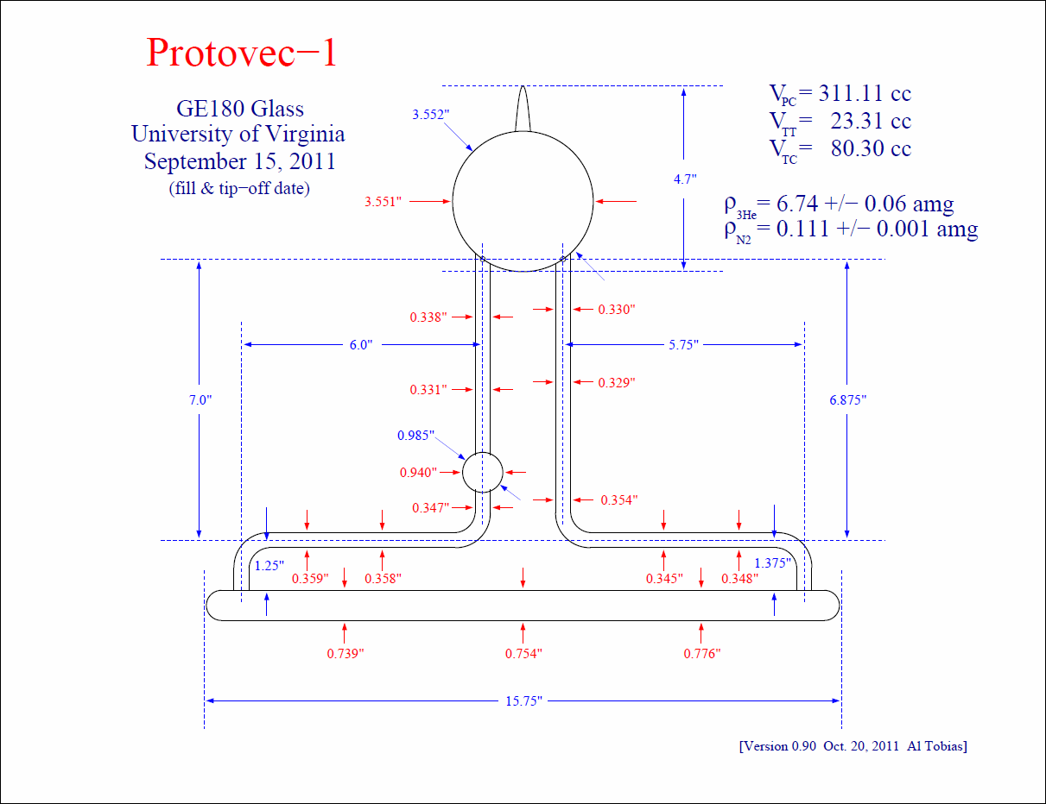
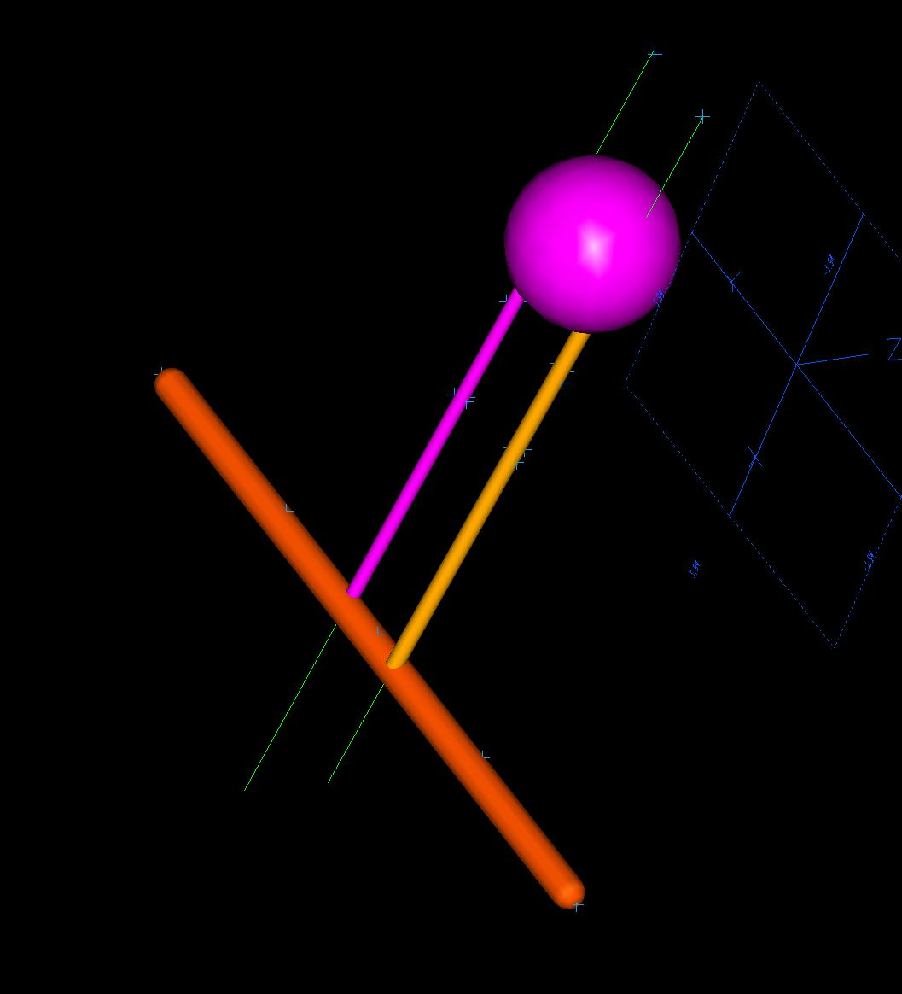
JLab Target Lab Status
new convection style cell (single pumping chamber)
“Protovec-I” tested at UVa, is at Jlab now.
3D measurement of the cell, transferring into CAD model, making customized mount and oven bottom piece.

Slide 5
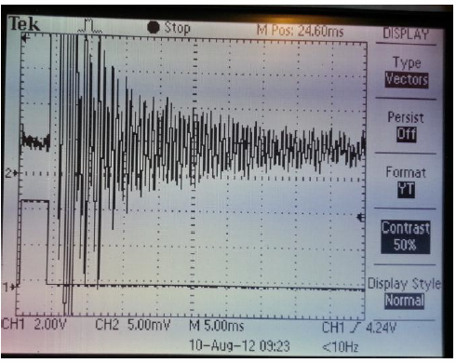
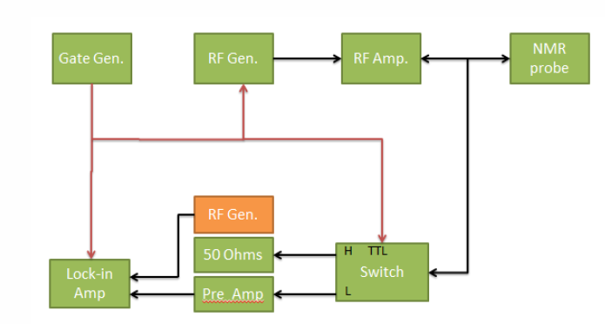
JLab Target Lab Status
pulse NMR
setting up electronics and testing on a transversity cell.
try to observe signals in lock-in amplifier and mixer+oscilloscope

