Slide 1

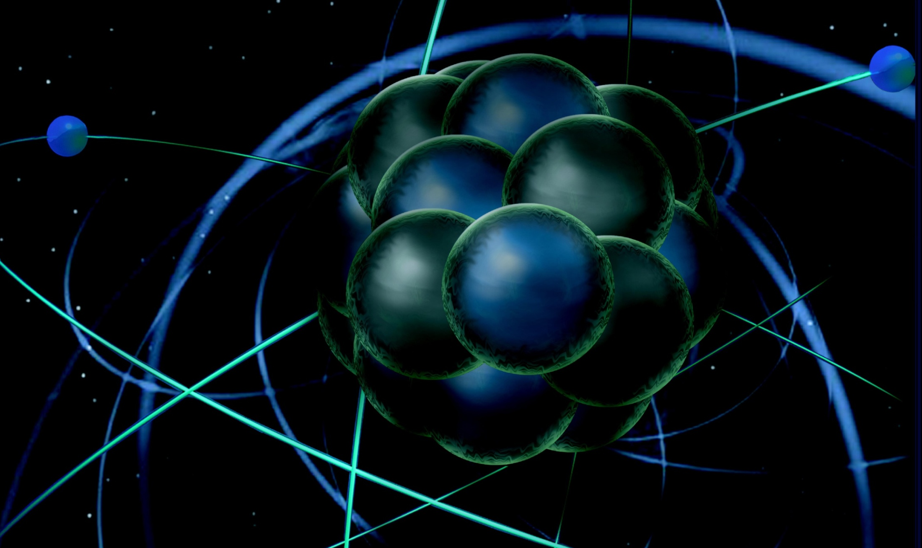
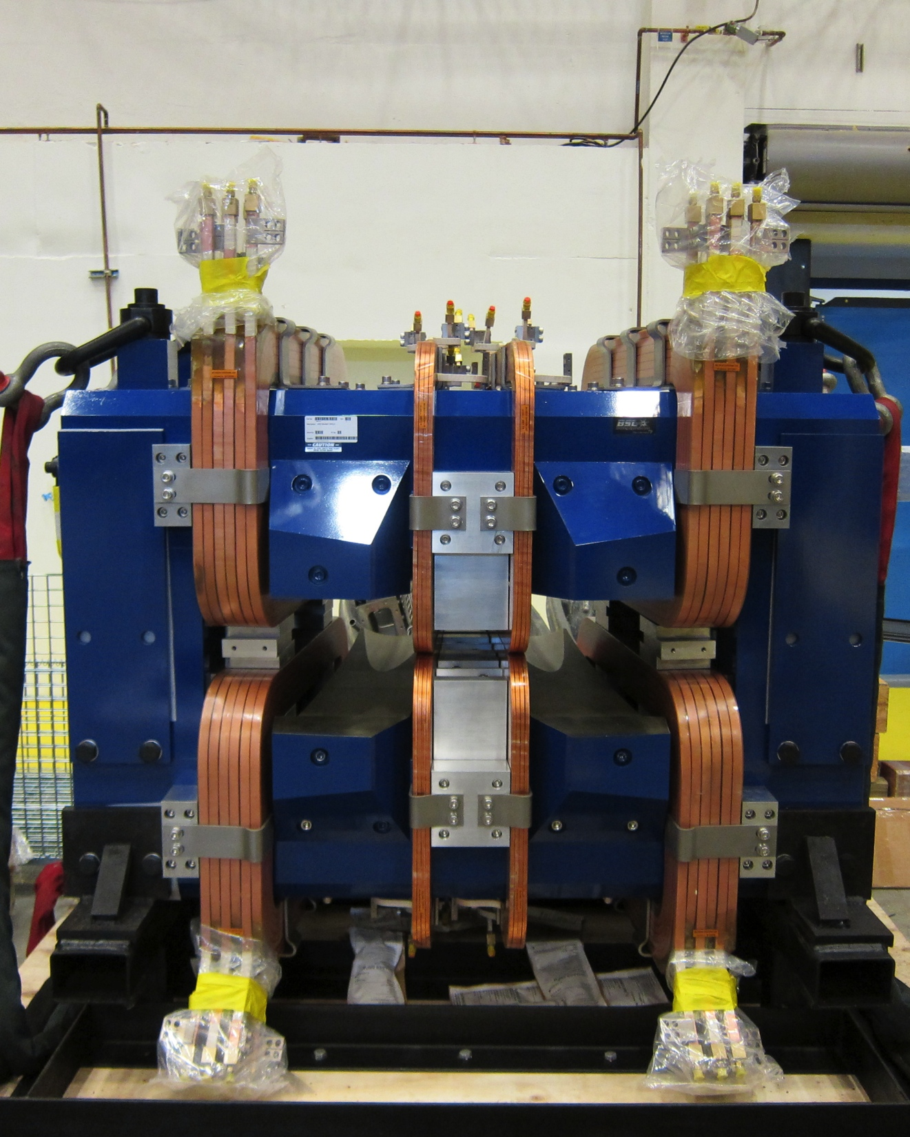
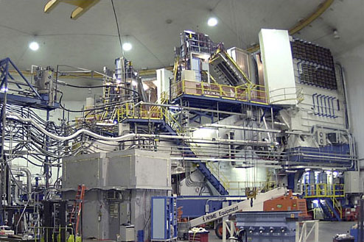
Hall A Update
Thia Keppel
APEX Collaboration Meeting
April 2015

Slide 2
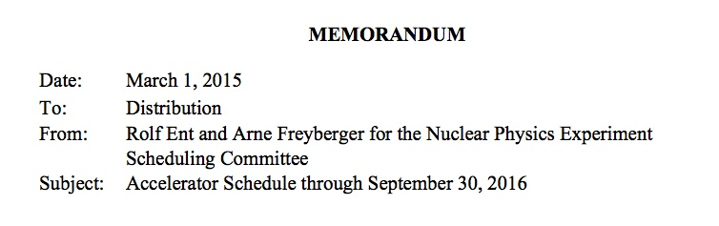
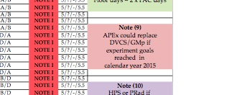
Scheduling
February 2015

Slide 3
Hall A Projected Experiment Schedule, updated 2/2015
- available on Hall A wiki
Spring | Fall | Spring | Fall | Spring | Fall
DVCS –I/ GMp | DVCS –I/ GMp
 |  | DVCS –I/ GMp [APEX] | ³H/³He group (1+1+2)
 |  |  |  | ³H/³He group (1+1+2) | APEX PREX12 CREX A₁^{n} Ar(e,e’p) DVCS-II
CY 2015
CY 2016
CY 2017
CY 2018 SBS start?
Experiments listed in italics represent potential schedule options, in no order
Red indicates PAC41 High Impact Experiments including SBS G_{e}^{p}
Purple indicates new experiments approved by PAC42
Blue indicates potential back-up experiment

Slide 4
Hall A Projected Experiment Schedule, updated 2/2015
- available on Hall A wiki
Spring | Fall | Spring | Fall | Spring | Fall
DVCS –I/ GMp | DVCS –I/ GMp
 |  | DVCS –I/ GMp [APEX] | ³H/³He group (1+1+2)
 |  |  |  | ³H/³He group (1+1+2) | APEX PREX12 CREX A₁^{n} Ar(e,e’p) DVCS-II
CY 2015
Bad run
CY 2016
CY 2017
CY 2018 SBS start?
Experiments listed in italics represent potential schedule options, in no order
Red indicates PAC41 High Impact Experiments including SBS G_{e}^{p}
Purple indicates new experiments approved by PAC42
Blue indicates potential back-up experiment

Slide 5
Hall A Projected Experiment Schedule, updated 2/2015
- available on Hall A wiki
Spring | Fall | Spring | Fall | Spring | Fall
DVCS –I/ GMp | DVCS –I/ GMp
 |  | DVCS –I/ GMp [APEX] | ³H/³He group (1+1+2)
 |  |  |  | ³H/³He group (1+1+2) | APEX PREX12 CREX A₁^{n} Ar(e,e’p) DVCS-II
CY 2015
Short run
CY 2016
More likely first opportunity
CY 2017
CY 2018 SBS start?
Experiments listed in italics represent potential schedule options, in no order
Red indicates PAC41 High Impact Experiments including SBS G_{e}^{p}
Purple indicates new experiments approved by PAC42
Blue indicates potential back-up experiment

Slide 6
APEX E&D Items Remaining
Corrector magnet(s)
Vacuum extension box
Support for extension box
Support for magnet
Target
  motion
  cooling
  Shielding
Power
  supply
  Magnet
Walter
  supply
  magnet
Sieve holders and fiducialization
Shielded beam pipe?

Slide 7
APEX Installation
Current
New septum magnet being fitted with water manifolds, buss bars and power guards
    must still be tested (only to 200 Amps).
Design/fabrication work ongoing (next slide)
Installation
Post run surveys
Remove target (Rad Con hold)
Remove DVCS arm
    Collaboration – crystal removal and de-cabling
    Manpower intensive
Disasemble and remove DVCS beam line, collimators from pivot
Install target, target chamber, integrate with services
Install APEX beamline and magnet
Installation of APEX magnet challenging due to the limited accessibility, plus it must be partially disassembled to install the vacuum transitions
Electronics equipment position and shielding questions open
Total installation time is approximately 14 weeks.

Slide 8
HRS-right Q1
HRS-Q1 right in repair
Old “Short Orbit Spectrometer” quad being used as replacement
Shorter, resistive, different
New leads on order
May be complete by Fall, Spring more likely
May or may not work
Can APEX use the SOS quad?

Slide 9
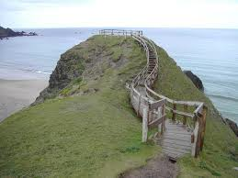
Formal Path
    Physics Division Readiness Process
      – Suggest aiming for shielding review Summer 2015
      Will need documentation for any new/substantially redesigned equipment
      Precursors to Request for Scheduling (look for e-mails from Rolf roughly every 6 months starting ~May)
      Readiness Review for installation
      Change in physics liaison

Slide 10
Summary
    Small window of opportunity for running Spring 2015
    Preparations underway
    A lot to do!
    Installation non-trivial
    Preparations are of benefit to APEX even if the run is later in the schedule

