Slide 1
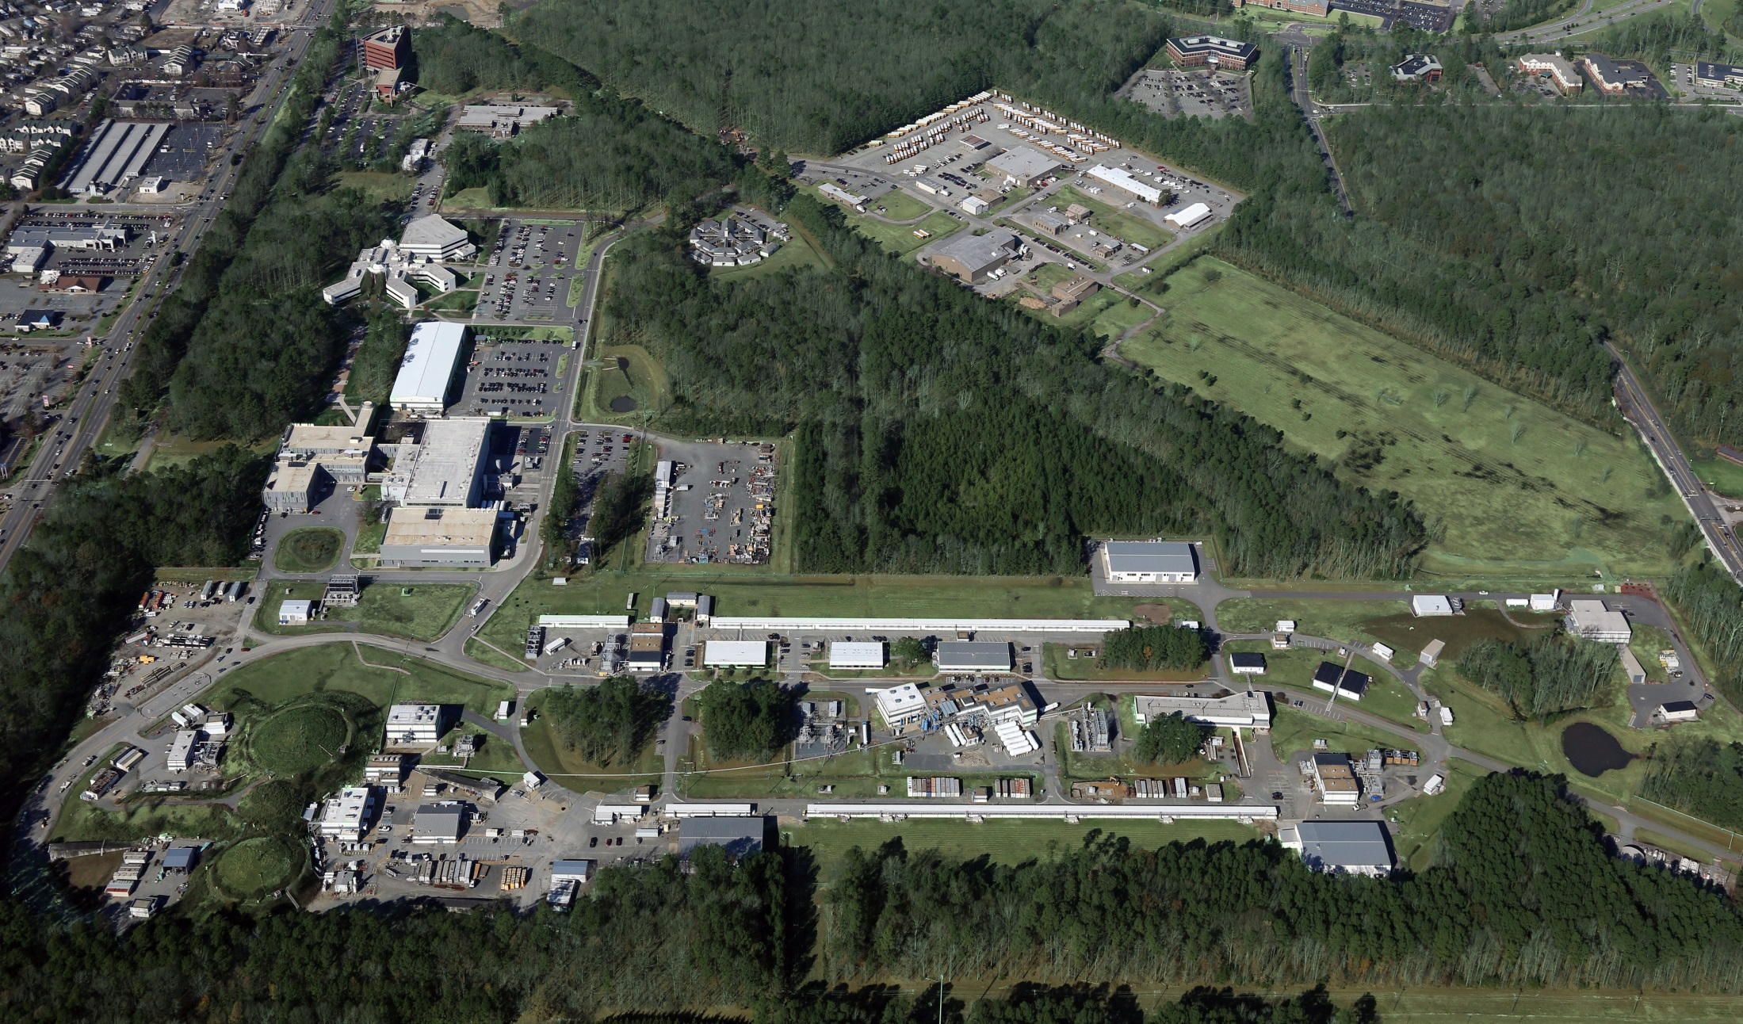
Jefferson Lab Overview
Bob McKeown
April 20, 2015

Slide 2
Outline
CEBAF Status
PAC
MOLLER, SoLID status
Budget
Experiment Schedule

Slide 3
CEBAF Commissioning
Hall A
Dec. 2014:
Hall B
Current
Hall D
Feb. 2015: restore 5 pass beam
Mar. 2015: commission new RF separator system in pass 5
Demonstrate 5 pass beam to D and A
Beam to Hall A, B, D for commissioning/physics

Slide 4
Power Outage Event
March 24, 4PM JLab site lost power due to off-site event
Power restored after a few hours, both CHL-1 and CHL-2 stable at 4K
Encountered difficulties restarting 2K cold boxes on CHL-1 and CHL-2
CHL-2 warmup to remove contamination restored functionality
CHL-1 has a failed compressor – will take weeks to repair, recovery plan still under discussion
Plan is to reconfigure cryoplant to use CHL-2 to cool both LINACs and attempt to restore beam at lower energy (~5.5 GeV) – work began April 10, beam restart expected mid-week (~April 15)
Hope for 2 weeks of running at lower energy before shutdown

Slide 5
2015 Summer Shutdown
May-June: CHL-1 maintenance (UIM project), need CHL-2 on to keep CEBAF cool
June-Oct.: CHL-2 warranty repair by vendor, CHL-1 used for CEBAF
LINACs at 2K for He processing (gradient maintenance)
Restart in November (see Rolf’s talk for physics)

Slide 6
12 GeV Approved Experiments by Physics Topics
Topic | Hall A | Hall B | Hall C | Hall D | Other | Total
The Hadron spectra as probes of QCD (GluEx and heavy baryon and meson spectroscopy) |  | 1 |  | 3 |  | 4
The transverse structure of the hadrons (Elastic and transition Form Factors) | 5 | 3 | 2 | 1 |  | 11
The longitudinal structure of the hadrons (Unpolarized and polarized parton distribution functions) | 2 | 3 | 6 |  |  | 11
The 3D structure of the hadrons (Generalized Parton Distributions and Transverse Momentum Distributions) | 5 | 9 | 7 |  |  | 21
Hadrons and cold nuclear matter (Medium modification of the nucleons, quark hadronization, N-N correlations, hypernuclear spectroscopy, few-body experiments) | 6 | 3 | 7 |  | 1 | 17
Low-energy tests of the Standard Model and Fundamental Symmetries | 3 | 1 |  | 1 | 1 | 6
TOTAL | 21 | 20 | 22 | 5 | 2 | 70

Slide 7
12 GeV Approved Experiments by PAC Days
Topic | Hall A | Hall B | Hall C | Hall D | Other | Total
The Hadron spectra as probes of QCD (GluEx and heavy baryon and meson spectroscopy) |  | 119 |  | 540 |  | 659
The transverse structure of the hadrons (Elastic and transition Form Factors) | 145.5 | 85 | 102 | 25 |  | 357.5
The longitudinal structure of the hadrons (Unpolarized and polarized parton distribution functions) | 65 | 230 | 165 |  |  | 460
The 3D structure of the hadrons (Generalized Parton Distributions and Transverse Momentum Distributions) | 409 | 872 | 212 |  |  | 1493
Hadrons and cold nuclear matter (Medium modification of the nucleons, quark hadronization, N-N correlations, hypernuclear spectroscopy, few-body experiments) | 180 | 175 | 201 |  | 14 | 570
Low-energy tests of the Standard Model and Fundamental Symmetries | 547 | 205 |  | 79 | 60 | 891
TOTAL | 1346.5 | 1686 | 680 | 644 | 74 | 4430.5

Slide 8
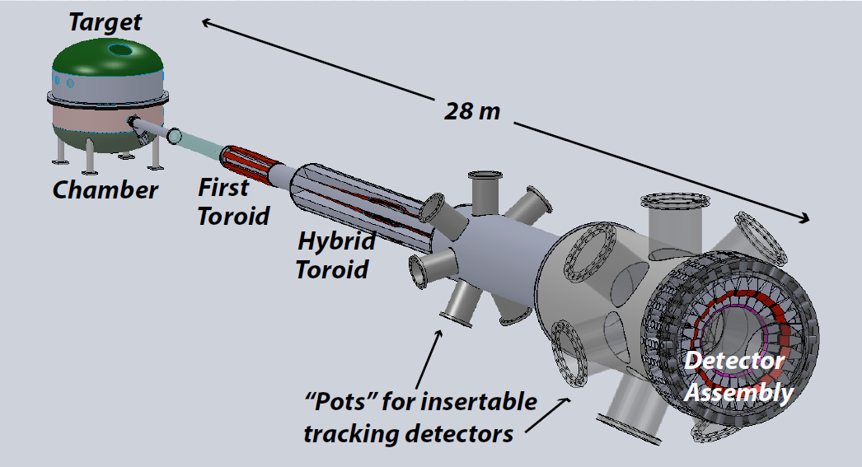
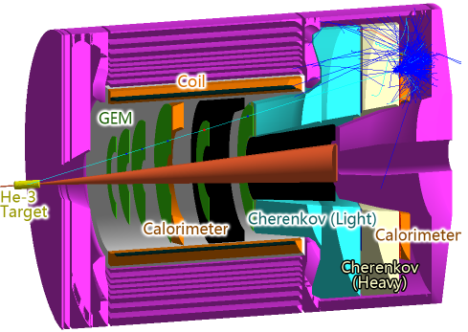
Future Projects
MOLLER experiment
(Possible MIE – FY17-20)
– Standard Model Test
– DOE science review (September 2014) – strong endorsement
- Technical, cost & schedule reviews?
SoLID
– Chinese collaboration
– CLEO Solenoid 
– Director’s review (Feb. 2015)
 lots of good feedback

Slide 9
JLab Operations Budget
FY15 – NP=$595M
Funded at $92.6M for 21 weeks
JLab proposed $97.6M for 30 weeks
FY16 – NP=$625M (Pres. Budget)
Pres. Budget is $95.7M for 16 weeks
JLab proposed $103.7M for 25 weeks
FY17
DOE guidance is $105.7M for 27 weeks
JLab proposed $112M for 30 weeks

Slide 10
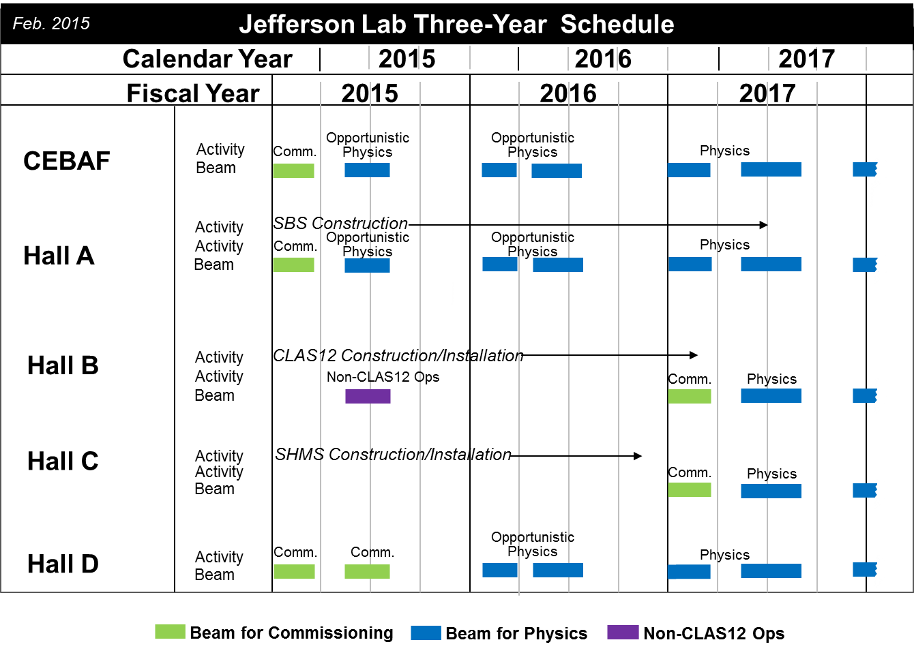
Jefferson Lab 3 Year Schedule

Slide 11
Hall A Projected Experiment Schedule, updated 2/2015 - available on Hall A wiki
Spring | Fall | Spring | Fall | Spring | Fall
DVCS –I/ GMp | DVCS –I/ GMp
 |  | DVCS –I/ GMp [APEX] | ³H/³He group (1+1+2)
 |  |  |  | ³H/³He group (1+1+2) | APEX PREX12 CREX A₁^{n} Ar(e,e’p) DVCS-II
CY 2015
CY 2016
CY 2017
CY 2018 SBS start?
Experiments listed in italics represent potential schedule options, in no order
Red indicates PAC41 High Impact Experiments including SBS G_{e}^{p}
Purple indicates new experiments approved by PAC42
Blue indicates potential back-up experiment

Slide 12
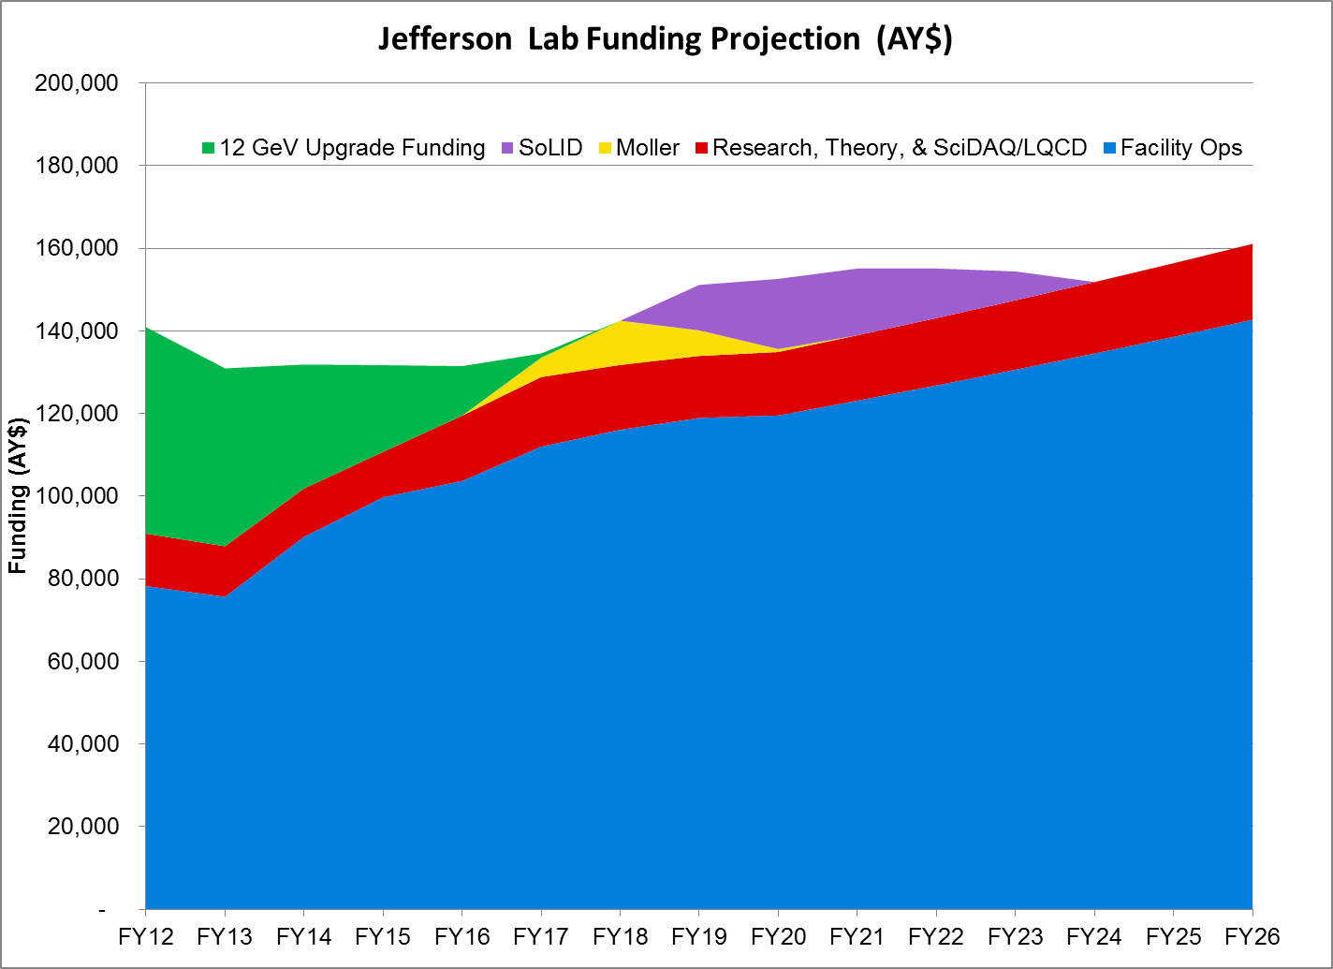
Jefferson Lab NP Funding Projection (AY$)
Actual Proposed
 
Proposed budget as presented at NSAC meeting November 2014
12 GeV Project completes in FY17
FY15 ops = senate mark (PB +$8M)
FY15-19 proposed for 30 weeks/yr ops
FY20+ is COL supporting 30 weeks/yr ops

Slide 13
Important to Get Priority from NSAC
• Recommendation 1:
With highest priority, we recommend both completion of construction and full operation of the 12 GeV CEBAF at the Thomas Jefferson National Accelerator Facility, along with targeted instrumentation investments, such as the SoLID and MOLLER projects.
• Recommendation 2:
A high luminosity, high-energy polarized Electron Ion Collider (EIC) is the highest priority of the U.S. Nuclear Physics QCD community for new construction after FRIB. (voted jointly with Phases of QCD community)
LRP Resolution Meeting: April 16-20

